Slide 1

Multi-model multi-constituent chemical (MOMO-Chem) data assimilation
for city-to-global scale atmospheric composition and emission analysis
Kazuyuki Miyazaki
NASA Jet Propulsion Laboratory, California Institute of Technology , USA
Takashi Sekiya (JAMSTEC), Kevin Bowman (JPL), Longtao Wu (JPL), Henk Eskes (KNMI), Pieter Rijsdijk (KNMI), Mukesh Rai (JPL), Jinkyul Choi (JPL), Jinhyeok Yu (JPL), Vivienne Payne (JPL), Nathaniel Livesey (JPL)
Copyright 2025, California Institute of Technology. Government sponsorship acknowledged.

Slide 2
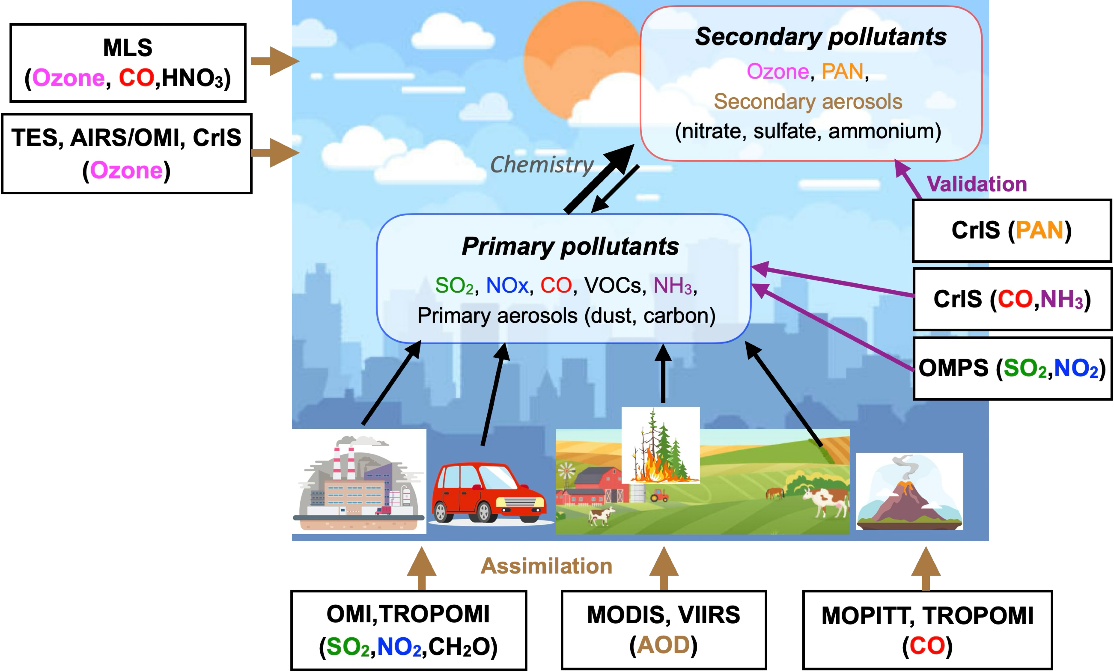
Long-lived GHGs
Oxidation capacity (OH)
↓
CH4
AQ-GHG co-emissions
↓
CO2
MOMO-Chem Tropospheric Chemistry Reanalysis (TCR-3)

Slide 3
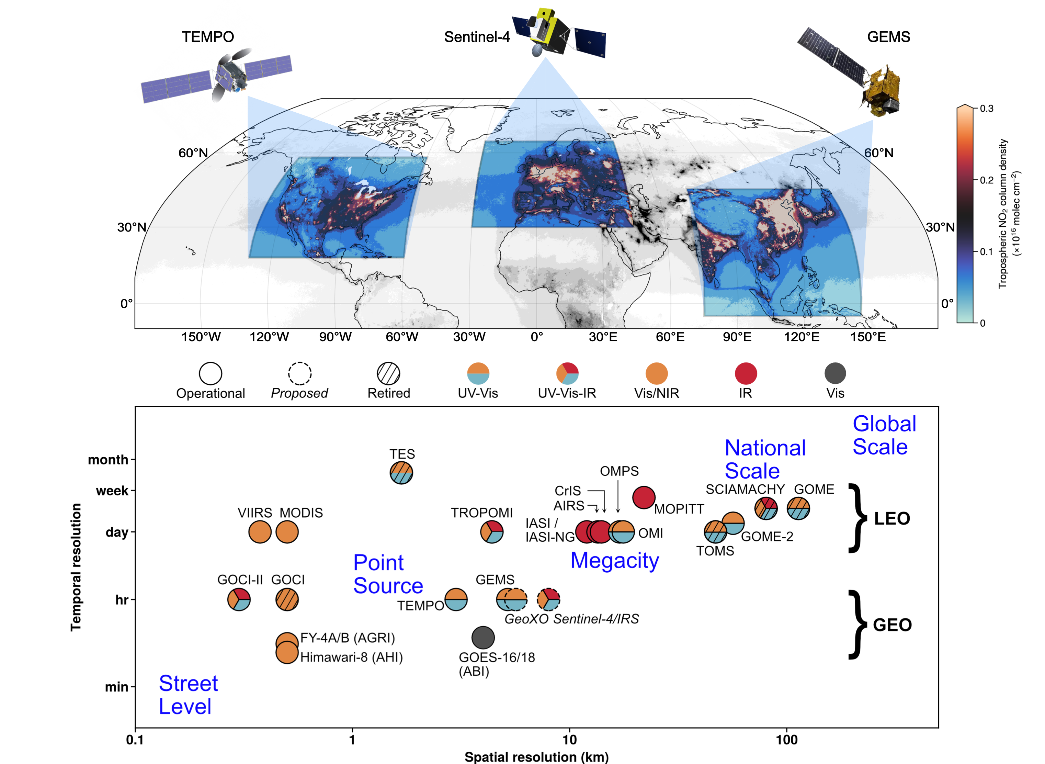
TCR-2/3
He et al., 2025 (BAMS)

Slide 4

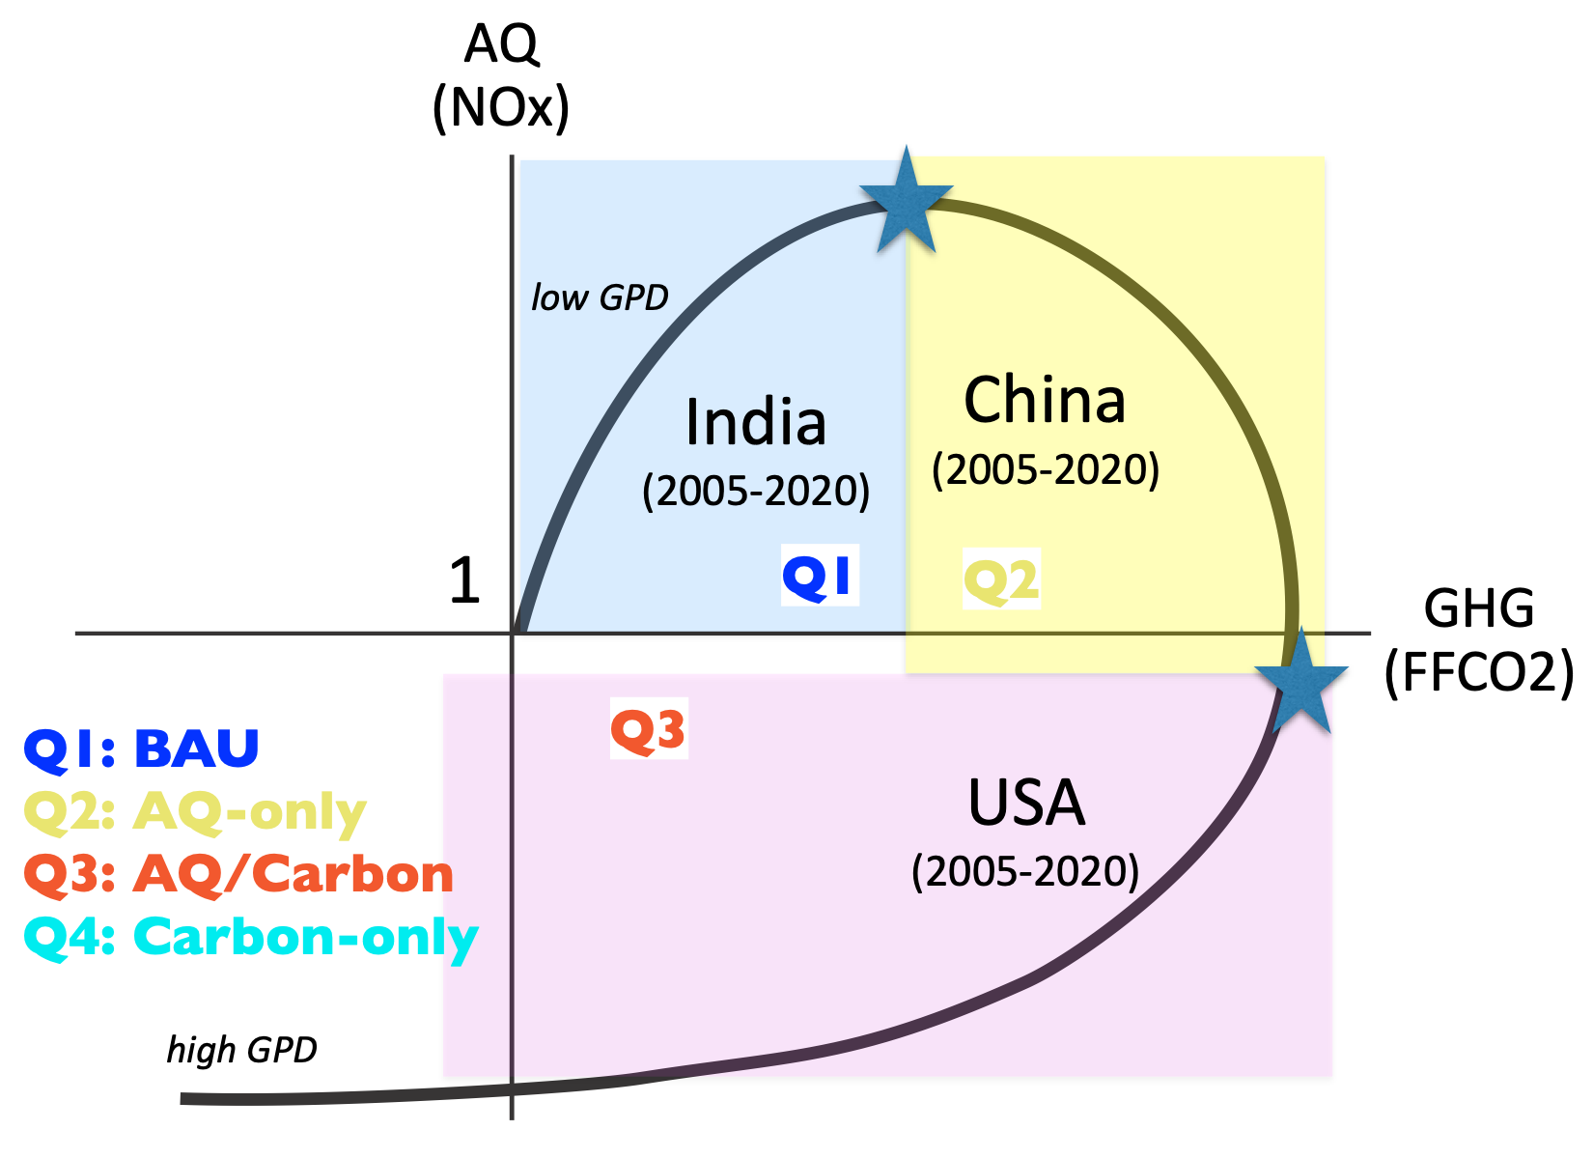
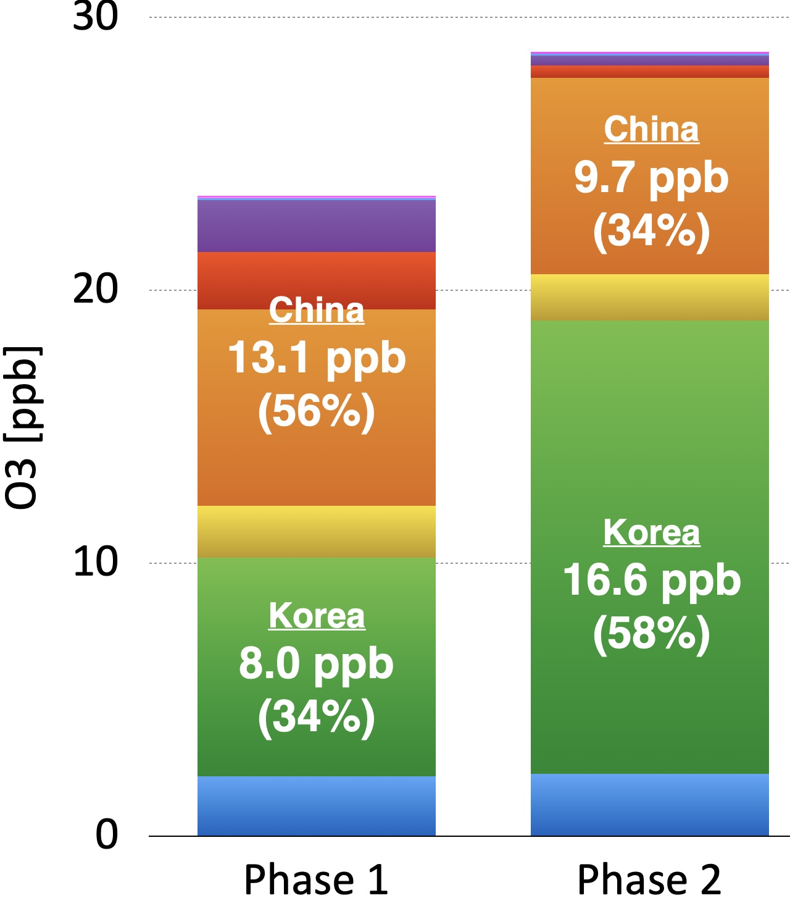
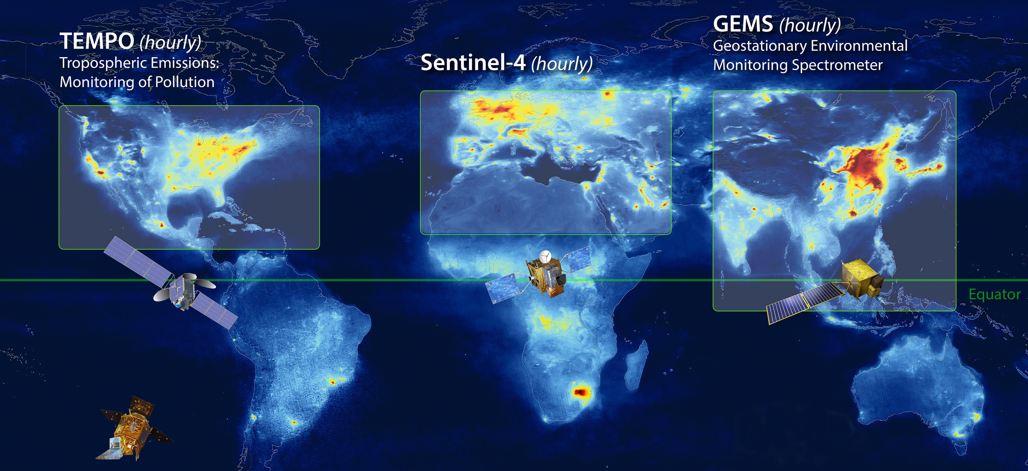
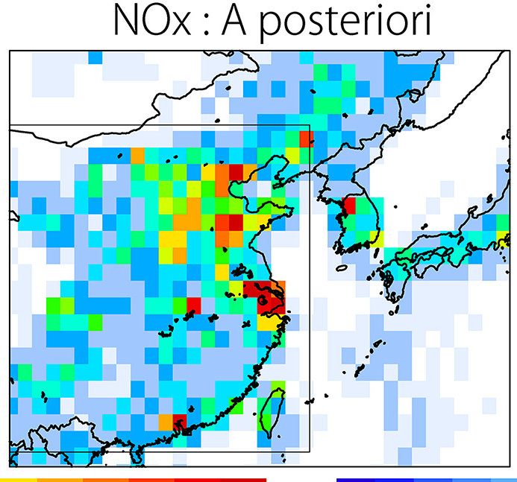
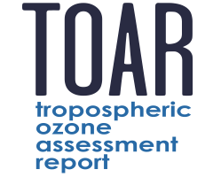
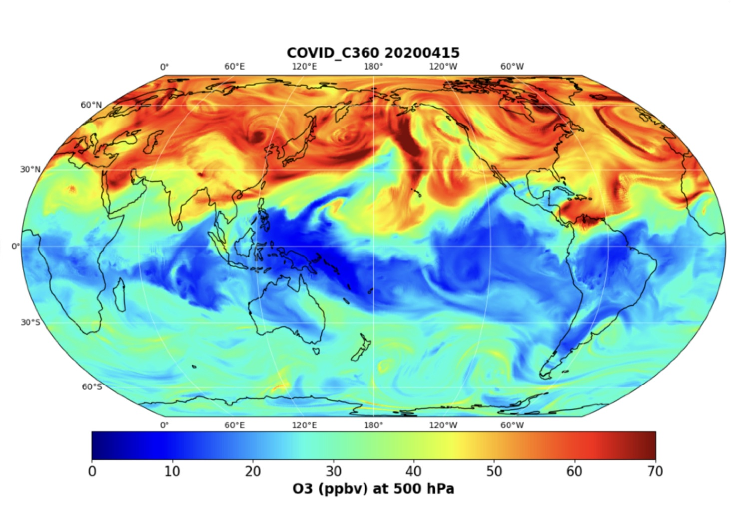

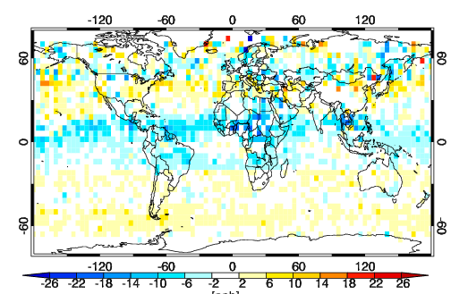
MOMO-Chem contribute to NASA’s current and future missions
Top-down emissions
(NOx,CO,SO2,Isoprene)
Attribution
GEO+LEO AQ integration
AQ-GHG synergy
OSSEs mission formation
GEMS, TEMPO
Explore class missions
CMS-flux, GOSAT-GW,
OCO-2/3, CO2M
New generation
chemical reanalysis
Aircraft campaigns (ASIA-AQ)
Support policy decisions
Science!
Broad communities
New satellite
products (e.g. TROPESS)
> 9 papers using MOMO-Chem and TROPESS data in TOAR-2
Satellite assessment paper lead
Health & Climate impacts
High-resolution DA
- IGAC GEIA, AMIGO, TOAR-2
- ISSI GEO AQ
NASA chemDA
CEOS-AC-VC
WMO observing system impact
NASA Earth Science to Action

Slide 5
Current MOMO-Chem developments
 | Tropospheric Chemistry Reanalysis v3 (TCR-3) | GEOS-Chem High Performance (GCHP)
Horizontal resolution | 1.1°x1.1° (0.56°x0.56°) | C90 (1°x1.25°) - C720 (0.125°)
Vertical resolution | 32 layers to 4 hPa | 72 layers to 0.01 hPa
Forecast model | MIROC-Chem | GEOS-Chem v14
Meteorological data | Nudged to ERA-5 | MERRA-2
A priori emissions | HTAP v3, GFAS, MEGAN v2.1 | CEDS v2, GFED v4, MEGAN
Assimilated measurements | TROPOMI, OMI, SCIAMACHY, GOME-2, MODIS, VIIRS, MOPITT, MLS, CrIS, TES | TROPOMI, MOPITT, MLS
Assimilated species | O3, CO, CH2O, AOD, NO2, SO2, HNO3 | O3, CO, NO2
State vector | 35 species + emissions (NOx ,C5H8, CO, SO2, LNOx, aerosols) | 3 species + emissions (NOx, CO)
Reference | Sekiya et al. (2018, 2021, 2023, 2025), Miyazaki et al. (2020,2021,2023,2024) | Eastham et al. (2018)

Slide 6
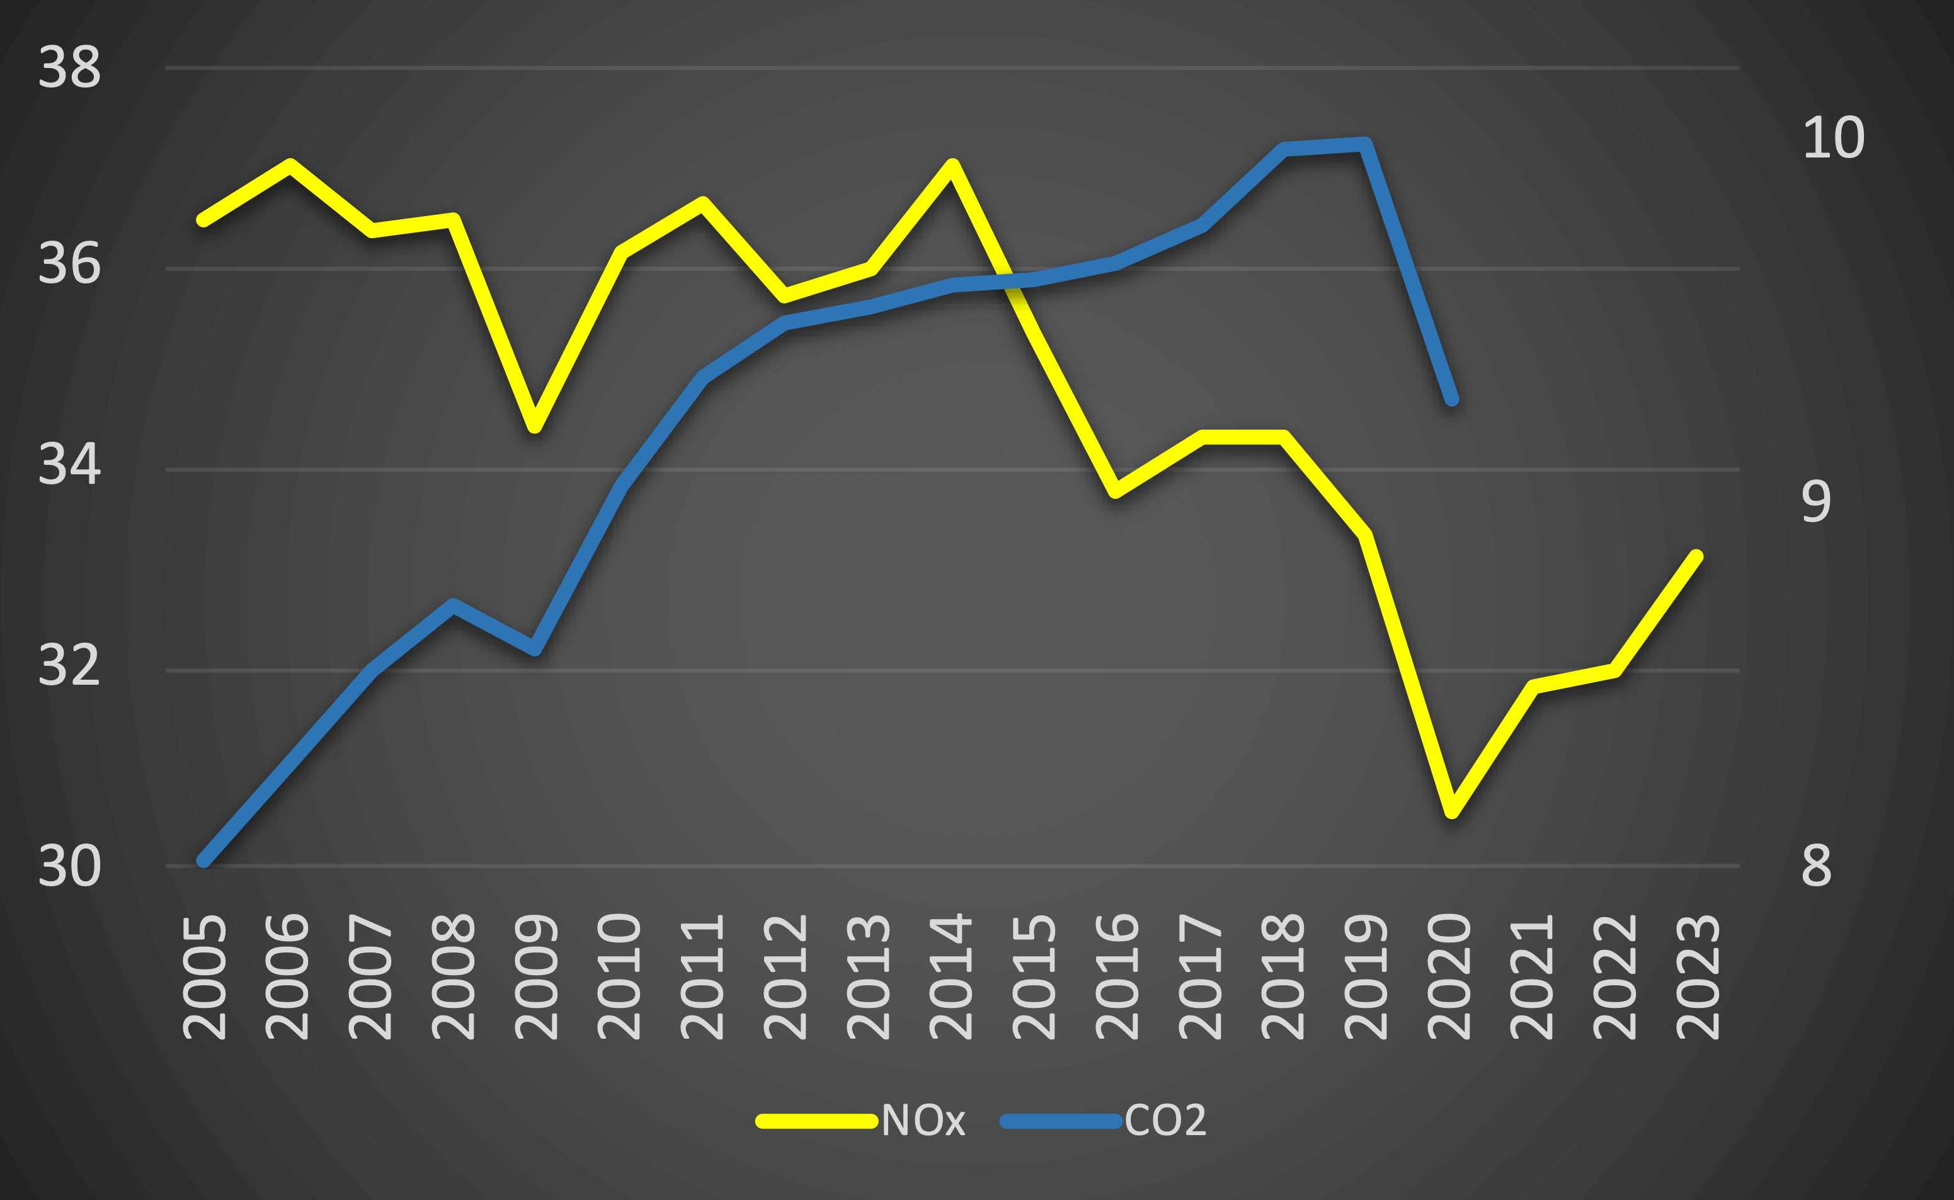
Global anthropogenic emissions over 19 years
Europe & USA ↓
China ↑
China ↓
India ↑
Top-down NOx (TgN/yr)
MOMO-Chem
Bottom-up CO2 (GtC/yr)
Le Quéré (2020)
Recovery & India ↑
COVID
Updated from Laughner et al 2021 (PNAS)
and Miyazaki et al. 2021 (Sci Adv)

Slide 7
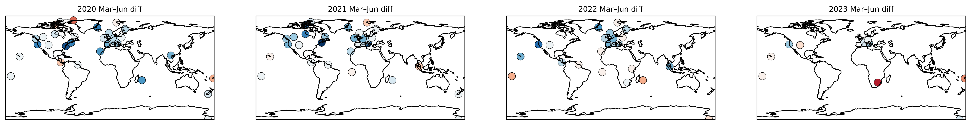
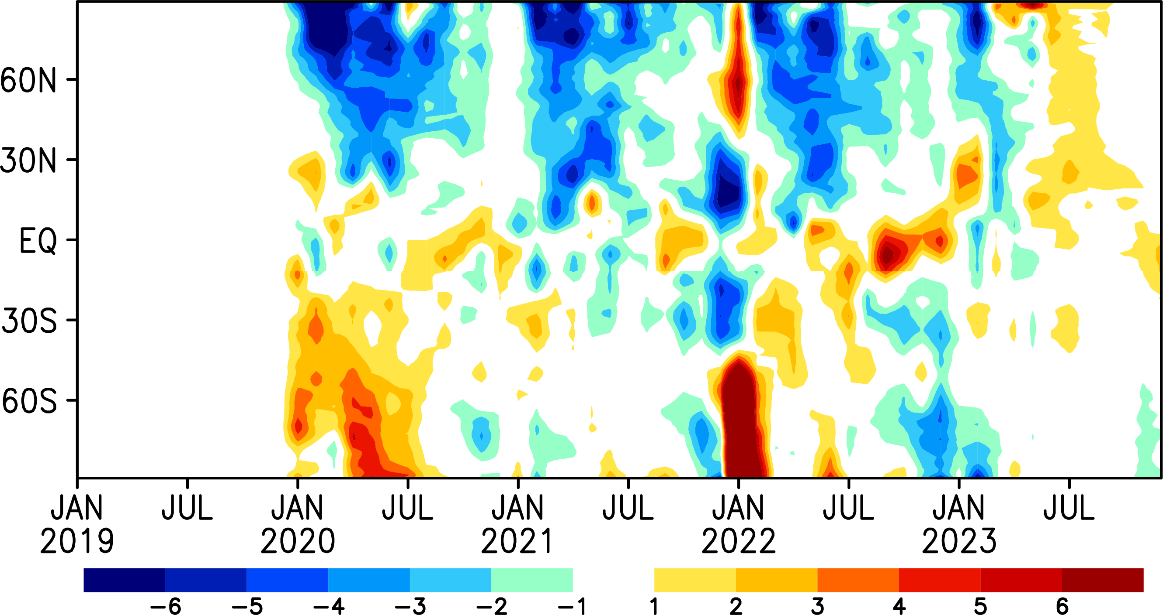
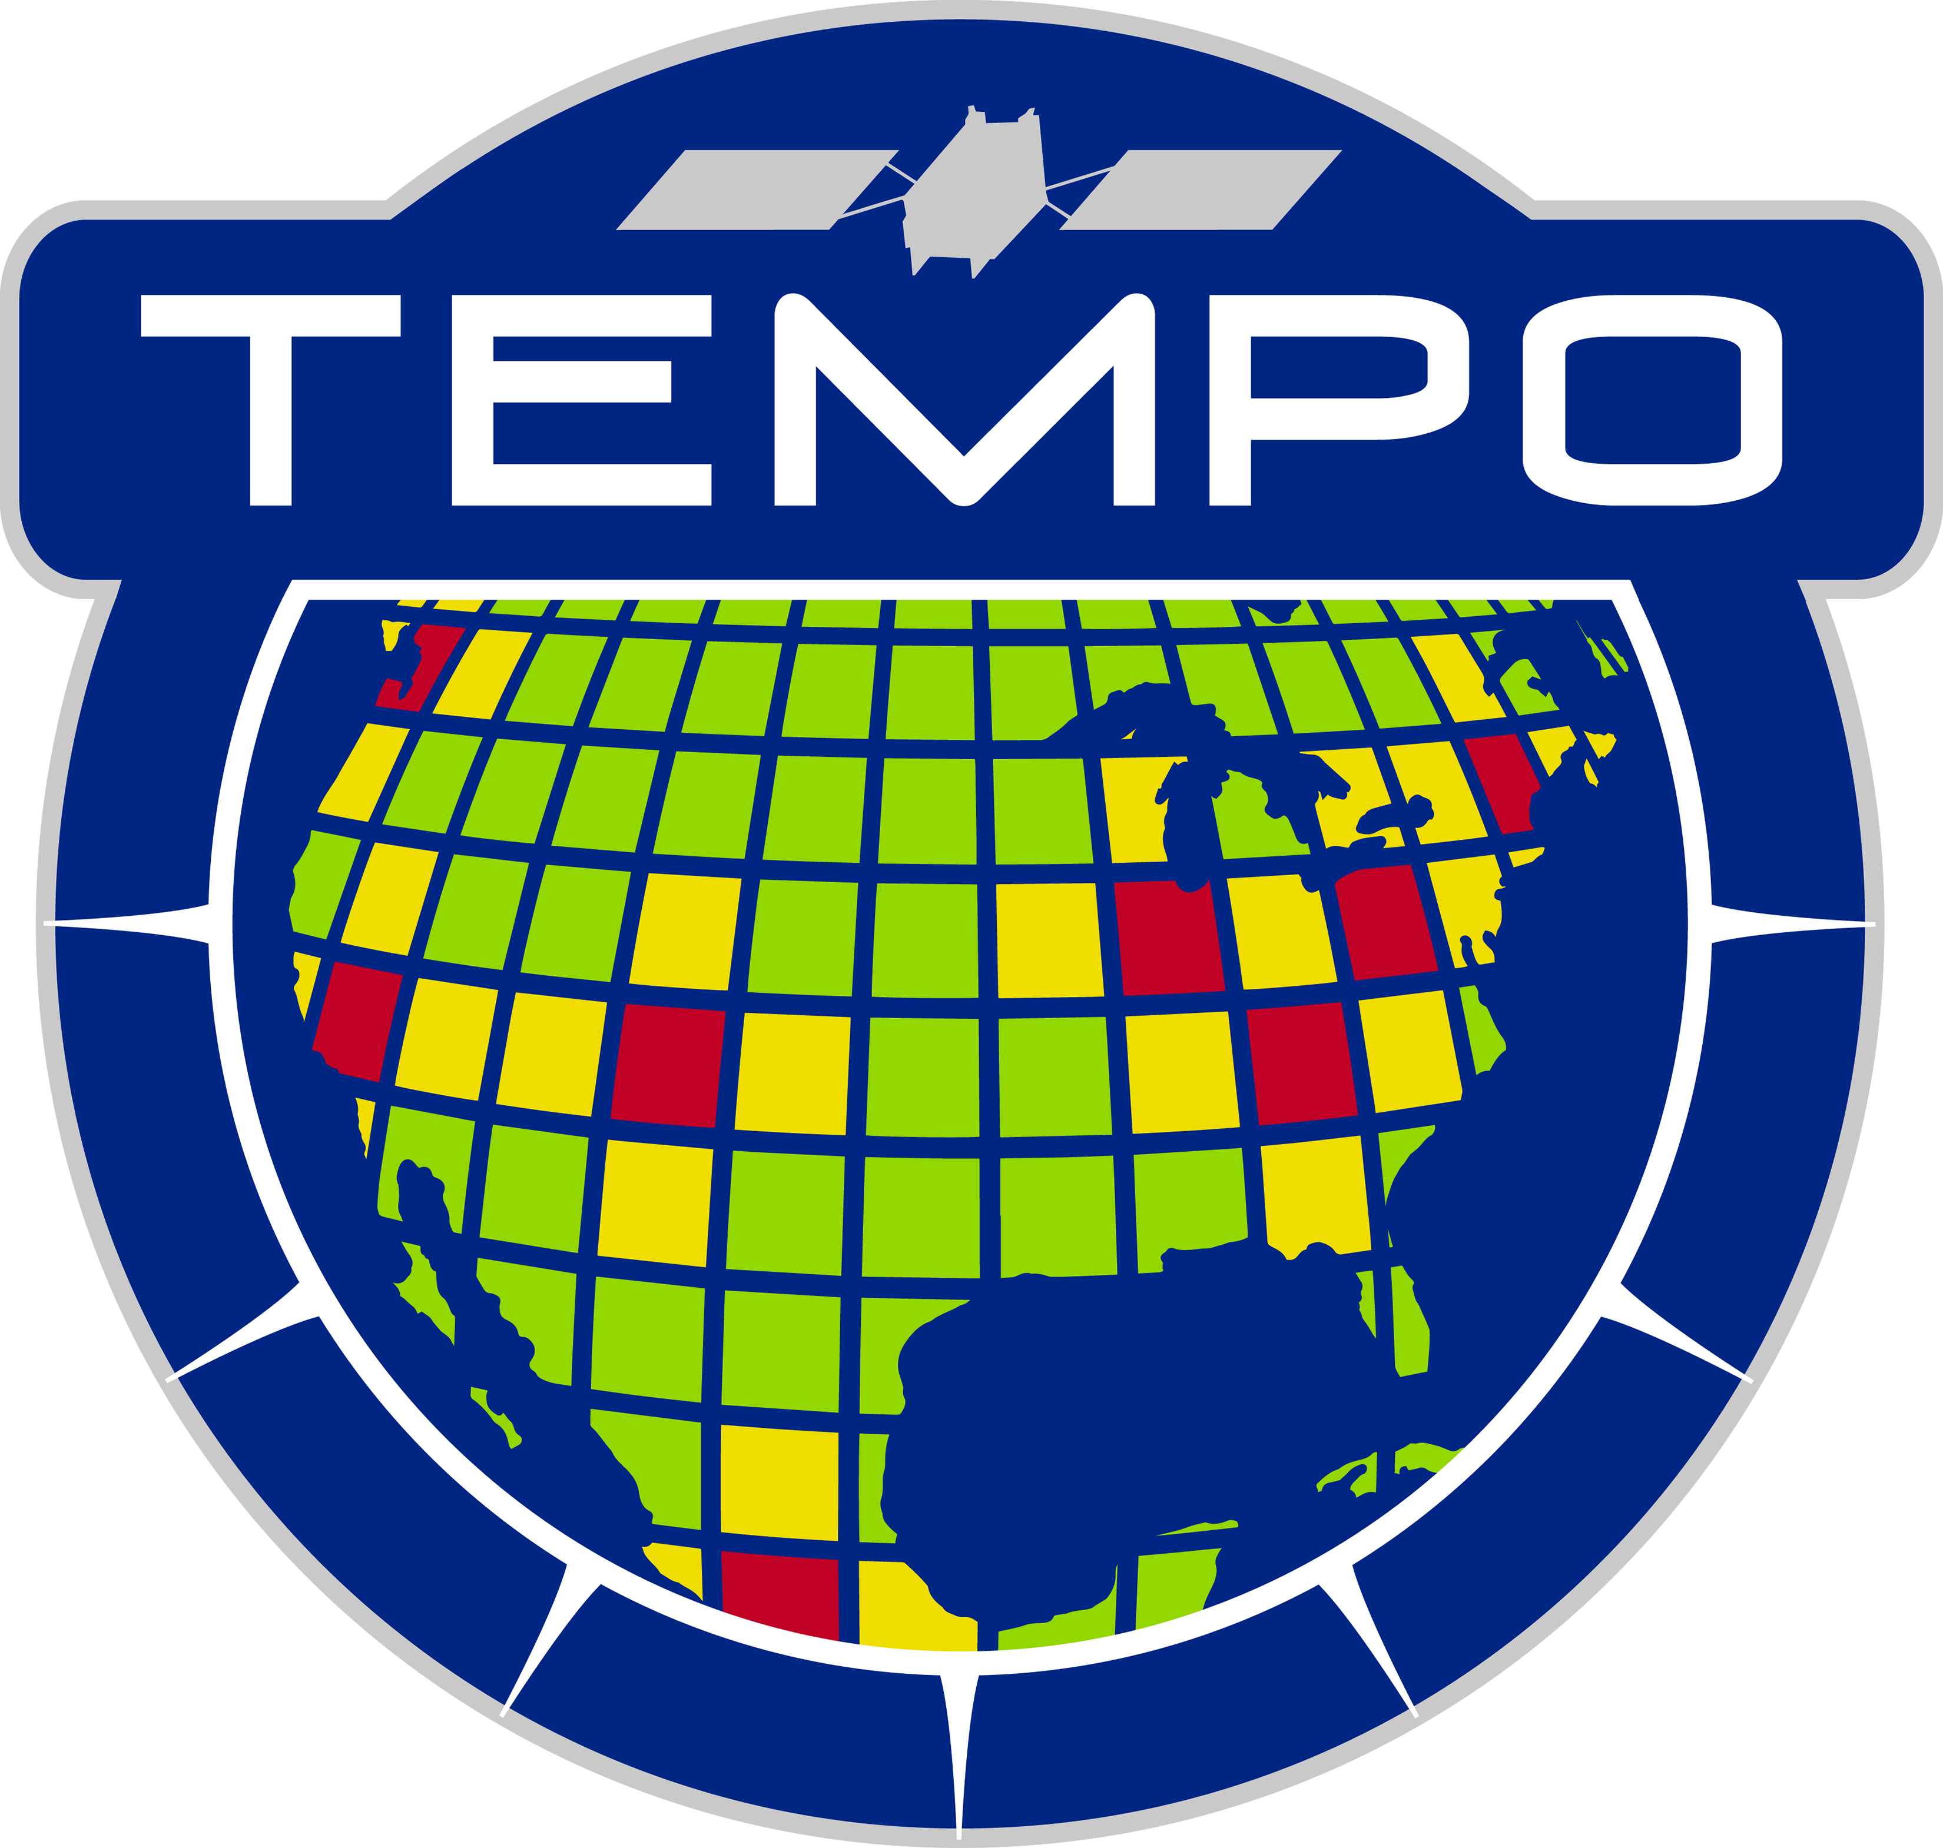

Impact of COVID lockdown and recovery
Ozonesonde TOC in May-Jun
2020-2019
2021-2019
2022-2019
2023-2019
TCR-3 ozone at 500 hPa:
anomaly from 2019
Updated from Miyazaki et al. 2021 (Sci Adv)
COVID
Hunga Tonga–Hunga
Australian fires
Canadian fires

Slide 8
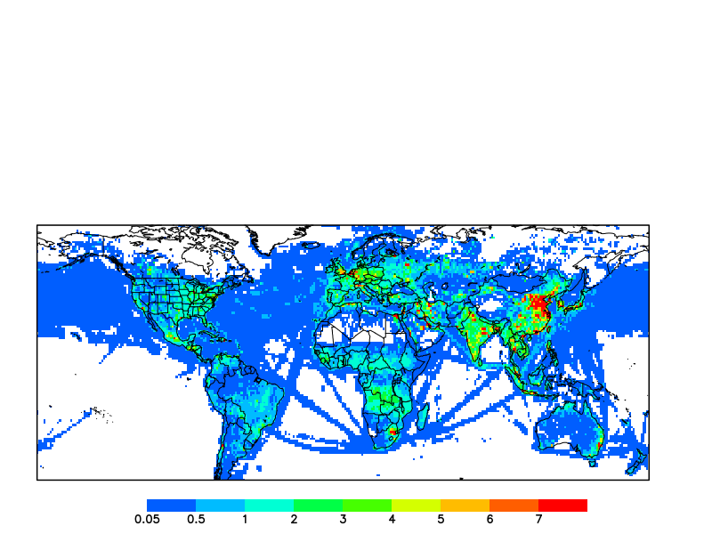
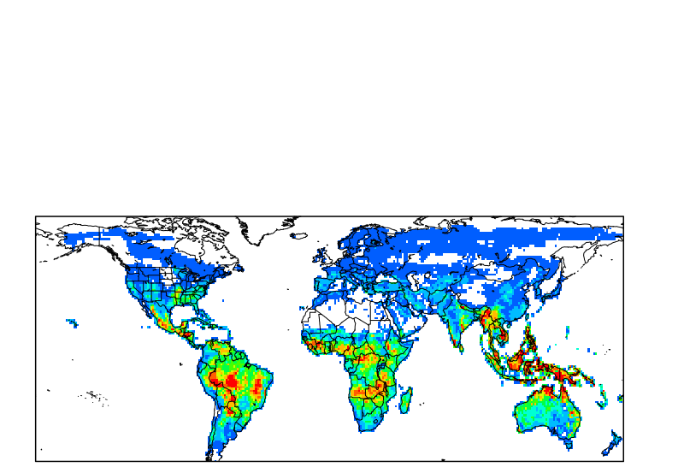
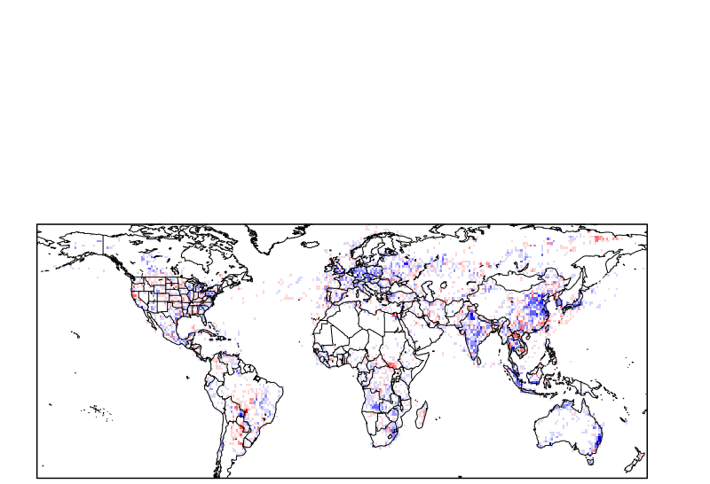
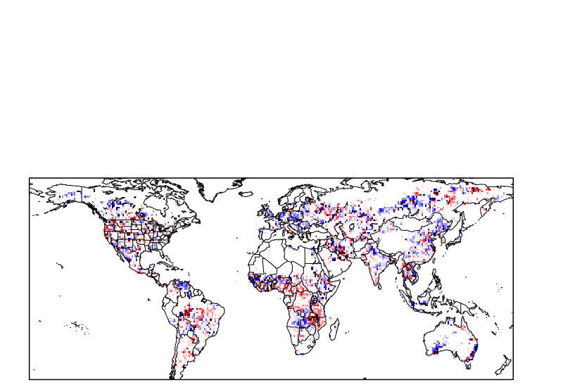
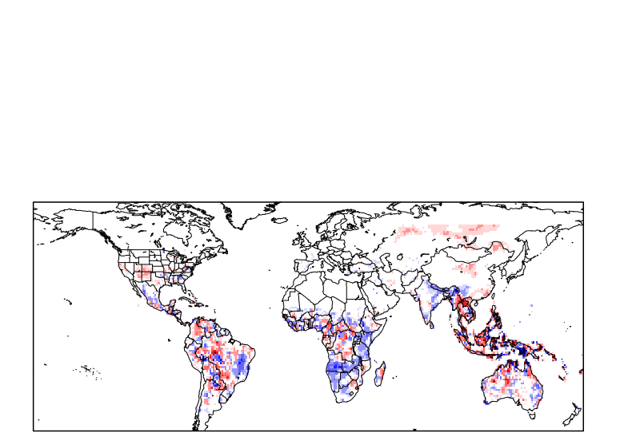
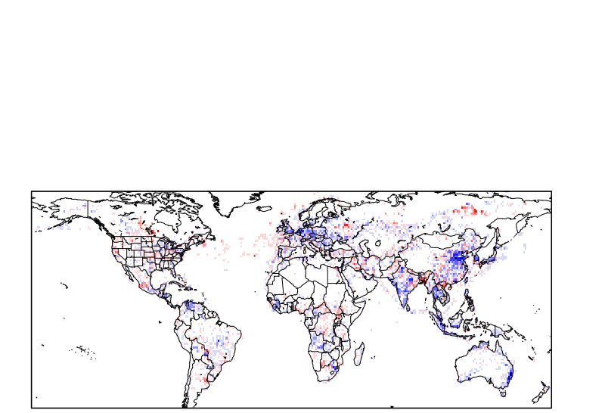
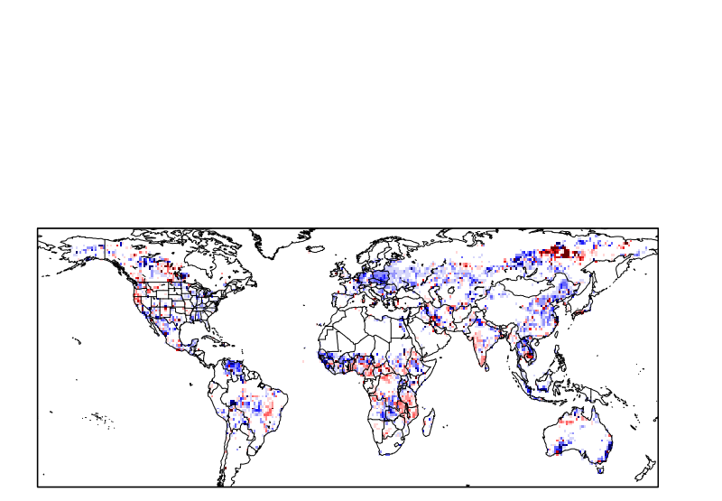
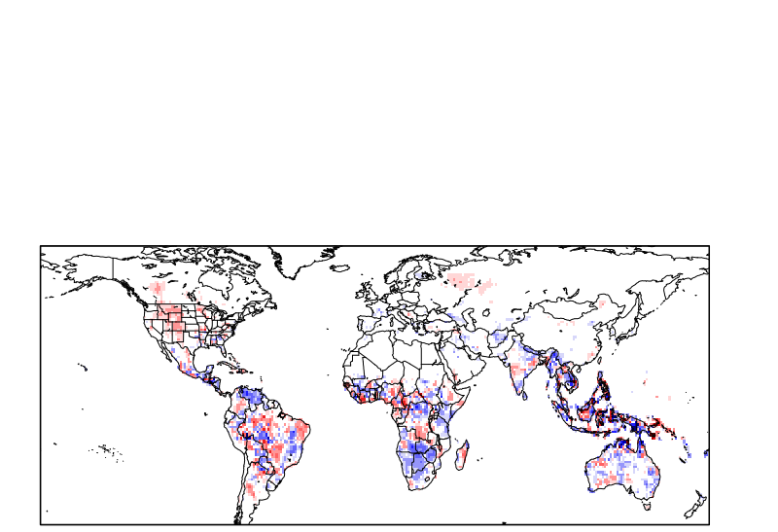
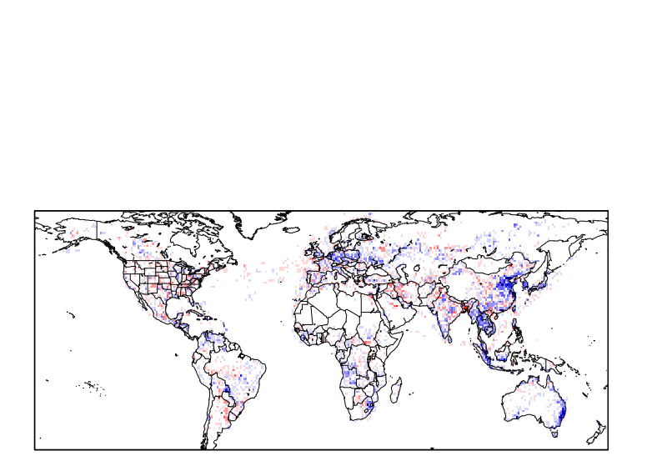
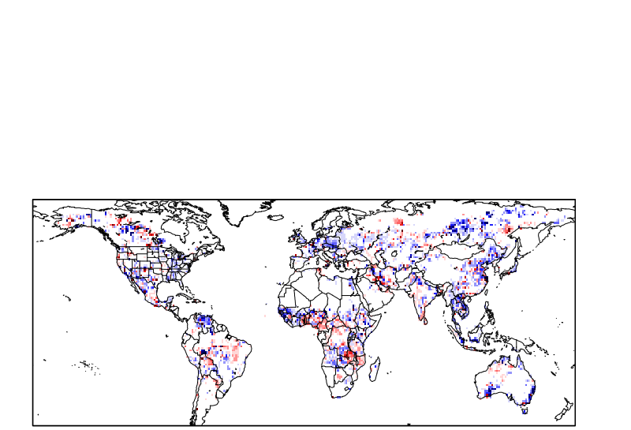
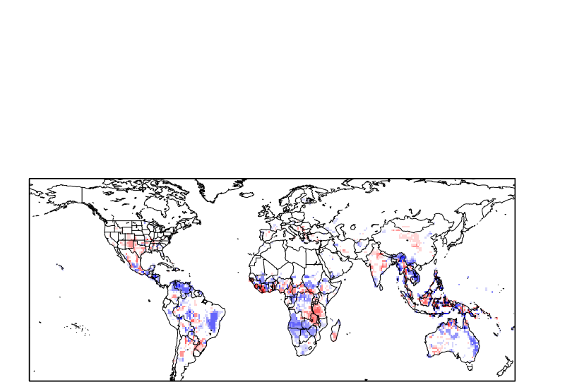
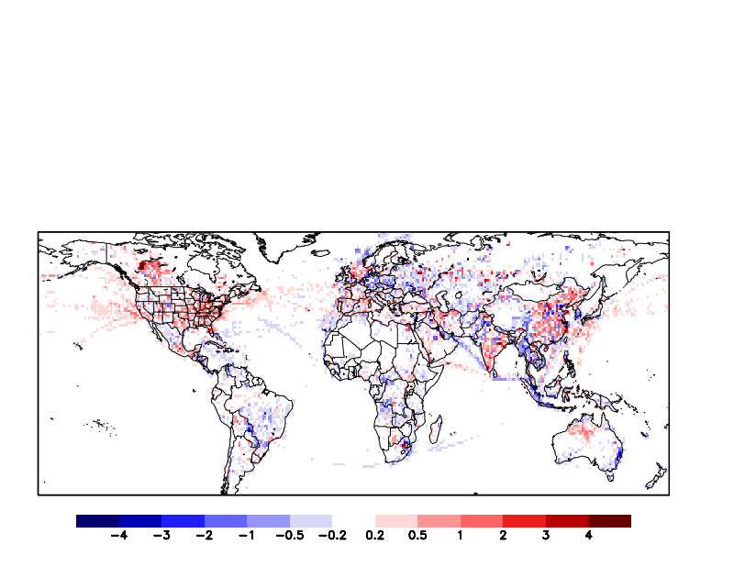
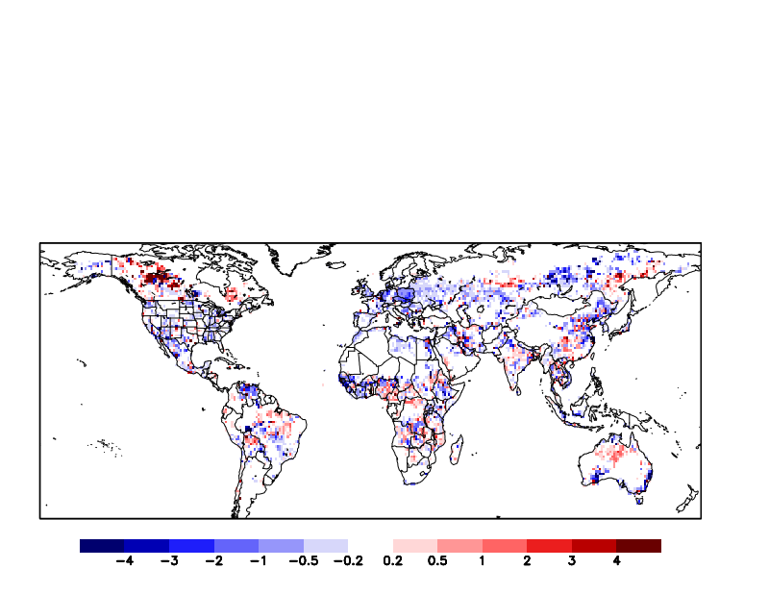
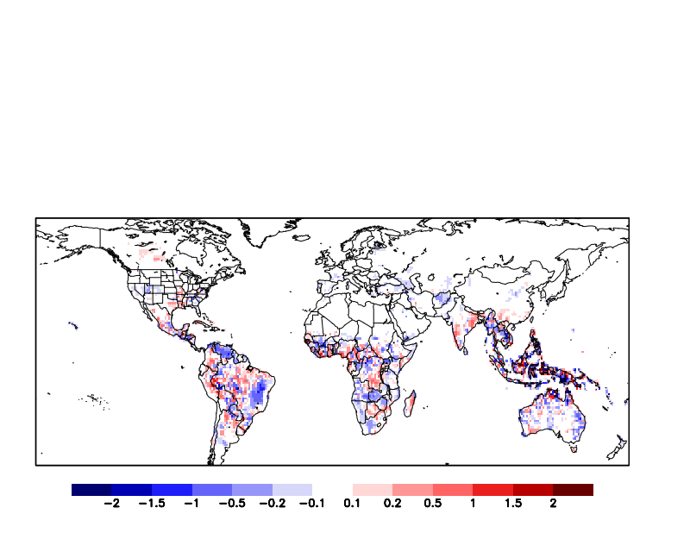
2021
2022
2023
NOx emissions
CO emissions
Isoprene emissions
2019
🔥
2020-2019
➘
🔥
☀️
☀️
2021-2019
🔥
2022-2019
🔥
2023-2019
➚
☀️
Attribution
NOx, CO, VOC, SO2
→ O3, OH, PM

Slide 9
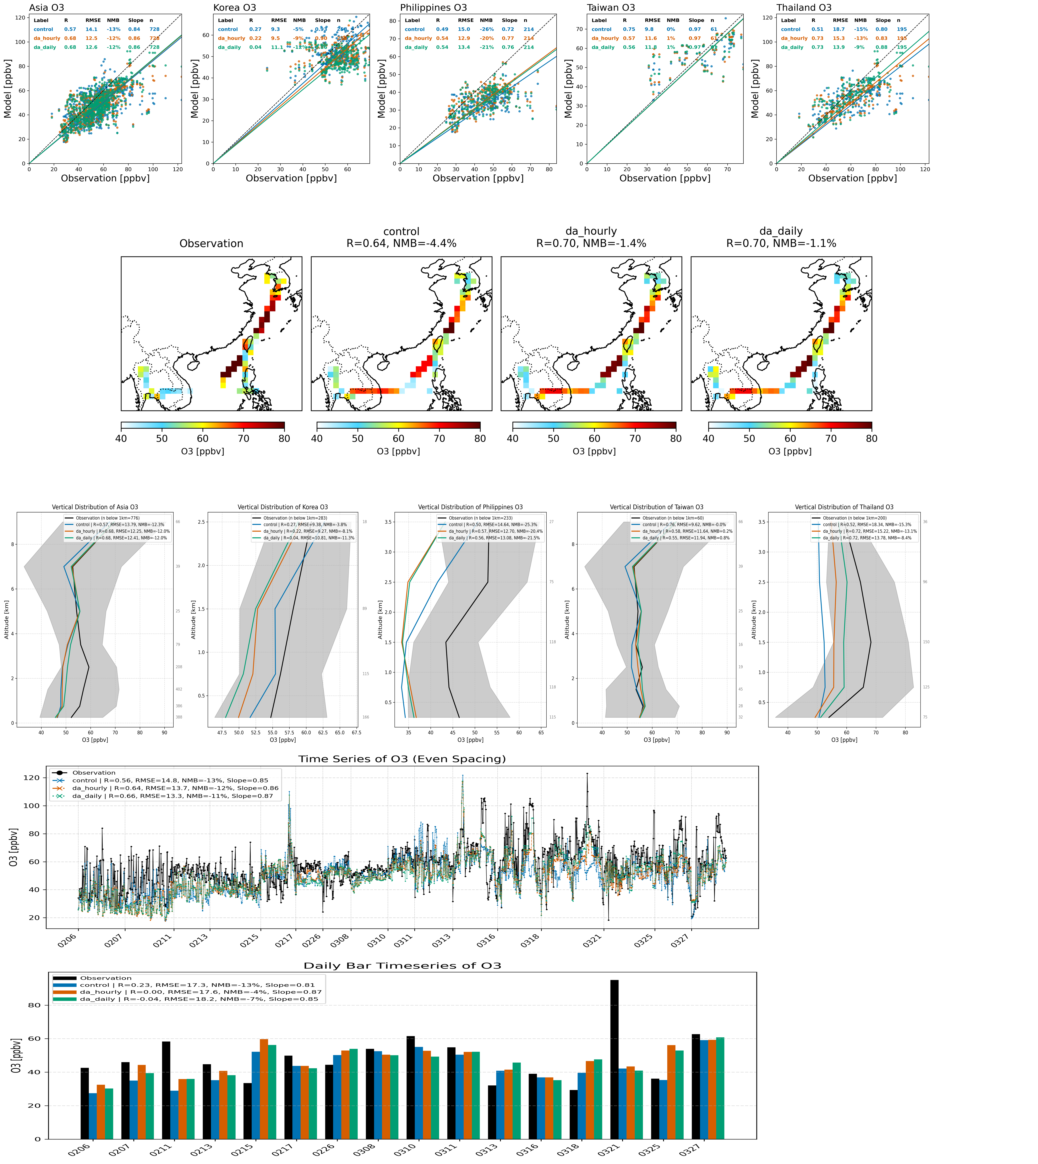

2024
Obs
Control
TCR-3
Ozone
Taiwan
Taiwan
Thailand
Taiwan
Philippine
Korea
Obs
Control
DA1
DA2

Slide 10
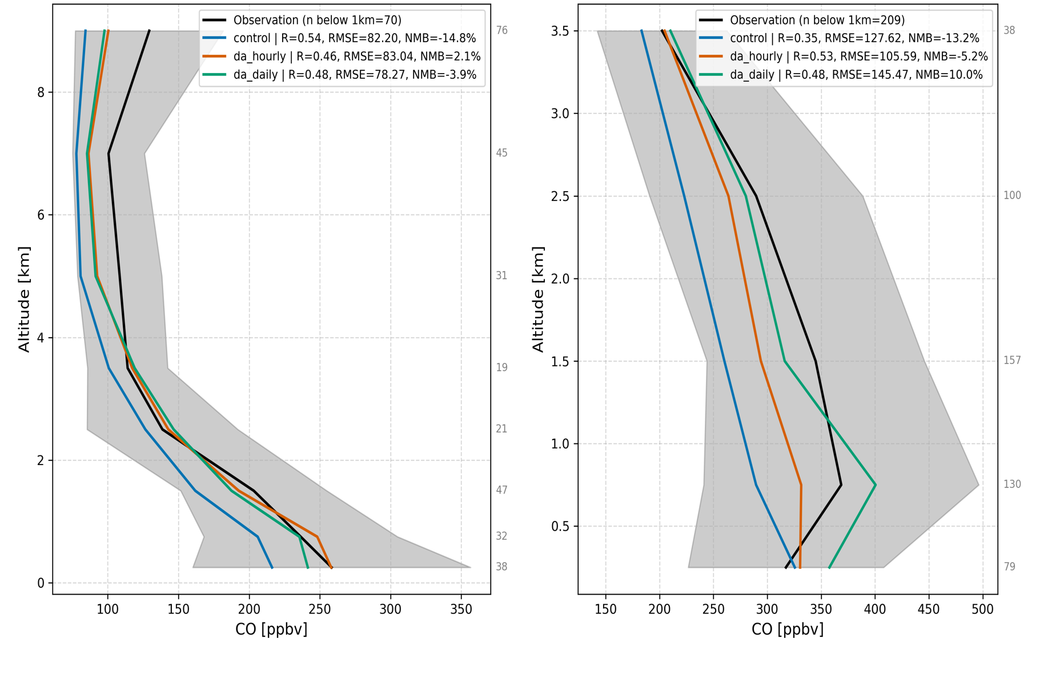
Ozone
CO
Taiwan
Thailand
Taiwan
Thailand
Obs
Control
DA1
DA2

Slide 11
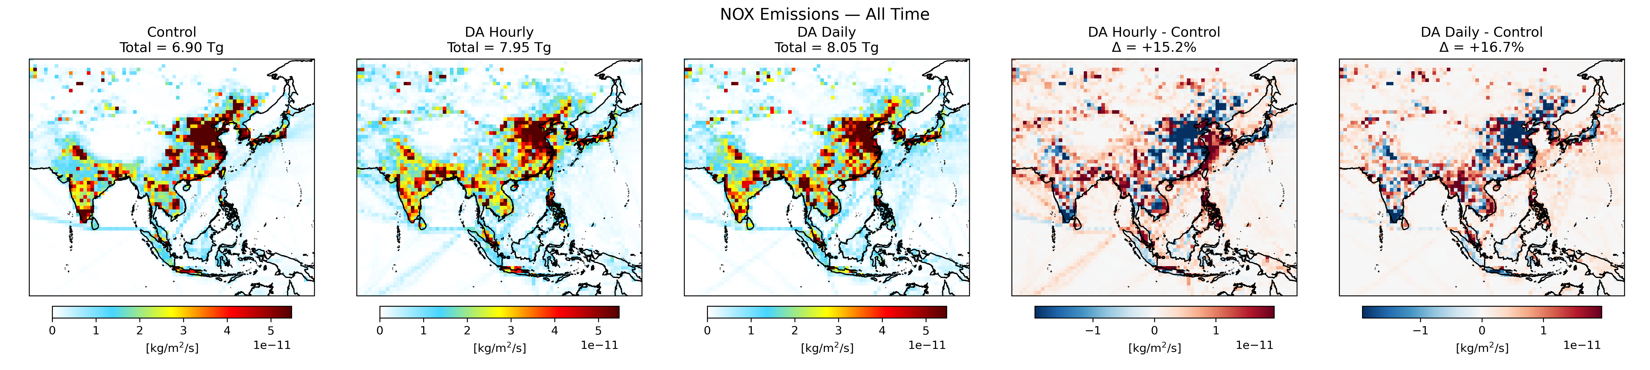
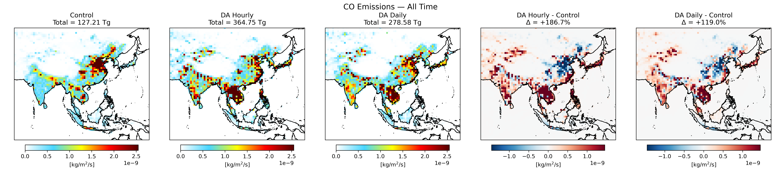
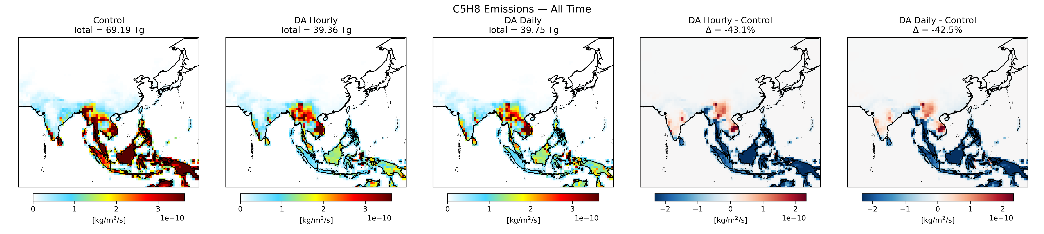
Prior (HTAP3, GFAS, MEGAN2.1)
Posterior
Difference
NOx emissions
CO emissions
Isoprene emissions
Attribution
NOx, SO2, CO, VOC, AOD
→ O3, OH, PM2.5

Slide 12
TCR-2/3
GCHP-EnKF
He et al., 2025 (BAMS)

Slide 13
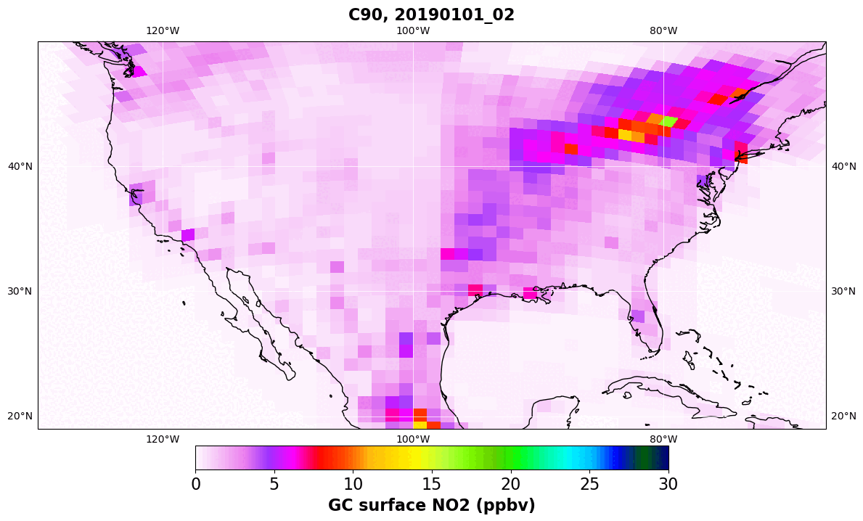
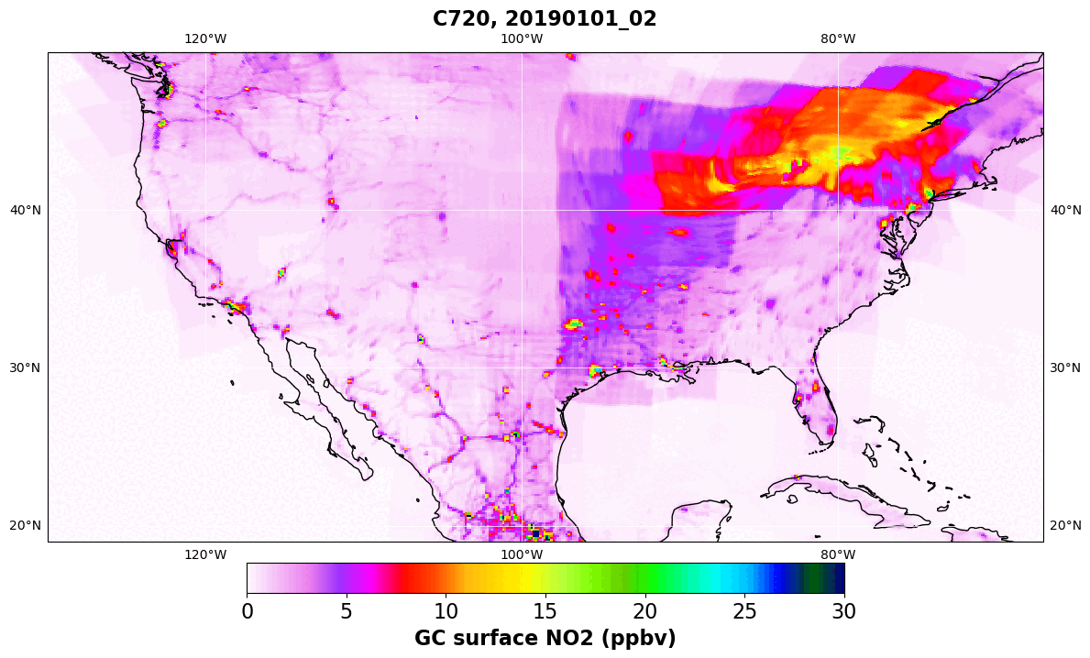
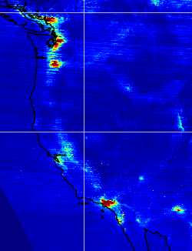
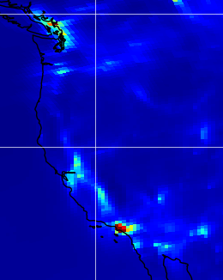
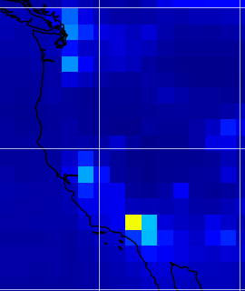
GCHP C90 (1° x 1.25°)
GCHP C720 (0.125°)
TEMPO
GCHP (0.25°)
TCR-2 (1.1°)
GEO + LEO + in situ integration enables seamless city-to-global scale composition analysis

Slide 14
Summary
Combined use of multi-scale multi-component DA in MOMO-Chem advance AQ and climate sciences and contribute to NASA’s missions.
Current & future applications: Satellites (GOSAT-GW, CO2M, GEMS, TEMPO, GEO-XO, Sentinel-4), aircraft missions (ASIA-AQ), scientific focuses (AQ+GHG, trace gas + aerosol interactions, OH, wildfires, NOx+VOCs), techniques (DA+ML).
Contributions/collaborations: Explore class missions, Schmidt Futures FETCH4 (Co-I), IGAC AMIGO (SC), IGAC TOAR-2 (Lead: Chemical reanalysis WG & satellite assessment report), ISSI (GEO AQ summary paper), JEDI, WMO observing system impacts, CEOS-AC-VC, TRACER-1 (NASA Ames regional reanalysis), JPL TROPESS (new satellite products)
NASA funded projects: AST (PI, Decadal reanalysis), ACMAP (PI, MOMO-Chem), ACMAP (PI, GCHP-EnKF), ESUSPI (PI, GOSAT-GW), Earth to Action for Air Quality (PI), JPL ML-AQ (PI), HAQAST (LBC), CMS-Flux (CO2-CO-NOx), NPP (NOx-VOCs), ACMAP (atmospheric river)

