Slide 1
Uptake of satellite data in the CAMS system
AC-VC#21 meeting - 11 June 2025
Antje Inness (ECMWF)
With thanks to the ECMWF CAMS team

Slide 2
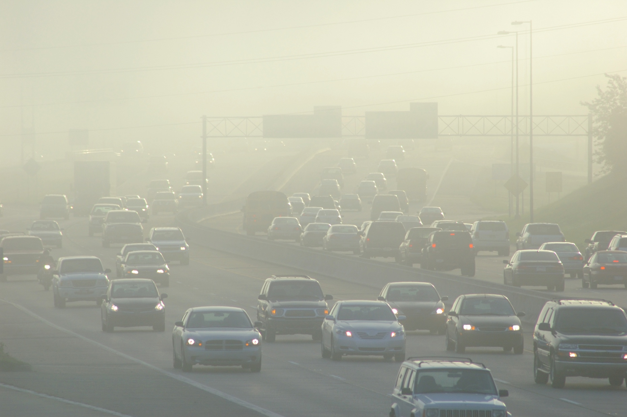





Copernicus Atmosphere Monitoring Service (CAMS)
Within the 6 Copernicus Services, the CAMS mandate is to deliver consistent and quality-controlled information related to the chemical composition of the atmosphere, its drivers (air pollutants and GHG) and its impact on air quality and health, solar energy, climate forcing, in Europe and everywhere in the world.
Air quality
Air quality
Policy tools
Solar energy
Ozone layer and UV radiation
Emissions and surface Fluxes
Climate forcing

Slide 3
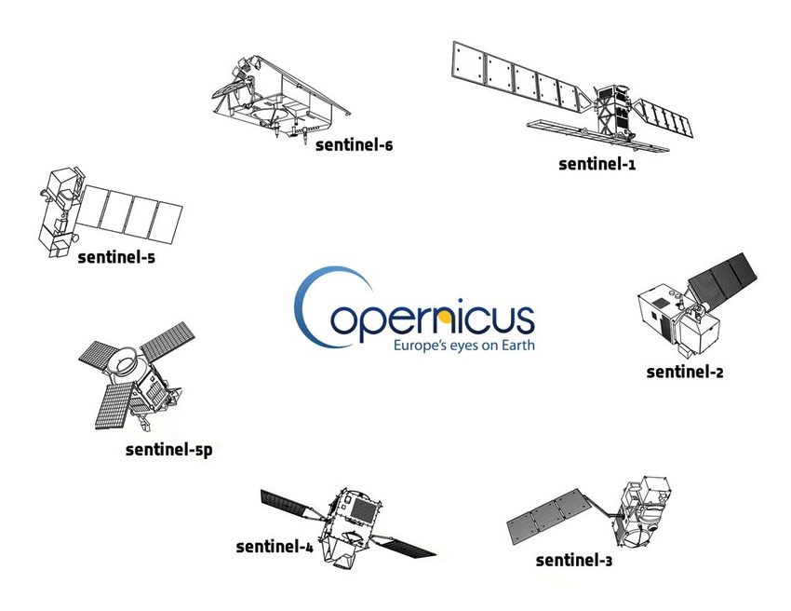
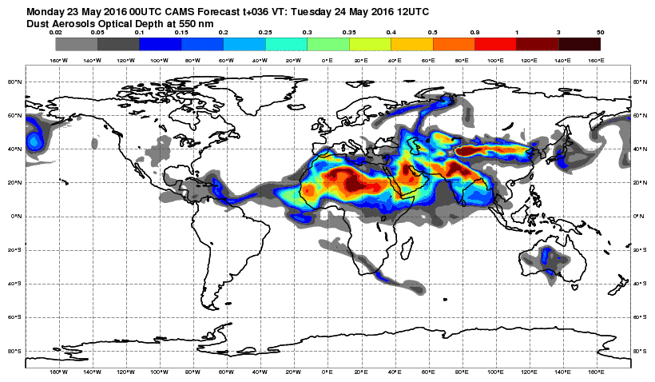
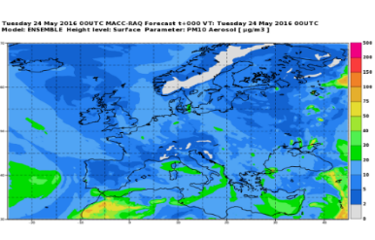
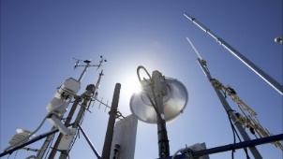
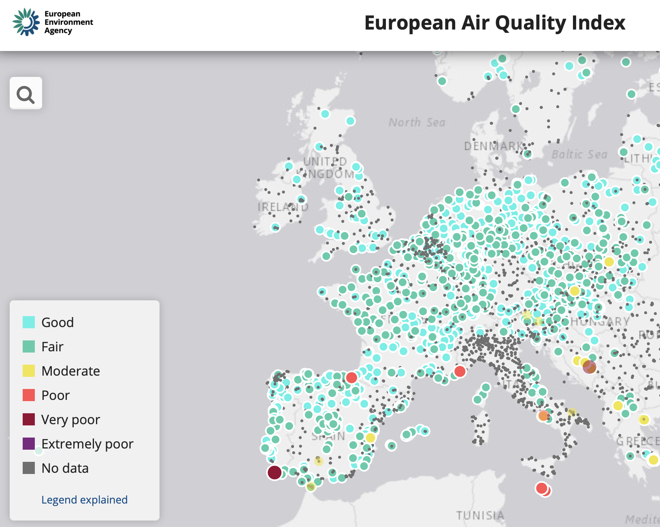
CAMS integrated framework
Global
CAMS Emissions
ECMWF
IFS
global,
40x40 km
Data assimilation
Satellite Observations
(AOD, O₃, CO, NO₂, SO₂,CH₄,CO₂)
GFAS
wildfire emissions
Boundary Conditions
11 regional CTMs over Europe,
10x10 km
European CAMS
Emissions
Data assimilation
Surface AQ observations

Slide 4
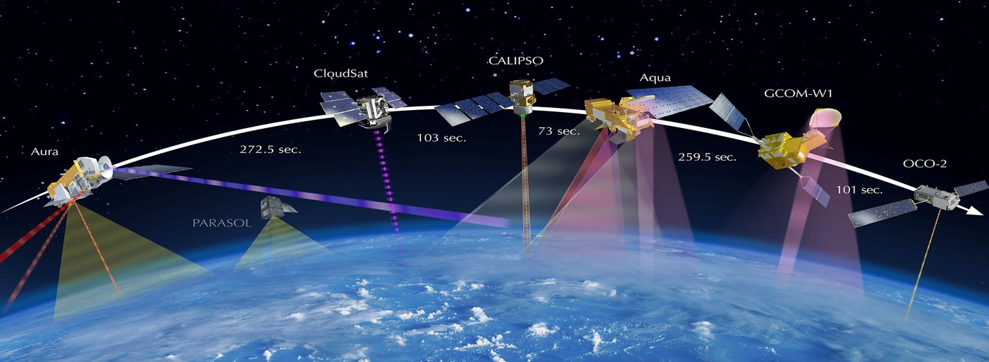
AC observations used in global NRT CAMS system
Species | Instruments
CAMS NRT
O₃ | S5P, GOME-2, OMI, OMPS-NP, MLS, OMPS-LP, GEMS, TEMPO
CO | S5P, IASI, MOPITT
NO₂ | S5P, GOME-2, GEMS, TEMPO
Aerosol | MODIS, VIIRS, PMAp, S3
CO₂ | GOSAT, IASI, OCO-2
CH₄ | GOSAT, IASI, S5P
SO₂ (volcanic) | S5P, GOME-2, IASI
SO₂ (anthropogenic) | S5P
HCHO | S5P, GEMS, TEMPO
GFAS fire emissions | MODIS, VIIRS, GOES, S3
CAMS uses Earth Observation data from many satellites for atmospheric composition and weather.
---- Used
---- Undergoing testing
---- Retired since Feb 2025

Slide 5
AC observations used in global NRT CAMS system
Species | Instruments
CAMS NRT
O₃ | S5P, GOME-2, OMI, OMPS-NP, MLS, OMPS-LP, GEMS, TEMPO
CO | S5P, IASI, MOPITT
NO₂ | S5P, GOME-2, GEMS, TEMPO
Aerosol | MODIS, VIIRS, PMAp, S3
CO₂ | GOSAT, IASI, OCO-2
CH₄ | GOSAT, IASI, S5P
SO₂ (volcanic) | S5P, GOME-2, IASI
SO₂ (anthropogenic) | S5P
HCHO | S5P, GEMS, TEMPO
GFAS fire emissions | MODIS, VIIRS, GOES, S3
CAMS uses Earth Observation data from many satellites for atmospheric composition and weather.
---- Used
---- Undergoing testing
---- Retired since Feb 2025

Slide 6

Geostationary AC data
The HE CAMEO project is helping prepare CAMS for the assimilation of geostationary AC data

Slide 7
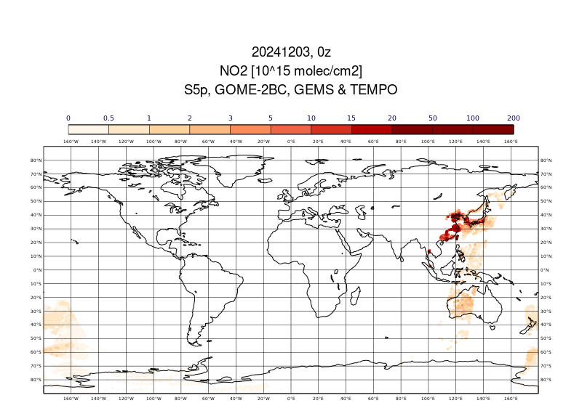
Animation of hourly NO2 retrievals 20241203
GEMS
Hourly during daytime
TEMPO
Hourly during daytime
S5p & GOME-2BC
polar orbits

Slide 8
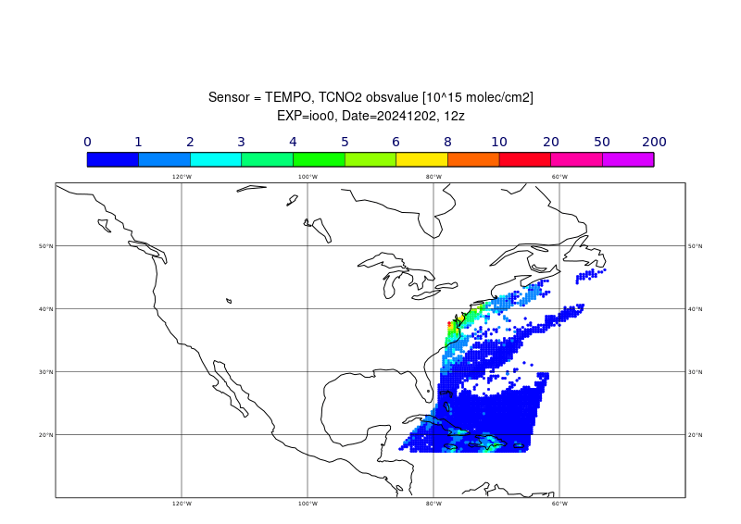
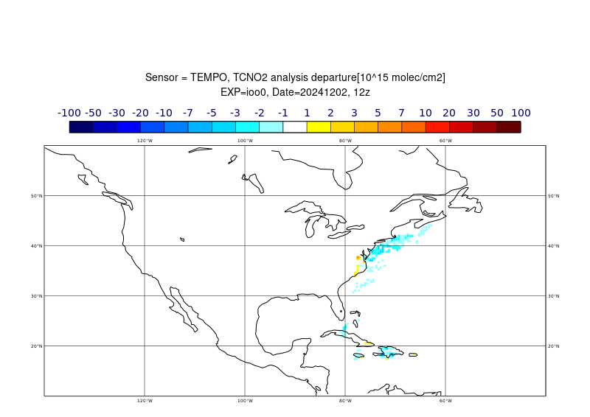
TEMPO NO2 animation: 2-15 Dec 2024
NO2 observations
NO2 analysis departures (obs-an)
Positive departures over pollution sources in Eastern US (morning)

Slide 9
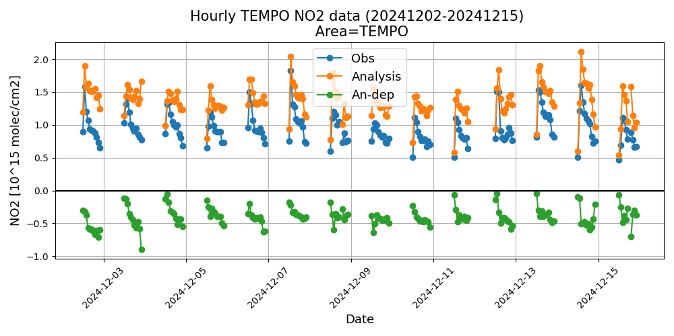
TEMPO NO2: Hourly timeseries
Larger negative departures in the afternoon

Slide 10
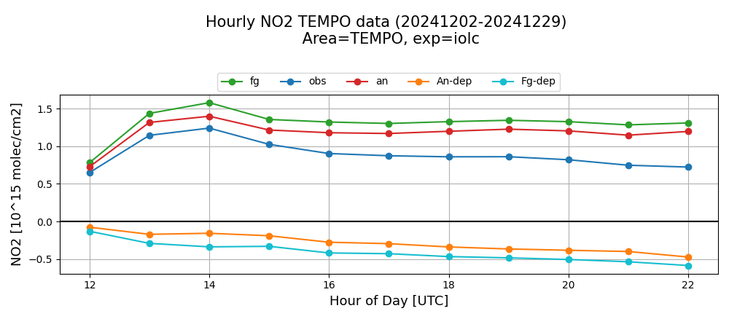
TEMPO NO2 assimilation test
Small reduction in departures when assimilating TEMPO NO2

Slide 11
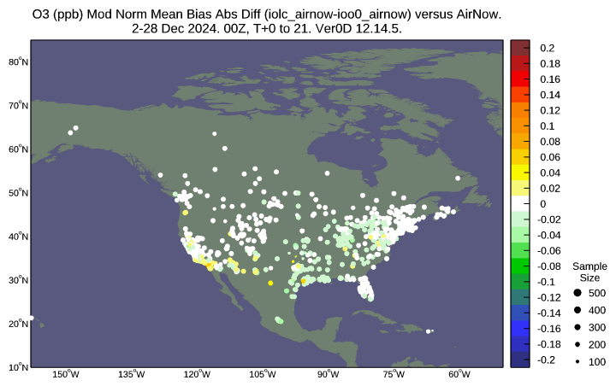
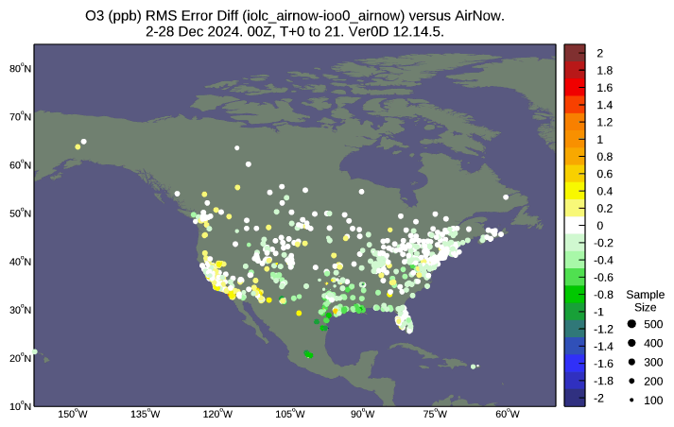
OZONE DIFFERENCES (NO2 ASSIM - CTRL)
MNMB (ASSIM – CTRL)
RMSE (ASSIM – CTRL)
Comparison with Airnow surface O3 observations
Small reduction in O3 MNMB and RMSE when assimilating TEMPO NO2, especially in central and eastern US

Slide 12
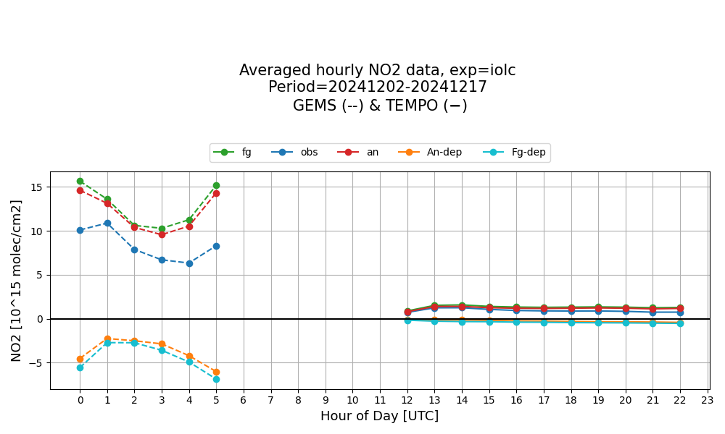
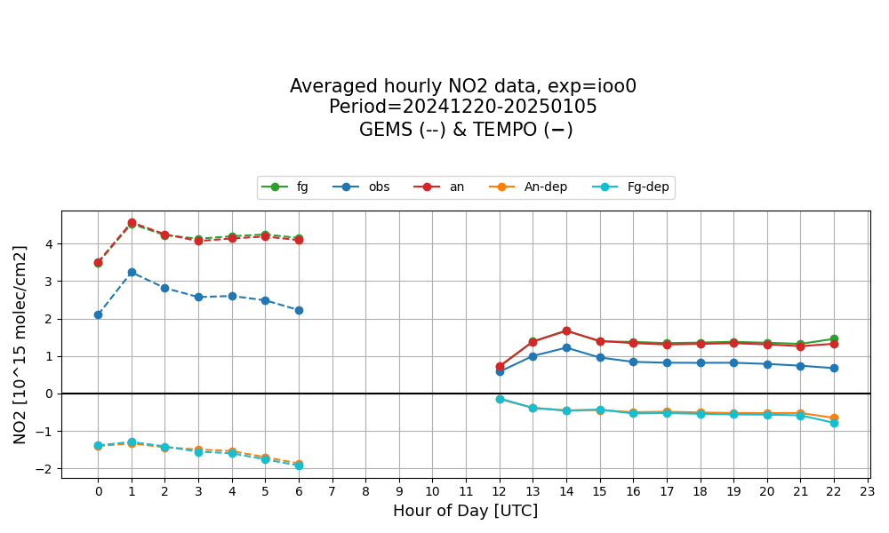
Average hourly NO2 data
2-17 Dec 2024
20 Dec 2024 – 5 Jan 2025
TEMPO
TEMPO
GEMS
GEMS
GEMS
V2 -> V3
Reduced bias in GEMS V3
But GEMS V3 still has larger NO2 bias wrt CAMS than TEMPO

Slide 13
A new CAMS reanalysis (EAC5)
Global reanalysis (EAC4)
~80 km, 60 levels, tropospheric chemisty, lin O₃ stratosphere
CAMS
2007
```
1979
2003
2014
2021
Global reanalysis (EAC5), preparations have started, start prod. in 2025
higher resolution (~ 40 km, 137L), tropospheric & stratospheric chemistry
CAMS 2.0
Final preparations for EAC5 ongoing
Improvements to chemistry (IFScompo-BASCOE, including stratospheric chemistry)
Newer/ improved IFS version (better meteorology): CY49R2 – same as ERA6
Increased resolution (137 vertical levels; TL511 horizontal, ~ 40 km)
New reprocessed observation, new emissions including online biogenic emissions
Status
Acquisition and processing of observations finished
Testing of model and DA configuration in final stages
Improved QC for assimilated data before starting production
No emission inversion yet in EAC5
Production to start in
2025

Slide 14
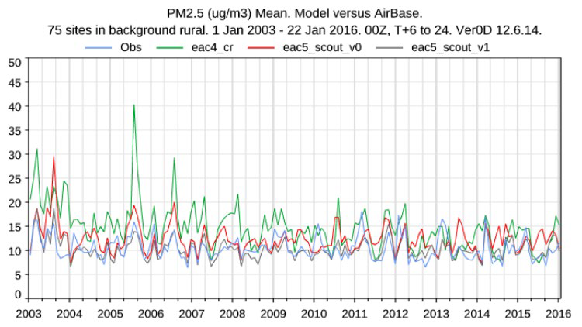
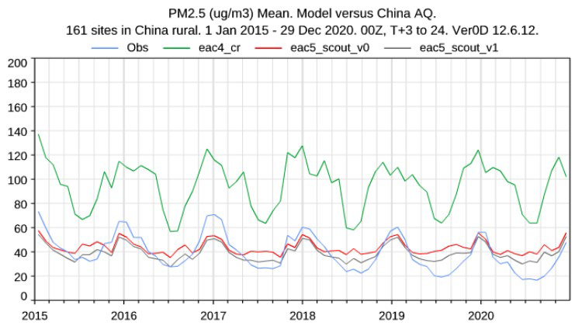
New model version (CY49R2) in EAC5
Model simulation without AC data assimilation (control runs) to test the impact of emissions and model upgrades
EAC5 CR show better results for many species, e.g. PM2.5
OBS EAC4 EAC5_1 CR (ECSAM4Clim=off) EAC5_2 CR (ECSAM4Clim=on)
Credit: Johannes Flemming

Slide 15
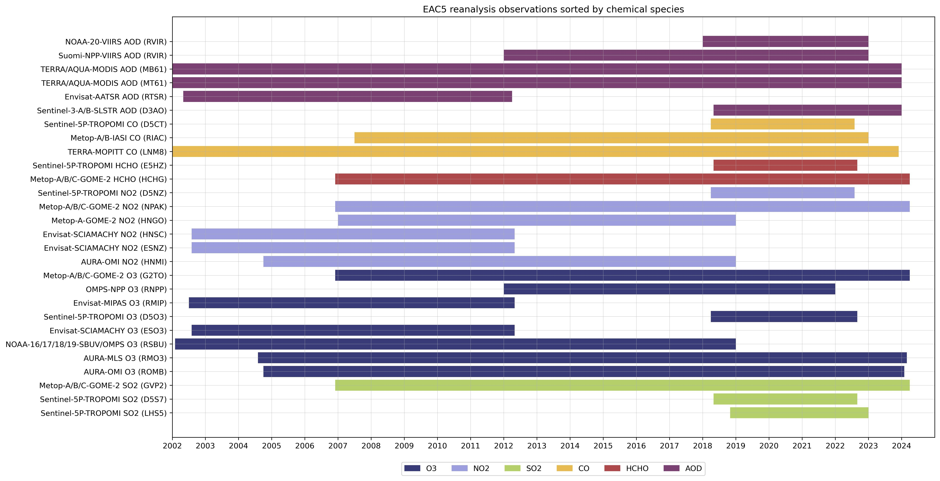
Data acquisition and preparation
Data acquisition complete
This was a big task taking several years
150 TB of data (more than 2 million compressed files) in different formats ranging from pure binary to netCDF/HDF/BUFR and coming from different providers
Credit: Chris Kelly

Slide 16
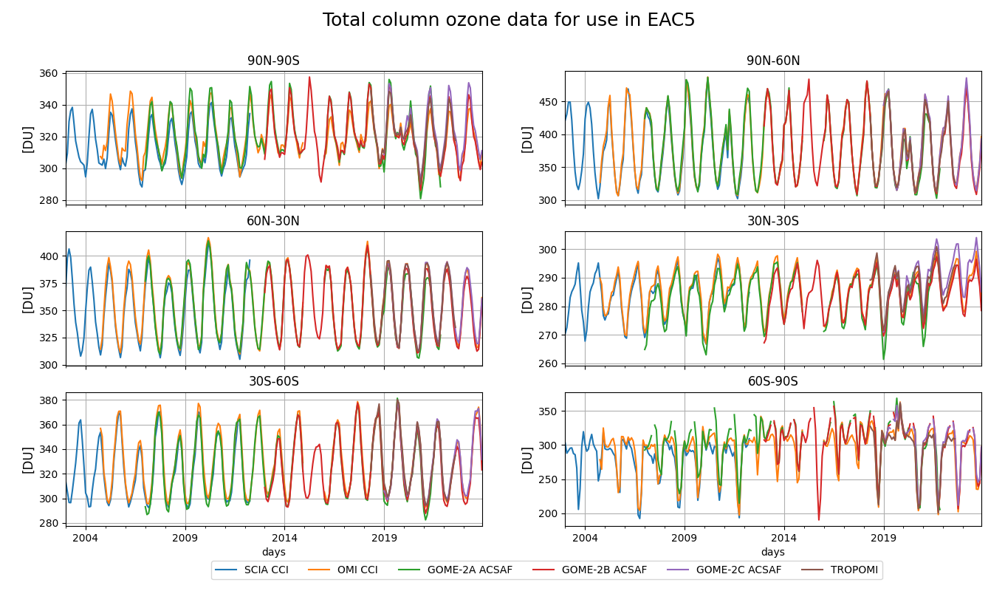
Quality check of TCO3 data
SCIA CCI
OMI CCI
GOME-2A AC-SAF
GOME-2B AC-SAF
GOME-2C AC-SAF
TROPOMI ESA
Good agreement between the TCO3 datasets
varBC will handle remaining differences

Slide 17
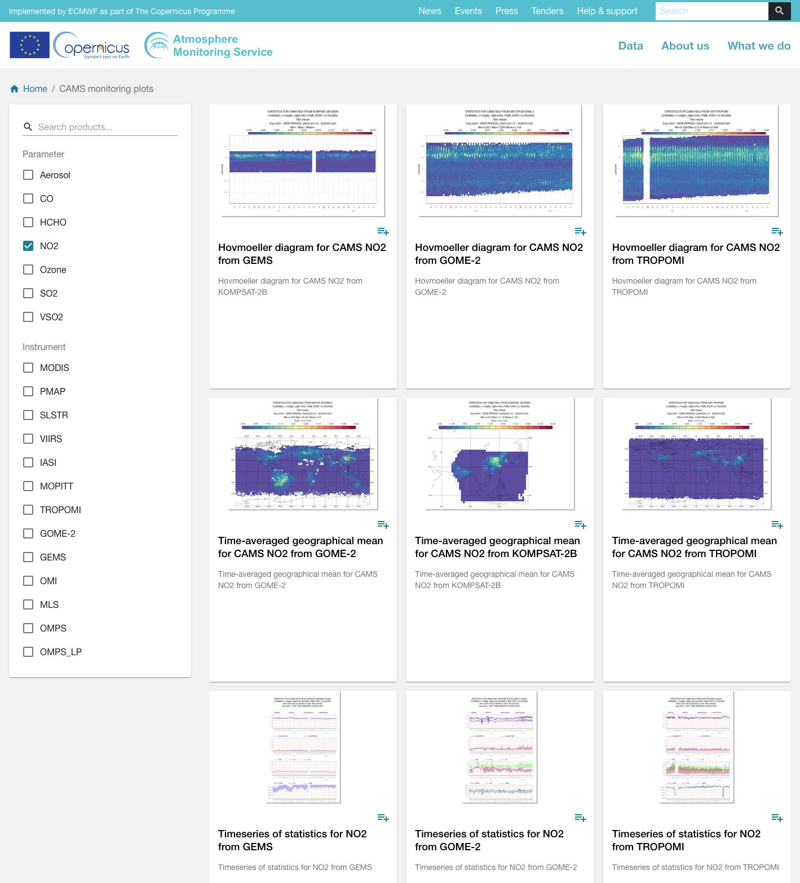
CAMS satellite monitoring page
Monitoring plots are
routinely displayed on the CAMS website
They give us and the data producers timely information about any changes in the data
https://atmosphere.copernicus.eu/charts/packages/cams_monitoring/

Slide 18
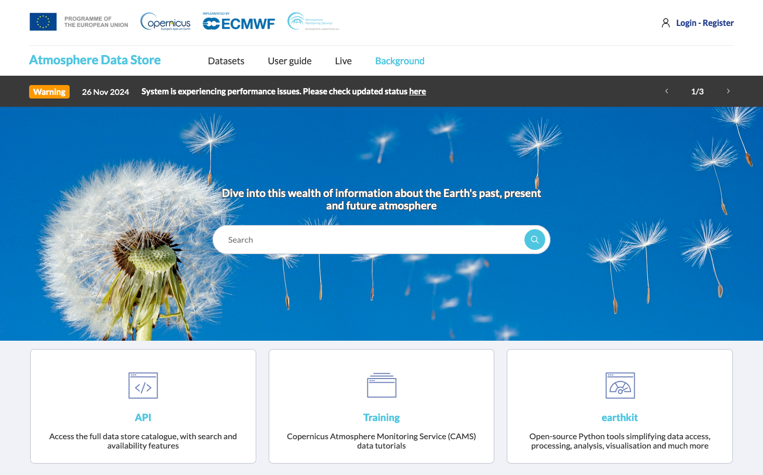

The Atmosphere Data Store (ADS)
All CAMS data are freely available: https://ads.atmosphere.copernicus.eu/
Copernicus EU
@copernicusecmwf
www.copernicus.eu
atmosphere.copernicus.eu
Copernicus ECMWF
@copernicusecmwf.bsky.social
Documentation of atmospheric composition in IFS:
https://www.ecmwf.int/en/elibrary/81374-ifs-documentation-cy48r1-part-viii-atmospheric-composition
Validation reports and validation servers:
https://atmosphere.copernicus.eu/quality-assurance

Slide 19

Thank you
© European Union 2023
Unless otherwise noted the reuse of this presentation is authorised under the CC BY 4.0 license. For any use or reproduction of elements that are not owned by the EU, permission may need to be sought directly from the respective right holders.
Slide xx: element concerned, source: e.g. Fotolia.com; Slide xx: element concerned, source: e.g. iStock.com

