Slide 1
Validating Satellite Aerosol‑Layer Height with the Unified Ceilometer Network
CEOS ACVC‑21 ALH Panel Discussion
Ruben Delgado
Center for Atmospheric Sciences
Hampton University, Hampton, VA
James Szykman
Center For Environmental Measurements and Modeling​
U.S. EPA Office of Research and Development, RTP NC USA​

Slide 2
Why ALH Validation Matters
ALH drives radiative forcing, air‑quality exposure, and data assimilation accuracy.
Satellite ALH suffers from cloud/aerosol confusion and scene‑dependent biases.
Surface‑based truth is the missing link for algorithm tuning and validation of satellite data products.
UCN offers continuous vertical profiling to close this gap.

Slide 3


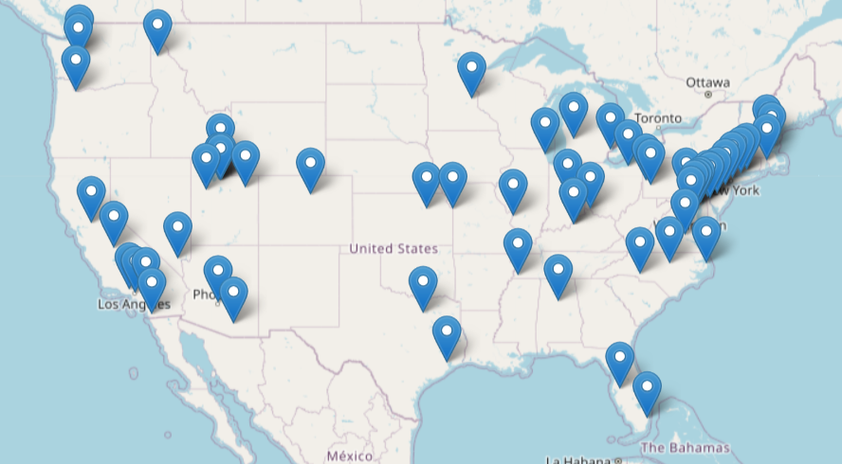
Unified Ceilometer Network (UCN)
Collaboration between Hampton University, EPA, NASA, NOAA, DOD, state and local agencies, and academia.
Network of ceilometers from U.S. Air Quality Network (~72 sites) and Academic Institutions.
Data archive of ceilometer attenuated backscatter profiles β(z); a subset of sites date back to 2001.
Near real-time data processing (MLH, NBL, residual layer (RL), aerosol layers) (Caicedo et al. 2020).
EPA PAMS/NCORE Sites
https://ucn.cas.hamptonu.edu

Slide 4
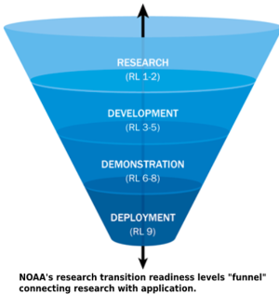
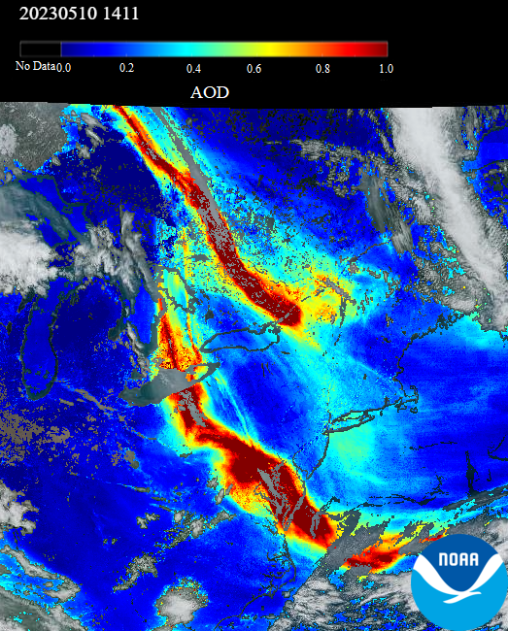
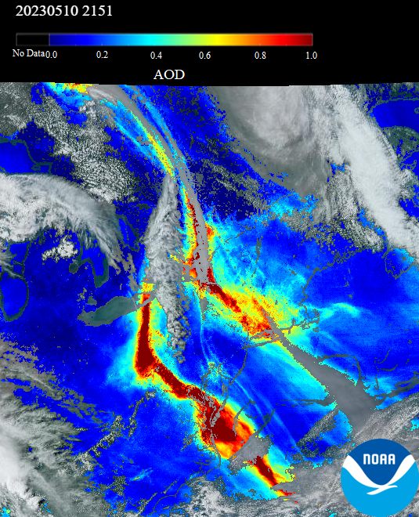
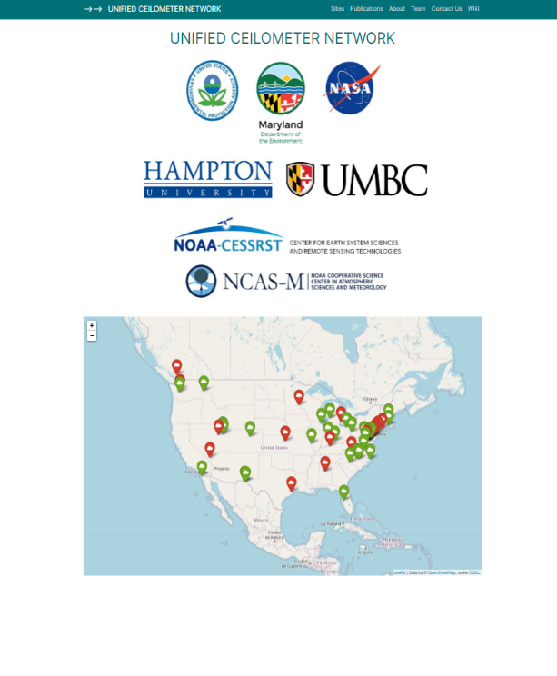
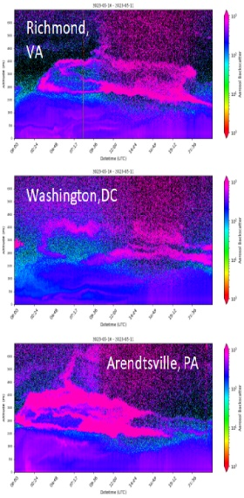
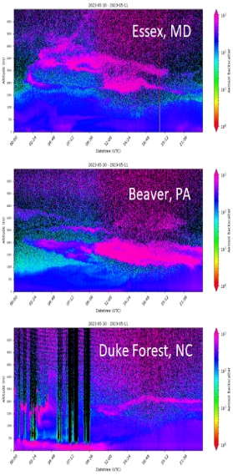
UCN: Ready‑Made Validation Backbone
Ceilometers (Vaisala and Lufft) across CONUS; harmonized ingest at NOAA/NESDIS.
High temporal and vertical resolution; hourly QC’d MLH + candidate ALH outputs.
Advantages: 24/7 sampling, co‑locations with AERONET and state air quality monitoring stations, open API access.
EPA PAMS/NCORE Sites
Readiness Level 8: Prototype Functionality
Prototype system, process, product, service or tool demonstrated in an operational or other relevant environment (functionality demonstrated in near-real world environment; subsystem components fully integrated into system).
https://ucn.cas.hamptonu.edu

Slide 5
Current Retrieval State‑of‑Play
Gradient/inflection, wavelet‑transform, and idealized‑fit algorithms dominate in operational ceilometer processing.
Emerging ML models (Random Forest, CNN) handle multilayer and noisy scenes but still lack broad validation datasets.
Satellite products: CALIOP v4, S5P/TROPOMI ALH, TEMPO early‑release layer heights—accuracy typically ±500 m to >1 km over land.
Notes:
Keep bullets tight; details live in the forthcoming review paper.

Slide 6
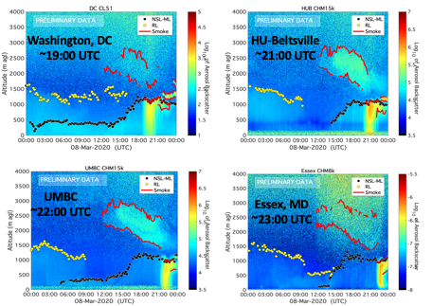
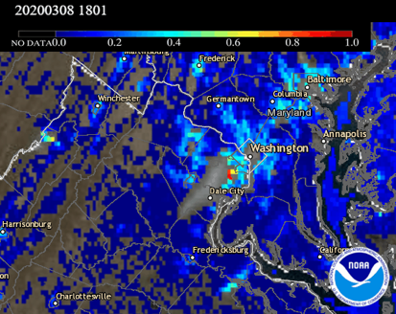
UCN Aerosol Layer Height
Network Sites Denser in Urban Corridors due to connection with EPA Photochemical Assessment Monitoring Stations.
Regional Smoke transport within PBL observed by ceilometers network supplementing GOES-16/ABI AOD
Huff et al. 2021
https://doi.org/10.1175/JTECH-D-20-0162.1

Slide 7
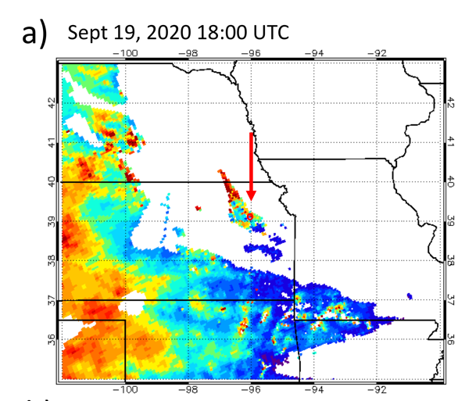
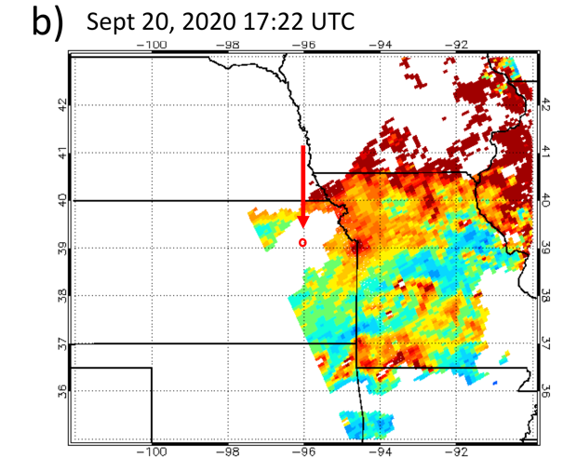
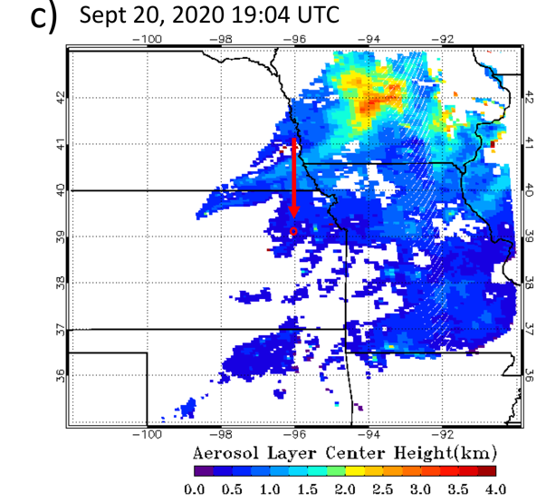
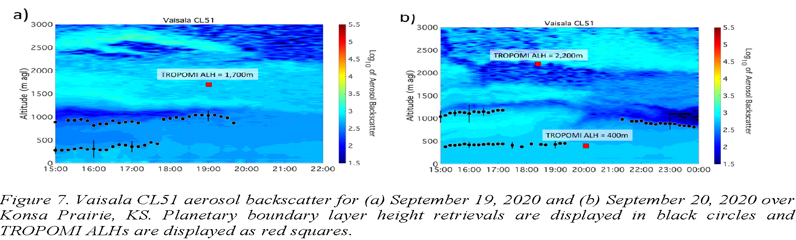
Illustrative Case Study: UCN vs TROPOMI ALH
TROPOMI
Aerosol Layer Heights
U.S. Region 7
CL51 at Konza Prairie Site
The UCN site in Konza Prairie, Kansas (EPA Region 7: 39.1022°N, 96.6096°W Bottom a-b) captured the evolution of the smoke plume transport. Ceilometer planetary boundary layer heights were calculated at the times of TROPOMI measurements and contrasted against TROPOMI ALH (Top a-c).

Slide 8
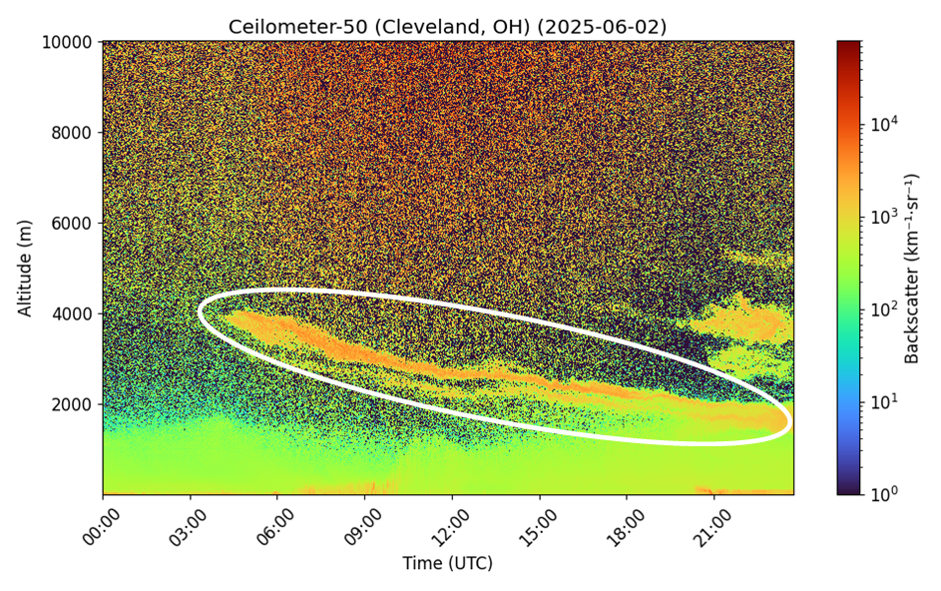
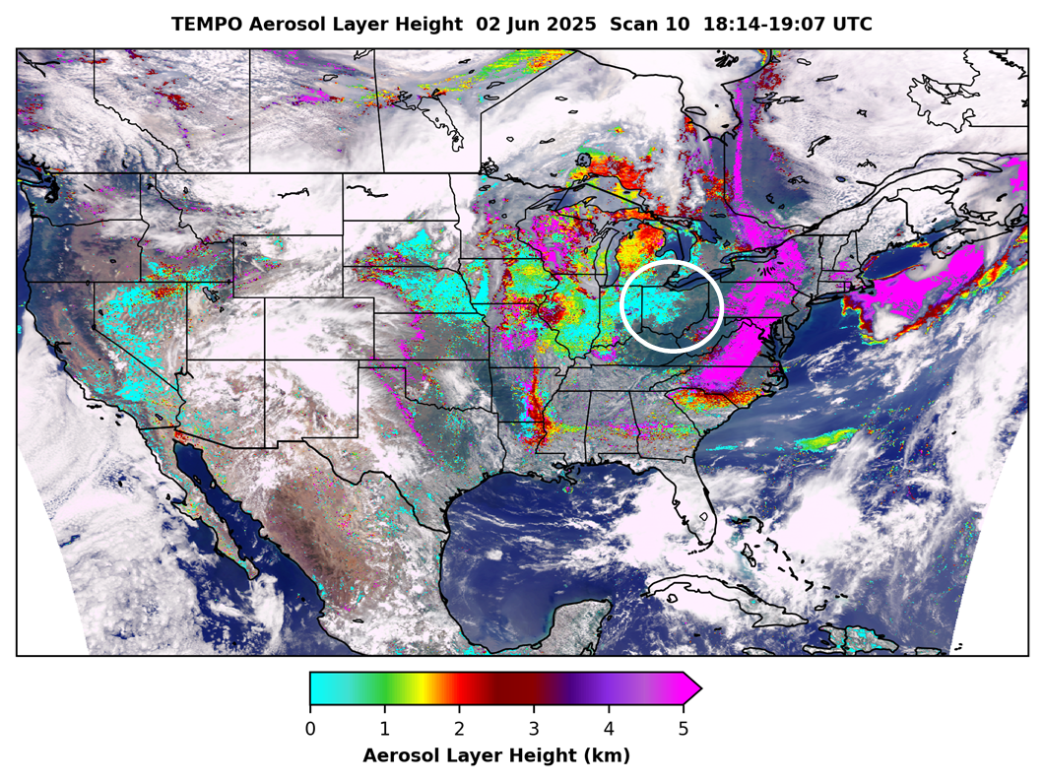
Illustrative Case Study: UCN vs TEMPO ALH
UCN ceilometer from Cleveland, OH (PAMS) shows smoke mixed down to the boundary layer by ~18:30 UTC; correlates with aerosol layer height from TEMPO Scan 10
Smoke plume
Credit: TEMPO AHL NOAA/NESDIS

Slide 9
Proposed Validation Framework
Step | What | Why
Collocation | ±30 min / 25 km satellite–ceilometer | balances temporal drift vs. sample size
Vertical Metric | Δz = z_sat – z_UCN (bias, RMSE, hit‑rate) | simple, interpretable
Uncertainty Stratification | AOD, cloud fraction, surface type | diagnose scene dependence
Multi‑sensor Fusion | Pair UCN with Raman/DIAL lidars (HU, LaRC), aircraft (e.g., AEROMMA) | anchor high layers & free‑troposphere smoke
Open Evaluation Portal | GitHub workflows; daily matchup plots | transparency, community feedback
Notes:
Highlight practicality: steps are actionable starting now.

Slide 10
Path Forward & Take‑Aways
Standardize: adopt common ALH algorithm and QC recipe across UCN.
Synergize: UCN–satellite-field campaign IOPs during extreme events.
Share: real‑time open matchup service under CEOS AC-VC umbrella.
“UCN offers an immediately actionable, community‑owned platform to close the satellite ALH validation gap.”
Notes:
Close strong: call to action & collaboration.

