Slide 1
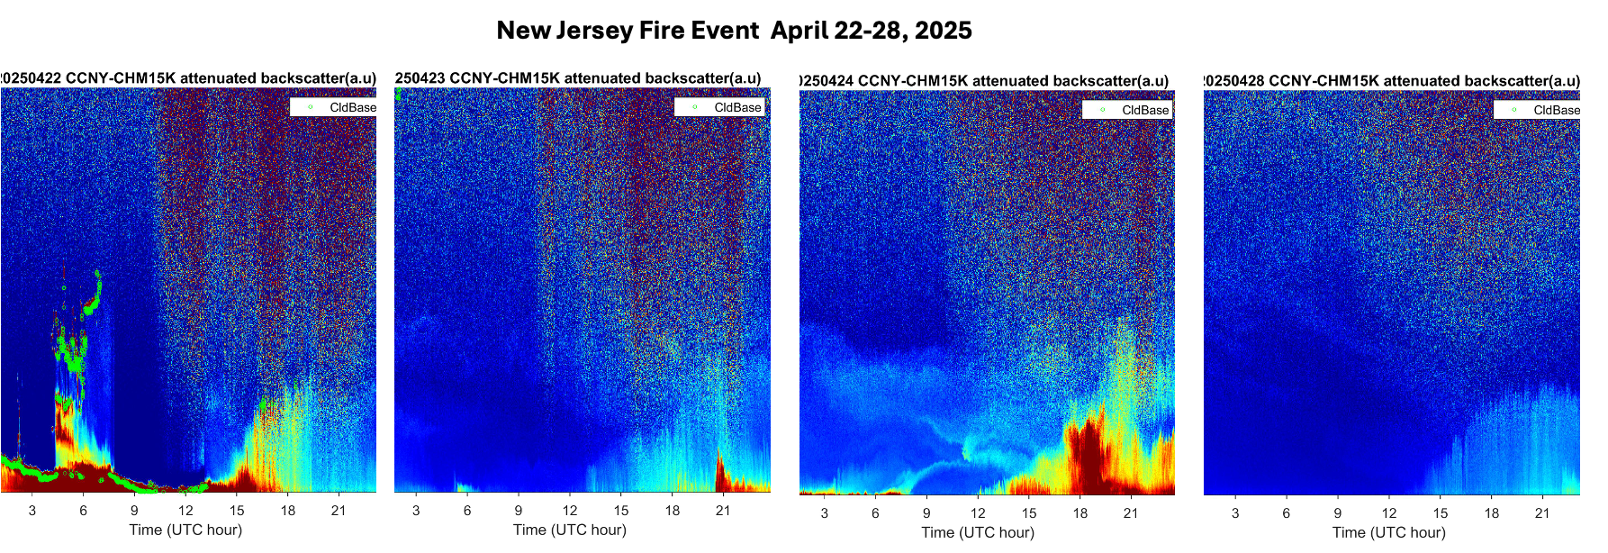
Atmospheric Composition Validation: Aerosol Layer Height
Mitch Goldberg, Mina Kang CCNY

Slide 2


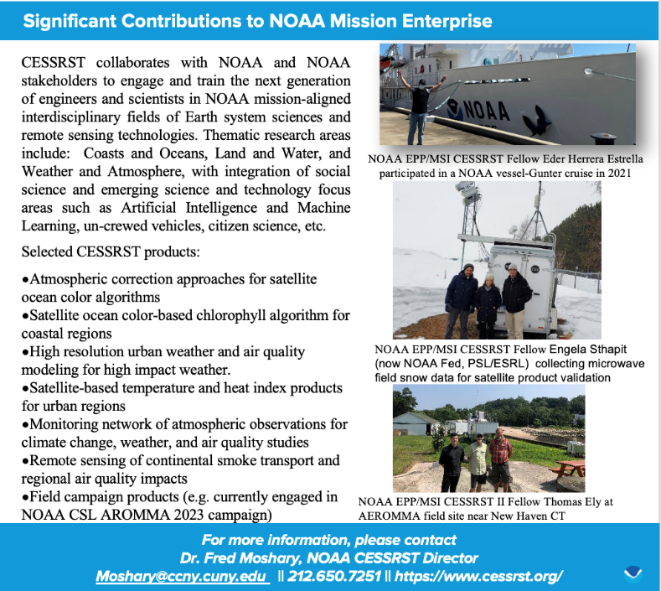


Fred Moshary, CESSRST-II Director
Professor of Electrical Engineering, City College of New York
Ruben Delgado, HU CESSRST PI, Professor of Atmospheric Science, Hampton University
Mitch Goldberg, CESSRST-II Distinguished Research Scientist, Professor Earth Systems Science and Environmental Engineering
Mina Kang CESSRST-II Research Scientist,

Slide 3


Joint Collaborative Research Development Project
JCRDP will produce a Satellite AC validation system by leveraging CESSRST II and NCAS-M observing systems, which include radiosondes, lidars, doppler radar, flux towers, microwave profilers, Aeronet and Pandora observations, and Meteorological Stations.
The validation system (with associated elements – data plan, data collection, collocations, statistical analysis, and website) will be developed collaboratively with CESSRT II and NCAS-M researchers and students together with guidance from SMEs at NOAA, NASA and EPA.
CENTER FOR EARTH SYSTEM SCIENCES & REMOTE SENSING TECHNOLOGIES (CESSRST-II)

Slide 4
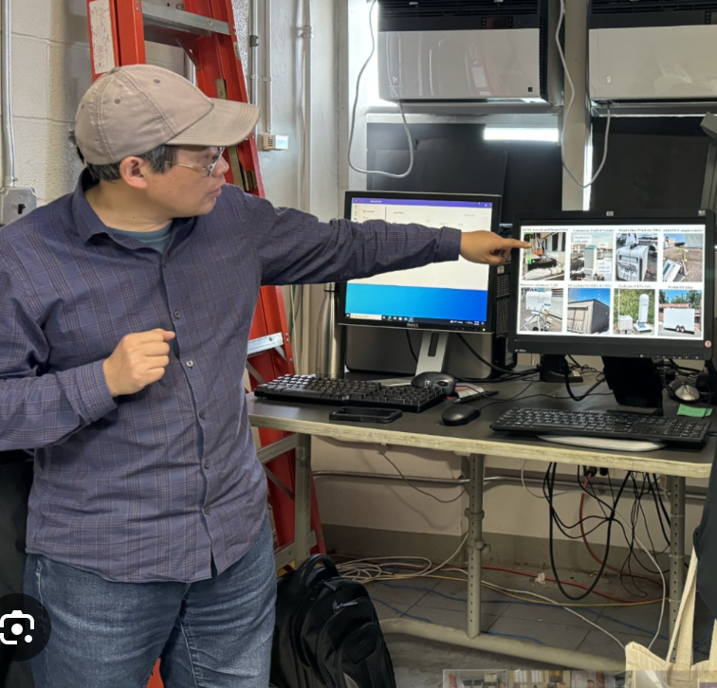
Atmospheric observations and data product at CCNY-ORSL
CCNY multi-wavelength elastic-Raman Lidar
Aerosol extinction & backscatter coefficient profile at 0.5-8 km altitude at 1064-532-355-nm,
Angstrom exponent, Water vapor in the PBL, Mixing-layer-height (MLH) and Cloud height
2. Ceilometers (Lufft-CHM15K, Vaisala CL51, CL31)
MLH or PBLH dynamics and Cloud base; 24-hr/7-day
3. NASA-AERONET Cimel Sunphotometer (CCNY site)
AOD, IPW, Angstrom exponent, size distribution, SSA, etc.
4. CCNY Ozone DIfferential Absorption Lidar (DIAL)
Ozone concentration profiles at 0.3-8 km altitude (daytime), NASA-TOLNet member
5. Coherent Doppler Wind Lidar (Leosphere/Vaisala Windcube S200)
3D winds in the PBL
6. Microwave radiometer (Radiometric TP 300A)
Temperature, RH or water vapor, Liquid water profiles (~10 km), total WV and LW
7. Ground samplers and weather station at CCNY (CCNY and NYSDEC)
O3, CO, PM2.5 (NYSDEC); O3, NO2, CO2/H2O, Aerosol size distribution (CCNY)
Dr. Yonghua Wu, CCNY

Slide 5
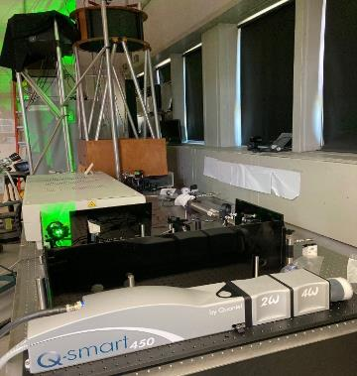
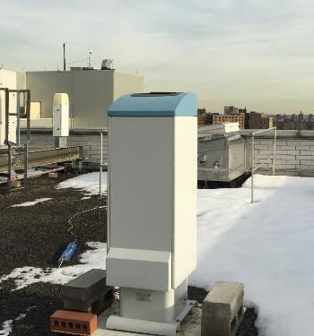
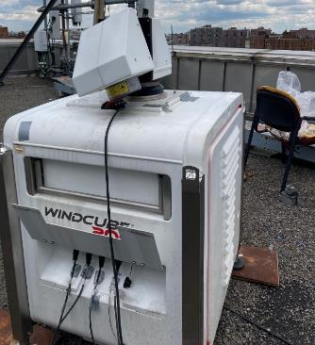
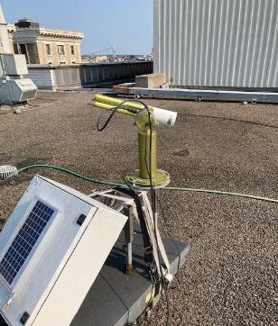
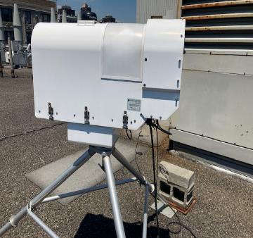
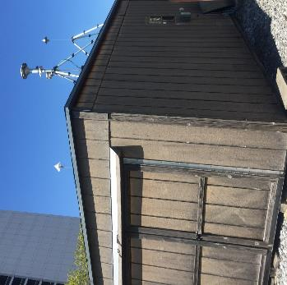
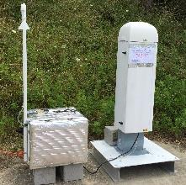
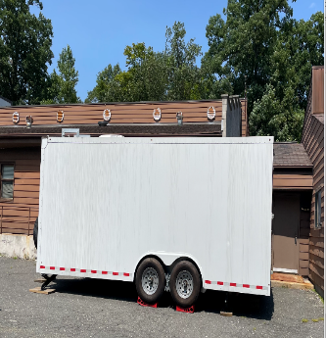
CCNY Aerosol and Ozone Lidar
Ceilometers (Lufft & Vaisala)
Wind Lidar (Windcube 200s)
AERONET sunphotometer
Vaisala CL31 ceilometer
Lidar
Lufft CHM15k ceilometer
Microwave radiometer: T, RH
AQ station (NYSDEC/CCNY)
Field obs (CL51+O3)
Mobile O3-lidar

Slide 6
Why UCN Is Valuable for Satellite Validation
Direct measurement of aerosol layer height
  Ceilometers record backscatter vs. altitude directly, providing ground truth for satellite retrieval bias.
High temporal resolution vs. satellite overpass
  Profiles every few seconds capture rapid evolution (e.g., boundary-layer growth, dust plumes) at overpass time.
Assessment of lower-tropospheric layers
  Excels at detecting layers below 3 km where satellites struggle to separate aerosol from molecular scattering.

Slide 7
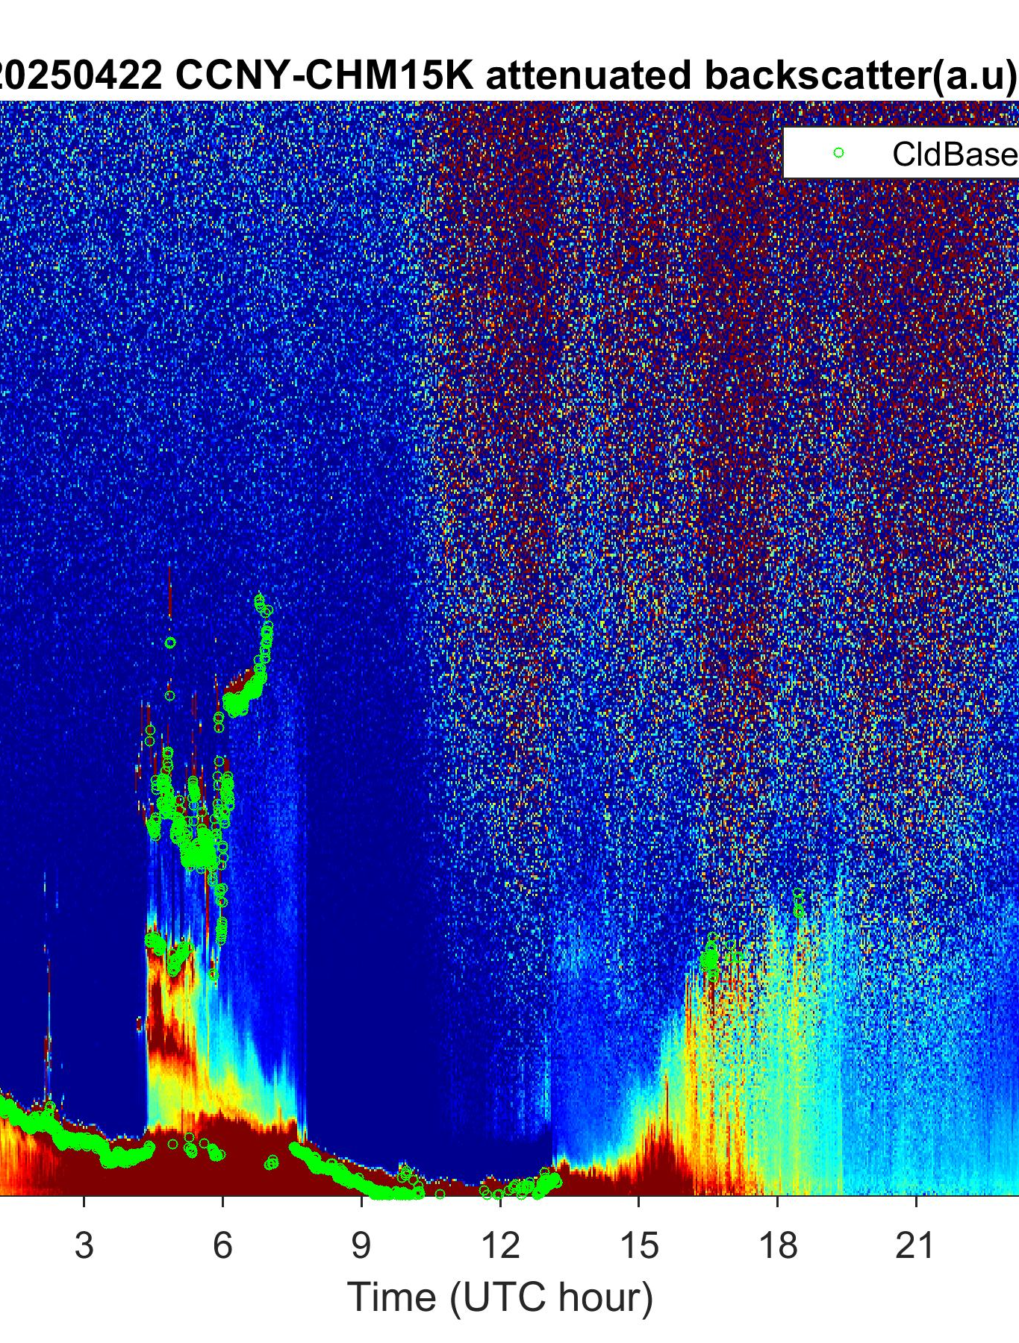
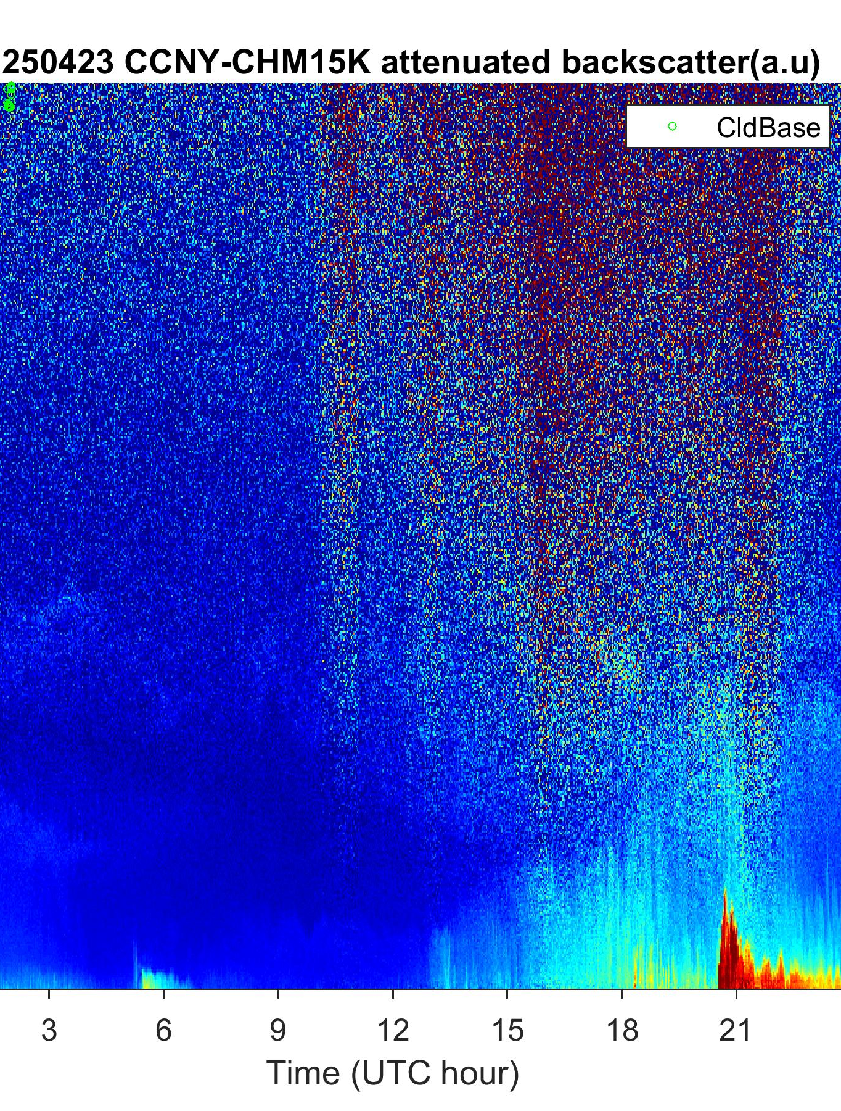
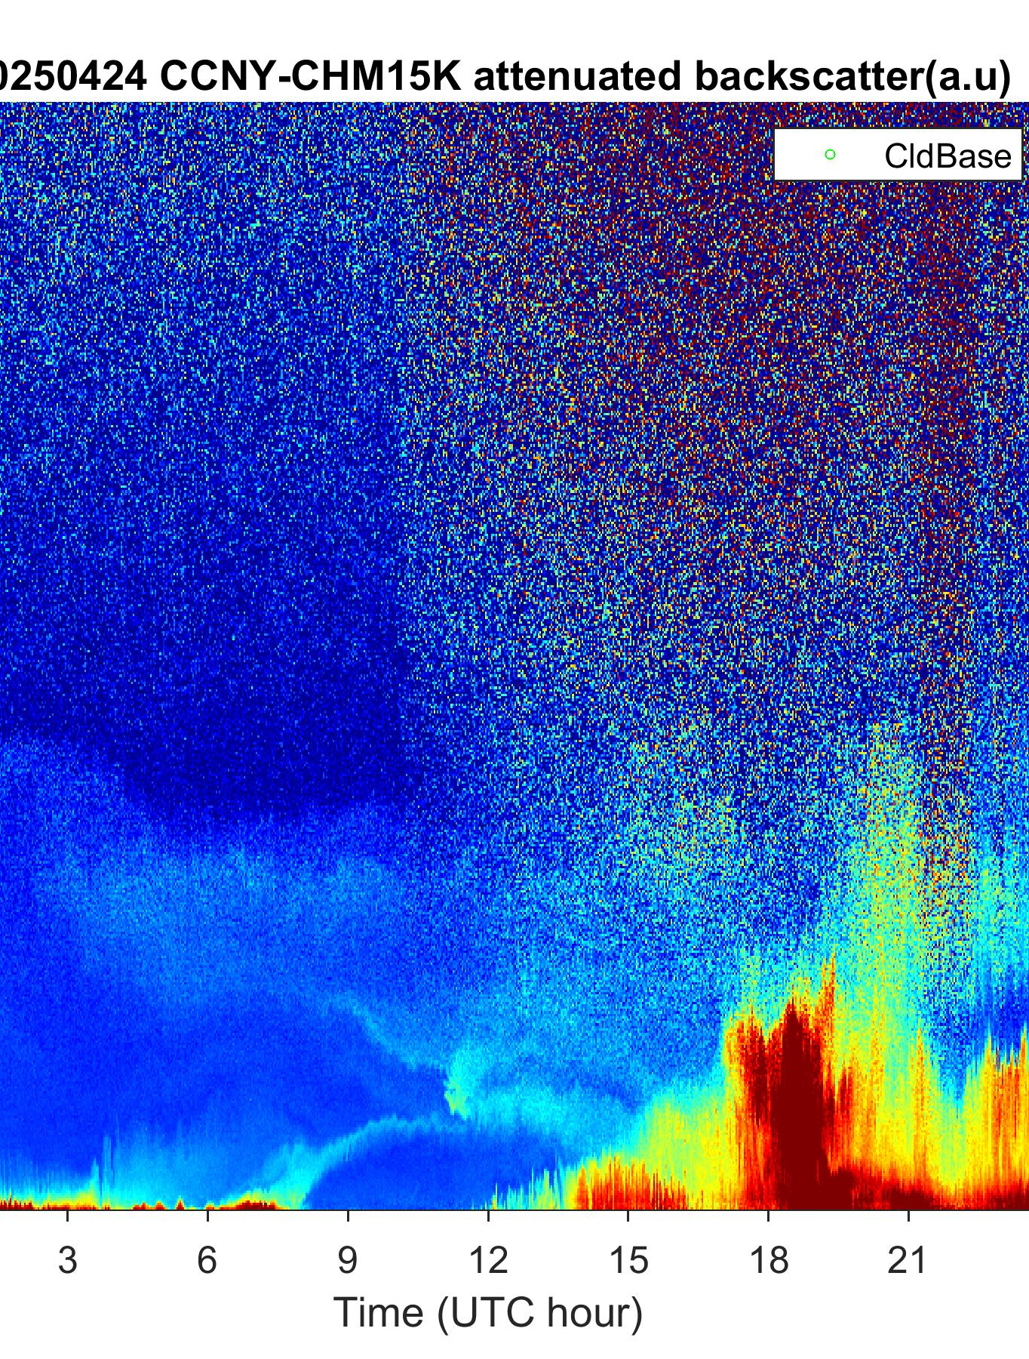
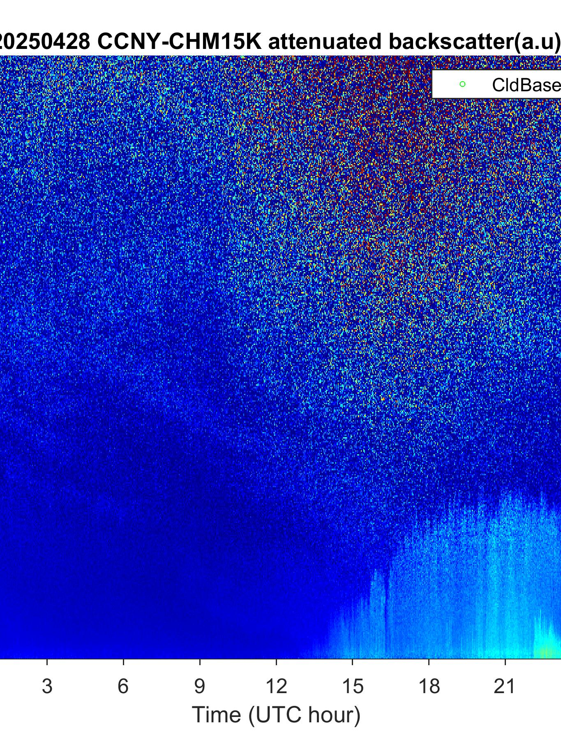
  CCNY-Ceilometer measurement
    April 22 shows a high aerosol loading event with strong backscatter signatures in the lower atmosphere.
New Jersey Fire Event April 22-28, 2025

Slide 8
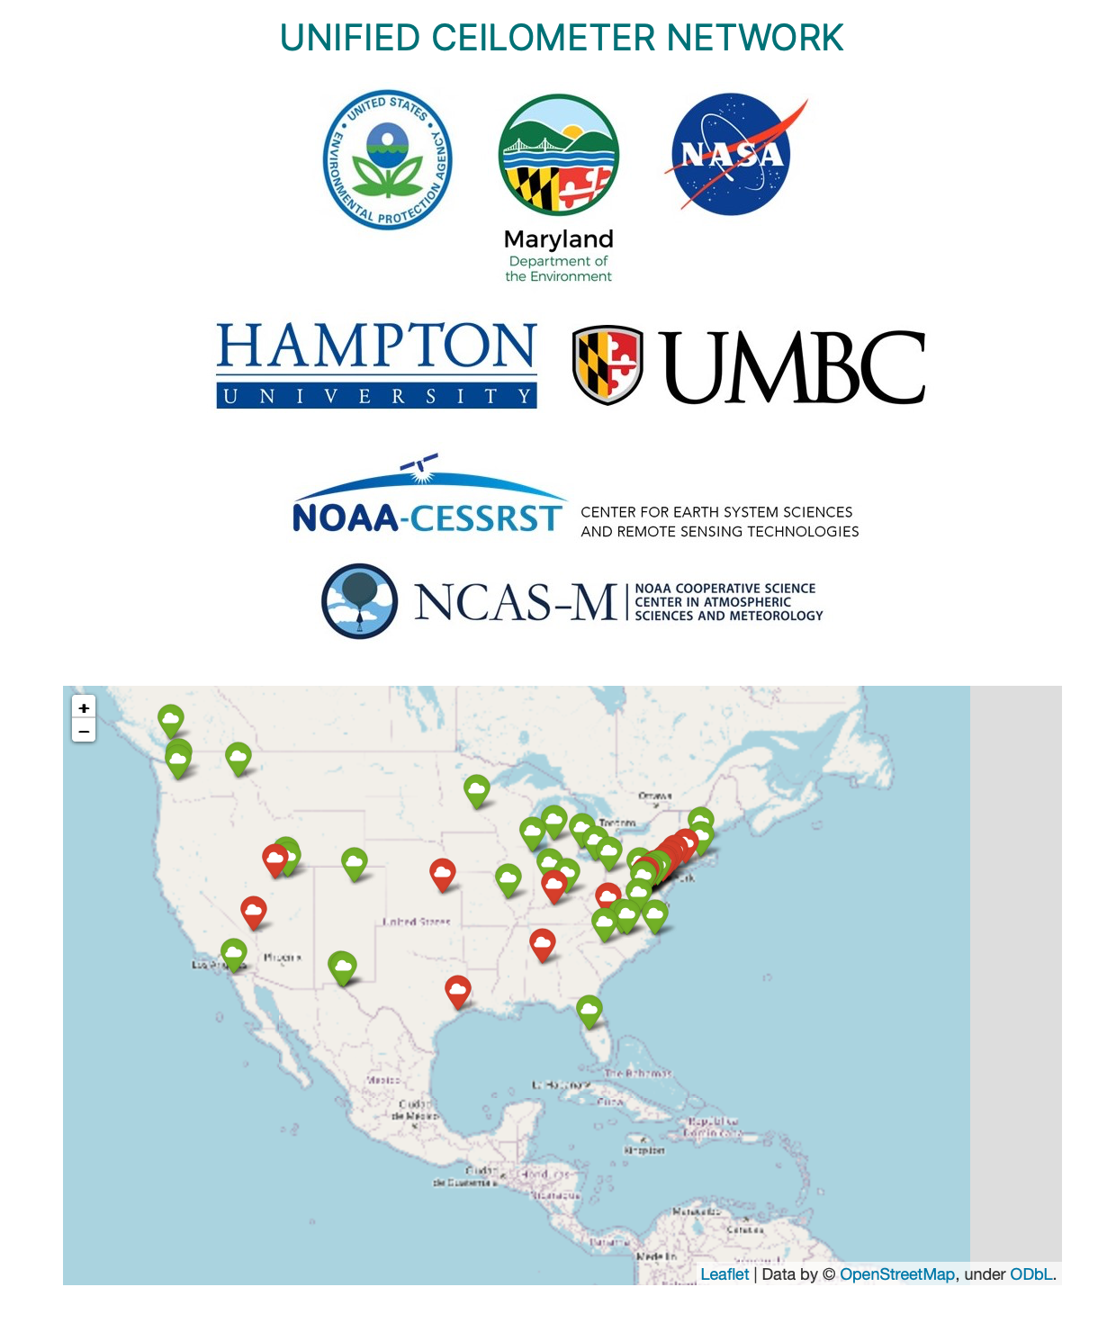
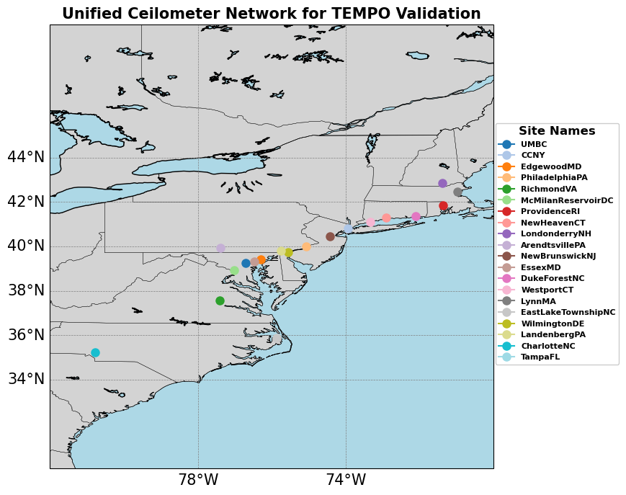

Slide 9
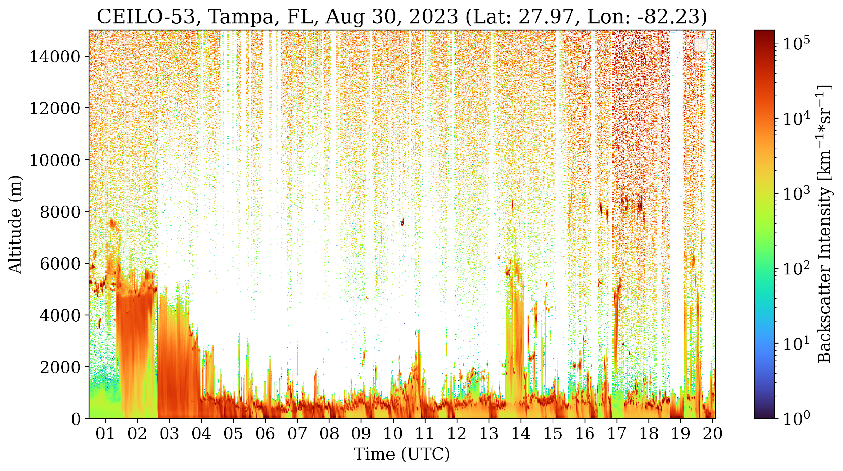
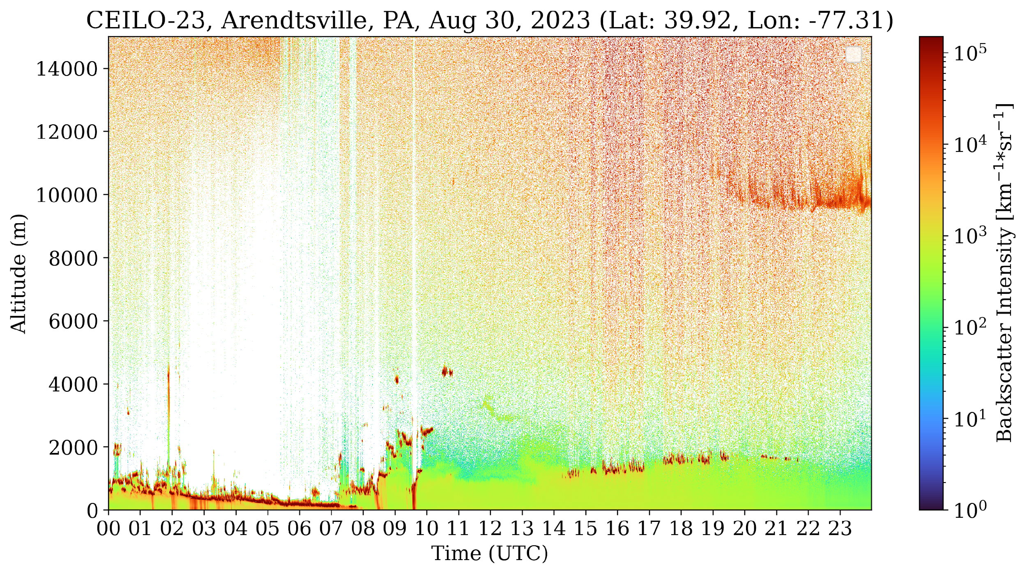
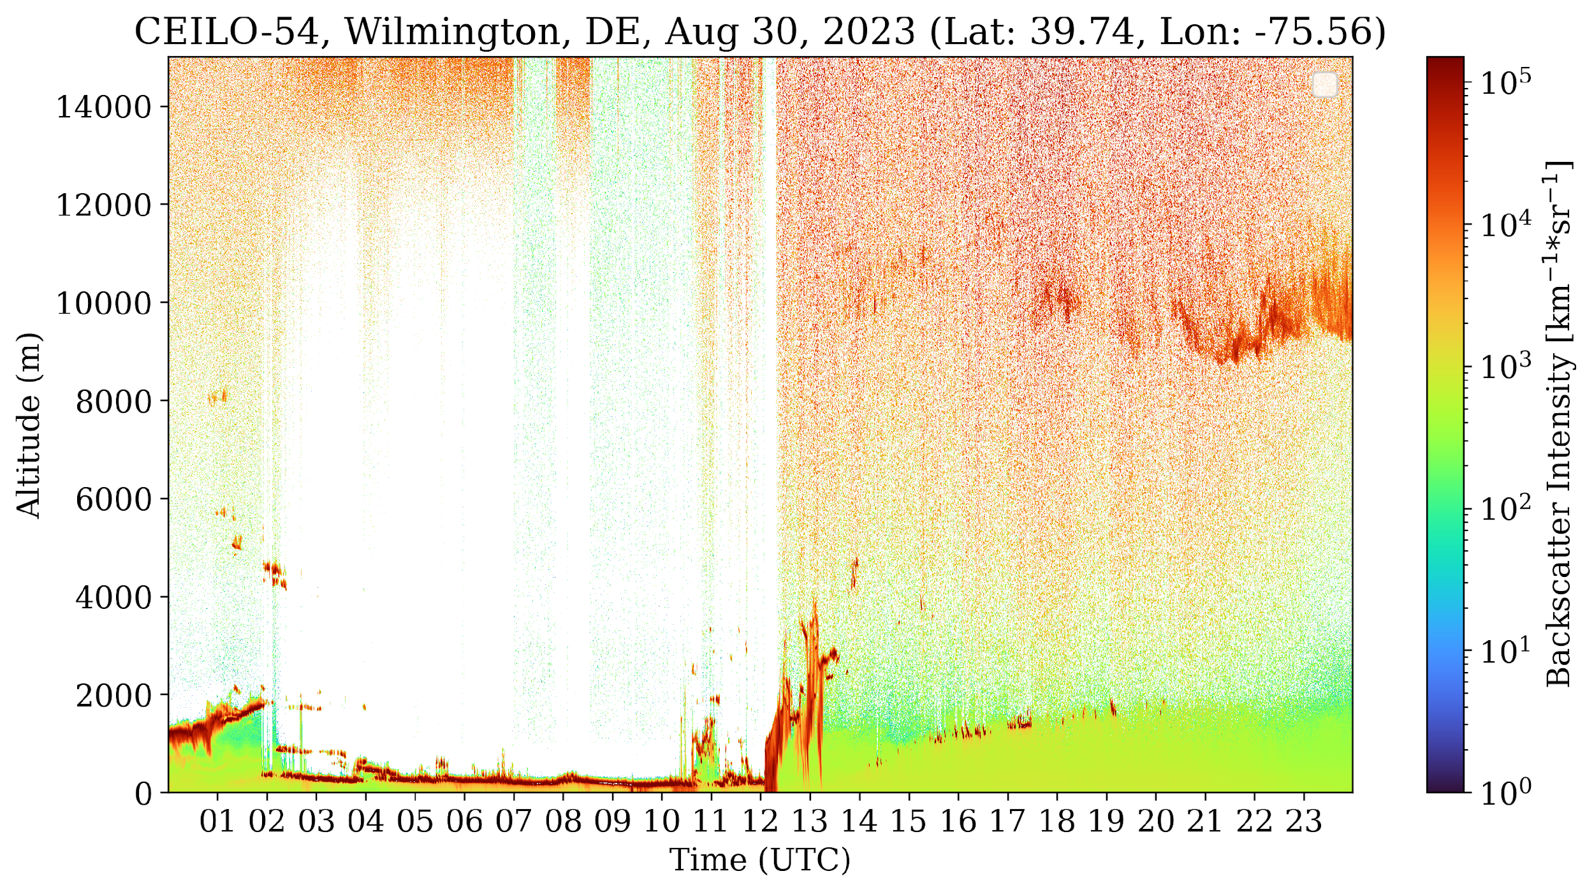
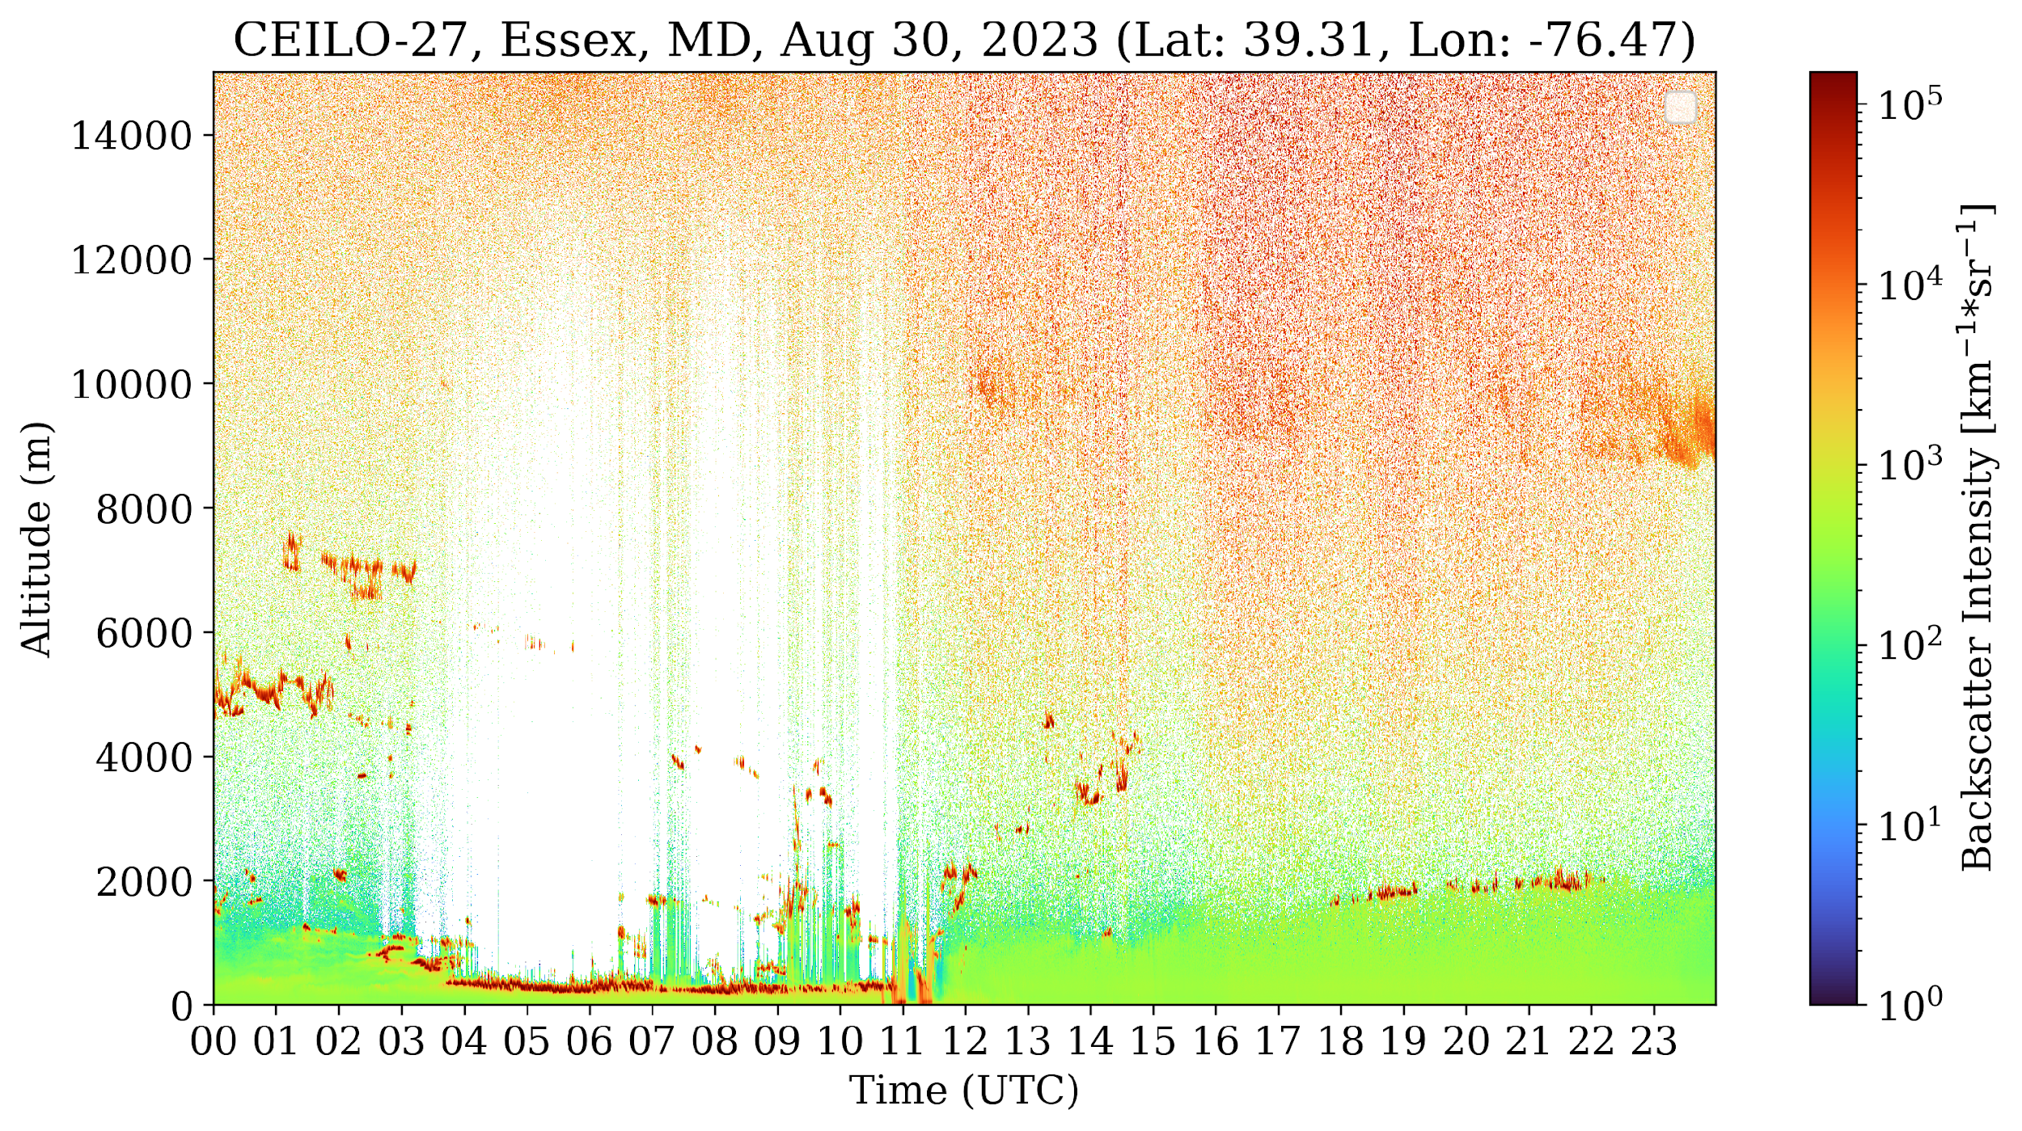
Advantage of UCN dataset
  Direct measurement of aerosol layer height
  High temporal and vertical resolution
  Assessment of lower‐tropospheric layers
Aerosol Enhancement Observed on August 30, 2023
Urban
Rural
Coastal
Urban, Costal

Slide 10
Collocation Procedure
*CAMS: Copernicus Atmosphere Monitoring Service global atmospheric composition forecasts
*GEOS-CF: Goddard Earth Observing System Composition Forecast
*PGN: Pandonia Global Network
*AERONET: Aerosol Robotic Network
*UCN: Unified Ceilometer Network
*AQS: Air Quality System
*NAQFC: NOAA National Air Quality Forecast Capability
Satellite Measurements
Atmospheric Composition
Forecast Models
Ground-based Observations
CAMS*, GEOS-CF* , NAQFC*
PGN*, AERONET*,
UCN*, AQS*
Validation Products
TOZ, NO₂, HCHO
(August 2023–2024)
AOD, ALH, PM2.5
(August 2023)
Collocation
Product | Time (min.) | Spatial (km) | Remarks
NO₂, HCHO, TOZ, PM2.5 | 30 | 25 | The nearest datasets are selected within collocated datasets for NO₂. Other datasets are averaged within collocated datasets.
AOD, ALH | 30 | 27.5
Temporal statistics
Time Series

Slide 11
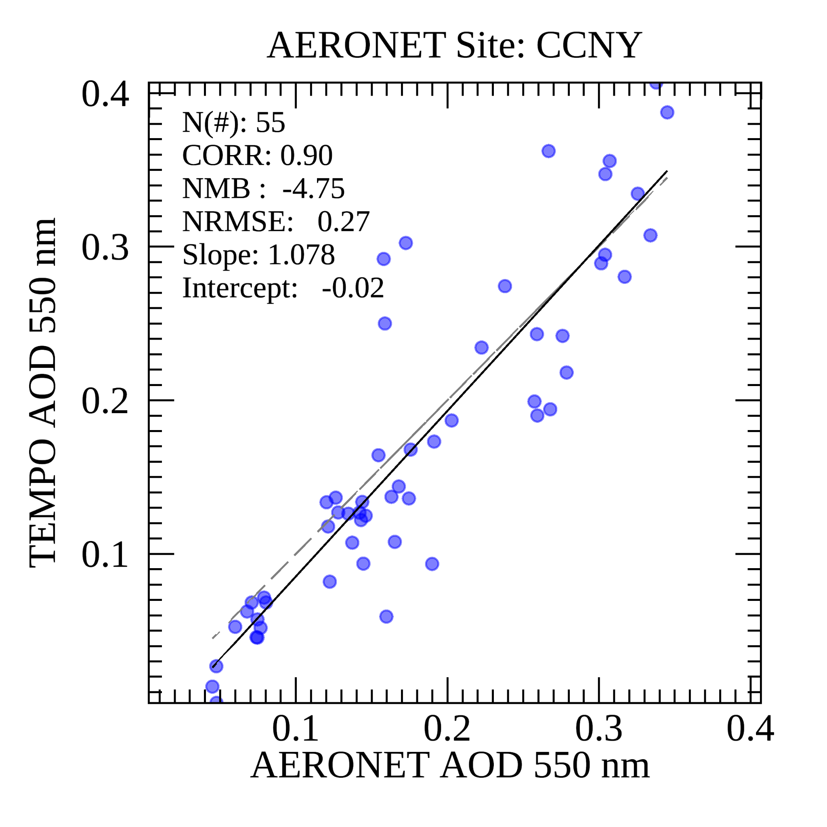
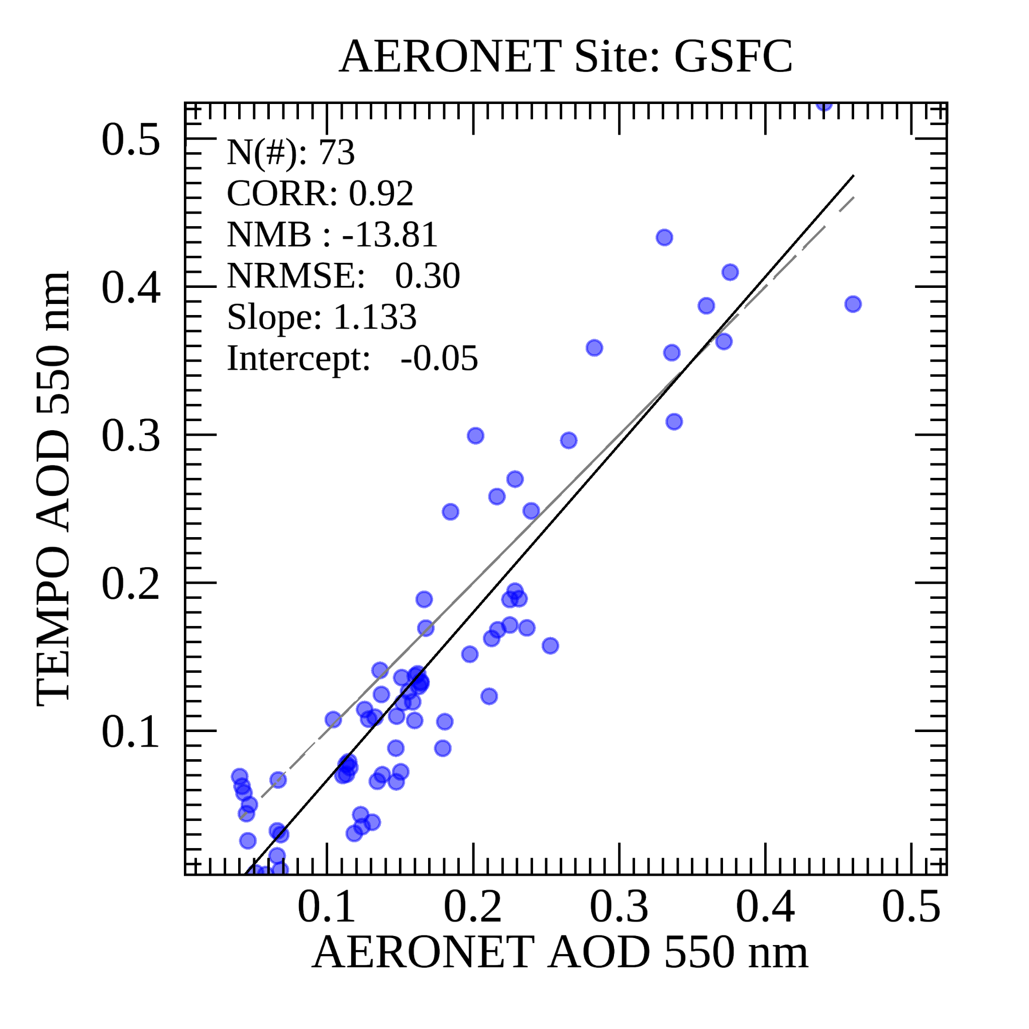
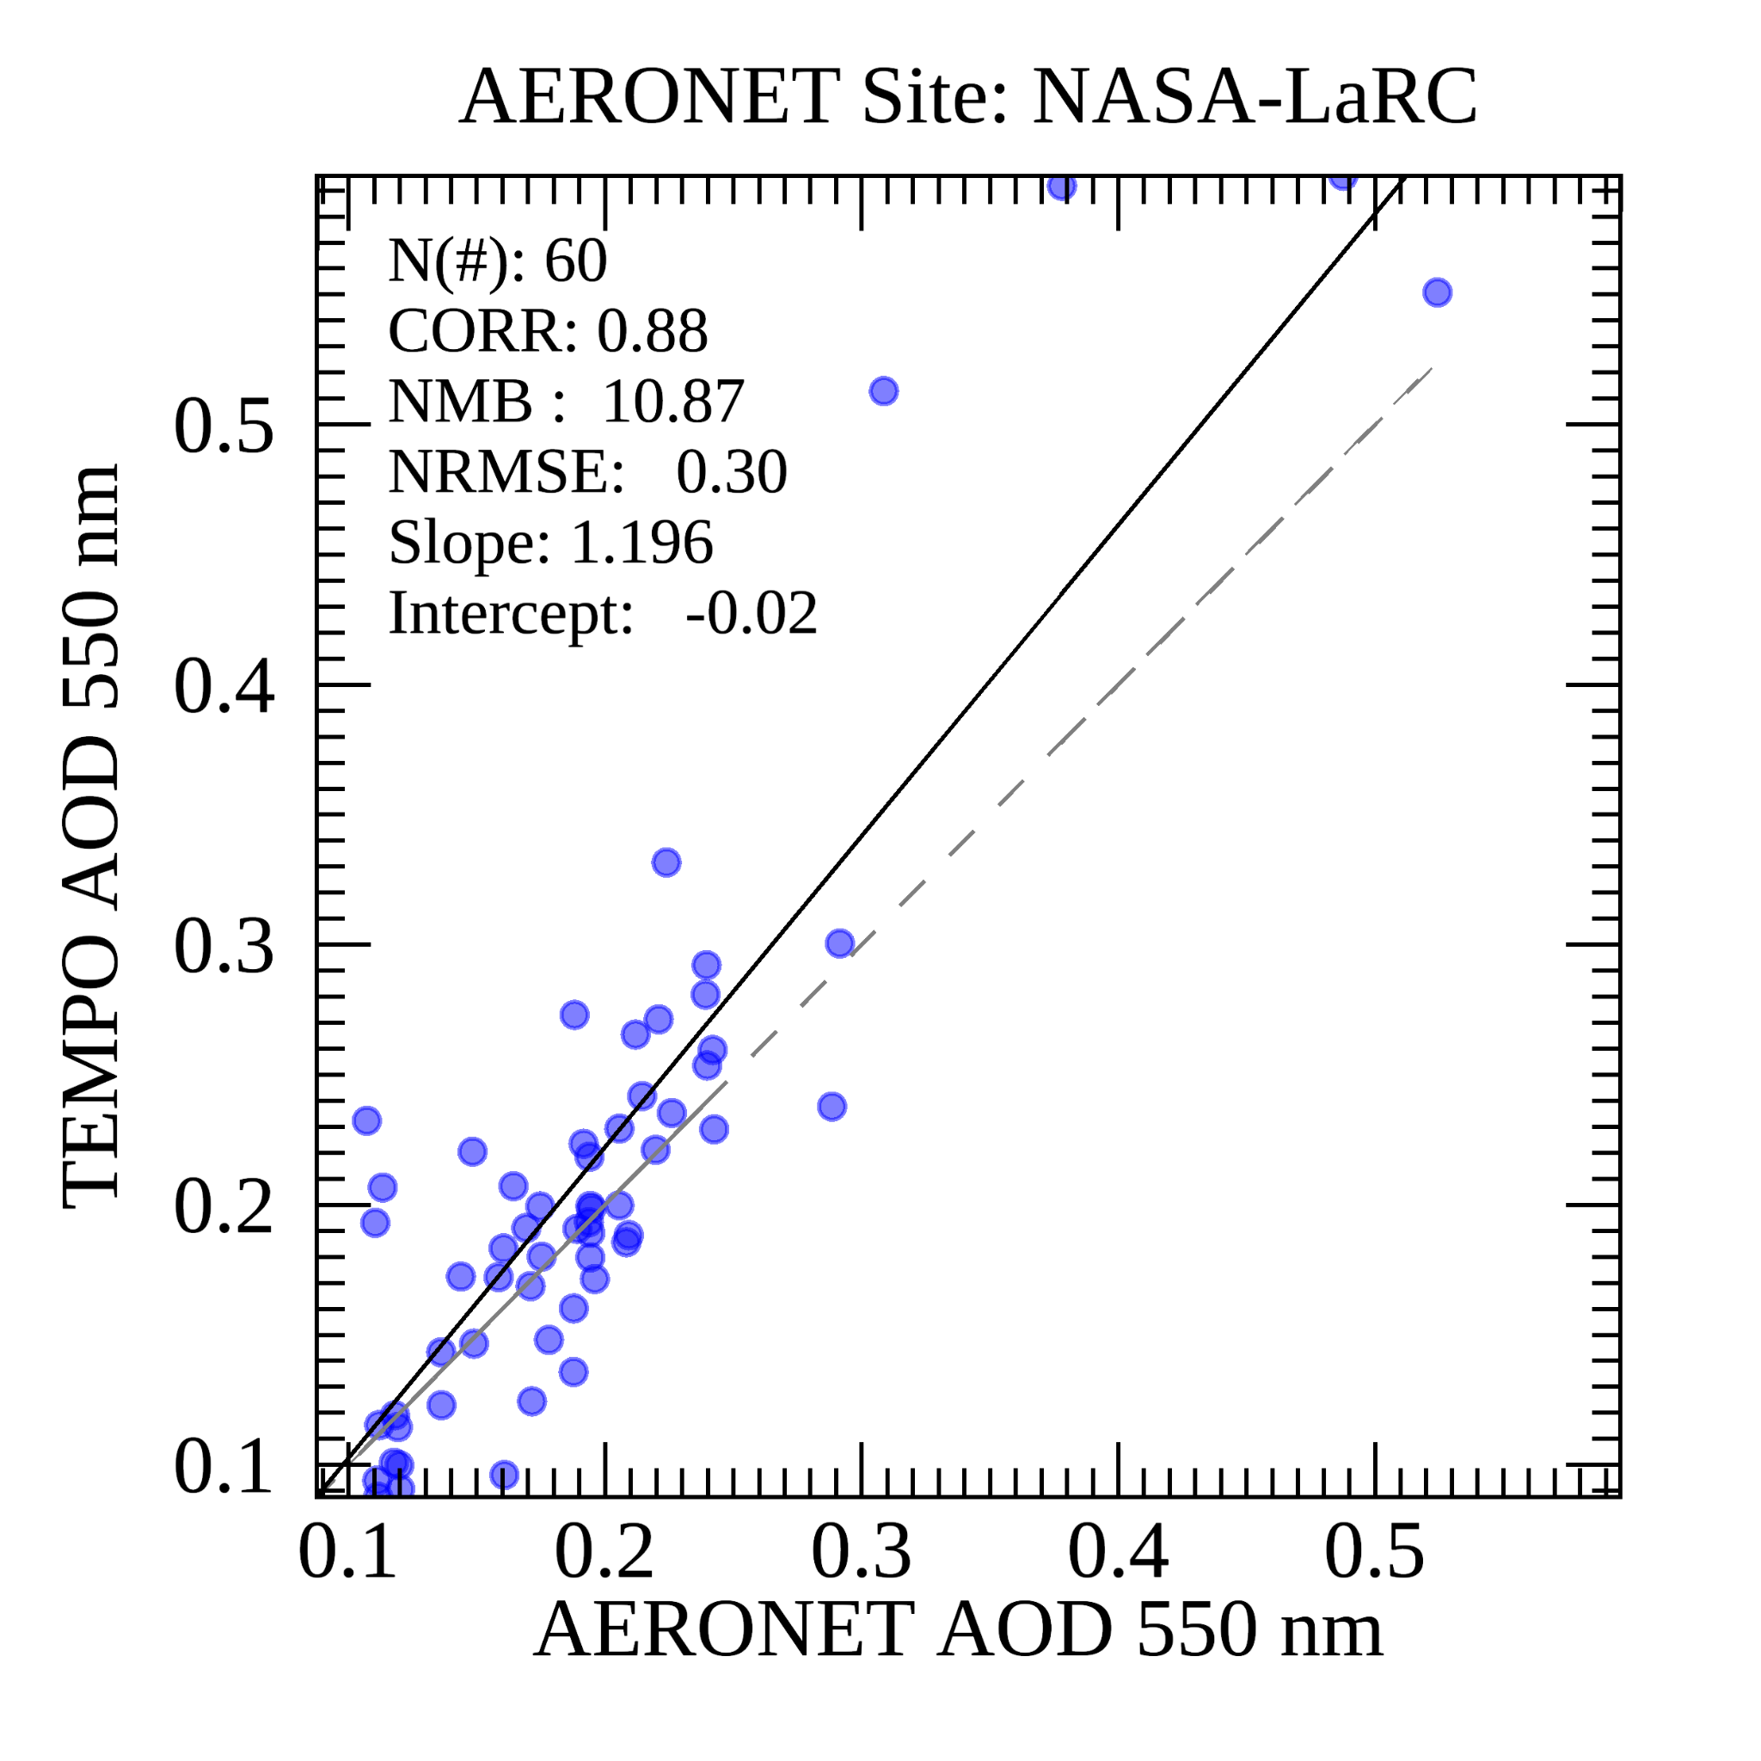
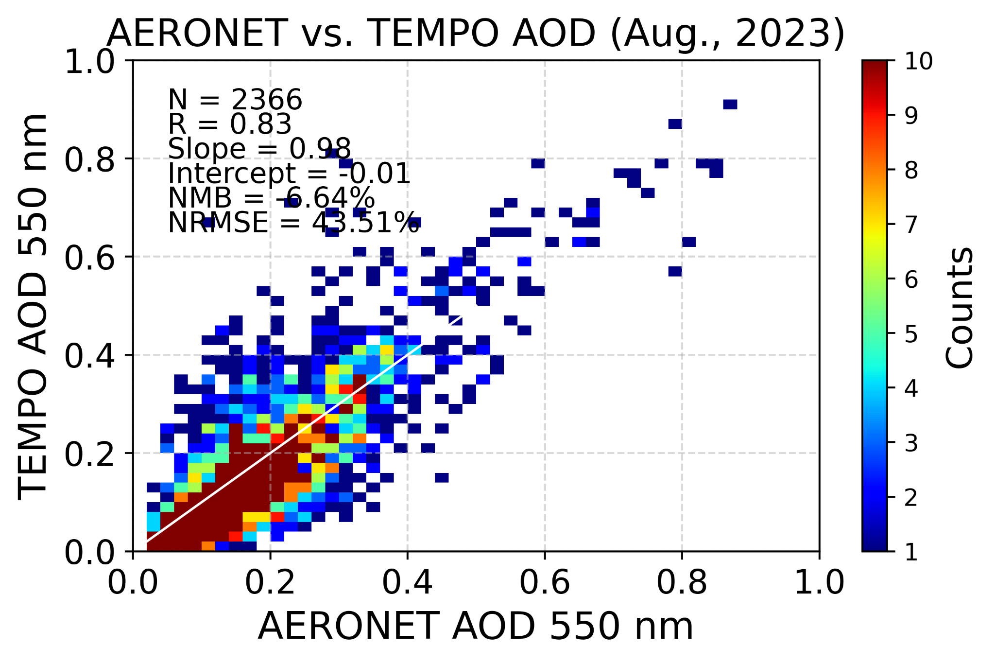
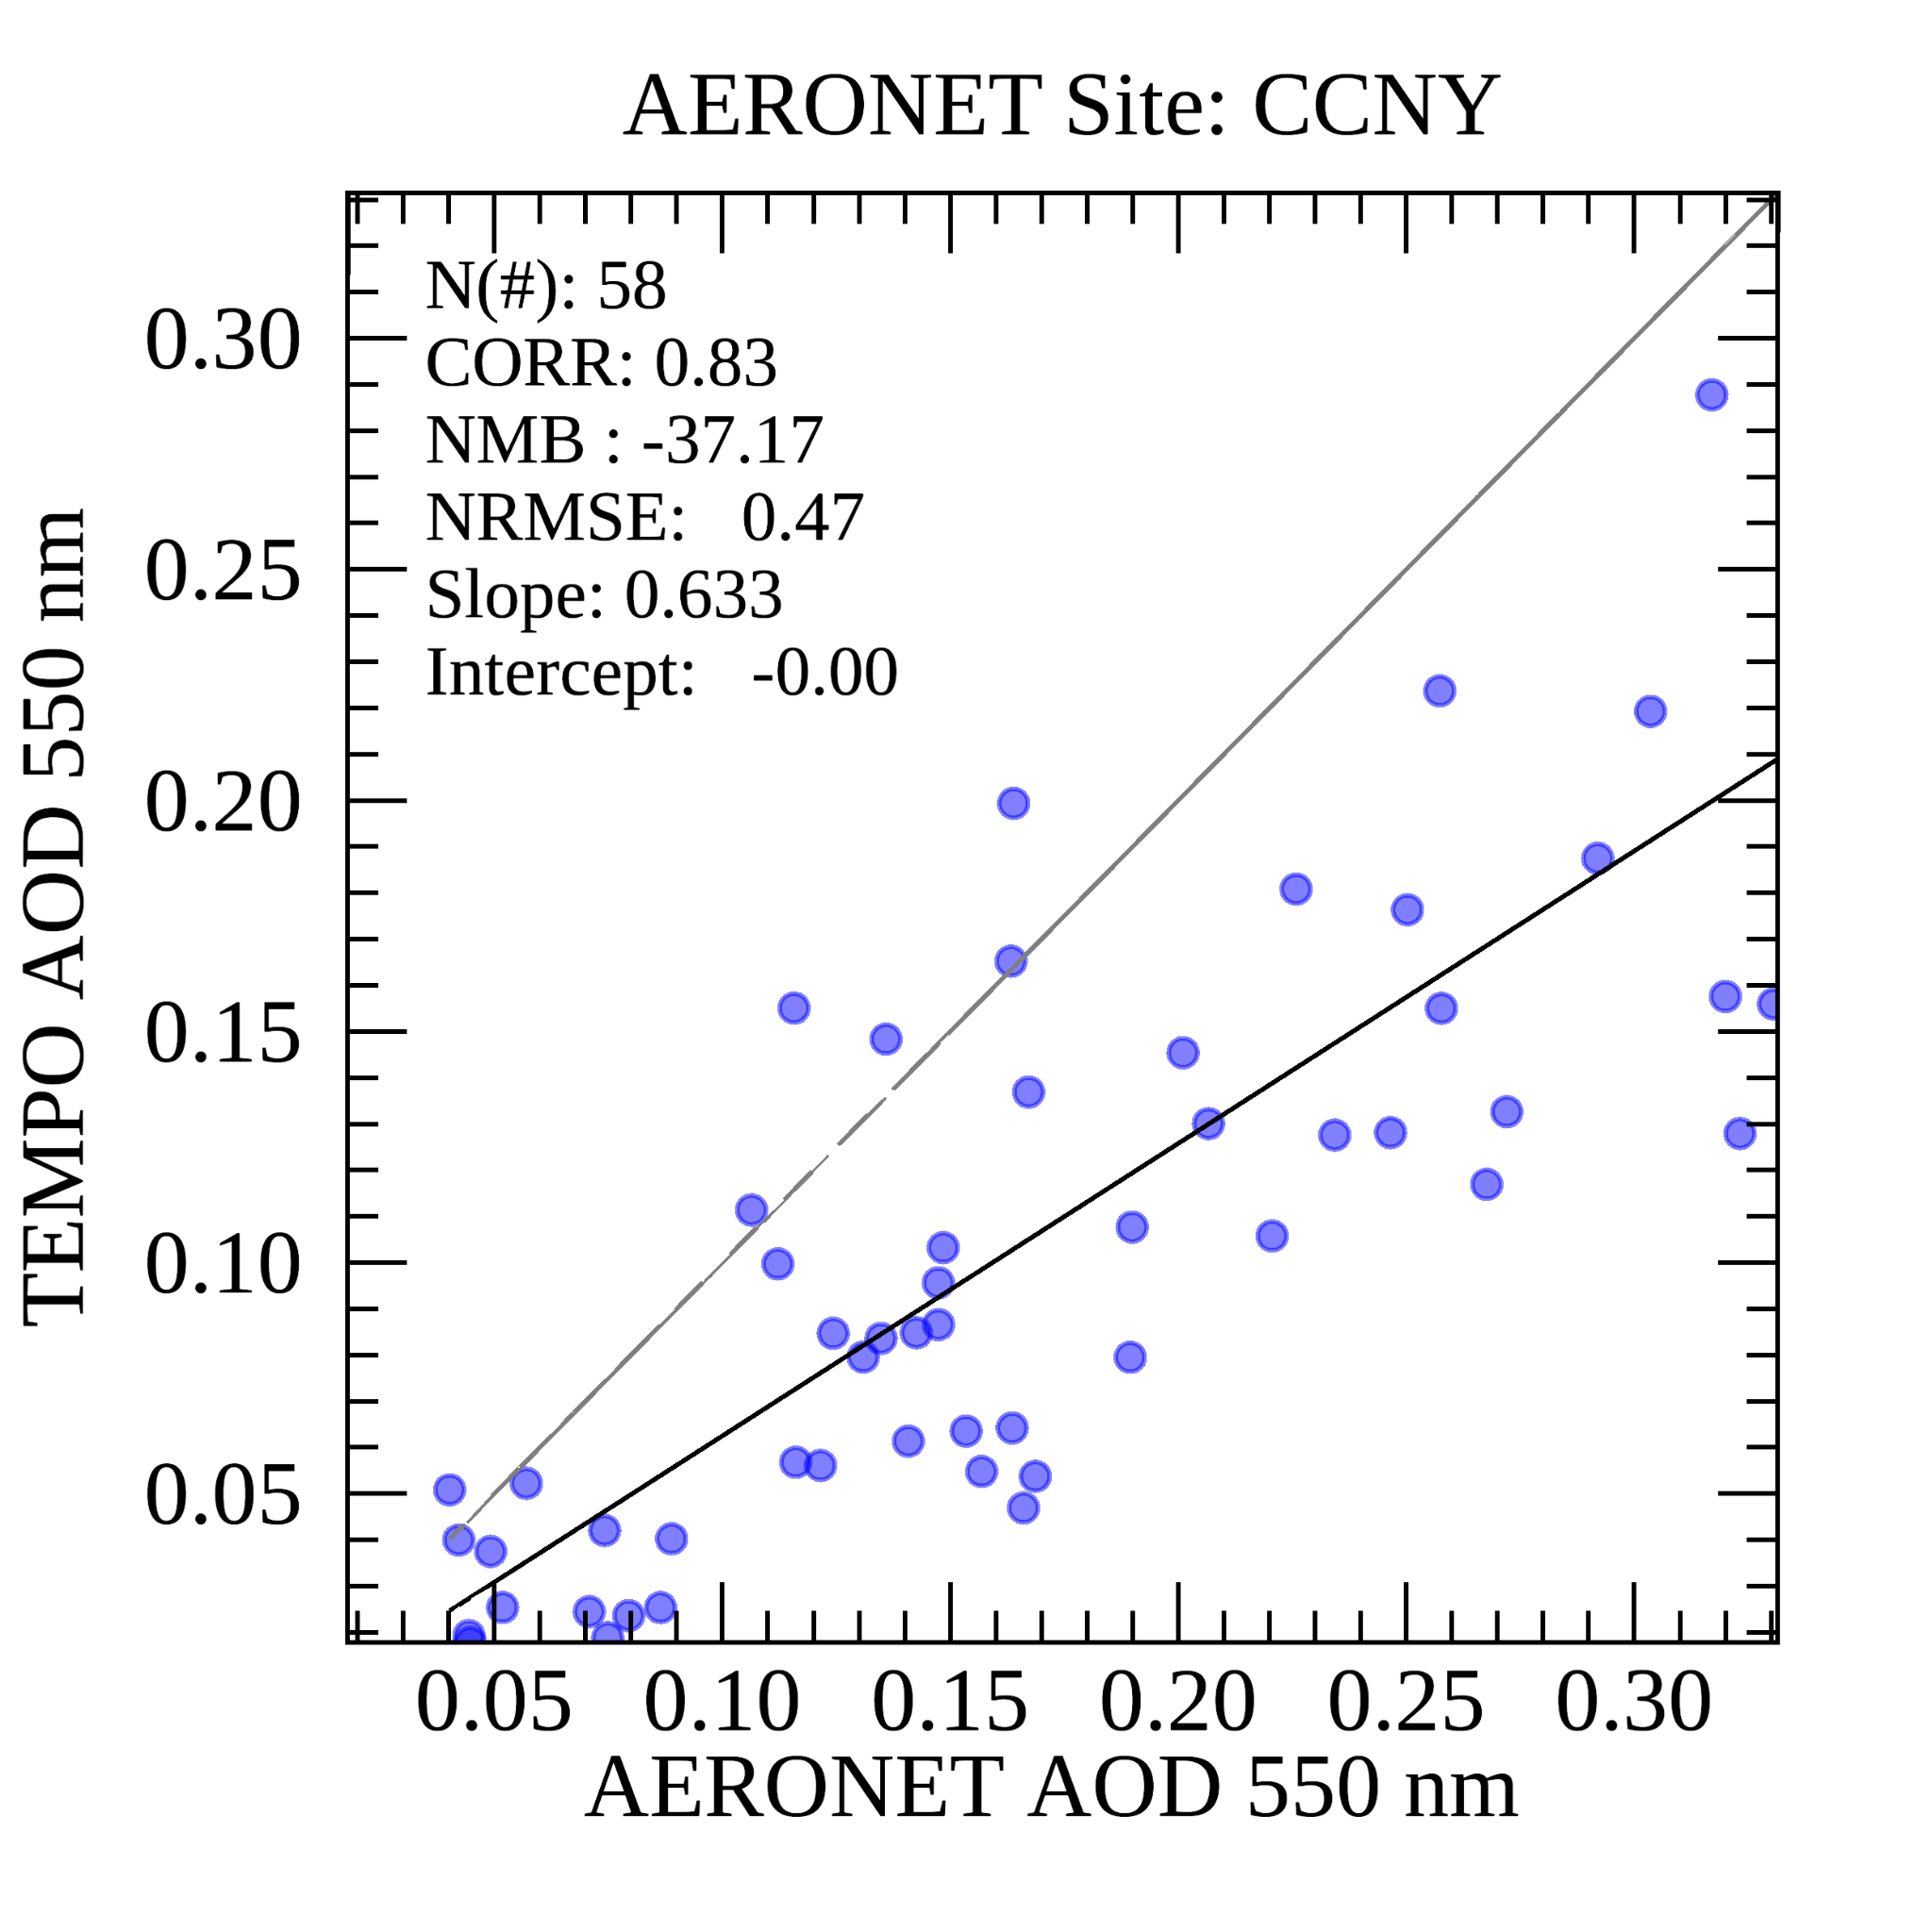
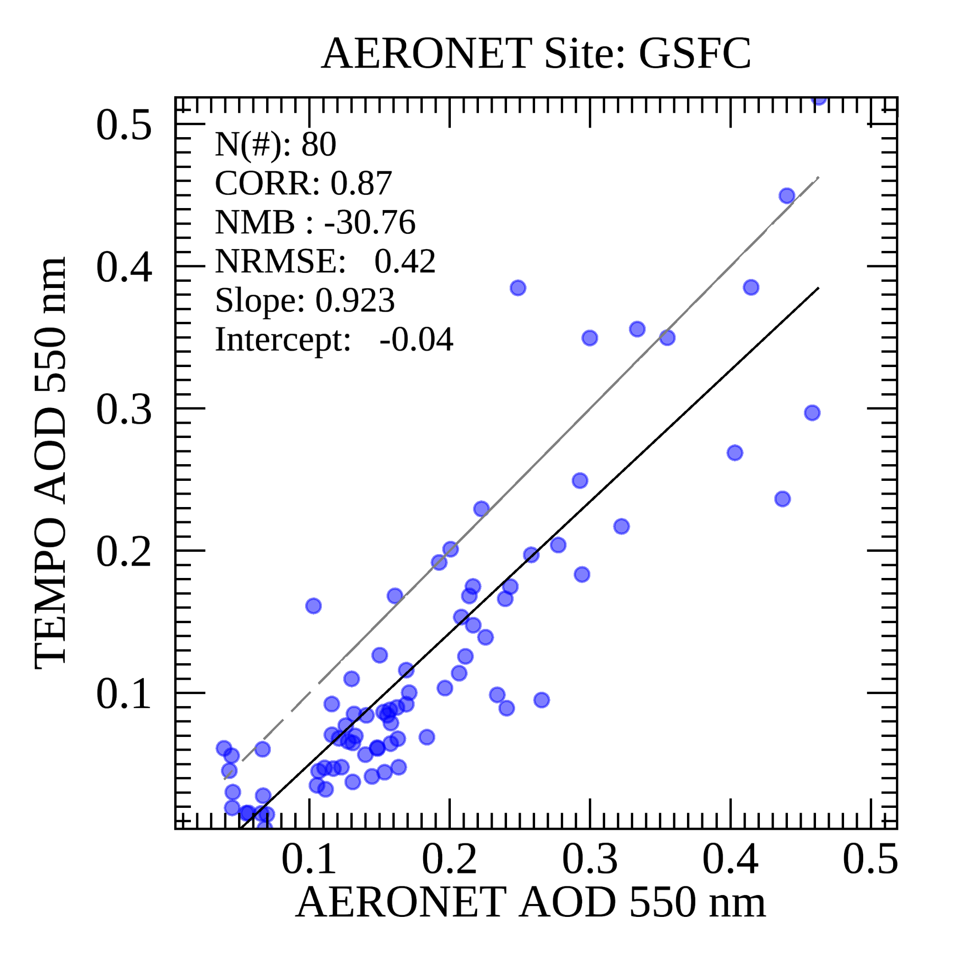
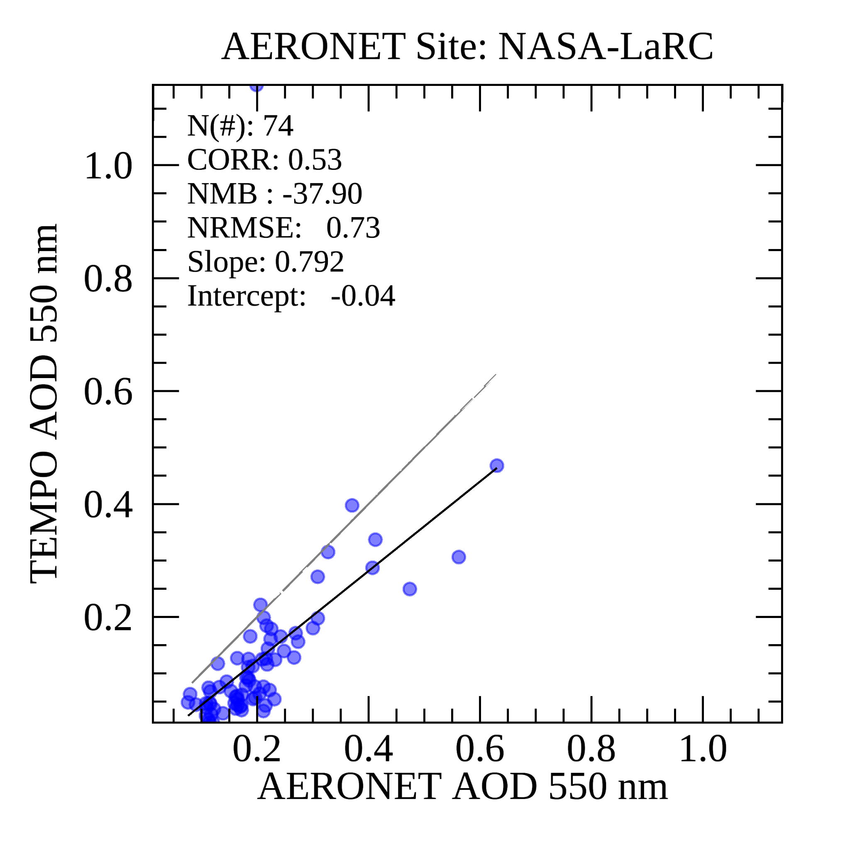
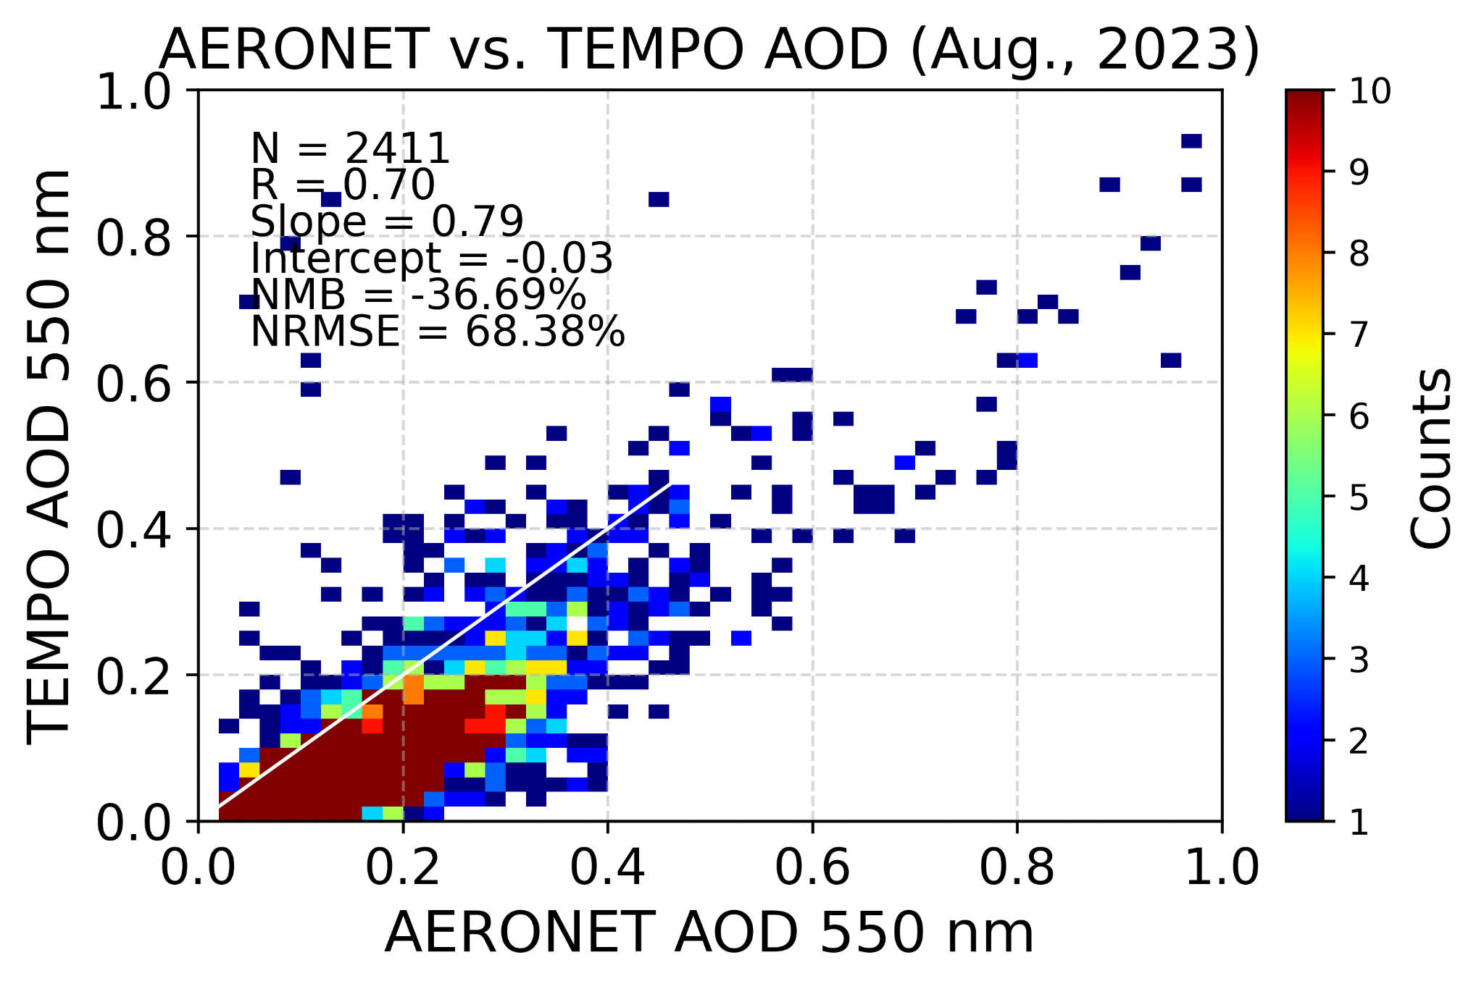
TEMPO AOD Validation
Updated retrieval algorithms result in revised datasets and updated validation statistics.
v1
v2
Notes:
V1>v2 , surface reflectance updated, but cloud contamination ; bias and rmse increase

Slide 12
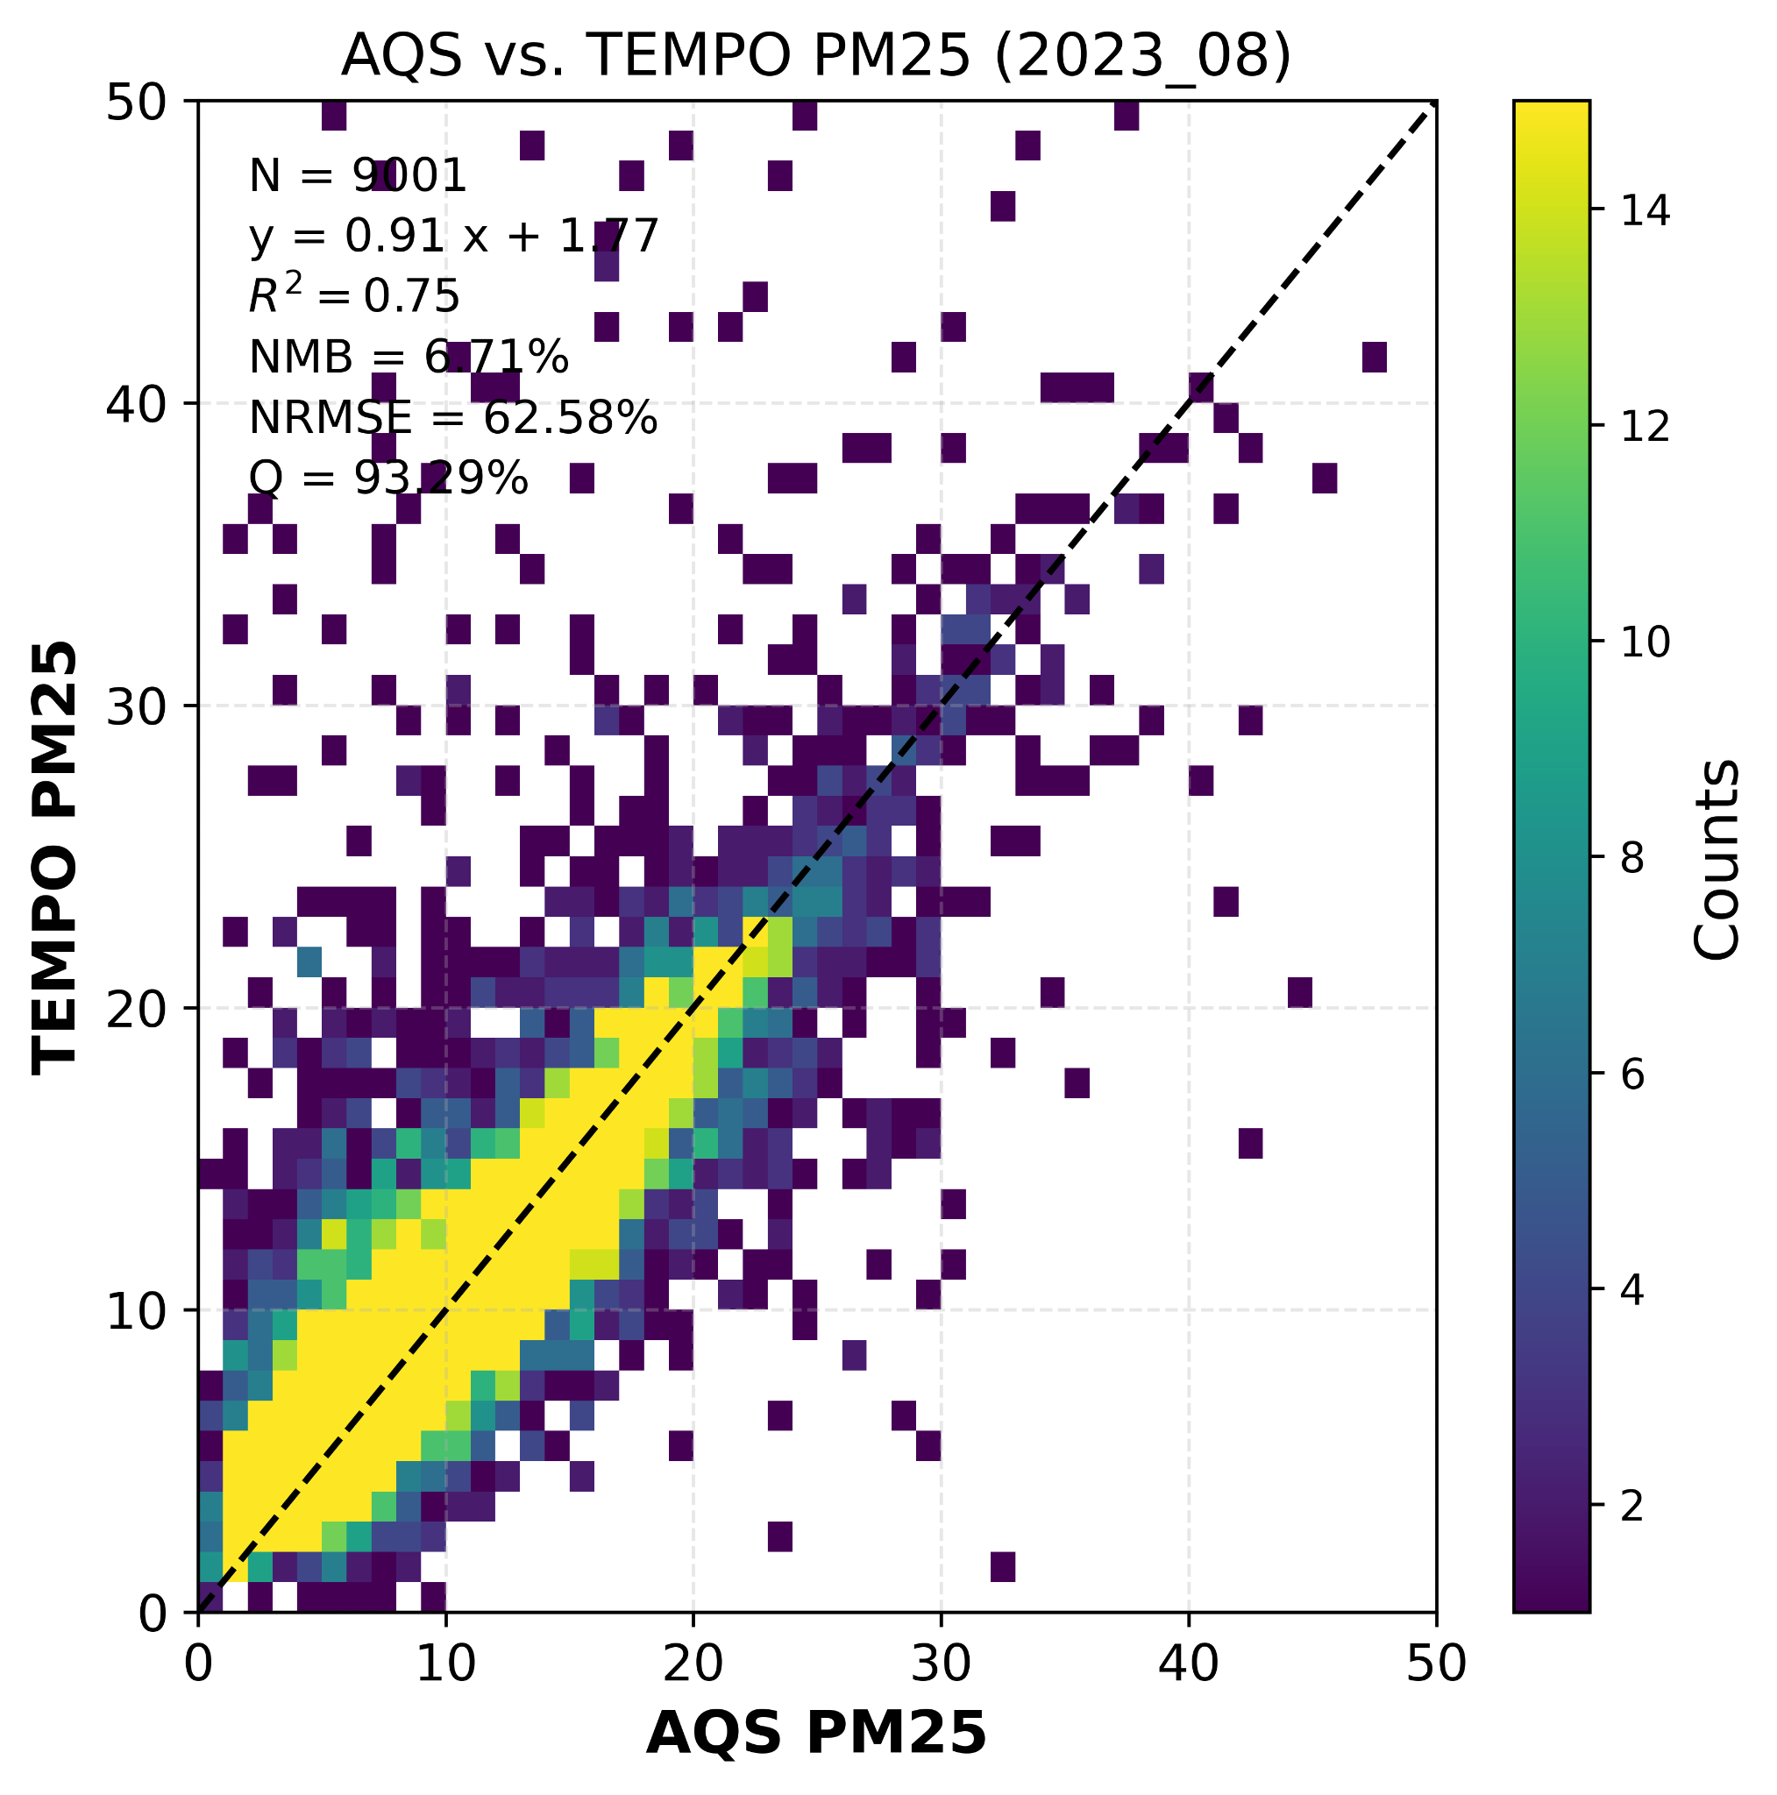
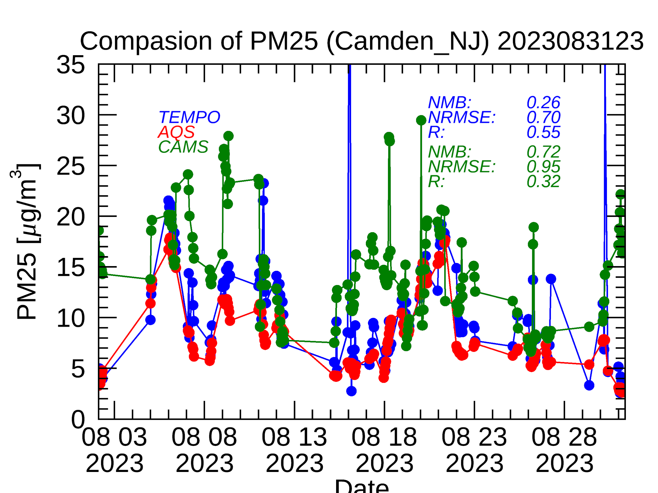
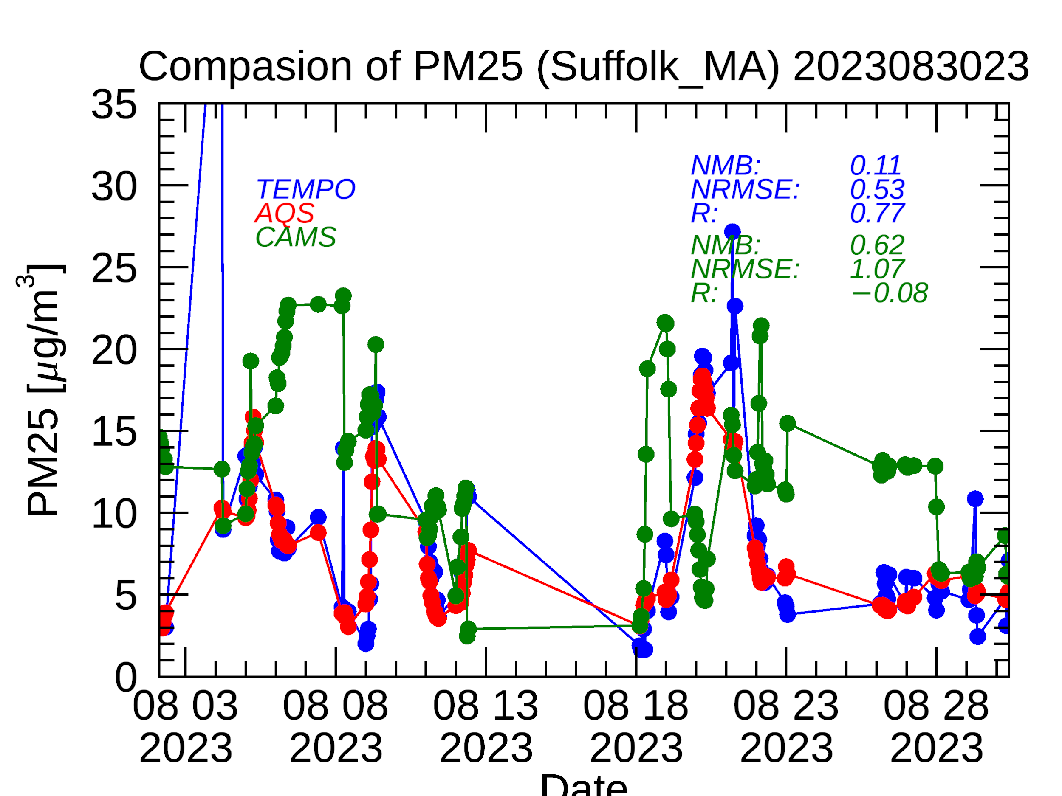
TEMPO PM2.5 Validation
Comparison with ground-based PM2.5 (126 sites available in the East Coast Corridor).
Consistent temporal pattern with high correlation

Slide 13
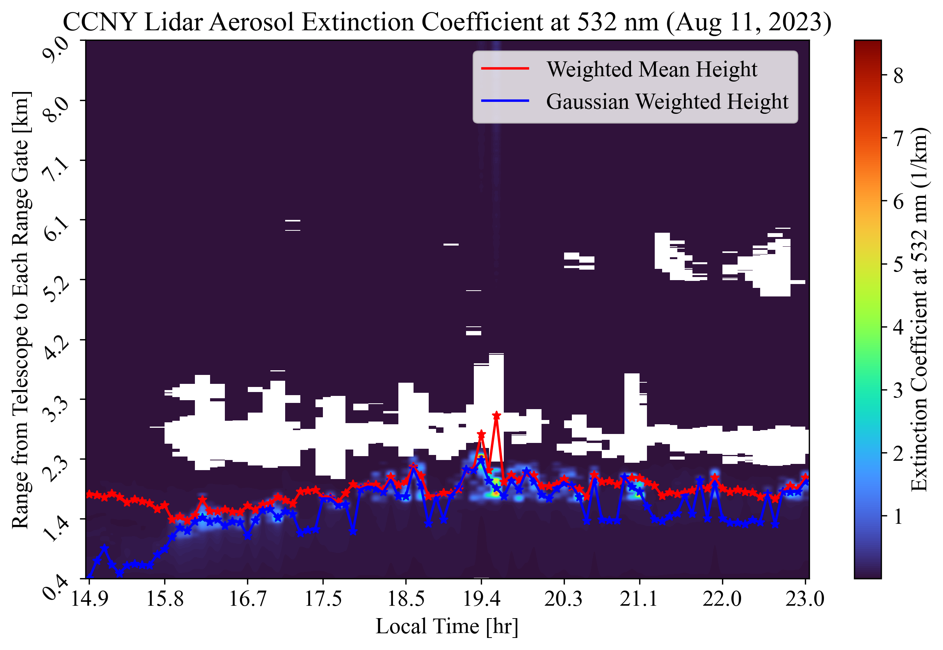
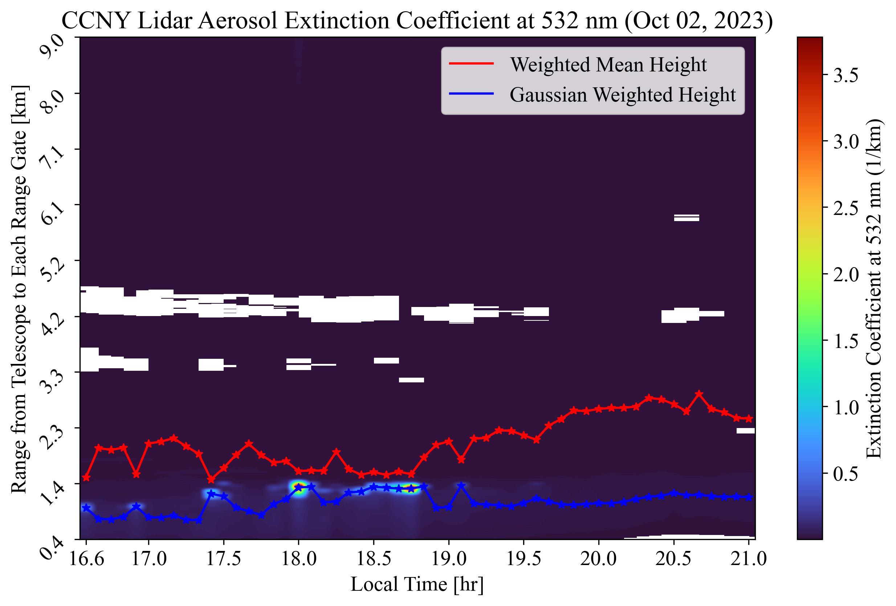
Example for utilizing UCN dataset for satellite validation
  Data source: CCNY Lufft CHM15k Ceilometer
  Aerosol extinction coefficients (not part of the standard CHM15k output) are used to compute:
    ALH: Weighted mean height based on extinction magnitude
    AEH: Gaussian-weighted center of aerosol layer
Notes:
Lufft CHM15k Ceilometer & Vaisala Ceilometer)

Slide 14
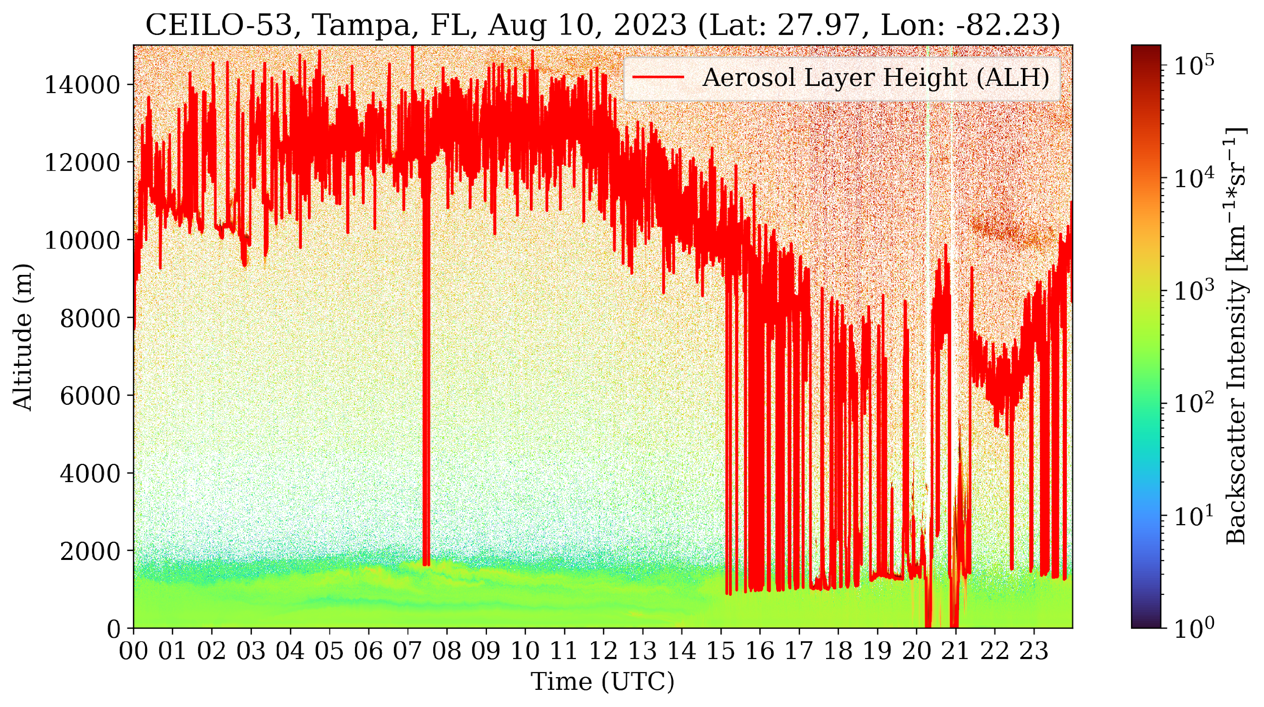
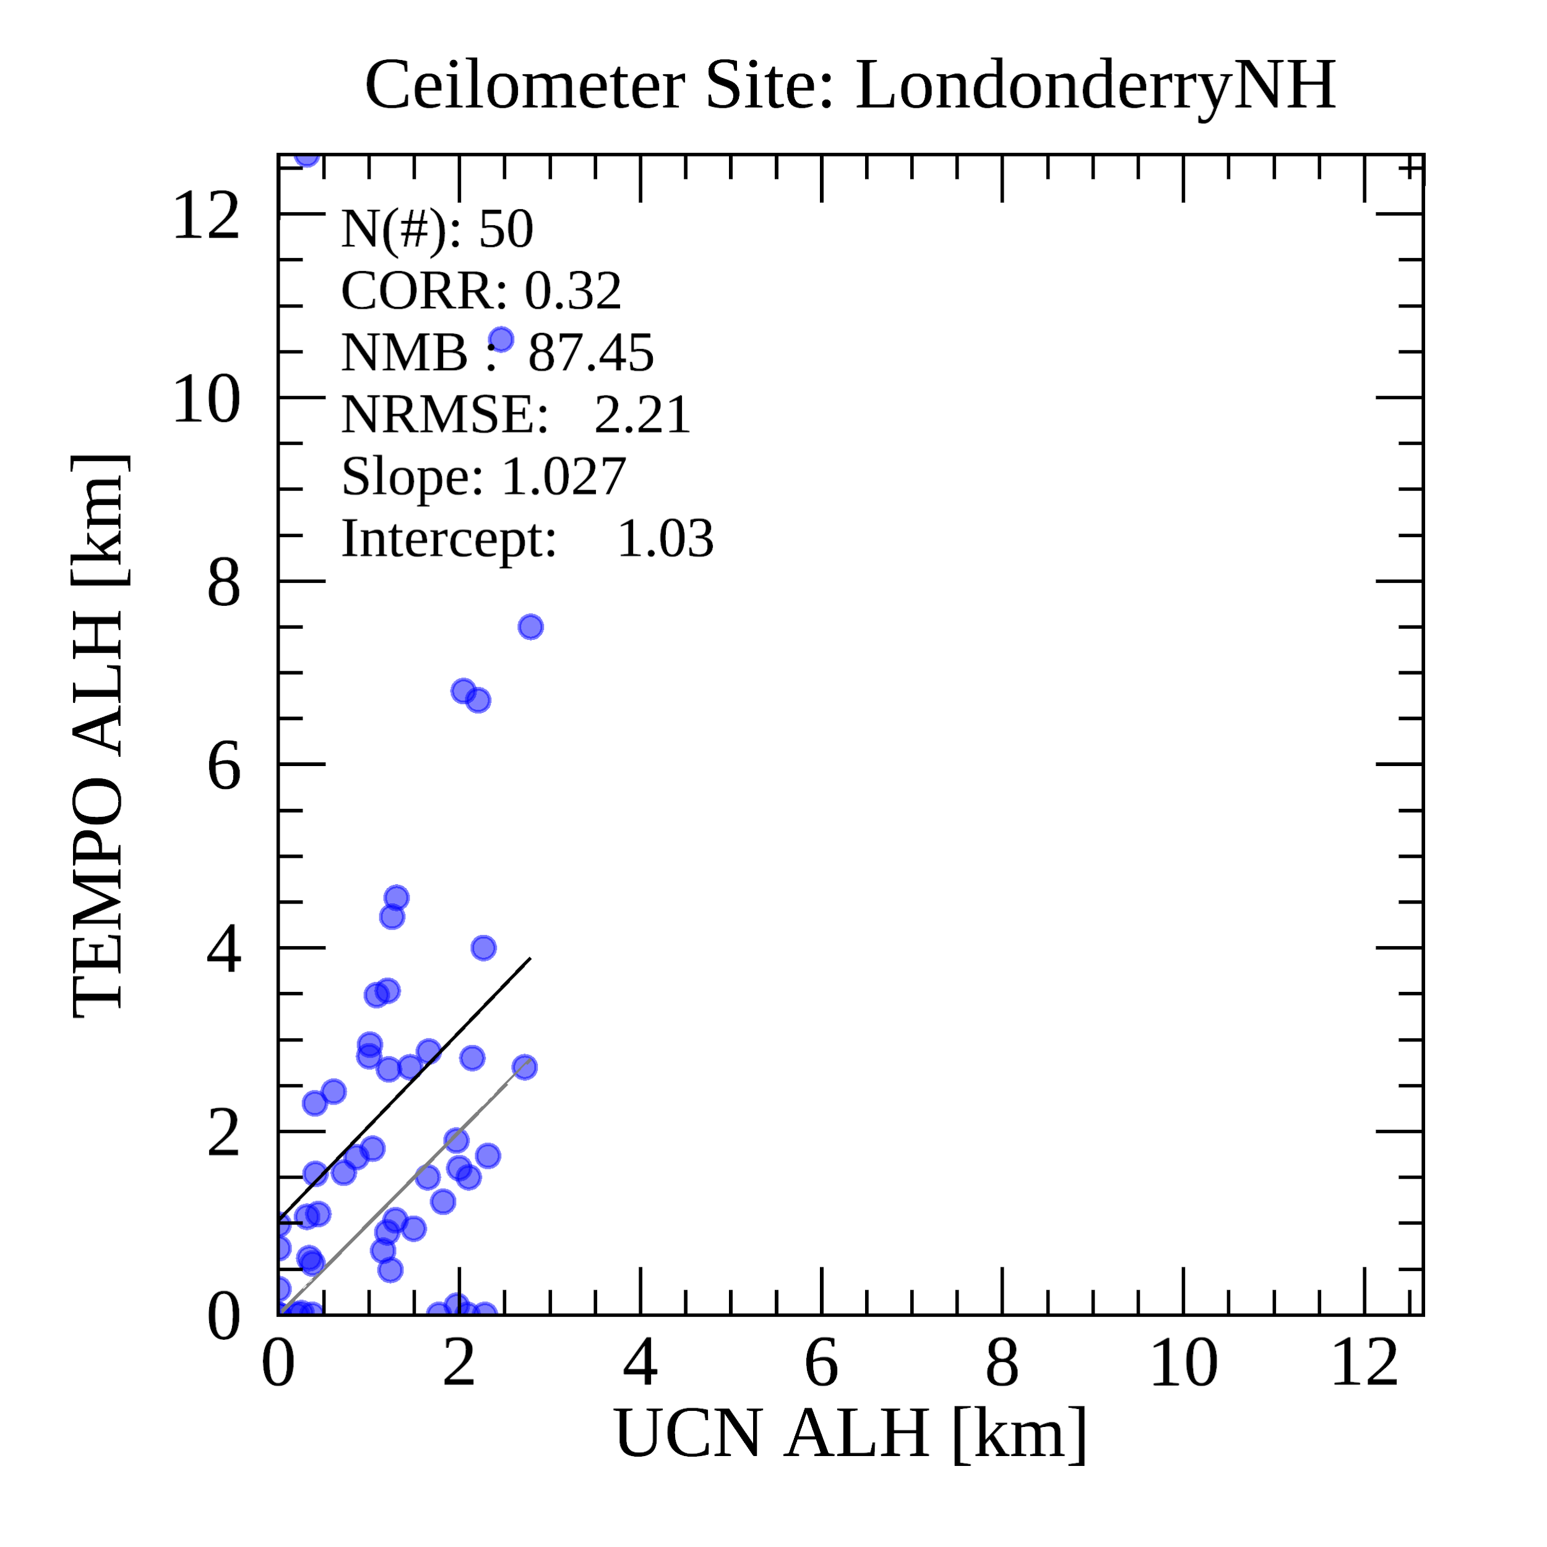
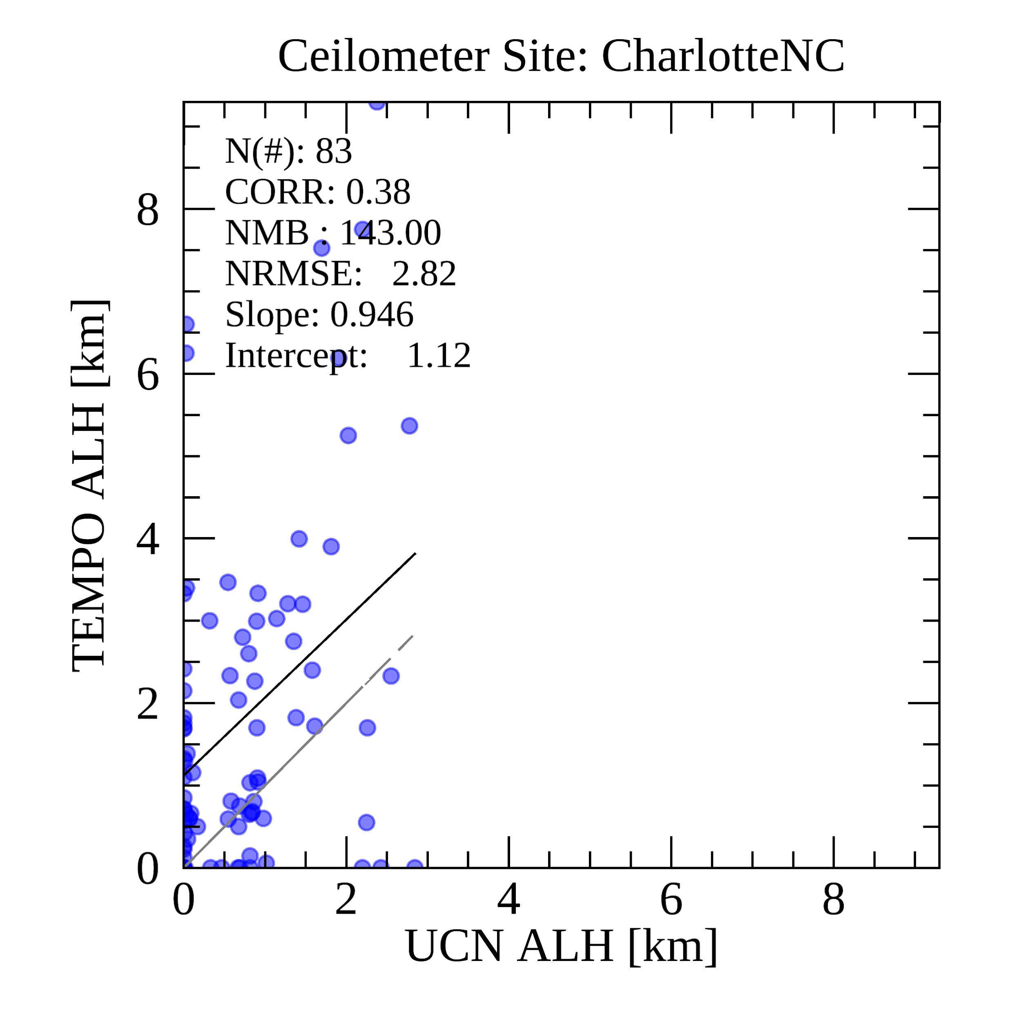
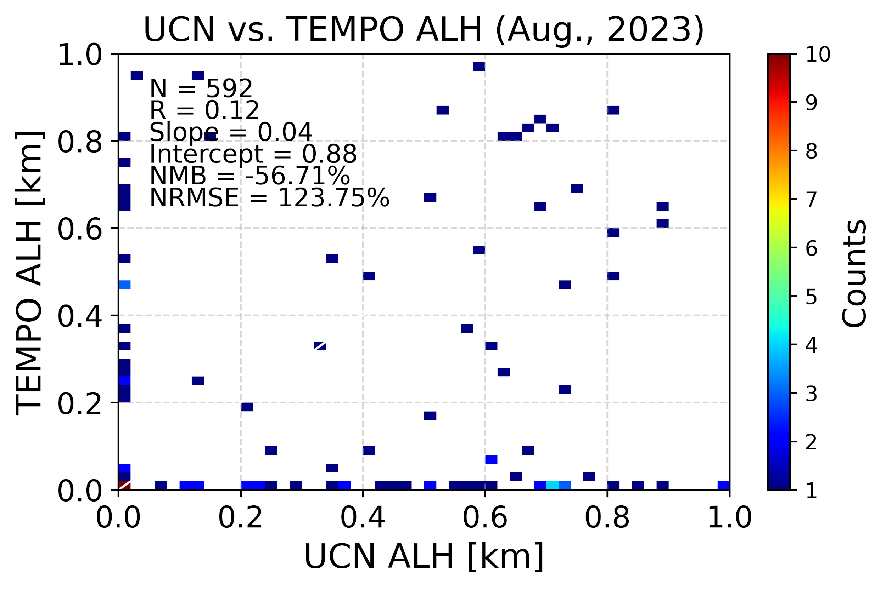
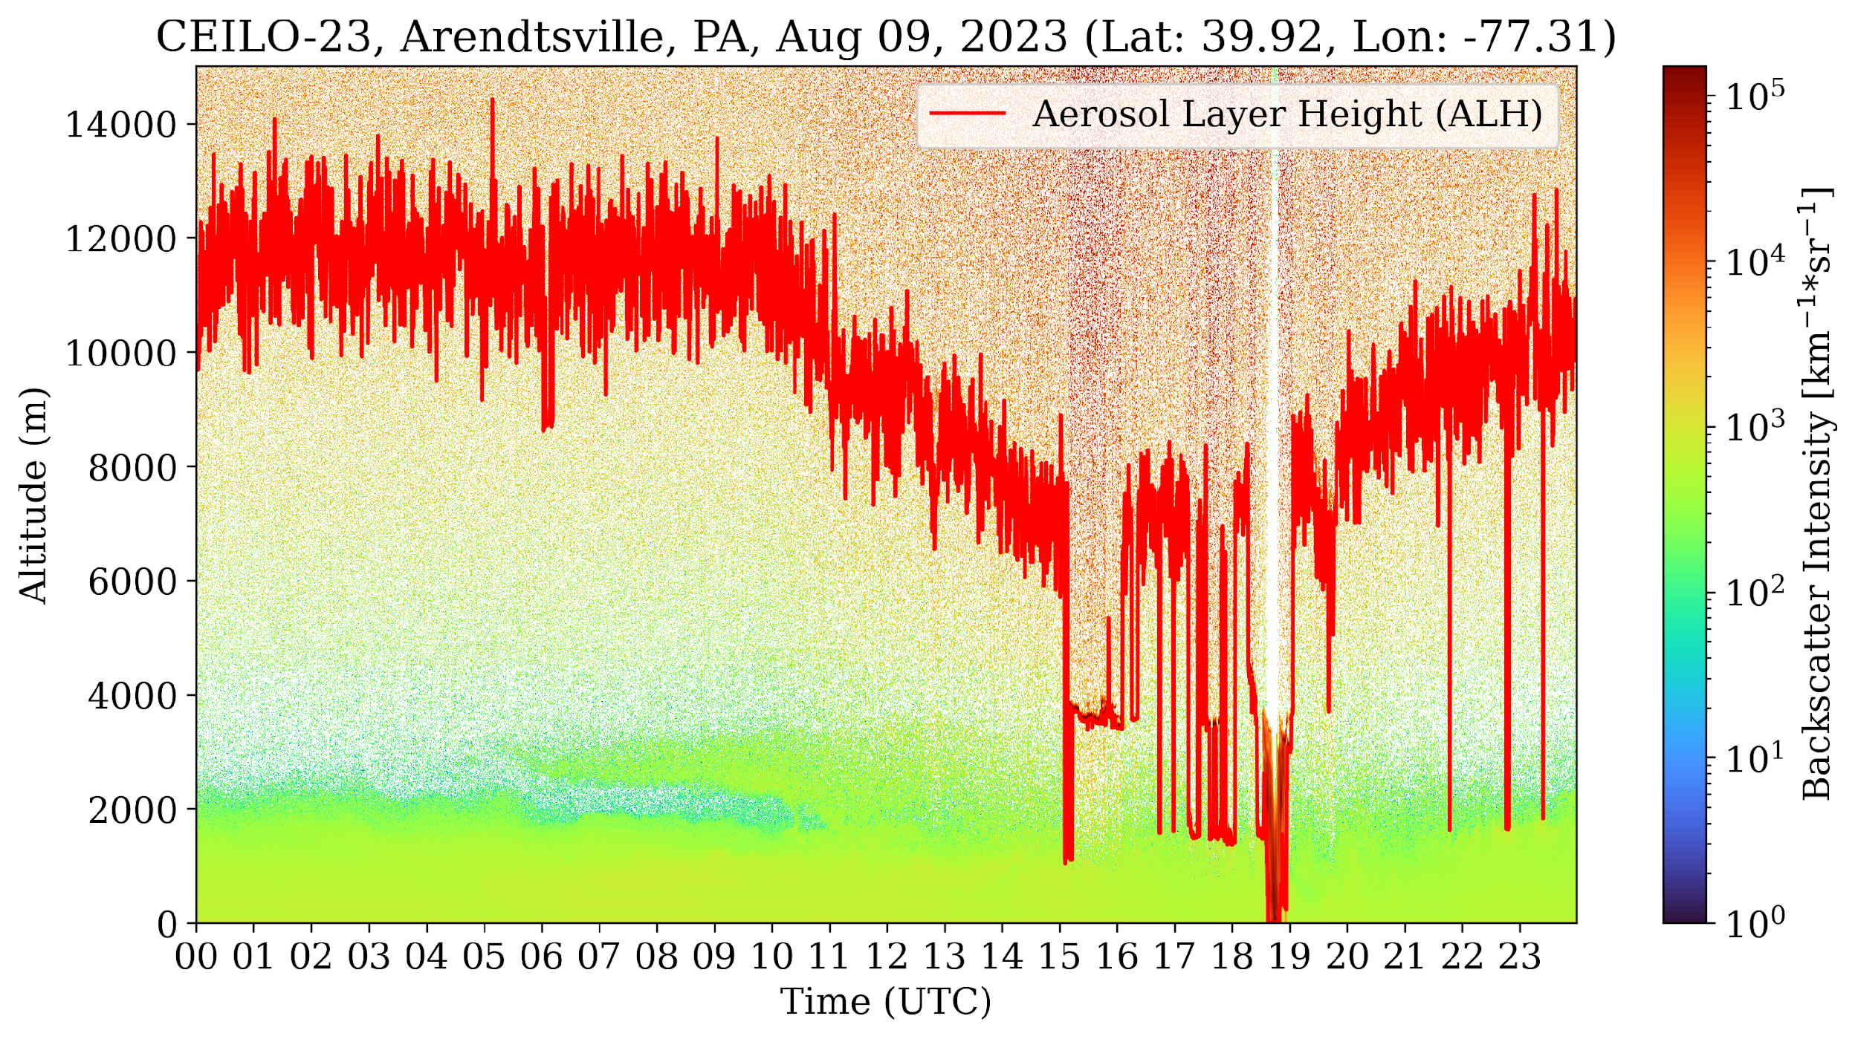
TEMPO ALH Validation
Derivation of ALH from extinction coefficient in Ceilometer Data (Among 21 sites in the East Coast Corridor, 9 sites available for August 2023)
  ALH is estimated based on the top 10% of backscatter intensity.
Plan to update the quality control (QC) and improve the algorithm for derivation of ALH from the ceilometer.

Slide 15
UCN Data Products to be covered in
US EPA Quality Assurance Project Plan
Measurement /Retrieved Parameter | Analysis Method | Derived parameter | Sampling Frequency | QC Check
Mixing Layer Height | Haar wavelet algorithm | PAMS -Hourly Mixing Layer Height | 10 min average MLH generated as common sample frequency | Visual check of data and products using aerosol backscatter and MLH
Residual height layer | Haar wavelet algorithm | PAMS - Hourly residual Layer Height | 10 min average MLH generated as common sample frequency | Visual check of data and products using aerosol backscatter and MLH
Aerosol Backscatter | measured | Non-PAMS derived parameter | Varies by ceilometer 15-36 seconds | Visual check of data and instrument diagnostics monitoring
Aerosol layers | Haar wavelet algorithm | Non-PAMS derived parameter | 10 min average generated as common sample frequency | Visual check of data and uncertainty evaluations
Cloud heights | Haar wavelet algorithm | Non-PAMS derived parameter | 10 min average generated as common sample frequency | Visual check of data and products using aerosol backscatter
Precipitation | Haar wavelet algorithm (measure properties of image regions) | Non-PAMS derived parameter | 10 min average MLH generated as common sample frequency | Visual check of data and products using aerosol backscatter

Slide 16
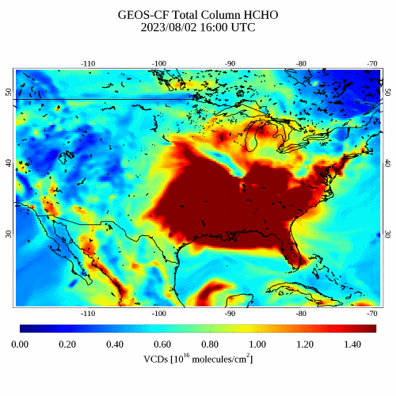
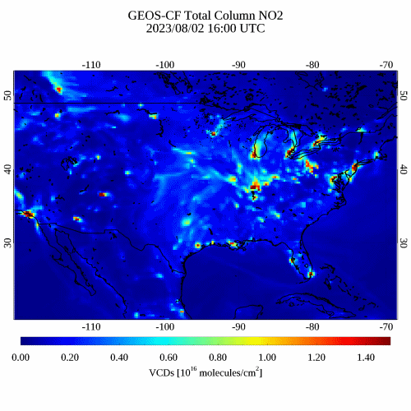
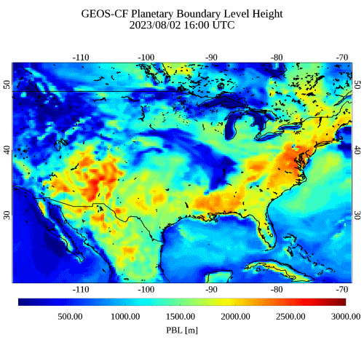
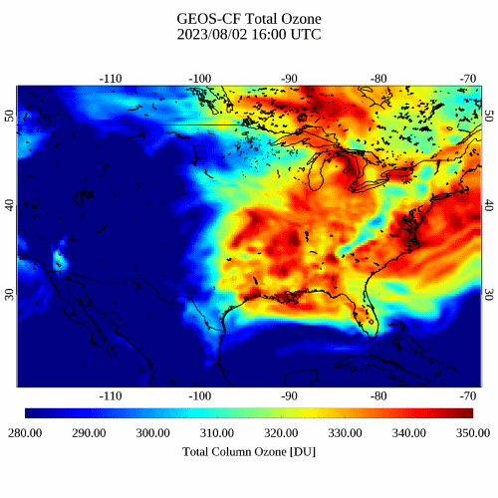
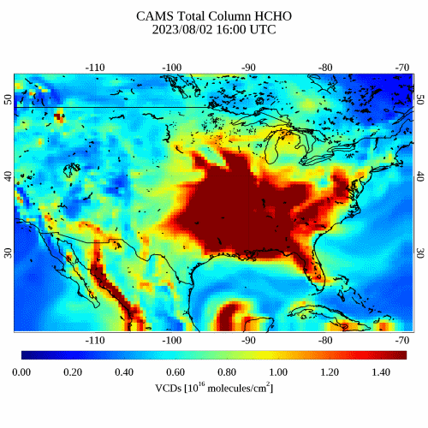
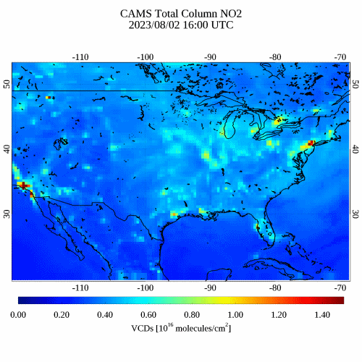
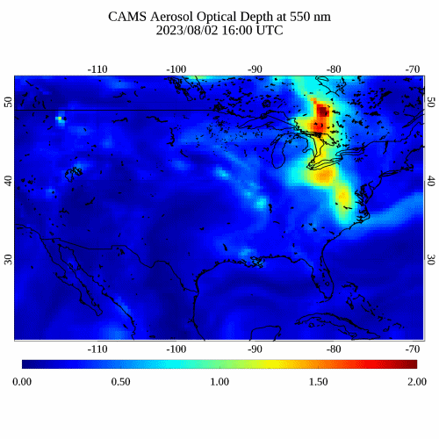
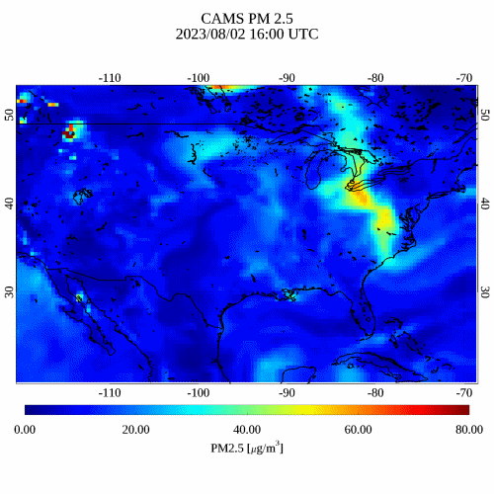
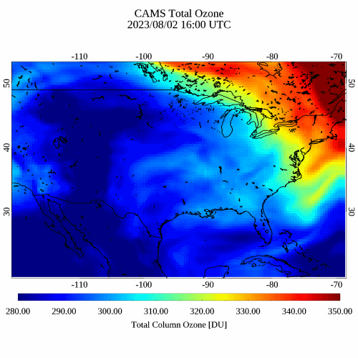
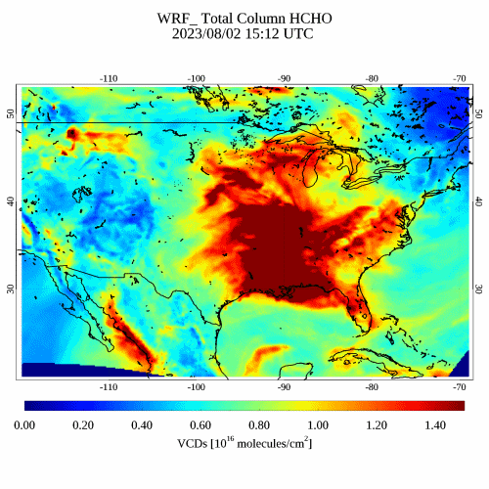
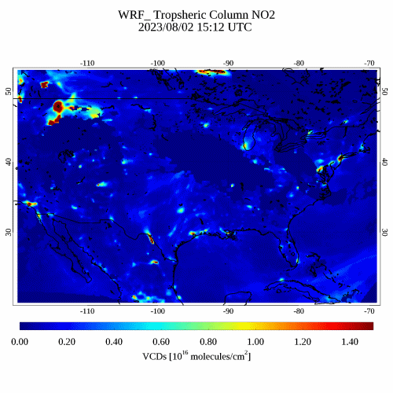









Compare Atmospheric Composition Forecast Model (August 02, 2023, 16 to 21 UTC)
HCHO
NO2
AOD 550 nm
PM2.5
PBL
TOZ
GEOS-CF
Resol.: 25 km
CAMS
Resol.: 40 km
WRF
Chem
Resol.:
13 km
TEMPO
Resol.:
2 by 5km

Slide 17










TEMPO O3T Yearly Validation

