Slide 1
Satellite remote sensing of aerosol vertical distribution:
A brief introduction
Jun Wang
College of Engineering
University of Iowa
AC-VC meeting
June 2025

Slide 2
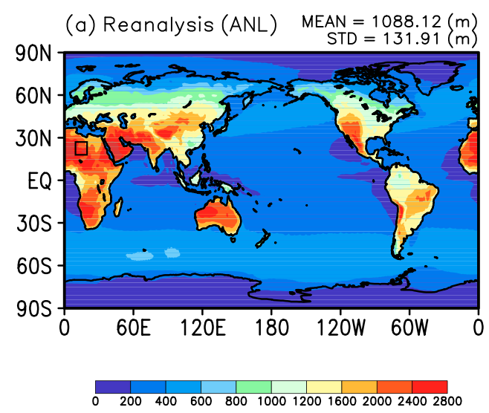
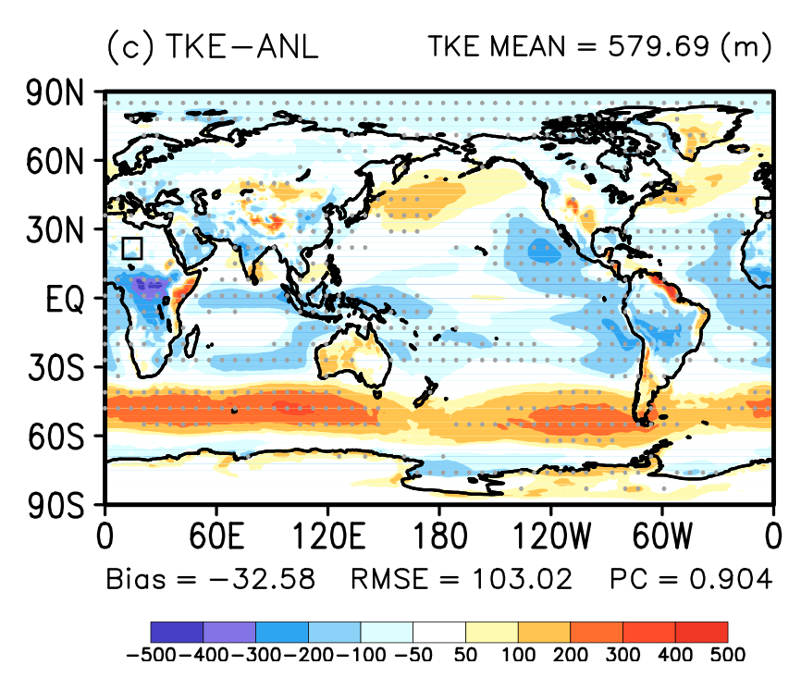
Modeled PBLH itself is elusive in some ways; diurnal cycle requires geo-stationary satellite measurement
Definition of PBLH; PBL scheme; …
PBLH diurnal amplitude
Annual-mean PBLH difference
Shin et al., 2018.
No observation data for evaluation of global PBLH
Three re-analysis datasets are used as the baseline
Inconsistent diurnal variation and definition of PBLH among different models

Slide 3
Different techniques for sensing AVD from space
Active
  Lidar such as CALIOP and CATS
  ATLID (ATmospheric LIDar)
Passive
  Limb/ occultation : SAGE, OMPS
  Stereo photogrammetry : ATSR, MISR
  UV, Deep Blue + Polarization : OMI, TROPOMI, POLDER/PARASOL
  Oxygen absorption spectroscopy: POLDER and MERIS, OMI, TROPOMI, SCIAMACHY; EPIC/DSCOVR, GEMS
  Infrared: dust and smoke, MODIS, VIIRS, AIRS…
Active + Passive: OMI/OMPS, MODIS/VIIRS, and CALIOP
Diurnal variation
Global converge

Slide 4
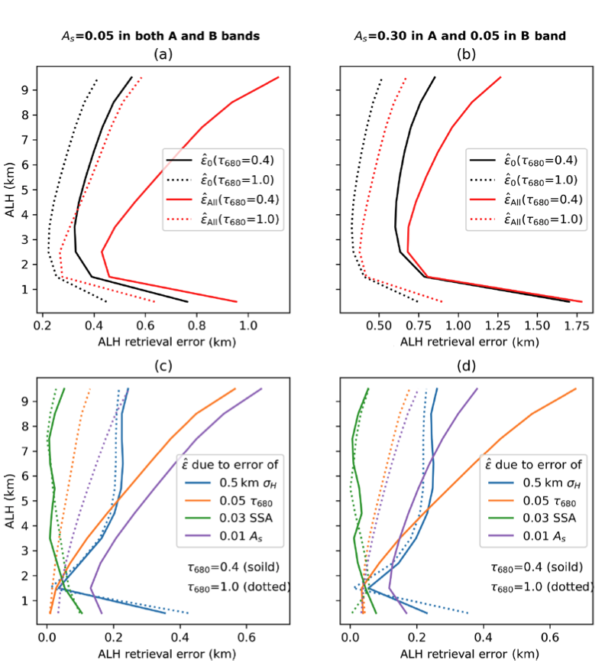
Oxygen absorption spectroscopy
Pros
    Surface reflectance is low in O2 B and O2-O2
    Has sensitivity in low, middle and upper troposphere.
    Work well for from source to downwind region
    Sensitive to both scattering and absorption aerosols
    Aerosol optical properties have less uncertainties (as compared to that in UV)
    Simplicity and robustness (the ratio between absorption and continuum bands can be well attributed to the aerosol height)
    Less sensitivity to aerosol absorption
Cons
    Subject to the shape of aerosol profile, but that is true for all passive techniques
    Subject to the surface reflectance (with a note that in O2 B-band, the reflectance is low).
Xu et al., 2019

Slide 5
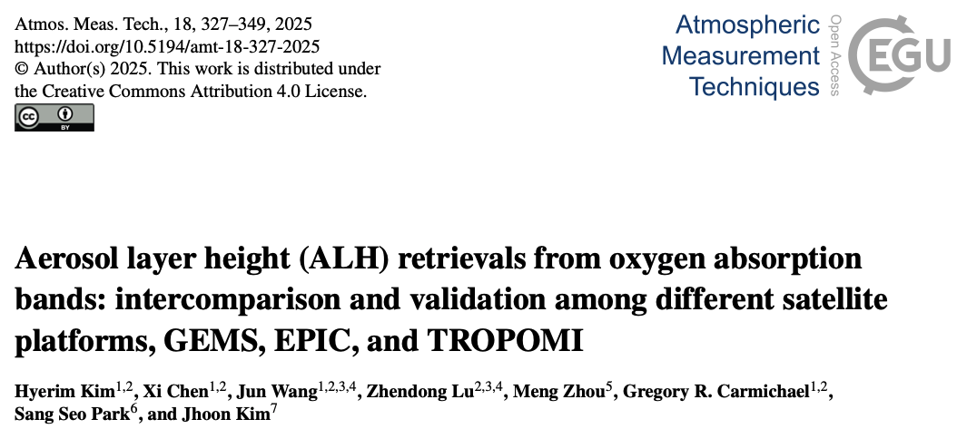
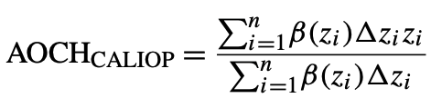
Definition & Validation
By definition, any optical parameters shall be wavelength dependence.
However, if wavelength dependence does not vary with altitude, AOCH may be independent of wavelength. In reality, AOCH shall vary with wavelength.

Slide 6
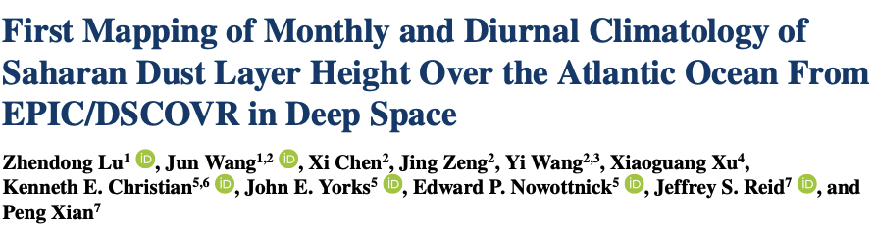
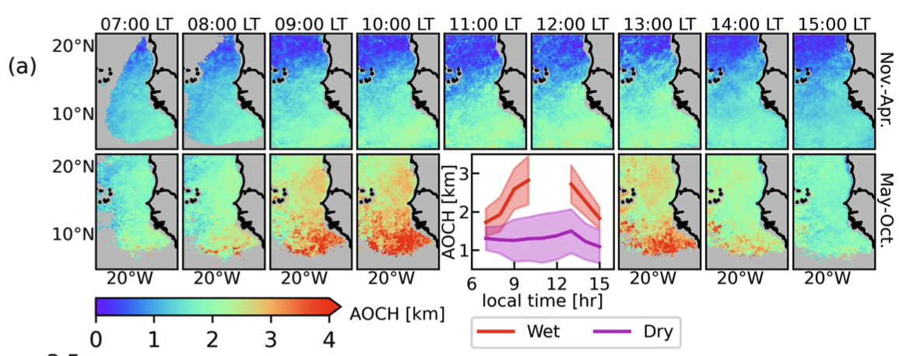
GRL 2023

Slide 7
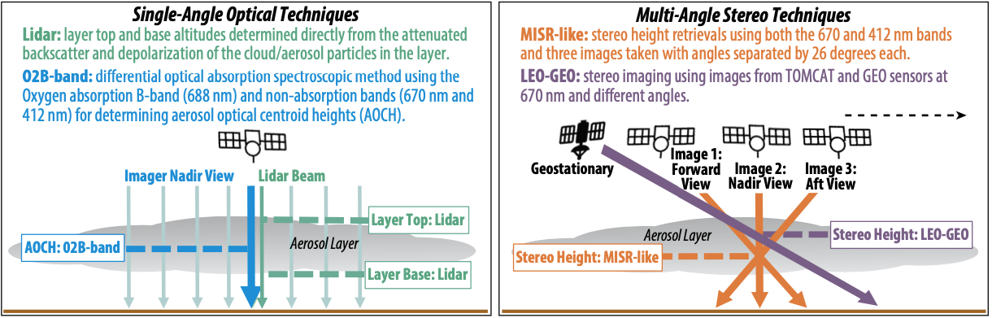
Four techniques together to provide unprecedented characterization of aerosol vertical distribution
Accuracy: lidar data can help correct localized bias in imager-based height data
Spatially: imager-based AOCH and stereo height data help expand lidar data
Temporally: time varying, around-the-clock measurements
Multiple-angle + O2 B-band further helps the retrieval in the downwind region.
Chen et al., 2021, in review.
Yorks, Wang, et al., BAMS, 2023

