Slide 1
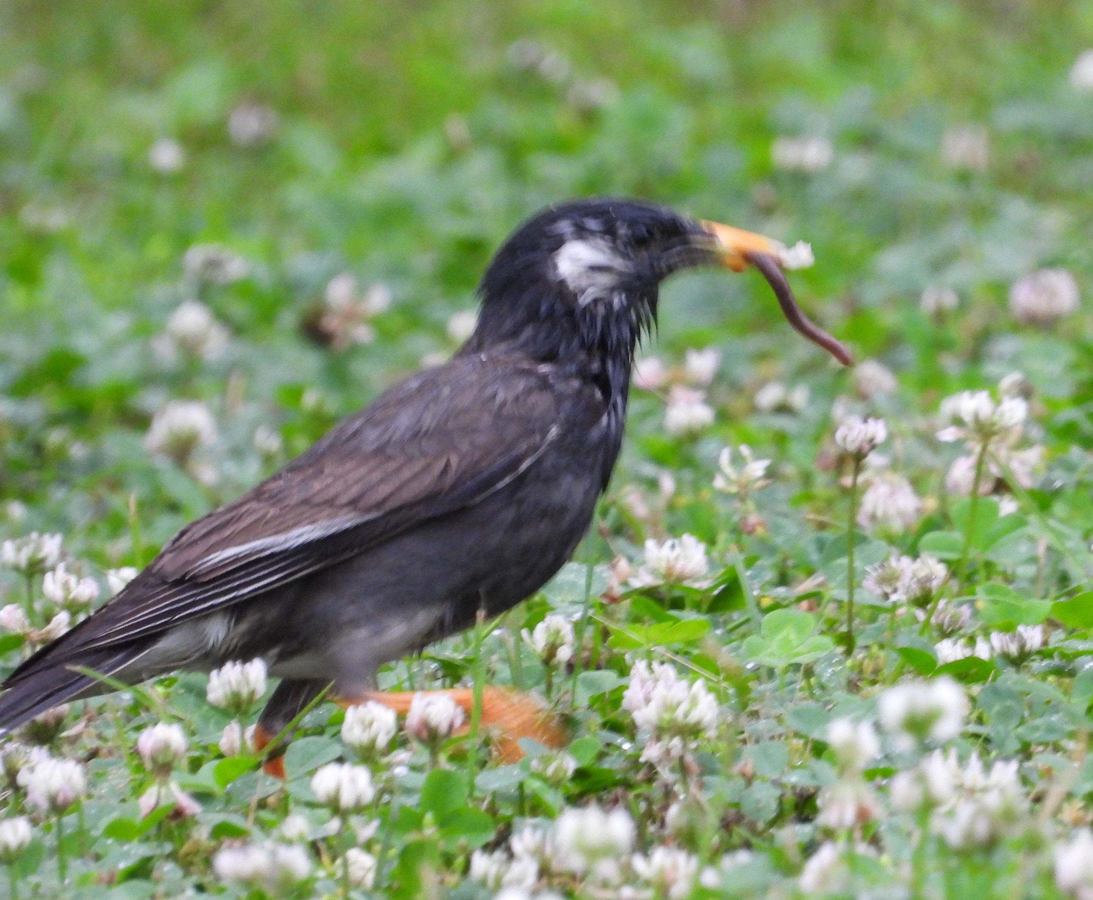
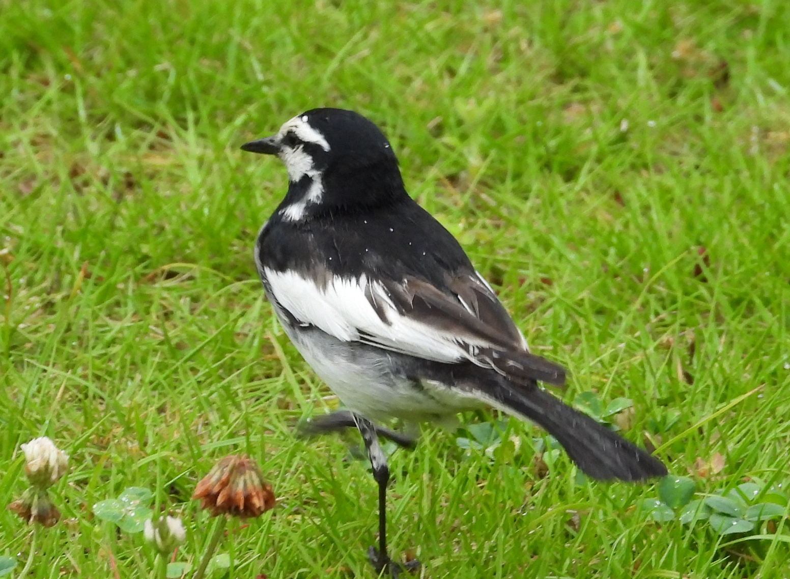
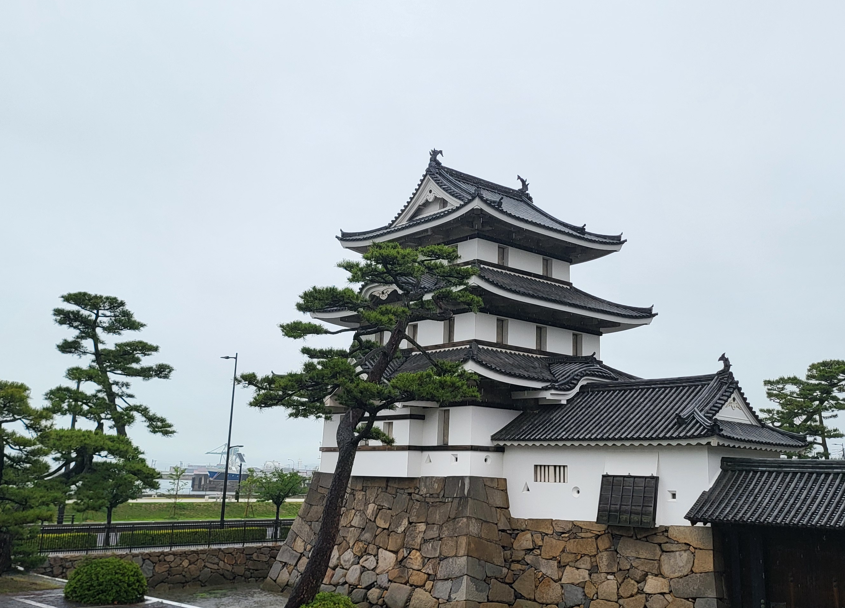
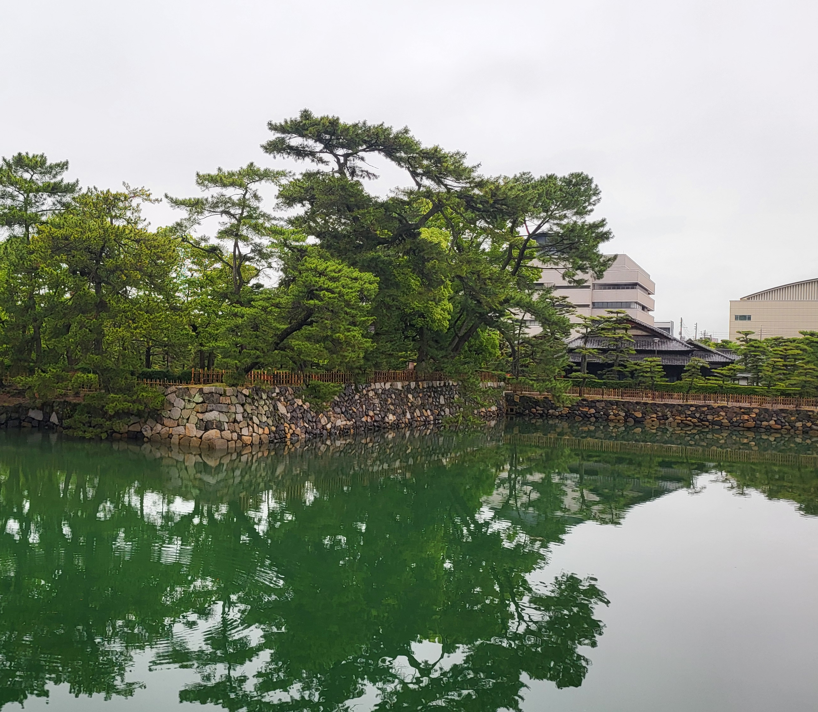

Aerosol Layer Heights from GEMS
Jhoon Kim
Lee Youn Jae Fellow Professor of Atmospheric Science, ¹Yonsei University, Korea

Slide 2
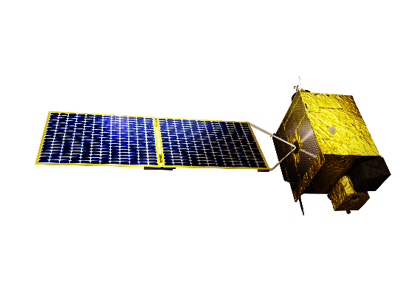
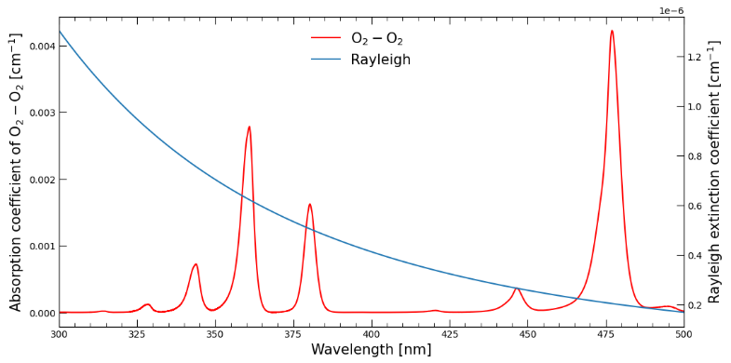
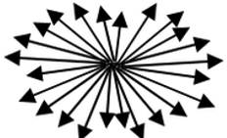
Principle of ALH Retrieval in UV-Vis
O₂O₂
absorption
Altitude (Z)
$$\int_{{z=0}_{}^{}}^{AEH}{AEC\left(z\right)dz}=\left(1−e^{−1}\right)\text{×}AOD$$
by DOAS
AEH
Aerosol Layer
ALH
Shielded O₂O₂
by OE
$$AOD=\int_{{z=0}_{}^{}}^{Z= ∞}{AEC\left(z\right)dz}$$
Rayleigh
scattering
$${∝λ}^{−4}$$
Aerosol Extinction Coefficient

Slide 3
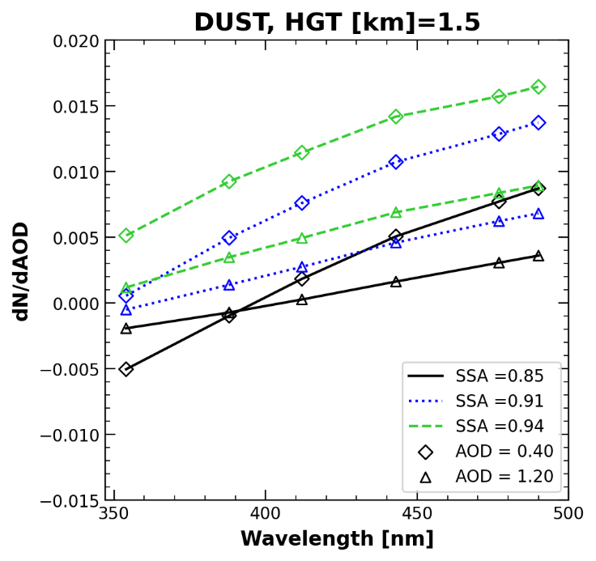
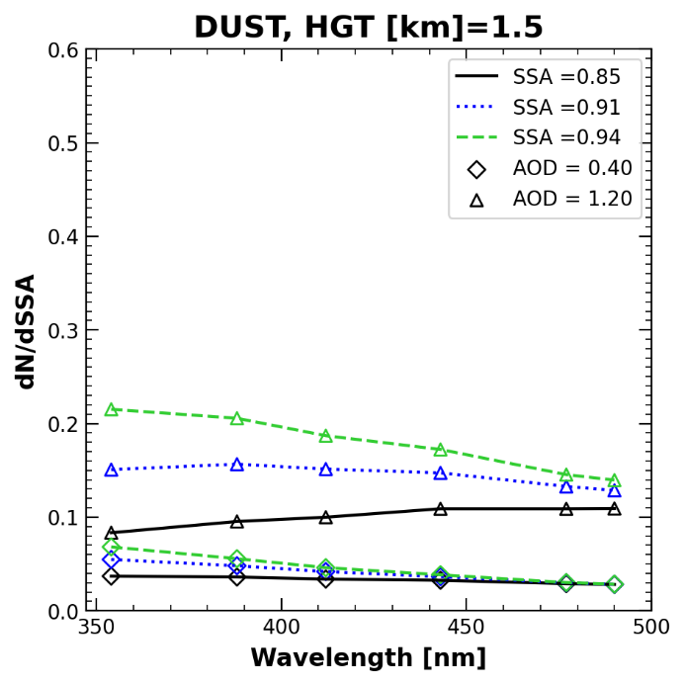
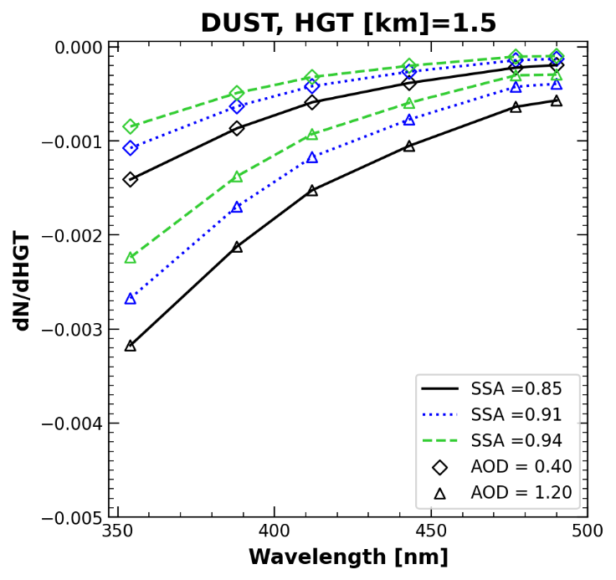
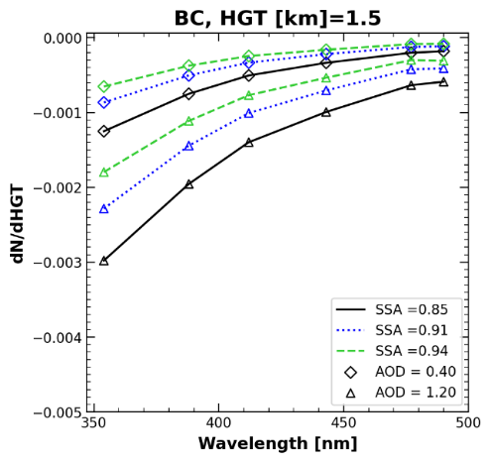
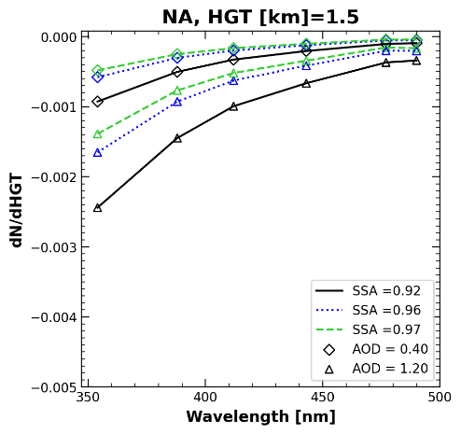
Sensitivity of UV-Visible reflectance to ALH
DUST [HGT = 1.5km]
dN/dAOD | dN/dSSA | dN/dHGT

Slide 4
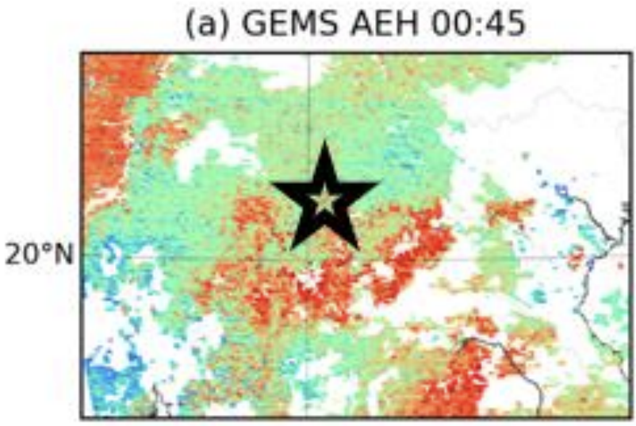
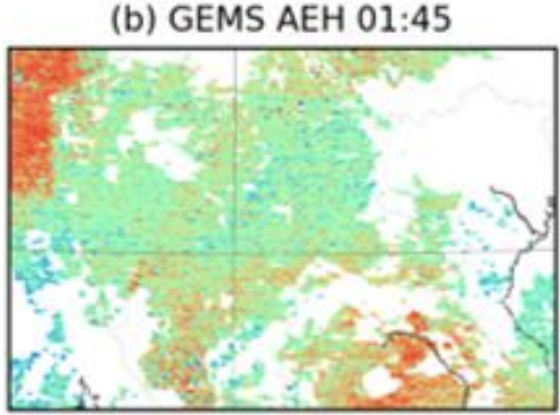
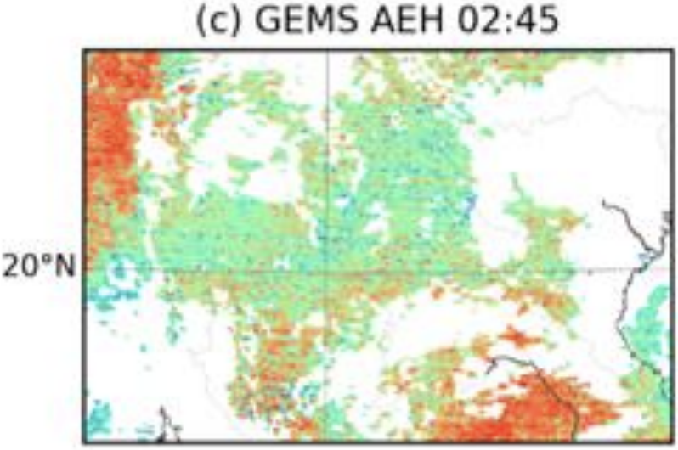
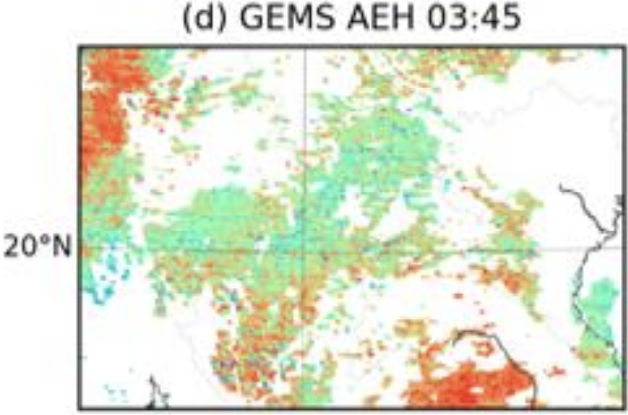
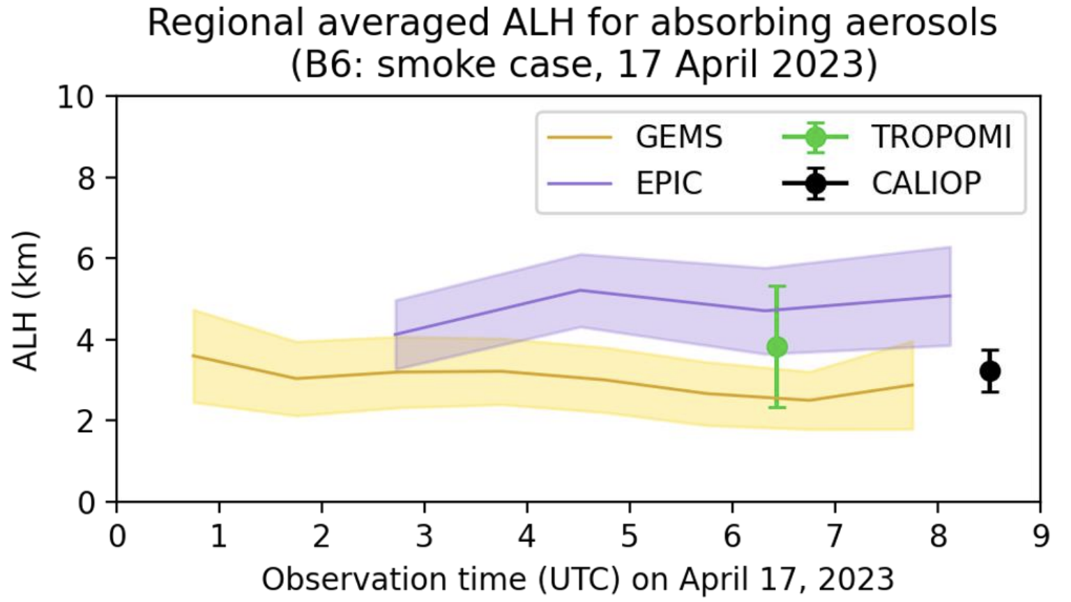
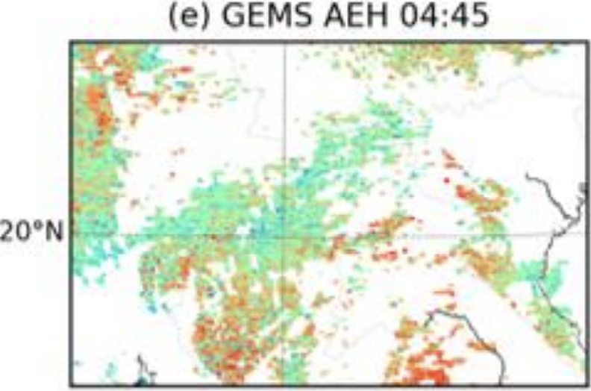
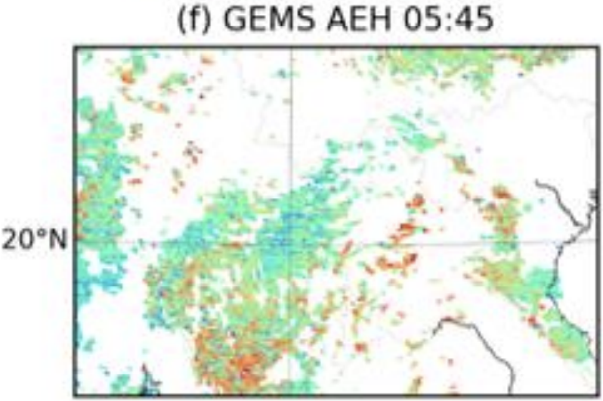
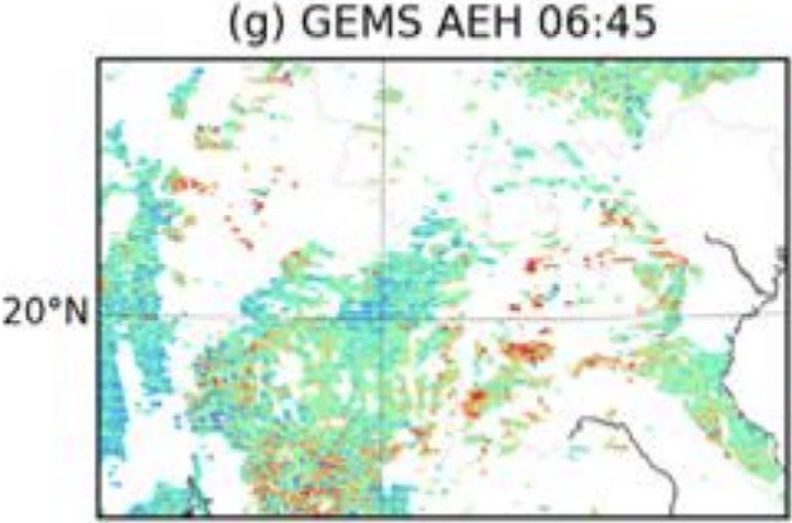
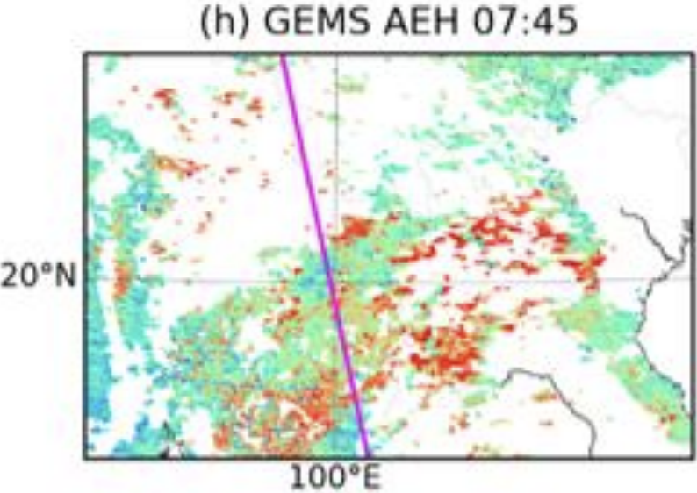
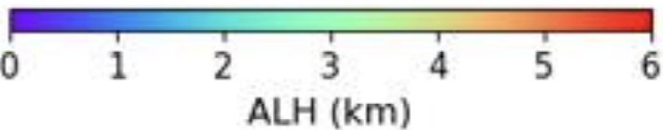
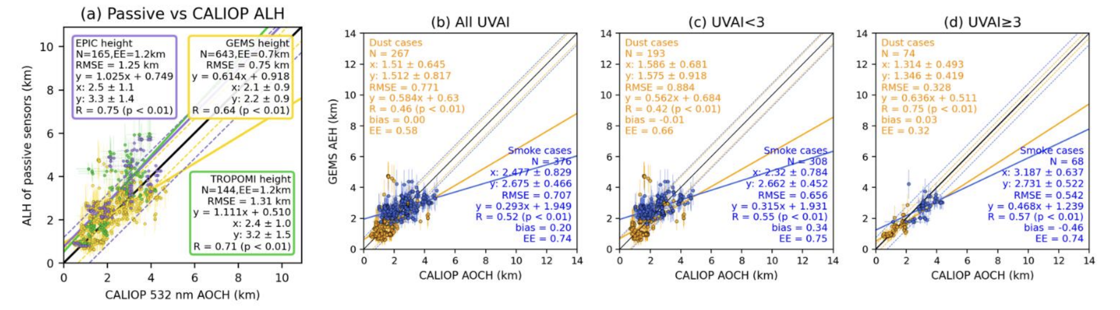
Aerosol Layer Height from O₂O₂ bands of GEMS, EPIC, & TROPOMI
H. Kim, J. Wang et al.
(AMT 2024)

Slide 5
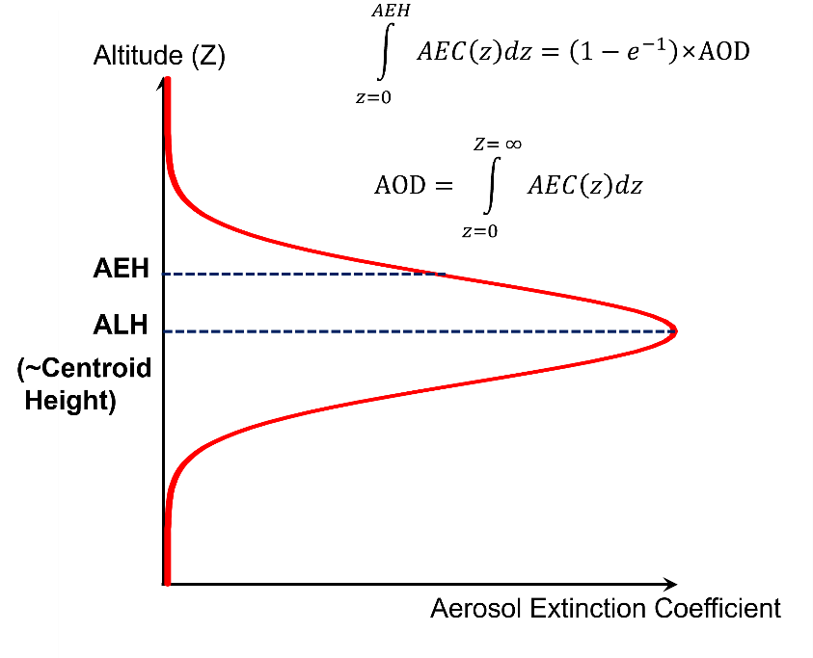
Aerosol Effective Height
AEH vs AEH (CALIOP vs GEMS)
ALH vs AEH (TROPOMI vs GEMS)
AEH vs ALH
AEH denotes the middle of layer between top and center height.
ALH defines most thick layer altitude.
Difference of definition between AEH and ALH → Difference (ALH-AEH) depends on the aerosol vertical distribution
Large variability still remains due to the variability of aerosol vertical distribution.
- σ(CALIOP vs. GEMS) > σ(TROPOMI vs. GEMS)
➔ Due to aerosol layer thickness and shape differences
Park et al. (AMT, 2025.)

Slide 6
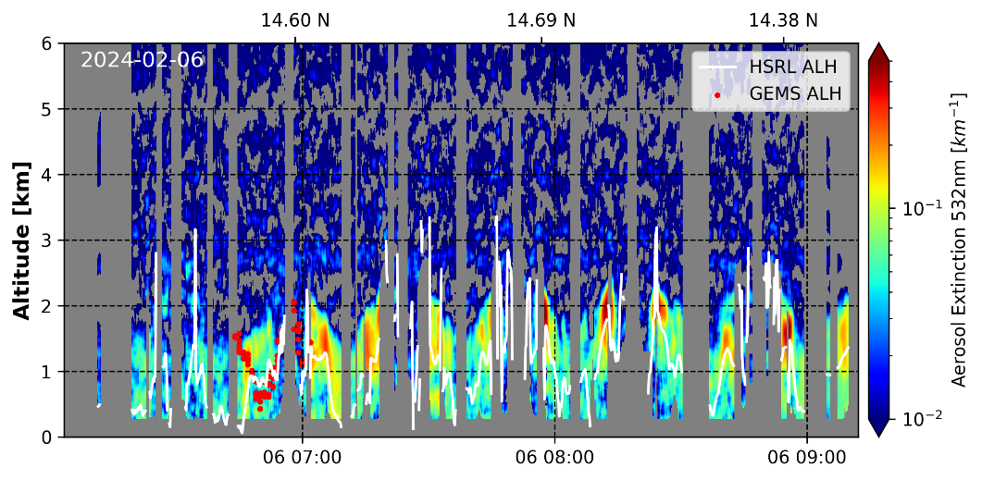
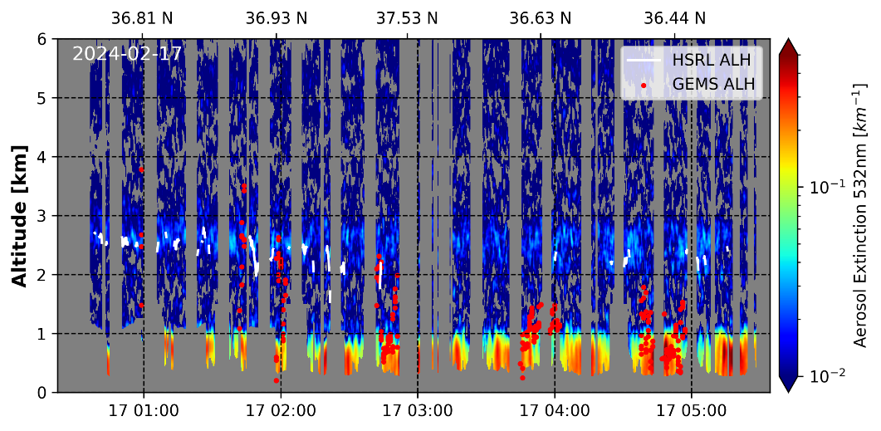
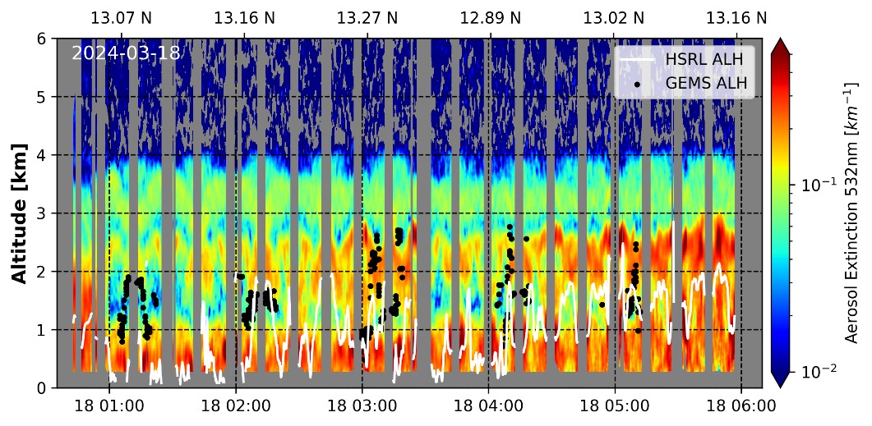
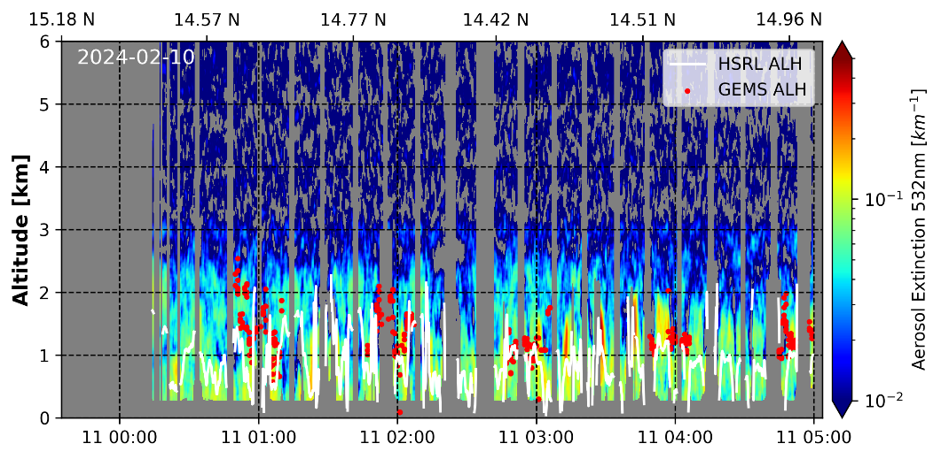
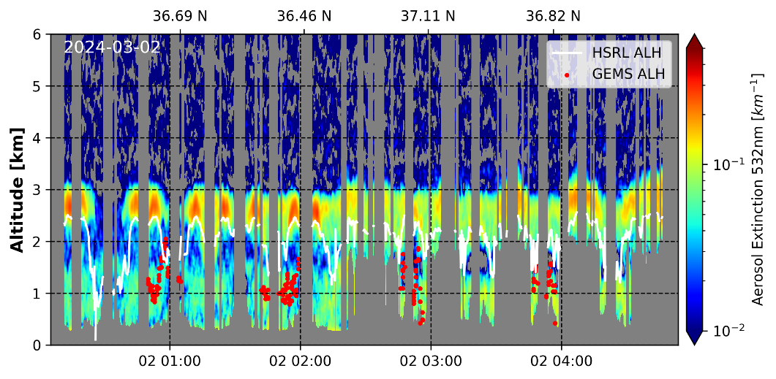
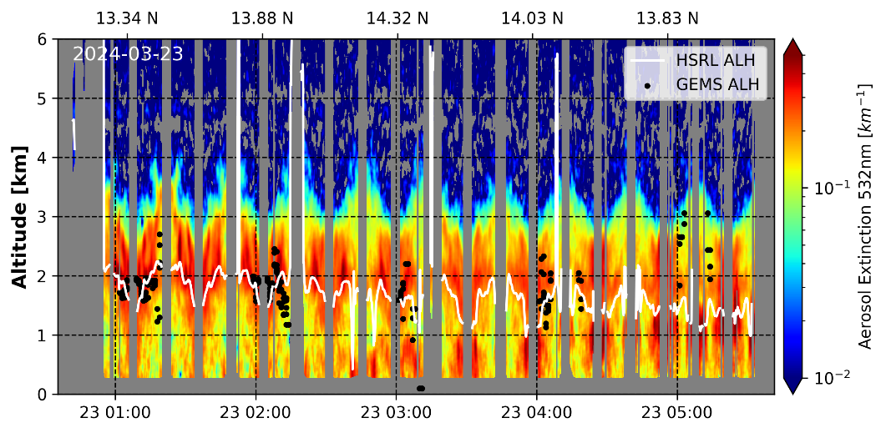
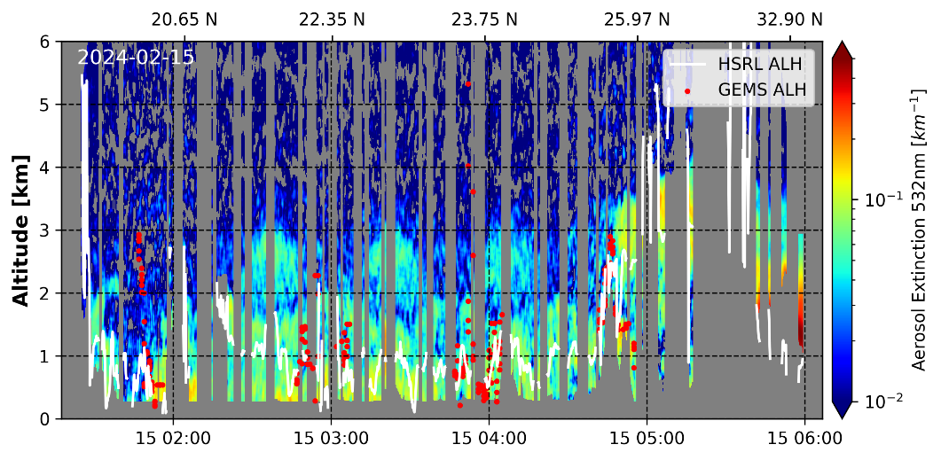
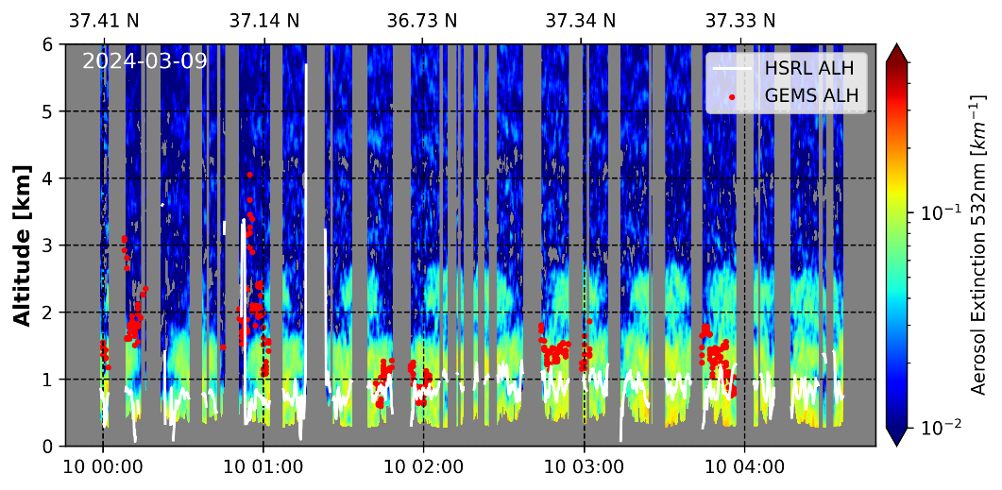
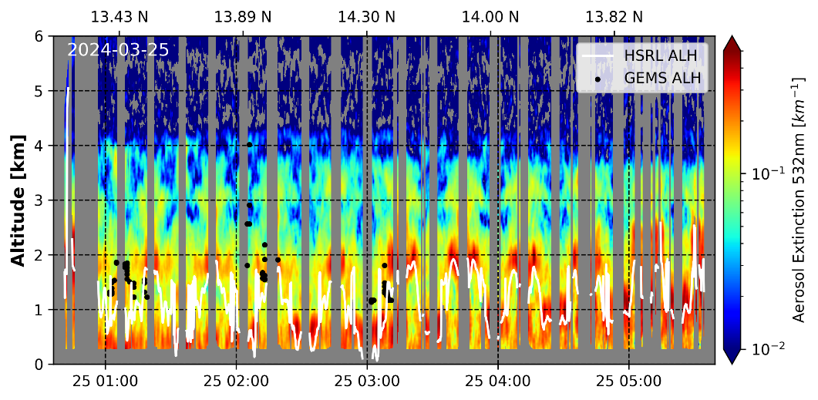
HSRL aerosol profile and GEMS ALH
Ph
2024-02-06
Kr
2024-02-17
Th
2024-03-18
Ph
2024-02-10
Kr
2024-03-02
Th
2024-03-23
Tw
2024-02-15
Kr
2024-03-09
Th
2024-03-25

Slide 7
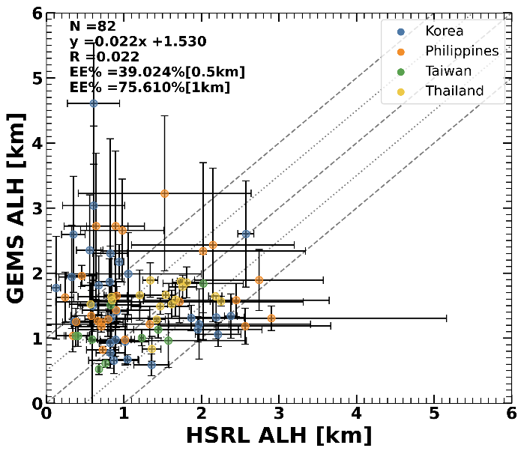
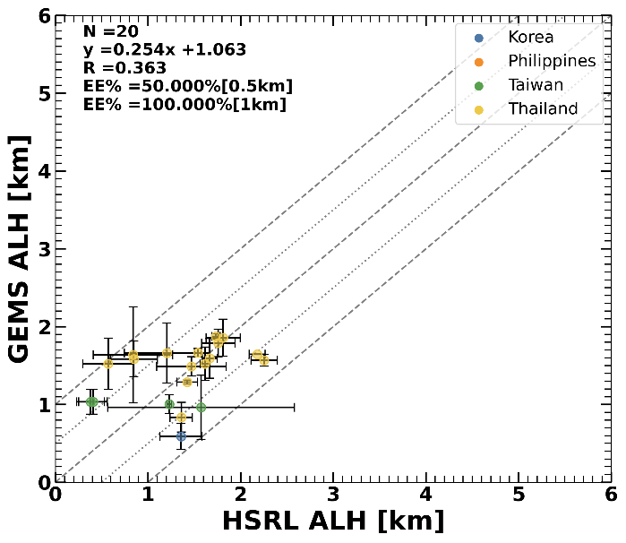
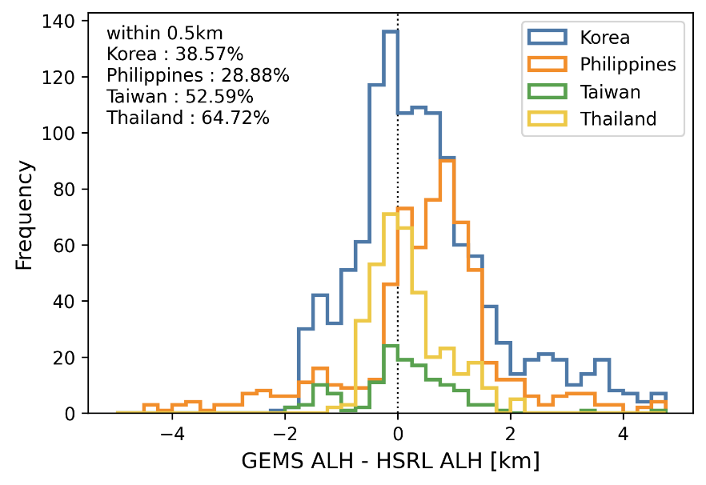
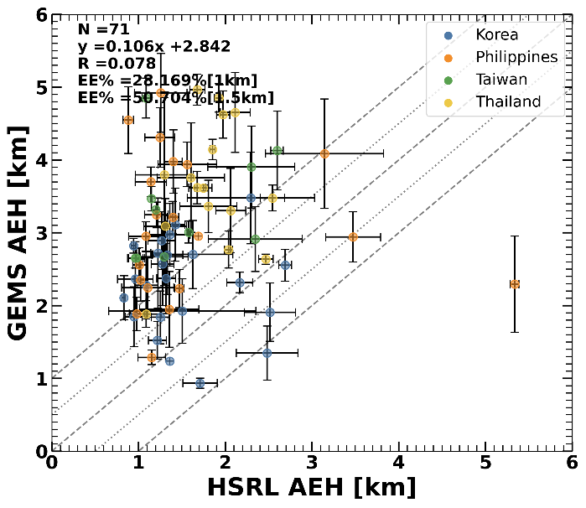
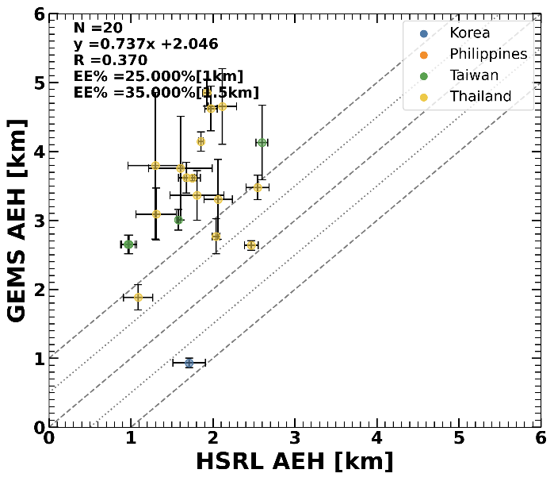
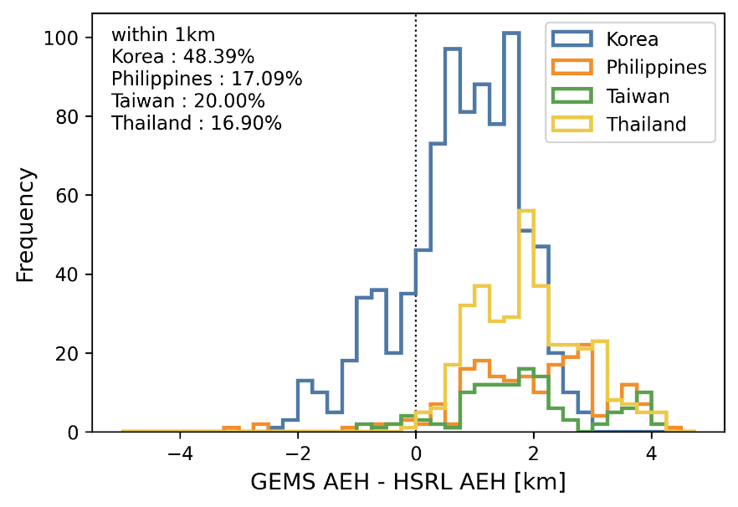

ASIA-AQ Intercomparison between GEMS and HSRL
ALH
AOD_{HSRL, 532 nm} > 0.4
AEH
AOD_{HSRL, 532 nm} > 0.4
39% of the ALH values fall within a 0.5 km difference, and 76% fall within 1 km. When AOD is greater than 0.4, GEMS shows better agreement with HSRL.
28% of the AEH values fall within 1 km, and 51% fall within 1.5 km, showing a tendency for overestimation.

