Slide 1
PM2.5 White Paper
ROADMAP FOR IMPLEMENTATION OF MONITORING SURFACE PM2.5: AN INTERNATIONAL CONSTELLATION APPROACH TO ENHANCING THE ROLE OF SATELLITE OBSERVATIONS
Sixteen Recommendations
Satellite products
  Exploit Near Real Time aerosol information from meteorological imagers
  Exploit aerosol information from multi-angle polarimetric imagers
  Exploit aerosol vertical information from spectrometers
  Develop synergetic aerosol retrievals from multiple sensors
  Enhance consistency of aerosol products
  Enhance radiometric consistency of space-borne sensors
Integration with models
  Develop fast forward operators for assimilation of satellite observations
  Improve consistency of aerosol representation in models and satellite products
  Improve uncertainty estimates in satellite aerosol products
  Develop schemes for assimilation of Level-1 satellite data
  Improve aerosol models and Level-2 assimilation schemes
  Develop data processing tools including machine learning
Validation
  Create ground-based validation supersites with comprehensive sets of sensors
  Enhance ground-based observation infrastructure including low-cost PM sensors
  Facilitate data access
Satellite Products
AC-VC
WGCV
GSICS
AEROSAT/
AEROCOM
Model Integration
Validation
Activities/Use Cases
Satellite Informed PM2.5
Health Applications
Policy Implications
EJ Applications

Slide 2
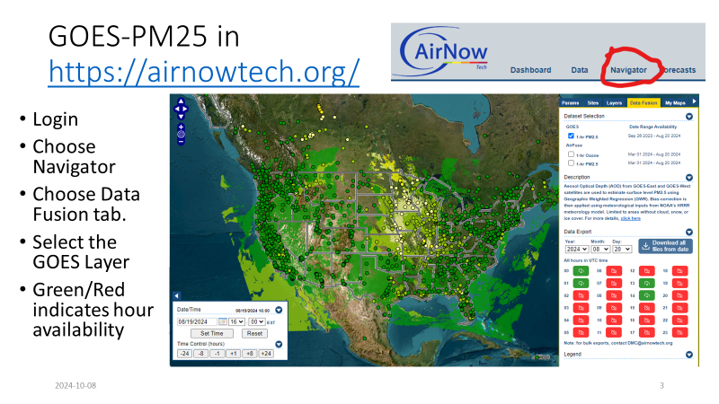
Recommendation 1: Exploit Near Real Time aerosol information from meteorological imagers
Agencies that are producing near real time air quality information from satellites should continue do that. NOAA using GOES and TEMPO for PM2.5 nowcasting applications (AiRFuse)
  NOAA using VIIRS for daily PM2.5 monitoring and trend analysis
  NIER using GEMS for PM2.5 monitoring applications
  Plans for aerosol product from FCI:i-AERUS by EUMETSAT/Météo-France/ICARE
  AHI and GOCI aerosol product
  Who else?
Where needed, ensure products are operational and available routinely and reliably. Do demonstration of usability of alerts and warnings

Slide 3
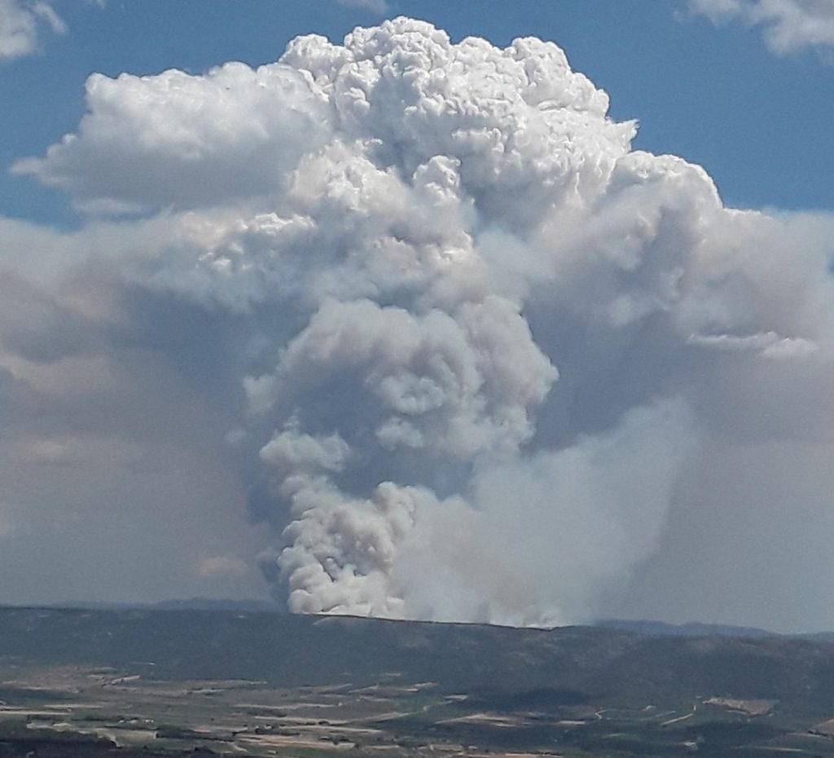
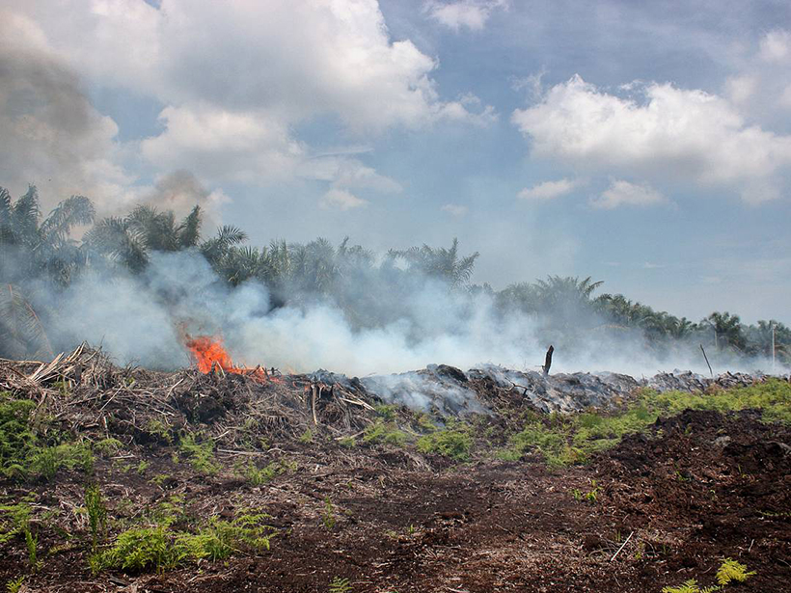
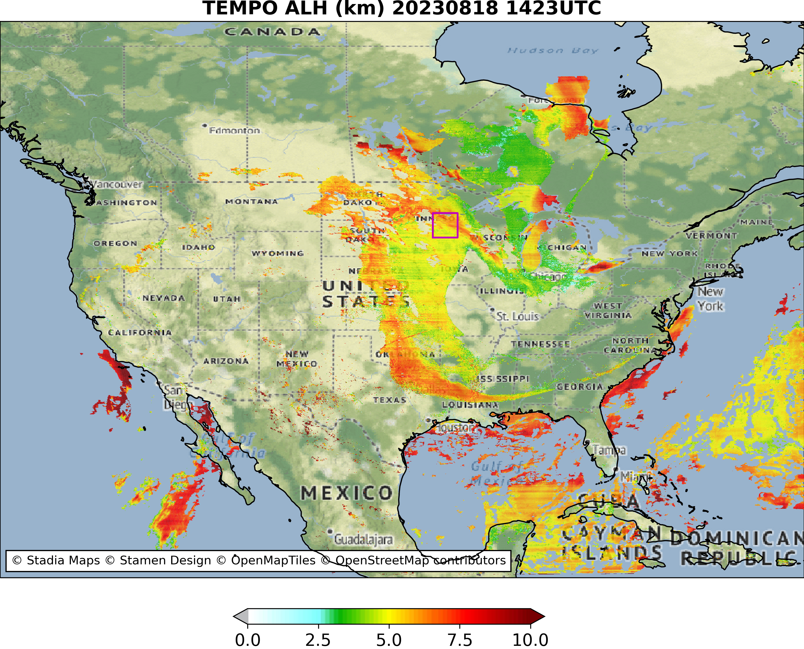
Recommendation 2: Pursue the use of aerosol height information from hyperspectral imagers for constraining surface PM.
Products from TEMPO, GEMS, S5P/TROPOMI, soon also S4 and S5
Modify statistical algorithms (various ML and GWR ones) to utilize aerosol layer height from GEMS, TEMPO and TROPOMI in estimating PM2.5
  Identify ways to resolve the differences between AOD and ALH information content. For example TROPOMI has layer height product but not AOD and VIIRS has AOD but no layer height
Conduct case studies to demonstrate the value of aerosol layer height
    Plume injection height in models
    Data assimilation in models

Slide 4
Recommendation 3: Exploit aerosol information from multi-angle polarimetric imagers
Multi-angle polarimeters provide information on aerosol properties. The community needs to figure out how this information can be used to improve PM2.5 estimates.
  Improvements to PM2.5 will come from improving AOD. For example, particle size and single scattering albedo information can be used to select the right loo-up-table to retrieve AOD. Conduct case studies with and without polarimeter information and identify errors. POLDER, PACE and 3MI could be exploited in these studies.
  Validating retrievals from these case studies is crucial
  Identify strategies for using polarimeter products in quantitative way

Slide 5
Recommendation 4: Continue efforts to establish, monitor, and enhance the radiometric calibration consistency of space-borne multispectral imagers
Work with Global Space based Intercalibration System (GSICS) working group to understand instrument calibration (absolute and time-dependent drifts) to soft calibrate datasets with respect to one another
Agencies should agree to adhere to applying calibration adjustments needed so product performance is optimal
Catalog calibration methods used for sensors in the UV-VIS in geostationary orbit vs. polar orbit.

Slide 6
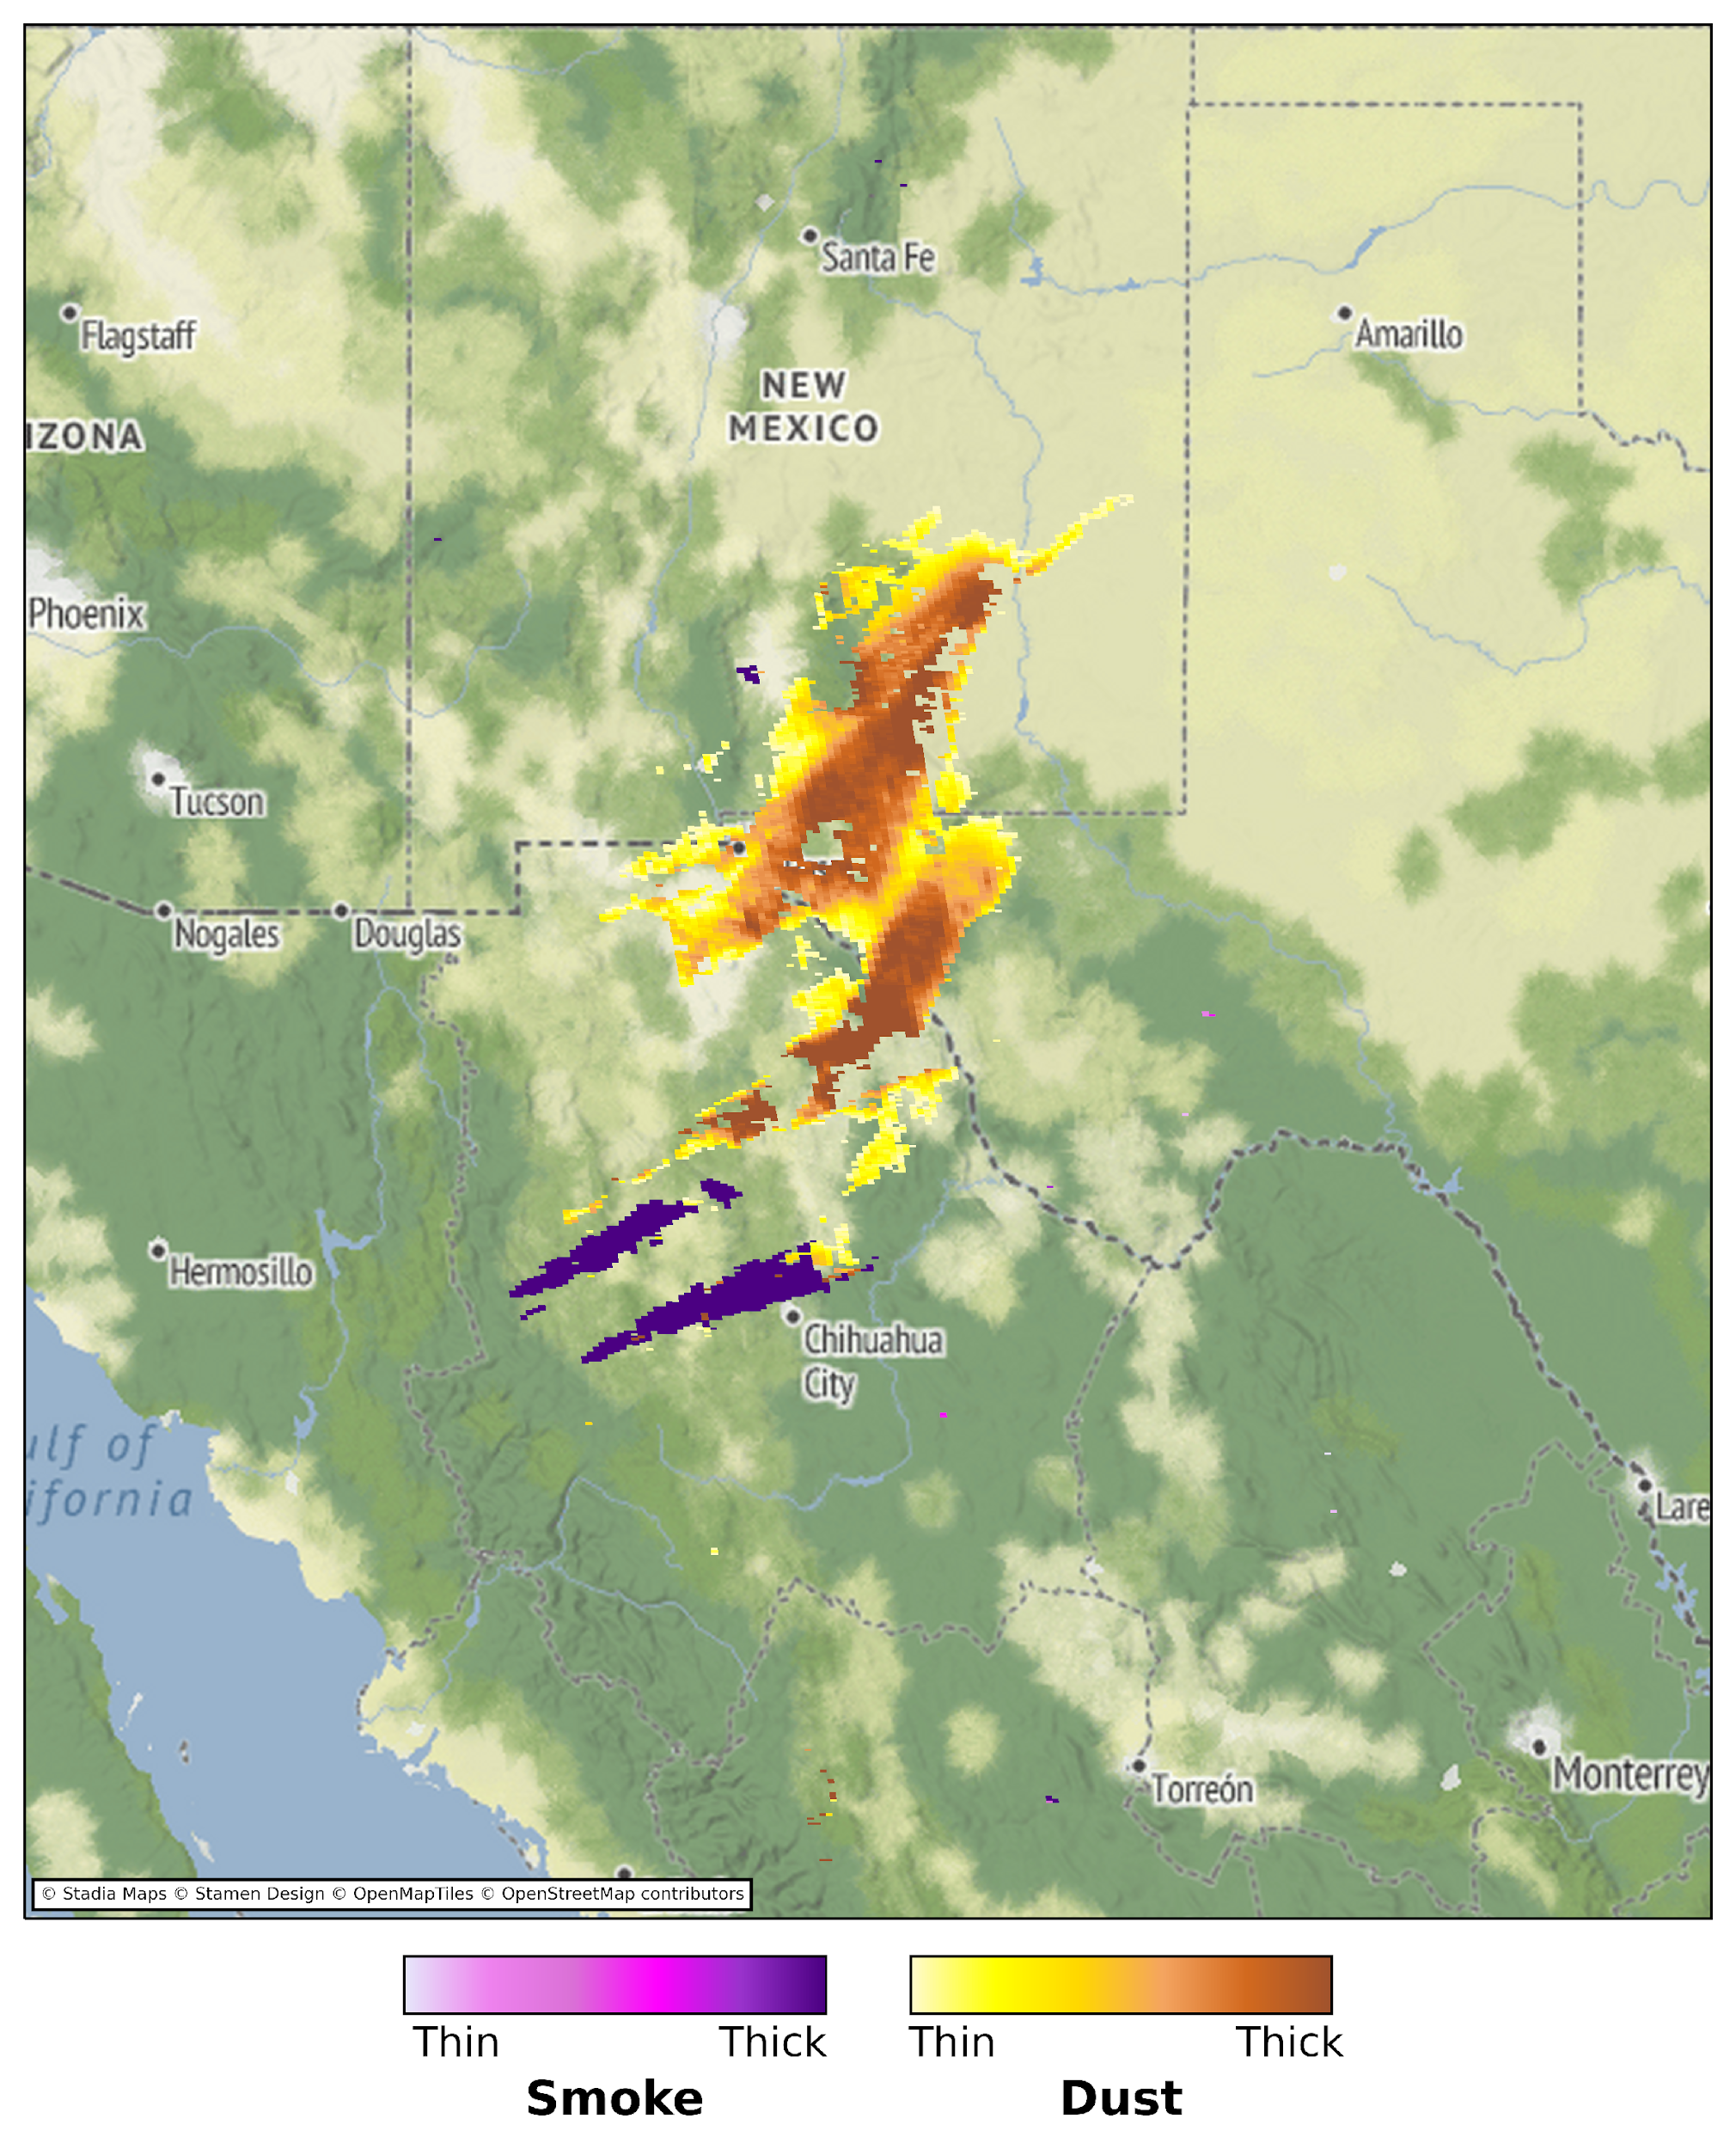
Recommendation 5: Develop synergetic aerosol retrievals from multiple sensors
Enhance hazards monitoring by synergistically blending imager and spectrometer data. Exploit VIIRS/TROPOMI, ABI/TEMPO, METImage/UVNS, and AHI/GEMS
  Discuss ways to combine imager and spectrometer to improve AOD so PM2.5 product can be improved.
    One way to do this is use smoke and dust detected by spectrometer in selecting the right look-up-table for the AOD algorithm
    Use imager and spectrometer L1B data matched up with AERONET AOD to train ML algorithm to derive AOD and other aerosol properties such as particle size etc.
GOES-16 ABI + TEMPO

Slide 7
Recommendation 6: Establish, monitor, and enhance radiometric consistency of space-borne multispectral imagers
As new missions like MAIA come along with information not attained thus far, there is a need to develop and explore new ML models. For example, we have not utilized speciation information as input to ML models
Develop gap filling techniques to generate missing AODs and apply ML models to derive PM2.5
Coincident satellite observations such as carbon monoxide etc. not from the same satellite sensor measuring AOD can be used as input to ML model to see if PM estimates improve

Slide 8
Recommendation 7: Identify satellite data product requirements and observational needs for PM estimation
Key space agencies should work with their stakeholders and conduct surveys about the specific requirements for PM2.5 estimated from satellites.
  Present current state of the art methods and discuss merits
  Probe stakeholders for feedback. Engage them in discussion related to their specific need vs. what is capable from satellites alone. Discuss if they have confidence in using satellite based estimates in their daily decision support system
The newly formed interagency governance board in the US (AIR4US) can help conduct this activity
Who in Europe and who in Asia will lead this?

Slide 9
Recommendation 8: Further enhance satellite PM2.5 algorithms using ML models
Many publications have come out recently on estimating PM2.5 using satellite data and ML models. Who will contribute to compiling this information for the roadmap?
Classify these models into categories and type of satellite information used. Discuss pros and cons of each and their limitations. Identify if any can be applied to operational imagers
Are there any ML models that use direct L1B data to derive PM2.5. Can those models be tested for their performance against conventional models (statistical or statistical with ML) to derive PM2.5.
How to identify the significance of a certain parameter in improving estimated PM2.5

Slide 10
Recommendation 9: Continue to develop the ability of chemical transport models to relate AOD to PM2.5 to represent long-term PM2.5 concentrations.
Sustain and enhance co-located measurements of AOD, PM2.5, PM2.5
chemical composition, aerosol extinction, and aerosol vertical profile for
model evaluation
Evaluate and improve representation of model processes affecting the AOD
to PM2.5 relationship including aerosol vertical profile, aerosol chemical
composition dependent hygroscopicity, and aerosol size

Slide 11
Recommendation 10: Continue and reinforce efforts (such as those made by the AEROCOM community) to evaluate and improve the skill of aerosol models and the capability of aerosol assimilation schemes.
Models are useful to understand the physical connections between AOD and PM2.5 on various timescales (e.g. hourly, daily, monthly, annually) and how their relationships vary with meteorological conditions and other parameters, and in different environments and aerosol regimes.
AeroCom advocates using multiple models to test hypotheses before arriving at an understanding of a particular issue. AC-VC can use a similar paradigm for testing out the dependencies of AOD-PM2.5 to various parameters such as RH, particle size and composition, etc.

Slide 12
Recommendation 11: Pursue scientific developments to identify ways to improve the consistency of the representation of aerosols between models and satellite products
When satellite data have to be assimilated into models, there is often disconnect in aerosol properties between numerical models and those used in generating look-up-tables for the retrieval algorithm.
  To understand the impact of these differences, we can pursue doing closed experiment where we match aerosol speciation and their properties between numerical models and look-up-tables.

Slide 13
Recommendation 12: Reinforce efforts to improve uncertainty estimates in satellite aerosol products, in order to
facilitate their use in data assimilation schemes.
For Level 2 retrievals, understanding pixel level uncertainties that is informative to a DA system should be developed.
  How do we generalize this across sensors in LEO vs. GEO?
For Level 1B observations, information content of observed radiances/reflectances
  Overlap with radiometric consistency argument, long-term stability of observations etc. come into play.

Slide 14
Recommendation 13: Pursue the development of schemes for assimilating Earth radiances measured by space-borne sensors
Who is investigating direct radiance assimilation from UV-VIS sensors?
Are the fast radiative transfer models available for the UV-VIS?
Past experiences of assimilating MODIS L1B reflectances exist at NASA GMAO. Will that continue at NASA?

Slide 15
Recommendation 14: Collect and analyze comprehensive reference data sets including measurements from ground-
based in-situ PM sensors and co-located radiometers and ceilometers, in order to enhance the understanding of the link between satellite observables and near-surface PM concentrations
Recommend the establishment of supersites where for a known period of time, we can make simultaneous observations of AOD, PM2.5, Ceilometer, and aerosol speciation
  Analyze the data and stratify the analysis to shed light on what are some of the sources of errors when aerosol types and loadings vary?
  Document how SPARTAN network can contribute to this work?

Slide 16
Recommendation 15: Validate satellite-informed PM products, using ground-based in-situ PM data from operational networks. Pursue extending the source of PM reference data by calibrating low-cost PM2.5 sensors and developing correction methodologies.

Slide 17
Recommendation 16: Create a data center for providing access to validation data

