Slide 1
AOD Data assimilation in CAMS
PM2.5 impact
Johannes Flemming, Cathy Li, Melanie Ades, Enza Di Tomaso, Michael Kahnert, Samuel Remy (HYGEOS) and the CAMS team

Slide 2

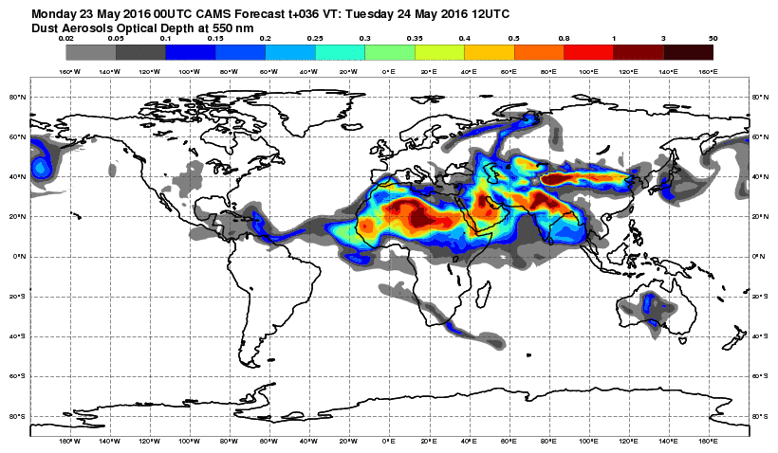

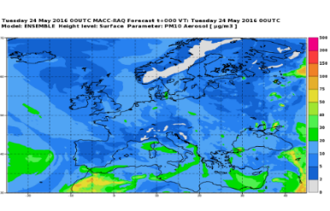
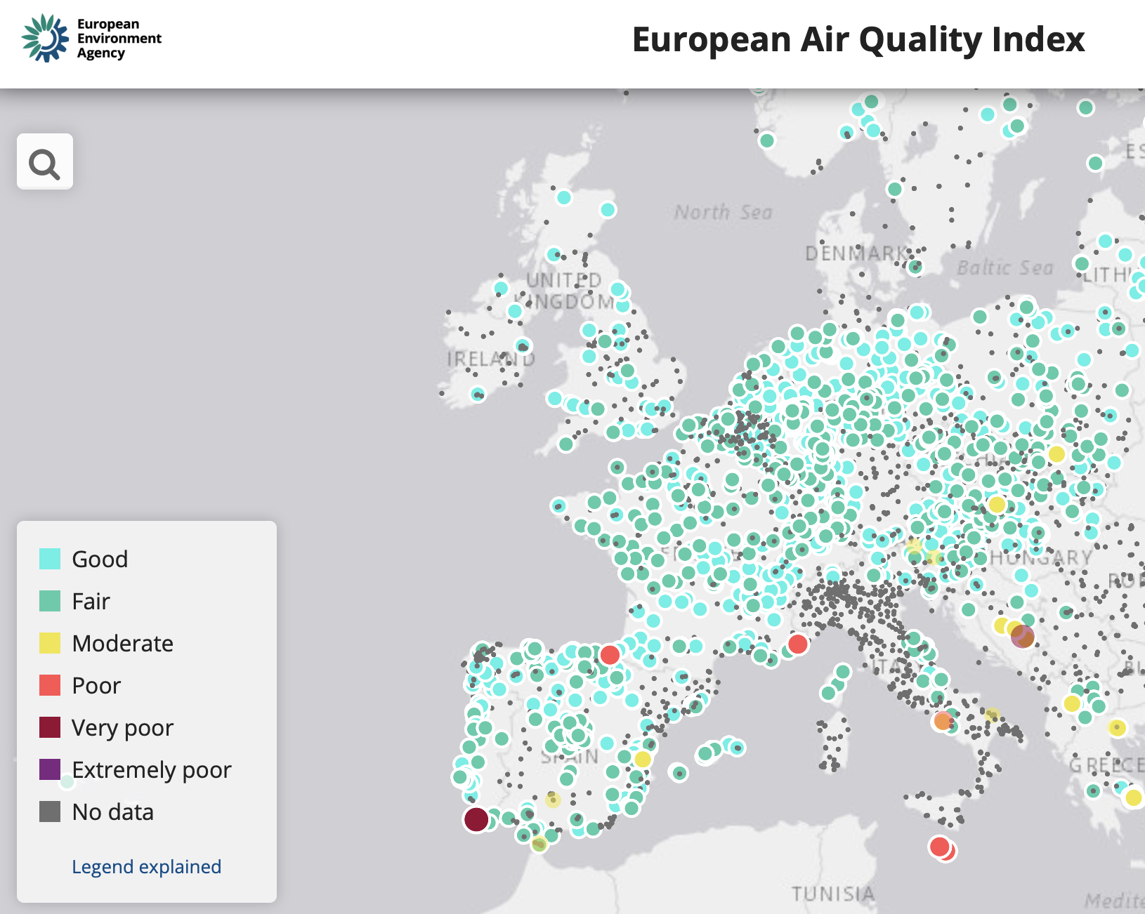
CAMS forecasting systems
CAMS SERVICE CHAIN
ECMWF
IFS
global,
40x40 km
Data assimilation
Global
CAMS Emissions
Satellite Observations
(AOD, O₃, CO, CH₄, NO₂, SO₂ )
GFAS
wildfire emissions
Boundary Conditions
11 regional CTMs over Europe,
10x10 km
European CAMS
Emissions
Surface AQ observations
Data assimilation
10
15

Slide 3
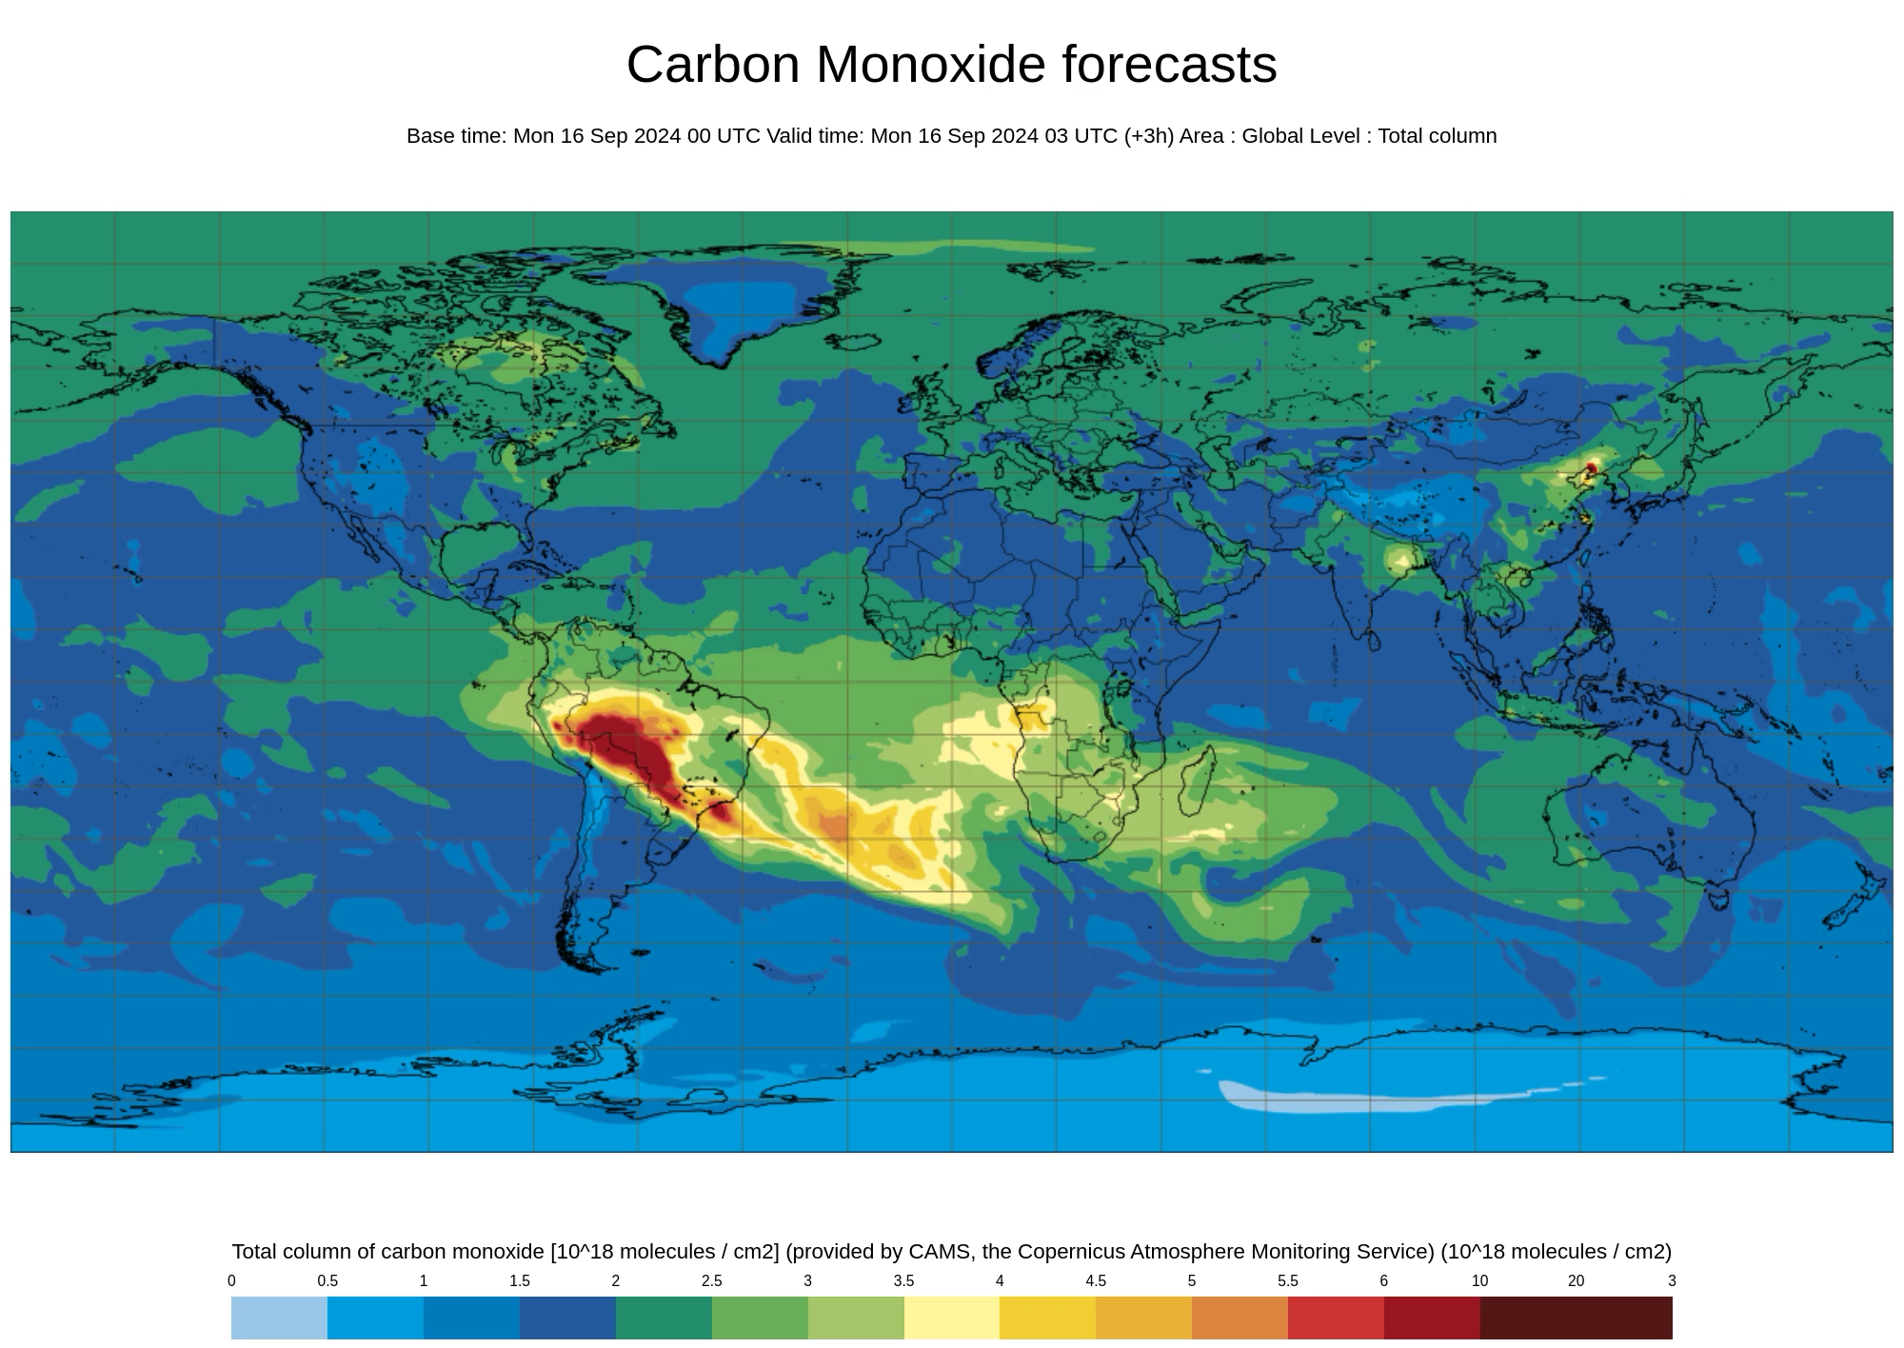
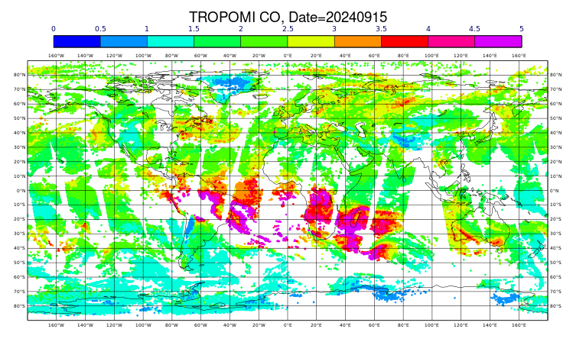
CAMS global forecasting system
Satellite observations (S-5p, MOPITT & IASI)
Medium-range forecast
Forecast
Analysis
Forecast
Analysis
Yesterday’s forecast is adjusted by today’s observations to produce the outlook for tomorrow. Every day.

Slide 4
Aerosol Data assimilation in the Global CAMS System
Assimilated observations of AOD at 550 nm
  MODIS &VIIRS over ocean and land
  PMAP over ocean only
  SLSTR from Sentinel 3A/B passively monitored
4D-VAR with prescribed background error statistics (NMC)
Variational Bias Correction for MODIS, VIIRS(SNPP) and PMAp; VIIRS (NOAA-20) is anchor
Control variable is formulated in terms of the total aerosol and fractional contribution of each aerosol type maintained in analysis

Slide 5
Challenges of AOD retrieval assimilation
No vertical information
Speciation
Biases (inter instrument)
Accuracy
Vertical background error profile (NMC)
Proportional increments
Variational bias correction (BC) and anchoring
QC flagging
Now:
Tuning vertical background errors
E-LIDAR assimilation
Dust-AOD assimilation
Coarse and fine mode
Testing new retrievals products
Harmonisation of optical properties
Work in
progress
Review of BC predictors and anchors

Slide 6
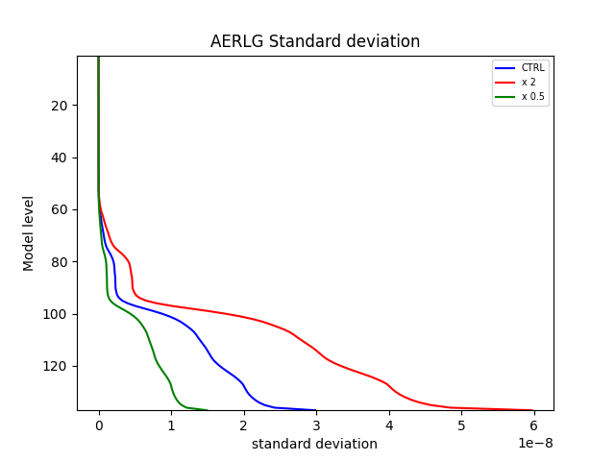
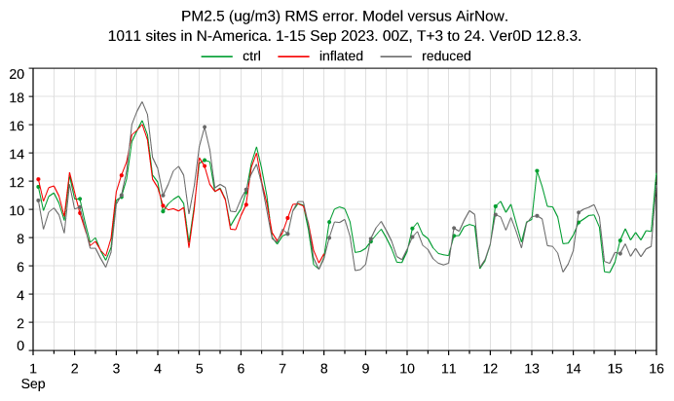
Vertical background error profiles
– impact on surface PM2.5
PM2.5 RMSE North-America
Note different colour coding

Slide 7
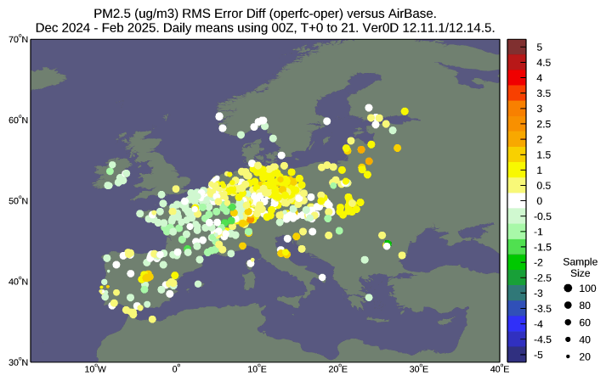
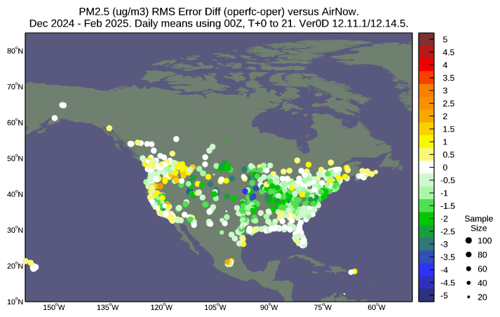
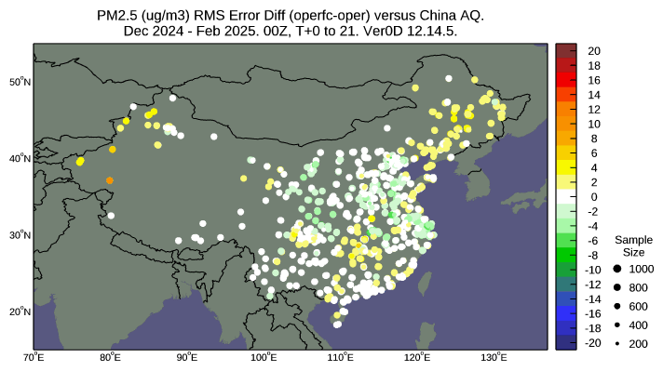
DJF 24/25 PM2.5 RMSE
CAMS vs CTR
AOD DA
Improved
AOD DA
worse
CAMS = AOD data assimilation
CTR = Control forecast no AC DA
Different colour range

Slide 8
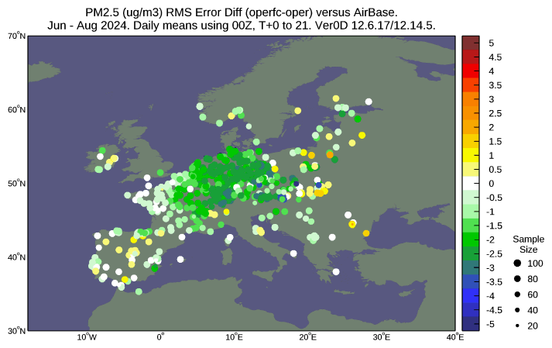
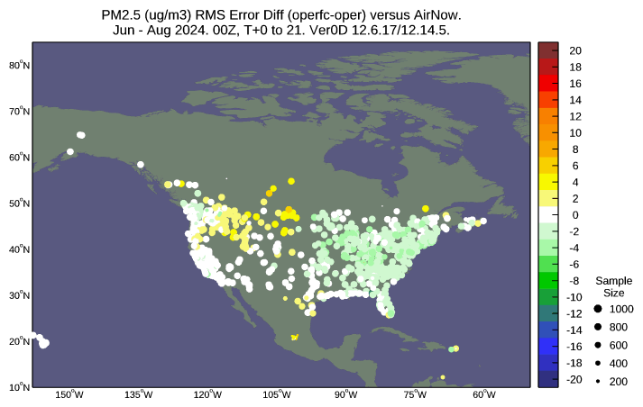
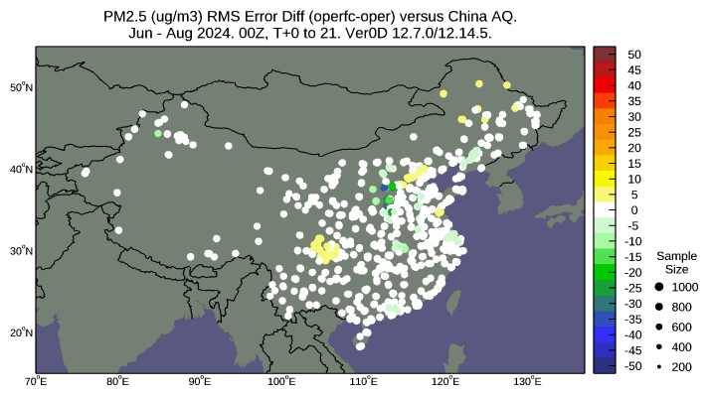
JJA 24 PM2.5 RMSE
CAMS vs CTR
AOD DA
Improved
AOD DA
worse
CAMS = AOD data assimilation
CTR = Control forecast no AC DA
Different colour range

Slide 9
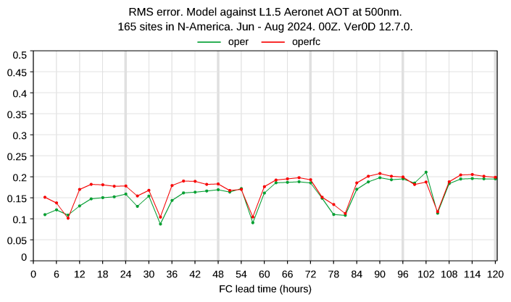
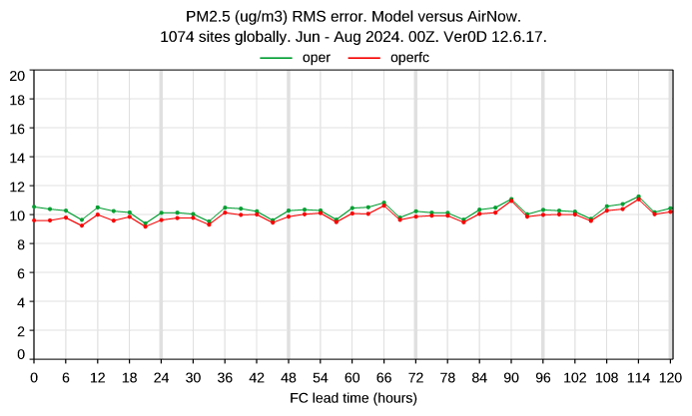
RMSE with lead time for AOD and PM2.5
CAMS o-suite AOD DA
Control – no AOD/AC DA

Slide 10
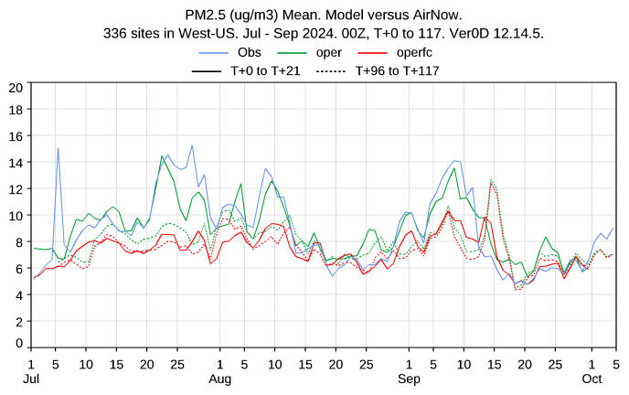
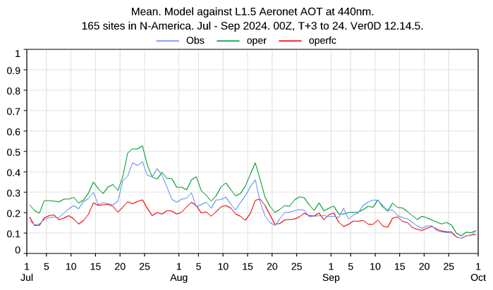
AOD vs. PM2.5 biases – N-America JJA 2024
AOD bias
AERONET
PM2.5 bias
Airnow Western US
CAMS o-suite AOD DA
Control – no AOD/AC DA

Slide 11
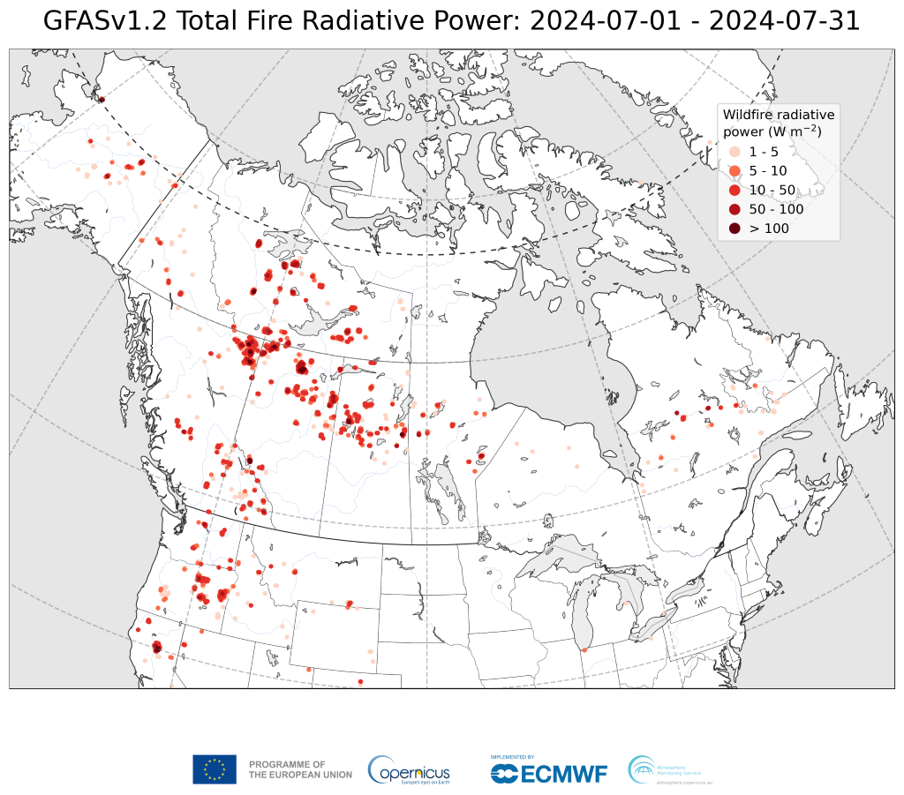
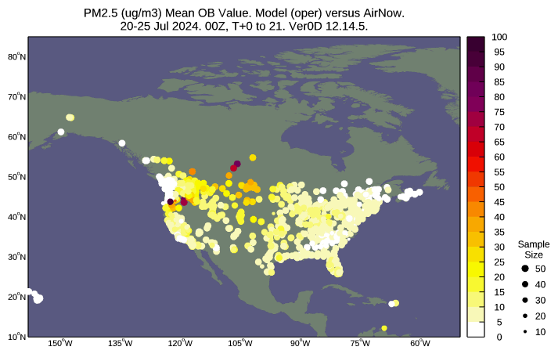
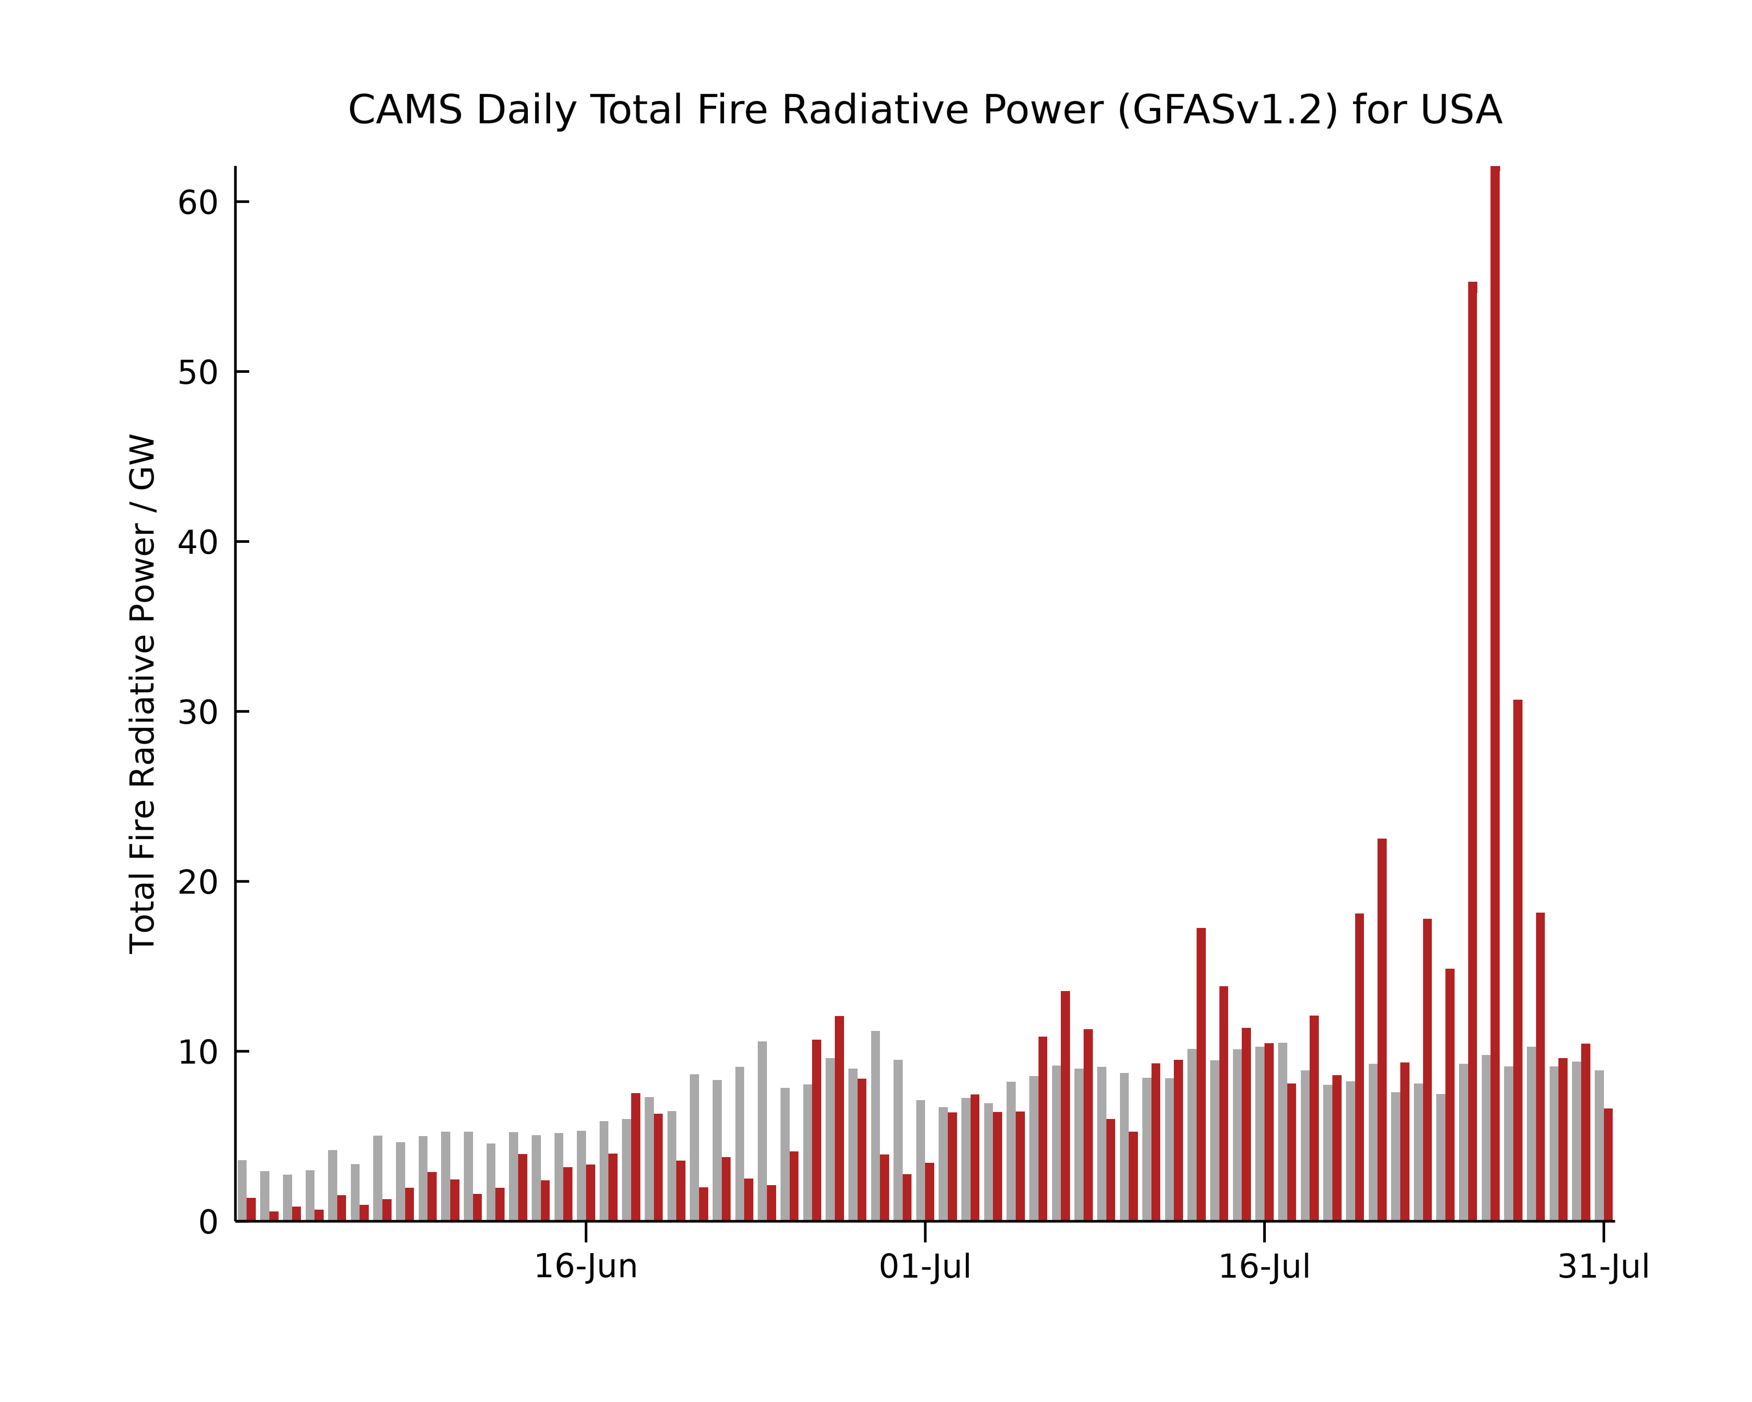

Case study: Late July in the boreal regions of North America
Time period: 20-25 July 2024
Domain: Northwestern US and Southwestern Canada
Wildfires were observed in Saskatchewan, Cananda and scattered fires were observed in Washington/Oregon, US (indicated in red below)
Cathy Li

Slide 12
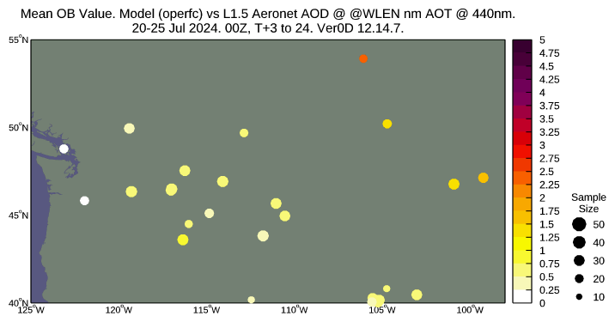
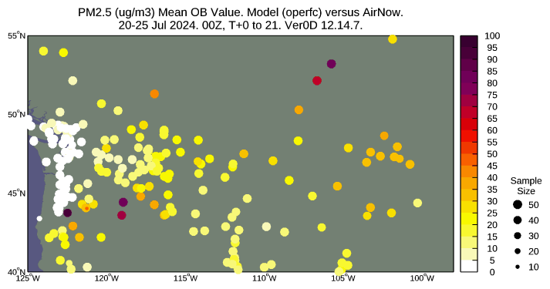
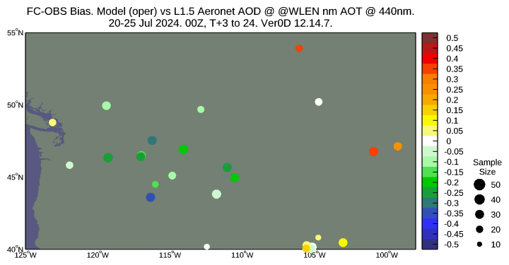
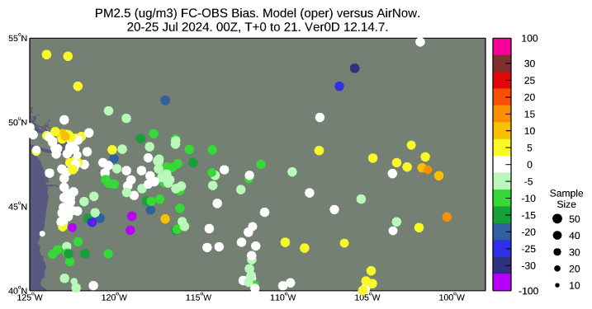
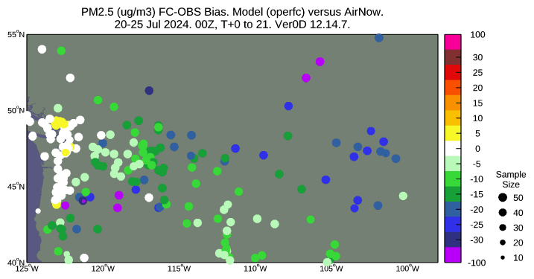
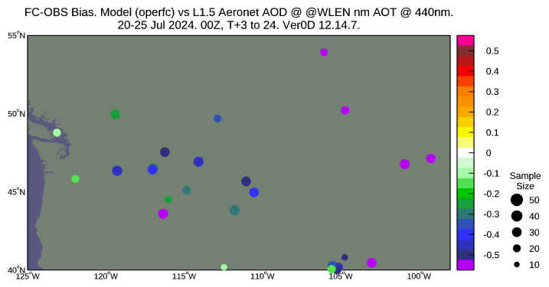
Observation and forecasts for the focus domain
20-25.7.2024
Observations
Bias (oper)
Bias (operfc)
Cathy Li
AOD – AERONET
PM2.5 – Airnow

Slide 13
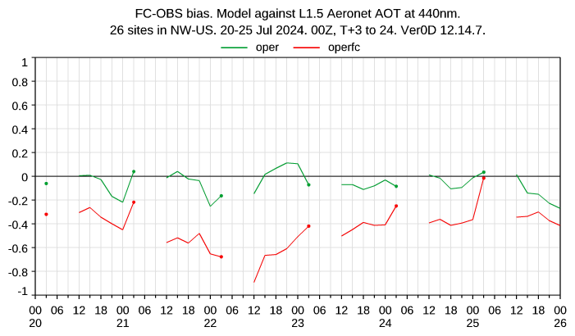
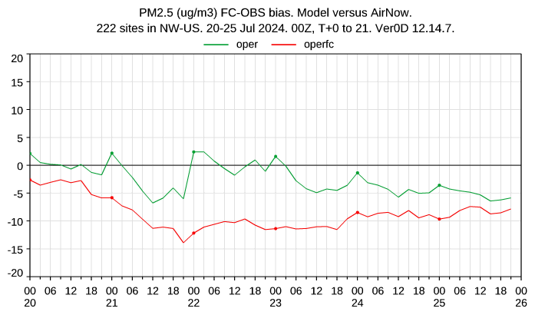
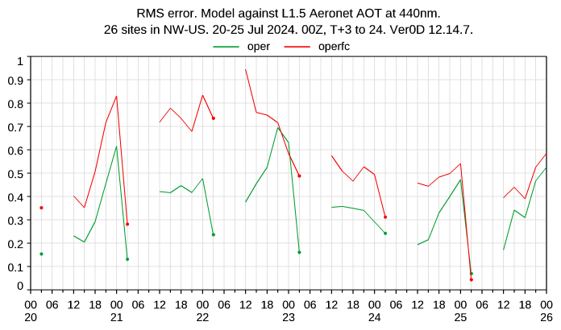
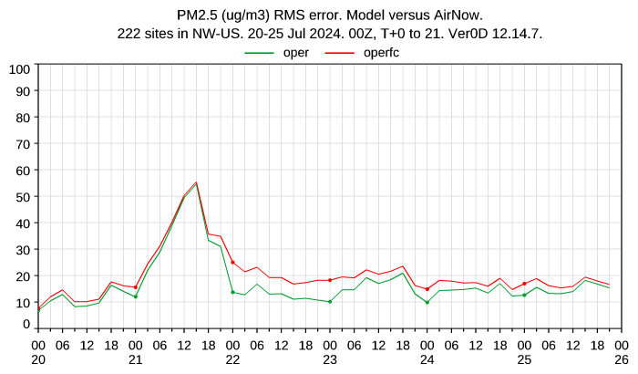
Averaged errors against observation in the focus domain
CAMS o-suite AOD DA
Control – no AOD/AC DA
Cathy Li

Slide 14
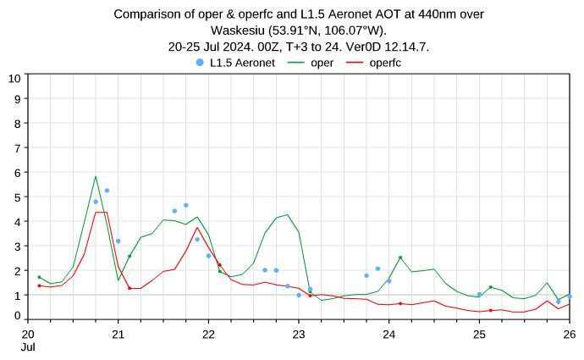
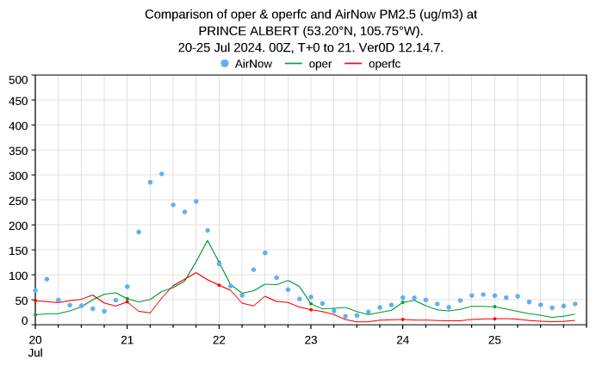
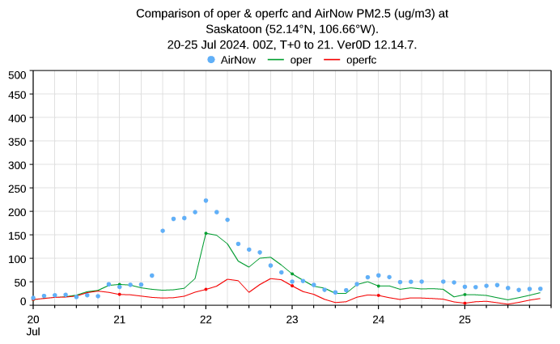
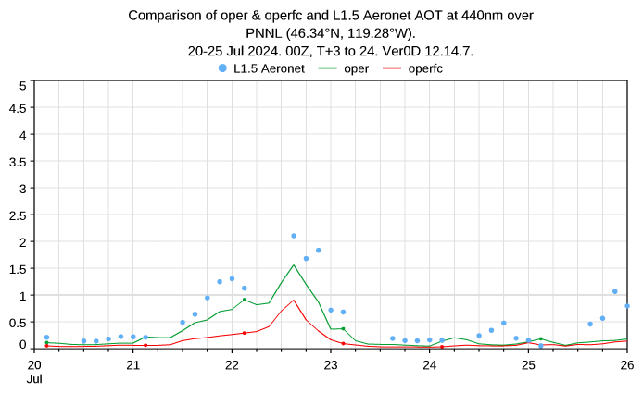
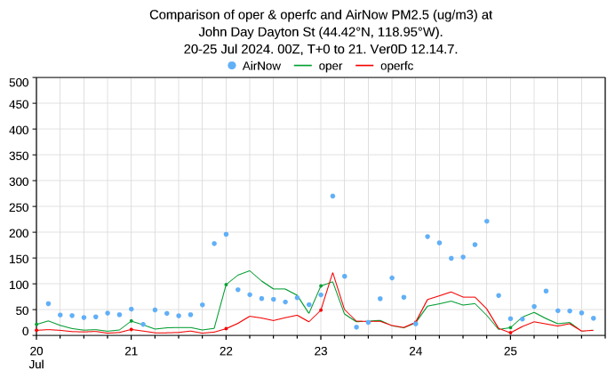
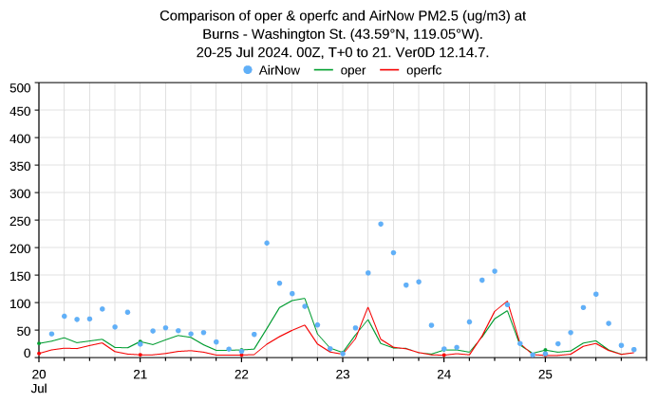

Stations time series
CAMS o-suite AOD DA
Control – no AOD/AC DA
AOD-AERONET
PM2.5 - AirNow
Cathy Li

Slide 15
Summary
The global CAMS system (ECMWF IFS) assimilates AOD retrievals (MODIS, VIIRS, PMAP, S3) to improve:
  CAMS operational atmospheric composition forecasts
  CAMS reanalysis (current EAC4, future EAC5)
Lack of information on vertical aerosol profiles and aerosol speciation in AOD retrievals as well as inter-instrument biases are challenges for AOD data assimilation in CAMS
Evaluating the impact of AOD assimilation on the PM2.5 forecast performance over North-America, Europe and China shows overall mixed results.
A more in-depth study for the July 2024 wild-fire episode in North-America could demonstrate a noticeable improvement of the PM2.5 forecasts (and AOD itself) in the affected area.

