Slide 1
Aerosol Data Assimilation
Activities at JCSDA
Jerome Barré, Maryam Abdi-Oskouei, Sarah Lu, Shih-Wei Wei
Joint Center for Satellite Data Assimilation (JCSDA), Boulder CO

Slide 2
Acknowledgement
JCSDA core tem
Cheng Dang, Fabio Diniz, Clementine Gas, Francois Hebert, Stephen Herbener, Benjamin Johnson, Eric J. Lingerfelt, Patrick Nichols, Benjamin Ruston, Christian Sampson, Anna Shlyaeva, Yannick Trémolet, Thomas Auligné
JCSDA collaborators
Virginie Buchard, Christoph Keller, Ricardo Tolding (NASA/GMAO)
Cory Martin, Andrew Tangborn, Hyundeok Choi, Y. Wang (NOAA/NCEP)
Hongli Wang, Bo Huang, Mariusz Pagowski (NOAA/OAR)

Slide 3
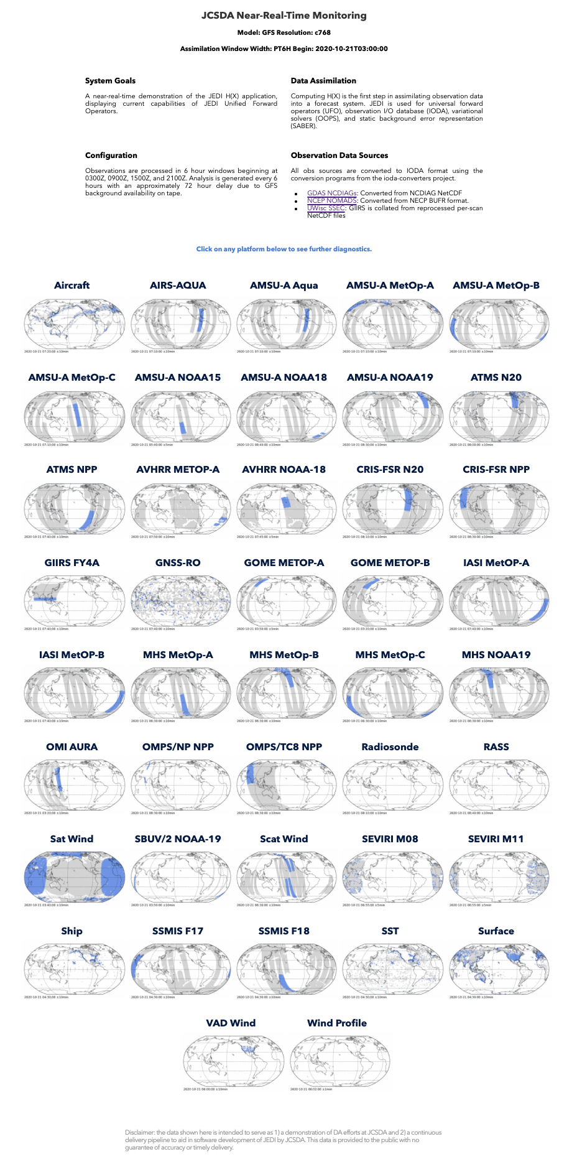











Joint Effort for Data Assimilation Integration (JEDI)
A unified data assimilation framework for Earth system prediction
JEDI-Skylab: JCSDA end-to-end data assimilation system
Ingest Use Evaluate
Observations
SKYLAB TESTBED
BUFR Tanks
Data Lake
CDAAC
Interface for
Observation
Data Access
(IODA)
Research Repository
for Data and Diagnostics
(R2D2)
Diagnostics
ODB
FTP
JEDI-Atmos
LDM
JEDI-Aerosols
Agile
JEDI-Trace gas
Experiment Workflow
and Orchestration Kit
(EWOK)
JEDI-Ocean
JEDI-Land
Config
+
Config
Code
3

Slide 4
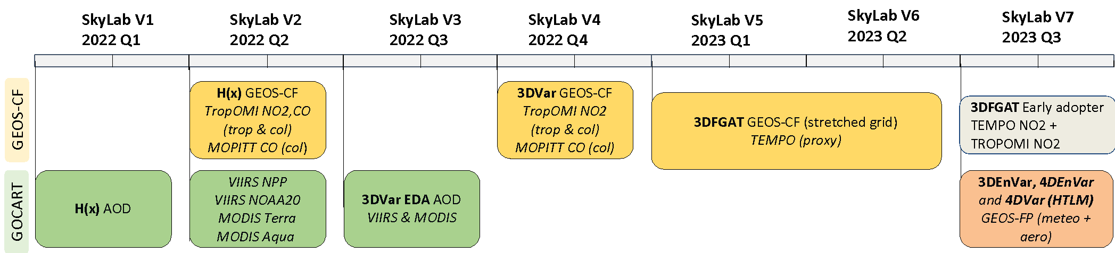
Current SkyLab capabilities
SkyLab v1 was released in June 2022, currently the team is working on v8
DA flavors:
3DVar
3DFGAT
3DEnVar
4DEnVar
4DVar/TL/AD
4DVar/HTLM
Models:
GFS (C96) - GOCART
GEOS-CF (C90, C360, Stretched Grid C540r25) – Trace gas
GEOS-FP (C90) – Meteorology + GOCART
Observations:
Tropomi NO₂, CO
MOPITT CO
VIIRS NPP and N20 AOD
MODIS AQUA and TERRA AOD
TEMPO NO₂
MLS O₃ limb profile
OMPS LP/TC O₃ limb profile/total column
Leveraging from NWP efforts and collaborations w/ NASA, UKMO, and NOAA

Slide 5
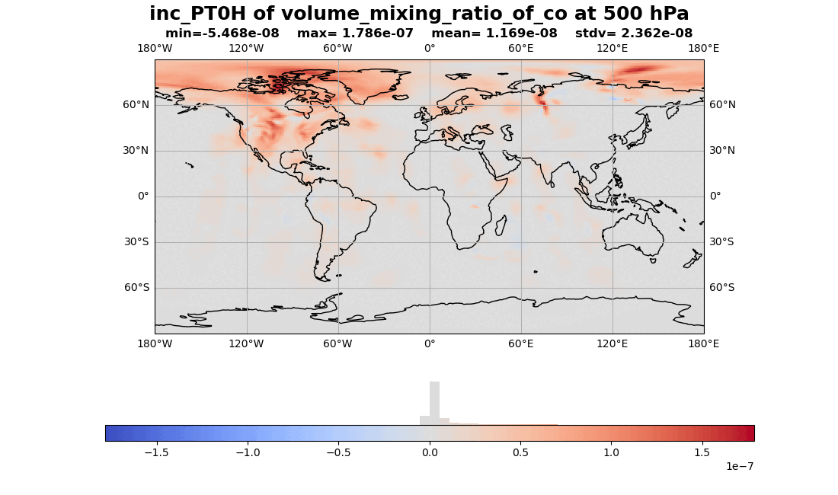
JEDI trace gas demonstration
4DEnVar with trace gas with:
  1h subwindow with c90 backgrounds
  TropOMI NO₂, CO, MOPITT CO
  Can produce 4D analysis: very important for TEMPO and emission data assimilation

Slide 6
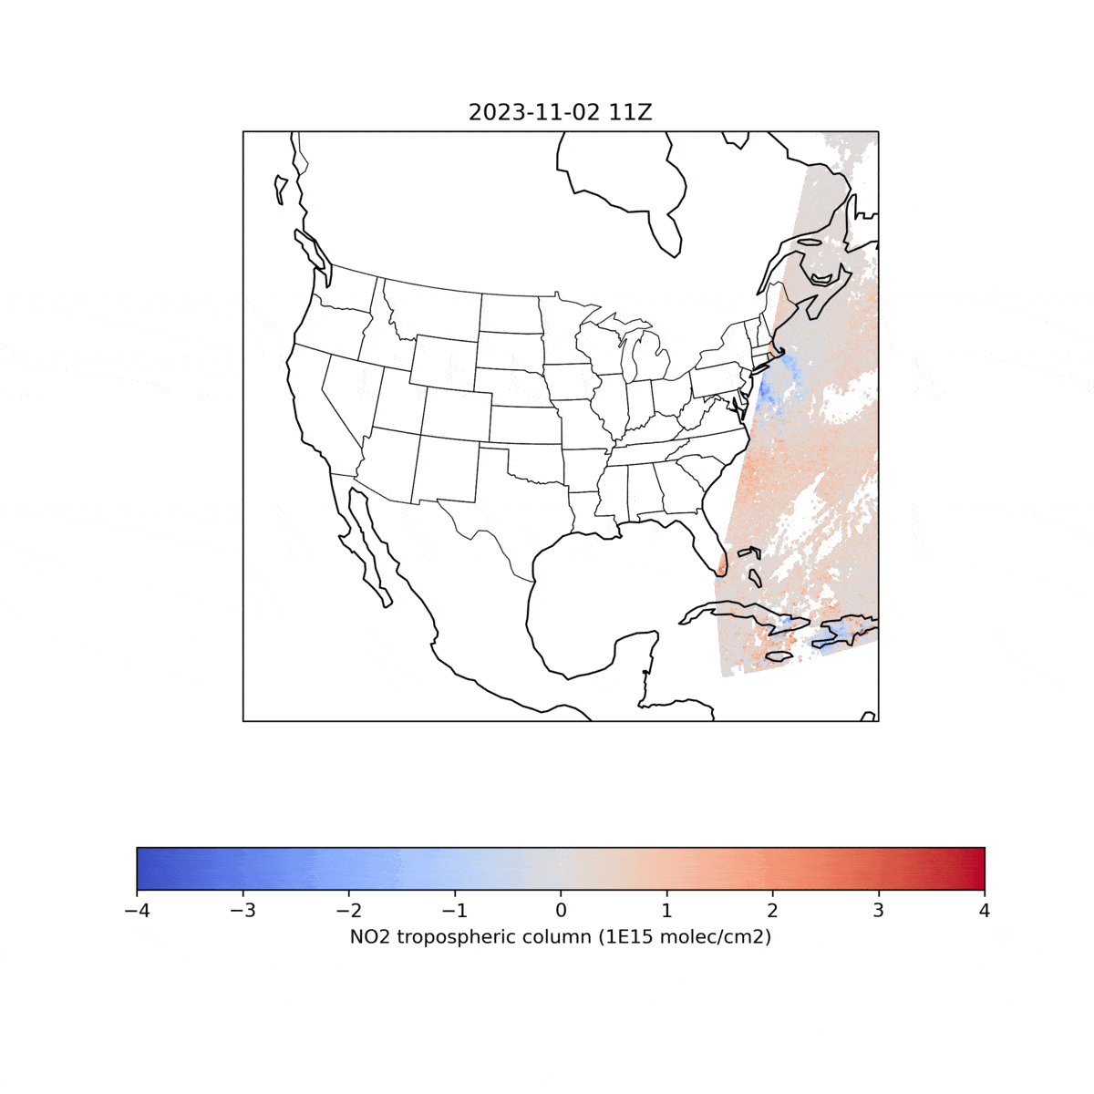
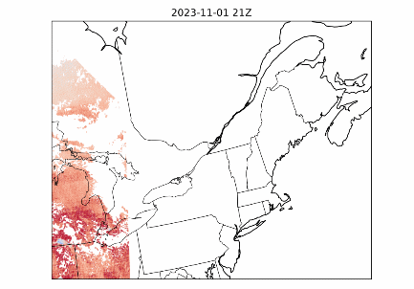
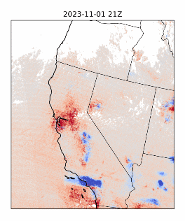
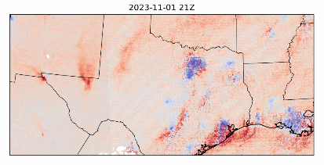
Adoption of new sensor: TEMPO demonstration
Run JEDI Skylab using GEOS_CF collections at C360 (~1/4 degree)
3DFGAT experiment in skylab
Compare with TROPOMI using the same observation operator.
North East
West
South
Obs - Background
ΔNO₂ tropospheric Column (1e15 molec/cm²)
NASA TEMPO (Tropospheric Emissions: Monitoring Pollution) mission, launched in 2023

Slide 7
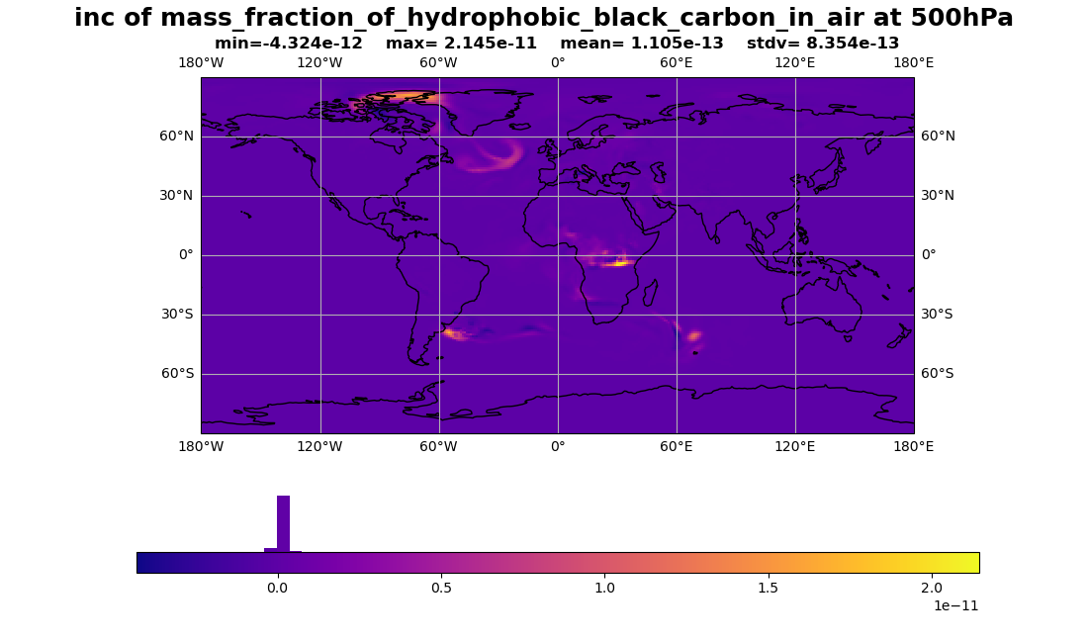
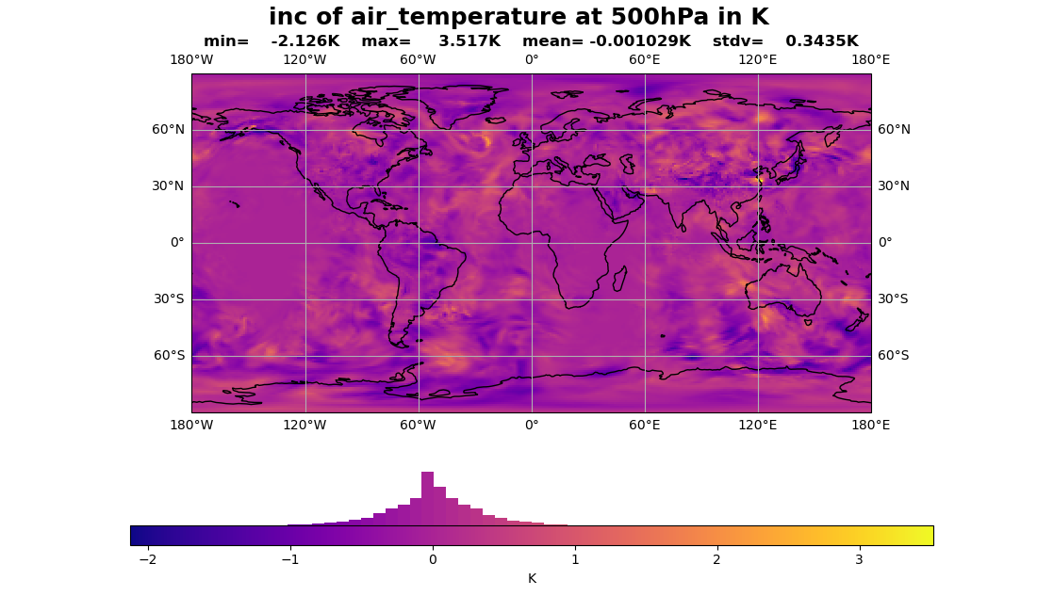
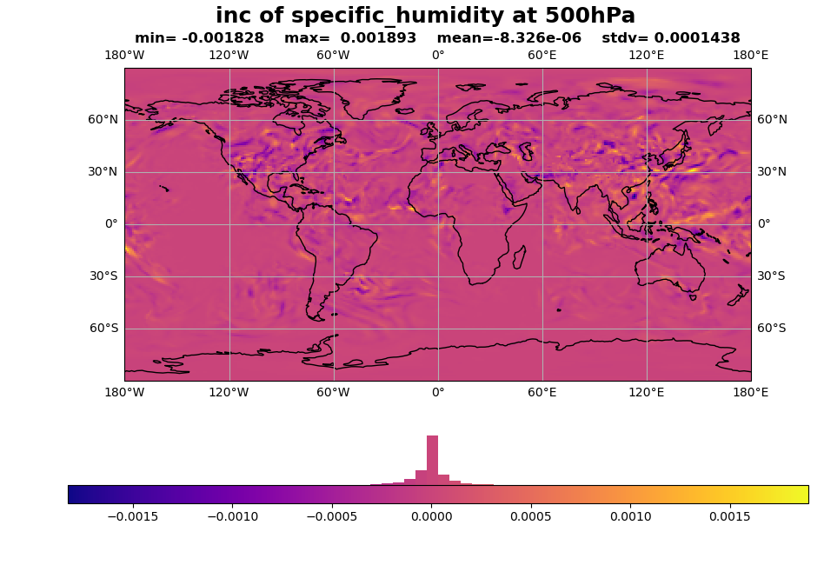
JEDI Aero+Weather data assimilation
4DEnVar with GEOS at C90 resolution with 32 members
Weather obs:
    radiosondes,
    windborne, satwinds_ssec_amv,
    AMSU_A (NOAA 15,18,19 and MetOP B,C),
    MHS (NOAA 19 and MetOP B, C)
    Aerosol obs:
    VIIRS (NPP and NOAA 20),
    MODIS (Aqua and Terra)
7

Slide 8
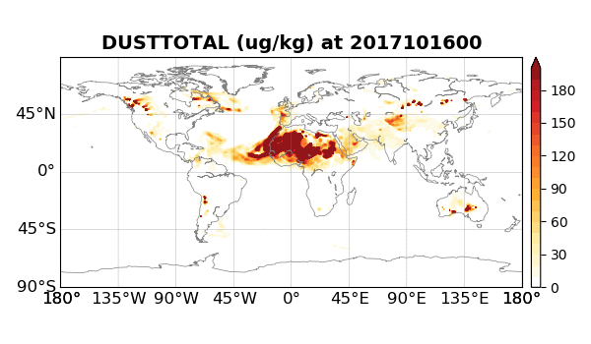
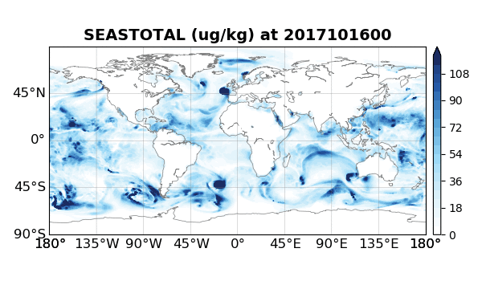
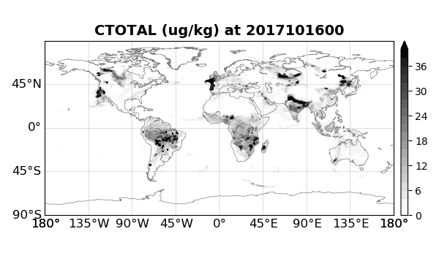
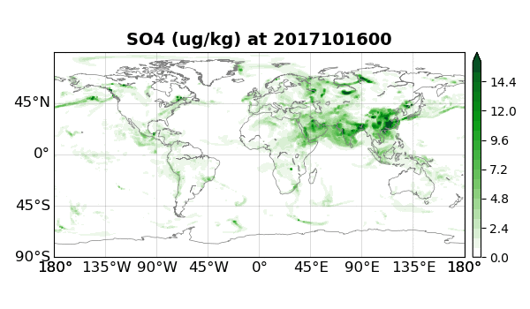
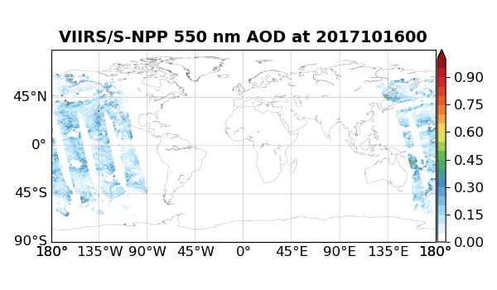
The NOAA global Aerosol ReAnalysis (NARA)
MODEL: NOAA’s global aerosol model based on NASA’s GOCART aerosol module (GEFS-Aerosols and UFS-Aerosols)
OBSERVATIONS: 2D Aerosol Optical Depth (AOD) retrievals at 550 nm that represents total extinction of solar radiation by aerosols over an atmospheric column
DA SYSTEM: Ensemble-Variational based on JEDI (Huang et al.,2023; Wei et al., 2024)
Total Dust w/ 5 size bins
Total Sea salt w/ 5 size bins
Total OC and BC w/ 2 size bins
Sulfate
Correct
Simulate
NOAA S-NPP VIIRS 550 nm AOD

Slide 9
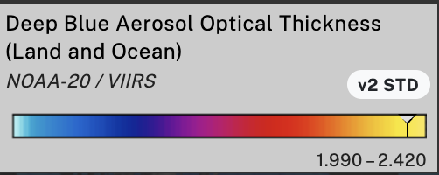
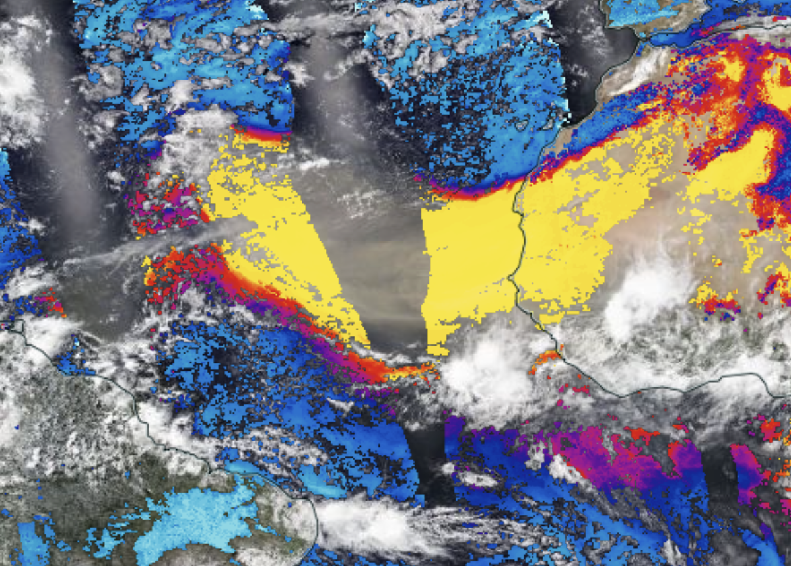

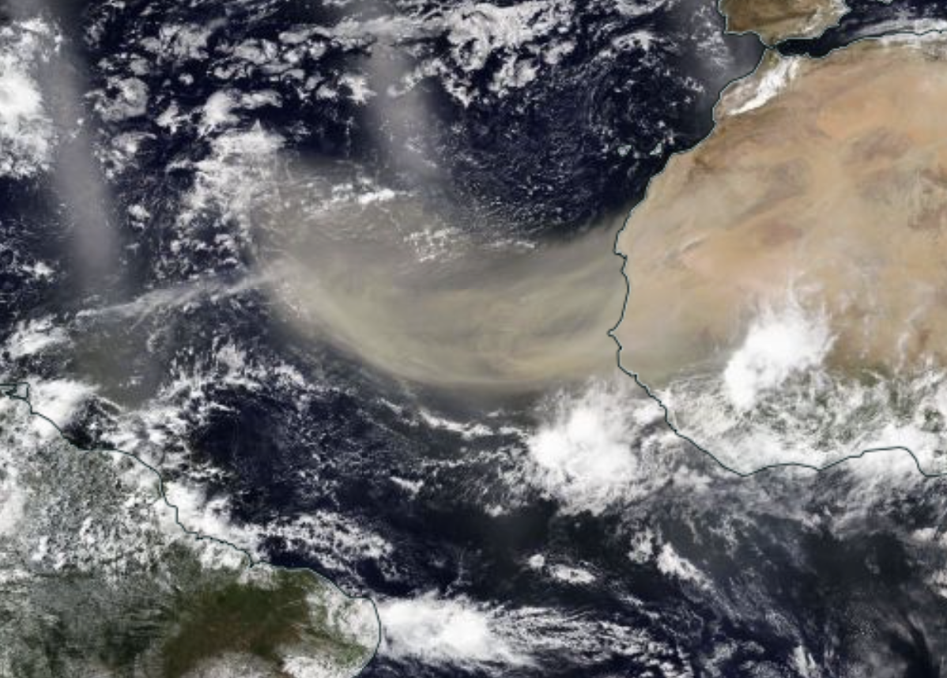
Ongoing aerosol DA activities
Aerosol optical depth (L2 retrieval): PACE AOD [NCAR MMM-JCSDA]
TOA reflectance (L1b) for aerosols: N20 VIIRS [JCSDA]
Lidar profiles (L1 attenuated backscatter): CALIOP [Howard U-UAlbany-JCSDA, CADRE]
@NASA WorldView

Slide 10
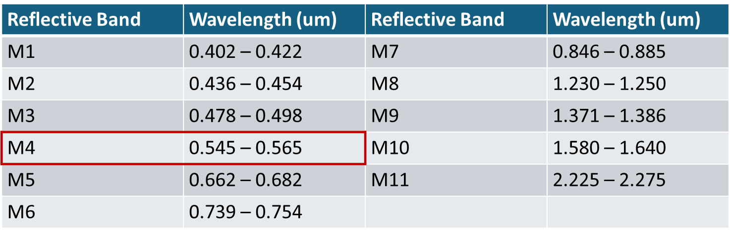
Visible Level 1b Aerosol DA
We attempt to assimilate the reflectance at the top of the atmosphere (TOA) from NOAA-20 VIIRS
VIIRS has 11 reflective channels in moderate band (~750 m).

Slide 11
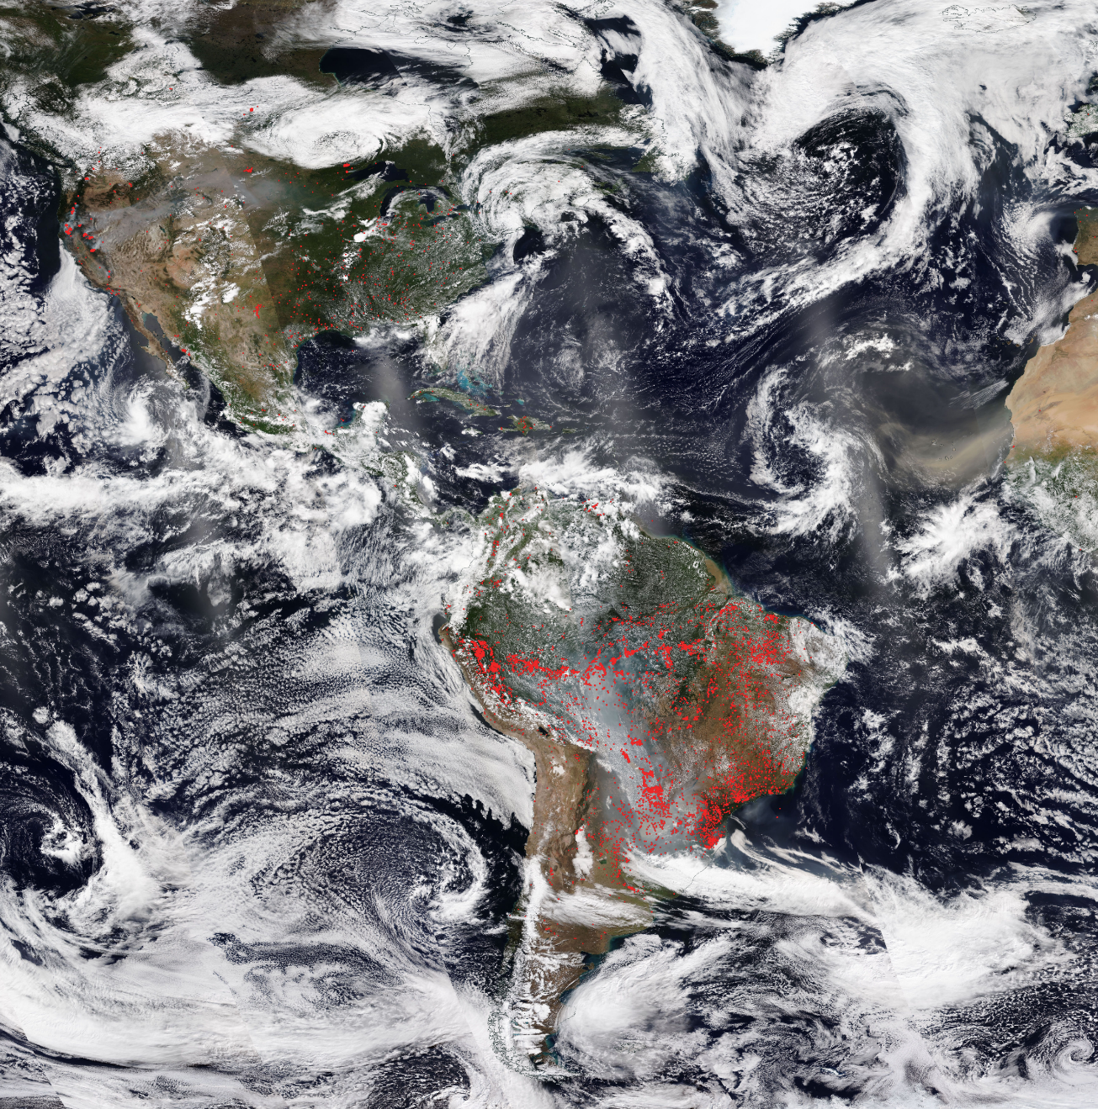
Visible Level 1b Aerosol DA
Case: 18Z (±3 hours) August 23, 2021
Background: C96 GEFS-Aerosols (~100 km)
Assimilated observation: TOA reflectance at Channel 4 (0.545 – 0.565 um) of VIIRS NOAA-20
Operator: Community Radiative Transfer Model (CRTM)
Quality control: none
Thinning: ~75 km
@NASA WorldView

Slide 12
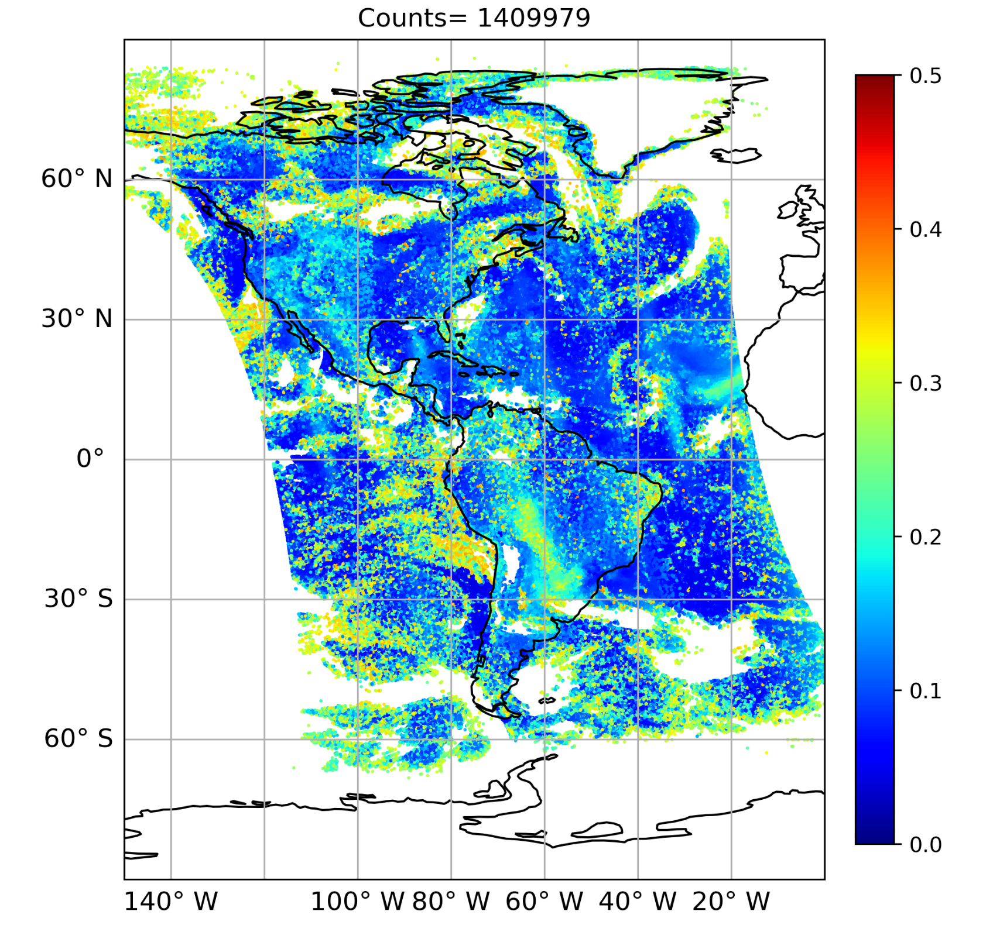
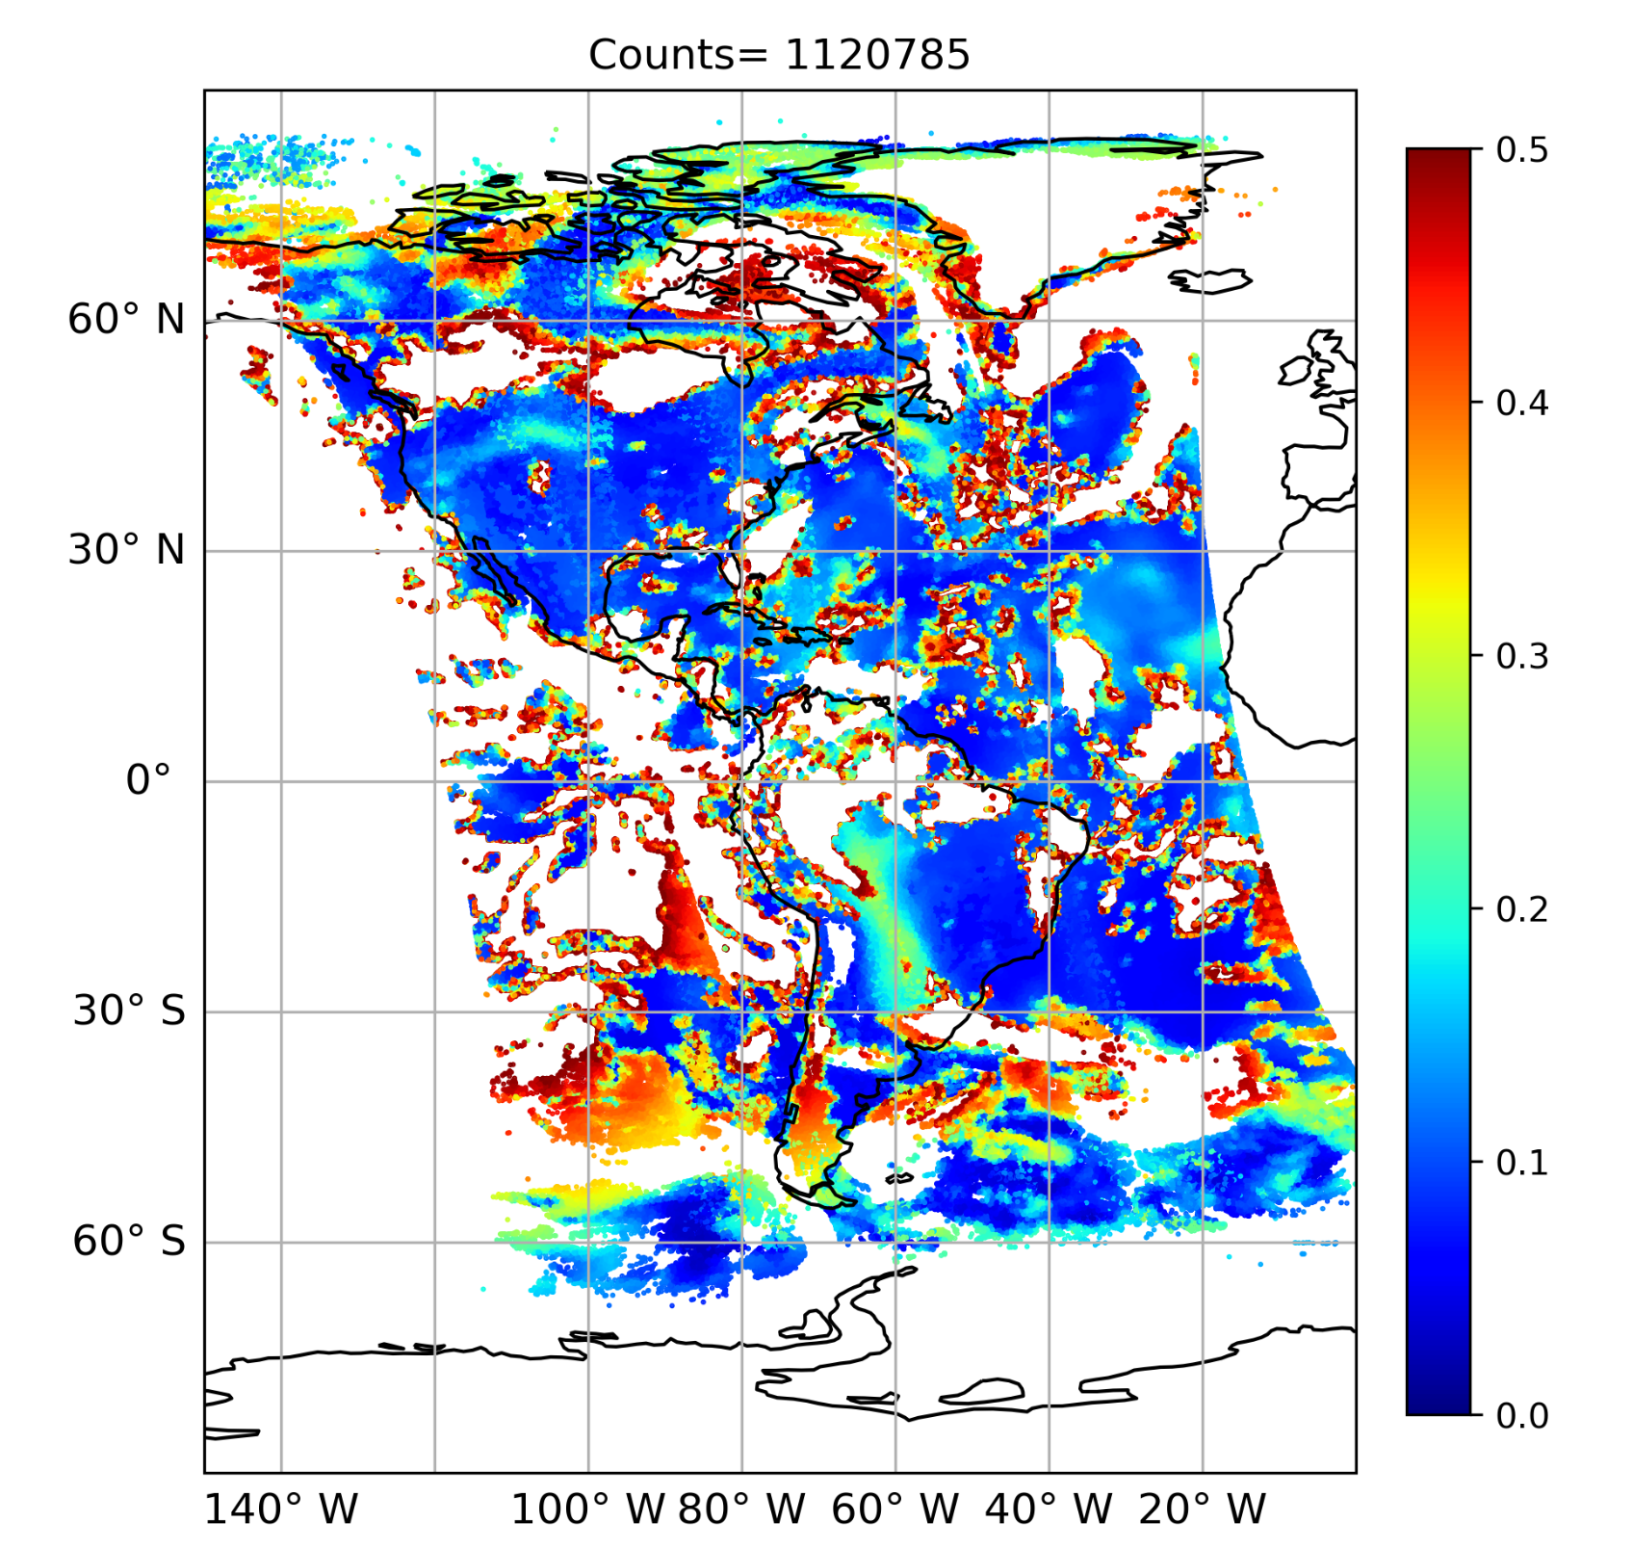

Aerosol L1 DA with VIIRS Channel 4 (~550 nm)
Obs
HofX
Pixels with ch.4 reflectance lower than 0.5 and passed DT-Ocean cloud checks are plotted.
Overestimation of clouds in the hofx.
Notes:
Masked out high reflectant pixels

Slide 13
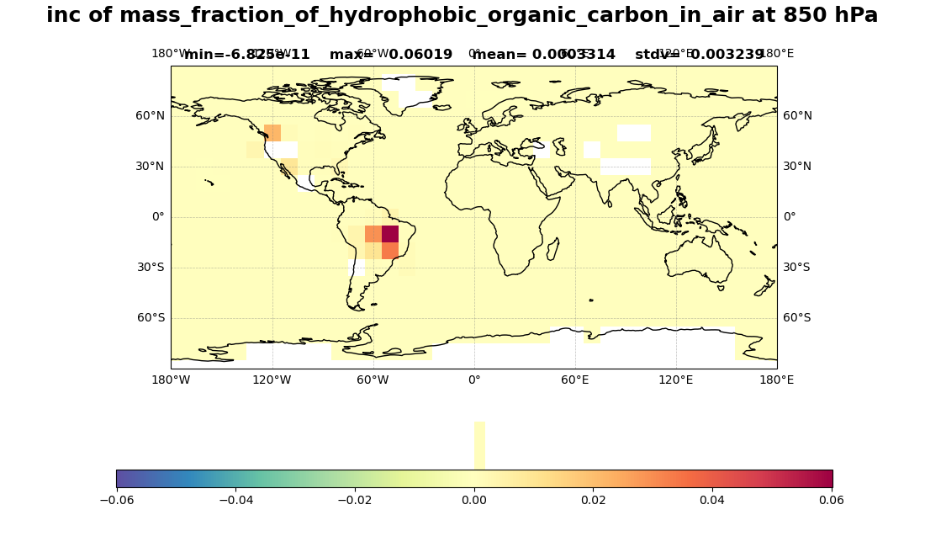
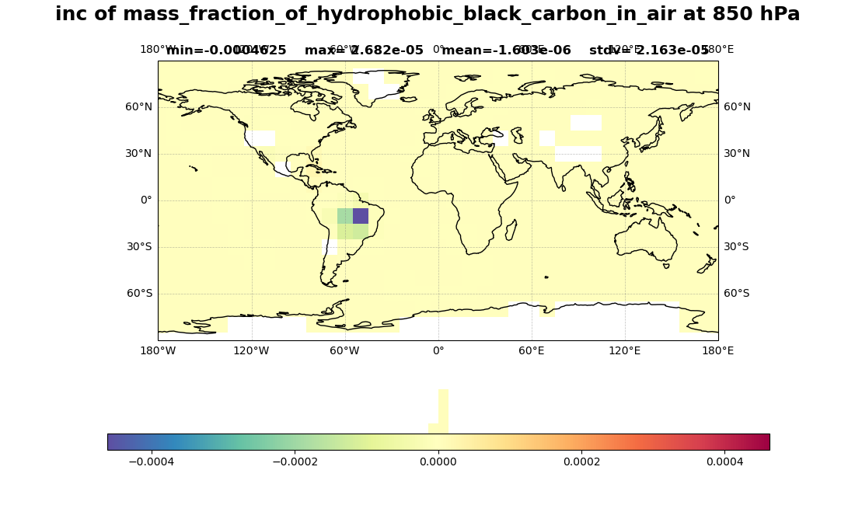
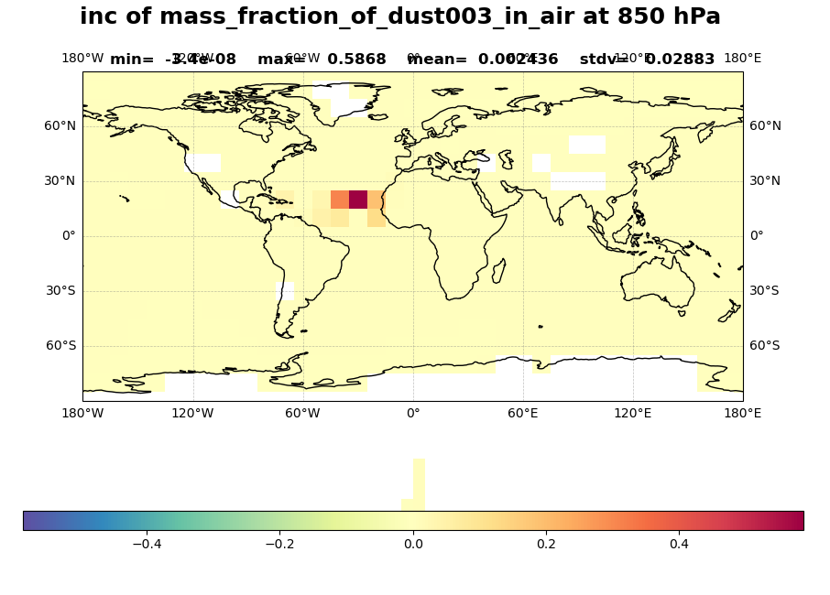
Analysis increments at 850 hPa
Analysis increments in the right place indicates that GEFS-Aerosols is able to capture major events.
The reduction of BC and increase of OC are attributed to the positive OMB (obs is brighter) over South America.
OCPHOBIC
BCPHOBIC
DUST3

Slide 14
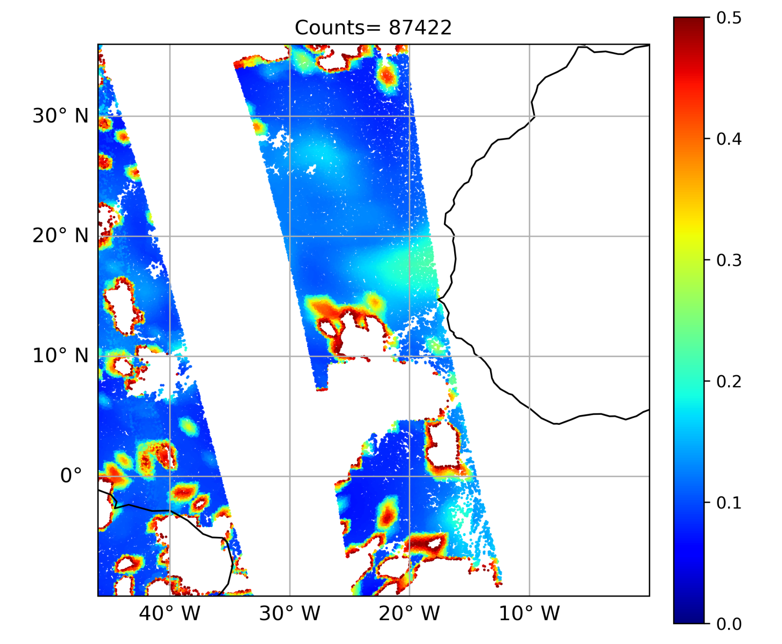
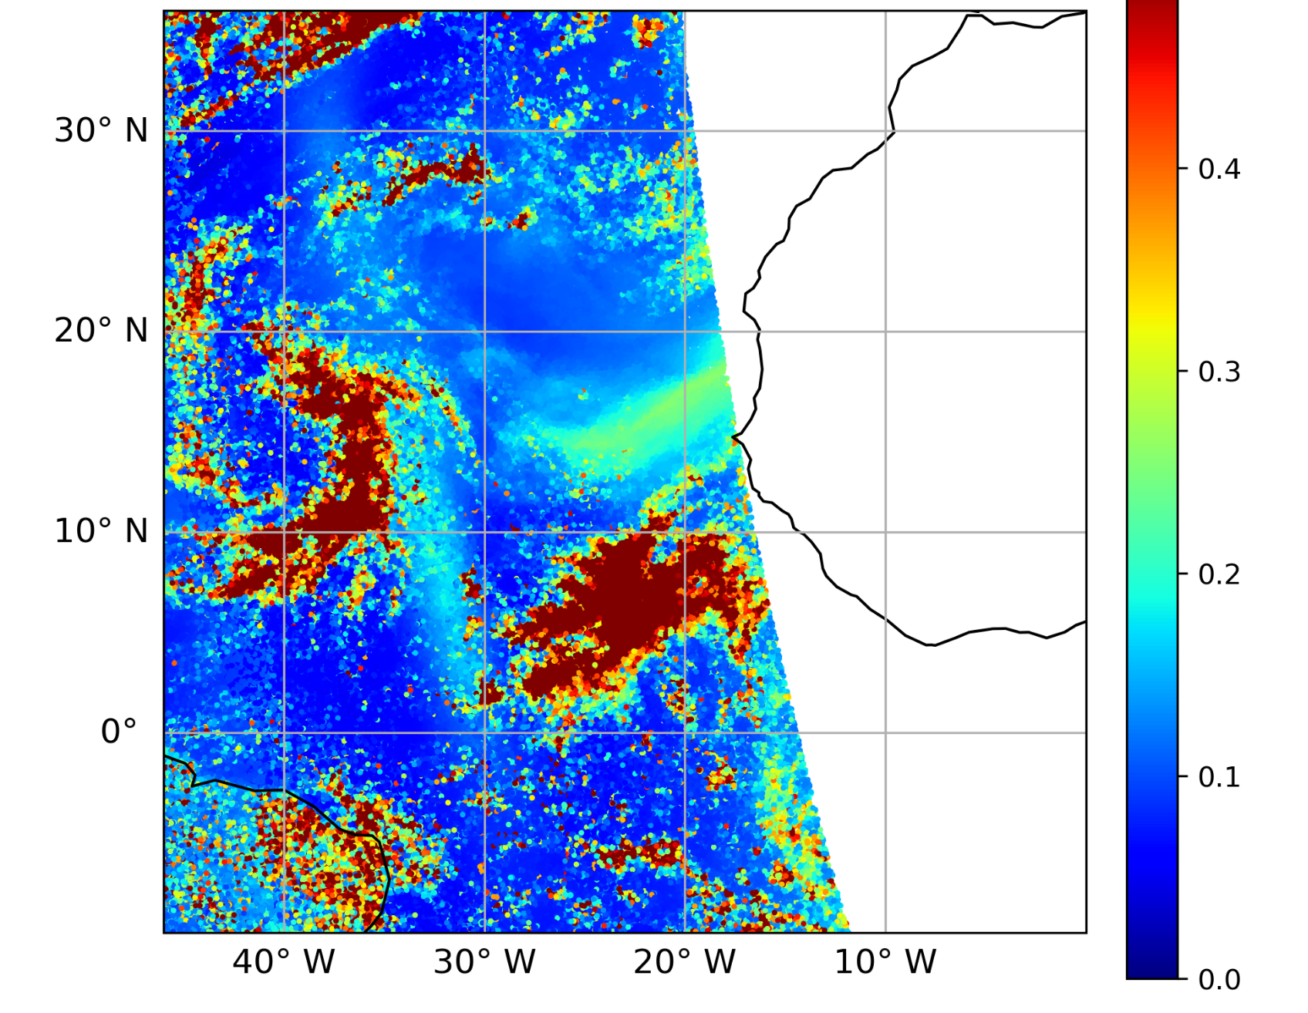
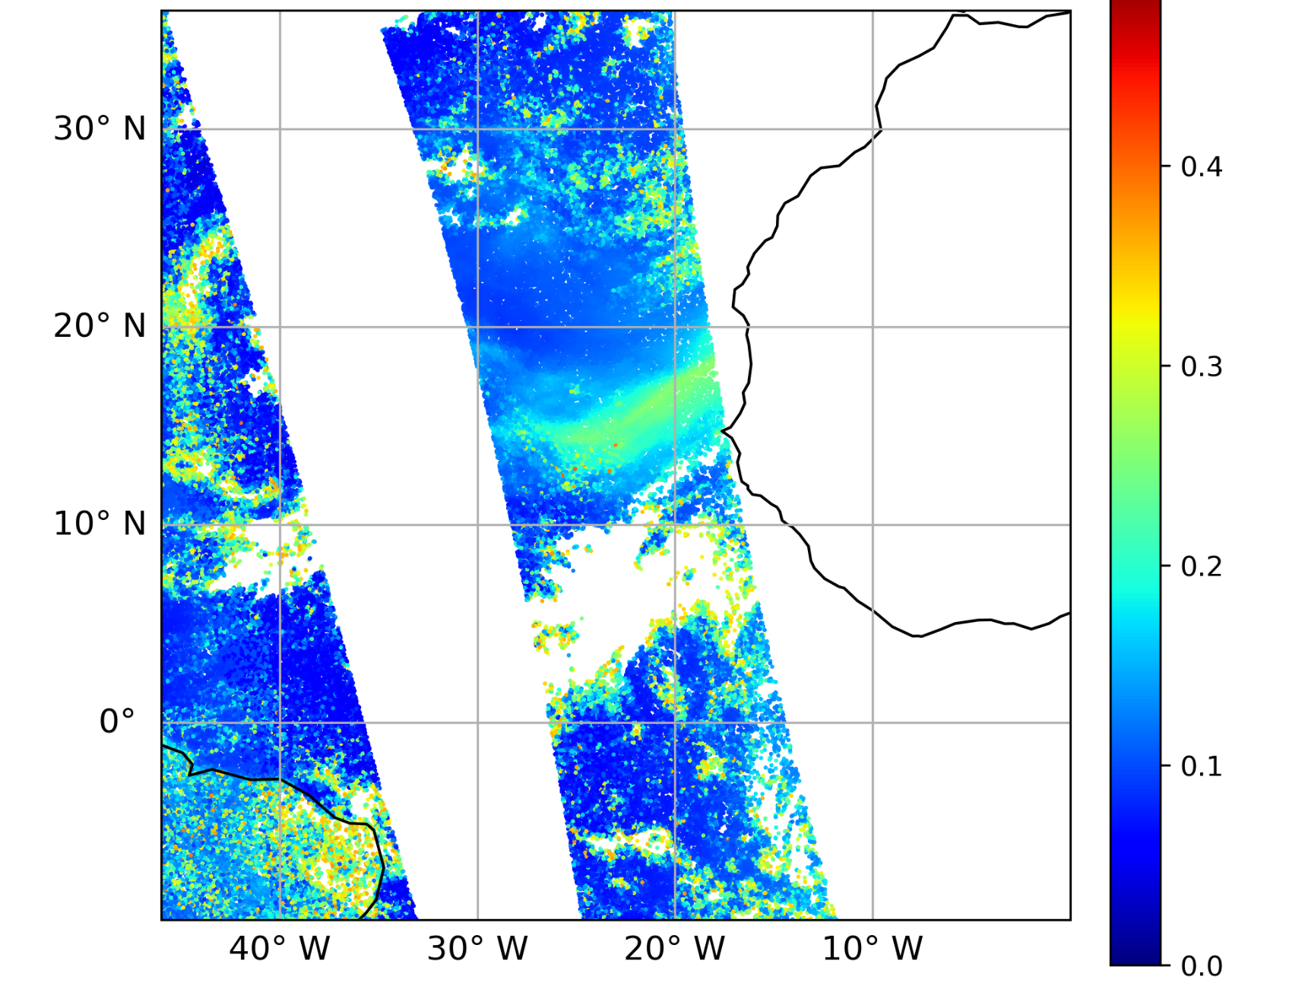
Aerosol L1 DA - Ongoing activities
Obs Filtering based on Dark Target retrieval algorithm.
  Remove thick cloud: M3 > 0.4 | Cirrus cloud: M9 > 0.03, 0.005 ≤ M9 ≤ 0.3 and M9/M8>0.3
  Remove sunglint affected pixels: glint angle ≤ 40 deg | Remove solar zenith angle larger than 84
Ch. 4
Original Obs
Filtered Obs
HofX
Notes:
It is still on python level.
The white area in hofx but not in filtered obs (e.g., south america) are pixels with hofx reflectance higher than 0.5.

Slide 15
Concluding Remarks
JCSDA is continuously working on expanding the JEDI code capabilities.
The atmospheric composition team is focusing the aerosol, trace gas and GHG DA capabilities
For aerosol DA development, the team is introducing new AOD observations (e.g., PACE) and developing the capability to assimilate L1b TOA reflectance and attenudated backscatter profiles

