Slide 1



Aerosol Modeling and DA at NOAA/NWS
Cory R Martin, PhD
Physical Scientist, NWS/NCEP/Environmental Modeling Center
National Weather Service

Slide 2
Current and Planned Operational Systems
GCAFS: Global Chemistry and Aerosol Forecast System
  5 day forecasts of aerosols twice daily
  introducing aerosol optical depth data assimilation
    VIIRS AOD retrievals in version 1
    plan to include geostationary and possibly in situ in v2
  V1 planned to go operational in first half of 2026
AQM: Air Quality Model
  72 hour forecasts of ozone and PM2.5 twice daily
  work underway for assimilation of trace gas and AOD retrievals and in situ observations

Slide 3
GCAFSv1 Aerosol DA Configuration
Cycle Frequency | 6-hourly; 00z and 12z forecasts are 120 hours, 06 and 18 are only 9 hours
Algorithm | 3DVar FGAT with 3-hourly backgrounds
Resolution | C384 (~25km) analysis and forecast; L127
Observations | VIIRS EPS 550nm AOD from NPP, NOAA-20, NOAA-21 Thinned to ~analysis resolution, VarBC with NOAA-20 as anchor
Background Error | Covariance: Hybrid blend of a climatology from lagged ensembles + background dependent localized variance (using neighboring gridpoints) and scaled spatially and by species Implicit diffusion operator for correlation length scales
Target implementation in early 2026

Slide 4
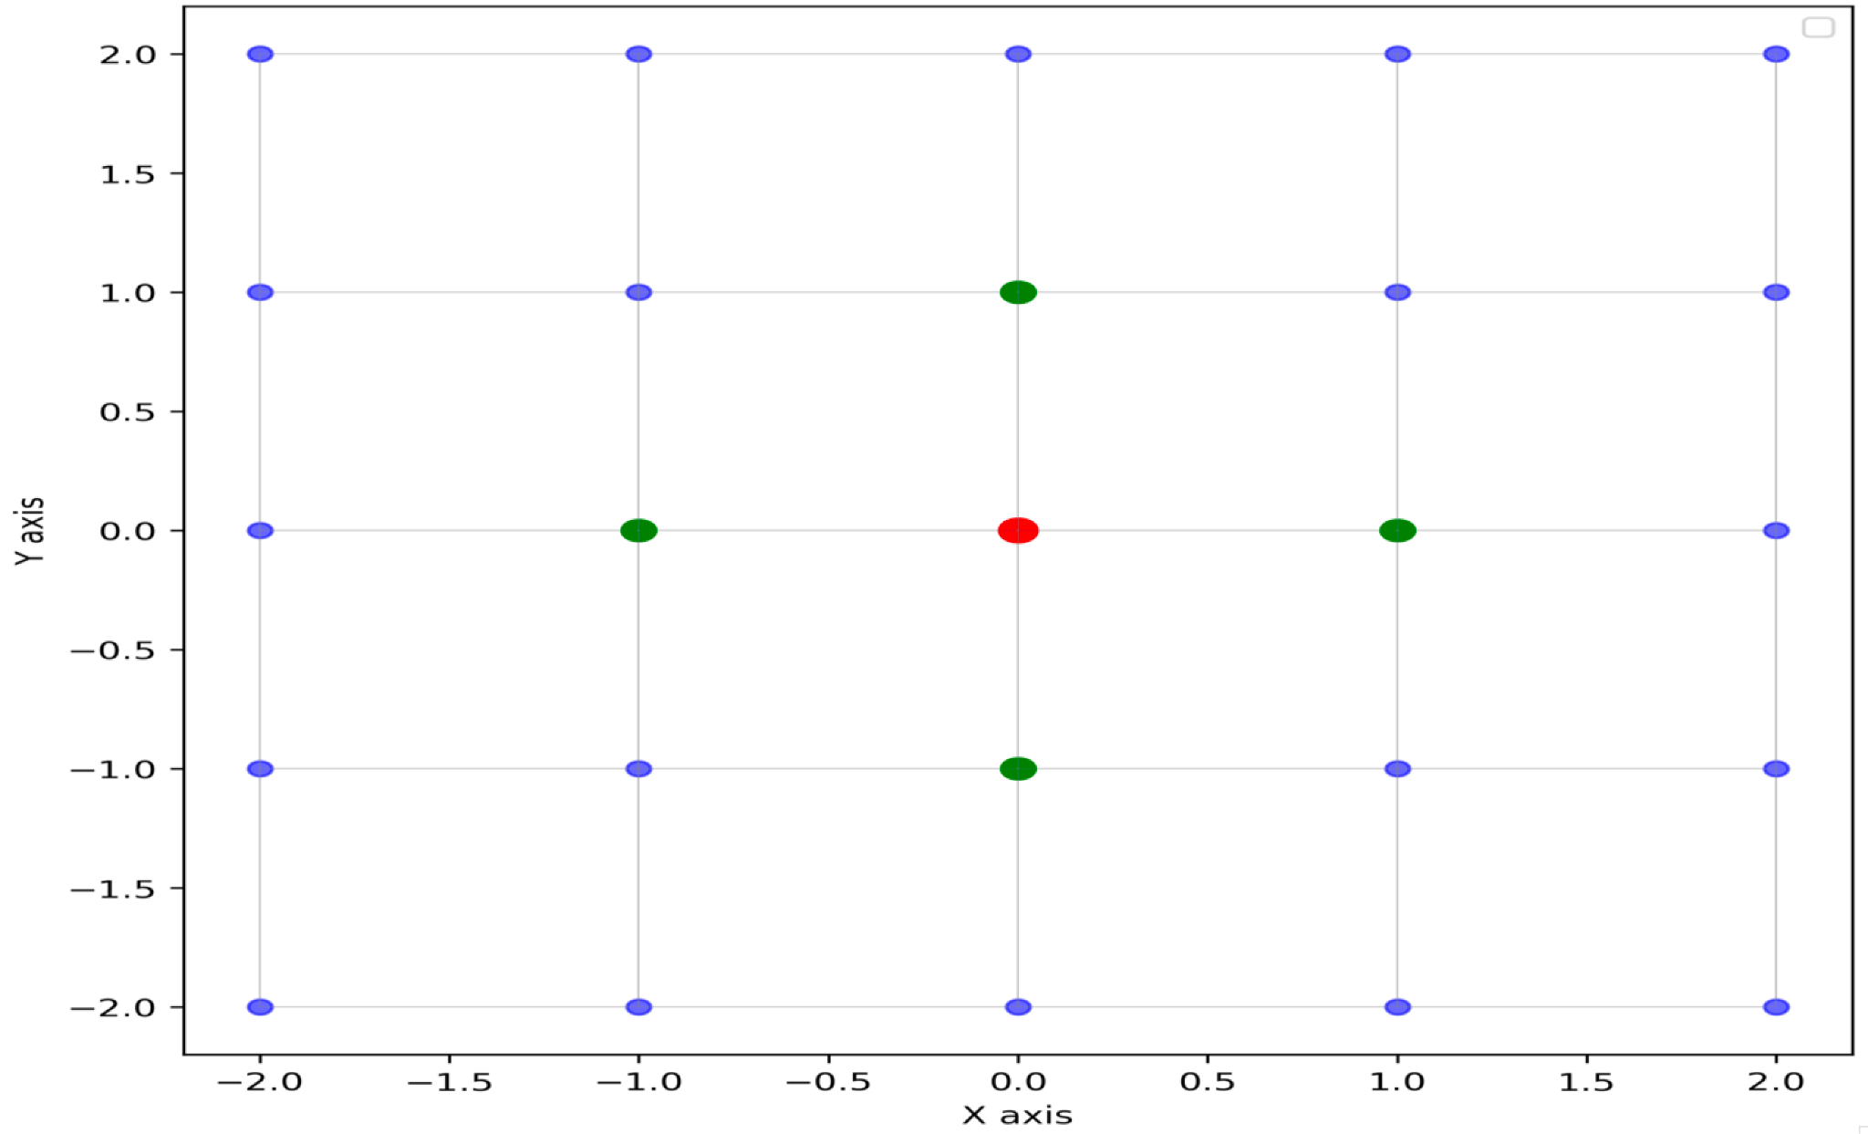
GCAFS - Background Error Tuning
For 3DVar, the background error covariance (B) matrix is essential to the quality of the analysis, thus a lot of time is spent on developing and tuning the B matrix.
As we cannot run an ensemble of forecasts to provide the flow dependent component due to computational cost, we use a “variance partitioning” method to estimate this:
Neighboring gridpoints are used to compute the variance around each gridpoint as a proxy for uncertainty at that gridpoint

Slide 5
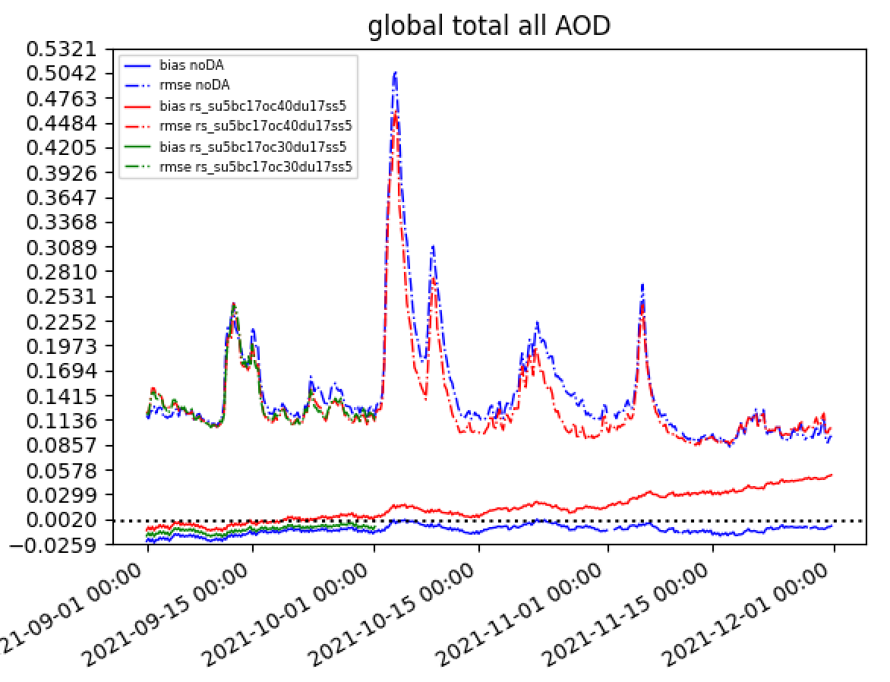
GCAFS - Background Error Tuning
Positive impact on RMSE until about 11/10.
Can rescale each of the 15 GOCART species in the B
Rescaling/tuning experiments are underway to balance impact from assimilation without causing instability to form
  Believe it is OC over oceans causing this
Instability appears first in bias
Fig. courtesy Andy Tangborn

Slide 6
GCAFS - Observation Usage
Aerosol optical depth (AOD) from NPP, NOAA-20 and NOAA-21 are assimilated.
Quality control:
Preprocessing: Thinning to approximately the analysis resolution
Quality flagging: Use high and medium-quality observations.
Range checking: Ensure values are within [0, 5].
Spatial filtering: Limit to 60°S–60°N latitude range.
Outlier handling: Inflate observation errors for obs with large departures from the background.

Slide 7
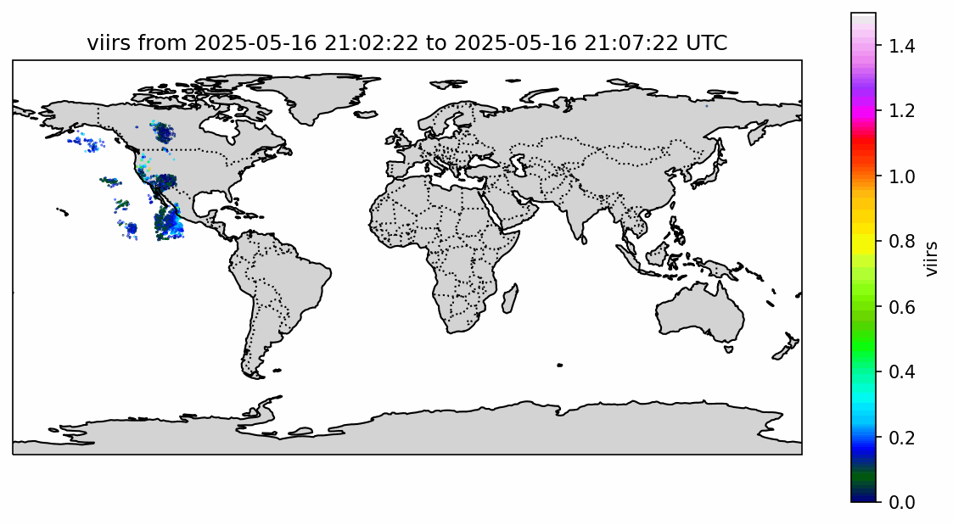
GCAFS - VIIRS AOD Example
GCAFS cycling is 7 hours past valid time for 2 reasons:
Leverage late cycle (GDAS) for meteorology
Allow for polar orbitors latency of ~1.5+ hours
Fig. courtesy Mindo Choi

Slide 8
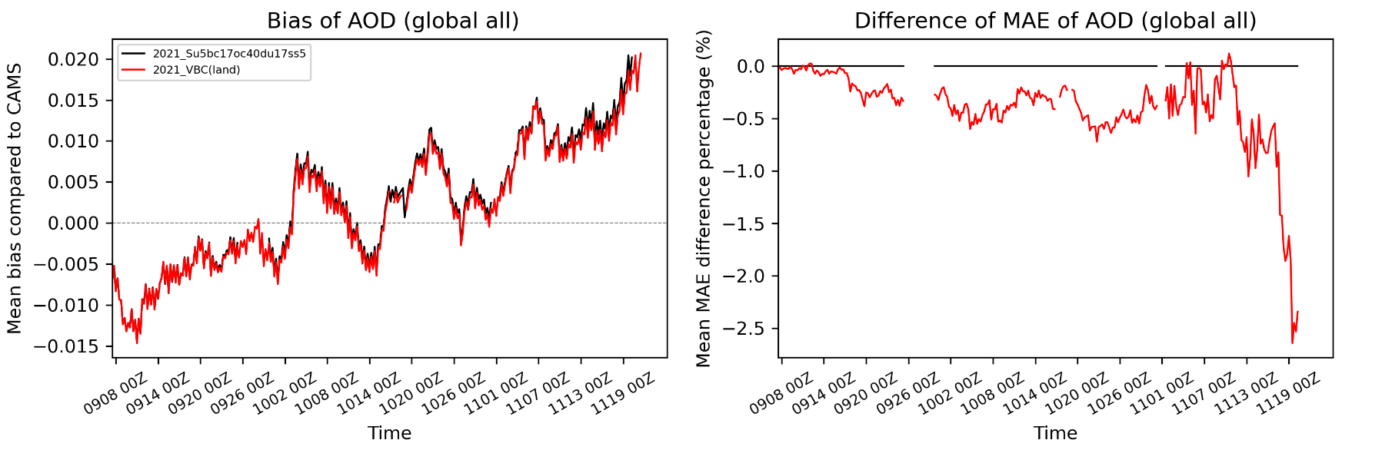
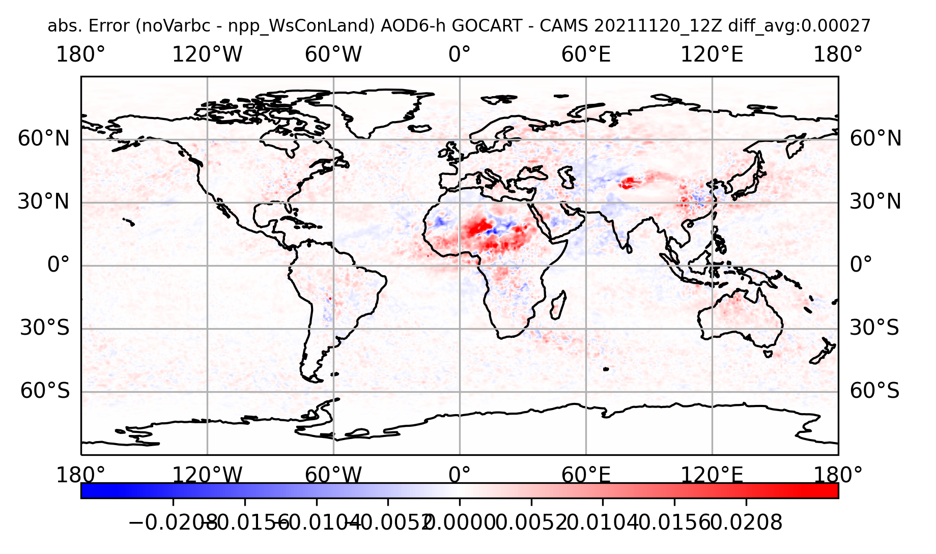
GCAFS - Variational Bias Correction
Work is still ongoing (but positive) in determining VarBC configuration (which predictors, etc.)
Constant, Wind Speed, Species…
(w/wo land sea mask)
Figs. courtesy Yaping Wang

Slide 9
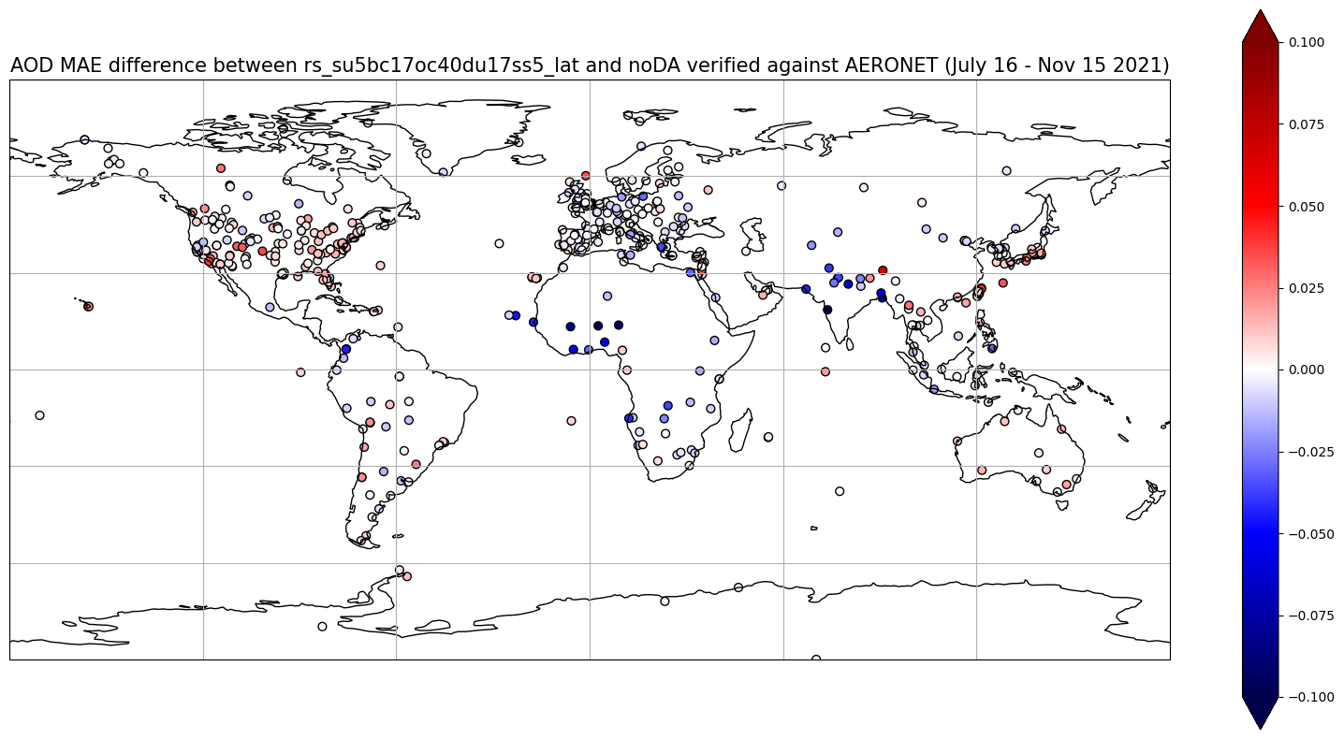
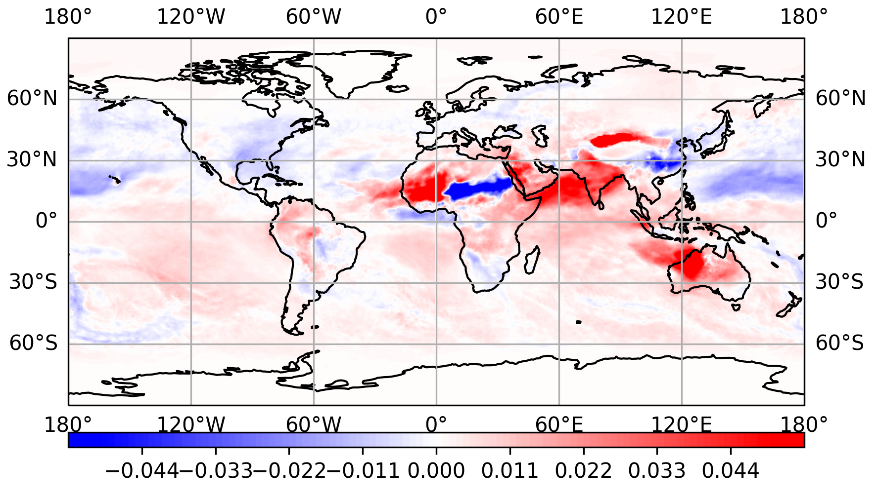
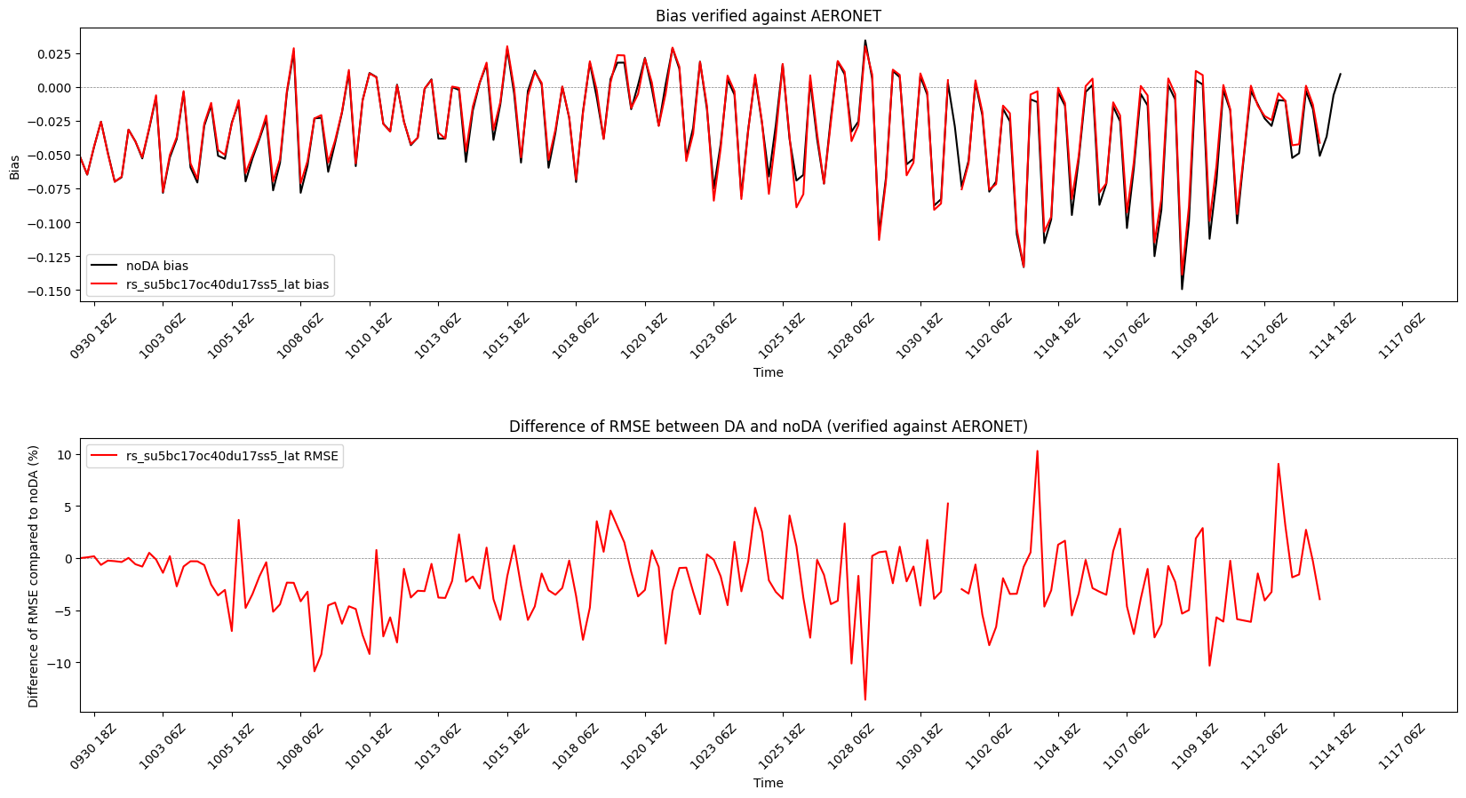
GCAFS - Validation
Fall 2023 compared to CAMS
Red: DA experiment “better” Blue: “worse”
^ 2021 AERONET 2023 v
Compared to AERONET: reduced bias and improved RMSE when assimilating VIIRS AOD
Figs. courtesy Yaping Wang

Slide 10
Future AQM Development
The current AQM does not contain any constraint from observations beyond fire emissions (nor does the GEFS-Aerosol member).
Planned upcoming upgrades include:
Increase in horizontal resolution
Update to newest chemical mechanisms
Emissions updates
Inclusion of data assimilation
  in situ PM2.5
  AOD, trace gas retrievals from both LEO and GEO

Slide 11
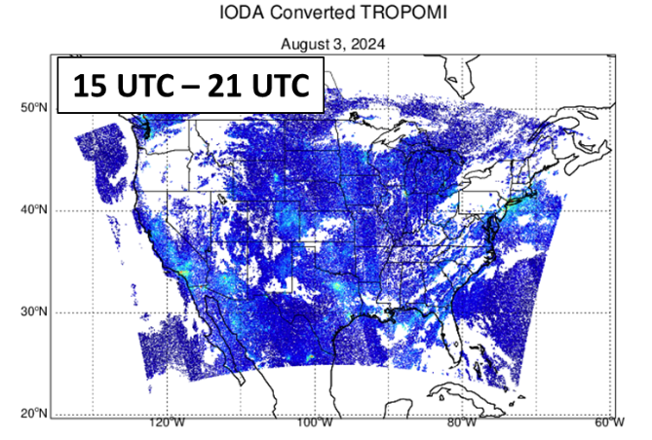
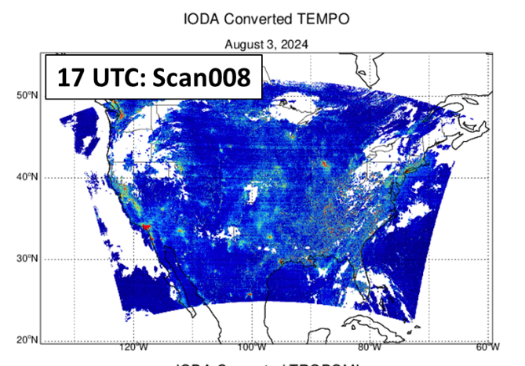
AQM - Trace Gas Assimilation
For regional models, polar orbiters have limited value; geostationary much more useful
Figs. courtesy Hyundeok Choi

Slide 12
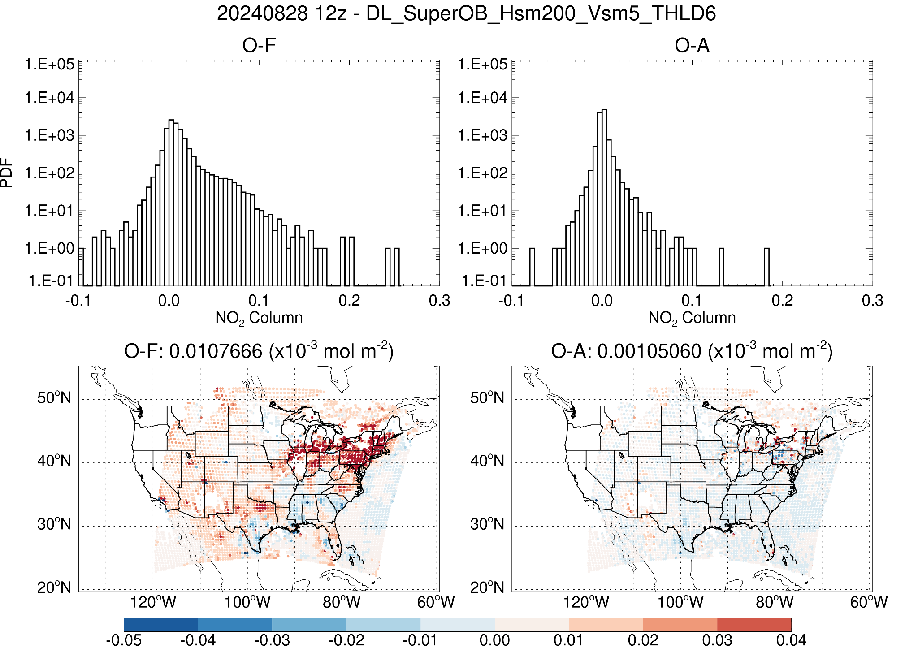
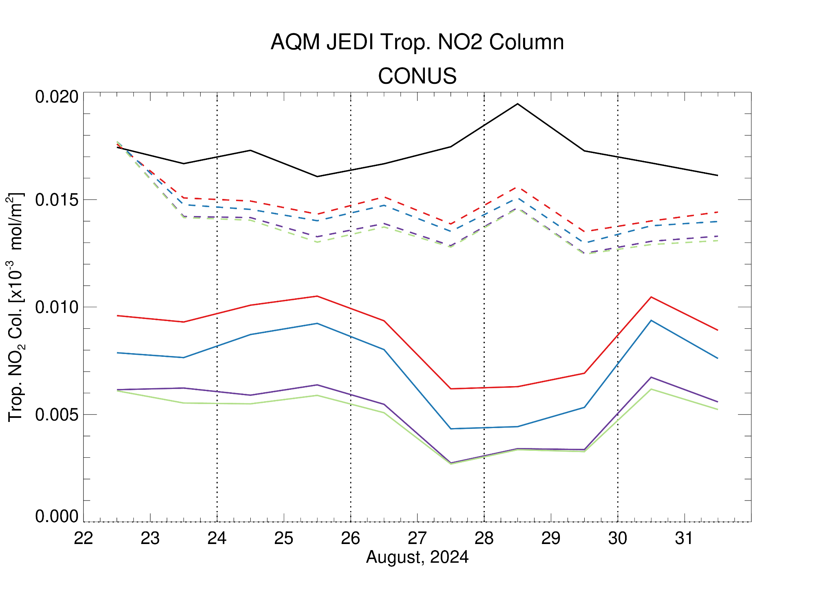
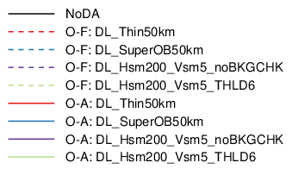
AQM - Trace Gas Assimilation
Tuning still underway but results are promising using TEMPO for short-term forecast improvement
Figs. courtesy Hyundeok Choi

Slide 13
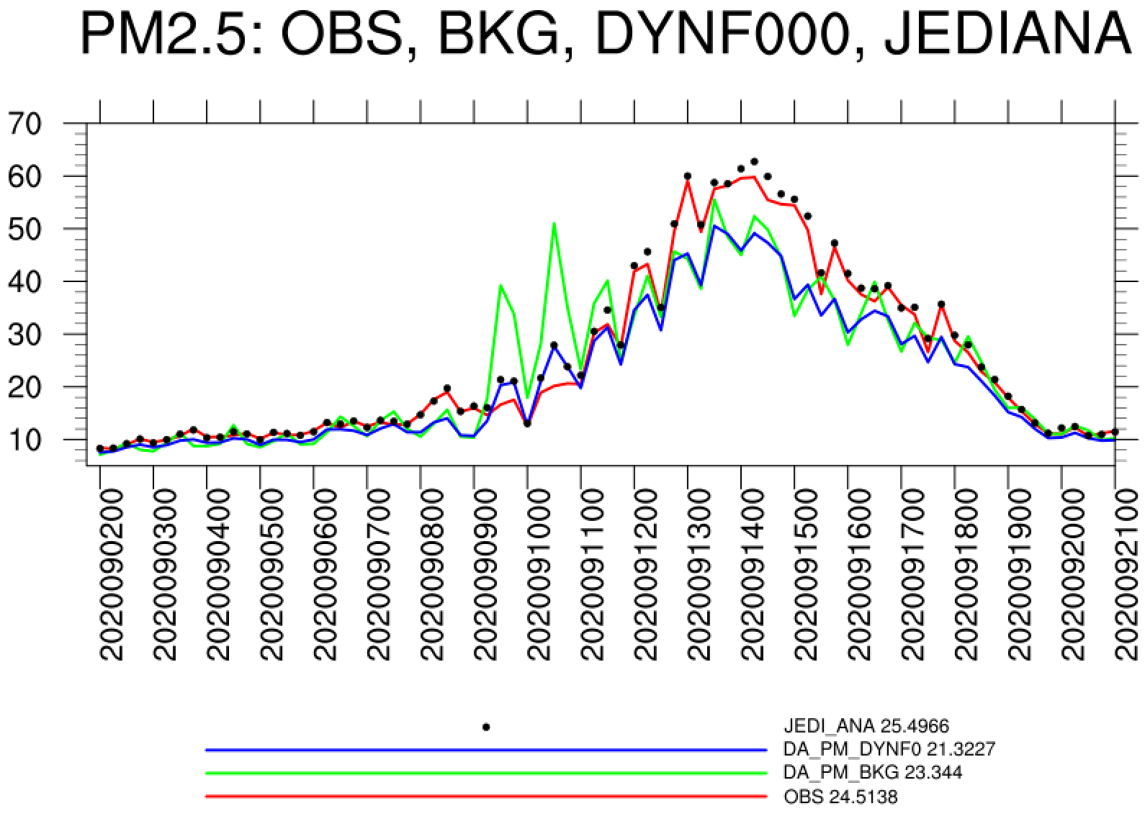
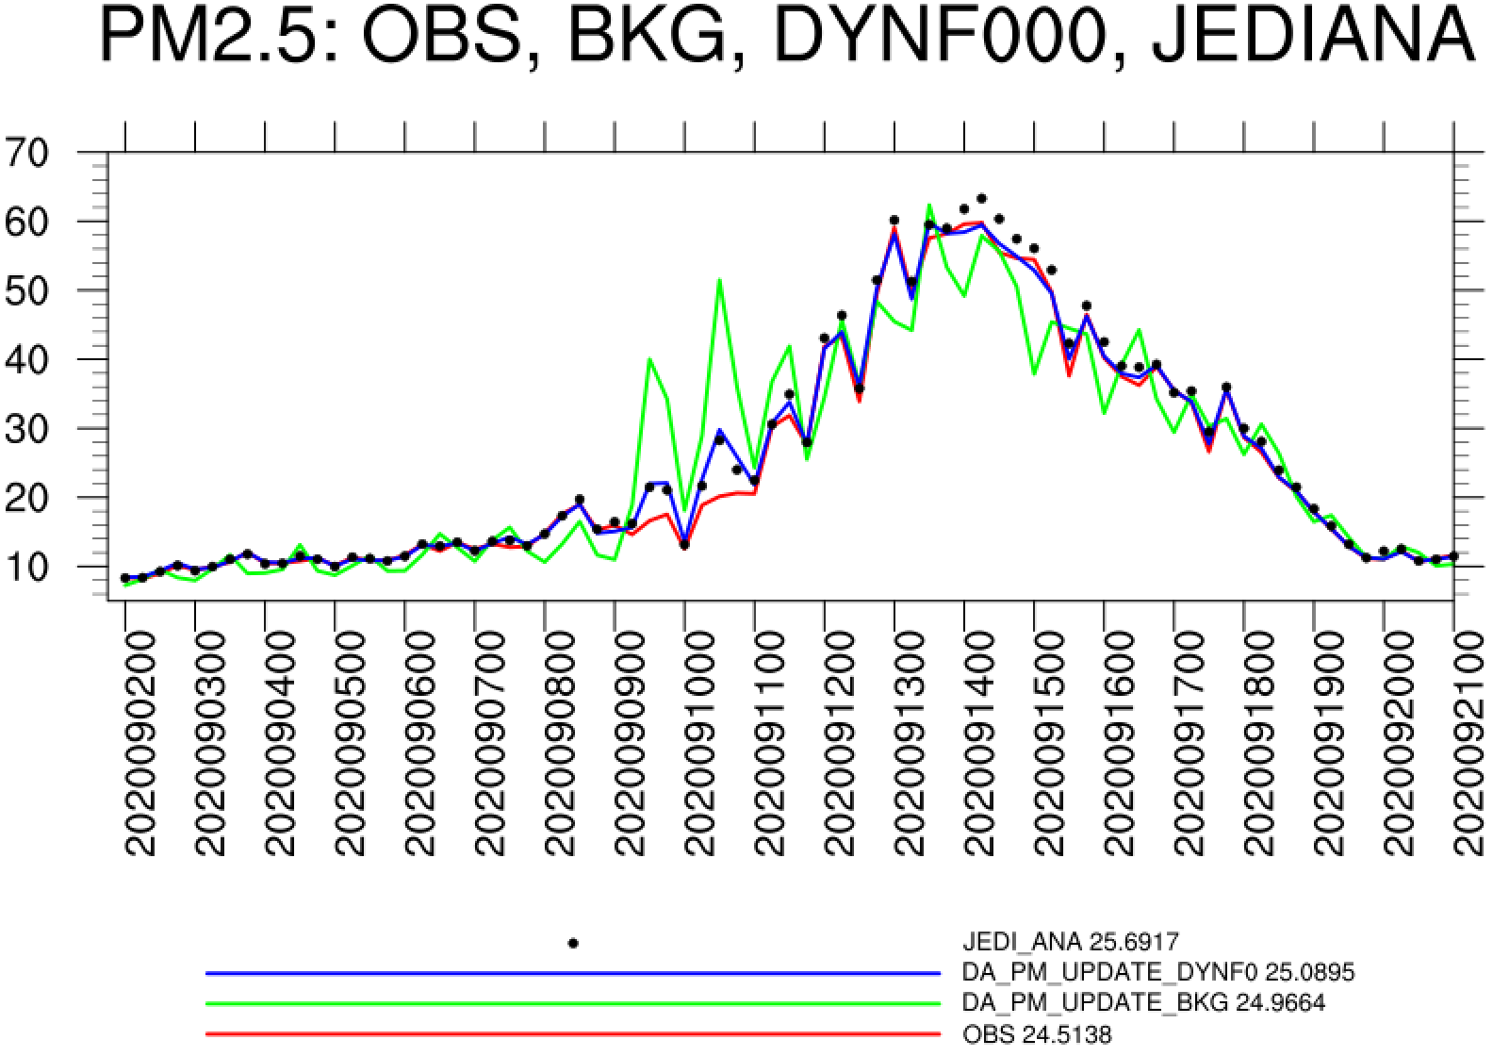
AQM - Surface PM2.5 Assimilation
JEDI analyzed PM is much close to AirNow obs.
When only mass concentrations were updated, most of assimilated signal lost after model initialization.
Updating all the prediction variables including total particle numbers and total surface areas concentrations helps to mitigate the issue.
EXP: DA_PM2.5_UM
JEDI analysis
0h FCST after model initialization
Background
OBS
EXP: DA_PM2.5
JEDI analysis
0h FCST after model initialization
Background
OBS
Figs. courtesy Hongli Wang

Slide 14
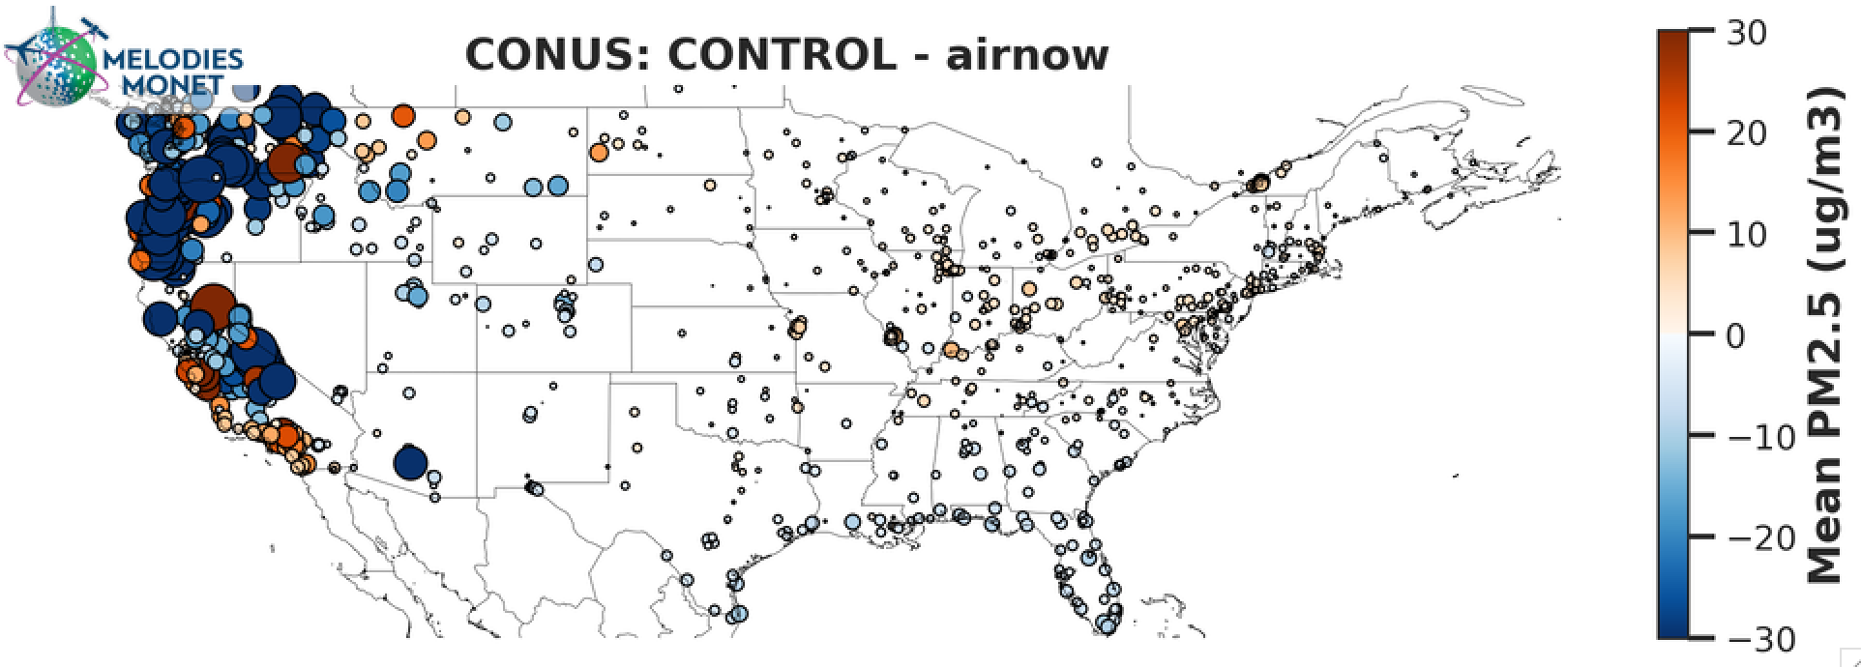
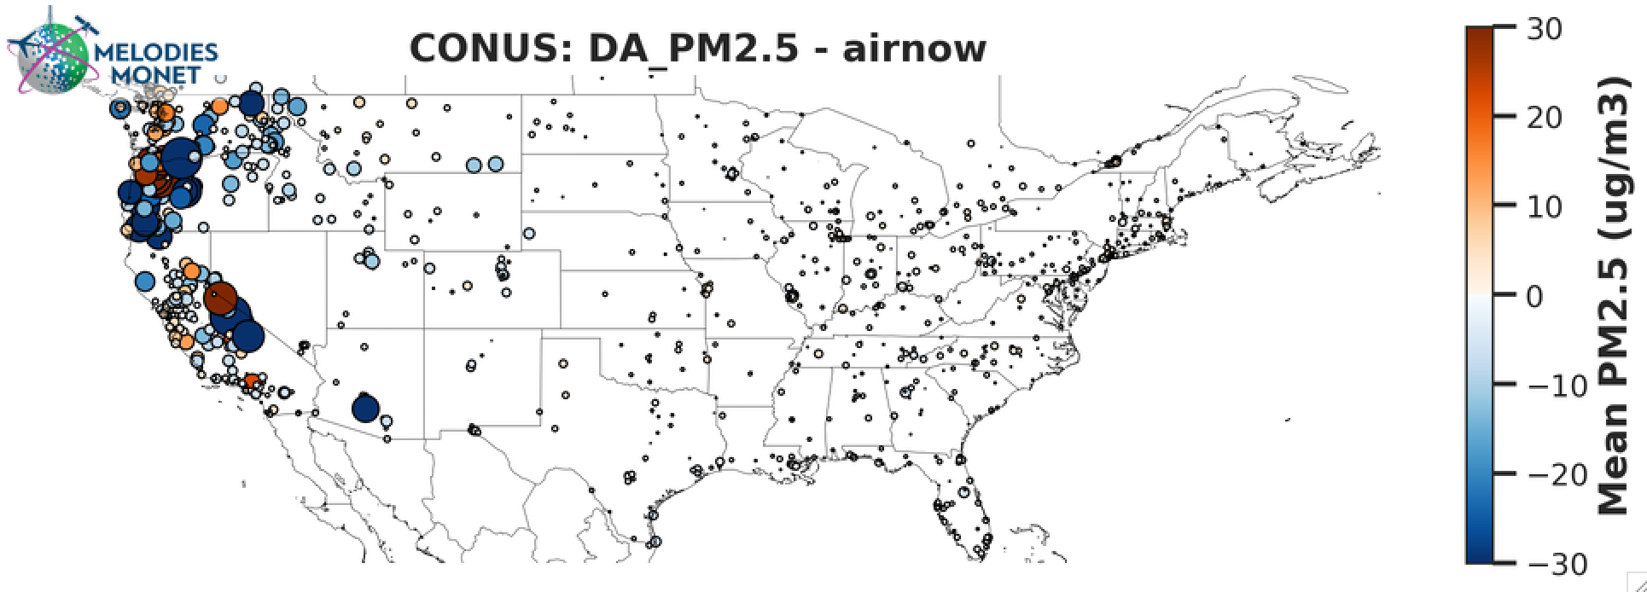
AQM - Surface PM2.5 Assimilation
1h forecast bias
NOAA GSL has made significant efforts in reducing surface PM2.5 bias and RMSE through assimilation of surface obs.
Work assimilating VIIRS AOD concurrently with surface obs is ongoing with limited success (not shown)
1h forecast bias
Figs. courtesy Hongli Wang

Slide 15
Ongoing and Future Work
Final tuning, configuration, and validation of initial GCAFS system underway
  Evaluation in second half of 2025; plan to transition to operations in early 2026
Increase readiness level of AQM DA
  Combine trace gas and aerosol/PM into one cycling system
  Refine background error and QC decision
  Explore VarBC (more difficult with a regional model)
Looking ahead with GCAFS:
  Short term: more obs assimilated, higher resolution
  Longer term: more complex chemistry, nests, possibly include/replace AQM

Slide 16

Questions?
email: cory.r.martin@noaa.gov
Acknowledgements:
Hyundeok Choi, Ruifang Li, Andy Tangborn, Hongli Wang, Yaping Wang, and others…

