Slide 1
Estimating PM2.5 with Satellite AOD and Auxiliary Variables with Machine Learning at Global Scale:
Promise, Challenges and Pitfalls
Tianle Yuan
UMBC - GESTAR II
NASA Goddard Space Flight Center
Notes:
How Earth system works. How we can learn from nature about anthropogenic forcings. How natural variability could work.

Slide 2
Acknowledgement:
Co-authors:
Hua Song¹, Mian Chin² ,Huisheng Bian^{2,3}, Jing Wei⁴, Hongbin Yu², Qian Tan⁵, Zhining Tao³, Dongchul Kim³
¹ SSAI, ²GSFC, ³UMBC GESTAR-II, ⁴UMD, ⁵NASA Ames
Funding from the NASA MAP Program

Slide 3
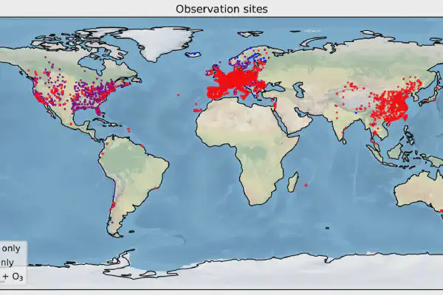
Introduction: estimate surface PM2.5 from satellite observations
Tiny fraction of the Earth is covered by routine PM2.5 measurements.
Satellite observations are globally available, but mostly do not directly observe surface quantities.
Typical approach:
  train ML models using spaceborne AOD, auxiliary variables, and surface PM2.5 measurements
  Estimate PM2.5 globally.
OpenAQ sites
Do the trained models generalize to other regions/times?

Slide 4
Introduction: Our approach/hypothesis
We train ML models with global CTM simulation data and transfer it to actual observations.
Train models on GEOS-GOCART simulation results: global coverage and high data volume, avoiding overfitting and poor generalization issues.
Apply the trained model on actual observations that have never been seen during training.
Test the transferability and gauge the generalization issues of the typical approach.

Slide 5
Introduction: Training setup
GEOS-GOCART simulations at 3hourly resolution
Training, test, and validation split of 7:2:1.
> 130 million data points in training, 38 million in test, 76 million in validation (largest as far as we are aware).
Gradient-boosted decision tree models
Different model complexity mimicking available observations
  AOD, Angstrom Exponent, Precipitable water, Precip, PBH: 5-var
  + DEM height, Surface T, wind speed^3: 8-var
  + wind direction, Surface P: 10-var
  + Lat and lon: 12-var
  With vertical profile of extinction: Profile

Slide 6
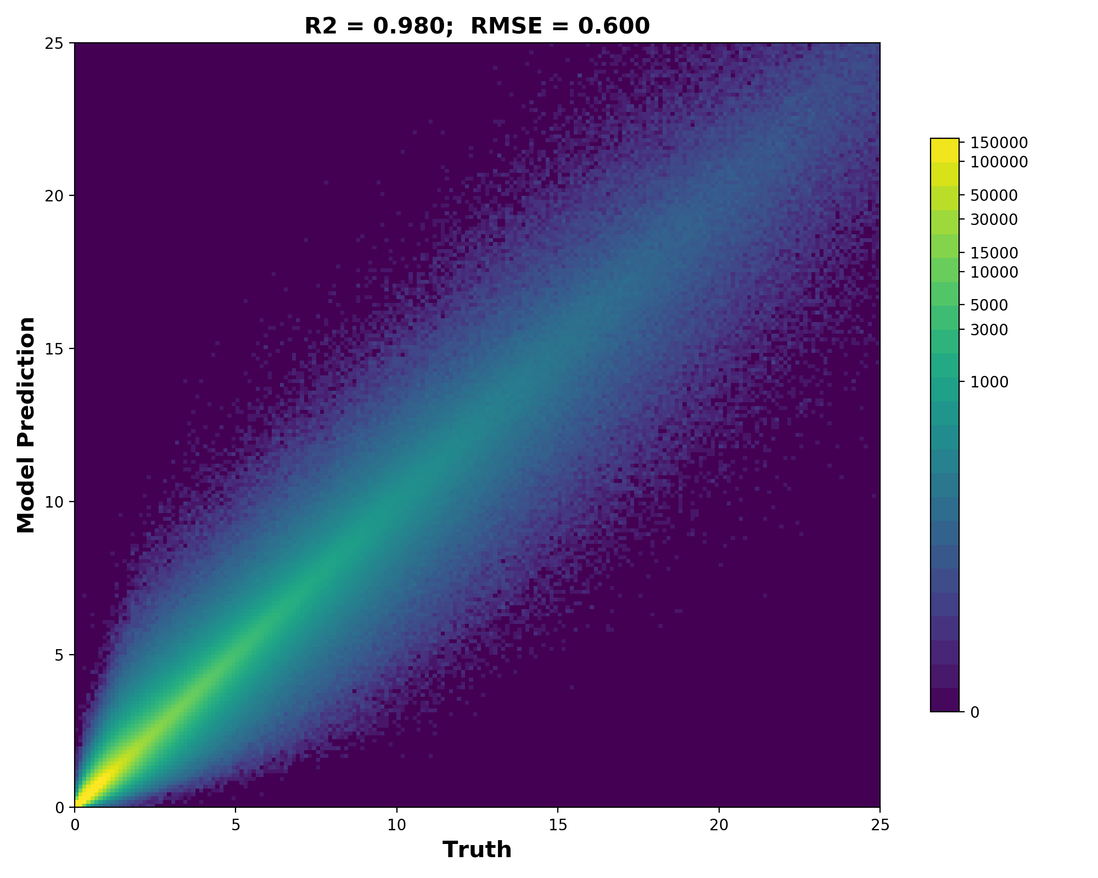
Results: vertical extinction profiles
With subsampled vertical extinction profile as input. The model can almost perfectly recover PM2.5.

Slide 7
Results
3hourly predictions
Spatially consistent
No systematic temporal bias
There are places with more pronounced errors
Performance on test data.

Slide 8
Results: performances of different models
5 var
8 var
10 var
12 var
With increasing complexity of model inputs, model performance on validation and test data gets better. All results here do not have vertical profile information.

Slide 9
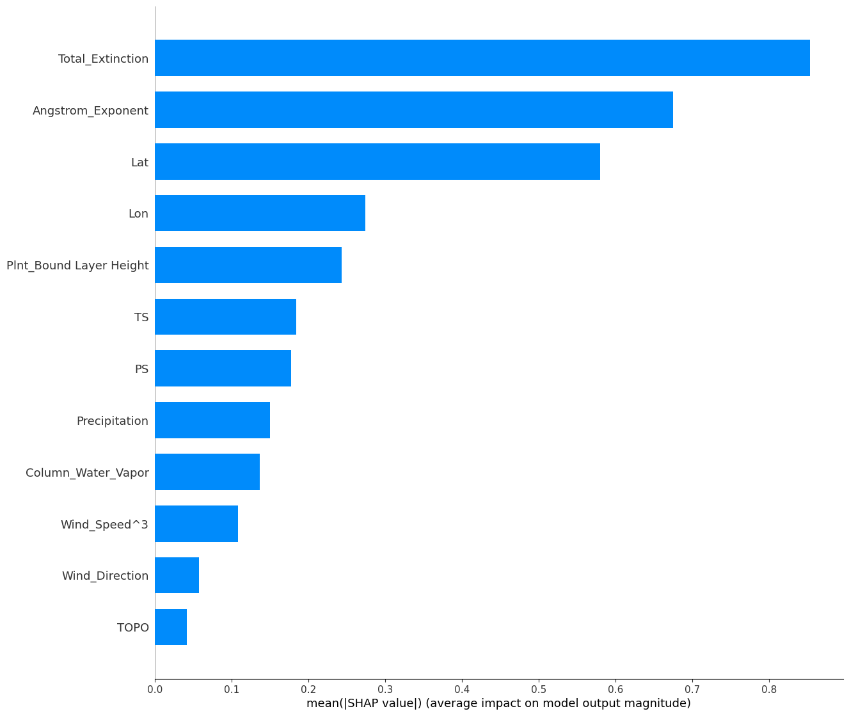
Results: performance statistics and SHAP values
Lat
lon
An illustration of mean SHAP values for the 12-var model.

Slide 10
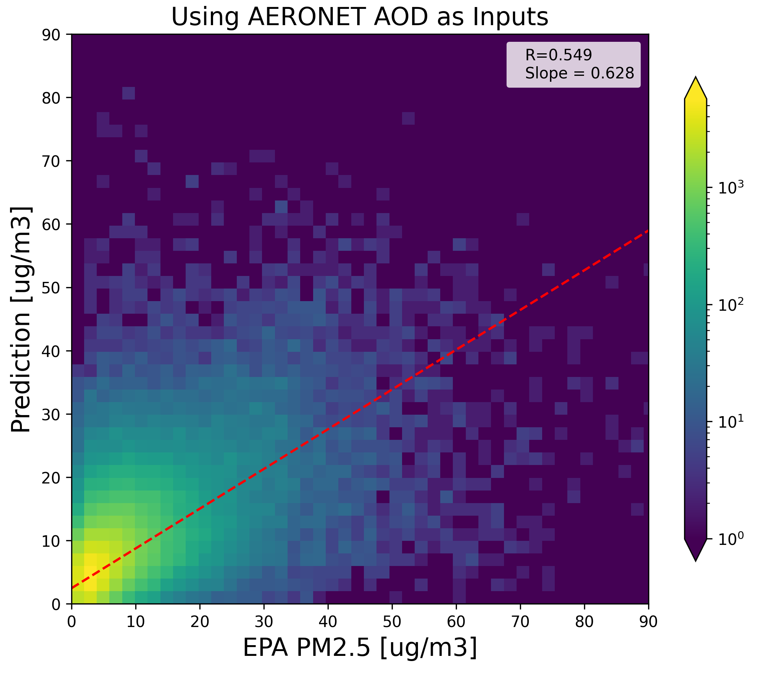
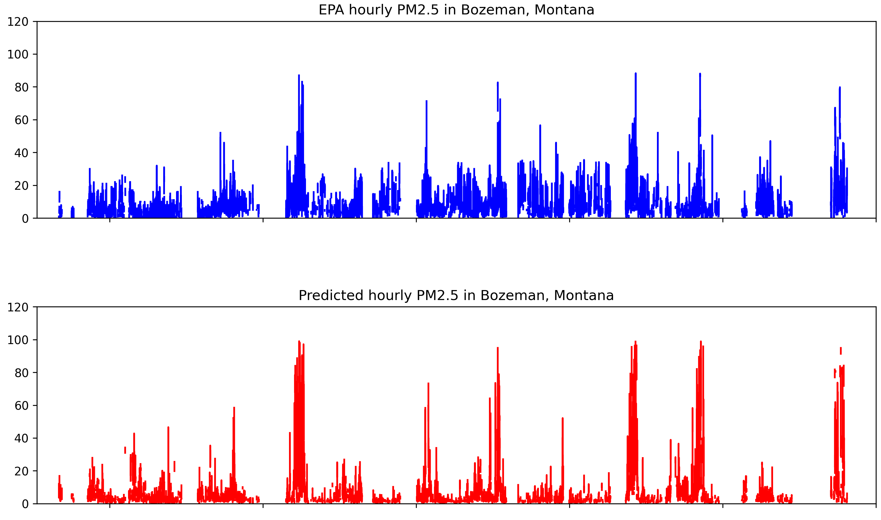
Results: application to real observations
The ‘basic’ 5-var model performs reasonably well when compared to EPA PM2.5 measurements at 3-hourly resolution.

Slide 11
OSSE experiments
Mimic the traditional approaches of training ML models on data from locations that have ground stations.
Poor generalization: more input variables, esp. non-physical ones, the larger the gap in performance.

Slide 12
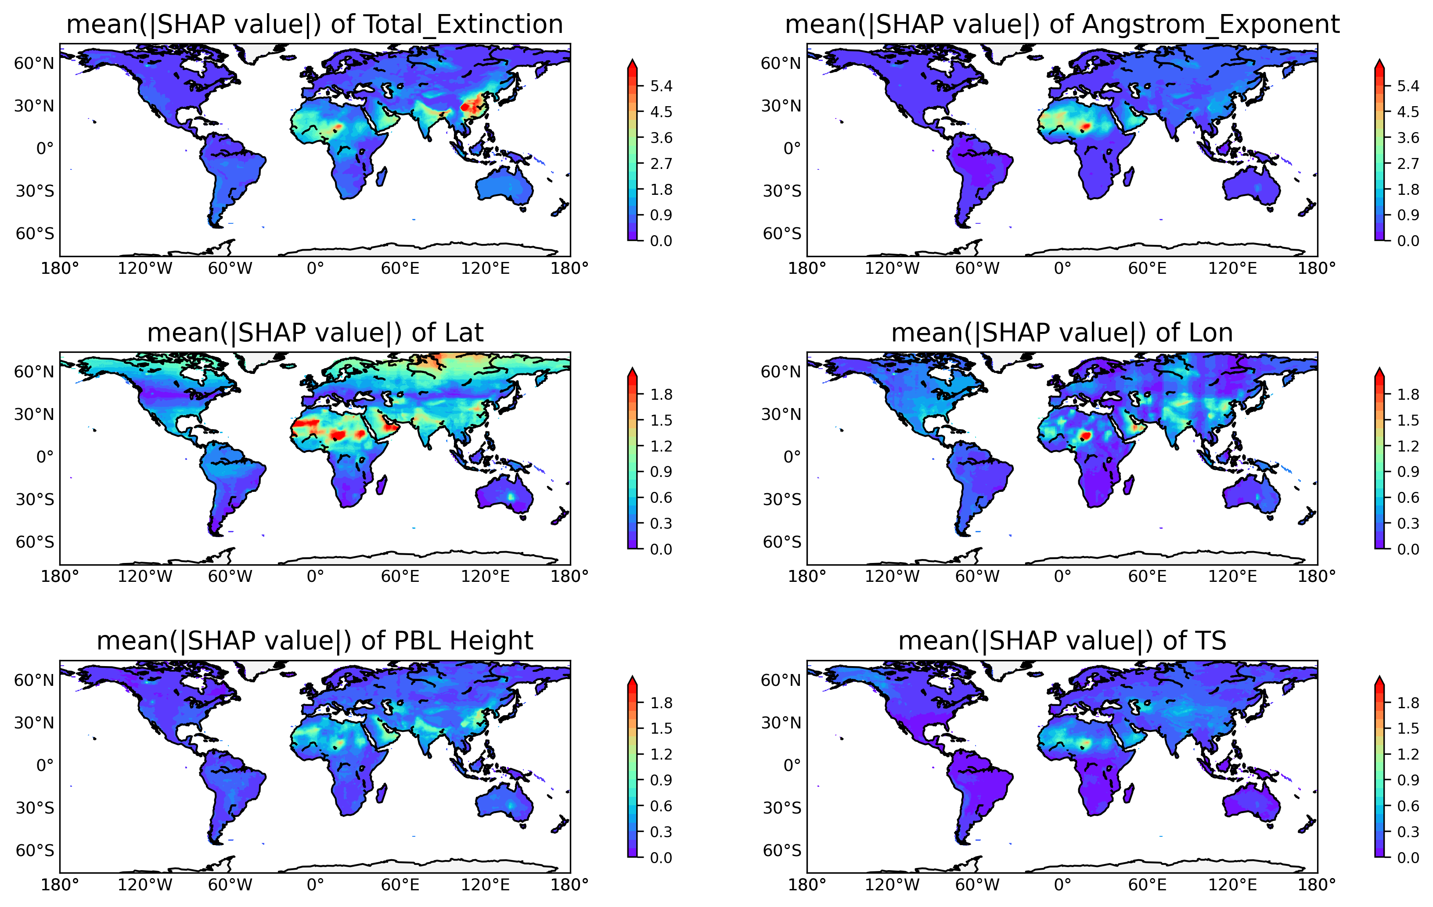
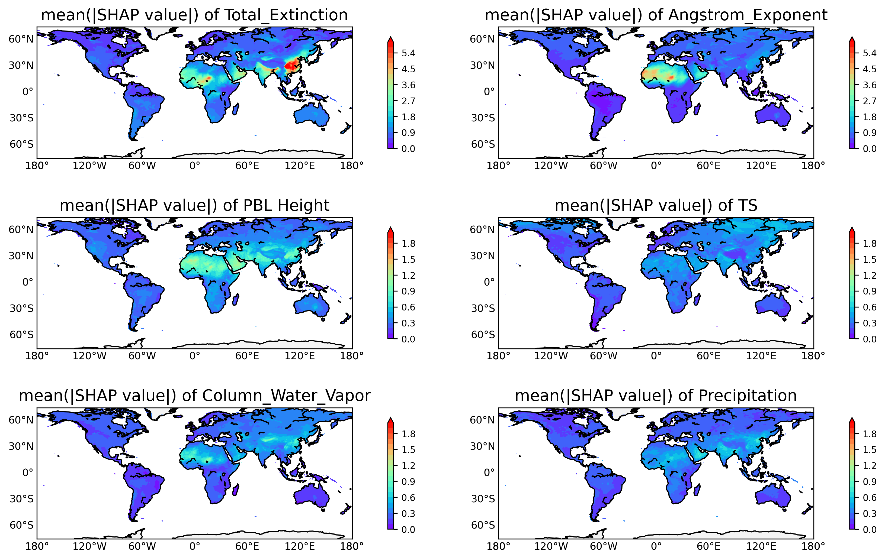
Why poor generalization?
Top 6 variables for 12-Var
Top 6 variables for 8-Var

Slide 13
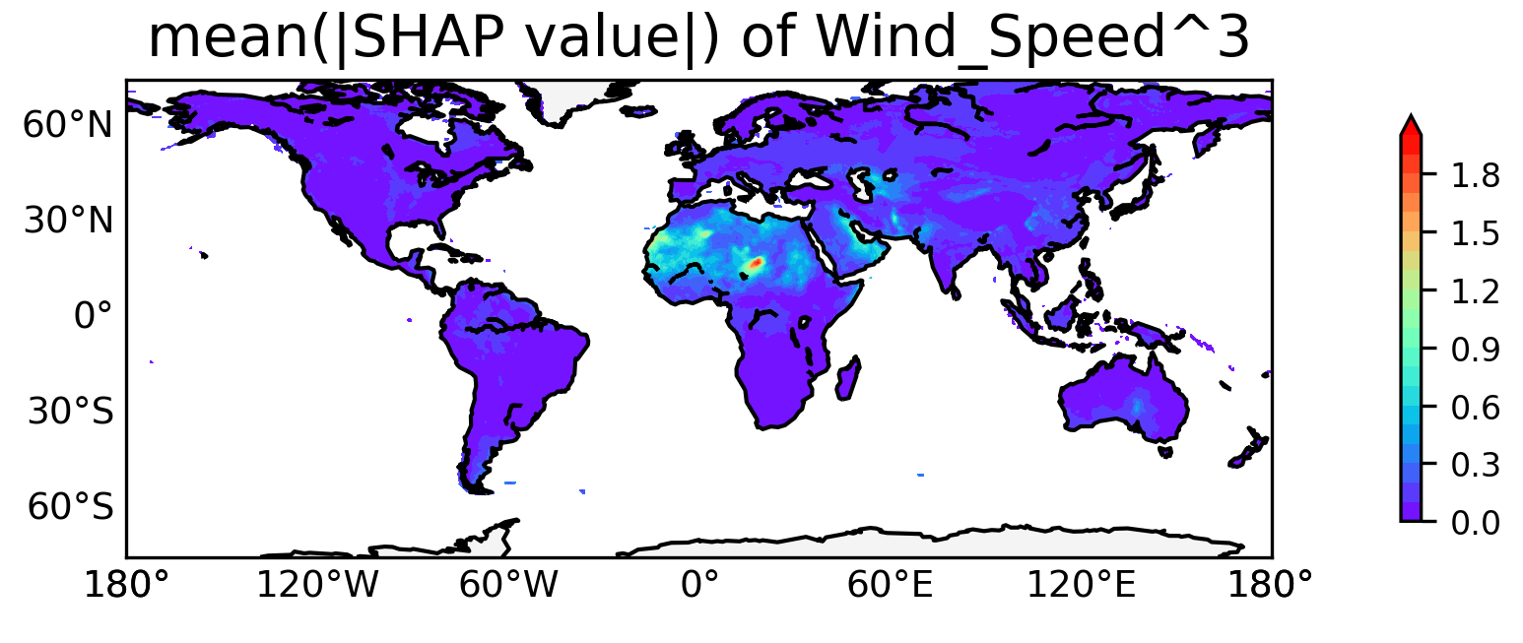
Physical Input variables
Map of SHAP values for Wind speed³ heavily concentrate around desert regions.

Slide 14
Conclusions
Relationship between AOD et al. and PM2.5 modeled by GEOS-GOCART captures part of the actual relationship.
Improved CTMs can transfer to better PM2.5 estimates.
Generalization of ML models need more attention.
OSSE-like experiments show some current methods may indeed suffer overfitting. Physical insights are valuable and helps generalization.

