Slide 1


CEOS AC-VC-21
Air Quality Aerosol Session
June 12, 2025
TEMPO Case Study: Tracking Canadian Wildfires Smoke and its Impact on Air Quality
Amy Huff¹
Hai Zhang¹, Pubu Ciren¹, Zigang Wei¹, and
Shobha Kondragunta²
Aerosols and Atmospheric Composition Science Team
¹STC at NOAA/NESDIS/STAR
²NOAA/NESDIS/STAR

Slide 2
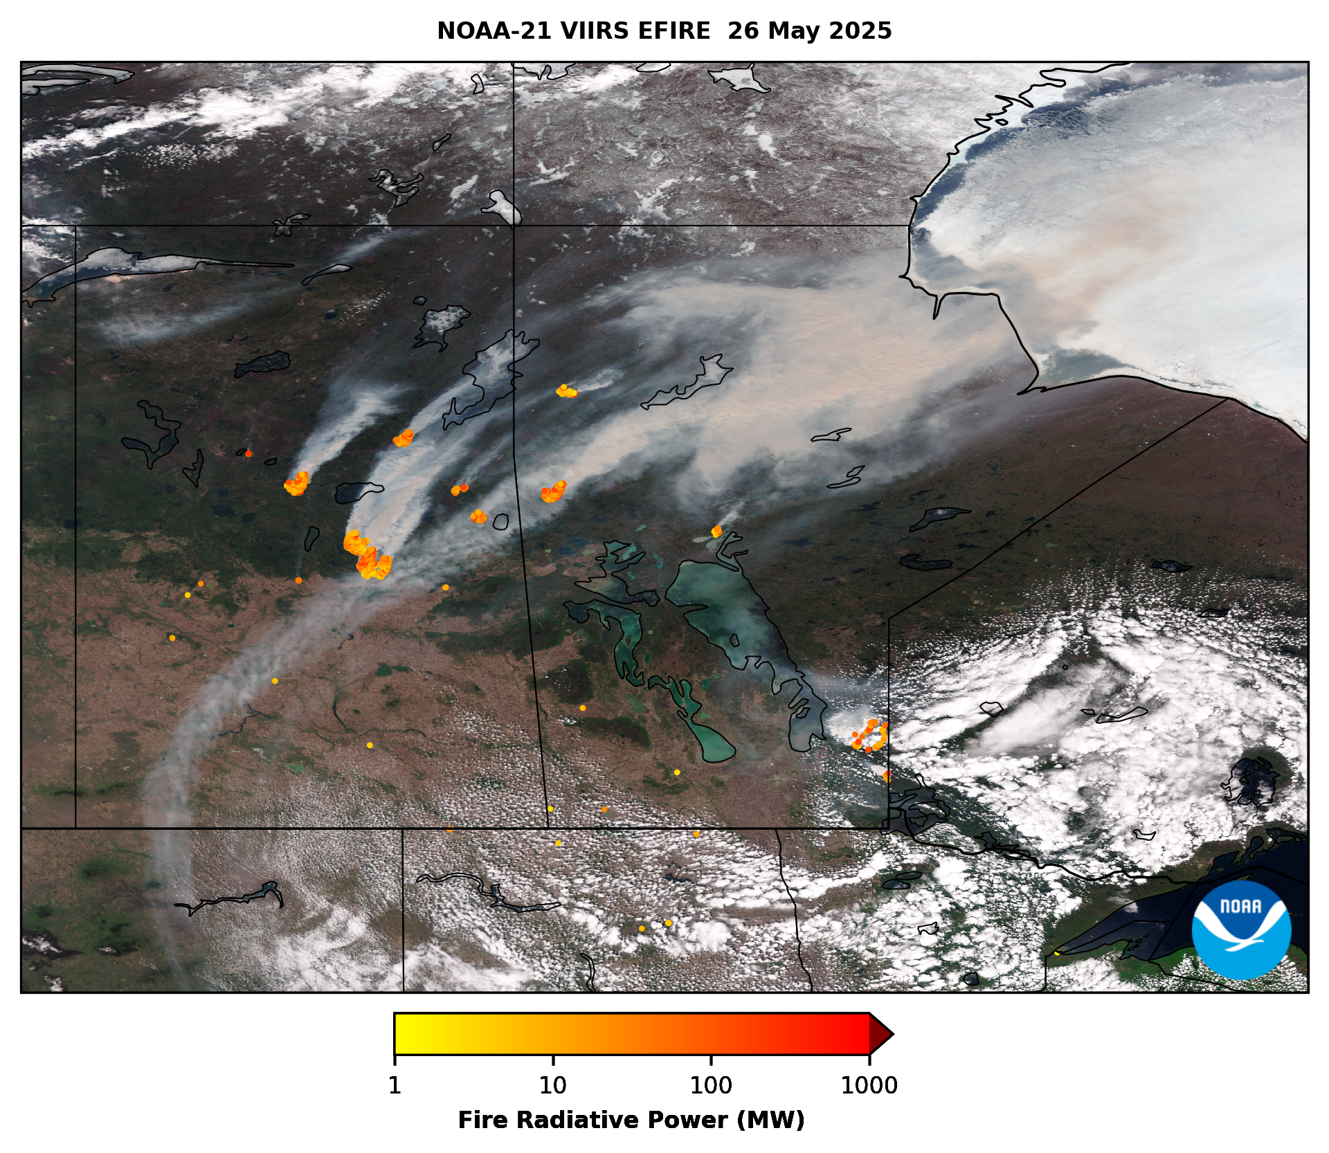
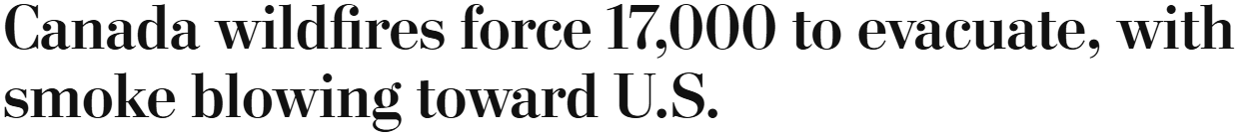
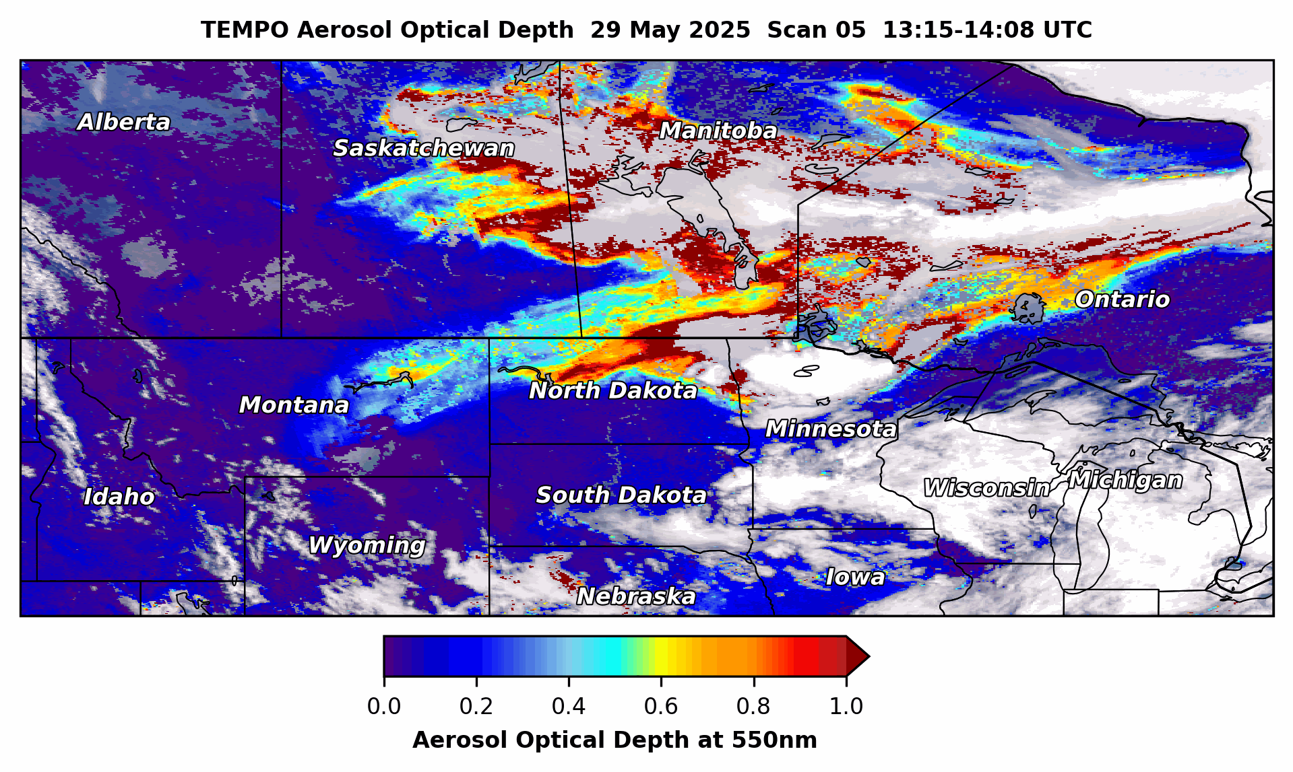

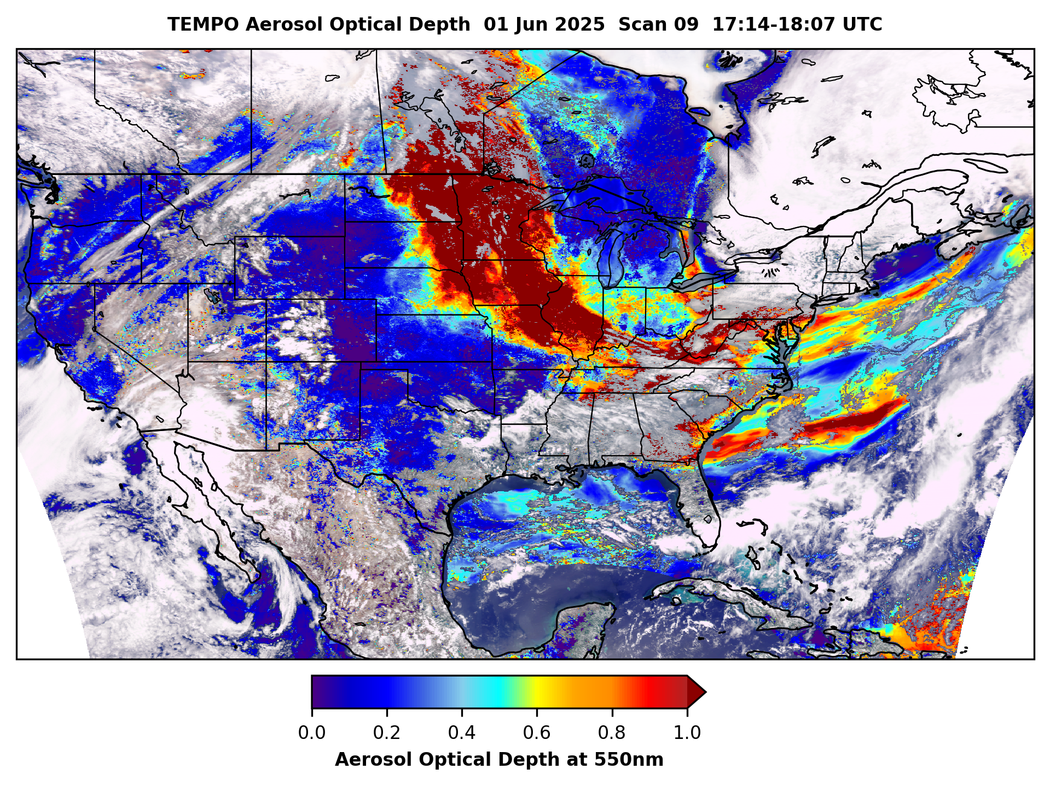
Central/Western Canada’s 2025 fire season is well above average to date
Driven by abnormally dry conditions
“Out of control” wildfires releasing thick, brown-colored smoke
  Degrading surface air quality
  Reducing visibility
Prompted state of emergency & evacuations of thousands in Manitoba
Northerly winds blew smoke into the continental US starting May 29-30
Ontario
Manitoba
Saskatchewan

Slide 3
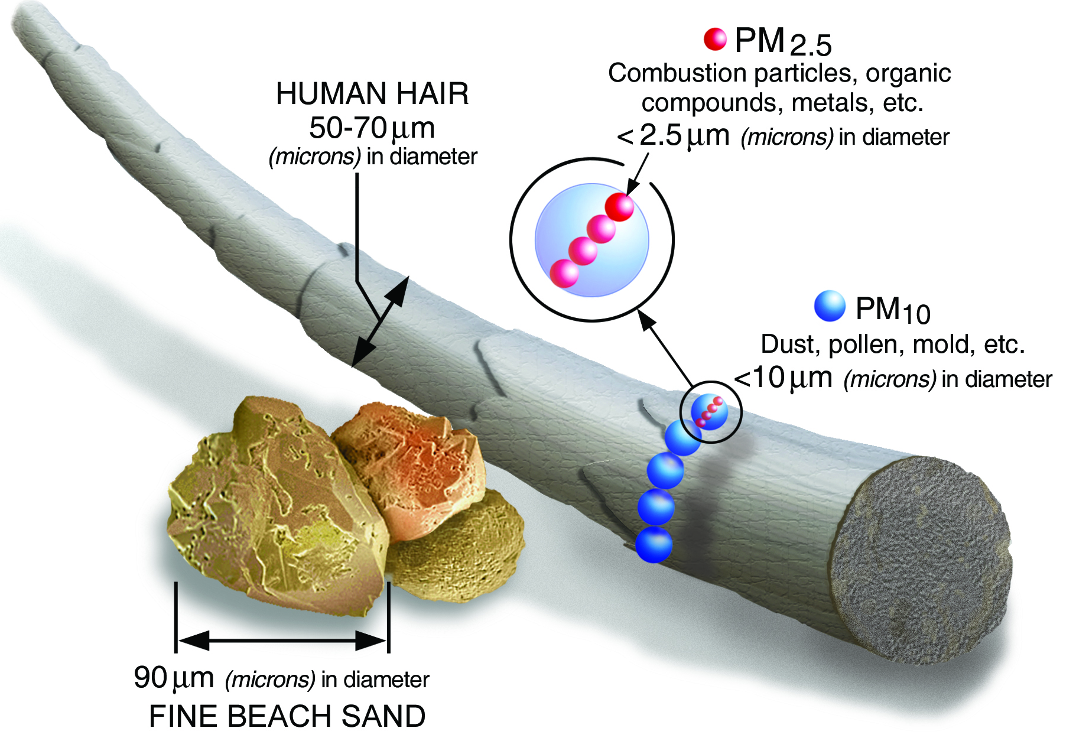
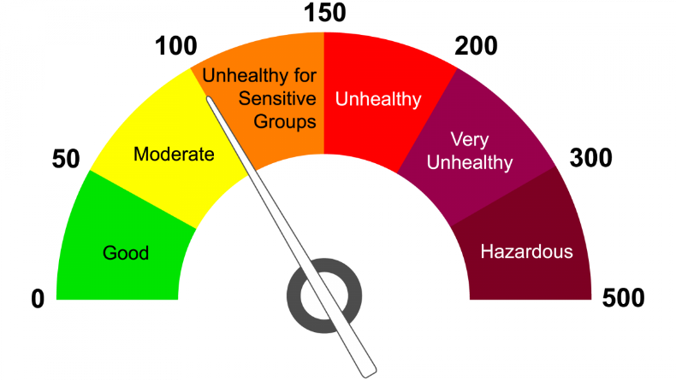
Smoke Contains PM_{2.5}
PM_{2.5} (fine particulate matter): very small aerosols, diameter ≤2.5μm
PM_{2.5} is harmful to human health
  Sensitive Groups are at greatest risk: children, seniors, people with existing respiratory or cardiovascular diseases
US EPA’s Air Quality Index (AQI) communicates PM_{2.5} concentrations
  Code Orange or higher: take action to limit exposure!
Images credit: US EPA

Slide 4
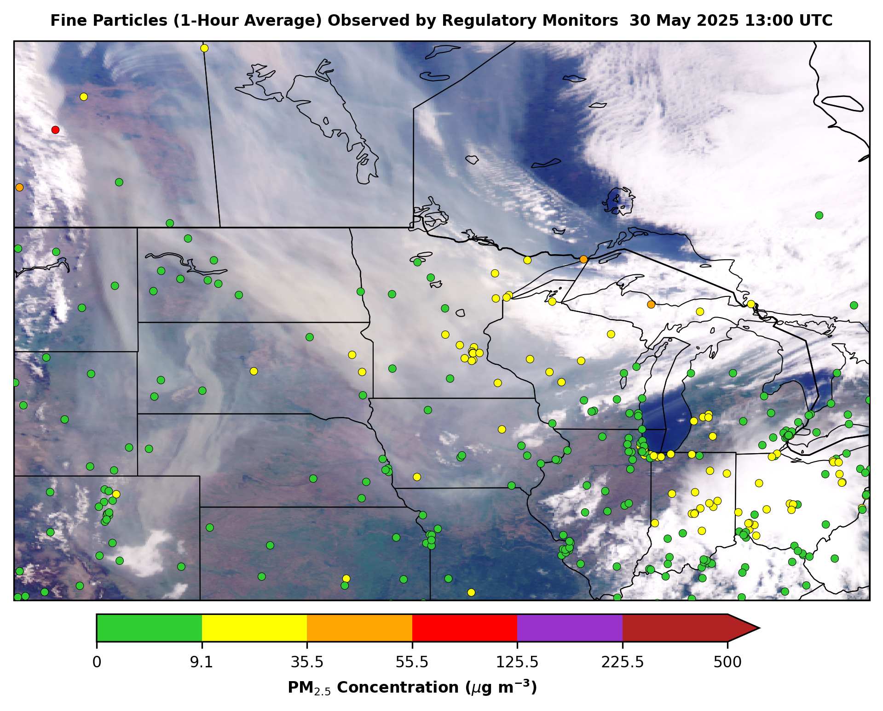
May 30: Smoke Pushes Southward into the US
Smoke flowed into the Upper Midwest on May 30
Most of the smoke remained above the surface, so initial impacts on PM_{2.5} air quality were limited
Thick brown-colored smoke caused hazy skies & vivid sunsets!
Notes:
TEMPO true color, scan 05 (13:15-14:08 UTC)

Slide 5
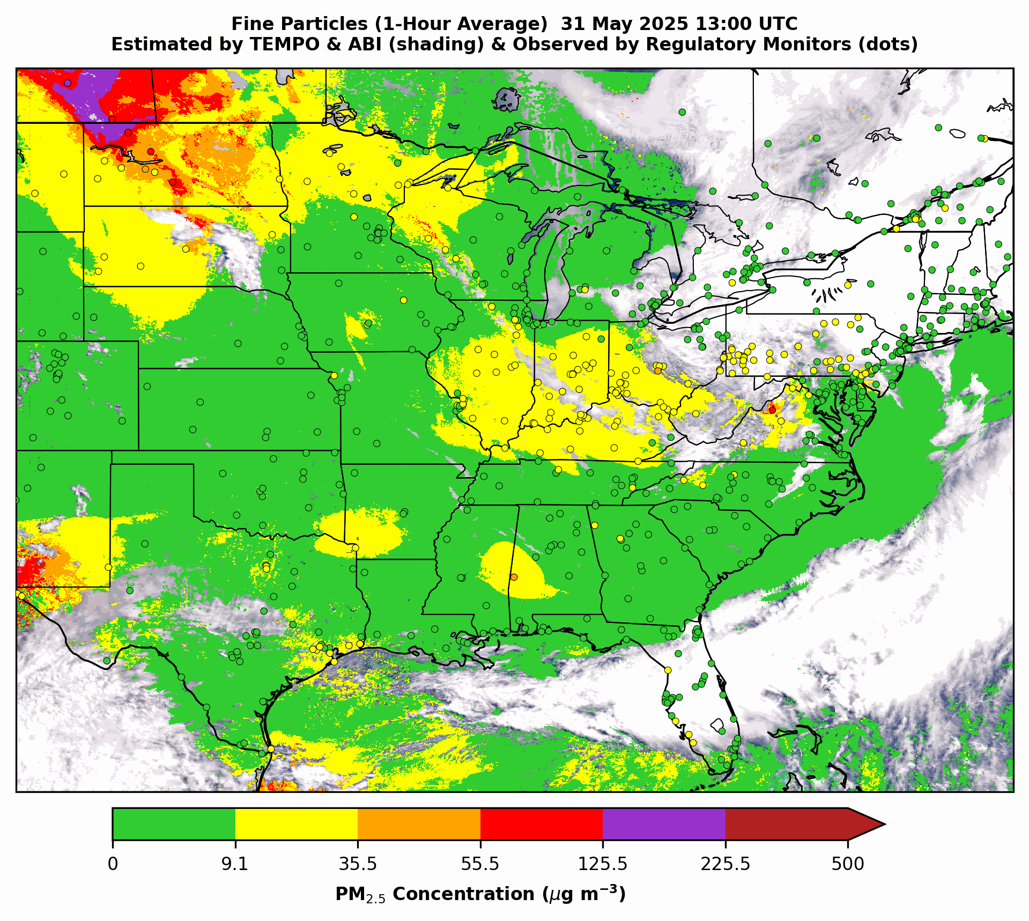
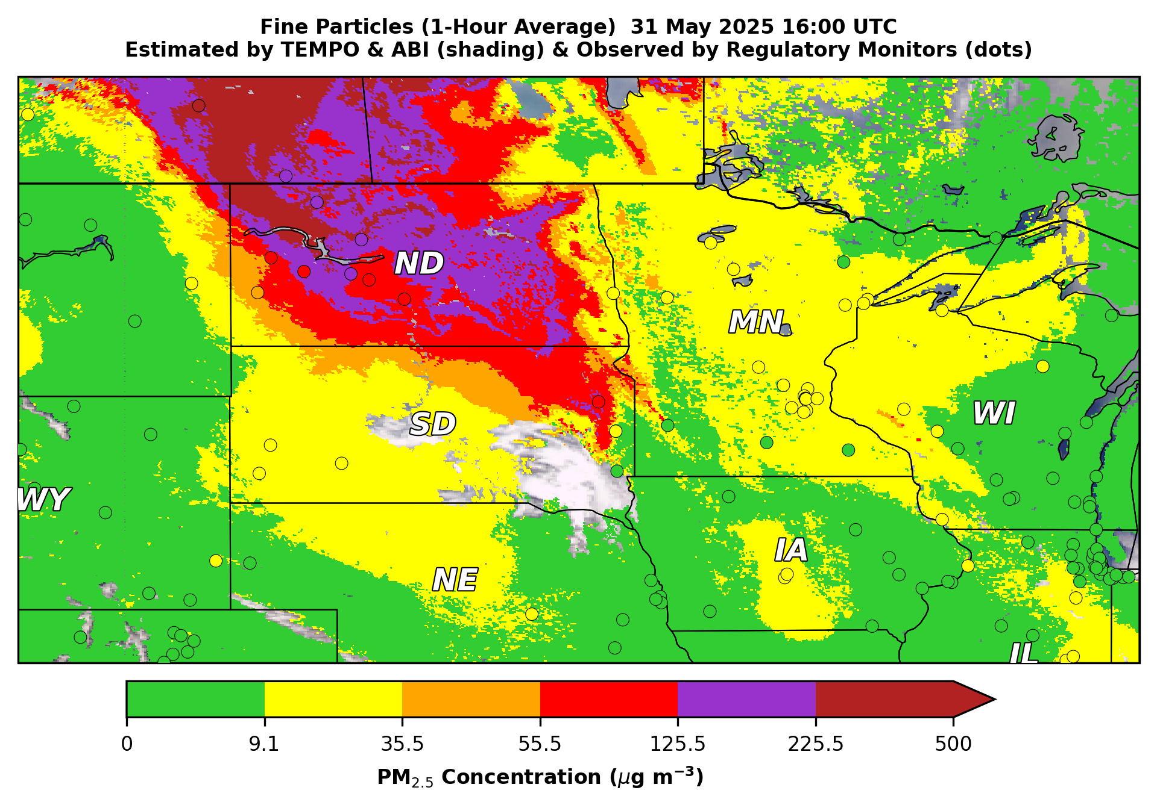
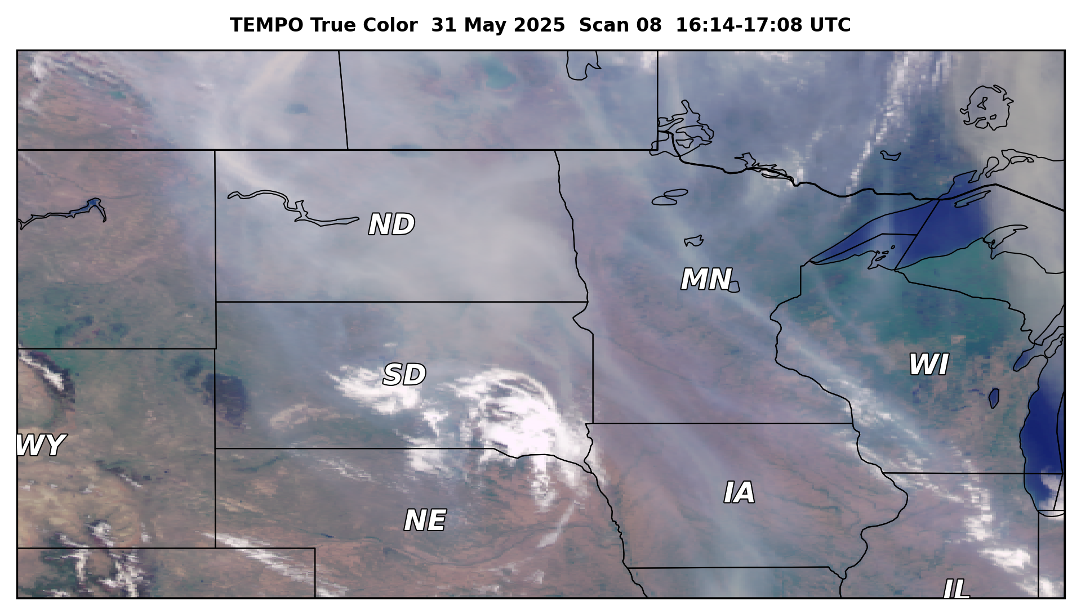
May 31: Poor Air Quality in North & South Dakota
Thick smoke impacted surface air quality in the Upper Midwest
  Very Unhealthy (Code Purple) & Unhealthy (Code Red) daily 24-hour average PM_{2.5}
Surface PM_{2.5} estimated from TEMPO & ABI synergy fills gaps in the PM_{2.5} regulatory monitor network
Smoke reached the eastern US but was aloft, so it had a limited effect on air quality
  Moderate (Code Yellow) conditions

Slide 6
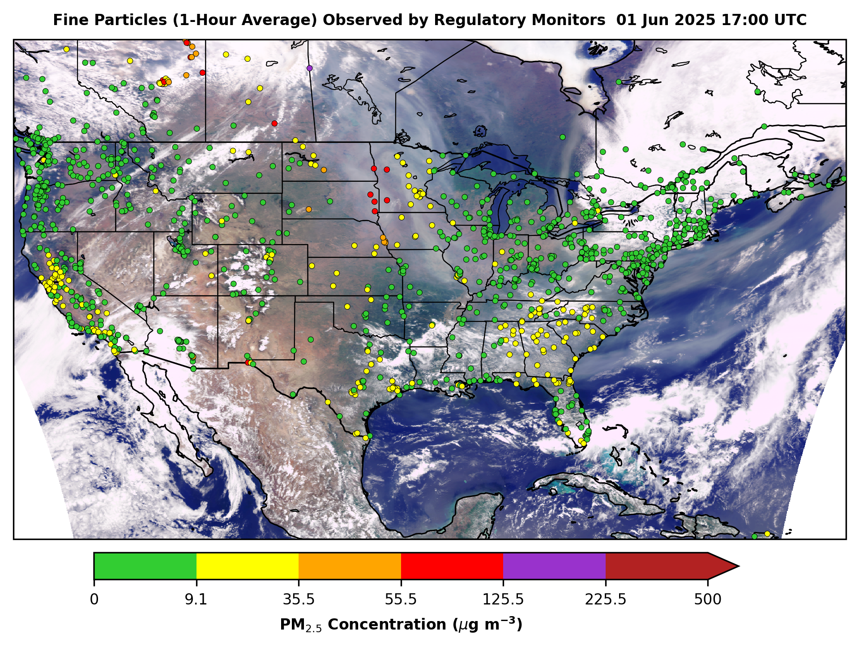
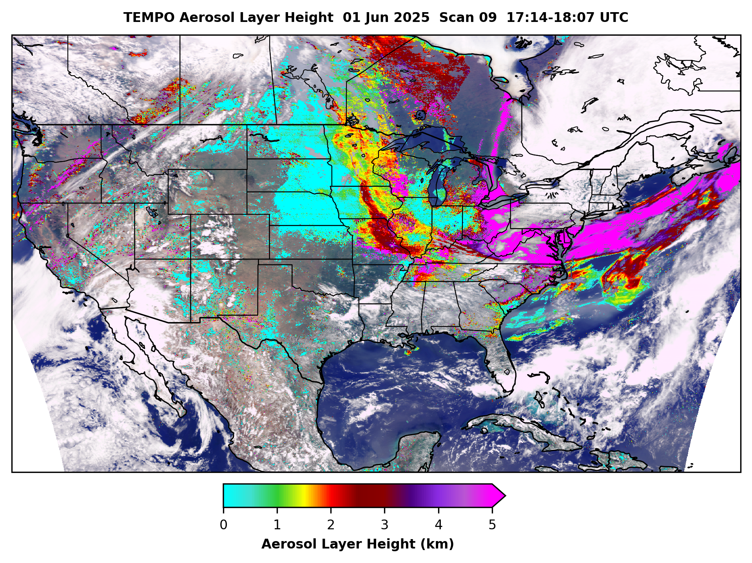
New! Height of Smoke in the Atmosphere from TEMPO
Aerosol Layer Height enhances Aerosol Optical Depth measurements with a 3-D view of smoke
High PM_{2.5} at the surface
Aerosols near the surface, poor AQ
High particle concentrations
Low PM_{2.5} at the surface
Smoke aloft, not impacting surface AQ

Slide 7
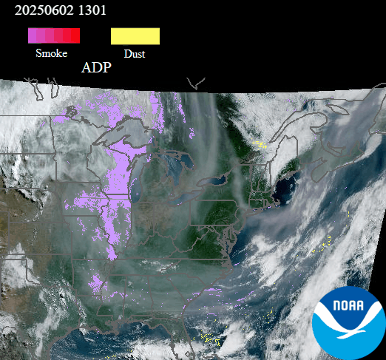
June 2: Smoke Swirls over the Eastern US
Satellite Aerosol Detection highlights smoke (lavender)
Useful for end users because it quickly draws the eye to areas of smoke or dust
ABI missed a lot of the wildfire smoke!
  ABI’s spectral range is Visible-IR
Absorbing aerosols, like smoke & dust, are more sensitive to shorter wavelengths, e.g., UV
GOES-East ABI
Aerosol Detection
Animation from the AerosolWatch website

Slide 8
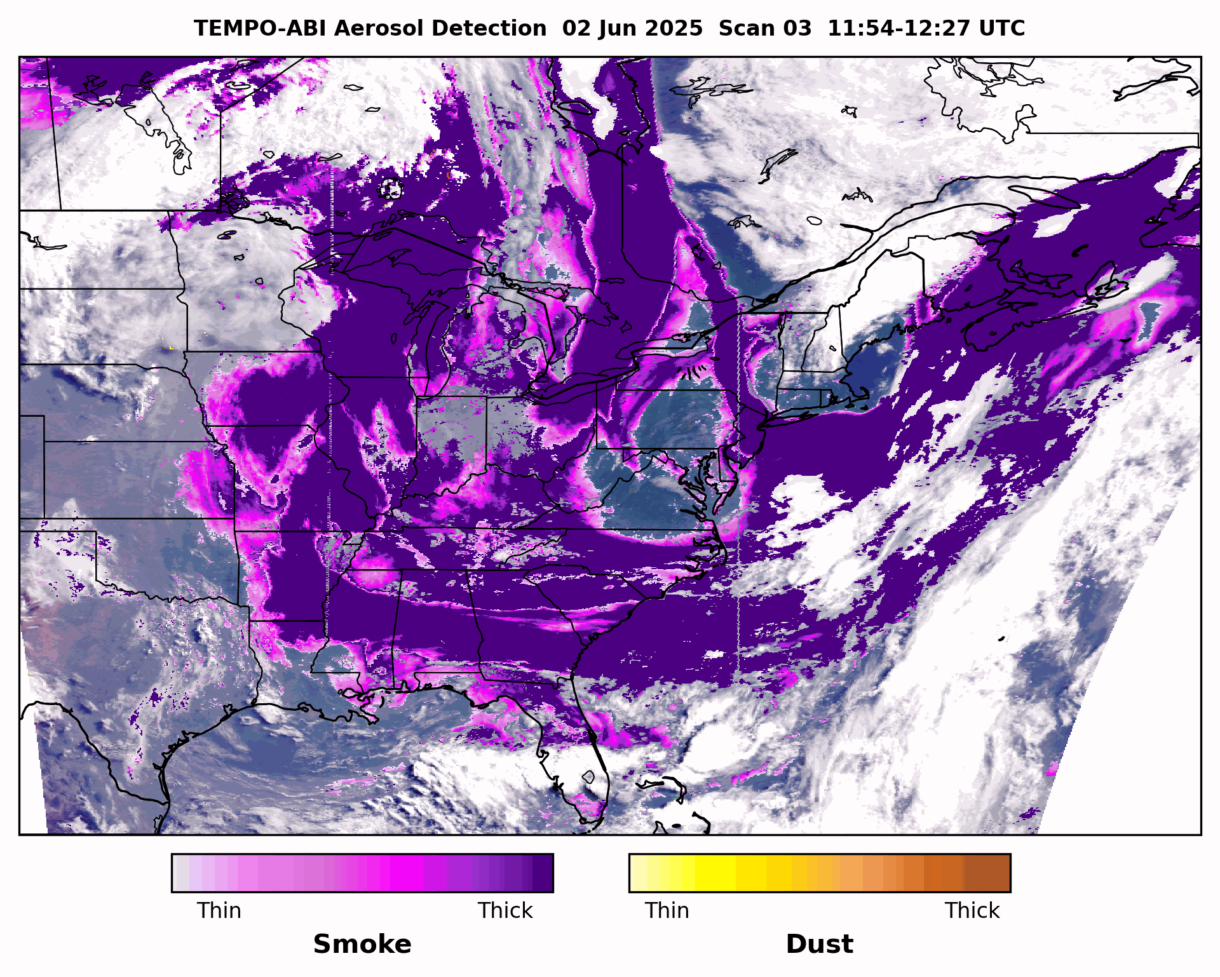
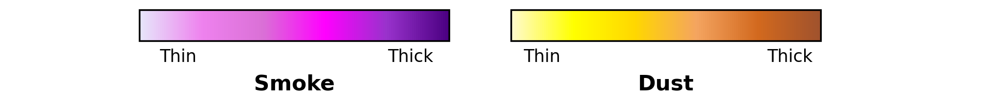
TEMPO-ABI Synergy Enhances Smoke Detection
TEMPO’s UV-Deep Blue spectral range is more sensitive to absorbing aerosols
Hybrid TEMPO-ABI Aerosol Detection algorithm takes advantage of the synergy between the two sensors
Much greater coverage of the wildfire smoke than using ABI alone!
  Also provides info on the relative intensity of smoke/dust (thick vs thin)

Slide 9
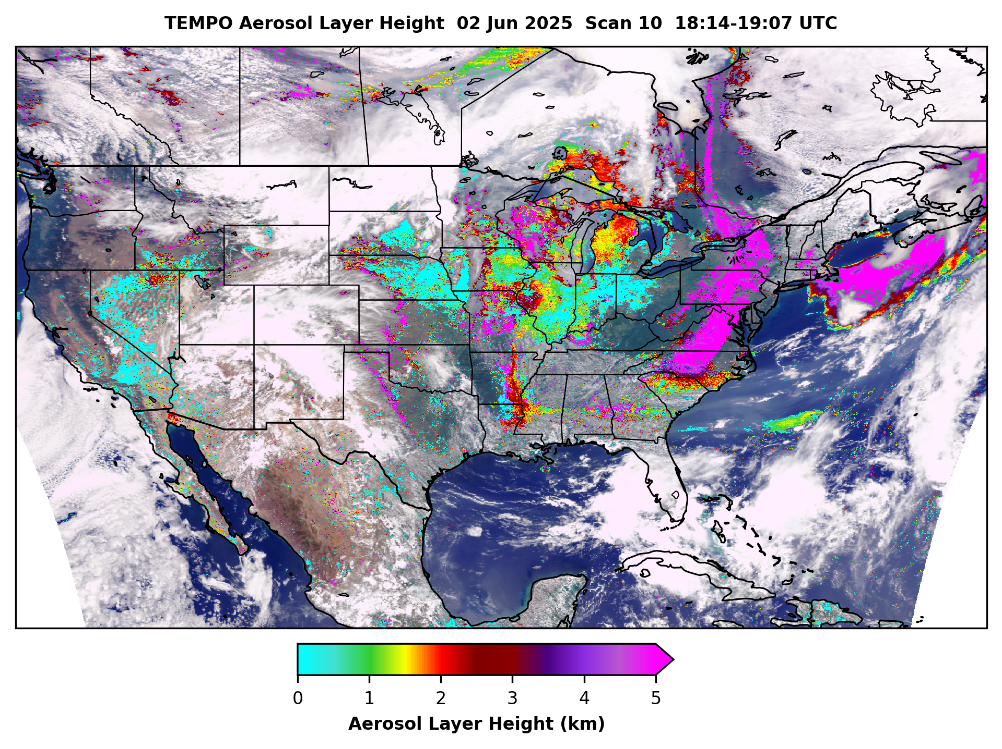
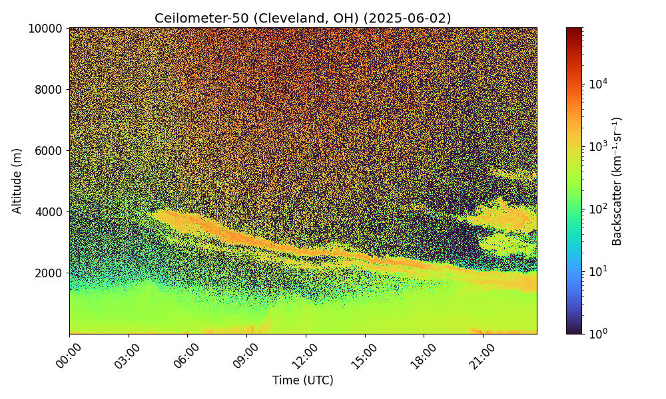
Ceilometer Profile Confirms TEMPO Smoke Layer Height on June 2
PAMS ceilometer in Cleveland, Ohio shows smoke mixed down to the boundary layer by ~18:30 UTC; correlates with aerosol layer height from TEMPO Scan 10
Smoke plume
Ceilometer plot courtesy of Jim Szykman (US EPA)

Slide 10
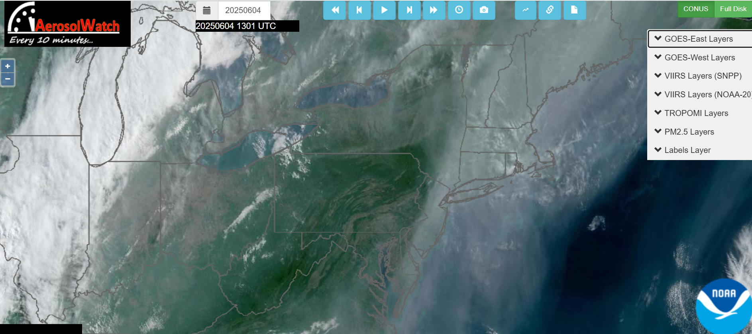
Summary
NOAA aerosol satellite imagery provides vital observations during smoke transport events
  Helps operational air quality forecasters issue accurate alerts to public
  Allows people to take action to minimize exposure to harmful conditions
Hourly surface PM_{2.5} estimated from TEMPO-ABI synergy fills gaps in the US regulatory monitor network & gives end users critical info on current
air quality conditions
TEMPO-ABI products have enhanced coverage & potentially higher accuracy compared to ABI alone
  Plus new products from TEMPO, e.g. Aerosol Layer Height
Near real-time TEMPO aerosol imagery is coming to our group’s AerosolWatch website in the next 1-2 months!
Enter “NOAA AerosolWatch” in your favorite search engine!

