Slide 1

TEMPO-ABI PM_{2.5} Product Development and Validation
Hai Zhang¹, Shobha Kondragunta², Pubu Ciren¹
¹STC at NOAA; ²NOAA
CEOS AC-VC #21 2025
Japan/virtual, June 9-12,2025
Disclaimer: The scientific results and conclusions, as well as any views or opinions expressed
herein, are those of the author(s) and do not necessarily reflect those of NOAA or
the Department of Commerce.

Slide 2
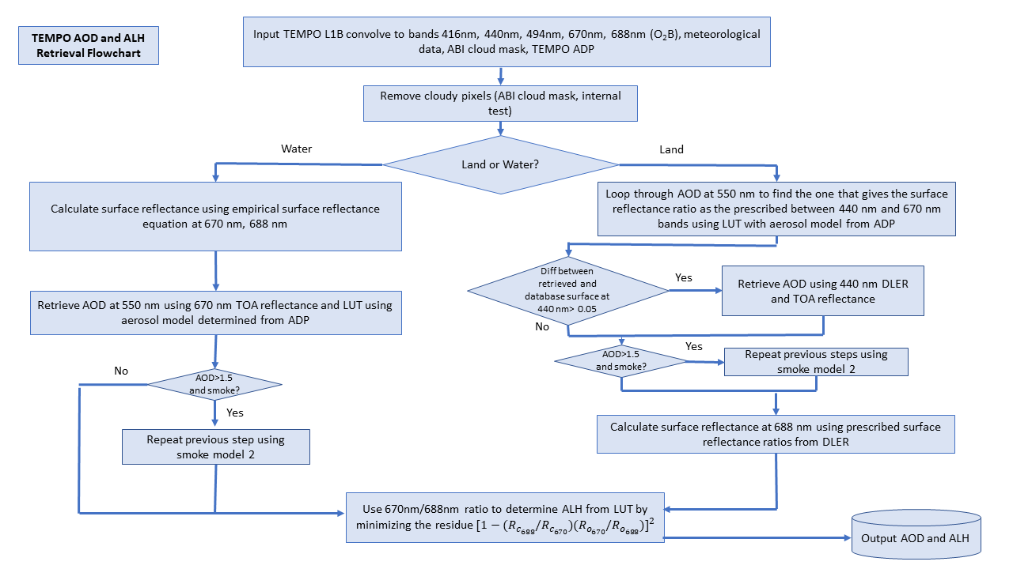
TEMPO AOD and ALH Retrieval
The algorithm retrieves AOD and ALH from convolved blue and red bands
Aerosol model selection based on the TEMPO ADP smoke dust mask
Use Look-up Table (LUT) generated from RTM
TEMPO Directional Lambertian Equivalent Reflectivity (DLER) Database
  Generated from TEMPO atmospheric corrected L1b data
TEMPO L1b data soft calibration

Slide 3
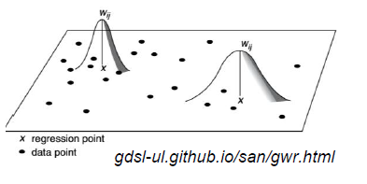
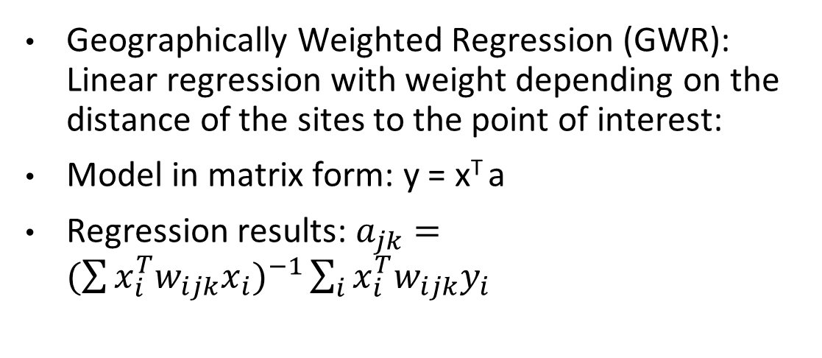
Geographically Weighted Regression (GWR) to estimate PM_{2.5} from AOD and ALH
Geographically Weighted Regression (GWR): Linear regression with weight depending on the distance of the sites to the point of interest:
Model in matrix form: y = x^{T} a
Regression results: $a_{jk}=(\sum{{x_{i}^{T}w_{ijk}x_{i})}^{−1}}\sum_{i}{x_{i}^{T}{w_{ijk}y}_{i}}$
GWR becomes simple linear regression if the weight is set to 1
Regression coefficients are updated dynamically for each time step using the satellite surface matchup data: Every hour for hourly PM_{2.5} estimates
The dynamic adjustment of the regression relation can catch the temporal and spatial variation of the PM_{2.5} and AOD-ALH relationship

Slide 4
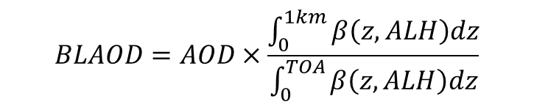
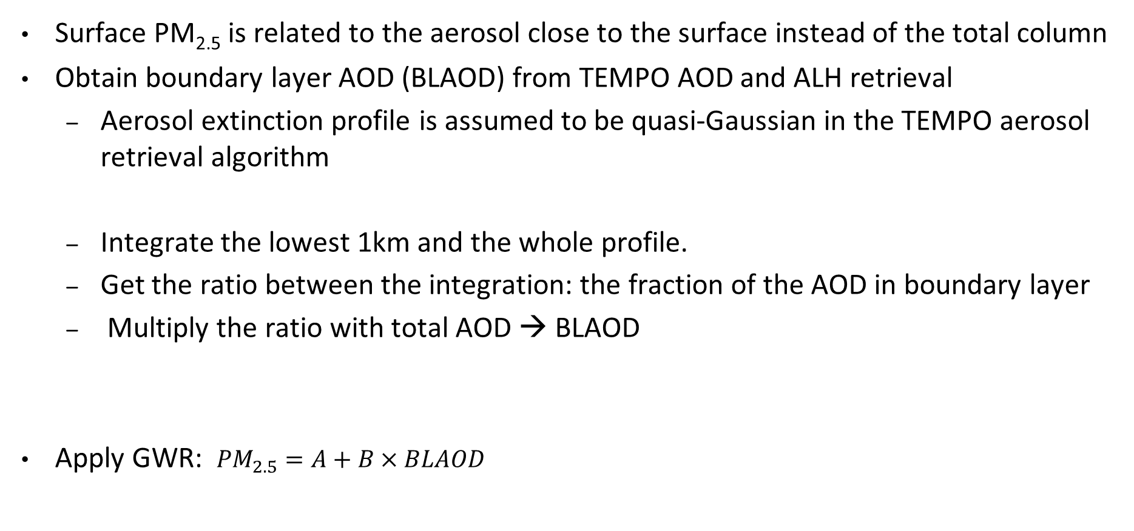
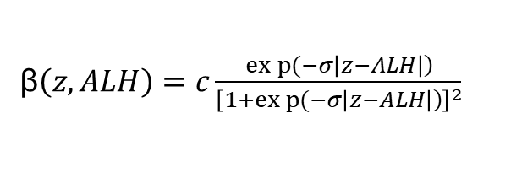
GWR for TEMPO PM_{2.5} estimates
Surface PM_{2.5} is related to the aerosol close to the surface instead of the total column
Obtain boundary layer AOD (BLAOD) from TEMPO AOD and ALH retrieval
  Aerosol extinction profile is assumed to be quasi-Gaussian in the TEMPO aerosol retrieval algorithm
  Integrate the lowest 1km and the whole profile.
  Get the ratio between the integration: the fraction of the AOD in boundary layer
  Multiply the ratio with total AOD → BLAOD
Apply GWR: ${PM}_{2.5}=A+B×BLAOD$
β$\left(z, ALH\right)=c\frac{\left.exp{(}−σ\left|z−ALH\right|\right)}{{\left[\left.1+exp{(}−σ\left|z−ALH\right|\right)\right]}^{2}}$
$$BLAOD=AOD×\frac{\int_{0}^{1km}{β\left(z,ALH\right)dz}}{\int_{0}^{TOA}{β\left(z,ALH\right)dz}}$$

Slide 5
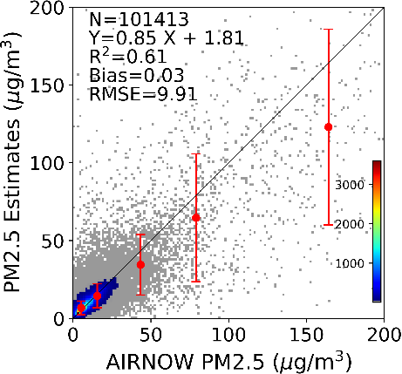
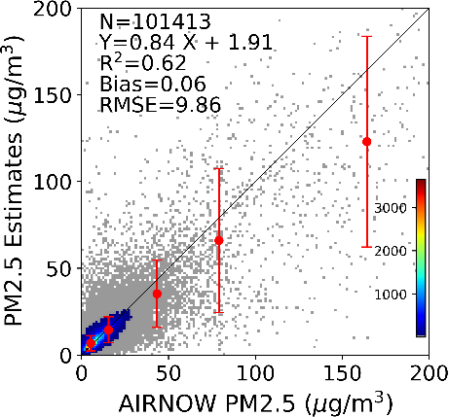

TEMPO PM_{2.5} 10-fold cross validation (August 2023)
Use boundary layer AOD
PM_{2.5}=A+BxBLAOD
AOD only
PM_{2.5}=A+BxAOD
Use both AOD and ALH
PM_{2.5}=A+BxAOD+CxALH
  For most matchups, aerosols are in boundary layer. Adding ALH information doesn’t help.
  The estimates from AOD implicitly include the ALH information: the regression coefficients are derived from nearby sites; for high ALH, we can get low PM_{2.5} estimates even though AOD retrievals are high, if it is represented by the matchup data from nearby sites.
  The improvements may be find when ALH is high and nearby sites matchups do not contain ALH information

Slide 6
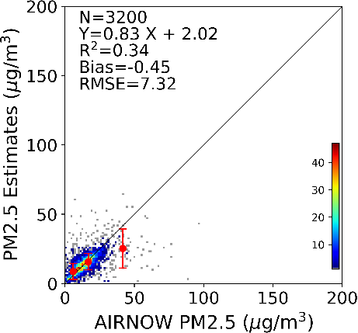
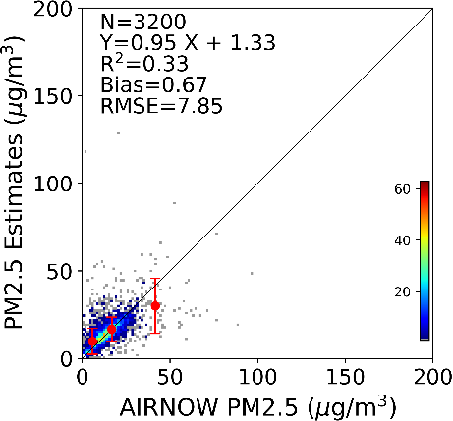

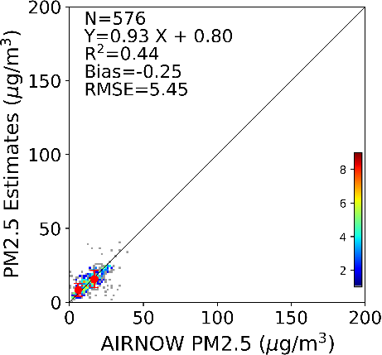
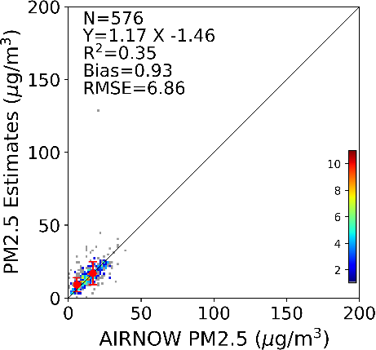

Matchups with High ALH
Use boundary layer AOD
PM_{2.5}=A+BxBLAOD
AOD only
PM_{2.5}=A+BxAOD
Use both AOD and ALH
PM_{2.5}=A+BxAOD+CxALH
ALH>3km
3.2%
of total matchups
ALH > 5km 0.5% of total matchups

Slide 7
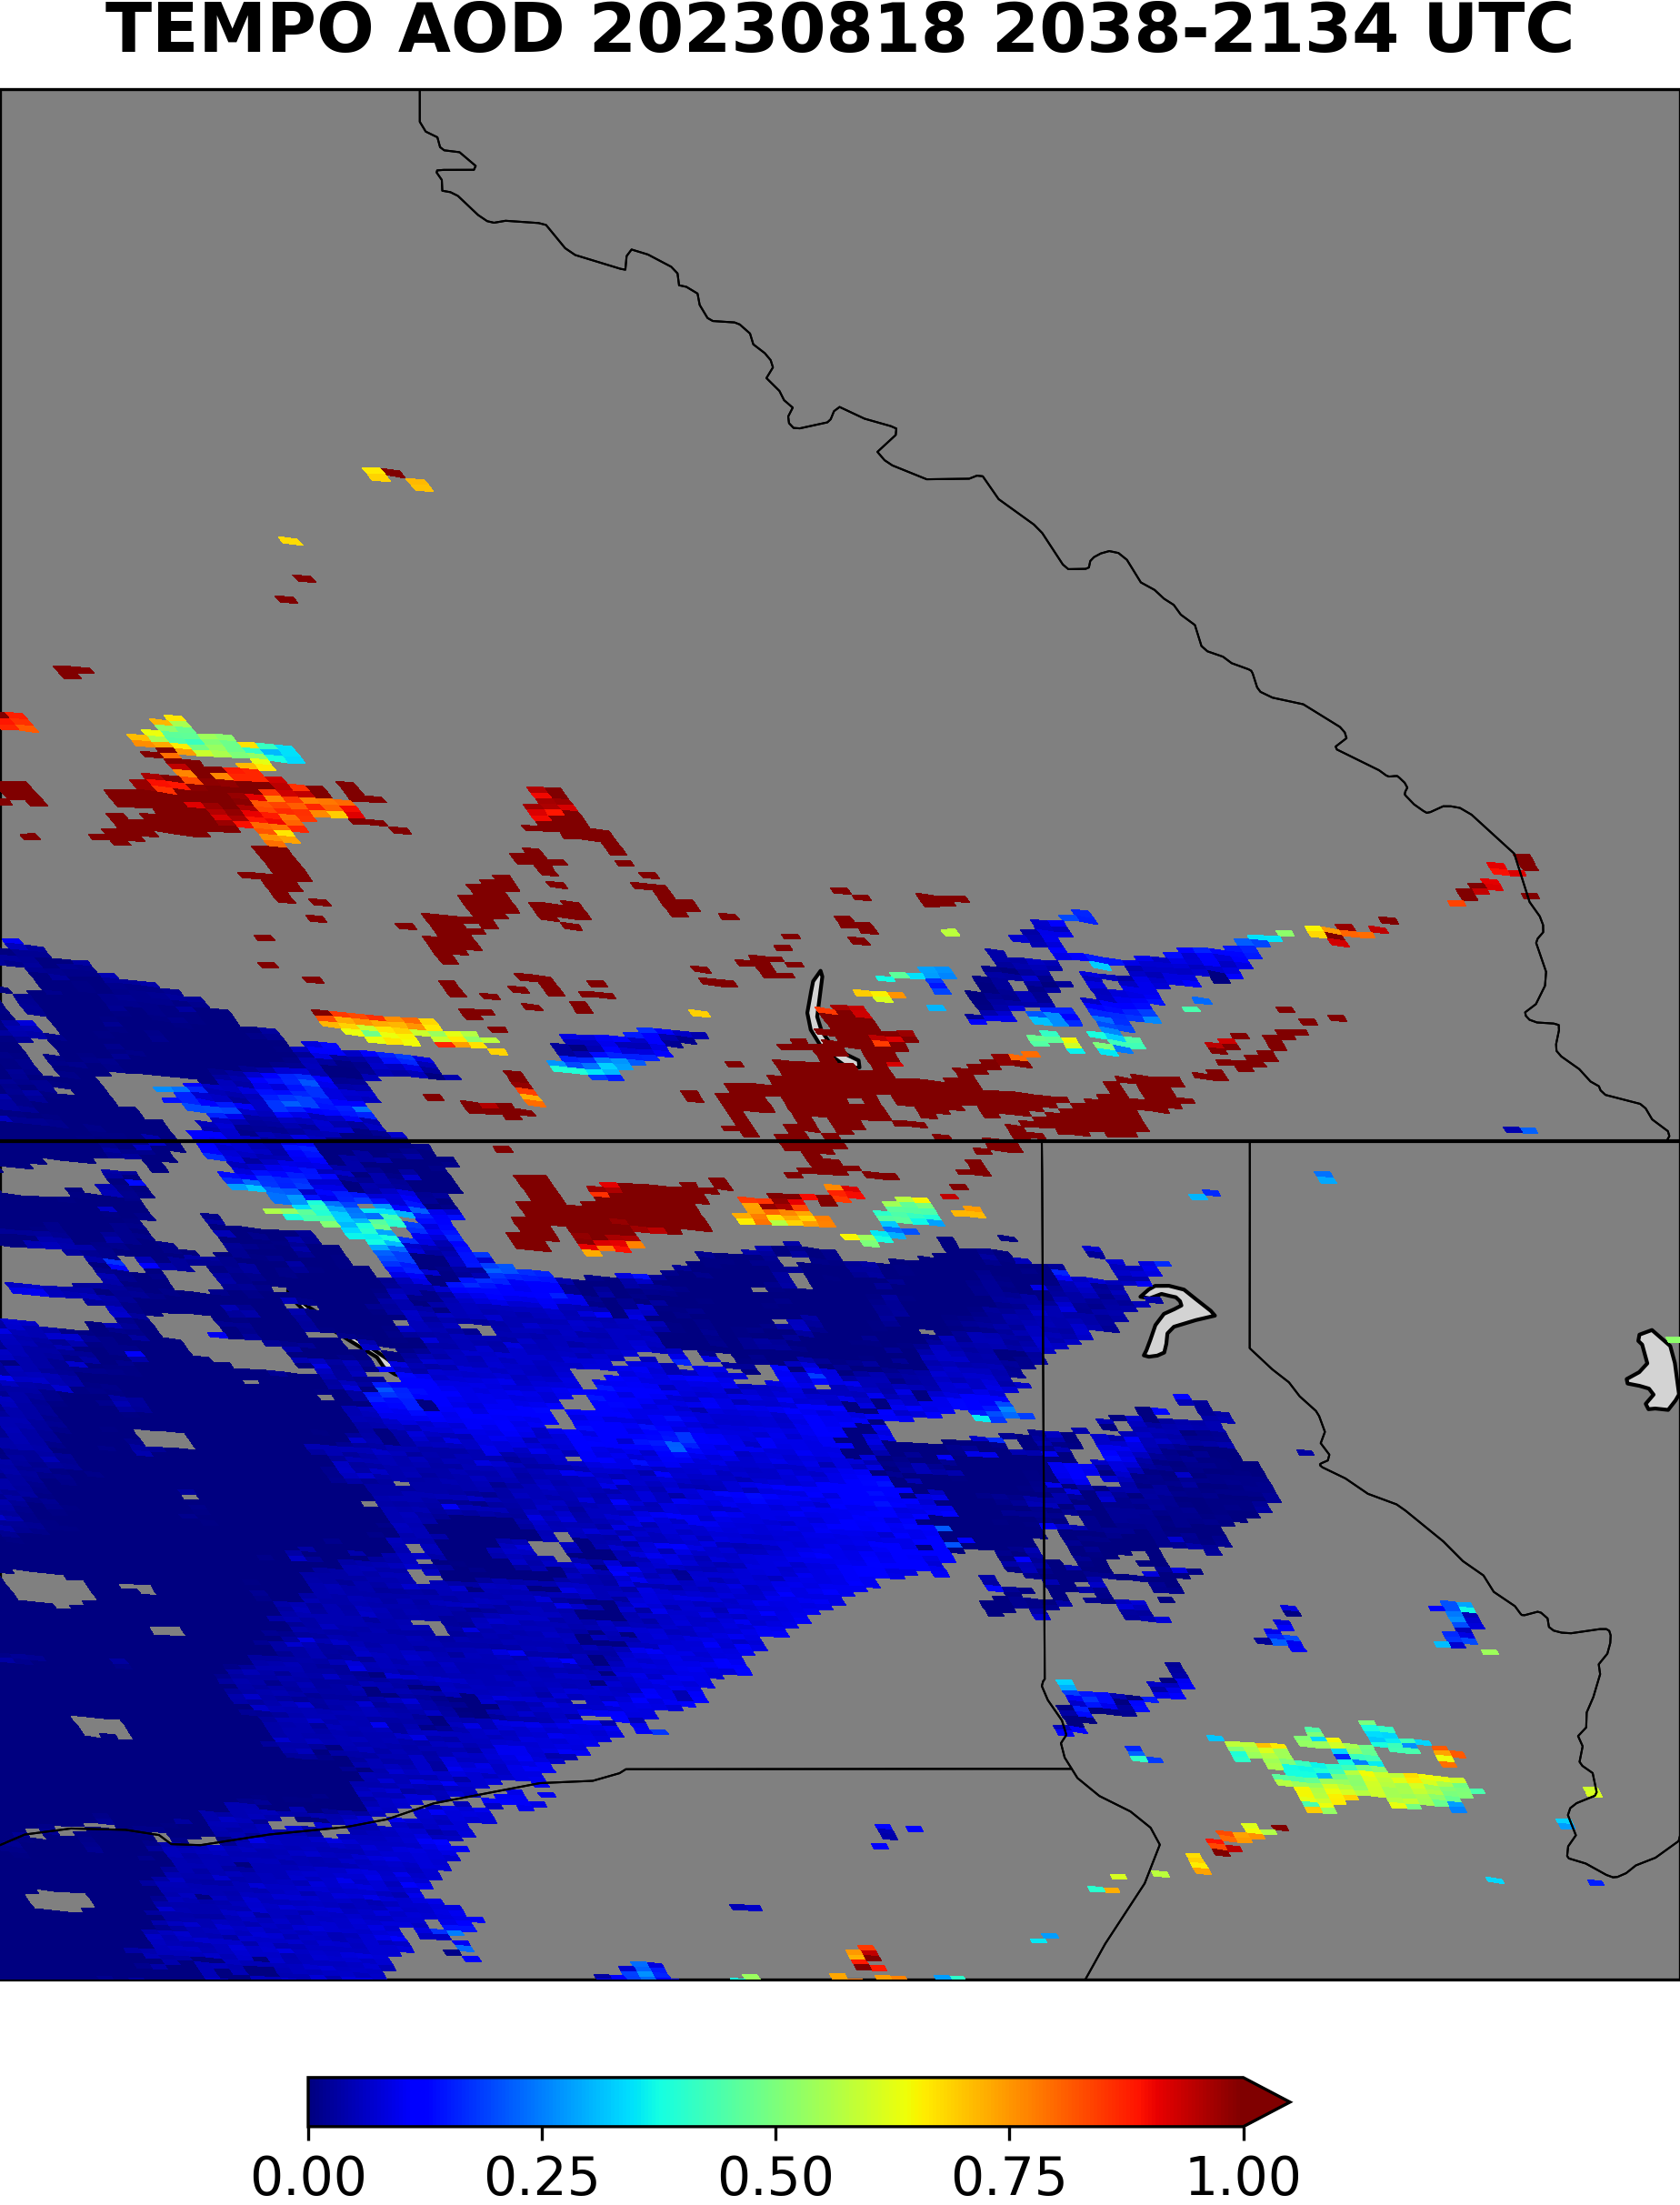
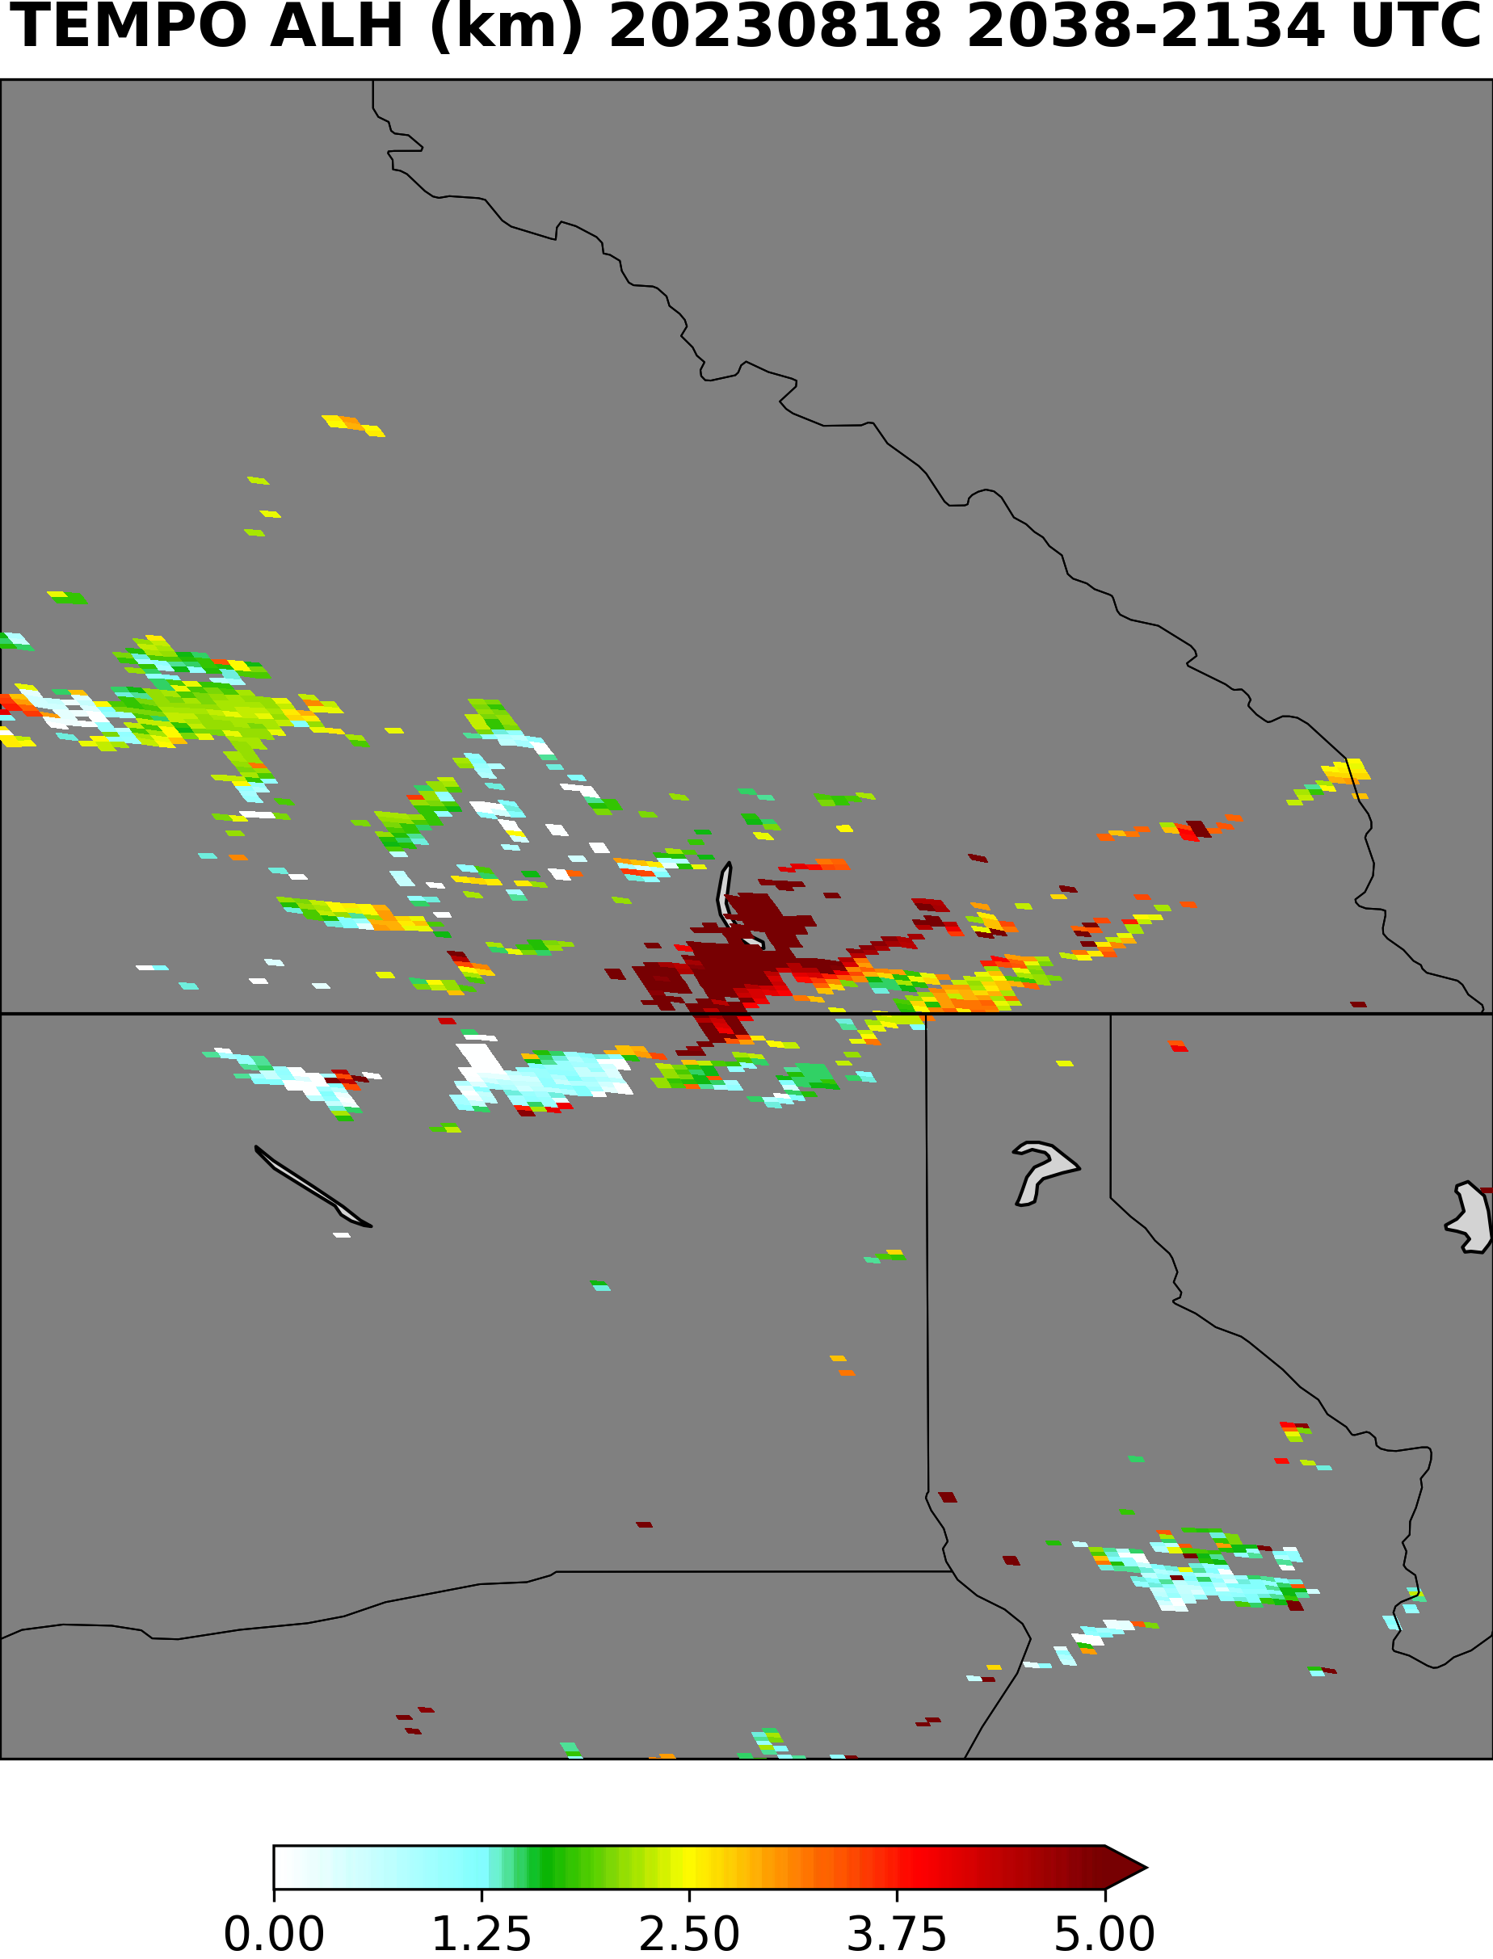
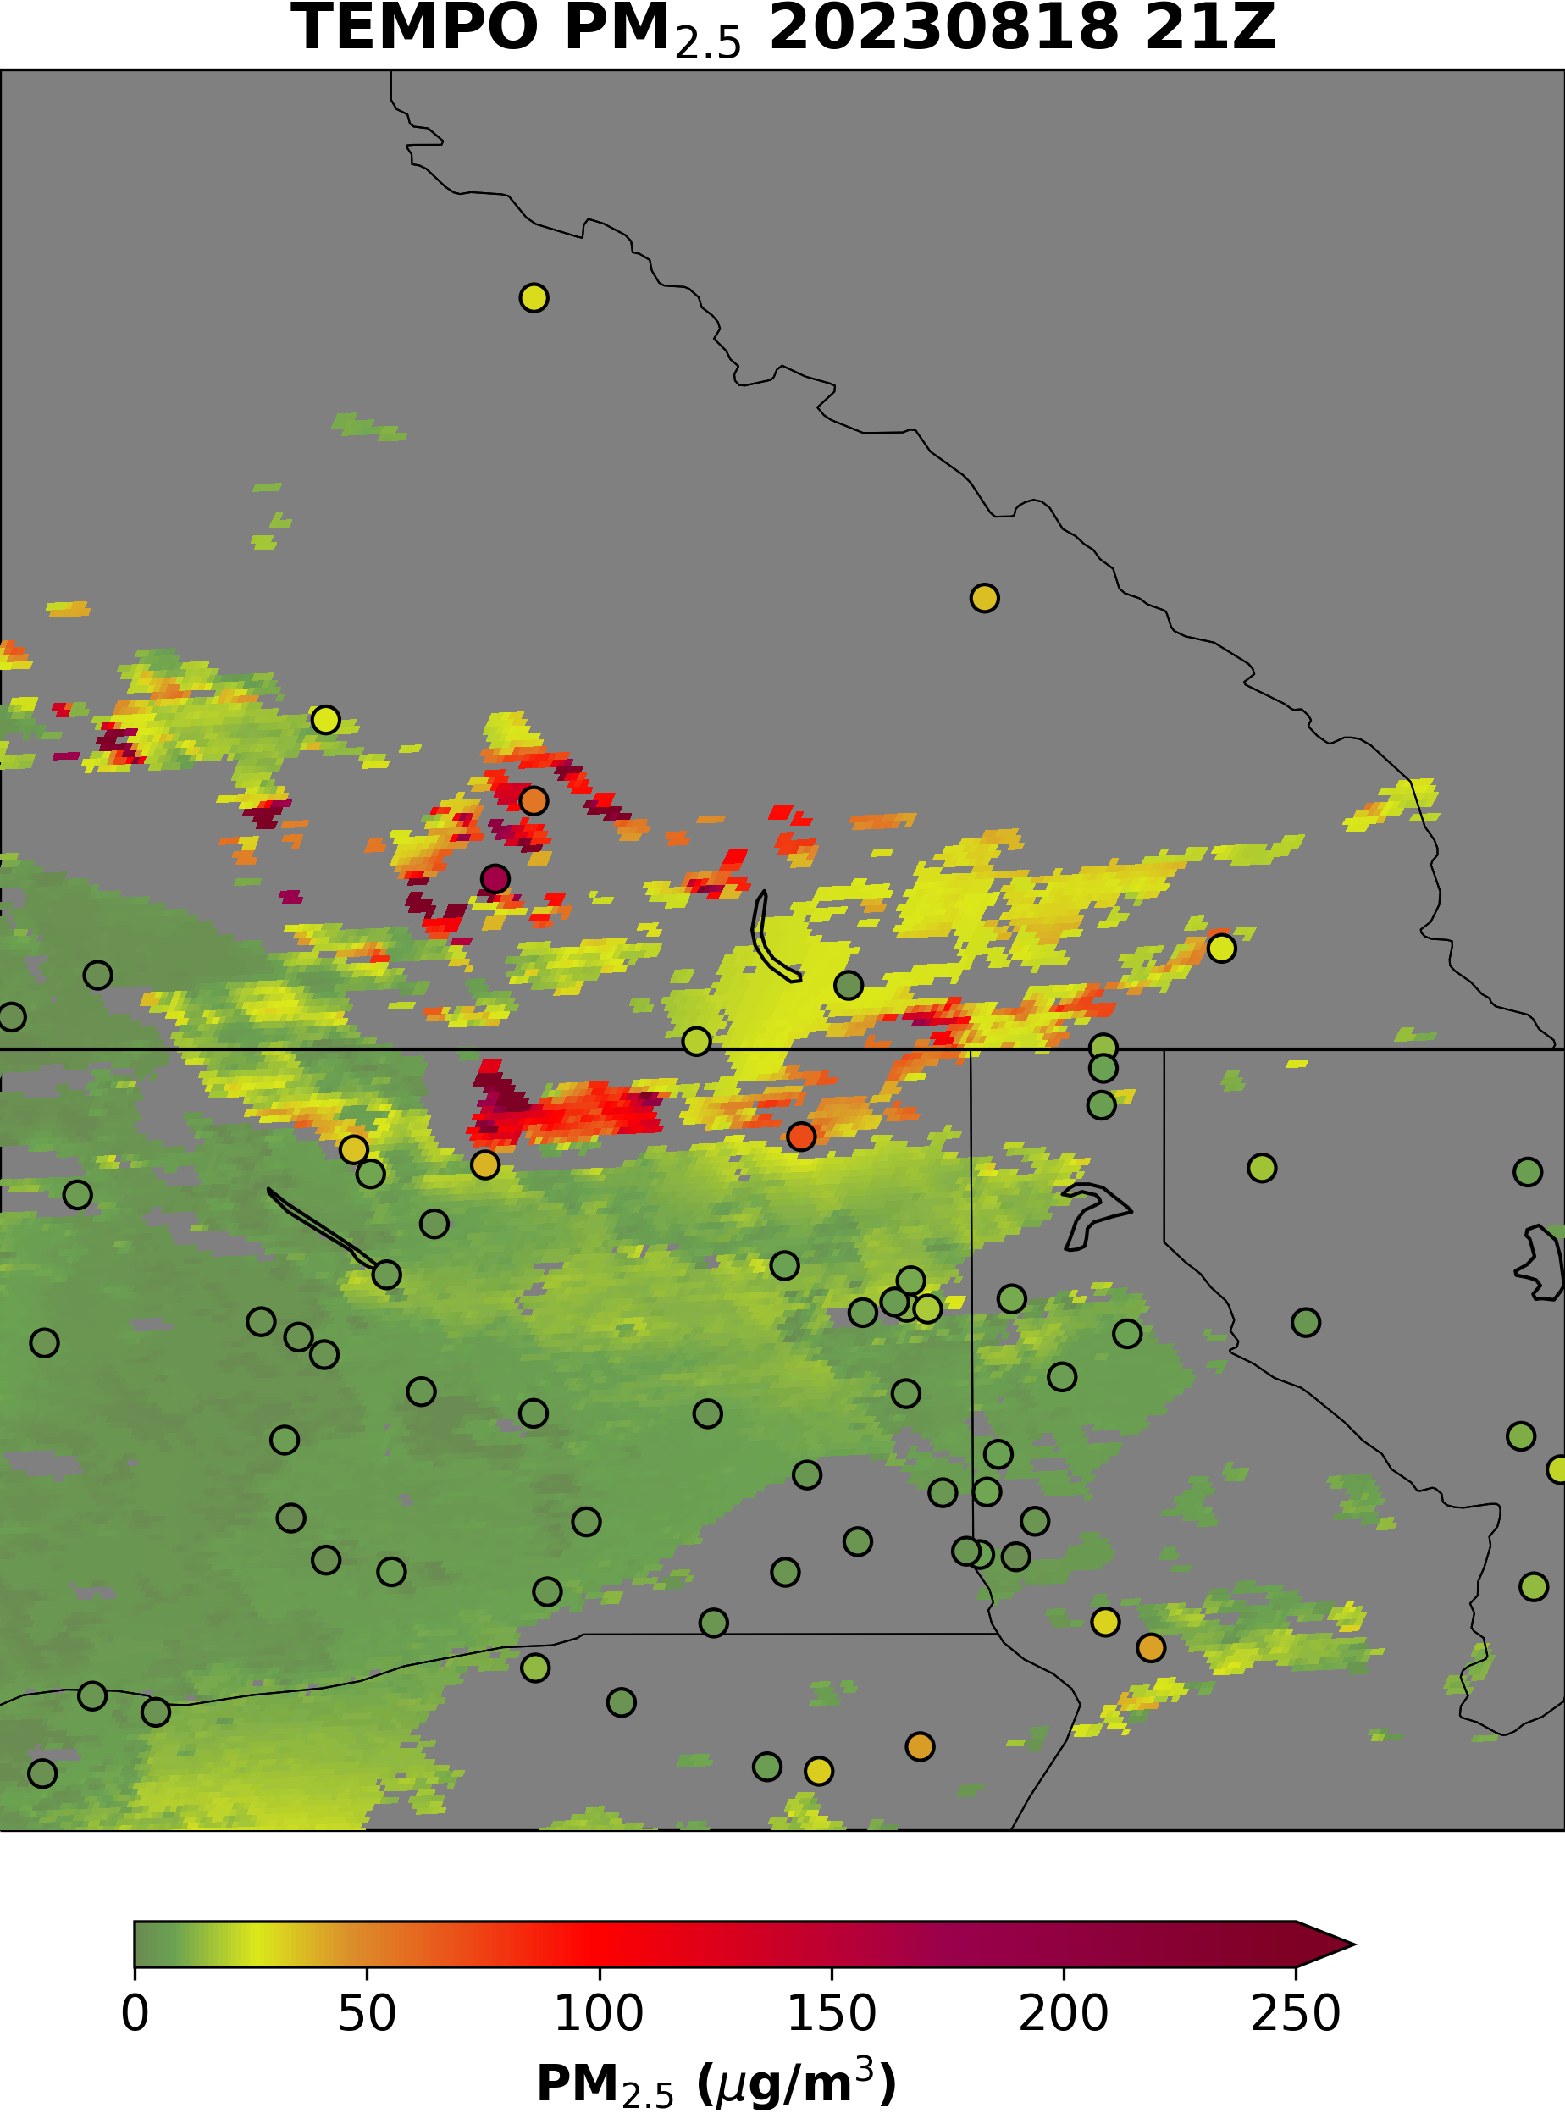
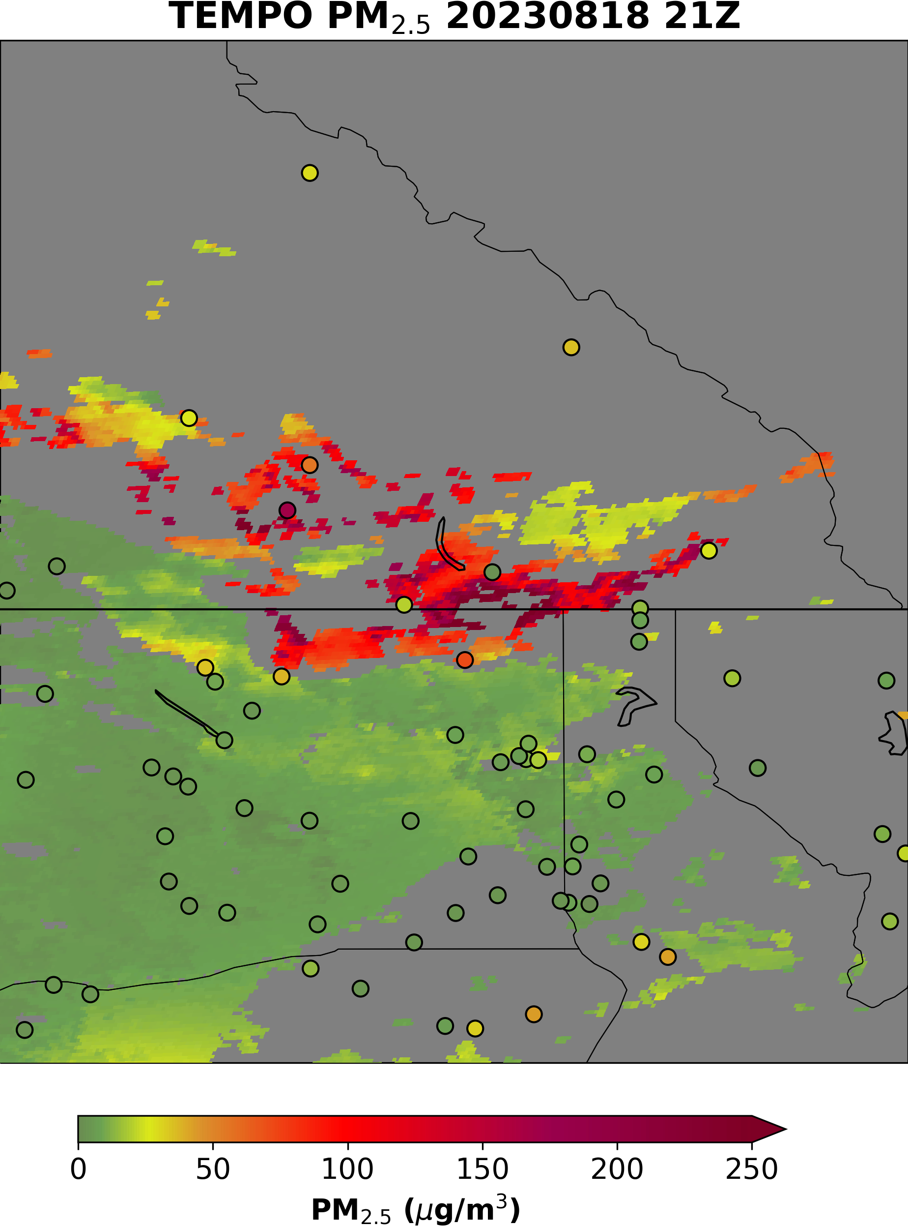
A case study from 10-fold cross validation
Use Boundary Layer AOD
Use AOD

Slide 8
A case study from 10-fold cross validation
Use Boundary Layer AOD
Use AOD
The area within the circle has high AOD and high ALH, surface PM_{2.5} measurements are also low: aerosols not in the boundary layer
The two sites in the smoke plume are among the sites that are removed for deriving GWR relations
The use of the boundary layer AOD method improves the estimates in this area

Slide 9
Merge TEMPO and ABI Hourly PM_{2.5} estimates
ABI AOD
TEMPO AOD
TEMPO ALH
GWR using AOD
AIRNOW PM_{2.5}
GWR using boundary layer AOD method
Merge
Merged PM_{2.5} estimates

Slide 10
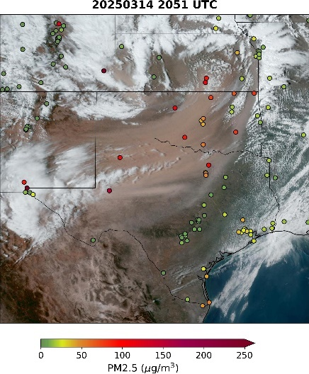
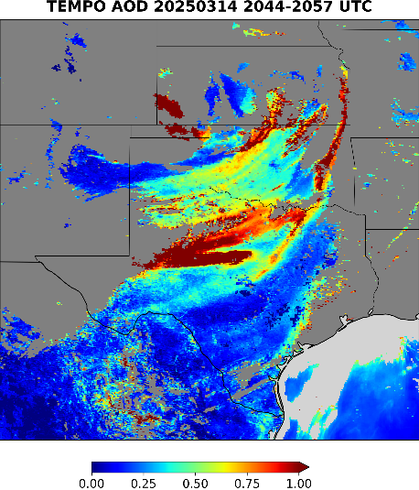
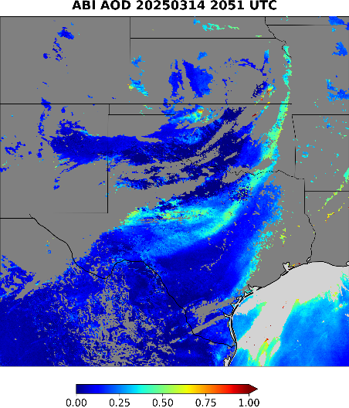
Merge TEMPO and ABI PM_{2.5} estimates
Take mean value if both have estimates. If only one has estimates, use the one.
Except two cases, in which we will use TEMPO estimates
  High ALH pixels (ALH > 3 km)
  Pixels with dust aerosol from TEMPO retrieval, where TEMPO has better retrieval
ABI geocolor

Slide 11
Summary
The TEMPO AOD and ALH retrievals are used to estimate PM_{2.5} over CONUS
A new approach is proposed that first estimates boundary layer AOD from AOD and ALH retrieval, and then estimates PM_{2.5} using GWR algorithm
The validation shows that in high ALH situations the PM_{2.5} improves compared to those using AOD only
TEMPO and ABI estimates PM_{2.5} are merged
The merged product may improve the ABI only PM_{2.5} estimates for situations such as high ALH and dust pixels.

