Slide 1
JPSS and Near Earth Orbit Network Mission Update
Satya Kalluri
Senior Scientist
Office of Low Earth Orbit (LEO) Observations
Satya.kalluri@noaa.gov
NOAA
CEOS AC-VC21
2025
Contributors: Brian McDonald, Own Cooper (NOAA/OAR), Kai Yang (UMD/CISESS), Shobha Kondragunta (NOAA/NESDIS)

Slide 2
Outline
Current status of JPSS mission
JPSS sensors and capabilities for measuring atmospheric composition
Recent examples of atmospheric composition application from JPSS data
NOAA intense flight campaigns for measuring atmospheric composition
Status of atmospheric composition data assimilation and modeling in NOAA’s Unified Forecast Modeling system
Plans for CrIS IR sounder follow on sensor under NOAA Near Earth Orbit Network (NEON).

Slide 3
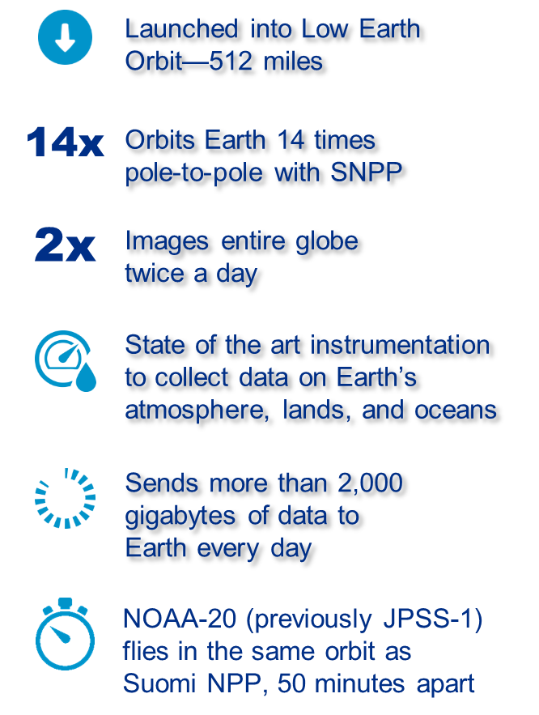
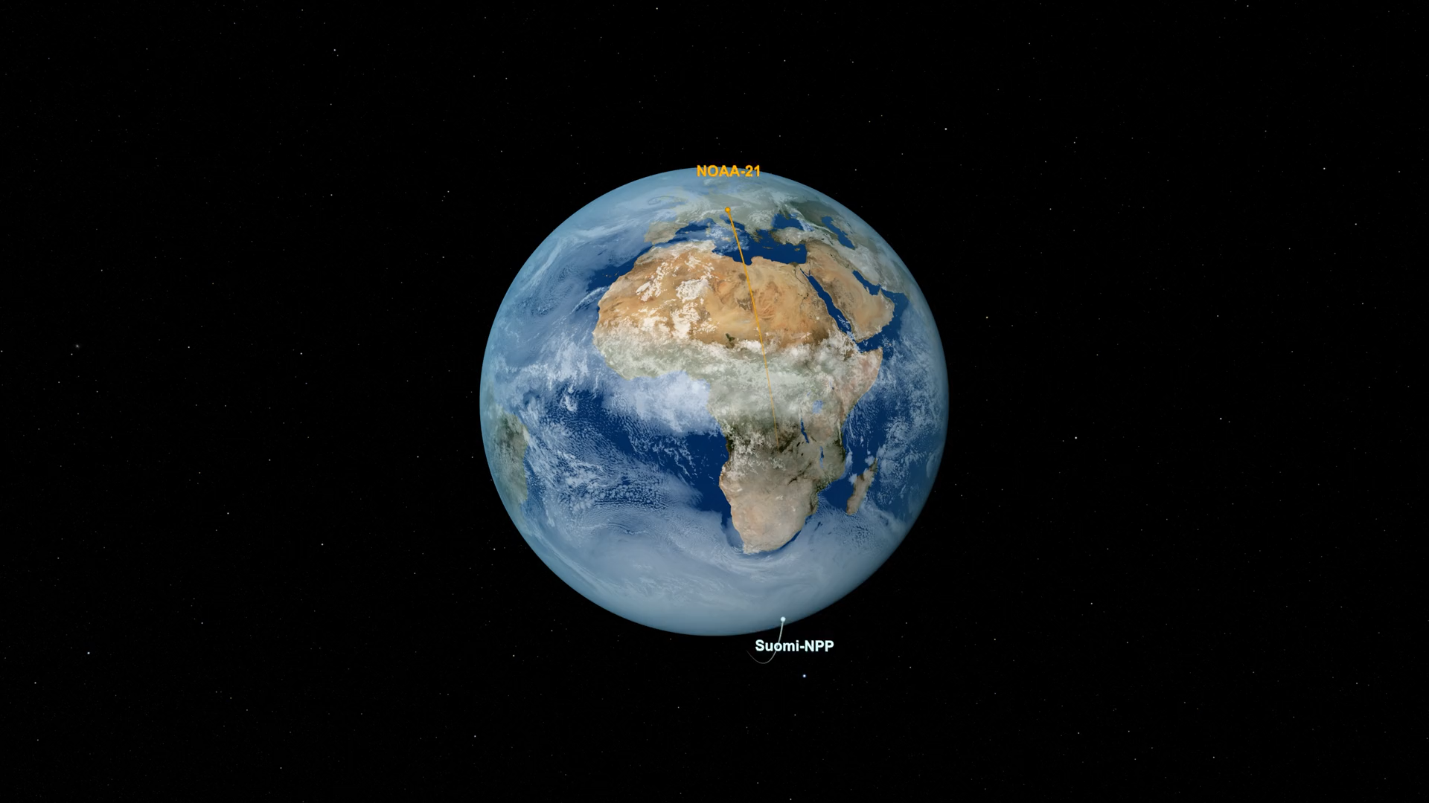
SNPP, NOAA20, NOAA21

Slide 4
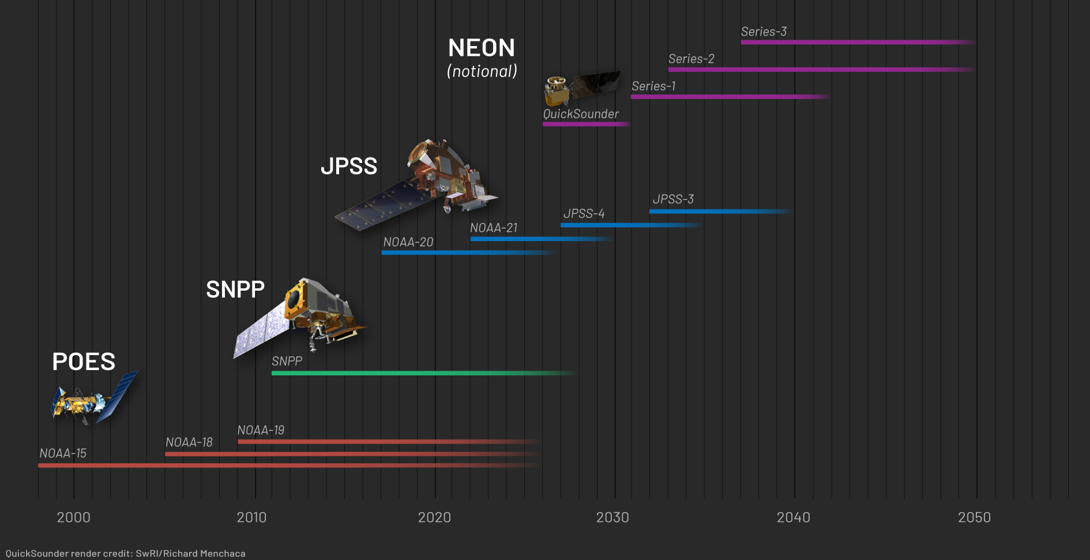
NOAA LEO Satellite Programs
4

Slide 5
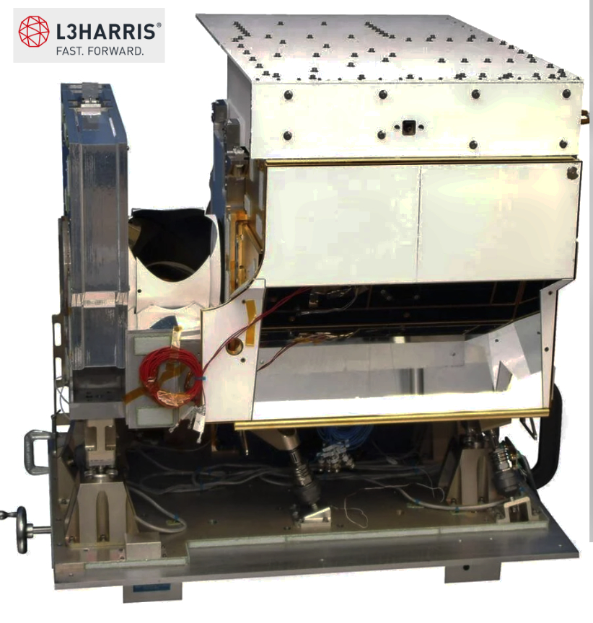
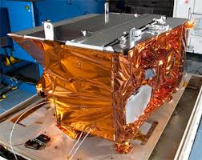
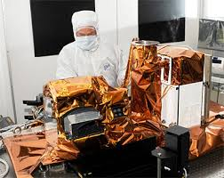
JPSS Sensors for Atmospheric Composition
Cross-track Infrared Sounder (CrIS)
Visible Infrared Imaging Radiometer Suite (VIIRS)
Ozone Mapping and Profiler Suite (OMPS)
CO, CO₂, O₃, CH₄
Aerosols, Smoke, Dust
O₃, SO₂, NO₂, Aerosol Index

Slide 6
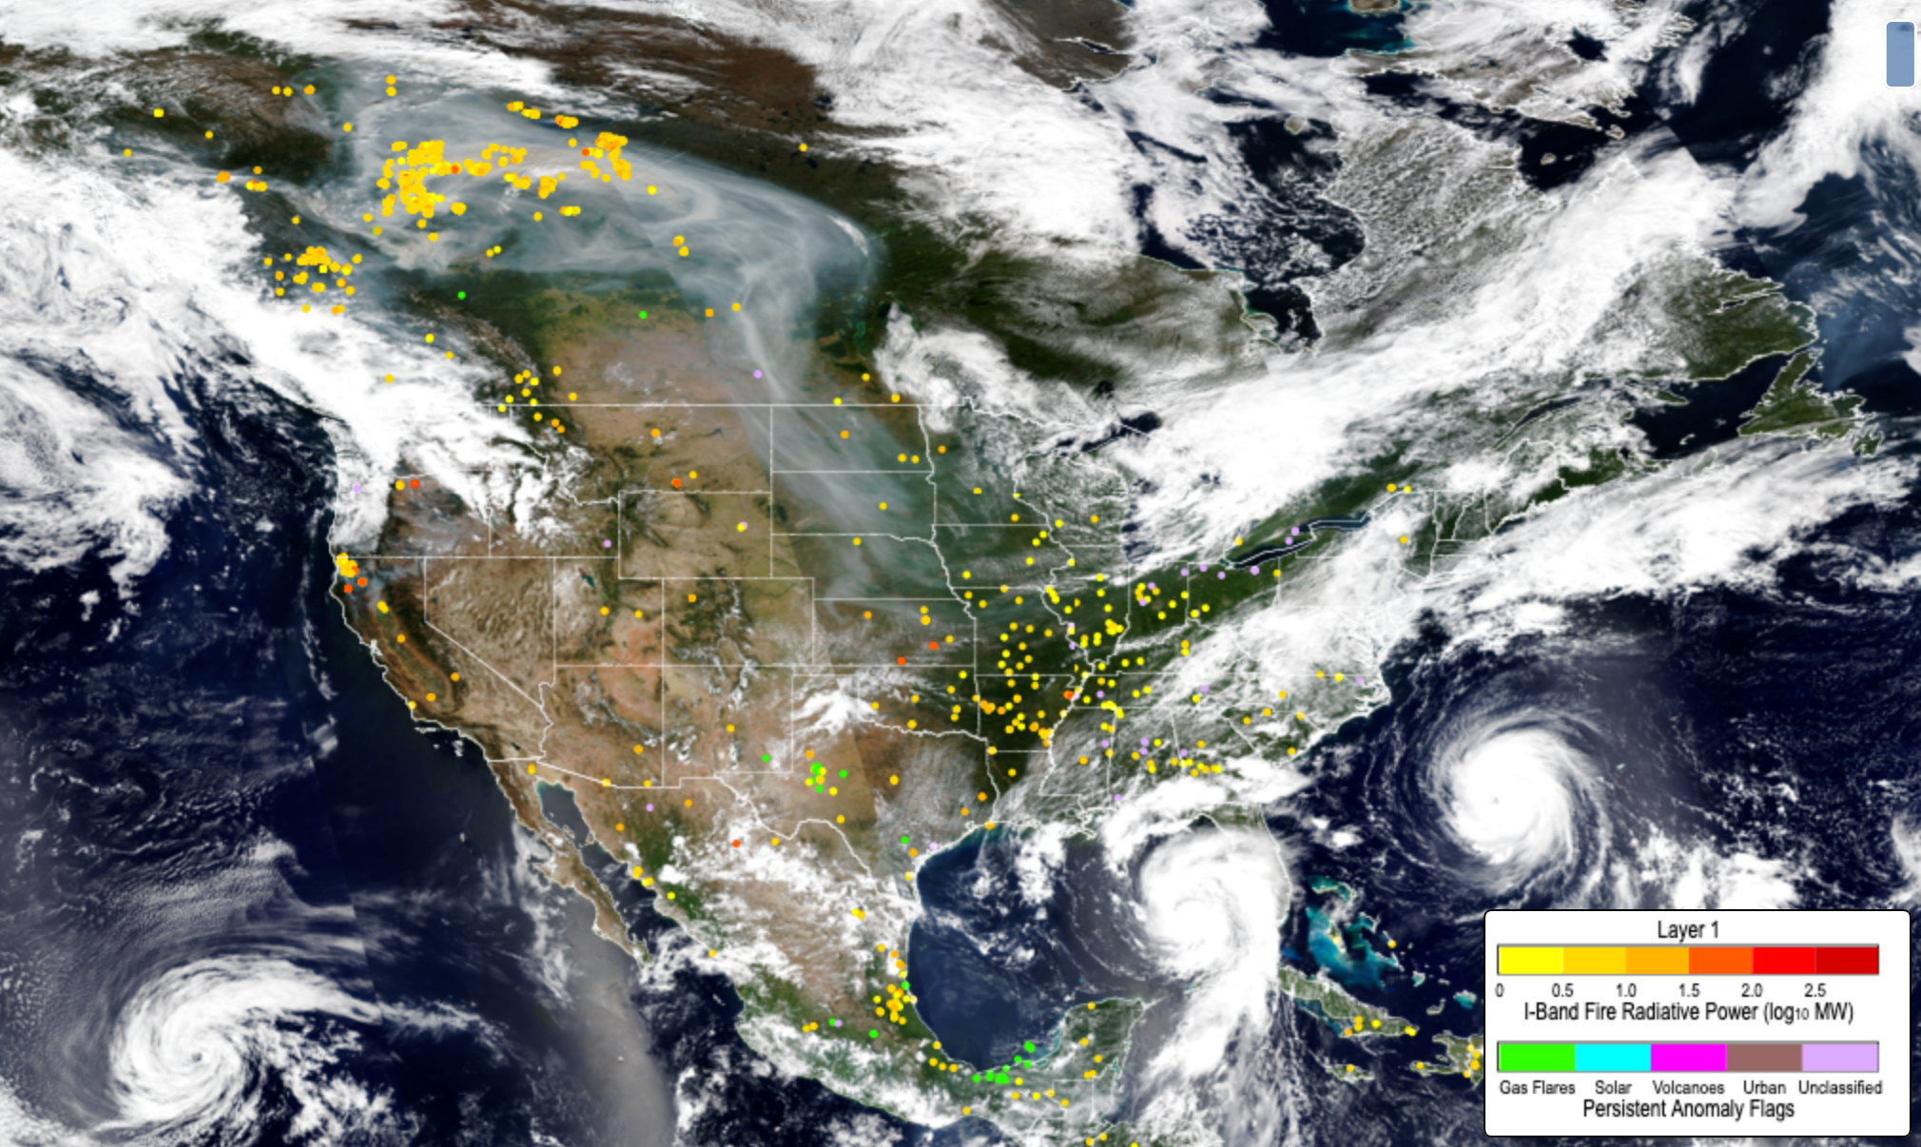
NOAA 21 VIIRS August 29, 2023
Franklin
Idalia

Slide 7
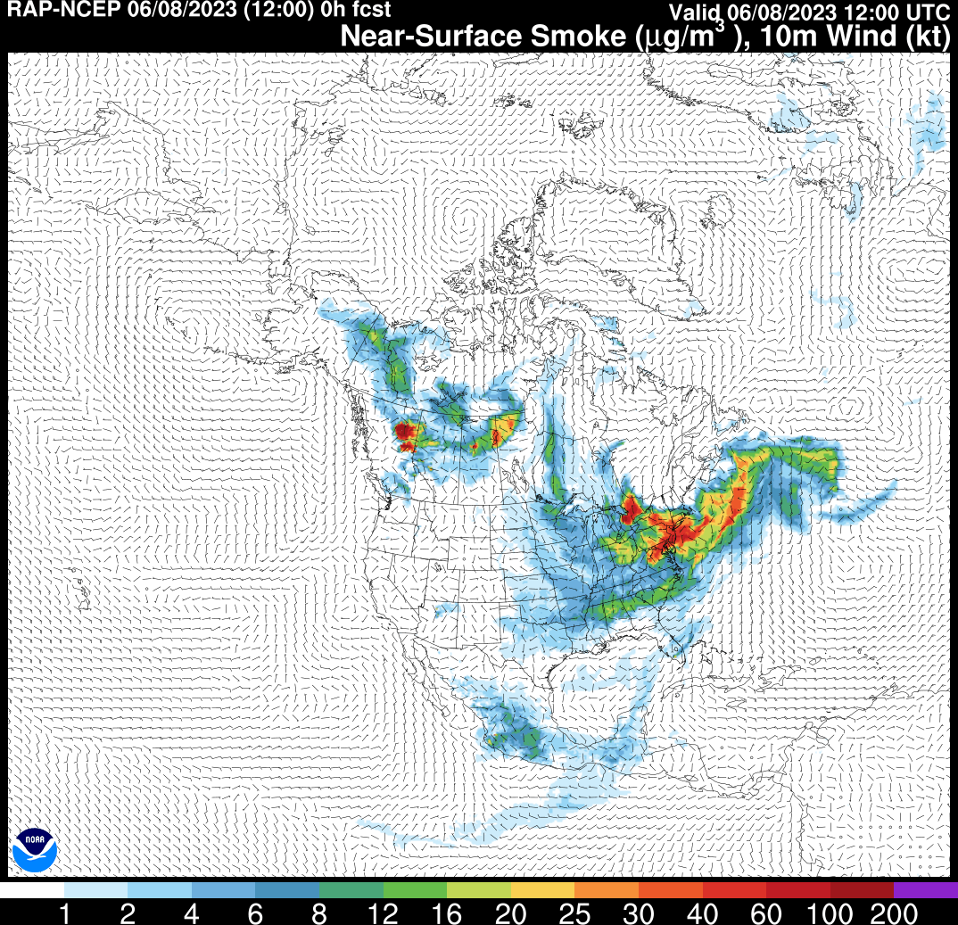
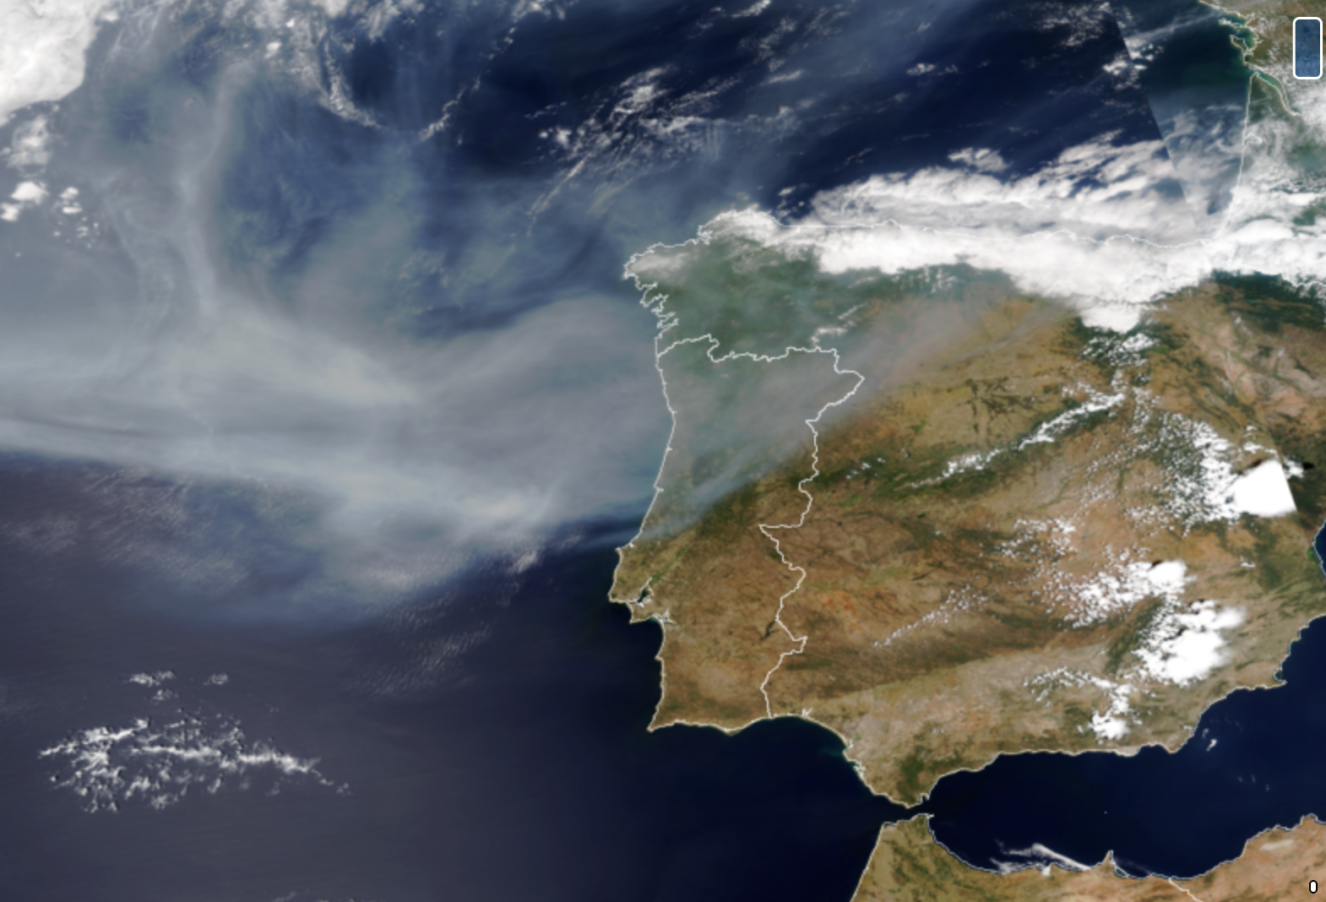
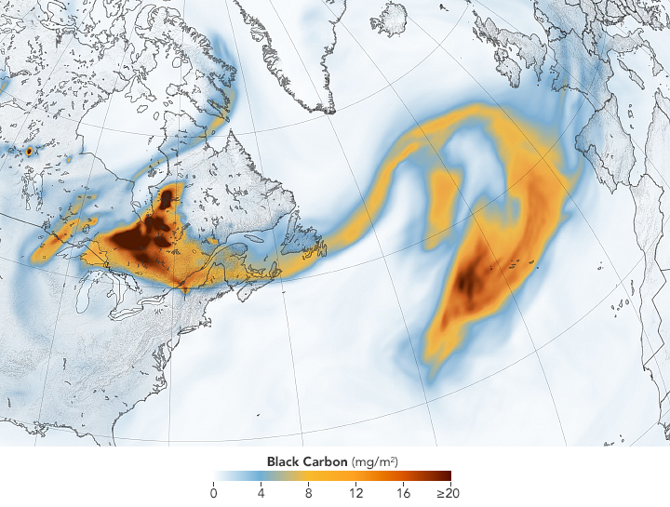
Canadian Fires Monitored by VIIRS
PORTUGAL
SPAIN
NOAA21 VIIRS
June 26, 2023
Ravan Ahmadov
NASA GEOS-FP

Slide 8
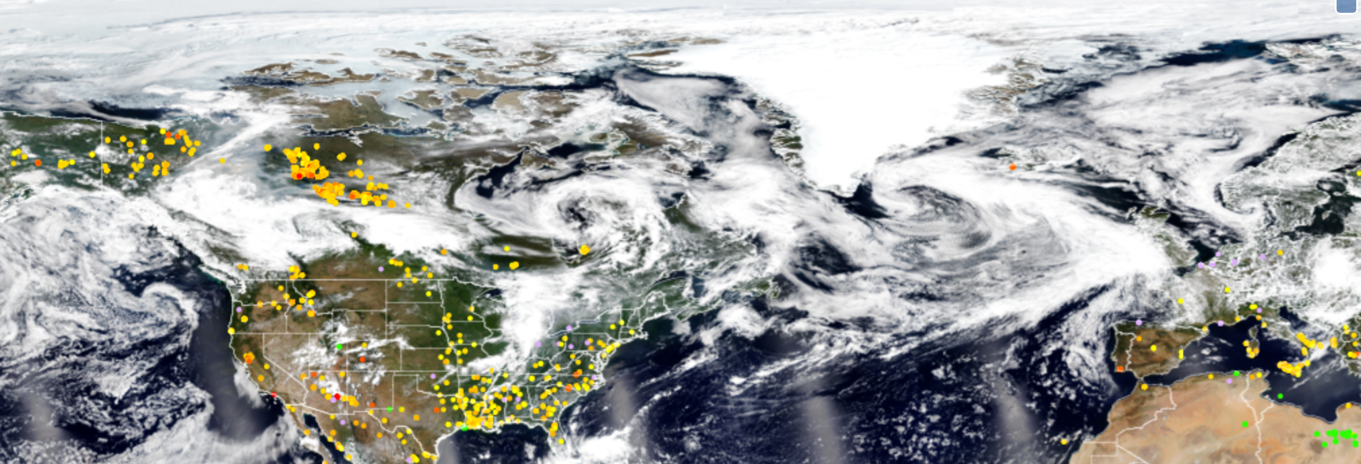
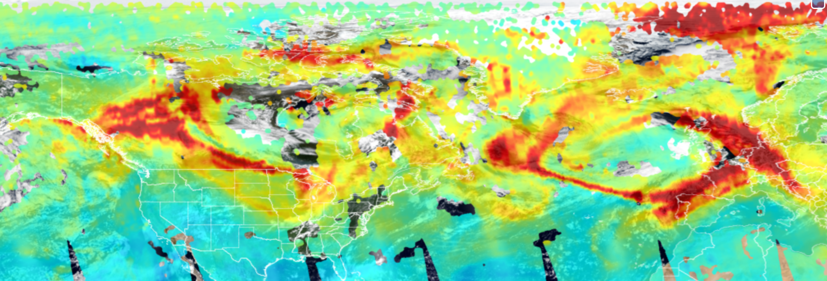
Carbon Monoxide From Canadian Fires Observed by CrIS June 26, 2023
VIIRS Active Fires
CrIS CO

Slide 9
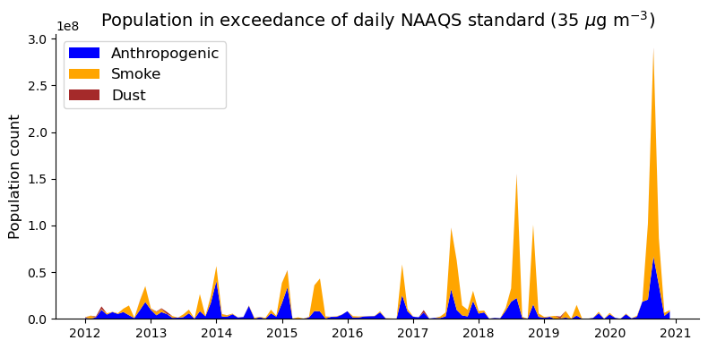
VIIRS PM2.5 Retrievals
SNPP VIIRS PM2.5 data shows that there is an increasing trend in smoke related exceedances of EPA National Ambient Air Quality Standard in the United States

Slide 10
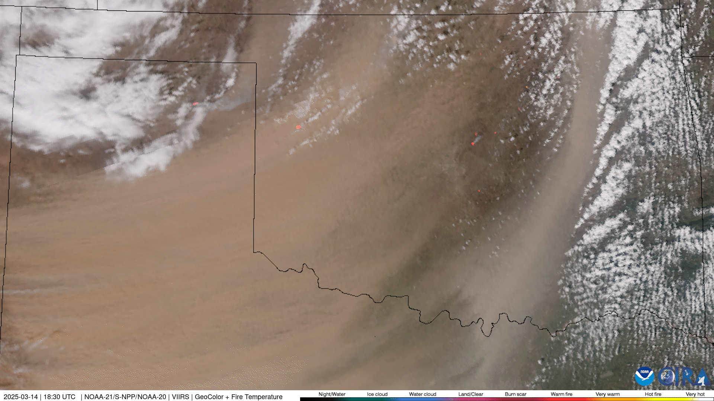
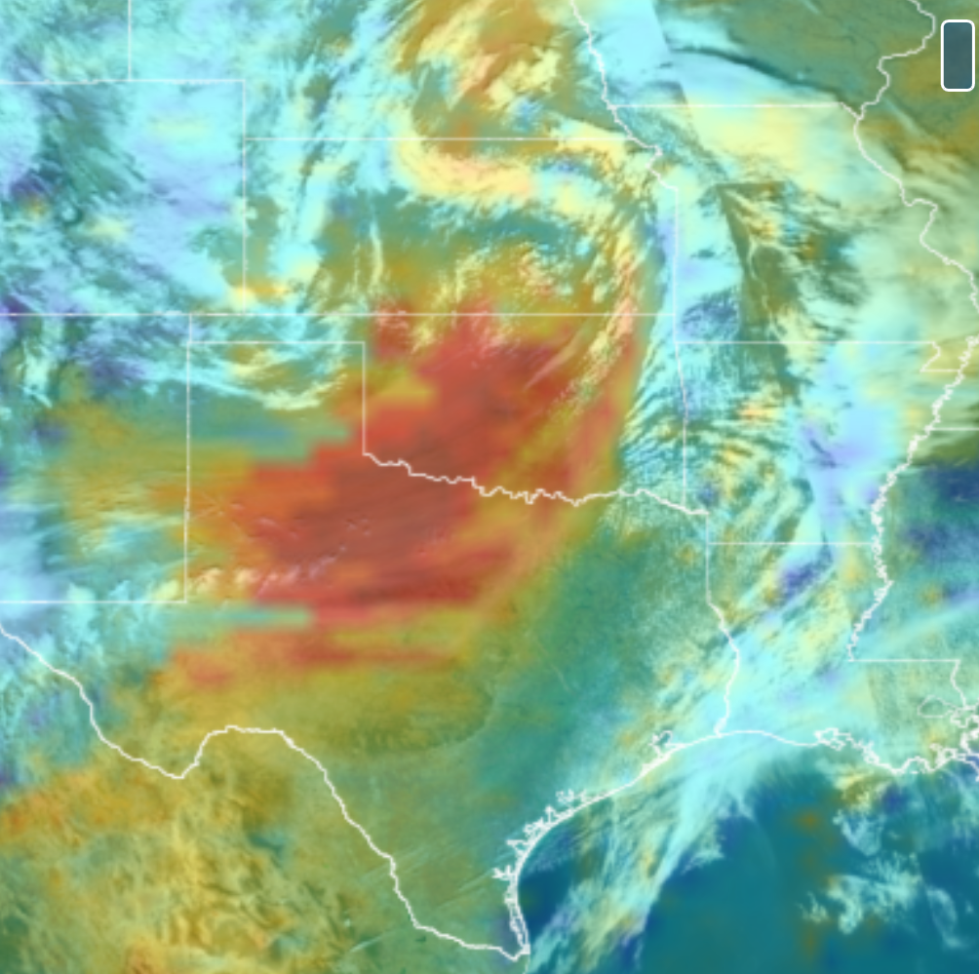
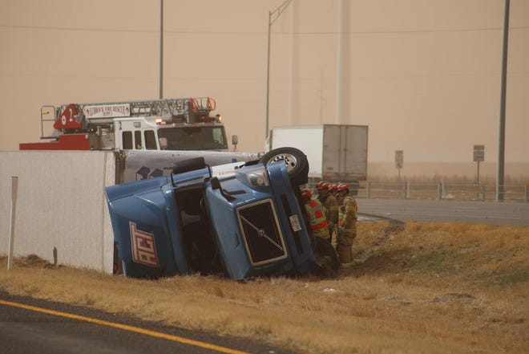
Texas Dust Storm, March 14, 2024
NOAA21 OMPS
March 14, 2024
© 2024 AFP
Photo: Lubbock Fire Rescue

Slide 11
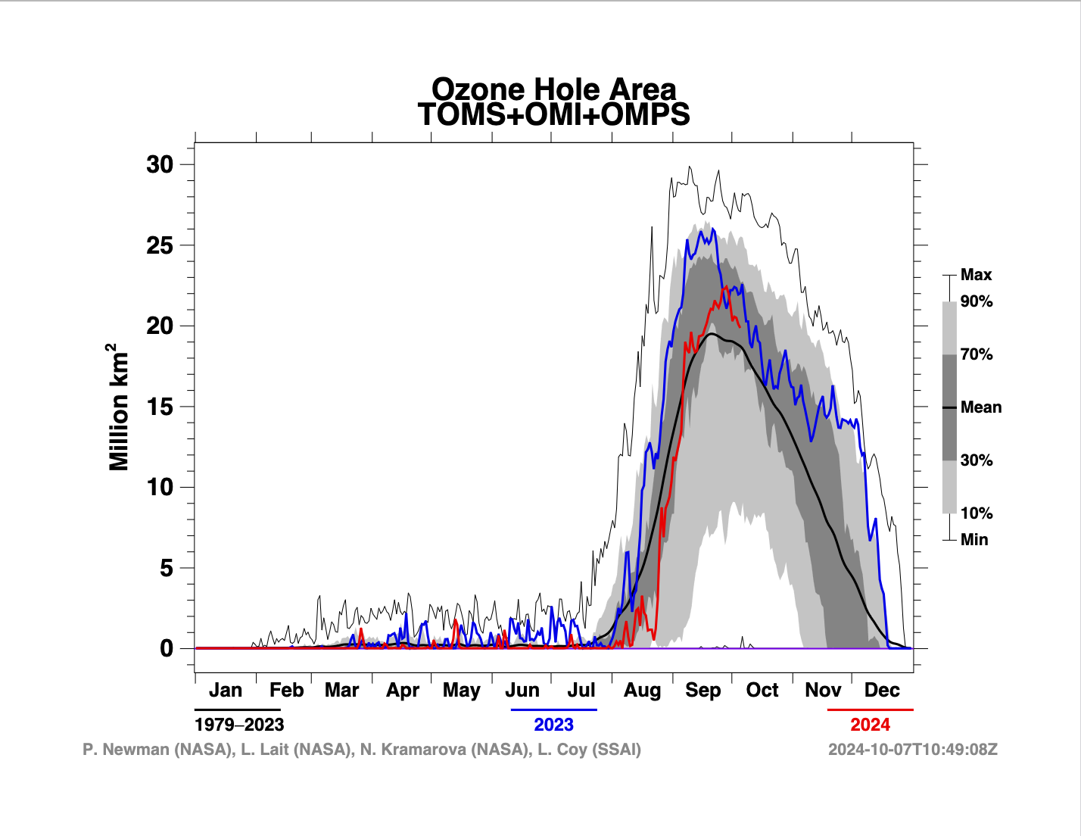
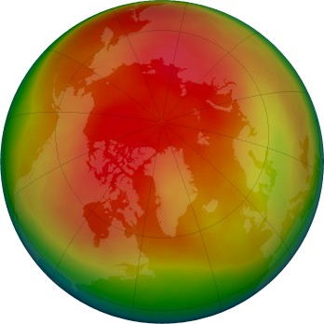
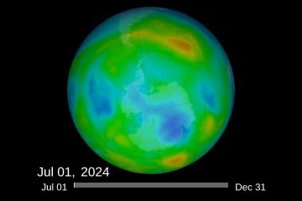
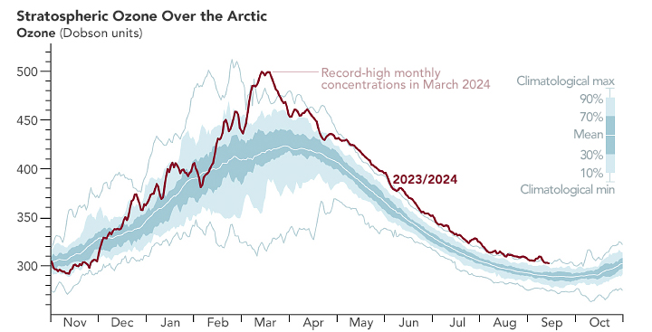
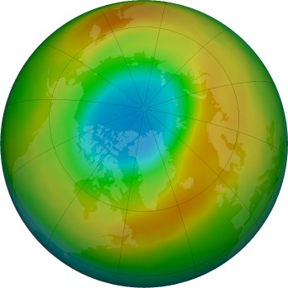

OMPS Data Vital For Monitoring Ozone
Antarctic
Arctic Ozone Record High
2024 Antarctic Ozone Hole
Arctic March 2024
Arctic Concentration
Arctic March 2020
NASA Earth Observatory/NASA ozone watch

Slide 12
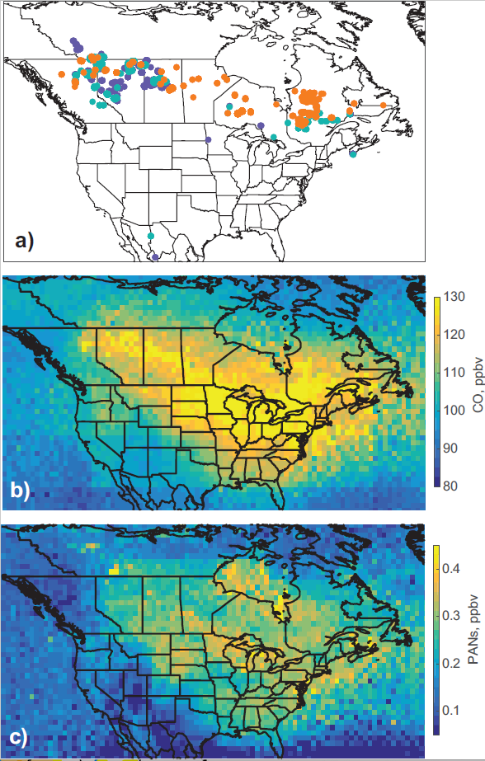
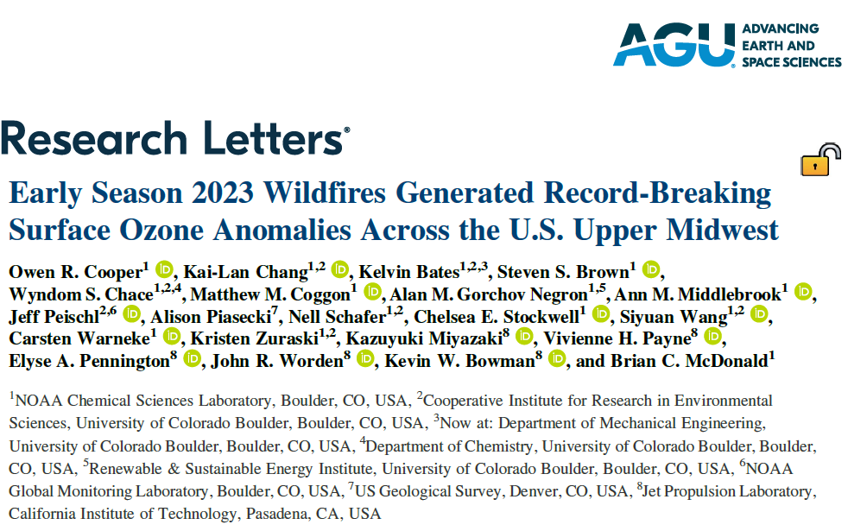

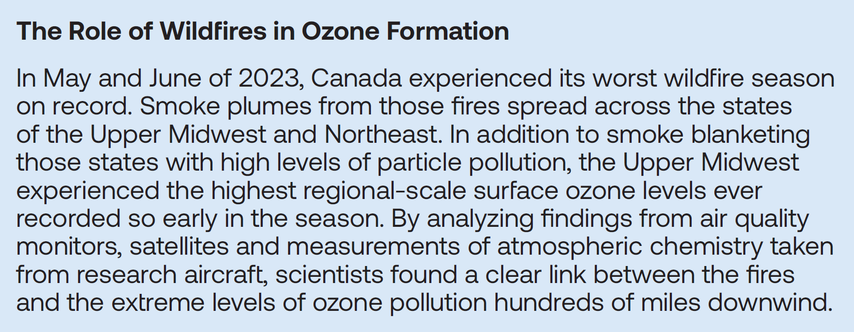
Intense Canadian Wildfires in the Summer of 2023
NOAA-20/VIIRS – Wildfires detected (May – Jun 2023)
highlighted
by
NOAA-20/CrIS - Carbon Monoxide
wildfire emissions & transport
NOAA-20/CrIS – Peroxyacetyl Nitrate
wildfire oxidant & pollutant

Slide 13
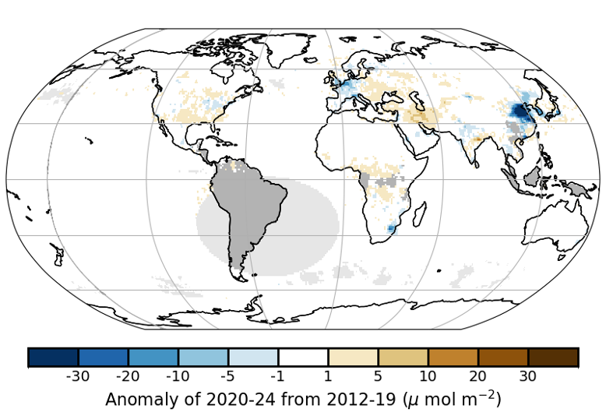
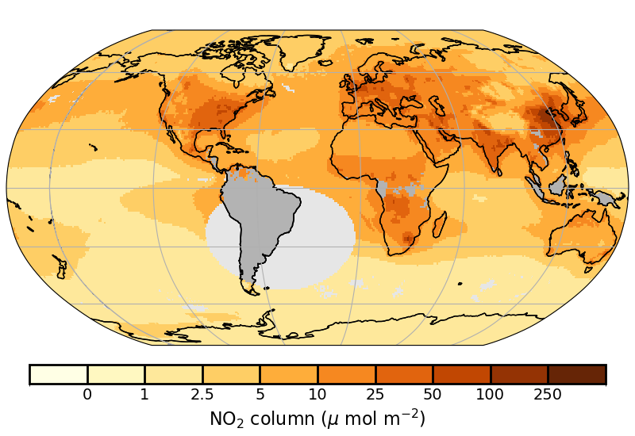
OMPS NO₂ Measurements
OMPS tropospheric column NO₂, 2020-2024
2020-2024 NO₂ Anomalies with reference to 2012-2019

Slide 14
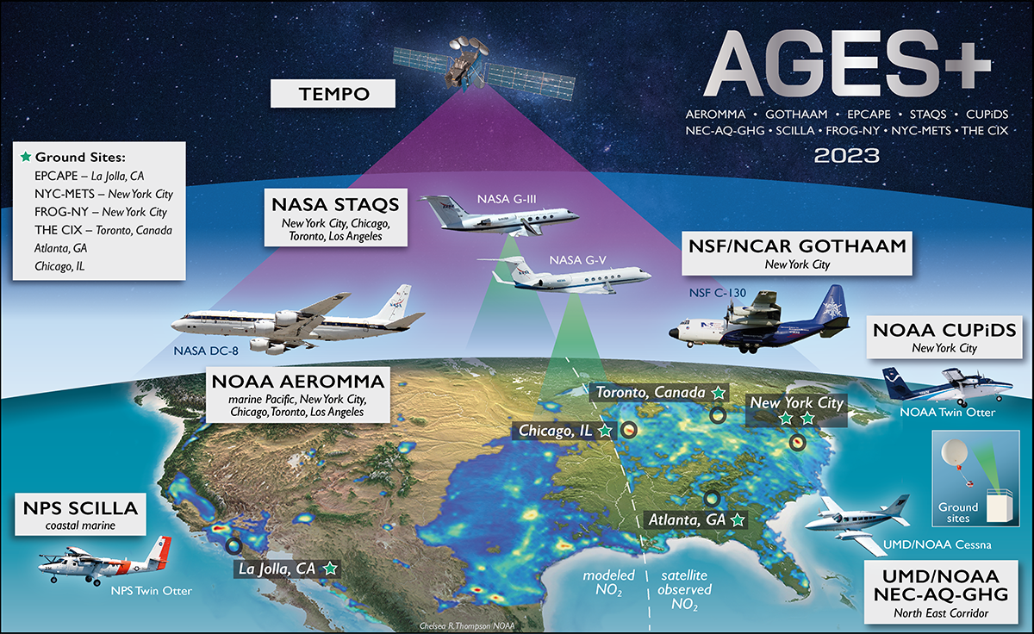







Large Multi-Agency Airborne Field Campaigns in Summer of 2023
https://csl.noaa.gov/projects/ages/

Slide 15
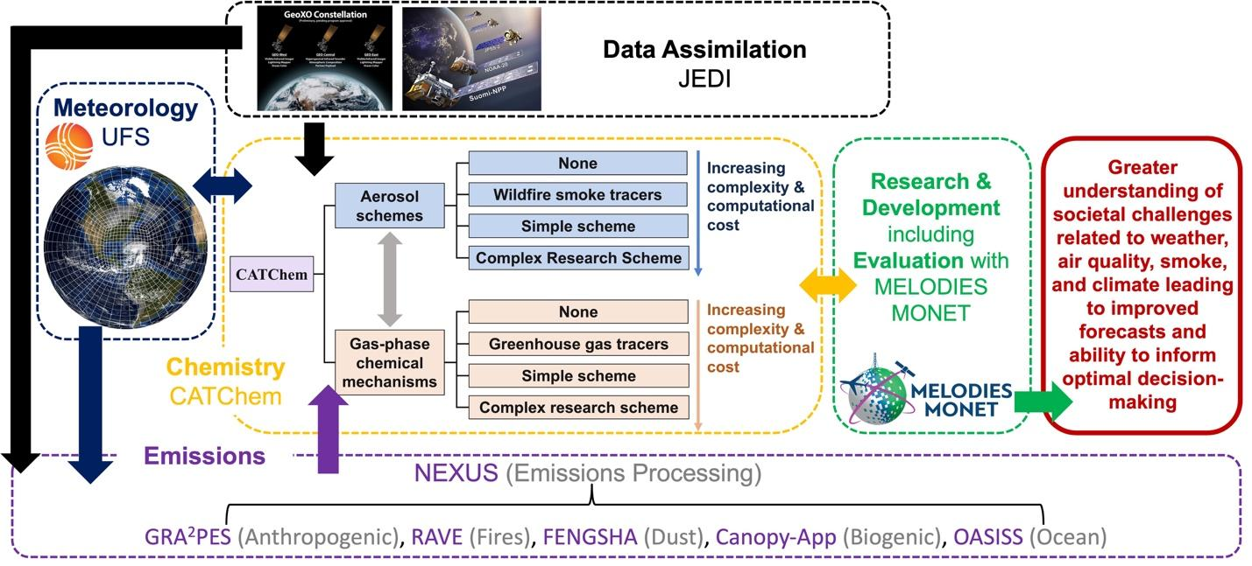
NOAA Developing Unified Forecasting System with Chemistry (UFS-Chem) Model
Multiple NOAA OAR laboratories developing Research-to-Operations modeling capability for global / regional atmospheric composition forecasting and reanalysis, capable of assimilating JPSS satellite products for air quality and smoke & dust forecasting.
https://csl.noaa.gov/groups/csl4/modeldata/ufs-chem/

Slide 16
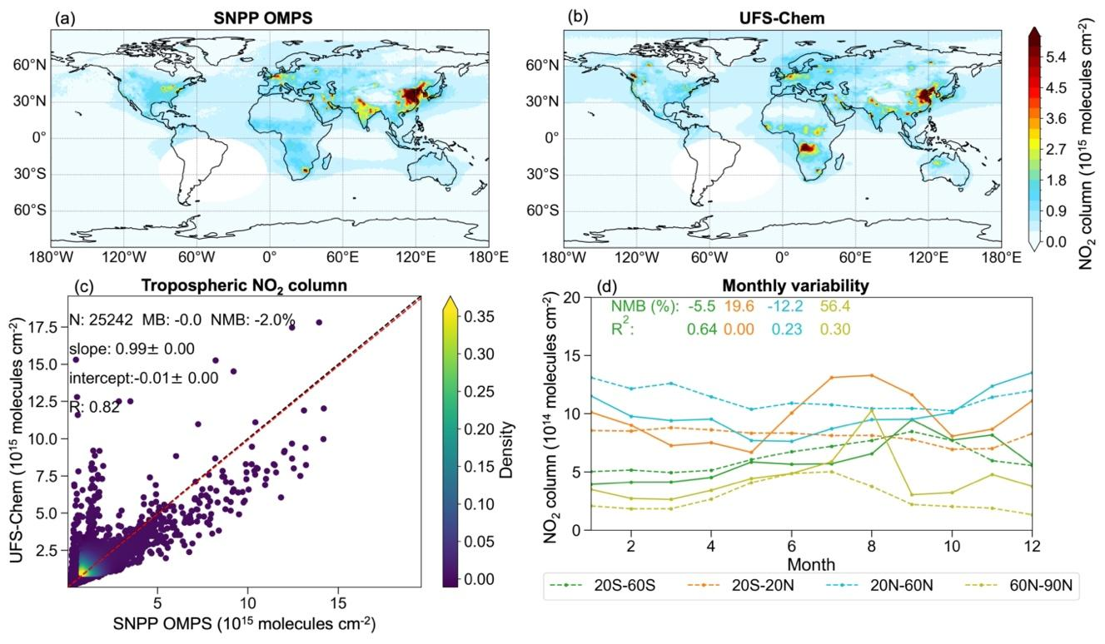
Strong Agreement of UFS-Chem with SNPP/OMPS NO₂ over Global Megacities

Slide 17
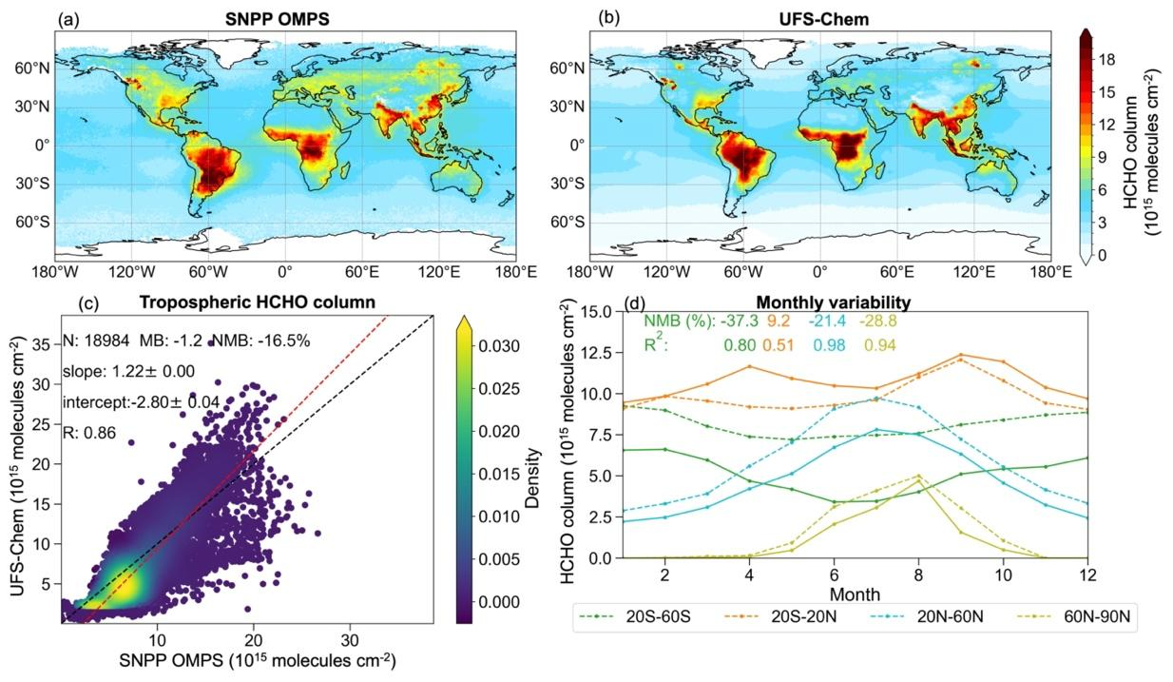
Strong Agreement of UFS-Chem with SNPP/OMPS HCHO over Biogenic Regions

Slide 18
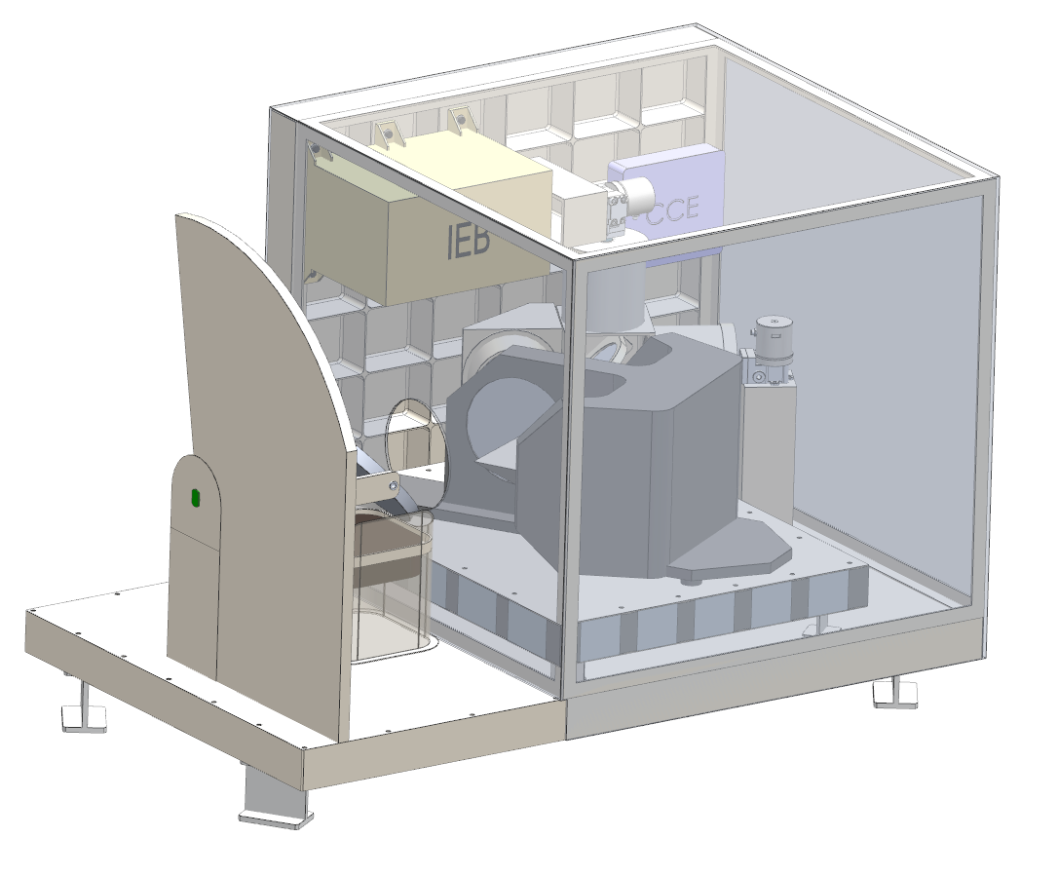
CrIS Follow-on IR Sounder Notional Requirements for NEON
Sounding for IR Based Applications (SIRBA)
Infrared Spectral Band Guidance
Priorities | Performance Factor | Aspirational Target
 | Channels for direct Temperature Sounding and spectral resolution | All bands below: LW Band around 15 µm MW Band around 5.55 µm SW Band around 4.3 µm 0.25 cm⁻¹ unapodized, 10 ppm spectral uncertainty No gaps
 | Channels for direct Moisture sounding and spectral resolution | MW Band around 6.3 µm 0.25 cm⁻¹ unapodized, 10 ppm spectral uncertainty
 | Channels for atmospheric composition monitoring | Add extended Shortwave at 1.5-2.5 µm
 | Spatial coverage (daily global coverage) | 95% Global Coverage
 | Noise Level NEDT for Temperature sounding channels | CrIS-type NEDT levels (CrIS_NEDT) or better
 | Noise level NEDT for Moisture sounding channels | CrIS-type NEDT levels (CrIS_NEDT) or better
 | Spatial resolution | ~ 2km resolution or better (@nadir)
 | Geolocation/ Cloud-clearing Capability | ~1km or better resolution
 | CrIS Channels Continuity | Yes, for similar channels
 | Spatial sampling | Contiguous Footprints
Wave | Spectral Range | Spectral Range | Primary Use
Longwave | 650-790 cm⁻¹ | 12.65-15.38 µm | Atmospheric temperature and cloudy-sky retrieval on the sensitivity to cold objects and CTH, CO2
Longwave | 790-1180 cm⁻¹ | 8.47-12.65 µm | Surface/cloud properties and O3
Midwave | 1210-1650 cm⁻¹ | 5.56 - 8.60 µm | Atmospheric water vapor and temperature, N2O, CH4, SO2
Shortwave | 2100-2150 cm⁻¹ | 4.65 - 4.76 µm | Total column CO
Shortwave | 2150-2250 cm⁻¹ | 4.44 - 4.65 µm | Atmospheric temperature and total column N2O
Shortwave | 2350-2420 cm⁻¹ | 4.13 – 4.25 µm | Atmospheric temperature, CO2
Shortwave | 2420-2700 cm⁻¹ | 3.7 – 4.13 µm | Surface/cloud properties
Shortwave | 4200-5210 cm⁻¹ | 2.38 – 1.92 µm | Total column carbon dioxide, moisture and carbon monoxide
Shortwave | 5920-6410 cm⁻¹ | 1.69 – 1.56 µm | Total column carbon dioxide and methane
Notes:
Updated slide after the Feb 28’s meeting

Slide 19
Summary
VIIRS, CrIS, and VIIRS (3 out of 4 JPSS sensors) operationally measure atmospheric composition.
With 3 JPSS satellites in operations and 2 more yet to be launched, the mission is expected to provide atmospheric composition measurements well in to the next decade.
These JPSS observations are routinely used for air quality measurements and will be assimilated into global chemical models in NOAA’s next generation Unified Forecast System.
Several, large airborne field campaigns by NOAA and its partners are providing valuable in-situ validation measurements.
Next generation IR sounders by NOAA are expected to have enhanced atmospheric chemistry capabilities under the NEON program.

