Slide 1

TEMPO Aerosol Algorithm and Products Update
Shobha Kondragunta¹, Hai Zhang², Pubu Ciren², Amy Huff²
¹NOAA | ²STC at NOAA
Disclaimer: The scientific results and conclusions, as well as any views or opinions expressed
herein, are those of the author(s) and do not necessarily reflect those of NOAA or
the Department of Commerce.
Disclaimer：TEMPO L1B data courtesy of NASA.

Slide 2
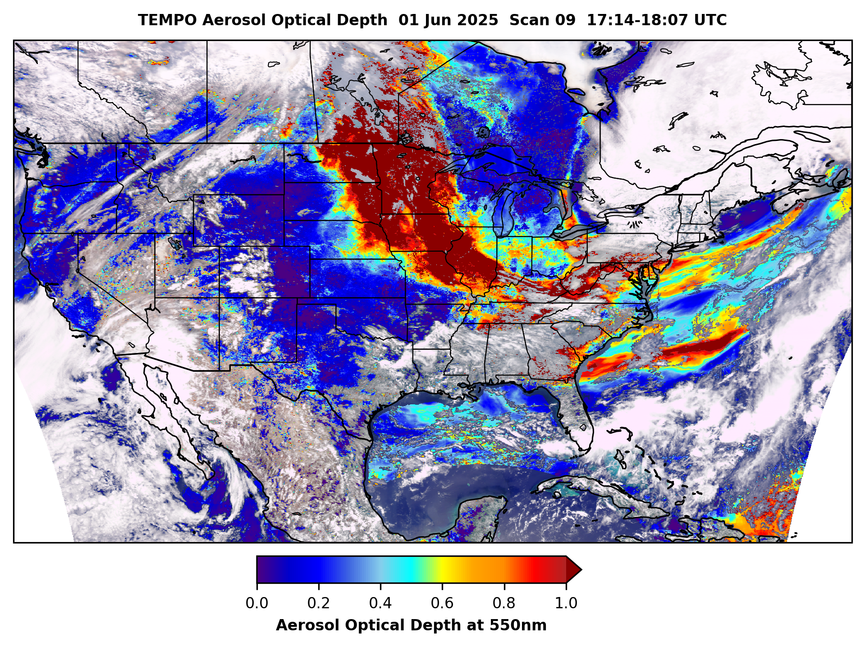

Aerosol Retrieval Algorithm Development
Aerosol Optical Depth
Aerosol Layer Height
Aerosol Detection (smoke and dust)
Surface PM2,5
UV Aerosol Index
True color RGB

Slide 3
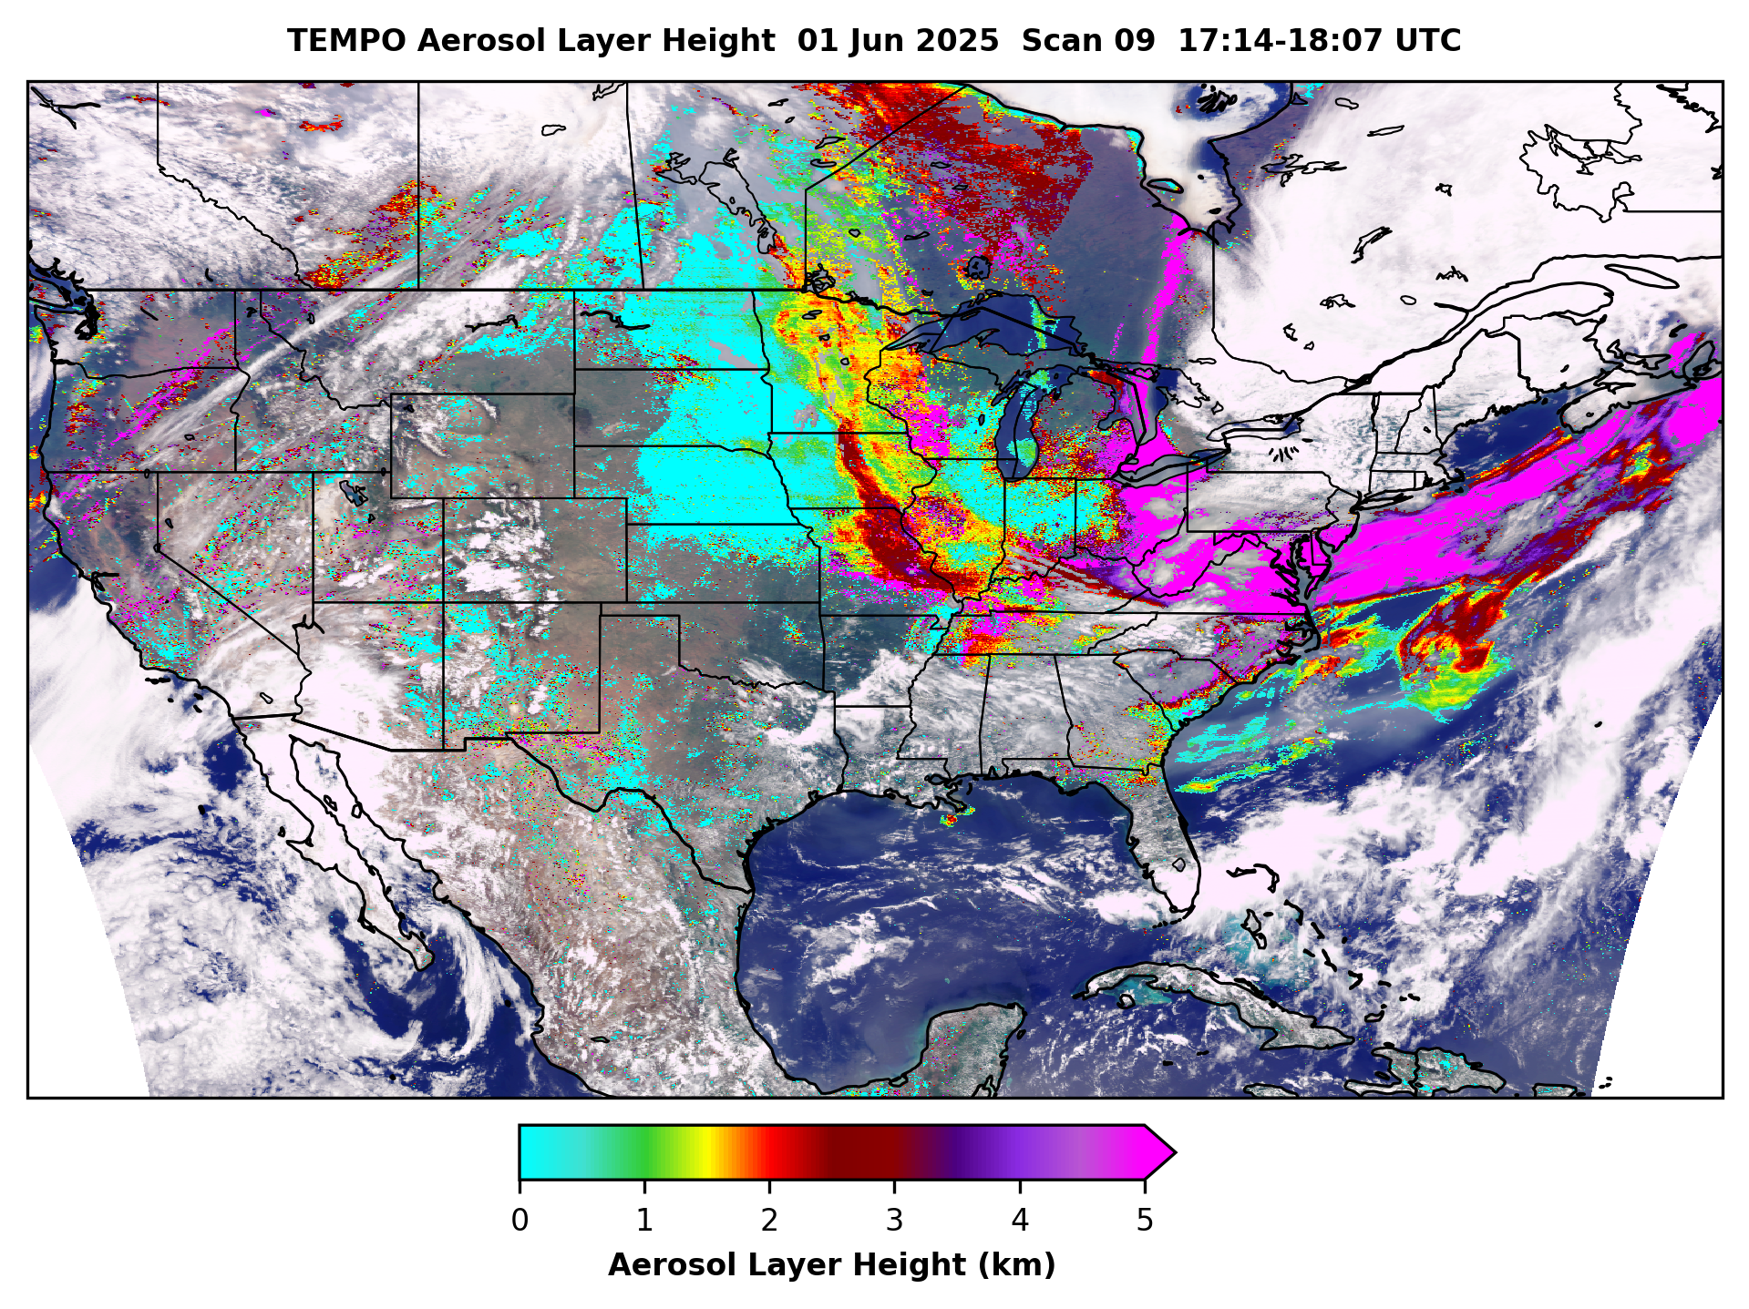
Aerosol Retrieval Algorithm Development
Aerosol Optical Depth
Aerosol Layer Height
Aerosol Detection (smoke and dust)
Surface PM2,5
UV Aerosol Index
True color RGB

Slide 4
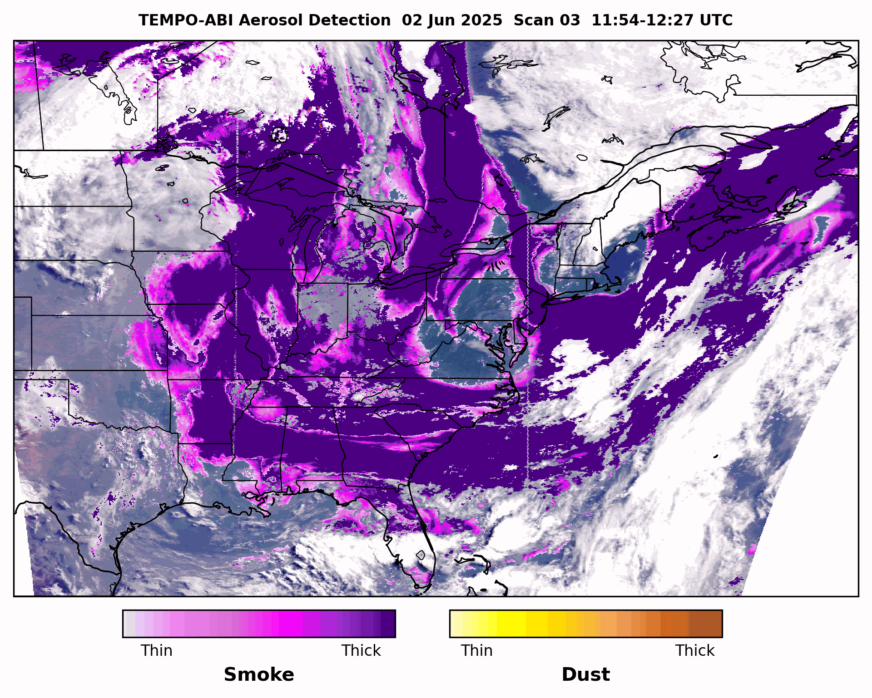
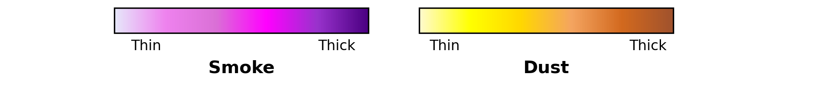
Aerosol Retrieval Algorithm Development
GOES-16 ABI + TEMPO
Aerosol Optical Depth
Aerosol Layer Height
Aerosol Detection (smoke and dust)
Surface PM2.5
UV Aerosol Index
True color RGB

Slide 5
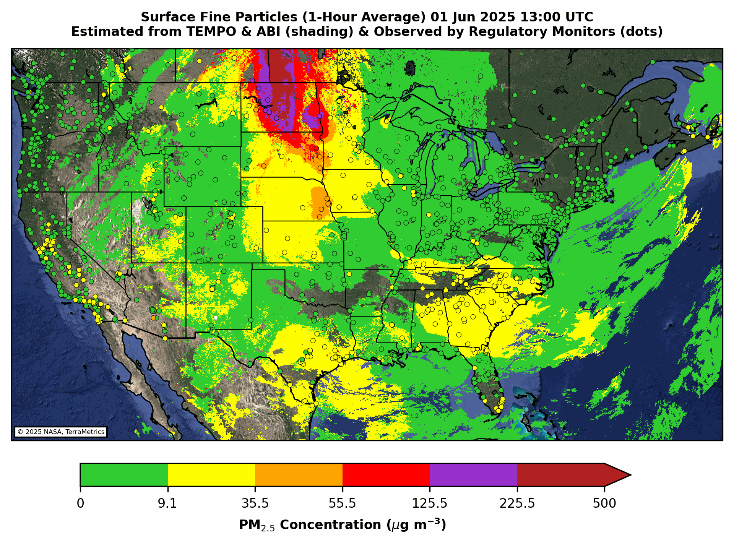
Aerosol Retrieval Algorithm Development
Aerosol Optical Depth
Aerosol Layer Height
Aerosol Detection (smoke and dust)
Surface PM2.5
UV Aerosol Index
True color RGB

Slide 6
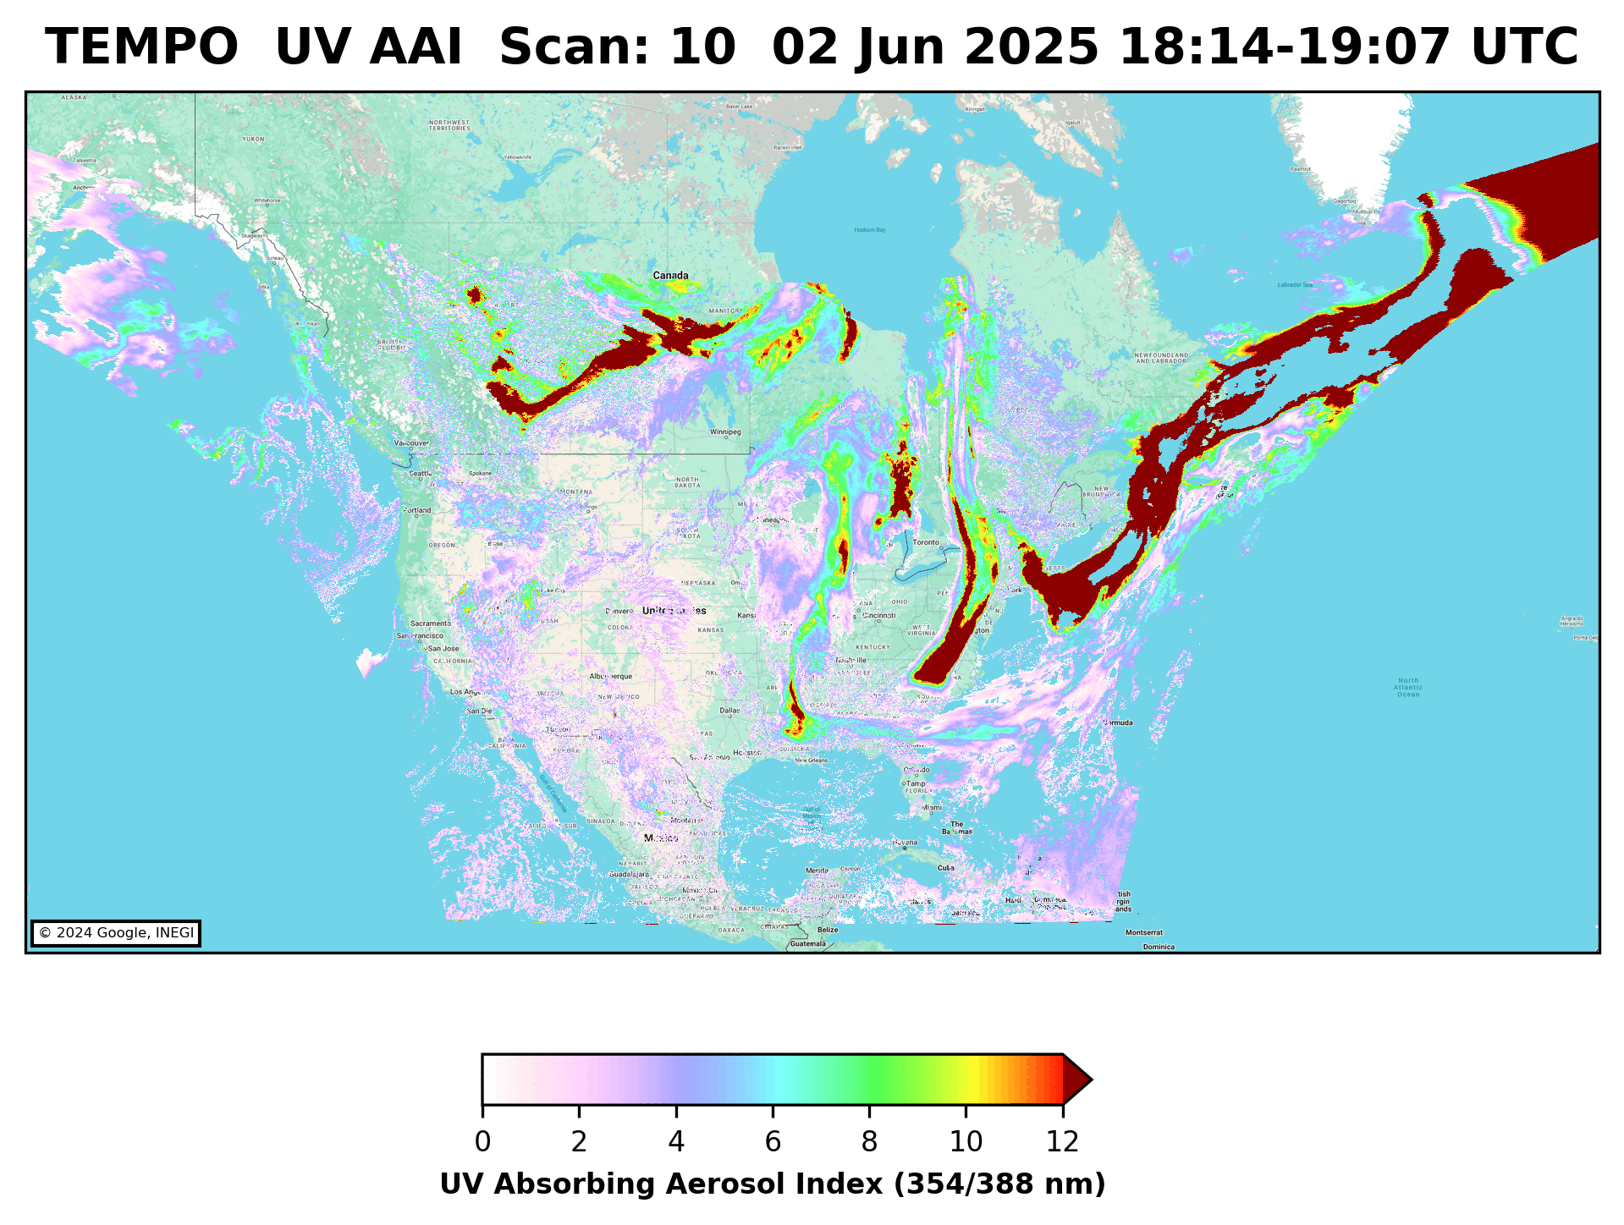
Aerosol Retrieval Algorithm Development
Aerosol Optical Depth
Aerosol Layer Height
Aerosol Detection (smoke and dust)
Surface PM2.5
UV Aerosol Index
True color RGB

Slide 7
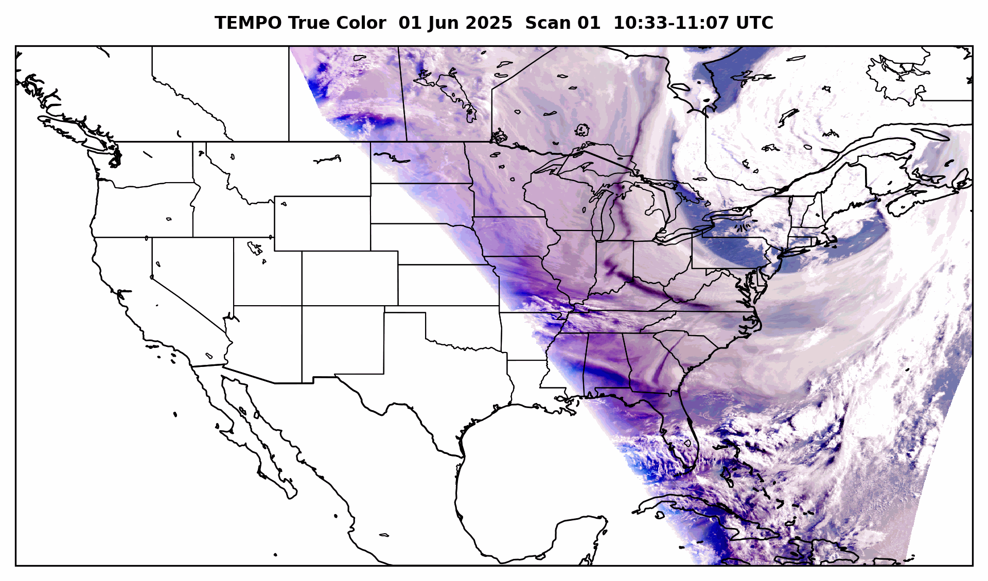
Aerosol Retrieval Algorithm Development
Aerosol Optical Depth
Aerosol Layer Height
Aerosol Detection (smoke and dust)
Surface PM2.5
UV Aerosol Index
True color RGB

Slide 8
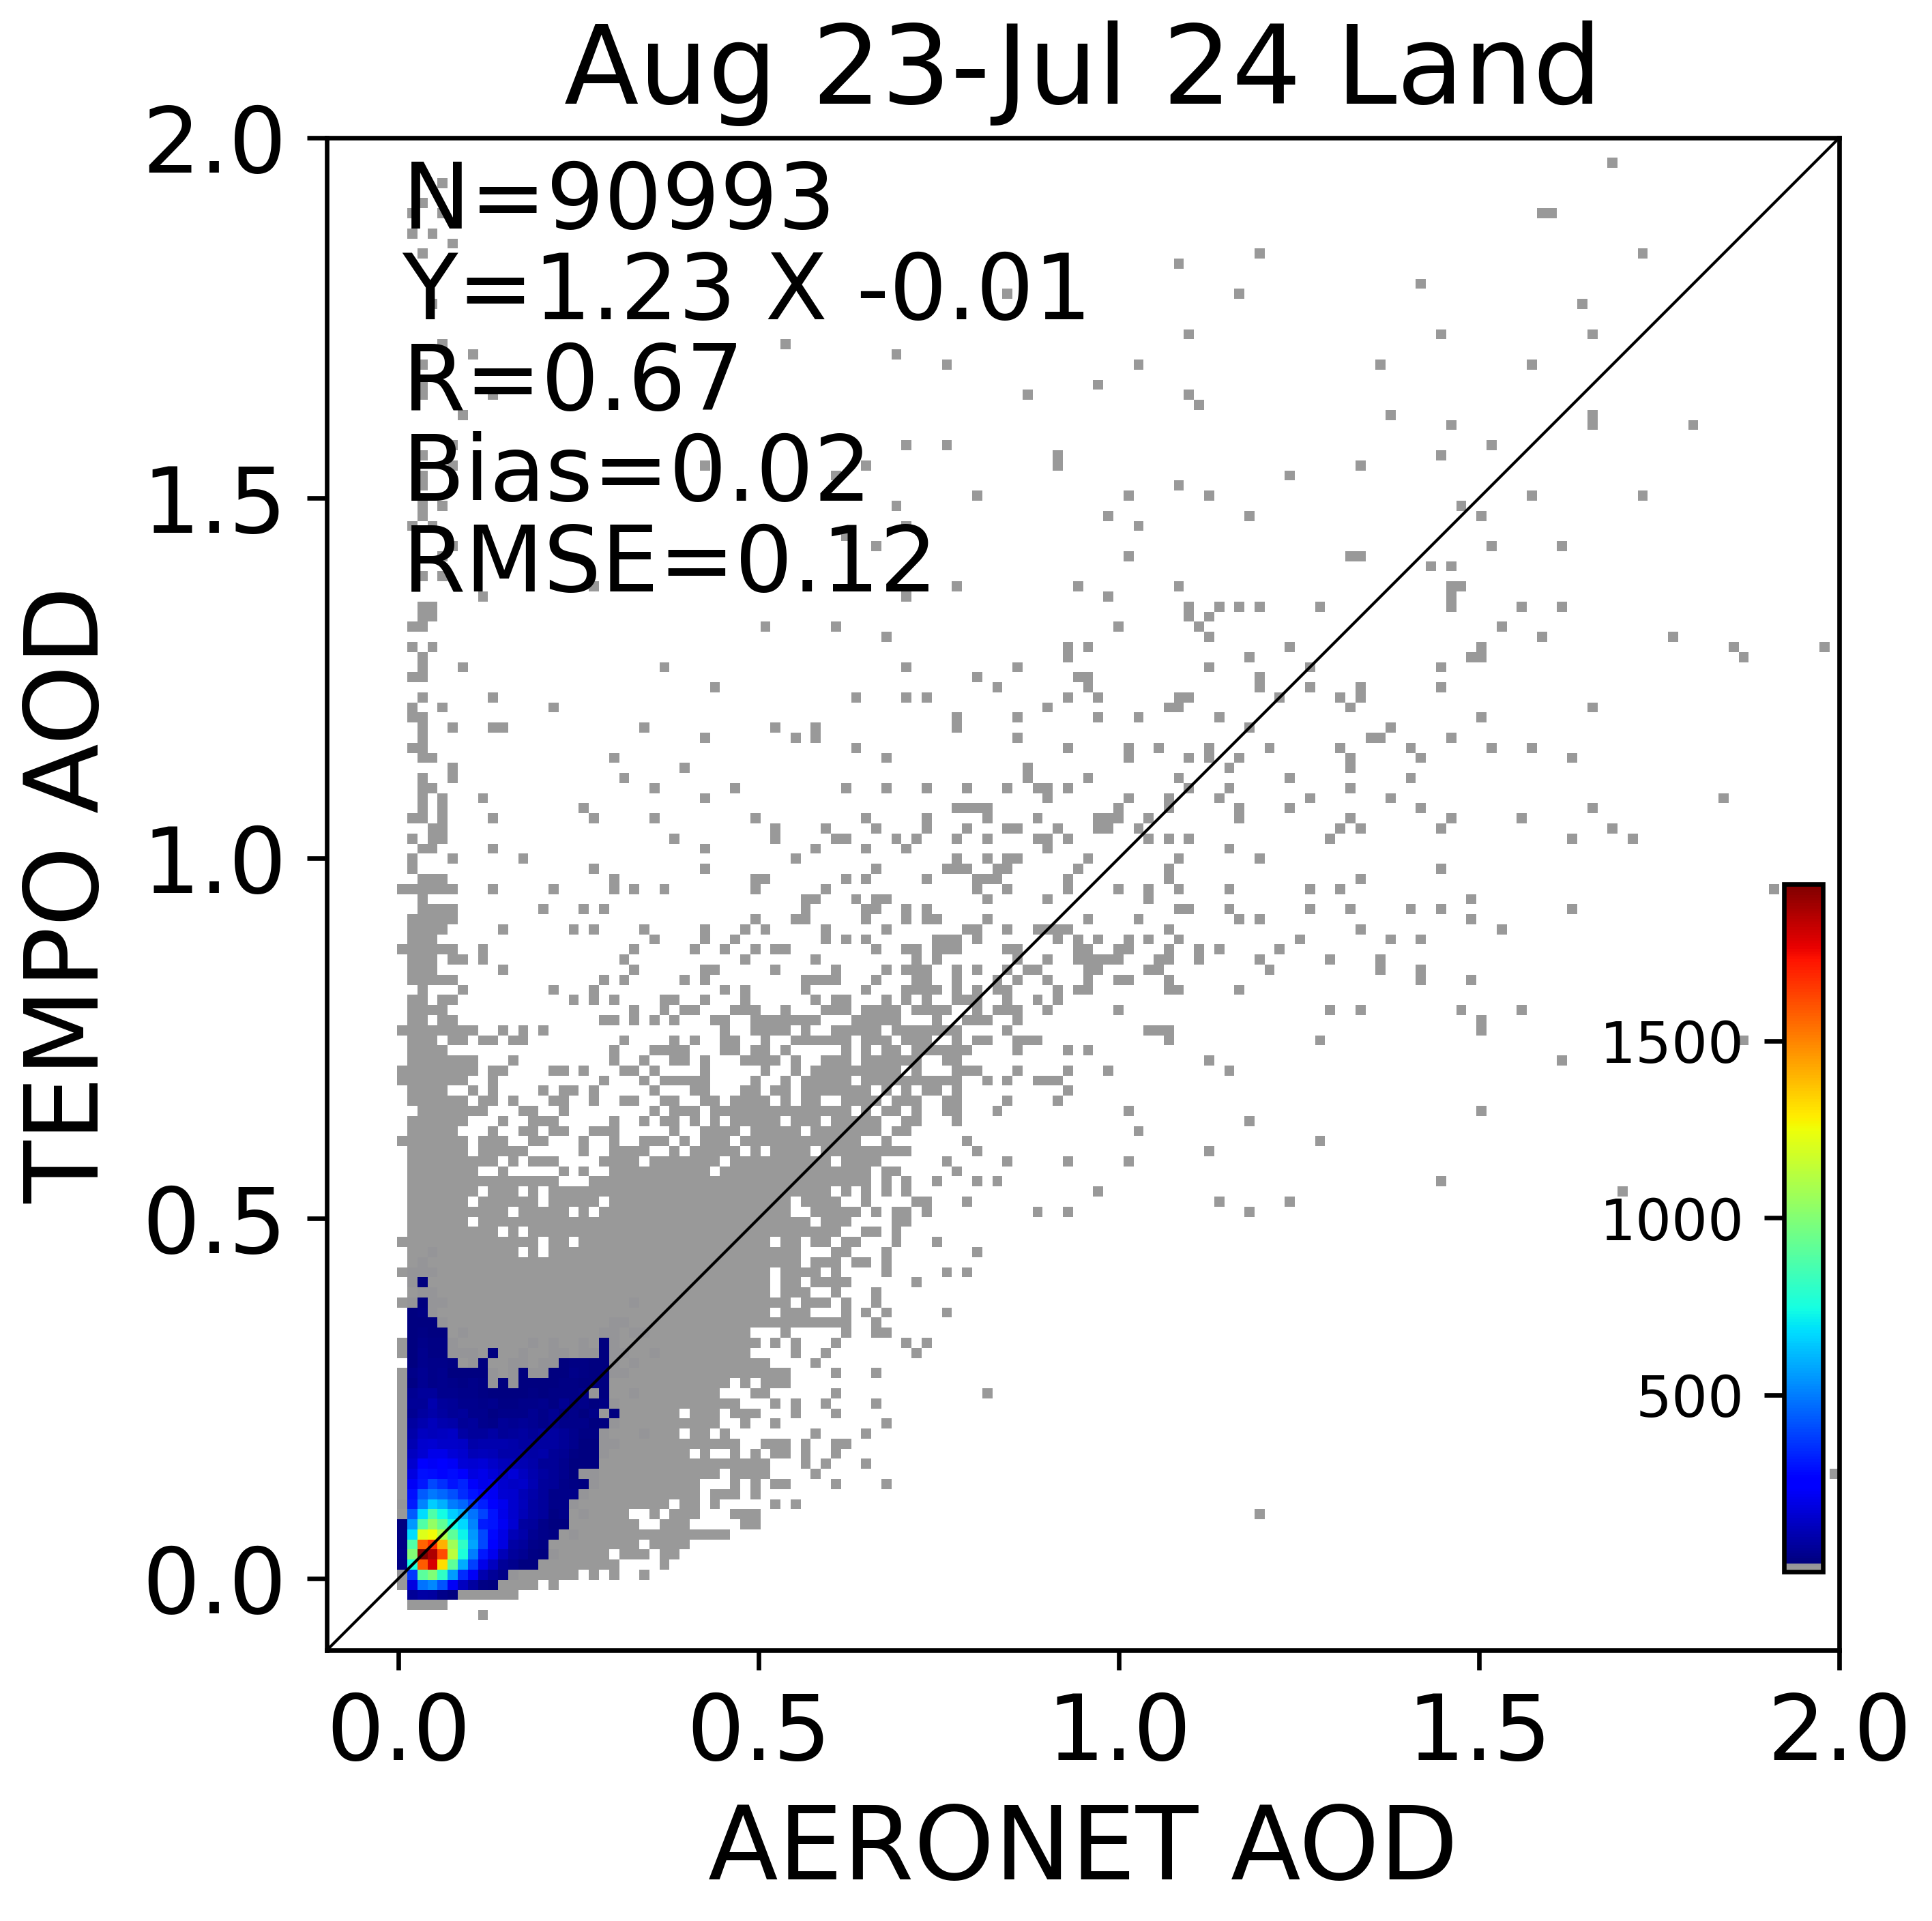
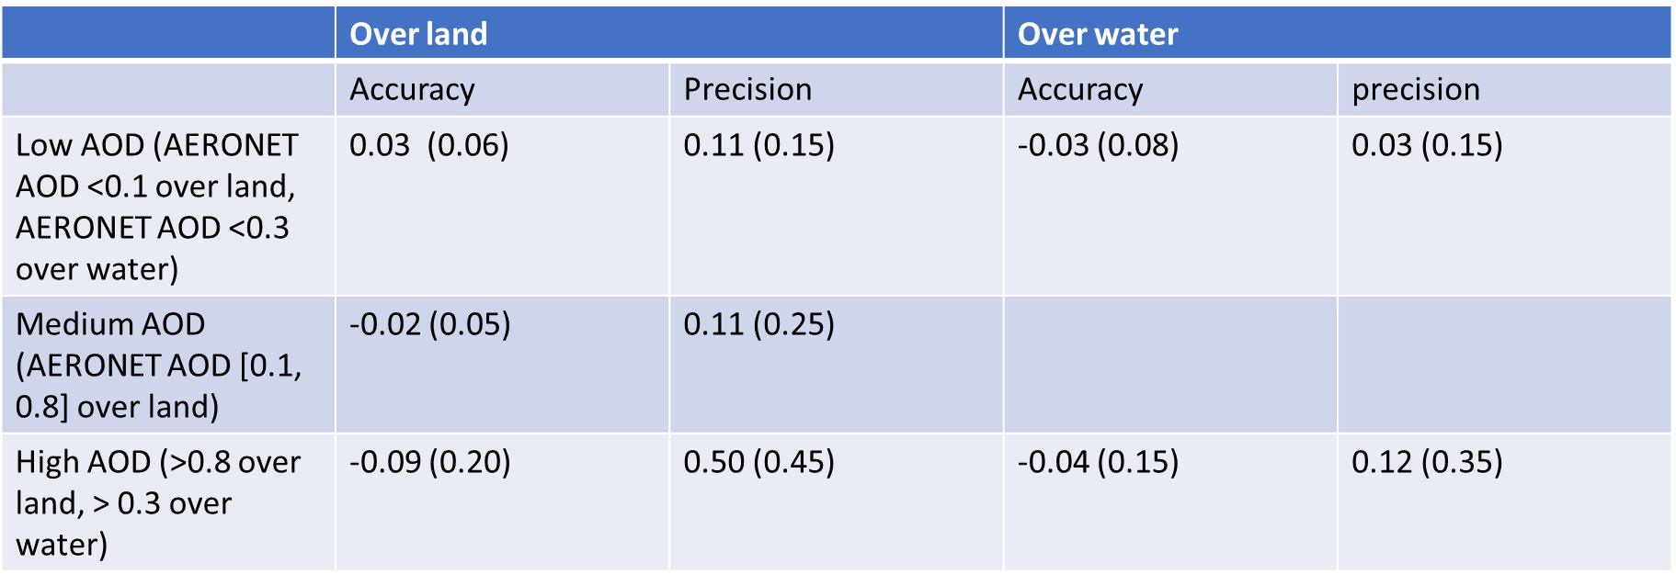
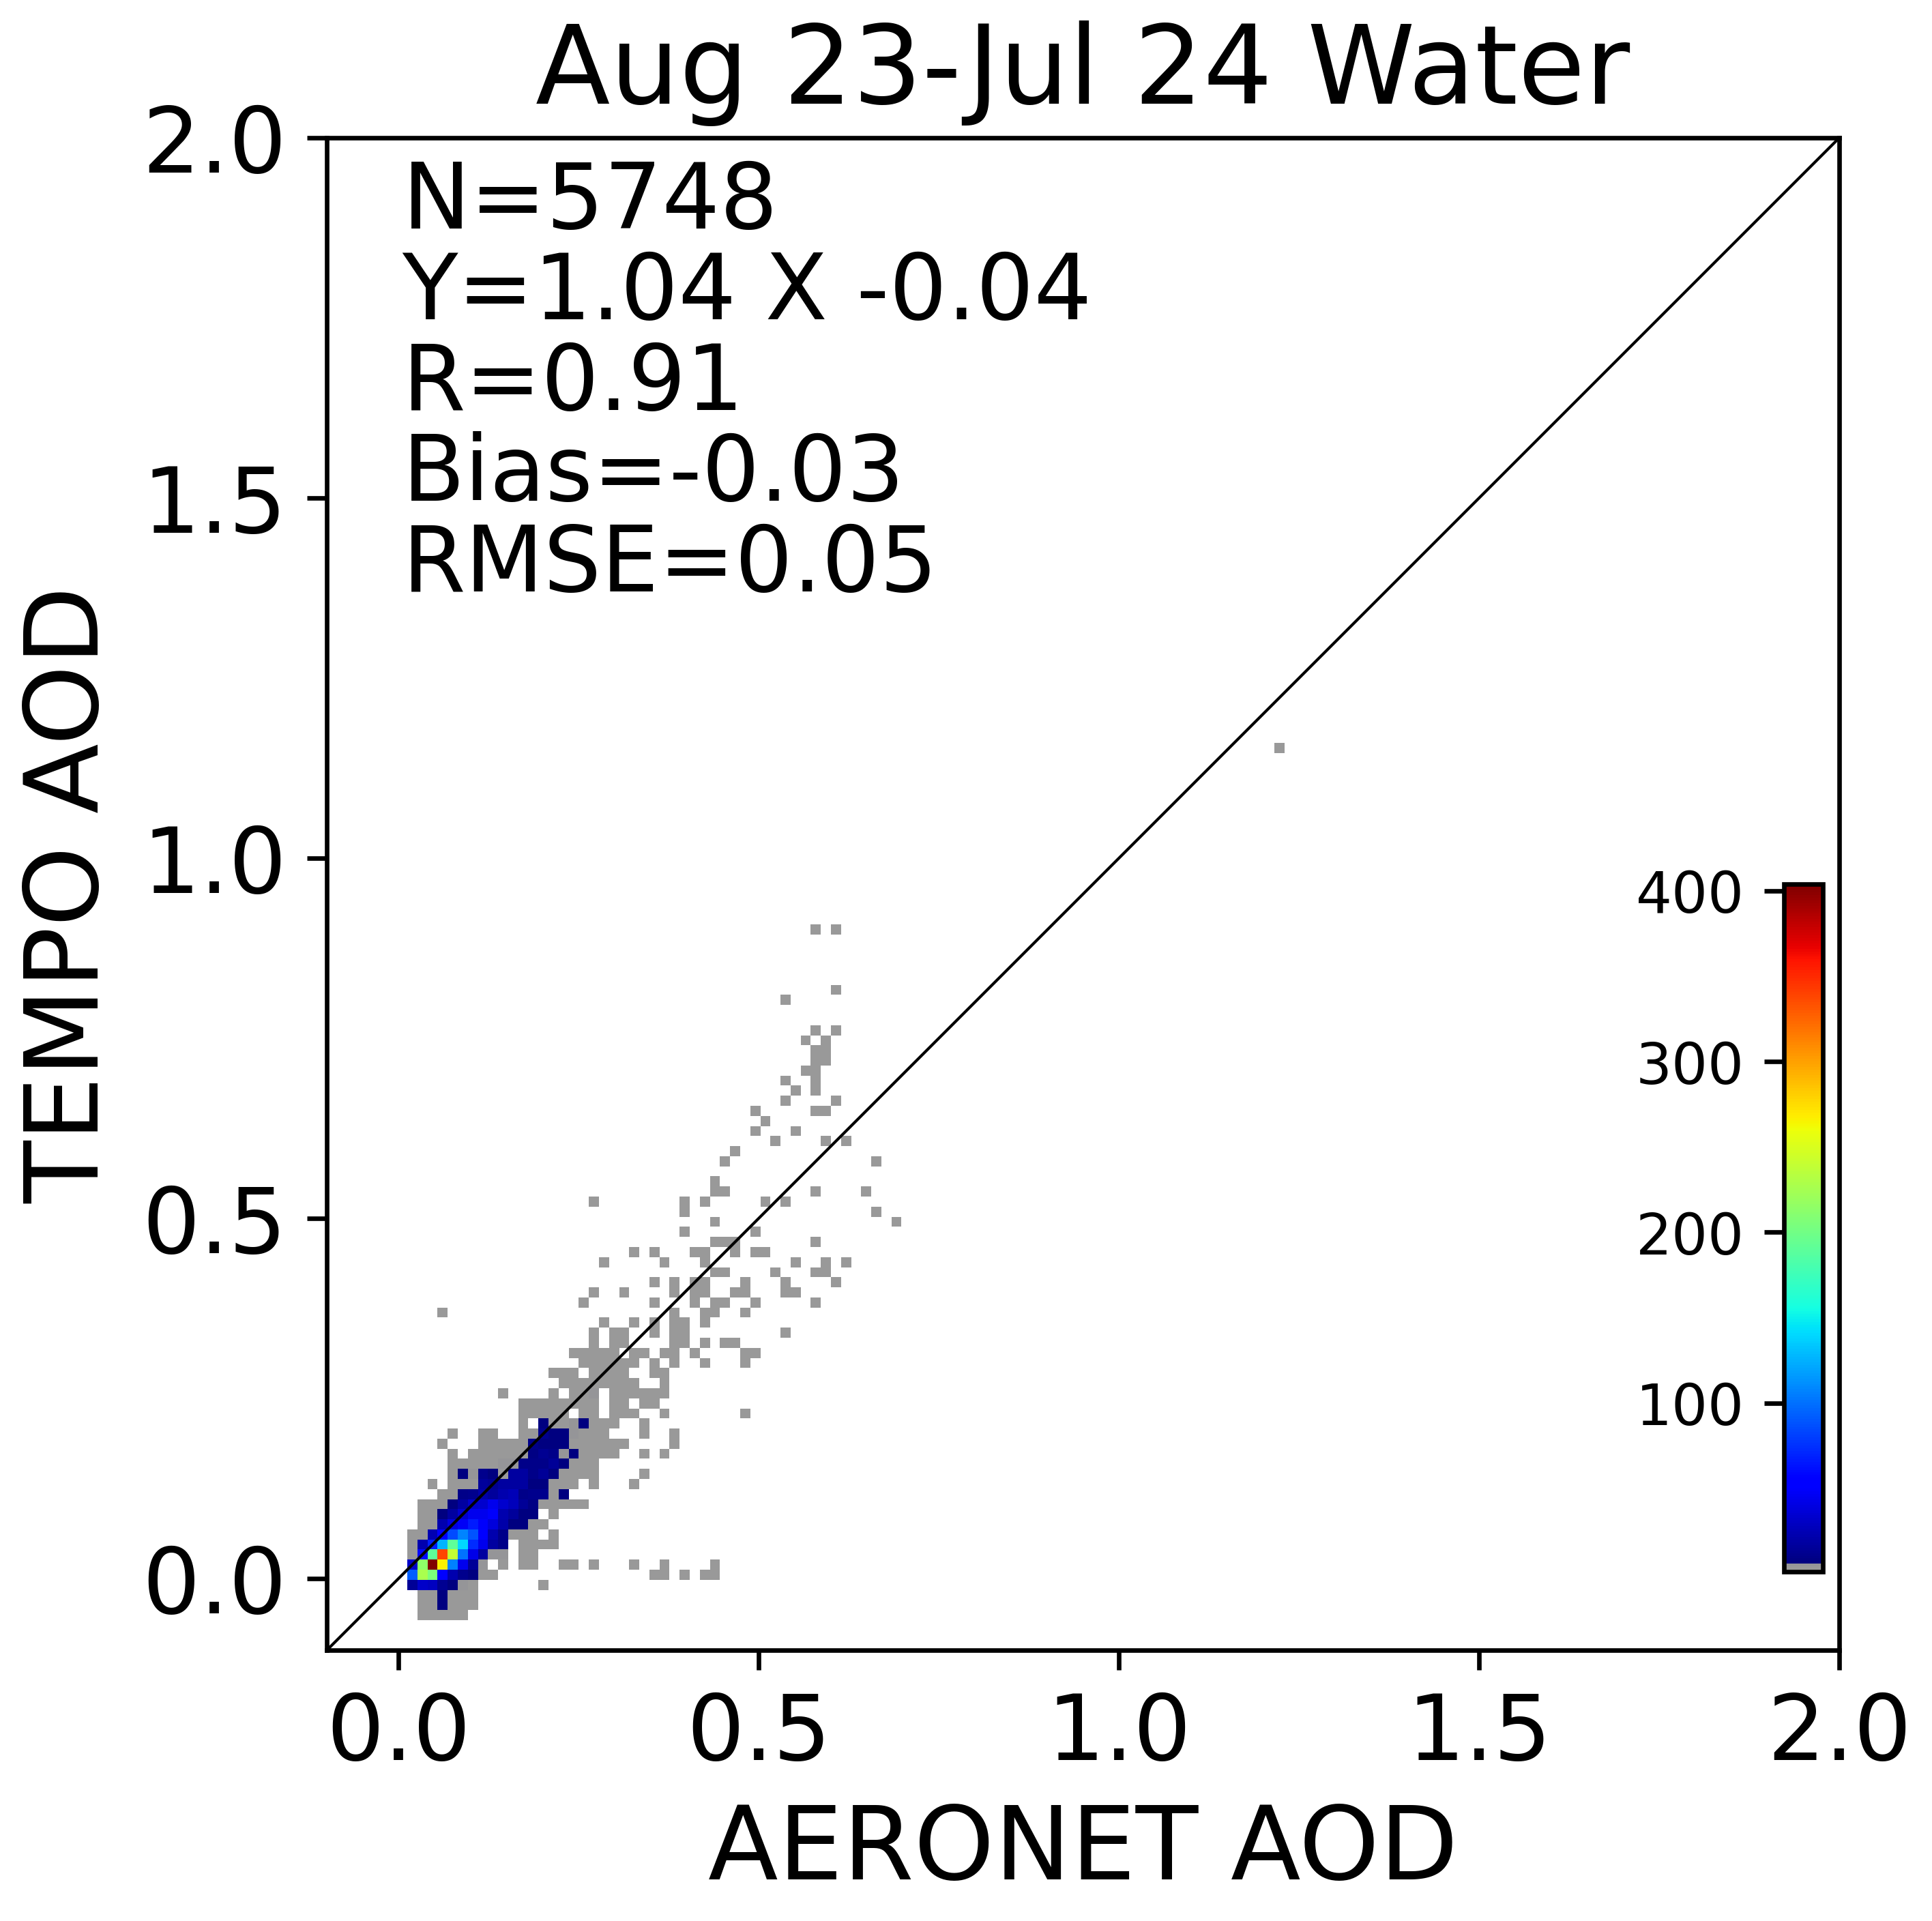
Validation

Slide 9
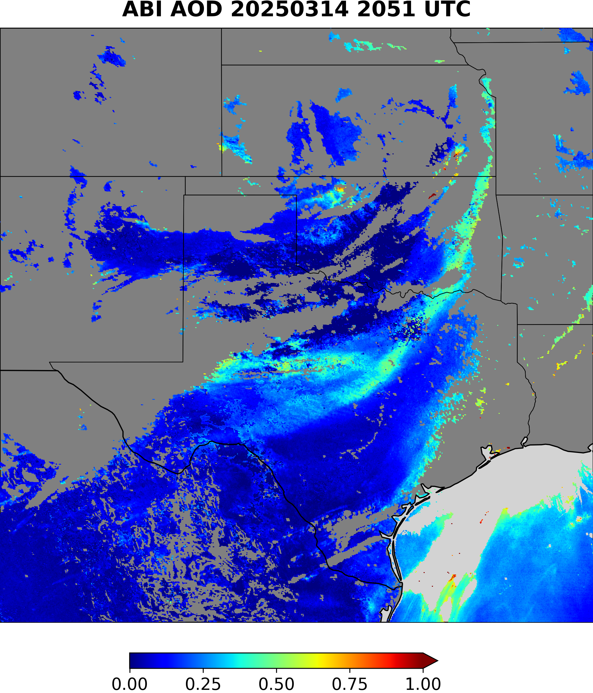
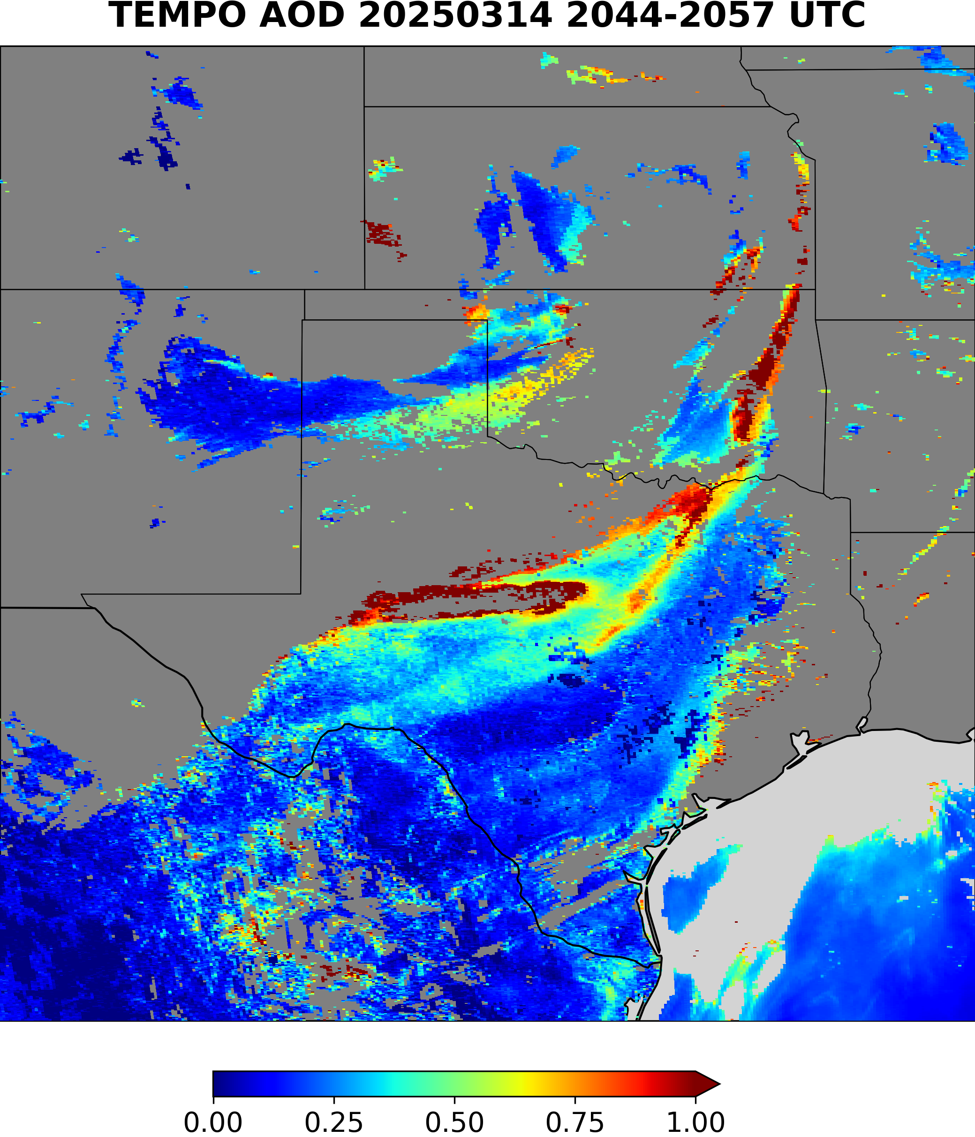
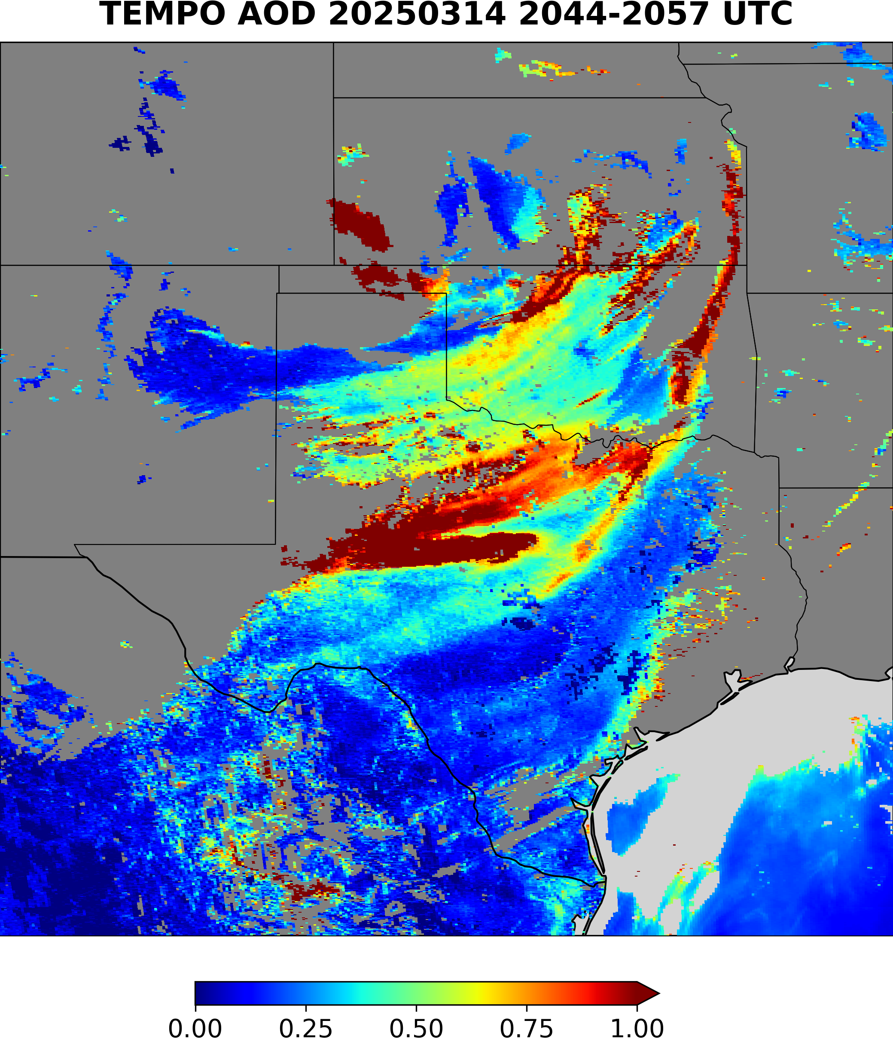
Algorithm Updates (1)
Retrieval before call back
Call back heavy dust pixels using ADP

Slide 10

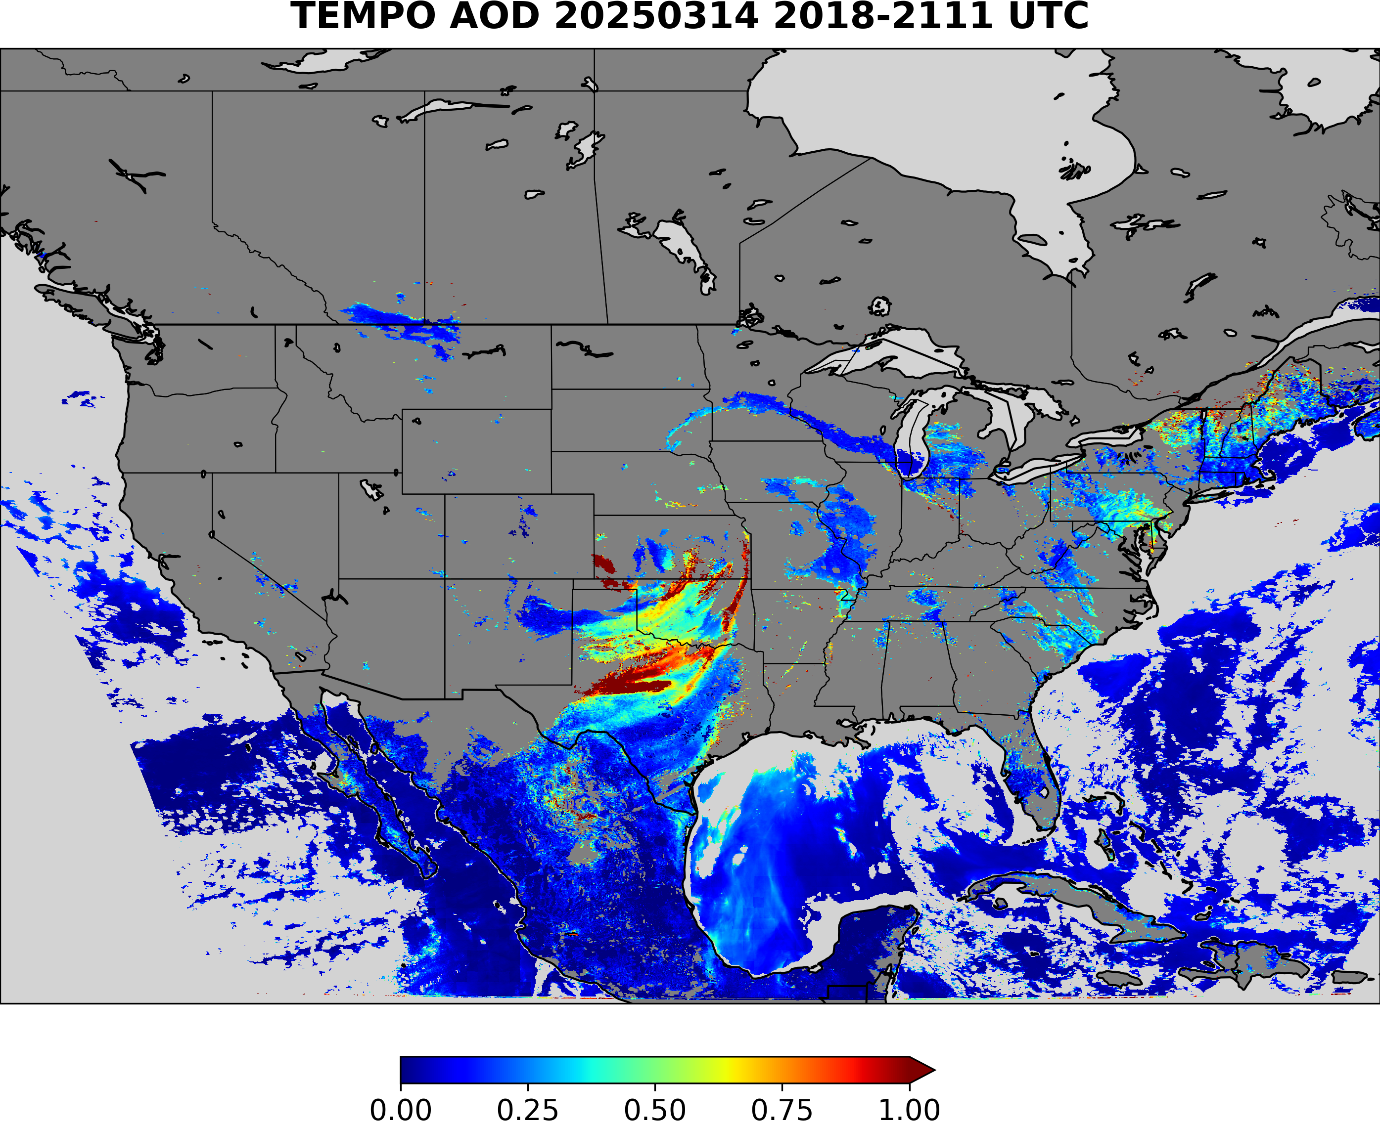
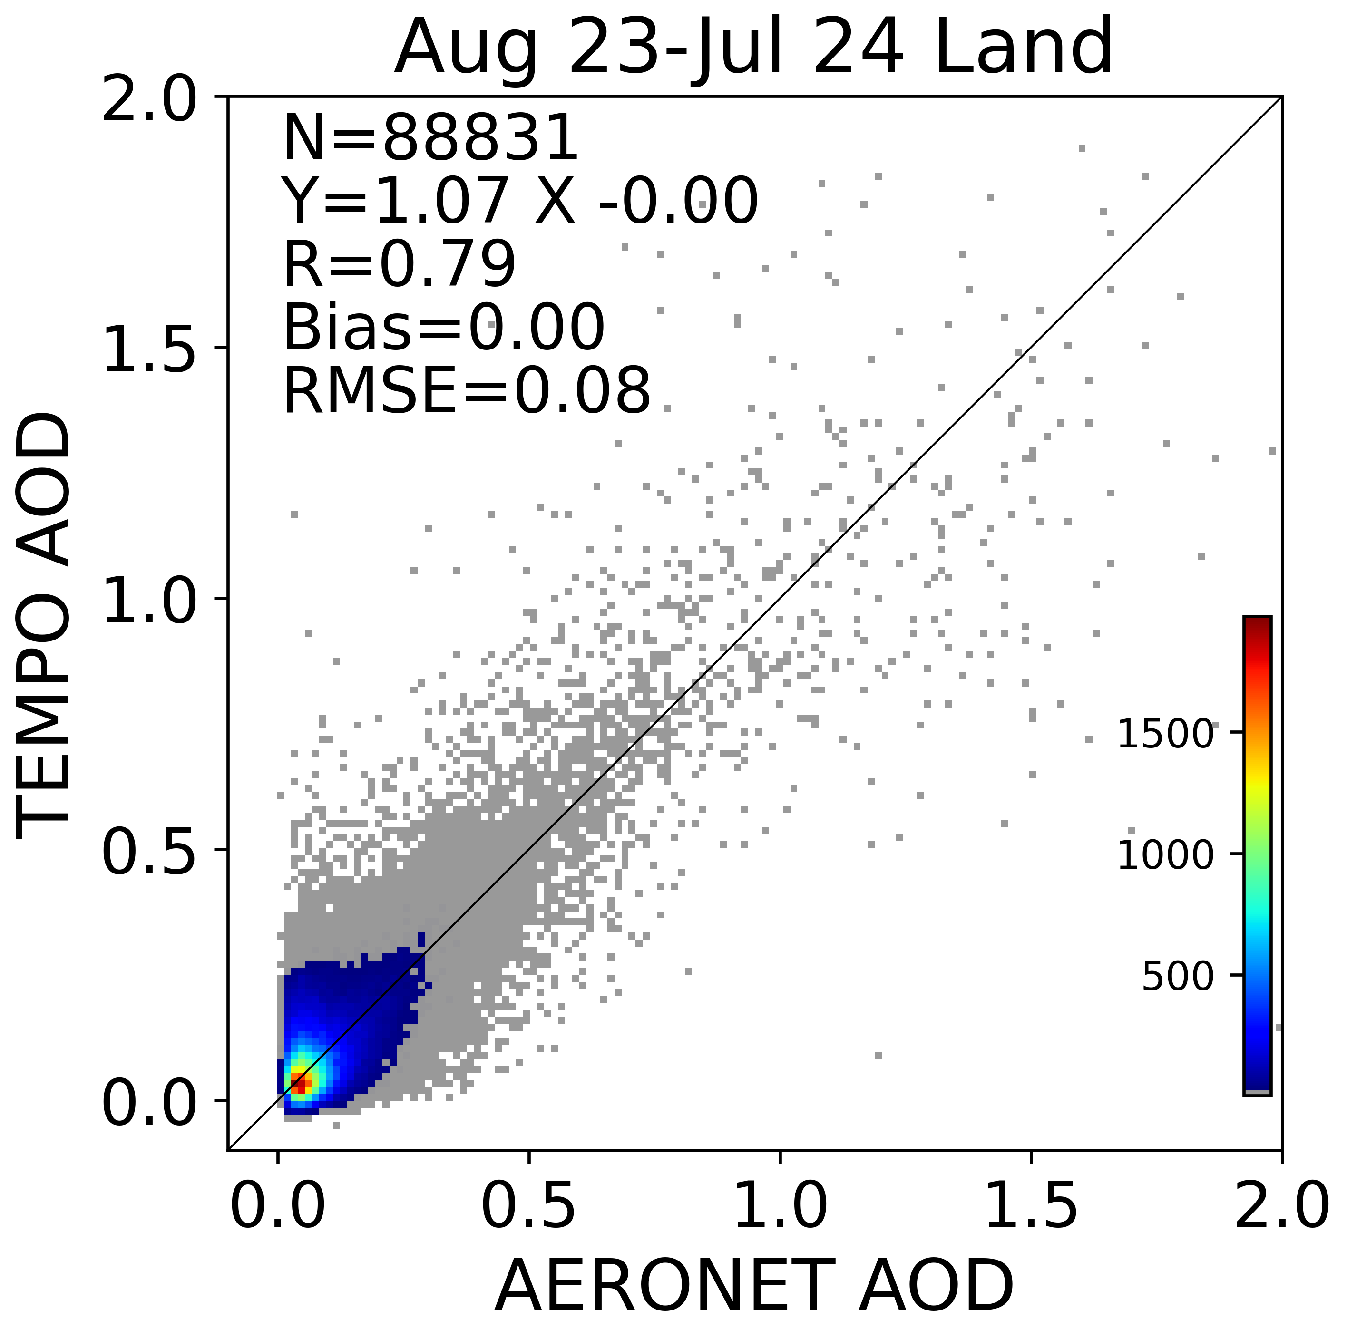

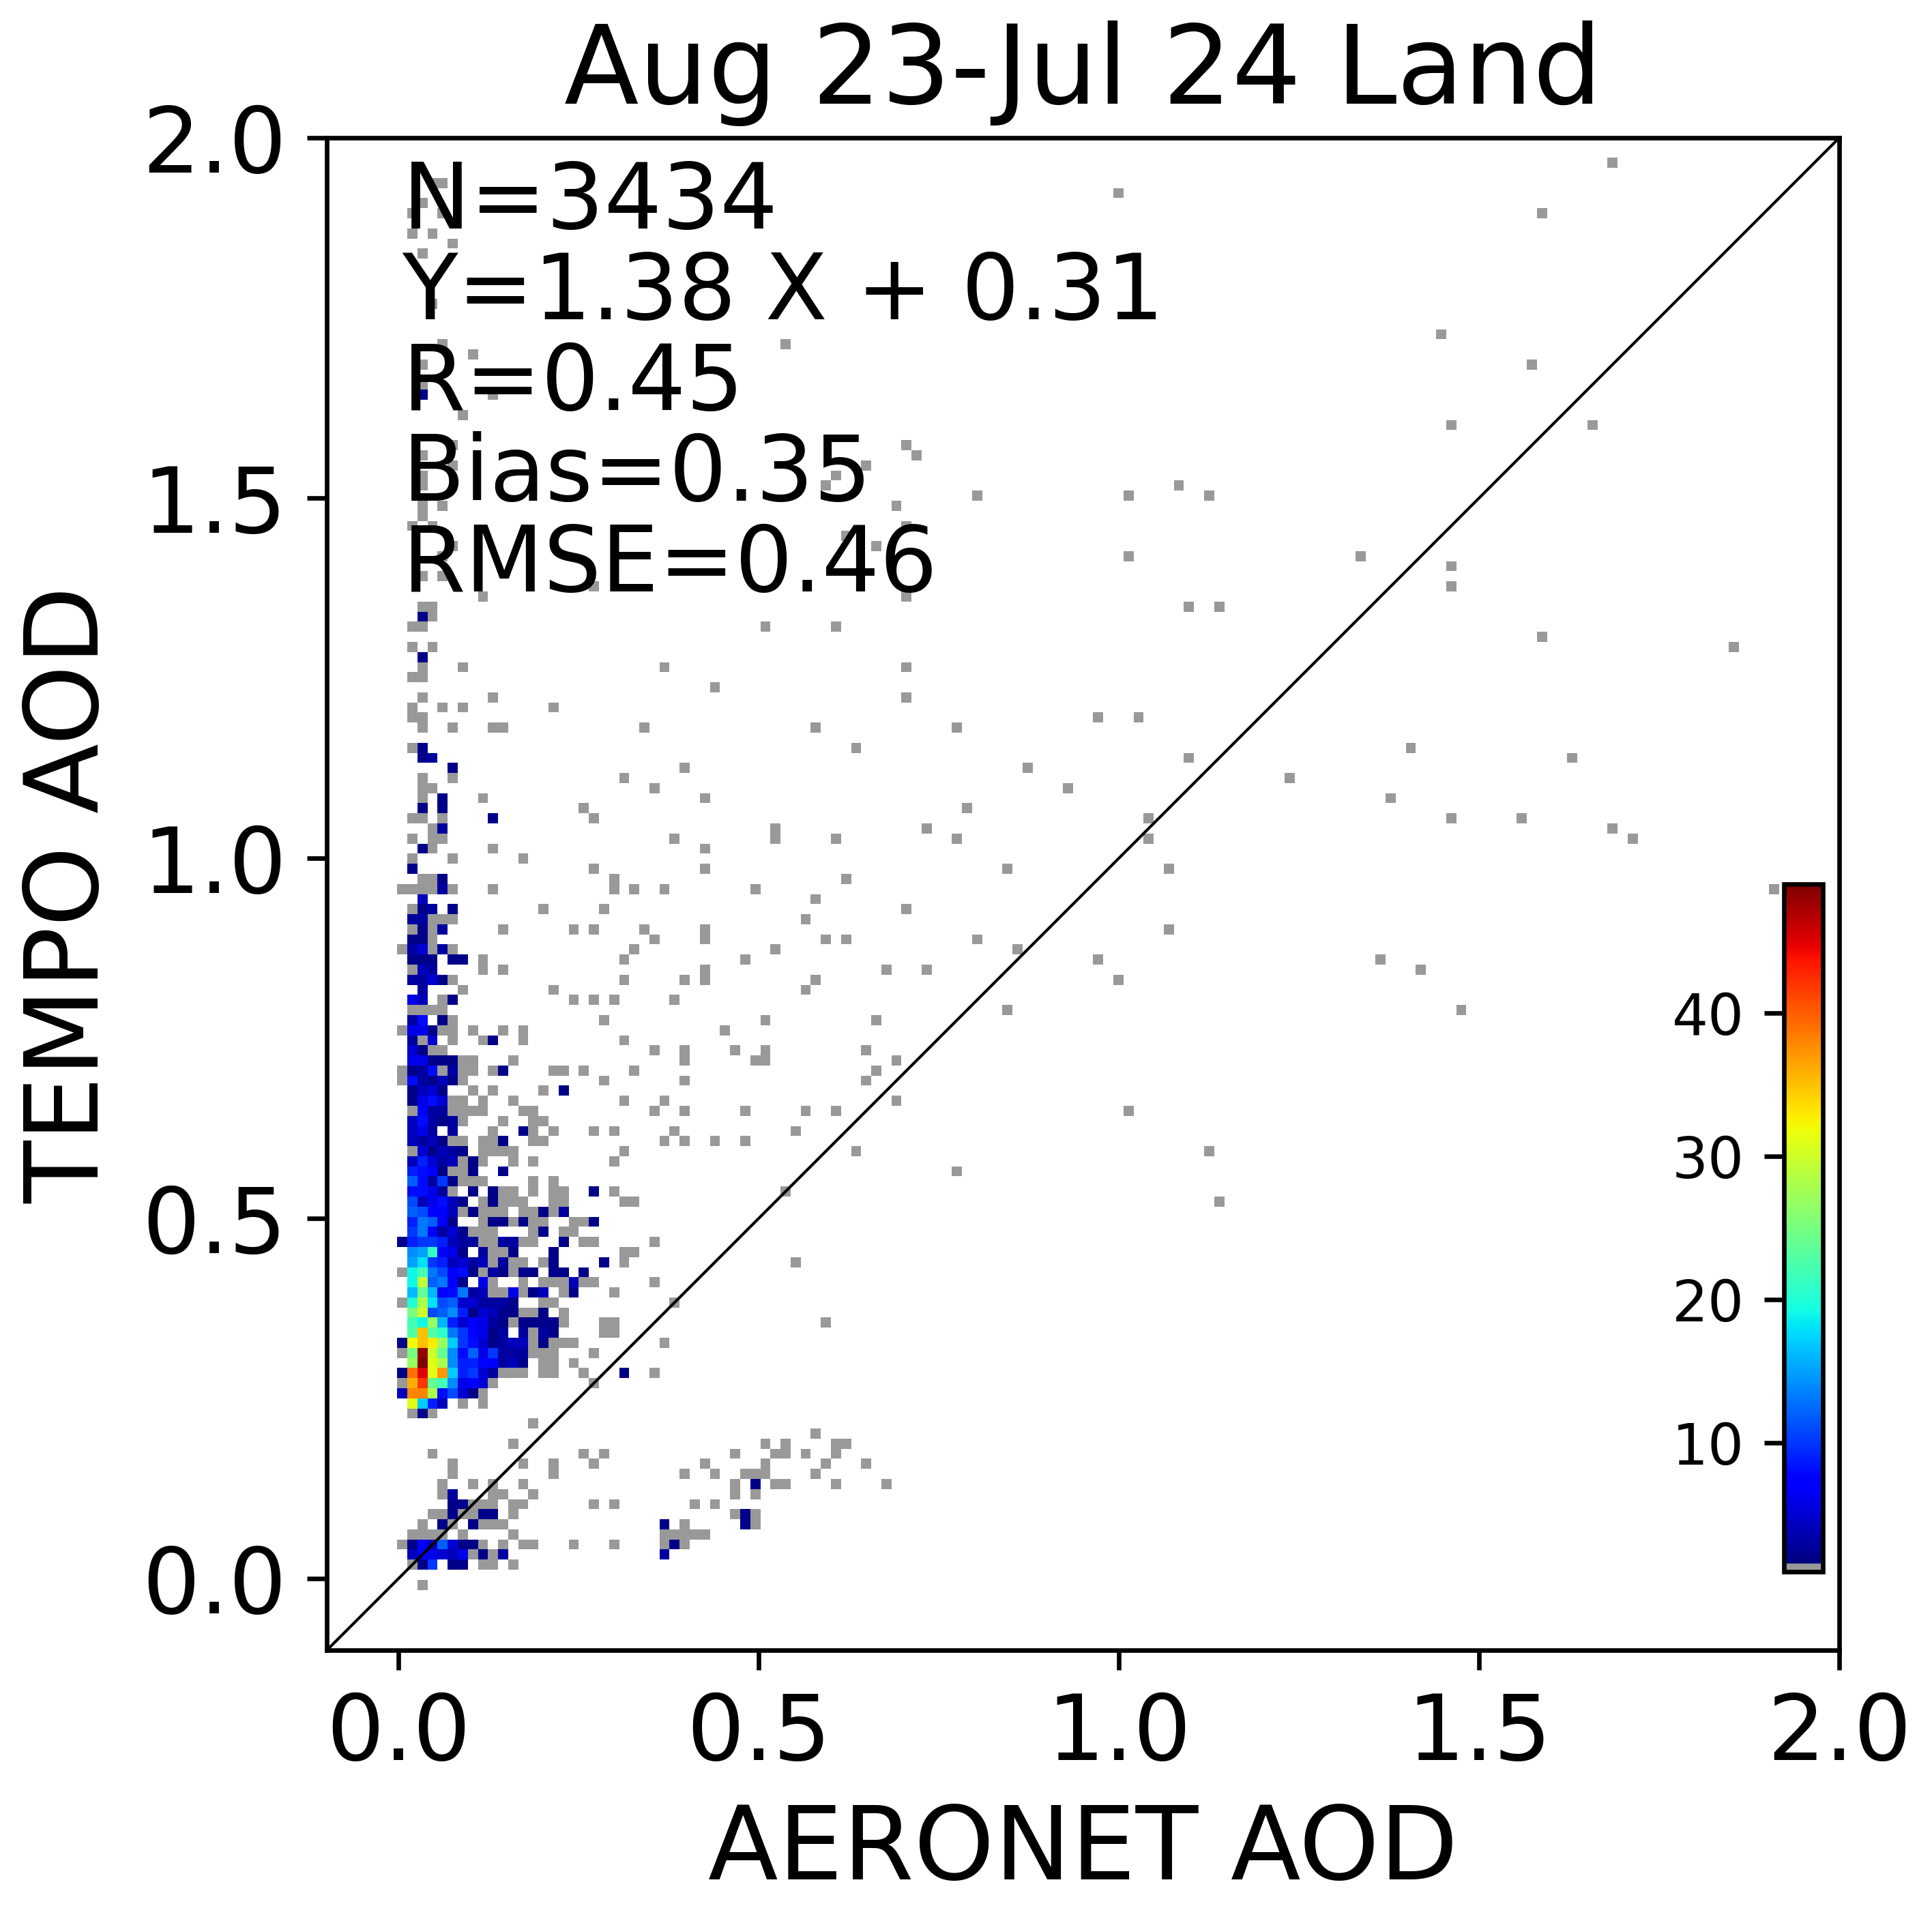
Algorithm Updates (2)
Original
A ML Data Screening Tool
Use LightGBM: a decision tree based machine learning algorithm
Input data:
  TEMPO matchup data between AOD retrievals and AERONET AOD over land
  August 2023-July 2024
  TOA reflectance at 416,440,494,670,688 nm.
  Surface reflectance from the DLER database
  Geometry: sza, vza, azi
Categorize the data into resulting categories based on the difference between retrieved and AERONET AOD using JPSS AOD requirements over land
  Precision: 0.15 (Tau < 0.1); 0.25 (0.1 ≤ Tau ≤ 0.8); 0.45 (Tau > 0.8)
  Accuracy: 0.06 (Tau < 0.1); 0.05 (0.1 ≤ Tau ≤ 0.8); 0.20 (Tau > 0.8)
  High quality if TEMPO AOD is within AERONET AOD ± (accuracy+precision), low quality otherwise
The trained model is able to predict the data category with the input data without AERONET AOD
Original
Filtered
Filtered
Removed Data

Slide 11
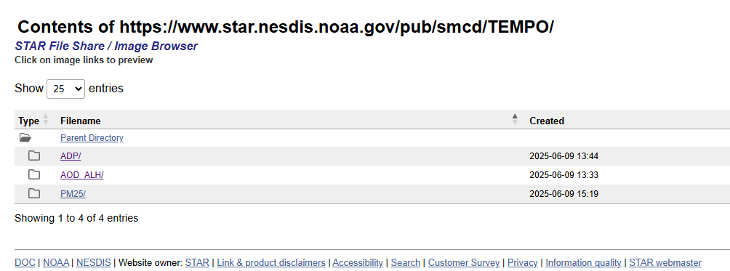
Status:
Products are being evaluated. Thorough validation of one year’s worth of data is needed to clear “provisional/validated” maturity level review at NOAA.
Seeking researchers outside of NOAA to access and conduct their own validation work and provide feedback to NOAA
Access TEMPO aerosol products via NOAA anonymous FTP

