Slide 1
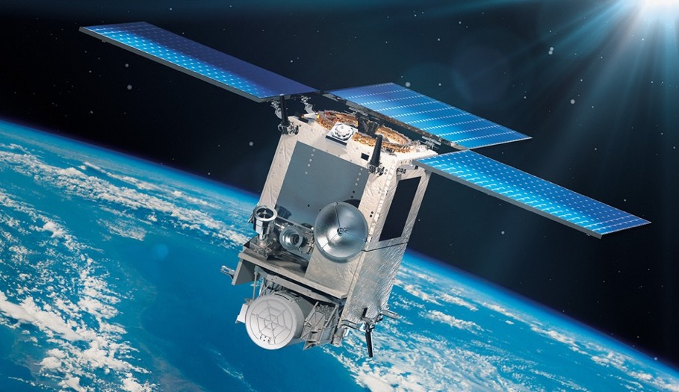


Update on the
Multi-Angle Imager for Aerosols (MAIA) Mission
David J. Diner¹, Sina Hasheminassab¹, Larry Di Girolamo², Yang Liu³, Jun Wang⁴, Feng Xu⁵, and Huanxin-Jessie Zhang⁴
¹Jet Propulsion Laboratory, California Institute of Technology
²University of Illinois at Urbana-Champaign
³Emory University
⁴University of Iowa
⁵University of Oklahoma
CEOS Atmospheric Composition – Virtual Constellation
12 June 2025
Reviewed and determined not to contain export-controlled CUI
© 2025 California Institute of Technology.
Government sponsorship acknowledged.

Slide 2
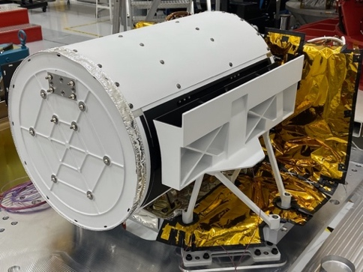
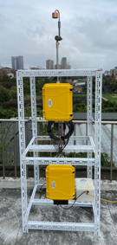
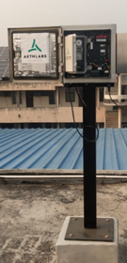
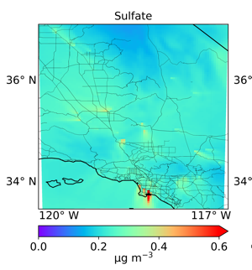

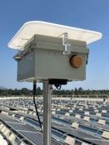
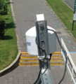

Elements of the MAIA Earth Venture Instrument investigation
1
MAIA will explore linkages between exposure to different types of ambient particulate matter (PM) – mixtures of particles with different sizes, shapes, and compositions – and human health.
Satellite instrument data Multiangle UV/VNIR/SWIR and polarization imagery | Surface monitor measurements Conversion of retrieved aerosol properties to surface PM concentrations |  |  |  | WRF-Chem outputs Meteorological data; PM gap-filling | Health records Birth, death, hospitalization
Publicly available data
Daily-averaged total PM₁₀, total PM_{2.5}, and speciated PM_{2.5} in selected target areas on a 1-km grid
Privacy protected data
Epidemiological study results

Slide 3
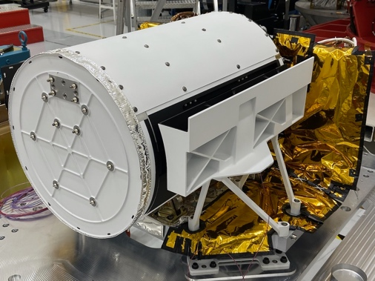
The MAIA instrument was delivered (in place at JPL) in October 2022; delivery to ASI is planned for Fall 2025
2
Band (nm) | Aerosol bands
364 | absorbing particles
388
414
440* | fine particles
551
646*
749
865
1044* | coarse particles
1608
 | Specialty bands
762.5 | O₂ absorption
943 | water vapor
1882 | cirrus screening
2124 | land surface
  Within the the MAIA instrument is a 14-band spectropolarimetric camera that is pointable in two axes
Scan (along-track) axis enables multiangle imaging of targets up to 70º view zenith angle
Pan (cross-track) axis provides ±48º field of regard, enabling frequent target observations (multiple times/week)
*polarimetric

Slide 4
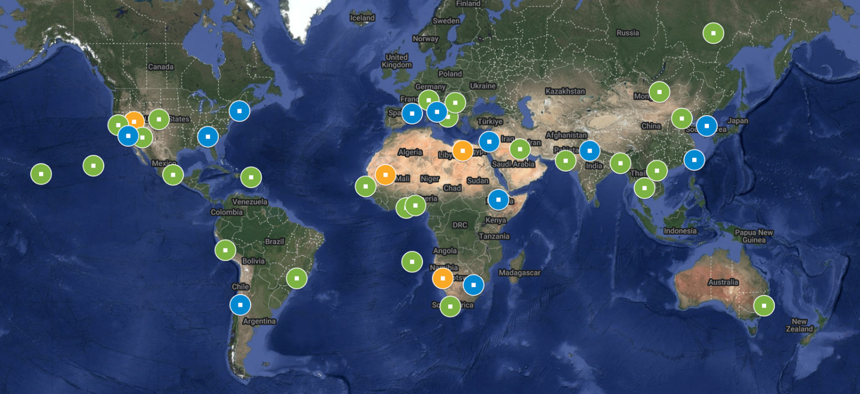
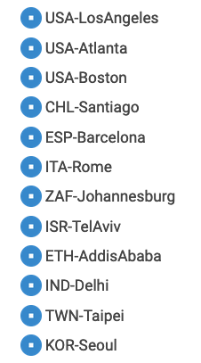
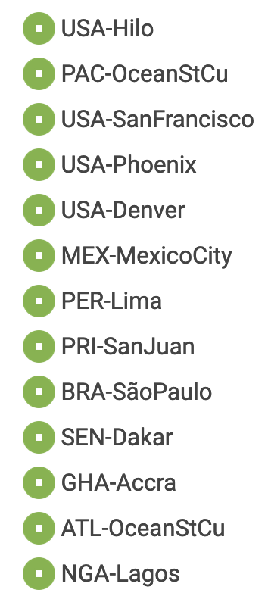

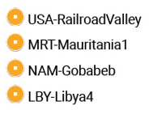
Current map of MAIA target areas
3
PTAs (12)
STAs (26)
3
PTA/STA dimensions: 360 km x 480 km
Primary Target Areas (PTAs): Surface monitor data collections, epidemiological studies (3-4 satellite observations/week)
Secondary Target Areas (STAs): Air quality and climate studies (1-4 satellite observations/week)
Calibration/Validation Target Areas (CVTAs) (~monthly for instrument/algorithm performance maintenance)
Calibration/Validation Target Areas (4)

Slide 5
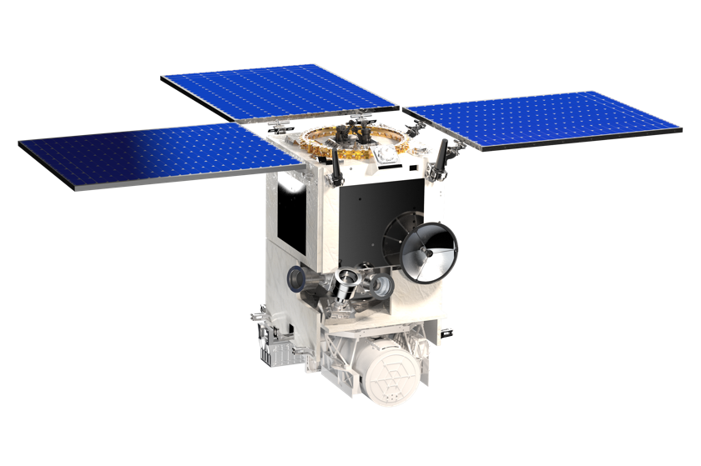
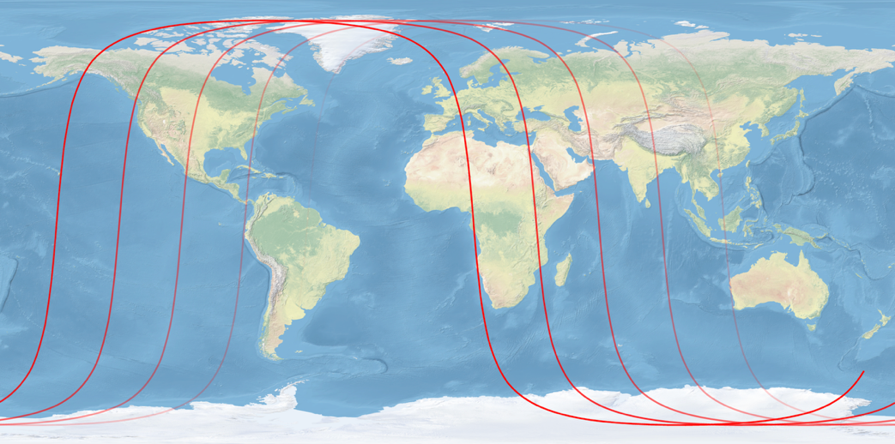
Spacecraft, launch, and orbit update
NASA’s mission partner, the Italian Space Agency (ASI), is planning for MAIA launch on a Vega-C launch vehicle in mid-2026 aboard ASI’s PLATiNO-2 spacecraft.
The launch manifest shows PLATiNO-2/MAIA as a shared ride with ESA’s Sentinel-3C spacecraft.
The launch plan has resulted in a change in the orbit from ascending to descending node.
Due to the targeting nature of the MAIA instrument, the reoriented ground tracks required a re-optimization of MAIA target coordinates.
Nominal equator-crossing time is moved up from 10:30 am to 10:00 am.
descending flight direction
ascending flight direction

Slide 6
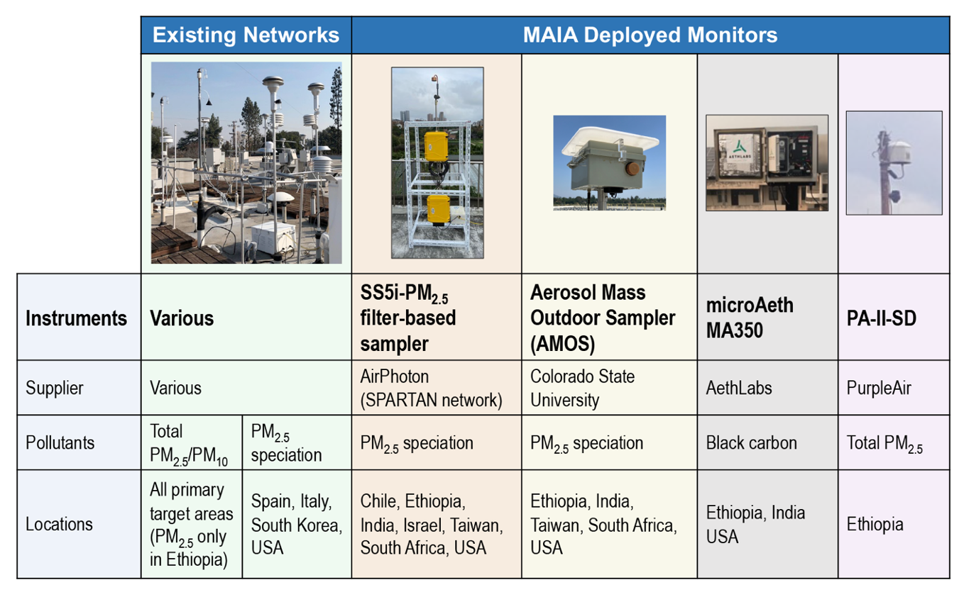
The MAIA surface monitor air pollution network is
currently in operation
5
Surface monitors are essential for calibrating the transformation of satellite-derived aerosol information to near-surface PM concentrations.

Slide 7
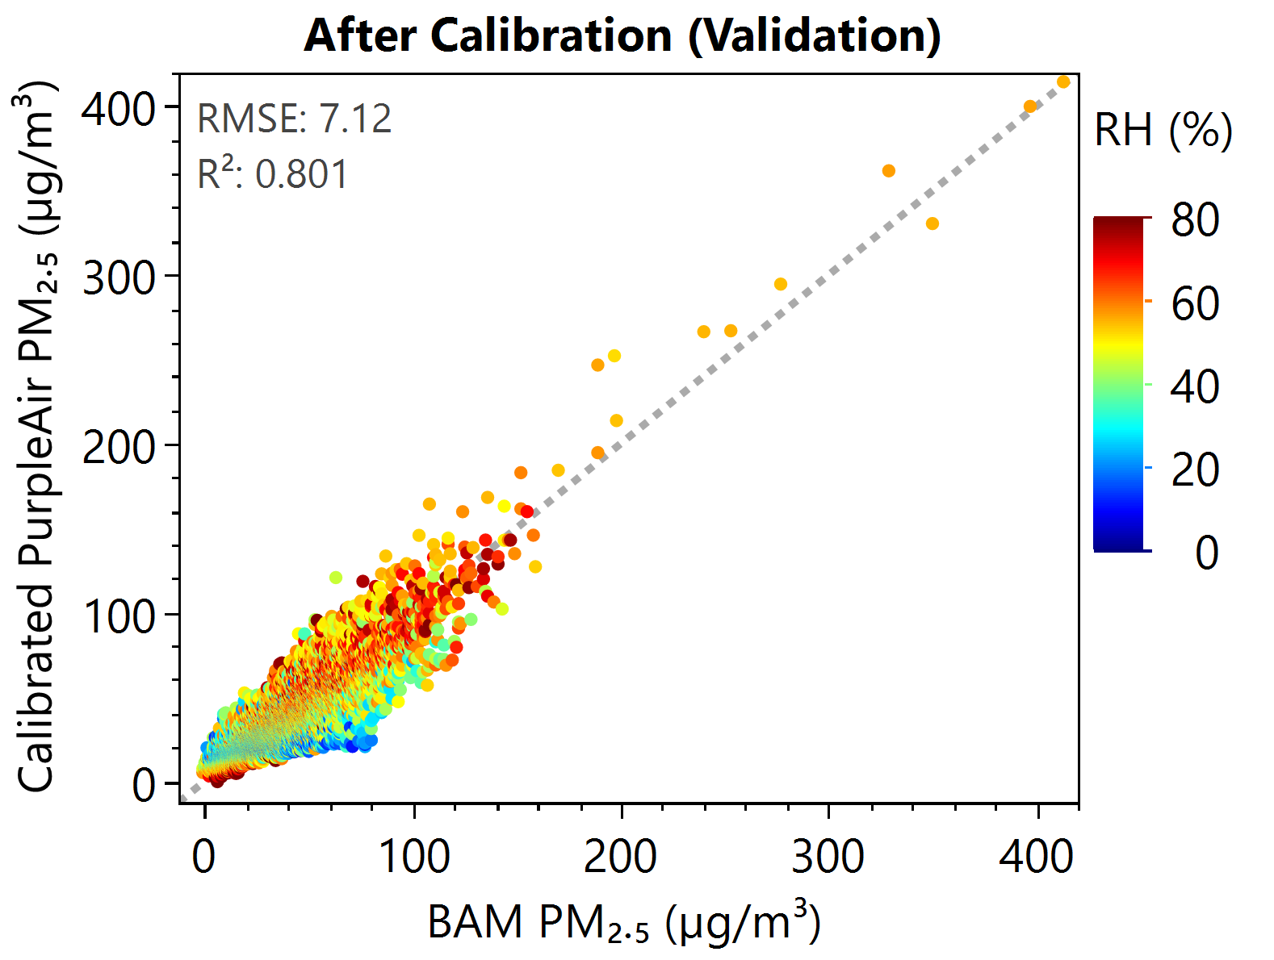
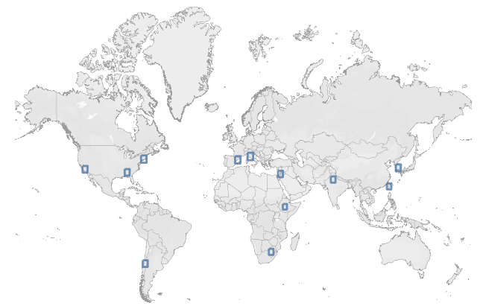


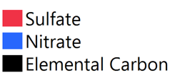


Mean PM_{2.5} concentrations and
chemical compositions in the MAIA PTAs (2022-2023)
6
Calibrated PurpleAir PM2.5 data in Ethiopia, using BAMs at US Embassy facilities as reference sensors
Spain
10 μg m⁻³
Rome
14 μg m⁻³
Israel
17 μg m⁻³
Boston
8 μg m⁻³
India
93 μg m⁻³
Los Angeles
9 μg m⁻³
S. Korea
19 μg m⁻³
${PM}_{2.5, calibrated}=α_{0}+α_{1}$ ${PM}_{2.5, raw}$+ $α_{2}$ $T$+ $α_{3}$ $RH$
Not yet available
Atlanta
10 μg m⁻³
Chile
30 μg m⁻³
S. Africa
25 μg m⁻³
Ethiopia
33 μg m⁻³
Taiwan
15 μg m⁻³

Slide 8
Geophysical retrieval algorithm overview
7
Retrieval | Algorithm approach
Cloud mask | 5 tests against predetermined thresholds (1) brightness; (2) normalized difference vegetation index or normalized difference snow index; (3) spectral whiteness; (4) cirrus test; (5) spatial variability
Aerosol | Optimal estimation (OE) preceded by initial step that constrains AOD using the MISR algorithm Employs a coupled atmosphere-surface vector Markov Chain/adding-doubling radiative transfer (RT) code A neural-network (NN)-based RT approach boosts computational efficiency Surface BRF climatology from MODIS MAIAC provides retrieval constraints
Satellite-based PM | Geostatistical Regression Models (GRMs) to map PM, trained using surface monitor measurements Offsets and satellite AOD coefficients are modeled as random effects; land use, meteorology, and other aerosol parameters are modeled as fixed effects Simplified pre-launch GRMs in the PTAs have been trained using AERONET AOD and WRF-Chem meteorology
Gap-filled PM | Similar GRM formulation but with WRF-Chem PM outputs as the primary predictor Training using surface monitors and addition of other predictors are employed to correct the CTM outputs for biases The corrected WRF-Chem estimates are merged with the satellite-based results using ensemble averaging

Slide 9
MAIA data products for the PTAs
(NetCDF format)
8
Data Product | Contents | Spatial Grid | Temporal Info
L1 Georectified Imagery | Map-projected radiance and polarization data, view and illumination geometry, latitude/longitude coordinates | 250 m | Time/days of target overpass
L2 Cloud Mask | Cloud or Clear designation and confidence indicator Incorporates NOAA snow and ice mask (GMASI) | 1 km | Time/days of target overpass
L2 Aerosol Product | AOD, fractional AOD by size/shape/absorption, size distribution, refractive index | 1 km | Time/days of target overpass
L2 PM Product | PM₁₀, PM_{2.5}, speciated PM_{2.5} (sulfate, nitrate, OC, EC, dust) | 1 km | 24-hr averaged/days of target overpass
L4 Gap-filled PM Product | PM₁₀, PM_{2.5}, speciated PM_{2.5} (sulfate, nitrate, OC, EC, dust), spatially and temporally gap-filled | 1 km | 24-hr averaged/daily
Ancillary Geographic Product (AGP) | Land use information | 125 m - 1 km | Static
Surface Monitor Product | Measured and quality-controlled surface-based PM data | Point locations | Days when surface monitor data are collected
Current plans are to process STAs through L2 Aerosol and to provide AGPs, with other processing on a best-efforts, resource availability basis.

Slide 10
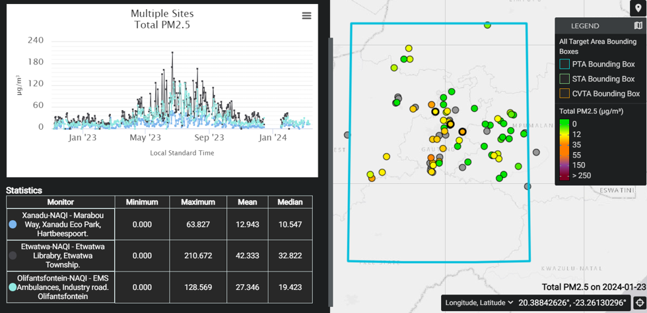
MAIA surface monitor data are publicly available
9
Example surface monitor data visualization in the Johannesburg PTA
The MAIA Geographic Information Visualization Tool (GIVT) is a web-based interactive GIS tool publicly available on the MAIA website.
GIVT enables exploration of MAIA target area locations and access to dynamic surface-based total and speciated PM data collected in the MAIA PTAs.
Surface Monitor Data Products in NetCDF format are also available from NASA Earthdata.
GIVT: https://maia.jpl.nasa.gov/mmgis/
Earthdata: https://search.earthdata.nasa.gov/search
Search on “MAIA PM Surface Monitor”

Slide 11
Concluding remarks
10
Generation of MAIA data products will integrate satellite, surface monitor, and CTM data.
  Data products will include daily maps of total PM_{2.5}, total PM₁₀, and speciated PM_{2.5} (sulfate, nitrate, EC, OC, dust) at 1-km spatial resolution in 12 PTAs.
Surface-based total and speciated PM data collection is now underway in all PTAs.
  The data can be explored using the GIVT tool on the MAIA website and NetCDF products available from NASA Earthdata.
The MAIA satellite instrument will be launched in 2026 (flight mission duration: 3 years).
After launch, epidemiologists on the MAIA Science Team will investigate linkages between PM type and human health.
Planned epidemiological studies in the MAIA PTAs
Exposure timescale Health outcomes
Acute (days to weeks) Emergency room visits, premature deaths
Subchronic (months) Adverse birth outcomes, pregnancy complications
Chronic (years) Cardiovascular and respiratory diseases
https://maia.jpl.nasa.gov

