Slide 1

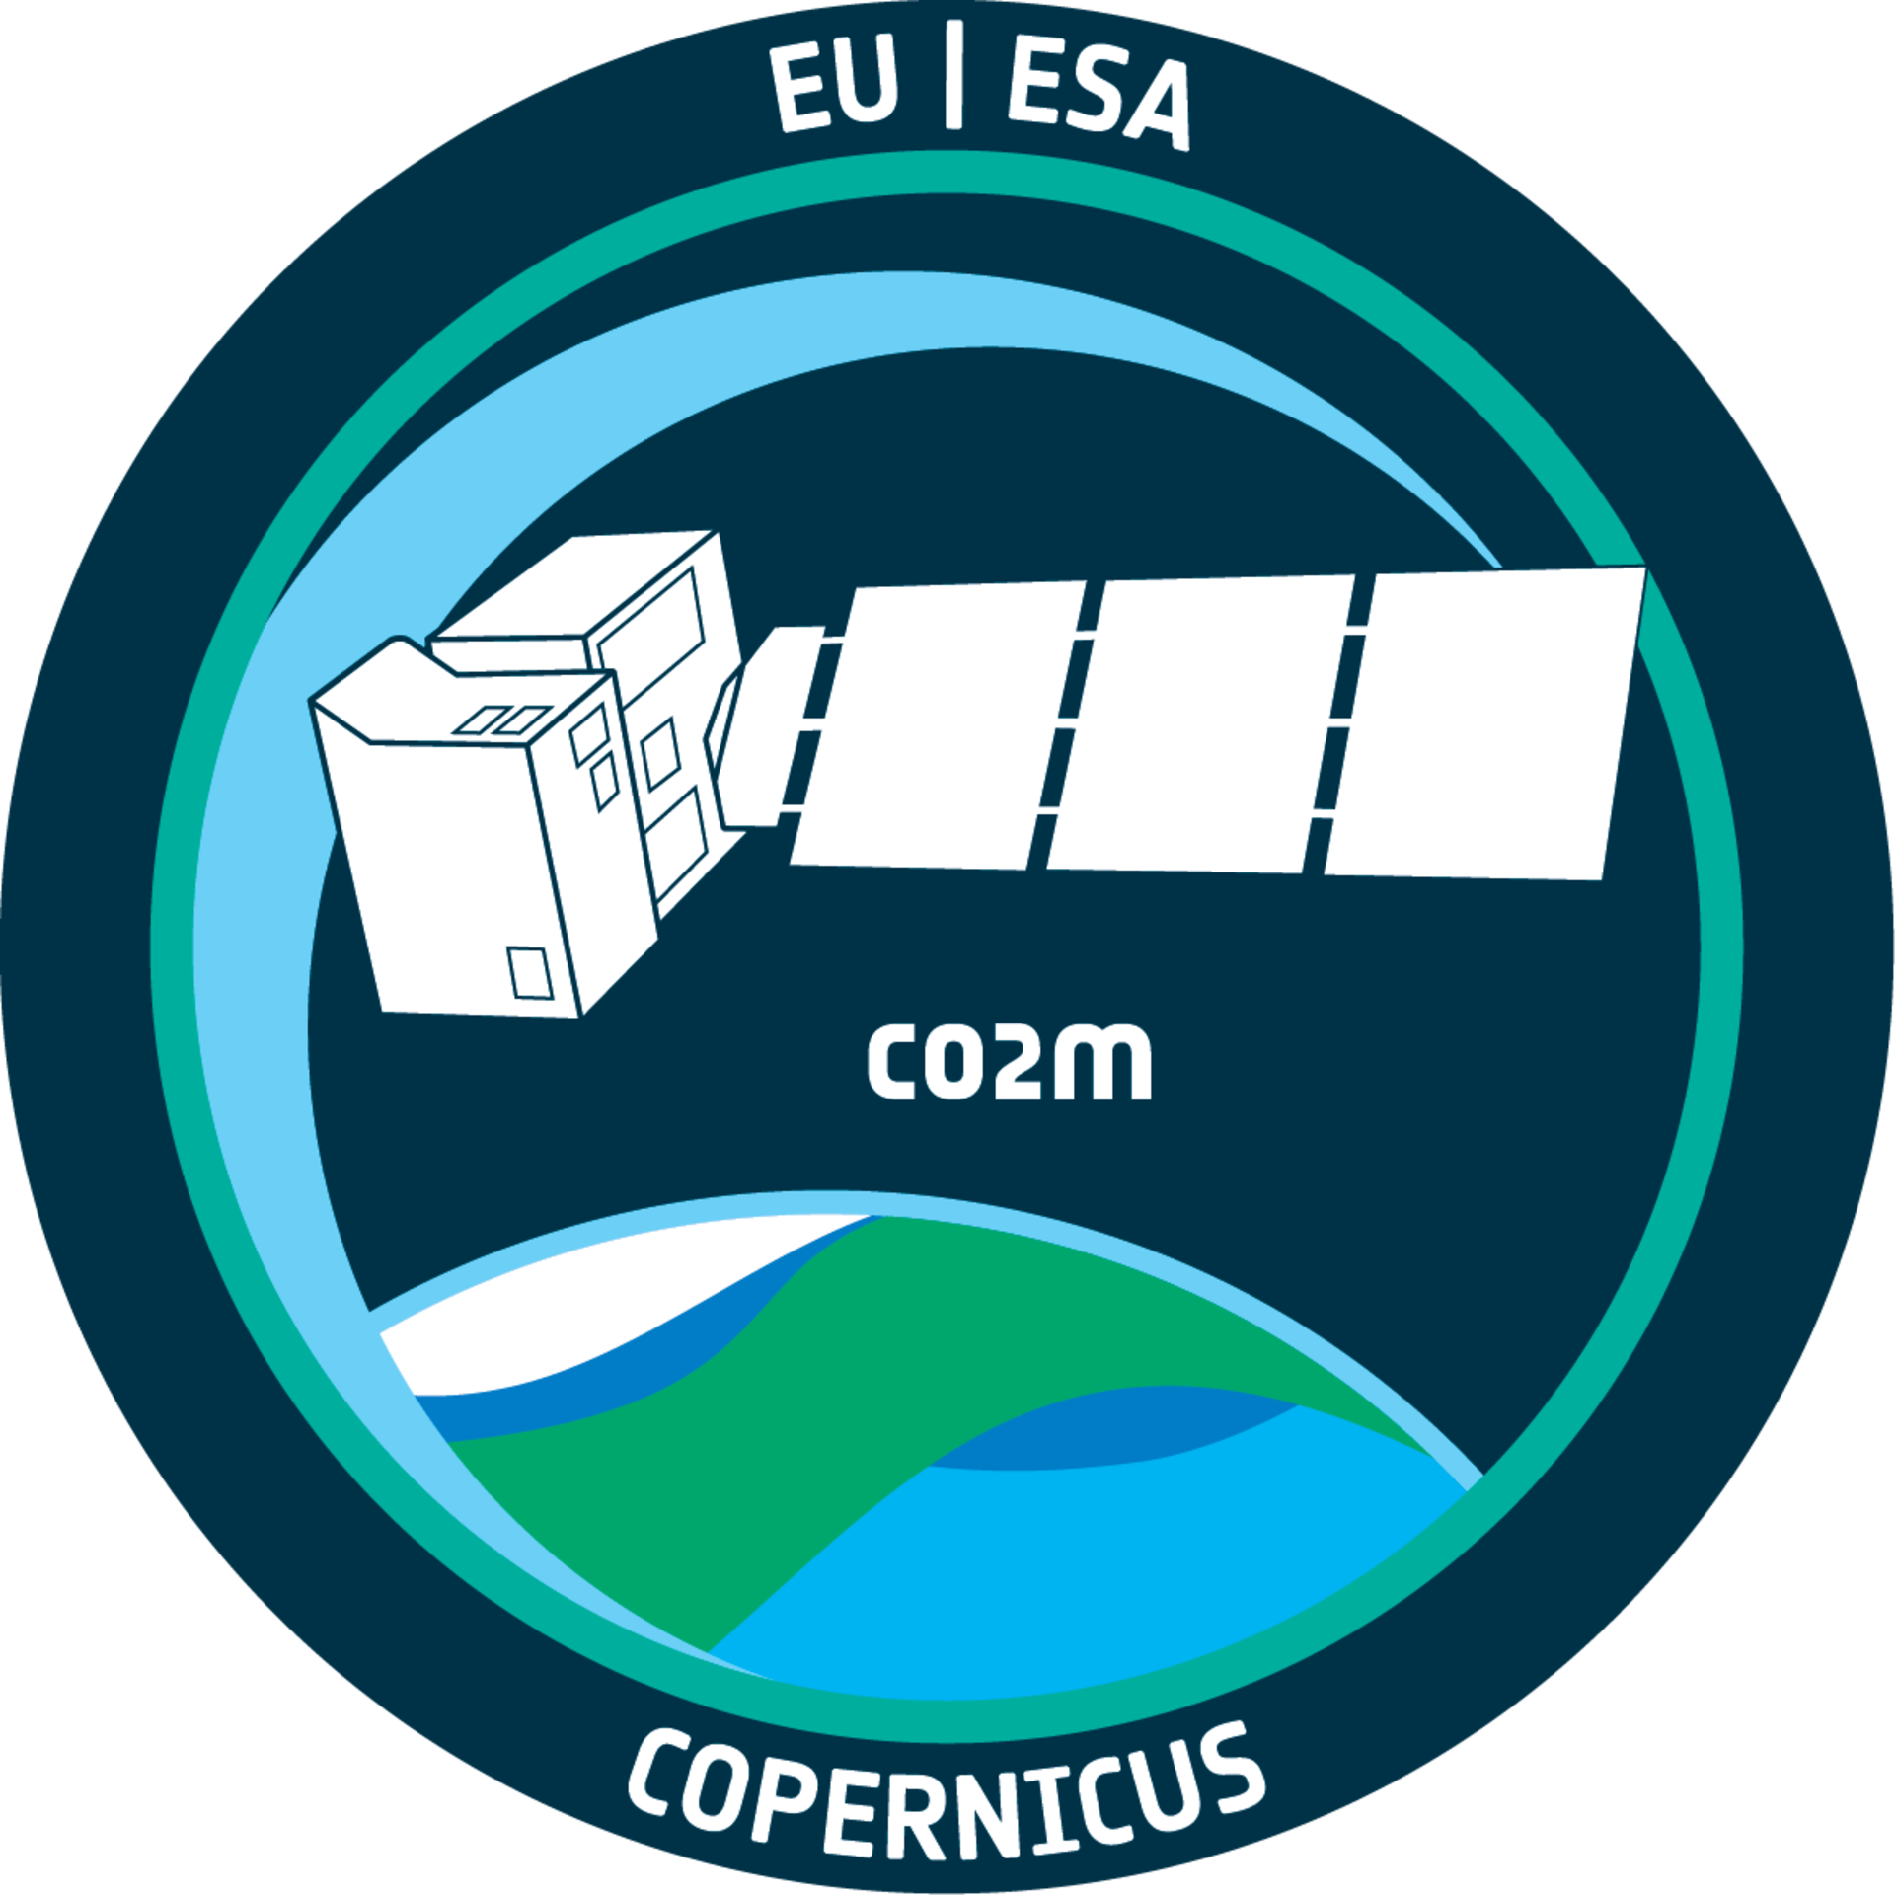
Multi-Angle Polarimeter observations supporting the
Copernicus Anthropogenic CO2 Monitoring (CO2M) Mission
Dr. Yasjka Meijer (ESA)
Dr. Rüdiger Lang (EUMETSAT)
AC-VC 21, Takamatsu, Japan

Slide 2
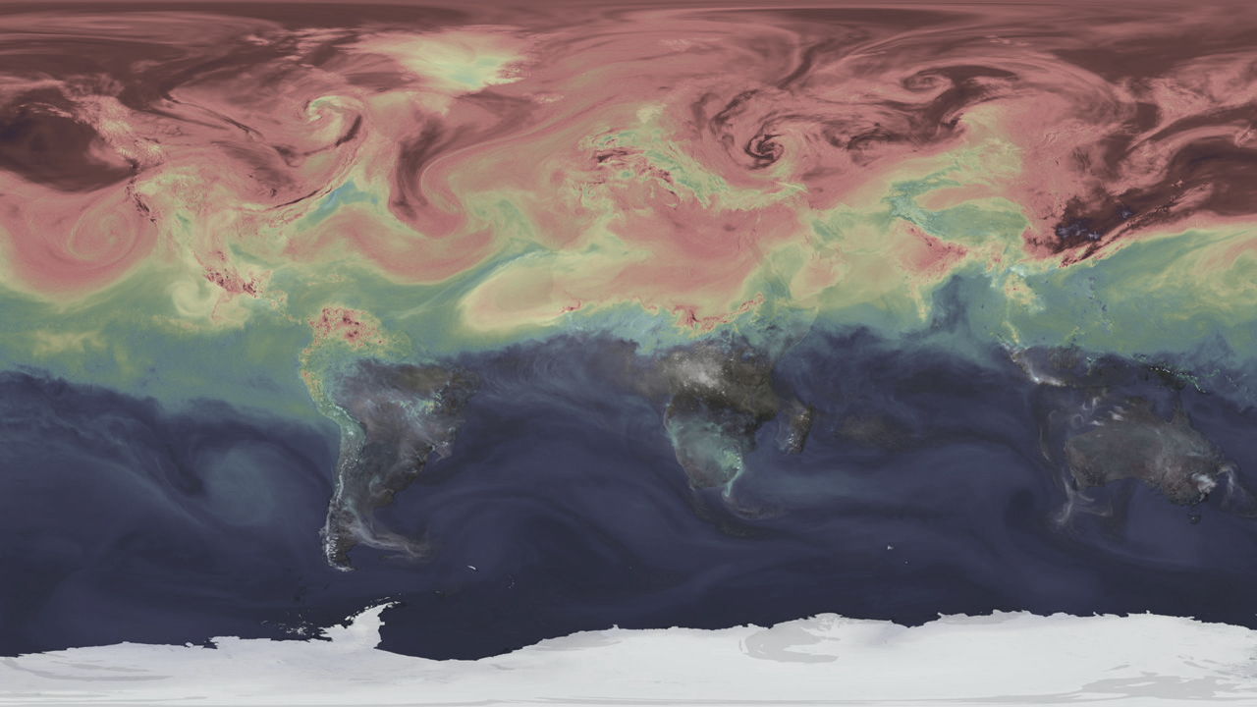
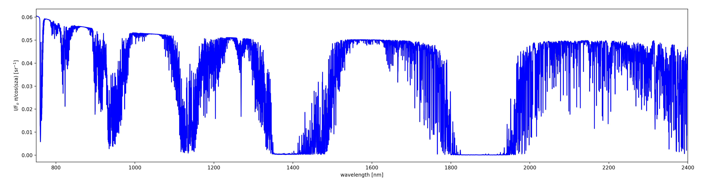
CO₂ Monitoring (CO2M) Mission
Detection of emitting hot spots
Monitoring the hot spot emissions
Assessing emission changes against local reduction targets
Assessing the national emissions and changes
CO₂ required precision: 0.16%
CO₂ required bias: <0.12%
747-773 nm
1590-1675 nm
1990-2095 nm

Slide 3

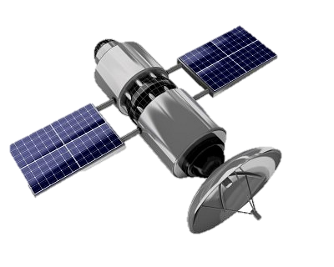
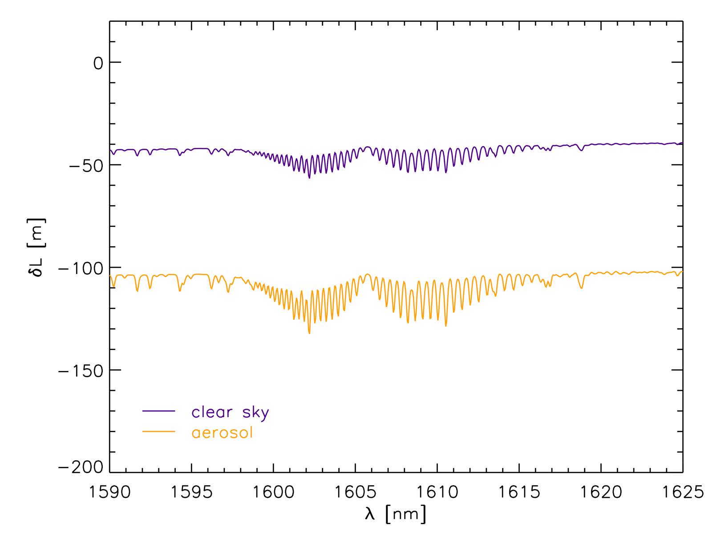
Change of light path
$τ_{aer}$(760nm)=0.3 and $τ_{aer}$(1600nm) =0.07
A change in light path (in lowest 1 km) of 13 meter can cause an error of 0.5 ppm (0.12%) in XCO₂ [SRON]
Notes:
Ignoring the light path change can induce XCO2 errors of $±5$ ppm. (see also non-scattering error Butz et al., App. Opt. 2009).
Just a back-of-the envelope calculation how relevant the light path is!

Slide 4
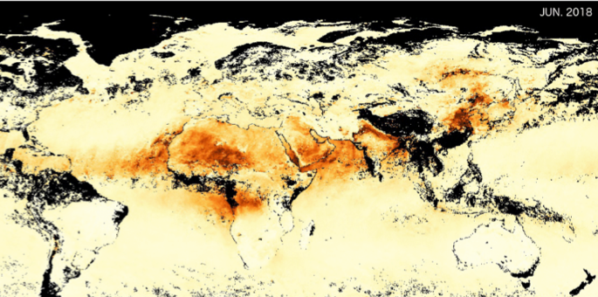

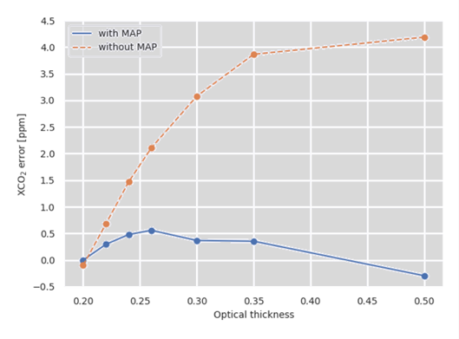
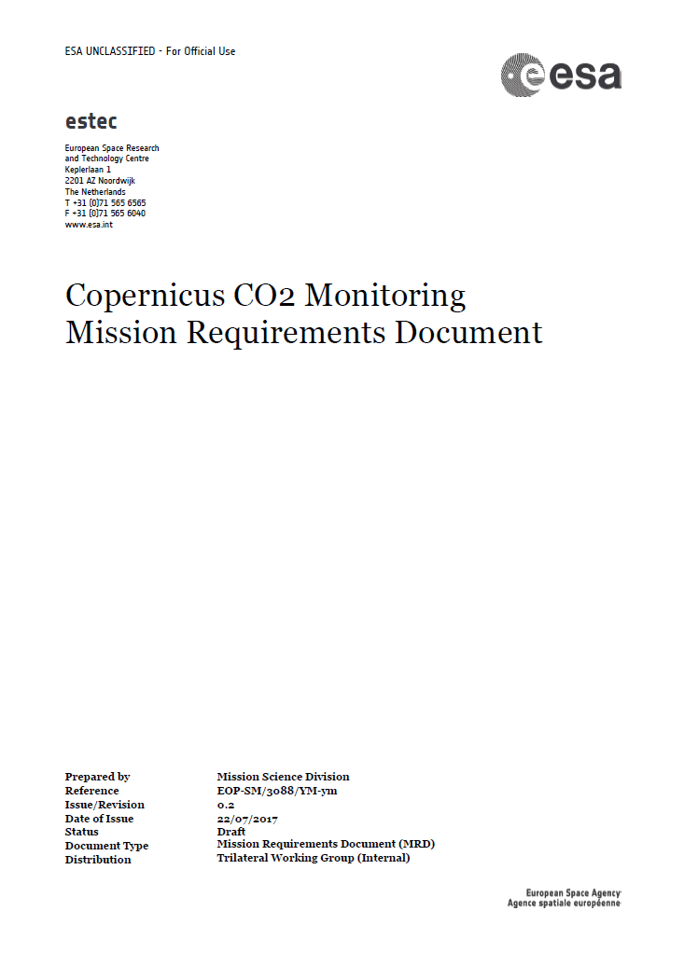
Aerosol for GHG monitoring
Aerosol & cloud scattering:
Heritage missions without MAP require bias correction
and strict quality filtering for AOD<0.3.
For CO2M, Light path correction by measuring effective aerosol & clouds:
Higher accuracy CO₂ data (less posterior bias correction)
More data and also at higher aerosol loading; up to 0.5 AOD
Cloud cover of CO₂ pixel 1 – 5%
0.0 0.5 1.0
With MAP
Without MAP
Credits: SRON, Utrecht
Aerosol amount (AOD)
XCO₂ bias (ppm)
MRD
Aerosol amount (AOD)

Slide 5
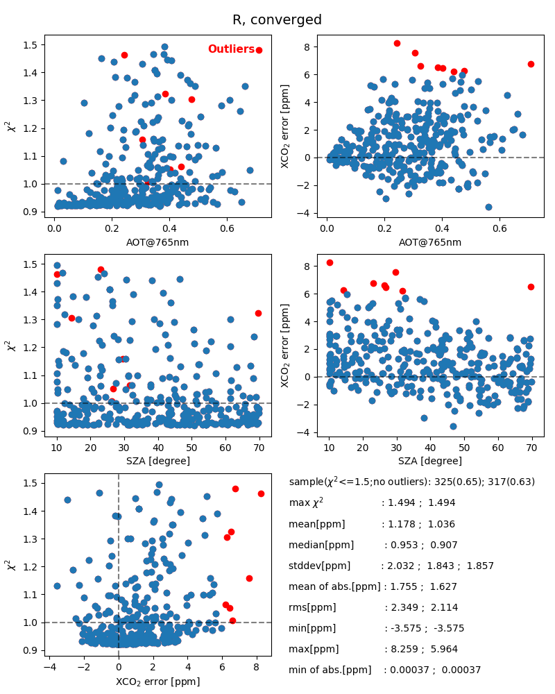
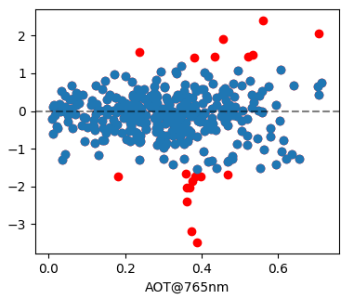
XCO₂ bias: dependence on AOT
CO₂I only retrieval
Joint CO₂I+MAP retrieval
std dev. =1.86 ppm
median bias = 0.95 ppm
std dev. =0.57 ppm
median bias = -0.088 ppm
Credits: SRON, Utrecht

Slide 6
XCO₂ bias: dependence on AOT
CO₂I only retrieval
Joint CO₂I+MAP retrieval
std dev. =1.86 ppm
median bias = 0.95 ppm
std dev. =0.57 ppm
median bias = -0.088 ppm
Credits: SRON, Utrecht

Slide 7
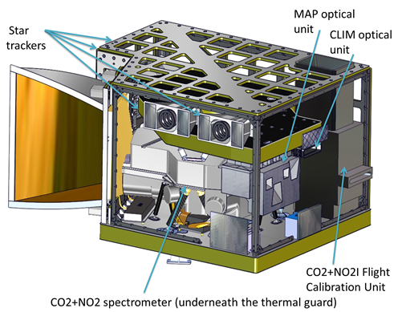
Payload Implementation
Payload Components
CO2 Imager (CO2I): 3 band (1 NIR, 2 SWIR)
co-located push-broom imaging spectrometer
NO2 Imager (NO2I): VIS band implemented as fourth band in CO2I instrument
Multi-Angle Polarimeter (MAP) for aerosol observations
CLoud IMager (CLIM) for low cloud & cirrus detection
Credits: TASiF

Slide 8

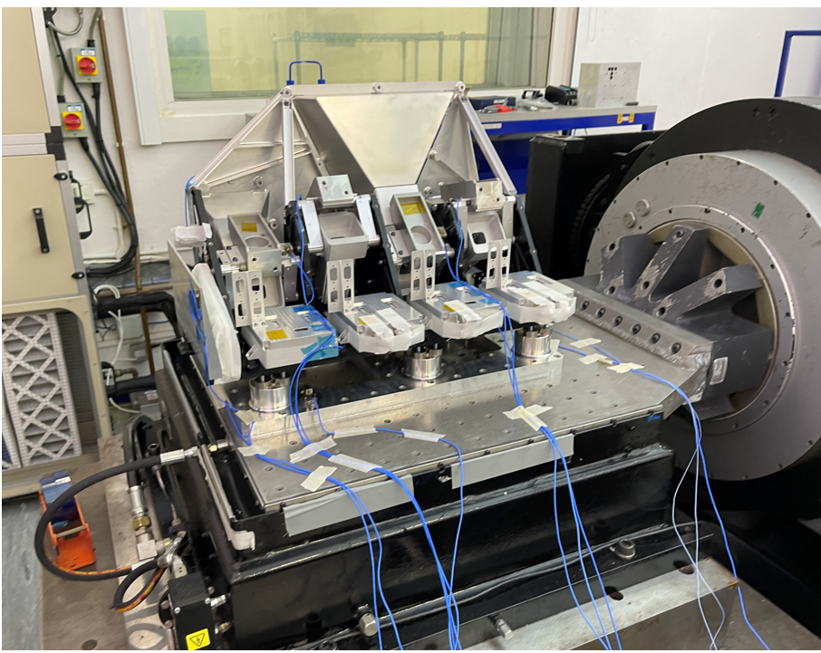
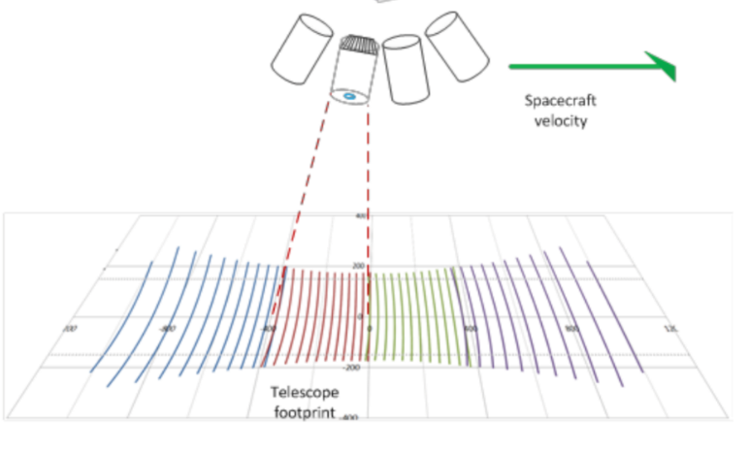
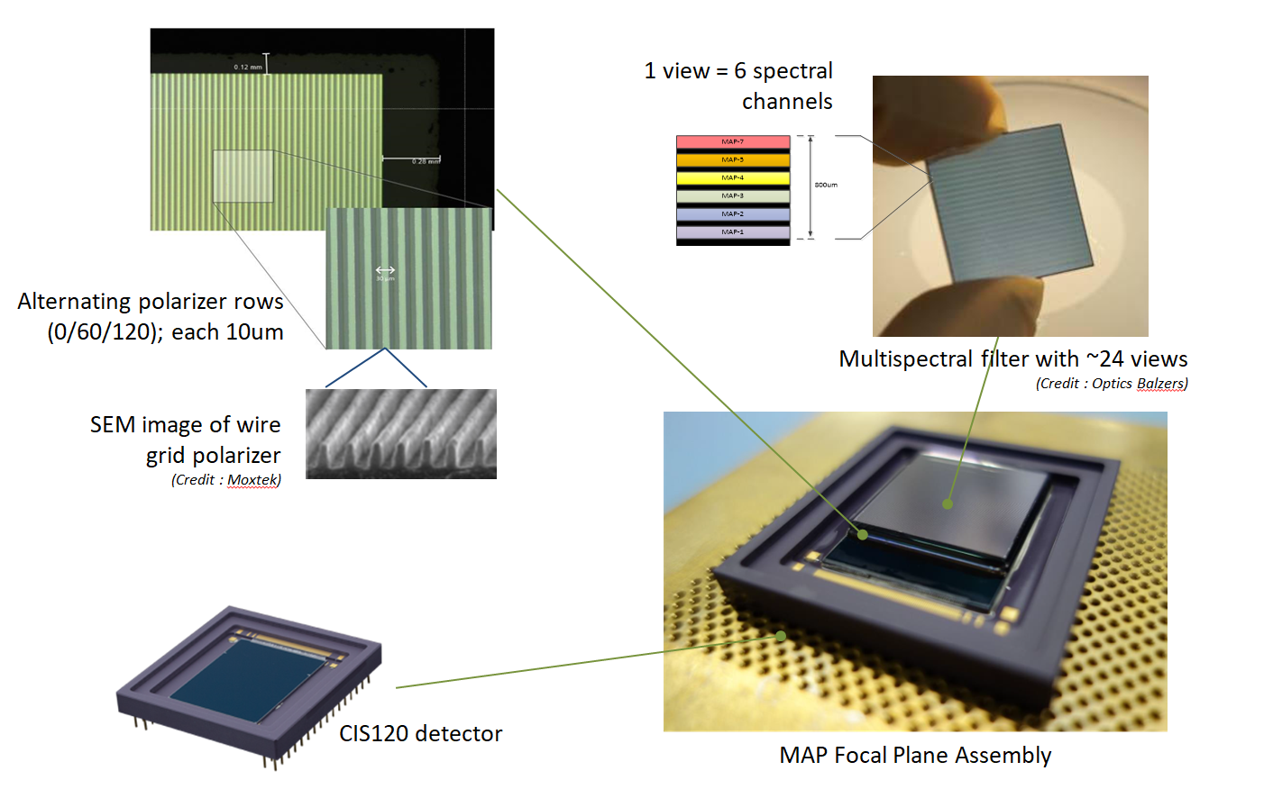

Multi Angle Polarimeter (TASiUK)
MAP Band | Wavelength
VNIR-1 | 410 nm
VNIR-2 | 443 nm
VNIR-3 | 490 nm
VNIR-4 | 555 nm
VNIR-5 | 670 nm
VNIR-6* | 753 nm
VNIR-7 | 865 nm
Multi-angle polarimeter (MAP) implementation:
Compact push broom imager:
40 viewing angles (+/- 60º), plus 8 more @larger angles
3 polarisations (0º, 60º, 120º)
Spatial resolution: 4x4 km2 and sampling < 1x1 km2
6 pol. spectral bands (+1 for co-reg with CO2I)
CDR
Required total DoLP error <0.0035
Credits:
TAS-UK
Credit © TAS-UK
MAP OU STM in mechanical testing
22-23 May calibration meeting 50 experts!

Slide 9
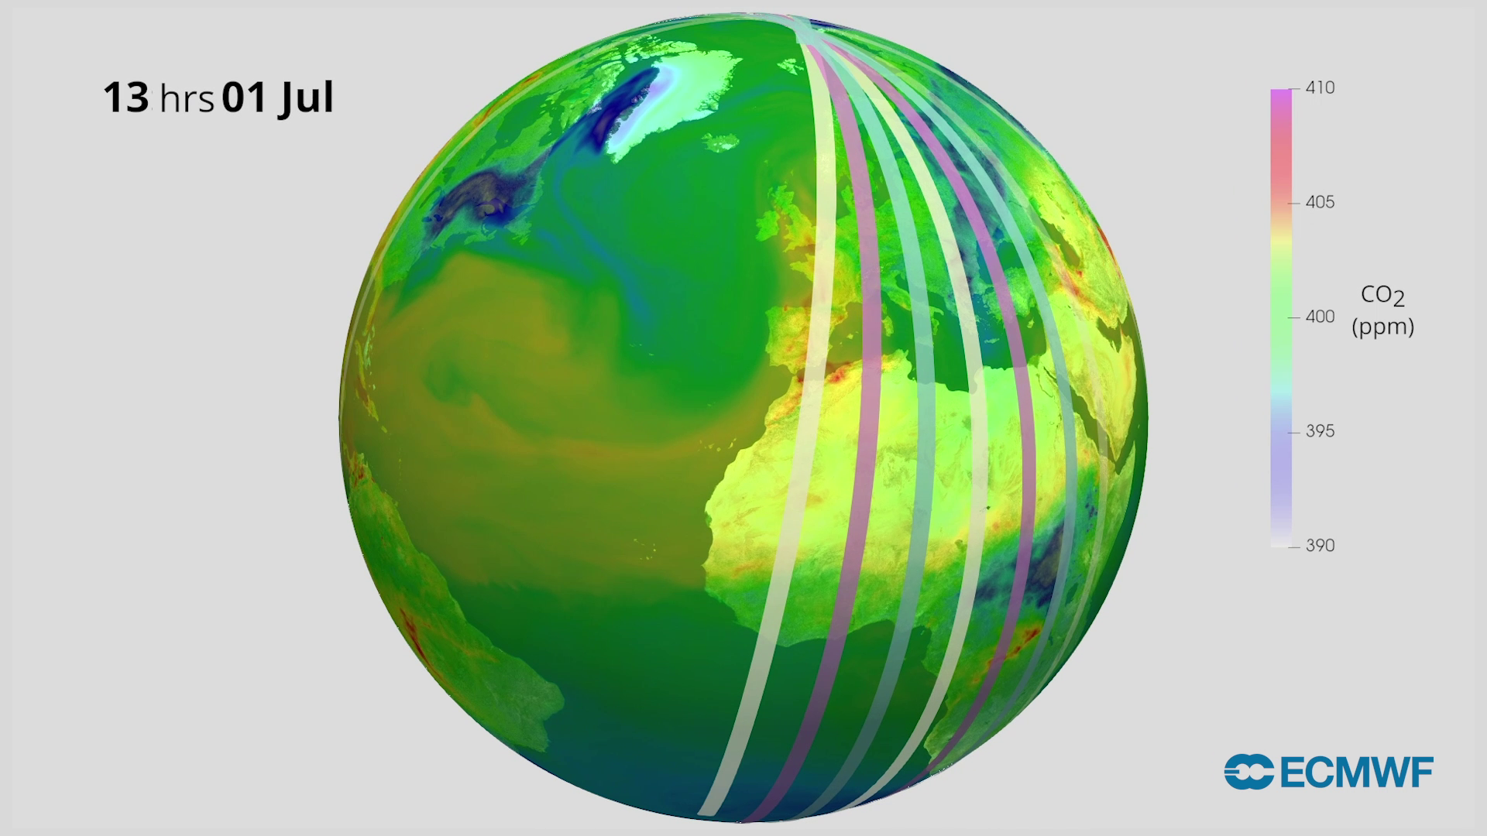
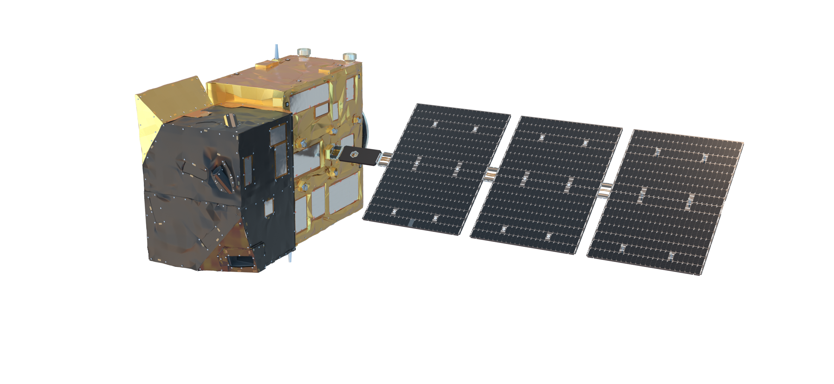
Copernicus CO2M Mission – Status
Project status:
Constellation of 3 satellites
Each satellite >270 km swath
First satellite Acceptance Review 08-2027
Second satellite Acceptance Review 02-2028
Third satellite is scheduled in 2029
Product | Spatial | Precision
CO₂ | 4 km² | 0.7 ppm
CH₄ | 4 km² | 10 ppb
NO₂ | 4 km² | 1.5 10¹⁵ molecules cm⁻²
Vegetation SIF | 4 km² | 0.7 mW m⁻² sr⁻¹ nm⁻¹
Aerosol params | 16 km² | 0.05 AOD, 500 m LH
Cloud fraction | 1% | Water clouds & cirrus
Copernicus data is made freely available
to any person and organisation around the world
EUMETSAT performs operational data processing
More info → https://doi.org/10.3389/frsen.2023.1217568
Credits: EMPA

Slide 10
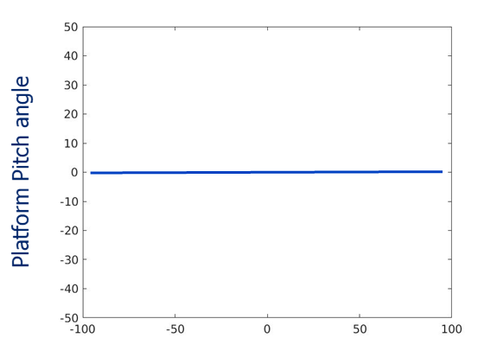
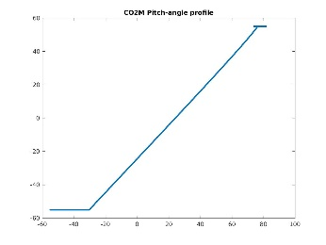
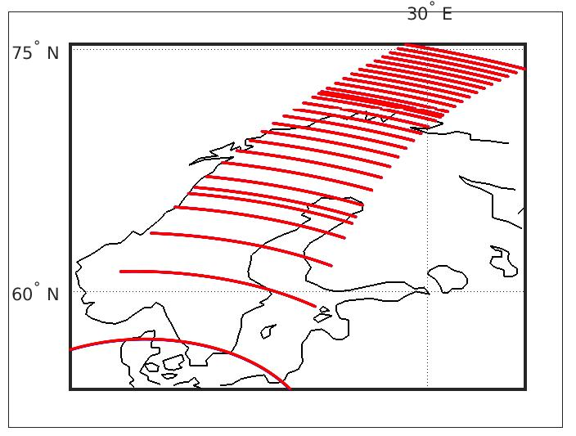
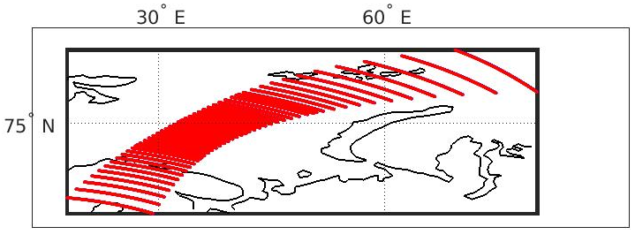
Nominal and pitched (“sun-glint”-pointing) platform orbits for CO2M
Nominal Orbit
Pitched Platform Orbit
*)
*)
Platform pitch angle at 0 deg
(all 41 views +-60 degrees)
Platform pitch angle at 50 deg forward looking
(all 29 valid views +-60 degrees)
*) Cox-Munk model for water (glint) reflectance at 7 m/s averaged wind-speed.

Slide 11
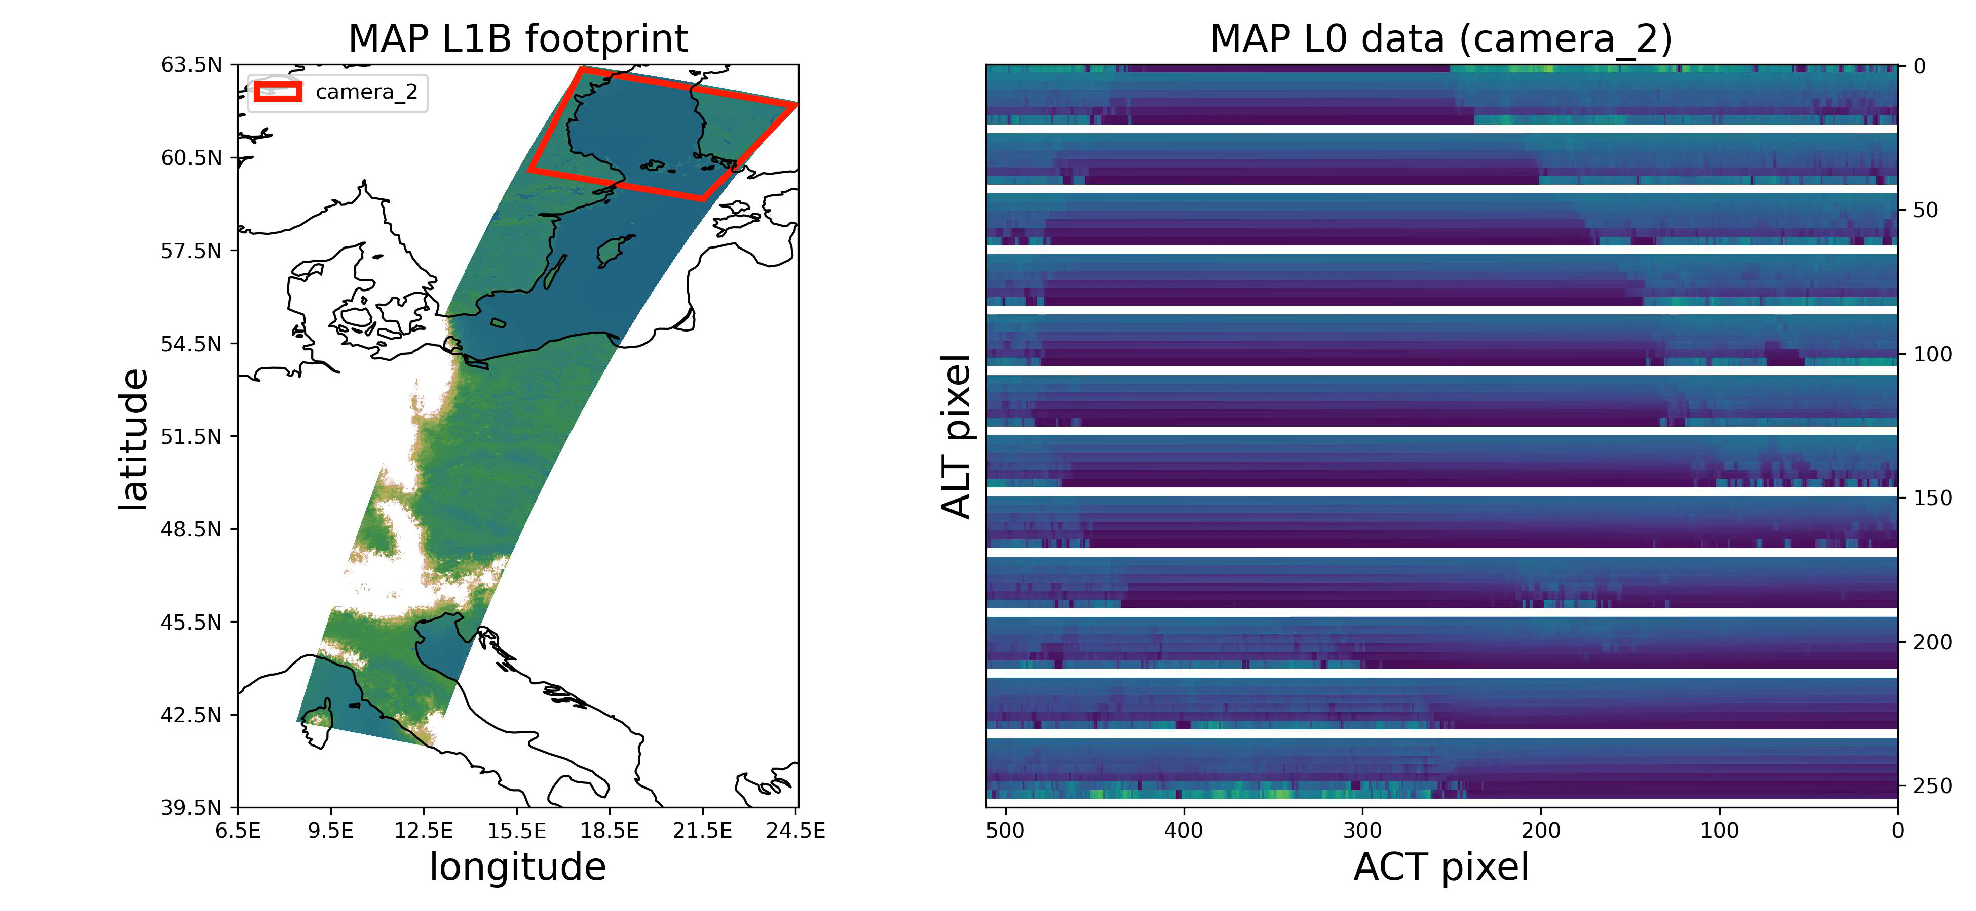
Simulation of CO2M MAP level-0 data – detector level

Slide 12
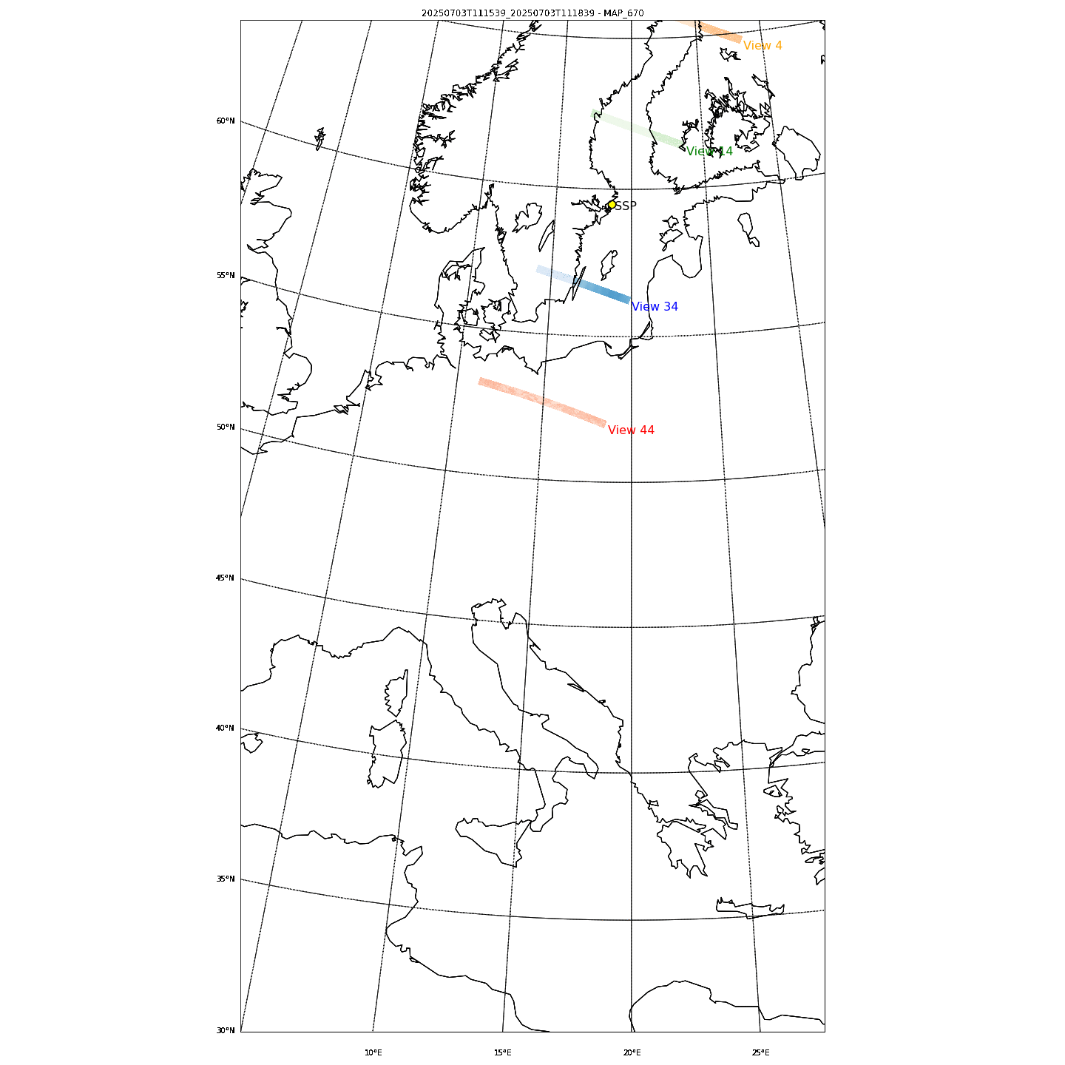
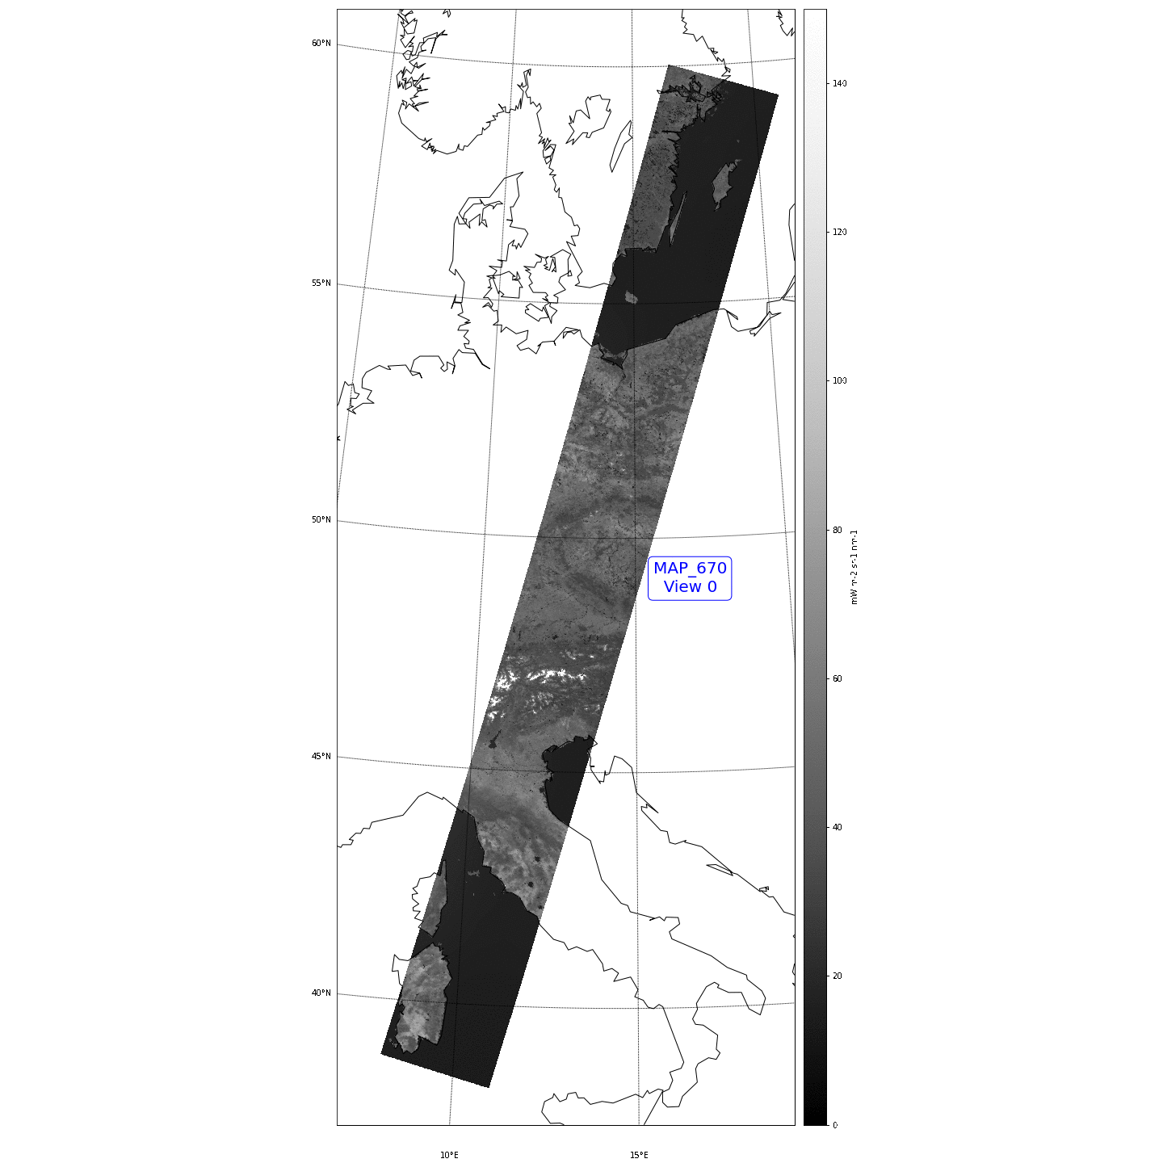
Simulation of CO2M MAP L1 data – L1B to L1C co-registration to CO2I grid
The CO2M MAP L1B
2 granules
(total 6 minutes)
Nadir pointing
4 views out of 48 are shown
The CO2M MAP L1C
2 granules
(total 6 minutes)
Nadir pointing
45 Co-registered views

Slide 13
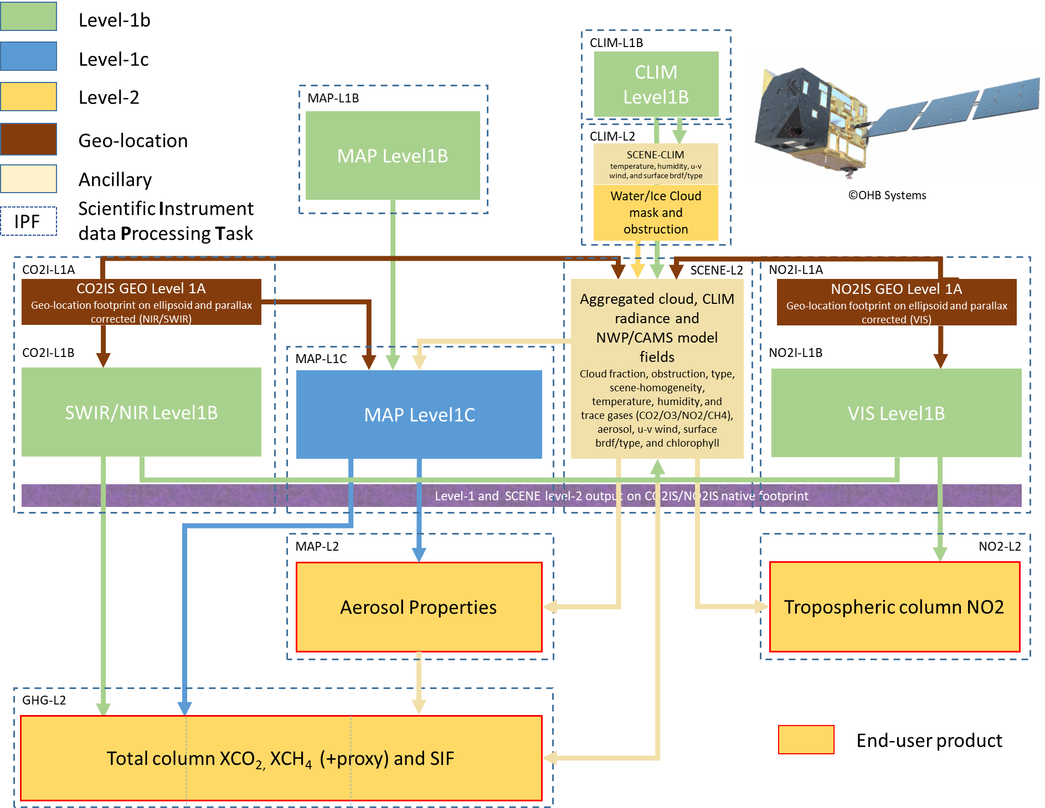

EUMETSAT CO2M MDPS scientific processing tasks
CO2M
Mission Data Processing System
Make one
“hyper-GHG/NO2-instrument”
out of three!
Below this level: everything is co-registered or provided at the CO2I/NO2I spectrometer footprint

Slide 14
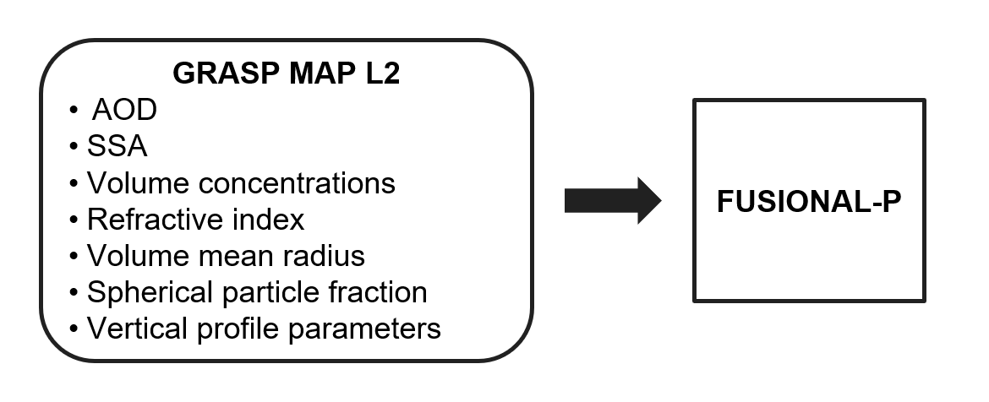
EUMETSAT CO2M MDPS scientific processing tasks
CO2M
Mission Data Processing System
Make one
“hyper-GHG/NO2-instrument”
out of three!
Below this level: everything is co-registered or provided at the CO2I/NO2I spectrometer footprint

Slide 15
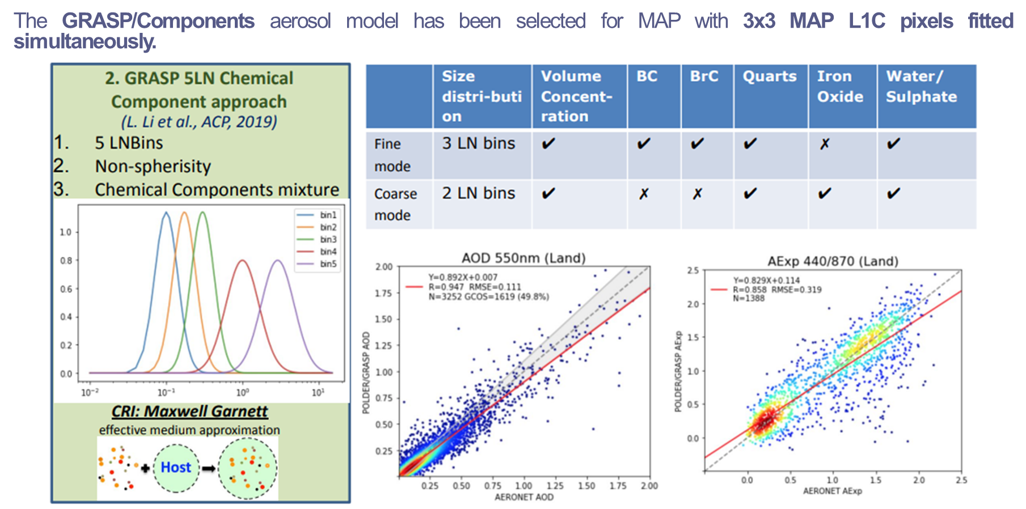
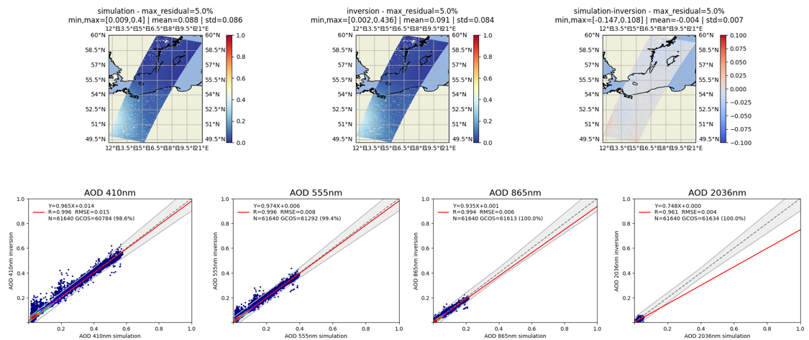
CO2M MAP level-2 aerosol product for pathlength correction
The GRASP (Generalized Retrieval of Aerosol and Surface Properties) is used for the simultaneous retrieval of both aerosol and surface properties.
Aerosol retrieval performed in the VNIR, is used for an atmospheric correction in the SWIR for the CO2 retrieval.
EUM2022713 v1A 28 April 2025

Slide 16
CO2M MAP level-2 aerosol product for pathlength correction
The GRASP (Generalized Retrieval of Aerosol and Surface Properties) is used for the simultaneous retrieval of both aerosol and surface properties.
Aerosol retrieval performed in the VNIR, is used for an atmospheric correction in the SWIR for the CO2 retrieval.
MAP Band | Wavelength
VNIR-1 | 410 nm
VNIR-2 | 443 nm
VNIR-3 | 490 nm
VNIR-4 | 555 nm
VNIR-5 | 670 nm
VNIR-6* | 753 nm
VNIR-7 | 865 nm
EUM2022713 v1A 28 April 2025

Slide 17
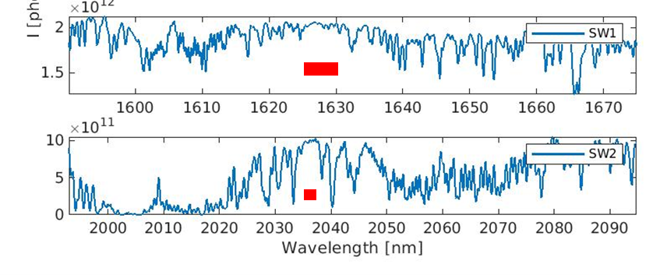
CO2M MAP level-2 aerosol product for pathlength correction
The GRASP (Generalized Retrieval of Aerosol and Surface Properties) is used for the simultaneous retrieval of both aerosol and surface properties.
Aerosol retrieval performed in the VNIR, is used for an atmospheric correction in the SWIR for the CO2 retrieval.
MAP Band | Wavelength
VNIR-1 | 410 nm
VNIR-2 | 443 nm
VNIR-3 | 490 nm
VNIR-4 | 555 nm
VNIR-5 | 670 nm
VNIR-6* | 753 nm
VNIR-7 | 865 nm
+
CO2I SWIR1/2 background reflectance
SWIR 1: 1620-1627.5 nm
SWIR 2: 2034.9-2037.5 nm
EUM2022713 v1A 28 April 2025

Slide 18
Outlook for AQ
In the frame of the Copernicus CO₂ Monitoring and Verification Support capacity (CO2-MVS) all CO2M products up to level-2 are provided with a latency of better than 24h and availability of better than 95% to CAMS.
We received recently a request from the EC to evaluate the possibility to provide NO₂, and (if possible) MAP Level-2 Aerosol product to CAMS with a latency between 3 and 5 hours.
Feasibility study ongoing at EUMETSAT
(results expected in Sep/Oct 25)

Slide 19
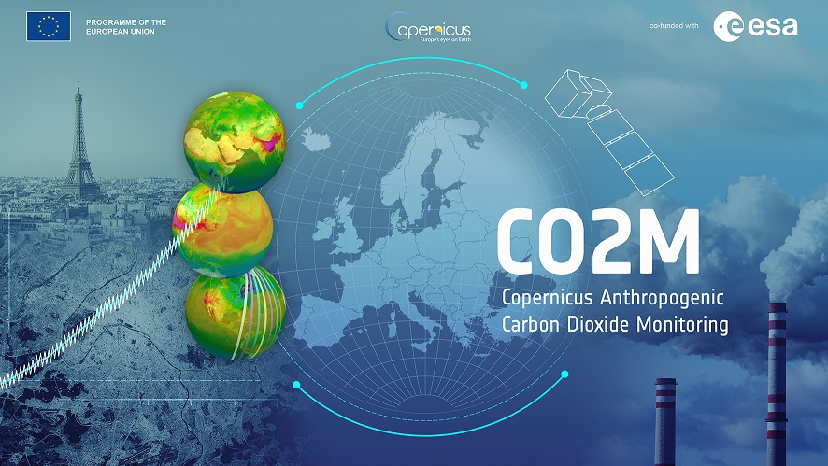
THANK YOU

