Slide 1
WGCV AGSG
Tracking gaps, evolving needs and issues for validation networks and systems
Jean-Christopher Lambert (BIRA-IASB)
Agenda Item 5.01
AC-VC #21 / ACSG Joint Meeting 2025
Takamatsu, Japan, 9-13 June 2025

Slide 2
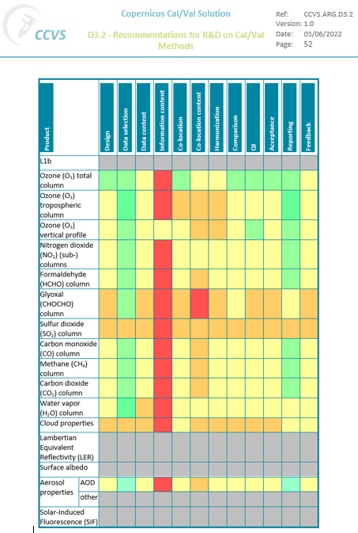
Background – CCVS Gap Analysis
Copernicus Cal/Val Solution – Maturity assessment and gap analysis of validation for the atmospheric Sentinels and CO2M
See Tuesday presentation 2.14 by T. Verhoelst
Sustainability of ground-based measurements and of validation capacity: geographical, influence quantities etc.
CEOS-FRM maturity level: unequal, from ‘class B’ to ‘class D’
Inhomogeneities within and between ground-based networks in data quality, uncertainty reporting, timeliness
Error budget closure of data comparisons demonstrated for ozone but not applied systematically
Validation of satellite uncertainty estimates in progress
Unequal application of state-of-the-art validation methodologies and Quality Indicators across validators
https://ccvs.eu

Slide 3
Background – GHG Cal/Val Networks
WGCV-ACSG recommendations to CEOS SIT TW 2023 / GHG-TT for
Cal/Val networks capabilities, infrastructure and operational capacity
NETWORKS DESIGN AND EVOLUTION: to support gap analysis studies with a view to tailoring CO₂,CH₄ and N₂O networks deployments to Cal/Val needs of the GHG satellite constellation: background/hot spots, land/ocean, low/high albedo, full range of atmospheric temperature…
INSTRUMENT DEPLOYMENT: (i) to further develop (low-cost, light-weight, mobile) low-resolution infrared instruments; (ii) to support standardized production of enclosures for their deployment in the field; (iii) to maintain a supply of spare parts.
CALIBRATION: to support the development of and maintain mutually consistent calibration and QA/QC of the GHG Cal/Val networks – within and across networks. Key actions: (i) traceability towards internationally agreed standards; (ii) more regular and network-wide deployment of traveling standard; (iii) more regular intercomparisons within and across networks, and between in situ (AirCore…) and remote sensing (networks); (iv) facilitate AirCore deployment; (v) establish a central AirCore data archive.
DATA PROCESSING: to support GHG Cal/Val network data processing improvements needed to maintain FTIR data precision/accuracy and meet future goals: formal intercomparison exercise of the GGG and PROFFAST retrieval algorithms, development and standardization of profile retrievals, spectroscopy studies.
Notes:
- Stratospheric gliders available and demonstrated. E. g., at NOAA with AirCore onboard; by Stratodynamics company (Canada) but not yet with AirCore onboard. Proposals for embedding AirCore as payload exist but have not been funded…

Slide 4
Background – GHG Cal/Val Networks
WGCV-ACSG recommendations to CEOS SIT TW 2023 / GHG-TT for
Cal/Val networks capabilities, infrastructure and operational capacity
DATA ACCESS: to establish interoperable GHG Constellation Cal/Val Data archives and tools for tailored network data (traceable, open, metadata, co-located…) and ‘hidden’ data (e.g. campaigns), ideally coupled to New Space related matchup database(s).
TIMELINESS: to organize concertation between stakeholders and with networks data providers to support rapid and continuous availability and improved access to networks-wide GHG data.
CENTRAL PROCESSING FACILITIES (CPF): to establish central processing facilities for every network product, which will directly support harmonized calibration (3), data processing, QA/QC and tailoring (4-5) and timeliness (6).
GHG EMISSIONS AND ATTRIBUTION: to support the development of new Cal/Val protocols for satellite derived GHG emissions and fluxes, in collaboration with relevant bodies and initiatives (global stocktakes, WMO GGGW, UNEP IMEO, New Space…) Consider co-located measurements of GHG and tracers of anthropogenic/biogenic contributions for better attribution of emissions.

Slide 5
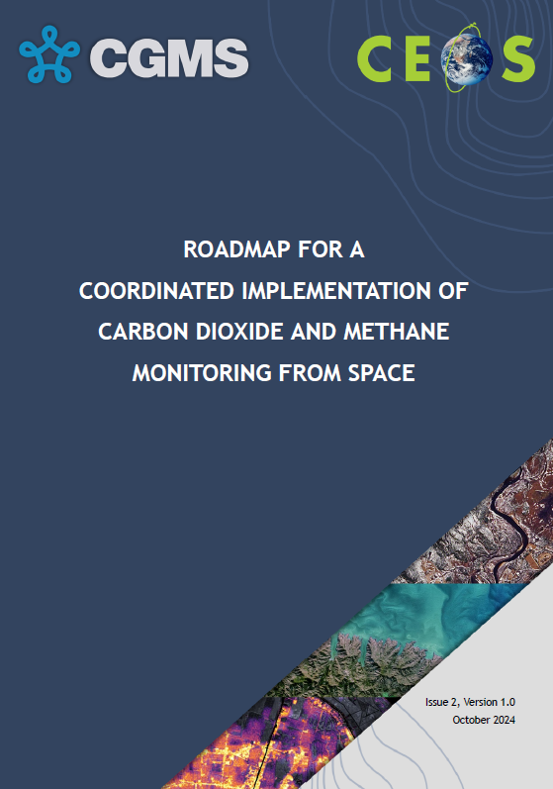
New action for GHG Roadmap V2
GHG Constellation Roadmap V2 – Annex C New ACSG-led action L2VAL-03
  To track L2 validation Capabilities, Evolving Needs and Gaps in the ground-based L2 validation system
  To explore a more operational framework for delivering its products to support evolving GHG mission needs

Slide 6
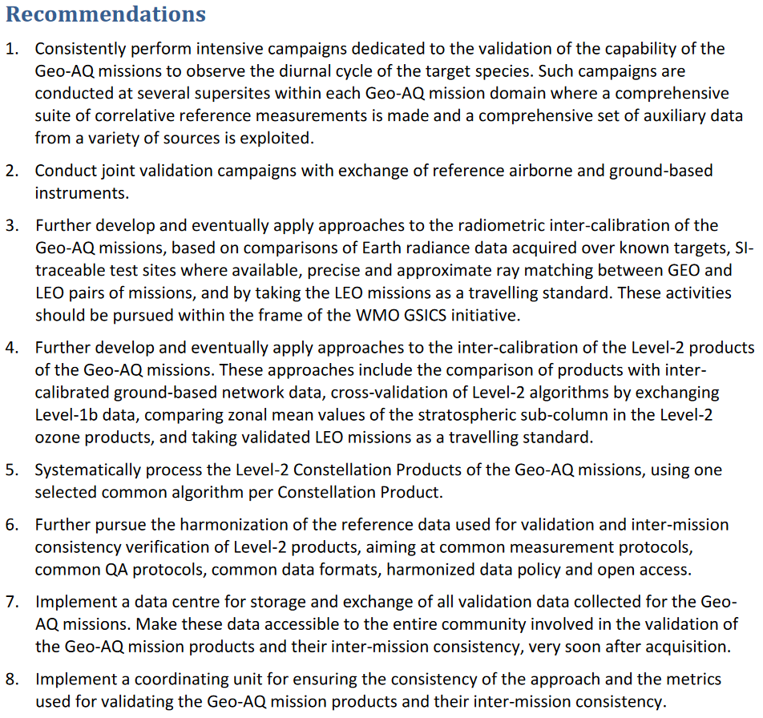
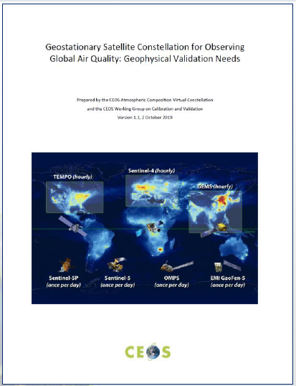
Air Quality Constellation Validation Needs

Slide 7

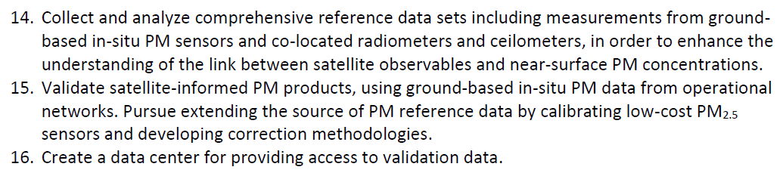
Air Quality Constellation – Surface PM2.5
AC-VC whitepaper “Monitoring Surface PM2.5” (VC-20-05) endorsed at CEOS Plenary 2022
Cal/Val related recommendations:
Future PM2.5 Roadmap discussed this morning

Slide 8
Tracking Needs, Gaps and Issues
FRM’ization of validation measurements (fitness for purpose)
  Systematic application of CEOS-FRM maturity assessment
  Identification of weaknesses, gaps and issues
Assessment and evolution of (network-based) validation capacity
  L2 product validation capacity: measurand range, geographical coverage, temporal sampling, dependence on influence quantities
  End-to-end L1-to-L2 validation capacity => ‘retrieval validation’ supersites
  Multi-products validation capacity: AQ-GHG, L2-to-services
Interoperability between established and new GB instrumentation
  EM27/SUN, VERTEX… vs. AirCore, NDACC-FTIR, TCCON
  Pandora vs. Brewer/Dobson (O₃), ozonesondes, NDACC (HCHO, SO₂)
  Low cost sensors vs. CEOS-FRM qualified instrumentation

Slide 9
Tracking Needs, Gaps and Issues
Validation methodologies:
  Representativeness differences, error budget closure
  Validation of uncertainties
  L2-to-L3 error propagation, validation of L3/L4, emissions, fluxes
Operationalization (processing, timeliness)
Sustainability of FRM data acquisition and validation capacity
Cross-constellation consistency and interoperability
  Conversations between validation teams helpful
Transfer of practices and knowledge
  Cal/Val Resources document

