Slide 1


WMO Expert Team for Atmospheric Composition Network Design and Evolution (ET-ACNDE) Activities
Richard Eckman & Hiroshi Tanimoto (co-chairs)
CEOS AC-VC-21, June 12, 2025

Slide 2
Purpose of RRR for Observations
  The purpose of the Rolling Review of Requirements (RRR) process is to provide a systematic and transparent process to support the high-level design and evolution of the WMO Integrated Global Observing System (WIGOS) aligned with its Vision in 2040.
  The RRR process compiles information about requirements for observations, about observing system capabilities, their cost-effectiveness, and draws on experts and impact studies to provide guidance on the most important priorities for addressing the gaps between requirements and capabilities.

Slide 3
WMO Application Areas
Global Numerical Weather Prediction
High Resolution Numerical Weather Prediction
Nowcasting and Very Short Range Forecasting
Sub-seasonal to longer predictions
Aeronautical Meteorology
Forecasting Atmospheric Composition
Monitoring Atmospheric Composition
Providing Atmospheric Composition information to support services in urban and populated areas
Ocean Applications
Agricultural Meteorology
Hydrology
Climate Monitoring (GCOS)
Climate Science
Space Weather
Cross cutting:
Global Cryosphere Watch (GCW)
Global Framework for Climate Services (GFCS)
} Merged

Slide 4
Statements of Guidance
The Statement of Guidance (SoG) for a WMO Application Area is a gap analysis; it provides an assessment of the adequacy of observations to fulfill the observational user requirements and suggests areas of progress towards improved use of space-based and surface-based observing systems. Only the most significant variables for the Application Area are analyzed in the SoGs.
https://space.oscar.wmo.int/applicationareas

Slide 5
Key Variables for Atmospheric Composition
Greenhouse Gases
Aerosols
Reactive Gases
Atmospheric Total Deposition
Ozone and UV Radiation

Slide 6
OSCAR Requirements
User requirements for each variable expressed in terms of:
  Threshold: value that has to be met to ensure that data are useful
Goal: value above which further improvement of the observation would not cause any significant improvement in performance for the application in question
Breakthrough: level between “threshold” and “goal“ which, if achieved, would result in a significant improvement for the targeted application
Requirements have been input into the WMO Oscar Requirements database (https://space.oscar.wmo.int/requirements)

Slide 7
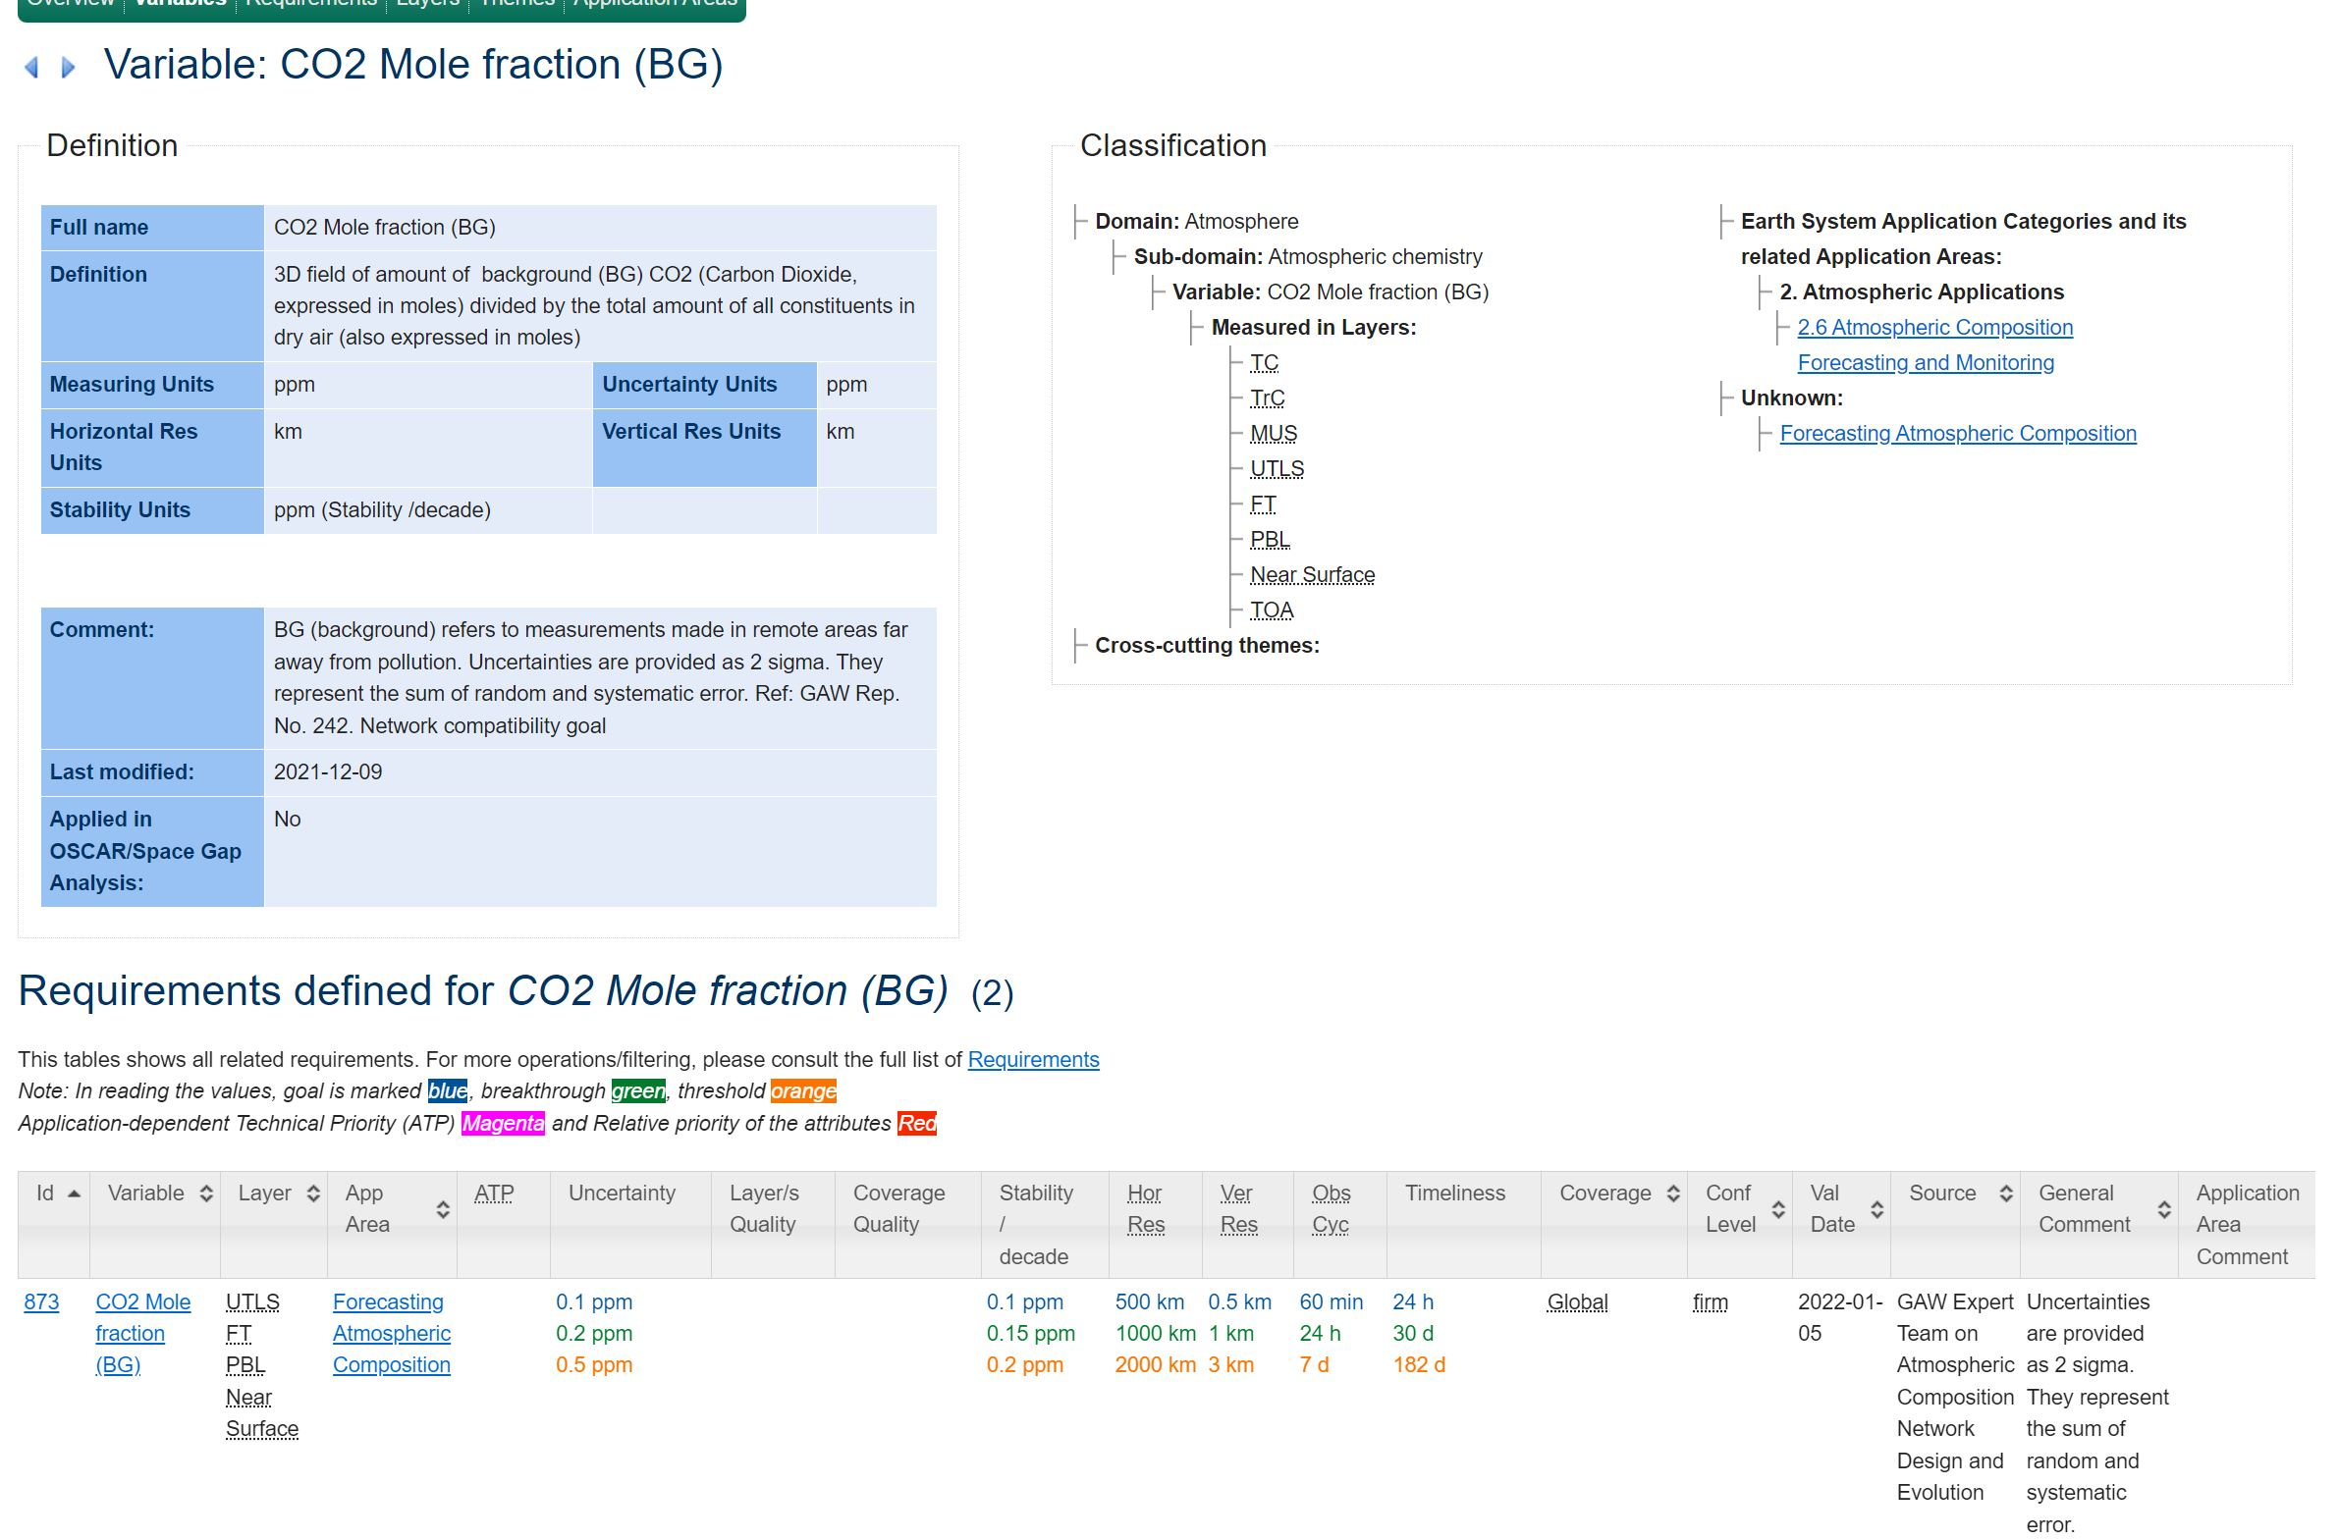
OSCAR Requirements (GHG example)
https://space.oscar.wmo.int/requirements

Slide 8

Status of Expert Team Activities
GAW ET-ACNDE has drafted its Atmospheric Composition Statement of Guidance over many years, and it has been recently published as GAW report 307.
  Comments are welcome!
Team is now exploring new projects
(see, e.g., Jean-Christopher’s
presentation)

