Slide 1
Some thoughts on what we need to consider when evaluating / validating atmospheric based GHG Fluxes
Main points for this presentation
Smoothing error (sensitivity and prior) needs to be considered when validating atmospheric based flux data with independent flux estimate
Can we use a series of flux measurements (e.g. eddy covariance) to compare with the atmospheric based (inverse) fluxes?
Ideally we want to compare to fluxes where the sources are as homogenous or as “smooth” as possible in space and time (i.e. no big short term sources and sinks)

Slide 2
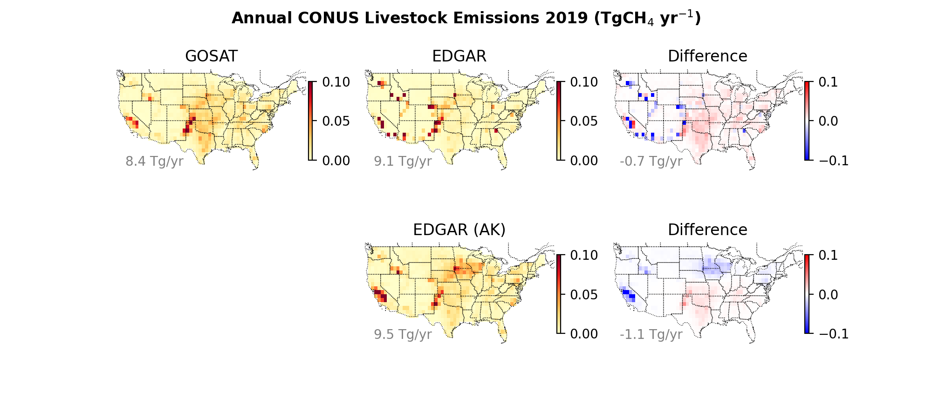
Not accounting for smoothing error would lead us to believe that GOSAT is larger than EDGAR inventory in Northern Midwest whereas in fact its negative (after passing EDGAR inventory through GOSAT flux inversion operator)
→ Not accounting for smoothing error via inversion operator could result in wrong interpretation when comparing atmospheric flux to validation data set

Slide 3
Can we use eddy covariance flux tower data to evaluate CH4 or CO2 fluxes?
Flux towers have spatial footprints of ~1-3 km
Atmospheric based fluxes have spatial footprints of 100 to 1000 km
So choose areas that are boring or smoothly vary with time
Example using water balance: Comparison of CARDAMOM, ERA5, and GRACE/river water balance (spatial scales of 50 to 500km) to flux tower data, spatial scales of 1-3 km
6/10/25
6/10/25
3

Slide 4
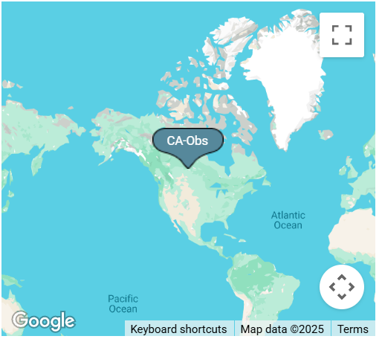
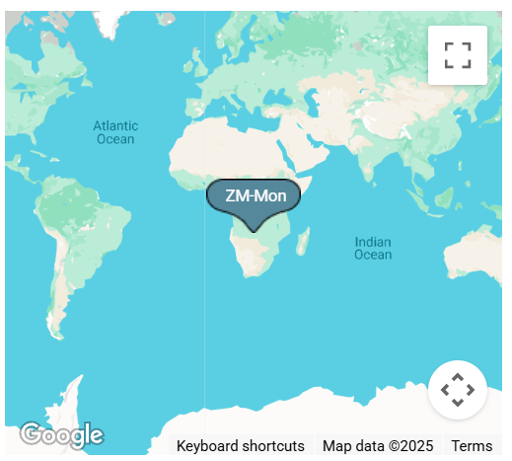
Can we use eddy covariance flux tower data to evaluate CH4 or CO2 fluxes?
Boreal Sites
Variability of these flux tower data agree with water balance estimates. Can we do the same for NBE? Do we need multiple flux tower estimates over a region to minimize smoothing error errors?
6/10/25
6/10/25
4

