Slide 1
Engaging with stakeholders through the Greenhouse Gas Task Team
Yasjka Meijer (ESA)
GHG Task Team Lead
Agenda Item 6.02, AC-VC-21
Takamatsu, Japan
13 June 2025

Slide 2
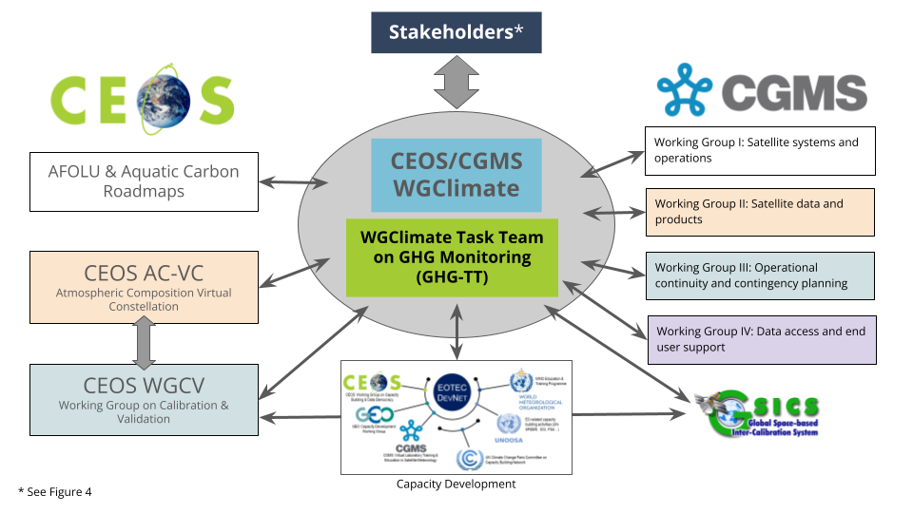
GHG Task Team & Roadmap - Recall
Greenhouse Gas Task Team (GHG TT) is part of joint CEOS-CGMS WGClimate
Responsible for maintaining and implementation of the GHG Roadmap
Coordinates GHG related activities across various CEOS & CGMS WGs
GHG Roadmap issue 1 is from Mar. 2020

Slide 3

GHG Roadmap – Issue 2 – final
Issue 2 has been established in close
coordination with CGMS, G3W and IMEO
Endorsement by CEOS
Endorsement by CGMS
Issued publicly in October 2024, available here
Issue 2 has specific focus on co-developing with stakeholders fit-for-purpose products

Slide 4
GHG TT – Next steps
Thematic activities (long-term goals) described in section 5 with leads (plus deputies):
Fostering Stakeholder Engagement - Mark Dowell (John Worden, Wenying Su)
Sensor Development and Constellation Architectures – John Worden (AC-VC) (Yasjka)
Calibration and Level 1 Products – Hiroshi Suto (Akihiko Kuze)
Level 2 Products and Validation – Ruediger Lang & Dave Crisp
Flux Inversion Modelling and Validation – Kevin Bowman (Frederic Chevallier)
Best Practices – John Worden (Paul Green)
System Development – Richard Engelen (John Worden, Kevin Bowman)
Capacity Building – TT and EO TecNet
CGMS role is specifically to support the transition to operational GHG Monitoring

Slide 5
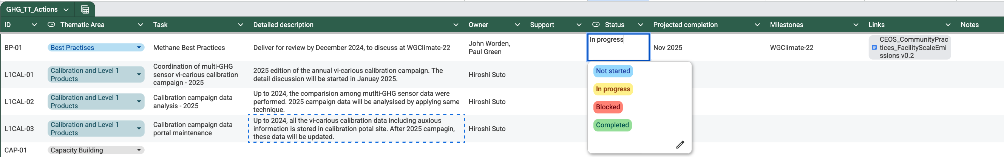
Short term activities – overview
Joint WGClimate and GHG Task Team meeting in Harwell
in February including stakeholders
8 Thenmatic area leads coordinat short-term action definition
Annex C of Roadmap issue 2 is maintained online → here

Slide 6
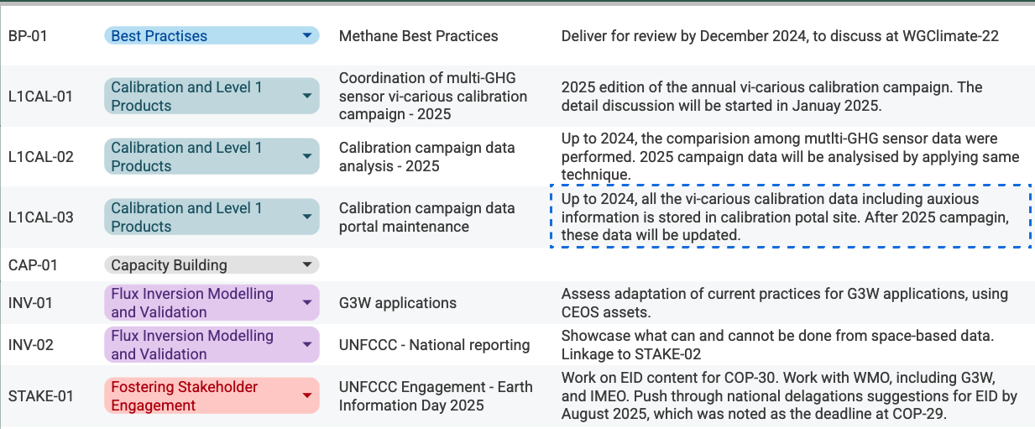
Short term activities – 1/3

Slide 7
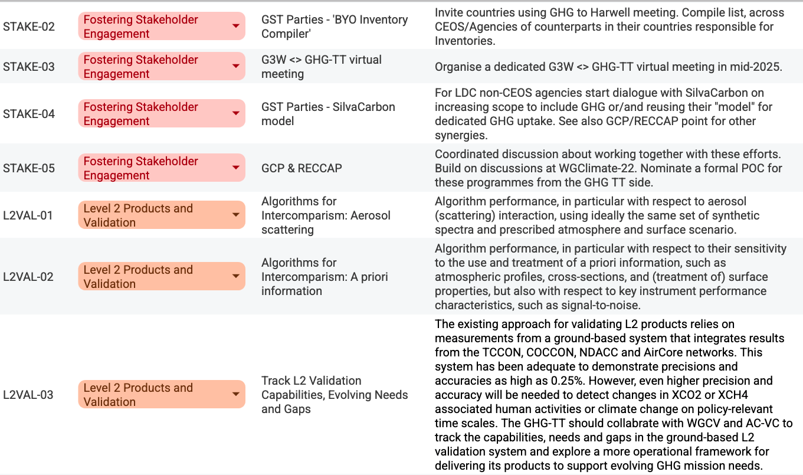
Short term activities – 2/3

Slide 8
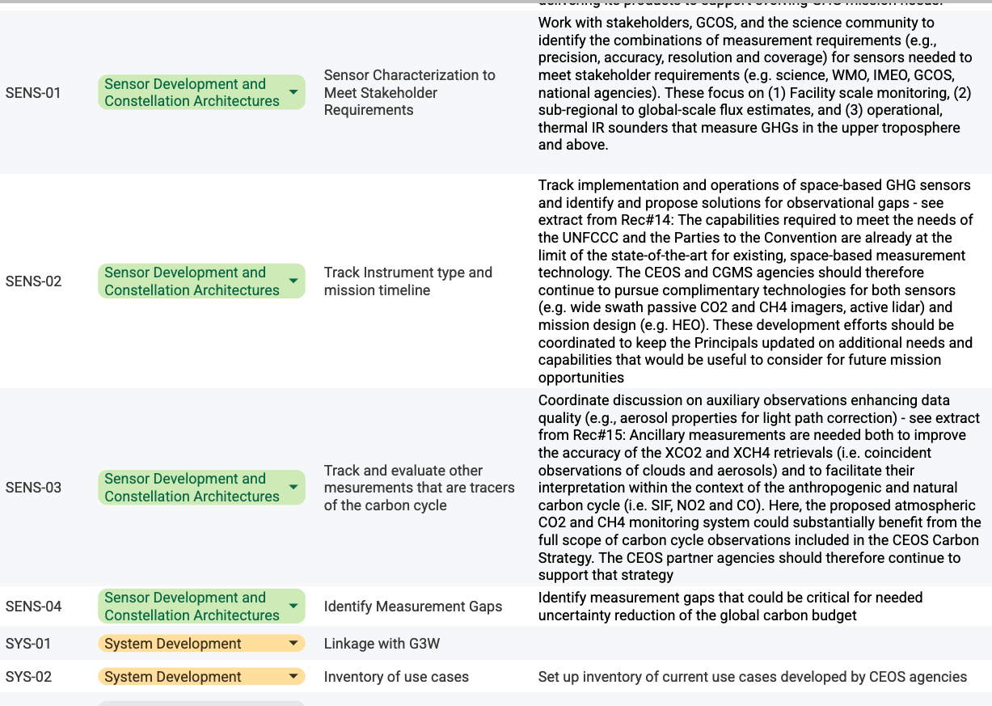
Short term activities – 3/3

Slide 9
Progress on activities
Started and on-going:
Best practices for GHG monitoring with initial focus on
facility-scale methane emissions → in final review
Collaboration with UNEP’s IMEO has been → reestablished
Continued strong involvement with WMO’s G3W → members in advisory boards
Engagement with UNFCCC and planning for GST-2, plus broader
coordination between related CEOS roadmaps → on-going & update of GST Strategy
National stakeholder engagement established in Harwell → to be expanded
Still some things to get started:
To be tackled today in this AC-VC GHG session
PLUS those that did start, can we continue?!

Slide 10

How to continue “Business as usual“?!
Elephant in the room…

