Slide 1

Summary of Current and Future Missions
Ray Nassar
CEOS AC-VC 2025, June 13, Takamatsu

Slide 2


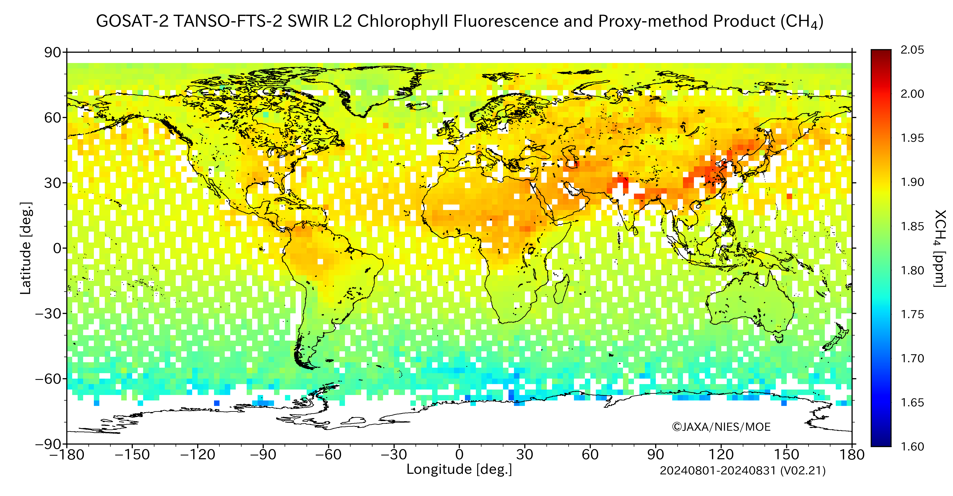
GOSAT and GOSAT-2
GOSAT launched in 2009 and GOSAT-2 in 2018, both continue to operate giving us a long-term record (16-year time series) of XCO₂ and XCH₄
New versions of L1 (GOSAT-2) and L2 data
GOSAT-2 now has full physics and proxy retrieval which gives improved high latitude coverage
Many talks and posters at global and regional scales, studying both natural and anthropogenic CO₂ and CH₄
G2, PR, CH4
Based on presentations by Tsuneo Matsunuga et al., Suto et al.

Slide 3


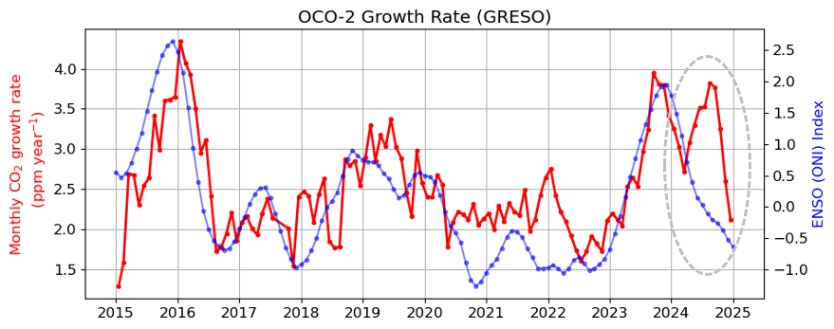
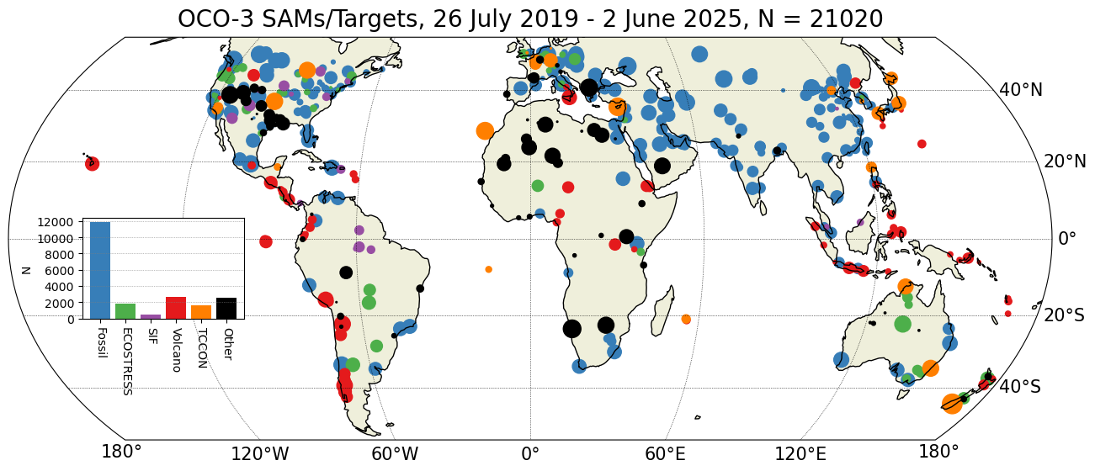
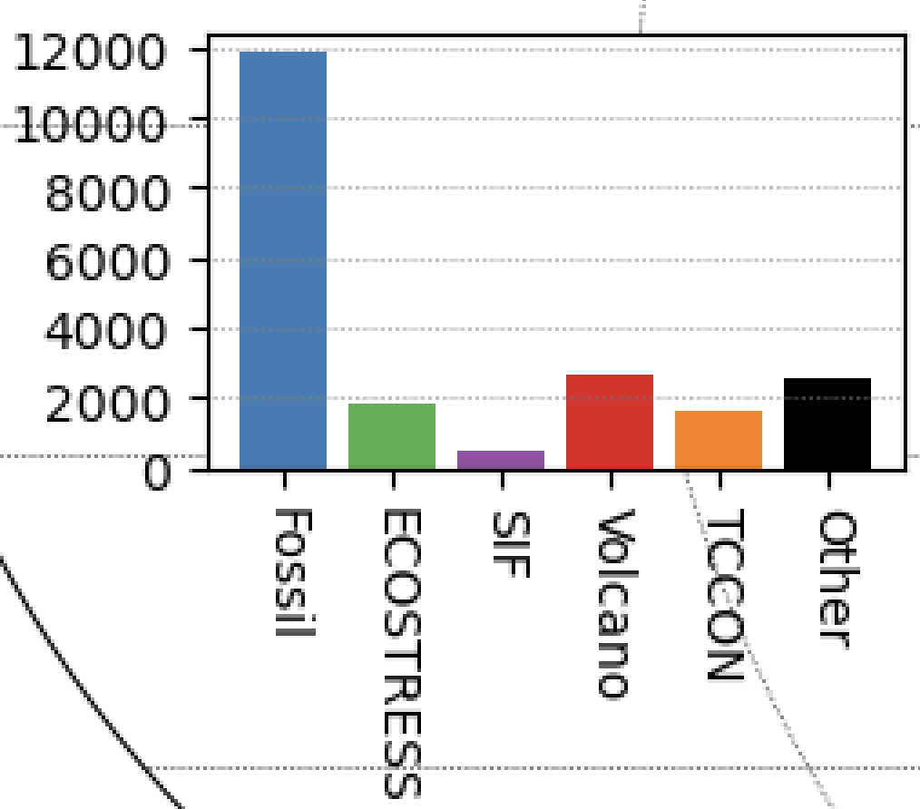
OCO-2 and OCO-3
High CO₂ growth rate for 2024
CO₂ growth rate calculated using OCO-2 data
Strongly decoupled from ENSO index, likely that anomaly originated in the Southern Tropics
Pandey et al. (2024) AGU Advances, 10.1029/2023AV001145
Pandey et al. (in preparation)
OCO-3 SAMs providing data for local source estimation.
OCO-2 v11.2 and OCO-3 v11 are latest/greatest XCO₂.
NASA Headquarters update on proposed Earth Science budget cuts means uncertainty in the continuation of OCO-2 and OCO-3 missions after 2026.
Science update by Vivienne Payne et al., Programmatic update Ken Jucks

Slide 4
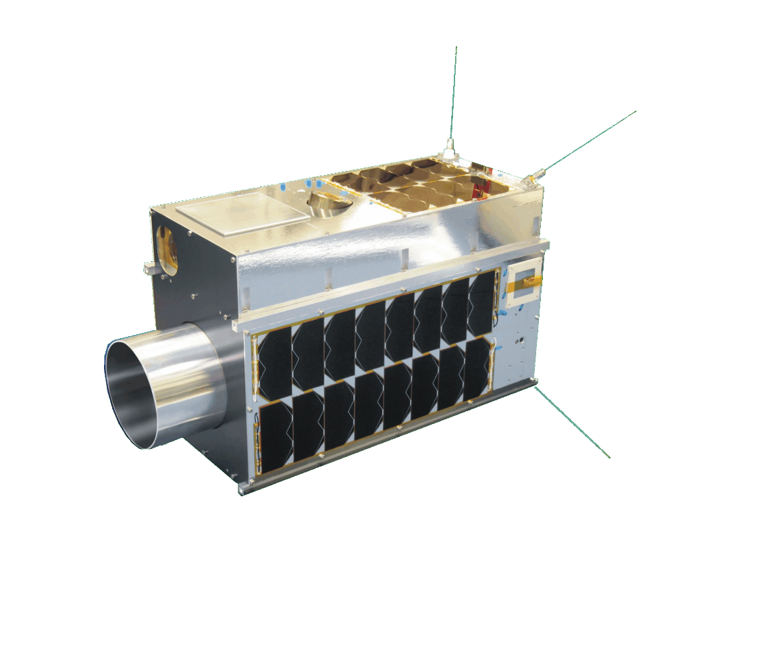

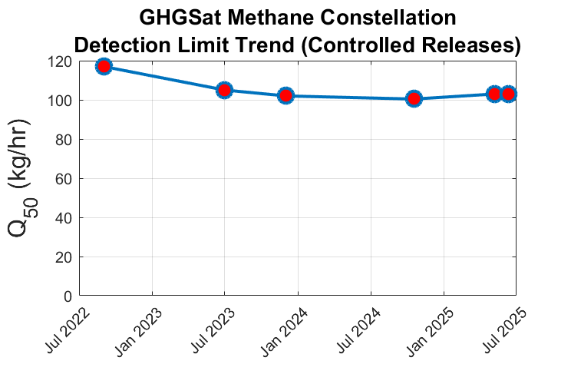

GHGSat
10 CH₄ satellites and now 1 CO₂ satellite, 4 more CH₄ sats launching in 2025. > 20,000 CH₄ plumes detected as of 2024.
CH₄ detection limits of ~100 kg/h (50% POD, 3 m/s) based on 79 controlled release experiments, although somewhat higher ‘in the wild’.
New CO₂ results show some challenges with data quality and emission estimates. CO₂ detection limit of ~5-15 MtCO₂/yr, but still fine tuning algorithms to deal with issues like stack height, which were not necessary to account for with CH_{4.}
4 7 10 12 14
# Satellites
New PoD
model
Based on GHGSat talks by D. Jervis et al. and J. McKeever et al.
VIS cam of power plant

Slide 5
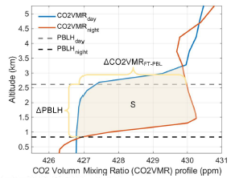

DQ-1 and DQ-2
DQ-1 CO₂ Lidar launched in April 2022
Online 1572.084 nm, offline 1574.025 nm
Evaluating the effects of water vapor on retrieval, comparing/validating with TCCON, dealing with day/night differences on the boundary layer and the impacts on XCO₂
Longer averaging (more pulses) over snow covered surfaces in the north/south polar regions to compensate for weaker signal
DQ-2 planned launch by end of 2025 with active and passive XCO₂ payloads!
Based on presentation by Lu Zhang et al.

Slide 6

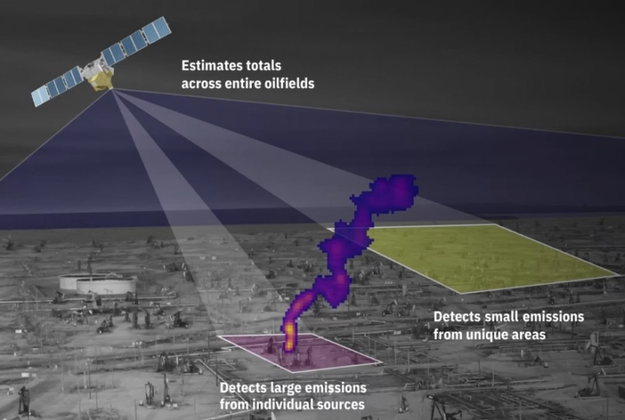
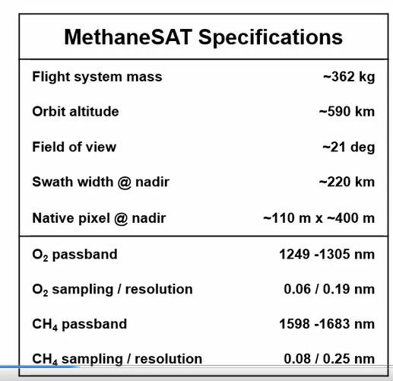
MethaneSat
Launched March 2024 to bridge gap between global mappers / point source imagers
Challenges with commissioning, but now acquiring a growing dataset
Conserved and Optimized Retrieval of Emissions (CORE) solves for point and area sources
Data available at https://portal.methanesat.org
Based on presentation by Jonathan Franklin et al.

Slide 7

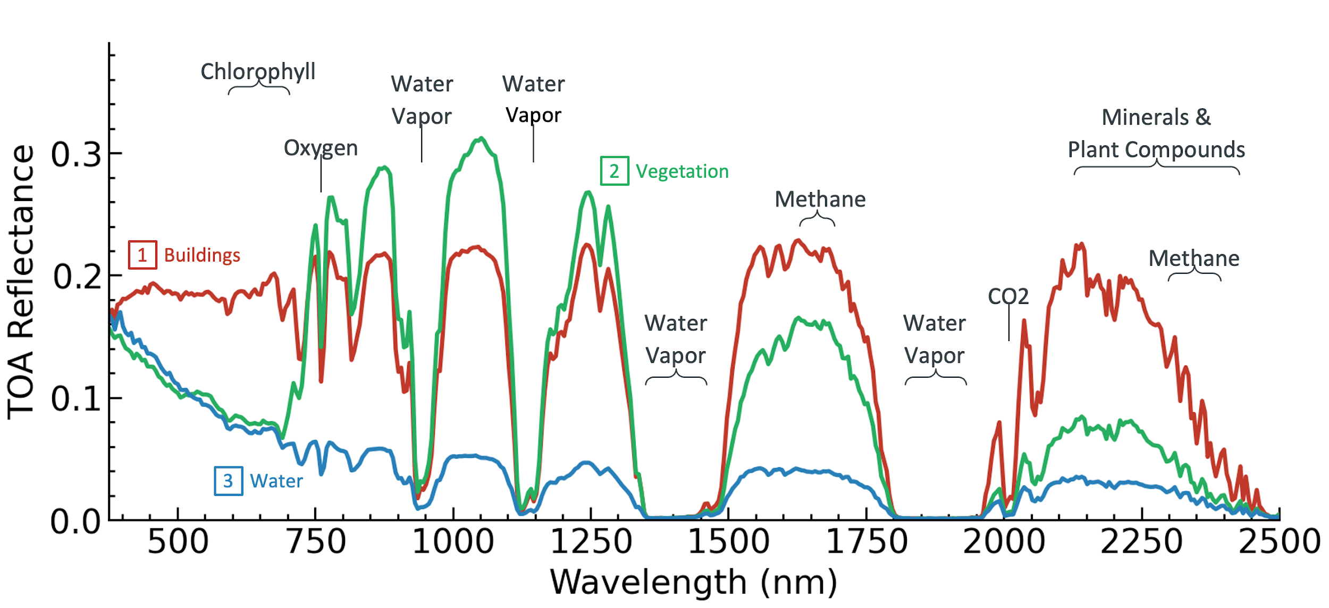
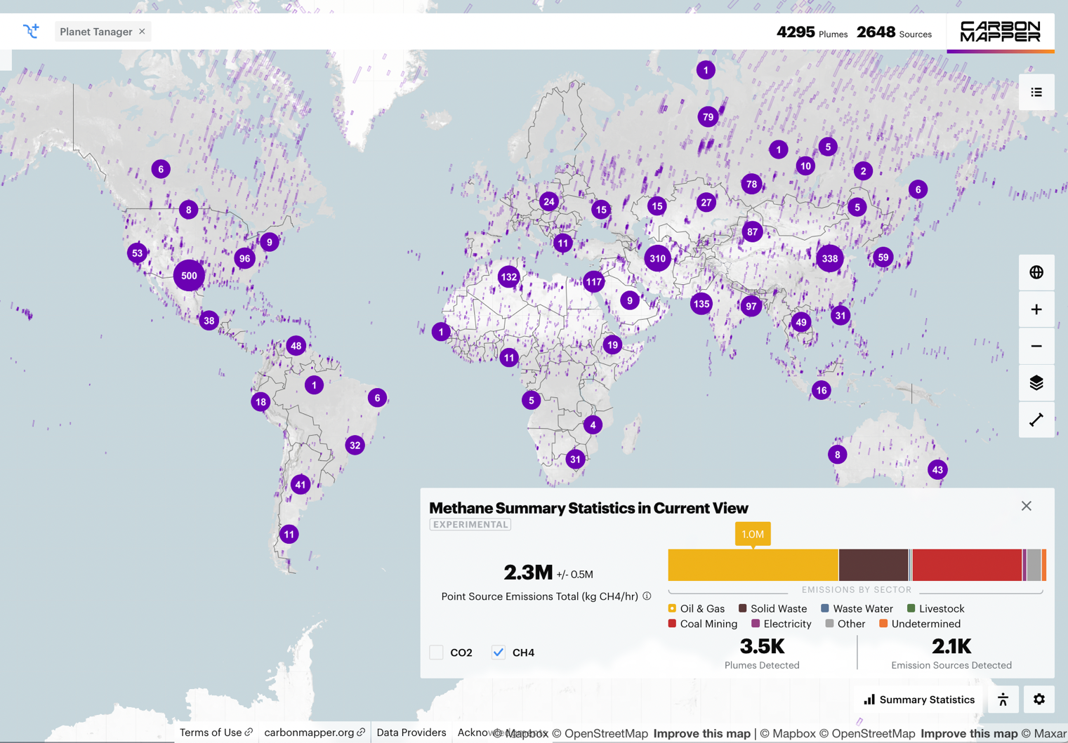
Carbon Mapper
Public-Private Partnership (PPP) hyperspectral imaging mission with broad spectral coverage
Data now flowing from Tanager-1 satellite along with associated aircraft data
Many Oil and Gas methane emission sources estimated, tracking persistent sources
Demonstrated mitigation success after contacting an operator to stop a large CH₄ leak
Some interesting plumes in high latitude snowy areas observed repeatedly
Still working on lowering detection limit by observing with longer integration time using forward motion compensation
Based on presentation by Riley Duren / Dan Cusworth et al.

Slide 8

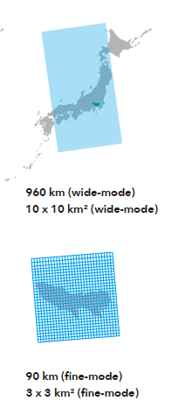
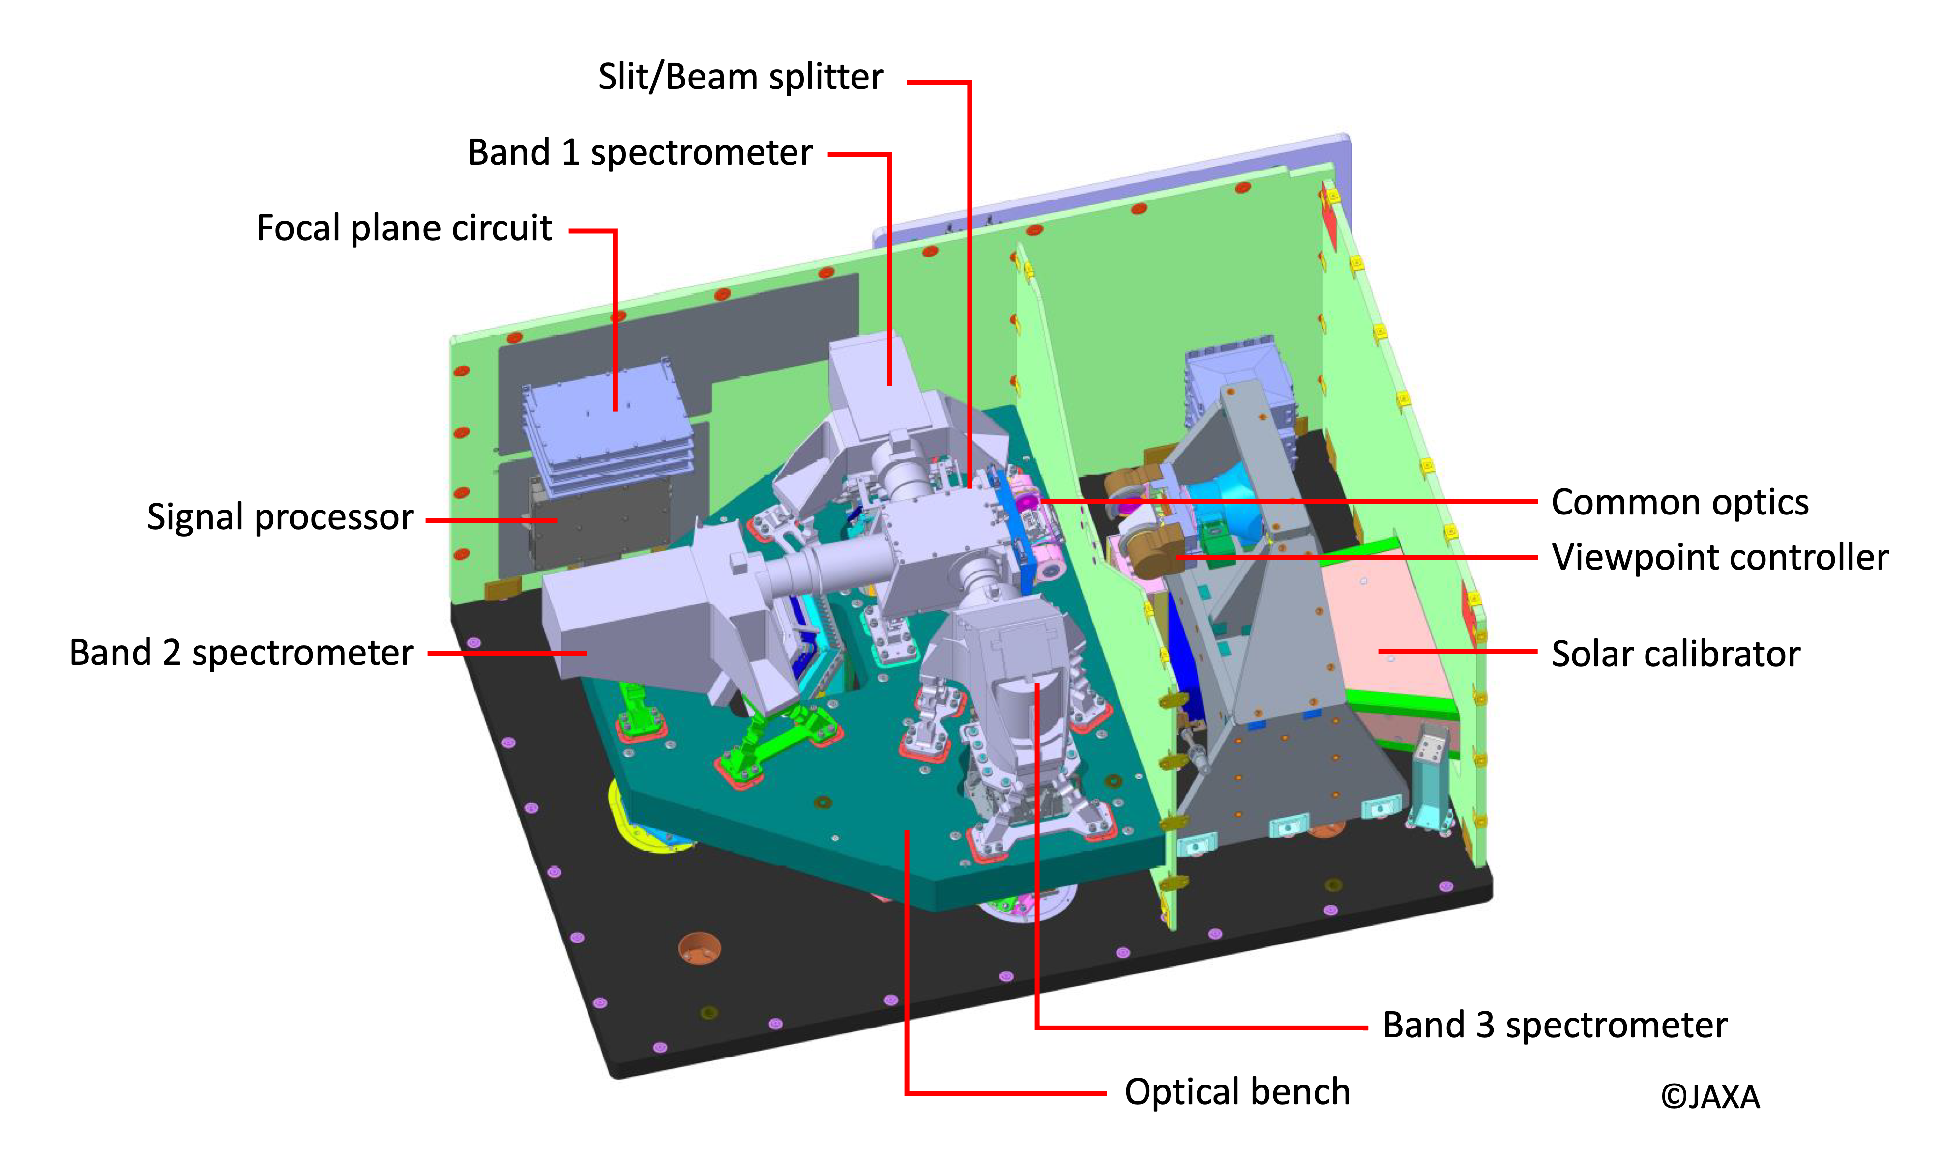
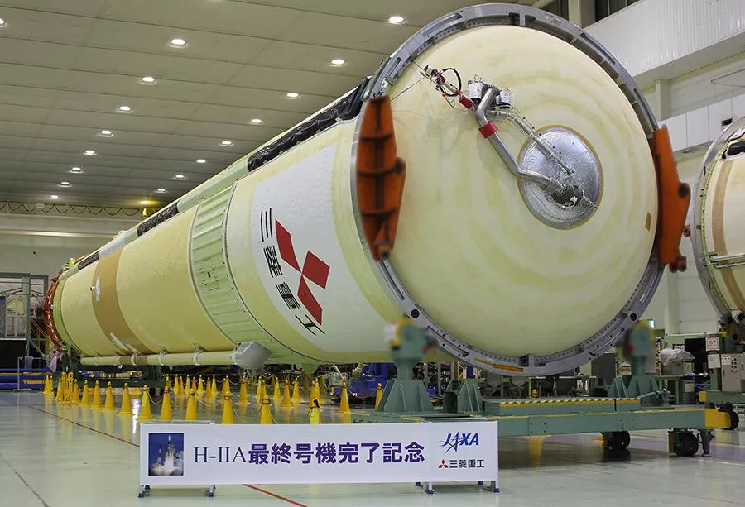
GOSAT-GW
TANSO-3 has a totally new design from previous GOSATs
A grating spectrometer now focused on CO₂, CH₄ and NO₂ with ‘wide mode’ (10-km footprint) and ‘focus mode’ (1-3 km footprint)
Algorithms ready, extensive validation planned
Launch scheduled for June 24th!
Based on presentation Hiroshi Tanimoto et al.

Slide 9

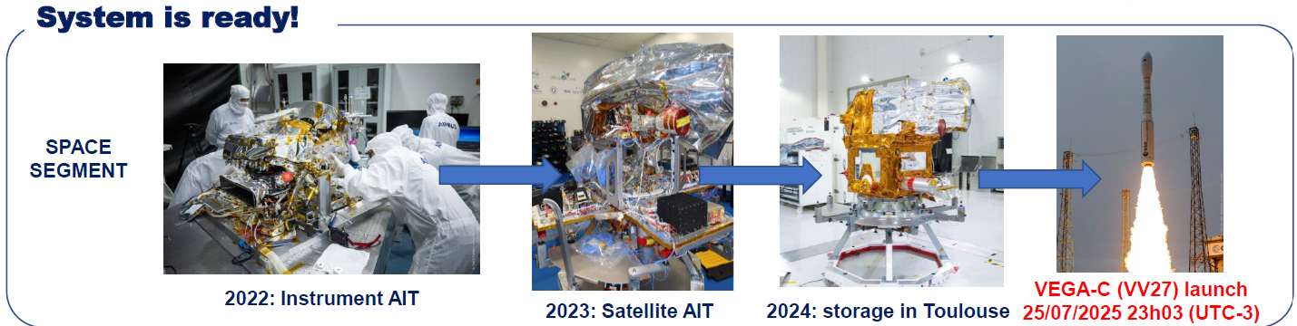
MicroCarb
Original work started in early 2000s on a concept once called CarboSat, began Phase 0 (2009), Phase A (2011) …. Phase D (2019), COVID-19 … now ready for launch in July 2025!
Instrument performance verification in TVAC was presented.
Demonstrated and assessed retrieval algorithm ‘4ARTIC’ on OCO-2 data and some future improvements are planned. LEOP and extended calibration and validation plans in place.
Team is eager to fly and share data with the community!
Based on presentation Denis Jouglet et al.

Slide 10
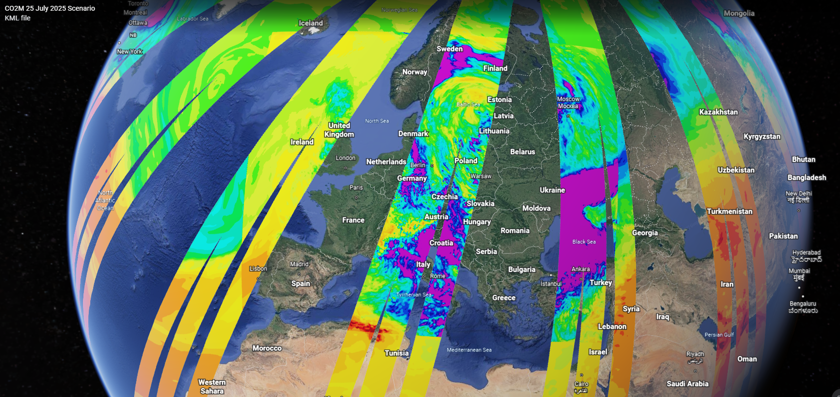

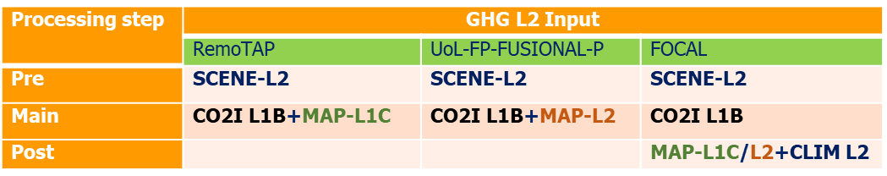
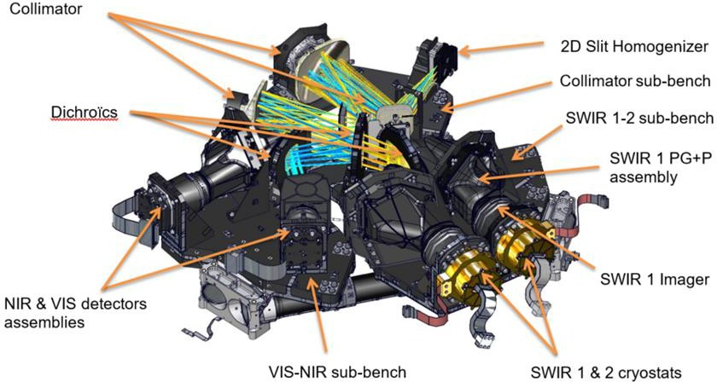
CO2M
3 satellites with 270-km wide swath to measure CO₂, CH₄, NO₂, clouds, aerosols
Acceptance Reviews:
  1st satellite 2027-08
  2nd satellite 2028-02
  3rd satellite scheduled for 2029
CO2M test-data study
Total column CO2 concentrations [ppm]
Three platform CO2M constellation
NO₂ retrieval based on OMI/TROPOMI
General Retrieval of Aerosol and Surface Properties (GRASP) to be used for Multi-Angle Polarimeter (MAP) data
Validation planning progressing for eventual delivery of CO2M operational data products!
Based on presentation by Rudiger Lang, Yasjka Meijer et al.
Credit Thales Alenia Space

Slide 11
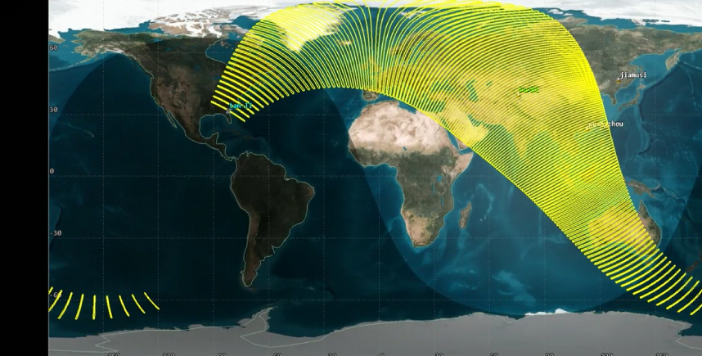
Chinese Status, Plans & TanSat-2
TanSat launched 2016, FengYun 3D-GAS launched 2017, GaoFeng-5 – GMI launched 2018, DQ-1 launched 2022
DQ-2, FengYun 3D – GASII, TanSat-2 are planned
TanSat-2 will observe CO₂, CH₄, NO₂, SIF with an elliptical medium Earth Orbit
Swath of ~290-2900 km and pixels of ~2-20 km depending on position in elliptical orbit
Period ~143 min
Parameters | Value
Perigee altitude | ~522km
Apogee altitude | ~7840km
Inclination | 116.565°
Latitude at Apogee | 35°N
Argument of Perigee | 210°
Revisit Period | 1 day
Based on presentation by Chen Lin et al.

Slide 12

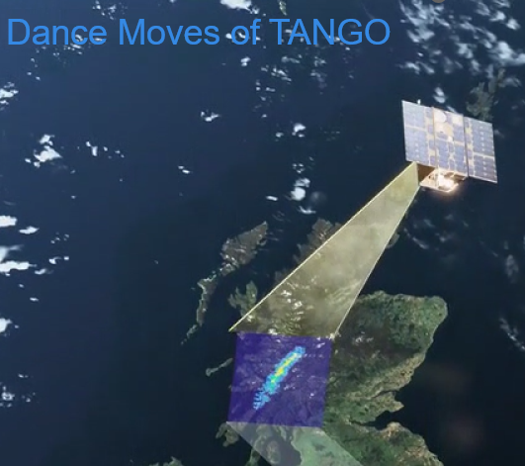
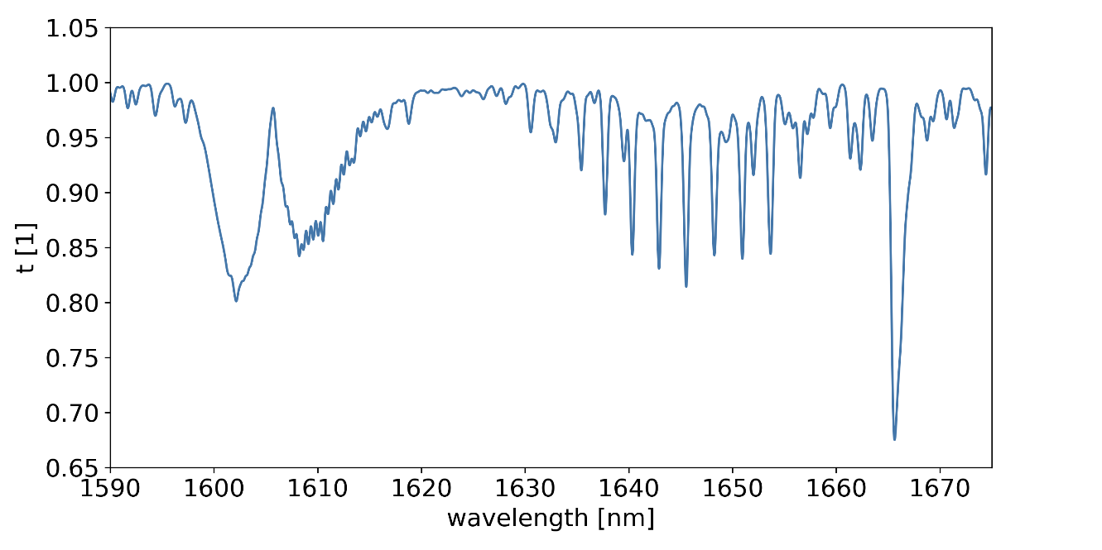
TANGO
Two 16L cubesats: 1) CO₂, CH₄ at spatial resolution of 300 m and 2) NO₂ with spatial resolutions of 200 m over a target region of 30x30 km²
TANGO implementation has now kicked-off, aiming for launch in 2028
Satellite will have the ability to compensate for its motion and lock on a target to enable longer integration and better SNR. Can also point crosstrack off-nadir as well.
Based on presentation by Chen Lin et al.
Based on presentation by Jochen Landgraf et al.

Slide 13

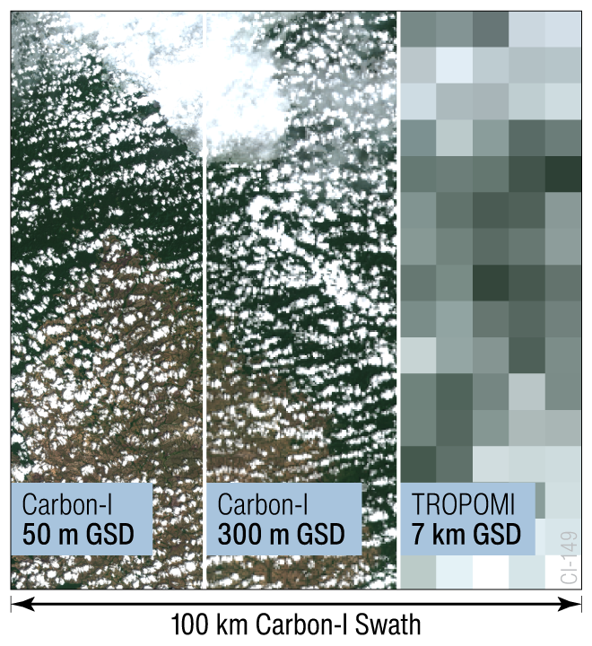
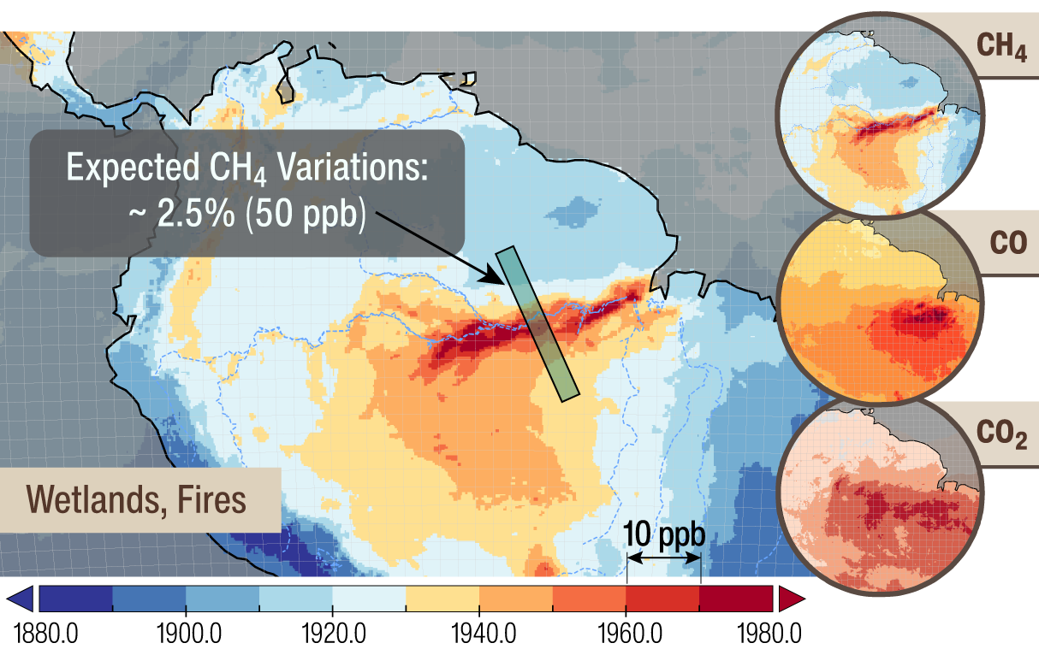
Carbon-I
NASA Earth System Explorer candidate (Phase A) for CH₄, CO₂ and CO globally especially in the humid tropics.
Global Mode: 100 km swath, 303 x 345 m² pixels (at nadir)
Target Mode: 100 x 100 km² area, 30 x 35 m² pixels (at nadir)
2.0-2.4 μm spectral region, using N₂O for total air column
Based on presentation by Christian Frankenberg et al.

Slide 14
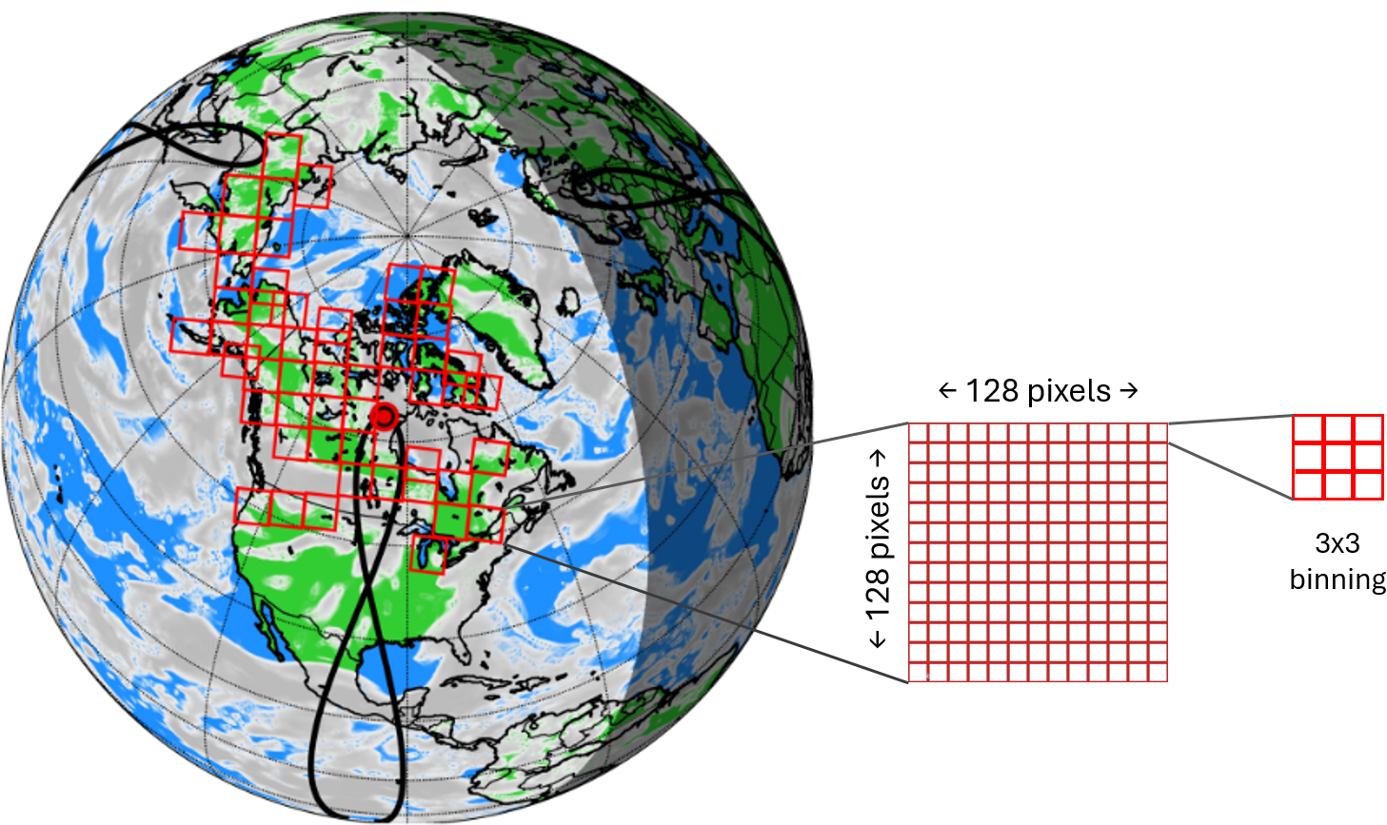
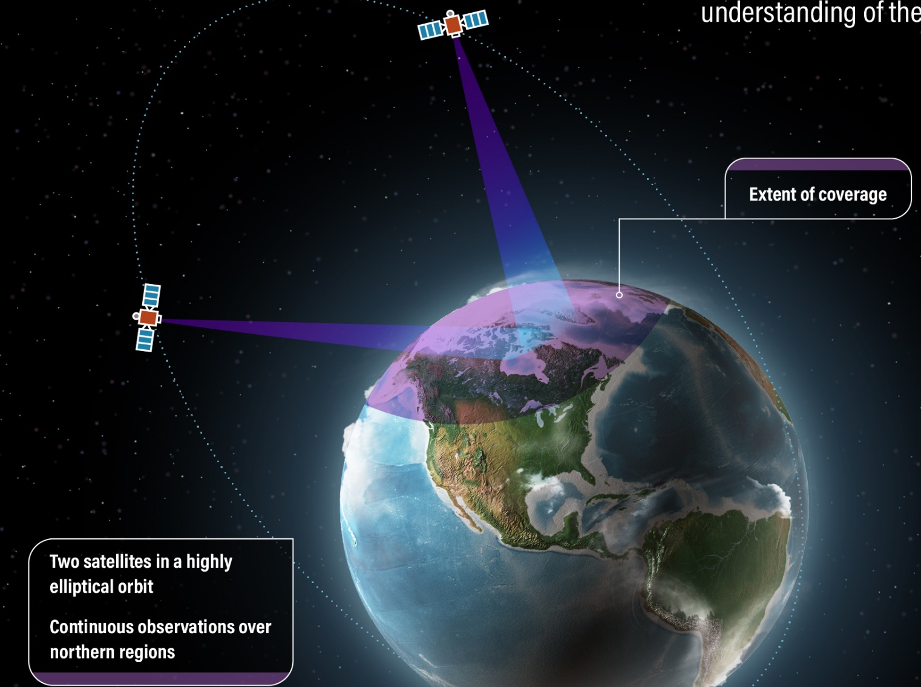
Arctic Observing Mission (AOM)
Imaging Fourier Transform Spectrometer (IFTS) observations of 128x128 pixels (~3x3 km²) simultaneously. Smaller ‘subpixel’ data of ~ 1x1 km² may be possible if pointing stability goal can be achieved.
Proposed mission for meteorology, GHGs and air quality using 2 satellites in a Highly Elliptical Orbit (HEO) for rapid-revisit observations of northern regions.
Intelligent Pointing
Apogee height of ~41,887 km
Period ~ 16 h
Option with Longwave and Midwave IR bands could give further benefits like CO₂, CH₄ and CO profiles over land/water, day/night, summer/winter. Preparing for funding request, possible decision around 2026.
Hourly CO₂, CH₄, CO and SIF over land during daylight north of ~40°N
Based on presentation by Ray Nassar et al.

Slide 15
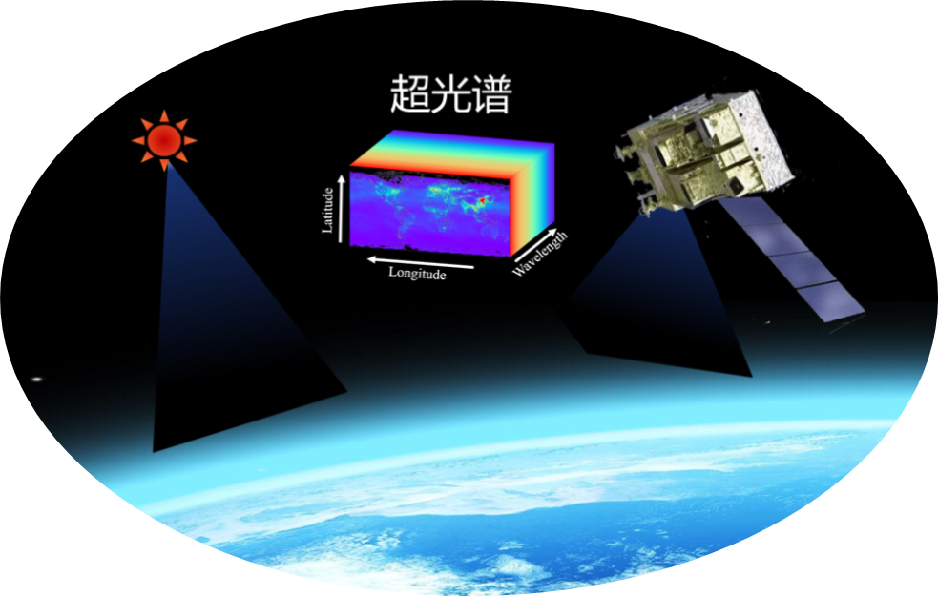

Spatial Heterodyne Interferometry
Working on next generation Spatial Heterodyne Spectroscopy (SHS) instrument that can achieve higher spatial resolution for CO₂ and CH₄ observation
Grating diffraction combined with heterodyne interference enables hyperspectral resolution
Monolithic cemented structure with no moving parts.
Team will continue advancing payload development.
Integrated Cemented Interferometer (SHS)
Based on presentation by Wu et al.

Slide 16
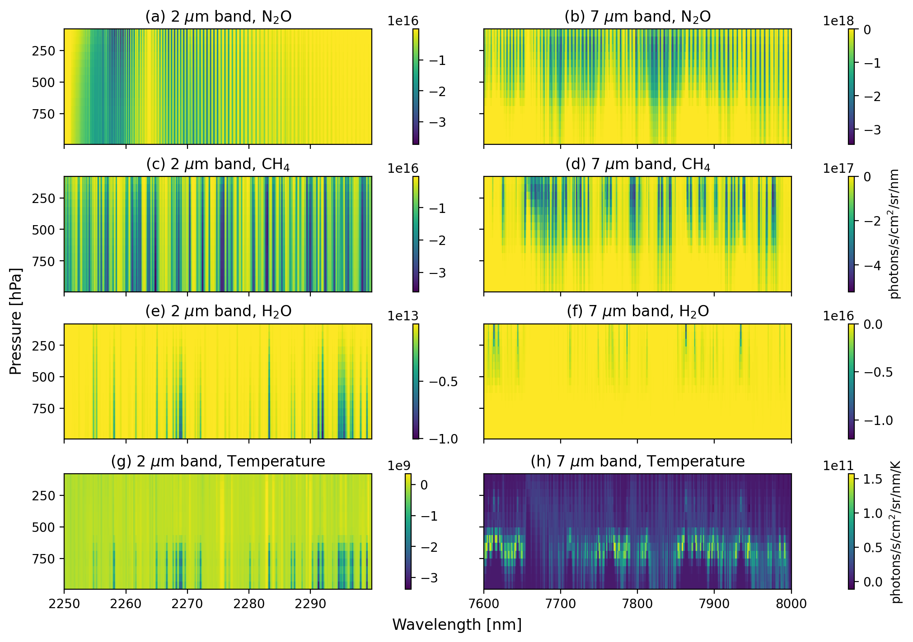
N₂O Mission Concept
N₂O is an under-observed GHG
Idea for a mission to use 2 micron and 7 micron N₂O bands
Retrieval state vector includes N₂O, CH₄, water vapor, temperature profiles, and surface temperature
Would help to better quantify N₂O emissions
Based on presentation by Ayesha Riaz & Kang Sun
State University of NY at Buffalo

Slide 17
Conclusion
Lots of activity and progress with existing GHG missions!
GOSAT-GW and MicroCarb are both launching in the coming weeks
GHGSats, DQ-2, CO2M, TanSat-2, TANGO … expect to launch within the next ~3 years
Carbon-I and AOM are working toward approval

