Slide 1

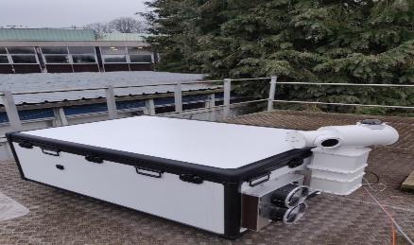
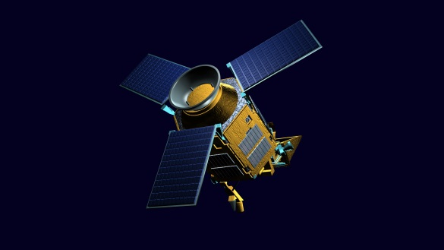
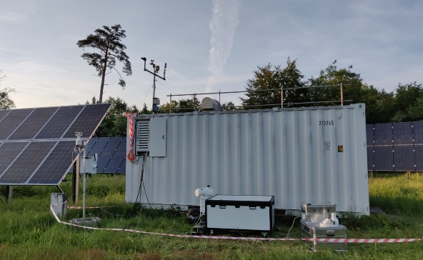


IWGGMS21
Cal-Val
Mahesh Kumar Sha¹ and Hirofumi Ohyama²
¹Royal Belgian Institute for Space Aeronomy (BIRA-IASB), Brussels, Belgium;
²National Institute for Environmental Studies (NIES), Tsukuba, Japan

Slide 2
Validation results
Satellites for which validation results were discussed and reference sources used:
OCO-2 v11.2 and OCO-3 v11 against TCCON, COCCON and airborne measurements from ATom
GOSAT, TROPOMI, validation results against TCCON
ACE-FTS CFC-11, CFC-12 & HCFC-22 validation results against ground-based FTIR
Individual site focused validation results were shown for locations like – Hefei, China;

Slide 3
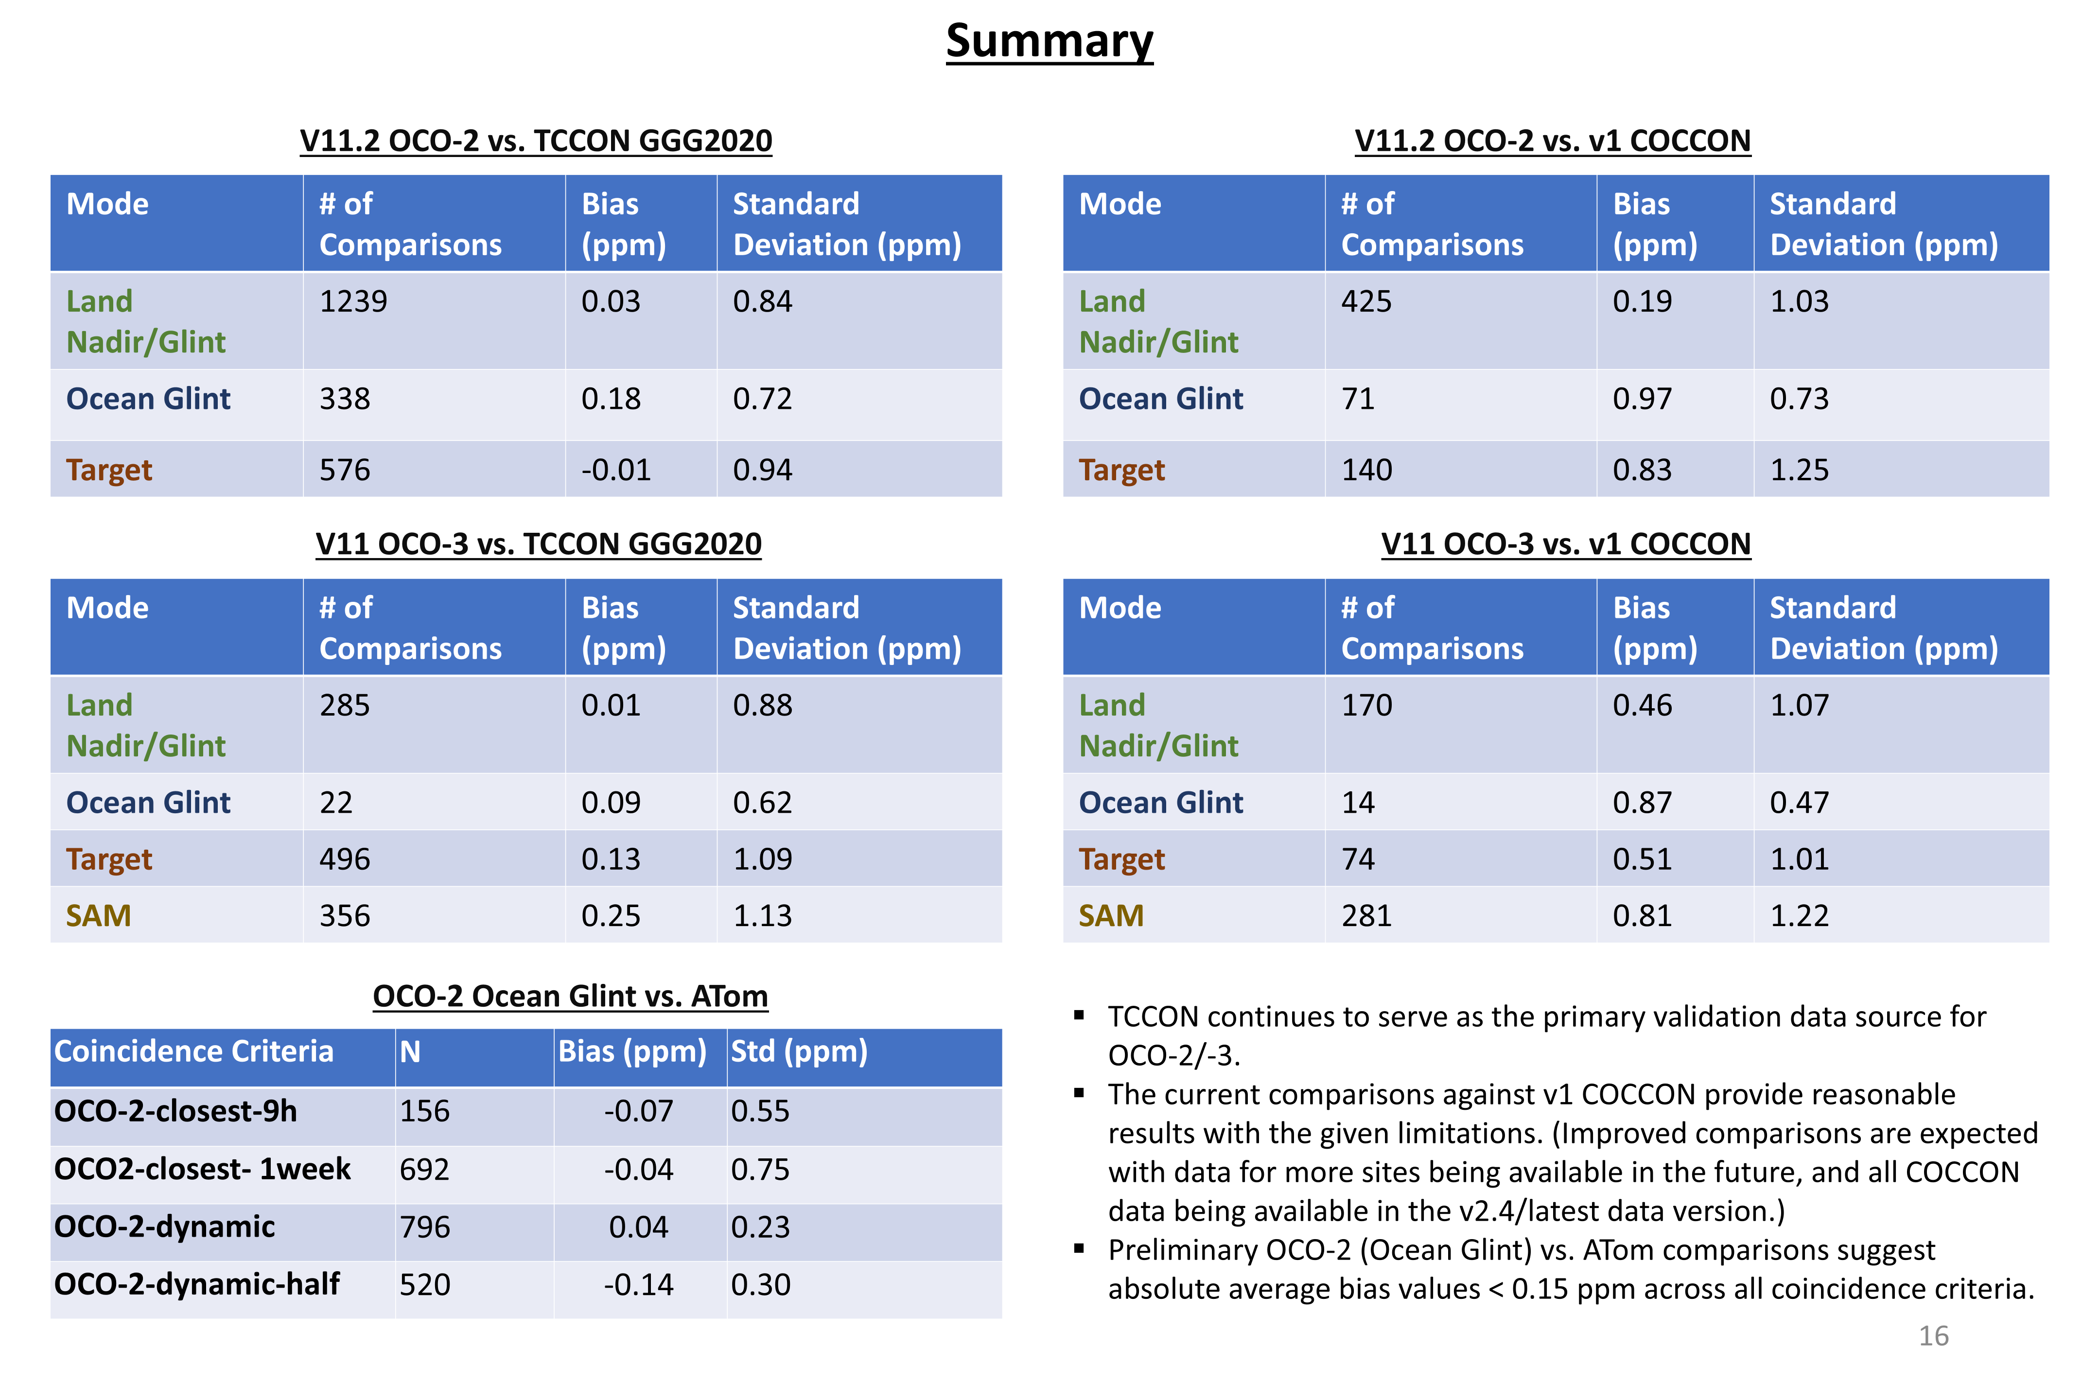
Validation studies using TCCON and COCCON data
Das et al., AC-VC#21

Slide 4
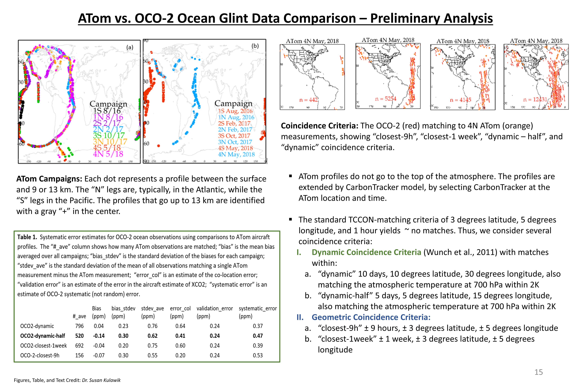
Validation study using airborne data
Das et al., AC-VC#21

Slide 5
Highlights
Number of COCCON stations is increasing rapidly. Until now 163 EM27/SUN spectrometers have been checked at KIT which are used for solar absorption measurements.
Very important to follow the standard procedures established under COCCON
New GB sites are deployed and planned around city source region – e.g., Tokyo, Madrid, Kolkata, Bhopal and Ahmedabad
Ship-based observations are performed using EM27/SUN and mini-DOAS – software adapted to take lat, lon changes into configuration
Co-located measurements of other parameters to be performed at the site and shared with the community, e.g., Max-DOAS or Pandora measurements, Lidar measurements
Introduction of Fiducial Reference Measurements (FRM) and FRM4GHG (FRM for Greenhouse Gases), intercomparison strategy and results

Slide 6
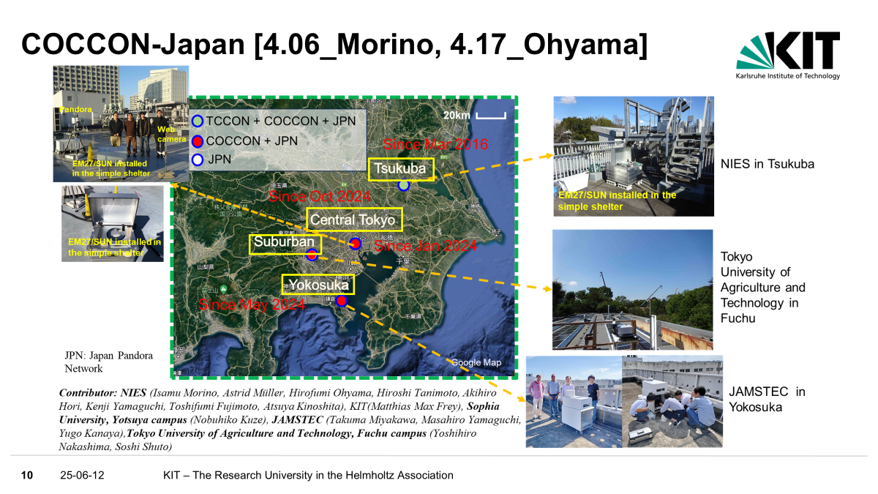
City based deployment of COCCON spectrometers
Frey et al., AC-VC#21

Slide 7
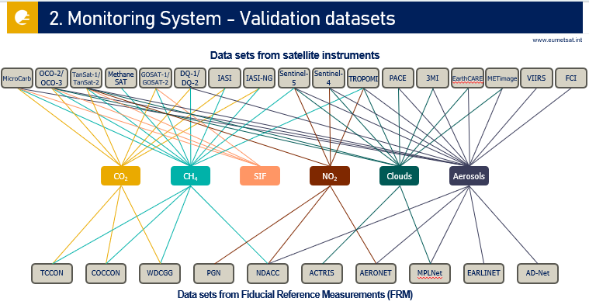
CO2M validation datasets
Hayer et al., AC-VC#21

Slide 8
Highlights
Calibration sources used for CO2M – Sun, Moon, WLS, Tuneable LED, Dark
Ground-based data provision study for CO2M has started – led by BIRA; planned to get rapid delivery of data for validation
EUMETSAT to use the STAR (Statistical Analysis and Reports) framework for Cal/Val – offline tool
Use of updated HITRAN databased (2012, 2020, 2020+) w.r.t cross-platform Cal &Val of satellite-based GHG retrievals
Significantly deeper CH4 absorption lines in the weak CH4 (1.6 µm) band with HITRAN 2020+. This will not be included in the upcoming HITRAN 2024.
Rail Road Valley is an important and only site shown for surface reflectance
MODIS BRDF used for estimation of off-nadir reflectance of multiple satellites
Comparison of TIR spectral radiance between multi-sensor (GOSAT, GOSAT-2, AIRS, IASI and CrIS) and aircraft-based S-HIS (Scanning High-Resolution Interferometer Sounder)
Study on MethaneSAT L0 and L1B processor and in-flight calibration and performance (Dark collects, straylight testing, radiometric calibration)

Slide 9
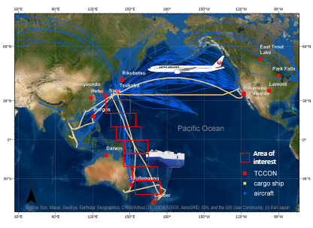
Future plans
New TCCON and NDACC-IRWG site planned at Kolkata, India
New TCCON site planned for deployment in Anhui province about 200 km away from the Hefei site
Two new COCCON sites planned in India as part of GOSAT-GW validation project
Ship-borne observations of in-situ and columnar concentration for satellite validation
Mueller et al., AC-VC#21

Slide 10
Thank you for your attention!
Questions / comments to mahesh.sha@aeronomie.be
oyama.hirofumi@nies.go.jp

