Slide 1

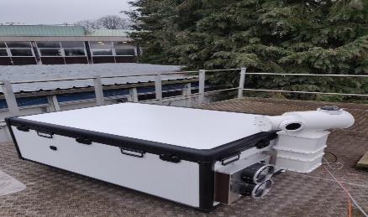
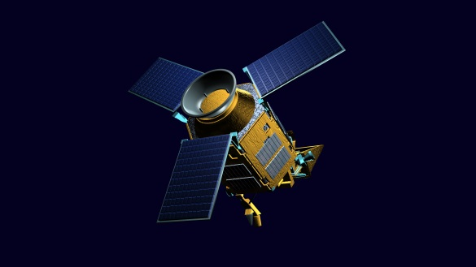
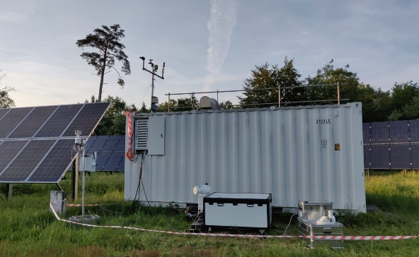


COCCON
Presenter: Mahesh Kumar Sha*
*Royal Belgian Institute for Space Aeronomy (BIRA-IASB), Brussels, Belgium;
* mahesh.sha@aeronomie.be

Slide 2






The network
COllaborative Carbon Column Observing Network (COCCON)
  A network of portable low-spectral resolution Fourier transform infrared spectrometer
  Primarily spectrometers of the type Bruker EM27/SUN with the recent addition of Bruker Vertex70 / INVENIO
Centralized calibration & QC methods (performed at KIT, cooperation with Bruker)
  So far 163 spectrometers are checked
Common software standards, community telecons
Centralized data processing, data provision via EVDC
Travel standard COCCON spectrometer (Europe, Americas, Asia-Oceania)

Slide 3
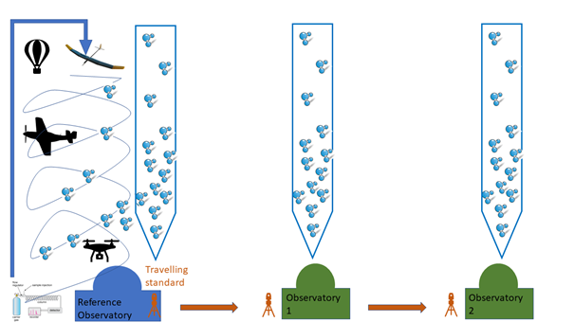
Traceability
Intercomparison Intercomparison Intercomparison …

Slide 4
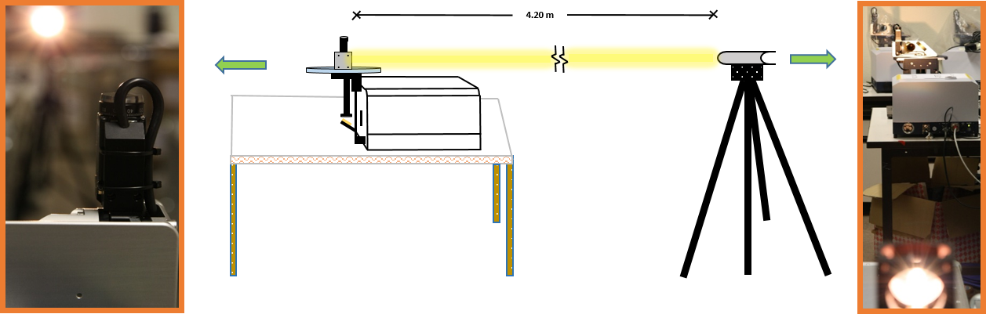
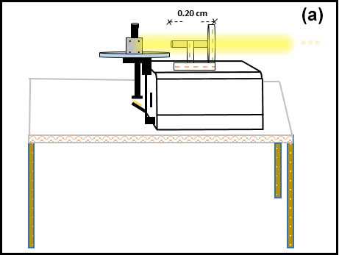
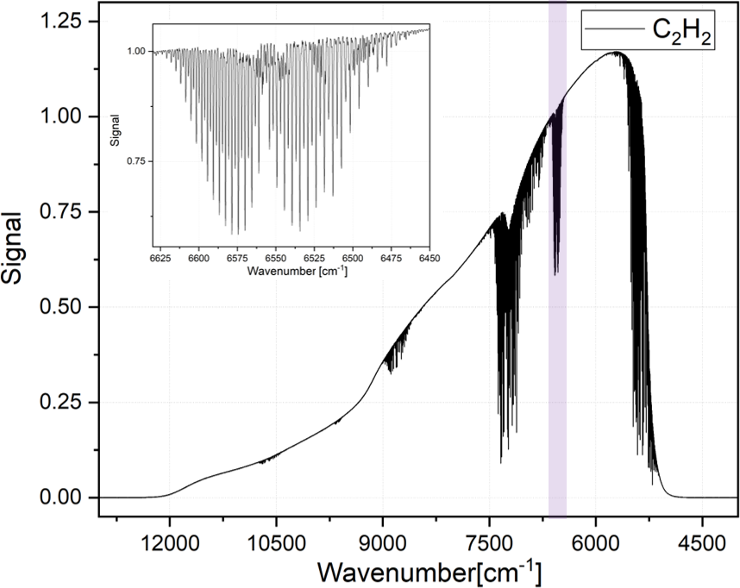
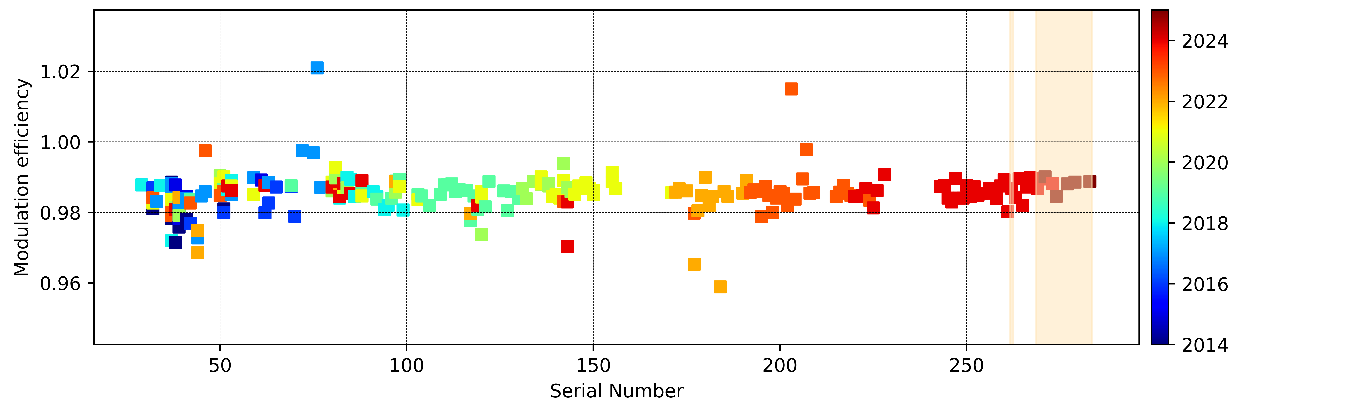
COCCON: Centralized calibration and QC
Frey, M., Hase, F., Blumenstock, T., Groß, J., Kiel, M., Mengistu Tsidu, G., Schäfer, K., Sha, M. K., and Orphal, J.: Calibration and instrumental line shape characterization of a set of portable FTIR spectrometers for detecting greenhouse gas emissions, AMT, 2015.
Alberti, C., Hase, F., Frey, M., Dubravica, D., Blumenstock, T., Dehn, A., Surawicz, G., Harig, R., Orphal, J., & EM27/SUN-partners team: Improved calibration procedures for the EM27/SUN spectrometers of the COllaborative Carbon Column Observing Network (COCCON), AMT, 2022.
Slide: Matthias Frey, IWGGMS21

Slide 5
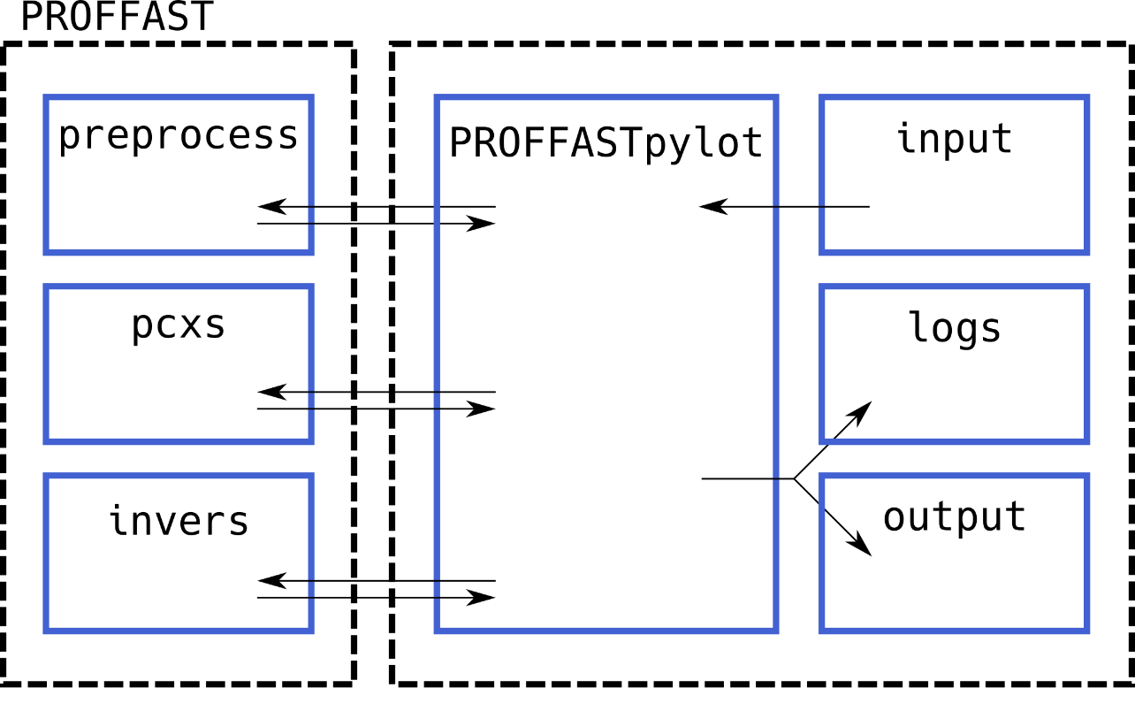
Data processing
PROFFAST
  Retrieval software
  Current version 2.4
PROFFASTpylot
  Python user interface
  Current version 1.3
Future update (v2.4.1) to be distributed
  Mobile observations supported
  Additional diagnostic output
Feld, L., Herkommer, B., Vestner, J., Dubravica, D., Alberti, C., and Hase, F.: PROFFASTpylot: Running PROFFAST with Python, JOSS, 2024.
Hase, F., Castracane, P., Dehn, A., Garcia, O. E., Griffith, D. W. T., Heizmann, L., Jones, N. B., Karpinnen, T., Kivi, R. Maziere, M., Notholt, J., and Sha, M. K.: Implementation and application of an improved phase spectrum determination scheme for Fourier transform spectroscopy, AMT, 2025.

Slide 6
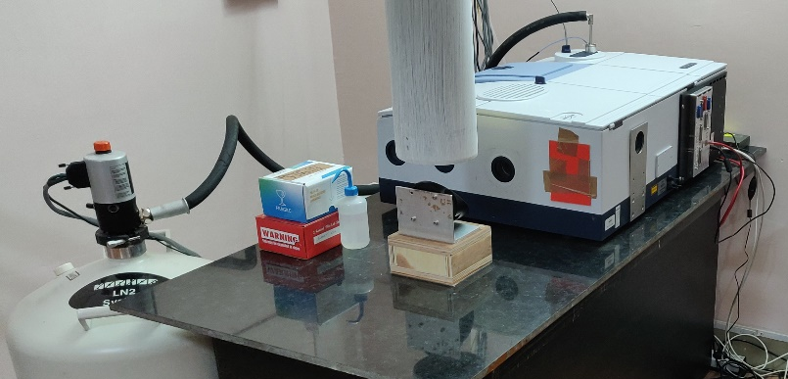
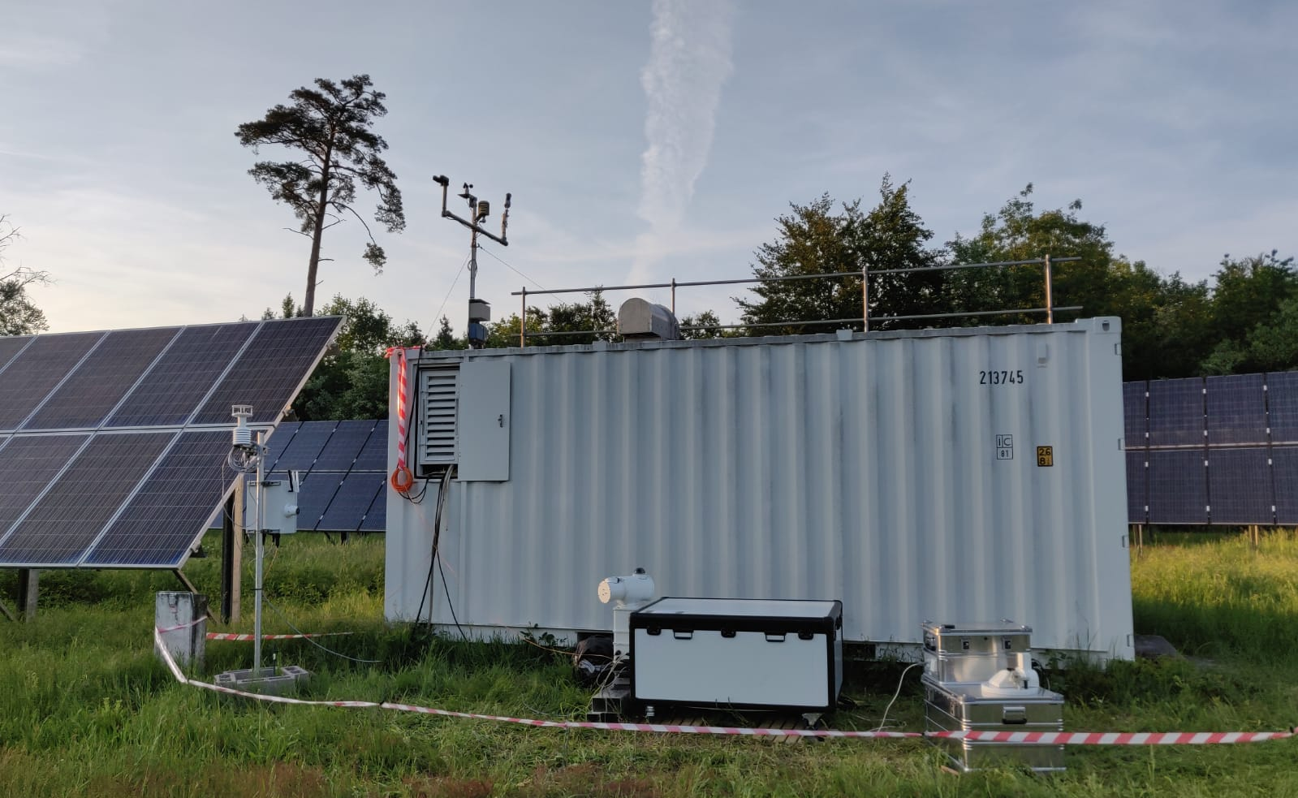
Addition of Vertex70 / Invenio as part of COCCON
Vertex70/Invenio operated at 0.2 cm⁻¹ resolution has the possibility to host two detectors
VERTEX70
Liquid nitrogen cooled InSb detector
OCS (total), HCHO (total), N₂O (tropospheric, total), CH₄ (total) at 0.2 cm⁻¹ (already published, retrieval other gases are under testing)
Next to try – C₂H6, NH₃, …
Measurements frequency = 52 sec
Room temperature operated InGaAs detector
Providing – XCO₂, XCH₄, XCO, XH₂O at 0.2 cm⁻¹
Measurements frequency = 52 sec
Perform side-by-side measurements at COCCON central facility at KIT, Karlsruhe for NIR data calibration
Perform side-by-side measurements at NDACC-IRWG sites to study the variability of the MIR data calibration
Traceability of the measurements and output

Slide 7
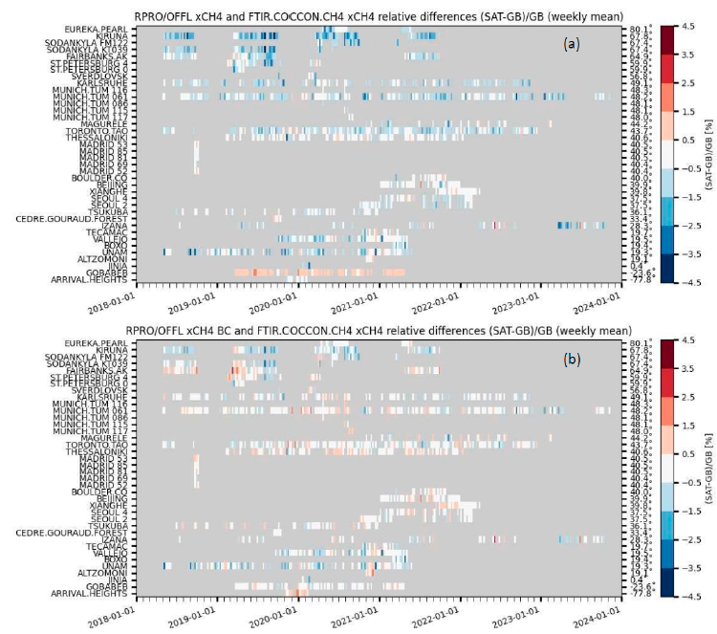
Satellite validation using COCCON data
Several validation papers have been published focusing on individual sites.
First publication using a global COCCON dataset (27 stations) for the validation of S5P, OCO-2 and GOSAT has been recently published by Sha et al., 2025
Sha, M.K.; Das, S.; Frey, M.M.; Dubravica, D.; et al. Fiducial Reference Measurements for Greenhouse Gases (FRM4GHG): Validation of Satellite (Sentinel-5 Precursor, OCO-2, and GOSAT) Missions Using the COllaborative Carbon Column Observing Network (COCCON). Remote Sens. 2025, 17, 734. https://doi.org/10.3390/rs17050734

Slide 8
Future
Deployment of COCCON-Spain, COCCON-UK, COCCON-Germany supporting satellite validation and MVS capacity building
Network is growing ➔ additional working groups joining in: e.g., Korea (KRISS, NIMS, SNU)
Due to still increasing network size and demands (timeliness), additional personnel is required – work on documentation and webpage, establishment of steering board, …
Deployment of travel standard to TCCON sites and perhaps also COCCON sites
Investigation of fiber-coupled EM27/SUN operation
EM27/SUN at higher spectral resolution (0.3 cm⁻¹ instead of 0.5 cm⁻¹)

Slide 9
COCCON as FRM data provider for satellite validation
COCCON data which are public is hosted at EVDC (ESA Validation Data Center); a DOI is minted per site
Central facility for data handling and processing facility hosted at KIT assist site PIs in data processing and quality checks – funded by ESA
Possible to expand the usage of COCCON data to other GHG satellites (traditional and new space missions)
Maturity Matrix completed with the current status of COCCON for the main target gases – Sha et al., 2024
Profile measurements at the COCCON sites would be needed to determine the independent scaling factor
Warning: The number of EM27/SUNs are growing fast ➔ key to follow the standardized procedures established under COCCON
  check new spectrometer before delivery, side-by-side solar measurements collocated at KIT TCCON site and reference EM27/SUN, alignment check and ILS meas., determination of Xgas scaling factors to establish the indirect traceability to WMO via TCCON
    If you are a data user using data from private data providers, then please check if these conditions are strictly followed

Slide 10
Thank you for your attention!
Questions / comments to mahesh.sha@aeronomie.be

