Slide 1


NDACC IRWG
Contributions, Synergies, Support with CEOS
James Hannigan, Emmanuel Mahieu, Bavo Langerock, Ivan Ortega
NCAR, U. Liege, BIRA
CEOS AC-VC-21 / Takamatsu / June 2025
Notes:
NOTE: Background image can be used as is or changed for a particular presentation in the “Slide Master” button found under the “View” tab.

Slide 2
Outline
Overview of IRWG does,
        Map
        Instrumentation, Calibration
        Data products, retrievals, retrieval methodologies, profiles, information content
        Trace species, O3 & ODS.
Recent / Current validation
  TROPOMI
  TEMPO H₂CO, NO₂ & Inter-Network validation with Pandora
Intra-Network improvements: new retrievals of CH₄, N₂O
  AirCore, Airborne in situ ‘training’
Small Instruments: mobile, automatic
  BIRA: Bruker Invenio, Vertex
  NCAR: MRPI
  Summarize Next Steps & Needs
CEOS AC-VC-21 / Takamatsu / June 2025

Slide 3
Infrared Working Group Stations
IRWG Station N Lat. E Long.
1 Eureka 80.0500 273.5800
2 Ny_Alesund 78.9000 11.9000
3 Thule 76.5300 291.2600
4 Kiruna 67.8400 20.4100
5 Harestua 60.2000 10.8000
6 St_Petersburg 59.8800 29.8300
7 Onsala 57.4000 11.9300
8 Bremen 53.1000 8.9000
9 Paris 48.9700 2.3700
10 Garmisch 47.4760 11.0630
11 Zugspitze 47.4200 10.9800
12 Jungfraujoch 46.5500 7.9800
13 Rikubetsu 43.4600 143.7700
14 Toronto 43.6600 280.6000
15 Boulder 40.0380 254.7600
16 Tsukuba 36.0500 140.1200
17 Hefei 31.9000 117.1700
18 Izana 28.3000 343.5200
19 Mauna_Loa 19.5400 204.4300
20 Altzomoni 19.1200 261.3500
21 Paramaribo 5.8100 304.7900
22 Reunion_Maido -21.0670 55.3800
23 Wollongong -34.4061 150.8793
24 Lauder -45.0500 169.6700
25 Arrival_Heights -78.8300 166.6600
CEOS AC-VC-21 / Takamatsu / June 2025

Slide 4
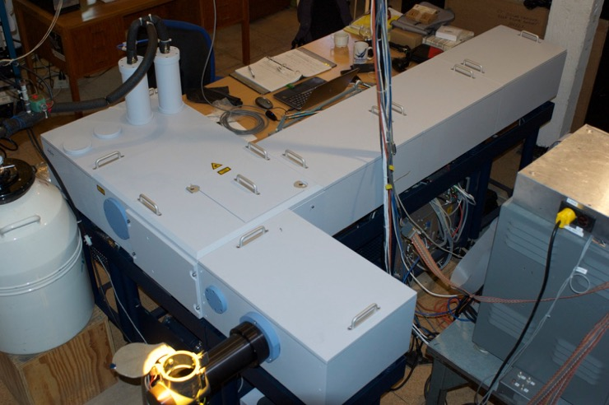
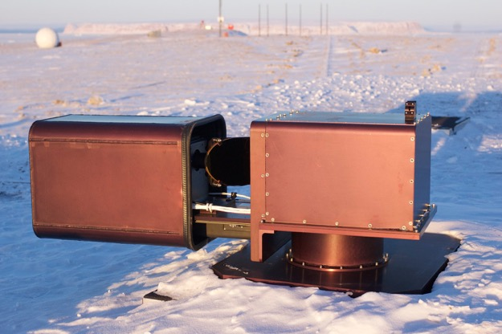
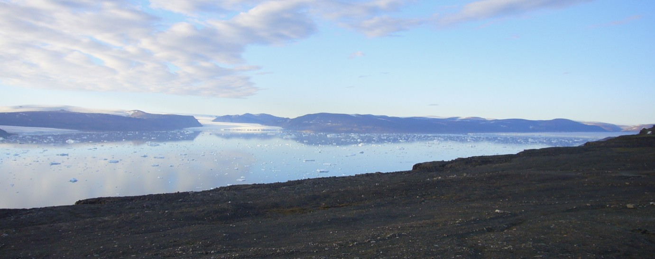
Observations / Instrumentation
NCAR / NDACC High Arctic
FTS at Thule Gr. (76˚N)
Bruker 125HR
Operational since 1999
CEOS AC-VC-21 / Takamatsu / June 2025

Slide 5
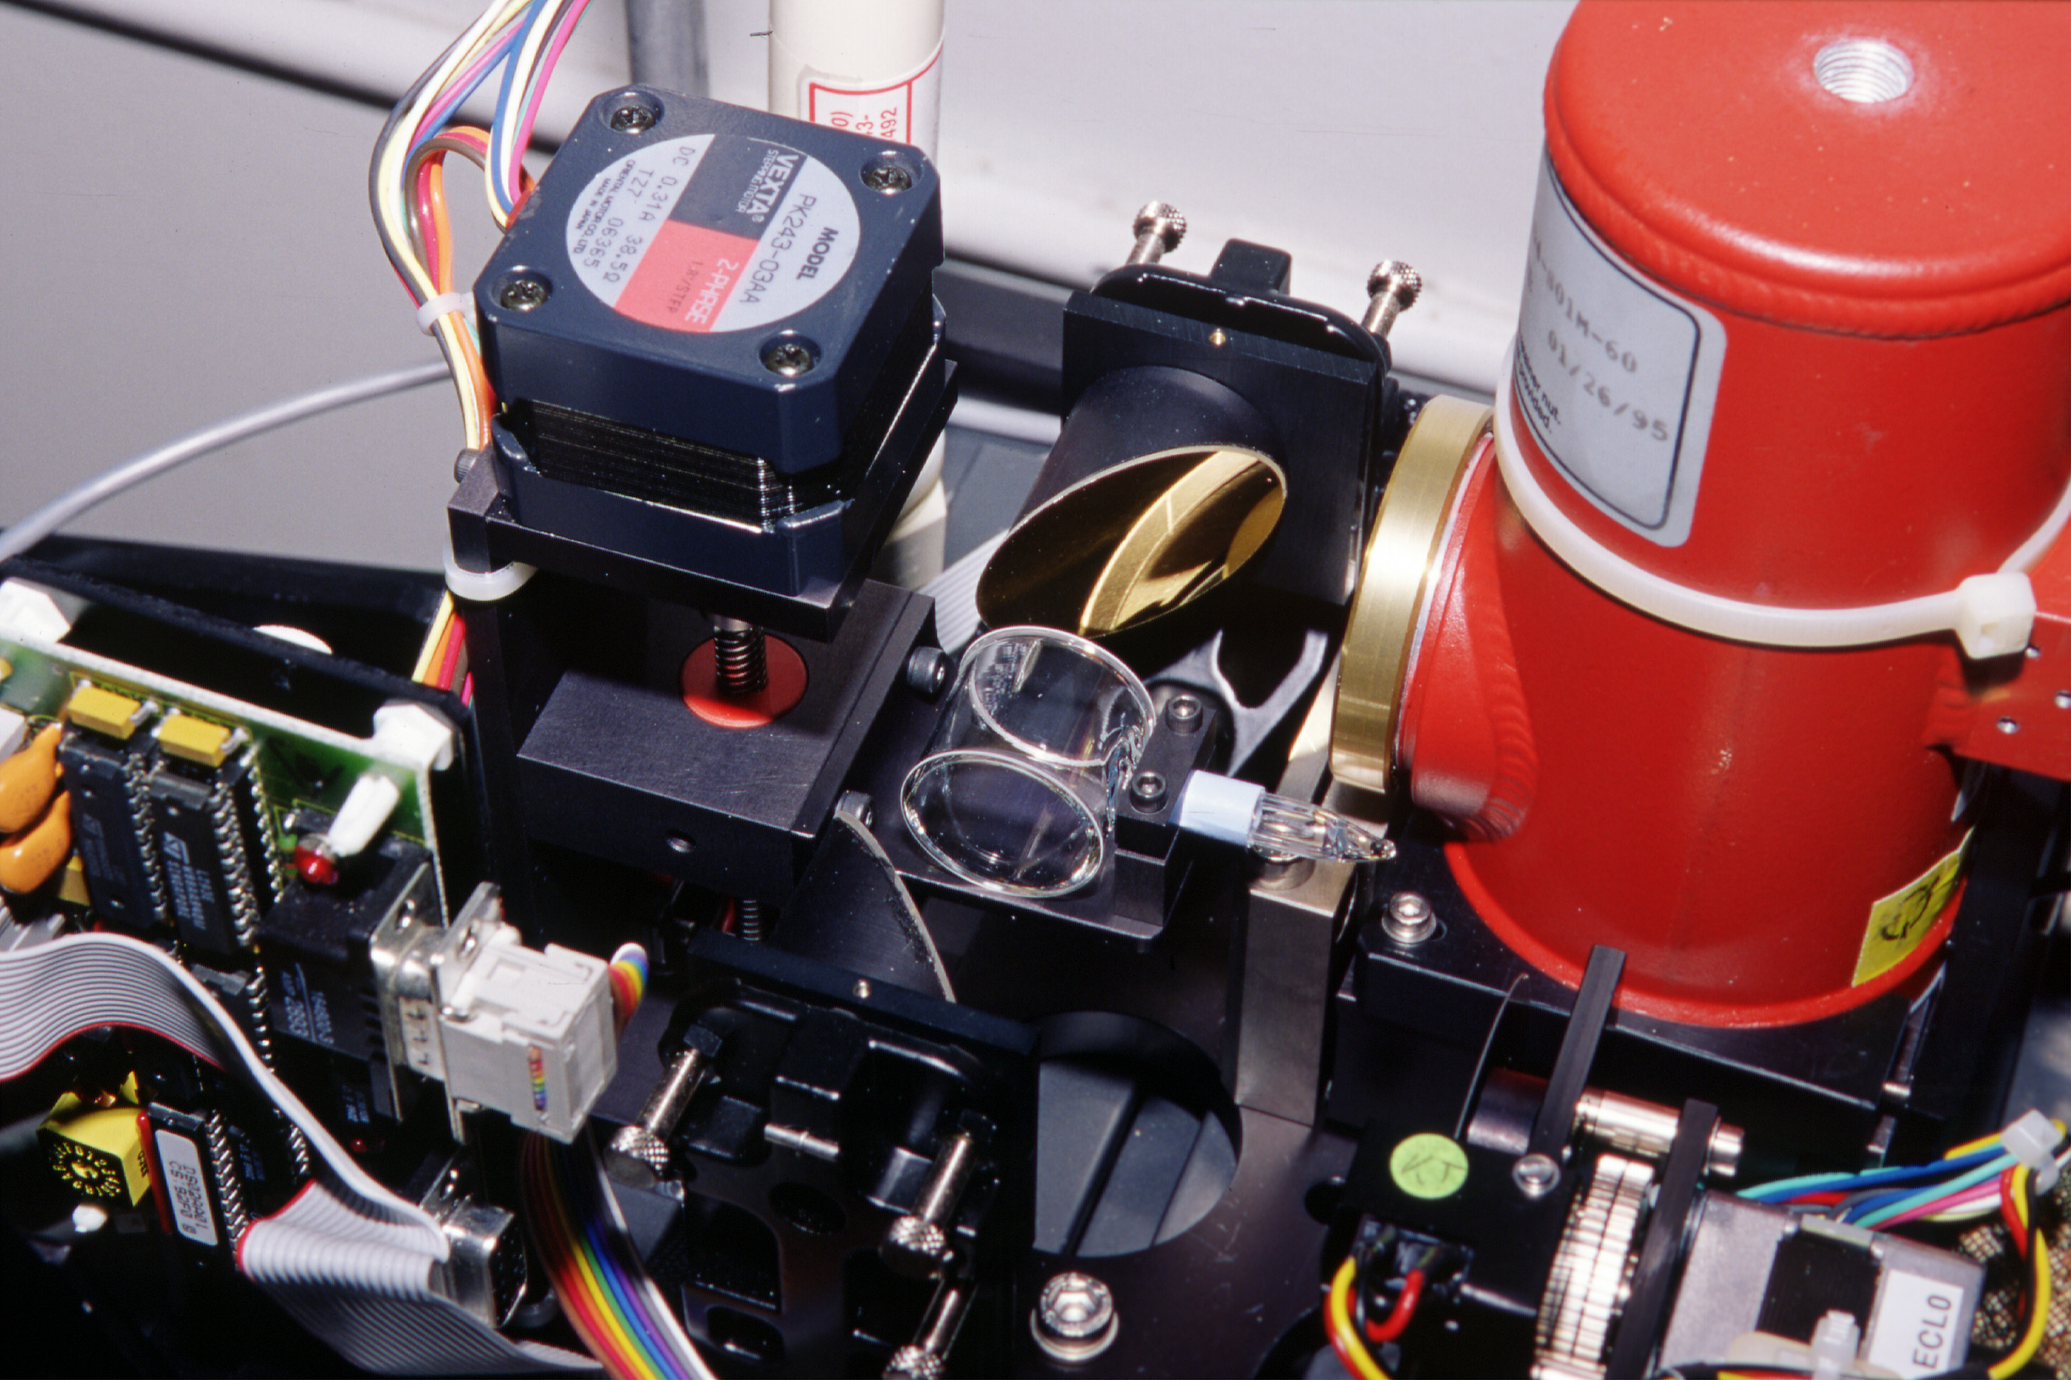
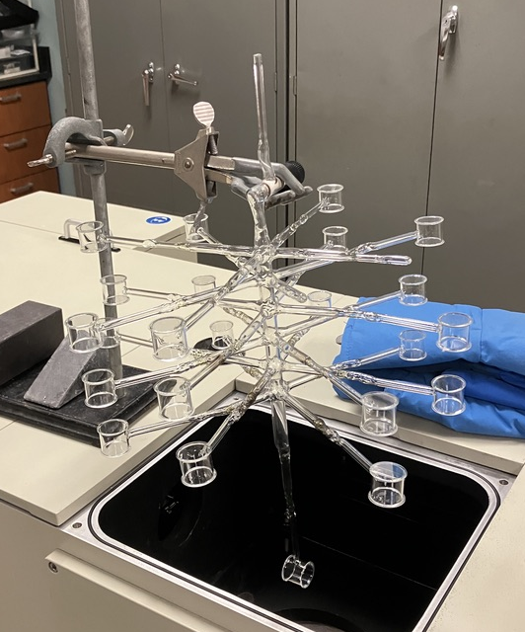
Observations : Calibration with HBr or N₂O Cell
Uniform cells across network
Analogous to passing a δ-function through instrument
Returns Instrument Line Function or ILS (ideally sinc function), Modulation Efficiency & Phase Function
H⁸¹Br H⁷⁹Br
Fit ~16 unique absorption features
Instrument Line Function
Modulation & Phase Function
CEOS AC-VC-21 / Takamatsu / June 2025

Slide 6
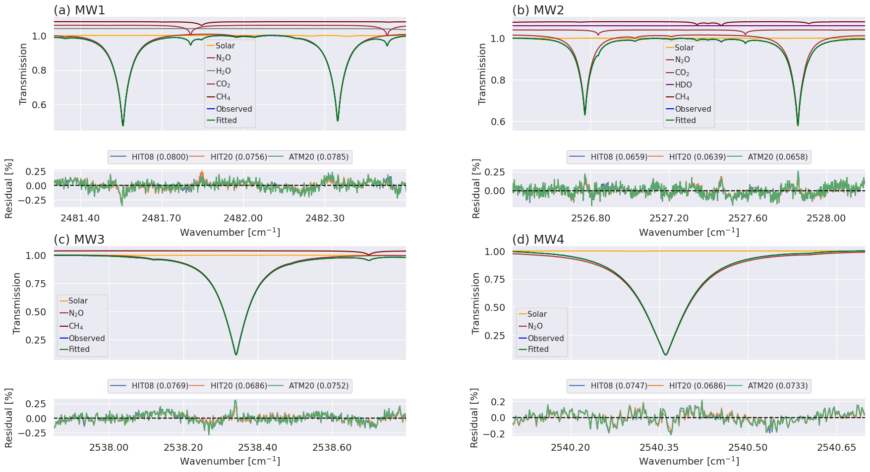
IRWG Retrievals: Spectra, Information Content, Altitude Resolution
Typical Instrument observes 750 – 5000 cm-1 in 6(+) separate optical filter ranges in about 30 minutes.
No constraint on when or how many filter cycles are performed
Absorptions features are determined for each species:
to minimize interference from other absorptions,
to minimize the effect of temperature uncertainty,
to maximize information content,
to usability for all stations ,
Retrieval fit example of N₂O on January 31th, 2019 (SZA = 63.8)
CEOS AC-VC-21 / Takamatsu / June 2025

Slide 7
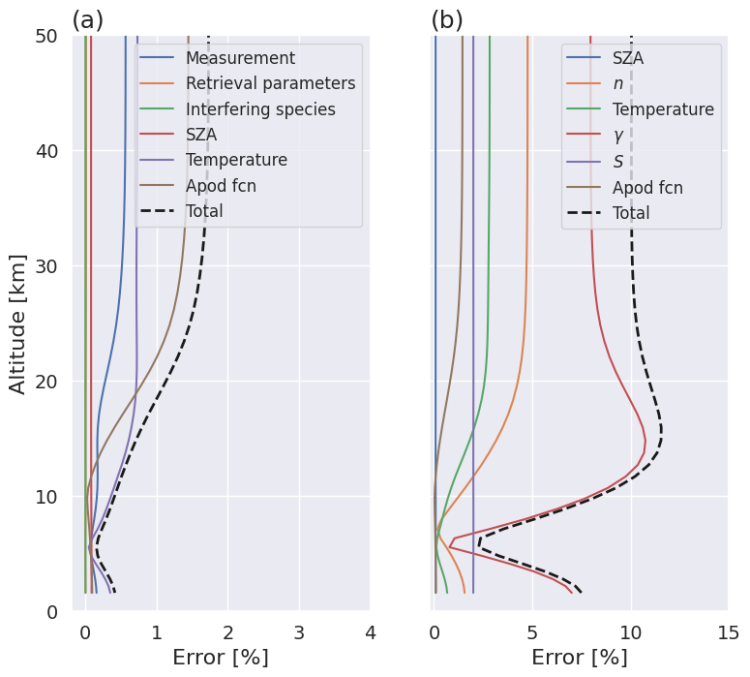
IRWG Retrievals: Spectra, Information Content, Altitude Resolution
N₂O example from Boulder – Retrieval characteristics are different for each species.
Averaging kernels represent the vertical information derived from the spectral signature
Summing the trace of the AK matrix yields layers that can represent full ‘pieces’ of information
Uncertainty profiles for major contributors Random on left, Systematic on right
CEOS AC-VC-21 / Takamatsu / June 2025

Slide 8
IRWG Retrievals / Data Products
Use HITRAN (now 2020 or ATM 2020) line list & a constant a priori in forward model
    Chemical profiles: WACCM v6 (CMIP) simulations mean 1980 – 2040 after ~100y spin-up, interpolated to station lat., long., altitude
    NCEP zpT, same vertical grid used at all stations above ~7km
IRWG *typically* does not scale results to any standard (yet)
With kernels, retrieved profiles, uncertainty estimates:
Archived HDF with kernels, a priori & retrieved target, appropriate H₂O profile, surface state, dry air column, zpt profiles, column, uncertainty profiles
The profile are integrated to a total column
Or integrated to partial columns or mass weighted mole fraction given adequate DOFS
These can be normalized by local barometric pressure and cast as dry air mole fraction over an appropriate altitude range
CEOS AC-VC-21 / Takamatsu / June 2025

Slide 9
Species Retrievable by IRWG
Recent use in satellite validation / correlative measurements
CEOS AC-VC-21 / Takamatsu / June 2025

Slide 10
IRWG : Publications 1/2
37 papers published or in press in 2023 to fall 2024 for many purposes:
  Time series and trend investigations,
  Satellite validation,
  Support to model simulations,
  Spectroscopy
H₂O Vertical distribution (1)
CO₂ Urban emissions, intercomparison, temporal variability, trend, volcanic (5)
O₃ Arctic modeling, intercomparison, trend, tropospheric modeling (6)
N₂O UTLS temporal variability, trend (3)
CH₄ Arctic modeling, satellite validation, trend (4)
CO Arctic modeling, Arctic pollution, biomass burning, temporal variability, trend (6)
NO/NO₂ Diurnal and seasonal variations, tropospheric NO₂ (3)
C₂H₆ Arctic pollution, biomass burning, fossil fuel emissions, trend (4)
C₂H₂ Arctic pollution, biomass burning, satellite validation, trend, CRiS (4)
CEOS AC-VC-21 / Takamatsu / June 2025

Slide 11
IRWG : Publications 2/2
C₂H₄ Satellite validation, CRiS (1)
CH₃OH Arctic pollution, trend, satellite validation, CRiS (3)
H₂CO Satellite validation (GEMS, OMI, OMPS Suomi NPP, OMPS NOAA20, TROPOMI), Arctic pollution, biomass burning, trend (8)
HCOOH Arctic pollution, trend (2)
HCN Biomass burning, trend, satellite validation, CRiS (3)
PAN Arctic pollution (1)
HCl Volcanic, temporal variability, intercomparison, trend (4)
HF Volcanic, temporal variability, intercomparison, trend (3)
SO₂ Volcanic (1)
HNO₃ Spectroscopy, intercomparison, trend (4)
ClONO₂ Intercomparison, trend (1)
NH₃ Trend (1)
HCFC-22. Multi-site trend, intercomparison (2)
HFC-134a New target, intercomparison (1)
C₅H₈ Satellite validation (CRiS)
CEOS AC-VC-21 / Takamatsu / June 2025

Slide 12
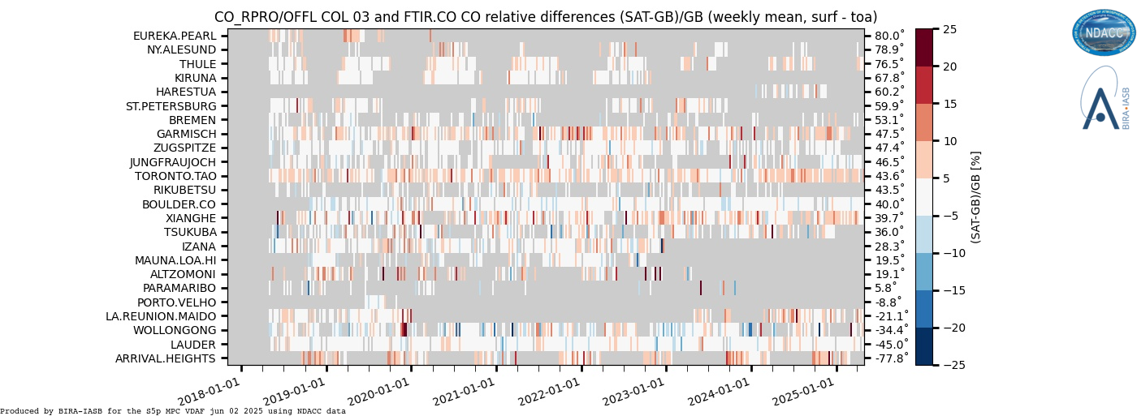
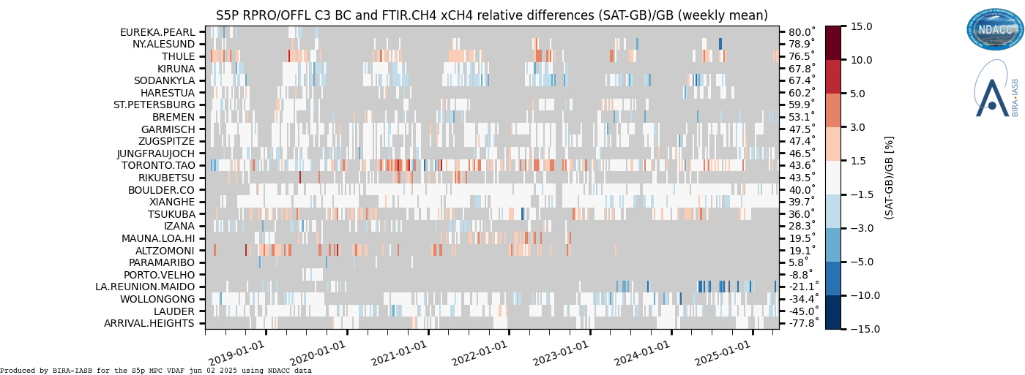
Sentinel-5p TROPOMI L2 Bias at IRWG stations
Continuous Validation performed at BIRA for TROPOMI using all NDACC IRWG stations + others.
CO
CH₄
The averaged correlation coefficient reaches 0.9 for the TCCON network and NDACC sites
4% SZA dependence of bias and ±2% seasonal dependence in bias.
Along orbit stripes.
Underestimation at low albedo. Remaining outliers with qa_value >0.5.
Outlying CH4 values observed along coastal or mountain regions, e.g. in Greenland.
CEOS AC-VC-21 / Takamatsu / June 2025

Slide 13
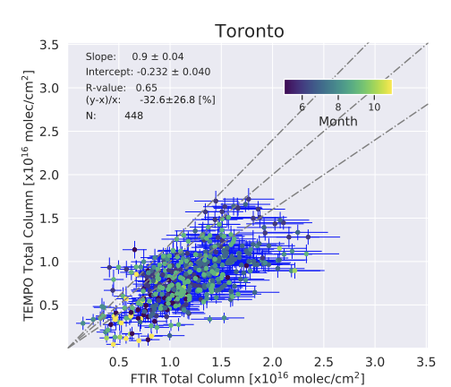
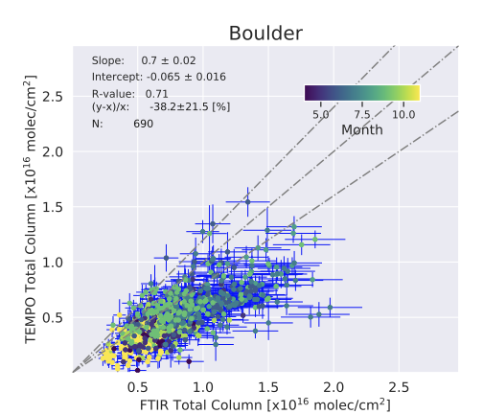
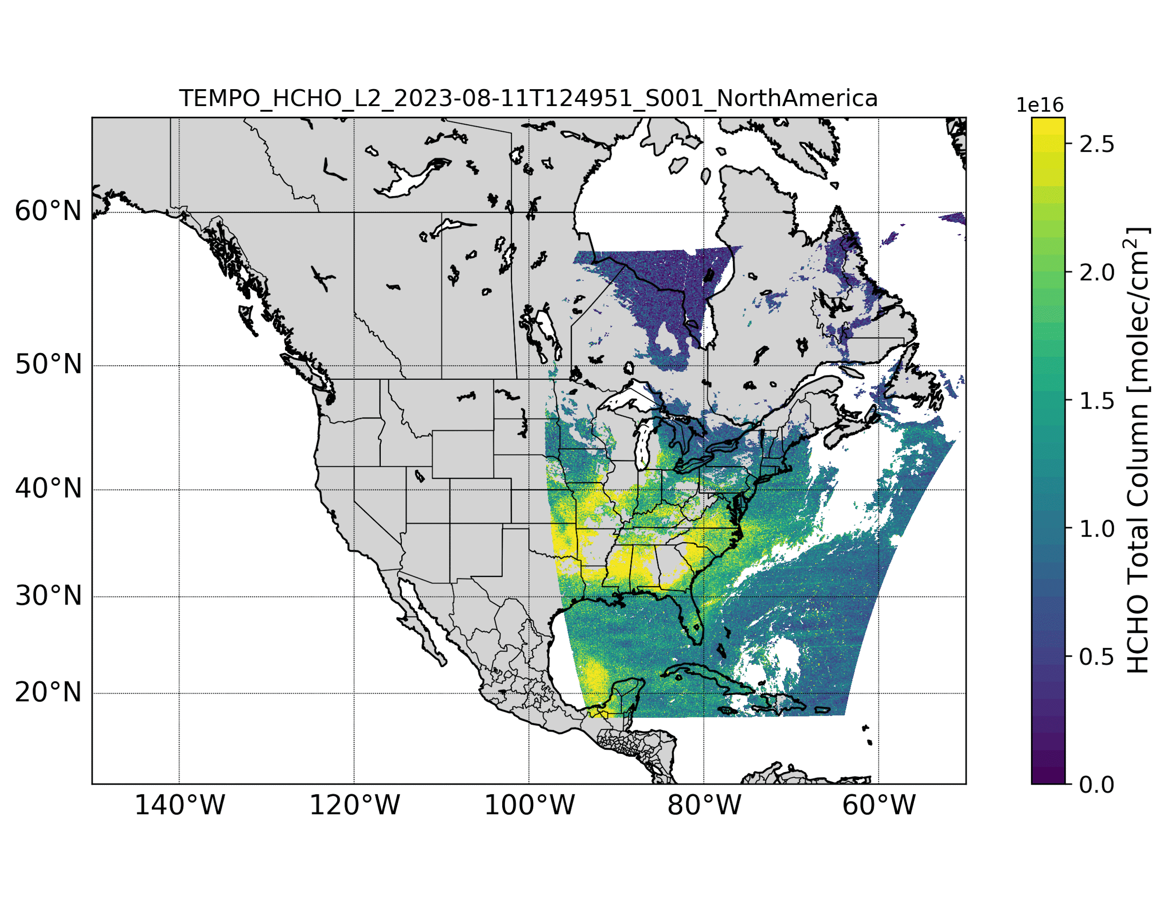
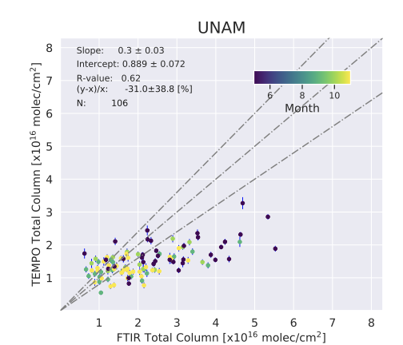
HCHO comparison of TEMPO/FTIR at Boulder, Mexico City, and Toronto
Ground-based FTIR and Pandora can retrieve similar gases like HCHO, Ozone, and NO₂. FTIR has been used to validate HCHO measurements with TROPOMI (Vigouroux et al., 2020).
Example of TEMPO L2 V3 HCHO on Aug 11 2023
Bias: -39%
Bias: -33%
- Strong and consistent correlation between TEMPO and FTIR → extremely encouraging results!
- TEMPO HCHO total columns observations are about 30 % lower than FTIR.
Could the underestimation be attributed to the radiance reference in TEMPO?
Bias: -31%
Data from Aug 2023 - Oct 2024
Bias = (TEMPO-FTIR)/FTIR
CEOS AC-VC-21 / Takamatsu / June 2025

Slide 14
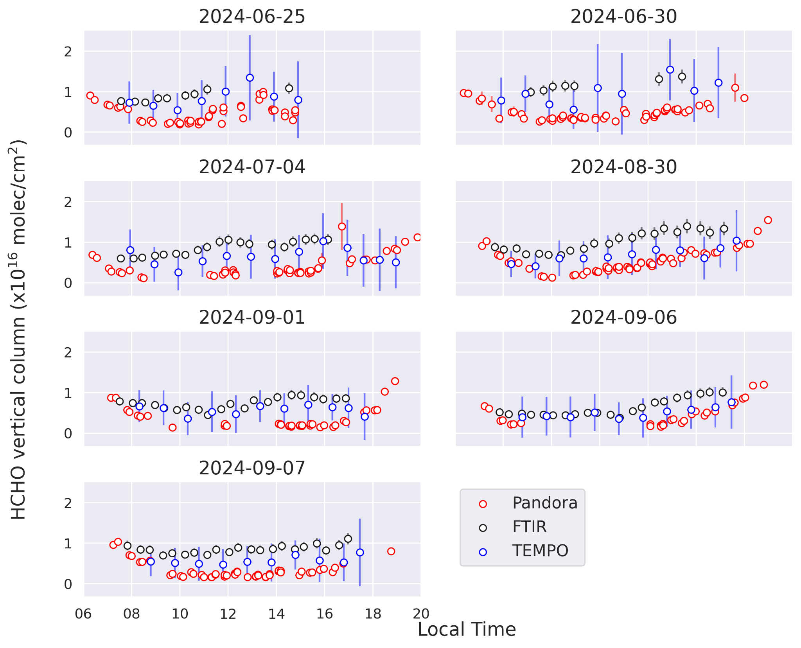
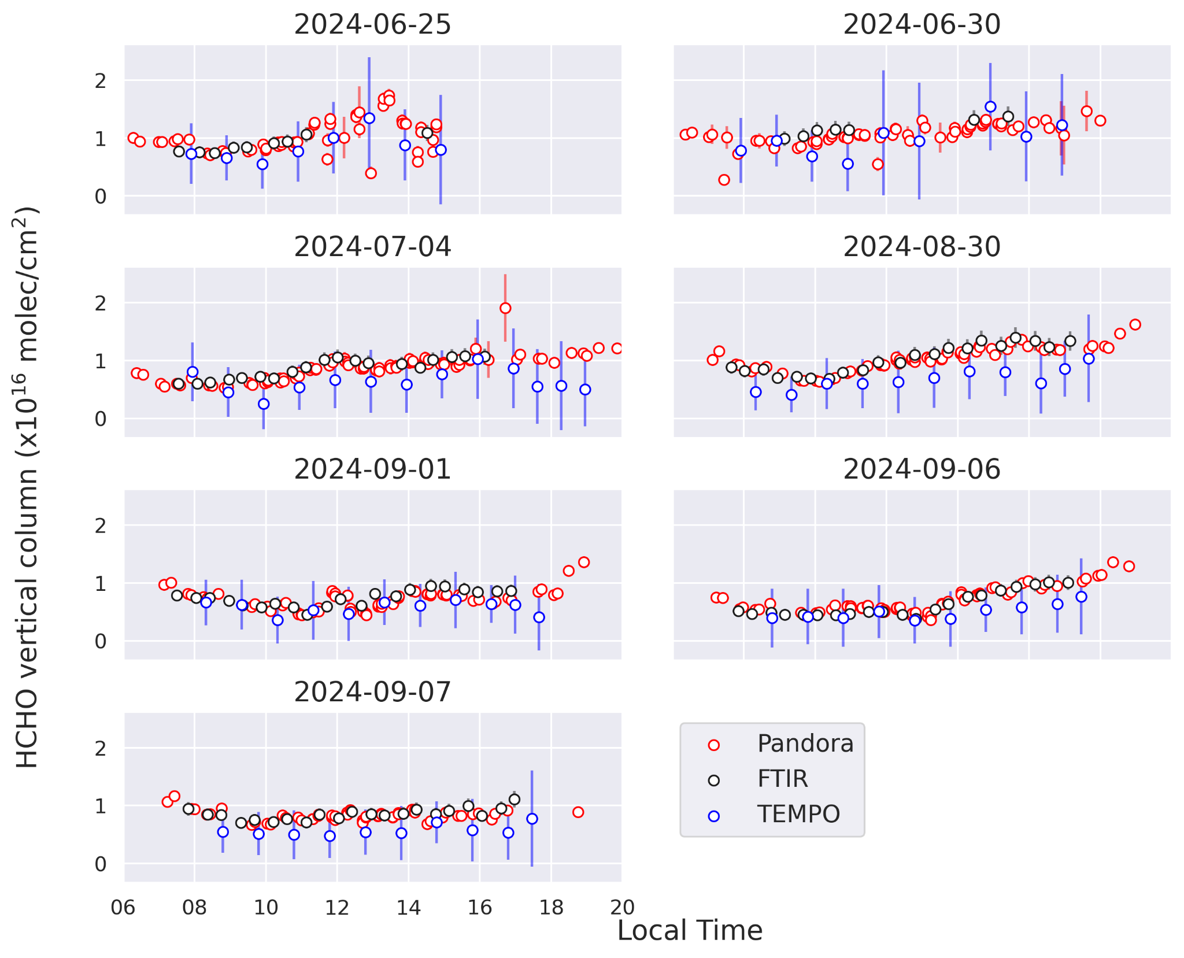
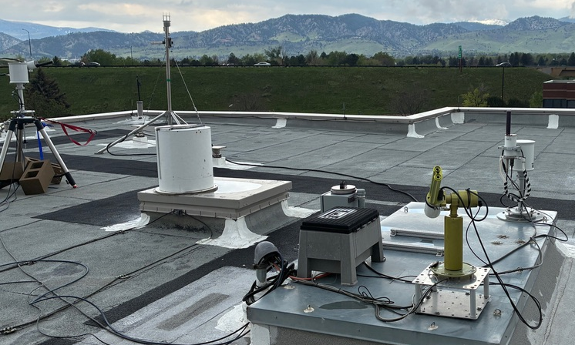
Inter-Network FTIR/Pandora: Diurnal comparison before / after Pandora correction
Boulder NDACC station: FTIR, Pandora & TEMPO H₂CO
Before the correction
After the correction
CEOS AC-VC-21 / Takamatsu / June 2025

Slide 15
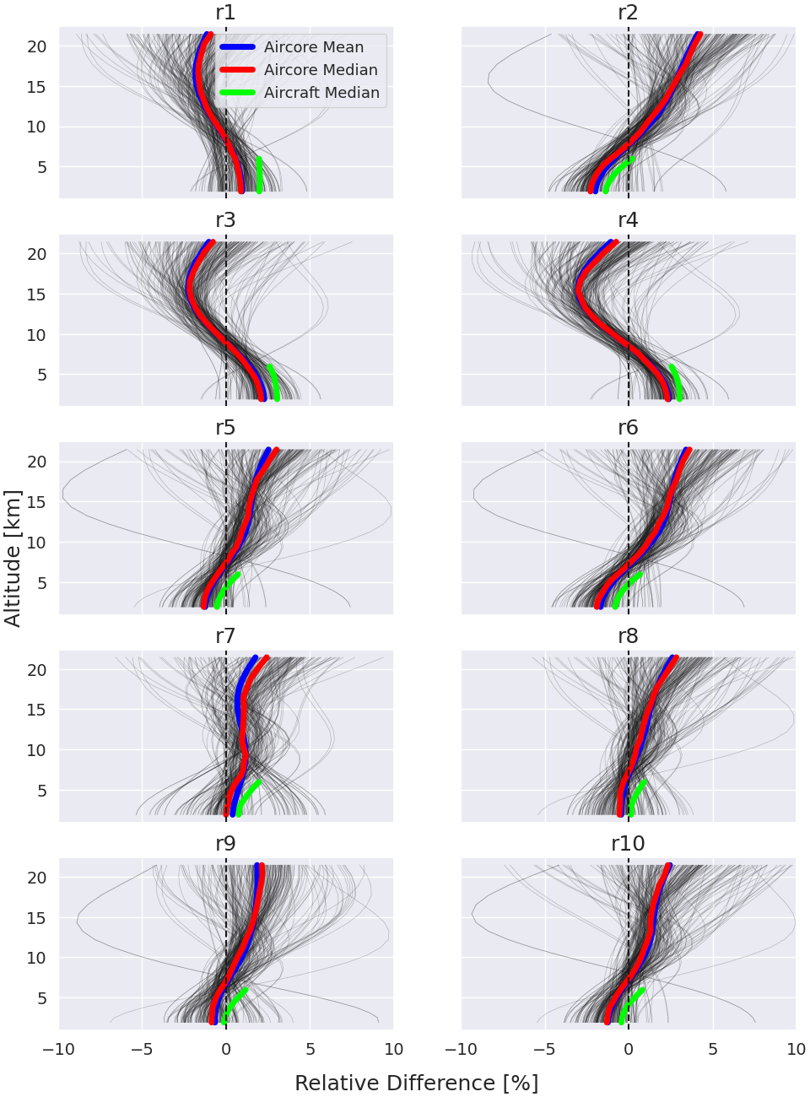
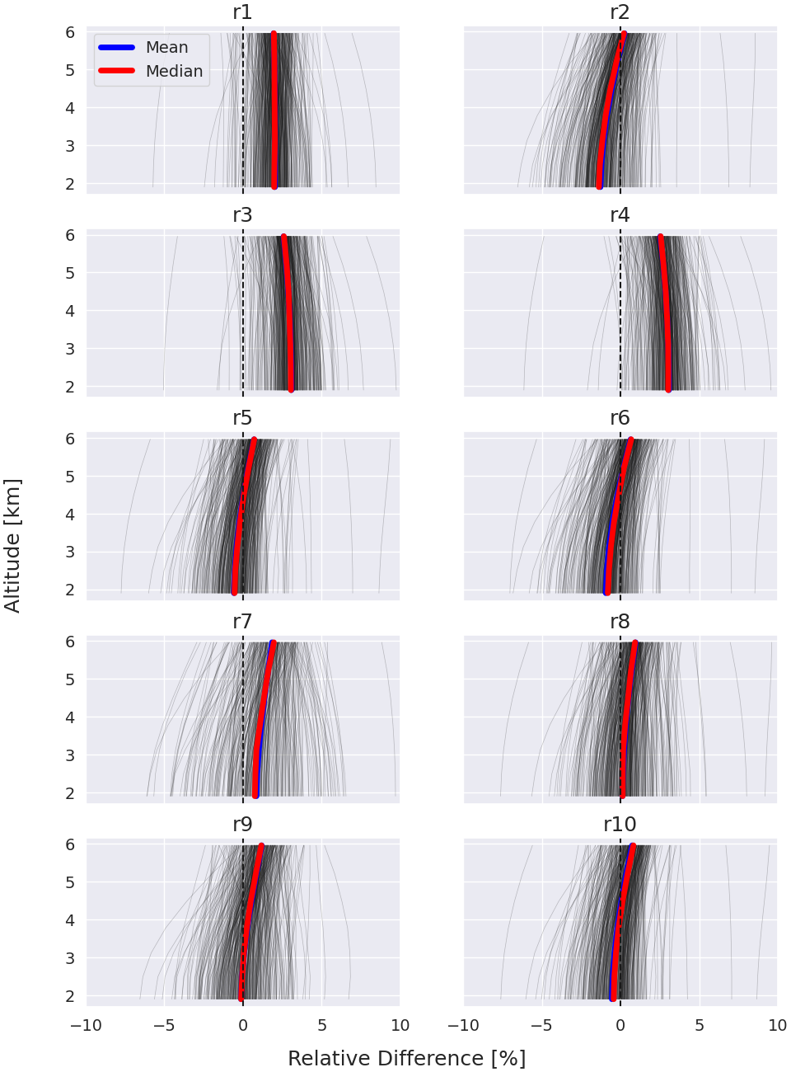
CH₄ : Inter-comparison: AirCore & in situ aircraft / Retrieval training
Aircore & Aircraft Differences (< 22 km)
Aircraft Differences (< 7 km)
Mean (AirCore)
Median (AirCore)
Median (Aircraft)
High consistency between AirCore and NOAA in situ aircraft measurements.
Systematic bias in some retrievals in the troposphere & stratosphere.
Retrieval chosen based on both residuals and biases is r8.
Scaling could be next step
CEOS AC-VC-21 / Takamatsu / June 2025
Notes:
2018 – 2022 36 aircore, 61 aircraft

Slide 16
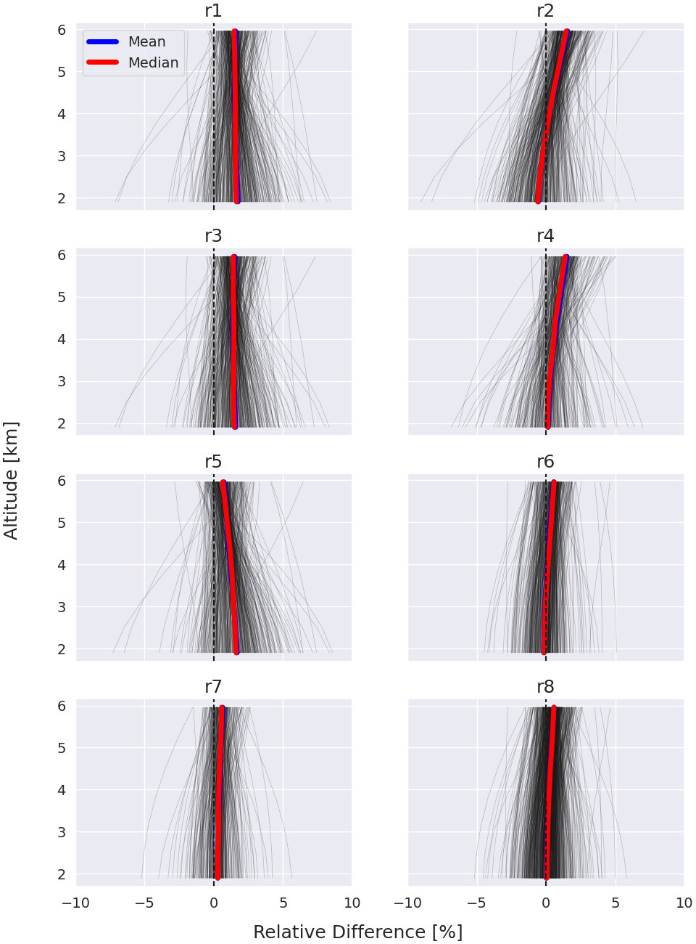
N2O : Inter-comparison: in situ aircraft / Retrieval training
Systematic bias in HIT08 retrievals. (r1, r5) (previous strategy)
HIT20, filters 3 and 4 and WACCM 6 recommended
R8 found to have least bias with airborne data :
    DOFS = ~2 through troposphere 1.6km to 17km
N₂O
CH₄ : Test r8
CEOS AC-VC-21 / Takamatsu / June 2025

Slide 17
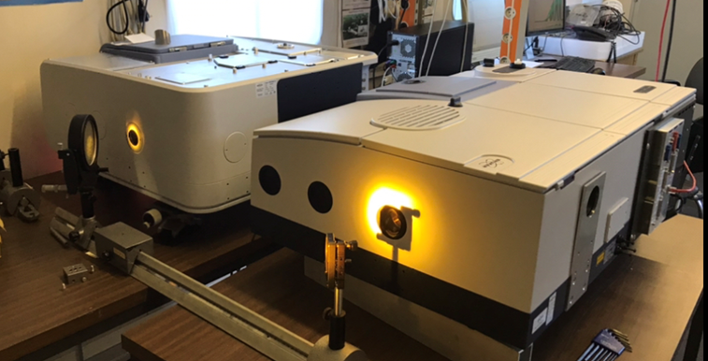
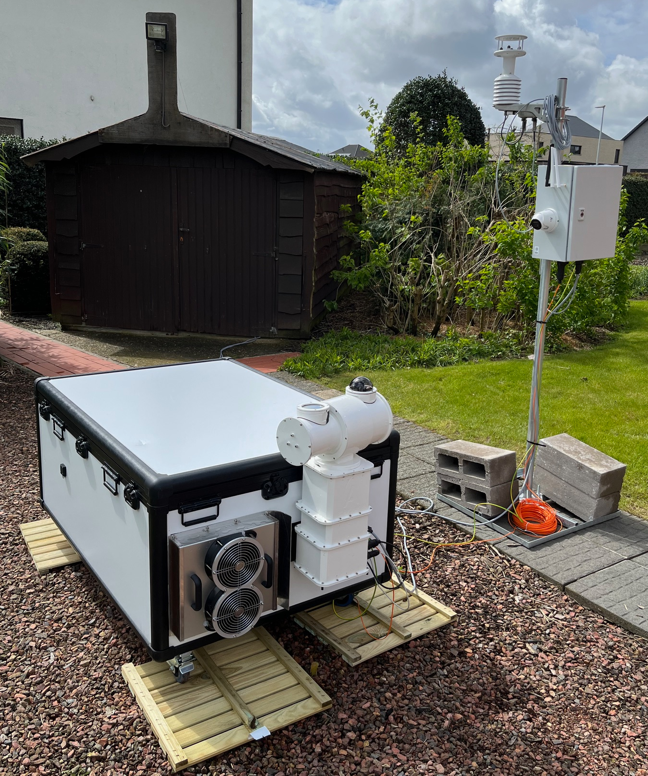
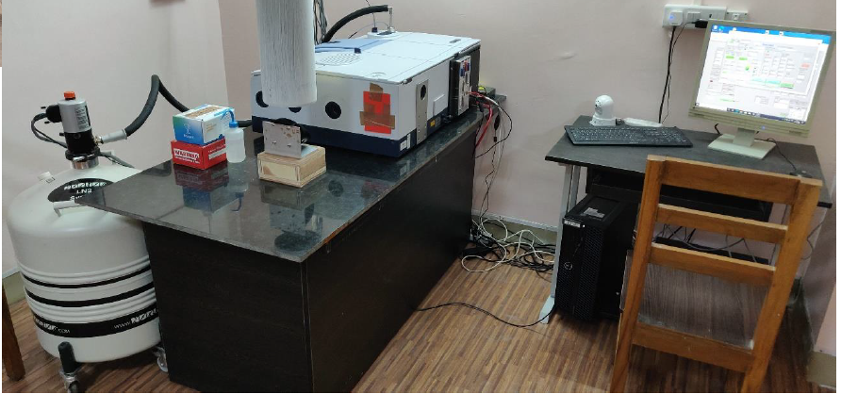
Portable Interferometers 1/2
Bruker Invenio (left) & Bruker Vertex 70 (right)
Both equipped with InGaAs detector contributing to COCCON and InSb detector and some NDACC filters for moderate resolution (0.02 cm⁻¹) measurements of e.g., H₂CO, OCS, CH₄, N₂O, no > 5µ
Jungfraujoch Revitalization Project
Replace 20+ year old Bruker 120HR with 125HR, Vertex used as a ‘transfer’ standard. Co-observations with old, new and during transition
Deployment Option 1
Automated setup in a traditional HR setup with large solar tracker
Deployment Option 2
Automated setup in an enclosure with customized small solar tracker
CEOS AC-VC-21 / Takamatsu / June 2025

Slide 18
Portable Interferometers 2/2
MRPI: Moderate Resolution Pointing Interferometer
Novel design Interferometer, active thermal and humidity control, N₂ charged dewar
4cm entrance field stop, optical beam width, Ag corner cube reflectors, all reflective optics except ZnSe wedged entrance window.
Linear motor motion control, absolute encoder, <200 nm repeatability, 1.5µm accuracy, stable velocity resolution to 0.61nm/s, runout <8µm full path
Full MIR to NIR bandwidth: 800 – 8000 cm⁻¹, captures features for a wide range of species of O₂ B-band at 1.27µ, for dry air mole fraction - compatible with TCCON/COCCON measurements for carbon science
20cm OPD / Resolution: 0.05 cm⁻¹, delivers vertical profile resolution for some species e.g., DOF=3 for O₃
Stirling cooled HgCdTe & InSb two color detector requiring no consumables, data sampled simultaneously at time based 3-channel 192kHz acquisition, ~5sec/scan
double sided interferograms
KBr (or similar) broad-band beamsplitter
wedged, (800-8,000 cm⁻¹)
~25kg, <0.2 m³, <1kW, internet
Centrally processed, web accessed data
Remote access/control, minimal local expertise
CEOS AC-VC-21 / Takamatsu / June 2025

Slide 19



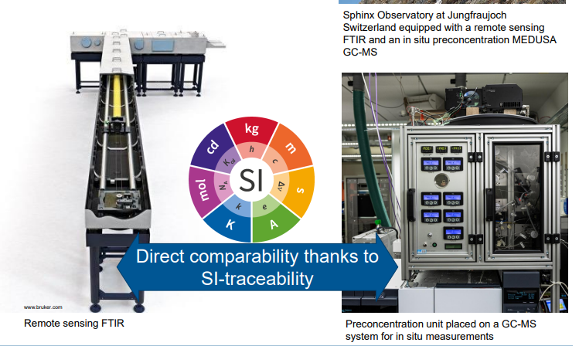
Standardizing long-term a remote sensing and in situ measurements of atmospheric halogenated VOCs based on SI-traceability…
SI-halo VOCs Project, now underway
Unique site :
The High-Altitude Research Station Jungfraujoch
To produce SI traceable cross-sections for HFC-23 and CF4
  University of Liège has been remotely measuring VOCs in the atmosphere for over 30 years
  EMPA has been measuring halogenated VOCs in situ at the same site for more than 20 years
By making both methods SI-traceable, these long-term datasets will become comparable
Remote sensing measurements will be made SI-traceable by using SI-traceable cross-sections gained in the 19ENV06 MetClimVOC project (PTB involvement)
Slide from Tobias Buehlmann (project coordinator, METAS)
CEOS AC-VC-21 / Takamatsu / June 2025

Slide 20
Summary: Current State, Implementing, Needs / Plans 1/3
Validation of data from various platforms including satellites is a key objective of NDACC
IRWG has been contributing for some time.
Improve intra-network consistency:
  Update retrieval parameters -> in process
  Traveling standard, mobile or lower resolution instruments (maybe less needed here)
  Central processing, implemented in part for ACTRIS effort
Improve inter-network consistency:
  Co-located measurements e.g. w/ TCCON, COCCON, Pandora
  At NCAR/NOAA we have plans to perform O3 correlative observations with Dobson, Umkehr
  Traveling standard, mobile or lower resolution instruments (maybe *more* needed here)
Algorithm development
  SFIT4 used by majority IRWG & adopted by ACTRIS / CREAGERS
    Maintained by U. Bremen, BIRA, NCAR + user feedback
    Adequate: major revision ~10y ago and minor update 2023
    Integrate pseudo-line generation
    Validate cell retrieval methodology
CEOS AC-VC-21 / Takamatsu / June 2025

Slide 21
Summary: Current State, Implementing, Needs / Plans 2/3
Calibrate to WMO-scale for selected species
  Use of co-located instruments / samples tied to standards -> Metas / JFJ SI effort
  Scaling co-located measurements AirCore or in situ aircraft -> Boulder CH₄, N₂O effort
  Can we use make and use calibrated cells?
  Representativeness of a single instrument calibration whether correlative or cell?
    Can we use of cells between instruments and co-measurements more sparsely?
  Already use same retrieval strategies for all sites but
    May need to require more restrictions:
      Instrument verification through regular cell measurements
      Traveling standard verification
Centrally Processed Retrievals
  Multiple algorithms for experimentation and algorithm validation
  Single algorithm used for operational data product
  Current CAMS27 & ACTRIS scheme could be adapted to other GHG species for e.g. consistent QA/QC
CEOS AC-VC-21 / Takamatsu / June 2025

Slide 22
Summary: Current State, Implementing, Needs / Plans 3/3
Traveling standard, mobile or lower resolution instruments
  Instrument standards need to be set
  Retrieval strategies with appropriate expectation (DOFS, interfering species etc) need to be set
  Validation method needs to be developed, agreed upon (blind intercomparison?)
  Can also be very useful as calibrated campaign instruments
Toward improving traceable CO₂, N₂O, CH₄, CO
  CO₂: a network retrieval strategy needs to be established
  Further profile training
  Calibrated cell and/or side-by-side with in situ measurement in field or lab
    For establishment and considered on-going
Further / on-going Intra-Network & Inter-Network side-by-side measurements
(Re) Processing of timeseries
  Move to central processing, for agility, improved NRT data provision
Advocate and be thoughtful for stationing & “super” sites
Contact IRWG co-chairs: jamesw@ucar.edu & emmanuel.mahieu@uliege.be
CEOS AC-VC-21 / Takamatsu / June 2025

