Slide 1

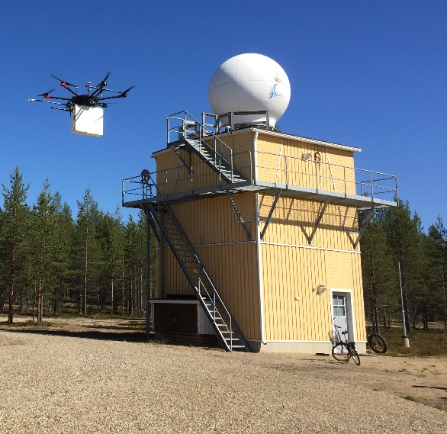
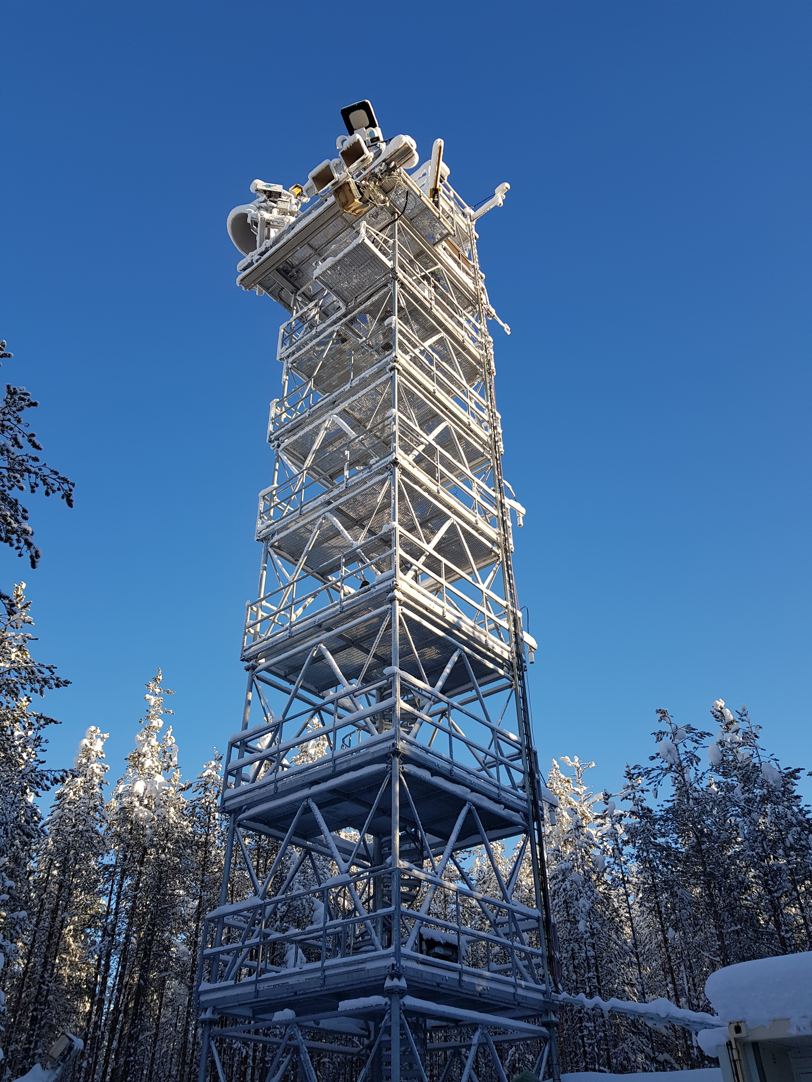
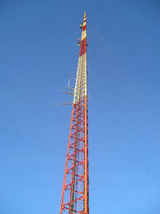
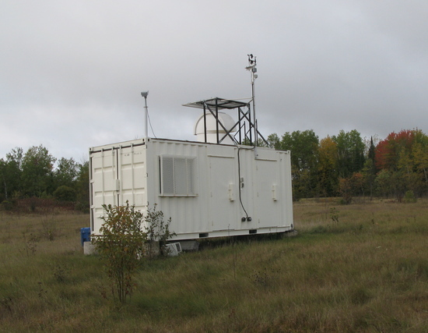
Sodankylä, Finland
Validation Supersite –
why, what, where, how?
Abhishek Chatterjee & many others (Sha, Wunch, Lindqvist et al.)
Jet Propulsion Laboratory
abhishek.chatterjee@jpl.nasa.gov
CEOS AC-VC-21
Friday, June 13, 2025
Park Falls, USA

Slide 2
In a nutshell...
Develop and implement a validation infrastructure (network of sites/validation targets) that will have a set of tiered measurements – L2 to L4 data products
Create a north-south gradient across land masses (Americas, Europe/Africa, Asia/Oceania) to span a variety of ecosystems and range of viewing conditions
Aim to leverage existing infrastructure, especially setups at TCCON/PGN/NDACC & augment instruments accordingly
Focus here is on the global GHG mappers

Slide 3
Additional Details

Slide 4
Why do we need “supersites”?
Primary focus is on validating SAT Level 2 data products (XCO₂, XCH₄)
  Workhorse: TCCON (long-term stable validation record), COCCON (portable, urban deployments)
  Additionally, via AirCore, airborne, potentially expand ship-based deployments
  Heritage from GOSAT and OCO missions (where the primary deliverable was the L2 X<GHG> data product)
  Gaps remain, e.g., ocean basins (note: Tropics and high-latitudes are getting A BIT more attention now)
Landscape has evolved, whereby lot more attention from our end-users on ”higher-level” data products, i.e., Level 3 and Level 4 (fluxes) data products
We simply do not have a framework to deliver an end-to-end validated product, consistent uncertainty numbers on data products from different missions, across ecosystems/biomes

Slide 5
What do we mean by “supersites”?
A single validation site where we can validate L2 – L4 data products
  enable hierarchical validation of satellite data products (ranging from geophysical, observed variables to ancillary datasets to flux data products)
  with multiple supersites we can create a north-south gradient that spans a variety of ecosystems and space
  help validation of not just individual satellite missions but ensure interoperability between them
  leverage existing assets including air quality validation network (such as PGN), aerosol validation network (such as AERONET), flux measurement networks (such as NEON and FLUXNET) etc.
Notes:
Key Points:
establishing such sites will enable us to also get ground-truth interferants (e.g., aerosols), obtain in-situ profiling from aircraft or AirCore measurements that can then be used to link our geophysical validation data to meteorological standards

Slide 6
Where should these “supersites” be located?
CAUTION – this is a conceptual figure only. Actual location of supersites TBD
Notes:
Notes:
A schematic concept of CEOS GHG super-sites, where tiered set of measurements will enable hierarchical validation of satellite data products – starting from the core CEOS AC-VC geophysical variables (like XCO2, XCH4, XCO) to flux products. In an ideal scenario, the sites should over the North-to-South transect across three main longitude zones and are evenly spread in terms of latitudinal coverage (thus filling critical gaps over the Tropics and the global south). We propose that super-sites falling within the three longitudinal zones can fall under the purview of specific international space agency and their national partners.

Slide 7
What level of instrumentation should/could we deploy?
A tiered deployment will potentially include –
  (must) Total column – TCCON or COCCON type of instruments
  (must) AirCore profiles
  (must) Aerosol measurements
  (must) Flux tower and/or SIF photospec
  (may) Tower or flask, or aircraft profiles for GHG concentrations
  (may) Ancillary measurements for P, T, H₂O
  (may) Other AQ measurements (NO₂, other species)?
  TBD
Class 1 – TCCON + AERONET + ... ← 4 sites globally
Class 2 – NDACC/PGN + COCCON + ... ← 8-9 sites globally
& other combinations maximizing existing infrastructure

Slide 8
How do we go about achieving this? & open discussion
Use of the word “supersite” – at the coordination meeting on “Operationalization of GHG observations in the framework of CGMS” (June 2), strong rejections were raised about use of the word “supersite”
“The recommendation is to use wording such as validation infrastructure and work towards one that could fit into a WMO GBON-like tiered network structure.”
Propose to begin by assessing the current capabilities based on known objectives and resource perspective
  for the final decision on the location of the super-sites and future expansion, need to bring all the principles in the same room, balance the science/mission requirements vs. logistical challenges vs. agency priorities
  balance background/clean air sites vs. urban sites
  cost!!!
Notes:
Notes:
From Wenying - Bojan Bojkov from EUMETSAT had strong rejection of using “supersite”, saying it’s misleading. The recommendation is to use wording such as validation infrastructure and work towards one that could fit into a GBON like tiered network structure. The first step is to assess the current capabilities based on known objectives and resource perspective.
Most TCCON sites already have significant infrastructure, so they have internet, power, enclosures, and some level of on-site support. Such a setup is critical for collecting a large amount of high quality data, making it easier to add additional equipment to the site.
balance between background/clean air sites vs. urban sites, (2) logistical challenges for setting up new sites

Slide 9
How do we go about achieving this? & open discussion
Funding structure
  stable funding needs to be secured for existing long-term measurements at some of these super-sites – ensure continuity of validation dataset that spans current and future missions (at least in the next 5-7 yr. horizon)
  additional funding to establish instrumentation at specific sites, particularly in the Global South
  logistical challenge for setting up new sites or adding instrumentation to existing sites
Ocean glint validation
  how do we expand the current validation network to cover more ocean basins? What additional measurements can help with validating ocean glint measurements?
  (note - Astrid M., Andre B. efforts are in the right direction here but what can we, as a community, do to augment those efforts?)
Notes:
Notes:

Slide 10

Discussion Notes

