Slide 1
IWGGMS-21 algorithm session (Session 3) summary
Yu Someya (NIES)
Christopher O’Dell (CSU/CIRA)

Slide 2
Oral Presentations
Day2 11:00 – 13:00
 | Title | Presenter
3.01 | OCO-3 Version 11 Snapshot Area Mapping (SAM) Mode Observations | Robert Nelson (JPL/Caltech) Talk by Abhisheck Chatterjee (JPL)
3.02 | MethaneSAT XCH4 retrieval | Sebastien Roche (EDF)
3.03 | First quantification of atmospheric carbon dioxide from the Geostationary Operational Environmental Satellite (GOES East) | Aaron Sonabend (Google Research)
3.04 | Correlated albedo and elevation variability leading to retrieval artefacts | Julia Marshall (DLR/University of Leipzig)
3.06 | Impact of Raman scattering on XCO2 and SIF retrievals from OCO-2/3 | Suniti Sanghavi (JPL/Caltech) Talk by Christian Frankenberg (Caltech)
3.07 | Development of a principal components-based radiative transfer model and its application to IASI CH4 retrievals | Charles Robert (BIRA)
3.08 | Retrieval of GHG from interferogram : exploration, comparison with spectra from spectra | Sebastien Payan (Sorbonne Universite - CNRS - LATMOS)

Slide 3
Poster Presentations
Day1 13:00 – 15:00
 | Title | Presenter
3.10 | Release and demonstration of a new open retrieval algorithm toolset | Peter Somkuti (University of Maryland / NASA)
3.11 | Latest topics about the GOSAT-2 SWIR L2 products | Yukio Yoshida (NIES)
3.12 | Improved CO2 retrievals with modified aerosol information using GOSAT measurements over East-Asia | Yeonjin Jung (Pukyong National University)
3.13 | A machine learning approach to fill the gap in global XCO2 using multiple satellite measurements | Jonghyuk Lee (Seoul National University)
3.14 | Updates of retrieval algorithm for GOSAT-2/TANSO-FTS-2 TIR bands | Naoko Saitoh (Chiba University)
3.15 | Sensitivity analysis of XCH4 retrieval algorithm for the Narsha microsatellites | Jaemin Hong (Seoul National University)
3.16 | Advances on the emission estimation using the divergence method for individual satellite overpasses with noise reduction | Anssi Koskinen (FMI/University of Helsinki)
3.18 | Monitoring formic acid emissions from GOSAT-2 satellite observations | Fengxin Xie (The University of Tokyo)
3.19 | Comparative validation of satellite-based GHG observations using FTS | Minju Kang (Ewha Womans University)
3.20 | Air mass factor calculation using deep neural network | Yajun Xu (NICT)
3.21 | Reprocessing the GOSAT TANSO-FTS record via ACOS v11 full physics retrieval algorithm | Christopher O'Dell (CSU/CIRA)
3.22 | Retrieving the Vertical Profiles of Carbon Dioxide (CO2) and Methane (CH4) Using TCCON Fourier Transform Spectrometer (FTS) | Man-Hae Kim (Seoul National Unversity)
3.23 | Satellite Multi-Band Multi-Path Approaches for Methane Quantification | Wook Kang (Yonsei University)
3.24 | Dual-domain injection network for methane plumes segmentation | Yuquan Liu (Hefei Institutes of Physical Science, CAS)

Slide 4
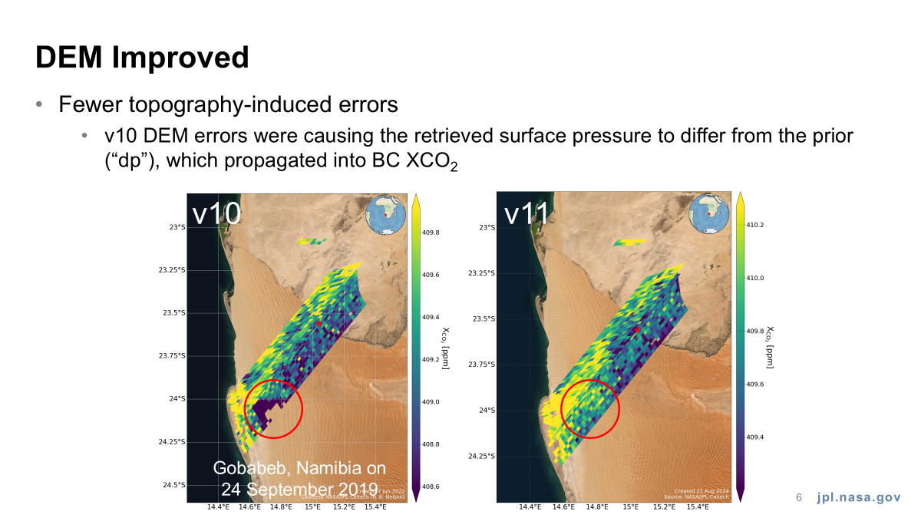
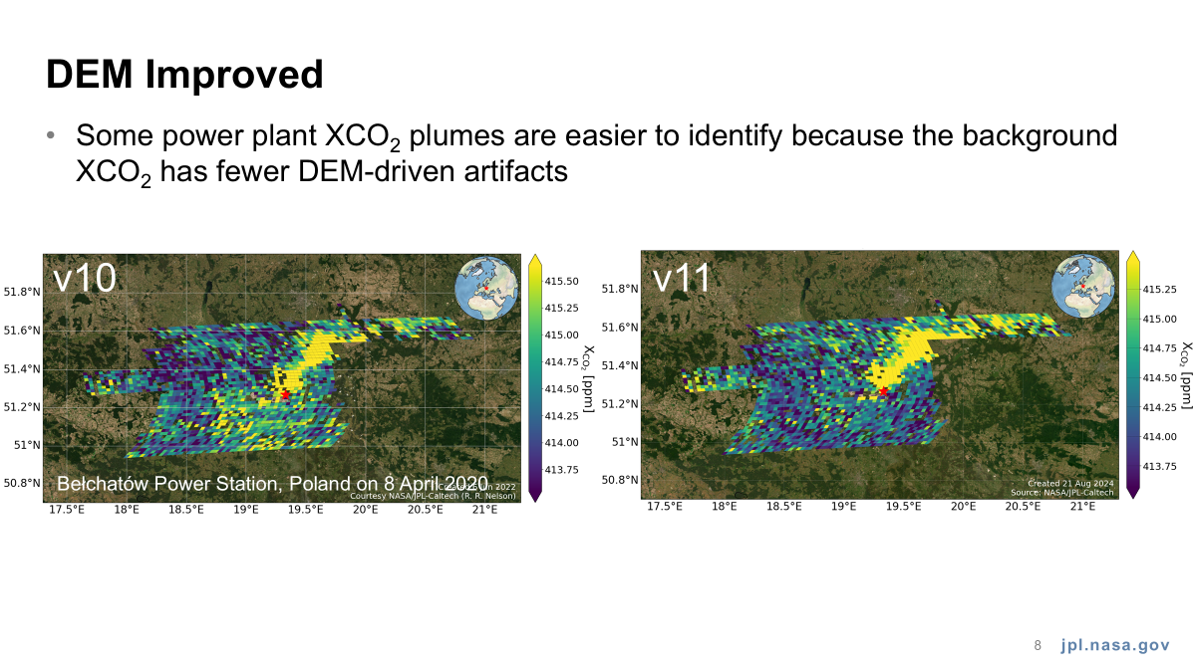
OCO-3 Version 11 Snapshot Area Mapping (SAM) Mode Observations (Nelson et al.)
Most SAMs appear similar in v11 versus v10
For some SAMs, v11 represents a clear improvement over v10
Some XCO₂ artifacts remain

Slide 5
MethaneSAT XCH4 retrieval (Roche et al.)
L2 XCH4 single sounding precision: 20-35 ppb (2-3.5 ppb at 2x2 km)
+6.4 ppb median diff. with TROPOMI (TCCON has +5.3 ppb median diff. with TROPOMI)
Root cause of striping unresolved and under investigation, corrected in post-processing.

Slide 6
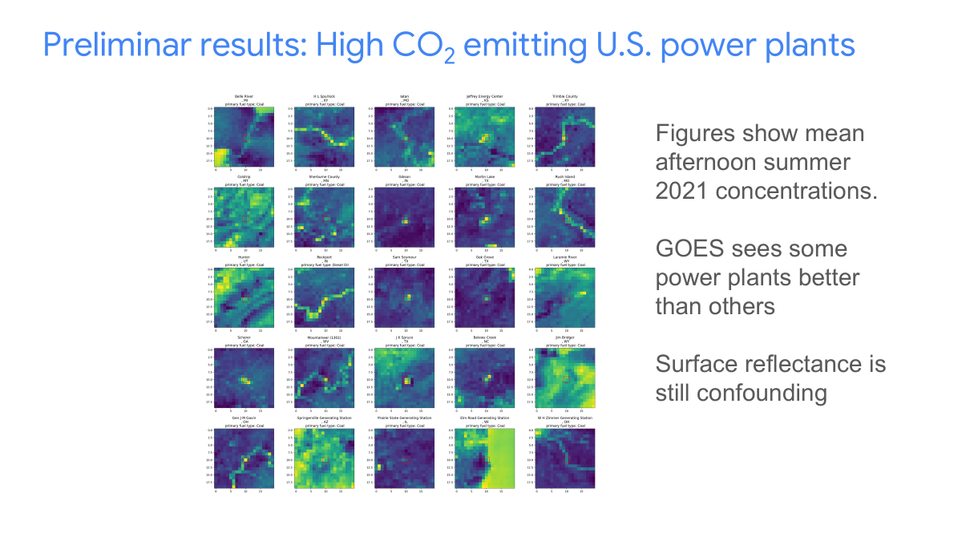
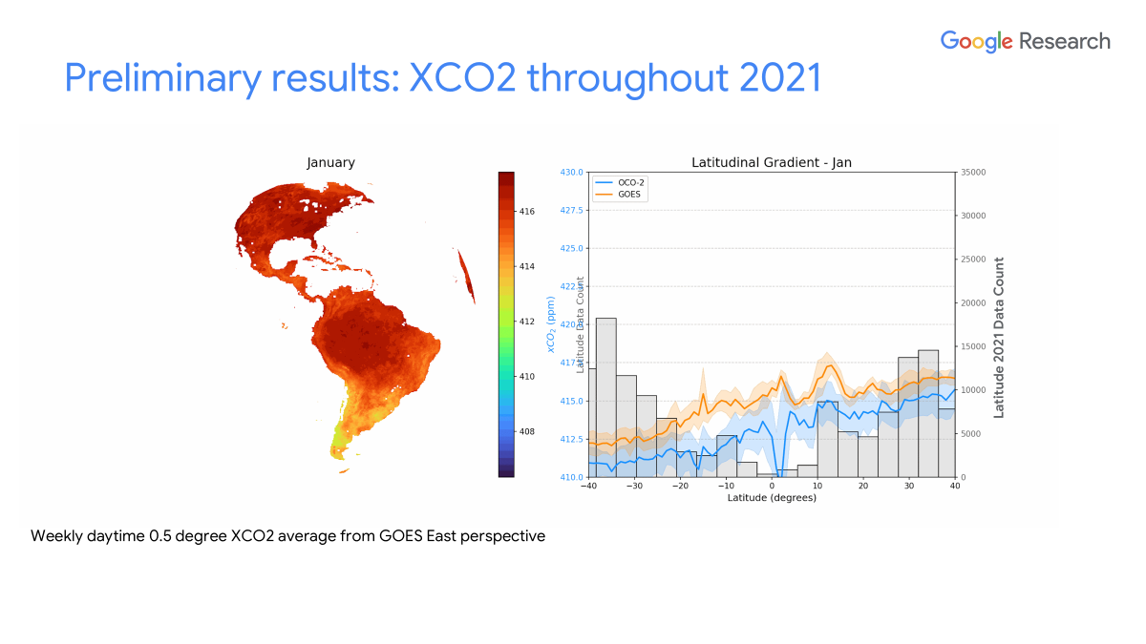
First quantification of atmospheric carbon dioxide from the Geostationary Operational Environmental Satellite (GOES East) (Sonabend et al.)
Google trained a Machine Learning model for GOES observations to give XCO2, by training against matched OCO-2 XCO2
ML model also ingests ERA-5 meteorological and MODIS surface data

Slide 7
Impact of Raman scattering on XCO2 and SIF retrievals from OCO-2/3 (Sanghavi et al.)
RRS has impacts on the SIF and p_{surf}/XCO₂ retrievals
RRS corrections to be incorporated in B12 of the OCO-2/3 products

Slide 8
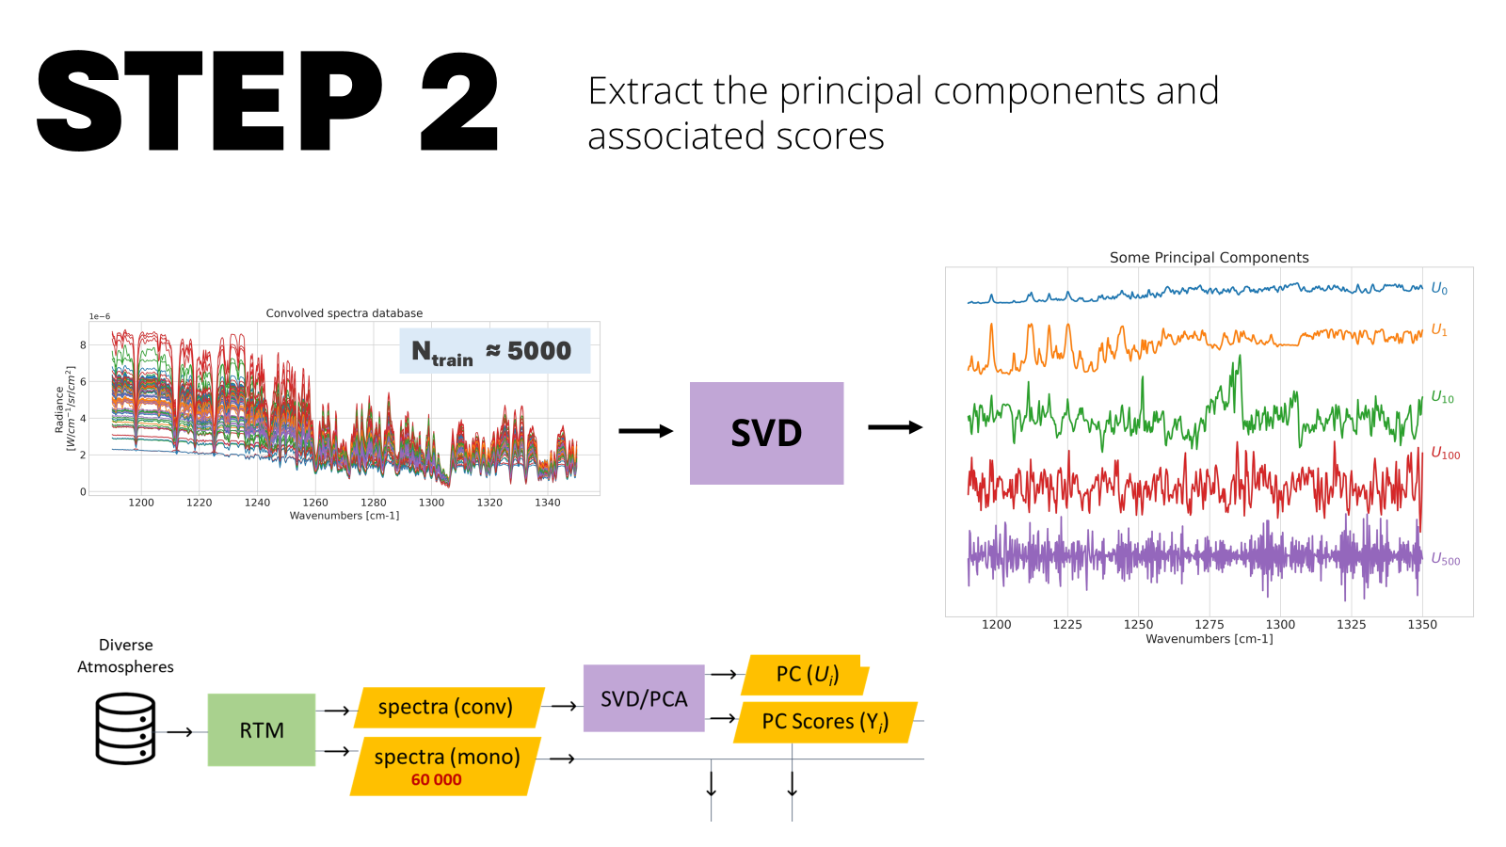
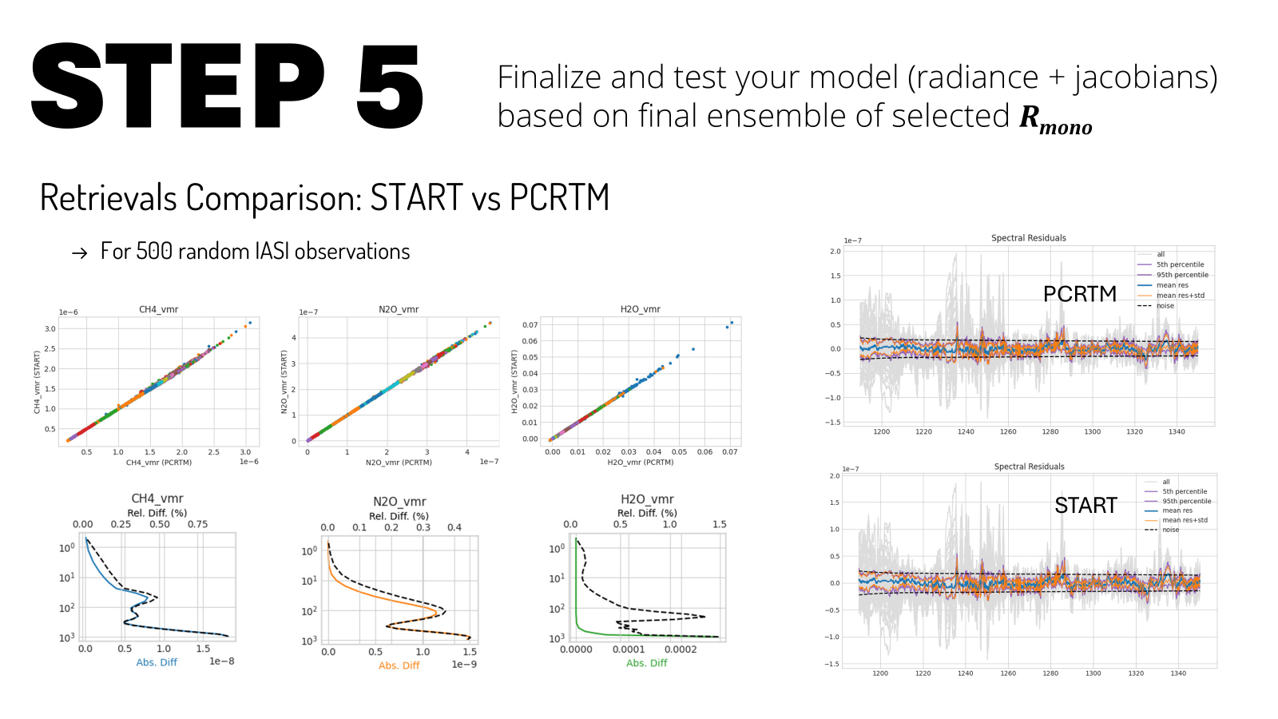
Development of a principal components-based radiative transfer model and its application to IASI CH4 retrievals (Robert et al.)
PCRTM model is faster by a factor of 40-100
Radiances and Jacobians (TIR region) can be reconstructed
A good fit for operational /NRT processing

