Slide 1



Ideas for / Need of a Retrieval Intercomparison Project
Chris O’Dell (CSU),
Dave Crisp (Spectra LLC),
John Worden (JPL)
CEOS AC/VC Meeting, Takamatsu Japan, 13 June 2025

Slide 2
Background
Idea for this introduced in October 2024 at Silver Spring (USA) CEOS Meeting
O’Dell has an aerosol scheme intercomparison funded by a NASA ROSES grant.
Many questions concerning scope:
  Will focus solely on CO2.
  Will exclude matched-filter / local scale (EMIT, GHGSat, CarbonMapper)
  Focus is for OCO 2+3, GOSAT 1+2+GW, MicroCarb, CO2M, etc
    Medium-high spectral resolution
Goal is to be both USEFUL and REALISTIC

Slide 3

The XCO₂ Goal for Regional-to-Global Fluxes
We have a goal (my own interpretation):
  To deduce accurate, science- and policy-relevant surface fluxes of CO2 at nation-state (or better) & monthly scales using top-down inversion systems driven by in-situ and satellite CO2 data.
To achieve this goal, we require:
  Extremely well-calibrated reflected sunlight spectra
  Highly accurate retrieved XCO2 from those spectra
  Robust top-down carbon source/sink inversion systems (with accurate transport and well-specified priors)
OCO-2 Has Largely Achieved this!
Gold standard for future sensors!
  < 0.5 ppm (0.12%)
  (CO2M MRD)
  < 0.2 ppm (0.05%)
  (MicroCarb Target;
  Common Opinion)
Notes:
Relevant to this audience - 0.2ppm is the MicroCarb target (the goal is 0.1 ppm)

Slide 4
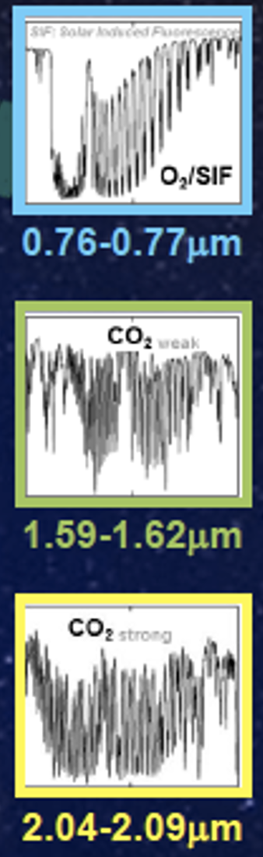
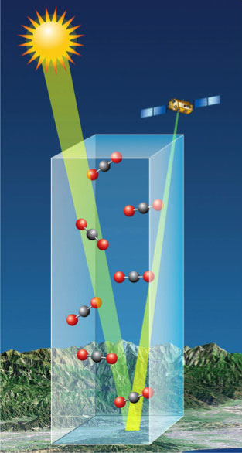
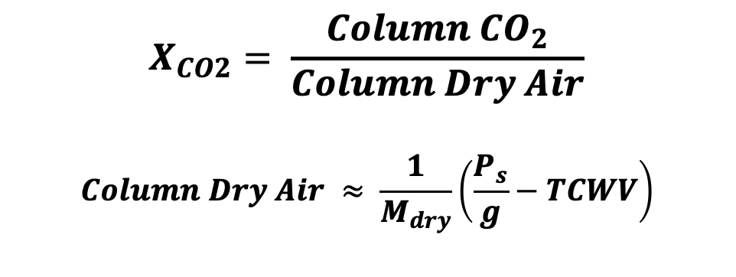
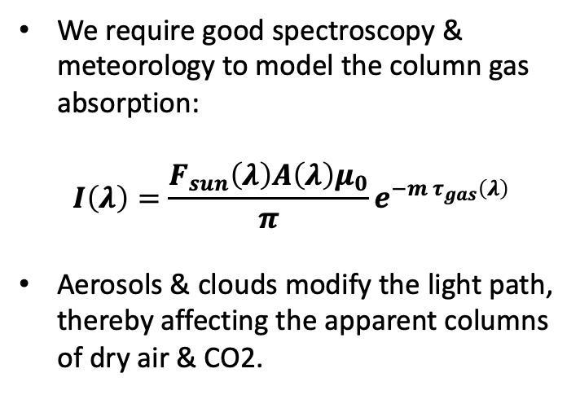
How do current XCO2 retrievals work?
Solar Induced Fluorescence (SIF),
O₂, Clouds, Aerosol
$$X_{CO2}= \frac{Column {CO}_{2}}{Column Dry Air}$$
$$Column Dry Air ≈ \frac{1}{M_{dry}}\left(\frac{P_{s}}{g}−TCWV\right)$$
CO₂, H₂O, Clouds, Aerosol
We require good spectroscopy & meteorology to model the column gas absorption:
$$I\left(λ\right)={\frac{F_{sun}\left(λ\right)A\left(λ\right)μ_{0}}{π}e}^{−m τ_{gas}\left(λ\right)}$$
Aerosols & clouds modify the light path, thereby affecting the apparent columns of dry air & CO2.
CO₂, H₂O, Clouds, Aerosol

Slide 5
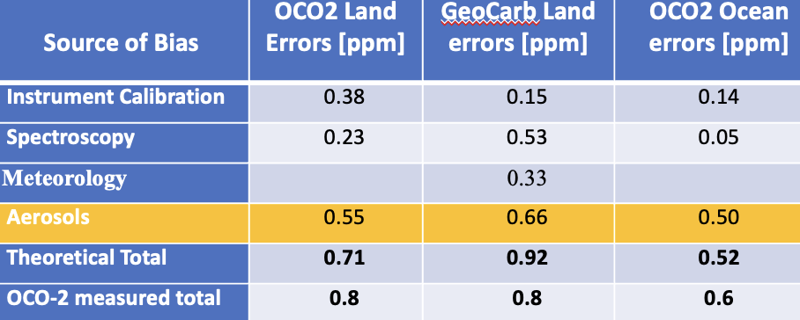
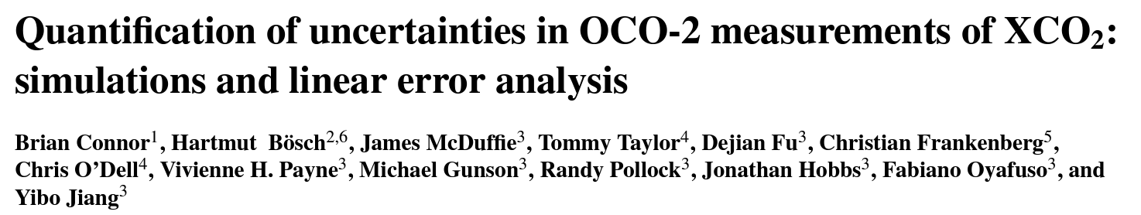
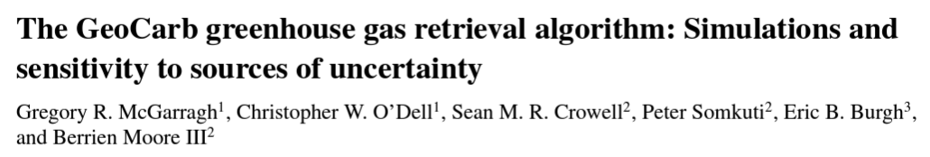
Sources of error in XCO2 retrievals
Aerosols are the single largest source of systematic error in SWIR-based XCO2
2016
2023

Slide 6
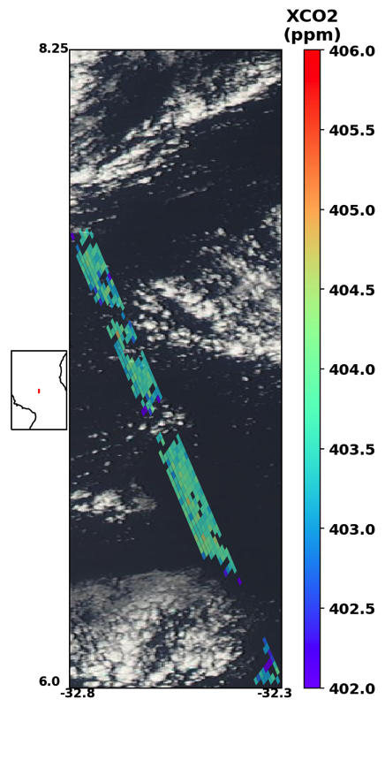
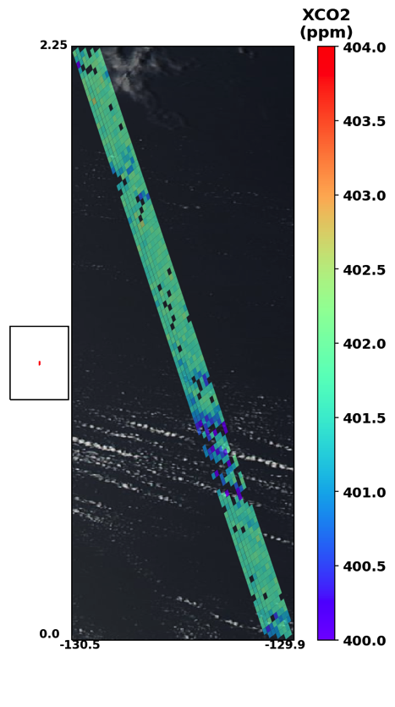
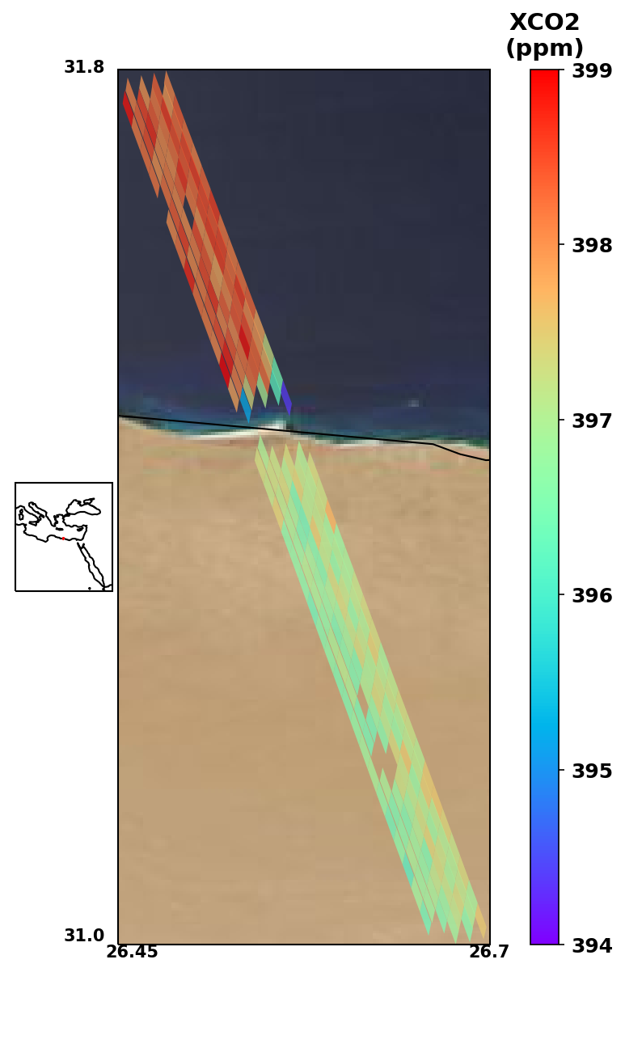
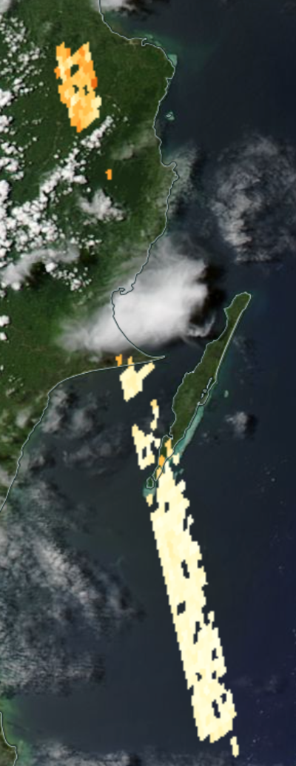
Early indicators of aerosol/cloud biases
Cloud-induced biases over water
Aerosol-induced land/water biases

Slide 7
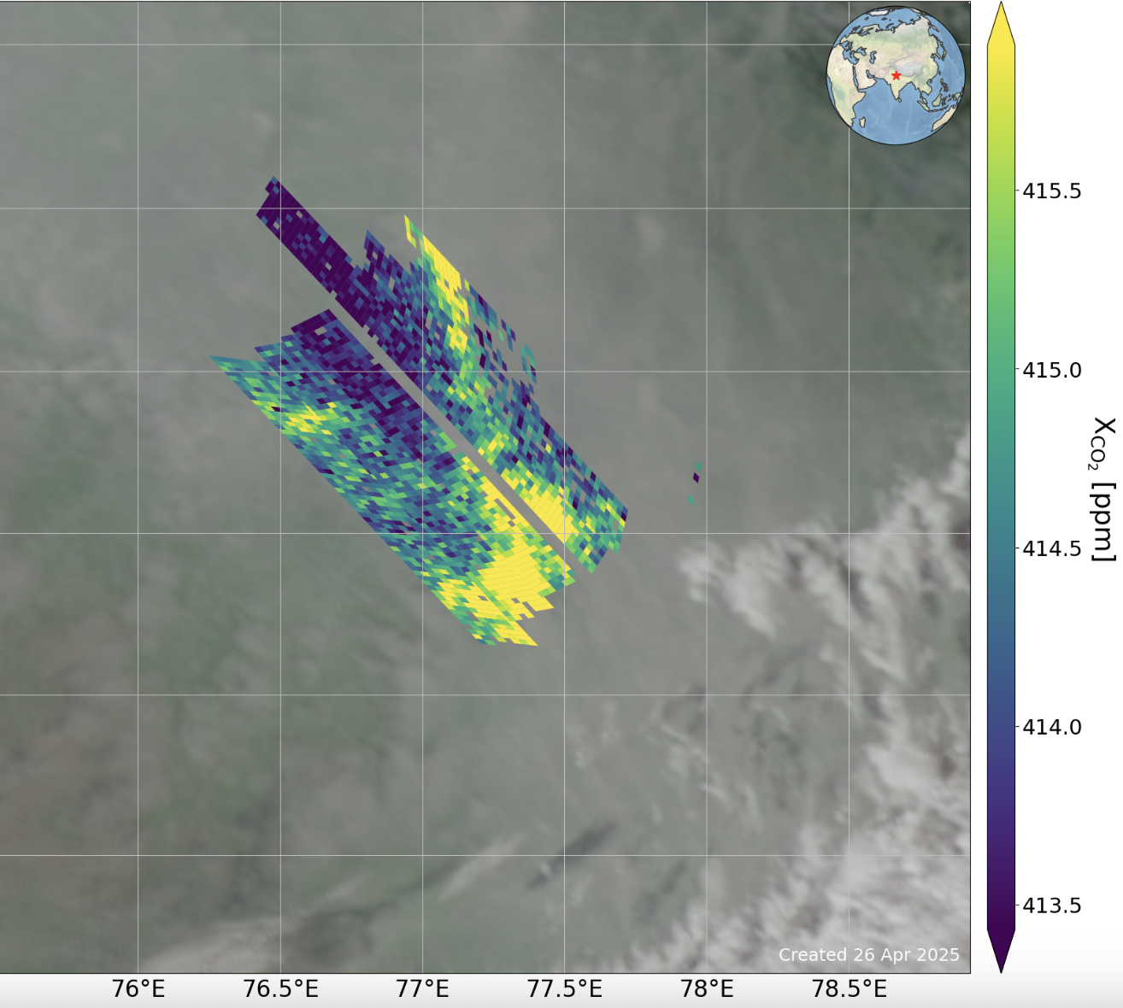
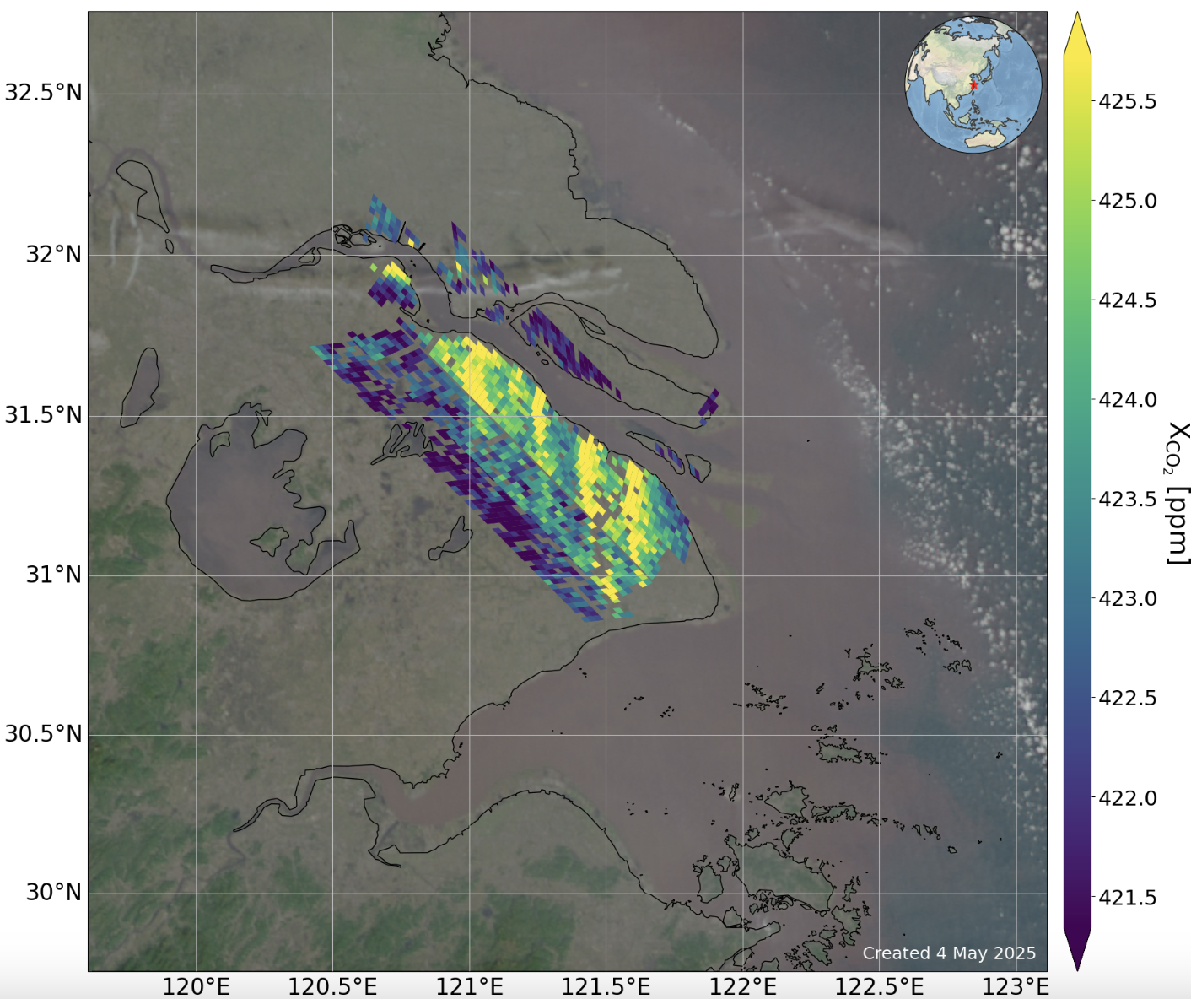
Heavily polluted, boundary layer aerosol cases (AOD >~ 0.5 via MODIS)
New Delhi, India, 22 Dec 2020
Shanghai, China, 30 Dec 2021

Slide 8
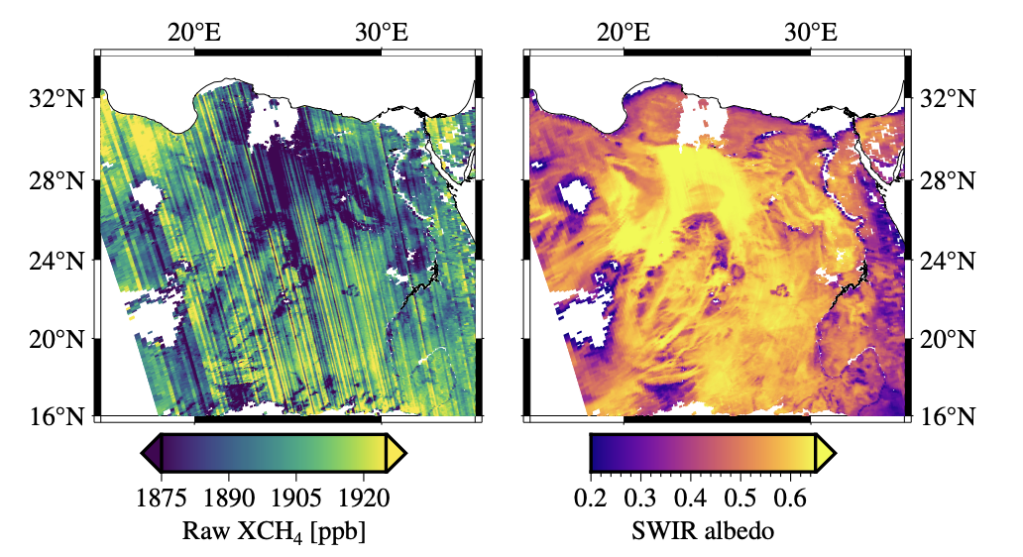
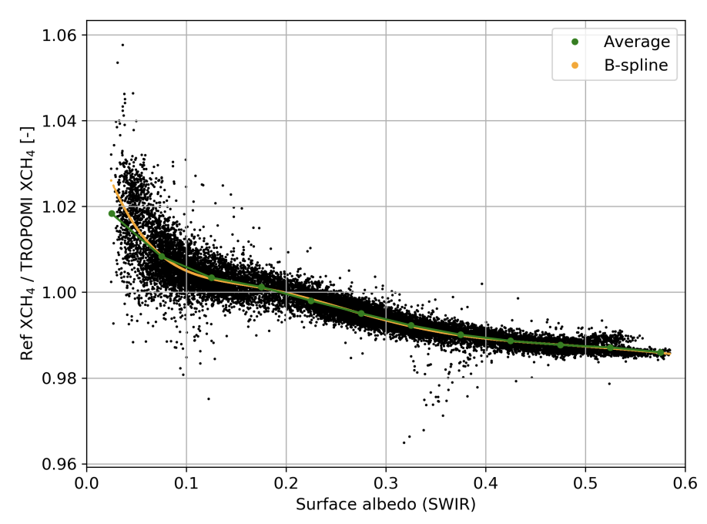
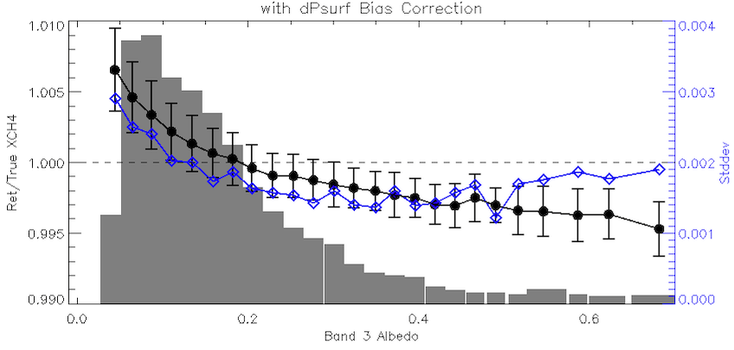
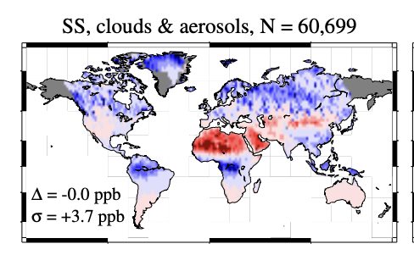

An Aside: Aerosol-Induced Biases in TROPOMI CH₄
Synthetic Retrieval Experiments
Full-physics Retrievals
Lorente et al., AMT 2021
TROPOMI Raw XCH₄ (no bias correction) and SWIR Albedo for TROPOMI orbit 27865, data version 2.4.0.
Simulated Aerosol-induced XCH₄ errors from 2.3 micron obs.
Well-known “albedo-bias” in TROPOMI CH4 retrievals
This bias emerges naturally in sim-retrieval experiments!
Source primarily related to surface albedo/aerosol interaction.
Somkuti et al, 2024, submitted to AMT:
“Surface reflectance biases in XCH₄ retrievals from the 2.3 µm band are enhanced in the presence of aerosols”
Notes:
remind everyone that both the sign and amplitude of the aerosol bias depends on surface albedo.

Slide 9
Pick your Poison: The Choice of Aerosol Scheme
X_{CO2} Retrieval | Satellite(s) applied to | Aerosol Scheme | # of aer params | Reference
ACOS | GOSAT, OCO-2, OCO-3 | 5 fixed types, AODs+heights | 9 | O’Dell et al., 2018
UoL-FP | GOSAT, OCO-2, CO2M | 2 Aerosols + Cirrus: full profiles | 60 | Cogan et al., 2012
RemoTeC | GOSAT, OCO-2, CO2M | 1 variable type: AOD, Height, Size | 3 | Butz et al., 2011
NIES | GOSAT, GOSAT-2, GOSAT-GW | 2 Aerosols: profiles; Cirrus: AOD+Height | 14 | Yoshida et al., 2013; Someya et al., 2023
4ARCTIC | OCO-2, MicroCarb | 1 variable type: AOD, ALH, Angstrom Exponent | 3 | Bertaux et al., 2020
FOCAL | OCO-2, GOSAT, CO2M | 1 type: AOD, Height, Angstrom Exponent | 3 | Reuter et al. (2017), Noel et al. (2021)
There are many schemes to account for aerosols in “Full Physics” retrievals
They have generally not been well-studied in terms of aerosol efficacy, because there are so many confounding factors in real data! (Prior Met, DEM, Spectroscopy, Filtering, Bias Correction, etc.)
Which is best? Let’s do a "Full-Physics Aerosol Scheme Intercomparison Project”
Notes:
Modify with Rob’s latest Figure?

Slide 10
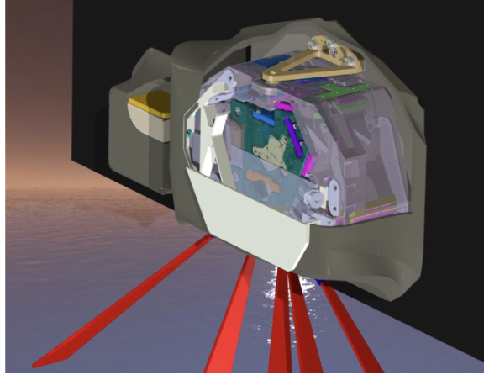
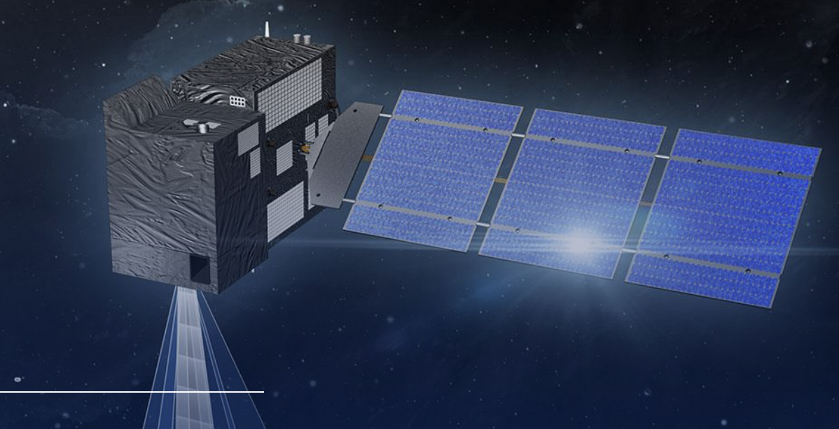
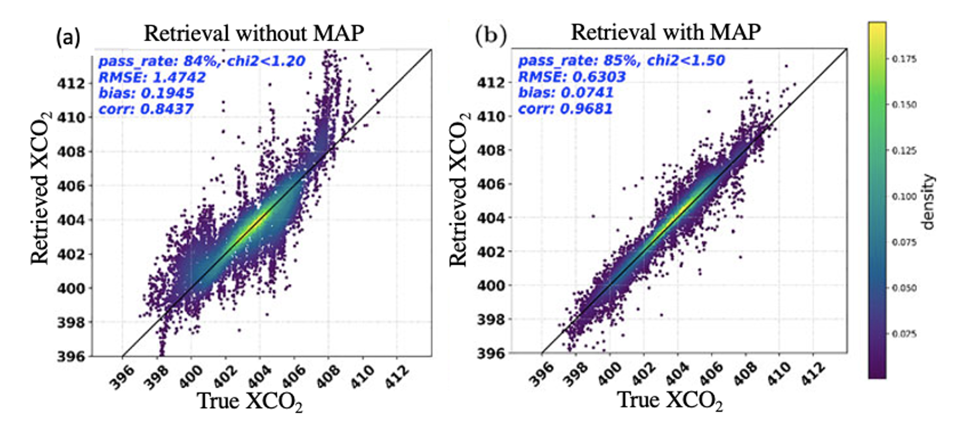
The alternative: The CO2M Plan for Aerosols
SpexONE Multi-Angle Polarimeter on PACE. Multiple dual-pol channels measure at multiple angles to derive a wealth of aerosol information.
CO2M will consist of:
GHG+NO2 GHG sensor
Multi-Angle Polarimeter (MAP)
Cloud Imager (CLIM)
Must include a very advanced aerosol sensor with your GHG sensor!
Will it work well in practice?
Many (most) GHG satellite missions will lack this.
Simulated CO2M retrievals without and with a coincident multi-angle aerosol polarimeter. (a) Standard 3-parameter RemoTeC retrieval without MAP. (b) New RemoTAP retrieval with MAP. From Lu et al. (2022, AMT).

Slide 11
Motivations for a retrieval intercomparison
Previous studies have evaluated the errors in different retrievals, e.g. CH4 and CO2 from GOSAT.
  GHG-CCI, EMMA (M. Reuter) papers, etc.
Only limited attempts to *understand* the differences in different retrieval approaches.
Many retrieval inputs are relatively solid and robust:
  Solar spectrum, spectroscopy [, calibration]
Some retrieval aspects are not as robust:
  Aerosol / scattering parameterization
  RT assumptions (e.g. Rotational Raman Scattering at 0.76 um)
Some new retrievals can skip ingredients altogether & just use machine learning methods (e.g. Reuter et al., 2024).

Slide 12
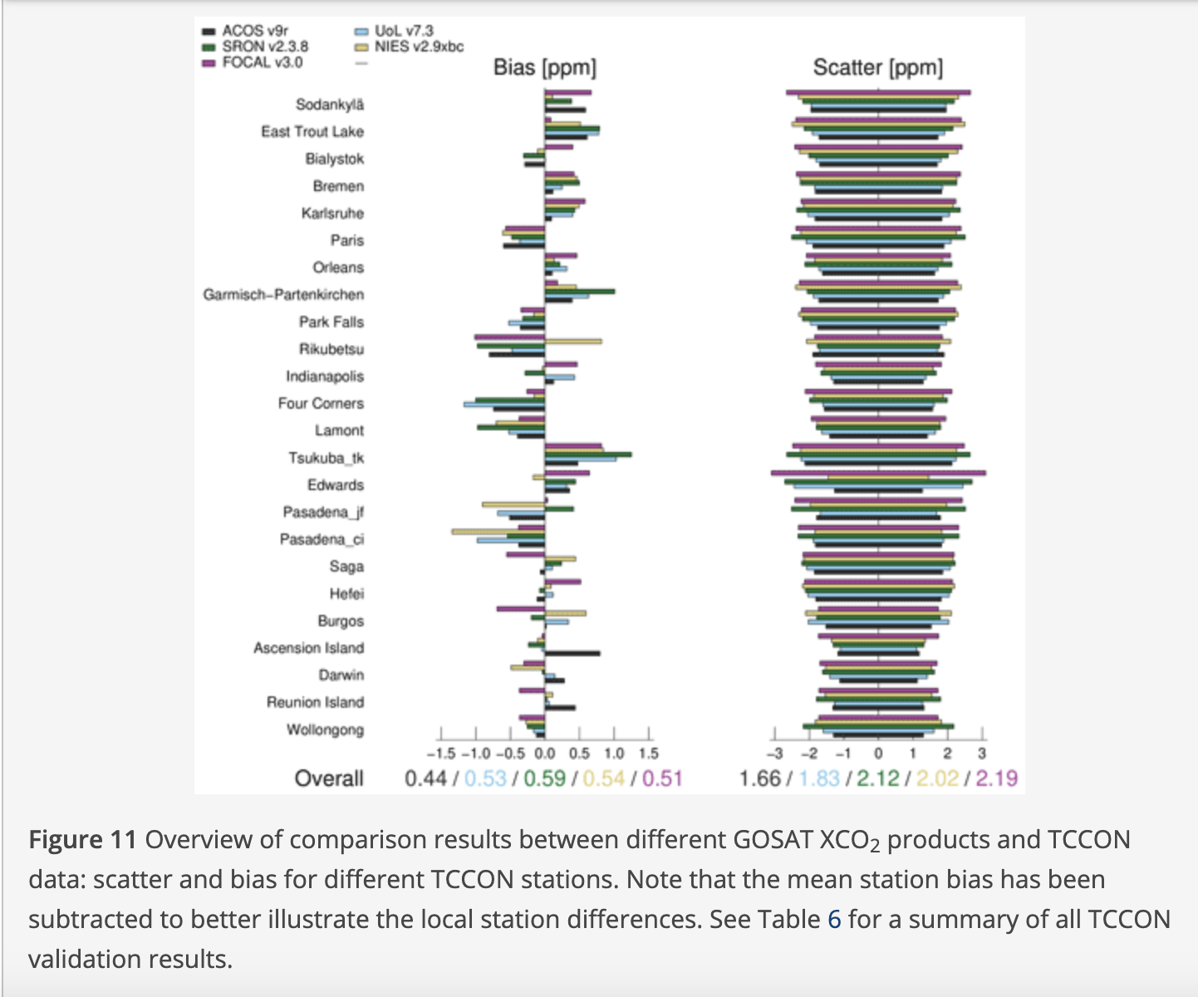
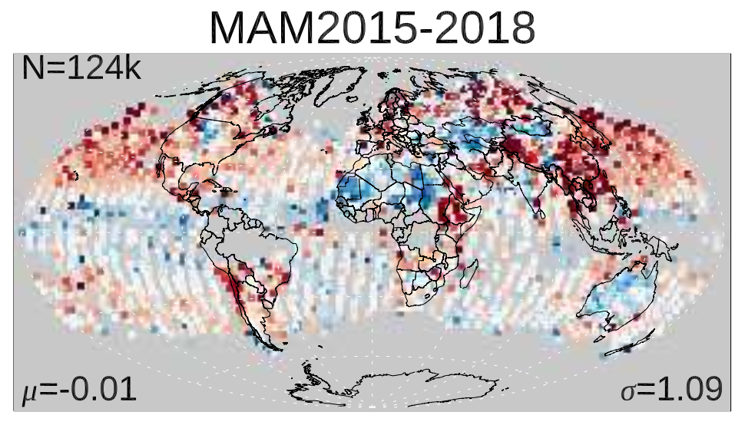
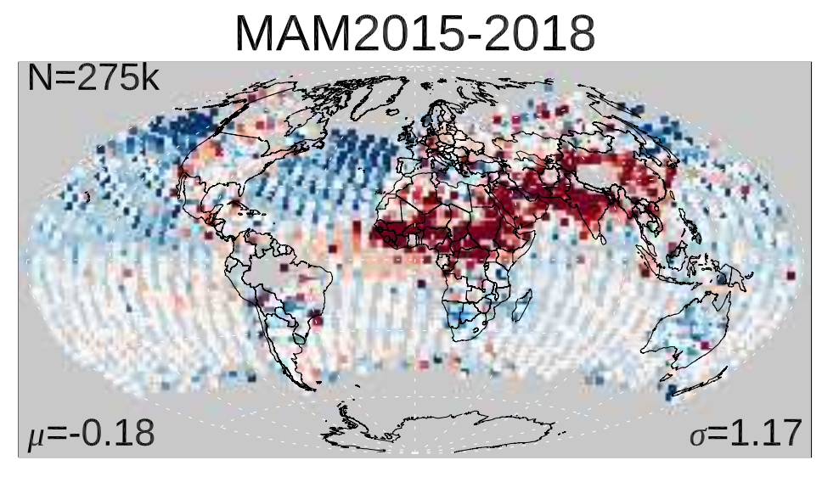
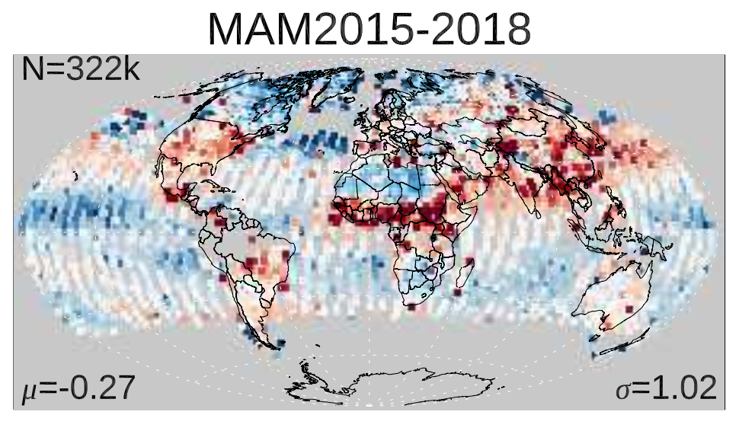
A bit more motivation
NIES v2.97 - Models
FOCAL v3.0 - Models
Noel et al., 2022
JAXA/EORC v3 - Models
GOSAT-XCO2 retrievals all look relatively similar vs. TCCON.
But can look very different compared to global models
These are the signals that drive regional fluxes!

Slide 13
Intercomparison Goals
CSU Workforce is now more limited, so effort will be modest.
CO2 Only.
  CH4 is more well-in-hand and really depends on 2.3 (non-proxy) vs 1.6 (proxy)
Focus for global/regional flux inversions
Global simulations (many papers have done this for their retrievals)
Include realistic aerosols (CAMS), surfaces (MODIS), etc.
Attempt to not give unfair advantage to any retrieval
Must include filtering & bias correction – so truth provided.
Purely volunteer participation.
Will not initially answer MAP vs. no-MAP question

Slide 14
MIP Participants (Goal)
ACOS
RemoTeC/RemoTAP
Fusional-P (formerly Univ of Leicester alg)
FOCAL
NIES
4ARCTIC
Other potentials:
  IAPCAS (TanSat)

Slide 15
Proposed Set-up
Inputs to Participants:
OCO-2 like L1B files (spectra, ISRF)
ABSCO (spectroscopy files)
Matched meteorology files (optional)
~ 2M soundings
Rough filtering already applied
True CO2 or matched-simulated TCCON data (for filtering & bias correction)
Participant Expectations
Use their own prefilter if desired
Run soundings
Develop filter, bias correction
Return results in GHGCCI-format (ideally):
  Raw XCO2
  Filter
  Bias-corrected XCO2

Slide 16
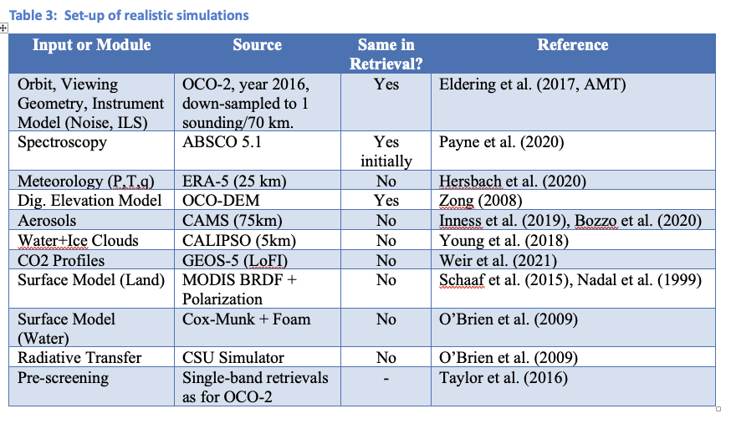
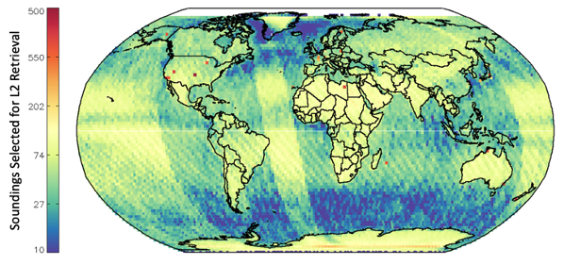
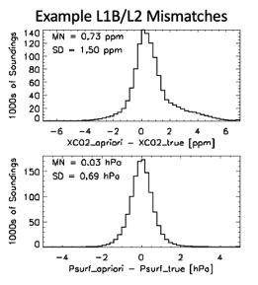
Proposed CSU Simulations
Top: Location of real OCO-2 soundings, after pre-screening in 2016 in our synthetic dataset. There are ~ 1.2M total soundings, and 600,000 soundings selected for X_{CO2} retrieval.
Left: Mismatches in XCO2 and Surface Pressure between the simulations (truth) and the retrievals (prior).
Will not include:
3D RT Effects
Subscene Effects (i.e., partial clouds)
Instrument Calibration errors

Slide 17
Draft Timeline
July 2025: Engage potential participants for willingness to participate.
Sept 2025: Send out simulations
Oct-Dec 2025: Runs occur
January 2026: Gather results
Jan-May 2026: Analyze results / discuss conclusions with participants.
Summer 2026: Draft manuscript if appropriate.

Slide 18
Open Questions
We MUST include clouds – subvisible clouds (esp cirrus) matter and are not always easily detectable. What cloud source?
  ISCCP? We tried this – doesn’t see thin clouds.
  Model output, e.g. ERA-5?
What “truth” data to allow for filtering and bias correction?
  All soundings, true XCo2?
  At TCCON sites only?
Is raw XCO2 output sufficient?
  Filtering & bias correction may confuse the issue?
  Requiring filtering and BC too onerous?

Slide 19







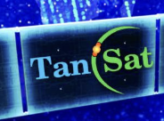
These issues may affect many missions!
FY 3H

