Slide 1
Recap of IWGGMS-21 Stakeholder Session
Prepared by Lesley Ott
Contributions from Yasjka Meijer (ESA), Itziar Irakulis Loitxate (IMEO), Hiroshi Tanimoto (NIES), Hironari Ishihara (Ministry of Environment, Japan), Ed Malina (ESA/ESRIN), Dan Moore (WattTime, Climate TRACE), Dave Crisp (Crisp Spectra)

Slide 2






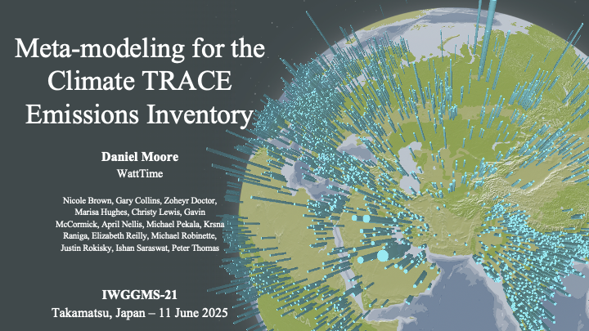

Theme 1 – Progress!!
The community has come a long way over the past 2 years – diversity of approaches, services, and actors

Slide 3
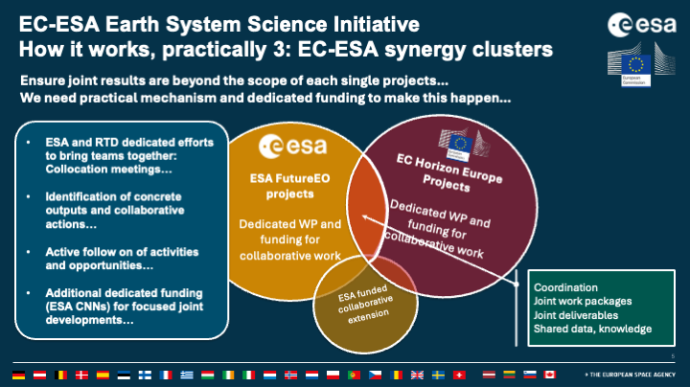






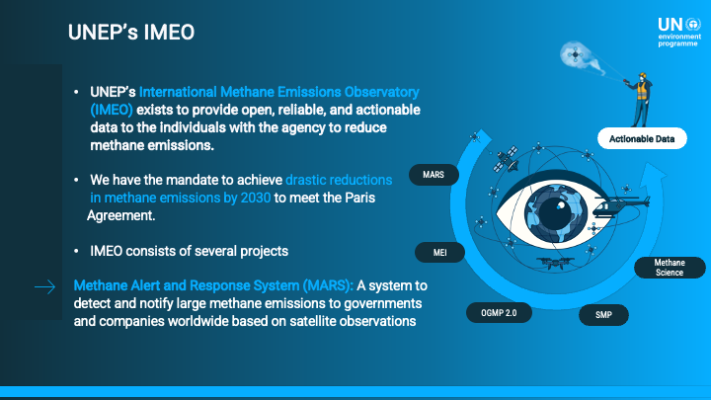
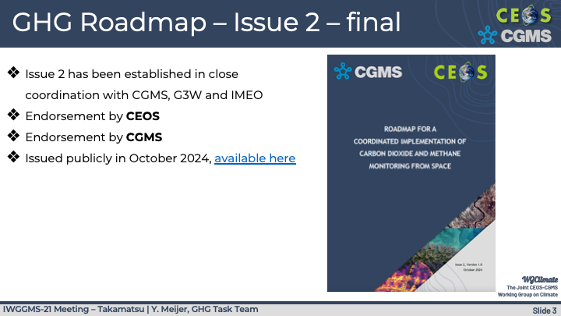
Theme 2 – Convening to speak with one scientific voice
International
National GHG Centers
Europe
Coming soon??
Progress in navigating institutional challenge to bring together expertise, info
Scientific
UNEP, CEOS, WMO, CGMS

Slide 4
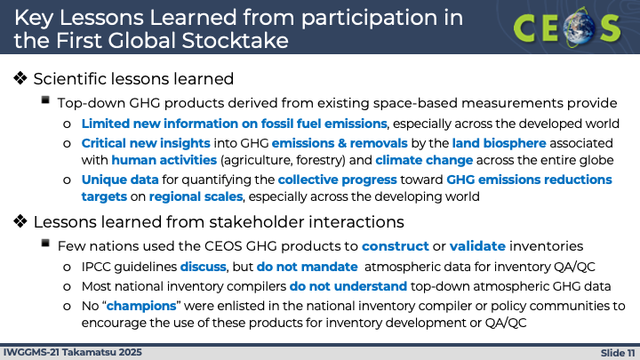
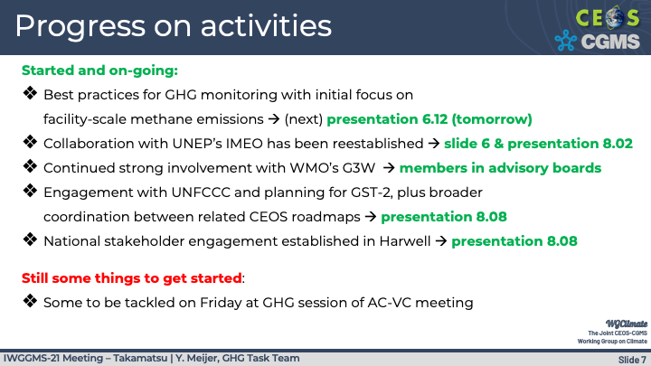
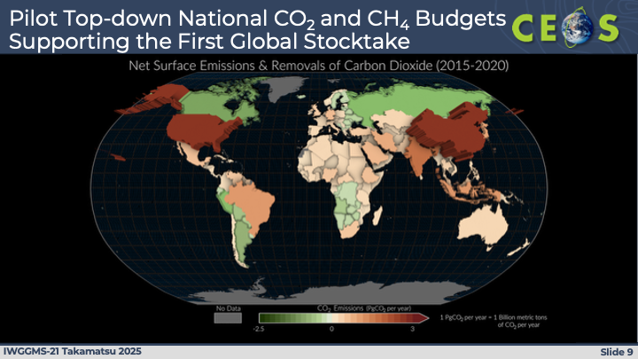
Theme 3 – Progress and challenges in connecting with policy community
Tremendous community-wide effort on policy, inventory communities
Some success stories, many remaining challenges – both scientific and programatic

Slide 5
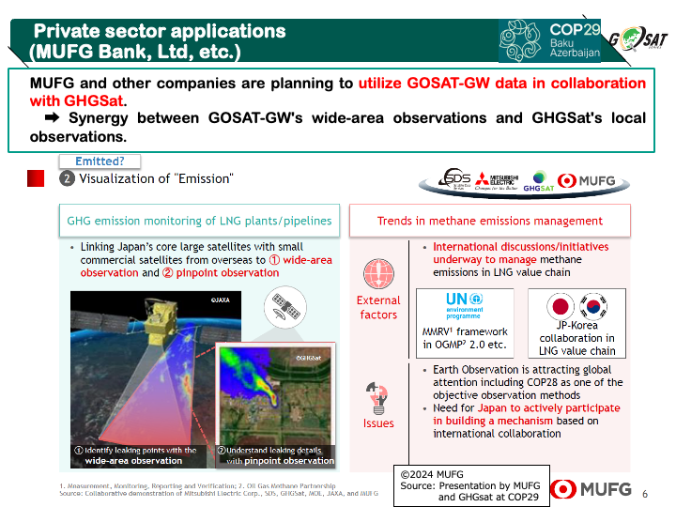
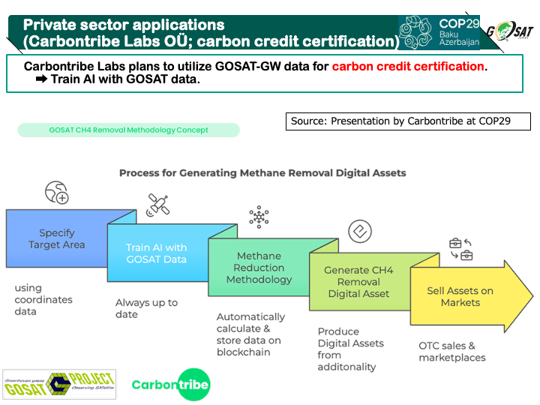
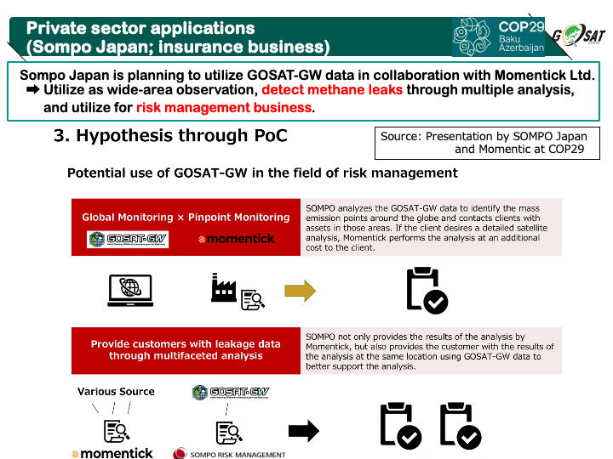
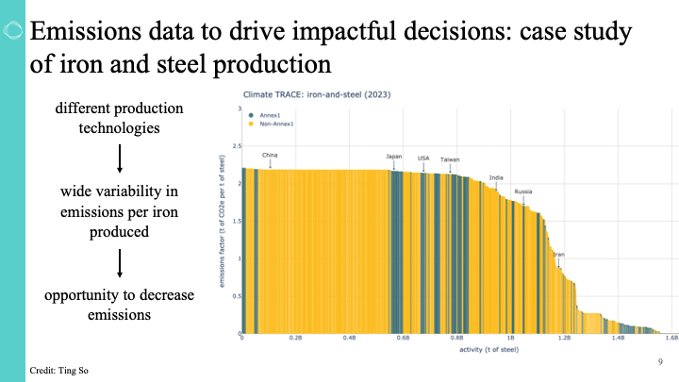
Theme 4 – Connections with private sector
Examples of private sector use cases from GOSAT
Carbon TRACE customized sectoral analysis, increasing focus on solutions

Slide 6
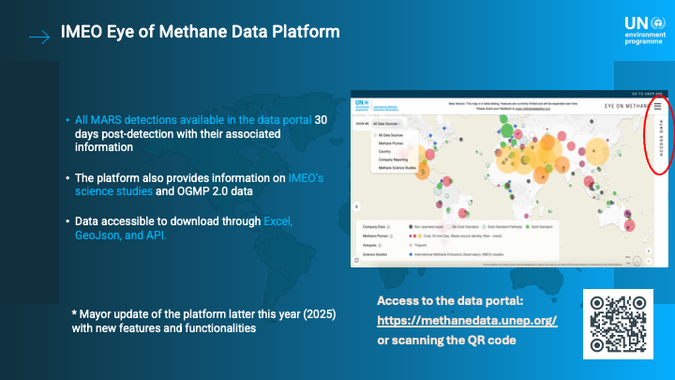
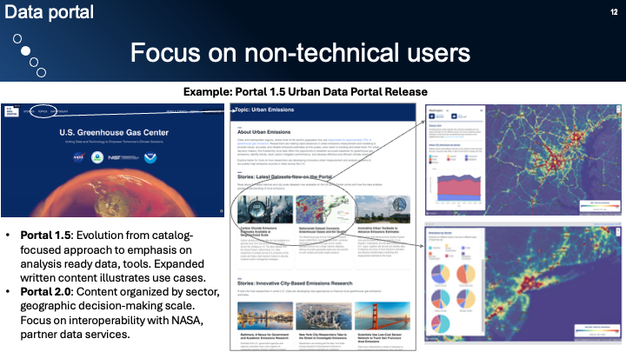
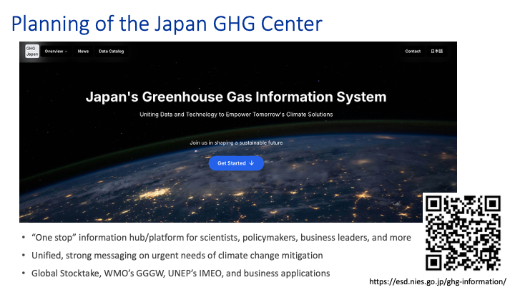
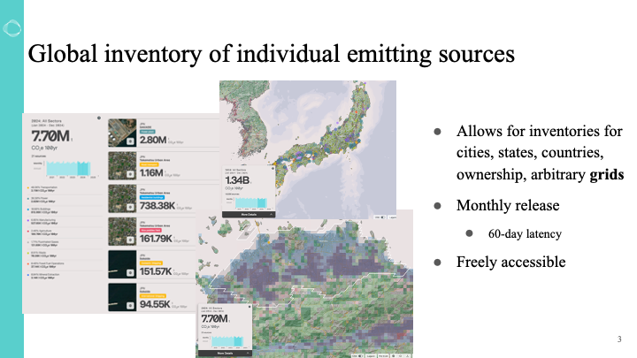
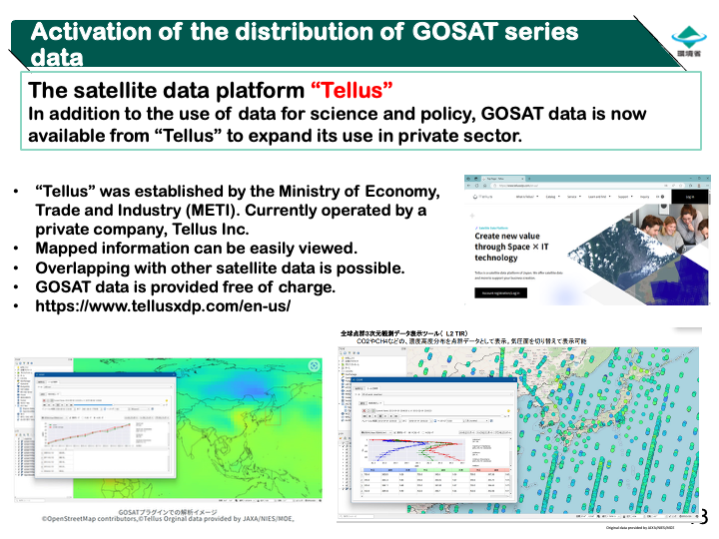
Theme 5 – End-user focused data systems
Growing array of public, private, national, and international data services facilitates access, awareness

Slide 7
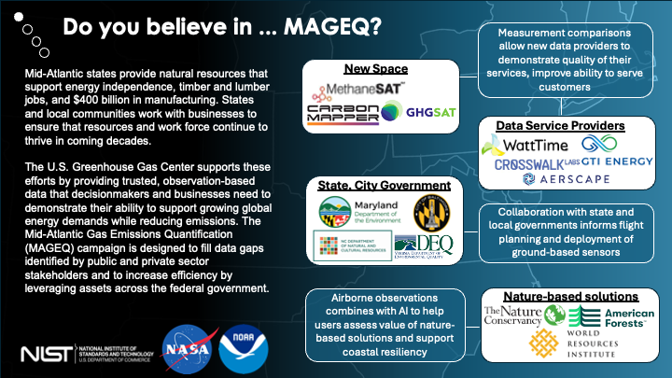
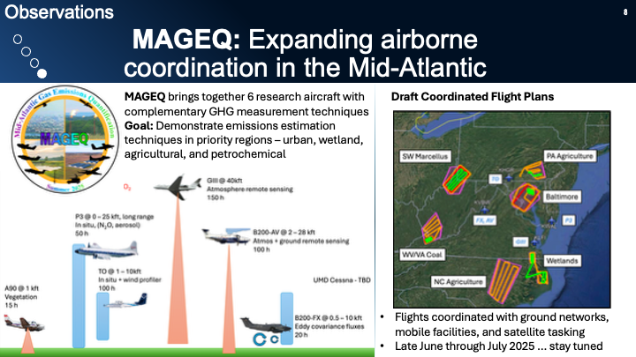
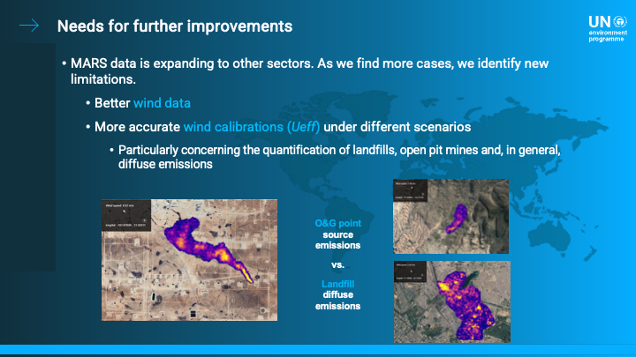
Theme 6 – Collecting new data that fills gaps identified by stakeholders
More opportunities for letting stakeholders inform next generation of measurement approaches

Slide 8
Questions, discussion
Is better data, information enough to drive policy and action?
  Relative prioritization of activities across inventory/(international/national policy) and other needs (private sector, cities, states)
How do we increase information sharing, interaction with private sector while protecting privacy concerns?
  Role of boundary organizations, private data service providers
Sharing processes, best practices for coordination across GHG Centers
How do we maximize impact of data services, last mile delivery?
Avoiding stakeholder fatigue

