Slide 1



The International Methane Emissions Observatory
Itziar Irakulis Loitxate
Remote Sensing Lead
June 2025

Slide 2
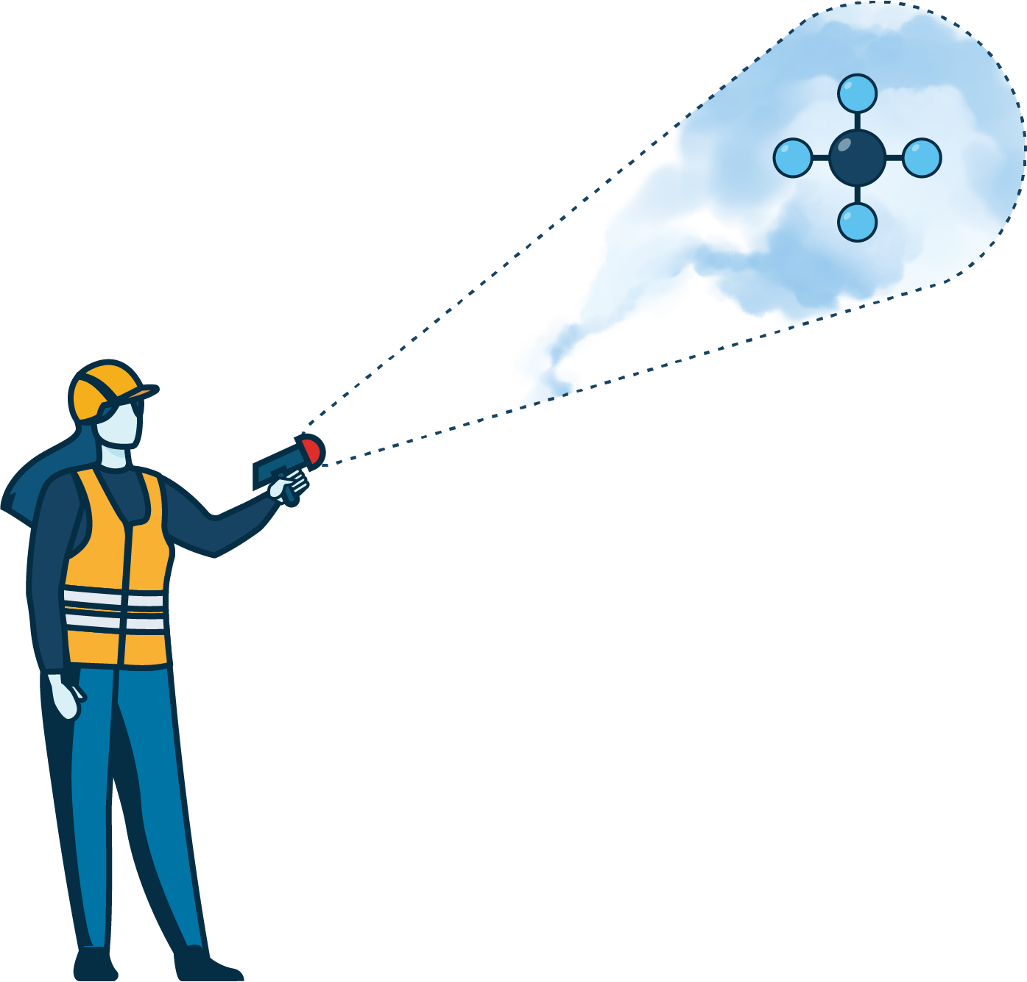

UNEP’s IMEO
UNEP’s International Methane Emissions Observatory (IMEO) exists to provide open, reliable, and actionable data to the individuals with the agency to reduce methane emissions.
We have a mandate to achieve drastic reductions in methane emissions by 2030 to meet the Paris Agreement.
IMEO consists of several projects
Methane Alert and Response System (MARS): A system to detect and notify large methane emissions to governments and companies worldwide based on satellite observations
Actionable Data
MARS
MEI
Methane Science
OGMP 2.0
SMP
Notes:
This is why UNEP launched, in 2021, the International Methane Emissions Observatory (IMEO), an initiative to drive drastic reduction of methane emissions through data.
IMEO is establishing a global and public database of methane emissions at an unprecedented level of accuracy and granularity.
The mission of IMEO is to provide free reliable actionable data to the individuals who act to reduce 150 Mt of methane emissions by 2030.
This free and reliable data will empower stakeholders who can make a difference to reduce methane emissions at the speed and scale needed to reach the landmark Paris Agreement.
IMEO catalyzes methane emissions reductions by interconnecting its data with actions on research, reporting, and regulation.
This is truly revolutionary as historically there was no single entity that brings data transparency, science, and government action together on this scale, which is exactly what is needed to address the methane emissions problem.
Idatzi sobre open, reliable and actionable
Measurement-based estimates to understand the performance of supplier countries and regions and track emissions over time

Slide 3
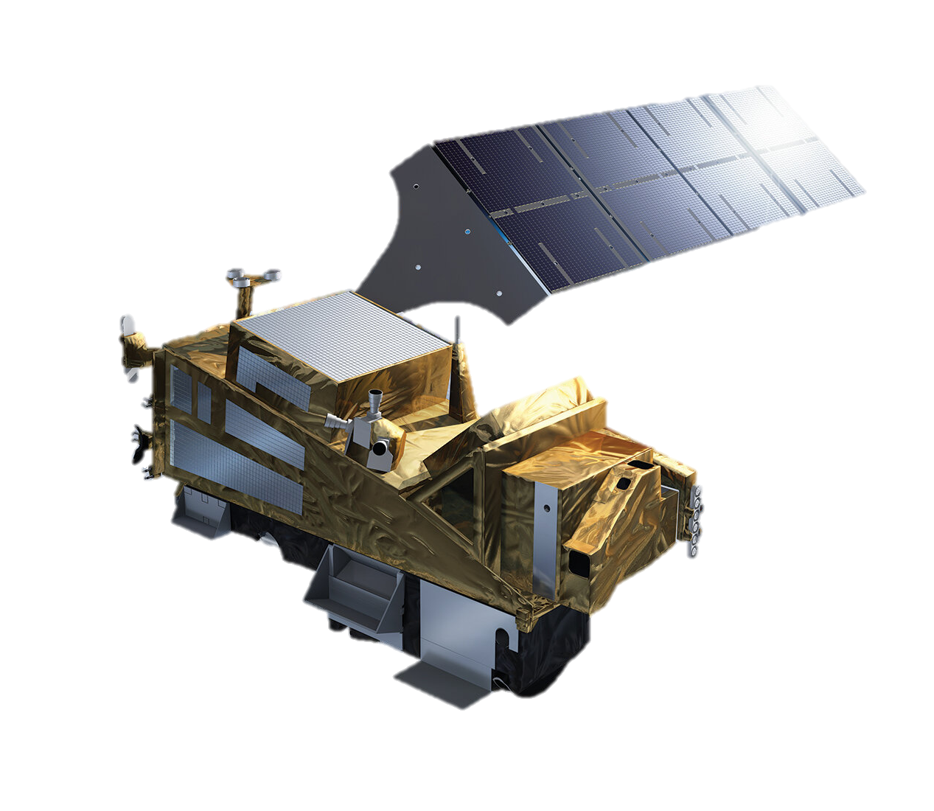
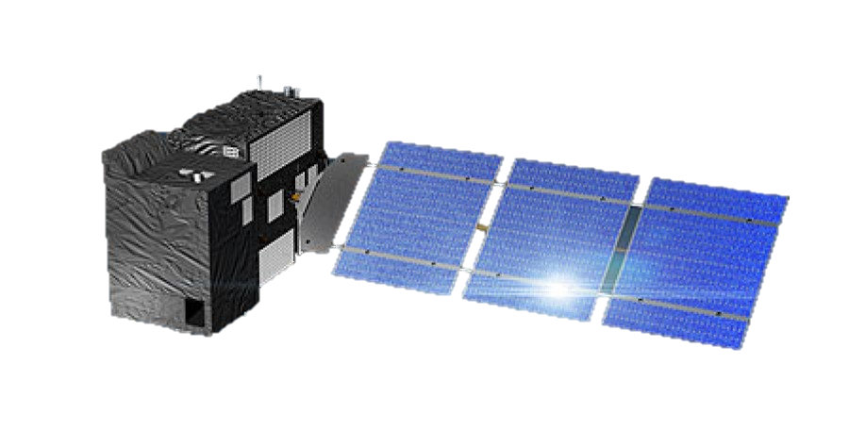
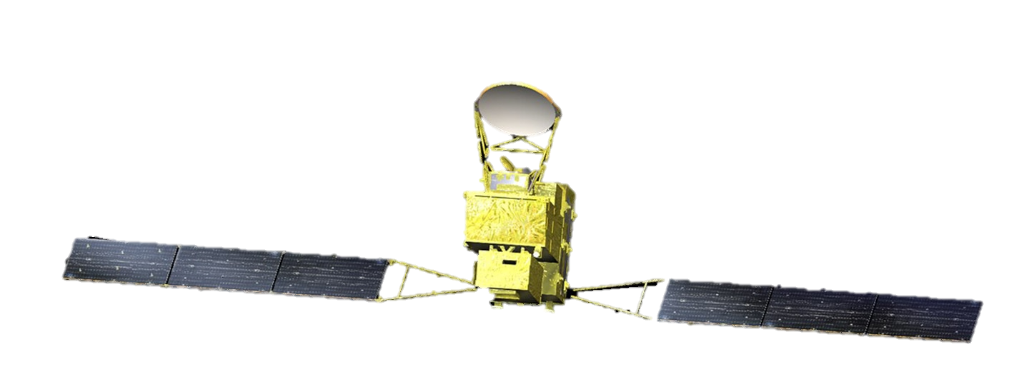
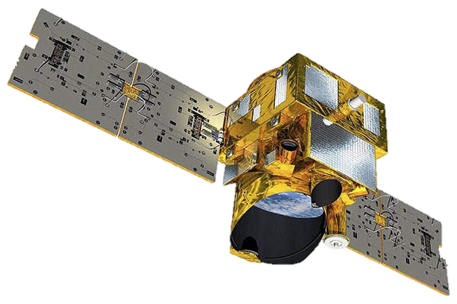
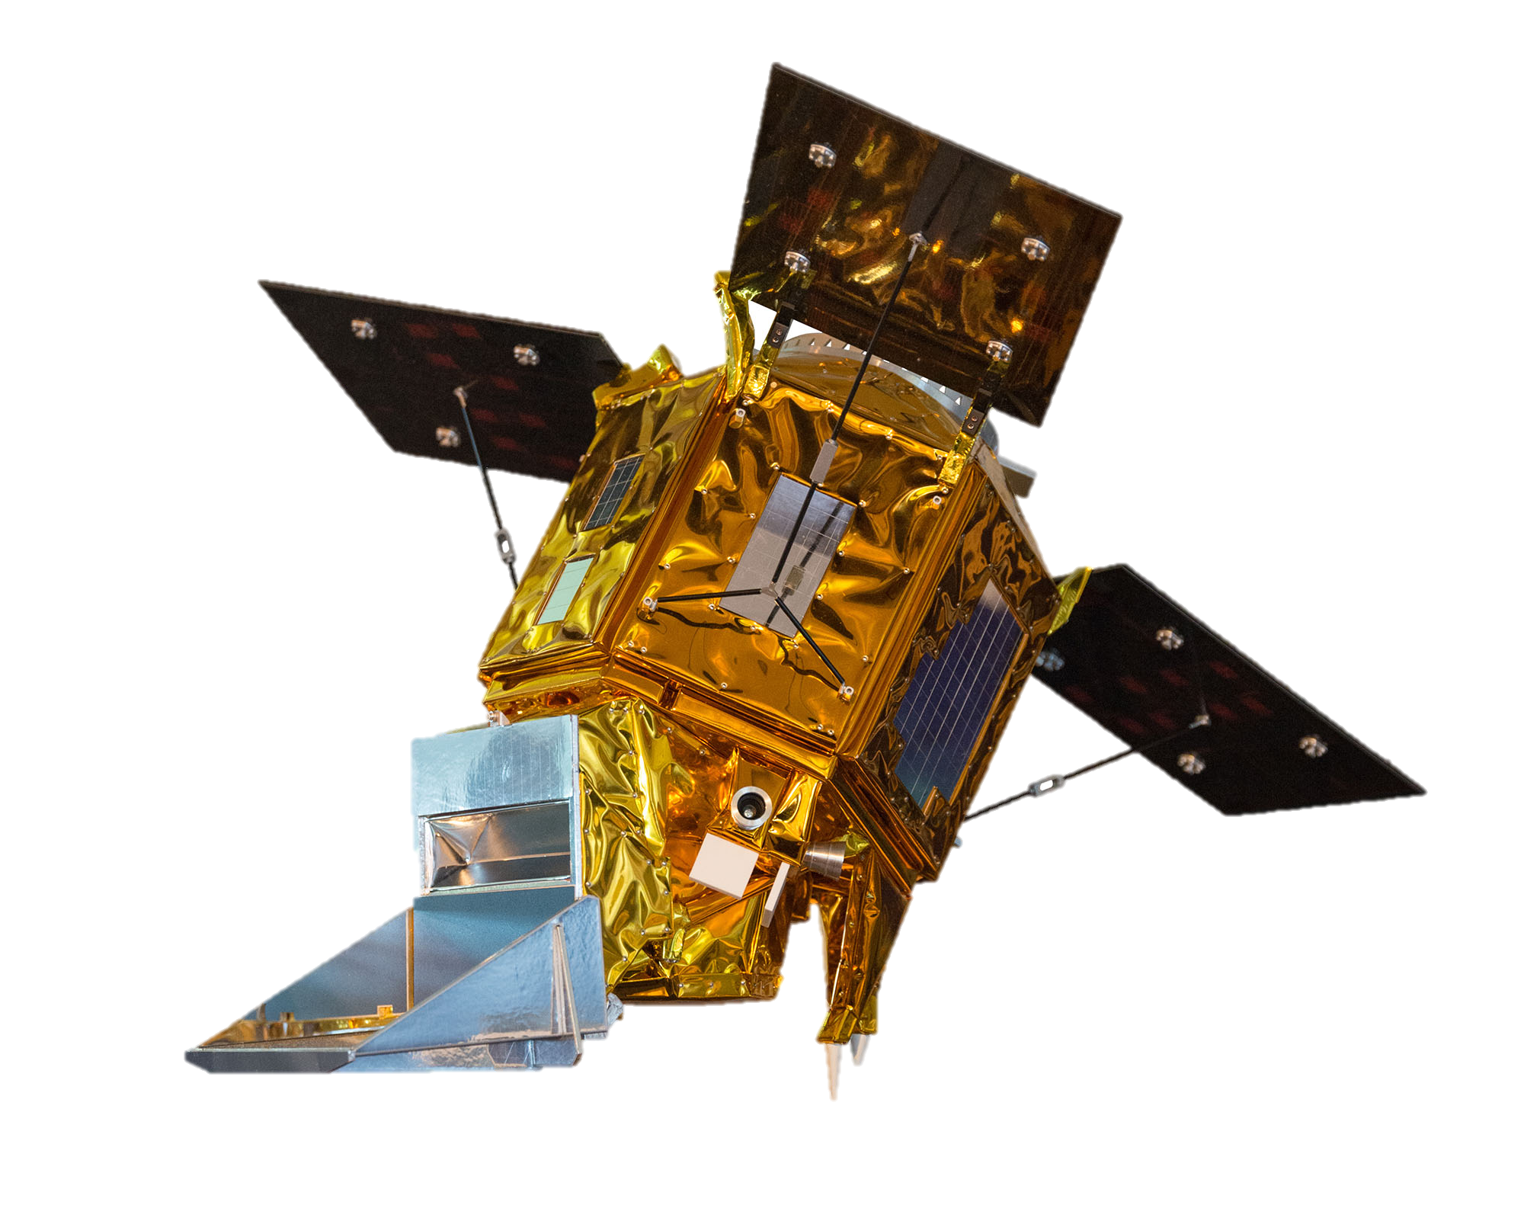
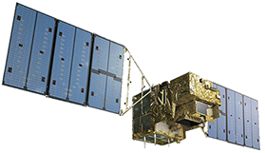
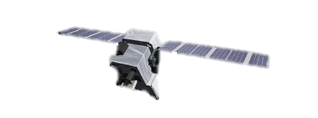

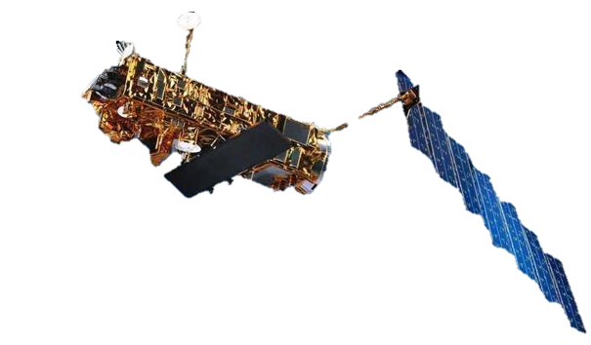
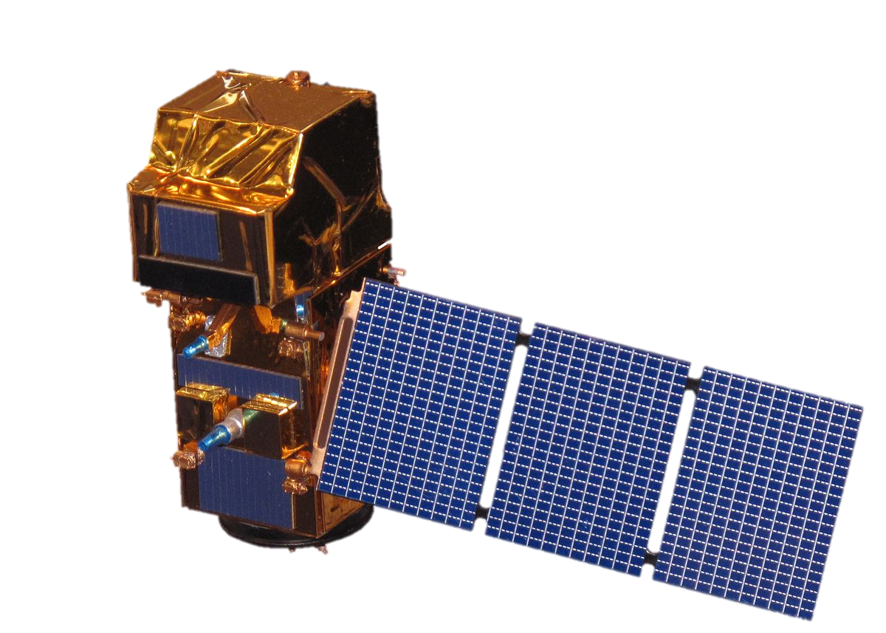
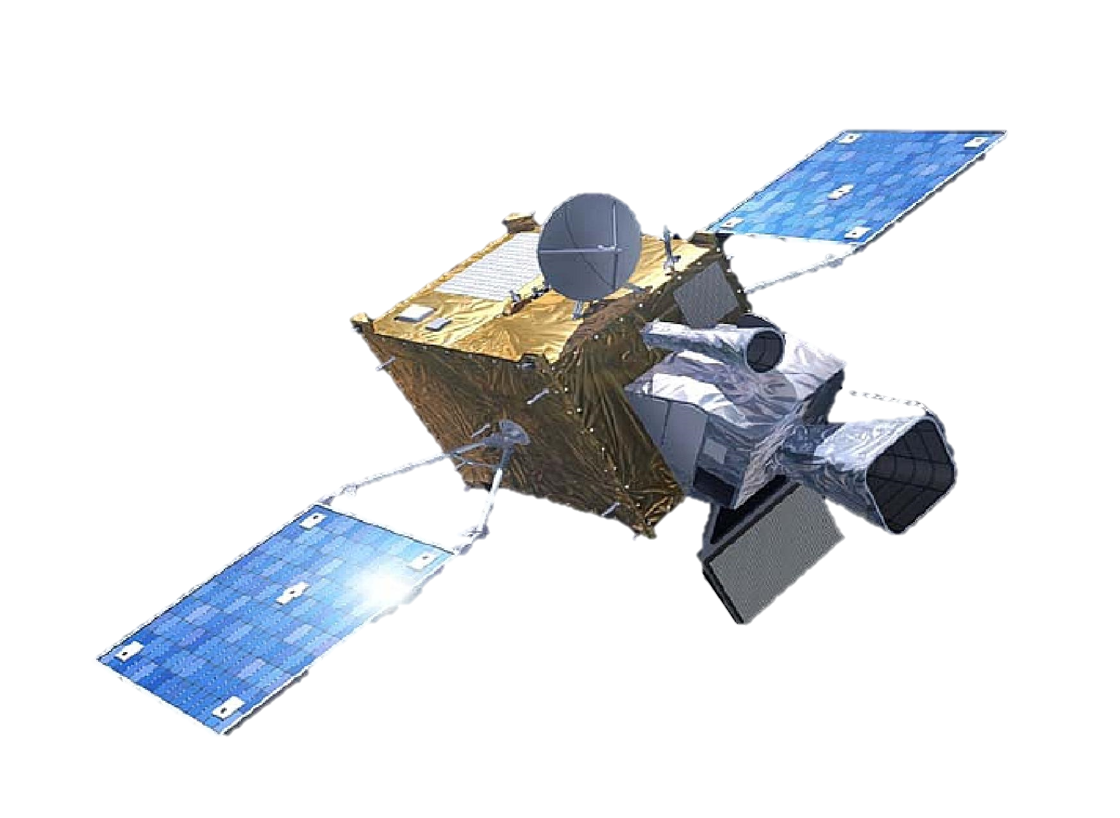
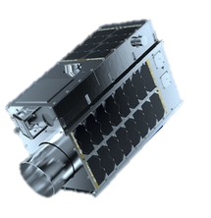
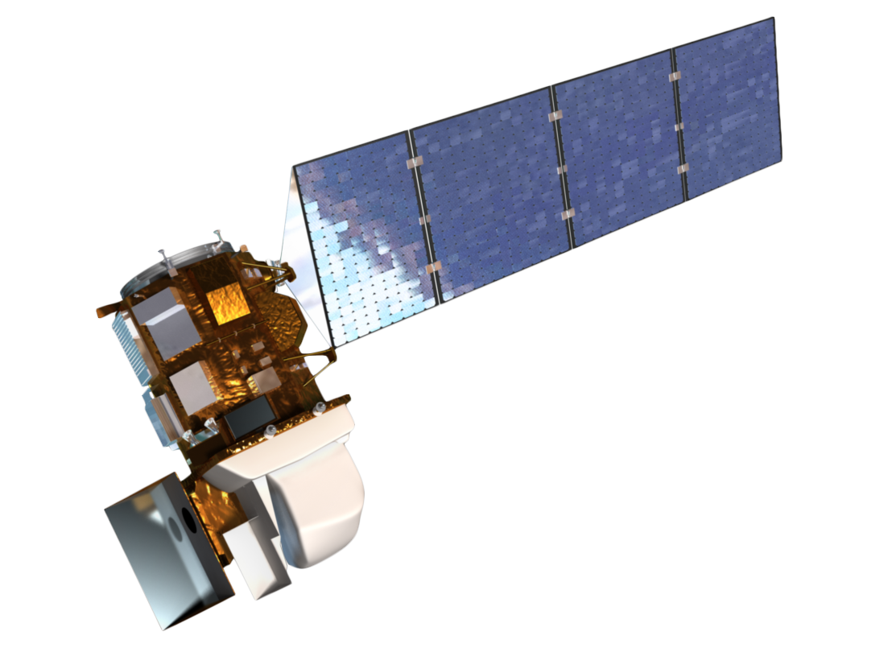
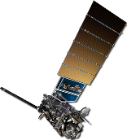

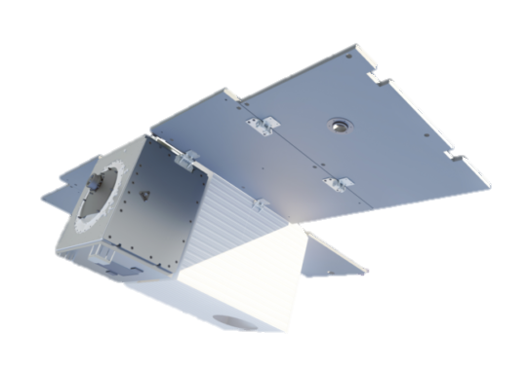
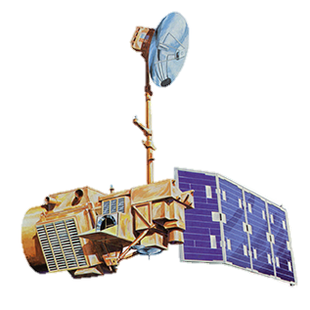

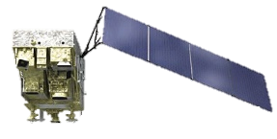
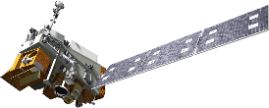
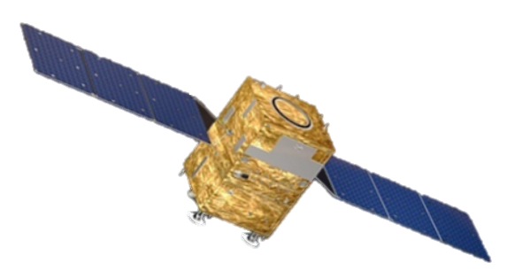
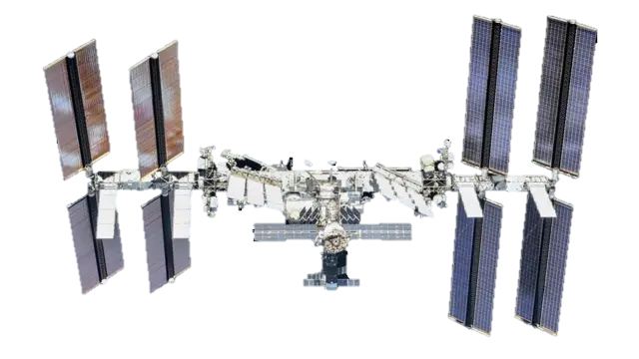
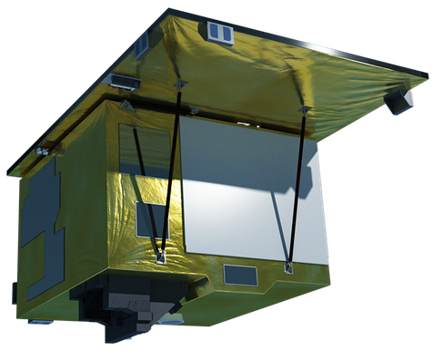
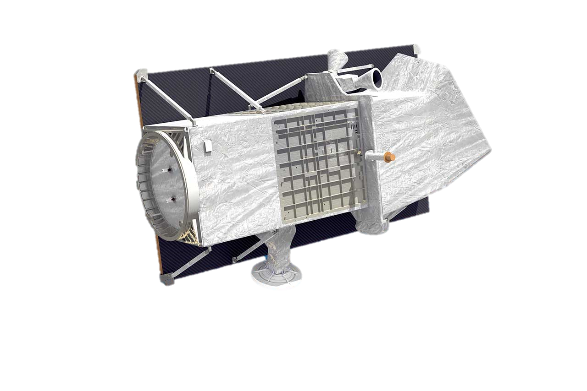
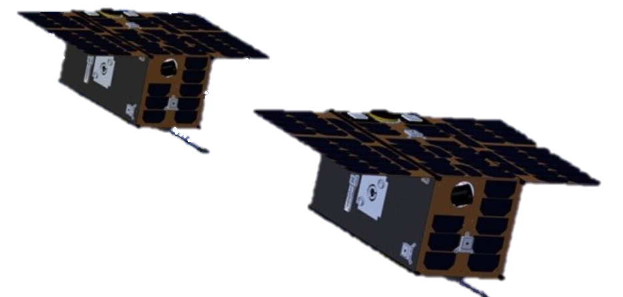
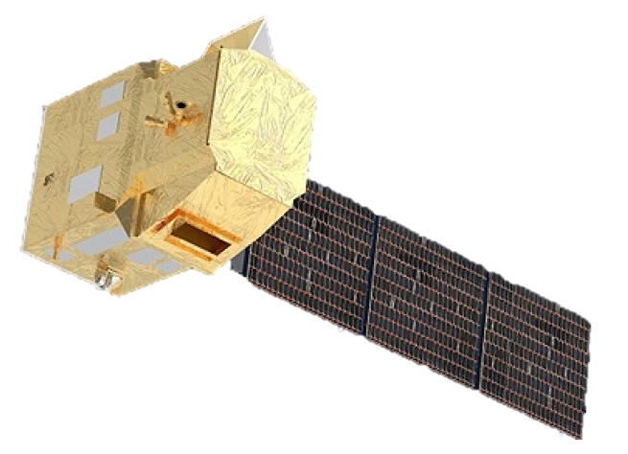
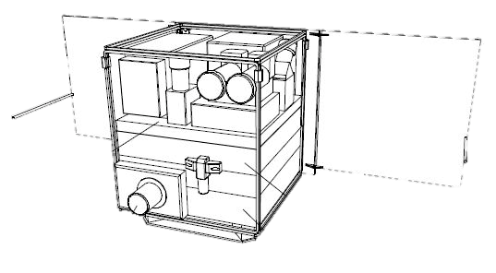
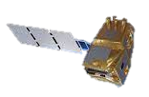
AREA FLUX MAPPERS
Sentinel-5
CO2M
GOSAT-GW
MERLIN
Sentinel-5P
GOSAT
MethaneSAT
SCIAMACHY
FUTURE
PRESENT
PAST
Sentinel-2
GHGSat
MTG
GOES
Landsat 8 & 9
Landsat 4 & 5
Landsat 7
Carbon Mapper
Sentinel-3
GoFen-5, 02
VIIRS
Ziyuan-1
EMIT
POINT SOURCE IMAGERS
EnMAP
PRISMA
TANGO
CHIME
CO2Image
SBG

Slide 4
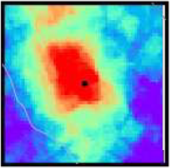
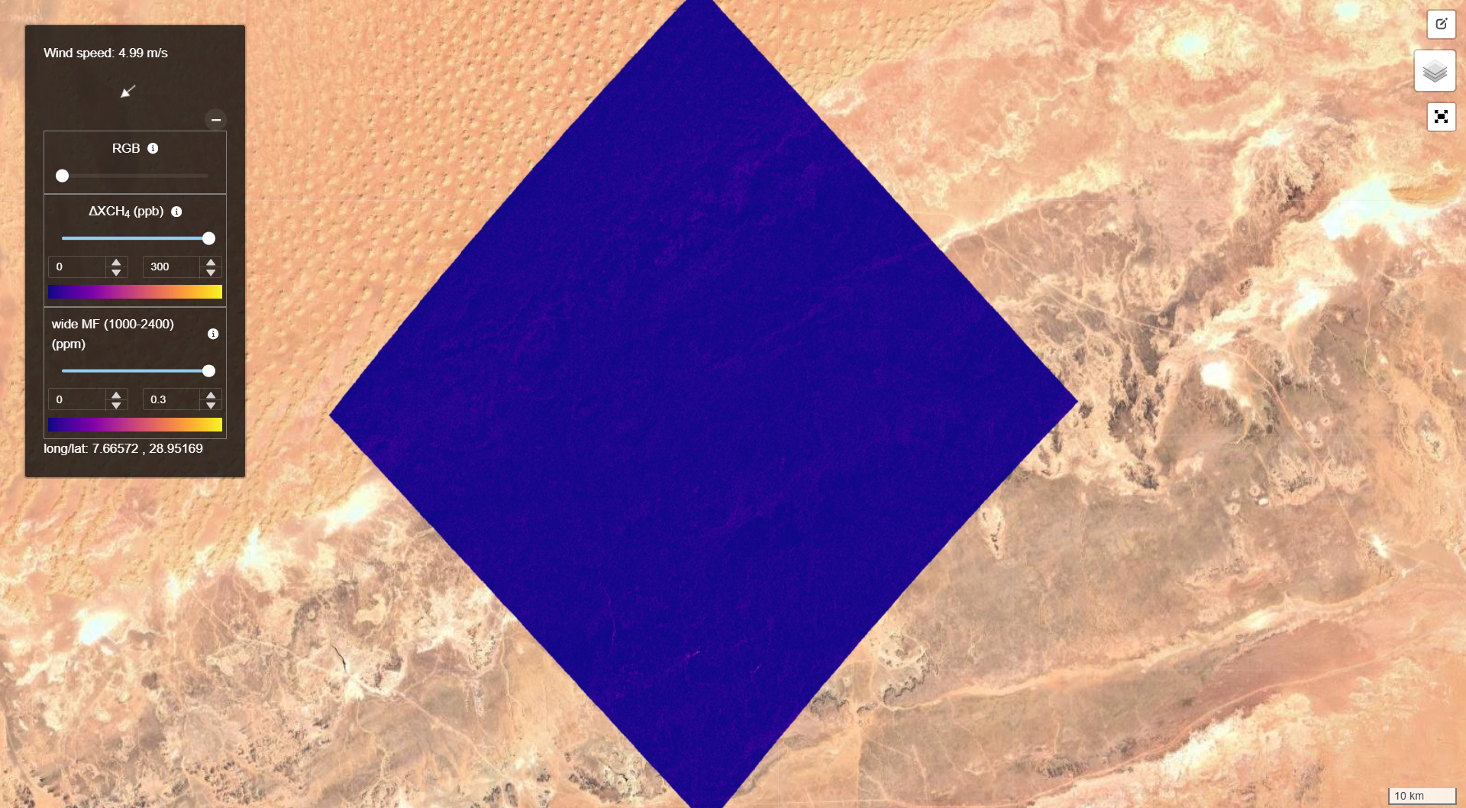
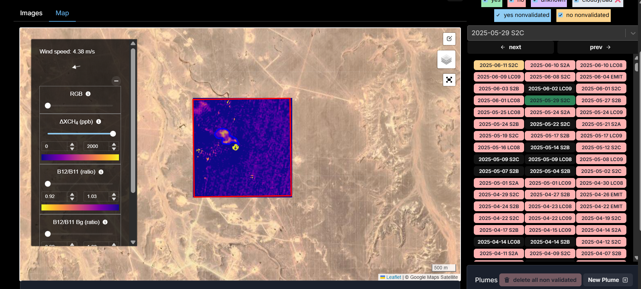
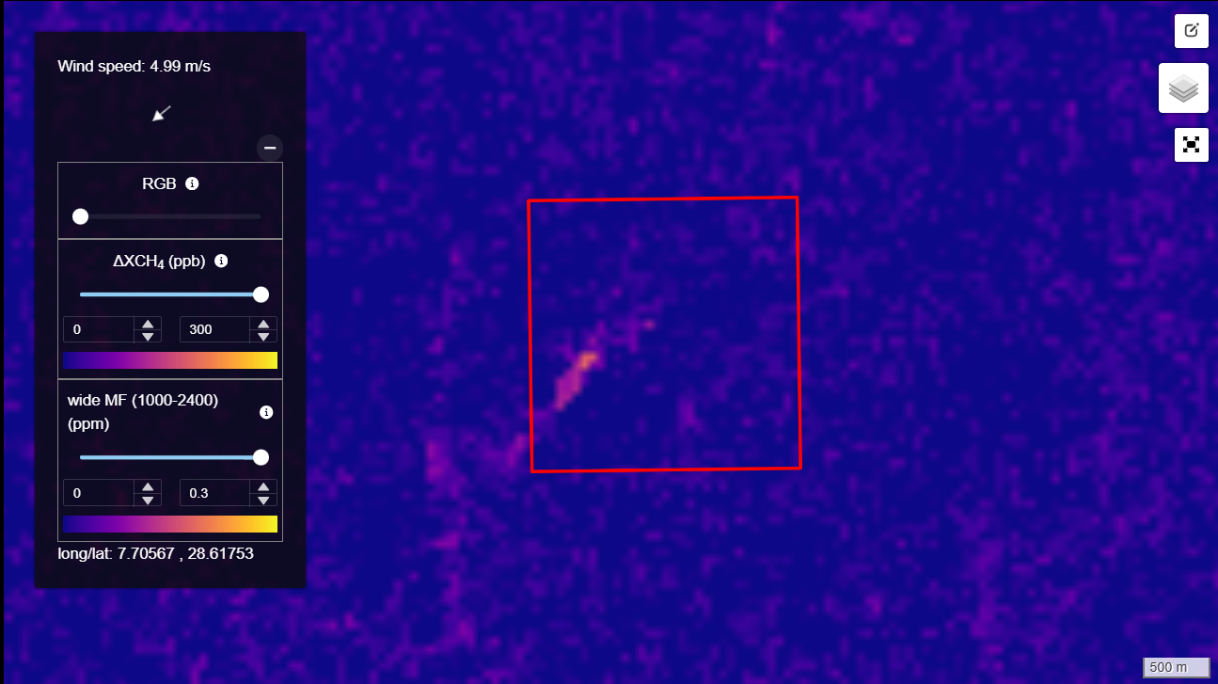
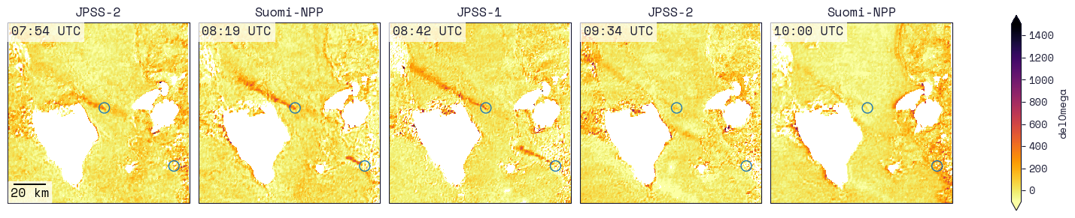

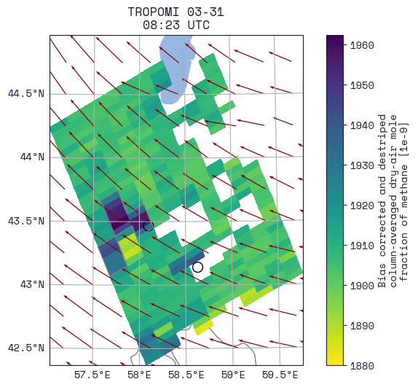
MARS notifications
Sentinel-2
Landsat 8-9
EMIT
EnMAP
PRISMA
Sentinel-3
VIIRS
GOES
Sentinel-5P
From SRON
Notes:
Satellites arriba. Imagen de imagen full tile, monitoring location, time serie

Slide 5
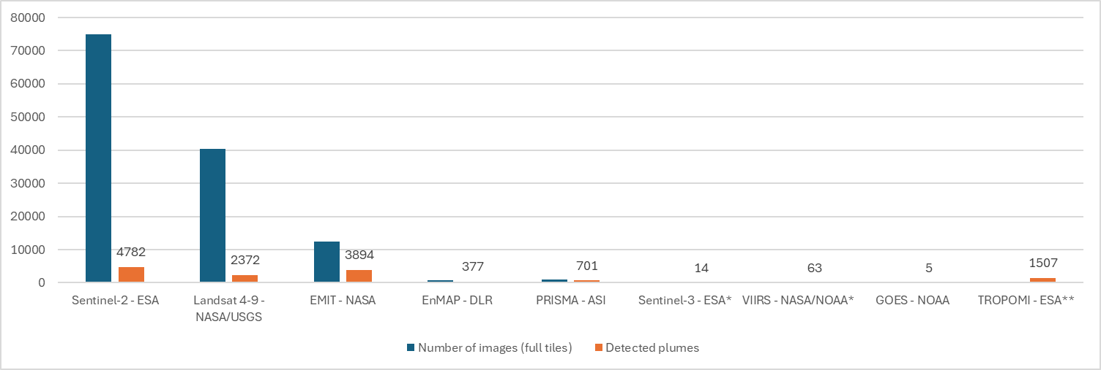
 | Sentinel-2 - ESA | Landsat 4-9 - NASA/USGS | EMIT - NASA | EnMAP - DLR | PRISMA - ASI | Sentinel-3 – ESA* | VIIRS - NASA/NOAA* | GOES - NOAA | TROPOMI – ESA**
Number of images (full tiles) | 74928 | 40407 | 12475 | 751 | 893 | 10 | 52
Detected plumes | 4782 | 2372 | 3894 | 377 | 701 | 14 | 63 | 5 | 1507
*From SRON since September 2024
**From Kayrros 2023-2024; CAMS/ECMWF/SRON 2025

Slide 6
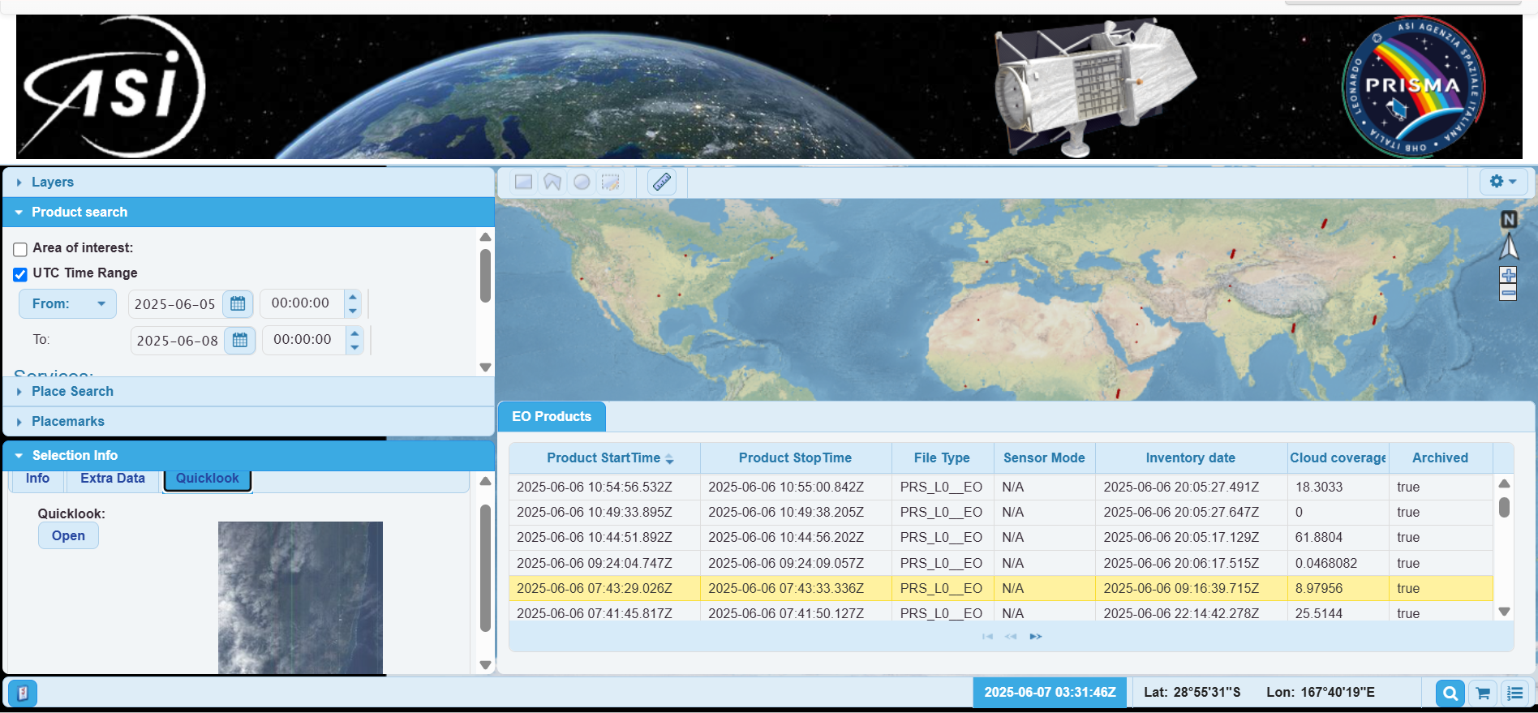
Example of PRISMA archive data access
Manual selection and check
5 image daily quota
Notes:
Ejemplo de como funciona PRISMA

Slide 7

The need of [as much as possible] hyperspectral open data
Hyperspectral data essential to cover “complex” areas, i.e. heterogeneous, dark, vegetated surfaces, high latitudes, etc.
Open-source data (with replicable results) important for IMEO transparency policy
Archive data valuable to identify potential active or frequent emitters
  Every time we detect a plume, even if it is old, we keep that location in monitoring to get more accurate alerts and increase the chance of detecting new (actionable) plumes in the upcoming images
Rapid access to new acquisitions even more valuable to detect and notify emission

Slide 8
Improvement opportunities
We work integrating new missions into our system to cover more areas with higher frequency
Requirements:
  Rapid and systematic access to the data.
    APIs are welcome
    Access to new observations in less than 10 days (MARS doesn’t notify emissions older than 15 days – and we need some time to analyze the data)
Options to improve work efficiency and data quality:
  Standardized data formats (e.g., file format, metadata)
  Improvement in the geolocation of TOA products (common to see several meter to kilometer offsets in hyperspectral images)
  Wind data per observation
  Start considering elevation and, thus, good/updated elevation data
Notes:
Only 55 months. Add eolocation problema image

Slide 9
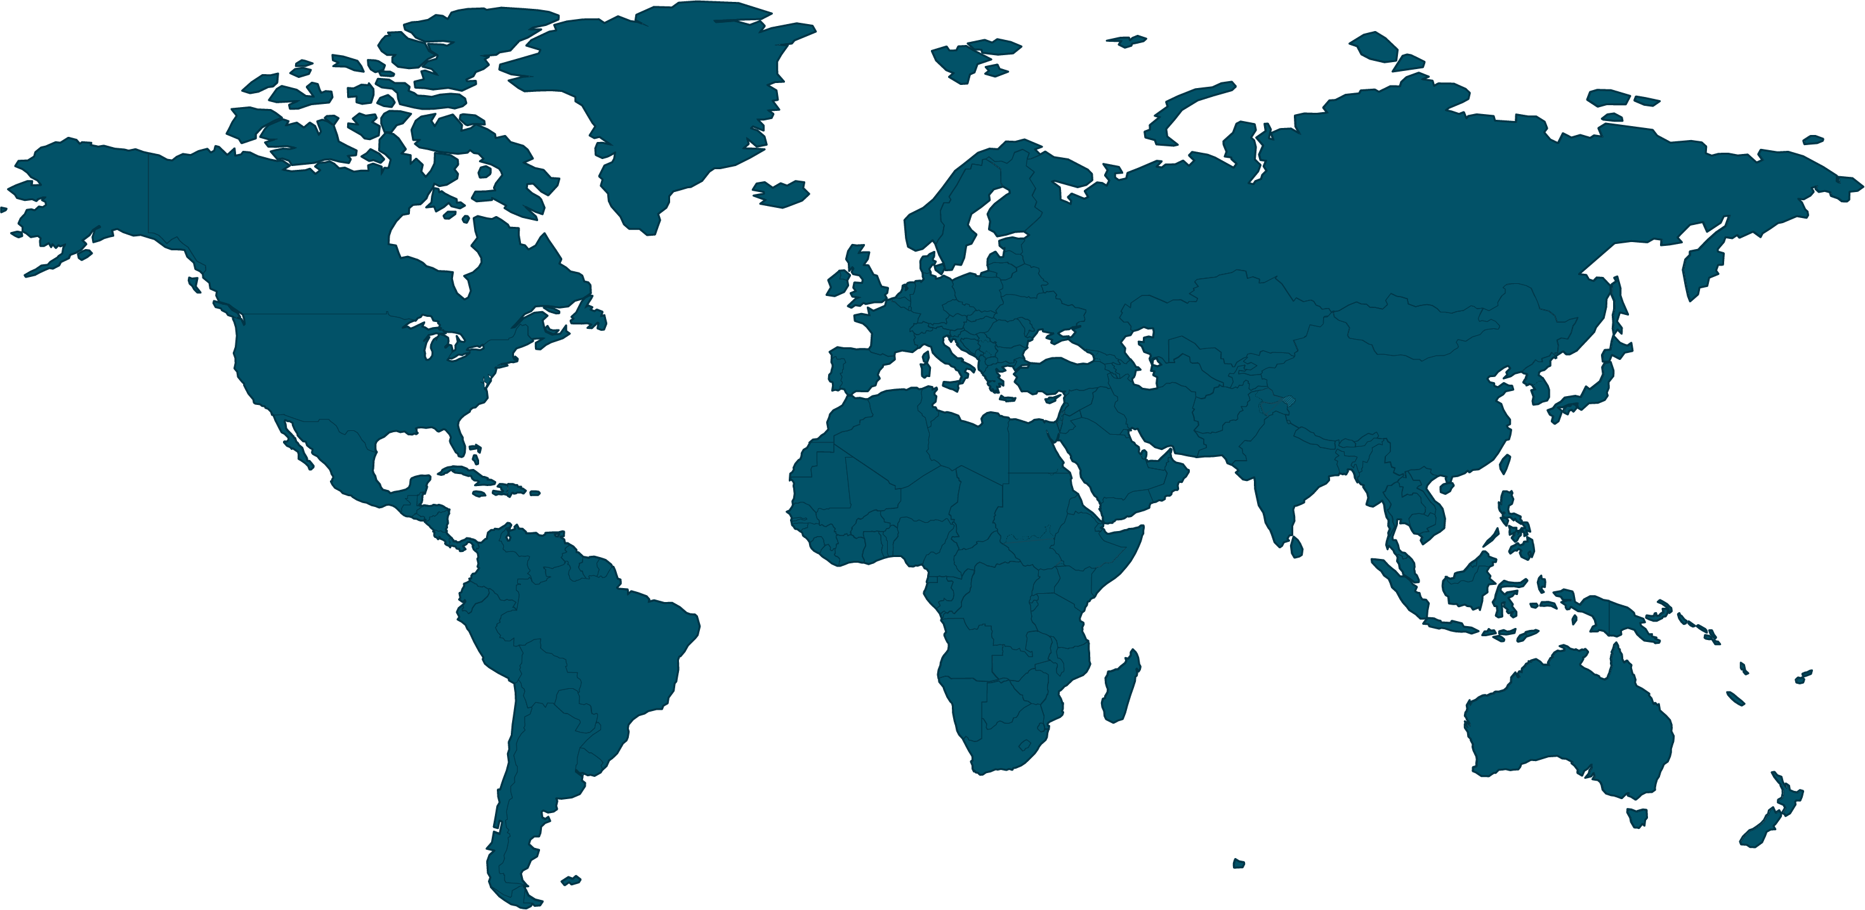
Controlled release experiments and measurement validation activities
IMEO, together with CEOS is putting together a controlled release experiment calendar for past, ongoing, and future release experiments.
Potentially also plume intercomparison activities and any other validation/intercomparison activities
Through OGMP 2.0 we are trying to find volunteer companies to share their planned emissions schedule (e.g., compressor station ventings, pipeline blowdowns)
If you do or know about new controlled/known release experiments, please share it with us!

Slide 10

Thank you !
Itziar Irakulis Loitxate
IMEO Remote Sensing Lead
itziar.irakulisloitxate@un.org

