Slide 1


Integrated Global Greenhouse Gas Information System
Connecting greenhouse gas science to policy outcomes
IG³IS co-chairs: Jocelyn Turnbull, Phil DeCola, Felix Vogel
IG³IS WMO Secretariat: Oksana Tarasova, Jarin Tasneem Oyshi
IG³IS Steering Committee: Luciana Gatti, Anita Ganesan, Sander Houweling, Kevin Gurney, Rona Thompson, Thomas Lauvaux, Alistair Manning, Yogesh Tiwari, Marc Chiappero, Daniel Zavala-Araiza, Bo Yao, Stephan Henne, Jorn Herner, Lei Hu, Jinkyu Hong
IG³IS Stakeholder Group: Yann Francoise, Paulo Silva, Beatrix Cardenas, Tabare Curras

Slide 2
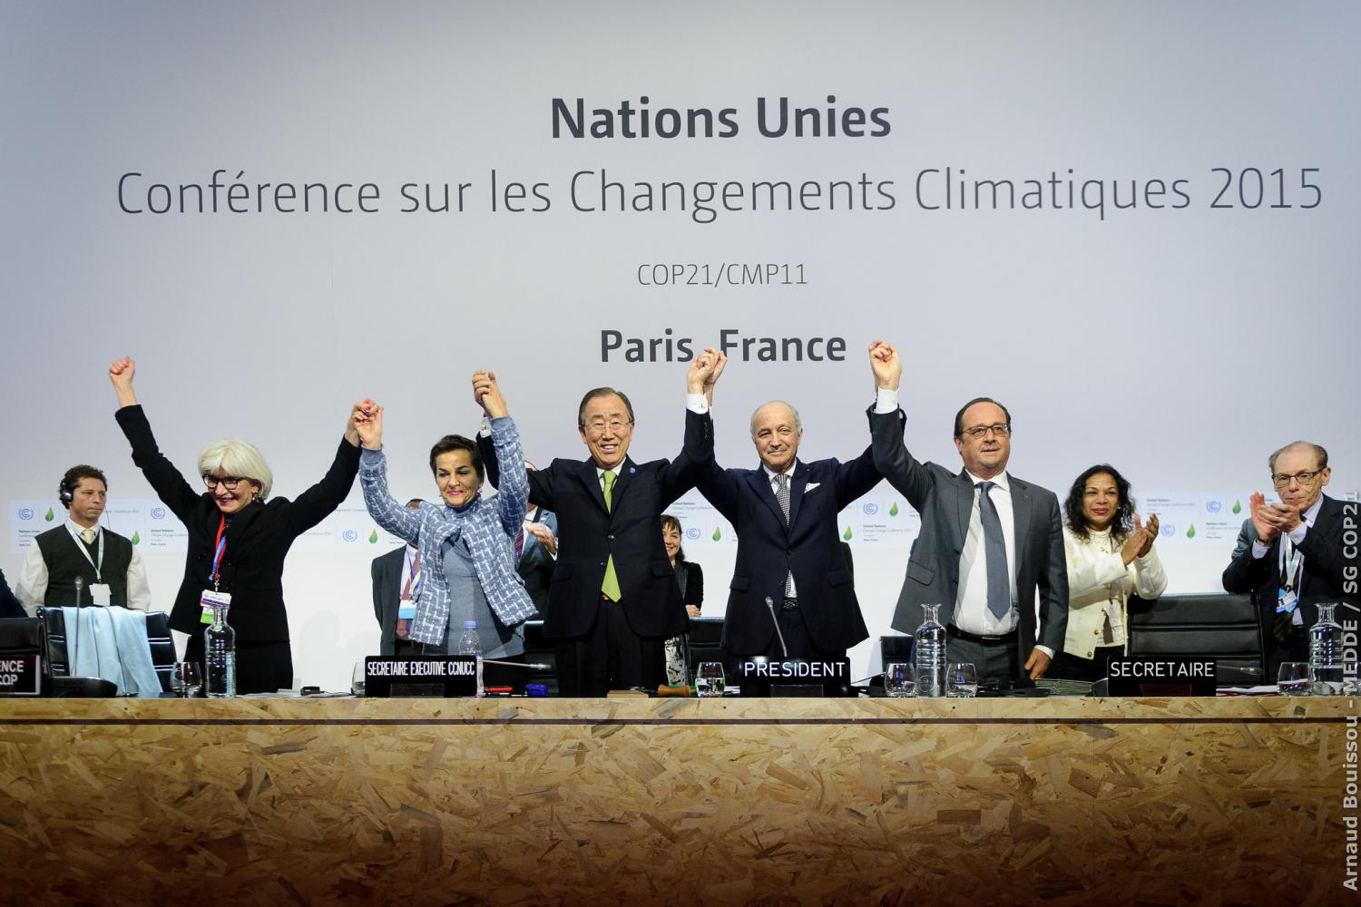
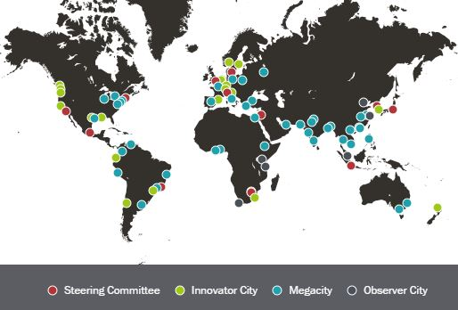





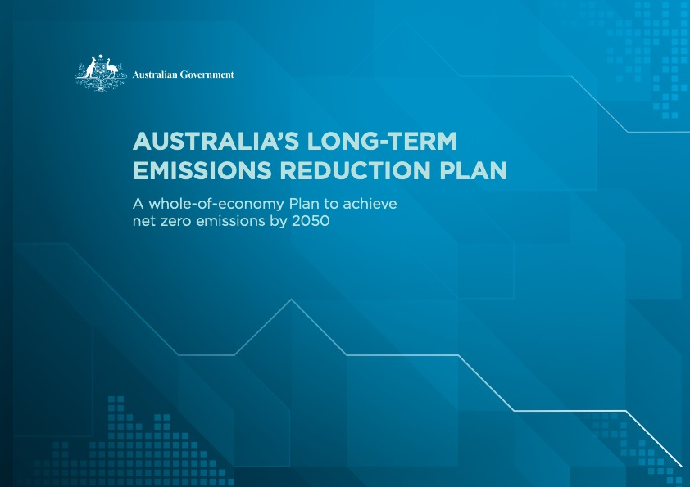
International, national, local commitment to emissions mitigation
All nations have committed to mitigate emissions under the Paris Agreement
Many nations have their own national mitigation plans
Cities, states, regions and industry have their own mitigation goals

Slide 3

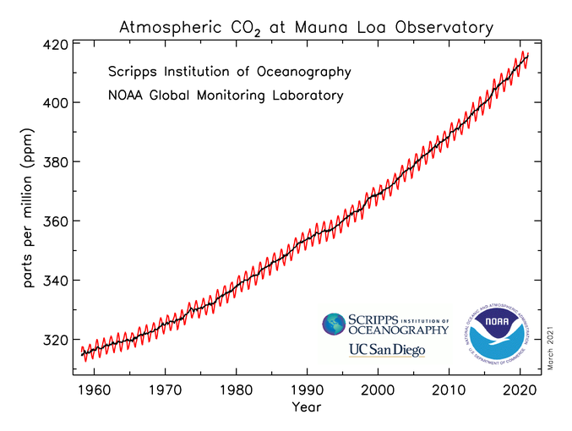
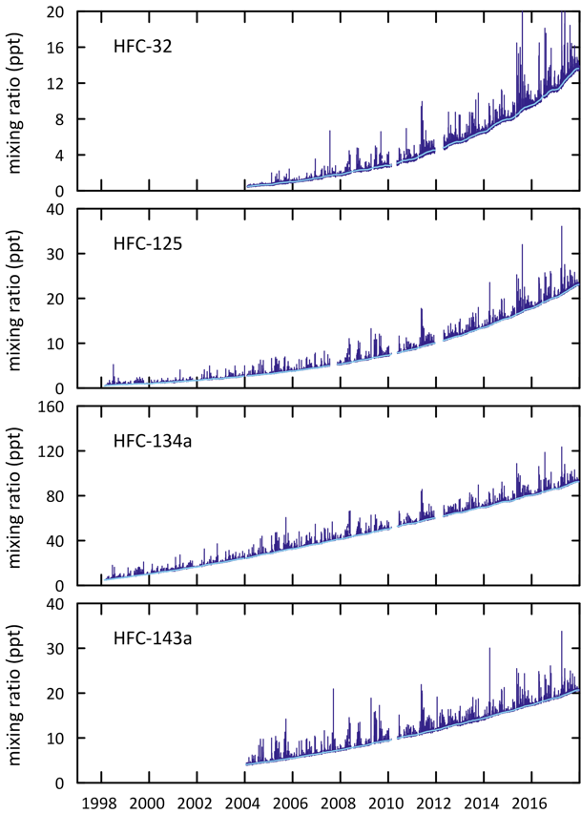

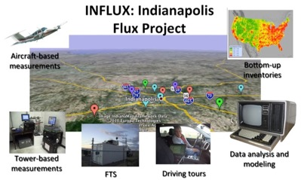
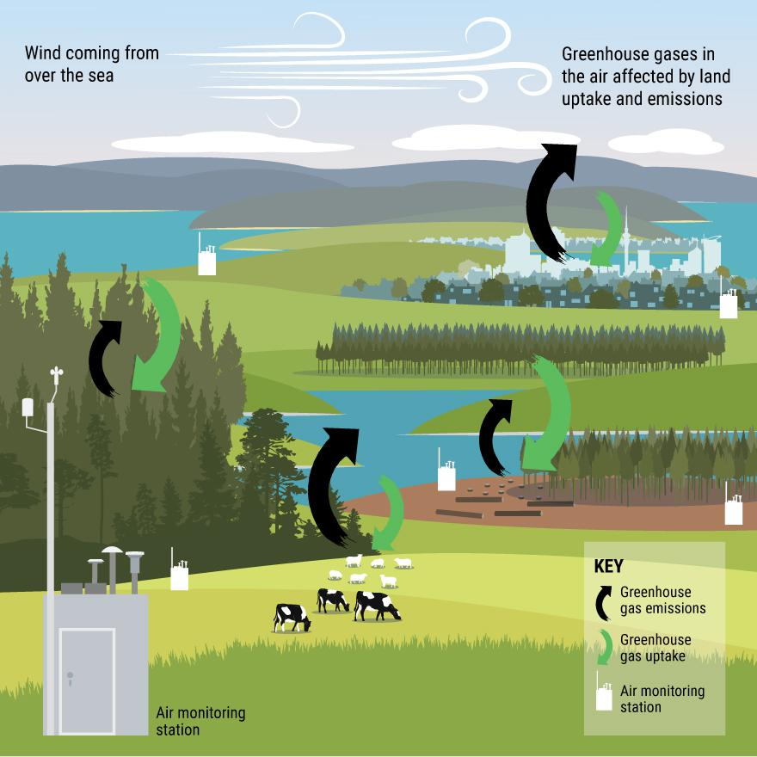
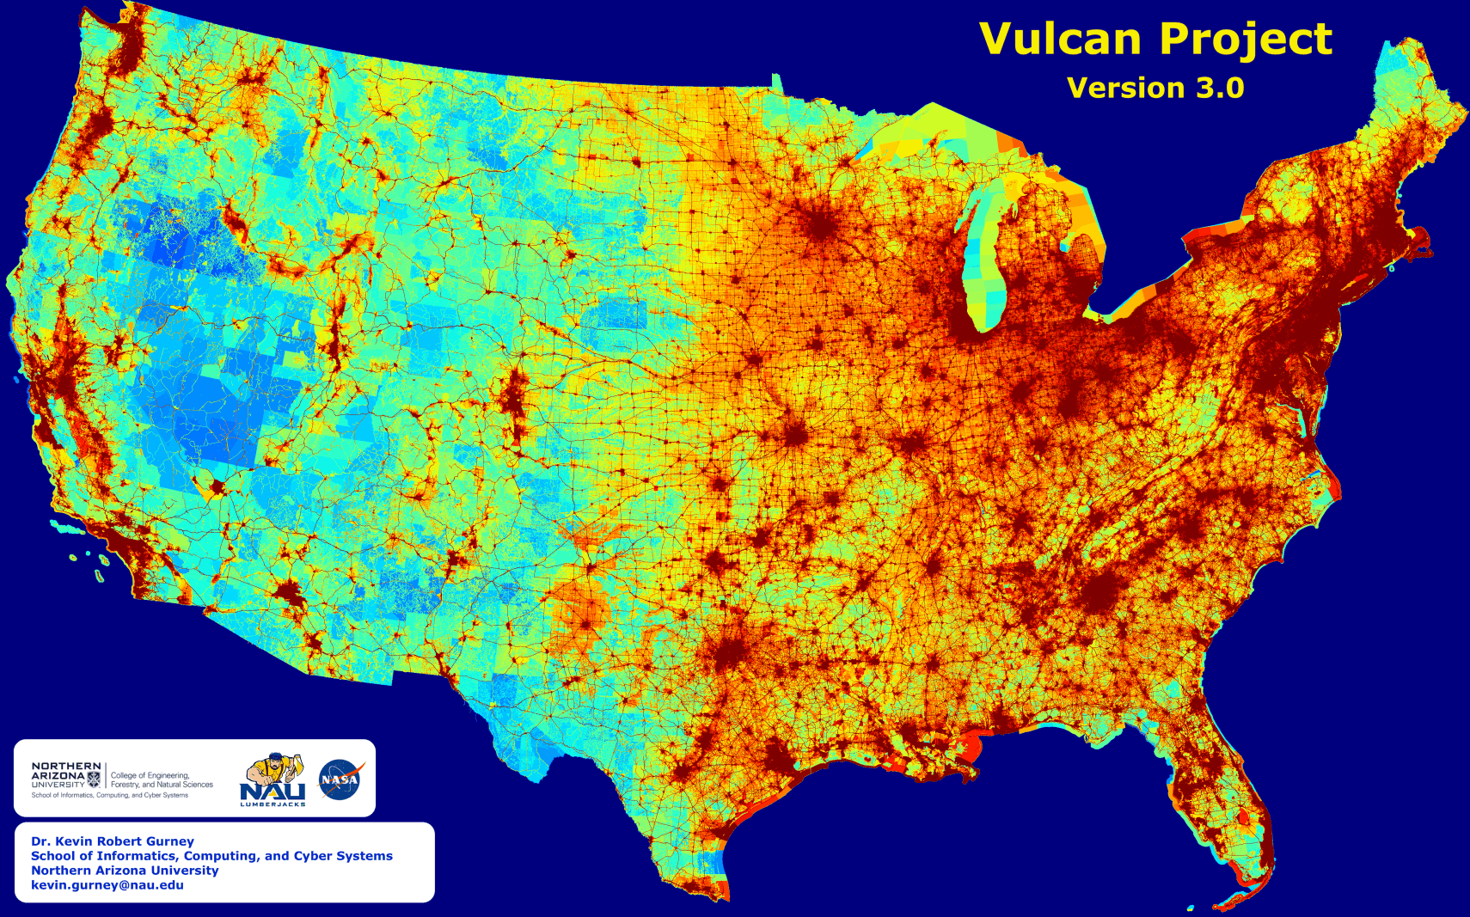

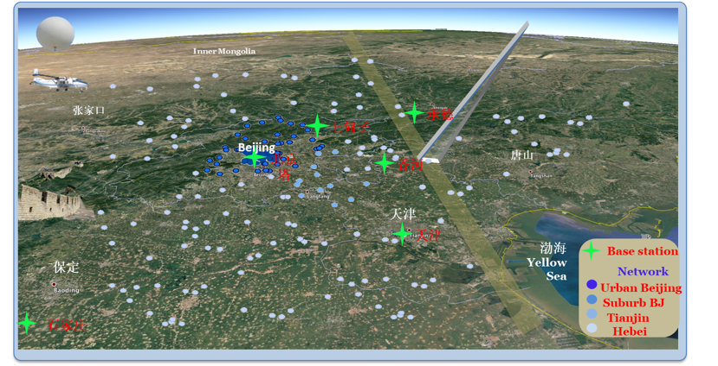
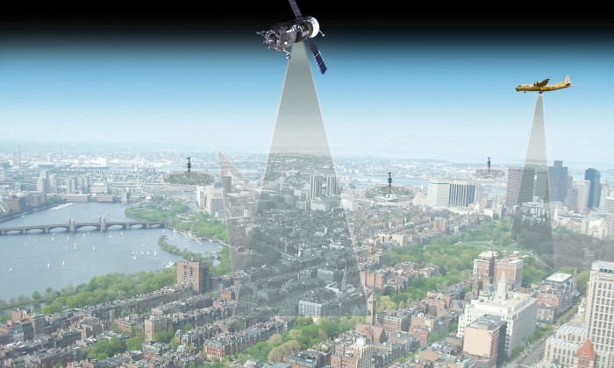

Researchers are developing methods to evaluate greenhouse gas emissions and sinks
Australia national synthetic GHG emissions
Global
National
Cities
Industry
Beijing-Tianjin-Hebei (JJJ) Megacity
Carbon Monitoring network

Slide 4
WMO Global Greenhouse Gas Watch (G³W)

Slide 5
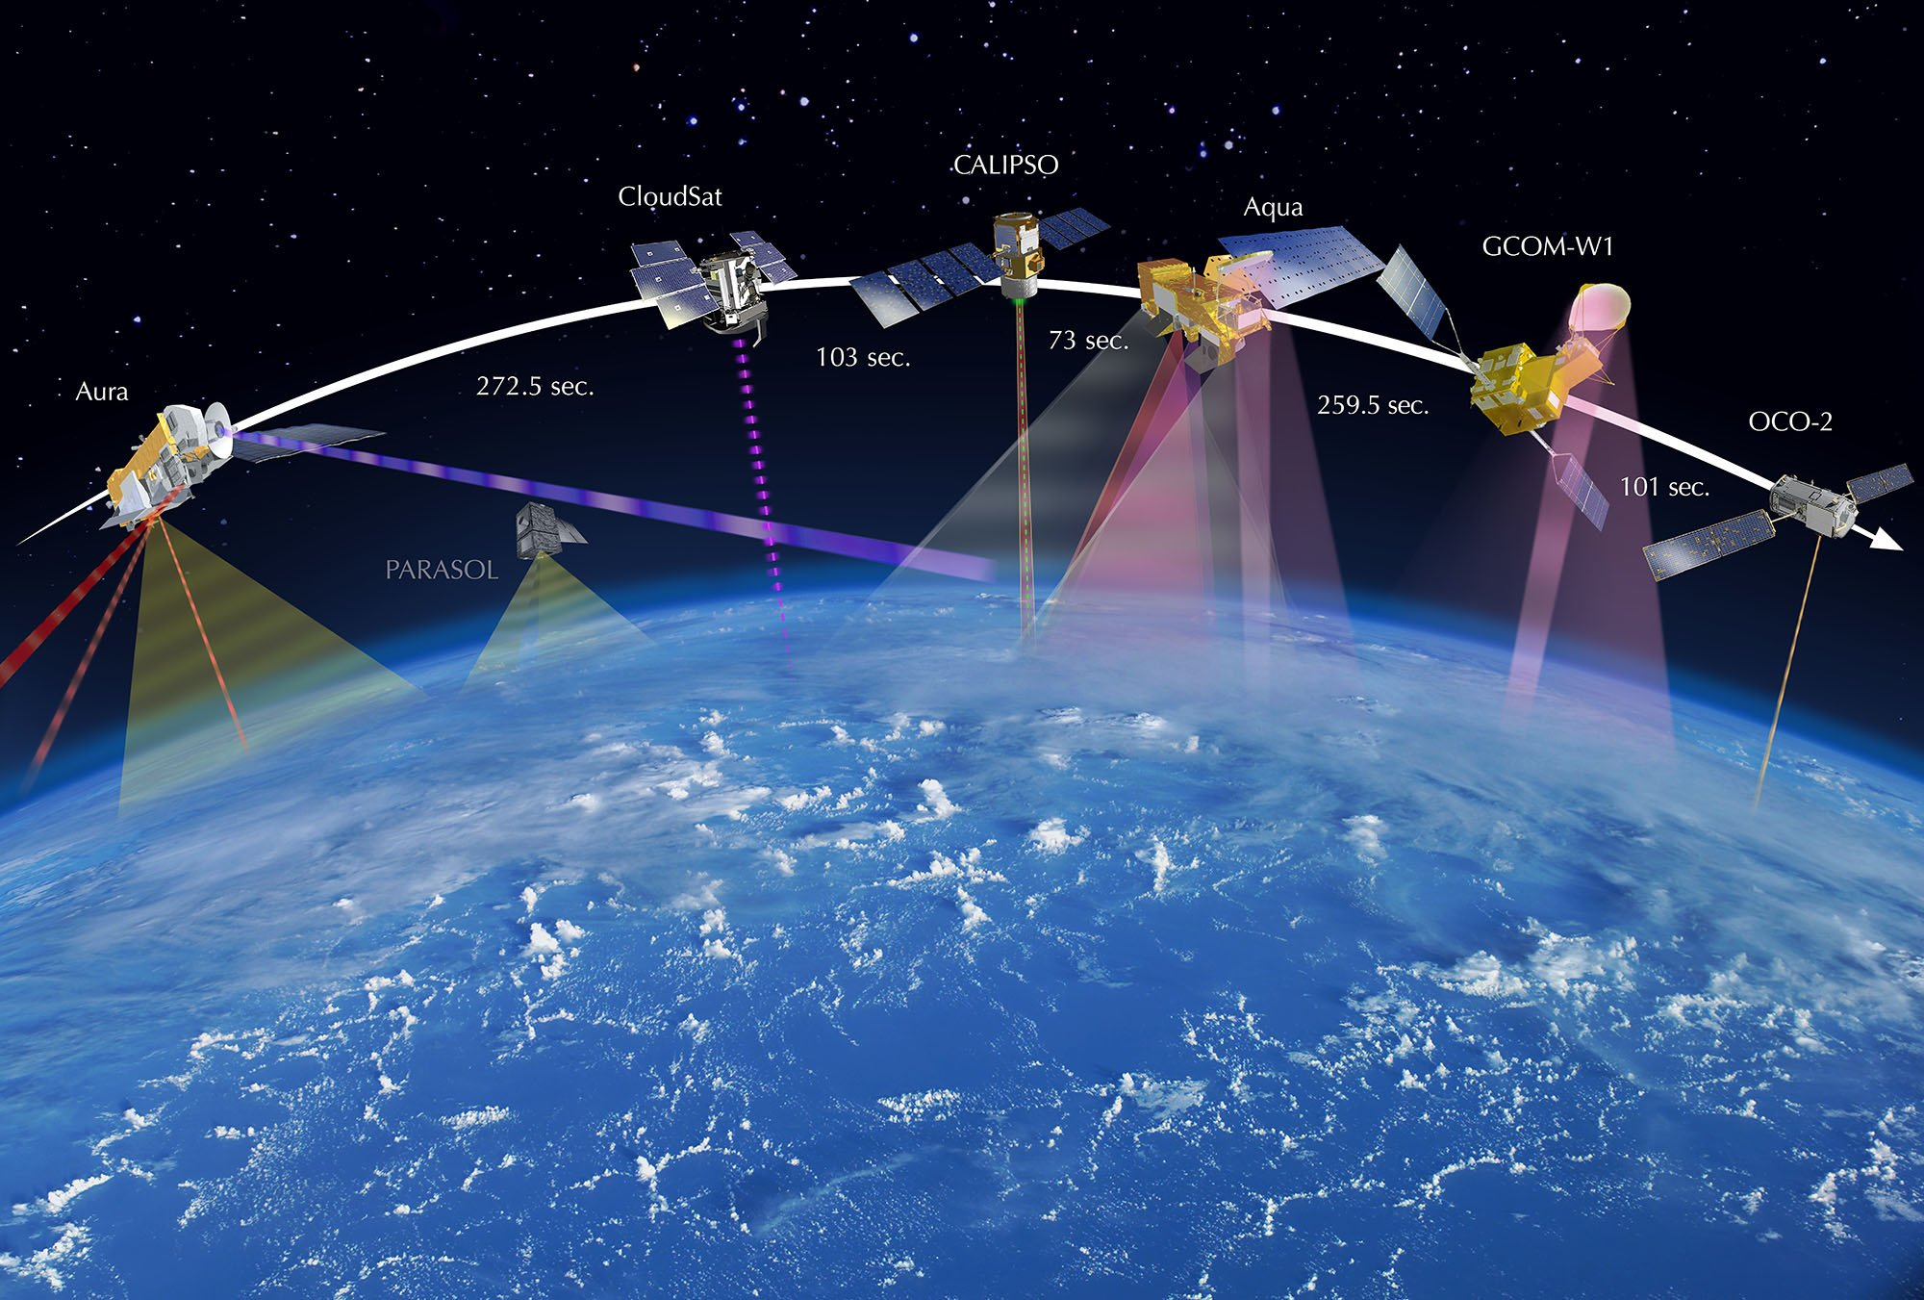


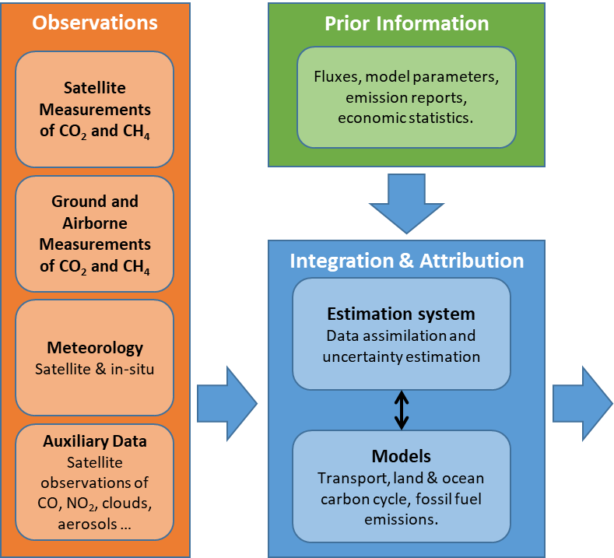

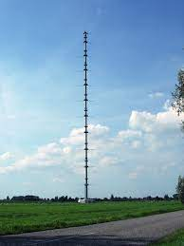
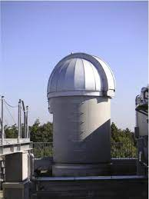
WMO Global Greenhouse Gas Watch (G³W) General principles
free and unrestricted data exchange
Scientifically objective data, based on consensus
Example of the conceptual architecture of the system (implemented by the European Commission)

Slide 6
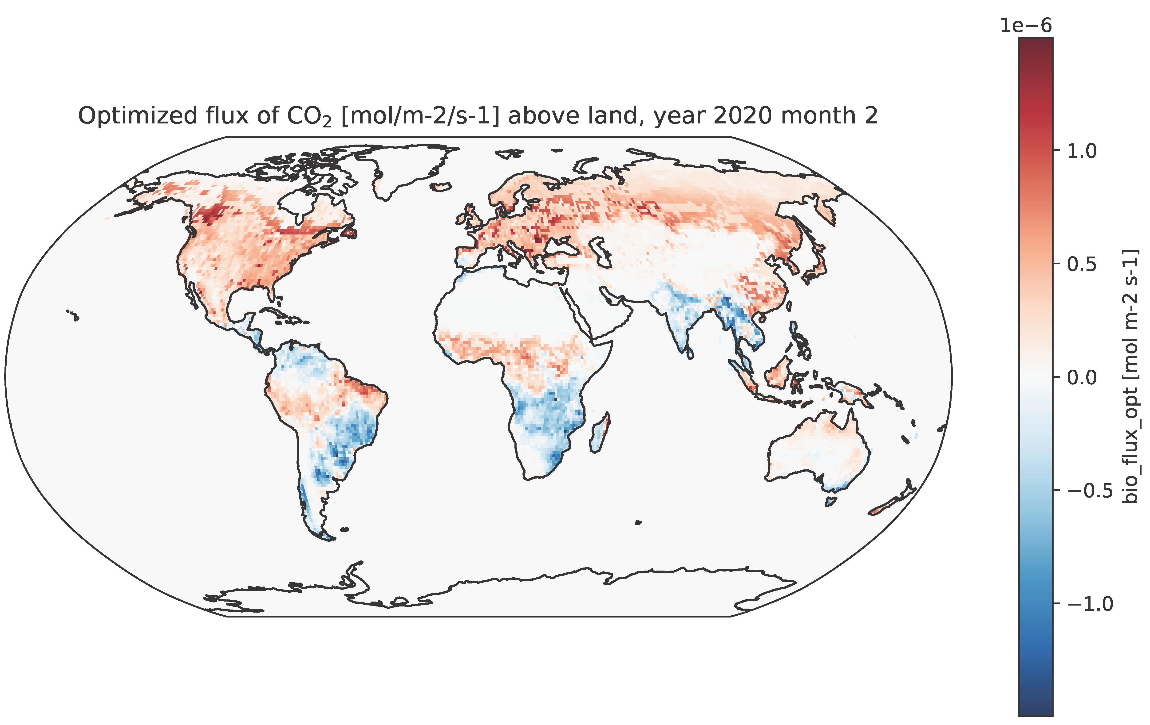
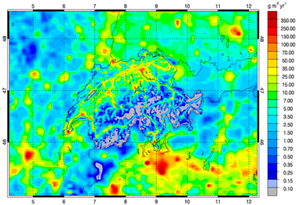
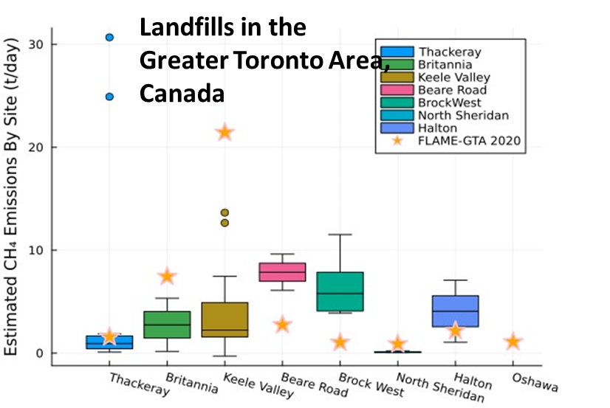

G³W can provide boundary conditions for decision-making scales
National
Boundary conditions
Urban
Facility
G3W: modelled global GHG concentration fields at 1x1° resolution, and modelled monthly net surface fluxes at 1x1° resolution
External to G3W programme
Space for research, private and national public initiatives

Slide 7
Integrated Global Greenhouse Gas Information System (IG³IS)

Slide 8



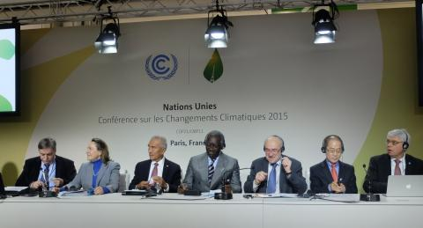
IG³IS Integrated Global Greenhouse Gas Information System
World Meteorological Organization programme
IG³IS is a bridge connecting atmospheric greenhouse gas science with stakeholders and policy outcomes
National Provide information to inventory builders in support of their efforts to reduce uncertainty of national emission inventory reporting to United Nations Framework Convention on Climate Change (UNFCCC)
Cities Support subnational government entities such as cities and states that represent large greenhouse gas (GHG) source regions (e.g., megacities) with actionable information on their GHG emissions at the needed spatial, temporal and sectoral resolution to evaluate and guide progress towards emission reduction goals
Industry Provide information to industry and private sector businesses that will help locate and quantify previously unknown emission reduction opportunities such as fugitive methane emissions from industrial sources
Global stocktake Support the Paris Agreement’s global stock take as governments and the UNFCCC define their requirements.

Slide 9

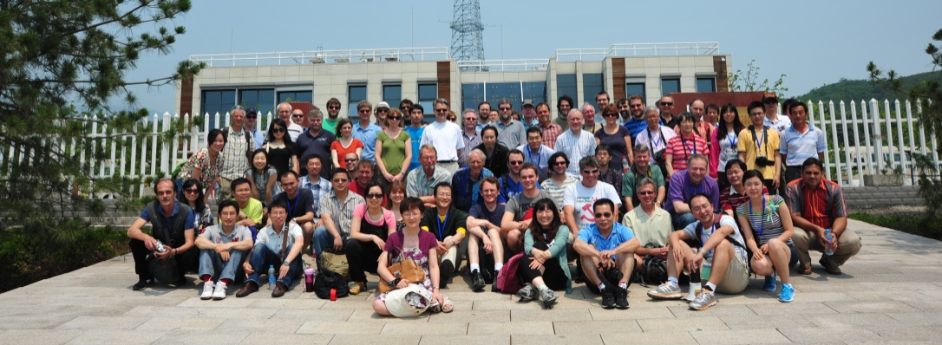
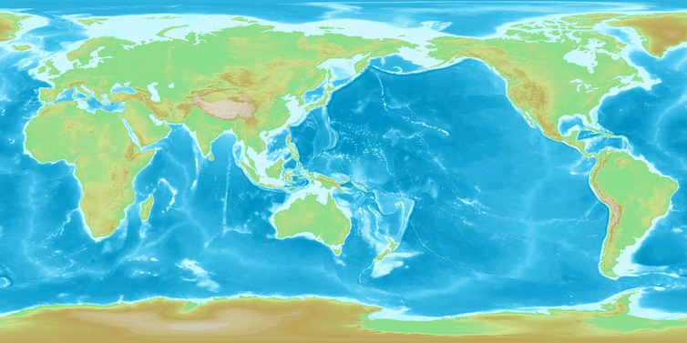
What does IG³IS do?
Endorse and support projects to achieve stakeholder outcomes
find and engage with local stakeholders
connect to experienced researchers and projects
Summer schools and other training opportunities
Facilitate engagement between scientists and policymakers
  Stakeholder summits
  Webinars
Collaborate with other international working groups
IPCC TFI, UNFCCC SBSTA
IMEO, CCAC
WMO G³W
Develop and disseminate good practice guidelines
Urban
National
Forestry
IG³IS endorsed projects

Slide 10
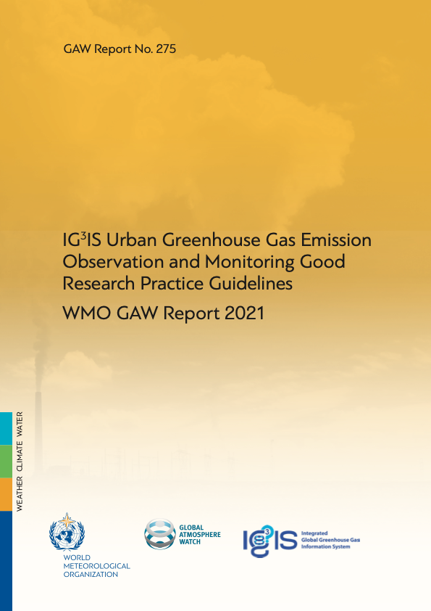
IG³IS Good Practice Guidelines for Greenhouse Gas Information
Urban
National
Forestry
Methane
Others…

Slide 11
IG³IS Good Practice Guidelines for Greenhouse Gas Information
Urban
National
Forestry
Methane
Others…
2021 release available, second edition release June 2025
Under development for release in late 2025
in planning stage
Under consideration

Slide 12
IG³IS Urban Greenhouse Gas Emission Observation and Monitoring Good Research Practice Guidelines
Technical guidelines which current and new practitioners can use to design and evaluate their research plans and outcomes
Expands on existing inventory methods with atmospheric methodologies
Allows stakeholders to assess the quality of existing and proposed urban greenhouse gas research
Consolidates detailed “review” information on methodologies for researchers and practitioners
The first step on the pathway to documentary standards
First edition Urban guidelines published in 2021 and now being updated

Slide 13
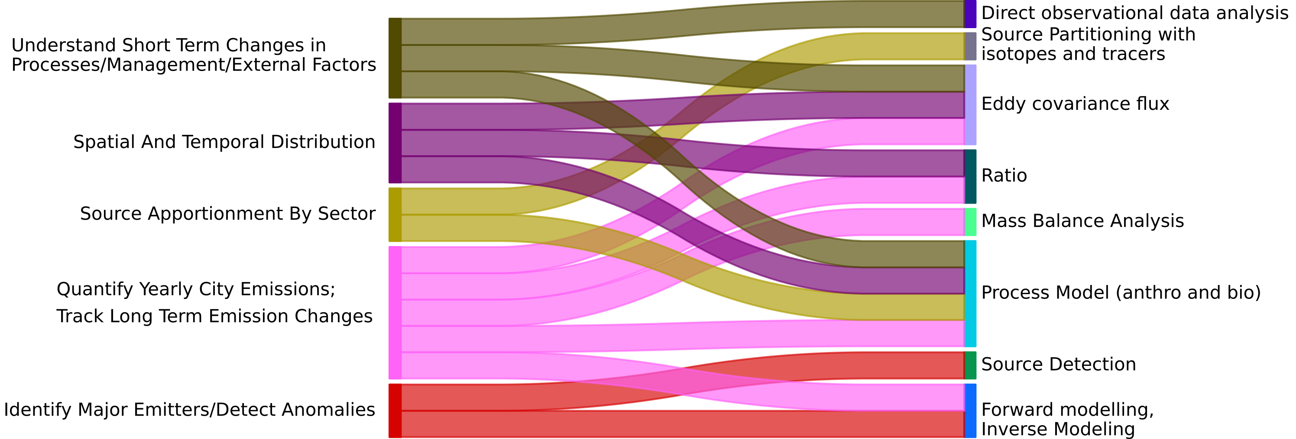
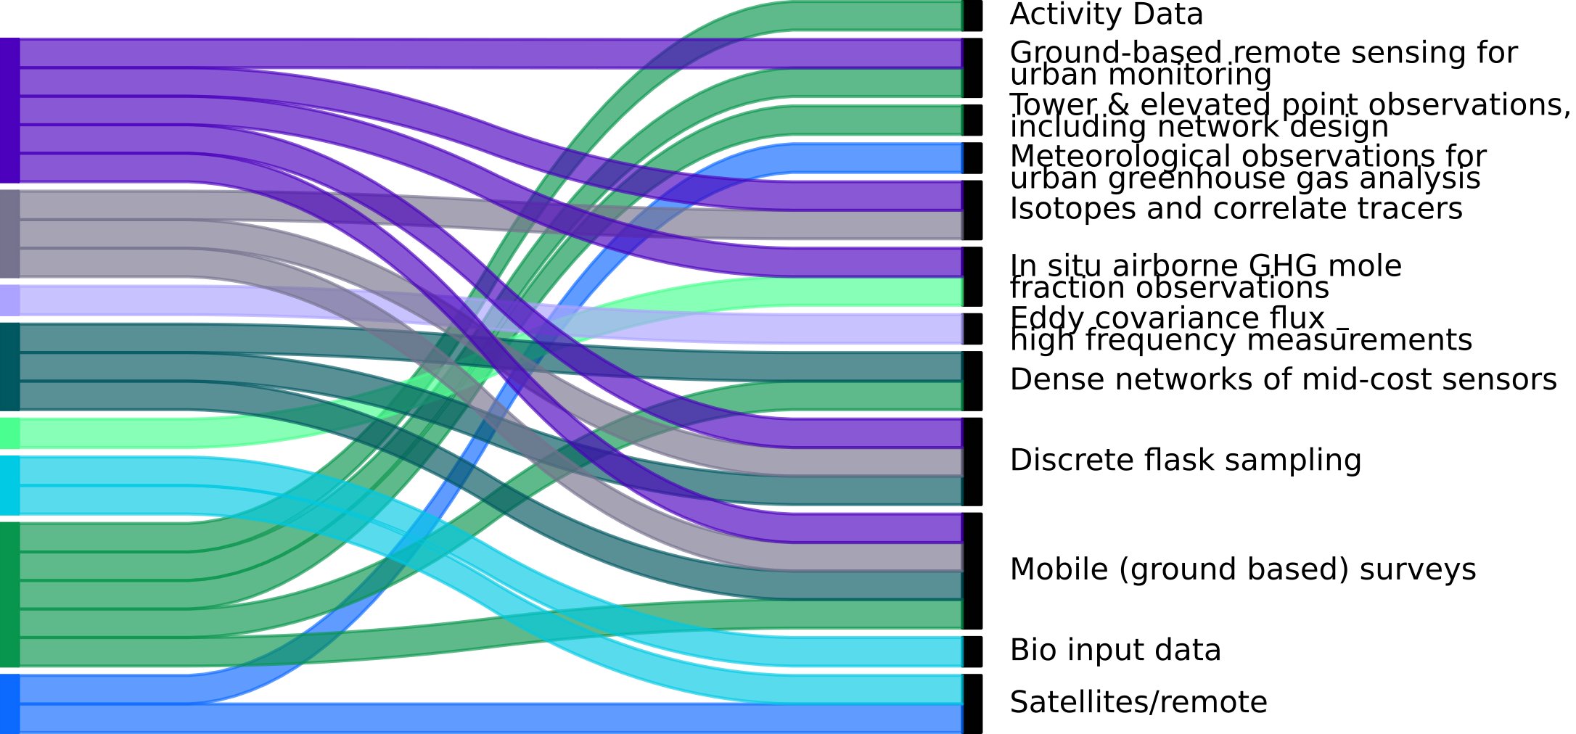
Urban Guidelines: Extended Technical Discussions
Urban Emissions Information
Emissions Quantification Tools
Input data
“Atmospheric components”
Flow of project planning
Data Management
Communication of data
Flow of information
Stakeholder needs are used to define the required emissions information, which can then be mapped to the Tools and Data needed
Extended Technical Discussions describe each method in detail

Slide 14
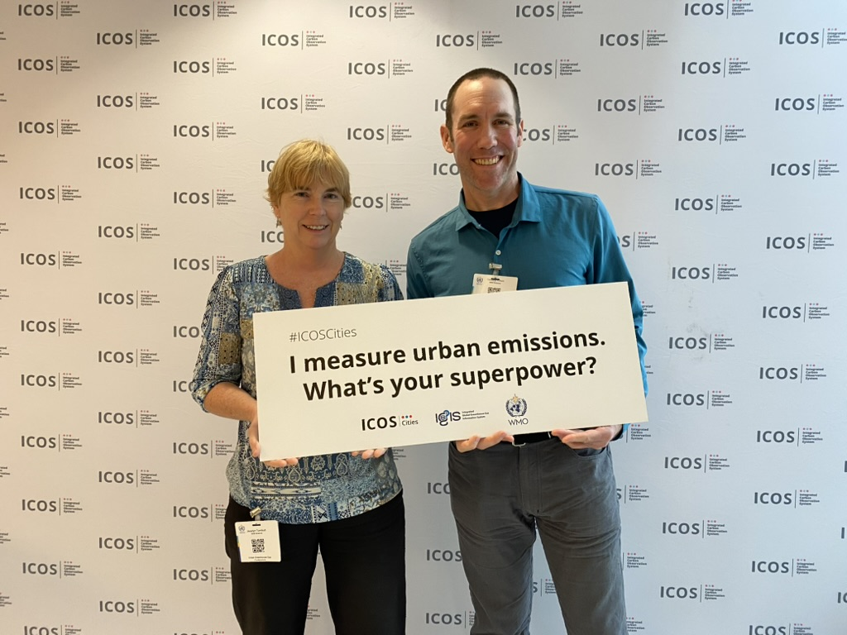
Urban Greenhouse Gas Conference (UGGC)
April 7-9 2025
Jointly hosted by IG³IS and ICOS Cities
Scientific sessions
Stakeholder sessions and panel discussions
Updates to the Urban Guidelines
Next UGGC 2028 or 2029
Urban Guidelines 2nd edition release late June 2025

Slide 15
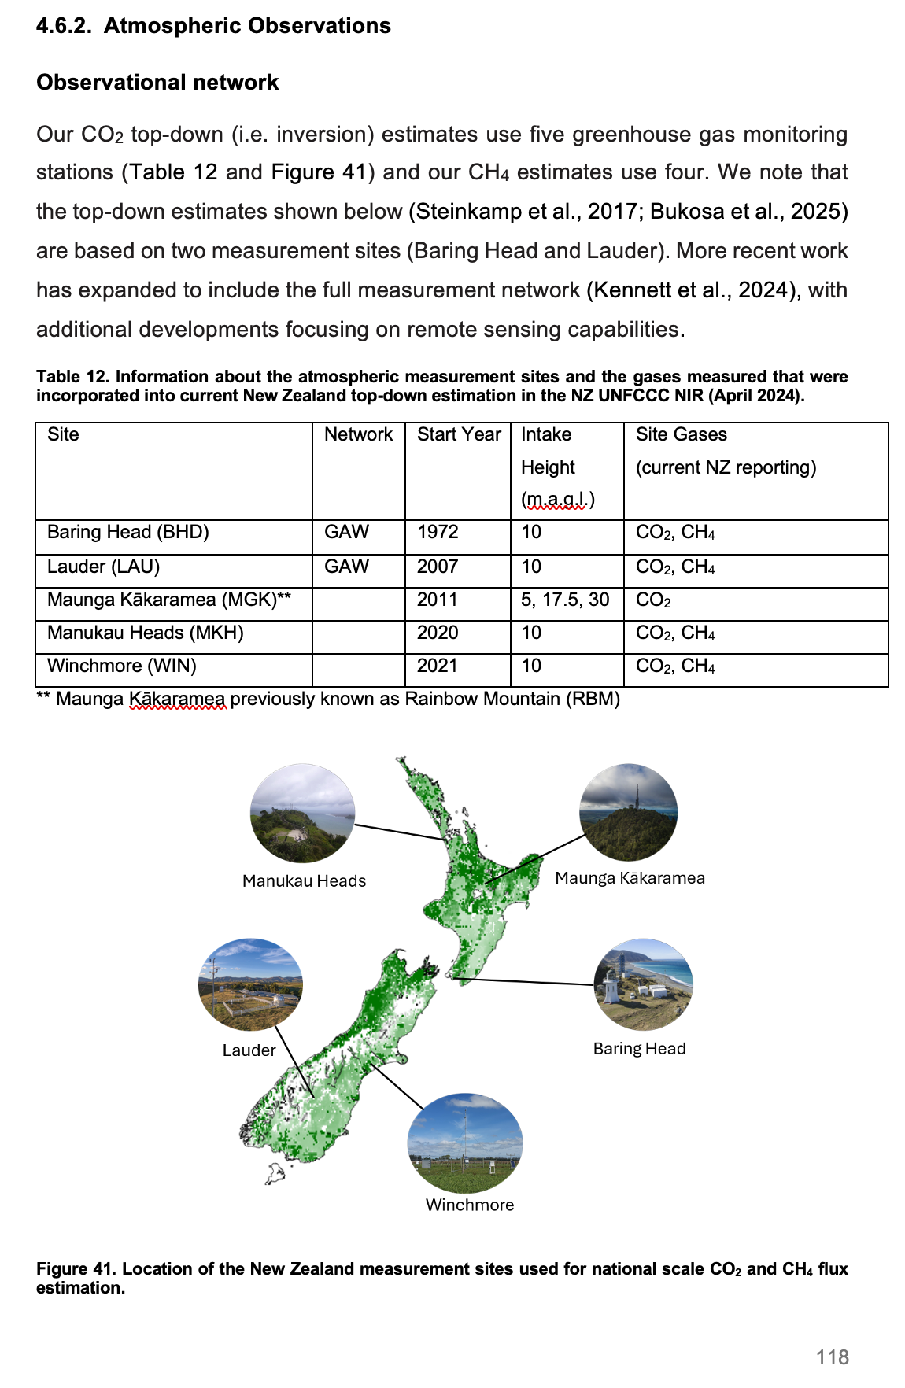
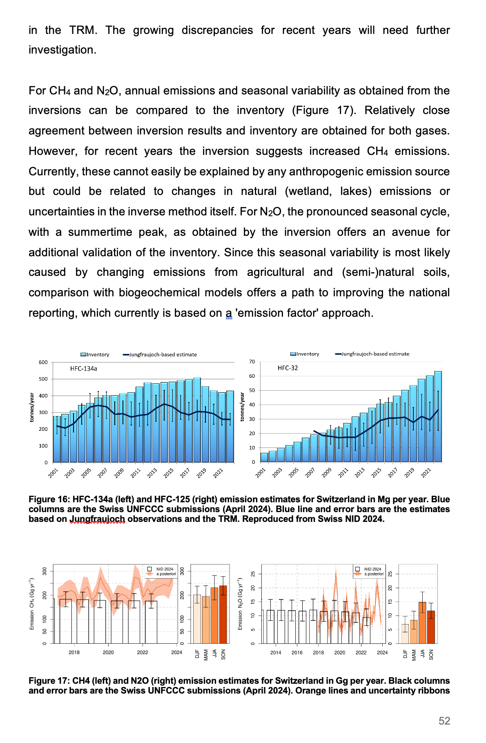
IG³IS National Scale Greenhouse Gas Emission Observation and Monitoring Good Research Practice Guidelines
Presented as a series of case studies from:
  UK – Switzerland – Australia – USA – Canada – New Zealand – Republic of Korea
Technical guidelines describing the application of atmospheric observing and modelling systems to estimate national GHG emissions
Primarily intended to support National Inventory Compilers
Pathways to incorporate atmospheric information into National Inventory Reports

Slide 16
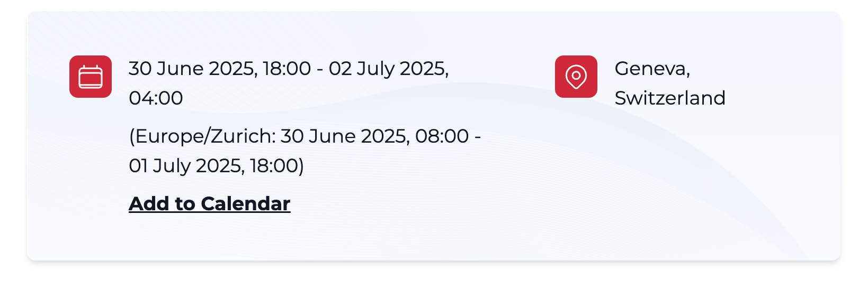
National Guidelines Workshop and Stakeholder Event
https://wmo.int/events/workshop/ig3is-national-scale-applications-of-science-based-quantification-of-emissions-and-removals
Or search: IG3IS national workshop
Hybrid conference, online attendance is strongly encouraged
Public comment on the National Guidelines: August – September 2025

Slide 17
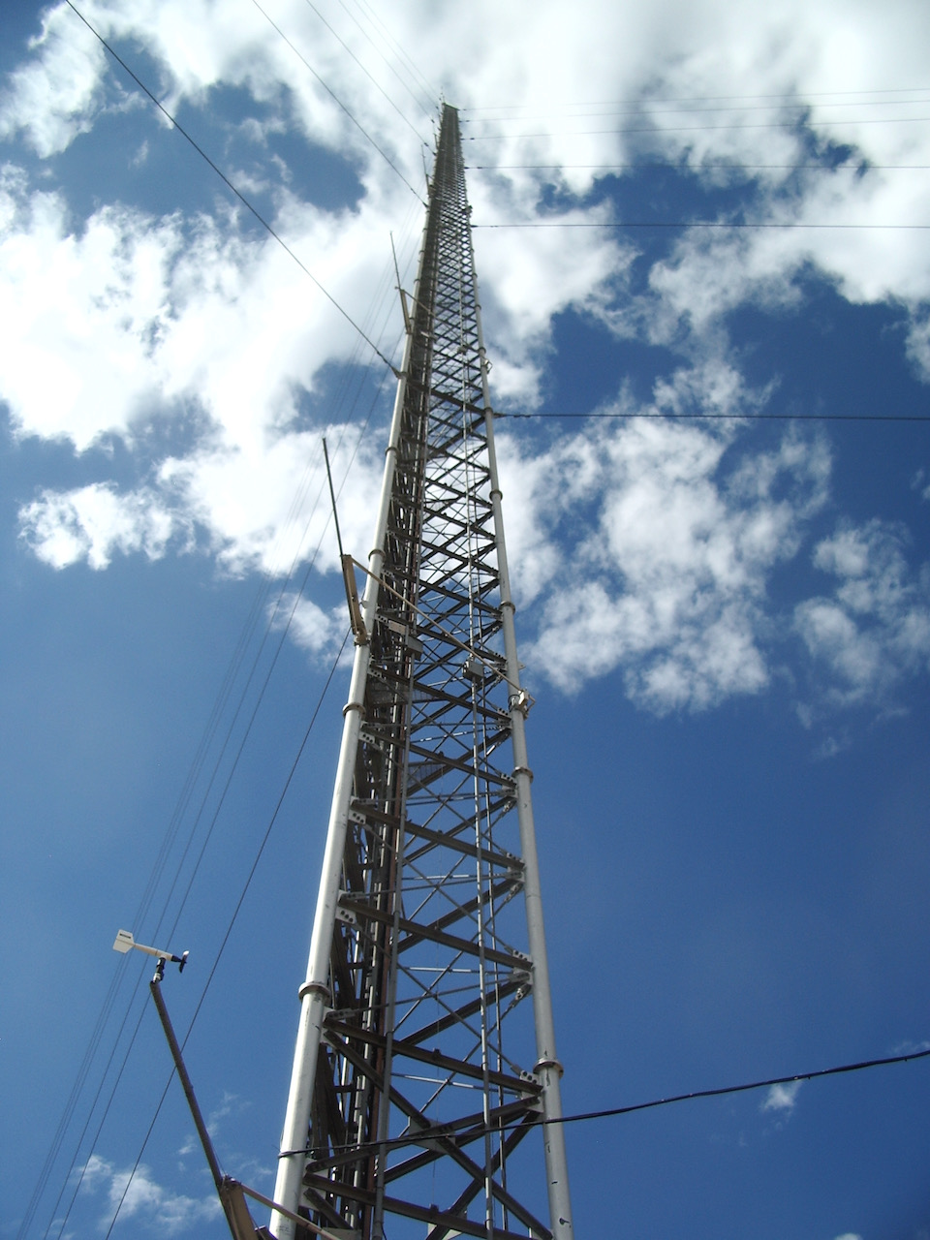
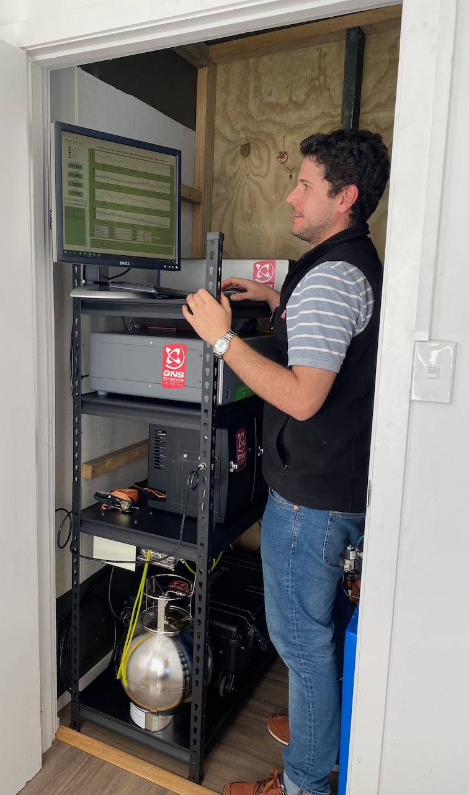


IG³IS – bridging greenhouse gas science and policy
IG³IS is a community effort, and you can contribute!
Contact us
IG³IS co-chairs: Jocelyn Turnbull, Phil DeCola, Felix Vogel
IG³IS WMO Secretariat: Oksana Tarasova, Jarin Tasneem Oyshi
IG³IS Steering Committee: Luciana Gatti, Anita Ganesan, Sander Houweling, Kevin Gurney, Rona Thompson, Thomas Lauvaux, Alistair Manning, Yogesh Tiwari, Marc Chiappero, Daniel Zavala-Araiza, Bo Yao, Stephan Henne, Jorn Herner, Lei Hu, Jinkyu Hong
IG³IS Stakeholder Group: Yann Francoise, Paulo Silva, Beatrix Cardenas, Tabare Curras
ig3is.wmo.int

