Slide 1
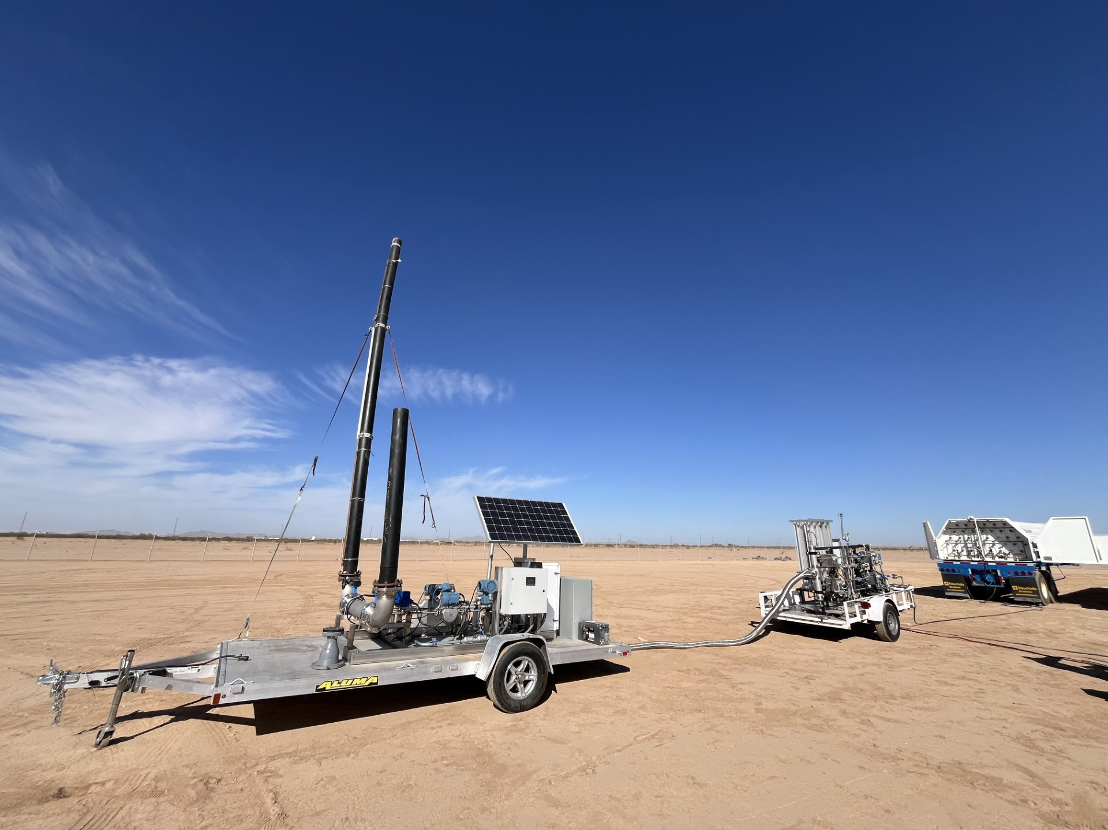
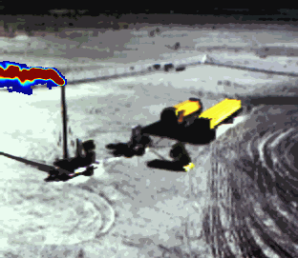
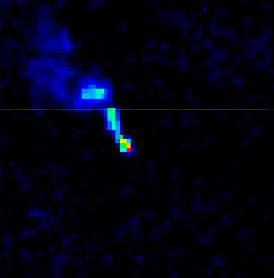



Initial results for 2025 single-blind controlled methane release testing of satellite detection and quantification
Left: AZ release site
Middle: Kuva IR image of 2/2 release
Right: Tanager-1 enhancement of 2/2 release
Frances Reuland¹, Taylor Adams², Kevin Galvin¹, Eric Kort², Evan Sherwin³, Adam R. Brandt¹
IWGGMS-21/AC-VC-21
13 June 2025, Takamatsu, Japan
¹
²
³

Slide 2
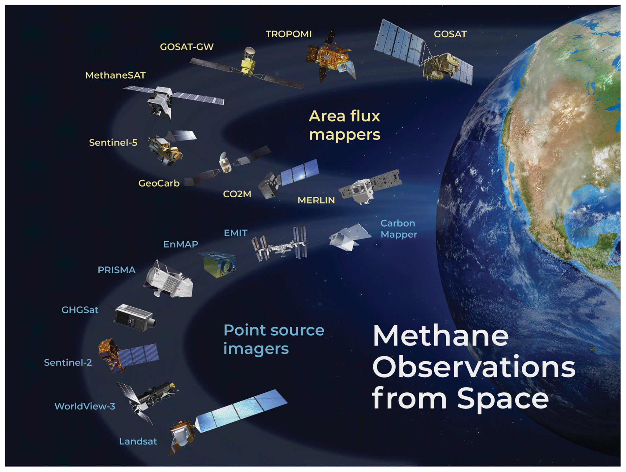
Motivation: independent testing of space-based methane detection needed
Satellite platforms are expanding quickly in number; new systems online
Remote sensing has a growing role in voluntary and regulatory emissions mitigation efforts globally
Systems need to be rigorously tested in a controlled way
Flexible and independent testing needed across various environmental conditions
Image credit: Daniel Jacob et al.

Slide 3
Prior studies
Current study
Sherwin et al. 2023
Releases Fall 2021
5 participating teams
5 participating satellites
19 days of releases
19 events
49 total estimates of emissions rates
Sherwin et al. 2024
Releases fall 2022
6 participating teams
9 participating satellites
2 months of releases
82 events
134 total estimates of emissions rates
Aug 1 2024 - Present
Initial cooperative “debugging” period
Q1 complete, Q2 observing finishes end June
Phased quarterly study design; At least 1 year deployment
Q1: 193 events (130 non-zero), 571 responses
New satellites participating - 12 total instruments
New analysis teams participating - 16 total analysis teams

Slide 4
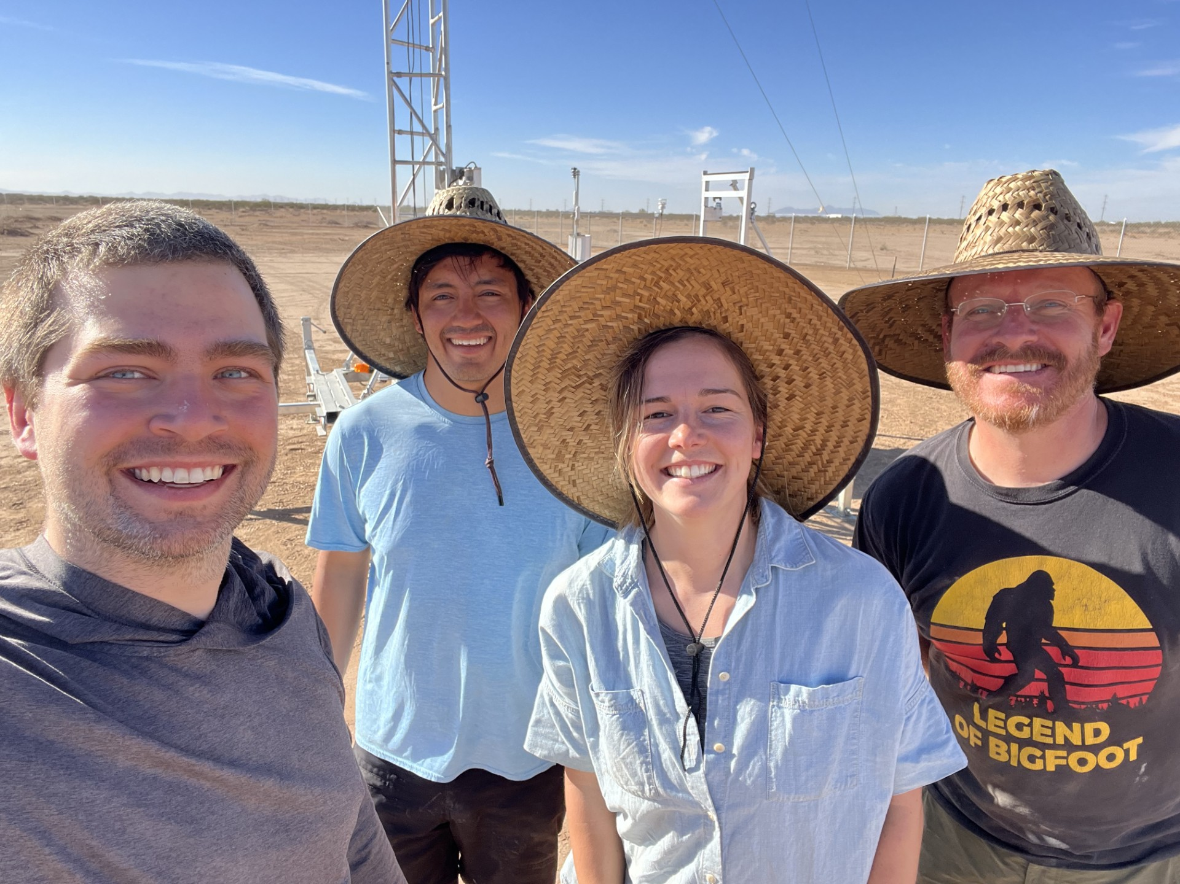
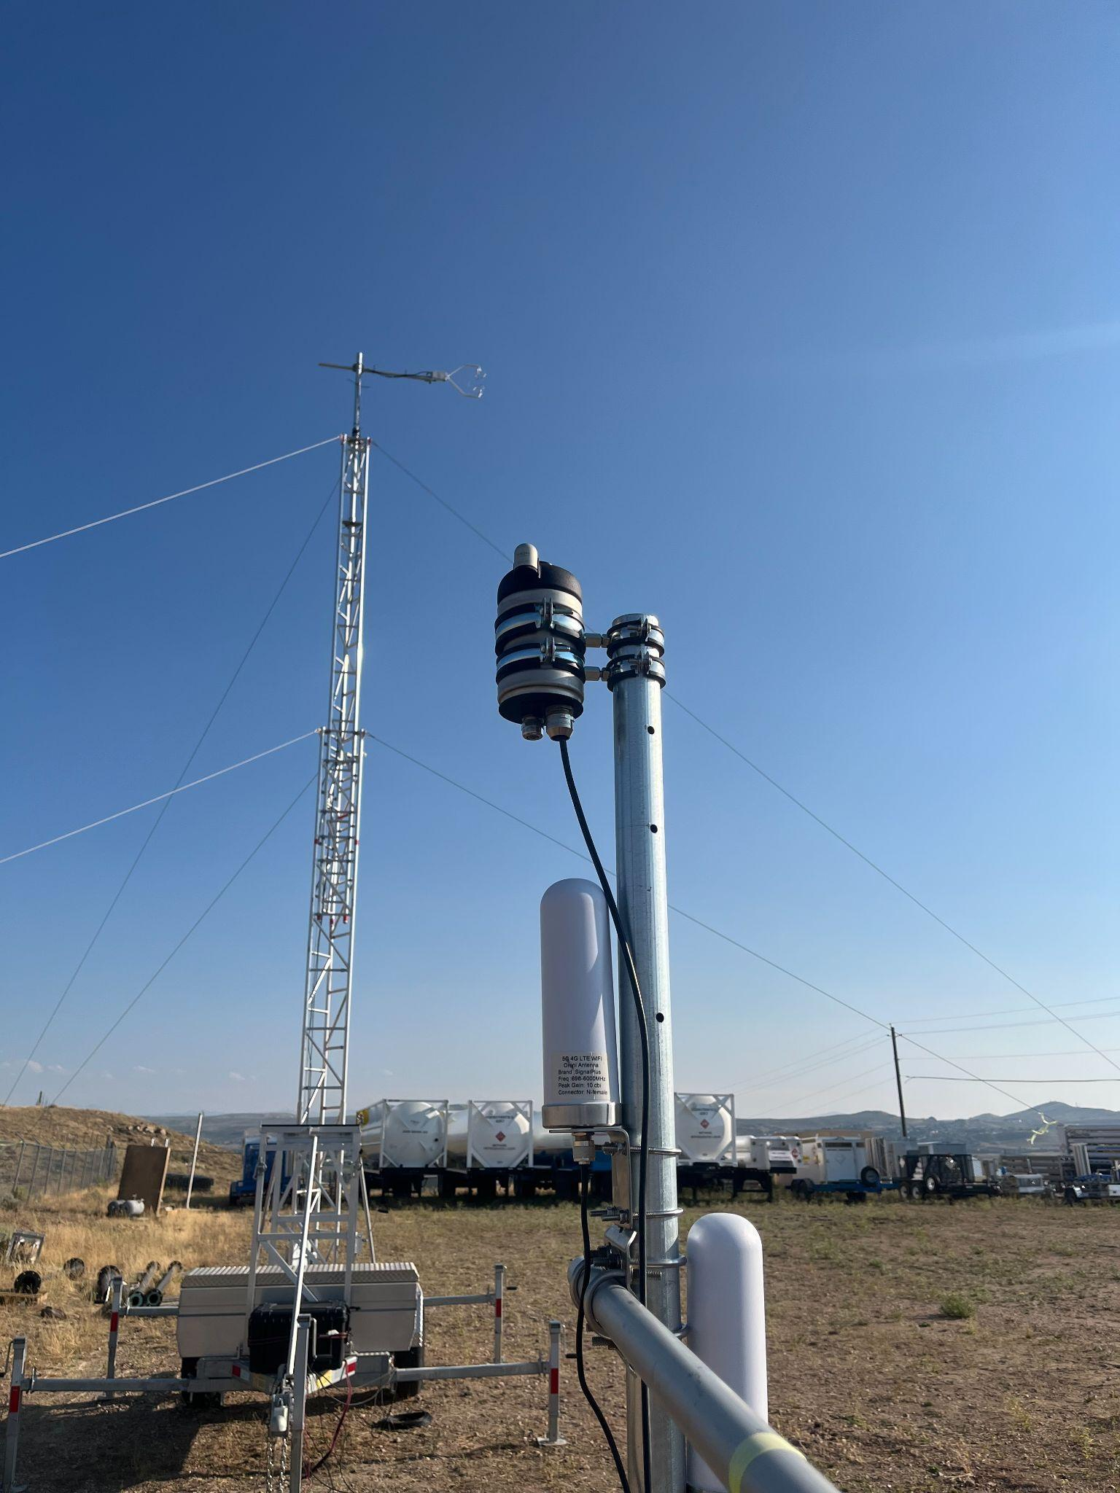
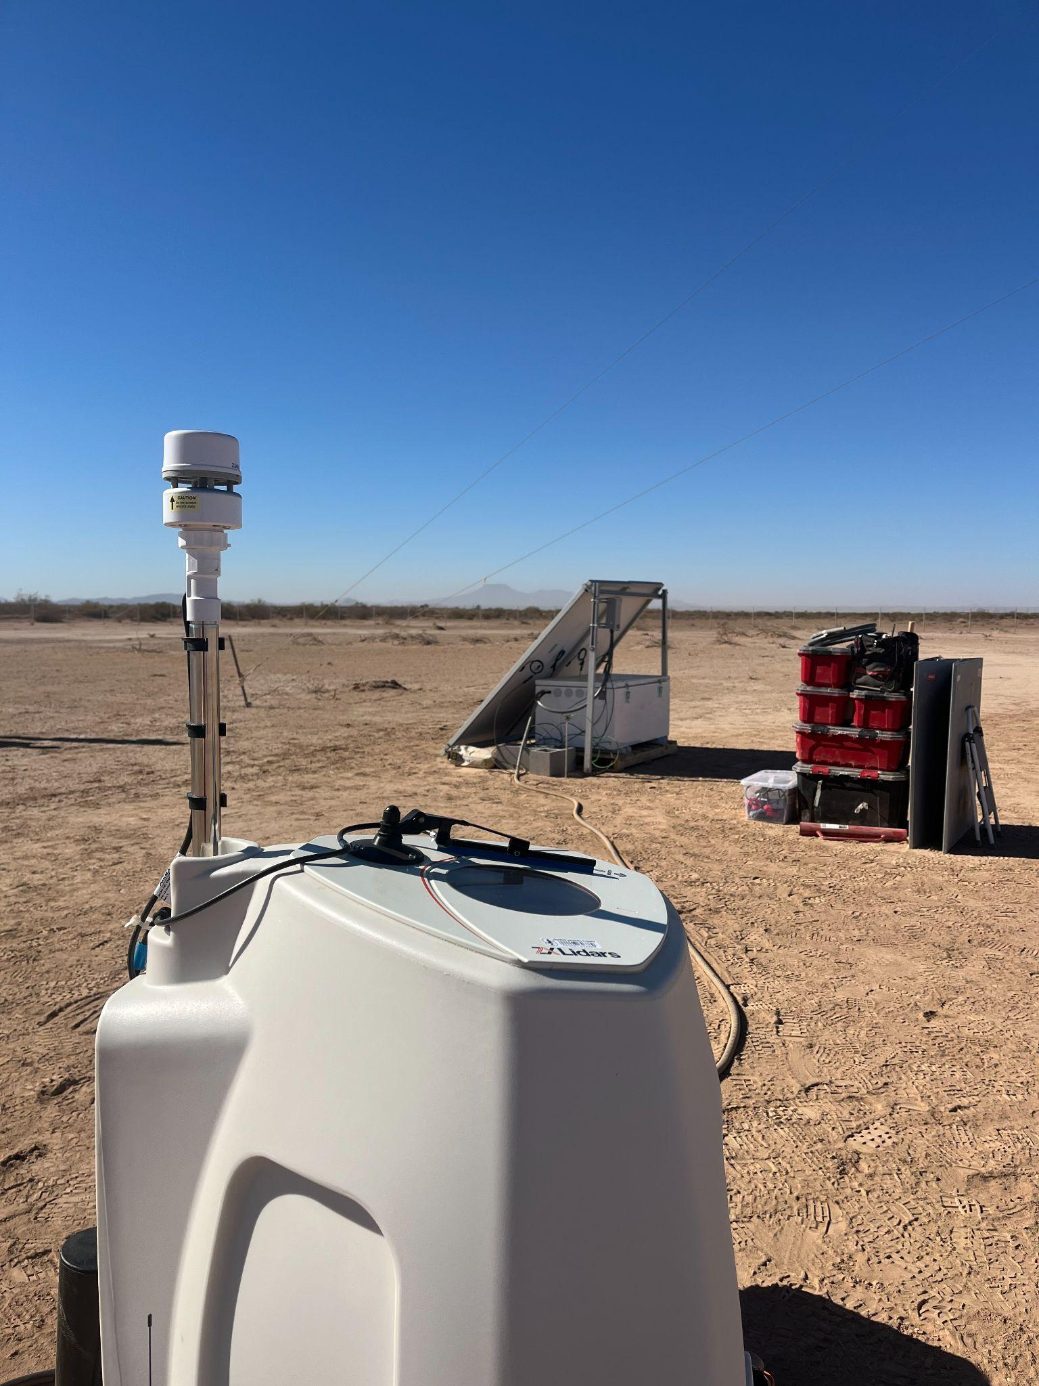
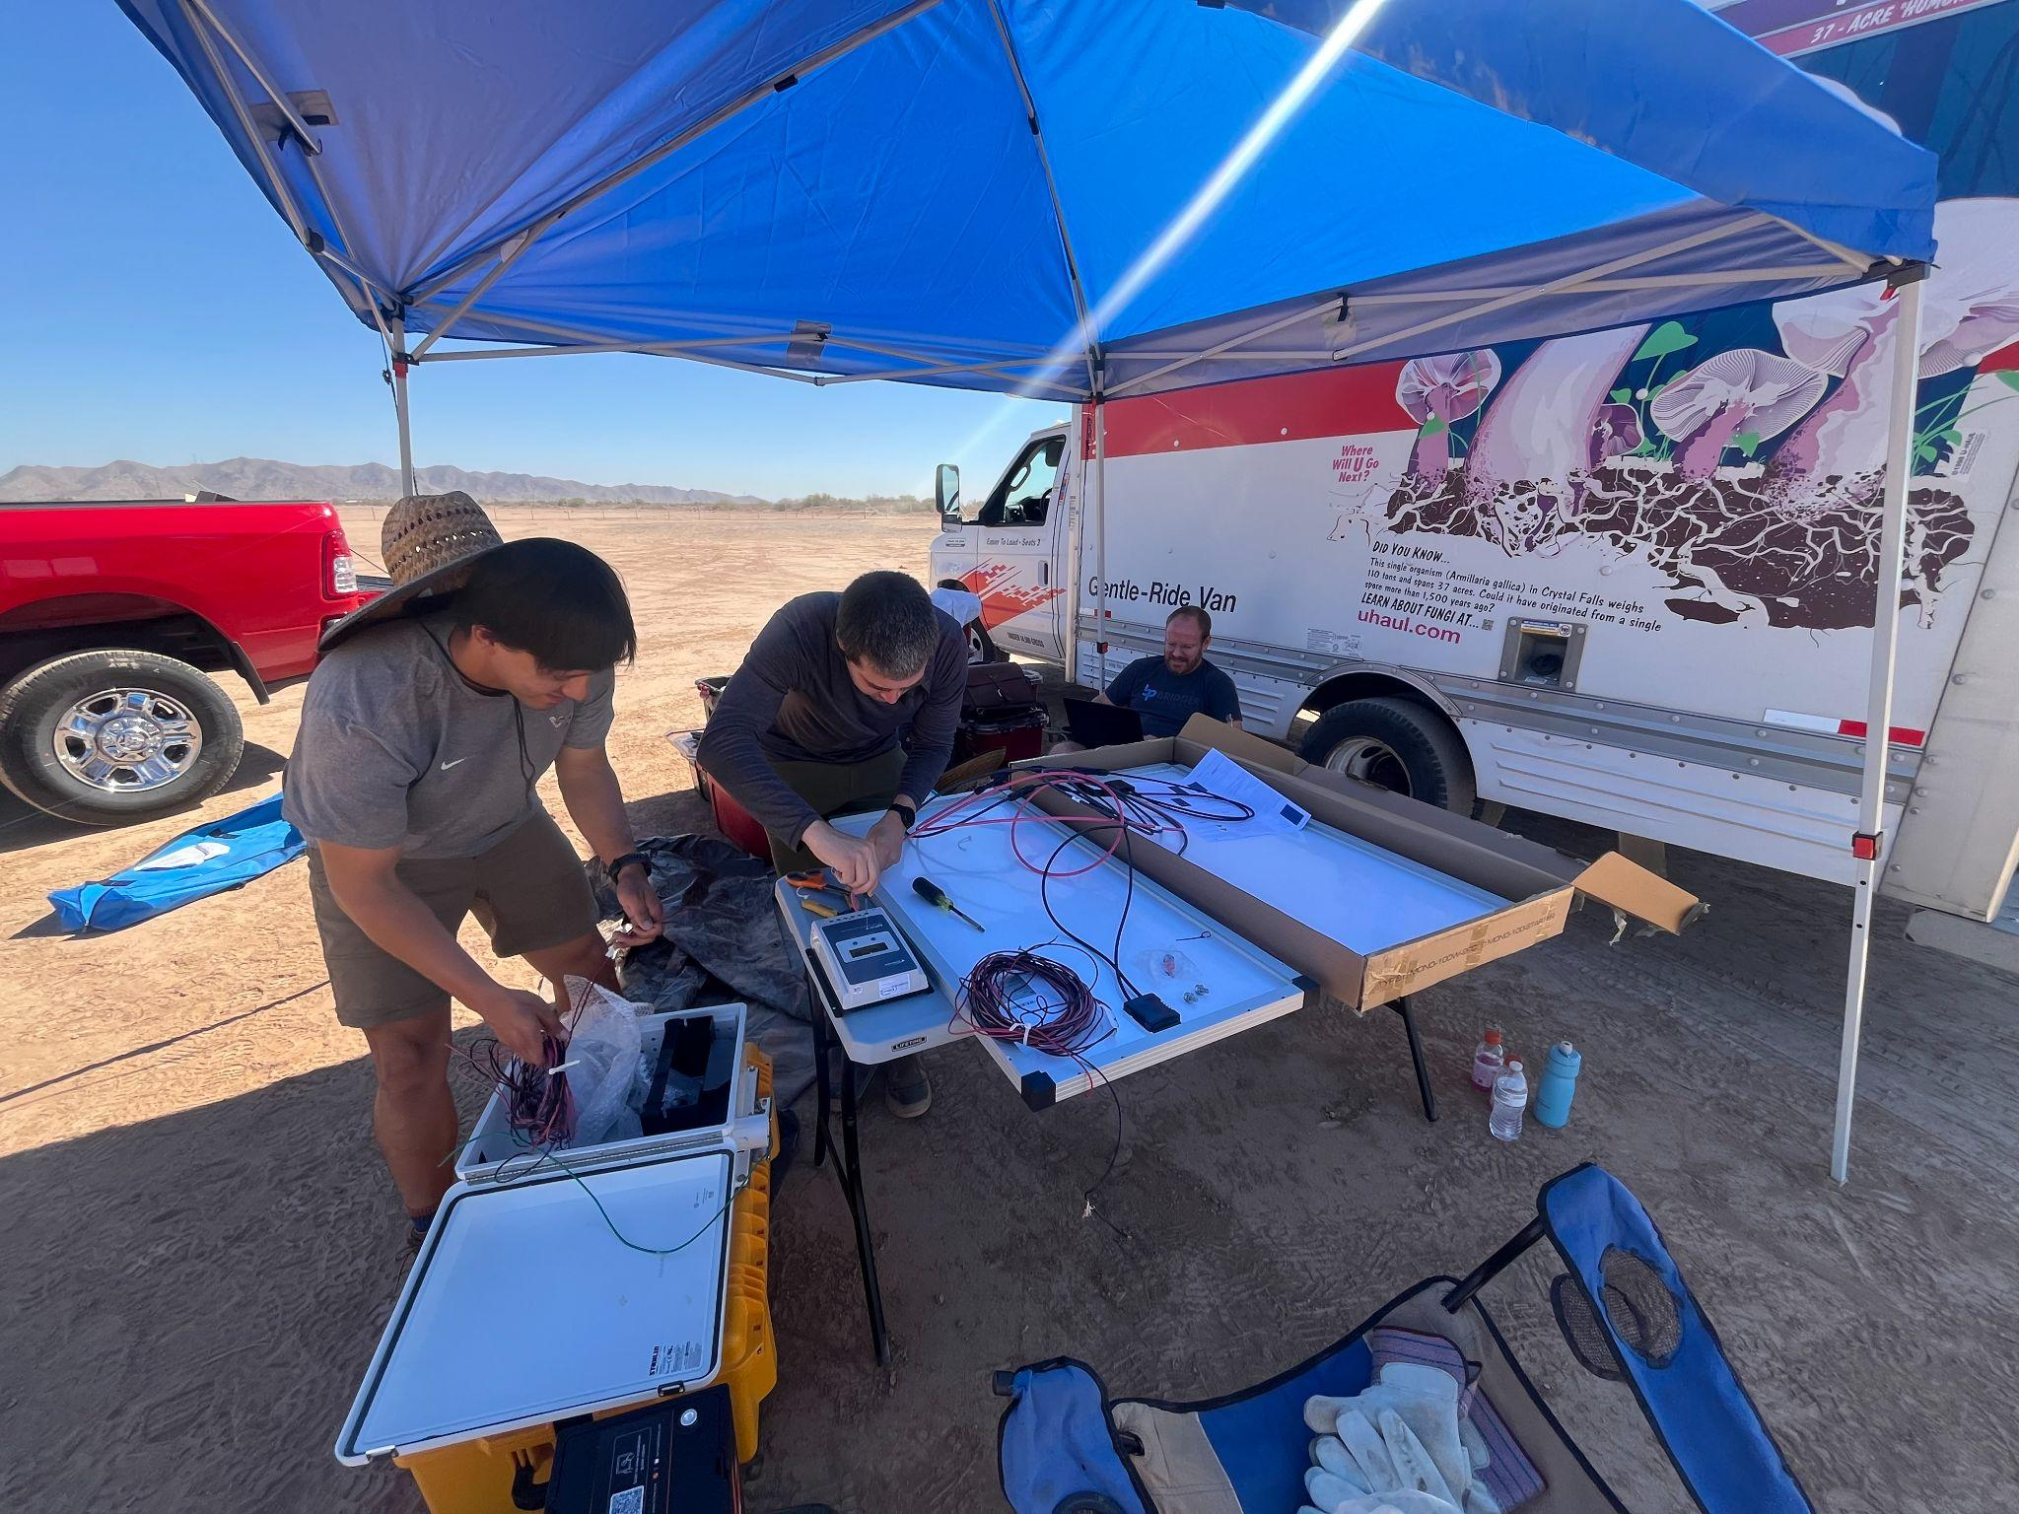

Slide 5
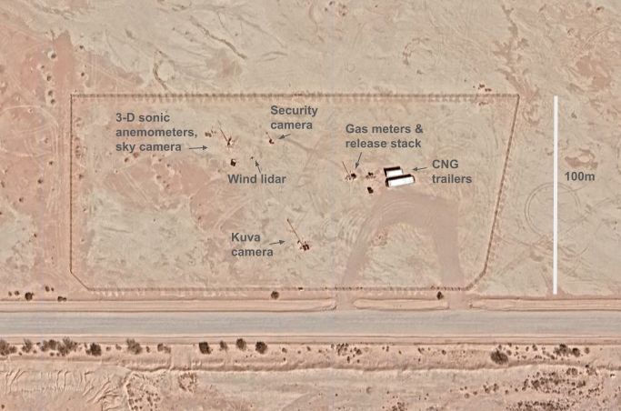
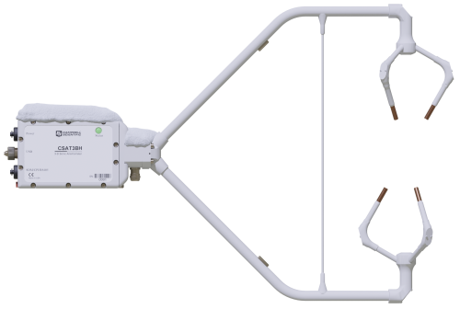
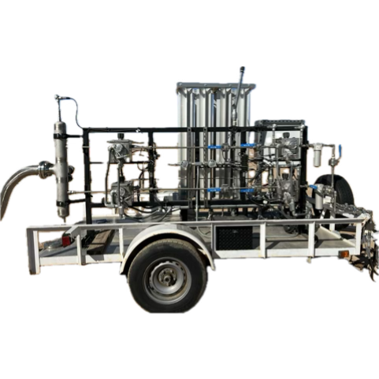
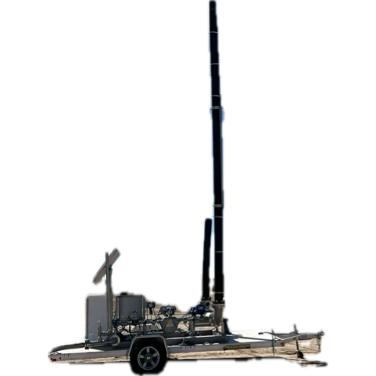
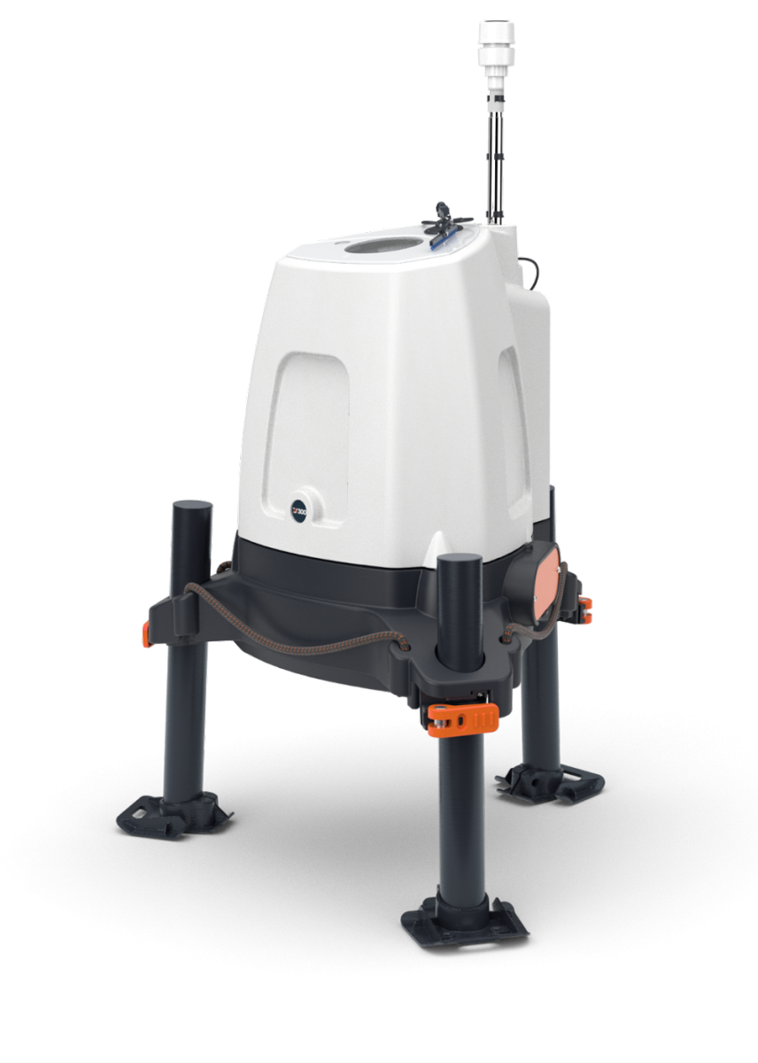
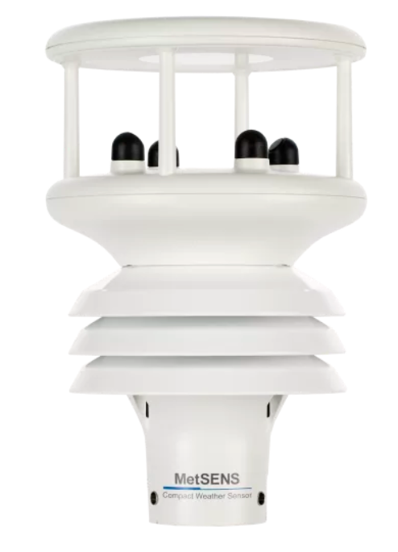
Gas flow and meteorological equipment
Release enabled by automated, solar/battery powered, remote-controlled release system of high-pressure gas
Designed to mimic a short-duration, high-emission event from a piece of emitting infrastructure, such as an unlit flare
CNG trailer
Up to 100m
Release stack
3 Coriolis-metered flow paths
10m
Sonic
15m
5m
Sonic
10m
Sky Camera
Pressure regulation unit
Soil moisture
sensor
2m
Sonic
Soil moisture
sensor

Slide 6
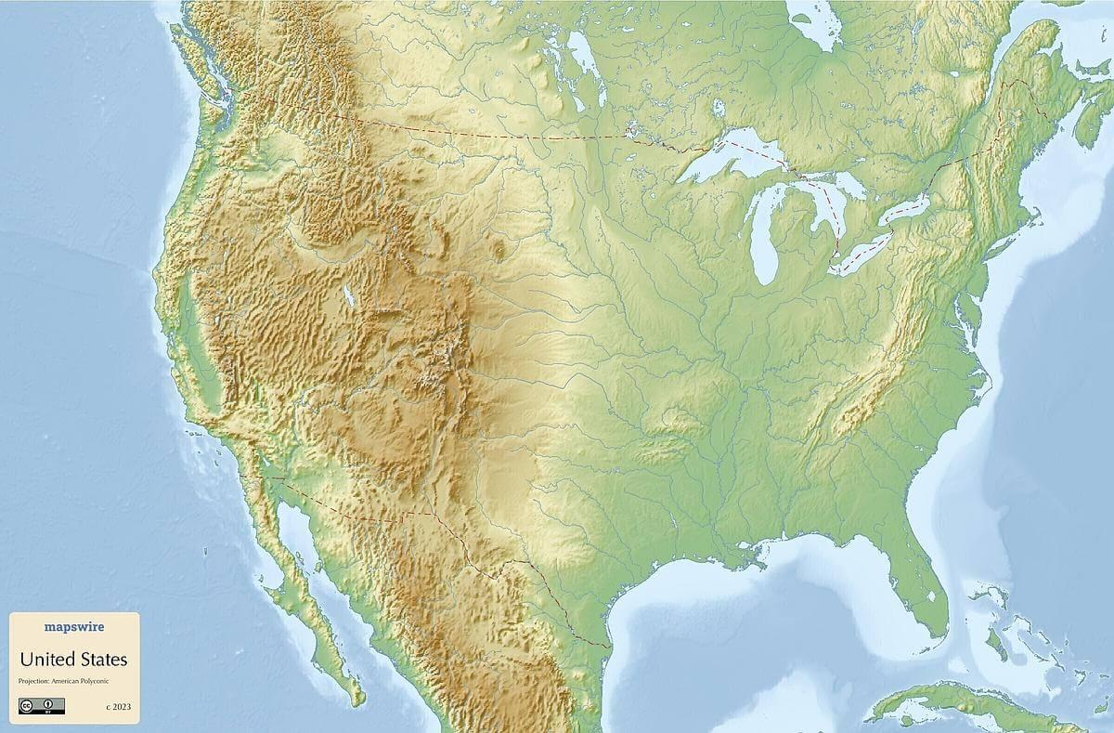
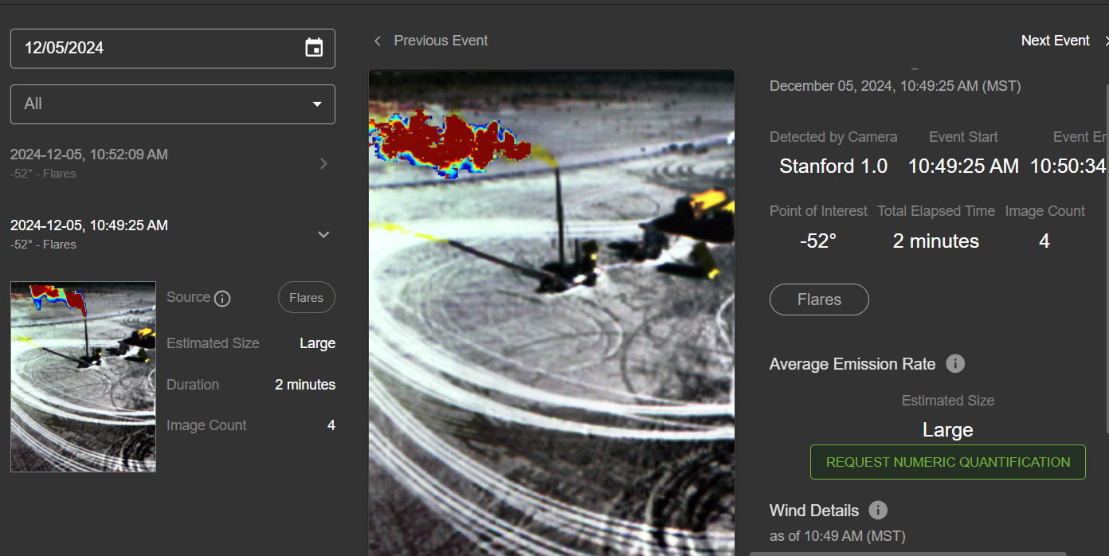
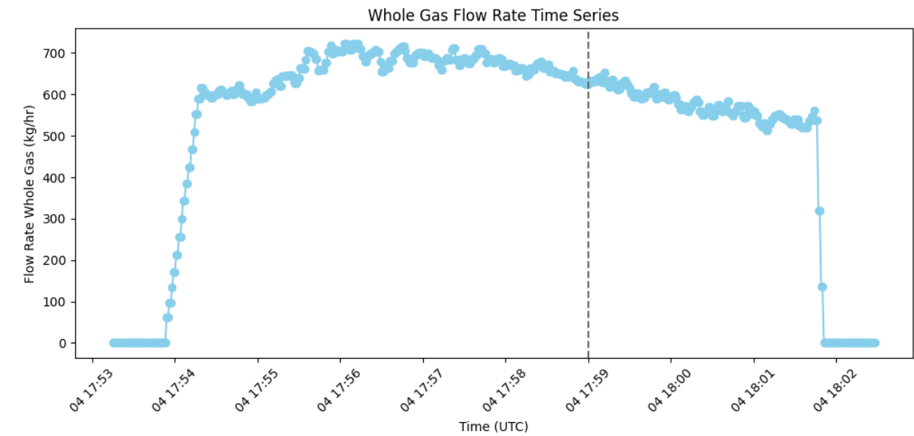
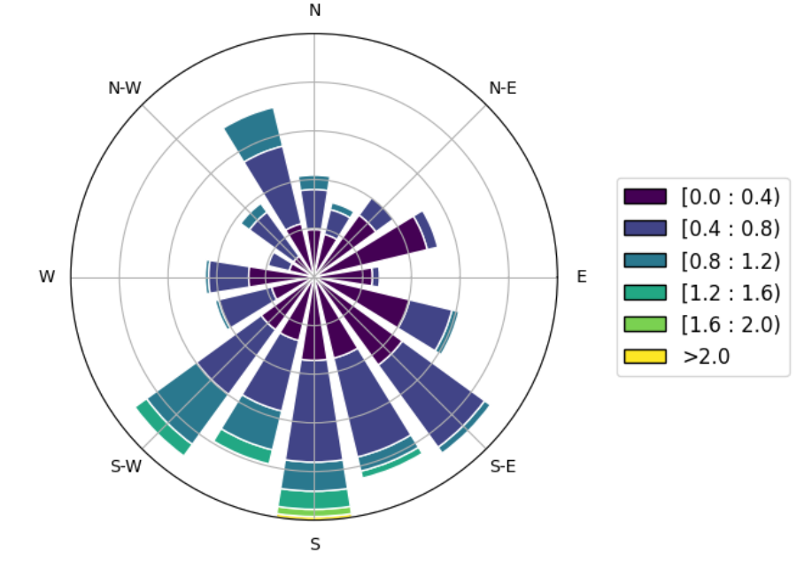
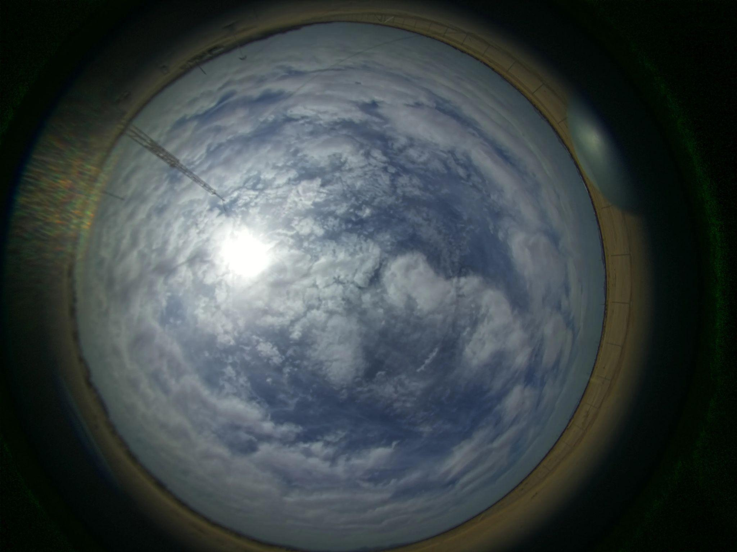
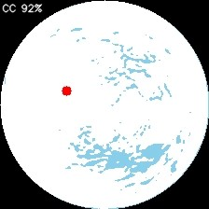
Data available for cooperative (159) and single-blind (130) controlled methane releases conducted at two U.S. locations
Datasets available via Stanford Digital Repository and Shared Drive
Data streams available:
  Coriolis-metered gas flow rates (1s resolution)
  Meteorological conditions from the release site:
    Ultrasonic anemometer - wind speed and wind direction at 2 m, 5 m and 10 m
    LIDAR wind measurements at 11, 15, 20, 25, 30, 35, 39, 40, 45, 50, 100 meters at regular interval (5s)
    Temperature, humidity, soil moisture (5s)
    Sky images (~30s), cloud mask and cover (%), solar irradiance
  Kuva SWIR RGB camera images of the plume (~30s)

Slide 7
Overpass outcomes (Phase 1)
Filtered due to clouds, etc
(70/351, 20%)
FN
(95/281, 34%)
Images (99/130) analyzed by teams, yielding 351 responses
Stanford/UMich conducts release
(n = 130)
TP, not quantified (2/281, 1%)
Detection Outcome
(281/351, 80%)
Not tasked/no image
(31/130)
TP, with estimate (184/281,65%)
Schedule of satellite overpass opportunities
Filtered due to clouds, etc.
(62/220, 28%)
Images (53/63) analyzed by teams, yielding 220 responses
TN (138/158,87%)
No release
(n=63)
Detection Outcome
(158/220, 72%)
Not tasked/no image
(10/63)
FP (20/158,
13%)

Slide 8
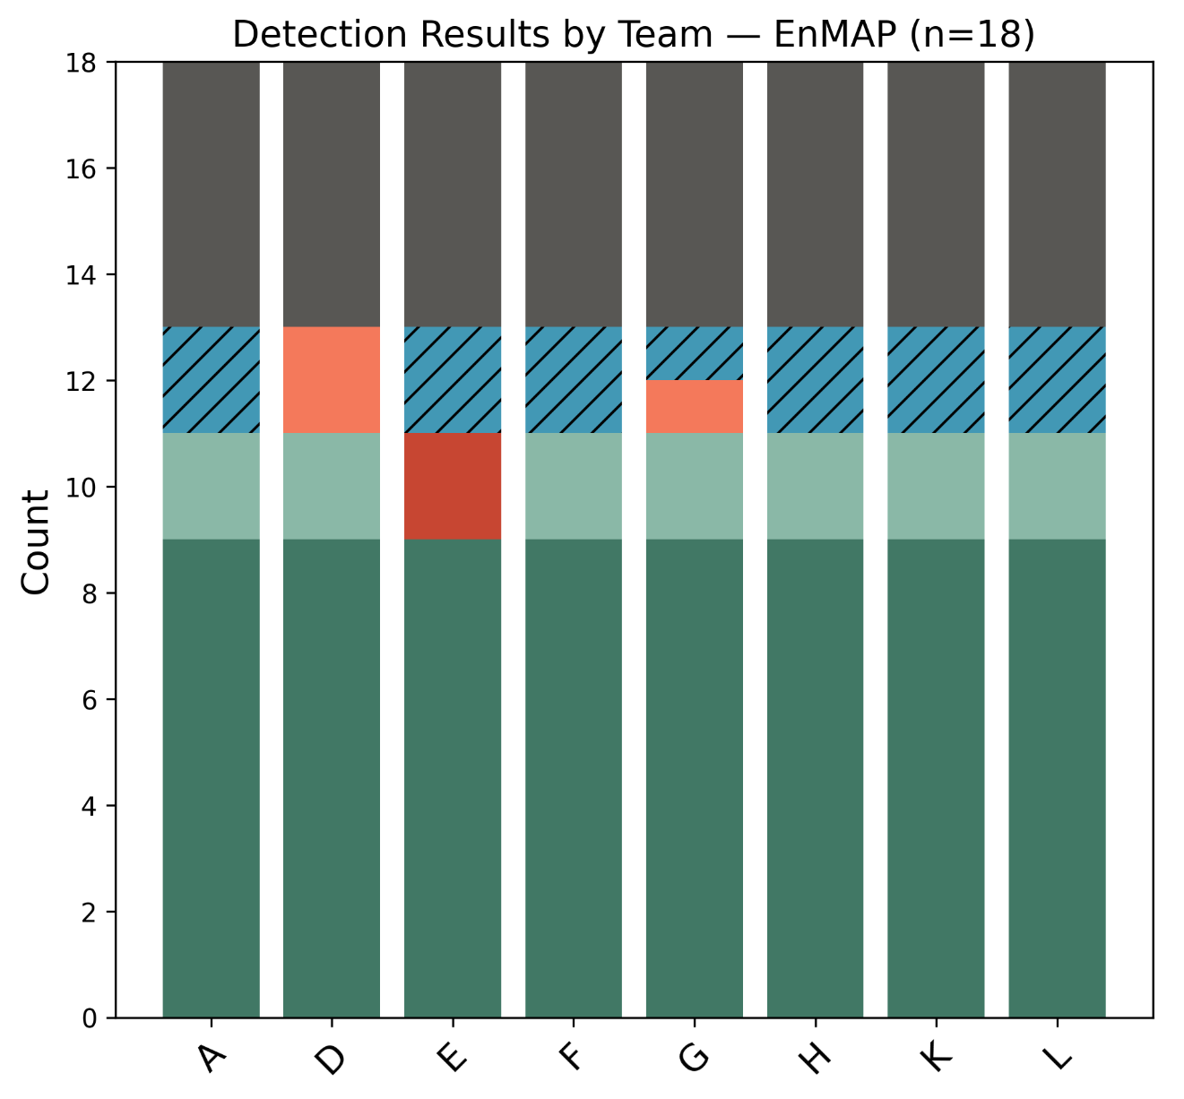
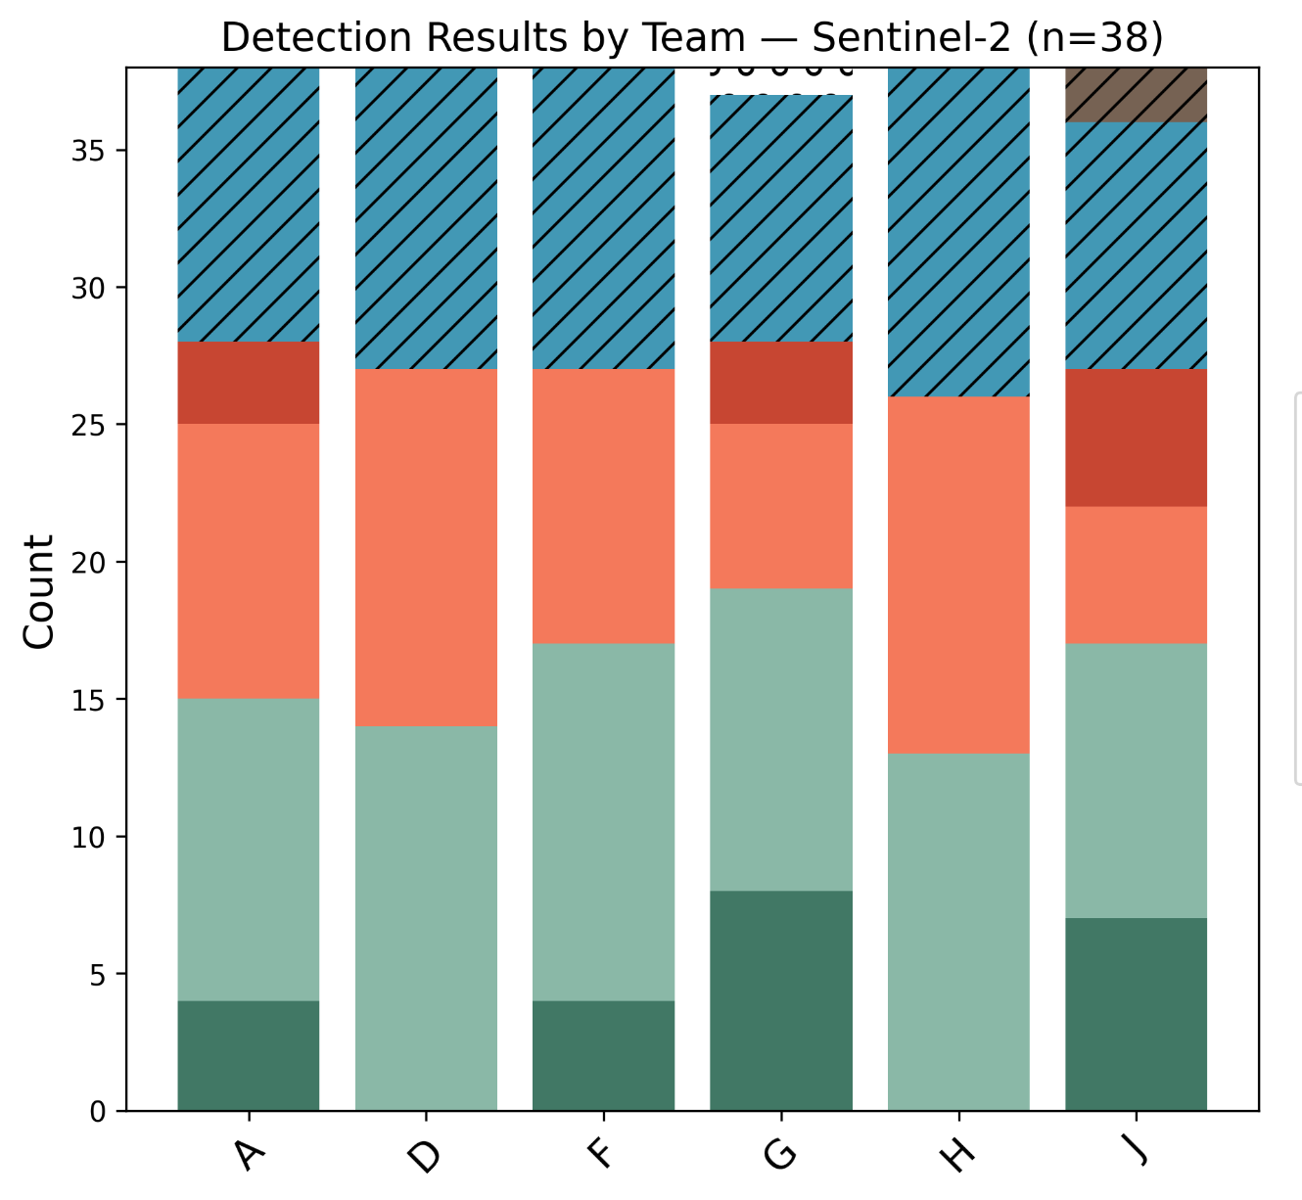
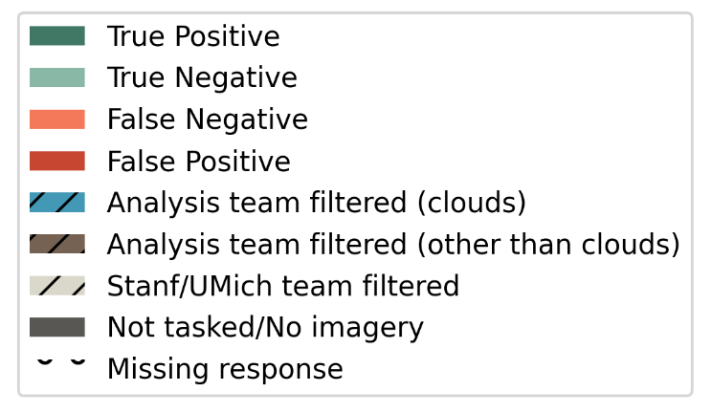
Example phase 1 single-blind results (PRELIMINARY)
Notes:
The total number of measurements per satellite listed above

Slide 9
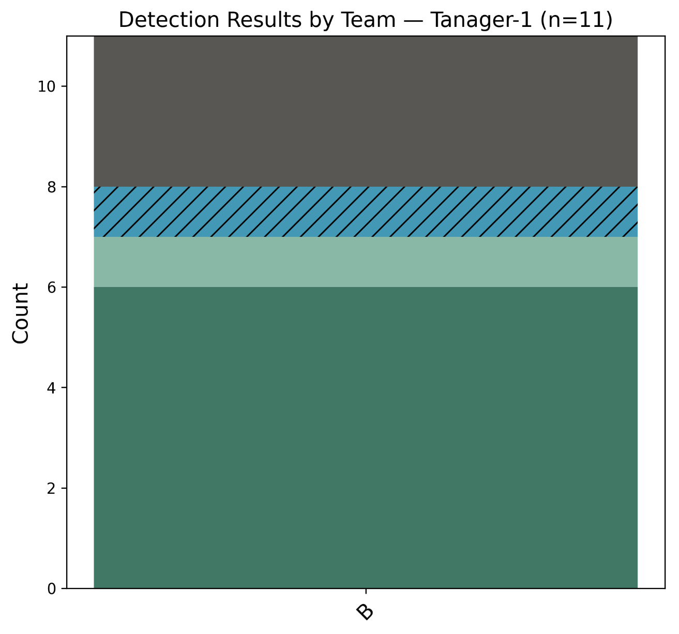
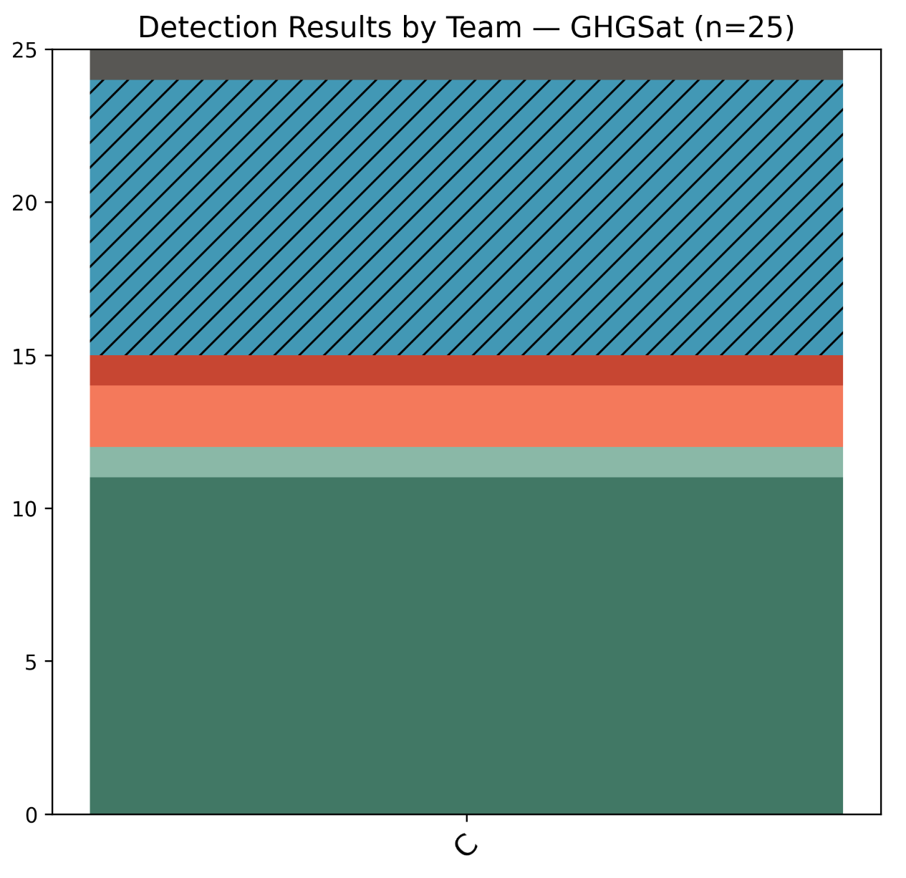
Example phase 1 single-blind results (PRELIMINARY)
Notes:
The total number of measurements per satellite listed above

Slide 10
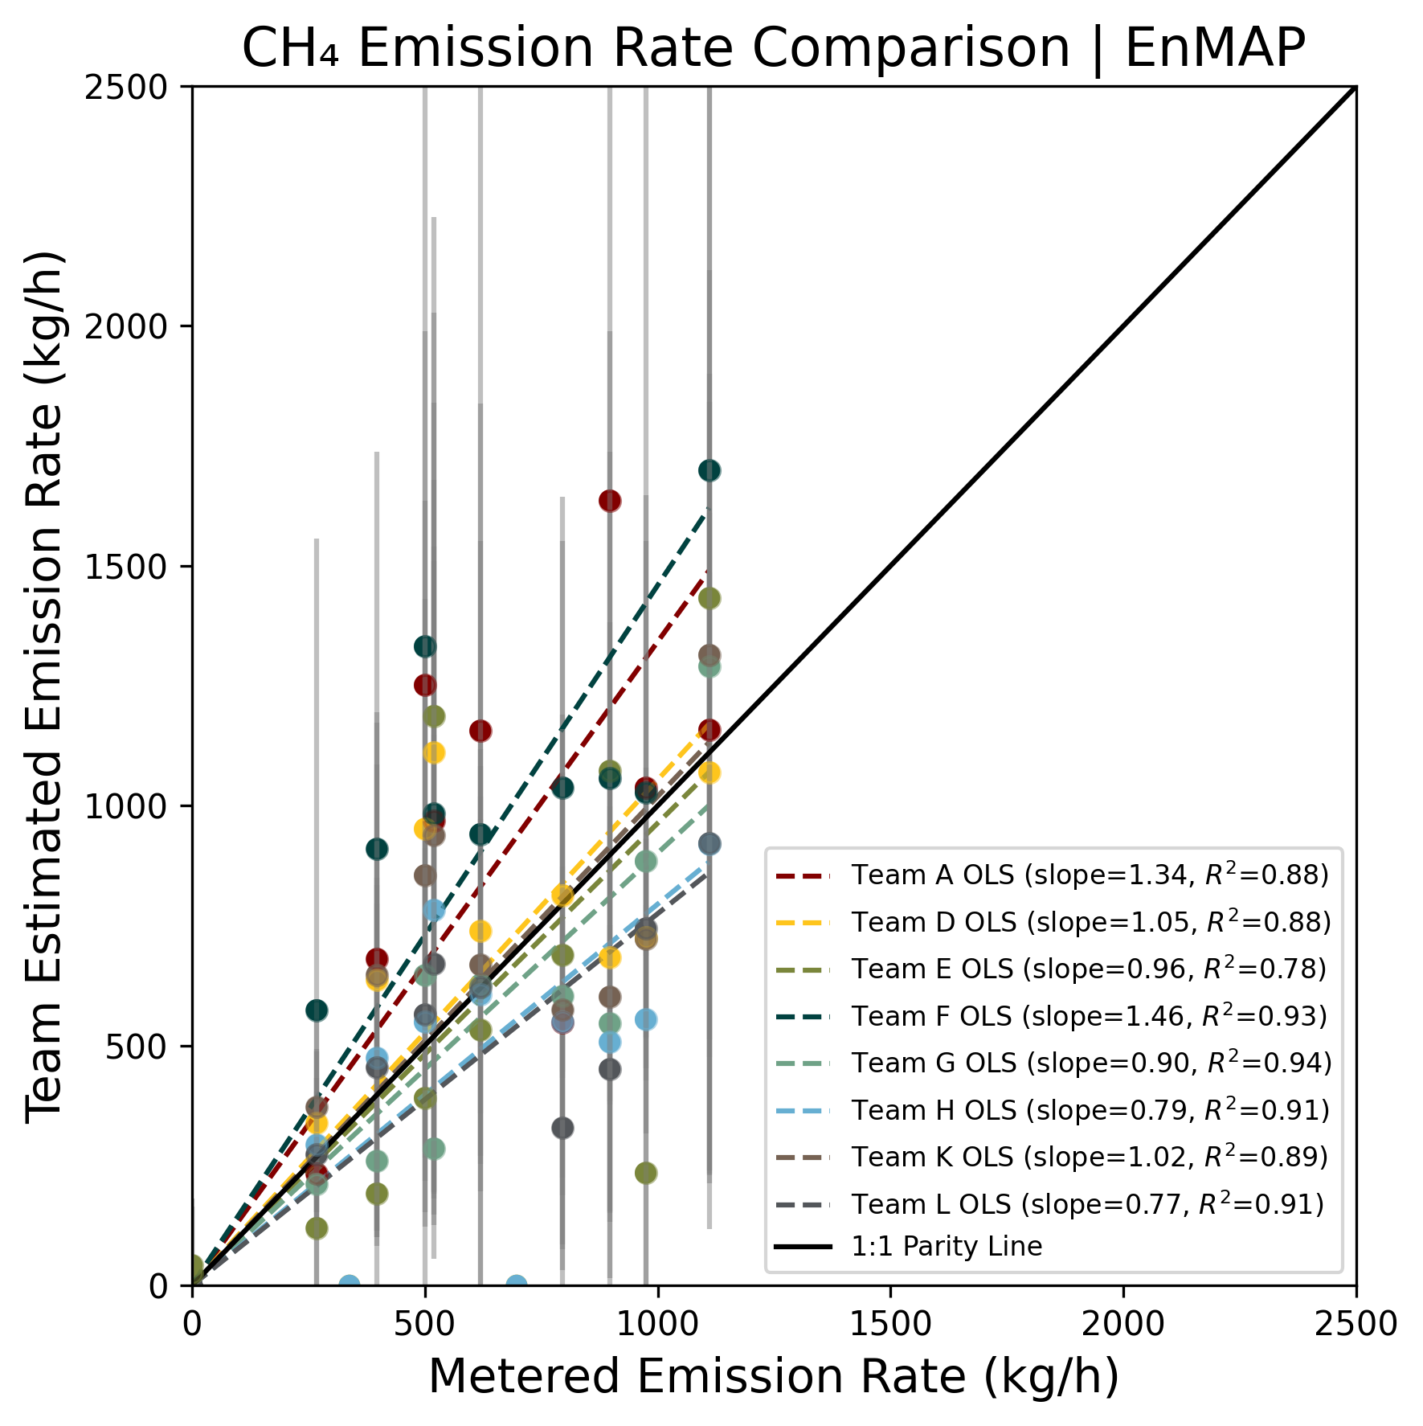
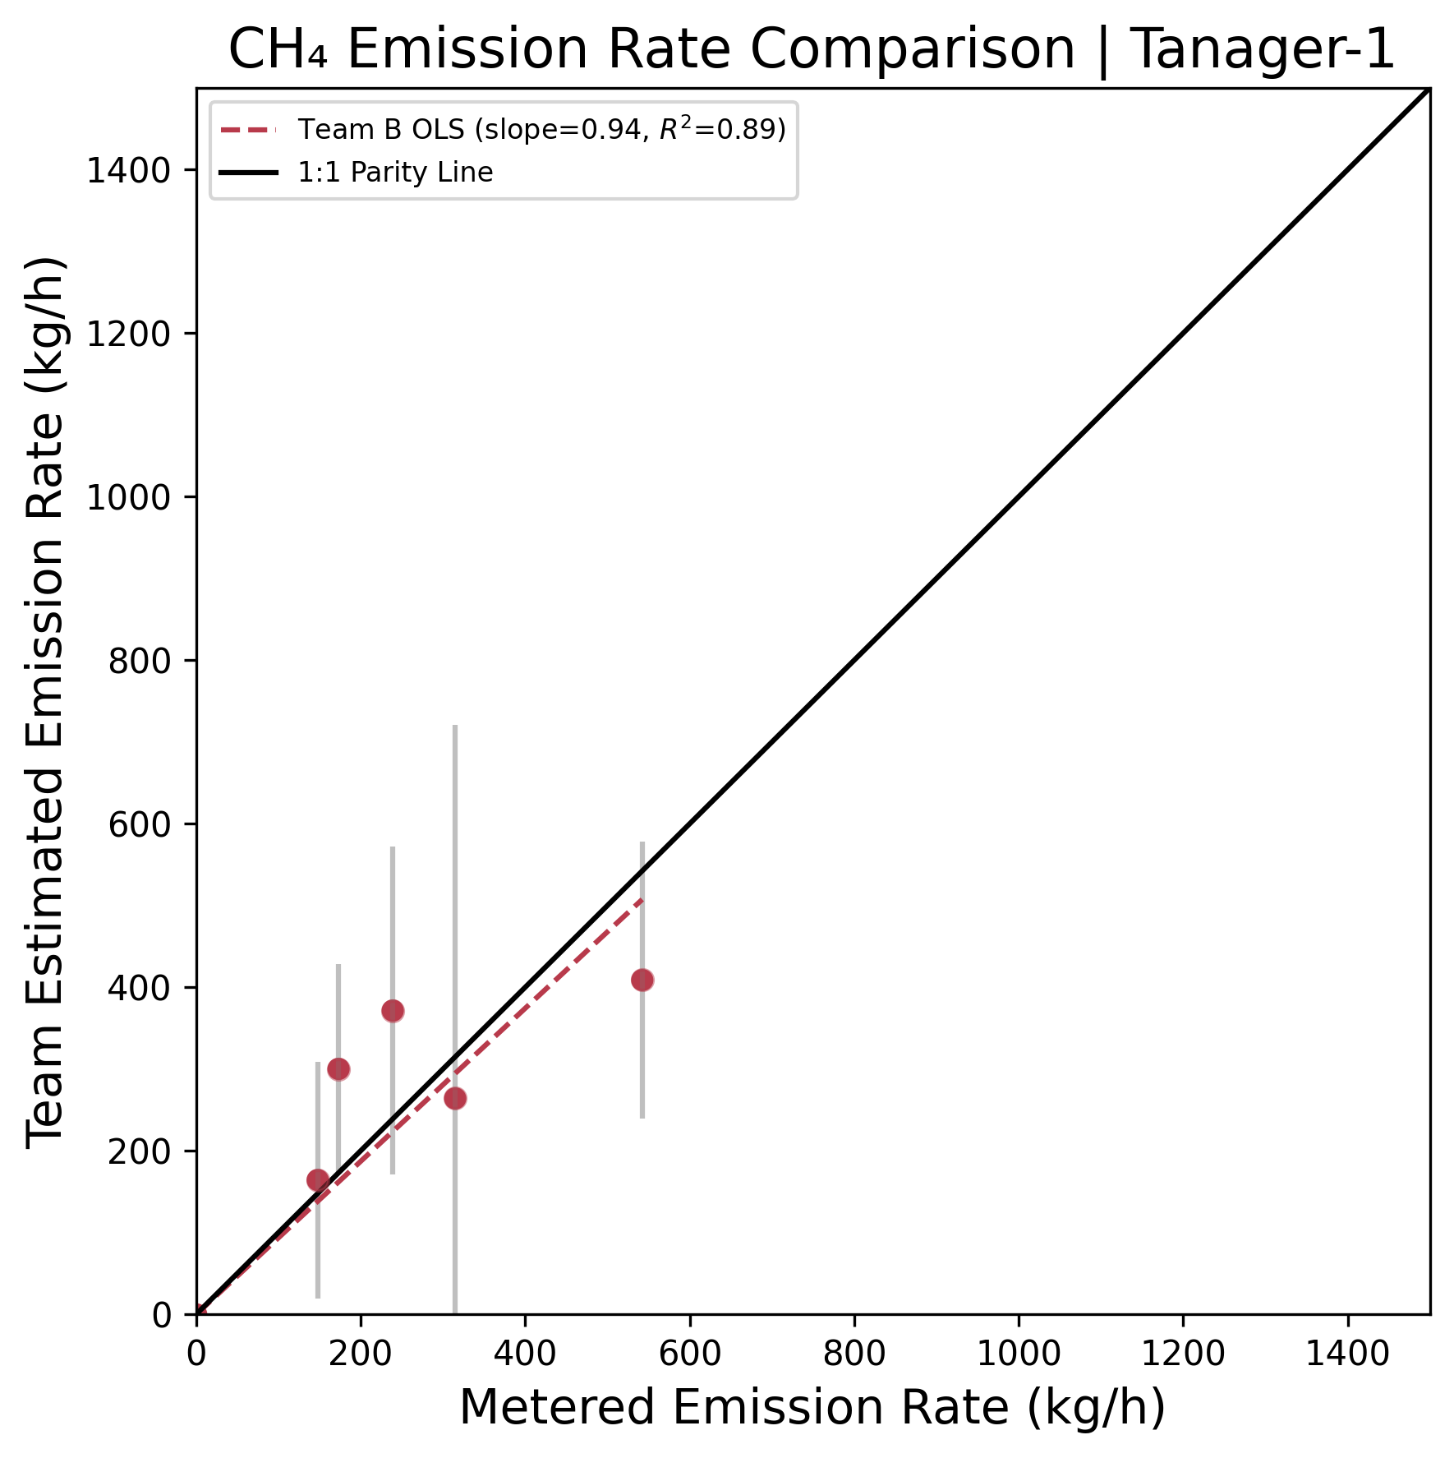
Estimated emission rates comparison: EnMAP, Tanager-1
All charts OLS fit with the intercept fixed at zero, showing slope, uncentered R2, 95% CI error bars
8 teams with at least 1 True Positive
Slopes range .77 (Team L) to 1.46 (Team F), best 1.02 (Team K)
R2 values range .78 (Team E) to .94 (Team G)
2 teams have error bars that contain metered value >95% of the time
1 analyzing team (Team B)
Slope .94, R2 = .89
100% of error bars contain metered value

Slide 11
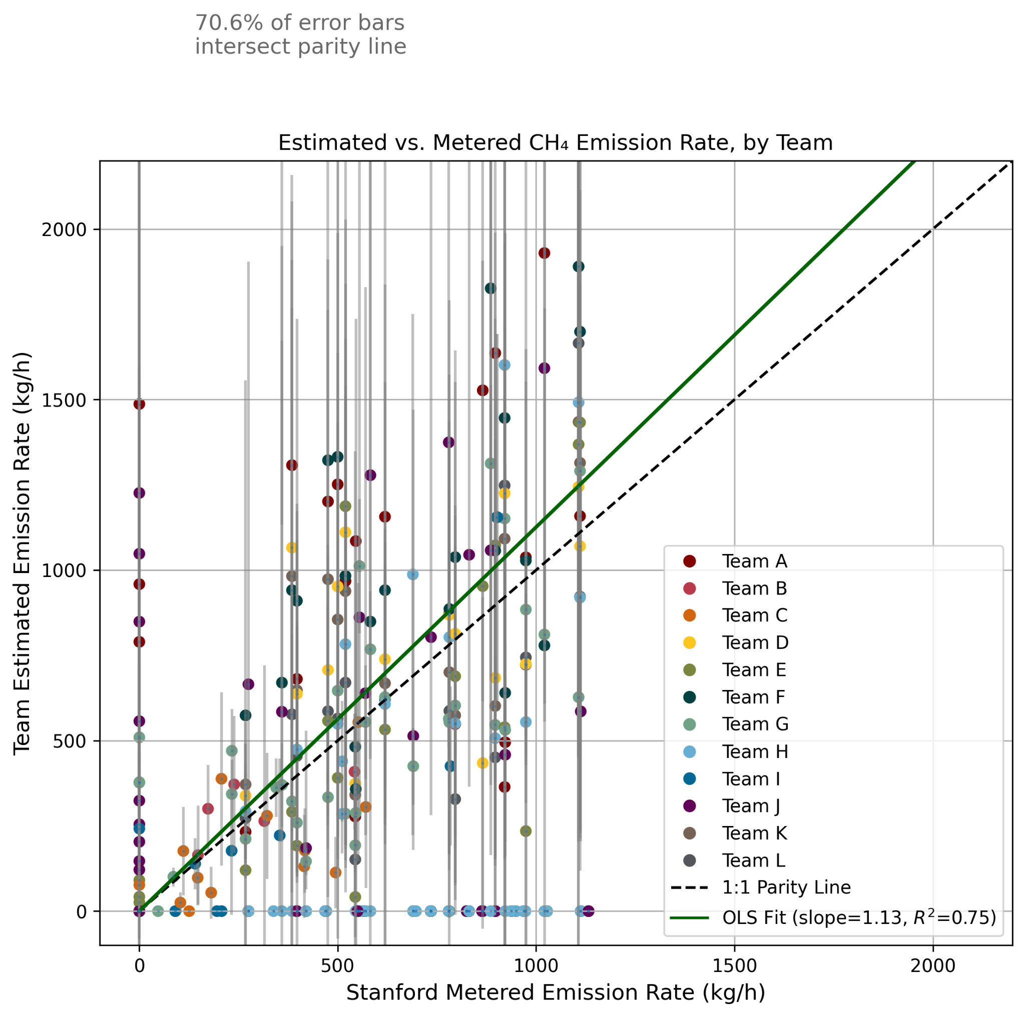
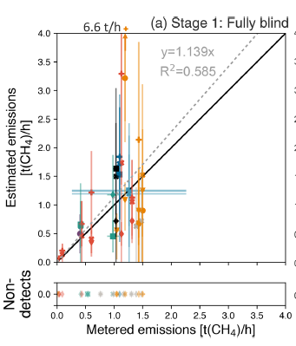
Global results similar to Sherwin 2024
This study (all participants) | Sherwin 2024
Global slope = 1.13 R2 = .75 | Global slope = 1.14 R2 = .59
71% of error bars contain metered value | 70% of error bars contain metered value

Slide 12
Limitations of existing tests
Single location, favorable environmental conditions
Single point-source plume
Participants know where to look and that a test is occurring
Hard to know whether tested data processing pipeline represents field practices

Slide 13
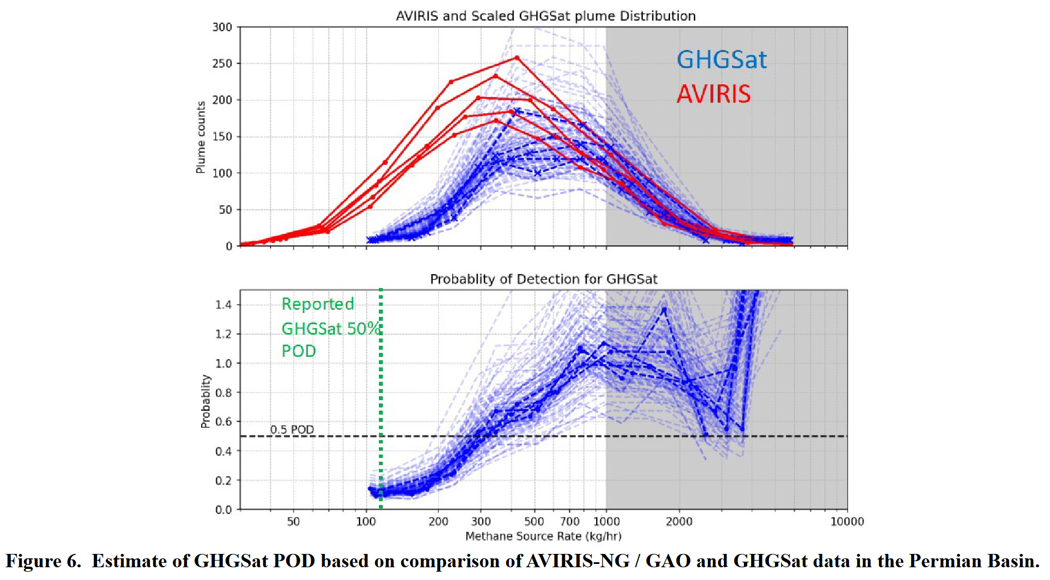
Asynchronous comparison of field statistics
NASA intercomparison study
GHGSat & aerial
Compared distribution of
detected emissions in the
Permian basin
Find evidence of higher
detection threshold than
suggested by test performance
Source: NASA 2024

Slide 14
Needs for future campaigns
Various environmental & illumination conditions (including offshore)
Diffuse or multi-point sources (e.g. SIMFLEX site led by Dave Risk at St. Francis Xavier U)
Synchronous and asynchronous intercomparison between satellite and aerial systems
  To estimate detection sensitivity in the field
Assess detection capabilities as a function of environment, cloud cover
Ideally, blind teams to the existence of a test (as in Johnson et al. 2021)
Workshop to discuss future plans with observing and analysis teams
  Fall 2025 at Stanford University CA and virtual
  Date TBD

Slide 15





















Many thanks to all teams for your time and contributions,
as well as to our partners and funders!

