Slide 1





Common Practices for Remote Sensing-based Estimates of Facility-scale Methane Emissions
Paul Green (NPL)
John Worden (JPL)
Evan Sherwin (LLBL)
Annmarie Eldering (NIST)
& CEOS GHG task team & ...

Slide 2
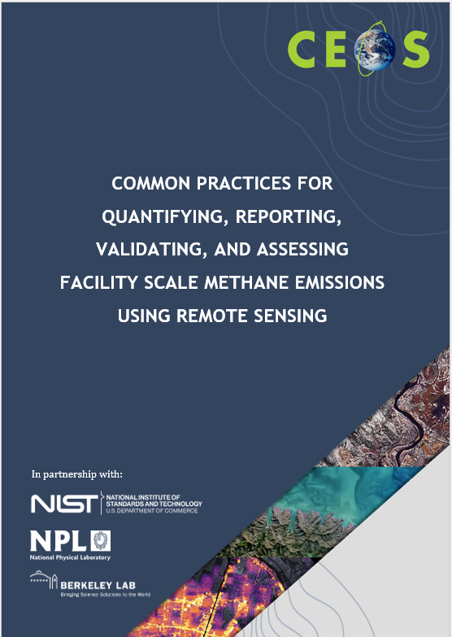
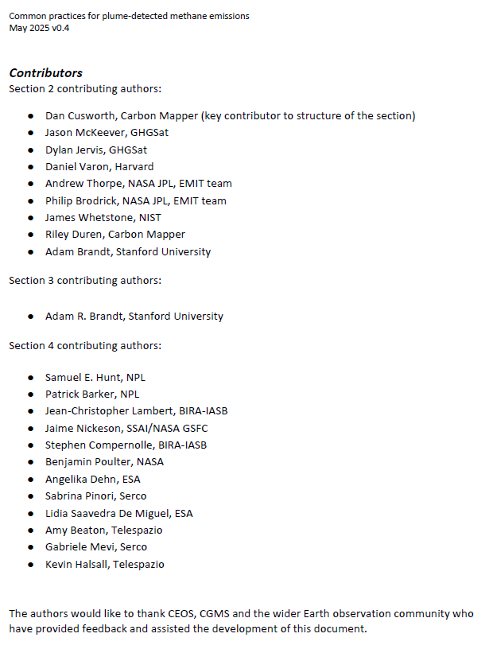
Common practice structure & contributors
Common practices intended users are
  producers of these data (to know what is expected by the community)
  users of these data (to understand how it should be generated and know how to use)
Overall structure
  Motivation, remit and timeliness
  Common practice for L0 to L4
  Validation current art
  Quality assessment framework
Integrates efforts across multiple agencies

Slide 3
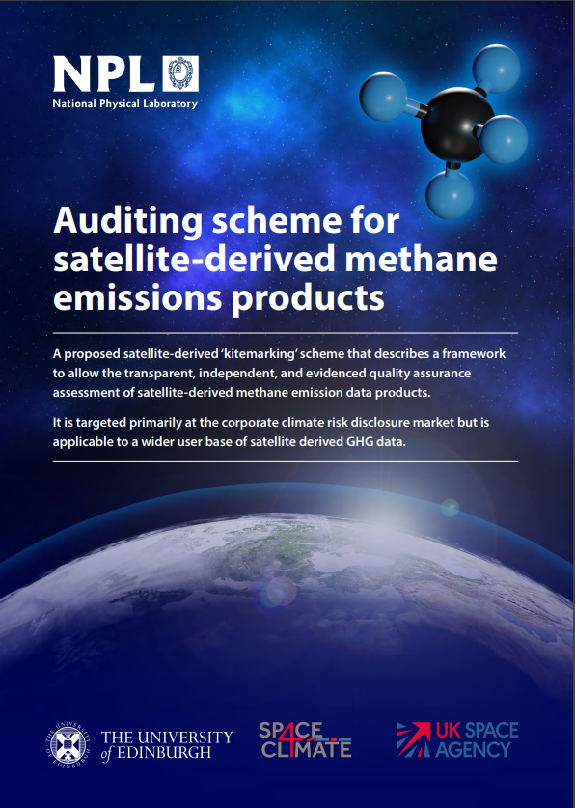
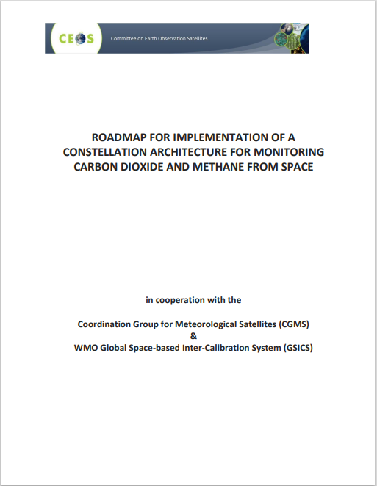

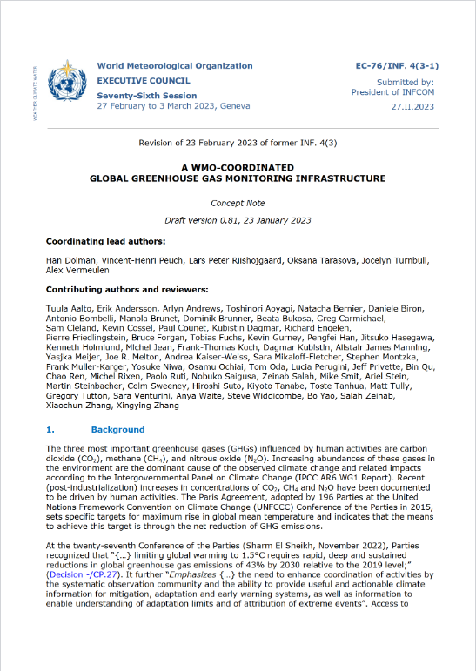
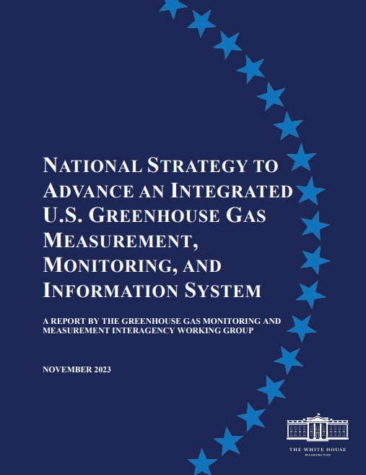
Best practice as an enabler
Build on previous CEOS work on best practises in the public and new space domains and want to partner with key parallel programmes and stakeholders to add value as an underpinning framework to enable reporting in the public and commercial sectors
Draft scheme
CEOS roadmap
UNEP IMEO
WMO G3W
US GHG Centre

Slide 4
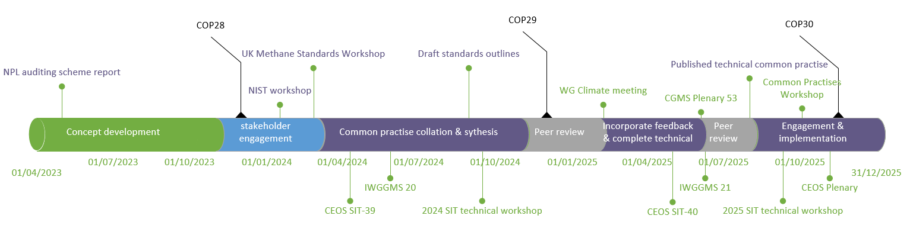
Progress and timeline
2024 – outline development & peer review
2025 – detailed completion, peer review & v1 finalization for end 2025
  now v0.4 out for community final review
  Final community review in June 2025 leading to static v1.0 July 2025.
  Case study development over Summer 2025.
  Stakeholder engagement workshop (IMEO) – late 2025

Slide 5
Summary
We need to define the common practices for reporting VVUQ and QA for facility scale emissions so that producers of these data know what is expected by the community and (new) users know how the data should be generated and reported so that it can be trusted
  Fantastic effort from all authors and contributors over the last year or so
  Please take a look and share any final comments by end of June.
  https://ceos.org/document_management/Working_Groups/WGClimate/Documents/CEOS_CommunityPractices_SiteScaleMethaneEmissions%20v0.4.pdf
  nvlpubs.nist.gov/nistpubs/ir/2025/NIST.IR.8575.pdf
  Submit for CEOS endorsement in/from July alongside key stakeholder engagement (IMEO/GMP/CCAC) and implementation & promotion towards COP 30
  Contact: paul.green@npl.co.uk

Slide 6
What next?
The science is evolving.
The plume-derived common practice v1.0 is an excellent start. A static version of the document is needed for stakeholder engagement.
  Evolution from common practice to best practice. Quantifying the pros/cons of different approaches. Studies are ongoing, but a systematic approach is needed and community agreed. So expect v2.0 to be developed in the next few years.
  The focus to date has been O&G point sources, but other point sources needs considering, so some expansion to landfills, wider waste and quasi-localised sources.
  Common/best practices for area mappers. Similar activity has been identified and is in the GHG TT road map.
  Common/best practices are required and useful – these activities need to continue, but in a manageable and targeted way.

