Slide 1
Morning Session: Global to Regional Flux Estimates and Validation
Junjie Liu and Yosuka Niwa

Slide 2
Spatial Resolution and Surface vs. Satellite (Mengistu et al.)
TROPOMI at 0.2x 0.2
Surface at 0.2x 0.2
TROPOMI at 0.5x 0.5
Surface at 0.5x 0.5
How to configure flux inversions for specific science and application purpose? How to reconcile flux inversions based on surface and satellite observations?
The spatial adjustment to the prior fluxes depends on spatial resolution and data source (surface vs. satellite)

Slide 3
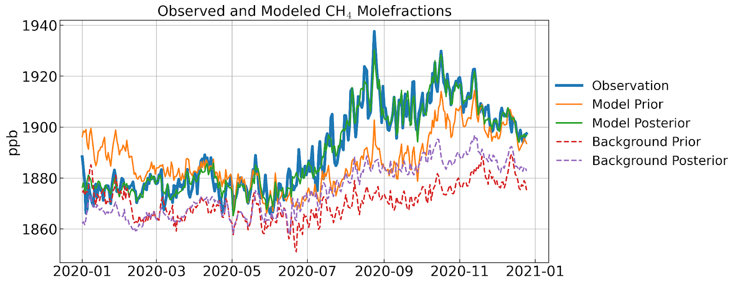
Regional Flux Inversion: Estimating Fluxes and Boundary Conditions Simultaneously (Subramanian et al.)
South Asia
Prior inventories overestimate methane emissions during the dry months (Jan–May) and underestimate them during the wet monsoon season (Jun–Nov).
This seasonal mismatch highlights the need to better capture agricultural cycles, wetland dynamics, and monsoonal impacts in emission estimates.
During June–September, cleaner air from the Southern Ocean is expected to lower background CH₄ levels.
However, the background posterior remains slightly higher than the background prior, indicating a notable contribution from local emissions.
How to estimate boundary conditions and fluxes simultaneously in regional flux inversions?
Simultaneously quantify fluxes and boundary conditions.

Slide 4
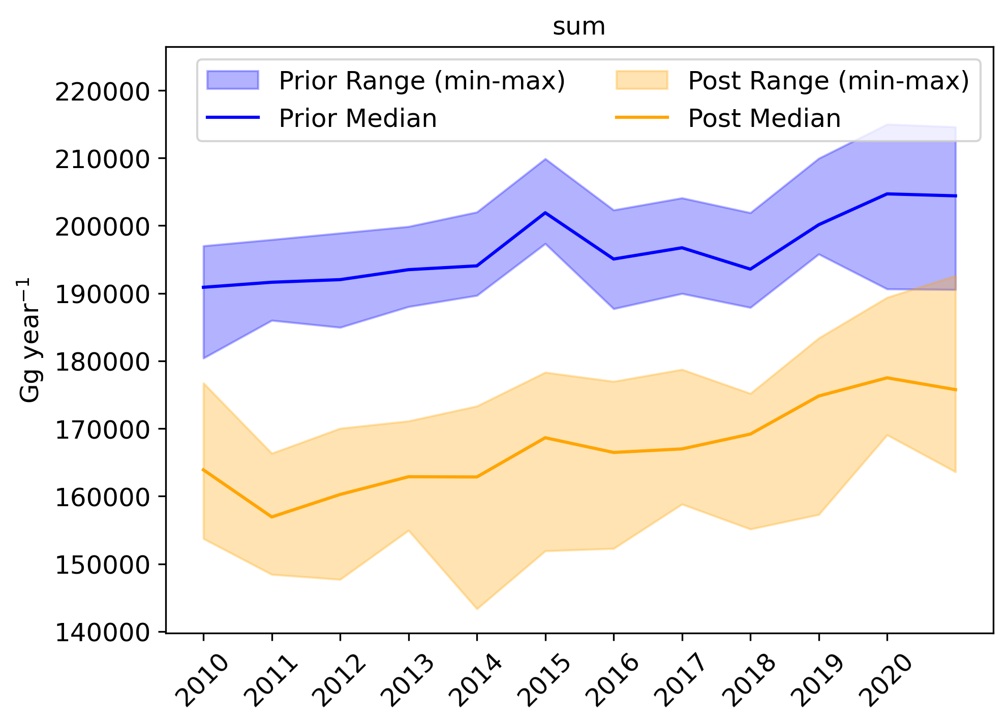
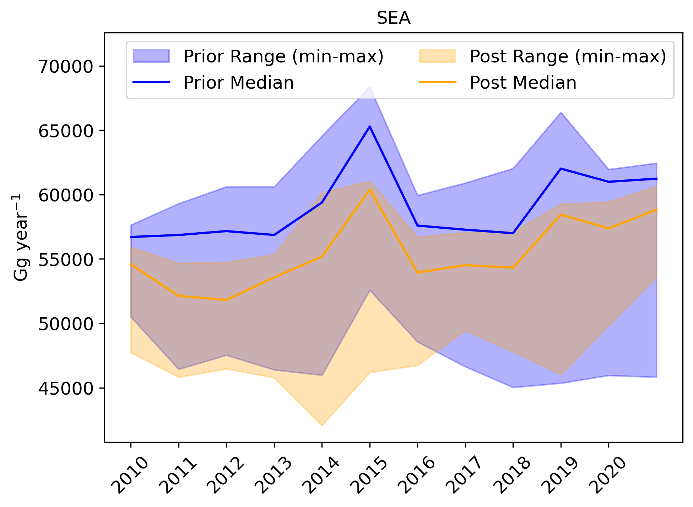
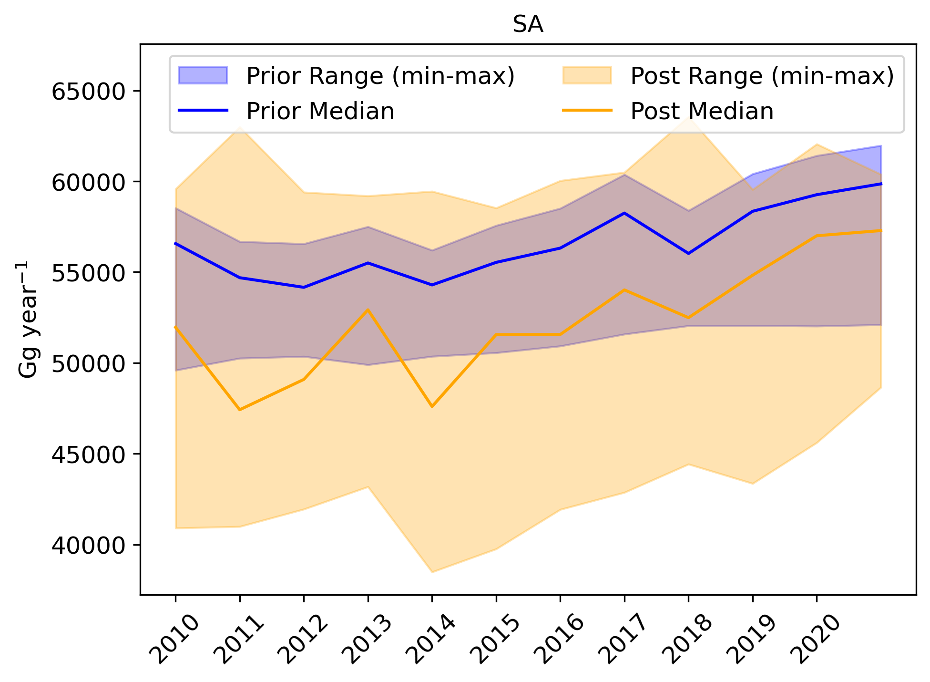
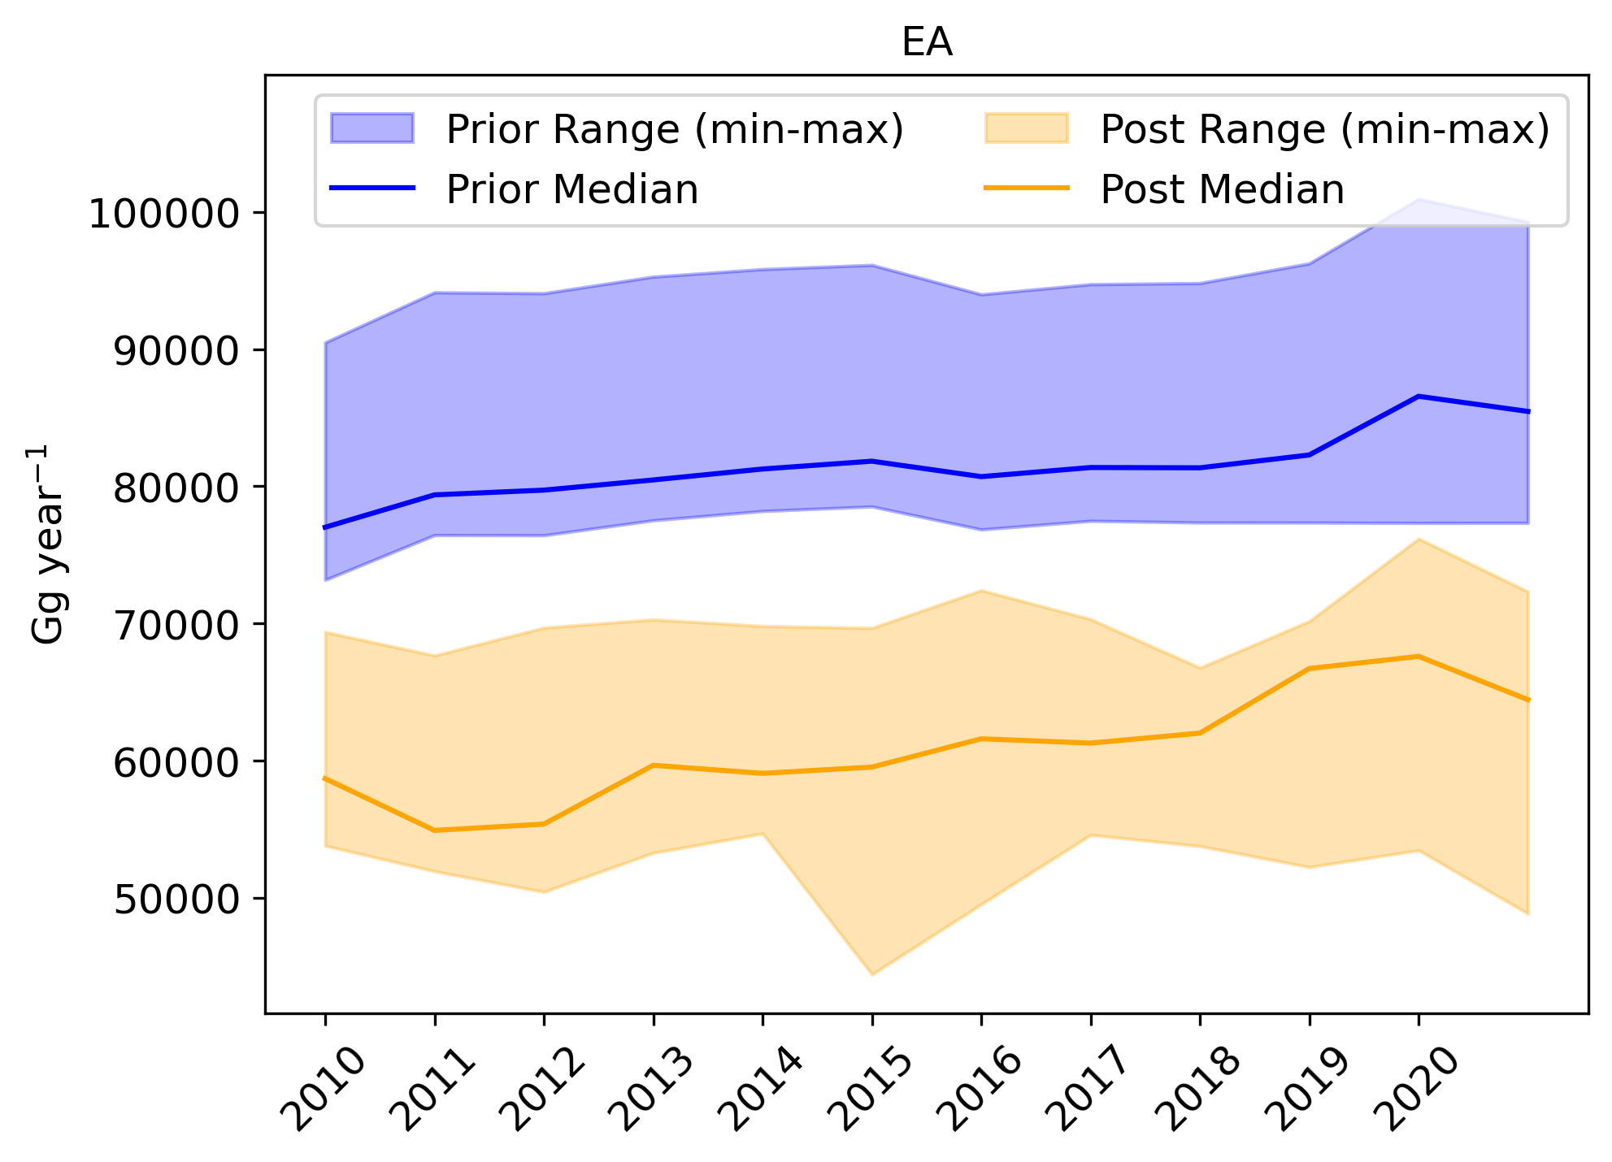
Regional CH4 CO2 Flux Inversion Intercomparison (MICA): East, South, and Southeast Asia
The dependency of flux inversion results on inversion setups.
models_all= ['NIES’, 'NIES2’, 'JAMSTEC’, 'FMI’, 'LSCE’, 'NIM']

Slide 5
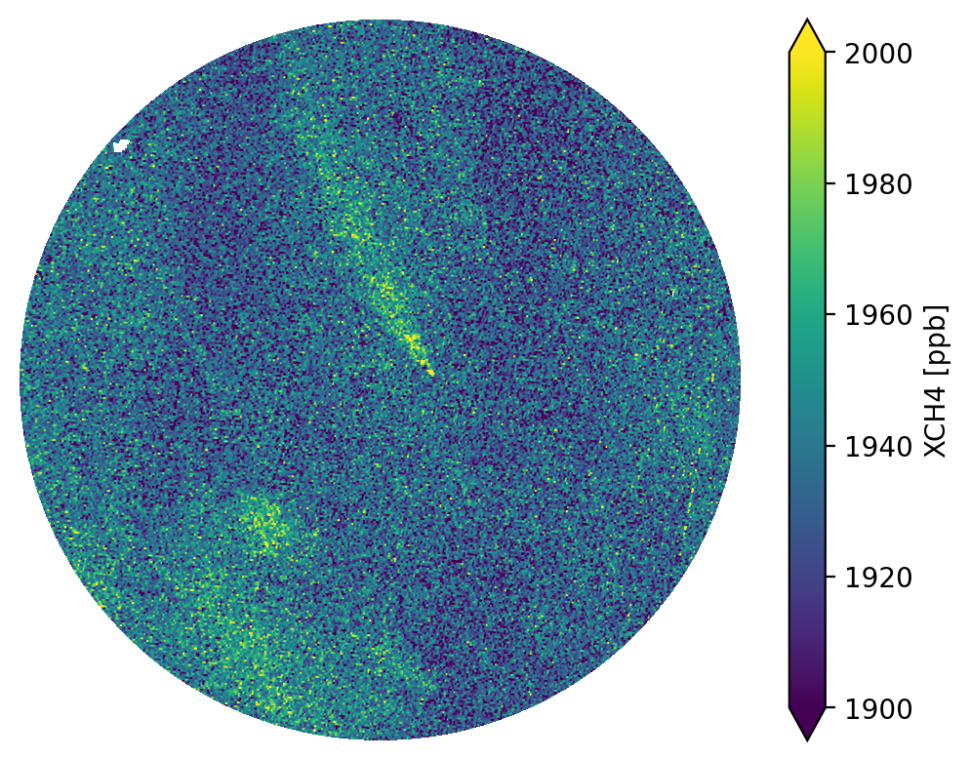
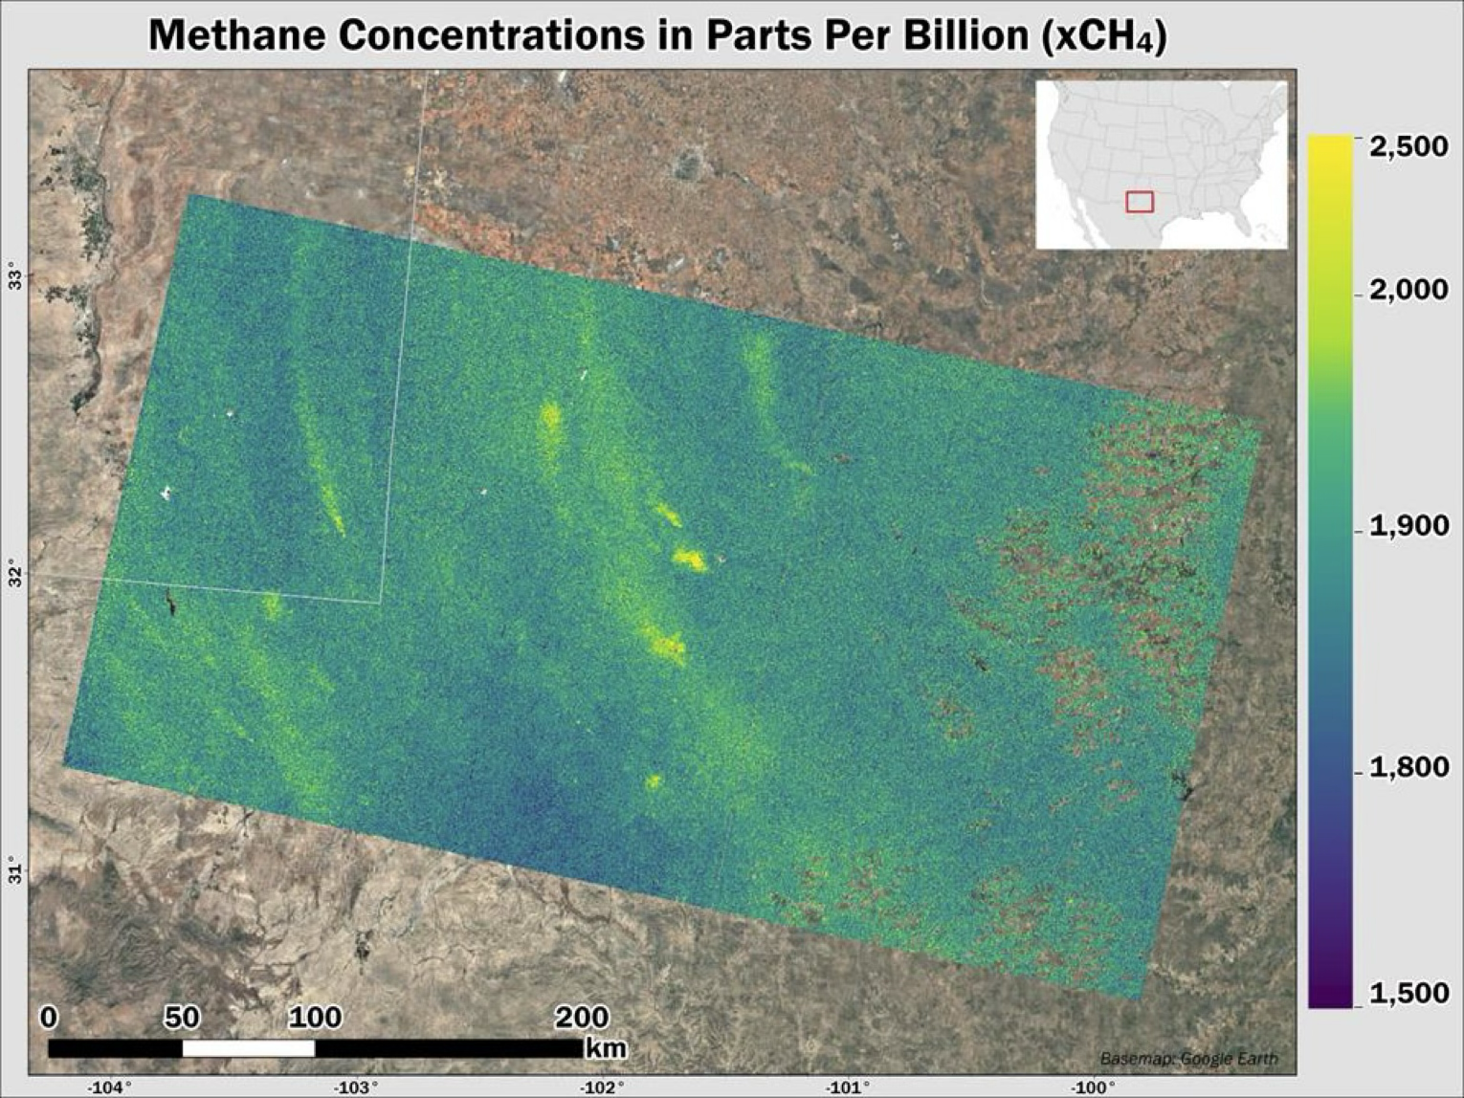

Isolating Point Sources in the Presence of Area Emissions (Bushy et al.)
MethaneSat L4 CORE: The instrument combines high sensitivity and spatial resolution to observe both point and area sources
How to estimate point and area sources simultaneously?
A. Chulakadabba et al., “Methane point source quantification using MethaneAIR: a new airborne imaging spectrometer,” Atmospheric Measurement Techniques, vol. 16, no. 23, pp. 5771–5785, Dec. 2023, doi: 10.5194/amt-16-5771-2023
Notes:
That big step is a combination of high sensitivity and high spatial resolution.
MethaneSAT bridges the gap between area flux mappers like TROPOMI and point source imagers like GHGSat,
which allows it to observe both point and area sources simultaneously.
This gives us new insights for answering policy relevant questions, for example determining the relative contribution of different source types to regional totals.
Here’s a sample data set collected in the Permian Basin last year, which demonstrates well the capabilities of the instrument.
The point sources in this image are readily apparent, from their steep concentration gradients and distinctive plume shapes.
Point source characterization and quantification was described here on Tuesday by my colleague, Dr. Zhen Zhan.
I’ll be focusing on the diffuse area sources and basin totals.
The CORE algorithm is our inverse modeling framework for this diffuse area source problem.

Slide 6
Sector Emission Attribution with a Combination of Satellite and Isotope Observations (Basu et al.)
How to attribute total CH4 emissions to specific sectors?

Slide 7
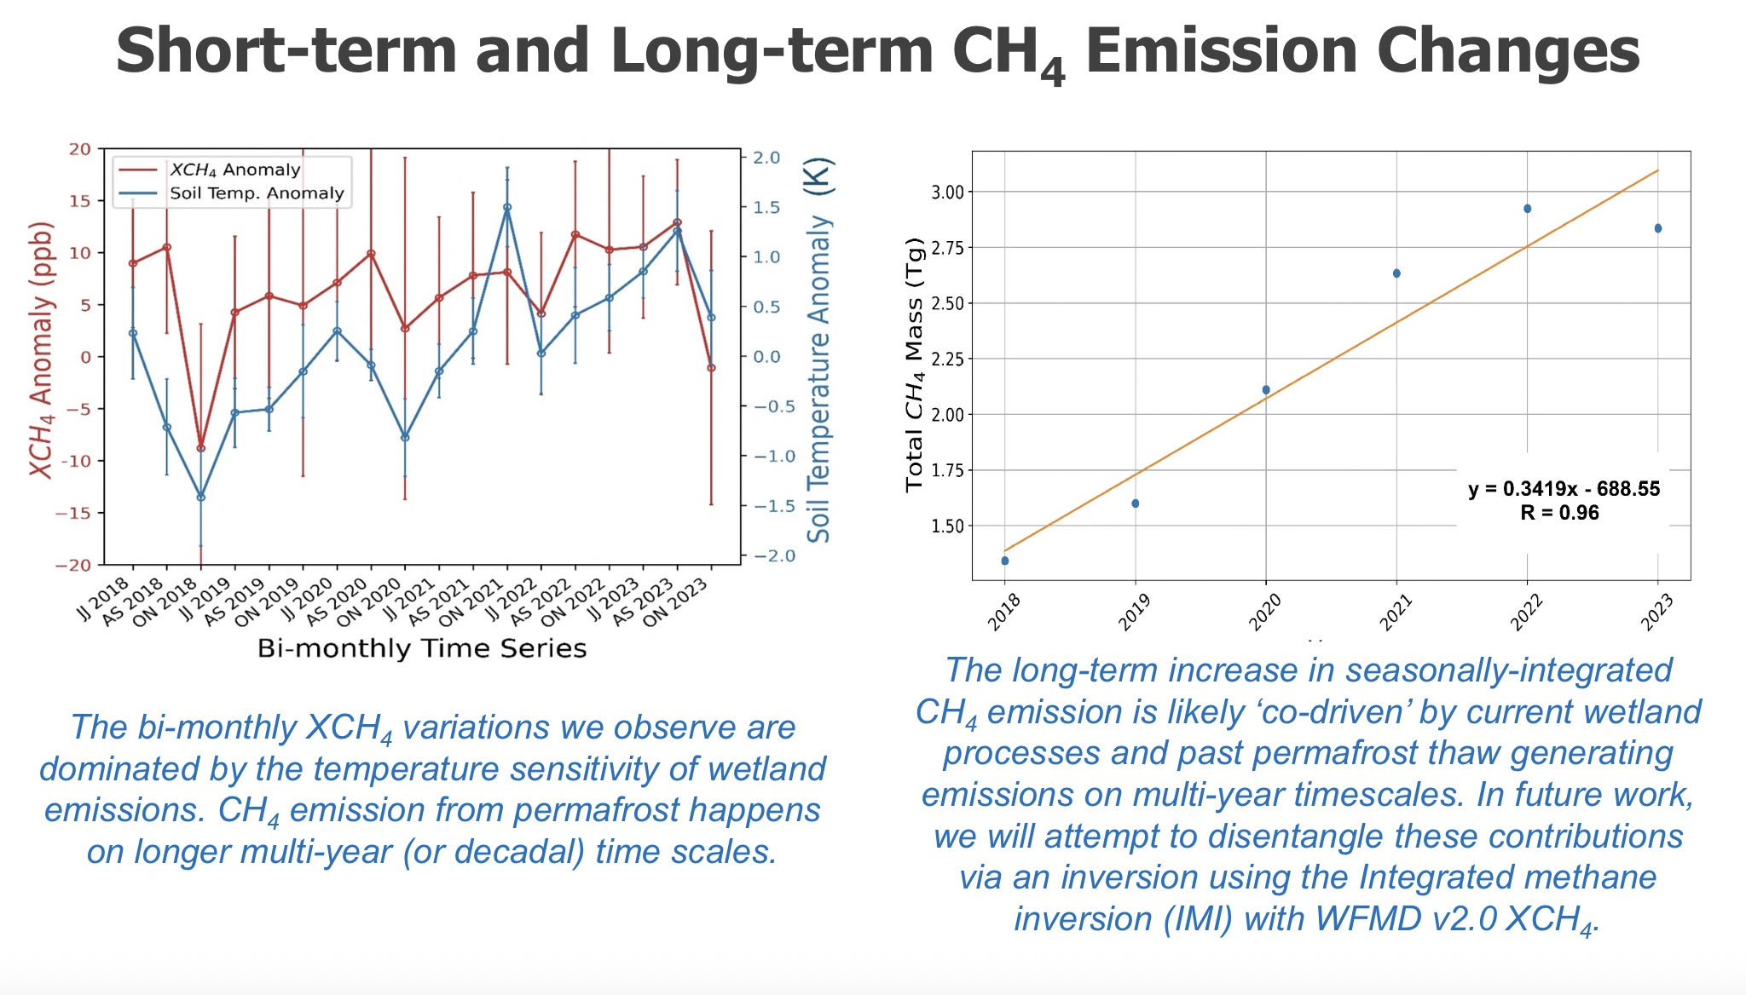
Detecting Changes in High-Latitude Wetland Emissions with Satellite Observations (Nassar et al)
How do wetland emissions changes with climate?

Slide 8
How to use top-down inversion results to evaluate national inventories? (J. Worden et al.)
Accounting for averaging kernels of the flux inversions

Slide 9
Recommendations:
Top-down flux inversion is an ill-conditioned problem. It is a crucial tool to understand the underlying processes that drive changes of atmosphere CO2/CH4 concentrations.
  Flux inversion is a useful tool to identify potential retrieval biases.
  Better configure flux inversion framework for specific scientific questions and applications.
  Better understand the impact of inversion setup on flux inversion results (e.g., transport errors, prior fluxes)(MIP)
  Better understand the differences between surface-based and satellite-based flux inversion results.
  Estimate boundary conditions and fluxes simultaneously in regional flux inversions
  Multi-scale flux estimates: point and area sources
  Sectorial attribution of total CH4 emissions (e.g., multiple species)
  Evaluate bottom-up inventory with top-down flux inversion results
  Better understand the response of natural carbon fluxes to climate perturbations along with quantification of anthropogenic emissions
Inversion setup

