Slide 1
Area Flux Validation
Junjie Liu
12 June, 2025

Slide 2
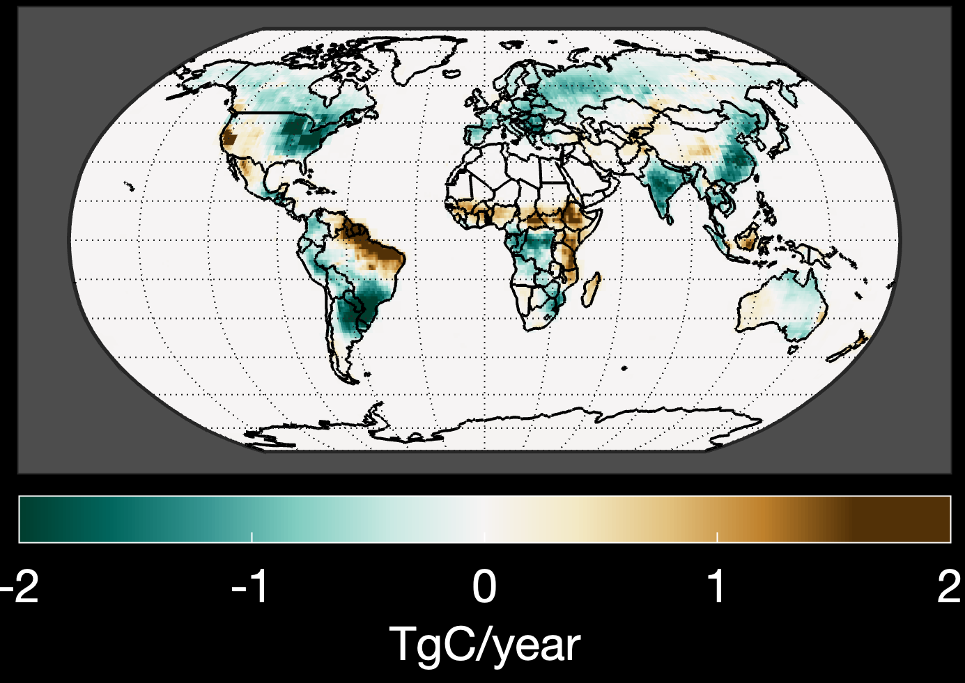
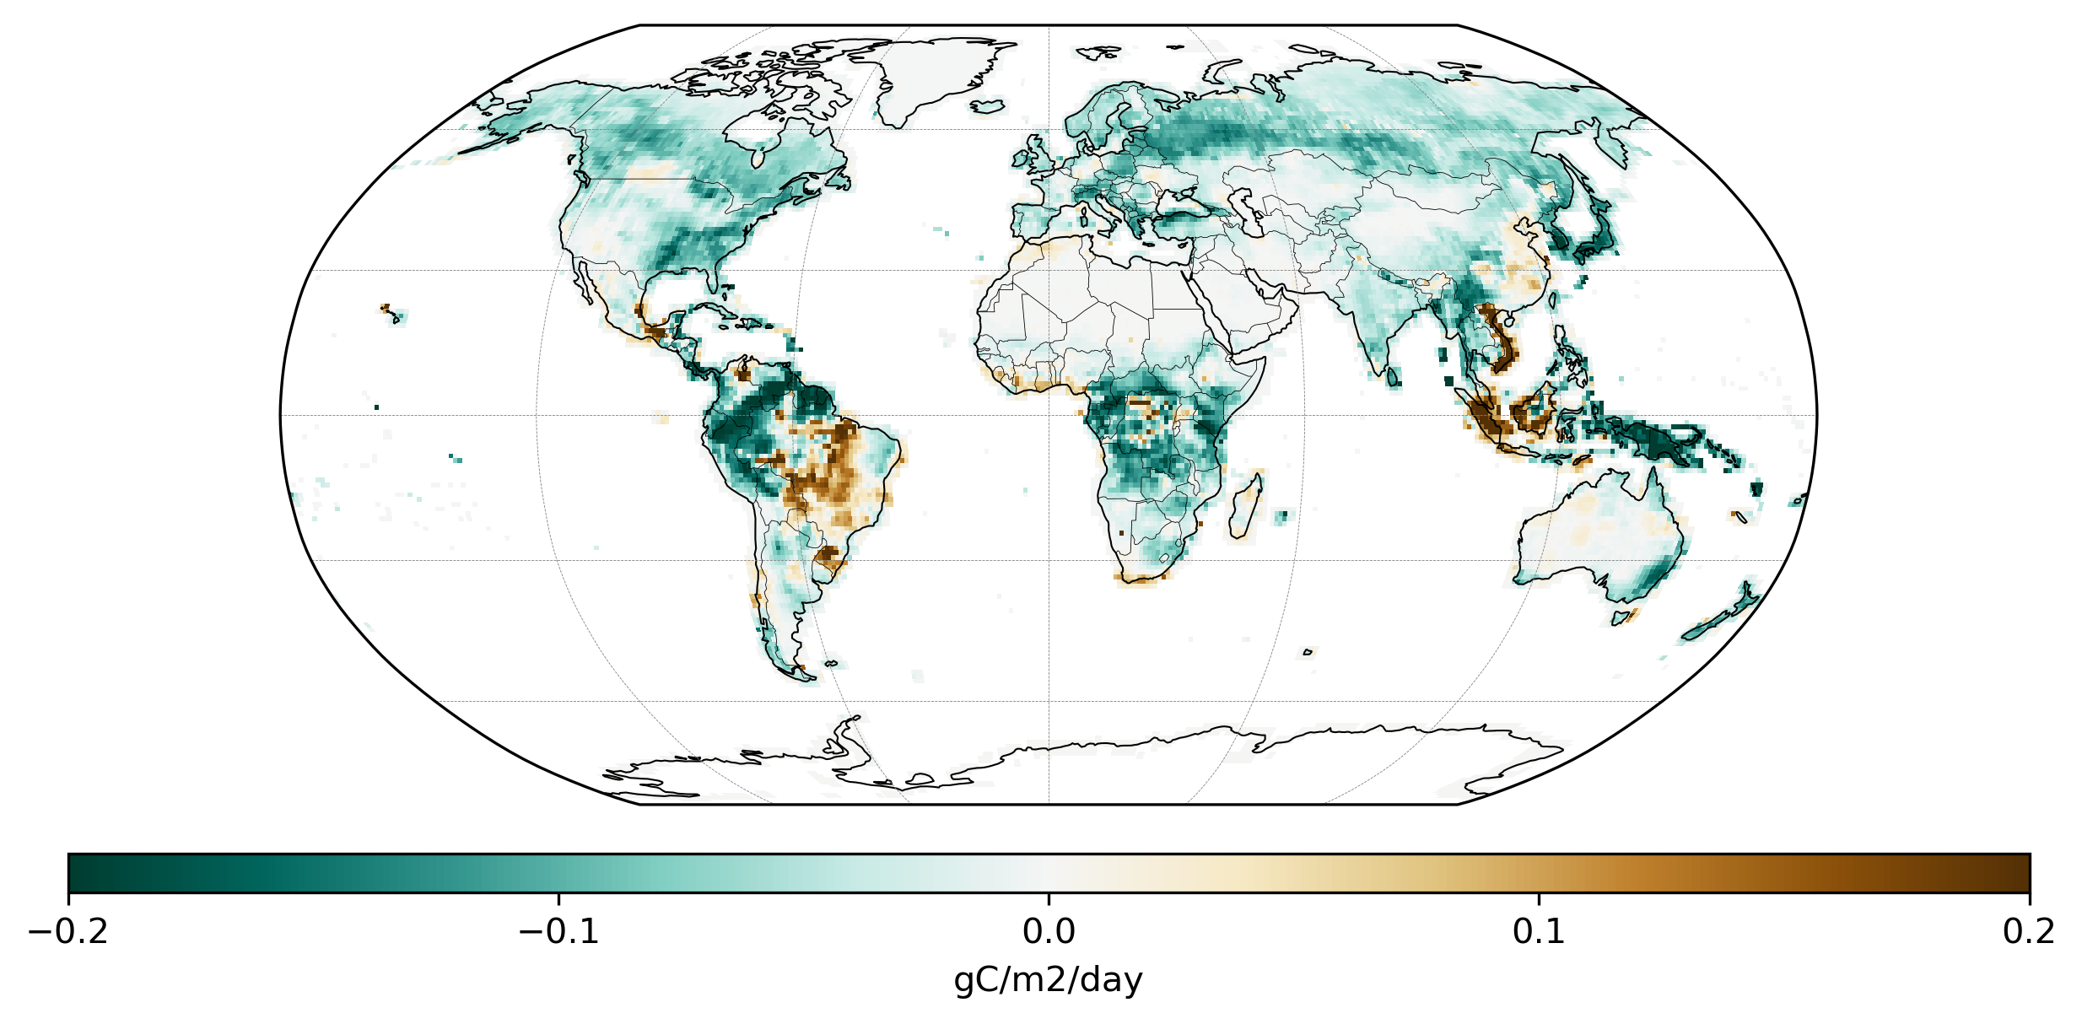
Spatial Distributions of Net Biosphere Exchange
Mean Net Biosphere Exchange (2015-2022)
TRENDY (GCP-2023)
OCO-2 V11 MIP
Large carbon sink over northeast NA, Europe, Asia, Congo Basin, and southern hemisphere mid latitudes;
Source over N-Africa, northeast Brazil, western US.
Notes:
Show Biogeochemical model results

Slide 3
Main methodology
Direct comparison to independent aircraft observations
  Global Carbon Project
  OCO-2 MIP
  (Shamil)
Emergent constraint: find a linear relationship between fluxes of the interest with CO2 concentrations
  Stephens et al., 2007
  Gaubert et al., 2023
Quantify flux errors with a combination of aircraft observations and adjoint sensitivities (Yun et al., 2025)

Slide 4
Friedlingstein et al., 2023
Mid-troposphere aircraft CO2 observations (2km-7km)
GCB uses the comparison to independent aircraft observations as a filter criterion to exclude those models that have biases larger than 0.5ppm

Slide 5
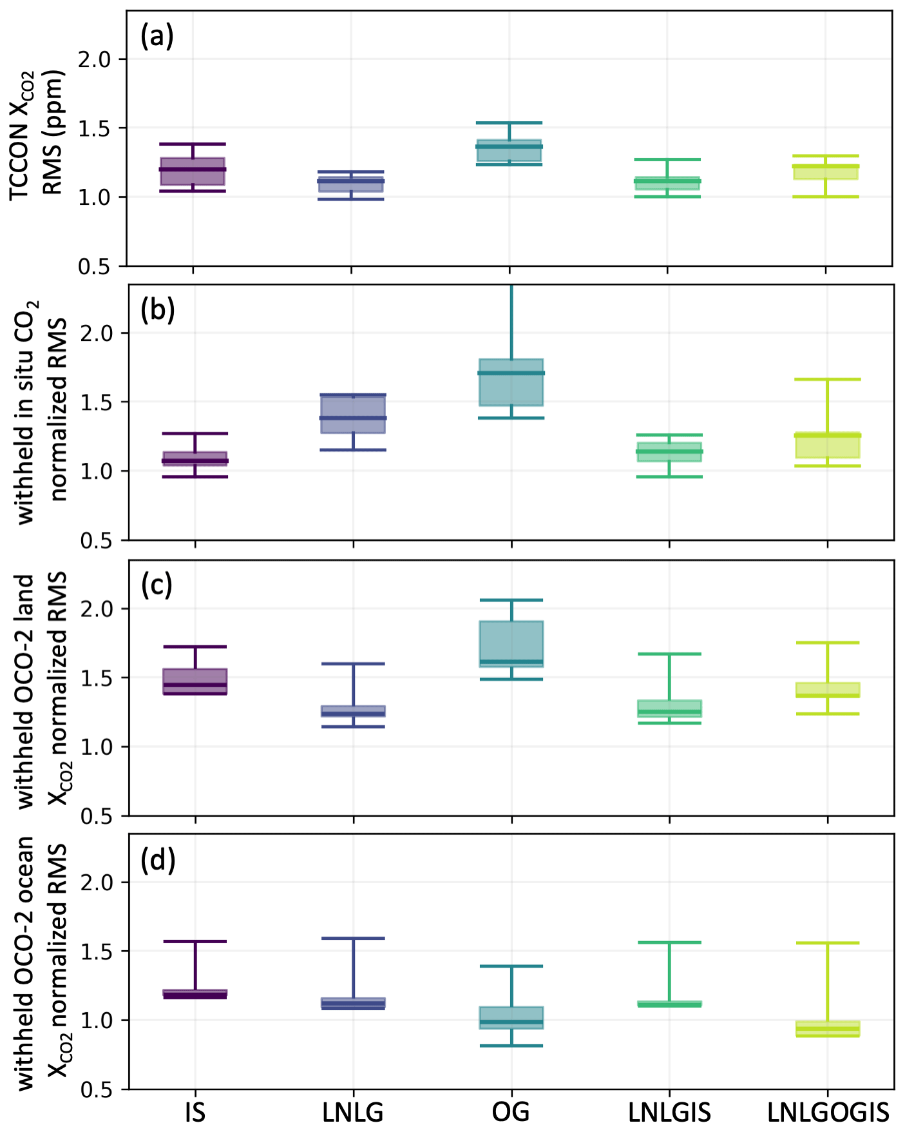
Flux inversions with different combinations of observation sources help Identify potential biases in satellite retrievals
Byrne et al., 2023

Slide 6
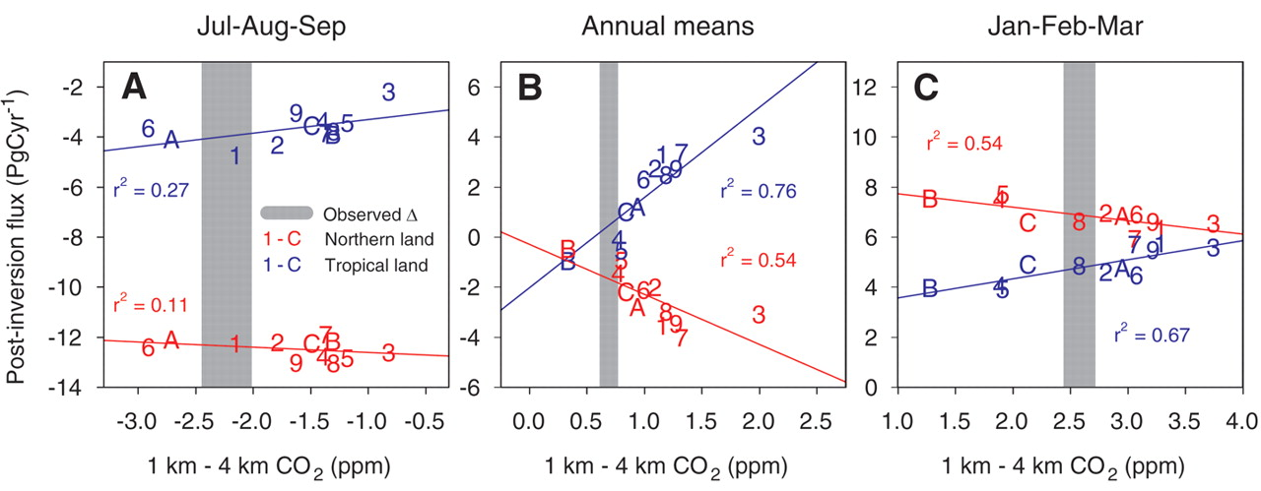
Emergent Constraint: Fluxes vs. Concentrations
TransCom 3
Stephens et al., 2007

Slide 7
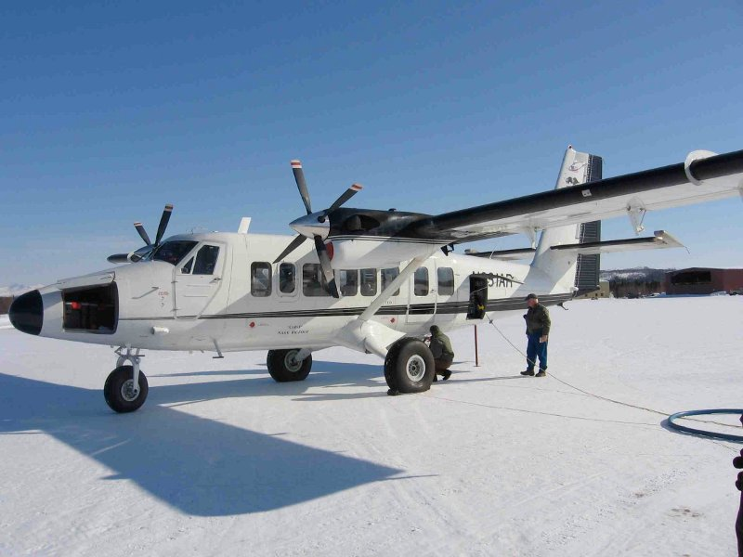
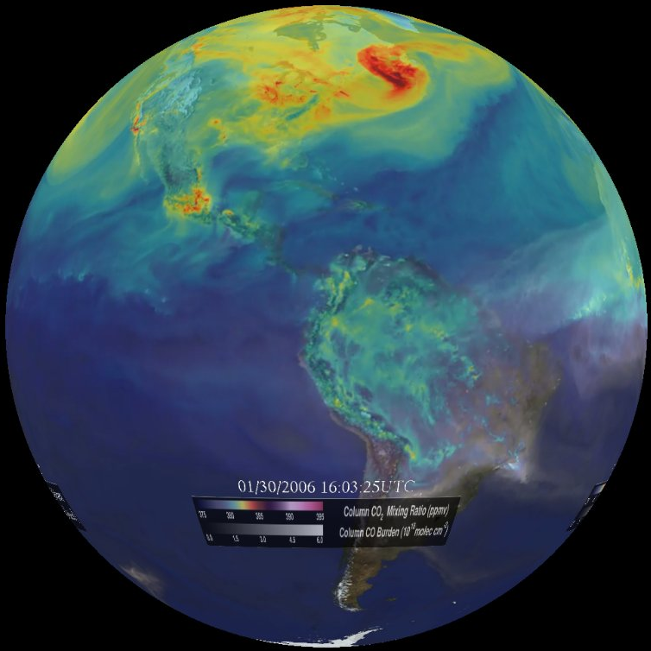


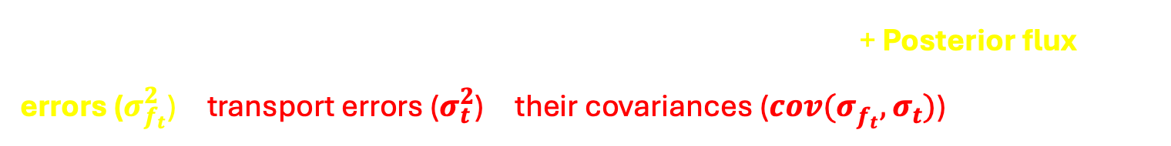


Quantifying Flux Errors with Aircraft and Adjoint Sensitivity
1) Isolate atmospheric CO₂ errors caused by the flux errors
Airborne measurements
Global inverse modeling
Observed atmospheric CO₂ concentration
Co-sampled ensemble mean of simulated CO₂ concentration
Comparing observed and simulated atmospheric CO₂ within 1$°$x1$°$ grid cell by month
$$RMSE^{2}$$
$$RMSE^{2}$$
= Measurement errors ($σ_{o}^{2}$) + Representativeness errors ($σ_{r}^{2}$) + Posterior flux errors ($σ_{f_{t}}^{2}$) + transport errors ($σ_{t}^{2}$) + their covariances ($cov(σ_{f_{t}}^{ },σ_{t}^{ })$)
Q. How can we isolate the atmospheric CO₂ errors solely
caused by the posterior flux errors?

Slide 8



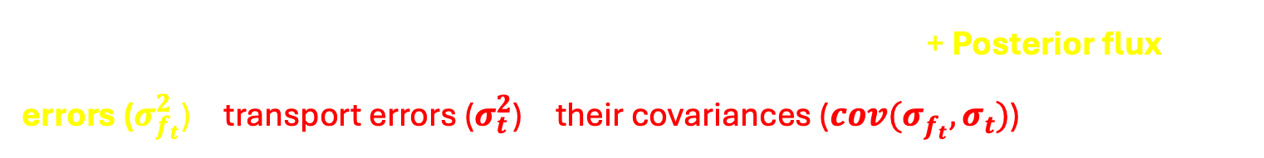


1) Isolate atmospheric CO₂ errors caused by the flux errors
Comparing to aircraft observations
$$RMSE^{2}$$
= Measurement errors ($σ_{o}^{2}$) + Representativeness errors ($σ_{r}^{2}$) + Posterior flux errors ($σ_{f_{t}}^{2}$) + transport errors ($σ_{t}^{2}$) + their covariances ($cov(σ_{f_{t}}^{ },σ_{t}^{ })$)
Approximation of RMSE with MIP
$${ERR}_{TOT}^{2}$$
= ${ERR}_{OBS}^{2 }+{ERR}_{REP}^{2 }+ {ERR}_{MIP}^{2}$
defined as the ensemble spread of co-sampled posterior atmospheric CO₂
If we could assume that the estimated transport errors from the ensemble spread among transport models used in OCO-2 MIP represent the true transport errors
$$σ_{o}^{2}+σ_{r}^{2}+σ_{f_{t}}^{2}+cov(σ_{f_{t}}^{ },σ_{t}^{ })+σ_{t}^{2}$$
$$σ_{f_{t}}^{2}$$
Estimated flux errors projected onto atmospheric CO₂ by conducting forward simulation
${RMSE}_{ }^{2}−{ERR}_{TOT}^{2}$ $≈ {h\left({err}_{f_{t}}\right)}^{2}− {h\left({err}_{f_{e}}\right)}^{2}$
$$σ_{o}^{2}+σ_{r}^{2}+σ_{f_{e}}^{2}+cov(σ_{f_{t}}^{ },σ_{t}^{ })+σ_{t}^{2}$$
Quantify whether the flux uncertainties estimated by the MIP are underestimated or overestimated in concentration space
Yun et al., ACP, 2025

Slide 9
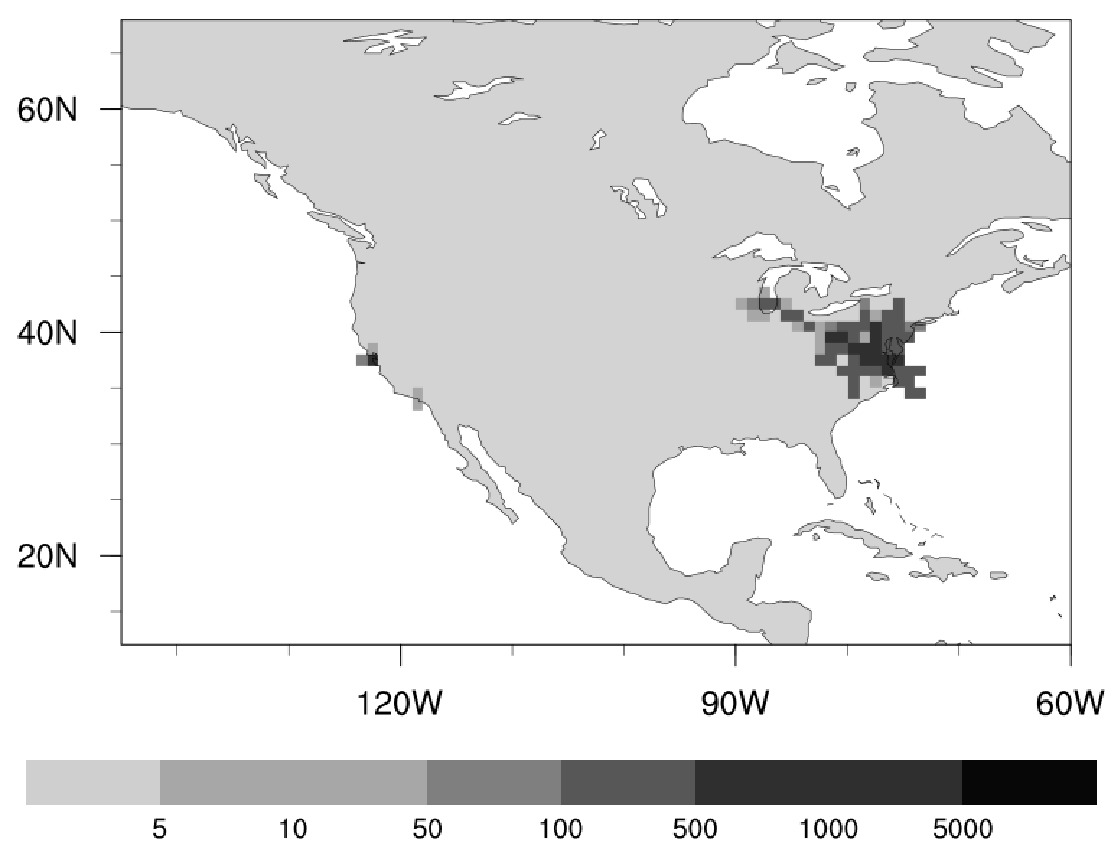
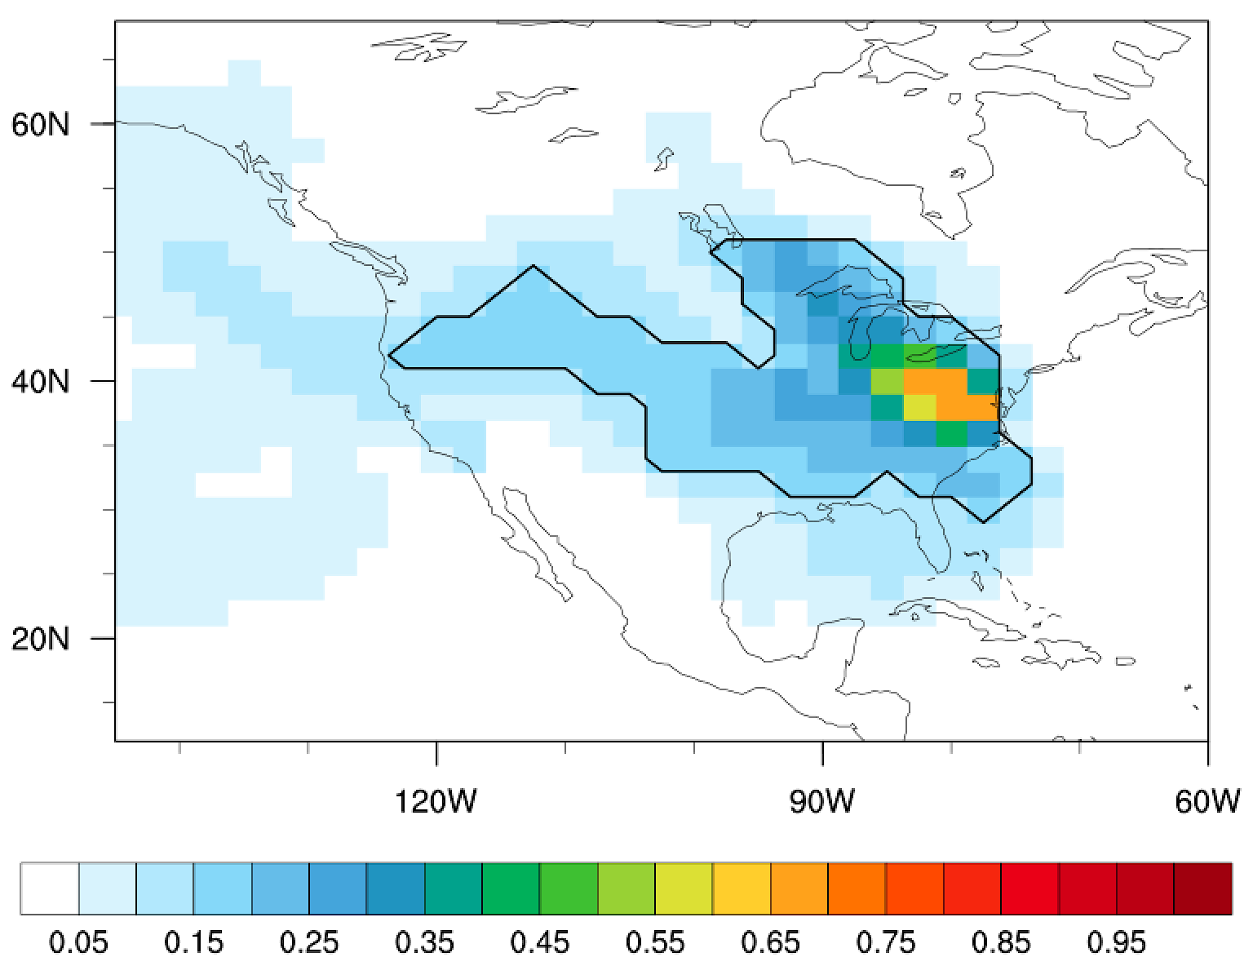
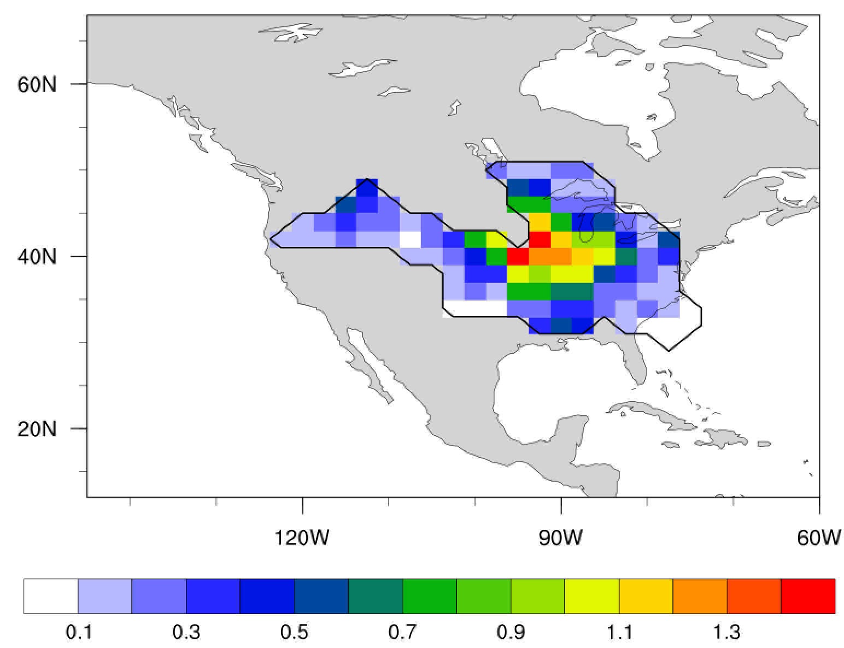

Flux error estimates:
2) Identification of observation-sensitive areas
Q. Where do these errors originate, and what are the true flux error values in flux space?
[Airborne CO₂ observations]
[Normalized adjoint sensitivity]
[${err}_{f_{e}}$]
(%)
(gC m⁻² day⁻¹)
(observation number)
Using Geos-chem adjoint model, calculate the adjoint sensitivity of atmospheric CO₂ to surface CO₂ fluxes by regions.
Compute the ensemble spread of the sum of posterior CO₂ fluxes within the 50th percentile adjoint sensitivity trajectory.
3. Assuming the observation operator is linear:${err}_{f_{t}} (=\frac{h\left({err}_{f_{t}}\right) }{h\left({err}_{f_{e}}\right)}×{err}_{f_{e}})$.

Slide 10
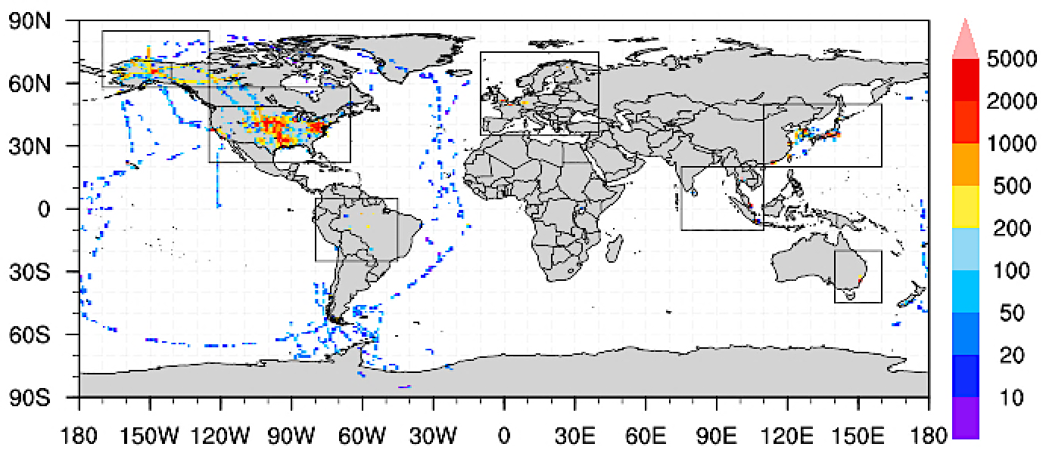
Number of Aircraft Observations (2km-5km)
In five regions, the observation-based error estimates exceed the errors computed from the ensemble spread of posterior CO₂ flux estimates by 1.3-1.9 times.

Slide 11
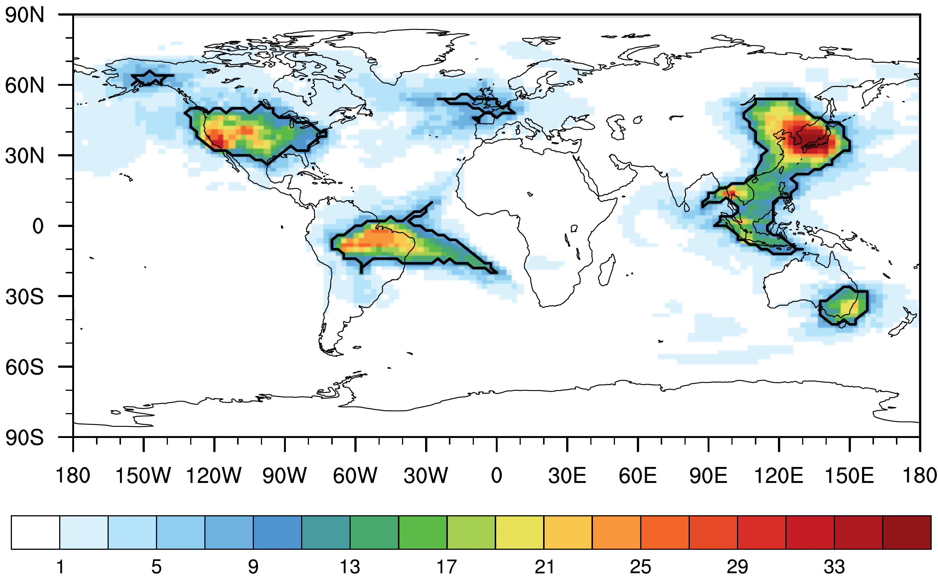
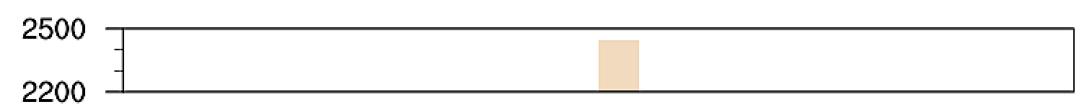
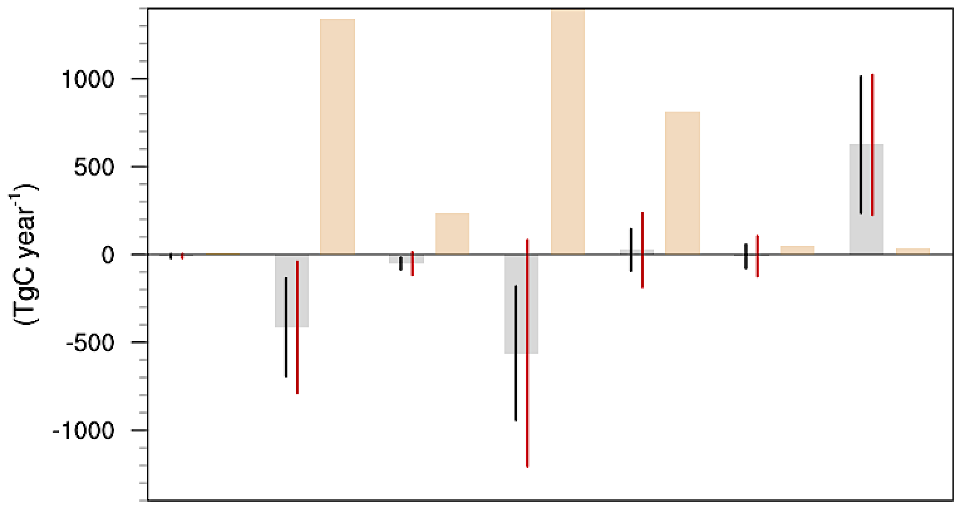

Errors in regional annual terrestrial biosphere CO₂ fluxes
<Number of months selected as the effective area for 2015-2017>
<Annual fossil fuel CO₂ emissions and terrestrial biosphere CO₂ flux with error ranges averaged for 2015-2017>
Fossil fuel CO₂ emissions
Previously estimated flux error range ($σ$ of posterior CO₂ fluxes)
Ensemble mean of posterior terrestrial biosphere CO₂ fluxes
Newly-estimated flux error range
Alaska
East Asia
Southeast Asia
Europe
Australia
(Number of months)
Mid NA
South America
Actual flux errors are underestimated in regions with higher fossil fuel emissions compared to terrestrial biosphere fluxes by 3-31 times.
It suggests the potential presence of systematic biases originating from errors in fossil fuel emission estimates.

Slide 12
Summary
Evaluating concentrations against independent observations
Emergent constraint to derive relationship between fluxes and concentrations
Combination of aircraft observations and adjoint sensitivity to quantify uncertainties of ensemble posterior fluxes
Flux inversions are useful tools to reveal biases in satellites observations
Aircraft CO2 observations (~1km-5km)
Ensemble flux estimates from top-down inversions
Can we use airborne flux estimates to evaluate area fluxes?

