Slide 1
Measurement Gaps
Dave Crisp
CEOS-SIT Chair Team

Slide 2
Examples of Space-based GHG Measurement Gaps
Sector - specific measurements at urban- regional scales
  high spatial resolution (0.1-1km) is critical
  Multiple species needed to resolve sectors
  high sensitivity/accuracy (0.25%)
  diurnal coverage may be needed to resolve activities
  MethaneSAT is a proof- of-concept
Missions focused on polar & tropical land carbon cycle
  persistent cloudiness
  dark surfaces/low sunlight
  Arctic Observing Mission and Carbon-I are future concepts
Ocean surface CO₂ fluxes
  Very high precision and accuracy is needed to quantify ocean fluxes
  only moderate spatial resolution needed for open ocean
  ocean-focused validation is critical to meet accuracy requirements.
  OCO-2 defines the current state of the art. GOSAT-GW and CO2M will provide greater coverage and resolution

Slide 3
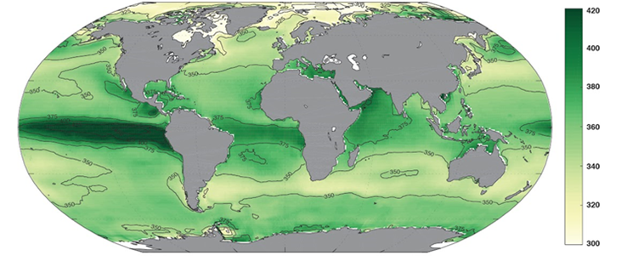
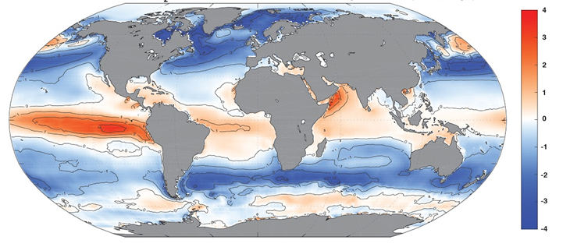
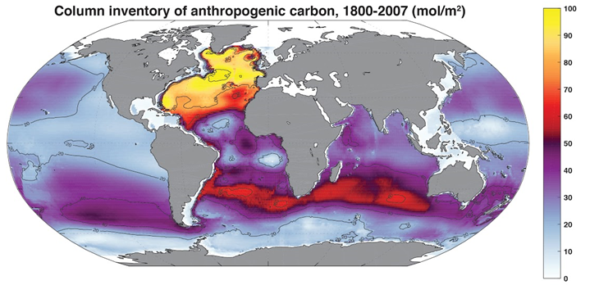
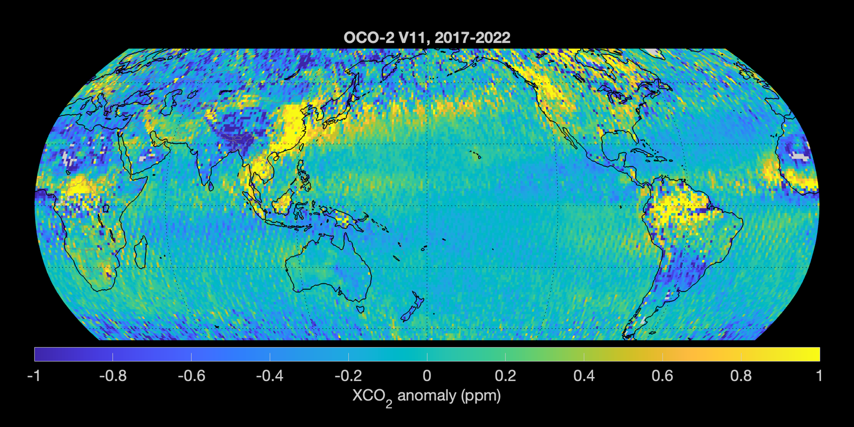
CO₂ flux from ocean pCO₂ vs Atmospheric XCO₂
1988-2018 mean pCO₂ from Observations (µatm)
1988-2018 mean fluxes (mol/m²/yr)
420
4
360
0
300
-4
Column Inventory of anthropogenic carbon (mol/m²)
100
50
0
pCO₂ and fluxes from Fay et al. (2021); Column inventory from Sabine et al. (2004), Gruber et al. (2019)
Persistent XCO2 anomalies from OCO-2

