Slide 1

IWGGMS-21
Session 7: Multispecies Observations-Modelling and GHG-AQ Synergy
From GHG monitoring to Process Understanding
Session chairs: Helen Worden, Jochen Landgraf

Slide 2
Presentations
Yugo Kanaya (NIES) et al.: Column and surface concentration observations of CO₂ & NO₂ at Yokosuka, Japan, in support of GOSAT-GW/TANSO-3
Astrid Müller (NIES) et al.: Towards Shipborne Emission Monitoring and Satellite Validation of CO₂, CH₄, CO, and NO₂ Through Simultaneous Columnar and In Situ Observations
Helen Worden (NSF-NCAR/ACOM) et al.: Step change in boreal fire emissions? Canadian case study
Kazuyuki Miyazaki (JPL) et al.: Predicting fossil fuel CO₂ using air quality emissions and emerging CO₂ satellite observations for global carbon cycle assessment
Zhen Qu (North Carolina State University) : Implementing a sector-based inversion framework for top-down CO₂ emission estimates
Brad Weir (NASA): Monitoring the “atmospheric stocks” of greenhouse gases from space
Posters also showed more model simulations
and additional co-emitted species: VOCs, AOD and BC

Slide 3
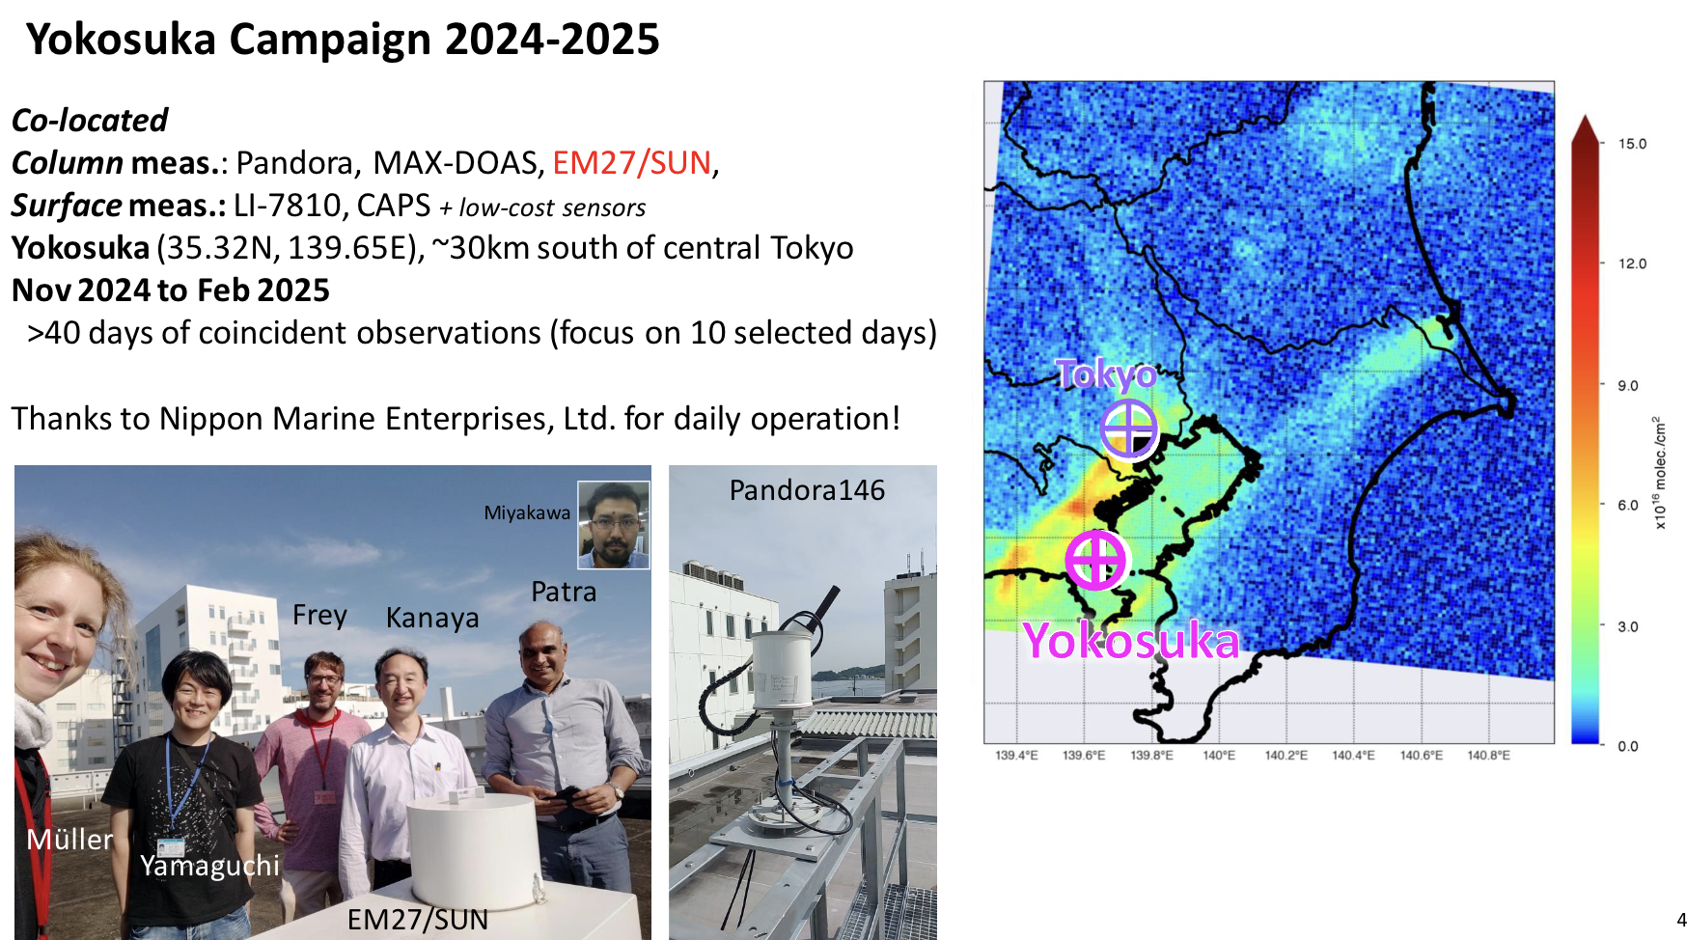
Y. Kanaya talk

Slide 4
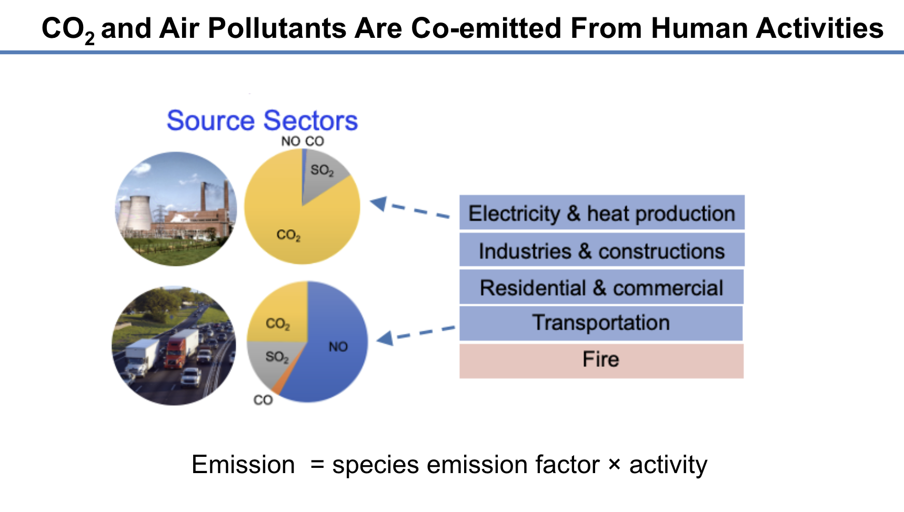
Z. Qu talk

Slide 5
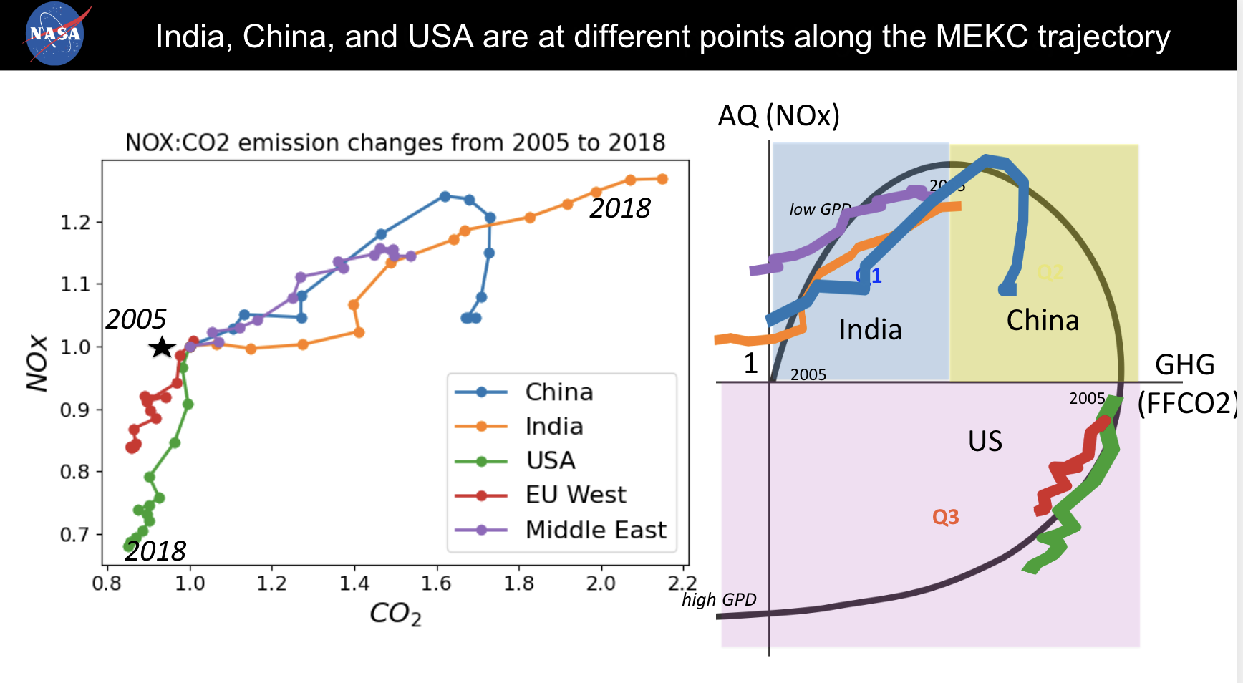
K. Miyazaki talk - given by K. Bowman

Slide 6
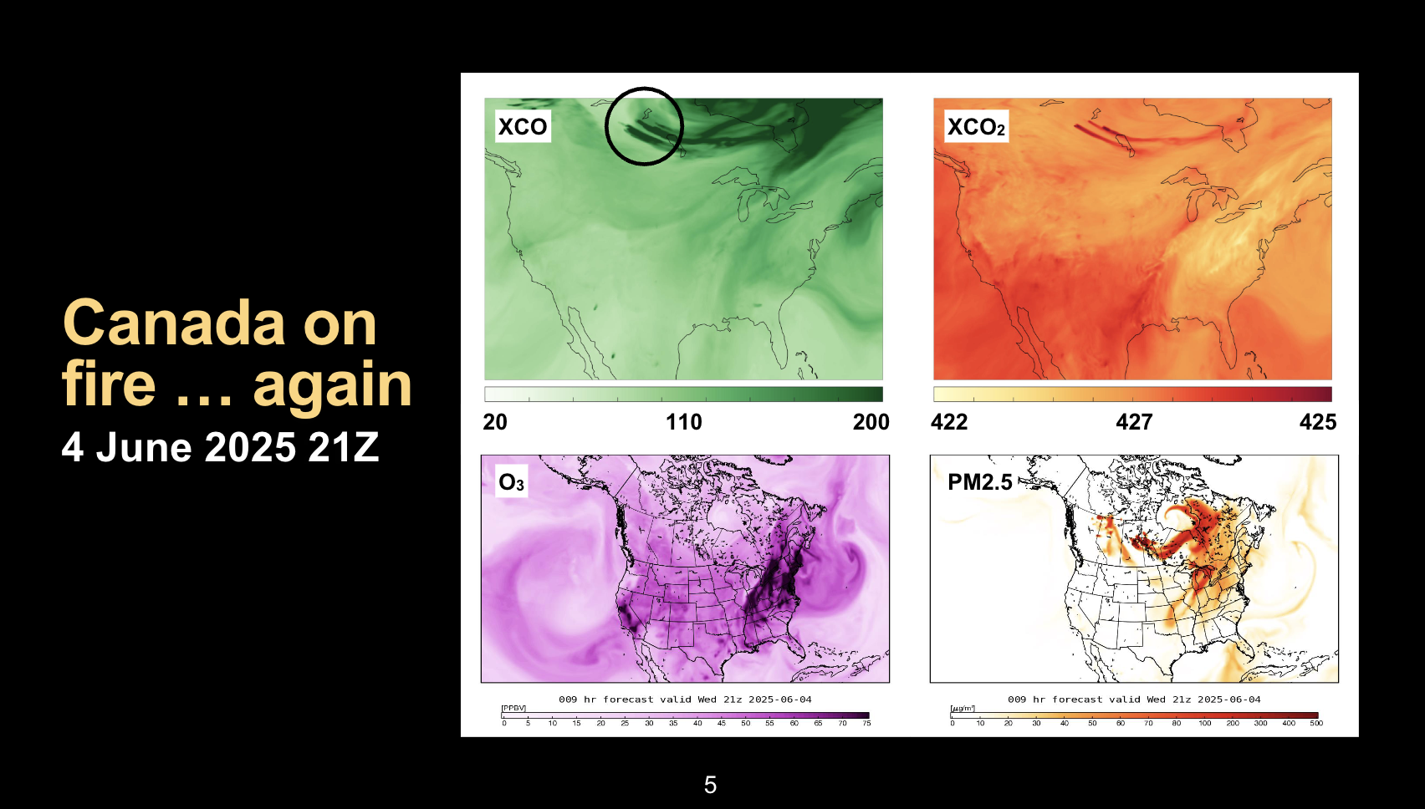
B. Weir talk

Slide 7
Conclusions based on the use of multiple species (1)
The enhancement ratios of ΔXCO₂/ΔTropNO₂VCD and their variations were demonstrated using co-located EM27/SUN and Pandora at Yokosuka, Japan (Kanaya et al.).
Combining observations of CO2,CH4, NO2, and CO by the semi-automatic FTIR–VIS Spectrometer with in situ surface observations, the potential for emission plume detection and its contribution to a better understanding of the vertical distribution of anthropogenic emissions was demonstrated (Mueller et al.).
Using MOPITT CO, surface temperature and other satellite sensors, Worden concluded: General increase in fires over satellite record for region of study, fire increase corresponds to increasing surface temperature, decreasing in RH and soil moisture (Worden et al.)

Slide 8
Conclusions based on the use of multiple species (2)
Modified environmental Kuznets Curve (NOx versus GHG) provides a useful framework to understand co-evolution of air quality and carbon emissions under macroeconomic growth (K. Miyazaki et al.)
Top-down emissions from a sector-based inversion framework (TEMPO NO₂, TROPOMI NO₂ & SO₂ MOPITT CO) lead to the best agreement with independent surface measurements and provide a new perspective to evaluate bottom-up activity-based emission estimates (Qu).
Multispecies assimilation (CO2: OCO-2, CH4: TROPOMI, CO: TROPOMI & IASI) shows ‘pretty good’ agreement with TCCON (Brad Weir).

Slide 9
Overall Conclusions
Multispecies observations are needed to understand underlying processes that cannot be derived from GHG observations only
Used observations other than GHGs:
  NO₂, CO, SO₂, surface temperature and soil humidity
Other useful species
  COS, aerosol, ….
  When going from monitoring to a process understanding, multispecies observations are required, and corresponding mission concepts need to be supported in the future.
New opportunities coming soon with launch of:
  Sentinel-4 and MTG-sounder on MTG in July 2025 (with full disk coverage from MTG-sounder for CO, NH3, etc)
  Sentinel-5 and IASI-NG on MetOp-SG in August 2025

