Slide 1
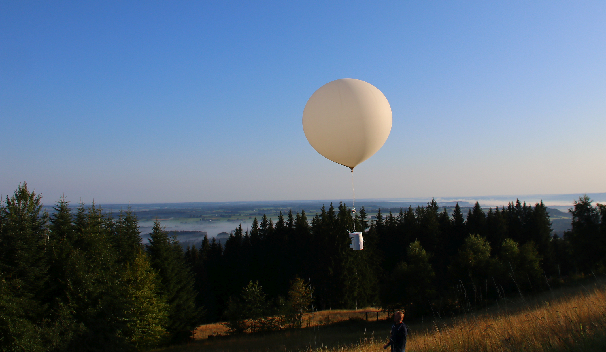
Observed free tropospheric ozone changes and their attribution through model simulations
Ground-Based Observations: W. Steinbrecht, D. Kubistin, C. Plass-Dülmer, J. Davies, D.W. Tarasick, P. von der Gathen, H. Deckelmann, N. Jepsen, R. Kivi, N. Lyall, M. Palm, J. Notholt, B. Kois, P. Oelsner, M. Allaart, A. Piters, M. Gill, R. Van Malderen, A.W. Delcloo, R. Sussmann, E. Mahieu, C. Servais, G. Romanens, R. Stübi, G. Ancellet, S. Godin-Beekmann, S. Yamanouchi, K. Strong, B. Johnson, P. Cullis, I. Petropavlovskikh, J. Hannigan., J.-L. Hernandez, A. Diaz Rodriguez, T. Nakano, F. Chouza, T. Leblanc, C. Torres, O. Garcia, A. Röhling, M. Schneider, T. Blumenstock, M. Tully, C. Paton-Walsh, N. Jones, R. Querel, S. Strahan, R.M. Stauffer, A.M. Thompson, A. Inness, R. Engelen, K.-L. Chang, O.R. Cooper, GRL paper: https://doi.org/10.1029/2020GL091987
Satellite Observations: Ziemke et al., Miyazaki et al.
NCAR / MPI Modelling: G. Brasseur, I. Bouarar, B. Gaubert, …
free troposphere: NO_{x} limited
less NO_{x} = less Ozone

Slide 2
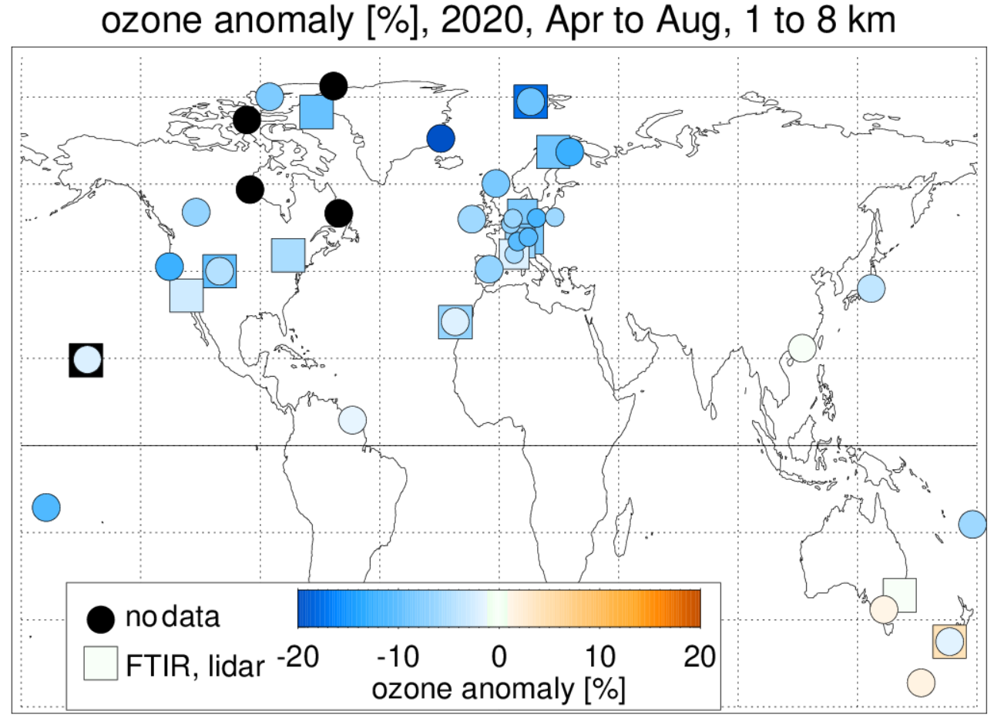
free troposphere ozone anomaly 2020
~45 stations / instruments
Sondes
11 FTIRs
2 lidars
reasonably fast data delivery (NILU, WOUDC, NDACC)

Slide 3
Satellites saw it too!
Total O3 – strat.
EPIC–MERRA2
OMPS-MERRA2
OMI - MLS
Ziemke et al., CEOS AC-VC 17, June 9 2021

Slide 4
JPL MOMO model + CrIS
Tropospheric ozone response
to COVID-19 (May 2020)
o3 change [ppb]
Miyazaki et al., CEOS AC-VC 17, June 9 2021
o3 change [ppb]
Miyazaki et al., Sci. Adv. 2021; 7 : eabf7460, 2021

Slide 5
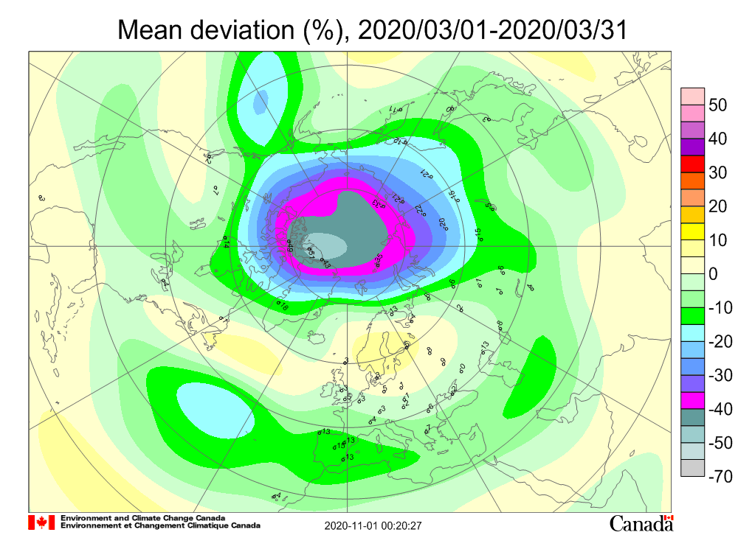
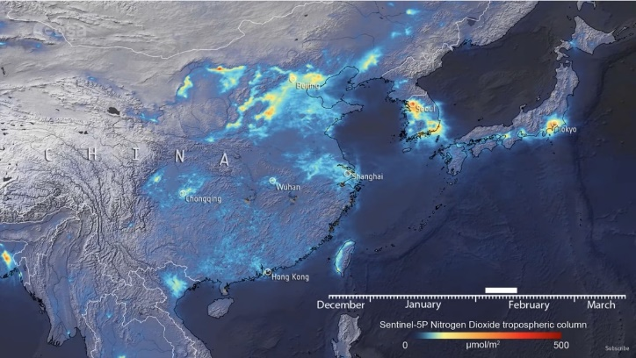
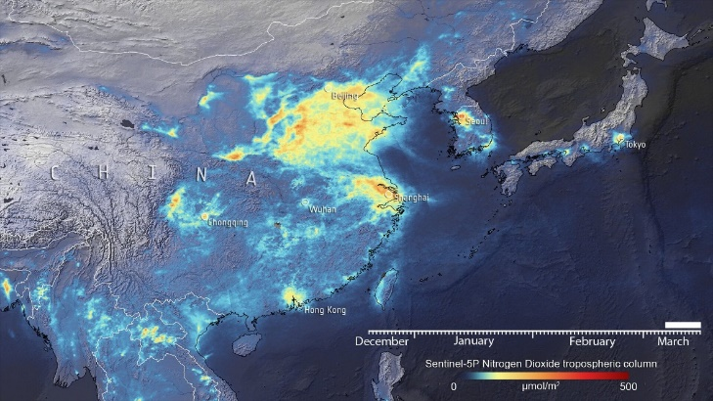
Different in 2020
1.) reduced emission due to COVID-19
2.) 2020 Arctic “ozone hole”
NO₂ over China, Feb. 2020 (lockdown)
March 2020
TROPOMI
www.copernicus.eu
www.esa.int
www.woudc.org

Slide 6
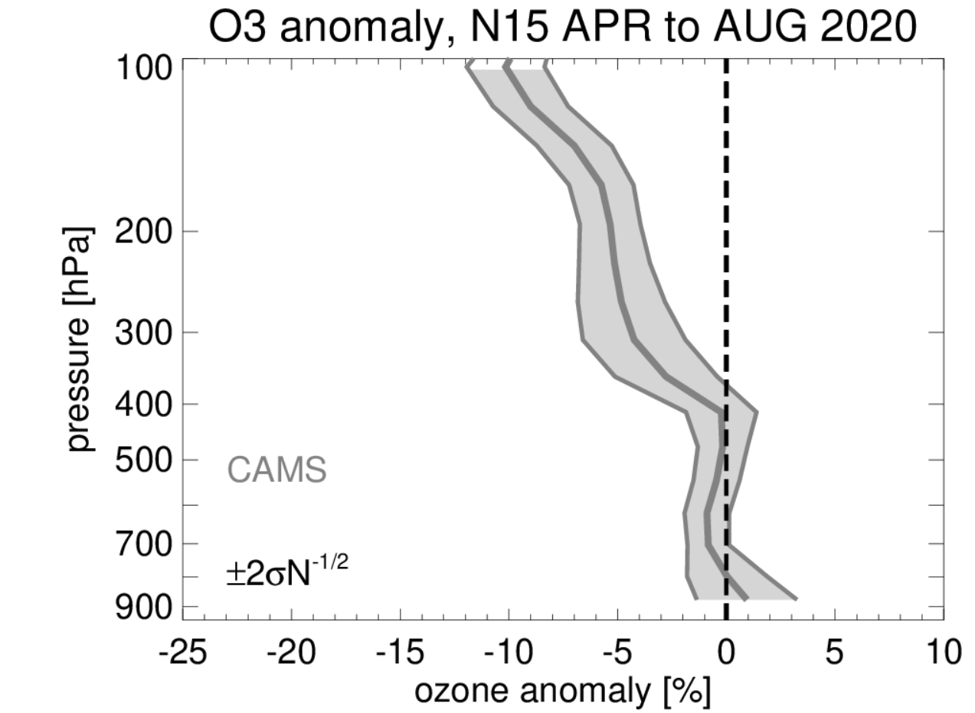
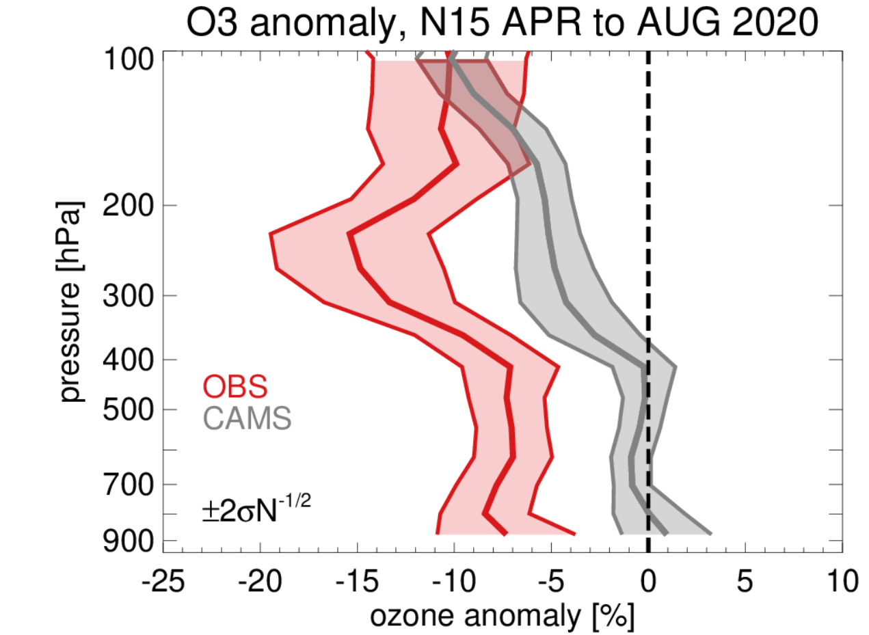
2020 anomalies, vertical profile
2020 ozone hole + meteo conditions above 400hPa
COVID-19 emission reductions below 200 hPa
2020
meteo
CAMS = Copernicus Atmosphere Monitoring Service =
ECMWF + chemistry
2020 meteorology, incl. O₃ hole
but “normal” emissions
COVID 19

Slide 7
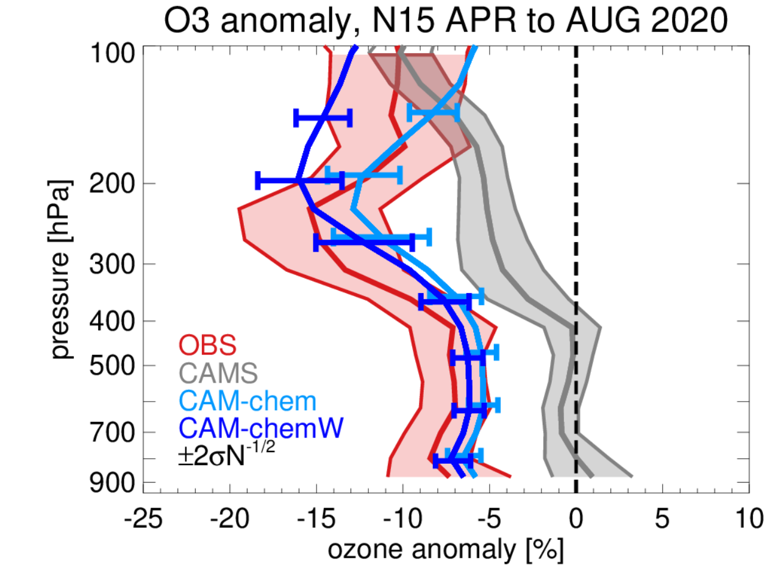
Vertical Profile, also NCAR simulations
2020 ozone hole + meteo conditions above 400hPa
COVID-19 emission reductions below 200 hPa
CAM-chem consistent with OBS
CAM-chemW better ozone hole: -1% trop O3

Slide 8
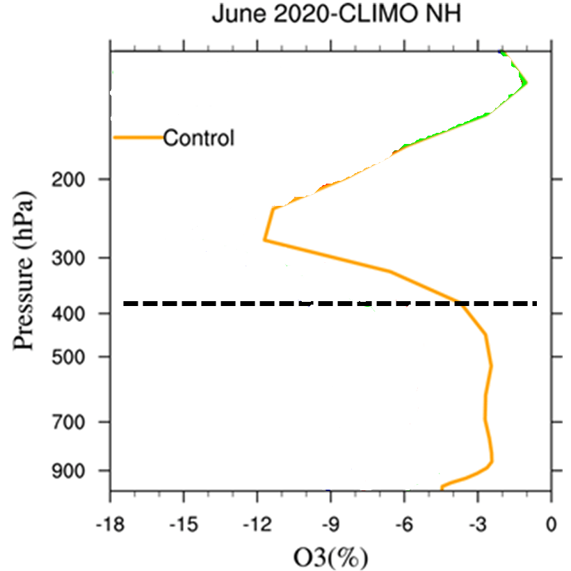
NCAR simulations (June, entire NH)
2020 meteo

Slide 9
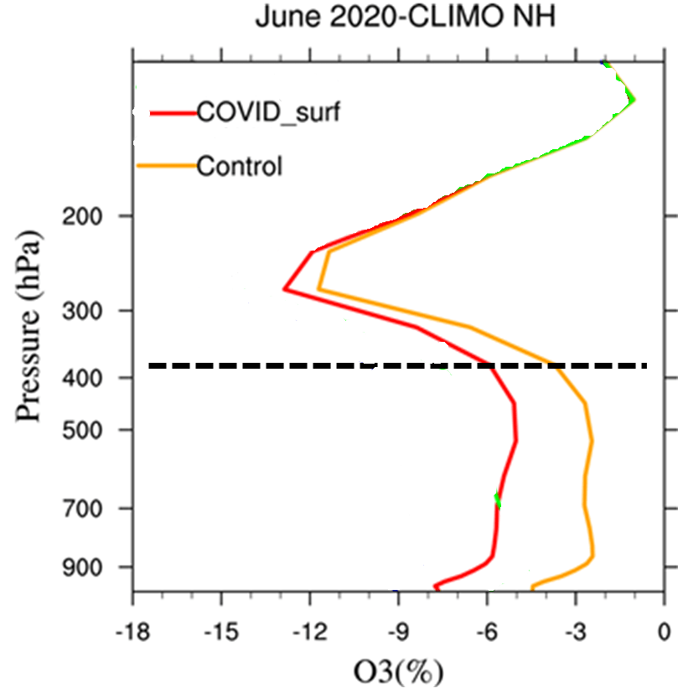
NCAR simulations (June, entire NH)
surface
2020 meteo

Slide 10
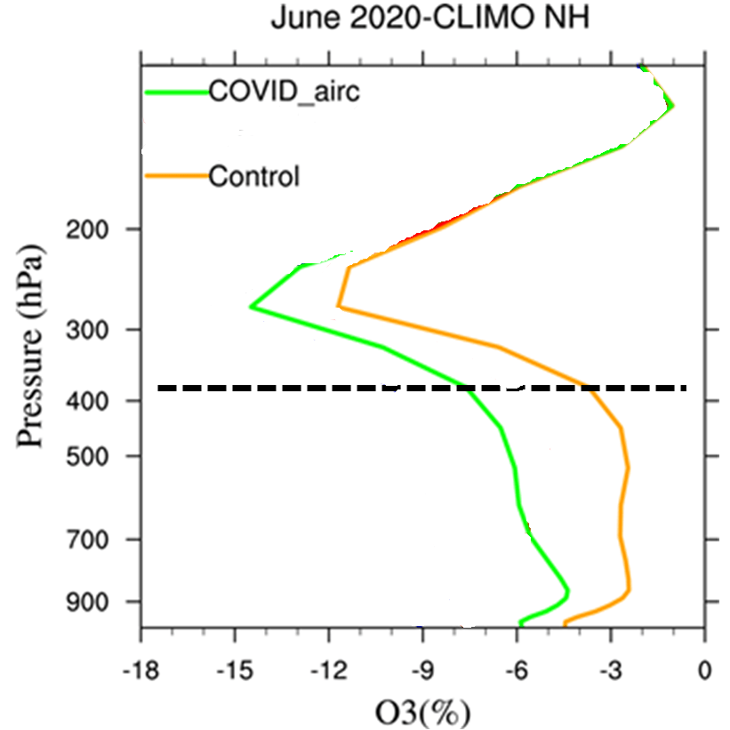
NCAR simulations (June, entire NH)
air-traffic
2020 meteo

Slide 11
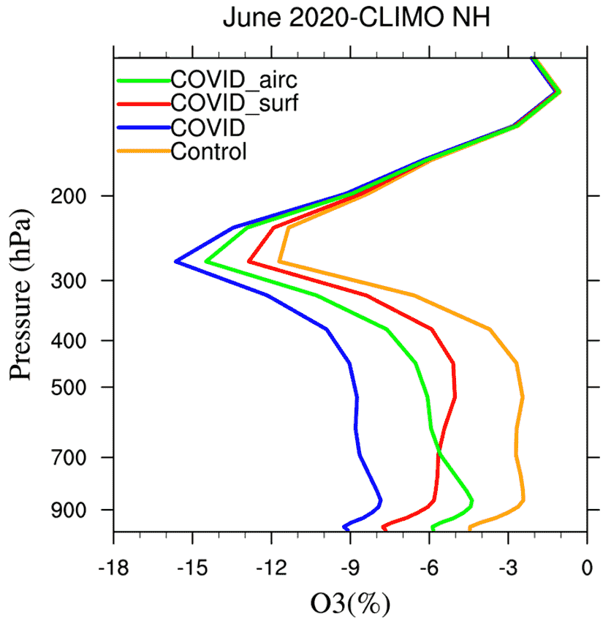
NCAR simulations (June, entire NH)
above 200hPa:
2020 meteo conditions, including ozone hole
below 400 hPa:
1/3 meteo conditions
1/3 surface emission reduction
1/3 air-traffic reduction
2/3 COVID-19 reductions
air-traffic
Surface
all
2020 meteo

Slide 12
summary
7% ozone reduction in NH free troposphere, April to August 2020, 1 to 8 km
below ~8 km: 2/3 due to COVID-19 emission reductions (NO_{x} ,…)
(1/3 surface emissions, 1/3 air-traffic reduction)
1/3 from 2020 meteorology (incl. Arctic stratospheric ozone hole)
in SH: (smaller) COVID-19 effect masked by 2020 natural conditions
accidental “global experiment”, much to be learned
importance of “monitoring” + data availability
GRL: obs: paper, simulations: submitted

Slide 13
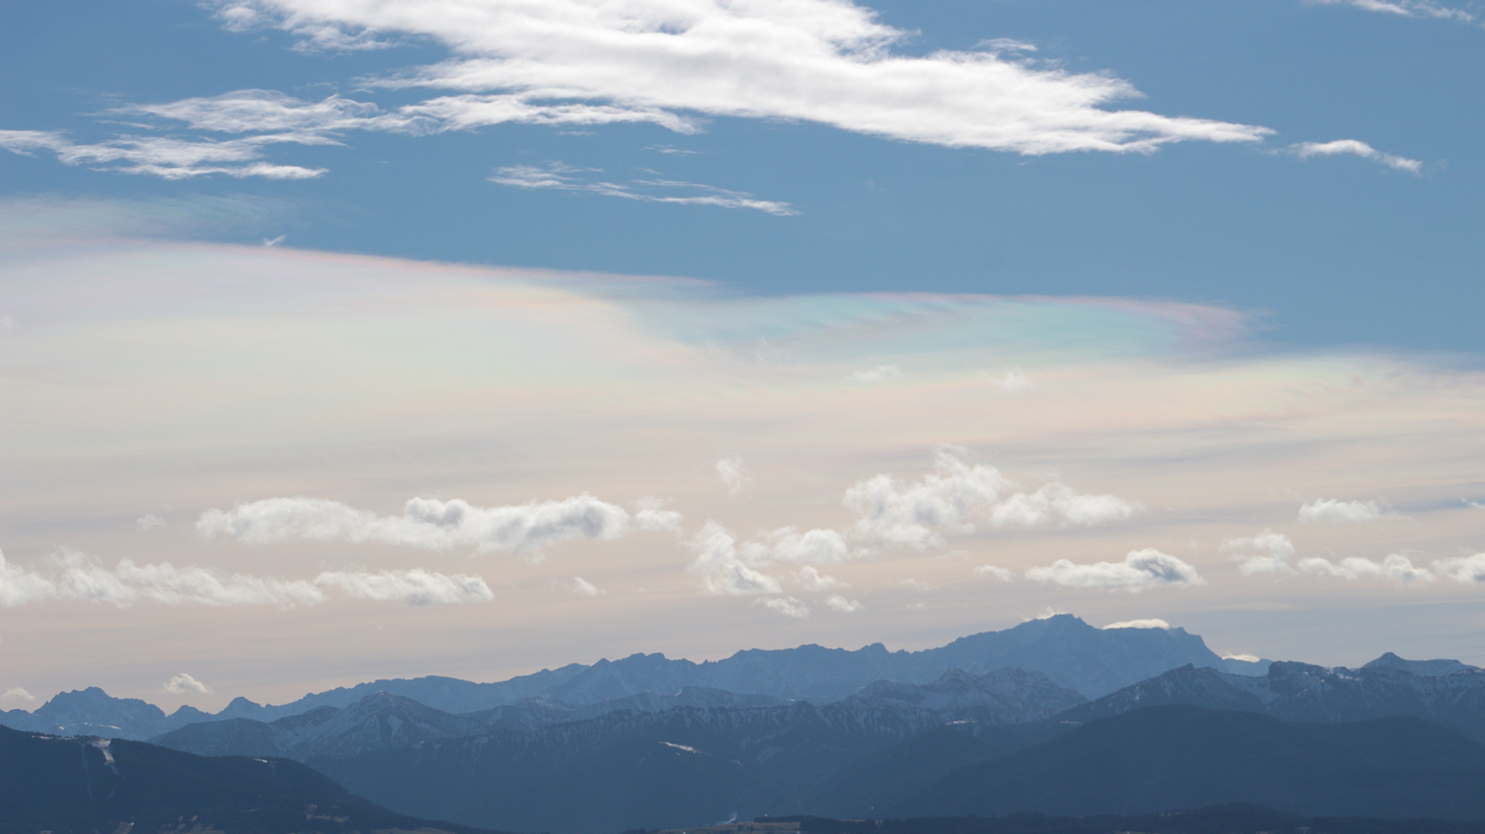
Thank You !
Photo: 1.Feb 2016 Ulf Köhler

