Slide 1
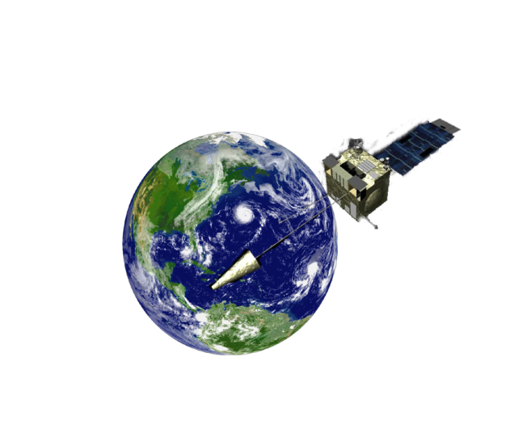

CEOS Atmospheric
Composition Portal (ACP)
Presented by Stefan Falke
on behalf of the ACP Team
ACC-7
June 21, 2011
Columbia, Maryland

Slide 2
ACP Mission Statement
Provide access, tools, and contextual guidance to scientists and value-adding organizations in using remotely sensed atmospheric composition data, information, and services.
Help foster interoperability and application of atmospheric composition data, information and services worldwide.
Identify the unique requirements and common (shared) features of the ACC and GEOSS users to provide a value-added and complementary capability.
Work with partners in CEOS and the broader AC community in advancing the ACP
2
Notes:
2

Slide 3
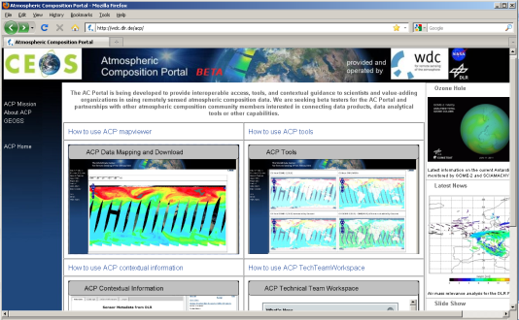
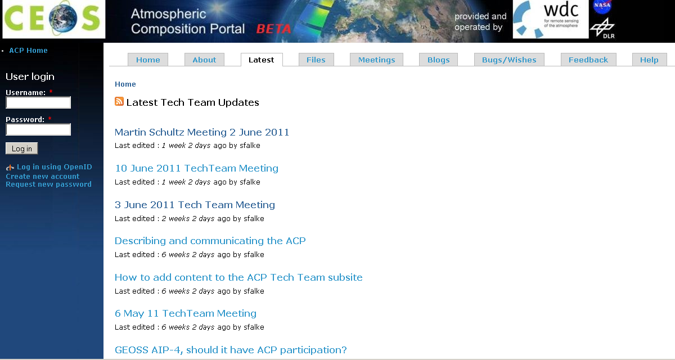
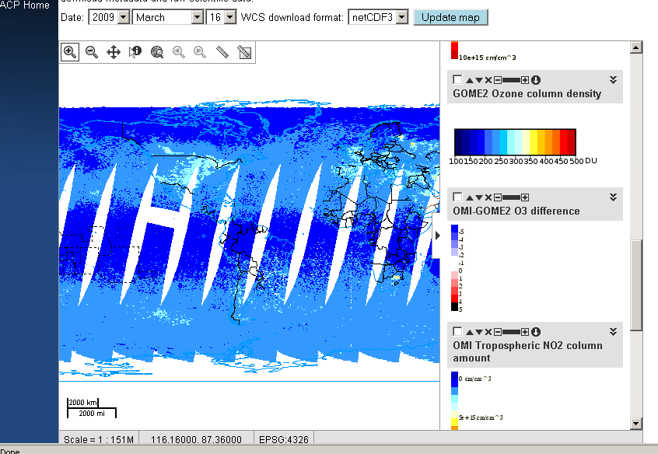
ACP at the Intersection of
AC Science and Information S&T
The ACP aims to provide a community-oriented framework that applies best practices in information science and technology to atmospheric composition science.
ACP-Beta
http://wdc.dlr.de/acp/

Slide 4
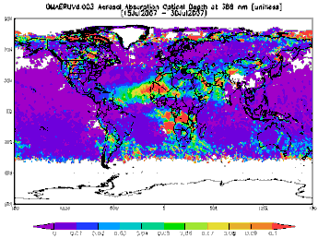
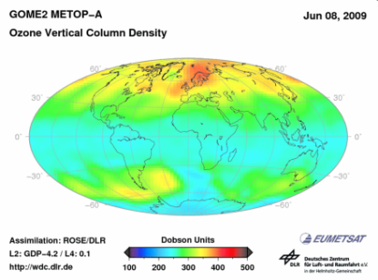
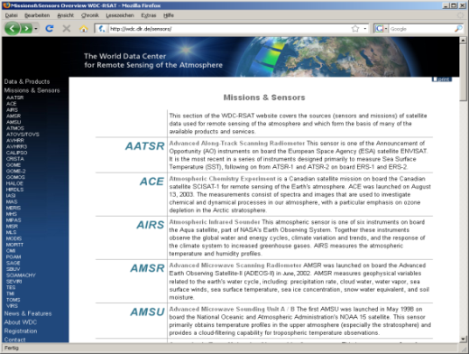
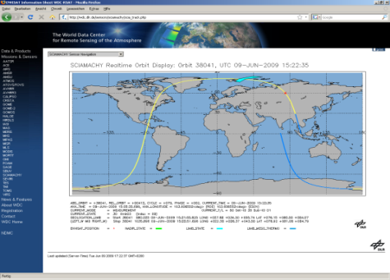
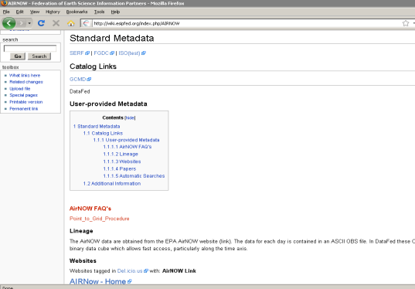
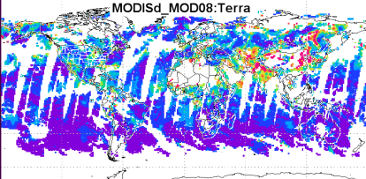
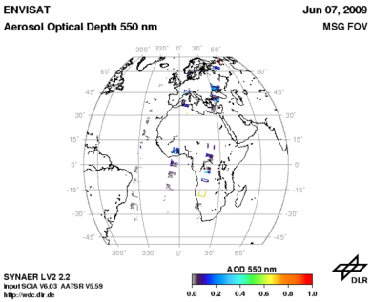
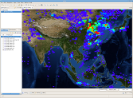
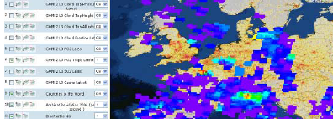
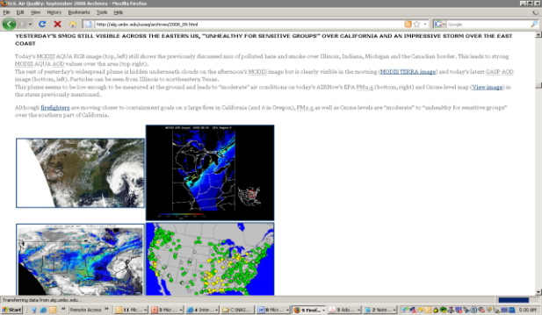
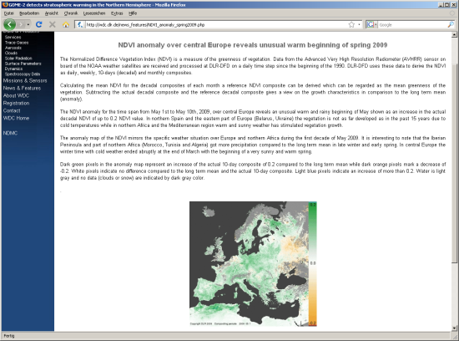
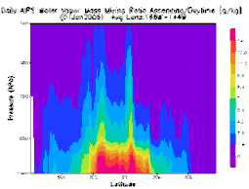
Features of the ACP Framework
4
Improved access to data
Contextual Information to help understand and use data
OMI
GOME-2
MODIS
SCIAMACHY/
AATSR
And others…
Tools for processing
and analysis
Collaboration tools for exchanging analyses and other information
4

Slide 5
Request your input on: which features are most useful for ACC?
Improved Data Access
  Discovery of, and access to, available AC data products
  Access through web standards and standard data formats
  Connections with related datasets (e.g., access to GEOSS AQ CoP Information Network)
Processing & Analysis Tools
  Data subsetting, regridding, aggregation services prior to download
  Comparison of data products
  Integrated analysis of satellite, model and ground-based data
  Online visualization in maps, time series, and other charts
Contextual Information
  Discovery of, and access to, available AC data product metadata (connections with catalogs)
  Data lineage/provenance
  Documentation (e.g., ATBDs) and literature
  Where and how are AC products being used
Collaboration Tools
  Online workspaces (content management, wikis, forums)

Slide 6
ACP Science Advisory Group
We propose to assemble an ACP Science Advisory Group to review and guide the ACP and help identify most useful features from previous slide
  members of ACC would be a core part of Science Advisory Group
The advancement of the ACP requires continual direction and advice from scientists and researchers, on both the science-team and end-user sides.
Science advice is needed to help ensure the ACP is addressing current needs of the AC Community and that its implementation and usage are appropriate
We envision that one or two members of the ACP Science Advisory Group work directly and closely with the AC Portal development team.

Slide 7
Other ACP Collaborations
QA4EO
  Albrecht van Bargen, DLR and Bojon Bojkov, ESA
  Defining ACP role in providing ‘inputs’ and using ‘outputs’ of QA4EO process
AC Modelers
  Martin Schultz, Juelich Research Center
  Sharing of data via OGC Web Coverage Service
  Reuse of processing, analysis and visualization tools
AC Emissions
  Greg Frost, NOAA
  Sharing of data via OGC Web Coverage Service
  Reuse of processing, analysis and visualization tools
GOESS Air Quality Community of Practice Information Network
  GEOSS AQ CoP meeting 23-25 August (co-organizers Rudy Husar and Martin Schultz) - http://wiki.esipfed.org/index.php/Air_Quality_Data_Network_Solta_2011
  Advancing networking and interoperability of AQ-related data systems

Slide 8
ACP Technical Team
DLR
  Oleg Goussev
  Séverine Bernonville
  Michael Bittner
NASA
  Richard Eckman
  Ernie Hilsenrath (emeritus)
  Frank Lindsay
  Karen Moe
  GES DISC
    Greg Leptoukh
    Chris Lynnes
    Peisheng Zhao
    Wenli Yang
    James Johnson
  Stefan Falke (Northrop Grumman)
  Rudolf Husar (Washington University)
  Erin Robinson (ESIP)

