Slide 1
The SPARC Data Initiative
Intercomparison of vertically resolved
chemical trace gas and aerosol climatologies
Michaela I. Hegglin
hegglin scientific, Menzingen, Switzerland
Susann Tegtmeier
GEOMAR, Kiel, Germany
Lucien Froidevaux
Jet Propulsion Laboratory, California Institute of Technology, Pasadena, USA
and the SPARC Data Initiative team
CEOS ACC-8 meeting, Columbia 18/19 April 2012
Notes:
1

Slide 2

What is SPARC and
where does the Data Initiative fit in?
SPARC - Stratospheric Processes And their Role in Climate
A core project of the World Climate Research Programme (WCRP)
Objective: engage and facilitate the stratospheric research community to focus on gaps in knowledge of particular relevance for climate, in coordination with relevant partners
Organization: Scientific Steering Group (SSG) and SPARC International Project Office (Zurich)
    New website: http://www.sparc-climate.org/organisation/sparc-office/
Themes:
  Climate-Chemistry Interactions
  Detection, Attribution, and Prediction of Stratospheric Change
  Stratosphere-Troposphere Dynamical Coupling
Several activities (e.g., CCMVal, Gravity Waves, Data Initiative)
SPARC reports, newsletters, meetings
SPARC Data Center
Notes:
2

Slide 3
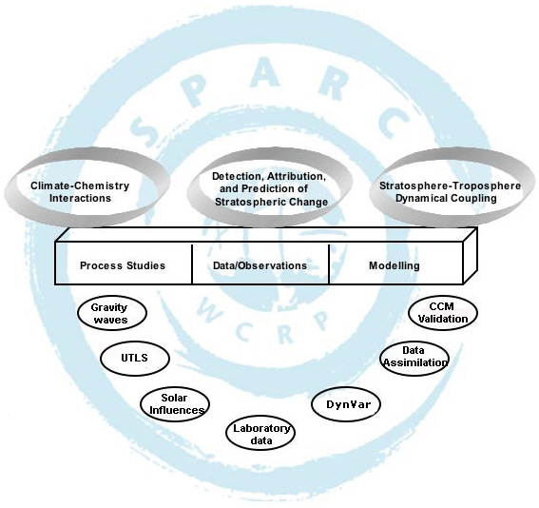
Data
initiative
Notes:
Observations represent a key foundation-stone of SPARC science

Slide 4
Motivation
Knowledge of quality of different satellite data sets needs to be improved for different applications:
    Tracer scenario validation (Montreal Protocol, Cl_{y})
    Empirical studies of stratospheric climate and variability
    Trend analyses (e.g., stratospheric water vapour)
    Model validation projects (CCMVal, IPCC)
    → model performance dependent on data quality
    → data knowledge makes comparison more meaningful
      CCMVal-2 recommendations:
      Long-term vertically resolved data sets of constituent observations in the stratosphere are required to assess model behavior and test model predictions.
      A systematic comparison of existing observations is required in order to underpin future model evaluation efforts, by providing a more accurate assessment of measurement uncertainties.
Notes:
Add recommendation and do layouting!
This includes ozone, but also other species that can be used to diagnose transport and chemistry. The current set of GCOS Essential Climate Variables is not sufficient for process-oriented validation of CCMs.

Slide 5
Objectives
  Assessing state of data availability from the multi-national suite of space-based instruments
  Compiling climatologies of chemical trace gases in collaboration with instrument PIs
  Main objective: detailed inter-comparison of climatologies
    Will summarize useful information and highlight differences between data sets
    Will be published as a peer-reviewed SPARC report, as well as in journal publications
Notes:
5

Slide 6
Scope
  Vertically resolved measurements of atmospheric constituents from the upper troposphere to the lower mesosphere (approximately 5-65 km).
  The main focus is on satellite measurements.
  The report is targeted at 25 different long-lived and short-lived trace gas species (O₃, H₂O, CH₄, N₂O, HNO₃, N₂O₅, NO_{x}, HCl, ClO, OClO, HOCl, HF, BrO, SF₆, CO, … ) and aerosol.
Notes:
6

Slide 7
Timeliness
The initiative is very timely given the fact that
    the “golden age” of stratospheric composition measurements of the past three decades is about to come to an end,
    it is highly likely that there will be much fewer measurements in the future,
    we need to capture existing knowledge on current and recent instruments before this knowledge is lost.
Notes:
Mention GOZCARDS and Climate Change Initiative
7

Slide 8
Projected value
  Introduction and overview on current and recent instruments, measurement and retrieval techniques
  Better knowledge of the quality of available data products
      Information on where various data products are consistent
      Information on unphysical features or strong deviations
  SDI report is direct input for
      Data merging exercises and trend evaluations (SI2N, WAVAS II, CCI)
      CCM-measurement comparisons (CCMVal)
  Based on the spread in the climatologies an estimate of the overall systematic uncertainty in our knowledge of the atmospheric state is achieved
  Monthly zonal mean time series of the observations are provided to the end user in a common format
  Guidance and feedback to space agencies about desired improvements in existing data sets and future observations
      identify priorities for reprocessing data or enhanced validation efforts
      Identify measurement gaps, which could motivate and provide support for future missions.
Notes:
8

Slide 9
Timeline
Author team defined by March 2010
Successful proposal to ISSI May 2010
Workshop I (November 2010)
Assembling zonal monthly mean time series (spring 2010)
Workshop II (June 2011)
Evaluations and comparisons (summer/autumn 2011)
Review meeting (December 2011)
Revisions, further evaluations, and second round of external reviews
Start production of SPARC report end of May
SPARC Report to be completed by Autumn 2012
Notes:
9

Slide 10
Participating instrument teams
  HALOE (UARS): John Anderson
  MLS (Aura/UARS): Lucien Froidevaux / Ryan Fuller
  TES (Aura): Jessica Neu
  ACE-FTS and ACE-MAESTRO (SCISAT-1): Kaley Walker, Ashley Jones
  OSIRIS (Odin): Doug Degenstein, Adam Bourassa, Samuel Brohede
  SMR (Odin): Joachim Urban
  MIPAS (ENVISAT): Thomas von Clarmann, Bernd Funke
  SCIAMACHY (ENVISAT): Alexei Rozanov
  GOMOS (ENVISAT): Erkki Kyrölä
  SAGE I / II / III (AEM-2 / ERBS / Meteor-3M): Ray Wang
  HIRDLS (AURA): John Gille / Lesley Smith
  SMILES (ISS): Yasuko Kasai
  LIMS (NIMBUS-7): Ellis Remsberg / Gretchen Lingenfelser
  POAM II / III (SPOT-3/4): Jerry Lumpe

Slide 11
Updated
tracer list
 | O₃ | H₂O | CH₄ | N₂O | CCl₃F | CCl₂F₂ | CO | HF | SF₆ | NO | NO₂ | NO_{x} | HNO₃ | HNO₄ | N₂O₅ | ClONO₂ | NO_{y} | HCl | ClO | HOCl | BrO | OH | HO₂ | CH₂O | aerosol
ACE-FTS | x | x | x | x | x | x | x | x | x | x | x | x | x | x | x | x | x | x |  |  |  |  |  | x
Aura-MLS | x | x |  | x |  |  | x |  |  |  |  |  | x |  |  |  |  | x | x | x |  | x | x
GOMOS | x |  |  |  |  |  |  |  |  |  | x |  |  |  |  |  |  |  |  |  |  |  |  |  | x
HALOE | x | x | x |  |  |  |  | x |  | x | x | x |  |  |  |  |  | x
HIRDLS | x |  |  |  | x | x |  |  |  |  | x |  | x
LIMS | x | x |  |  |  |  |  |  |  |  | x |  | x
MAESTRO | x
MIPAS | x | x | x | x | x | x | x |  | x | x | x | x | x | x | x | x | x |  | x | x |  |  |  | x
OSIRIS | x |  |  |  |  |  |  |  |  |  | x | x_{d} |  |  |  |  | x_{d} |  |  |  | x |  |  |  | x
POAM II | x |  |  |  |  |  |  |  |  |  | x |  |  |  |  |  |  |  |  |  |  |  |  |  | x
POAM III | x | x |  |  |  |  |  |  |  |  | x |  |  |  |  |  |  |  |  |  |  |  |  |  | x
SAGE I | x
SAGE II | x | x |  |  |  |  |  |  |  |  | x |  |  |  |  |  |  |  |  |  |  |  |  |  | x
SAGE III | x | x |  |  |  |  |  |  |  |  | x |  |  |  |  |  |  |  |  |  |  |  |  |  | x
SCIAMACHY | x | x |  |  |  |  |  |  |  |  | x | x_{d} |  |  |  |  |  |  |  |  | x |  |  |  | x
SMILES | x |  |  |  |  |  |  |  |  |  |  |  | x |  |  |  |  | x | x | x | x |  |  |  | x
SMR | x | x |  | x |  |  | x |  |  | x |  |  | x |  |  |  | x_{d} |  | x |  |  |  | x_{lc}
TES | x_{t} |  |  |  |  |  | x_{t}
UARS-MLS | x | x |  |  |  |  |  |  |  |  |  |  | x |  |  |  |  |  | x

Slide 12
Some example evaluations
Preliminary results!

Slide 13
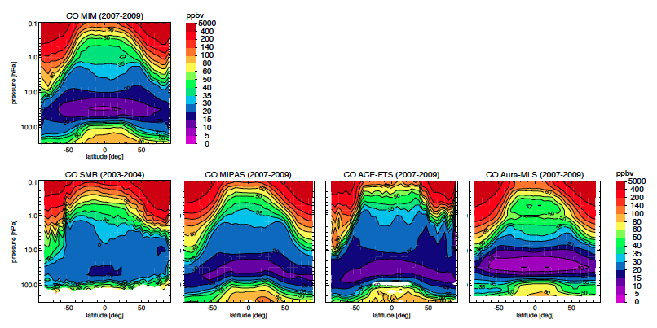
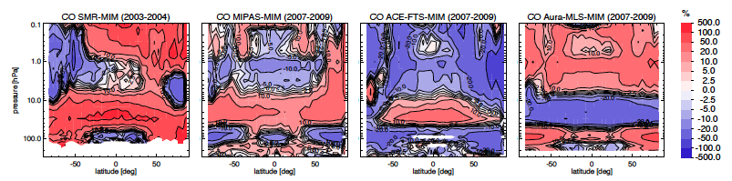
Carbon monoxide annual zonal mean cross sections
Large differences exist in some of the species in the annual zonal means. Nevertheless the instruments agree well in their interannual variability. Further retrieval studies are suggested to get at the cause of this discrepancy.

Slide 14
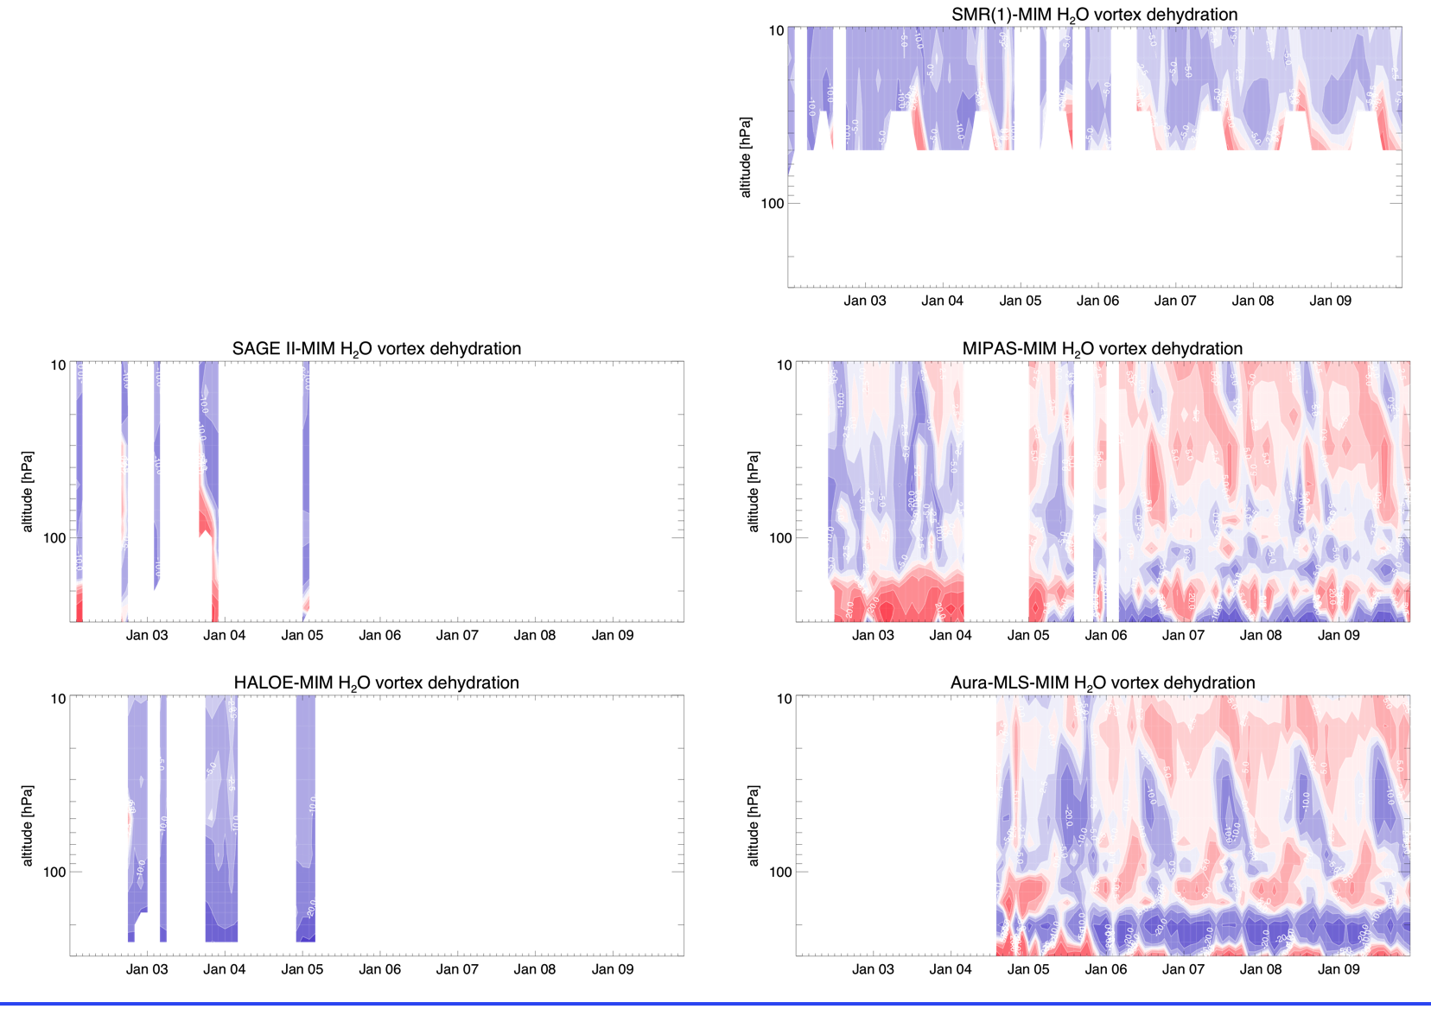
SH polar vortex dehydration
Multi-instrument mean and deviations from it in a subset of the available instruments.
Instruments capture dehydration in the SH polar vortex. Geographical sampling and different vertical resolutions may affect captured signal.

Slide 15
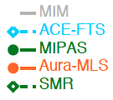
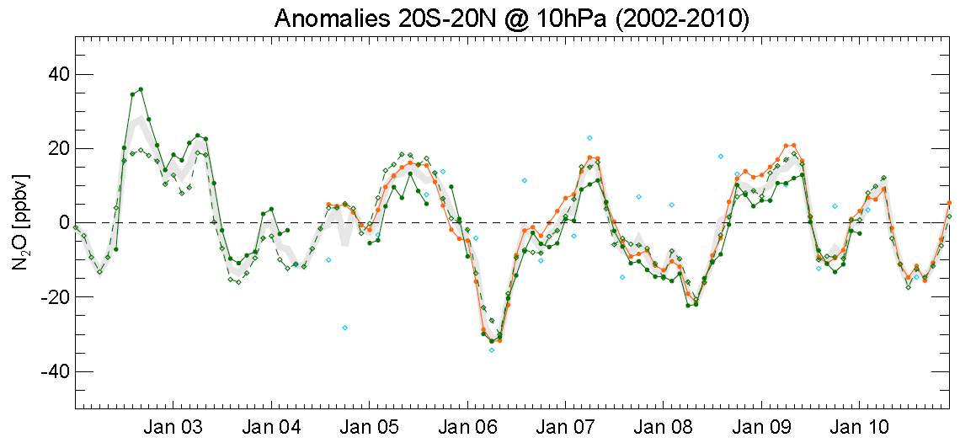
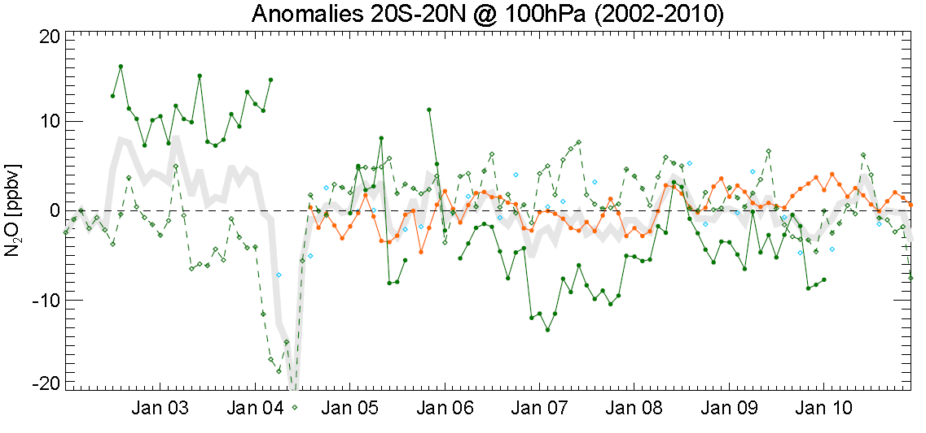
N₂O interannual variability 2002-2010
Time series of deseasonalized N₂O for 20S–20N at 100 and
10 hPa.
Instruments agree well at 10 hPa, displaying a strong QBO signal but do not capture the interannual variability at
100 hPa coherently.

Slide 16
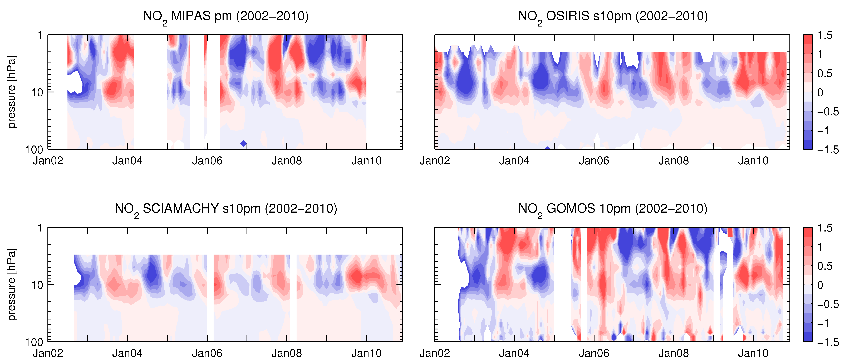
NO₂ QBO signal 2002-2010
Altitude-time sections of deseasonalized NO₂ anomalies for 10S-10N.
Most instruments agree well in the tropics and display the expected downward propagating QBO signal, but show less consistent results in the extra-tropics possibly due to higher natural variability in this region.

Slide 17
Report structure
Executive Summary Preface - Key Findings - Key Recommendations
Chapter 0 Abbreviations and Definitions
Chapter 1 Introduction / scope of the SPARC Data Initiative
Chapter 2 Satellite instruments and data sets
Chapter 3 Climatologies / Methods
Chapter 4 Evaluations
4.1 Ozone - O₃
4.2 Water vapour - H₂O
4.3 Methane – CH₄
…
4.24 Formaldehyde – CH₂O
4.25 Aerosol
4.26 Evaluations in UTLS based on TES averaging kernels
Chapter 5 Discussion and Summary
Chapter 6 Recommendations
Notes:
17

Slide 18
Recommendations: follow-on activities
SDI should coordinate a follow-on activity with specific focus on the UTLS (include diagnostics that take into account geophysical variability, available in-situ measurements, nadir sounders)
SDI should coordinate a follow-on activity with specific focus on the mesosphere
Generation of specific model validation diagnostics
  Mixed team of scientists from the SDI and the model analysis community
  Includes a ‘best’ estimate and its uncertainty range
Include additional instruments (SAMS, iSAMS, CLAES, ILAS, and ATMOS) in future and follow on SDI activities
Include different retrieval products obtained for the same satellite instrument data in future and follow on SDI activities
Establish better knowledge of bottom-up, absolute measurement uncertainty

Slide 19
The different space agencies for their support of the instrument teams and for providing great data!
International Space Science Institute (ISSI, Bern, Switzerland)
    Local costs and location for 2 working meetings at ISSI in Bern
SPARC office Toronto
    Local host for review meeting in December 2011
    Travel support for team members, invited experts and reviewers
    Production of the report
World Climate Research Programme (WCRP)
    Generous travel support for team members, reviewers and invited experts
CSA & ESA
    Funding of team leader ( MIH ☺ )
Acknowledgments

