Slide 1
Status Report for OMPS:
Preliminary Findings
Compilation of results from
JPSS and Suomi NPP OMPS Teams
April 19, 2012
Edited by L. Flynn, NOAA/STAR

Slide 2
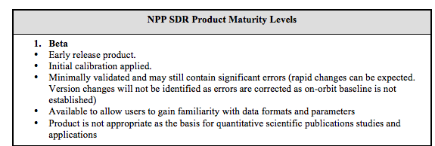
Data Product Beta Maturity Definition

Slide 3
Outline
Initial Instrument Performance
  Dark Current
  Hot Pixels
  Non-linearity
  Detector Temperature
Irradiance Validation
  Solar diffuser measurements
Radiance Validation
  Signal-to-Noise
  South Atlantic Anomaly – charged particle effects
  Stray Light
  Wavelength Scale
Geolocation Registration
Radiance/Irradiance Validation
SDR (Level 1) Status
EDR (Level 2) Status

Slide 4
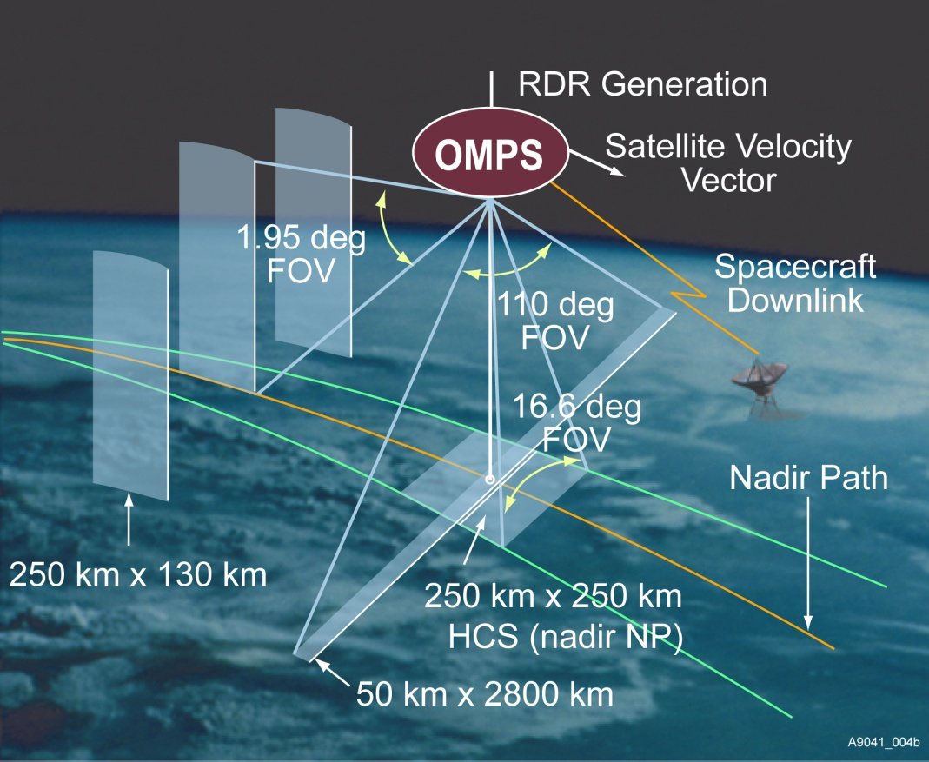
Nadir Mapper &
Profiler
Main
Electronics
Limb
Profiler
Diffuser
Entrance Aperture
Entrance Aperture
Instrument Fields of View. Schematic from Ball Aerospace and Technology Corporation.
Suomi NPP Launch 10/28/2011
Earth
Sun
Each instrument has two solar diffusers; a working and a reference.

Slide 5
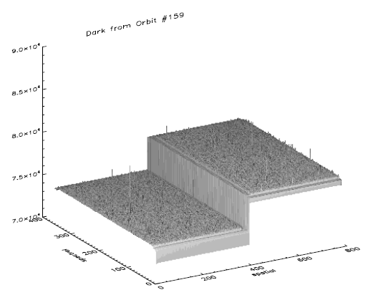
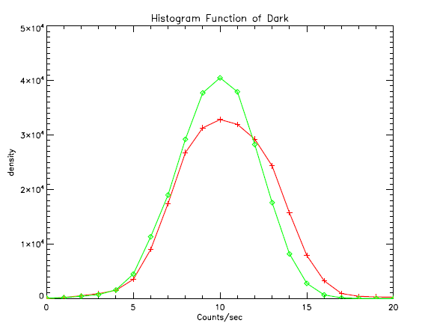
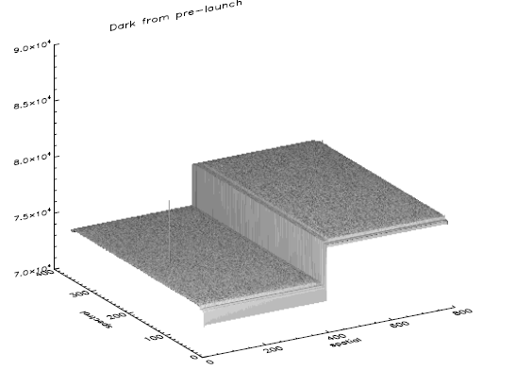
Dark Current: Transition from Ground to Orbit
On-orbit
Histogram function
Raw dark image from Orbit #159
Exposure time of 1247.1 second
The number of coadds is 100
A few potential hot pixels are observed.
Gaussian distribution
On-orbit
Pre-launch
Bin index
Pre-launch →
Raw dark image for pre-launch
Exposure time of 1247.1 second
The number of coadds is 100
Only one hot pixel was identified
Notes:
Provided by C. Pan

Slide 6
Dark Current Monitoring
The figures on the previous slide show consistent behavior for the OMPS Nadir Mapper dark current for both sides of the Charge-Coupled Device (CCD) detector between pre- and post-launch measurements. The step function is produced by the electronic offset.
As expected the On-orbit distribution shown in the Top Right Histogram has broadened slightly relative to the Pre-launch distribution.
Similar results are obtained for the OMPS Nadir Profiler.
The Pre-launch calibration Dark Current tables will be used until the next build when the use of tables from the On-orbit measurements will be activated.

Slide 7
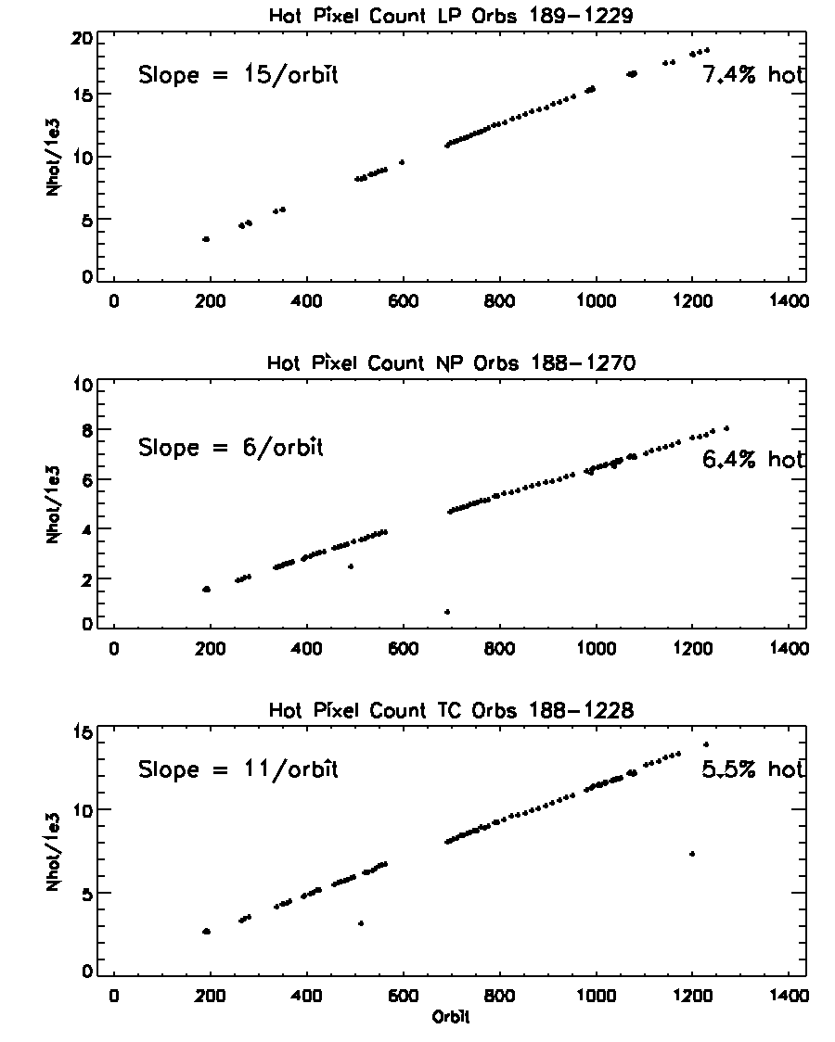
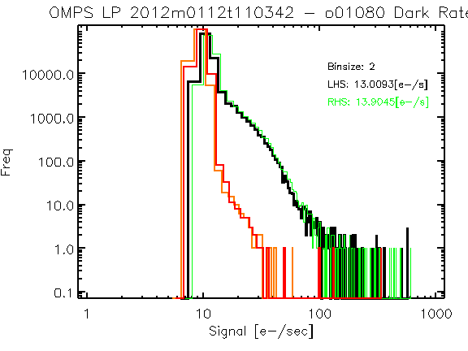
Hot pixels increasing as expected
Hot pixel are defined as 8-σ above the pre-launch distribution.
Pre-launch
Orbit 1080
Notes:
Provided by G. Jaross

Slide 8
Dark Current / Hot Pixels
The histogram on the Left in the previous slide compares the distribution of dark currents Pre-launch (Right-hand side – RHS & Left-hand side – LHS of the Charge-Coupled Device – CCD detector) and On-orbit (RHS & LHS) for the Limb Profiler detector. While the changes appear dramatic, the full-well values for the CCD are ~200000 e- for one pixel.
The three figures on the Right show the near linear trend in the increase in “Hot Pixels” for the three detectors; Limb Profiler, Nadir Profiler and Nadir Mapper from top to bottom. The trends over the first 1000 orbits can be accommodated even if the increase continue over the life of the mission as only a small minority of hot pixels have values over 100 e-.

Slide 9
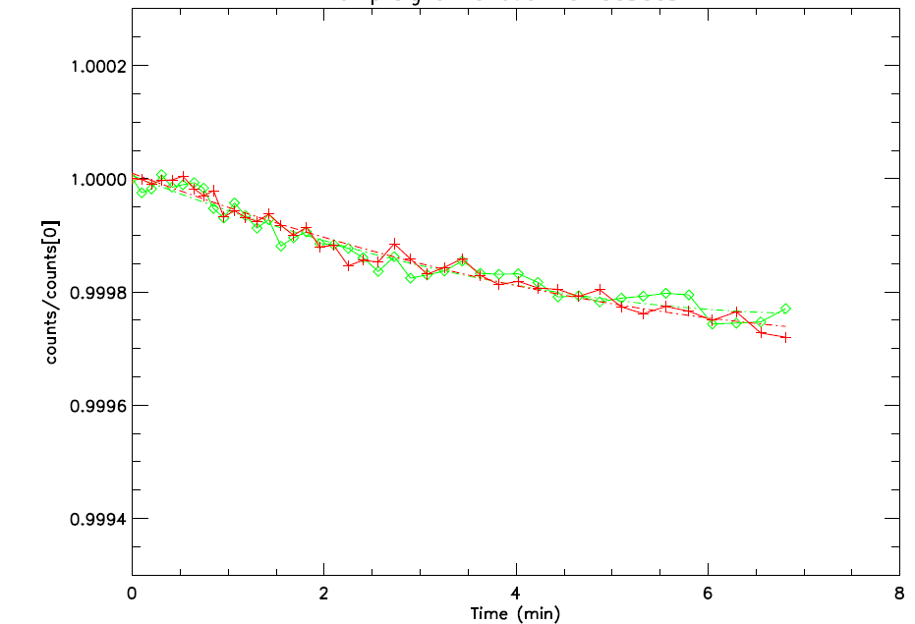
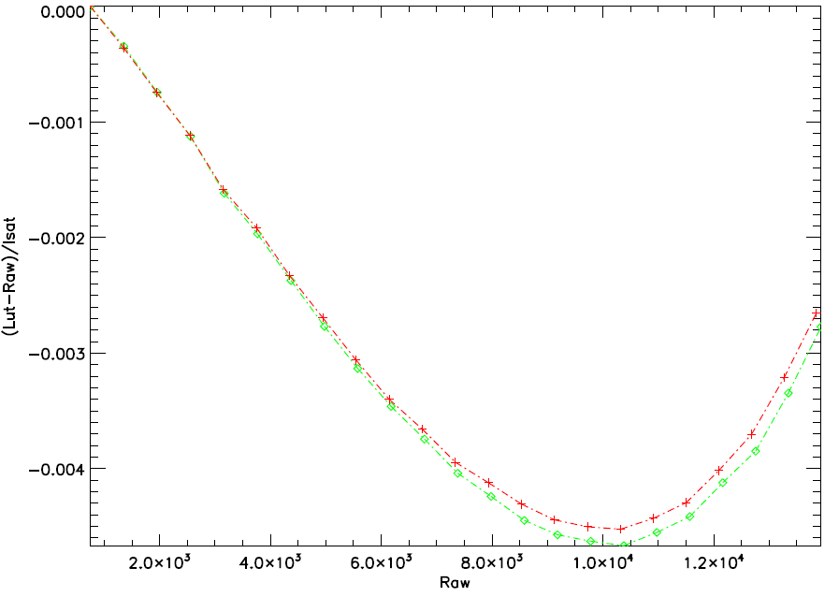
Linearity Performance
Transition from Ground to Orbit
LED signal drifts
System nonlinearity
On-orbit
Pre-launch
On-orbit
Pre-launch
Observed OMPS TC LED drifts over time meets the system requirement of < 1% per minute.
Sensor nonlinearity is compliant with the specification of < 2%
The Figure on the Left shows that the LED signal has the same minimal drift, an order of magnitude better than the requirement, for both On-orbit and Pre-launch operations. The sensor non-linearity characterization in the figure on the Right shows excellent stability for On-orbit versus Pre-launch. Given these stable results, the calibration team expects that the original plans to adjust this characterization weekly can be greatly relaxed.
Notes:
Provide by C. Pan

Slide 10
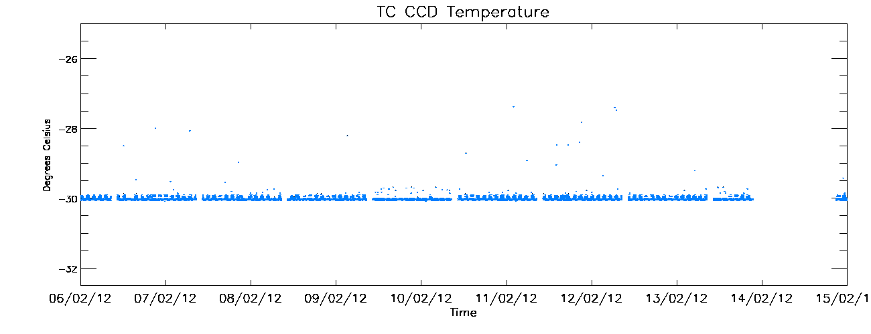
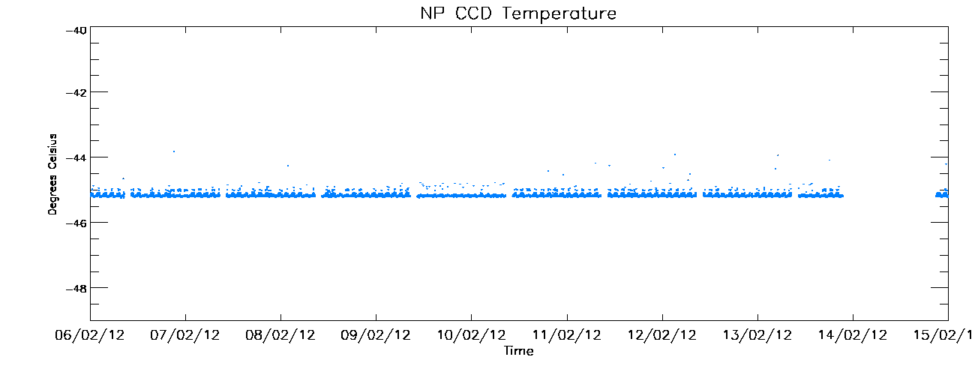
CCD Temperatures for ten days In Early February
Design temperature is -30∘C.
Deviations yet to be investigated.
Small intra-orbit cycle observed.
Design temperature is -45∘C.
Deviations yet to be investigated.
Small intra-orbit cycle observed.
Notes:
Provided by W. Yu

Slide 11
CCD Detector Temperature Target and Stability
The figures on the previous slide show two of the telemetry monitoring plots that are regularly updated at STAR. The top plot gives the Nadir Mapper’s CCD temperature and the bottom plot gives the Nadir Profiler’s.
The active temperature control systems are accurately maintaining the proper target temperatures. The small intra-orbital variations will be examined in future studies.
Infrequent noisy measurements will also be investigated but are not believed to be important.

Slide 12
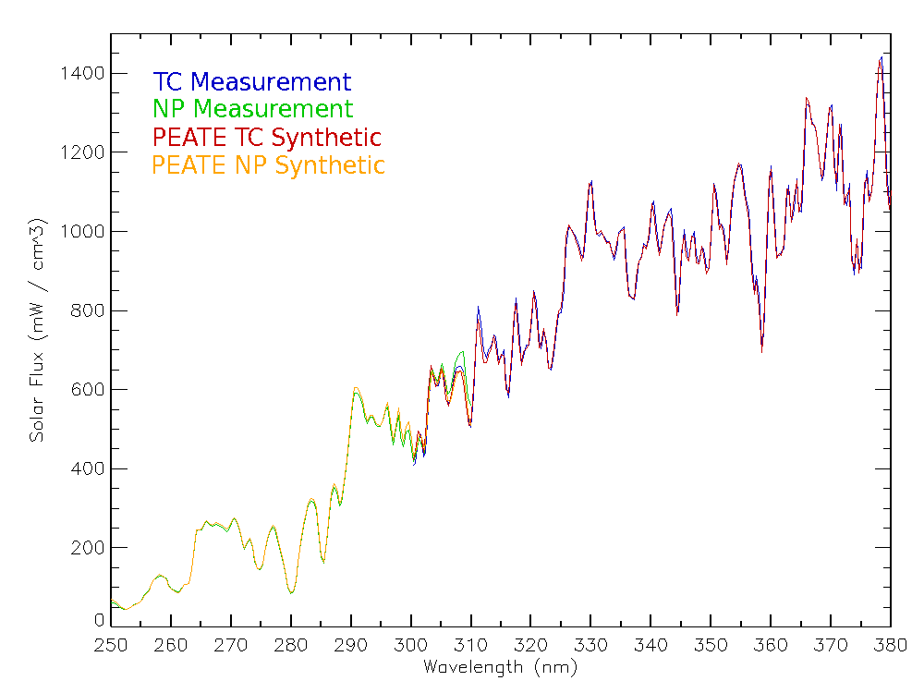
Solar Irradiance: Spectral and Radiometric Calibration
Transition from Ground to Orbit
On-orbit
Pre-launch
Notes:
Provided by C. Seftor

Slide 13
Irradiance Comparison
The figure on the previous slide shows a comparison of synthetic solar spectra, computed Pre-launch (NM & NP) by applying the laboratory bandpasses to a high-spectral-resolution reference spectrum, to On-orbit (NM & NP) observations, measured by using the working solar diffuser and the initial goniometry and radiometric calibration.
The observed spectrum for the Nadir Mapper (Total Column) from 300 nm to 380 nm was within 2% on average with +-5% smaller scale variations.
The observed spectrum for the Nadir Profiler from 250 nm to 300 nm was within 5% on average.

Slide 14
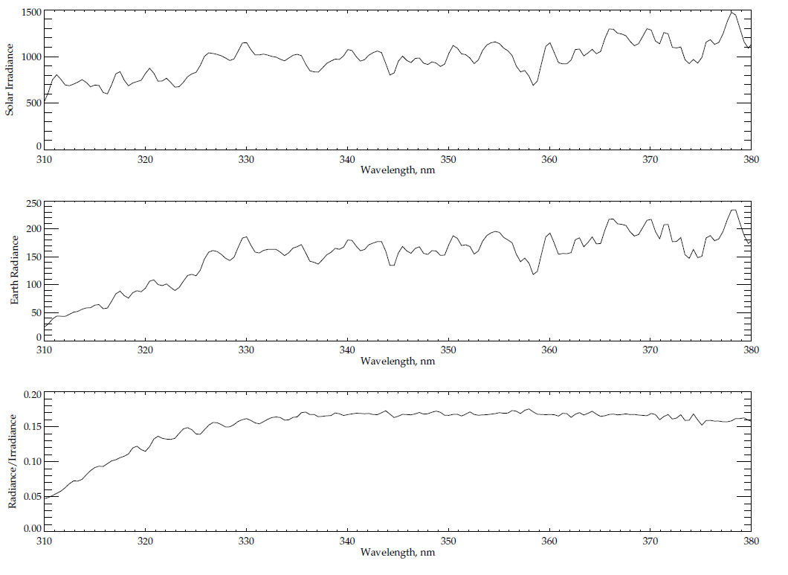
Solar Irradiance
Solar Line
Earth Radiance
Ozone Absorption Features
Radiance/Irradiance Ratio
Typical spectra from 310 to 380 nm for OMPS Nadir Mapper.

Slide 15
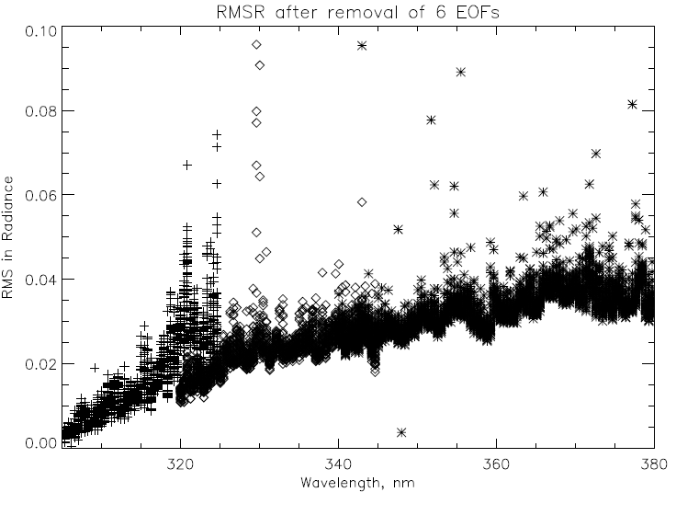
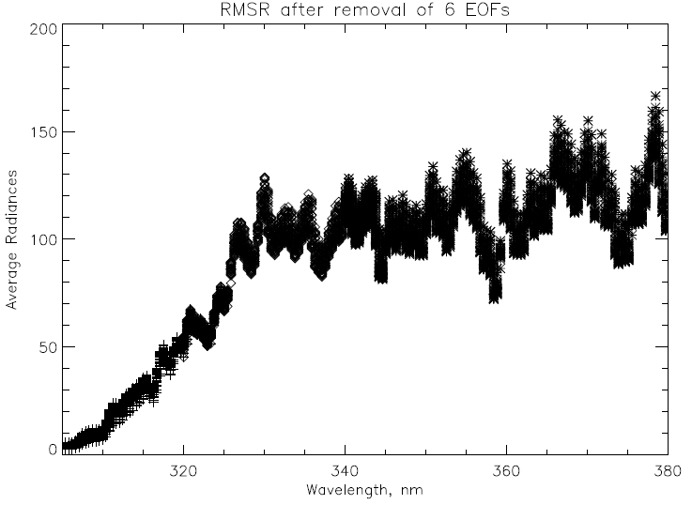
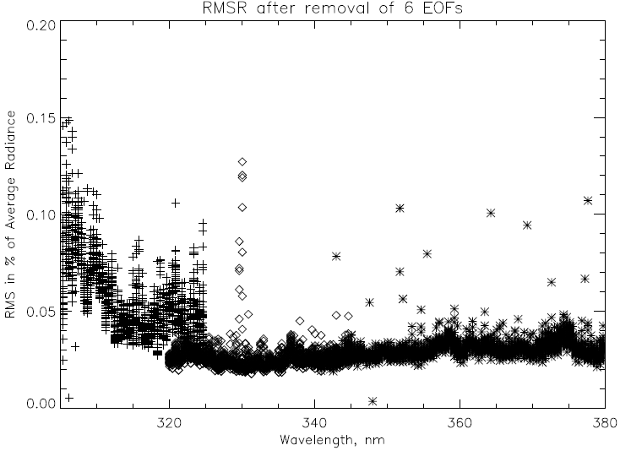
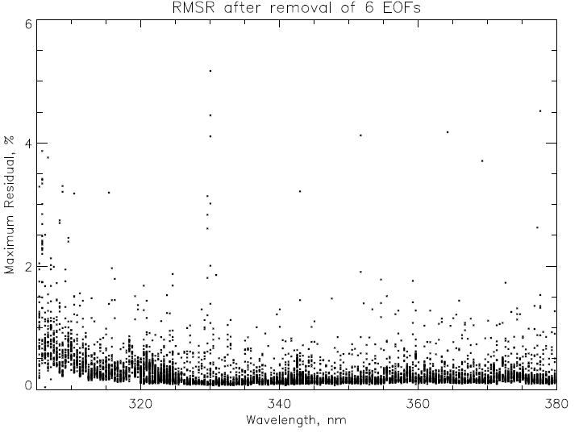
EOF/SNR analysis for six orbits (~1800 scans) OMPS NM on 1/28/2012 using three wavelength ranges (305-325, 320-345, 340-380) for 35 CT
Average Radiances
Root Mean Squared Residual
Relative RMSR as %.
0.1% is equivalent to a SNR of 1000.
Maximum Residuals.
Spikes could be filtered.
0.1%
2%
Notes:
All 35 cross-track positions. Top left shows noise in radiance units. Spikes not removed.
Provided by L. Flynn

Slide 16
Nadir Mapper Earth Radiance
Signal to Noise Ratio Estimates
Empirical Orthogonal Function (EOF) decomposition analysis was used to investigate the measurement noise. The covariance matrices were constructed for each of the 35 cross-track positions for three separate wavelength intervals ([305,325], [320,345], and [340,380] nm) for six orbits of earth view radiances. The radiances for each of the 3X35X1800 spectral intervals were normalized by using the overall average spectrum for that cross track position and interval, and a fit with a third degree polynomial in wavelength before computation of the 105 covariance matrices. For each matrix, the six largest patterns were considered to be signals and the remaining variations were regarded as noise.
The figure on the Top Left of the previous slide shows the resulting Root-Mean-Squared-Residual (RMSR) noise estimates in radiance units, while the one directly below it shows the estimates as percents of the average radiances. (The 35 average radiance spectra appear in the figure on the Top Right.)
The figure on the Bottom Left shows RMSR values that equate to Signal-to-Noise Ratios (SNR) better than 2000:1 at most wavelengths for most cross-track positions with the SNR dropping to 1000:0 at the shorter wavelengths.
No screening of obvious outliers was performed on the radiances, and this is apparent in the scatter of results at 320 nm. The figure on the Bottom Right shows maximum absolute residuals after removal of the six largest patterns. A few outliers over 2% for some of the cross-track positions are dominating the RMSR calculation for those cases.

Slide 17
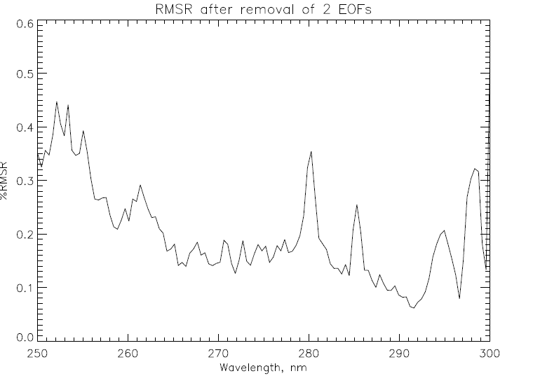
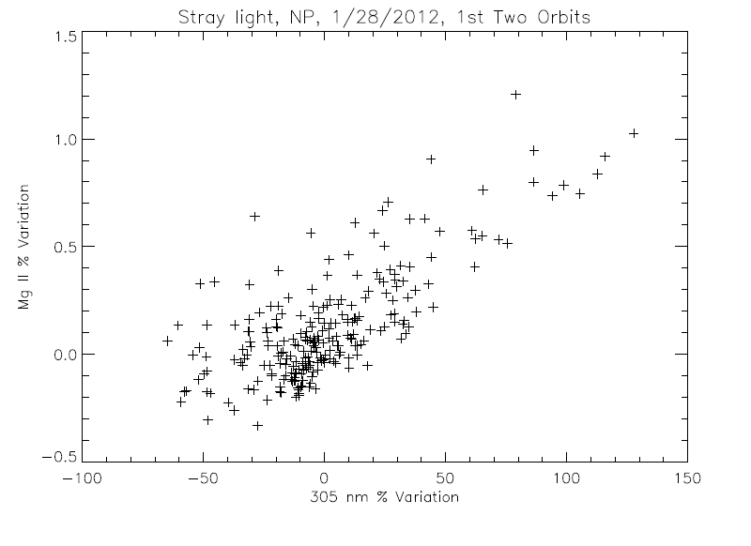
Noise and Stray Light for OMPS NP Earth Radiances
The % RMSR estimates on the right were computed using EOF analysis on clean data for 230 spectra. A spectral screen detected and removed one deviant value on average from each of the 120-wavelength spectra. The removal of the second EOF pattern was somewhat arbitrary as it and the third EOF may be stray light patterns. The covariance computation used a 6th order polynomial in wavelength for normalization.
The scatter plot on the left compares simple three-wavelength Mg II core-to-wing ratio variations (280 nm to the average of 277 nm and 282 nm) with longer wavelength variations at 305 nm. There is no geophysical reason to expect the two to be correlated, and the exposed relationship is symptomatic of out-of-band stray light. The core average is ~0.4 of wings, so this -0.5% to 1.5% variation represents (1.0/0.4 – 1 =) 1.5 times the expected stray light variations in the wings.
Notes:
Provided by L. Flynn

Slide 18
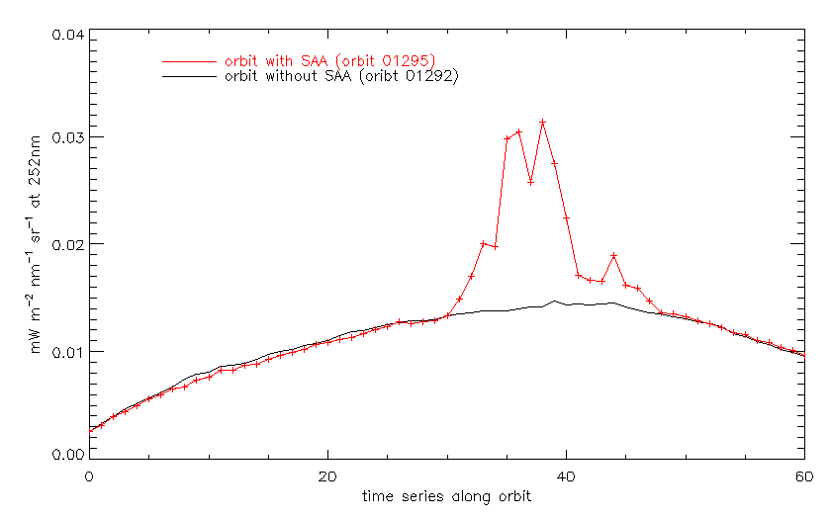
SAA Effects on NP Earth Radiances
The figure above shows the effects of charged-particle-induced noise/spikes on the Nadir Profiler radiances for the 252 nm channel. The + symbols are for an orbit passing through the South Atlantic Anomaly while the black line is for an orbit 100 degrees to the East. The SAA orbit shows the expected increases when the path falls within the SAA but the behavior returns to normal levels after passing through. The limited geographic location of these spikes is consistent with pre-launch analysis.
Figure: J. Niu, NOAA/STAR (ERT)
Notes:
Provided by J. Niu

Slide 19
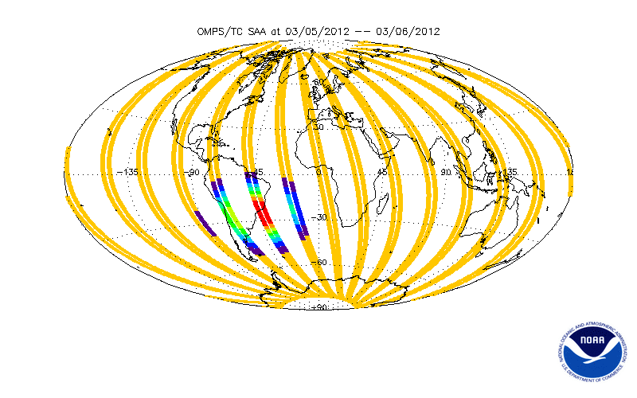
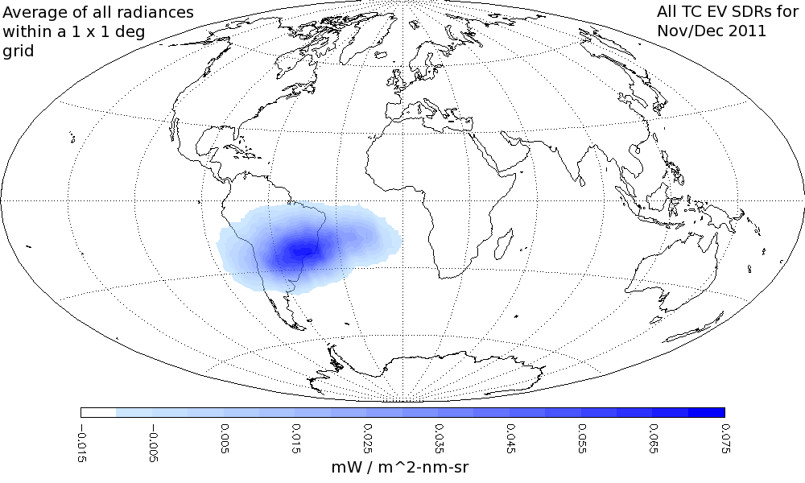
Map of South Atlantic Anomaly effects on OMPS NM closed-door dark current measurements in December and November 2011, overlaid with OMPS NP SAA Flags (0 to 8) for 3/5-6/2012
Current map C. Seftor, SSAI, Flag map Y. Hao, IMSG

Slide 20
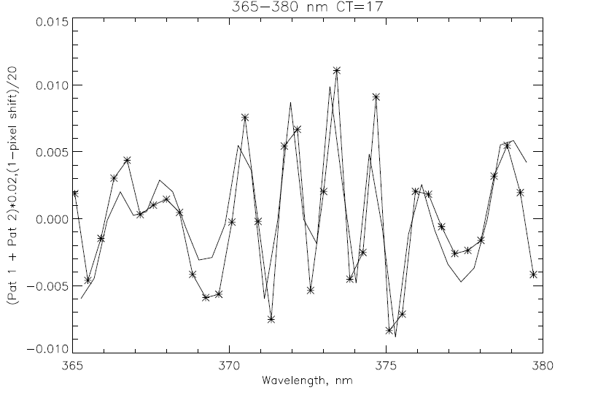
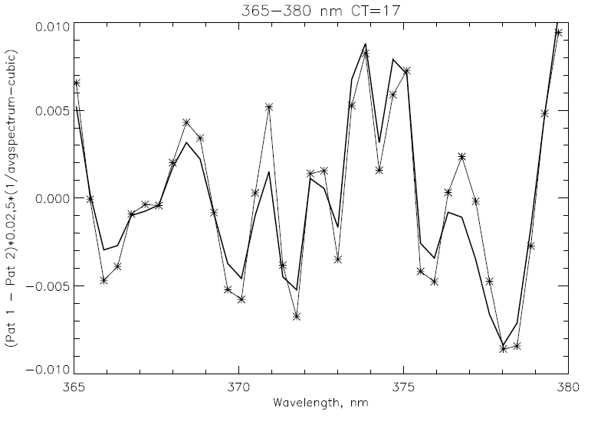
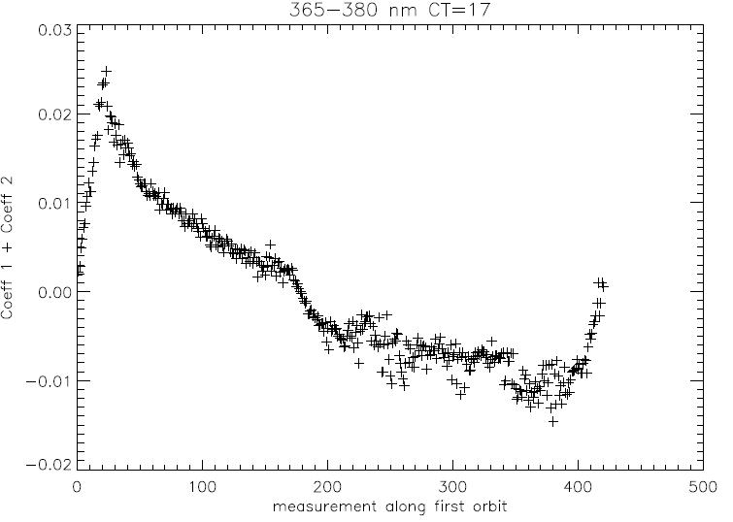
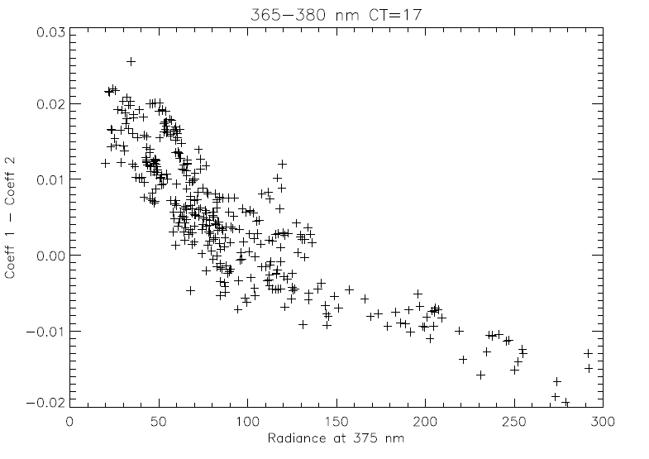
Wavelength Shift and Ring Effect/Stray Light
* EOF pattern
–– 0.02-nm shift
0.5%
* EOF pattern
–– ∝ (1/Avg-poly)
0.5%
365 Wavelength, nm 380
365 Wavelength, nm 380
Measurement along Orbit, South to North
Radiance at 375 nm
Notes:
Provided by L. Flynn

Slide 21
Wavelength Scale and Ring Effect/Stray Light
The EOF Covariance analysis was applied to the Nadir Mapper for the central cross-track position for the 365 nm to 380 nm wavelength ranges for parts of six orbits on 1/28/2012. The first two patterns contain 90% of the variability after removing a 3rd order polynomial from Rad/AvgRad. The two patterns are combinations of Wavelength Scale Shift and Ring Effect/Stray Light variations.
The figures on the Left of the previous slide show the sum of the first two EOF patterns (Top) and the coefficients for the first orbit (Bottom). The Top figure also has the computed variations expected from a 0.02-nm wavelength scale shift. The two curves agree very well. The pattern of the coefficients in the Bottom may be related to wavelength scale changes produces by intra-orbital variations in the optical bench temperatures. While the shifts are small, we plan to implement a correction/adjustment to improve the ozone products.
The figure on the top Right shows the differences of the first two EOF patterns. Now the additional curve is a scaled set of the variations for the reciprocal average spectra. Again, the two curves agree very well. One would expect this pattern to be produced by inelastic scattering (Ring Effect) or Out-of-Band Stray light. The figure on the Bottom Right tests this by looking at the dependence of the coefficients (y-axis) with the 375-nm radiances (x-axis). The inverse relationship between the two suggest that the major source of these variations is the Ring Effect – not Stray Light. The OMPS NPP Science Team plans to exploit this signal to create UV cloud optical centroid estimates.
Given the radiance levels, a 0.01 change in the figures on the Top equates to approximately a 1% variation.

Slide 22
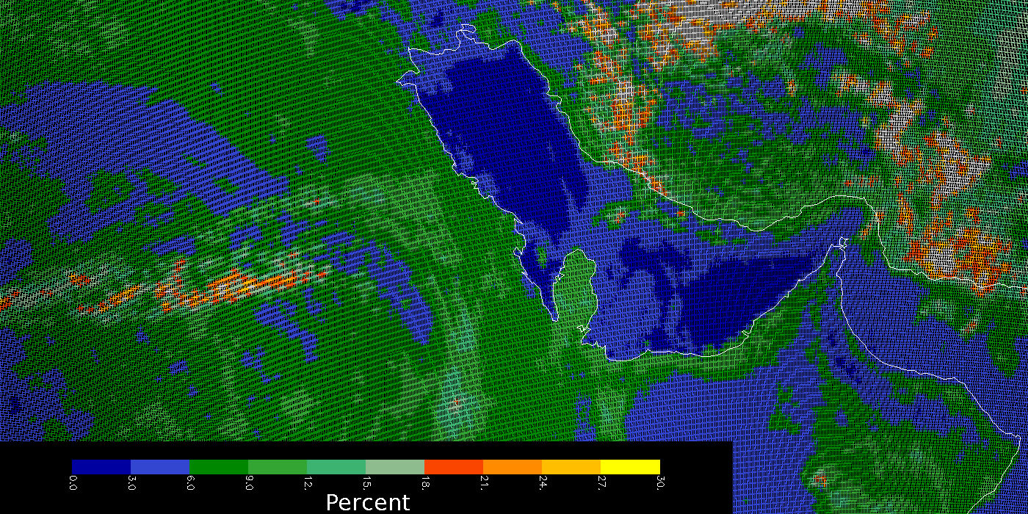
OMPS Geolocation
This false color image shows the derived effective reflectivity in percent for the 380-nm Channel for part of an orbit of small Field-of-View (5 KM X 10 KM at Nadir) made by the OMPS Nadir Mapper in a special diagnostic mode. The Qatar peninsula sticking into the Persian Gulf in the middle of the picture lies along the nadir view of the orbital track and gives a preliminary assurance of the Earth geolocation accuracy at better the 5 KM.
C. Seftor, NASA/GSFC (SSAI) 1/26-27/2012
Notes:
Provided by C. Seftor

Slide 23
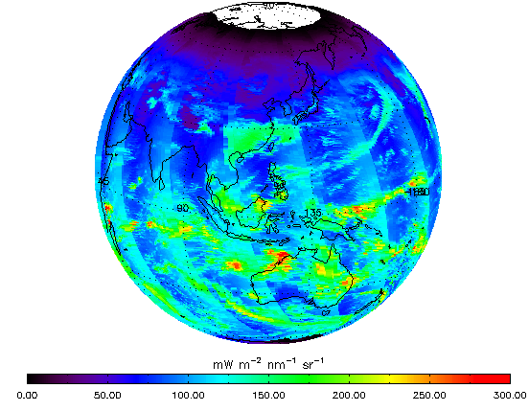
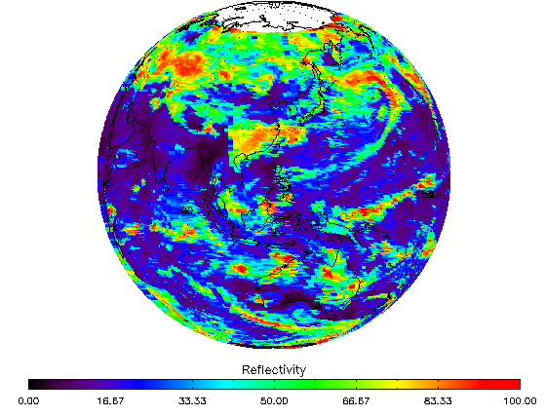
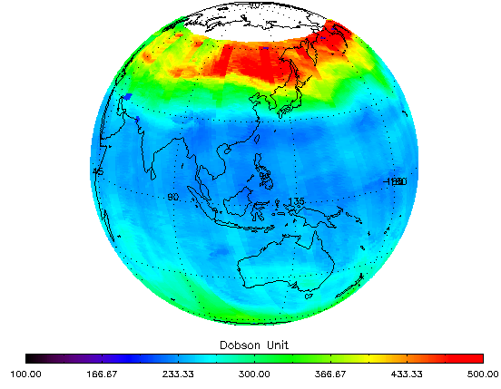
Figures: J. Niu, NOAA/STAR (ERT) 1/26-27/2012
← 331-nm Channel Radiances for the first eight orbits of OMPS Nadir Mapper measurement (end of 1/26/2012 and start of 1/27/2012). This image shows the expected range of values and variations across the orbital track and with solar zenith angles at the times of the measurements. The white circle around the North Pole is the region of polar night during the Northern Hemisphere Winter. The OMPS needs scattered sunlight to make its measurements, so there are no data there.
Effective Reflectivity from the multiple triplet retrieval algorithm in IDPS for the same eight orbits. The quantity represents the UV reflectivity of the clouds and surface in each Field-of-View. Again, the range of values from bright clouds to dark open ocean scenes is as expected. Reflectivity →
Total Ozone from the multiple triplet retrieval algorithm in IDPS for the same eight orbits for the first pass ozone retrieval (first guess IP product without CrIS or VIIRS information). The values show some cross track variations and are offset approximately 5-10% from other satellite ozone products. These uncertainty levels for preliminary products are consistent with the use of prelaunch calibration parameters and tables in the initial operational system.

Slide 24
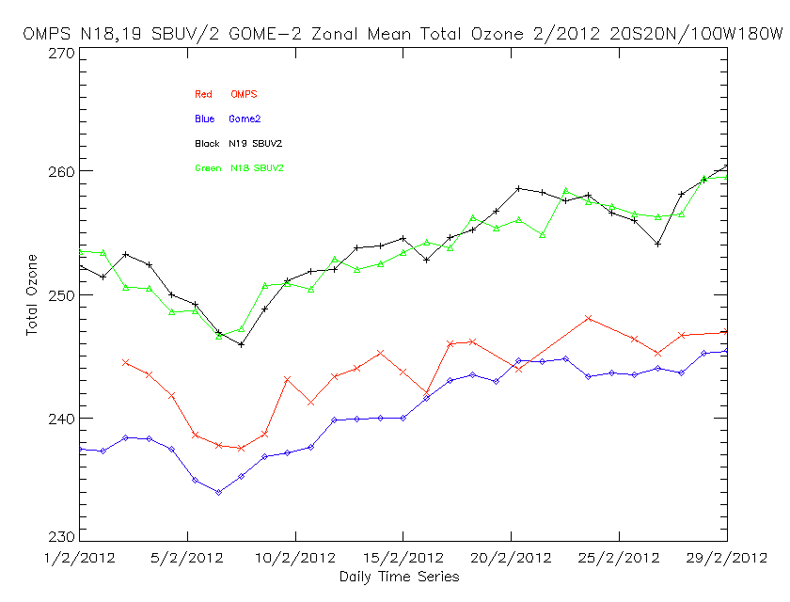
Red OMPS
Blue GOME-2
Black N19 SBUV/2
Green N18 SBUV/2
|Lat|<20
Lon<-100
Comparison of daily mean total column ozone estimates from SBUV/2 NOAA-18 (BLACK) & NOAA-19 (GREEN), NPP OMPS (RED) and MetOP-A GOME-2 NOAA V8 Processing (BLUE) for February 2012 for a latitude/longitude box in the Equatorial Pacific.

Slide 25
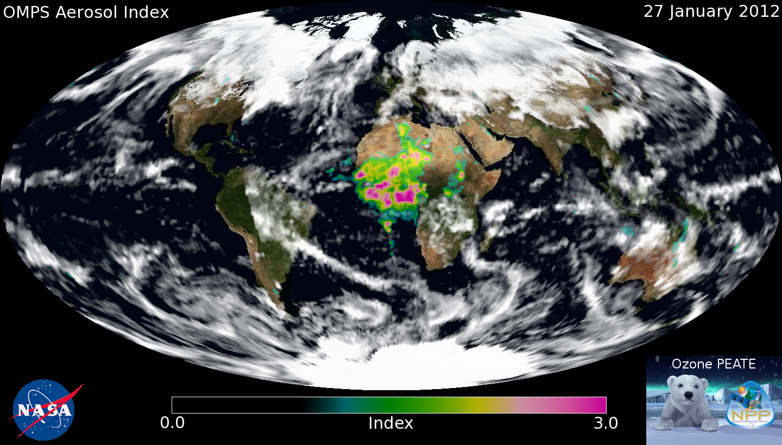
We've been working on a (very) preliminary set of soft calibration factors using the extremely limited amount of data we have so far. Using this calibration, we've generated the first daily aerosol index map from OMPS, which I'm attaching here. Sun glint has been screened out (for the most part), and clouds are represented by the OMPS reflectivity measurements. The MODIS Blue Marble image is being used for the background. Note the missing orbit segment over North / South America.
C. Seftor, NASA/GSFC (SSAI) 1/26-27/2012

Slide 26
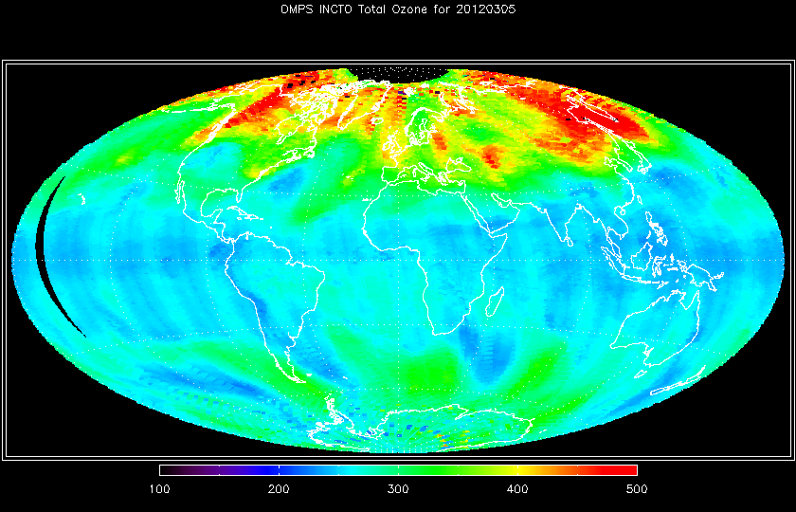
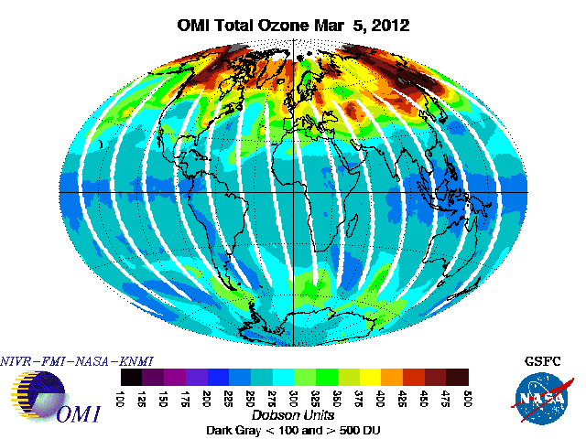

Slide 27
OMPS Earth View SDR Status
A good amount of Earth-View SDR data has been obtained over the last three months for both Nadir instruments.
Dark Current levels and the increase in Hot Pixels are consistent with pre-launch characterization and expectations.
On-orbit Non-Linearity measurements match laboratory data very well.
The CCD array Detector Temperatures are within allowable tolerance of the design values.
The Solar Spectra are consistent with synthetic spectra from instrument bandpass convolved reference spectra.
Preliminary analysis of Signal-to-Noise levels show performance similar to requirements.
Charge particle effects in the South Atlantic Anomaly are apparent in the Nadir Profiler spectra in the expected limited geographical region.
The Wavelength Scale shows small intra-orbit variations tracking the optical bench temperatures
Stray Light is present in the Nadir Profiler spectra and will need a correction. Measurements were taken in the laboratory to provide a basis for these corrections.
Preliminary evaluation of the Geolocation Registration shows it is within specifications
OMPS EV SDRs have been used successfully to generate total ozone and ozone profiles both at the IDPS and in offline processing (at the PEATE and STAR) with various flavors of the Version 8 Algorithms.
The process to provide new and updated SDR Calibration tables to IDPS is now working well. Fast Track Calibration Tables have been identified and can be replaced with less bureaucratic overhead.
Several discrepancies have been identified (both SDR and EDR related) and solutions are proceeding through the system.

Slide 28
Summary
The Nadir Mapper and Nadir Profiler instruments electronics, detectors, optics, and on-board calibration systems are performing well and giving consistent results relative to laboratory measurements and predictions.
The irradiance and radiance measurements have been found to have appropriate ranges and variations. They are responding to real solar and atmospheric signals, and have good information content on ozone and UV reflectivity. Relative levels of instrument noise, stray light, non-linearity, and dark current are small and preliminary evaluations find they are close to the design requirements.
The OMPS Nadir Mapper and Nadir Profiler Earth-View SDR products have advanced to Beta Maturity.

Slide 29
Backup

Slide 30
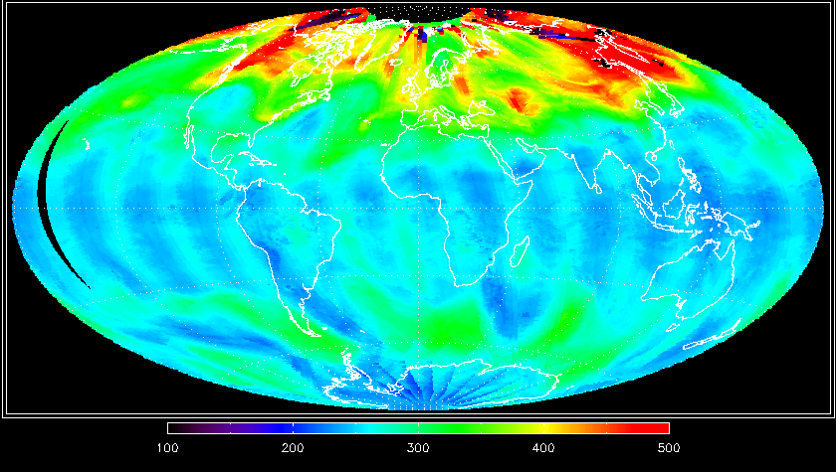
These maps show false color plots of the total column ozone estimated from OMPS Nadir Mapper measurements for March 5, 2012. The top map shows the First Guess product from IDPS processing. The lower map shows a processing with the Version 8 algorithm at STAR. Both maps show cross-track bias patterns but generally detect the appropriate global ozone variations. (Figures created by W. Yu, ERT.)

Slide 31
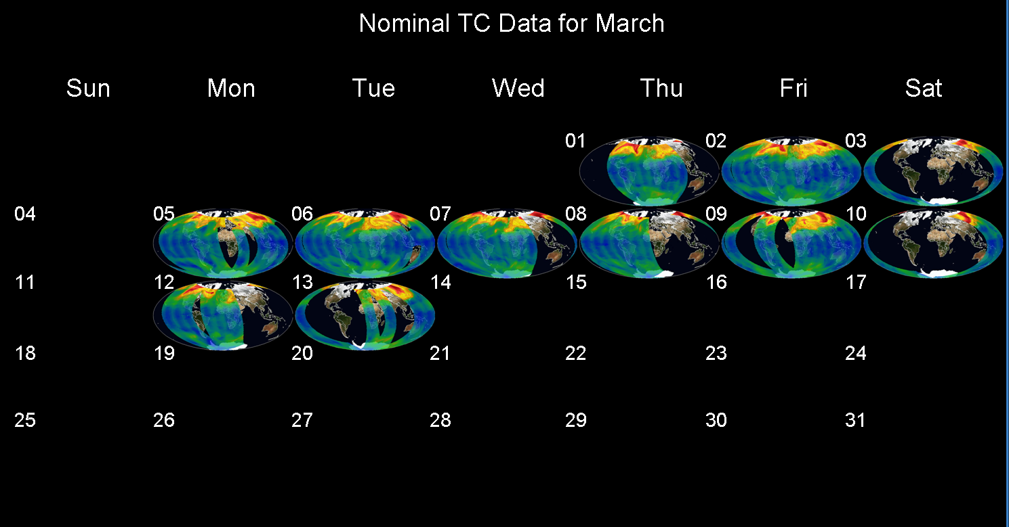
Earth-view Data coverage for OMPS Nadir Mapper for the first two weeks of March from O3 PEATE.

Slide 32
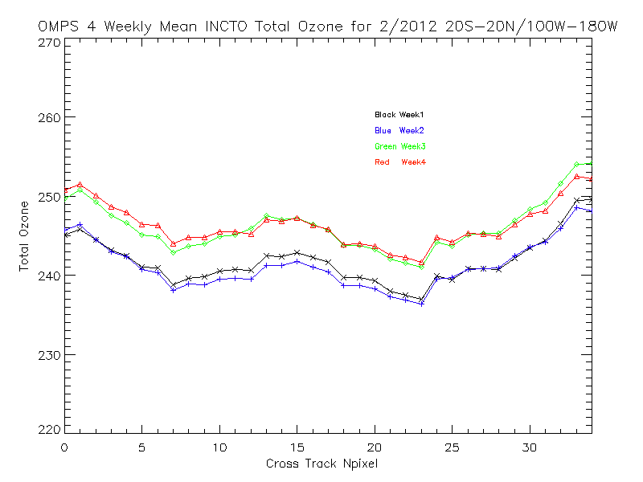
Black Week 1
Blue Week 2
Green Week 3
Red Week 4
Total Ozone, DU
2%
|Lat|<20
Lon<-100
Cross-track View Position
February weekly-mean total column ozone (OMPS Nadir Mapper Multiple Triplet First Guess retrievals) as a function of the cross-track view angle for the region defined by 20S to 20N Latitude and 100W to 180W Longitude. The persistent cross-track bias could be caused by deficiencies in the initial calibration or solar data values.

