Slide 1
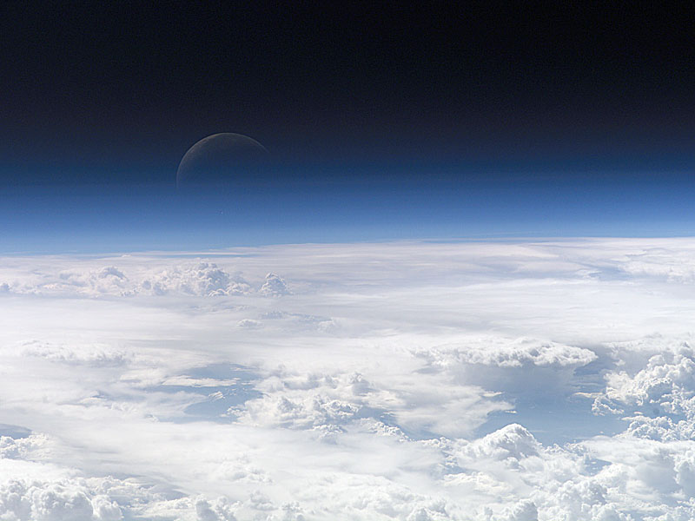



OSIRIS on Odin
Over a decade of ozone from limb-scattered sunlight measurements
CEOS-ACC
April 19, 2012
Columbia, MD
Notes:
1

Slide 2
The Atmosphere as Seen from Odin
OSIRIS is a 280 to 810 nm spectrograph with approximately 1 nm resolution
The sky is blue
Notes:
2

Slide 3
Ozone
Ozone

Slide 4
Ozone: Limb Scatter Signature
Ozone Retrieval at Optical Wavelengths
UV wavelengths (Hartley-Huggins bands)
Visible wavelengths (Chappuis bands)
Limb Signature of Ozone
Minimum altitude probed by a line of sight identified by a “knee” in the radiance profile (optically thick)
Hartley-Huggins
Band
Chappuis
Band
The use of normalized wavelength pairs and triplets make the ozone retrieval process self calibrating so instrument stability is less of an issue

Slide 5
After slowly varying features due to Rayleigh scatter are removed through “normalization” at high alttiude
The low altitude ozone signature is quantified by the depth of the Chappuis absorption feature using three wavelengths
The high altitude ozone signature is quantified using the depth of the Hartley-Huggins absorption at two wavelengths

Slide 6
Sulphate Aerosols
Sulphate Aerosols
The secret to limb scatter ozone retrievals!

Slide 7
The OSIRIS Aerosol Retrieval
Typical limb spectrum at 22 km tangent altitude
calculated with the SASKTRAN Radiative Transfer Model
The Measurement Vector
Model with no aerosol
Effectively a measure of
the residual scattering
Assume typical sulphate aerosol particle size distribution and composition
Use Mie scattering cross sections and phase functions
Retrieve number density of assumed particles – convert to extinction at 750 nm

Slide 8
Comparison with SAGE III
SAGE III (V4) 755 nm Aerosol Extinction
OSIRIS 750 nm Aerosol Extinction
Tight coincident scan comparison
  1° latitude, 2.5° longitude, 6 hours
Good agreement of magnitude and vertical features

Slide 9
Comparison with SAGE III – Zonal Average Time Series

Slide 10
OSIRIS Stratospheric Aerosol Time Series
50 N to 80 N
20 S to 20 N
50 S to 80 S
Figure from Vernier et al, GRL, 2011

Slide 11
The Up-To-Date OSIRIS Stratospheric AOD Record

Slide 12
OSIRIS Measurements of the Nabro Aerosol Cloud
The Nabro stratovolcano in Eritrea, Northeastern Africa, erupted on June 13, 2011, injecting approximately 1.3 Tg SO₂ to altitudes of 9 to 14 km in the upper troposphere
This resulted in a large aerosol enhancement in the stratosphere.
The SO₂ was lofted into the lower stratosphere by deep convection and the circulation associated with the Asian monsoon
To impact climate, volcanic eruptions need not be strong enough to inject sulfur directly to the stratosphere.

Slide 13
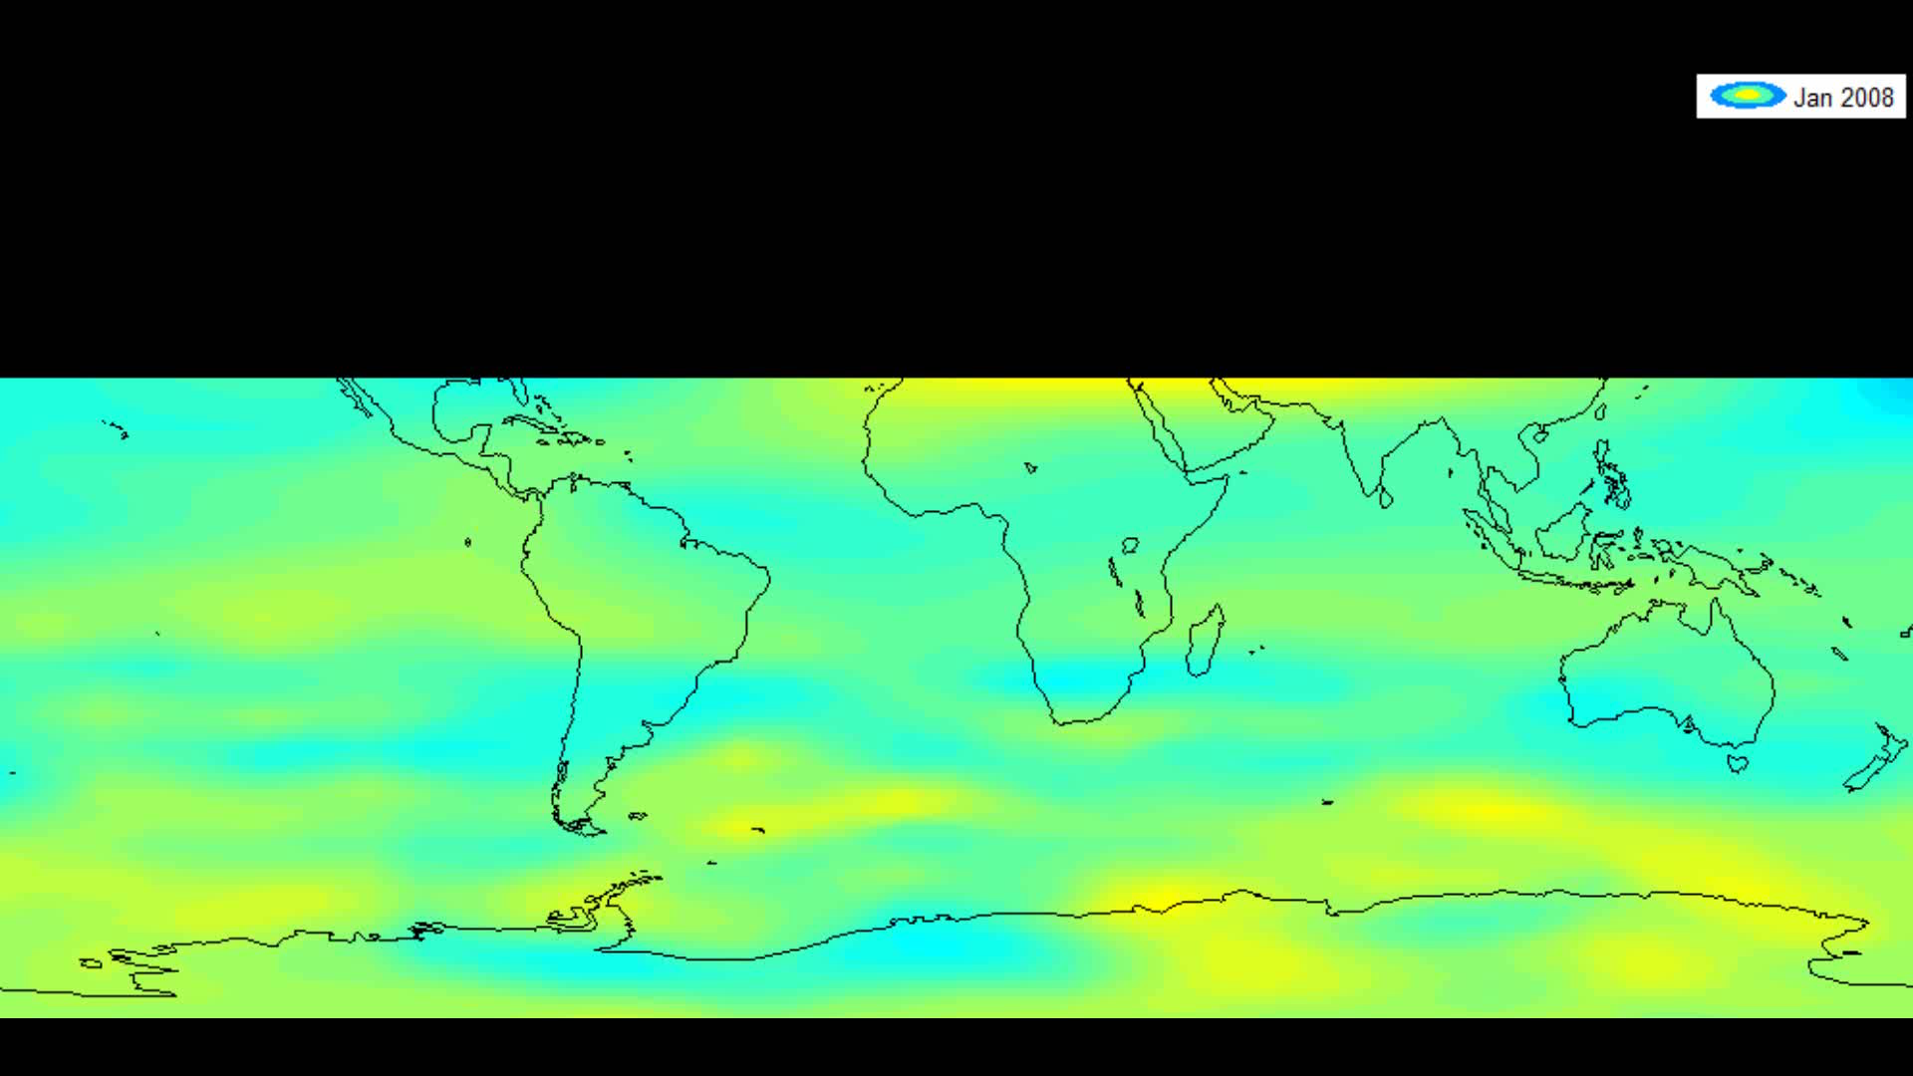
Two years of total aerosol optical depth from 380 K level and above

Slide 14
Sulphate Aerosols
Sub-visual Cirrus
The new secret to ozone retrieval using limb-scattered sunlight!

Slide 15
Subvisual Cirrus Cloud Database: Truitt Wiensz, University of Saskatchewan
We have a database of occurrences and we are in the process of retrieving cloud properties such as vertical and optical thickness

Slide 16
The culmination of a recent PhD project
We can now model the spectral signature of sub-visual cirrus clouds
The parameters were retrieved from the OSIRIS measurements and the forward model successfully simulates observations
This will help with biases in the ozone retrieval at altitudes just below the tropopause

Slide 17
Ozone
Back to Ozone
Self calibrating measurement vector
Two sources of biases that result from scattering by aerosols are accounted for
A third source of bias, absorption by NO₂, hasn’t been discussed but it is also accounted for by simultaneous retrieval
Use a Multiplicative Algebraic Reconstruction Technique that needs an initial estimate but no apriori

Slide 18
Ozone: Odin-OSIRIS Comparison
SAGE II Ozone is the “Gold Standard” 1984-2005 (Langley Team)
Four years of overlap with OSIRIS mission
Coincidence criteria: 200 km, 2 hours
  196 measurement events
Notes:
18

Slide 19
Ozone: Odin-OSIRIS Comparison
Individual profiles show main vertical structure is well captured, even at lowest altitudes
Statistics on 196 “coincidences”
  Mean bias of <2% from 18-50 km
  Standard dev ~5% from 20-50 km
Notes:
19

Slide 20
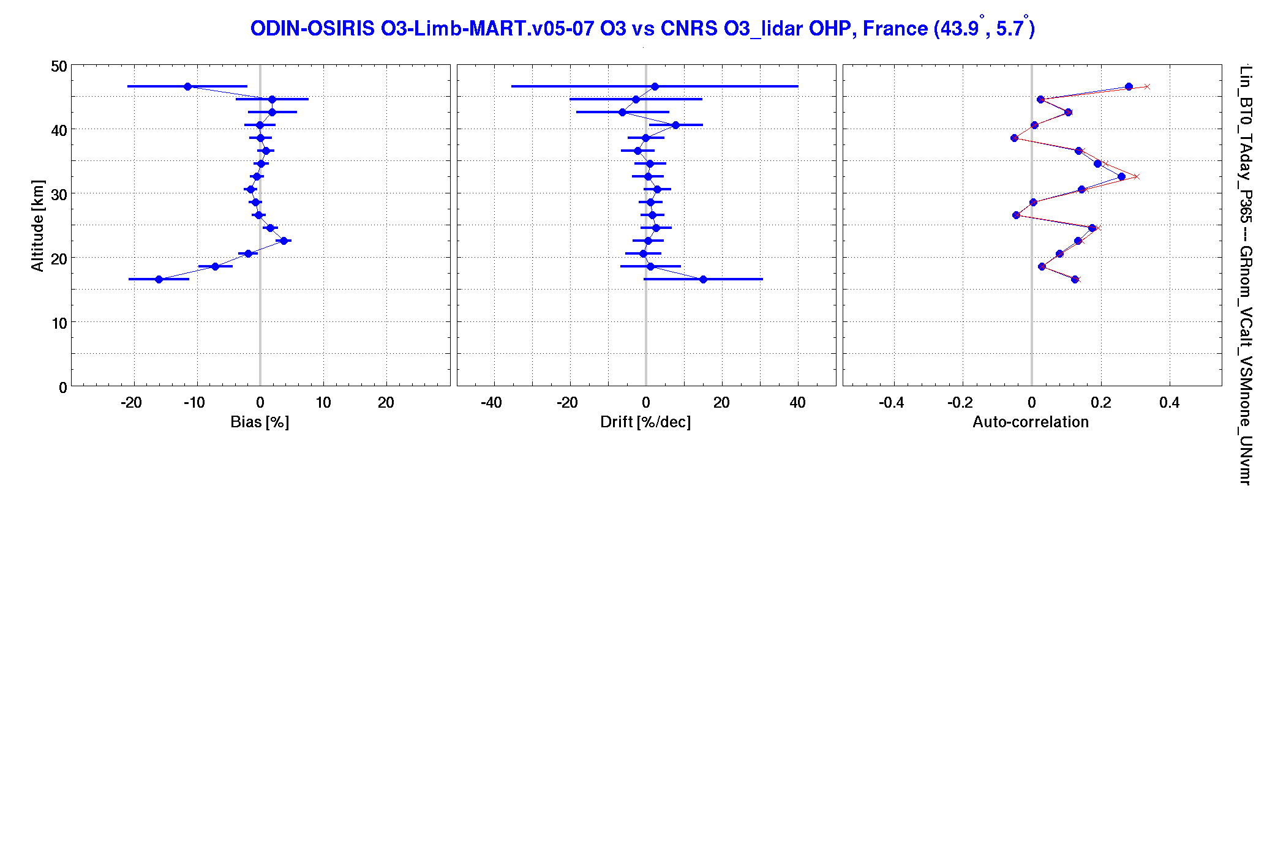
OSIRIS Ozone
Work by Daan Hubert presented in the SI2N meeting shows no significant drift in OSIRIS ozone data when compared with lidars and sondes.
These lidar results are from one station but are consistent with entire analysis

Slide 21
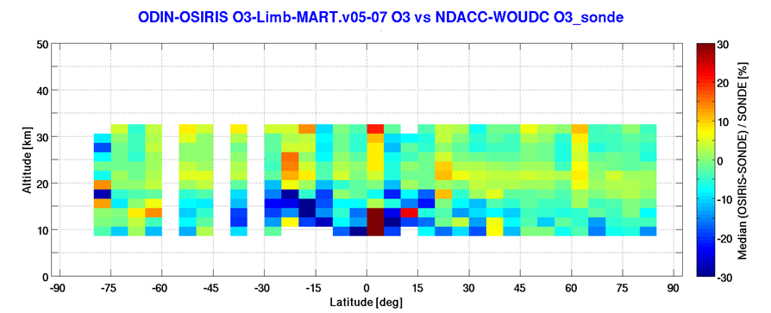
OSIRIS Ozone
These low altitude sonde comparisons are from the same work by Daan
What may not be obvious from this figure is that the OSIRIS biases with respect to the sondes are very low in the UTLS region
Other work by independent groups is also demonstrating the utility of the OSIRIS data set for study of the UTLS

Slide 22
OSIRIS Ozone
A sample of the OSIRIS time series as compared with SAGE II
Overall agreement is remarkable when it should be

Slide 23
Odin-OSIRIS Ozone Trend Analysis Done at Environment Canada
Environment Canada scientists led by Chris McLinden are using the OSIRIS ozone data product (2001-2009) to extend the SAGE I and II time series
Together with SBUV and the various SBUV2 instruments, a 1979-2009 homogeneous monthly, zonal-mean data set is being constructed that may be suitable for use in trend studies.
The precision and stability of the OSIRIS data make it a useful resource for extending the data record from 2005 to the present.

Slide 24
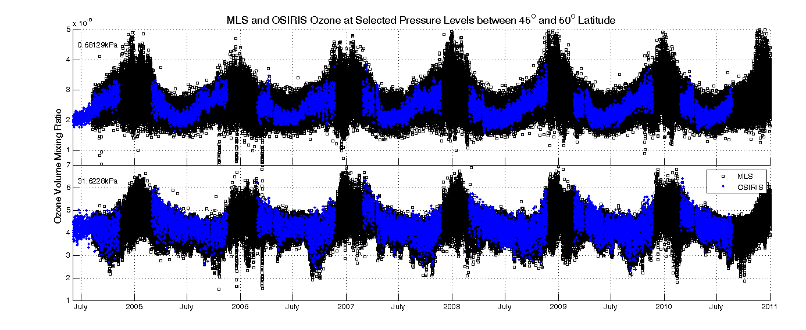
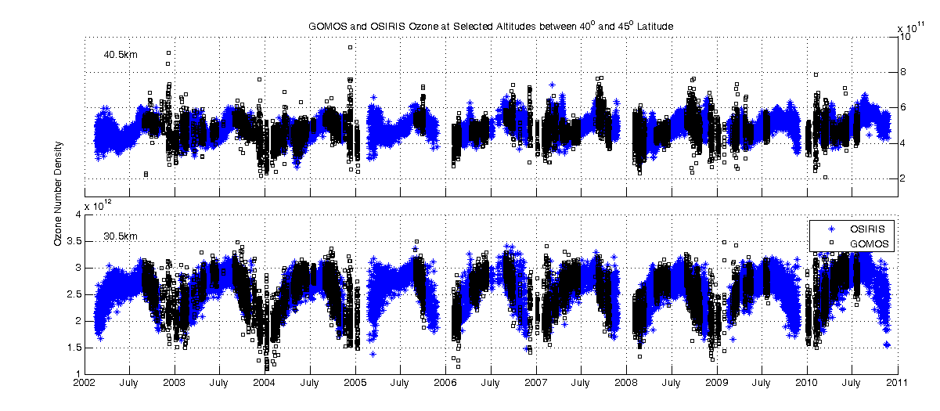
OSIRIS Ozone
Agreement with MLS and GOMOS time series just as good
Work ongoing

Slide 25
The Way Forward
OSIRIS to CASS-CATS

Slide 26
Simplified OSIRIS Spectrograph Optics
CCD
Objective
Slit Plate
Collimator
Grating
Camera
Mirror
Mirror
Mirror
No Filter
UV/Blue Rejection Filter
Notes:
26

Slide 27
One Spectrum of OSIRIS Data
single slit or one altitude at a time
Notes:
27

Slide 28
The Canadian Atmospheric Tomography System (CATS) Optics
CCD
Objective
Slit Plate
Collimator
Grating
Camera
Mirror
Mirror
Mirror
different slit sizes imply different vertical resolution
Notes:
28

Slide 29
One Image of CATS Data
multiple slits or many altitudes at the same time
add a scan mirror out front
the current design has 11 slits and will allow for one scan every seven second with 200 m vertical resolution in the UTLS
Notes:
29

Slide 30
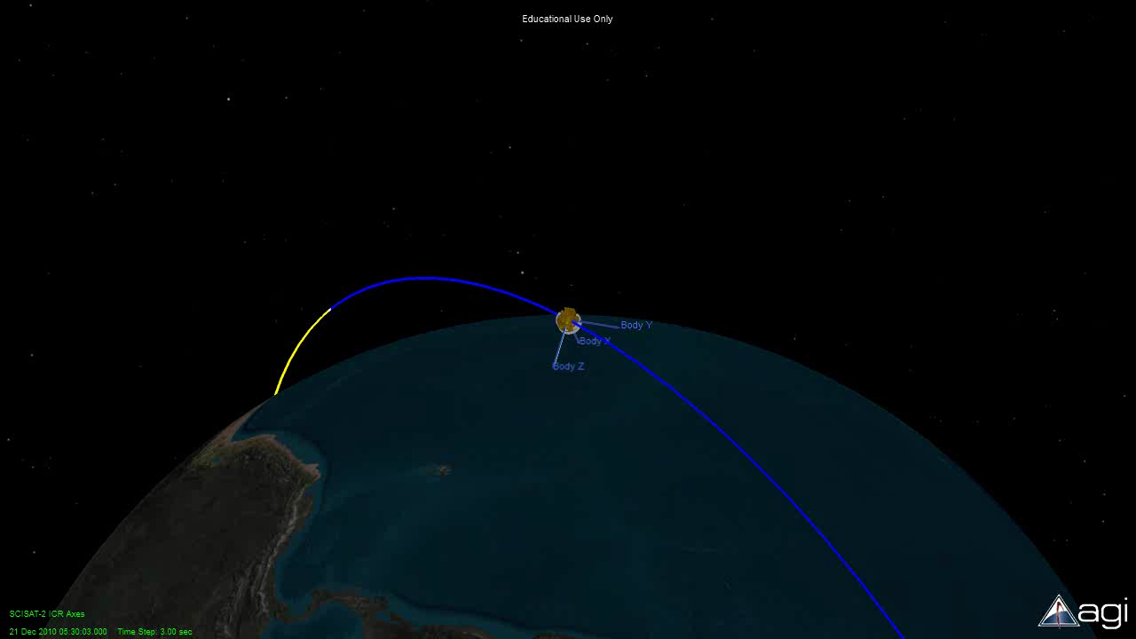

Slide 31
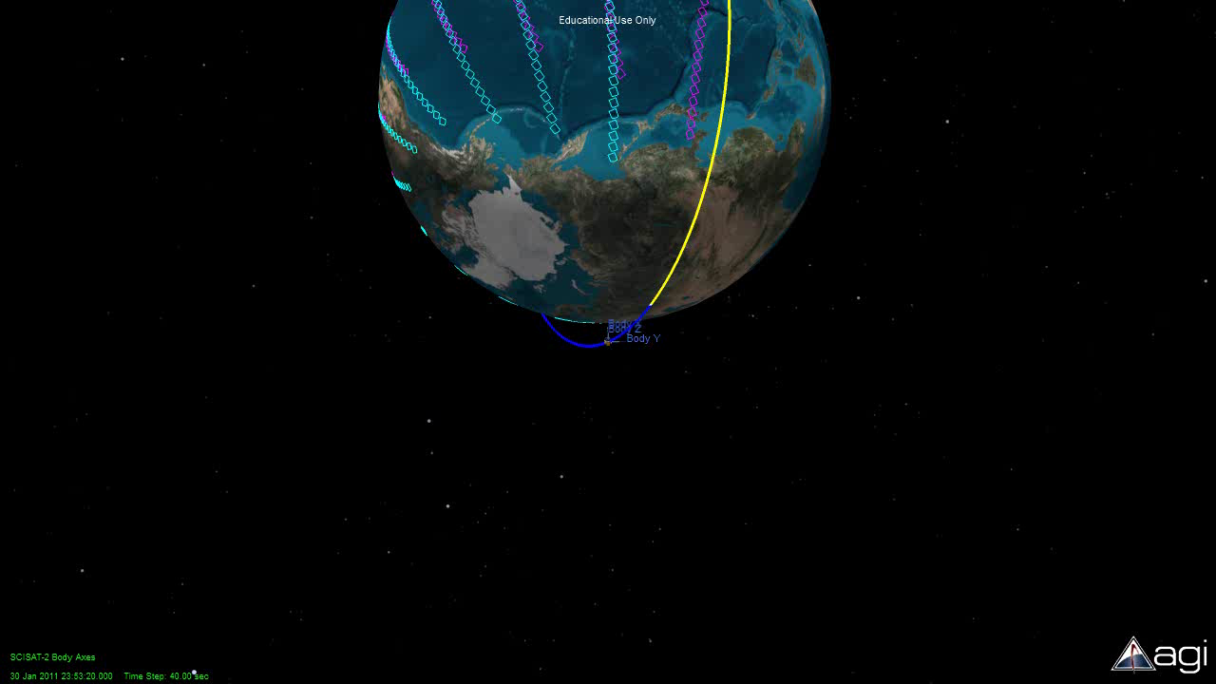

Slide 32
Summary
OSIRIS on Odin has collected data for over a decade
We have learned much about the retrieval of ozone etc. from limb scattered sunlight
We look forward to continued collaborations with the OMPS-LP and SCIAMACHY teams
We hope for many more years of OSIRIS and CATS results to add to the existing data sets
Thank You!

Slide 33
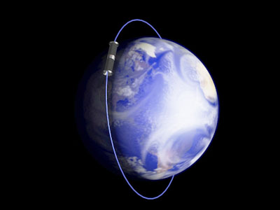
The Ideal Orbits
sun-synchronous
near-terminator
98 degree inclination
0600h, 0630h and 0700h descending nodes
as well as 1800h, 1830h and 1900h descending nodes
96 minute period
600 km altitude
Notes:
33

