Slide 1
Chinese Missions for Polar Ozone Depletion Monitoring
Fuxiang Huang
National Satellite Meteorological Center, Beijing, China 100081
huangfx@cma.gov.cn

Slide 2
Outline
1. Chinese surface observations in the Antarctic
2. Chinese satellite monitoring for the 2011 spring Arctic
ozone depletion
3. Discussion of uncertainties in satellite retrieval
4. Remarks and conclusions

Slide 3
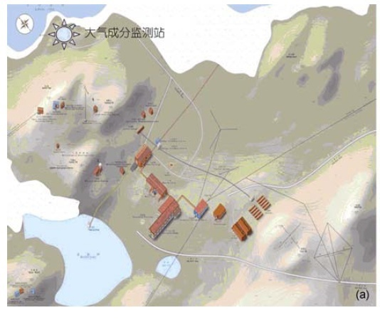
1. Chinese Surface observations in the Antarctic
The Zhongshan is situated at 69°22′12″S, 76°21′49″E with an altitude 18.5 m.
The observation started in 1993.

Slide 4
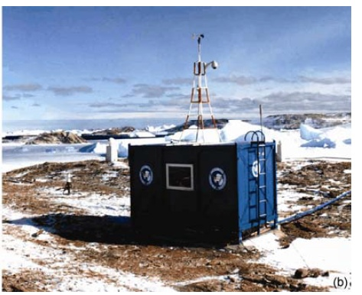
A photo for the Zhongshan station in summer

Slide 5
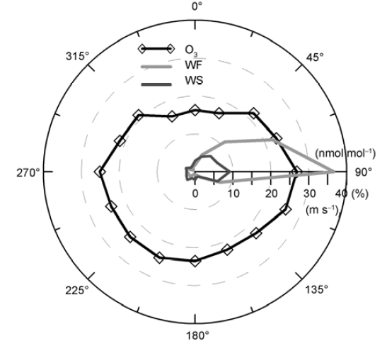
From Wang Y T, et al., 2011
Wind direction rose and the corresponding wind speed(WS) and surface ozone concentration for the station in 2008

Slide 6
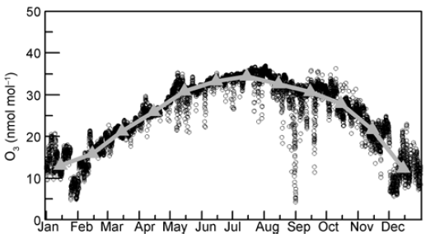
From Wang Y T, et al., 2011
Hourly mean surface ozone concentrations in 2008. the solid line is the monthly mean values.

Slide 7
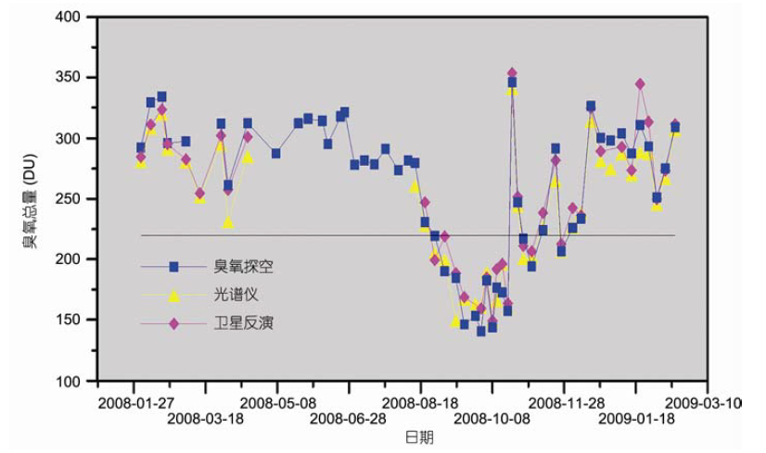
From Bian L G, et al., 2011
Comparison of total ozone data from ozone sonde, surface observation and remote sensing of satellite during 2008-09.

Slide 8
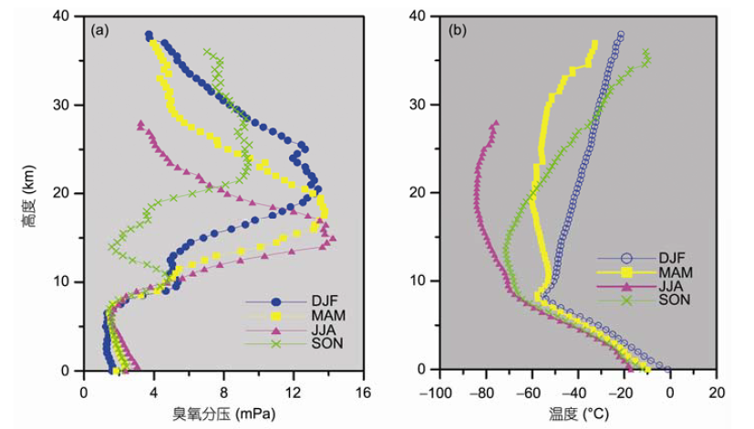
Mean vertical profiles for different seasons in 2008:
(a)ozone partial pressure and (b)temperature
From Bian L G, et al., 2011

Slide 9
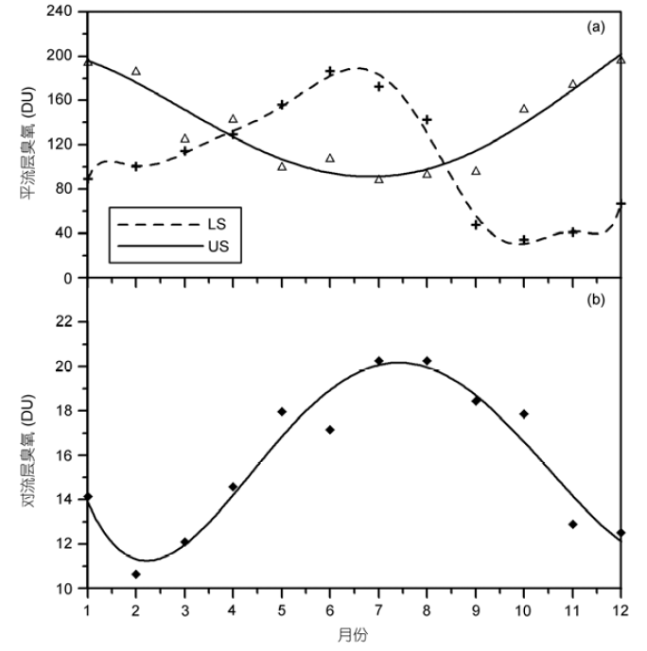
Monthly variation of ozone in upper stratosphere (US) and lower stratosphere(LS) (a) and in the troposphere (b)
From Wang Y T, et al., 2011

Slide 10
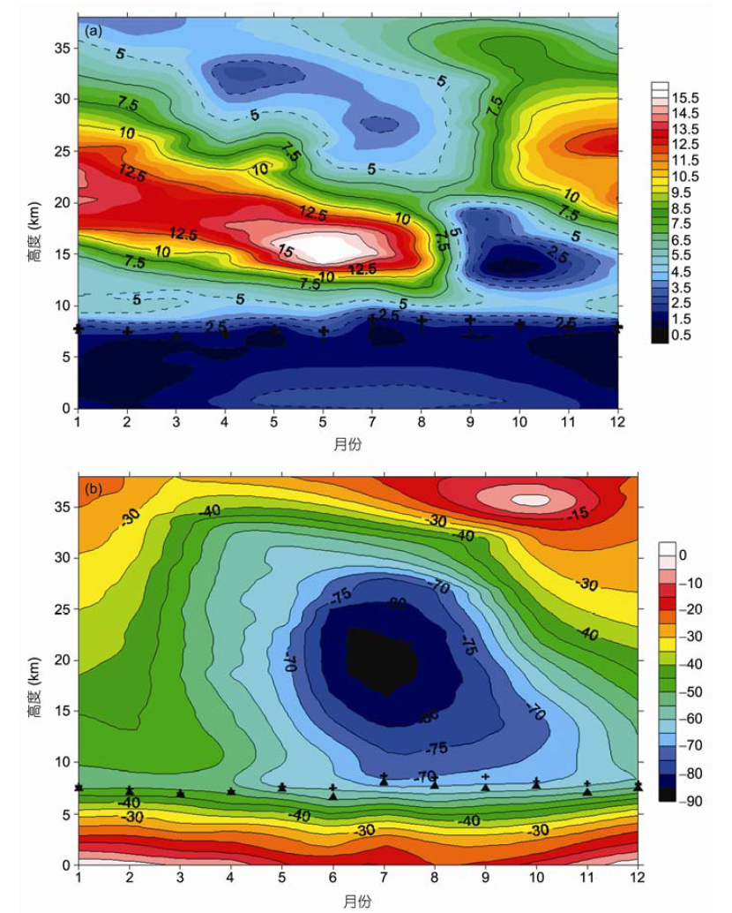
Monthly mean profile of ozone (a) and temperature in the station(“+” is the TP-LRT and “Δ” is the TP-OP)
From Bian L G, et al., 2011

Slide 11
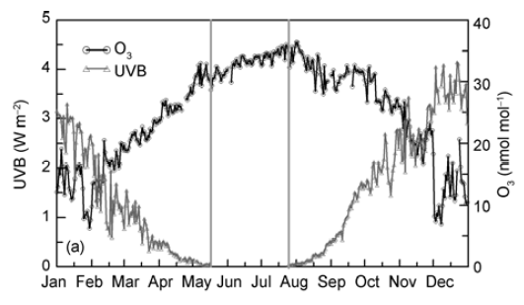
Daily mean UVB and surface ozone concentration for the Zhongshan station
From Wang Y T, et al., 2011

Slide 12
2. Chinese satellite monitoring for the 2011 spring Arctic ozone depletion
During the 2011 spring severe Arctic ozone depletion, Chinese satellite ozone data were applied to monitor the depletion processes.
Data from the FY-3B SBUS, FY-3A TOU and NOAA-16, 17,18 and 19
SBUV/2were used in the monitoring.

Slide 13
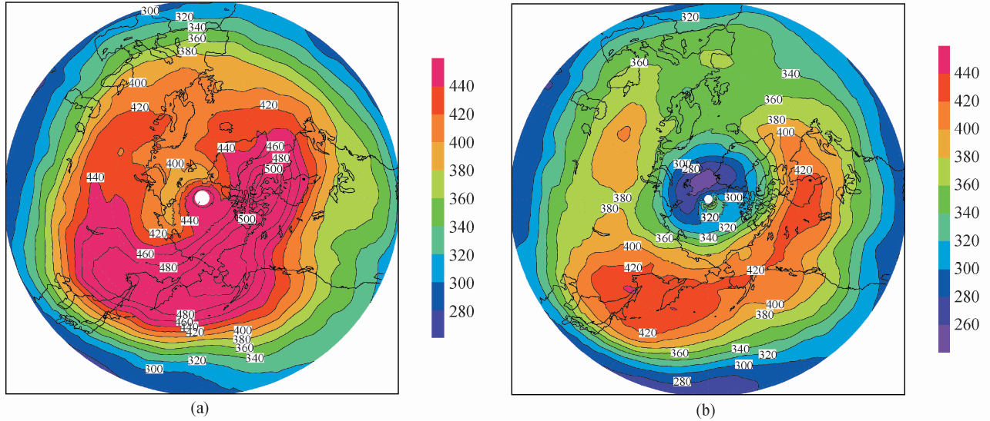
Comparison of March mean total ozone in the Arctic region for 2010 and 2011 (FY-3A TOU data) from Wang et al., 2011
The FY-3 SBUS (Solar Backscatter Ultraviolet Sounder) is Chinese first ozone monitoring instrument carried on Chinese satellites.
FY-3 A SBUS, the first one was launched in 2008, and FY-3B SBUS was launched in 2010.

Slide 14
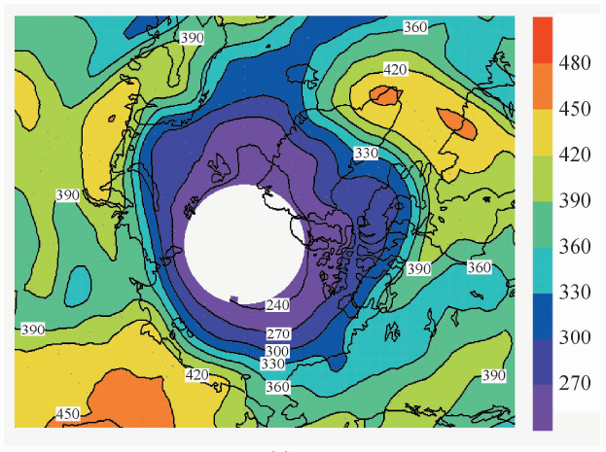
Contour lines of total ozone for the Arctic on 14 March (data from FY-3 TOU). From Wang et al., 2011

Slide 15
Arctic ozone distribution(14 March,2011)(a)SBUS+SBUV/2s,
(2)FY-3 TOU, and (c) surface observations.
From Liu N Q et al., 2011
The FY-3 SBUS (Solar Backscatter Ultraviolet Sounder) is Chinese first ozone monitoring instrument carried on Chinese satellites.
FY-3 A SBUS, the first one was launched in 2008, and FY-3B SBUS was launched in 2010.

Slide 16
Comparison of ozone profiles from the FY-3B SBUS for the same point(71.11°N, 77.09°E)on three dates. The figure reveals 77-83% of total ozone decrease comes from the atmosphere located at height 100-10hpa.
From Liu N Q et al., 2011

Slide 17
Movement of Arctic ozone depletion area from the pole towards the equator during 28-31 March. From Liu et al., 2011

Slide 18
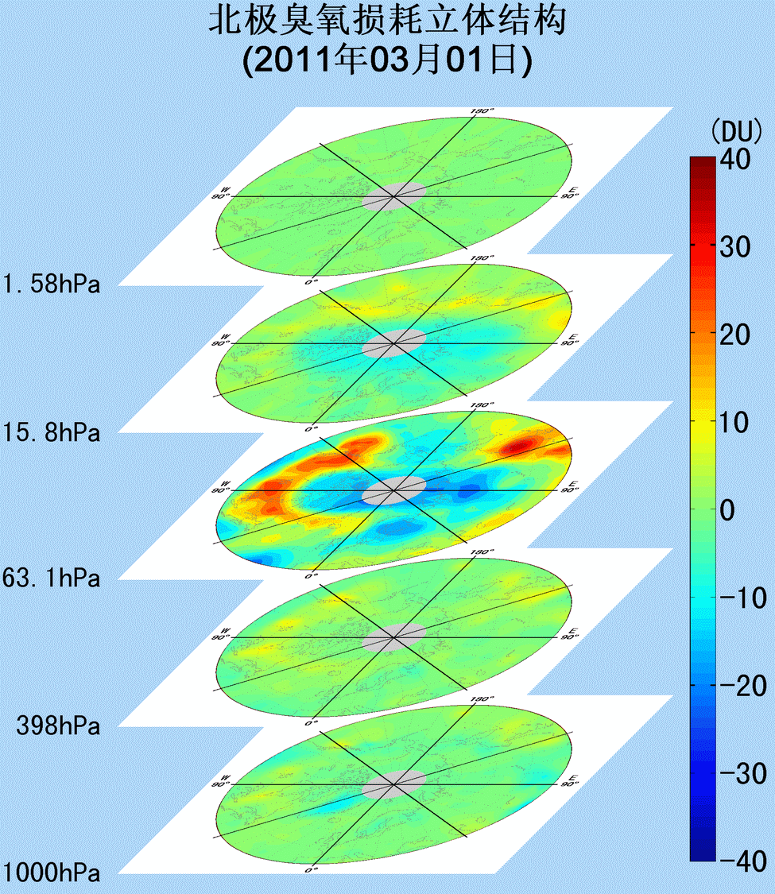
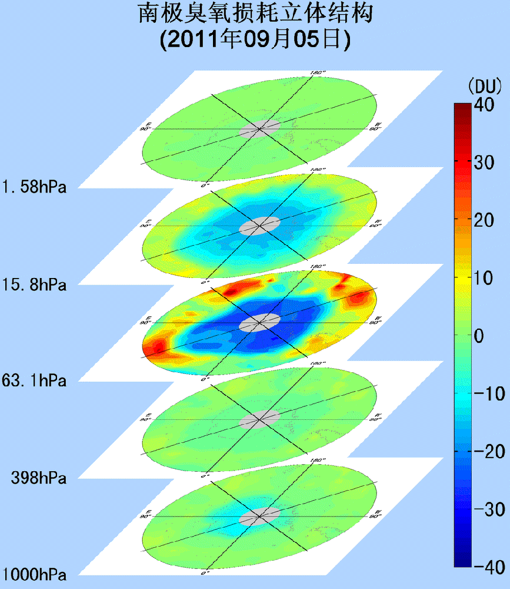
Movies of vertical ozone distribution change for the Arctic ozone loss and the Antarctic ozone loss in 2011.
From Liu et al., 2011

Slide 19
3. Discussion of uncertainty in satellite monitoring data
On one hand, everyone knows PSCs play a very important role
in polar ozone depletion. But, on the other hand, effects of PSCs
are actually ignored in ozone retrieval.
Some research shows that CALIPSO provide good observations for PSCs. But, how to treat PSCs correctly in the retrieval is still a challenge.

Slide 20
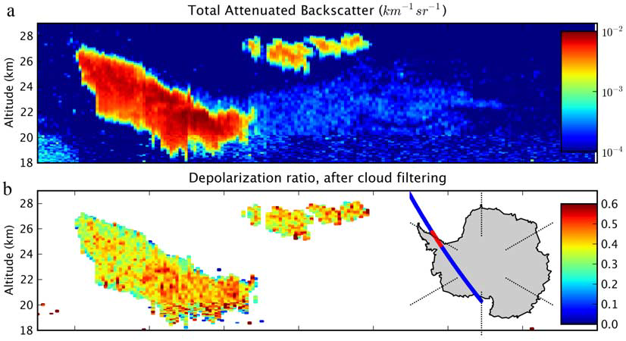
(a)Attenuated total backscattered observed from CALIPSO.
(b) depolarization ratio after clear sky removal
From NOEL et al., 2009
PSCs observations from CALIPSO

Slide 21
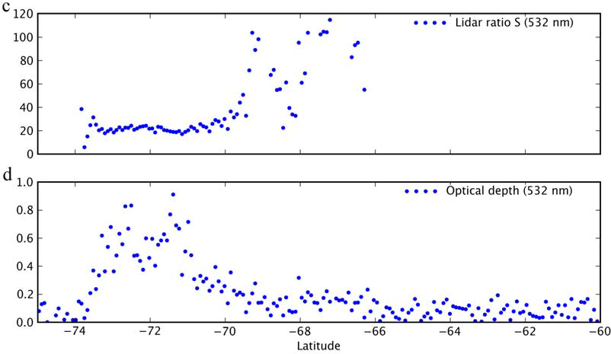
(c) Lidar ratio S observed from CALIPSO.
(d) Optical depth at 532nm
From NOEL et al., 2009

Slide 22
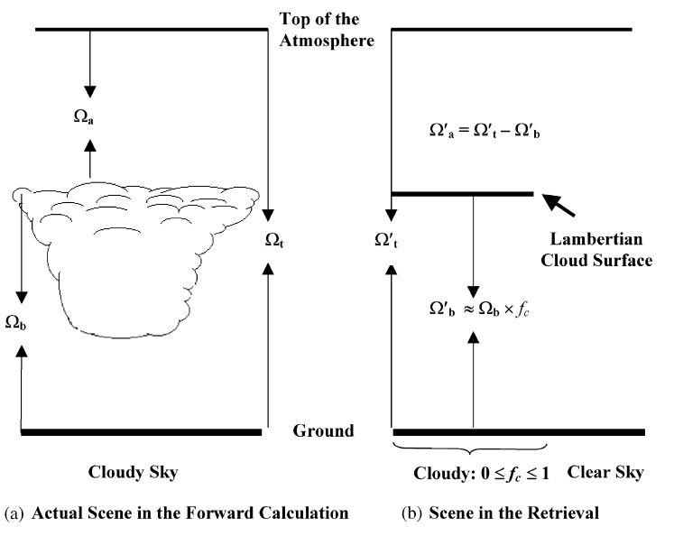
In present algorithm, cloud treatments are highly idealized and mainly focus on tropospheric clouds and aerosol rather than PSCs.
From X Liu, et al., 2004
Cloud treatment in BUV retrieval algorithms

Slide 23
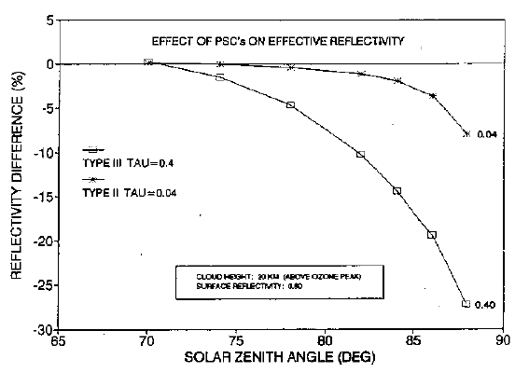
Two cloud types are considered and the cloud has a narrow density peak at 20Km. From O.Torres and Z.Ahmad, 1992
Simulating of PSCs effect on reflectivity

Slide 24
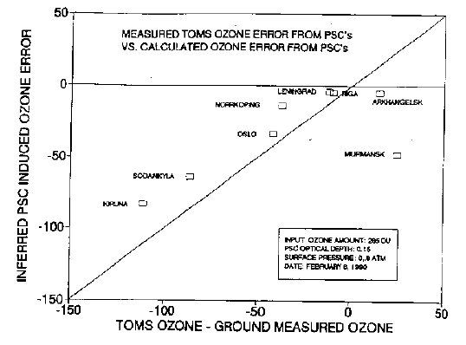
Comparison of the calculated TOMS error(Measured TOMS-Ground observation for the mini-hole event of Feb 6,1990).
From O.Torres and Z.Ahmad, 1992
Simulating PSCs effect on TOMS ozone retrieval

Slide 25
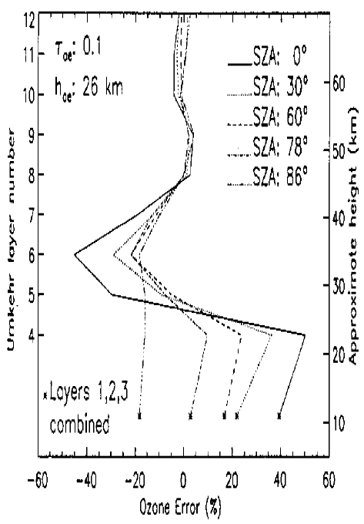
Simulated error in retrieved layer ozone in percent for 7 SZA for an aerosol cloud of optical depth 0.1 at 26 Km.
From O.Torres and P.K.Bhartia, 1995
Simulating PSCs effect on TOMS ozone retrieval

Slide 26
4. Remarks and conclusions
In past years, Chinese have paid great efforts on polar ozone
depletion monitoring including space and surface-based
observations.
However, we also realize that there is uncertainty in satellite monitoring data, resulting from the presence of PSCs.
CALIPSO is helpful for us to know PSCs. But considering
PSCs correctly in the retrieval still have much to do.

Slide 27
Theoretical simulating studies have shown retrieval error
can reach as big as 20-30DU for some vertical layers, or 20-
50% for the total ozone.
It is obvious that most present BUV algorithms are unable to deal with PSCs correctly. if it is the time for us to develop a new algorithm to monitor polar ozone loss?

Slide 28
Thanks for your attention!

