Slide 1
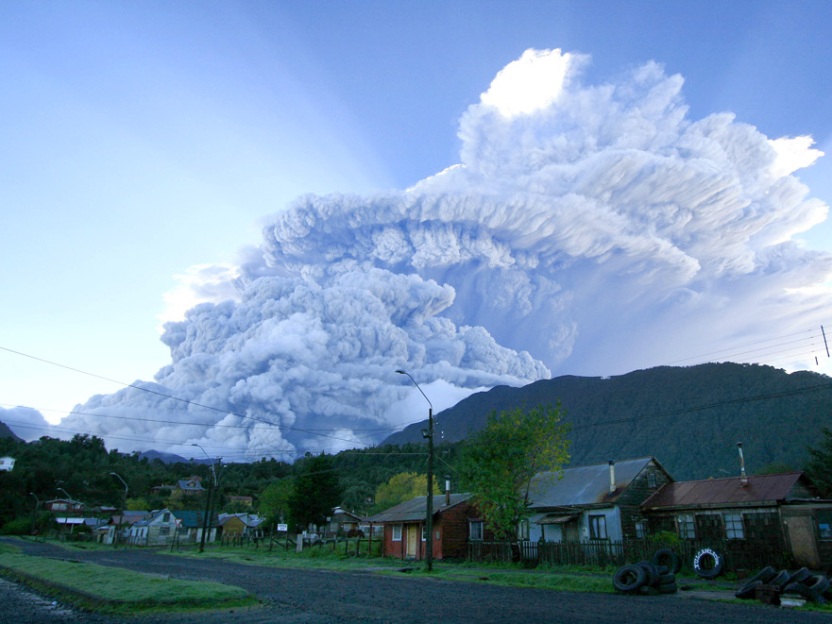

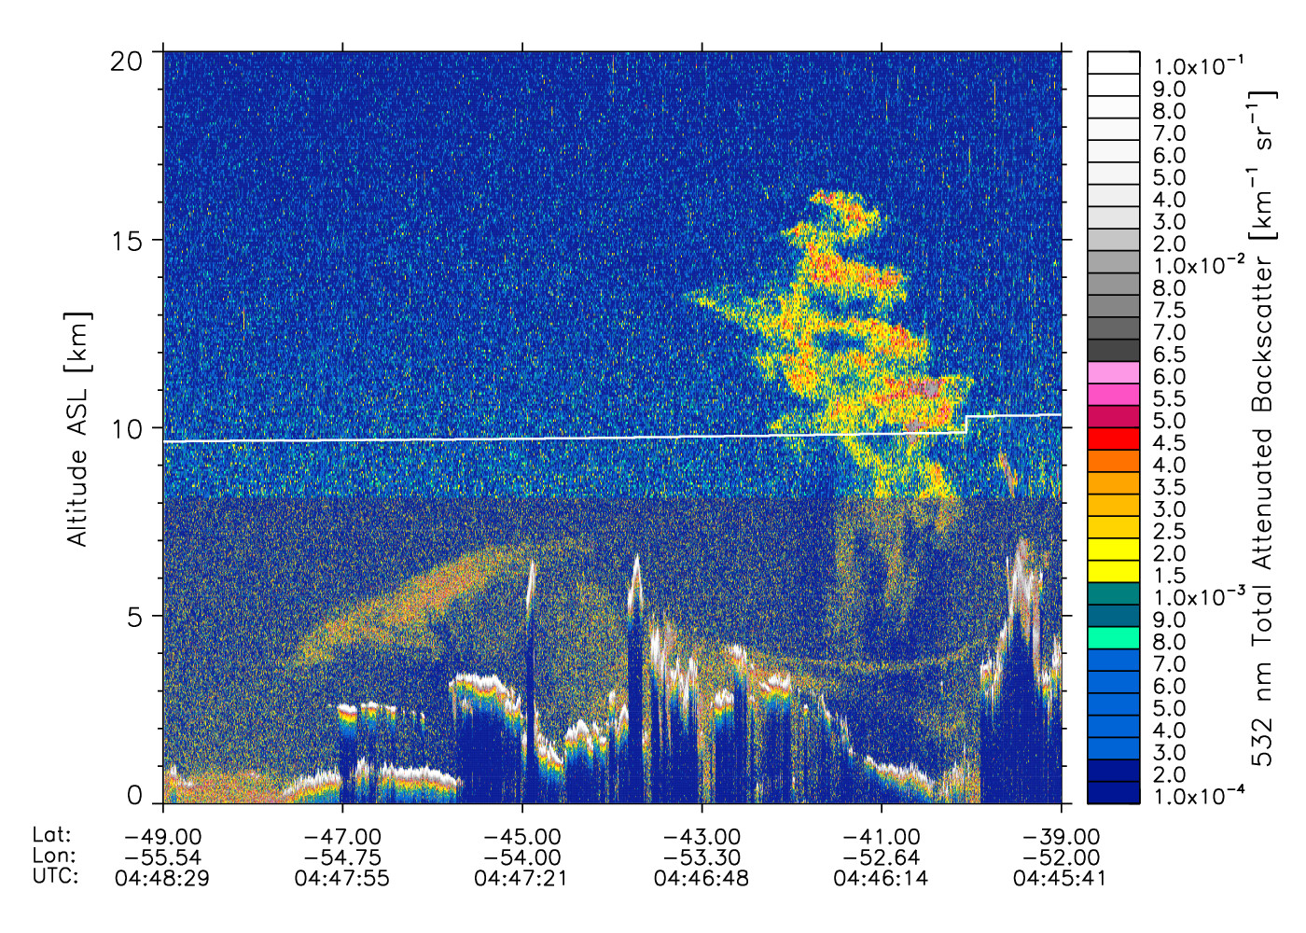
NASA activities on Volcanic SO₂ and ash
N. Krotkov ¹, S. Habib¹, J. Murray², J. Al-Saadi² (presenter), Kai Yang ³, E. Hughes³, A. da Silva¹, J. Joiner¹, S. Carn⁴, K. Evans ⁵, Jay Cable ⁶, C. Seftor⁷, K. Brentzel⁸, P. Coronado⁸, G. Vicente ², G. Swanson¹⁰, F. Prata¹¹, M. Guffanti¹², Johanna Tamminen¹³, Seppo Hassinen¹³, A. Lima¹⁴, J. Martins¹⁴, Y. Ben-Ami^{14,} , A. Krueger¹⁵
1. NASA Goddard Space Flight Center (GSFC), Greenbelt, Maryland, USA
2. NASA Langley Research Center, Hampton, Virginia, USA
3. University of Maryland, Atmospheric and Oceanic Science, College Park, Maryland, USA
4. Michigan Technological University, Geological/mining Engineering and Sciences, Michigan, USA
5. University of Maryland Baltimore County, JCET, Baltimore, USA
6. University of Alaska, Geophysical Institute, Fairbanks, Alaska, USA
7. Science Systems and Applications, Inc, Lanham, Maryland, USA
NASA, GSFC, Direct Readout Laboratory, Greenbelt, Maryland, USA
NOAA, NESDIS/OSPO, Satellite Products and Service Division, College Park, Maryland, USA
10. NOAA, NESDIS-SAB, W-VAAC, College Park, Maryland, USA
11. Norwegian Institute for Air Research, Climate and Atmosphere, Norway
12. U.S. Geological Survey, Reston, Virginia, USA
13. Finnish Meteorological Institute, Helsinki, Finland
14. University of Maryland Baltimore County, Baltimore, Maryland, USA
15. NASA and UMBC (retired), USA
CALIOP ash backscatter
Notes:
NASA application DISASTERS program supports producing near real time volcanic SO2 and ash data and their integration in aviation decision support systems,
e.g., Volcanic Ash Advisory Centers (VAACs),

Slide 2
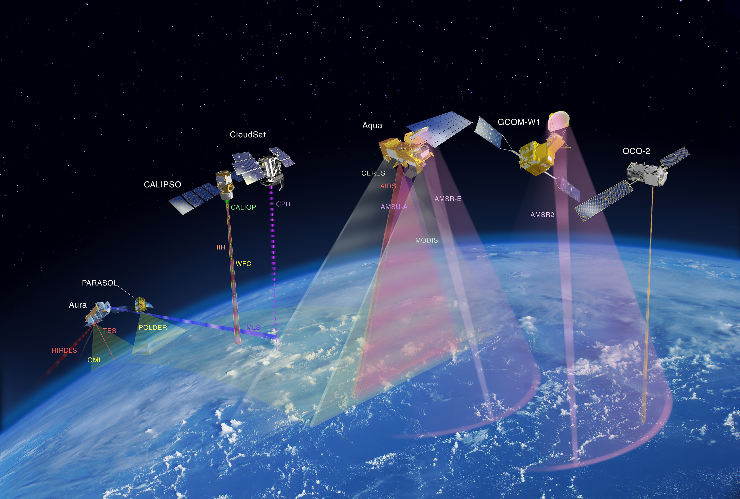

The A-Train
Aura (2004-)
CloudSat (2006-)
Aqua (2002-)
OMI - SO₂, NO₂, BrO
TES - SO₂
MLS - strat. SO₂, HCl
CPR (radar) – precipitation, hydrometeors
MODIS - SO₂, ash, sulfate
AIRS - UTLS SO₂, ash
Dec 2014?
CALIPSO (2006-)
CALIOP (lidar) –ash/ cloud altitude, aerosol phase
Notes:
NASA A-train formation of polar satellites provide multiple instruments capable of observing volcanic clouds gases and aerosols:
Aqua/MODIS - Vis + TIR
Aura/OMI - SO2 + aerosol Index (dust, ash)
CALIPSO/CALIOP lidar - ash vertical profile

Slide 3
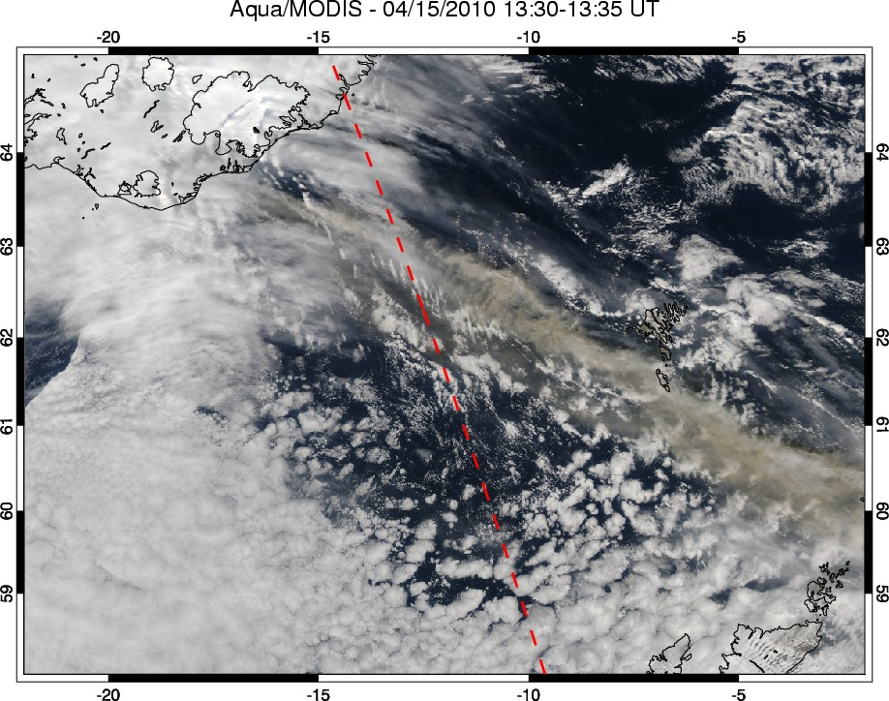
April 15 Eyjafjallajökull eruption plume – Aqua/MODIS
Extent of ash plume
Notes:
Dash line – CALIOP track determines ash vertical extent ( see next slide)
Thick ash plumes attached to volcanoes are easily detectable in MODIS like visible (RGB) imagery. This MODIS RGB image shows ash plume extending Eastward from volcano, above low marine stratocumulus clouds
Away from source dispersed VA clouds are difficult to discriminate from meteorological clouds, tropospheric aerosols or surface in visible imagery.

Slide 4
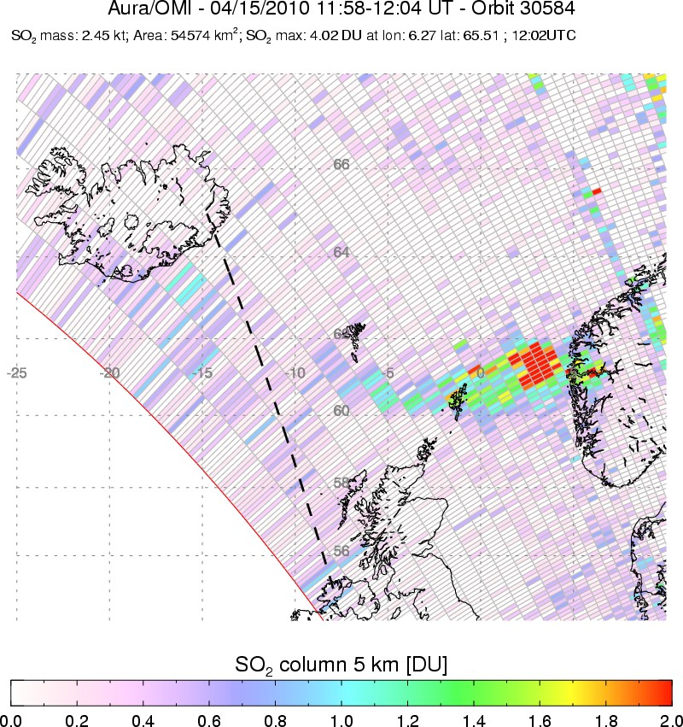
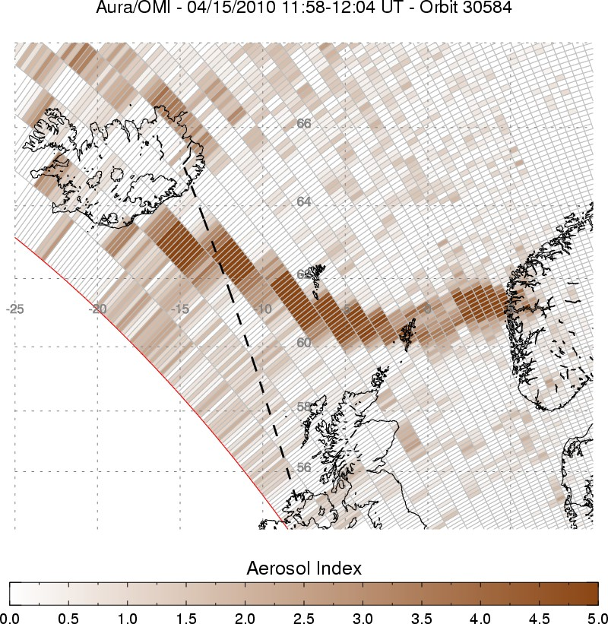
OMI view of Eyjafjallajökull eruption plume on April 15, 2010
CALIPSO/CloudSat
OMI SO₂ column
OMI Aerosol Index
Near real-time (NRT) OMI SO₂ and AI data produced within 3 hours of satellite overpass and displayed at NOAA operational site:
(http://satepsanone.nesdis.noaa.gov/pub/OMI/OMISO2/index.html)
Notes:
Unique discrimination of Volcanic clouds is possible ONLY with UV or Thermal IR measurements:
Solution 1: using UV (OMI – Aerosol Index) or TIR (Aqua/AIRS) direct ash measurements (typically for 1 -2 days, however, false alarms are possible, e. g. from dust clouds)
Solution 2: using measurements of volcanic SO2 gas as unique marker of dispersed volcanic clouds away from their sources - this is most sensitive method for SO2 reach clouds from magmatic eruptions
In this example, OMI detected both SO2 (left) and ash (Aerosol Index – right panel) in the initial Eyjafjallajökull eruption on April 14 2010.
Note: SO2 cloud (left) co-insides with ash (Aerosol Index – right) over Eastern part of the plume;
Ash was emitted to the same height as SO2
- No SO2 signal near volcano is explained by phreatic (steam driven) eruption style (magma interaction with ice and SO2 conversion in the vent )
Dash line shows CALIPSO and CLOUDSatT tracks
OMI facts:
Launched on NASA EOS Aura platform in 2004,
Joint Dutch-Finnish Instrument with Duch/Finish/U.S. Science Team
PI: P. Levelt, KNMI
Hyperspectral wide FOV Radiometer
270-500 nm
13x24 km nadir footprint (highest UV resolution from space ! )
Swath width 2600 km ( contiguous coverage )
Radicals: Column O₃, NO₂, BrO, OClO
O₃ profile ~ 5-10 km vert resolution
Tracers: Column SO₂ , HCHO
Aerosols ( Volcanic Ash, smoke, dust)
Note: none of the volcanoes with SO2 plumes shown in the image are monitored regularly from the ground.
Using OMI we can monitor global volcanic SO2 emissions remotely and economically.

Slide 5
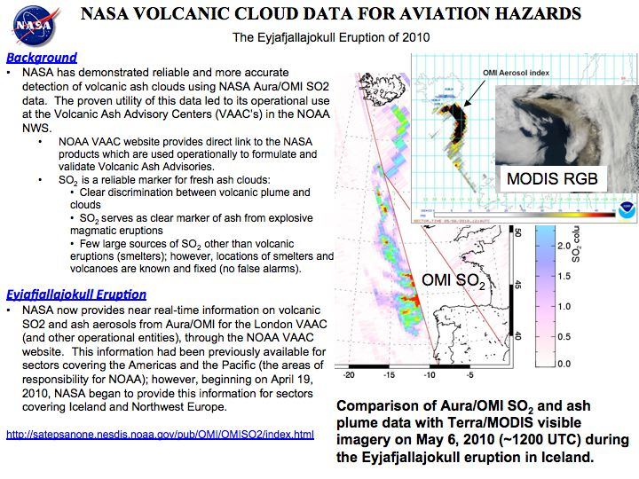
Notes:
NASA Applied Sciences program supports Near Real Time (NRT) production of BOTH ash and SO2 data from OMI (UV) and AIRS (TIR) measurements
Combination of SO2 and ash measurements provides robust detection of Volc clouds (no false alarms) and accurate lateral position.
Next step: estimating ash Mass density in the plume from satellite (UV and TIR ) measurements

Slide 6
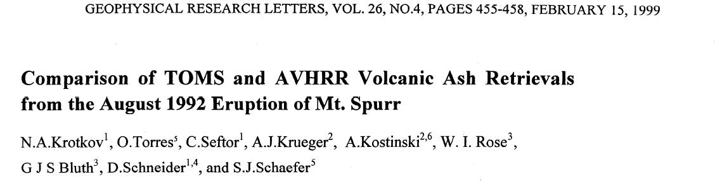
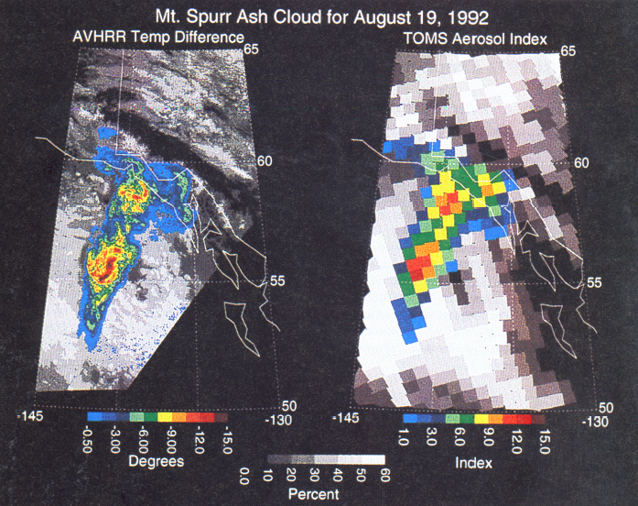
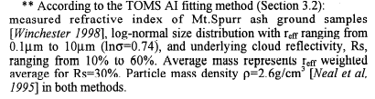

Ash column mass retrievals require a priori information about ash refractive index
AVHRR BTD ash mass= 0.7 Tg
TOMS UV AI ash mass ~ 0.8 Tg
Krotkov et al 1999]
Notes:
Satellite retrievals volcanic ash column mass require a priori knowledge of spectral refractive indices from UV (right figure shows mass estimate from TOMS UV minimal mass estimate) to thermal IR wavelengths (left figure shows AVHRR ash mass retrieval)
With satellite hyperspectral measurements available from UV (OMI, GOME-2) to TIR (IASI, AIRS) there is an urgent need in laboratory hyperspectral measurements of volcanic ash samples from UV to TIR.
Studies are also needed that relate ash composition (SiO2 content ) with the refractive index

Slide 7
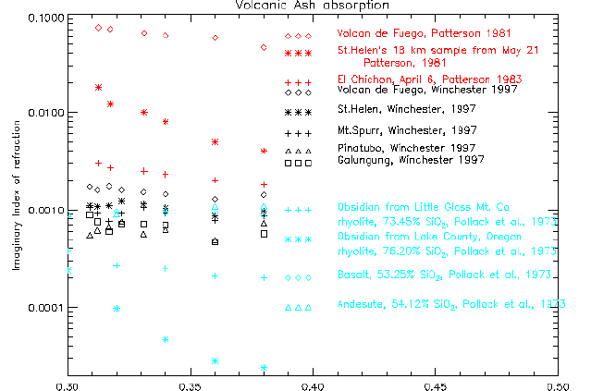
Previous measurements UV ash refractive index
Notes:
There is 3 order of magnitude differences in ash absorption in UV reflecting different as composition from different volcanoes;
However, different measuring techniques and ash preparation techniques could have contributed to the differences.
There is urgent need to re-measure ash refractive index spectrally using modern lab techniques.

Slide 8

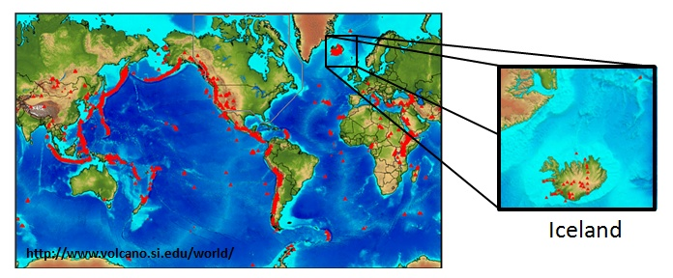
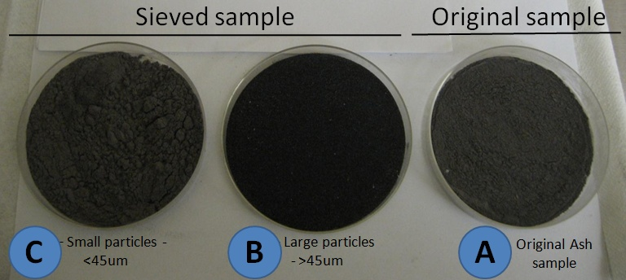
Laboratory measurements of Volcanic Ash
from Eyjafjallajökull eruption
by Adriana Rocha Lima and Prof. J. Vanderlei (UMBC) (Martins
Eyjafjallajökull “Island mountain glacier” .
Most recent eruptions: April- May 2010.
Eyjafjallajökul (Iceland) Volcano ash samples were first prepared by sieving to diameter <45um.
Next , sieved samples were deaglomerated, selected to sizes < 10um and collected in filters.
Ash samples courtesy to Dr. Ulrich Schumann
Notes:
NASA supports hypespectral lab measurements of ash refractive indices at UMBC.
Fallout volcanic samples are collected from the ground,
Fine ash fraction, representative of airborne ash is separated using number of procedures: sieving, re-suspension in aerosol generator and deposition to nucleopore filters with fine and coarse pores.
Mass of the volcanic ash per unit of area of each filter Sigma (g/cm²) was determined using a high precision scale.

Slide 9
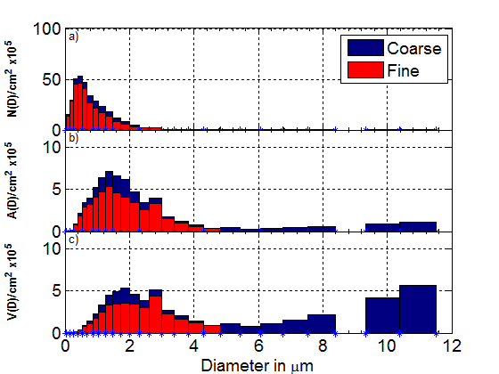
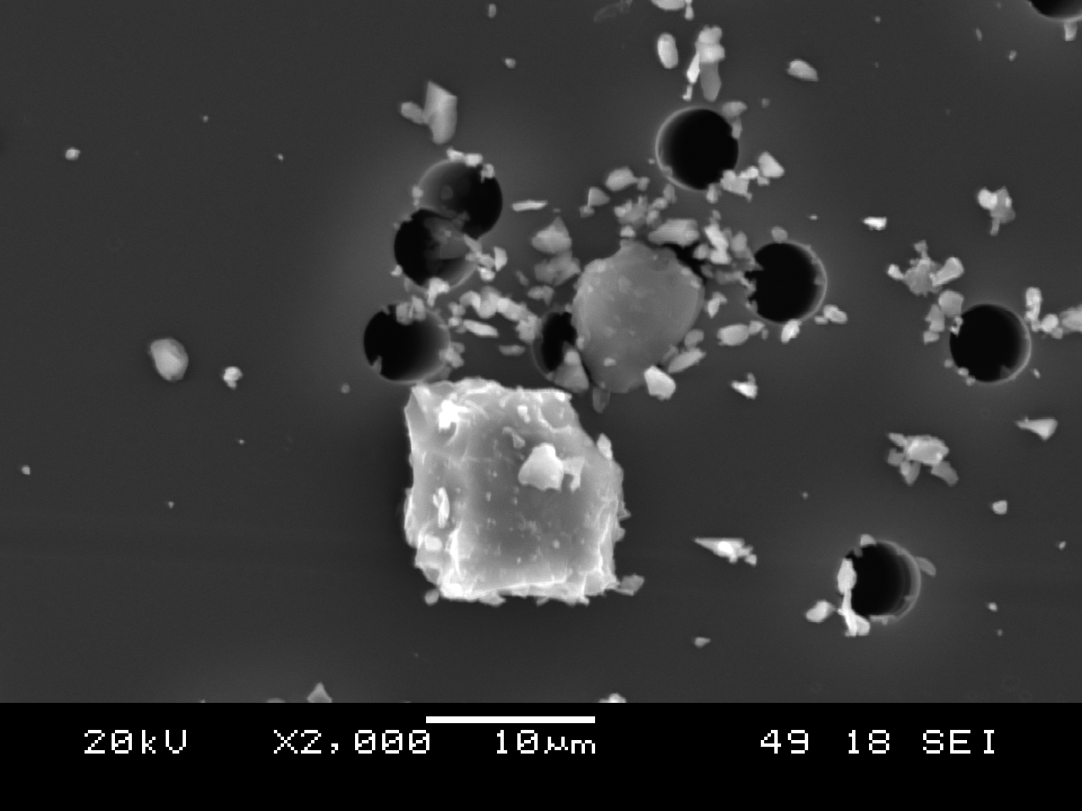
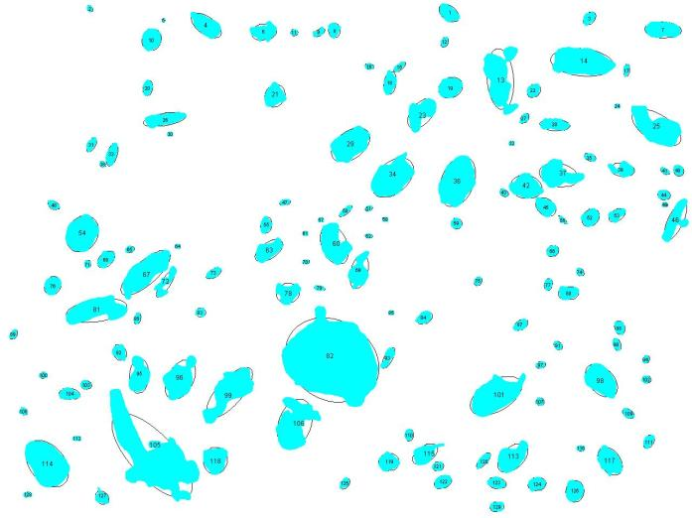
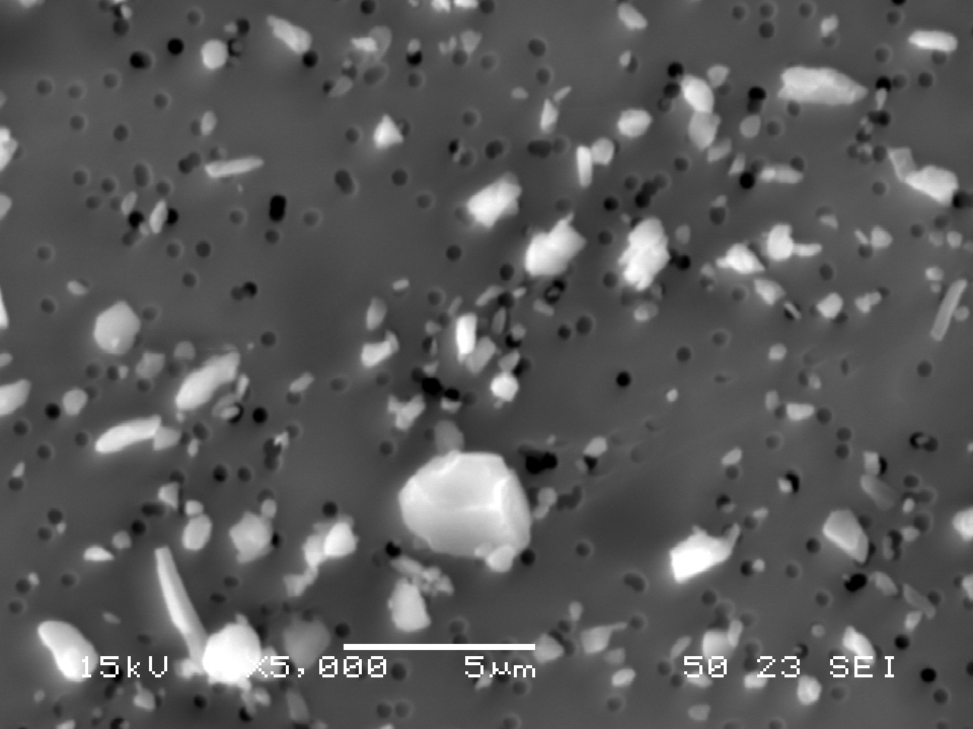
Size distribution measurements on filters
Scanning Electron microscopy
Size, area and volume distribution
COARSE FILTER
FINE FILTER
Sample VAE21F and VAE21M (more than 3000 particles) - diameter from area
Notes:
Ash size distributions (number – n(r) and volume – V (r) on the filters were measured using Scanning Electron microscopy on both coarse and fine filters

Slide 10
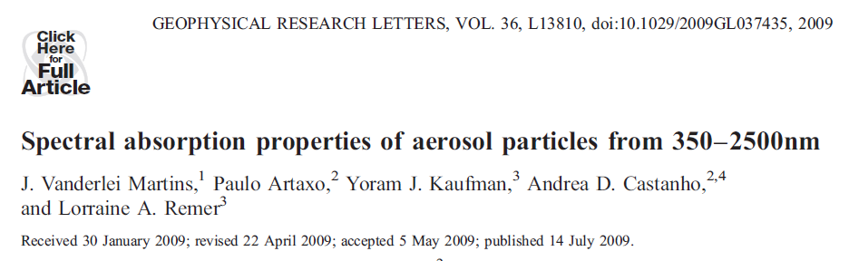

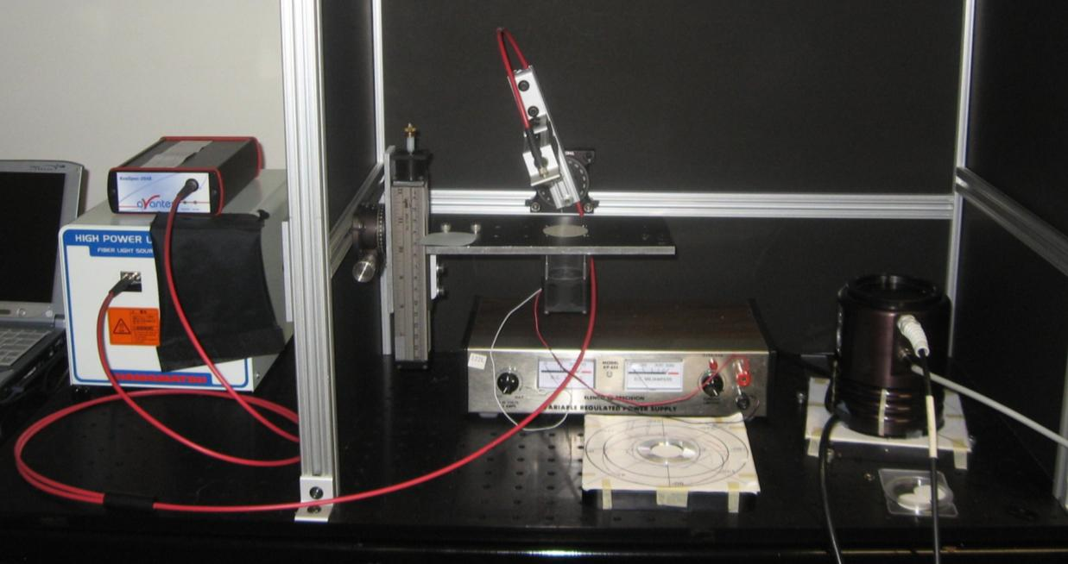
Spectral Aerosol Absorption measurements: filter reflection technique
Fiber Optic System: from 350 nm – 2500nm.
Notes:
Spectral reflectance from the filters was measured in spectral range 350-2500nm using reflection technique [Martins et al., 2009]
Spectral mass absorption efficiency [m2/g] was derived from reflectance ratios:
R_with ash / R_without ash

Slide 11
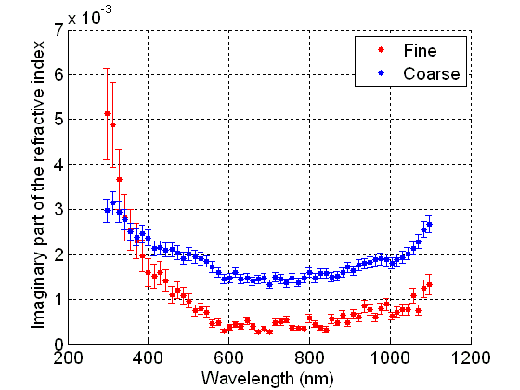
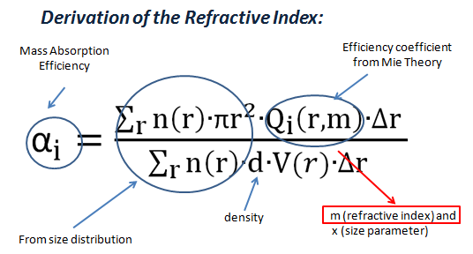
Refractive Index inversion (preliminary results)
Compare with previously published results:
(Bukowiecki et al, 2011, Shumann et al, 2011) → 0.003i -0.005i, 0.004i (780nm, 632nm).
(Rauthe-Schoch, 2012) → 1.54 – 0.003i (830 nm).
(Newman, 2011)→ 0.0015i (coarse mode) and 0.00i (fine mode) – (UV – visible).
Notes:
Ash refractive index was estimated from the measured mass absorption efficiency
using Mie theory and measured size distributions and ash density (d)
Note: fine and coarse ash fractions exhibit different spectral dependence of refractive index.
This is currently not explained: might be a composition effect.
Ashes from different eruptions need to be measured

Slide 12
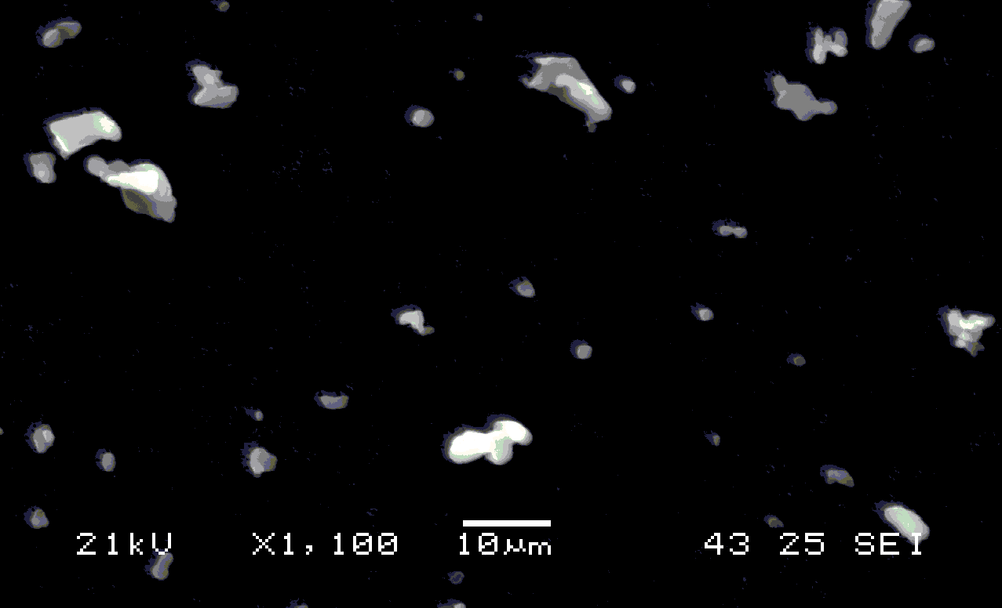
Modifying reflectance technique for Thermal IR:
testing with Ammonium sulfate aerosol
Particles were re-suspended and collected on filters. Particles size distribution and shape were estimated from the filters, using a scanning electron microscope.
Preliminary results support
the feasibility of the proposed
retrieval method and the
measurement setup.
Size distribution of particles
SEM scan of particles
Preliminary results: retrieved refractive indices of Ammonium sulfate vs. refractive indices by Earle et al., (2006)
Notes:
The technique is being modified for measurements in Thermal Infrared region:
6-17 micron , where AIRS and IASI instruments retrieve ash mass loading.
The measurement technique is based on the modification of background black-body radiation transmitted by aerosol deposited on reflective filters.
Refractive-indices of deposited aerosol are estimated based on finding the solution with least error between spectral measurements and results of radiative transfer model.
Radiance measurements with different temperature contrast, between the deposited aerosols and the background radiation source, are conducted to constrain the variables in the retrieval method.
The technique is being tuned using Ammonium sulfate aerosol with known refractive index

Slide 13
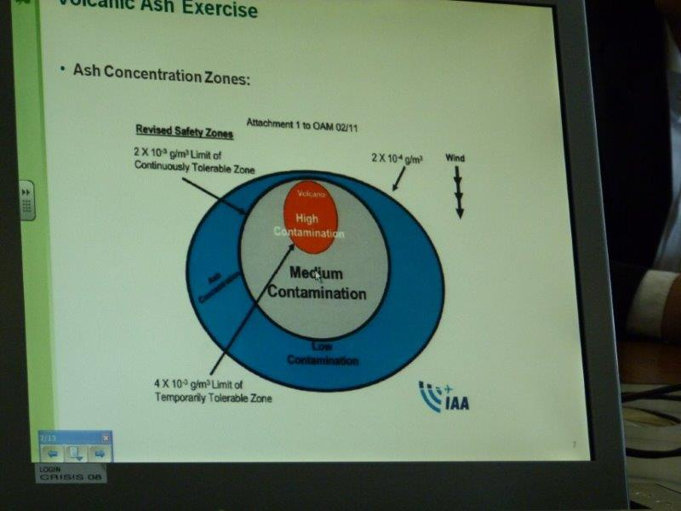
Airlines require information about ash vertical profile and mass density [g/m3]
Currently ash tolerance threshold is assumed < 2 mg/m3
Slide presented at Air Lingus volcanic ash Exercise on March 5 2013
ESA/EUMETSAT Volcanic Ash workshop,
March 4-6, 2013
Dublin, IE
Notes:
Airlines require information about ash mass density [g/m3]
Passive satellite instruments can only measure ash COLUMN mass density [g/m2]
To convert satellite measurements into mass density active Lidar space measurements are needed

Slide 14
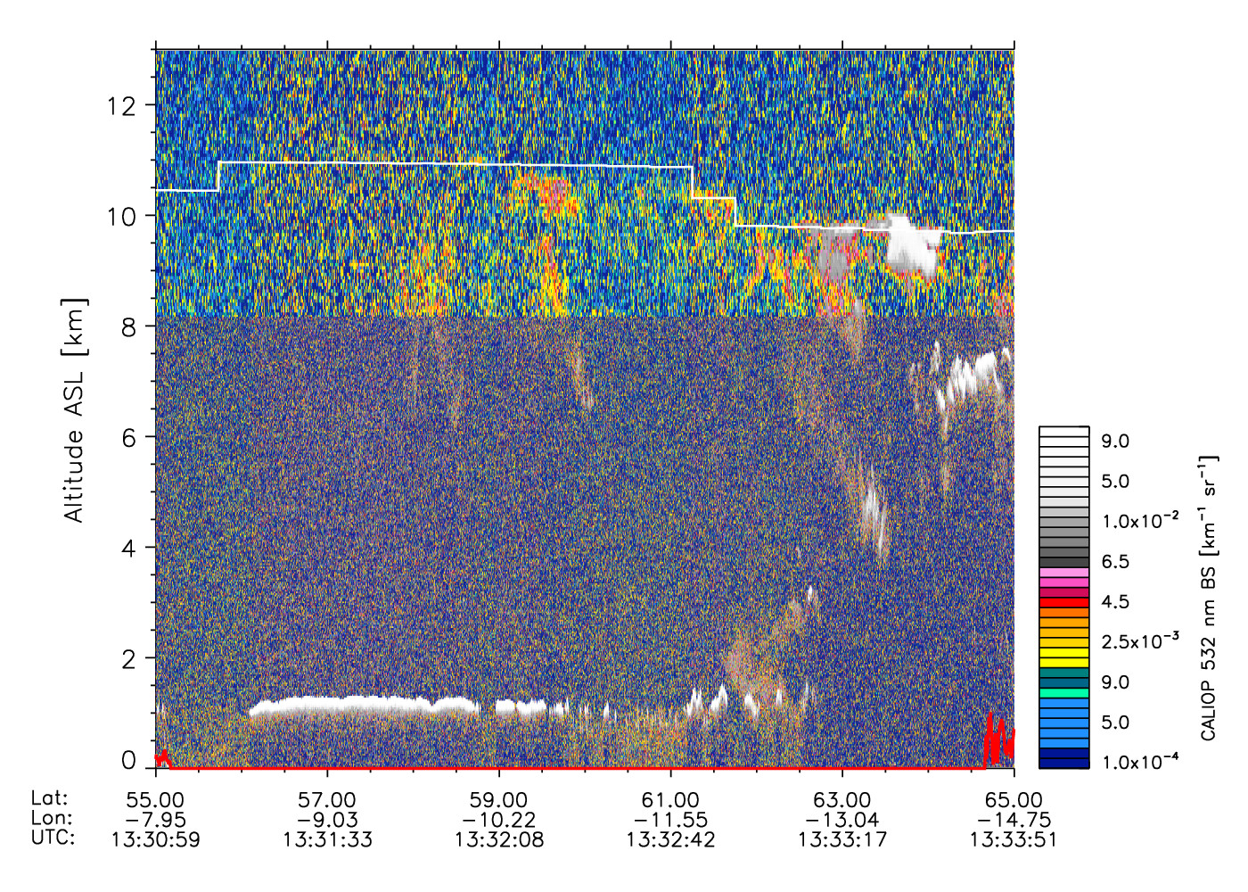
CALIOP view of Eyjafjallajökull eruption plume on April 152010
Satellite retrievals of ash vertical profile are possible with CALIOP space Lidar on CALIPSO satellite (A-train)
Cirrus
Winker et al., JGR [2012]
-> Ash at 1-3 km altitude
Marine stratocumulus
Notes:
CALIOP 532nm backscatter “curtain” constrains ash plume altitude and vertical extend - 1-3km:
Ash vertical thickness information is needed to convert satellite retrieved Column Ash mass [mg/m2] into Ash concentration [mg/m3]
Currently threshold 2-4 mg/m3 is considered dangerous for commercial jet engines

Slide 15


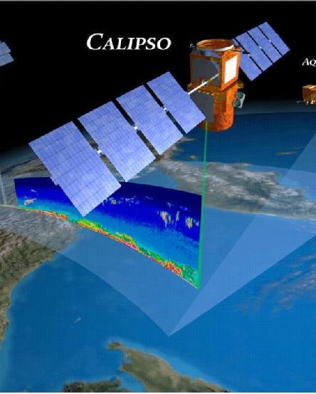
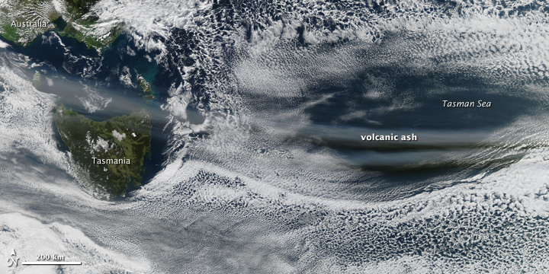
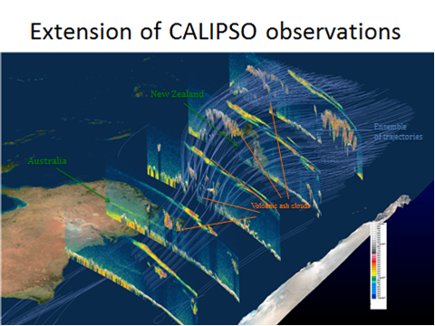

Tracking the vertical structure of diffuse volcanic ash clouds with space lidar: CALIOP
J.-P. Vernier^{1,2}, T. D. Fairlie², J. J. Murray², A. Tupper³, C. Trepte² , D. Winker², J. Pelon⁴, A. Garnier^{1,2,4}, J. Jumelet⁴, M. Pavolonis⁵, A.H. Omar² and K.A. Powell².
1- Science Systems and Applications, Inc., Hampton, USA
2- NASA Langley Research Center, Hampton, USA
3- Australian Bureau of Meteorology, Northern Territory Regional Office, Casuarina, NT, Australia
4- LATMOS, CNRS-INSU, Université de Versailles St Quentin, Université de Paris 6 , France
5- NOAA/NESDIS, Madison, Wisconsin, USA
A case study after Puyehue-Cordon Caulle eruption in June 2011
Notes:
New NASA Applied Sciences program supports expedited production of CALIOP data for volcanic ash warnings.
CALIOP data are combined with trajectory mapping technique to provide 3D ash forecasts
Paper in press: An advanced system to monitor the 3D structure of diffuse volcanic ash clouds
J.-P. Vernier1,2, T. D. Fairlie2, J. J. Murray2, A. Tupper3, C. Trepte2 , D. Winker2, J.
4 Pelon4, A. Garnier1,2,4, J. Jumelet4, M. Pavolonis5, A.H. Omar2 and K.A. Powell2.
26 Abstract :
28 Major disruptions of the aviation system from recent volcanic eruptions have increased
29 intense international discussions to improve volcanic ash warnings. Central to making
30 progress is to better discern low levels of volcanic ash, and to describe the ash cloud
31 structure more accurately in 3-dimensional space, and time. Here, we study dispersed
32 volcanic ash observed by the CALIPSO space-based lidar near 20,000-40,000ft (6-13
33 km) over Australia and New Zealand in June 2011, 3 weeks after the Puyehue-Cordon
34 Caulle eruption, which disrupted air traffic in much of the Southern Hemisphere. The
35 volcanic ash layers are shown to exhibit color ratios (1064/532 nm) near 0.5, significantly
36 lower than unity, typical values observed with ice. We use those optical properties to
37 develop an ash detection algorithm. We then demonstrate a “trajectory-mapping”
38 technique, wherein ash cloud observations are ingested into a Lagrangian model, to
39 construct ash dispersion maps and cross-sections. Comparisons of the model results with
40 independent observations suggest that the model successfully reproduces the 3D structure
41 of volcanic ash clouds. This technique has a potential operational application to provide
42 important additional information to worldwide Volcanic Ash Advisory Centers.

Slide 16
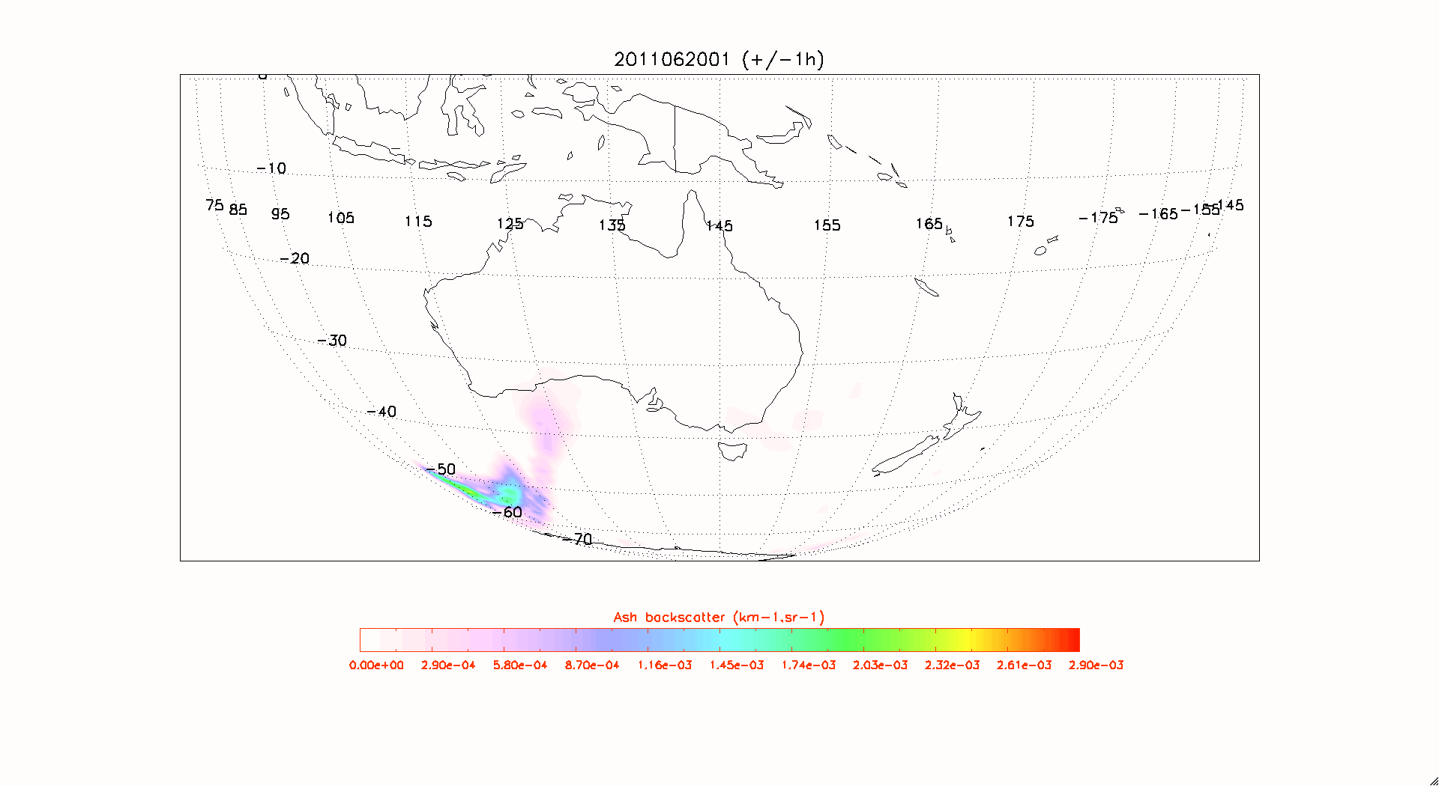

Cordon ash episode between Australia and New Zealand
20-24 June 2011
Langley Trajectory Model (LaTM) initialized with Calipso retrievals of volcanic ash using pixels with low 532/1064 color ratio and high 532 nm depolarization ratio.
20000-40000 ft.
Notes:
Langley Trajectory Model (LaTM) initialized with Calipso retrievals of volcanic ash using pixels with low 532/1064 color ratio and high 532 nm depolarization ratio. LaTM uses a 4th order Runge-Kutta scheme.

Slide 17
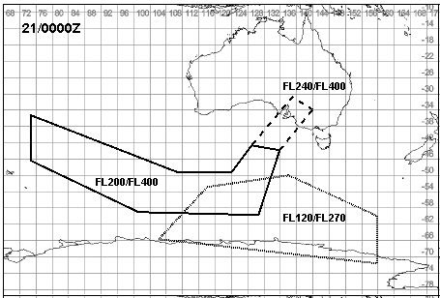
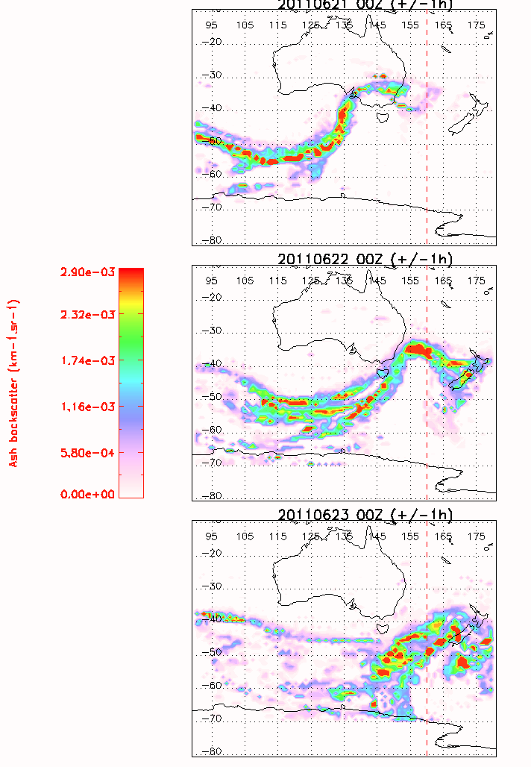
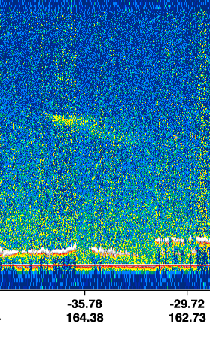
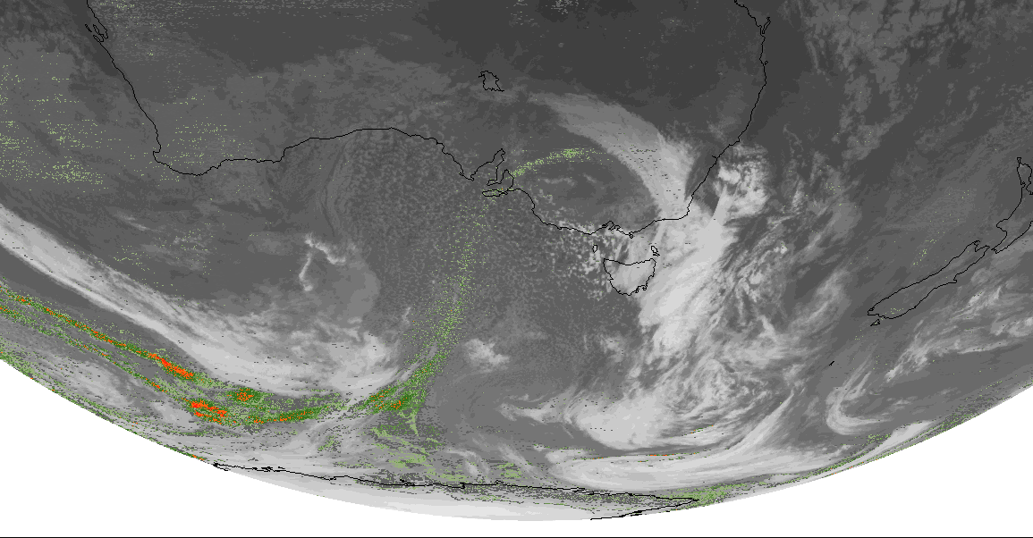
CALIOP space lidar provides
Enhanced information for the VAACs
CALIPSO-trajectory mapping
Now cast from Darwin VAAC
MTSAT ash
Ash cloud masked by Clouds in MTSAT data over SE Australia (Sydney)
Ash Advisory was affected by this limitation
CALIPSO-trajectory map captured the head of the plume on time (as validated by a subsequent independent daytime overpass)
Volcanic ash cloud
Notes:
In this case geostationary MTSAT data (Right-bottom) and Hysplit model alone were not able to see the ash that extended beyond the [ash] advisory from Darvin VAAC (Top right). The [Darvin] VAAC did an excellent job with the information they had available and even scrambled to quickly update the warning when it became clear that things were moving faster than could be discerned from the earlier MTSAT imagery.

Slide 18
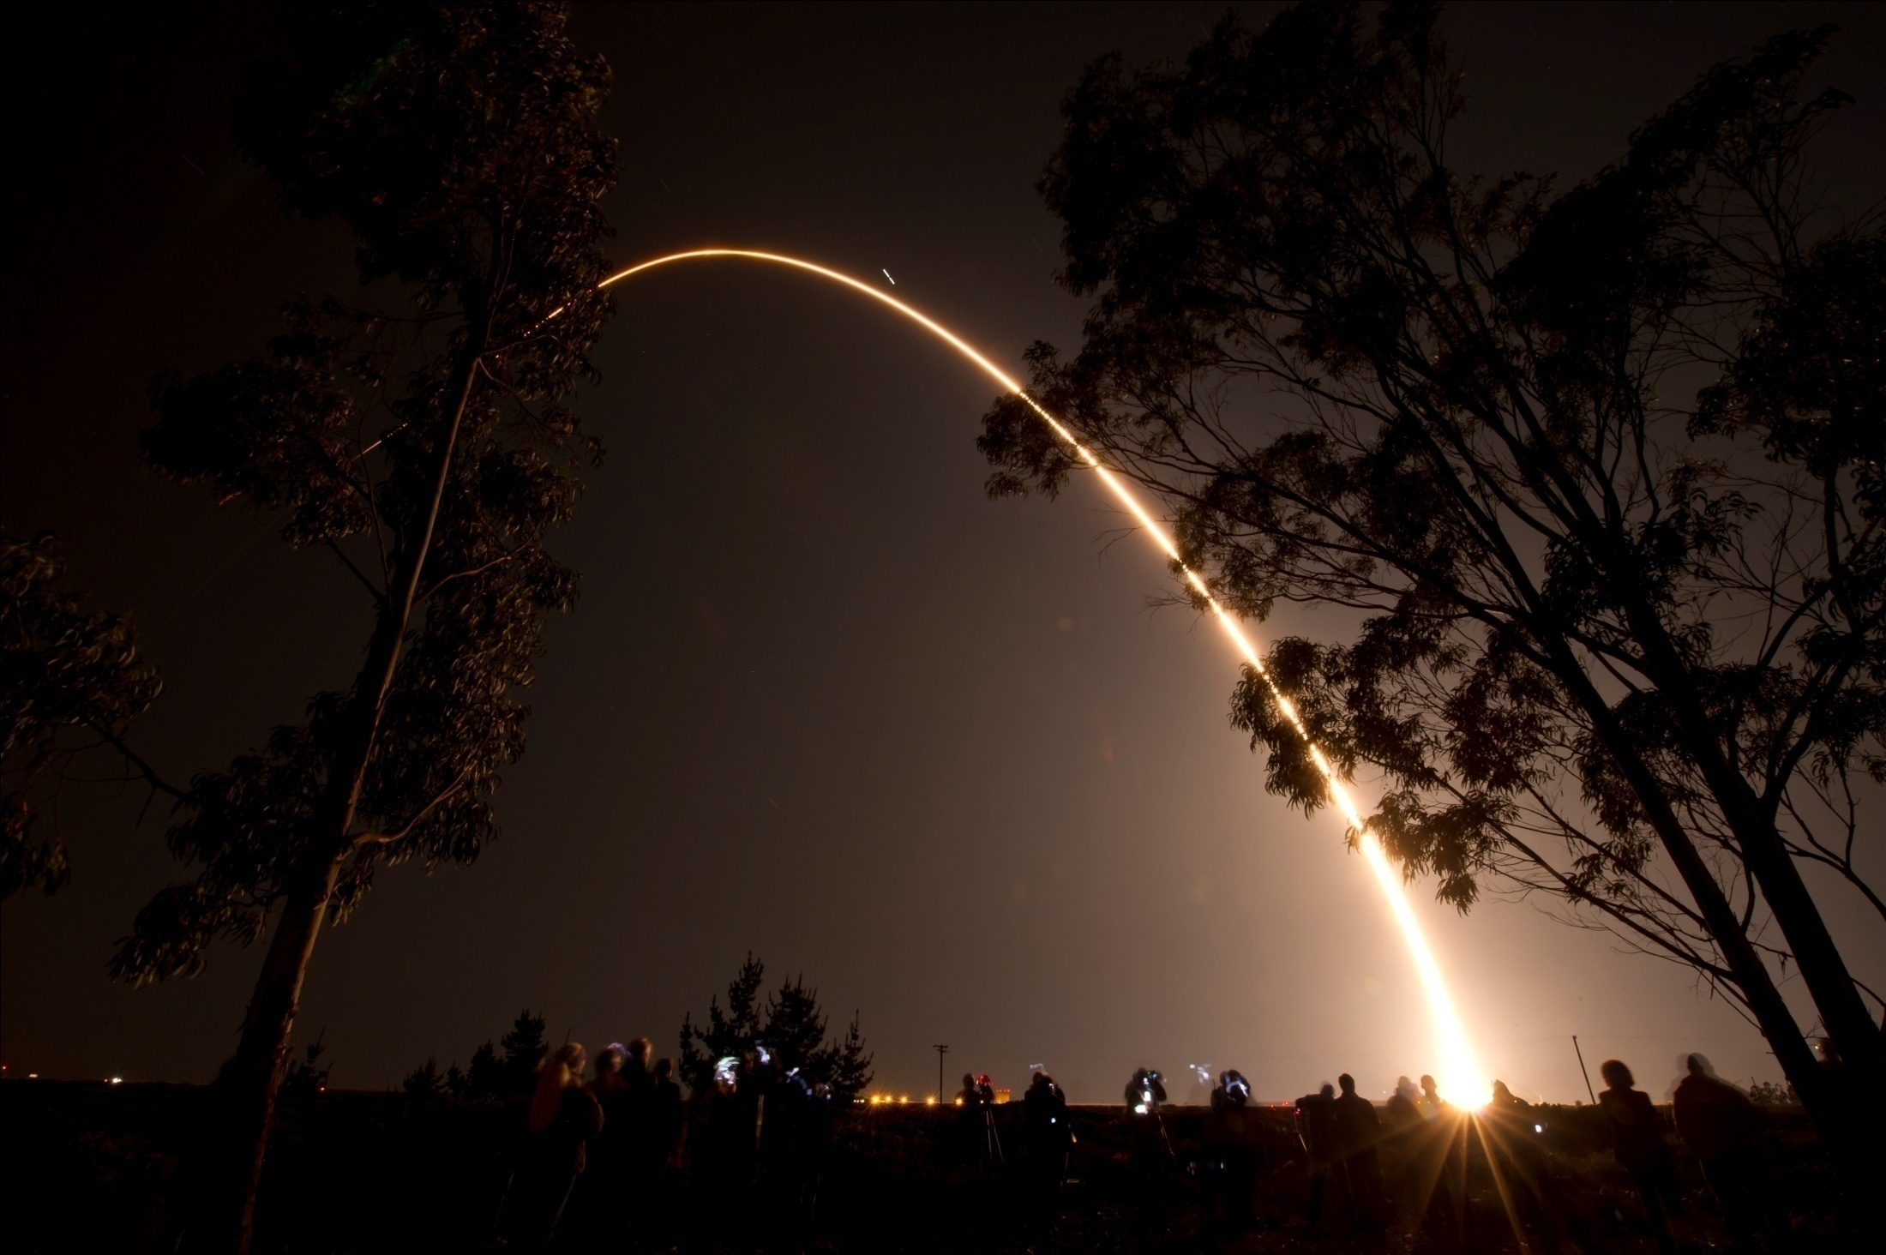
NASA- NOAA Suomi- National Polar Orbiting Partnership (NPP) satellite Launched on Oct. 28, 2011 into 1:30pm ascending polar orbit
Notes:
NASA- NOAA partnership launched new generation weather Suomi - NPP satellite in 2011

Slide 19
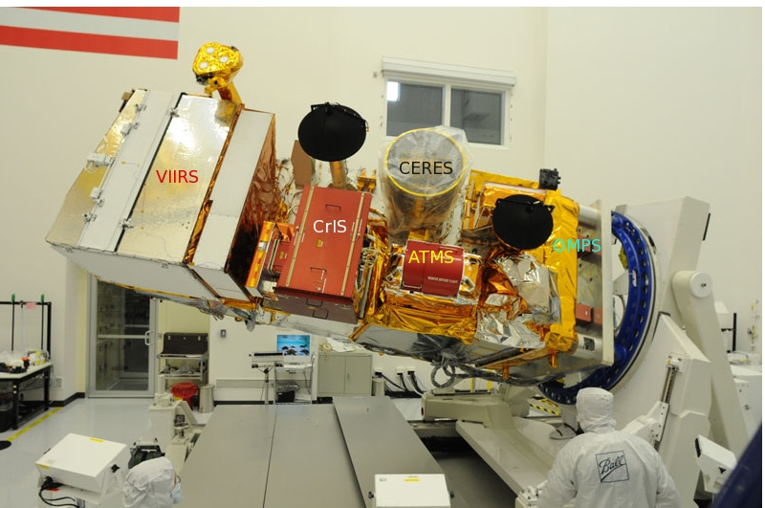
NASA-NOAA Suomi- National Polar-orbiting Partnership (NPP) satellite bridges NASA EOS to the next generation of U.S. Earth-observing satellites -- JPSS.
Ozone Mapper and Profiling Suite (OMPS)
Notes:
S-NPP satellite has 5 advanced instruments for weather and atm composition measurements.

Slide 20
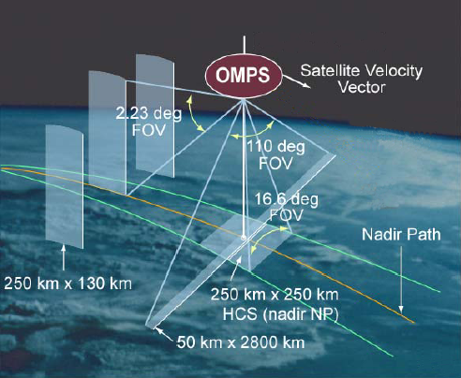
Suomi-NPP/OMPS UV Sensors
Limb instrument:
Aerosol and Ozone
profiles above
tropopause12-15km
NP
Nadir Mapper (NM):
swath similar to OMI
Notes:
Ozone Monitoring and profiling Suite (OMPS) consists of three sensors:
Nadir mapper (similar to OMI , 110° nadir cross-track field of view ) provides Total Column Ozone and SO2
Nadir Profile instrument provides Nadir ozone profiles
Limb instrument provides Limb Profile of ozone and aerosols above tropopause

Slide 21
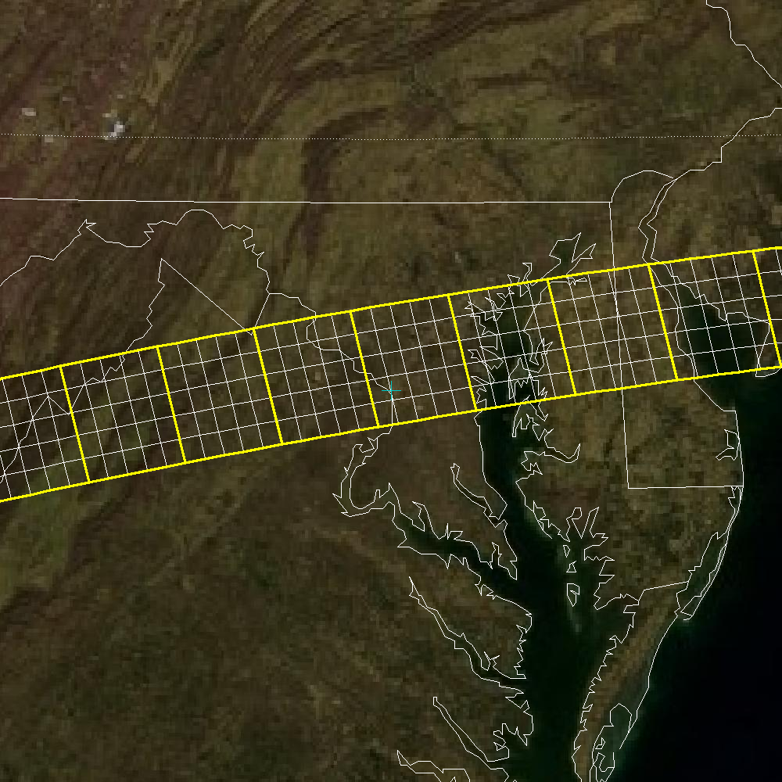
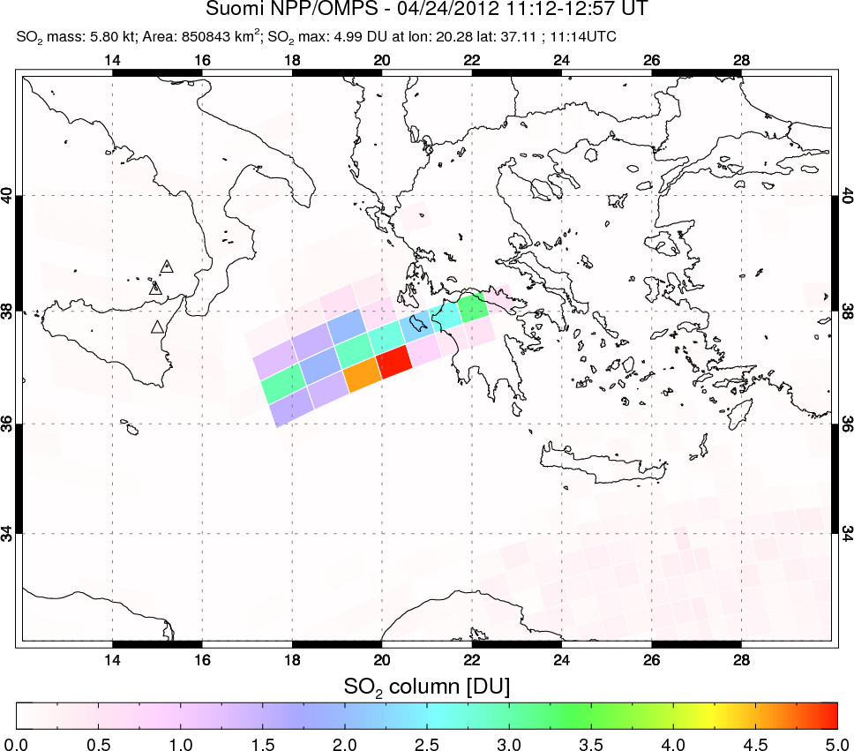
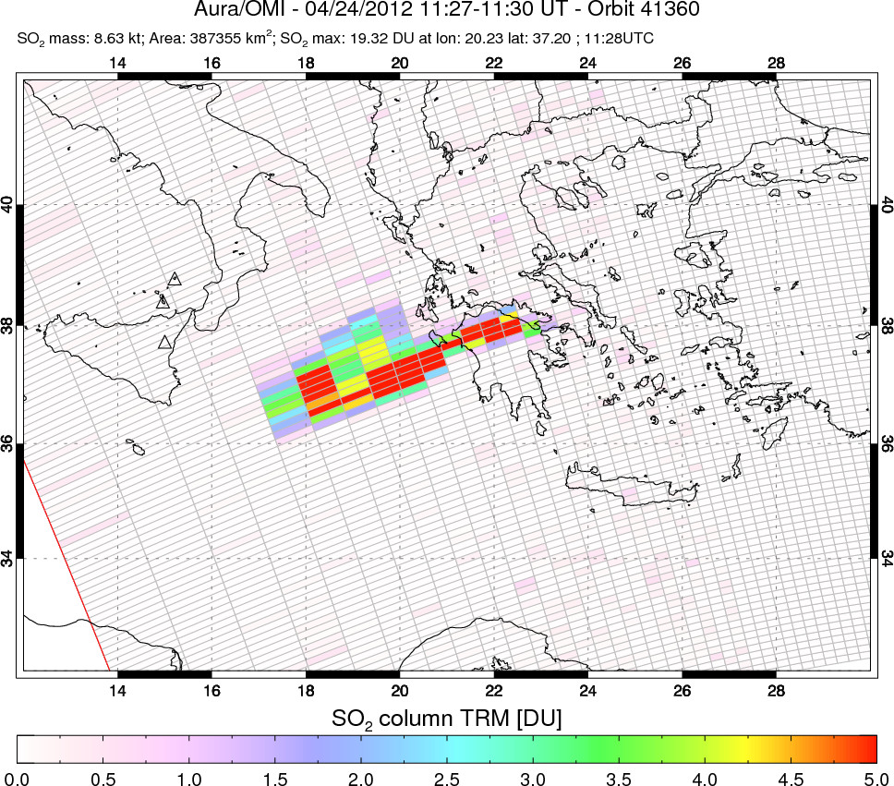
OMPS NM operational SO₂ data
Yellow boxes are nominal (50 x 50 km FOV)
White boxes –measured resolution ~ 12 x 12 km FOV
Co-adding NM pixels on board results in low ground resolution ~50km (left map). Allowing higher data rate improves resolution to 12km by 12 km: better than current Aura OMI (OMI SO₂ map from Etna eruption on right)
OMPS/NM SO₂ at nominal 50km ground resolution
OMI SO₂ at 13km by 24km resolution (nadir)
Notes:
OMPS- Limb instrument takes out ~80% data rate available.
Then the limb instrument is turned-off (on Sundays) nadir mapper data are transmitted to the ground at full resolution.

Slide 22
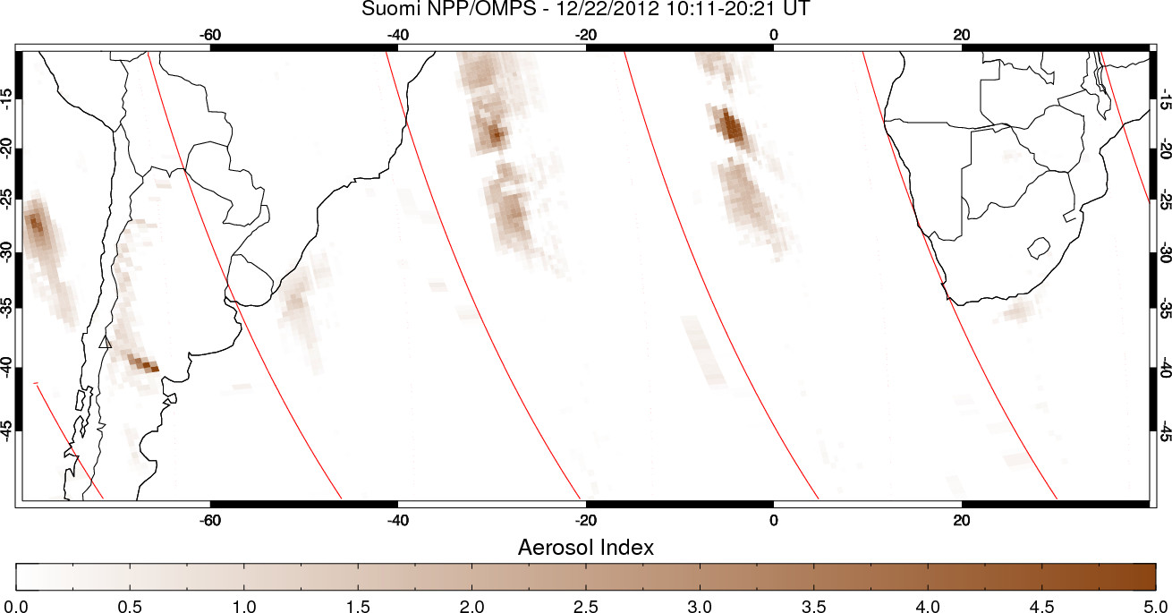
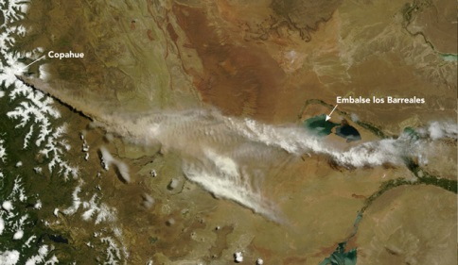
OMPS Aerosol Index data (ash and dust) – insert: MODIS RGB - Copahue eruption (Dec 2012)
Notes:
OMPS Nadir Mapper is similar to OMI.
OMPS Nadir Mapper provides Aerosol Index (AI) data at lower resolution (50km), but at contiguous global coverage (OMI has lost part of the swath due to raw anomaly)
This example shows recent volcanic ash cloud from Copahue eruption in Chilie in December 2012. The ash signal was not detectable on second day
Insert: MODIS RGB image

Slide 23
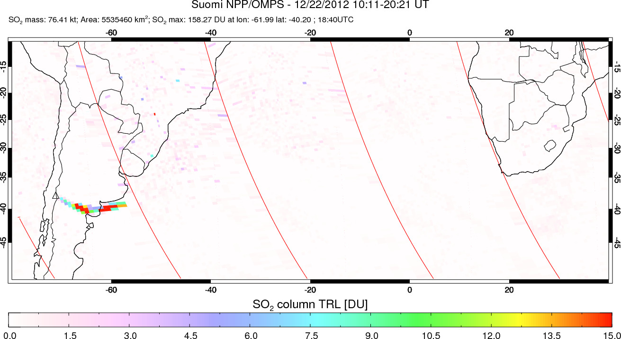
OMPS SO₂ data – Copahue eruption (Dec 2012)
Notes:
OMPS- Nadir Mapper is similar to OMI.
It provides ozone and volcanic SO2 data at lower resolution (50km), but at contiguous global coverage
This example shows volcanic SO2 cloud from Copahue eruption in Chilie in December 2012

Slide 24
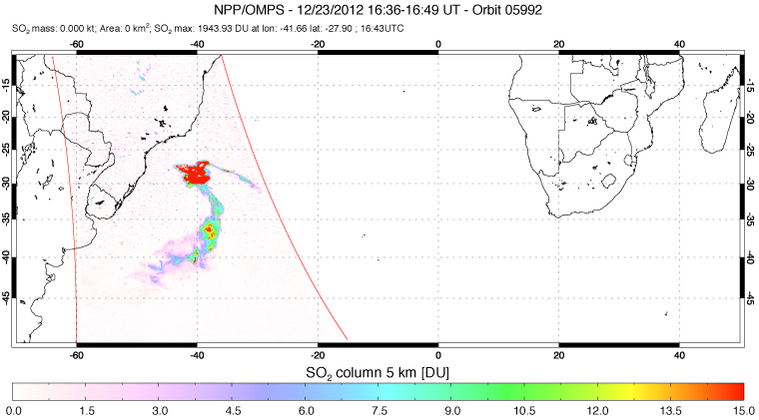
OMPS high-res SO₂ data – Copahue eruption (Dec 2012)
Notes:
This is OMPS high resolution SO2 cloud on second day after eruption - Dec 23
Volcanic cloud is much enlarged and moves fast with prevailing winds.

Slide 25
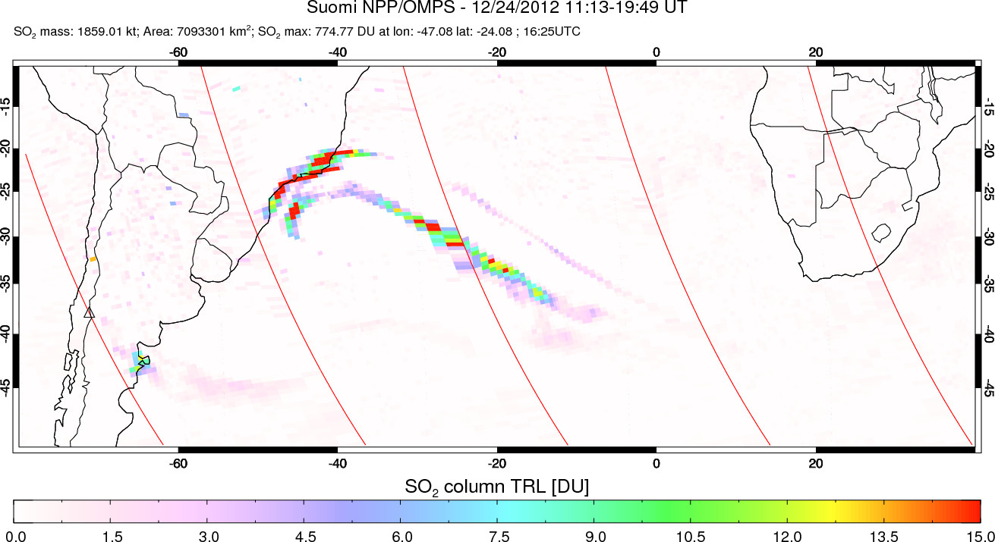
OMPS SO₂ data – Copahue eruption (Dec 2012)
Notes:
Same on Dec 24

Slide 26
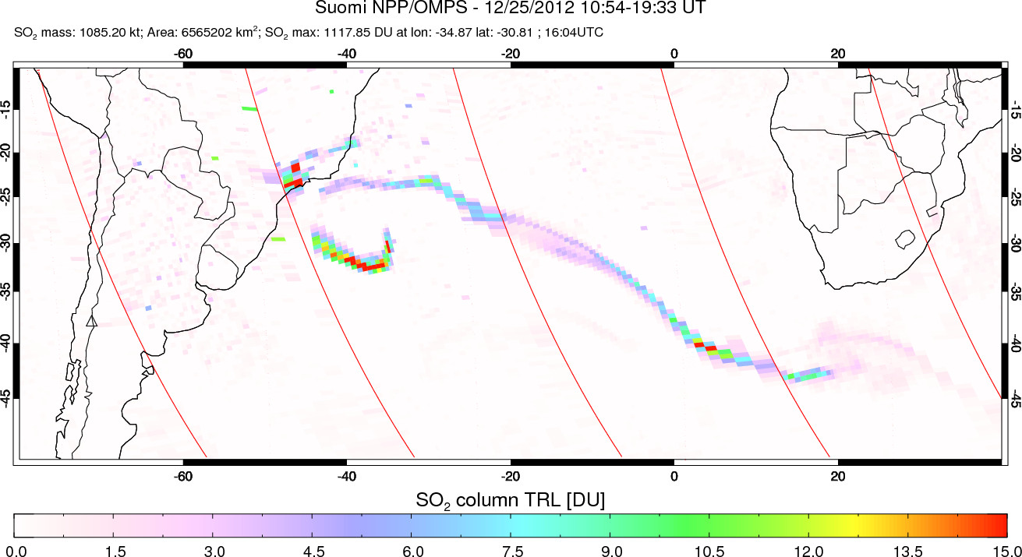
OMPS SO₂ data – Copahue eruption (Dec 2012)
Notes:
Same on Dec 25

Slide 27


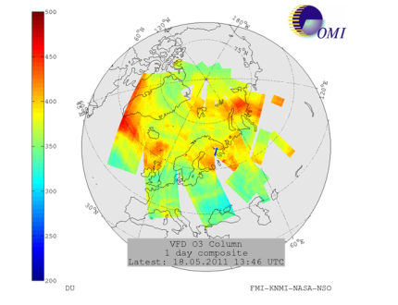
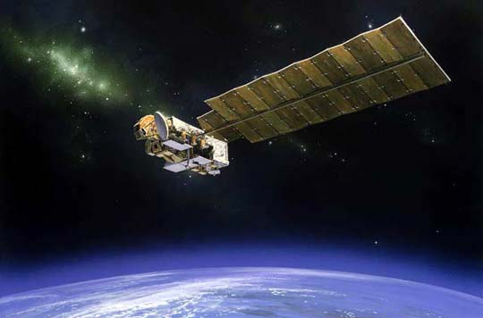
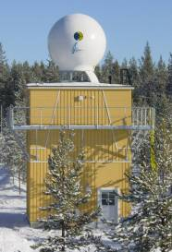
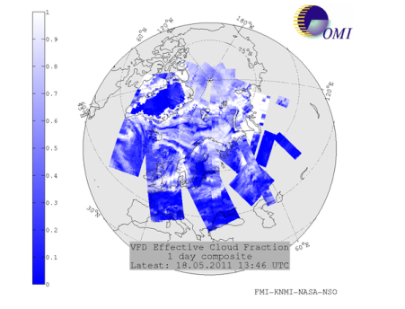
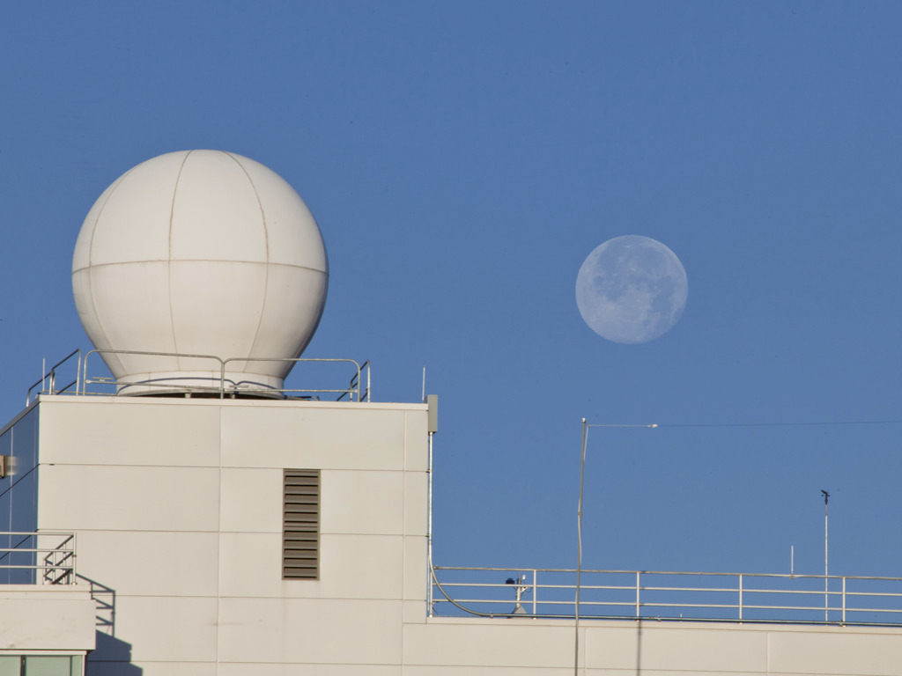
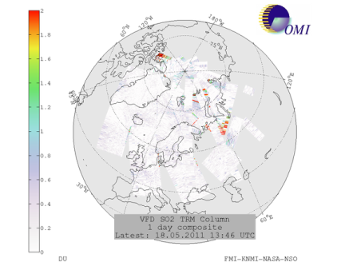



OMI Very Fast Delivery (VFD) service and plan for two stations: FMI, NASA and UAF/GINA
OMI/Aura
Direct Broadcast from NASA Aura satellite
Ozone
Receiving stations in Sodankylä (FMI) and Fairbanks (UAF/GINA)
Image: UAF/GINA
Cloud
fraction
FTP from Fairbanks to FMI
OMI VFD Processing in Sodankylä
SO₂
WWW and FTP services. Available within 20 min after data reception.
UV Aerosol
Index: Ash, dust or smoke
http://omivfd.fmi.fi
Notes:
Fast data delivery is key for Volcanic disasters application.
The NASA’s EOS-Aura satellite has so called Direct Broadcast (DB) capability, i.e. the ability to broadcast data at the same time as it is measured. This possibility is utilized in the OMI Very Fast Delivery (VFD) Service (http://omivfd.fmi.fi) for monitoring atmospheric composition and UV-radiation in almost real time, within 20 minutes after the overpass. The service started in 2006 with UV and ozone. After the eruption of the Eyjafjallajökul the system was updated in 2010-11 with volcanic products: ash and SO2. The OMI VFD covers presently Northern Europe and Arctic Ocean, but the coverage is restricted by the fact that the satellite has to be visible from the Sodankylä ground station in northern Finland. Work is on-going to extend the coverage by using a ground station in Alaska.

Slide 28


Summary of NASA DISASTERS project: Near Real-time Volcanic Cloud Products for Aviation Alerts. Stage 1: Feasibility study
http://so2.gsfc.nasa.gov
FMI Very Fast Delivery (Direct Broadcast ) link
NASA AIRS NRT SO2 maps
NOAA OMI/OMPS NRT interactive map
Notes:
Summary
Current NASA Applied sciences volcanic disasters project continues collaboration with NOAA and other partner organizations to fully utilize and disseminate NASA SO2 and ash volcanic data to further improve their Decision Support System (DSS) for early warning. The products will be enhanced with Aqua/AIRS data and continued using new SO2 and ash data from the next generation operational NPP/JPSS sensors.
We demonstrate the value of increased observational frequency of polar orbit swath overlaps together with reduced satellite data latency times to 20 minutes by utilizing direct broadcast data received at ground stations in Finland and Alaska. Given a new emphasis on quantitative ash mass forecasts for air traffic management (ATM) we propose utilizing satellite data assimilation techniques in a NASA global model to demonstrate improved medium range forecasts of volcanic cloud location and vertical extent. Our proposal directly responds to the priority topic of the solicitation: “Volcanic effluent detection and monitoring, particularly in regard to impacts on aviation”. It describes the initial feasibility study phase to explore several improvements to existing DSSs and ensure all community users are engaged and are planning to use NASA products in their decision support process. Metron Aviation’s experience in developing ATM DSS for use by the FAA, airlines and other key players will be used to help shape satellite products. This will ensure that they are relevant and more readily transitioned into operational use.

