Slide 1

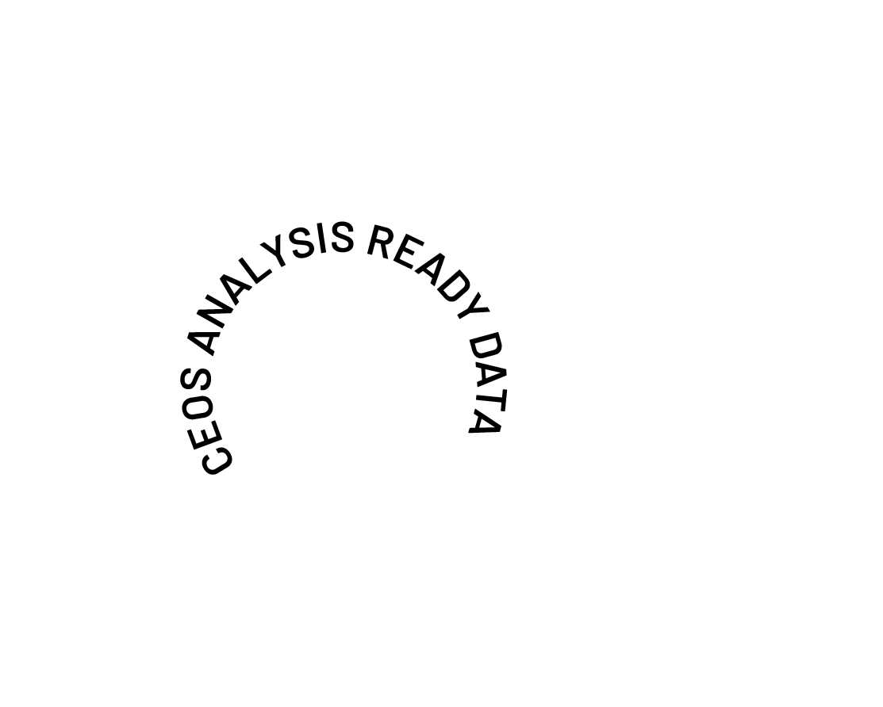
CEOS Analysis Ready Data
Surface Temperature Product Family Specification V6.0
Siri Jodha Khalsa, IEEE GRSS
Harvey Jones, Matthew Steventon, Peter Strobl, Anastasia Sarelli, Josephine Wong
and the CEOS-ARD Oversight Group
EGU26-13110
Notes:
Good morning. It will be my pleasure to tell you about the committee on earth observation satellites plans for an update to the surface temperature product family specification. I’m Siri Jodha Singh Khalsa and I’m making this presentation on behalf of the CEOS-ARD Oversight Group

Slide 2
Outline
Who is CEOS?
The CEOS Analysis Ready Data (ARD) concept
The CEOS-ARD Product Family Specifications (PFS)
Background of the Surface Temperature PFS
Update of the Surface Temperature PFS
Invitation to participate
Notes:
I’ll start by telling you a bit about CEOS and the concept of analysis ready data, and then about how CEOS has created specifications for how earth observation products should be produced and documented in order to qualify as CEOS ARD certified products. Then I’ll get into one particular PFS – that for earth surface temperature as measured from space – and how we are in a process of updating it, inviting broad community participation, from producers and users of surface temperature data, in this revision

Slide 3

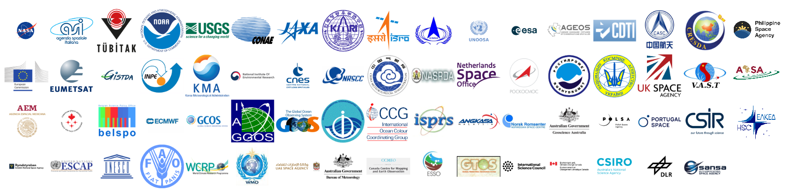
Who is CEOS?
35 Members
  Space Agencies
32 Associates
  UN Agencies, Phase A programmes or supporting ground facility programmes
Mission: CEOS ensures international coordination of civil space-based Earth observation programs and promotes exchange of data to optimize societal benefit and inform decision making for securing a prosperous and sustainable future for humankind.
Notes:
The Committee on Earth Observation Satellites (CEOS) was established in September 1984 to coordinate international civil space-based Earth observation efforts. It currently consists of 35 member space agencies and 32 associate organizations.
There are 5 Working Groups that address long-term, cross-cutting technical areas. These are:
Calibration and Validation (WGCV)
Capacity Building and Data Democracy (WGCapD)
Climate (WGClimate)
Disasters (WGDisasters)
Information Systems and Services (WGISS)
In addition, there are Virtual Constellations that coordinate space-based, ground-based, and data delivery systems within specific domains to meet common requirements, and one of these, the Land Surface Imaging virtual constellation, initiated the ARD activity

Slide 4
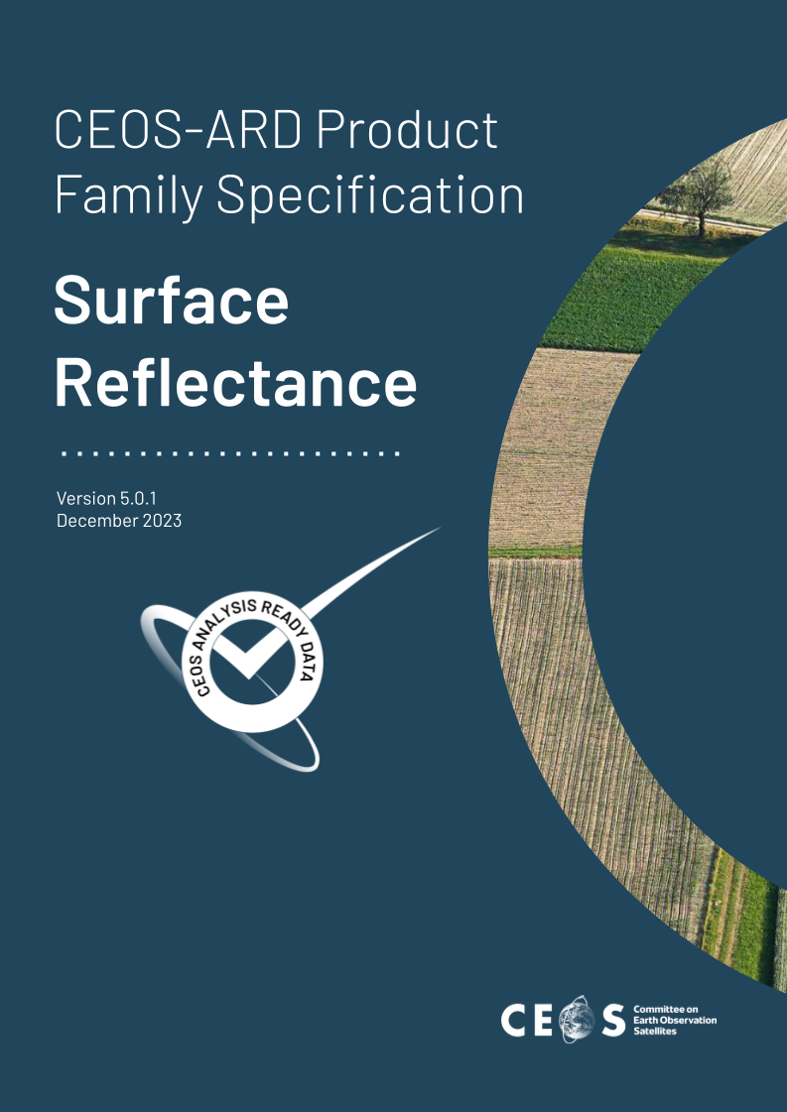



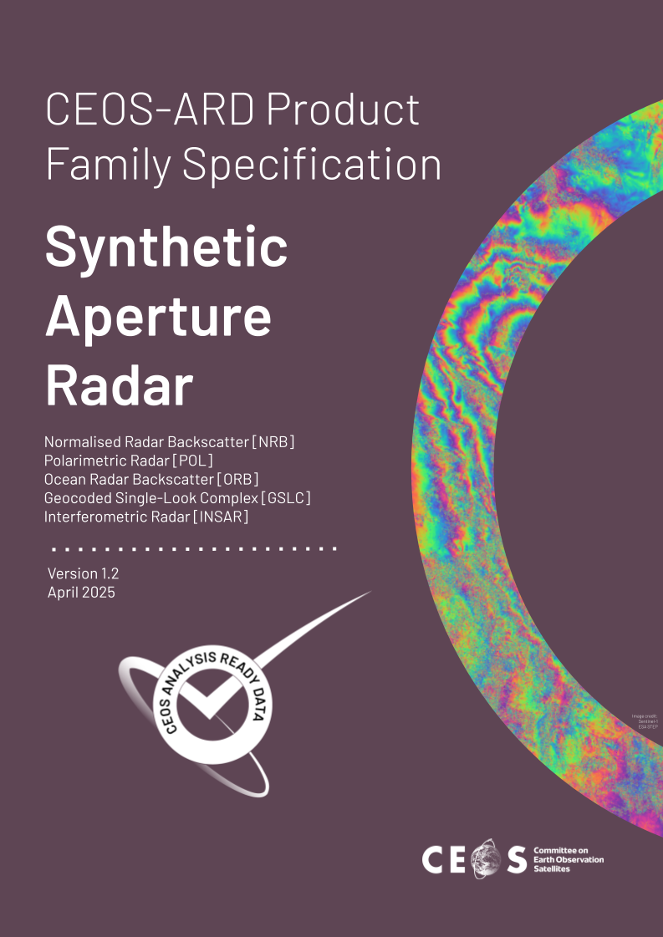
Since 2016, CEOS has developed nine CEOS-ARD Product Family Specifications (PFS)
* Combined SAR PFS includes: Normalised Radar Backscatter, Polarimetric Radar, Ocean Radar Backscatter, Geocoded Single-Look Complex, Interferometric Radar
Notes:
CEOS Analysis Ready Data (ARD) Product Family Specification (PFS) documents are developed through a collaborative, thematic process led by the CEOS Virtual Constellations (VCs).
The development follows a structured governance framework that ensures technical rigour and community consensus.
Because PFS are thematic (e.g., Optical, SAR, Atmospheric), they are proposed and developed within the relevant VC, such as the Land Surface Imaging Virtual Constellation (LSI-VC), which developed the first PFS on Surface Reflectance
The process is open and often includes external experts, commercial data providers, and end users to ensure the specifications meet real-world needs.
To ensure consistency across different product types, authors use a shared PFS template that defines core requirement categories like General Metadata, Per-Pixel Metadata, and Radiometric/Geometric Corrections.
There are two levels of specifications: Threshold: The minimum requirements a dataset must meet to be considered CEOS ARD; and Goal: A higher level of specification that encourages increased quality and interoperability.
Drafts undergo multiple rounds of internal and external review. For example, the Working Group on Calibration and Validation (WGCV) provides essential technical expertise on accuracy requirements.
Existing PFS documents are not static; the LSI-VC maintains an annual review cycle to incorporate feedback from data providers and the broader community.

Slide 5
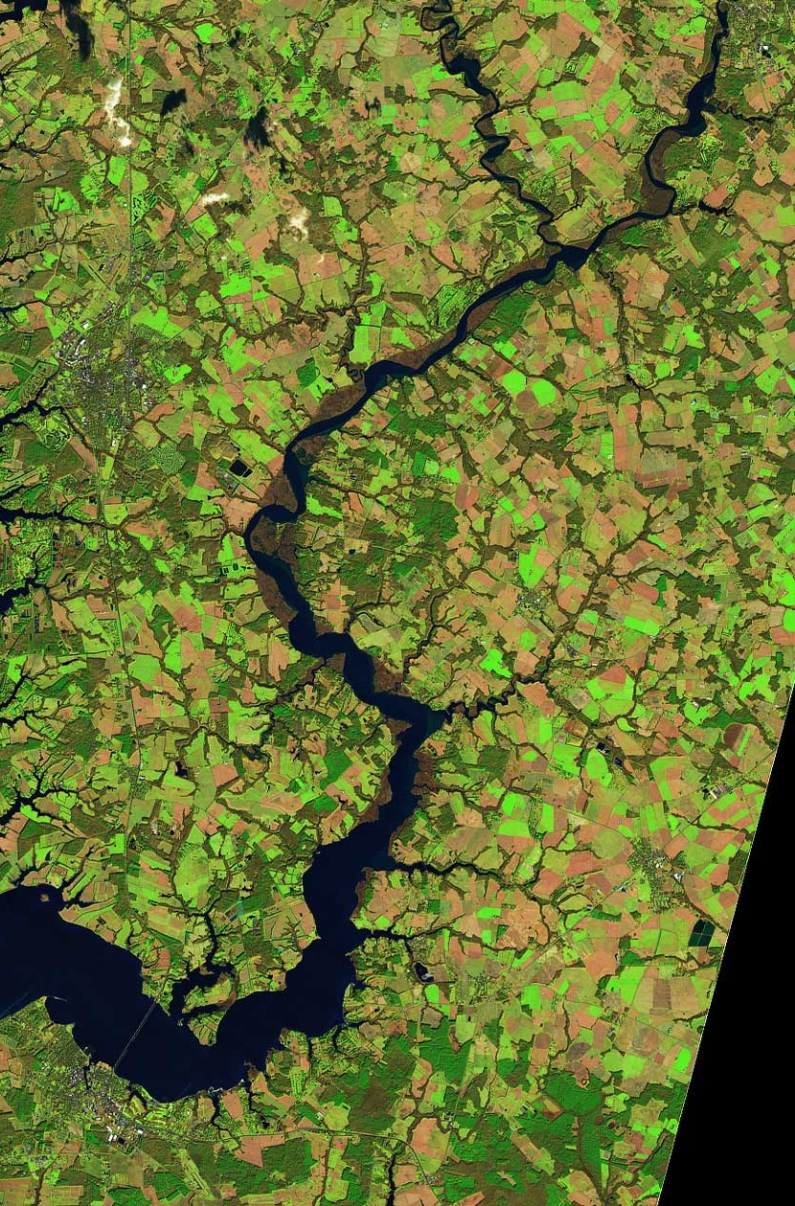

CEOS-ARD Background
CEOS Analysis Ready Data (CEOS-ARD) has caused a significant and positive paradigm shift in the Earth observation community:
Making data more transparent and easy to use
Basis for improved interoperability
Critical benchmark for non-CEOS data providers
Encouraged a more thoughtful approach to data provision
Ensuring non-experts can benefit alongside the scientific community
Democratising EO data
Notes:
CEOS Analysis Ready Data (CEOS-ARD) has caused a significant and positive paradigm shift in the Earth observation community by making EO data more transparent and easier to use by non-experts. Moreover, commercial data providers have significantly benefited from involvement with the CEOS Analysis Ready Data (ARD) framework by gaining market differentiation, technical interoperability, and easier access to government procurement. By adhering to CEOS ARD Product Family Specifications (PFS), commercial entities can signal to the global community that their data meets rigorous scientific standards, reducing the "perception barrier" that often surrounds commercial imagery compared to trusted public missions.

Slide 6



Impact
For our Global Mangrove Watch (GMW) data workflow where we process thousands of images, the CEOS-ARD standard used for the JERS-1/ALOS/ALOS-2 SAR data from JAXA has simplified our processing chains with data now provided as GeoTIFFs and with standardised metadata. The specified pre-processing, including geometric rectification and radiometric terrain correction, has also been a significant help and reduced our internal data processing effort.
Dr Pete Bunting, Global Mangrove Watch Product Lead, Aberystwyth University, UK
By adopting CEOS Analysis Ready Data (CEOS-ARD) specifications, Digital Earth Africa is ensuring that satellite data is available, findable, accessible, and suitable for use by as many users as possible. Using CEOS-ARD, DE Africa is providing a rich source of information to better understand and address challenges of sustainable development in Africa. This information tells a story over time to support decision-making by governments, private sector and civil society.
Dr Adam Lewis PSM, Senior Advisor on the Global Team for Digital Earth Africa
Landsat Collection 2’s compliance with CEOS-ARD standards has been a game changer for the global Earth observation community. Users gain faster, more dependable insights for diverse applications from land cover change and agricultural monitoring to natural resource management and disaster response. CEOS-ARD compliance has truly unlocked the analytical power of the 50+ year Landsat archive, significantly enhancing USGS's contribution to our understanding and stewardship of the planet.
Dr. Christopher Barnes (KBR), Sustainable Land Imaging Partnerships, USGS EROS Center, USA
Notes:
Here are three testimonials describing the impact that adherence to CEOS ARD specifications has had. You can read these in the presentation slides linked in the program.
https://earthdaily.com/blog/earthdaily-achieves-ceos-analysis-ready-data-ceos-ard-compliance

Slide 7
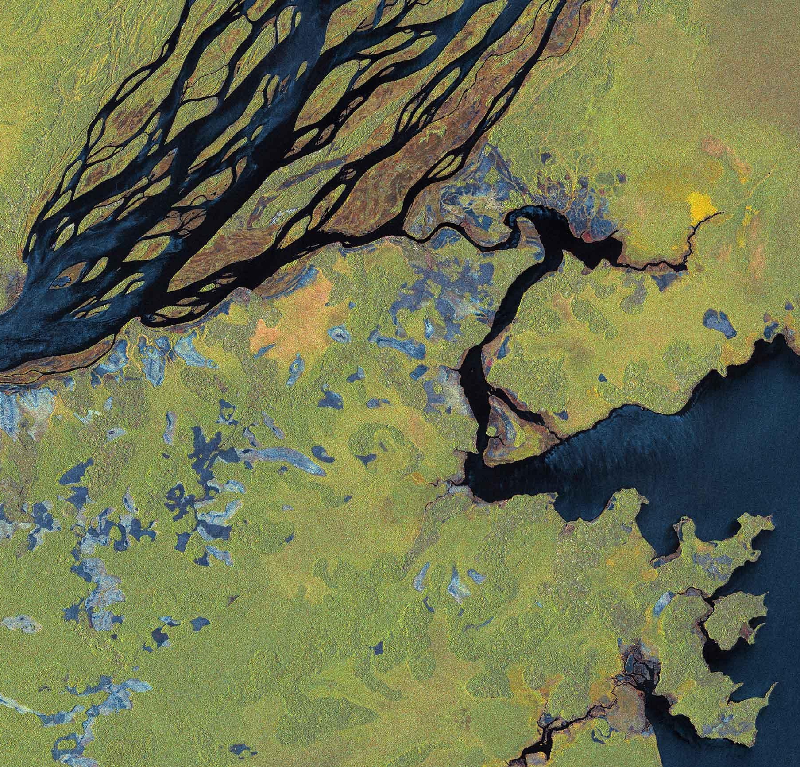

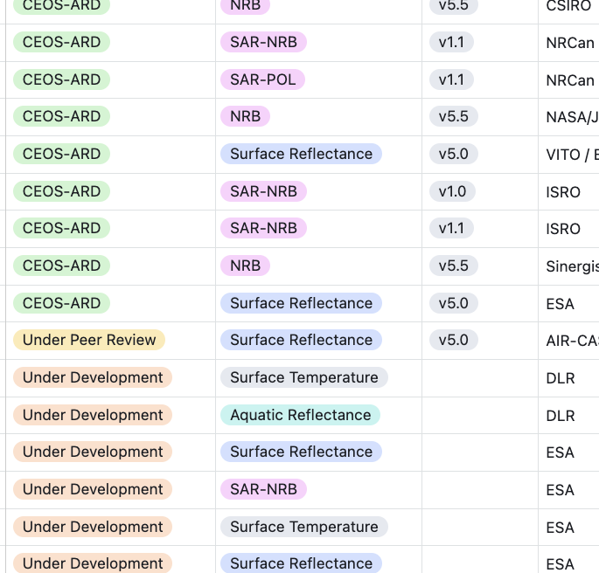
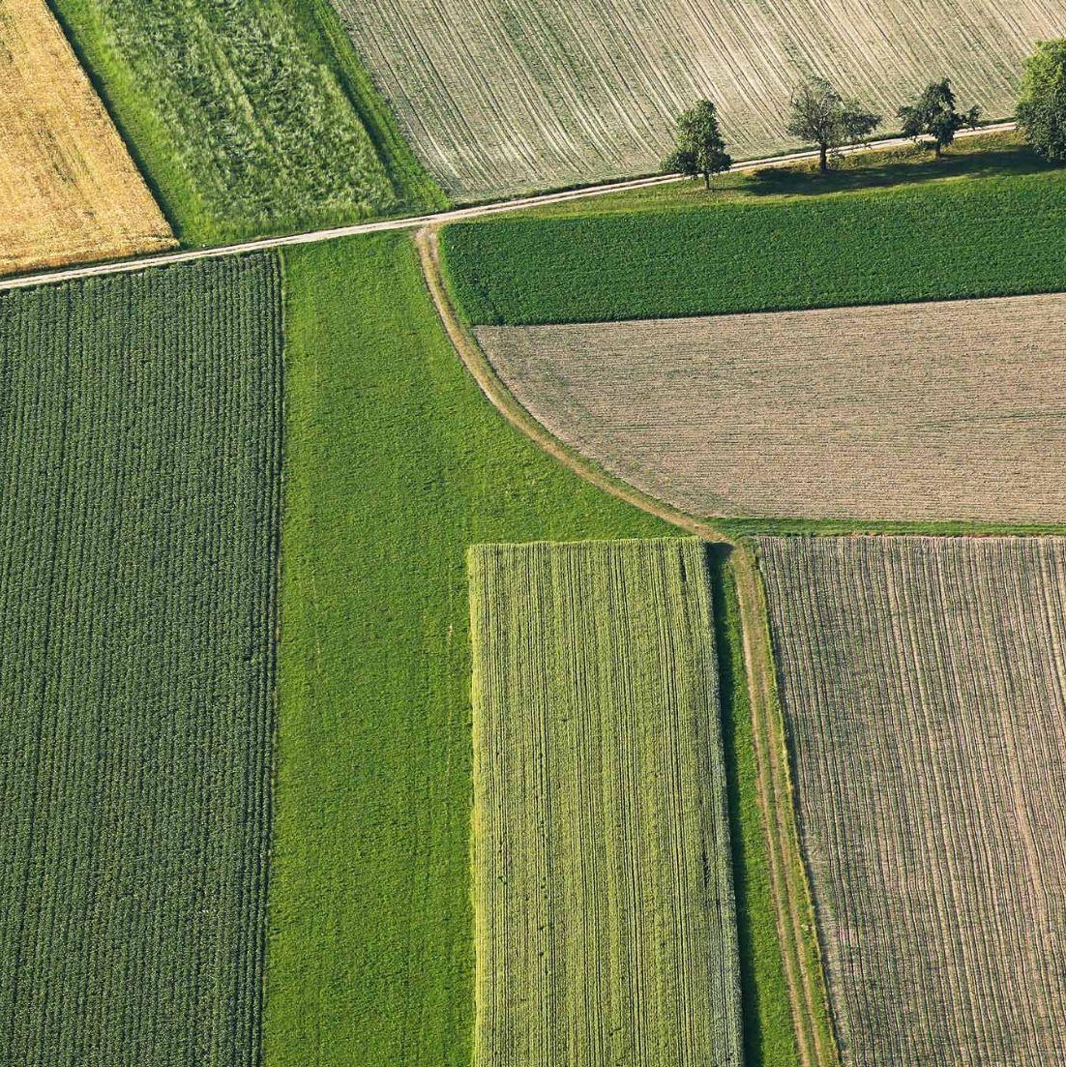
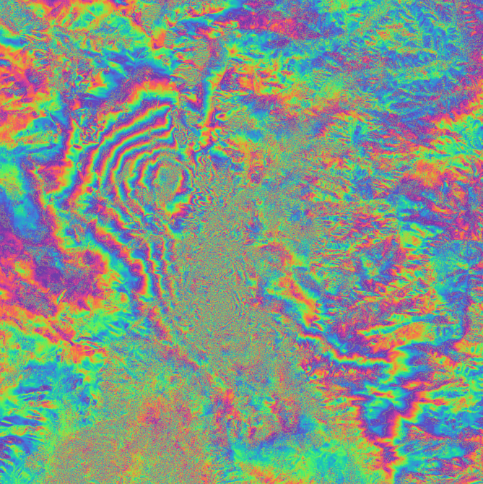
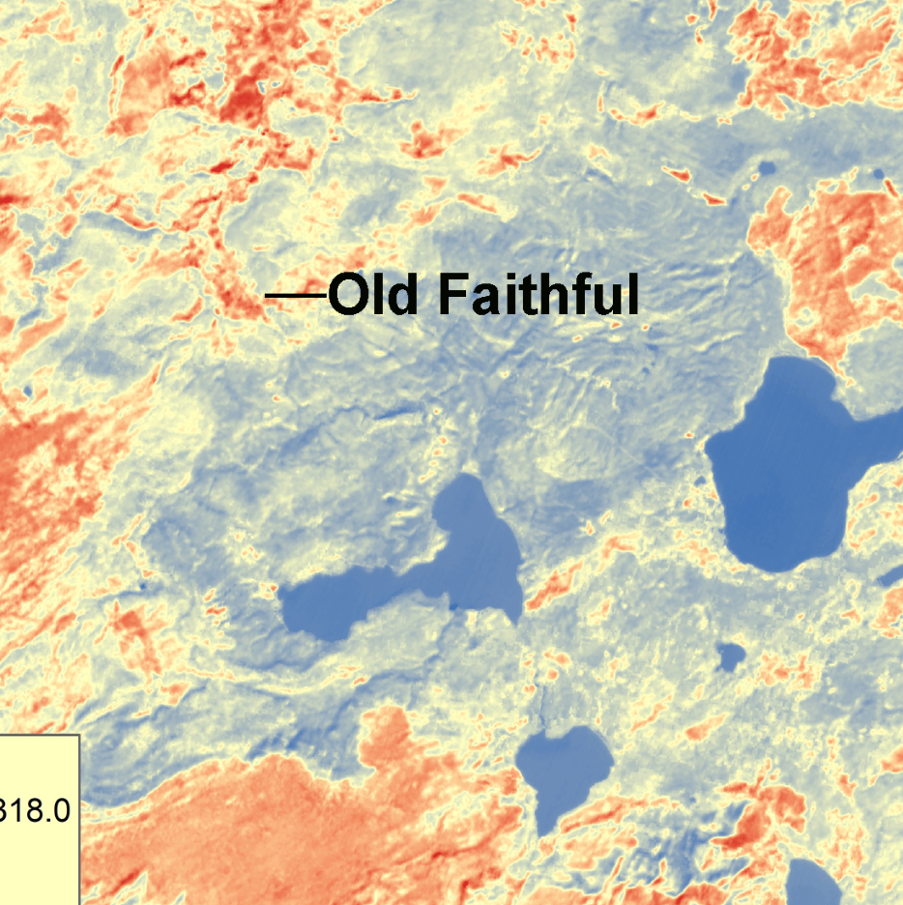


Where are we now?
CEOS-ARD Specifications have been powerful catalysts for progress:
USGS Landsat Collection 2
Copernicus Sentinel-2 Collection 1
ALOS-2 PALSAR-2 ScanSAR NRB and Global Mosaics
DLR EnMAP
ISRO RISAT-1A
And many more… See all datasets on ceos.org/ard
CEOS-ARD Product Family Specifications
Synthetic Aperture Radar
Normalised Radar Backscatter, Polarimetric Radar, Ocean Radar Backscatter, Geocoded Single-Look Complex, Interferometric Radar
Surface Reflectance
Nighttime Lights Surface Radiance
Surface Temperature
Aquatic Reflectance
Notes:
You can view all the datasets that have achieved ARD compliance at the ceos.ard website

Slide 8
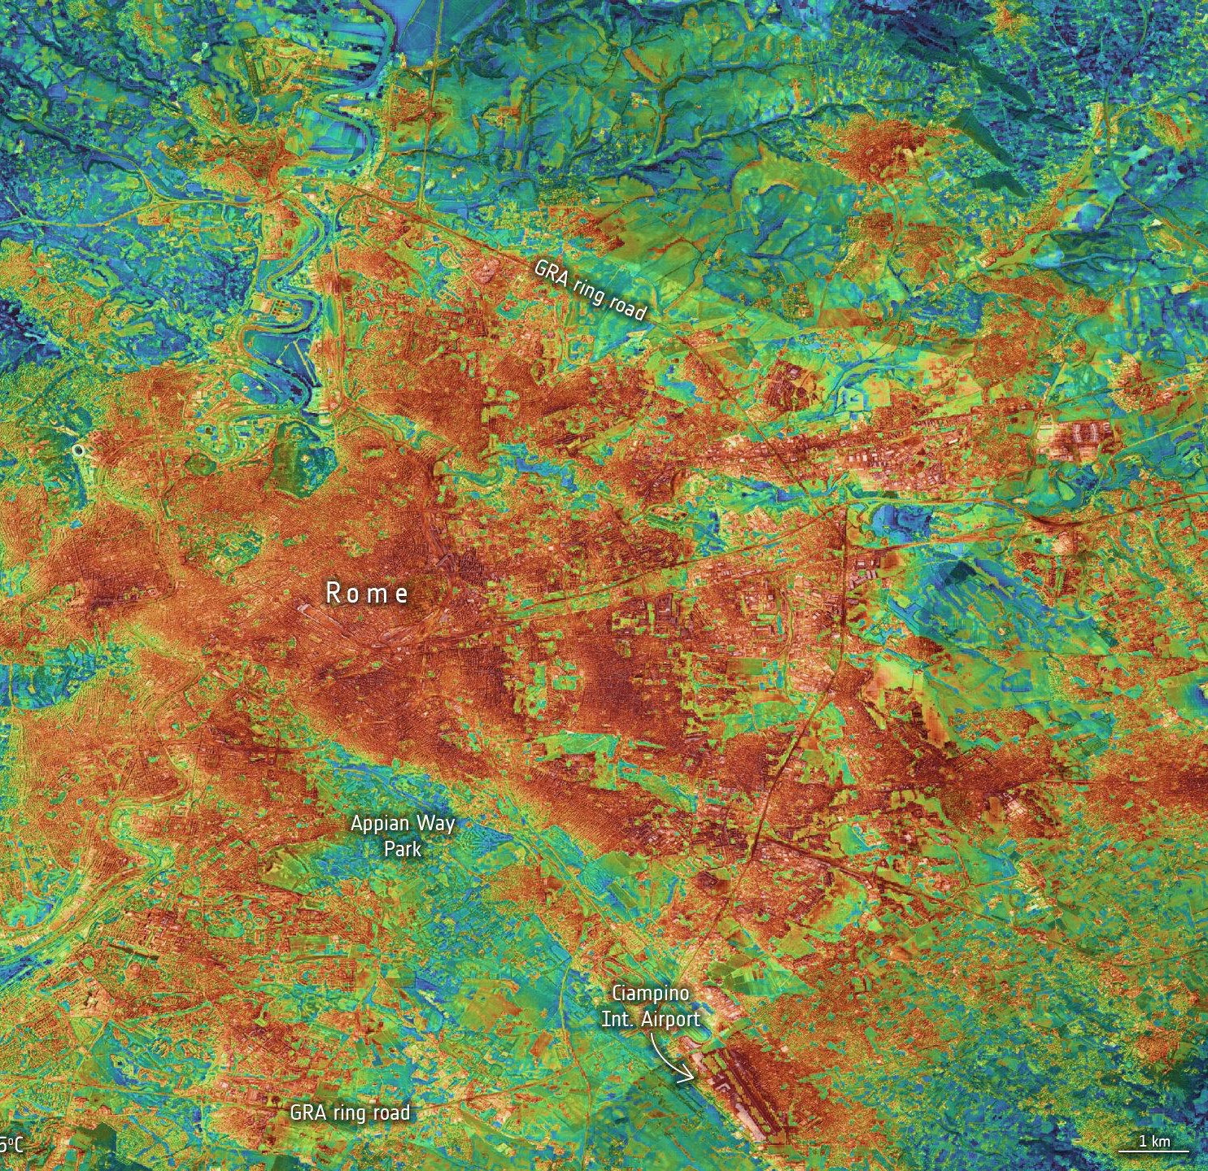

History of the Surface Temperature PFS
The ST PFS was initiated in 2017, led by Geoscience Australia
Feedback was provided by the US Landsat community, ESA, UK (D. Ghent), and others
Surface Brightness Temperature (SBT) was removed from the PFS, as it was concluded there was no clear user base at the time
Land Surface Temperature (LST) became the minimum requirement (threshold)
The current Version 5.0 (2020) incorporated feedback from ESA and USGS self-assessments plus minor edits
Notes:
The surface temperature PFS was one of the first 2 PFSs developed. The "Zero Draft" was created in March 2017, drawing heavily on technical materials from Geoscience Australia and the USGS. It went through multiple rounds of peer review by international experts to define what metadata and atmospheric corrections were necessary for temperature data to be considered "science-ready."
A critical evolution occurred in early 2019 when the community decided to retain only Surface Temperature as the minimum "Threshold" requirement. References to Surface Brightness Temperature (SBT) were removed to ensure users received a product that was fully corrected for atmospheric and emissivity effects, rather than raw sensor measurements.
The current version of the PFS requires rigorous correction for water vapor and ozone, as well as documentation on providers treatment of land surface emissivity, accounting for different land cover types

Slide 9
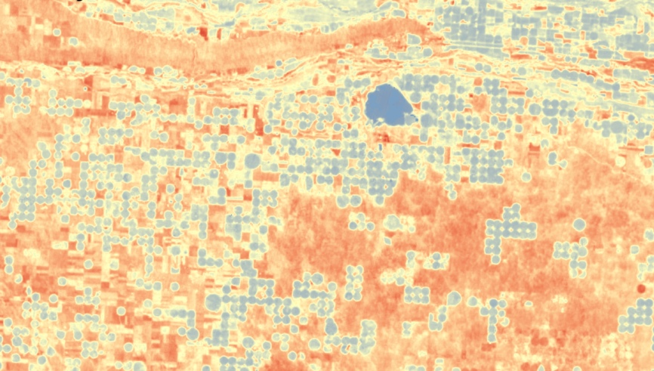
Surface Temperature Datasets
Compliant w/ Version 5
Landsat Collection 2 U.S. ARD
Landsat 8 ST (AIR-CAS)
Constellr LSTprecision
Under Development
DLR AVHRR LST
ERS ATSR
SatVu HotSat
Ororatech
Future
LSTM L2A ST
LSTM L2H/L2F ST
Others?
Notes:
Listed here are the ST datasets that are compliant with the current version, as well as those undergoing development. What is important to note here is that the participation of commercial providers. Constellr has achieved certification and In the “under development” box are SatVu and Ororatech. While SatVu focuses on high-resolution urban heat and industrial monitoring, and OroraTech on wildfire intelligence, both are moving toward a standard where their data is a "geophysical measurement" rather than just a thermal image.

Slide 10
Why update the ST PFS?
Key driver: Recognise and accommodate the evolving user base, technology, and applications of space-based infrared observations from public and commercial sector missions.
An updated PFS will:
Facilitate analysis-ready products that providers (inc. commercial sector) can realistically develop and that users actually want
Better support for MWIR products (through SBT requirements)
Address requirements for higher level products (e.g. ECV stability, Wildfire monitoring)
Better align with the more recently updated optical CEOS-ARD PFS
Notes:
A Key driver for the update to the surface temperature PFS is the need to accommodate the evolving user base, technology, and applications of space-based infrared observations from both the public and commercial sector missions. The updated PFS is being designed to facilitate ARD products that providers, including the commercial sector, can realistically develop and that users actually want. We also want to support for MWIR products (through including SBT requirements). We also intend to address requirements for higher level products (e.g. stability requirements for essential climate variables, and requirements appropriate for wildfire monitoring). We are also attempting to align the PFS with the recently updated optical CEOS-ARD PFS

Slide 11
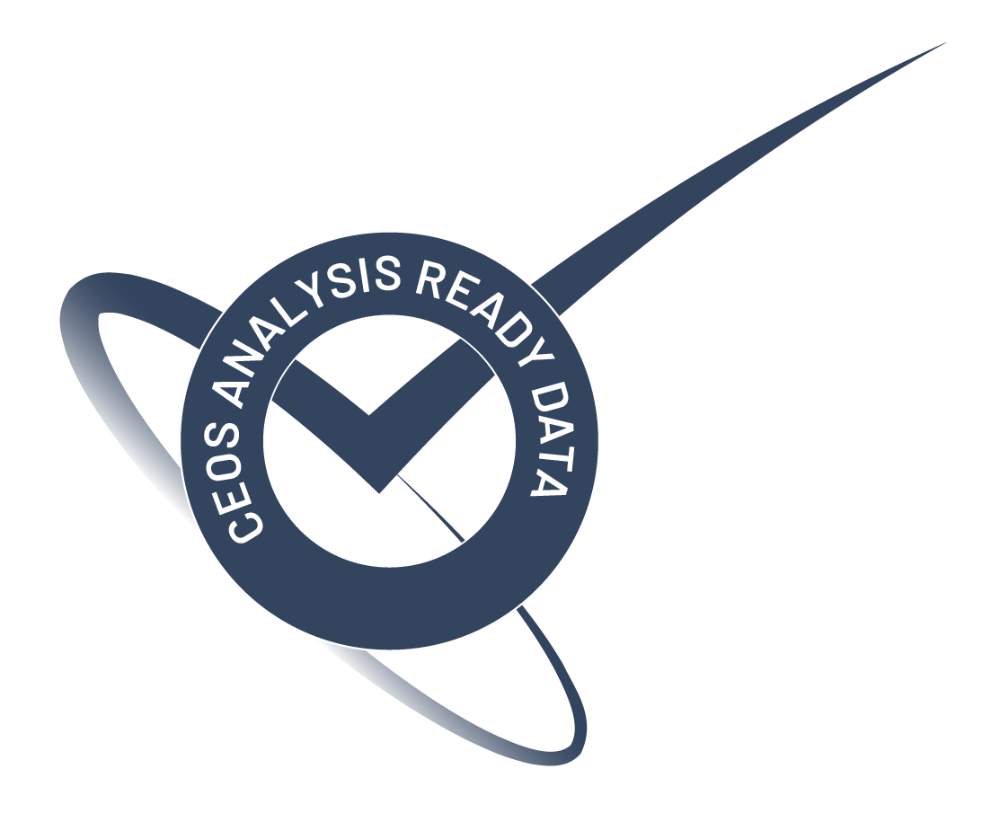


















Initiative
In September 2025, a working group was formed to explore updates to the ST PFS
Active participation from CEOS Agencies and the commercial sector
Meeting online every 2-3 weeks
Additional participation is encouraged
Notes:
This initiative began in September 2025 with active participation for CEOS agencies and associates as well as the commercial sector. We have been meeting online every 2-3 weeks.

Slide 12
Revised PFS Scope (draft)
“Data collected with satellite sensors operating in the thermal infrared (TIR and MWIR) and microwave wavelengths. These typically operate with ground sample distance and resolution on the order 1 dm - 50 km, however the specification is not inherently limited to these resolutions.
Remotely sensed surface temperature measurements tend to be provided as surface brightness temperature (SBT), land surface temperature (LST), water surface temperature (WST), or ice surface temperature (IST), where LST, WST, and IST are derived from SBT accounting for the emissivity of the target.”
Notes:
The proposed updated scope for the PFS refers to data collected with satellite sensors operating in the thermal infrared (TIR and MWIR) and microwave wavelengths, with ground sample distance and resolution on the order 1 dm - 50 km, with measurements provided as surface brightness temperature (SBT), land surface temperature (LST), water surface temperature (WST), or ice surface temperature (IST), where these are derived from SBT accounting for the emissivity of the target.

Slide 13
Metadata Requirements
1. General Metadata
1.1 Traceability
1.2 Metadata Machine Readability
1.3 Data Collection Time
1.4 Geographical Area
1.5 Coordinate Reference System
1.6 Map Projection
1.7 Geometric Correction Methods
1.8 Geometric Accuracy of the Data
1.9 Instrument
1.10 Spectral Bands
1.11 Sensor Calibration
1.12 Radiometric Accuracy
1.13 Algorithms
1.14 Auxiliary Data
1.15 Processing Chain Provenance
1.16 Data Access
1.17 Overall Data Quality
Allows the user to assess the overall suitability of the dataset
2. Per-Pixel Metadata
2.1 No Data
2.2 Incomplete Testing
2.3 Saturation
2.4 Cloud
2.5 Cloud Shadow
2.6 Snow/Ice Mask
2.7 Solar and Viewing Geometry
Allows the user to discriminate between observations on the basis of their individual suitability for application. Includes ‘quality flags’.
3. Radiometric and Atmospheric Corrections
3.1 Measurement
3.2 Corrections for Atmosphere
3.3 Adjustments for Emissivity
3.4 Measurement Uncertainty
Corrections leading to a valid measurement of surface temperature.
4. Geometric Corrections
4.1 Geometric Correction
Corrections placing the measurement accurately on the surface of the Earth.
Notes:
This is a listing of the proposed metadata requirements in the revised ST PFS. It inherits some additional requirements from the surface reflectance PFS. Each of these has a threshold and goal level requirement.

Slide 14

Development
CEOS-ARD development is moving to GitHub
  For PFS developers, CEOS-ARD product developers, and CEOS-ARD users
  Enabling traceability, version control and open collaboration
Individual metadata requirements converted to ‘Building blocks’ in GitHub
Dedicated tooling for PFS editing, self-assessment and review
Issue tracker for open discussion
github.com/ceos-org/ceos-ard
Notes:
The development of the CEOS-ARD specifications and the process for performing self-assessments and review is being hosted on github. This will allow for better version control and open collaboration. Individual metadata requirements become building blocks which are assembled into the PFS documents. There will be tools for editing PFSs and performing self-assessments.

Slide 15
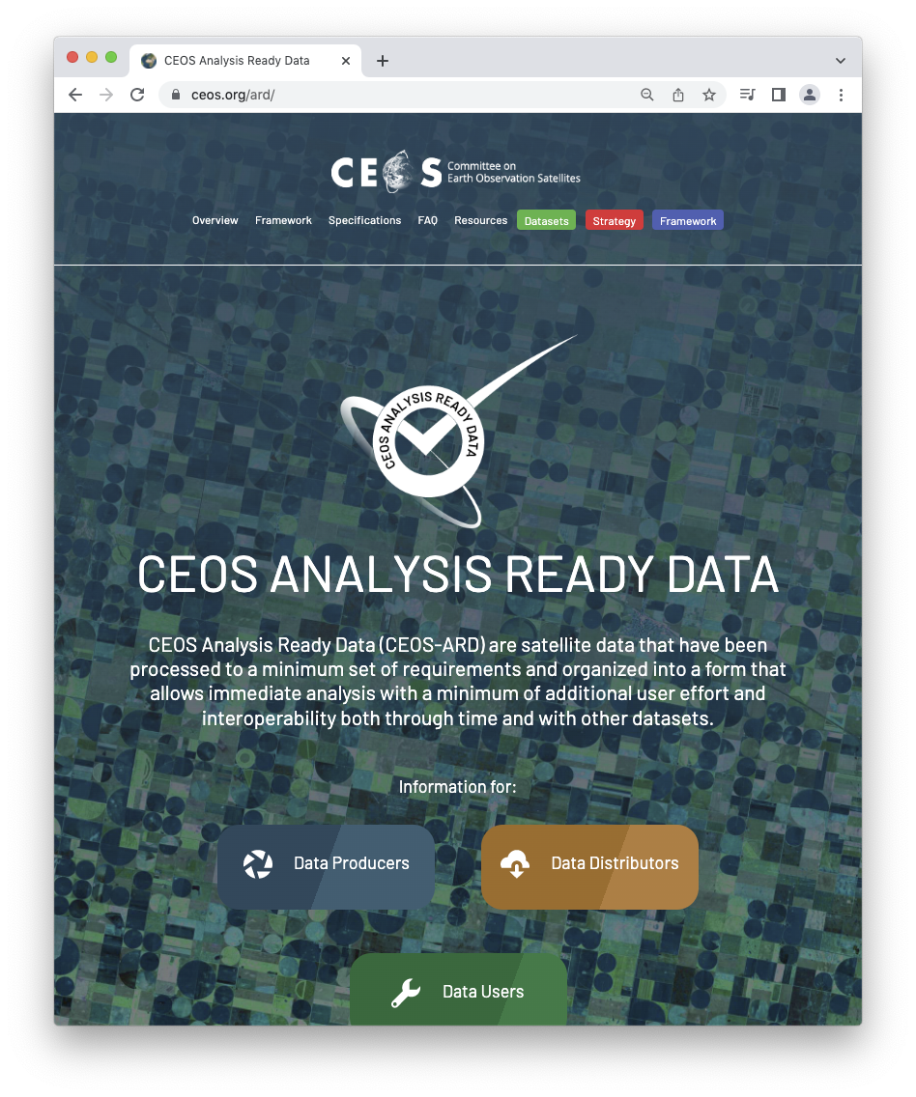
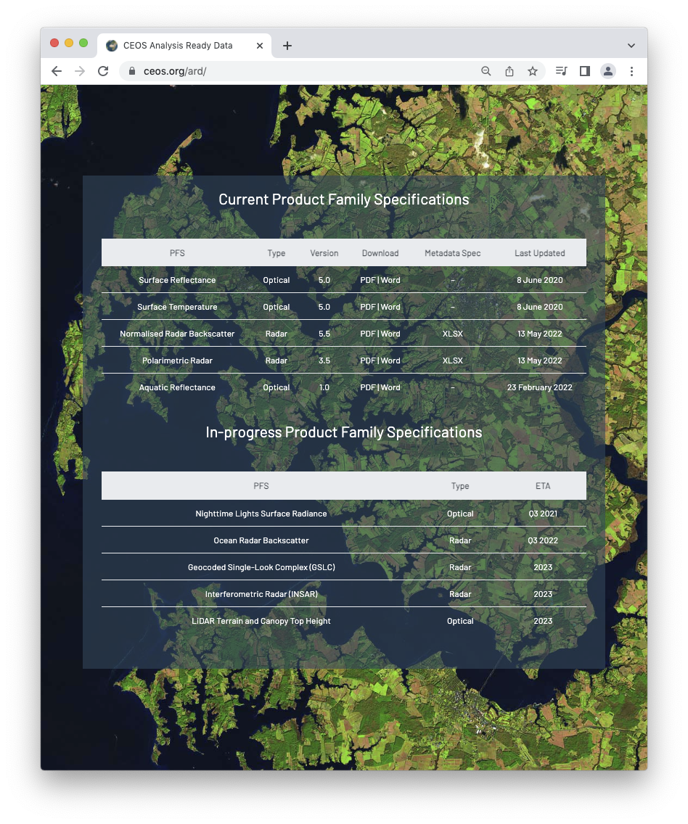
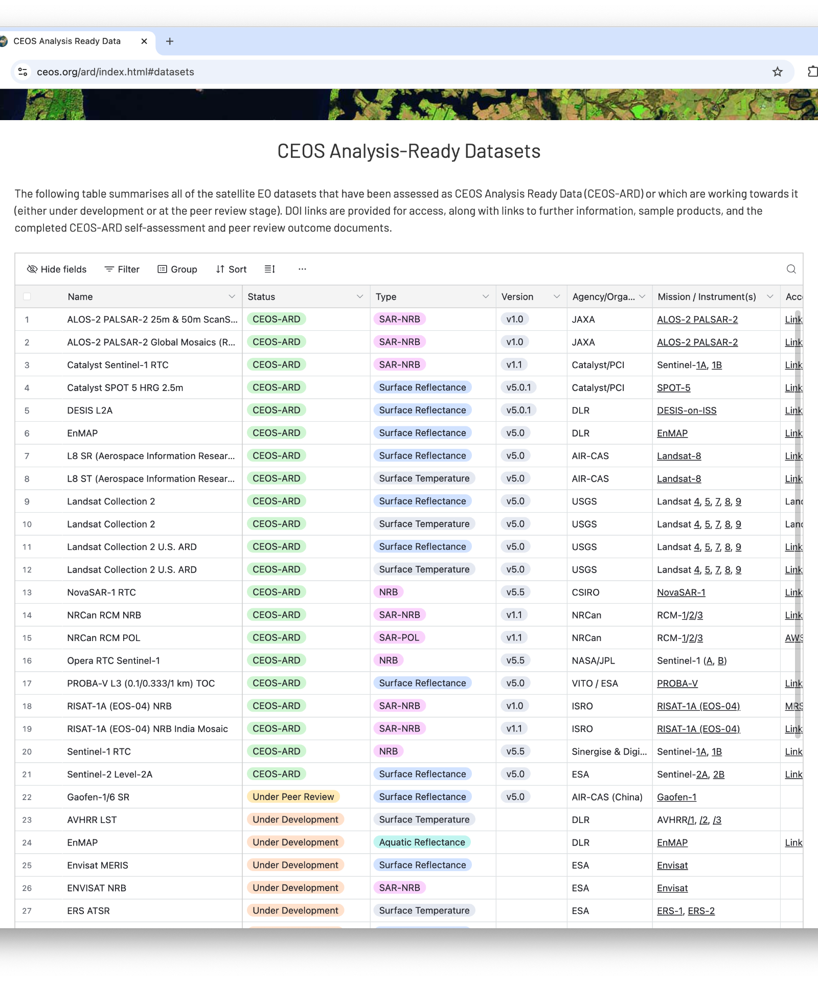
Connect
ceos.org/ard
khalsa@colorado.edu
harvey@symbios.space
Notes:
You are all cordially invited to participate in the development of the CEOS ARD for surface temperature. You can go to this web address to learn more about CEOS ARD, and contact either myself or Harvey Jones, who leads the secretariat for LSI-VC and the WGCV,to sign up

