Slide 1

CEOS-Analysis Ready Data for Land (CARD4L) for SAR
Prospects and Roadmap to Realization
Authors: Hari Priya S, Samvaram Sahu,Usha Sundari HSV, Sita Kumari EVS,Manju Sarma
Presented By : Dr.Ramana MV
National Remote Sensing Centre
Indian Space Research Organization
27/05/2022

Slide 2
Presentation Overview
Introduction to CEOS-ARD
SAR CARD4L Specifications and Compliance
CARD-PFS FOR SAR DATA
NRSC/ISRO-An Overview
In-House ARD Generation for Current SAR missions-NRB and PolSAR
Proposals for Upcoming SAR missions
Futuristic Deep Learning ARD Creation for SAR
Open SAR datasets- For DL Implementation

Slide 3
CEOS-ARD
CEOS Analysis Ready Data for Land (CARD4L) has been proposed to support the objective of simplified EO data handling for the user.
CARD4L for Optical/SAR/LIDAR data are processed to a minimum set of user based requirements .
Data providers to take the responsibility of fundamental data correction and processing tasks, so the users can take up spatial-temporal analysis and research of remote sensing data in a time-bound sense.
Data Organized into a form that allows immediate analysis with minimum effort and time , thus facilitating inter-operability both through time and with other datasets.
This involves data suppliers removing many of the fundamental data correction and processing tasks in order to increase the user-base .

Slide 4
CARD-PFS FOR SAR DATA
The general guidance document for data providers specifies the minimum set of requirements corresponding to geometric and radiometric data corrections, ancillary meta data information and the per pixel meta data corresponding to the image.
CARD4L Product Family Specifications (PFS) for SAR comprises four primary concepts pertaining to SAR, the Normalized Radar Backscatter (NRB), Polarimetric SAR, Geo-coded SLC and SAR Interferometry.
The SAR product is declared to be CARD4L compliant once all the above thresholding requirements are incorporated.
CARD for Ocean and atmospheric studies is also devised.

Slide 5
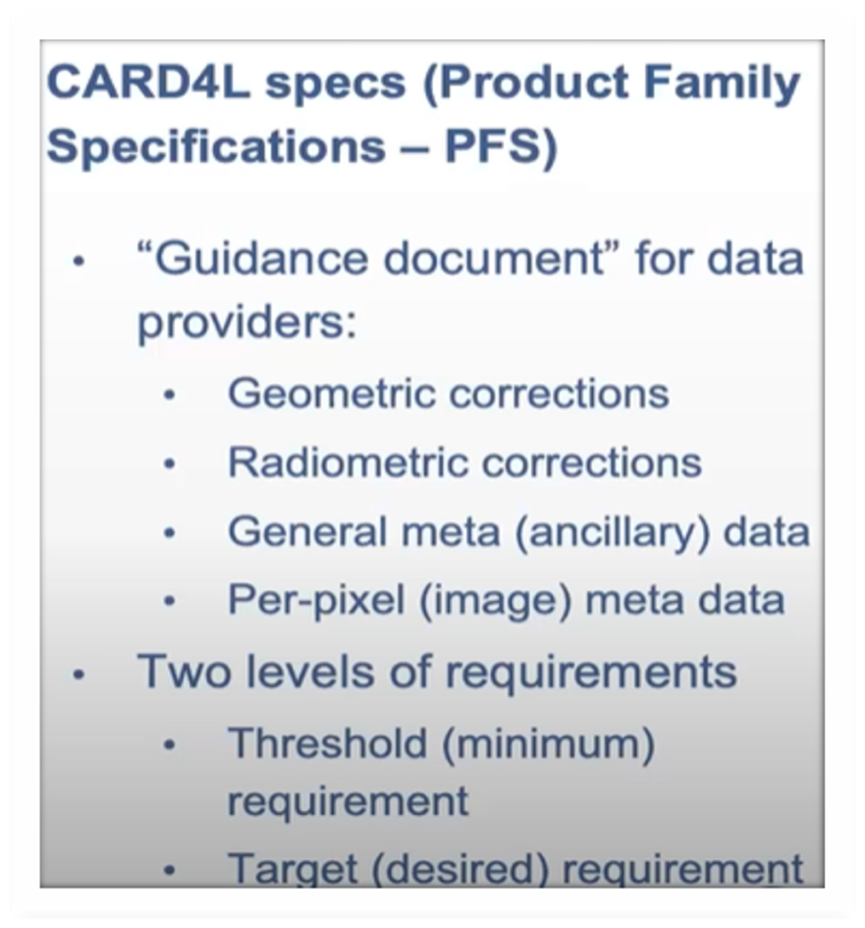
CARD-PFS FOR SAR DATA
CARD4L Specifications Completed and endorsed for :
Normalised Radar BackScatter(NRB)
Polarimetric Radar (POL)
Under Development:
Geocoded SLC
Interferometric SAR
Ocean Radar Backscatter
The Product Family Specifications (PFS) are the devised guidelines to the EO Data providers for catering to the minimum threshold requirements and the desired target requirements.

Slide 6
CARD4L –PFS FOR SAR
POL
Any one Polarimetric Decomposition (As per the discretion of the data provider)
Polarimetric Covariance Matrix
(C-Matrix)
NRB
Radar Measurements
with RTC
Pixel-wise Meta Data
(Incidence Angle map
Layover/Shadow Mask)
General Meta Data
(Can be modified as per the requirements)

Slide 7
NRSC-IMGEOS –An Overview
National Remote Sensing Centre-NRSC is an arm of Indian Space Research Organization –ISRO and is equipped with an Integrated Multi-Mission Ground Segment for Earth Observation Satellites -IMGEOS
IMGEOS is set for acquisition, processing and dissemination of data on a 24x7 basis from Indian and Global remote sensing satellite missions.
The acquired SAR data corresponding to every data dump is pre-processed for extracting the Level-0 raw files which are then processed for generating the higher levels of data.
The processed data is archived and based on the online user requests, they are either re-processed or fetched from the archives for dissemination.

Slide 8

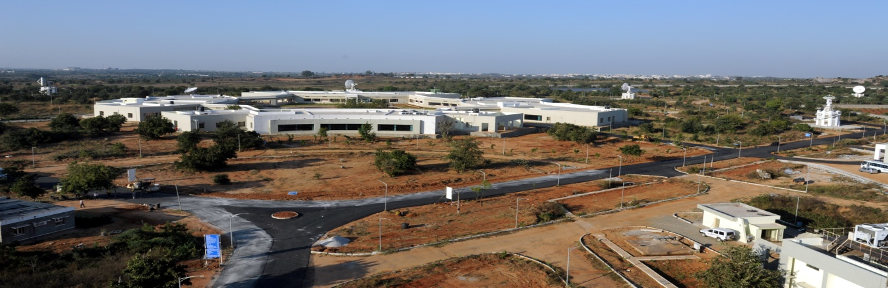

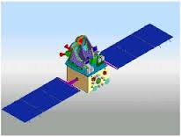

IMGEOS -NRSC

Slide 9
RISAT-1 - Radar Backscatter and Polarimetric Products realization
RISAT-1 is C –Band SAR (5.35 GHz) developed and launched by ISRO in 2012.
The primary imaging modes are Fine Resolution Stripmap (FRS1) at 3m,Medium/Coarse Resolution ScanSAR MRS/CRS with 24 m to 48m ground resolution and High Resolution Spotlight with 1m resolution.
The TX/RX polarizations are Single (HH/VV), Dual (HH+HV/VV+VH) for all modes.
The standard Data provided is Level-2 Enhanced ,which is Terrain Geo-Referenced with per-pixel local incidence angle map (LIA) and the Mask Layers
Using, In-house development, the Sigma Nought Backscatter image data is generated using the LIA and the calibration values along with the image intensity values .

Slide 10
RISAT-1 - Radar Backscatter and Polarimetric Products realization
RISAT-1 Imaging also features a unique Hybrid Polarimetric mode , which has enhanced our remote sensing capability and has opened a new dimension to the scientists over a wide range of applications.. The circular FRS-1 mode is realized in the Circular Transmit Linear Receive -CTLR- polarization configuration wherein, the transmission is Right Circular with linear receive giving rise to RH and RV channels.
The CFRS-1 Single Look Complex data is in CEOS format comprising of the real and imaginary components of the processed signal.
In –house software has been developed for polarimetric processing and derivation of the Stokes vector . Hybrid polarimetric parameters like Degree of Polarization-m, relative phase(delta) , axial ratio(AR),circular polarization ratio(CPR) from the data channels .
These parameters are in turn used to generate the channels corresponding to Surface, Double and Volume Bounce scattering of the target area.
Based on the scattering mechanism, hybrid polarimetric decomposition techniques m-delta and m-chi are implemented and provided for Application based studies.

Slide 11
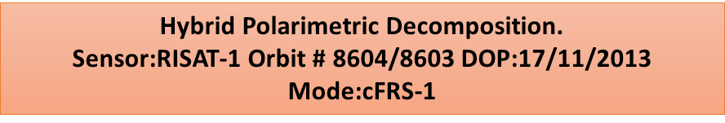
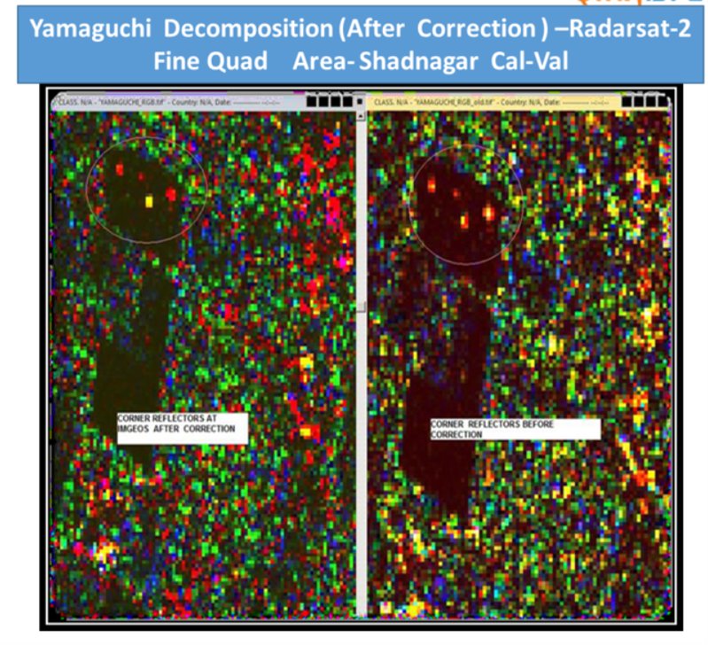
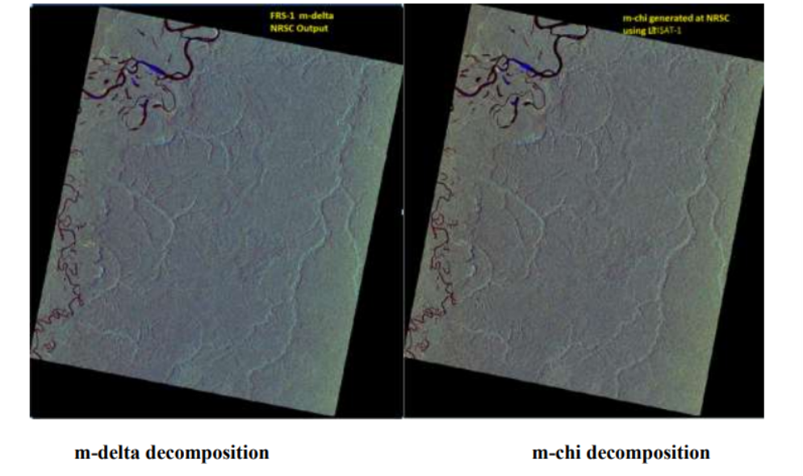
Polarimetric Products –RISAT1 (CP) and Radarsat2(FP)

Slide 12
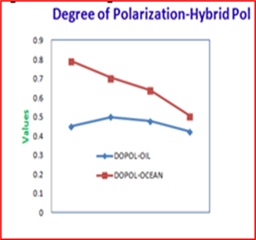
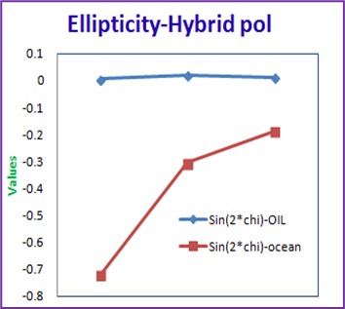
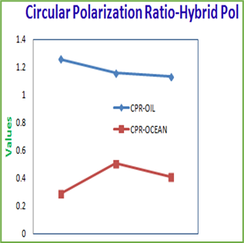
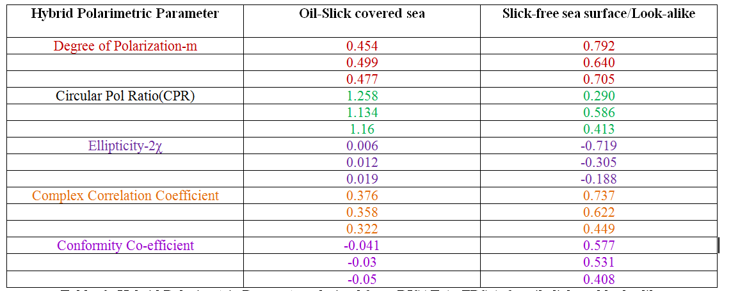
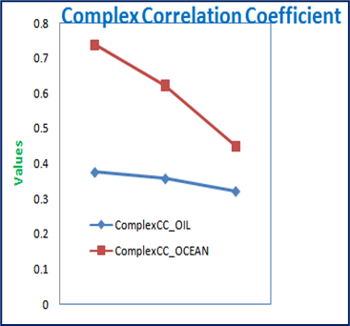
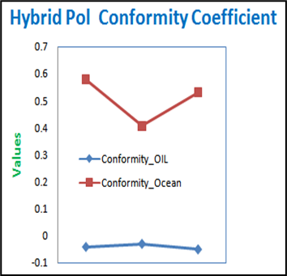
Hybrid Polarimetric Parameters derived from RISAT-1 cFRS-1 for oil-slick and look-alike signatures
RISAT-1 cFRS1 hybrid Pol data with oilslick Date of Imaging: 17-June 2014 Orbit #: 11810/11805 Mode: cFRS-1 Incidence Angle: 49.4 deg

Slide 13
NovaSAR – Data Analysis for CARD realization
NovaSAR (S Band-3.1-3,5GHz) is a joint technology demonstration initiative of SSTL (Surrey Satellite Technology Ltd.), UKSA, and Airbus DS. It was launched by ISRO in 2018.
The primary imaging modes are Stripmap at 6m and ScanSAR with 25 m to 45 m ground resolution. The TX/RX polarizations are Single (HH/VV), Dual (HH+HV/VV+VH) and Tripol (HH,VV,HV) .
The Level-1 NovaSAR products generated by the SSTL IFP (Image Formation Processor) comprise Single Look Complex (SLC) and Ground Range data for Stripmap mode and Mutilook Detected data for ScanSAR mode in various polarization combinations. The Level-1 Products are geocoded and ellipsoid corrected.
Terrain Correction for realising
NovaSAR-GTC Mode:6m-Stripmap
Date of imaging: 4/8/2021;
Scene No.:15
Area: Near Uttar Pradesh, India

Slide 14
NovaSAR Data Analysis for CARD realization
Geometric Accuracy validation is carried out at regular intervals using corner reflectors (Point Targets ) deployed in IMGEOS Cal-Val site .
The implementation methodology for Geometric and Radiometric Corrections is being modified for improving the accuracies.

Slide 15
NovaSAR- Sigma Naught Backscatter Analysis

Slide 16
NovaSAR- Sigma Naught Backscatter
Software is developed for generation of Scene-based Data products based on the Imaging mode and archived as Level-1 Data .
Based on the User Requests, Level-2 Bundled Products are generated in an automated fashion in the IMGEOS data production chain.
Level-2 Bundle Product contains SAR Imagery Files , Backscatter Files for the respective polarizations along with Surface Water Layer Products.

Slide 17
CEOS –ARD Compliance and Challenges
CEOS- ARD compliance :
The Realization of CEOS ARD products are to be implemented in the Automated IMGEOS Chain .
Additional Software Tools are also under development and validation for generating ARD as per User Requirements.
New software Plug-Ins are proposed and devised for the existing In-house Tool for generating CARD using Polarimetric and Interferometric Processing for the future SAR Missions
Challenges: With the provided Satellite Ephemeris and External DEM sources, Geometric and Radiometric Terrain Correction methodologies are implemented for the Sensor Specific SAR data formats.
The Process is revived and modified for obtaining better Geometric and Radiometric accuracies .
The resulting Normalised Radar Backscatter –NRB layers can be provided in the automated chain.
For PolSAR, the CARD4L PFS requirements have been developed and analysed.

Slide 18
Upcoming SAR Missions
EOS04 : The Data Processing is carried out at various levels :
Level-2 Standard Geo-referenced Products
Level-1 Single Look Complex and Ground Range Products
Level1C comprising Covariance Matrix and Stokes component layers
Level3A Comprising Polarimetric Decomposition Channels
NISAR :NASA-ISRO SAR is designed to provide Polarimetric, Interferometric Products which have to be Analysis Ready evaluated for the required quality metrics at various Levels of Processing.

Slide 19
Futuristic Deep Learning ARD Creation for SAR
In the recent times, several Deep Learning Models have been successfully implemented for SAR data. Analysis using Fully Convolutional Neural Networks.
Training of such neural networks also requires densely annotated training data which can serve as ARD for :
Image classification
Scene classification:
Semantic segmentation
Object detection
Registration/matching
Challenges:
The Complex Nature of SAR Data-This means that the entire CNN must be able to handle complex numbers. For the convolution operation this is trivial. The nonlinear activation function and the loss function, however, require thorough consideration.
Depending on whether the activation function acts on the real and imaginary parts of the signal independently, or only on its magnitude, the target classification methods are deployed.
Wide Dynamic Range of SAR data

Slide 20
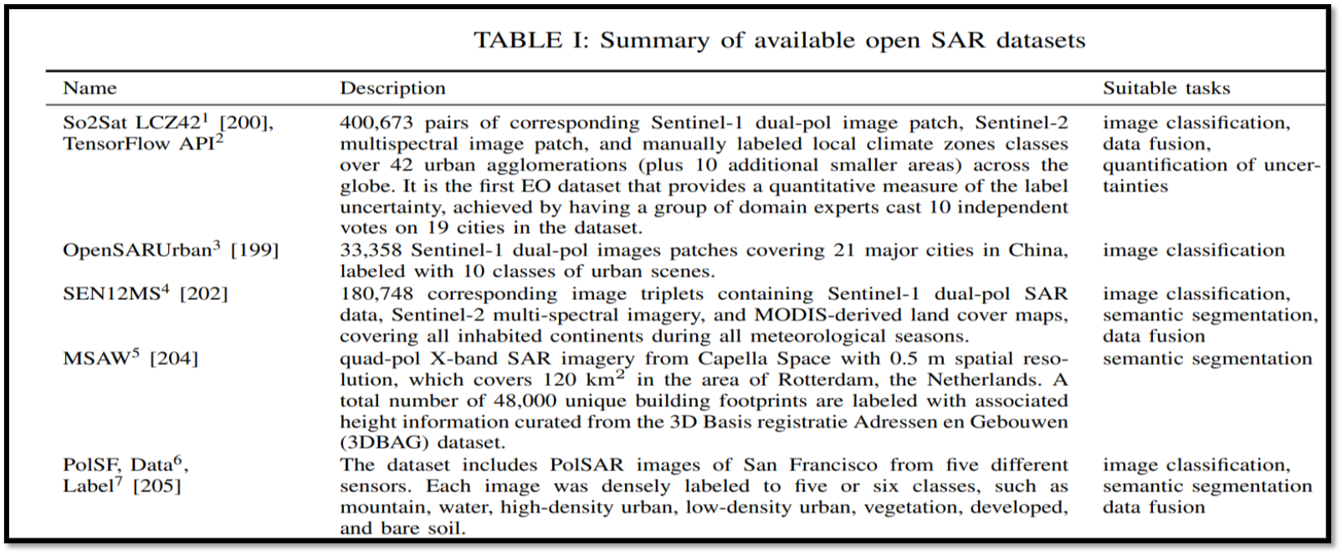
Open SAR datasets- For DL Implementation [8]
Annotated ARD at different frequency bands can be realised for the specific study regions and for the corresponding Land-Use Land Cover / Applications scenario with appropriate product specifications.

Slide 21
References
[1] https://ceos.org/ard/
[2] ISRO NovaSAR Ground Segment ICD- NV K V - #0324588
[3] Scene-based Level-1 and Level-2 Products Generation for NovaSAR-NRSC-DPA-MDPGSAR-DPD-Dec2020-TR-0001740-V1.0
[4] Concept of operations of NovaSAR in IMGEOS-Dec 2019.
[5] Synthetic Aperture Radar –Radiometric Calibration-David Small Erich Meler-Department of Geography-University of Zuich- www.geo.uzh.ch
[6]J.-C. Souyris, P. Imbo, R. Fjrtoft, S. Mingot, and J.-S. Lee, “Compact polarimetry based on symmetry properties of geophysical media:Then π/4 mode,” IEEE Trans. Geosci. Remote Sens., vol. 43, no. 3, pp. 634–646, Mar. 2005.
[7] M. Nord, T. Ainsworth, J.-S. Lee, and N. Stacy, “Comparison of compact polarimetric synthetic aperture radar modes,” IEEE Trans. Geosci. Remote Sens., vol. 47, no. 1, pp. 174–188
[8] Deep Learning Methods for Synthetic Aperture Radar Image Despeckling :An Overview of Trends and Perspectives-Giulia Fracastoro, Enrico Magli et al –arXiv:.05508v2(eess.IV) 2 may 2021

Slide 22

Thank You

