Slide 1
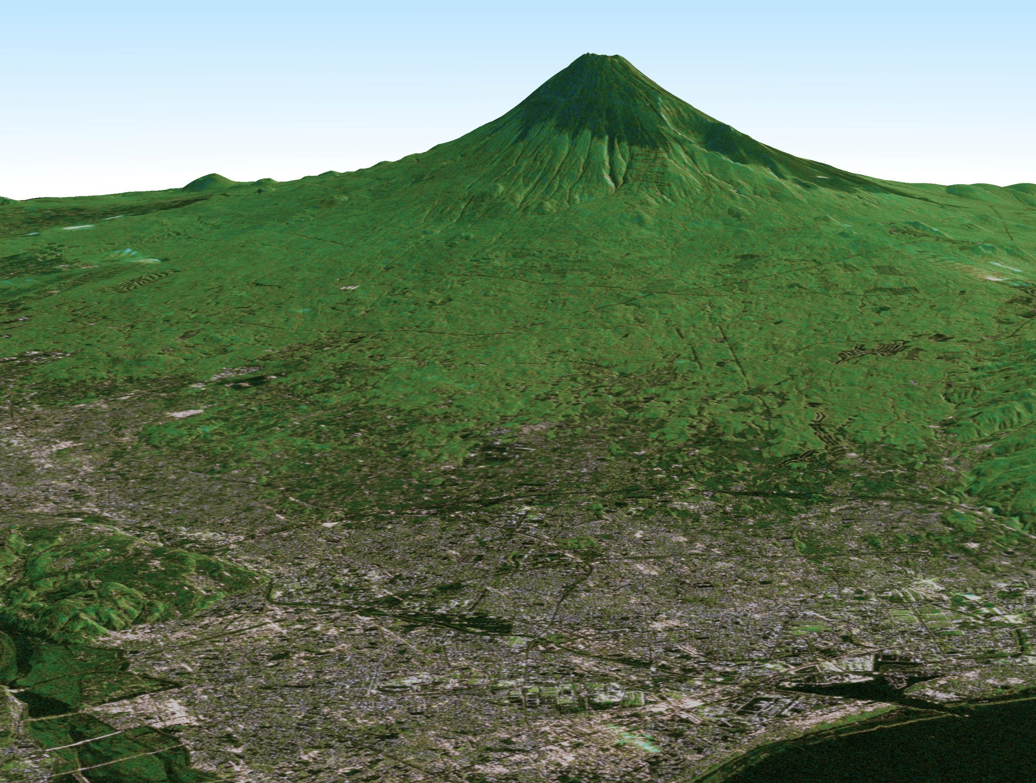
CEOS LSI-VC #6 Meeting, EU JRC, Ispra, Italy
JAXA Analysis Ready Data (ARD) Updates and Assessments
SAR Global Mosaic Datasets
5-7 September, 2018
Takeo Tadono¹ and Ake Rosenqvist²
¹ Earth Observation Research Center (EORC)
Japan Aerospace Exploration Agency (JAXA)
² SoloEO, Japan

Slide 2
Contents
JAXA EO Status
  Open & Free data access schedule updates: ALOS and ALOS-2
JAXA SAR BS Analysis Ready Data (ARD)
  Global mosaic dataset
  Assessment to CARD4L PSF
Summary

Slide 3
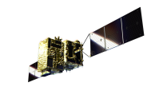
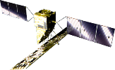
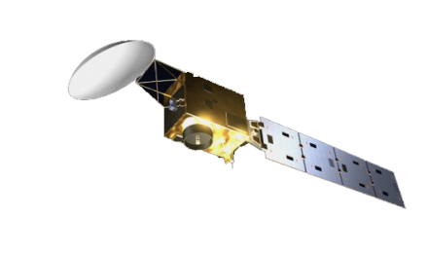
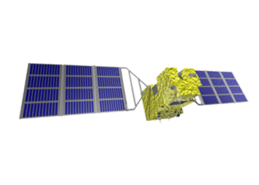
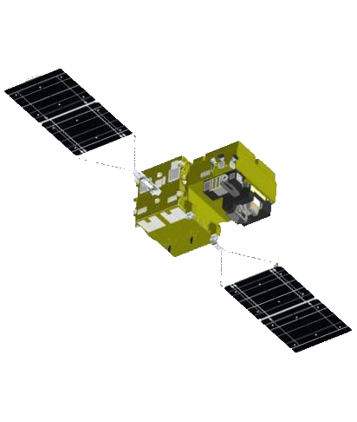
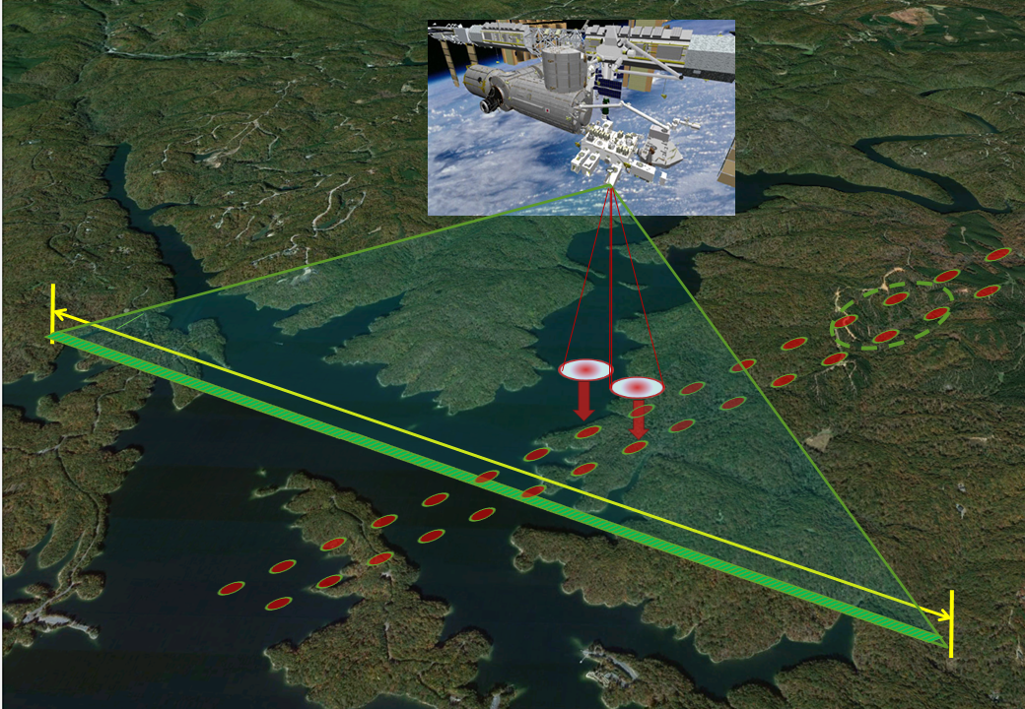

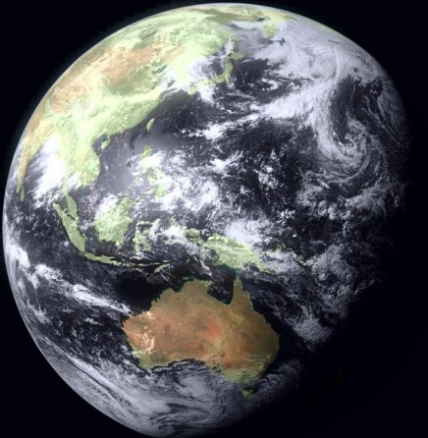
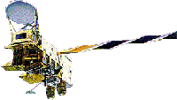

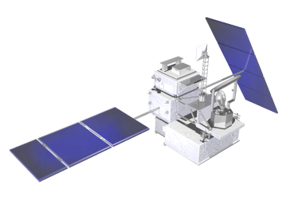

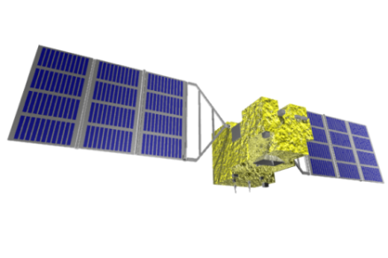
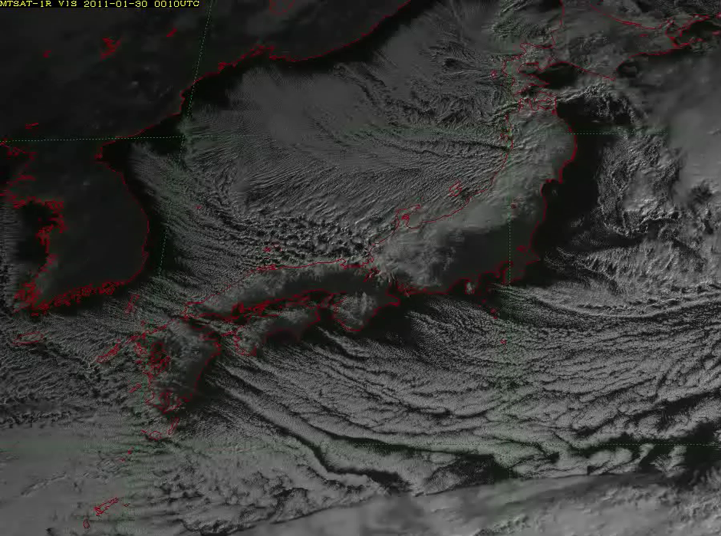
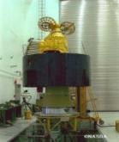
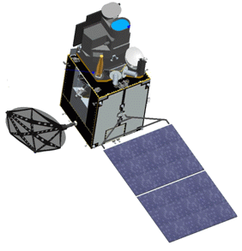
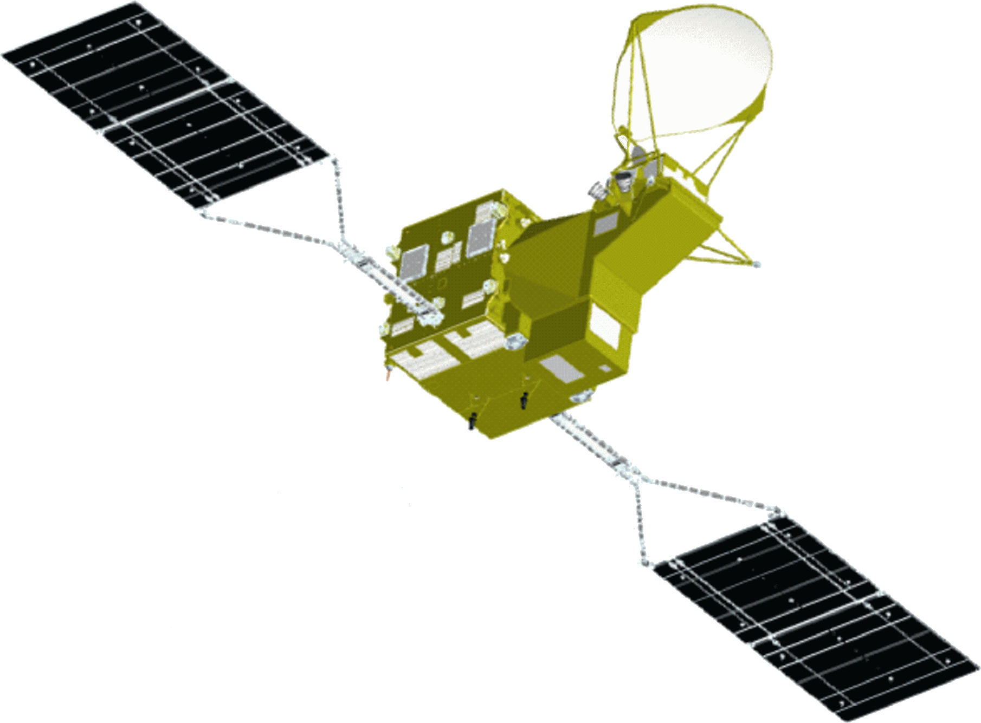
JAXA’s Past, Current and Future Satellite/Sensor Activities
Advanced Optical Satellite (ALOS-3)
Advanced SAR Satellite (ALOS-4)
Earth CARE/CPR
(JFY 2020)
(JFY 2020)
GOSAT-2
(JFY 2019 (TBC))
GCOM-C
(JFY 2018)
(JFY 2017)
Multi-footprint Observation LIDAR and Imager (MOLI)
ALOS-2
(CY 2014)
(JFY 2020, proposed)
GPM/DPR
DAICHI (ALOS)
(CY 2014)
Aqua/AMSR-E
(CY 2006)
(CY 2002)
ADEOS/ADEOS-II
(CY 1996/CY 2002)
JERS-1
TRMM/PR
(CY 1992)
MOS-1/MOS-1b
SHIZUKU
(GCOM-W)
(CY 1997)
(CY 1987/ CY 1990)
(CY 2012)
IBUKI (GOSAT)
(CY 2009)
2
JMA Geostationary
GMS (’77)-GMS-5
(’95) (Himawari-5)
MTSAT-1R, 2 (’05,
’06) (-6,7)
Himawari-8, 9
(’14, ’16)
2
ⒸNASDA

Slide 4
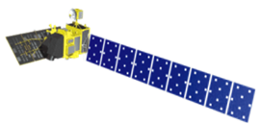

Updated Schedule of ALOS/ALOS-2
Data Processing and Open Free Access
As of August 2018
 |  | 2018 |  |  |  | 2019
 |  | 1Q Jan Mar | 2Q Apr Jun | 3Q Jul Sept | 4Q Oct Dec | 1Q Jan Mar | 2Q Apr Jun | 3Q Jul Sept | 4Q Oct Dec
ALOS | AVNIR-2 (10 m)
 | PALSAR (10 m)
ALOS-2 | ScanSAR (100 m)
 | Fine Mode (10 m)
Japan Area
±60
Degree Area
Global
Data Processing
Under negotiation with METI
Japan Area
±60
Degree Area
Global
Data Processing
Under negotiation with PD
Under negotiation with PD

Slide 5
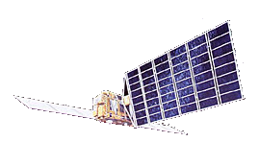
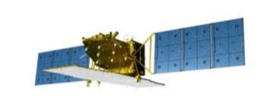
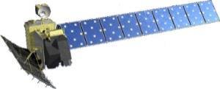
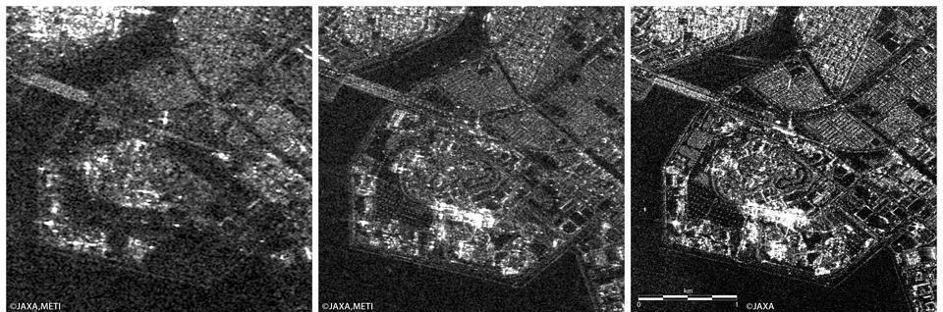
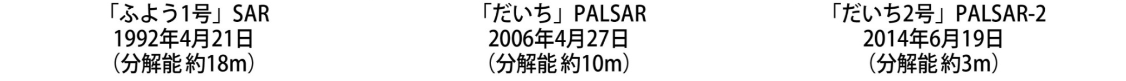
History of Japanese L-band SARs
JERS-1 SAR
1992 - 1998
ALOS PALSAR
2006 - 2011
ALOS-2 PALSAR-2
2014 -
Transmit power:
~1.5 kW
~2 kW
~6.1 kW
Resolution:
18 m
10 m / 100 m
3 m / 100 m
Swath width:
75 km
70 km / 350 km
50 km / 490 km
Polarization:
Single
Single, Dual, Quad
Single, Dual, Quad
Obs. direction:
Right
Right
Right or Left

Slide 6
JAXA SAR BS ARD Production on Global Mosaics
Pre-processing (Multiple path processing):
SLC generation, Ortho-rectification+
Slope correction
Multiple raw data
DEM preparation
Multiple ortho generations
Mosaic (processing)
One examples for generating a mosaic image
Flowchart of producing a mosaic product.

Slide 7
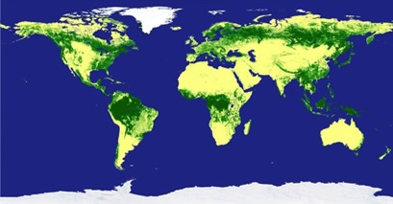
JAXA SAR BS ARD Production on Global Mosaics
Download: SAR BS ARD (analysis ready Data) available from the web site:
http://www.eorc.jaxa.jp/ALOS/en/palsar_fnf/fnf_index.htm
Contents:
  Satellite: JERS-1/SAR (1996), ALOS/PALSAR (2007-2010), and ALOS-2/ PALSAR-2 (2015-2017)
  Frequency: Annual summer data (June-September)
  Data: gamma-zero image and forest/non-forest (FNF), ancillary data (local incidence, mask, etc.), spaced in 0.8 arcsec (approx. 25 m) and averaged in 100 m, ortho-rectified, and slope corrected
  Geometric accuracy: 10 m
  Expression: 2 byte data (unsigned short integer) for amplitude image
  Area: Global Land
  Download unit: 1 x 1 deg. or 5 x 5
  degrees in lat/long unit
Access:
  Free of charge
  E-mail registered

Slide 8
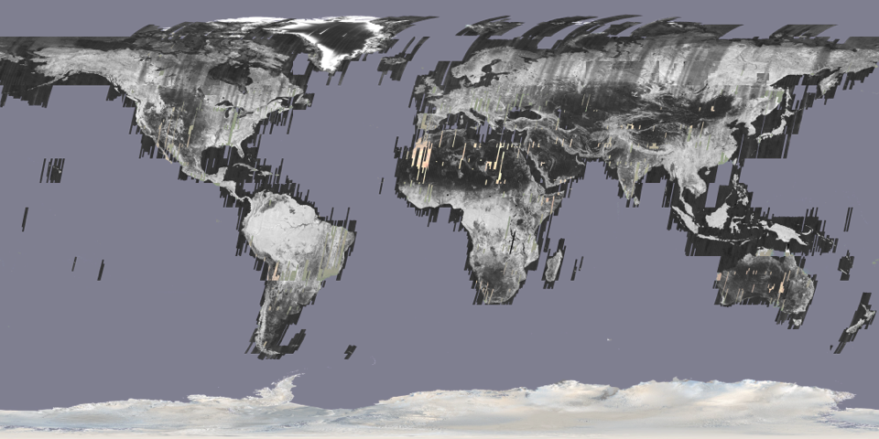
JAXA SAR BS ARD Production on Global Mosaics
JERS-1 25 m pan-tropical, 100 m global mosaic dataset (HH): 1992 - 1998

Slide 9
JAXA SAR BS ARD Production on Global Mosaics
ALOS PALSAR 25 m global mosaic dataset (HH, HV): 2007 - 2010
Global 25 m mosaic (Ortho+slope correction)
Global 25m Forest/non-forest map

Slide 10
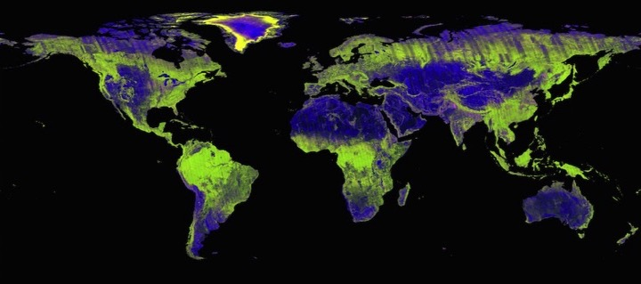
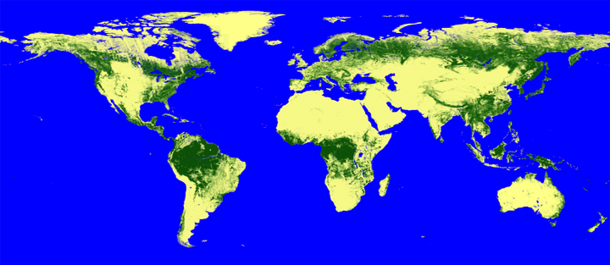
JAXA SAR BS ARD Production on Global Mosaics
ALOS-2 PALSAR-2 25 m global mosaic dataset (HH, HV): 2015 - 2017
Global 25 m mosaic (Ortho+slope correction)
Global 25m Forest/non-forest map

Slide 11
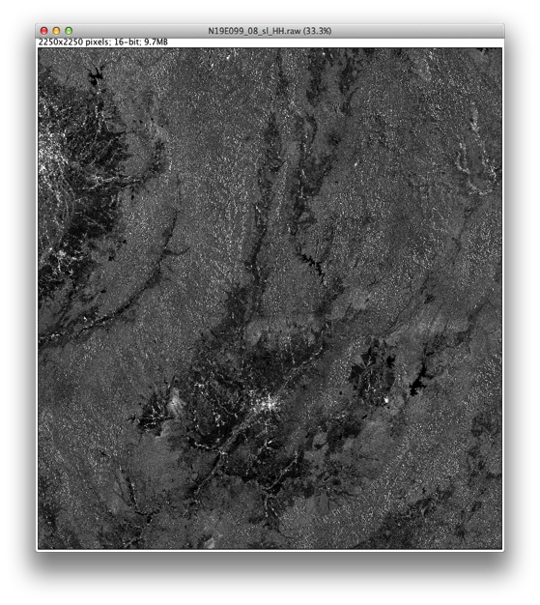
Contents of SAR BS ARD on Global Mosaics
PALSAR, PALSAR-2, and JERS-1 25 m global mosaic dataset:
Backscatter image (HH)
Radar backscatter, normalised for incidence angle ( γº = σº/cosθ_{i} )
Radiometric and geometric corrections for topography
16 bits (Unsigned INT)
ENVI header information

Slide 12
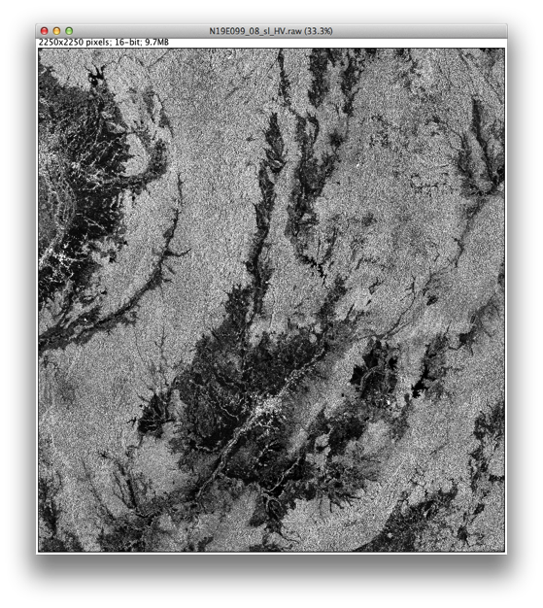
Contents of SAR BS ARD on Global Mosaics
PALSAR and PALSAR-2 25 m global mosaic dataset:
Backscatter image (HV)
Radar backscatter, normalised for incidence angle ( γº = σº/cosθ_{i} )
Radiometric and geometric corrections for topography
16 bits (Unsigned INT)
ENVI header information

Slide 13
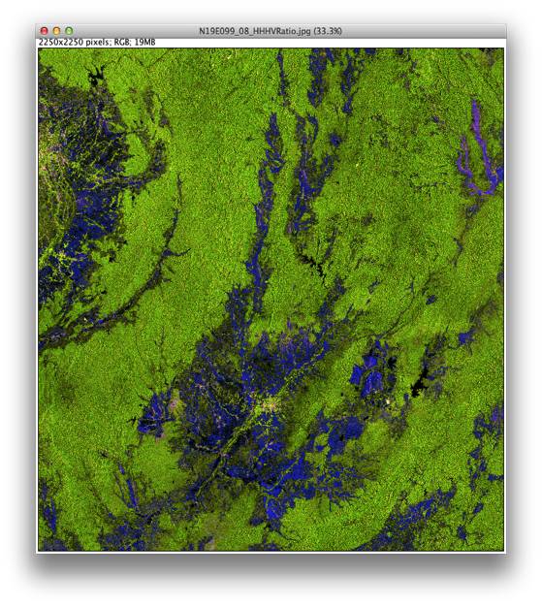
Contents of SAR BS ARD on Global Mosaics
PALSAR and PALSAR-2 25 m global mosaic dataset:
Backscatter image
Faulse color composite
R: HH
G: HV
B: HH/HV

Slide 14

Contents of SAR BS ARD on Global Mosaics
PALSAR, PALSAR-2, and JERS-1 25 m global mosaic dataset:
Observation date layer
Data layer showing the acquisition date for each pixel in the image
Date = [Launch date] + DN
11/2/1992 for JERS-1,
24/1/2006 for ALOS, and
24/5/2014 for ALOS-2
16 bits (Unsigned INT)
DN=975
25/09/2008
DN=917
29/07/2008
DN=854
27/05/2008

Slide 15
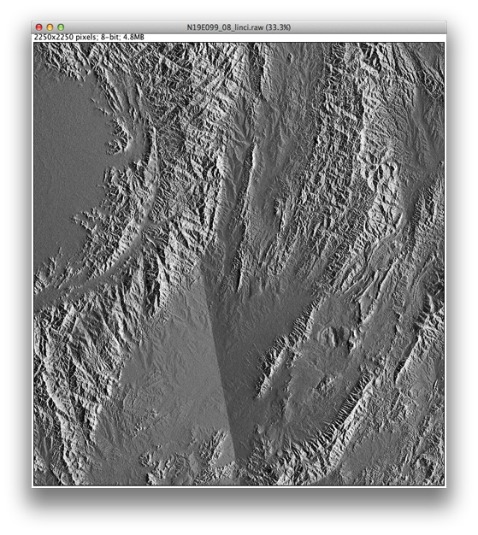
Contents of SAR BS ARD on Global Mosaics
PALSAR, PALSAR-2, and JERS-1 25 m global mosaic dataset:
Incidence angle layer
Layer with local incidence angle for each pixel
8 bits

Slide 16

Contents of SAR BS ARD on Global Mosaics
PALSAR, PALSAR-2, and JERS-1 25 m global mosaic dataset:
Mask information layer
Ocean and no-data areas: layover and shadow
8 bits

Slide 17
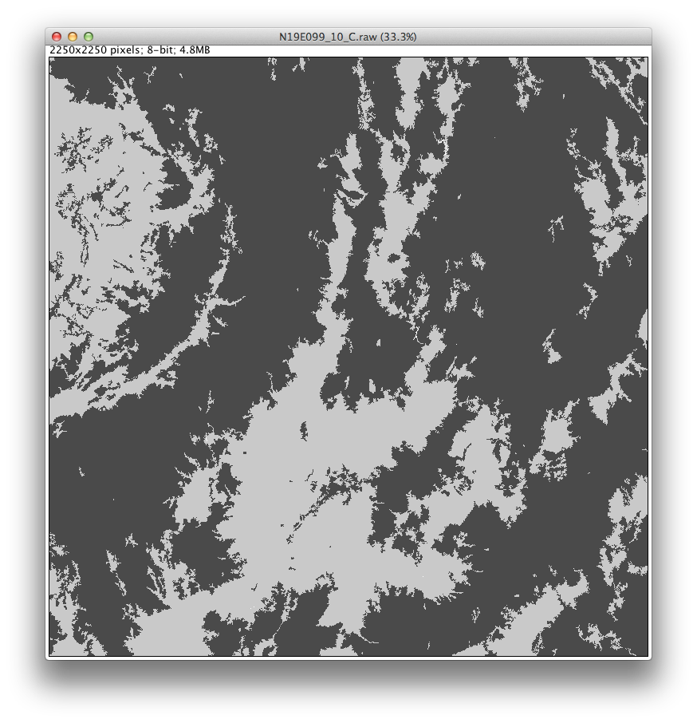
Contents of SAR BS ARD on Global Mosaics
PALSAR and PALSAR-2 25 m global mosaic dataset:
Forest and Non-Forest Classification
8 bits

Slide 18
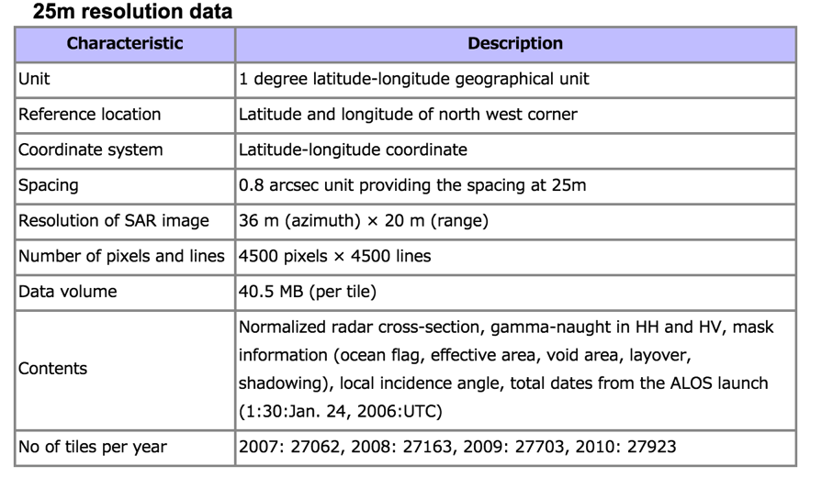
Contents of SAR BS ARD on Global Mosaics
PALSAR, PALSAR-2, and JERS-1 25 m global mosaic dataset:
Specifications and ancillary information (for PALSAR)

Slide 19
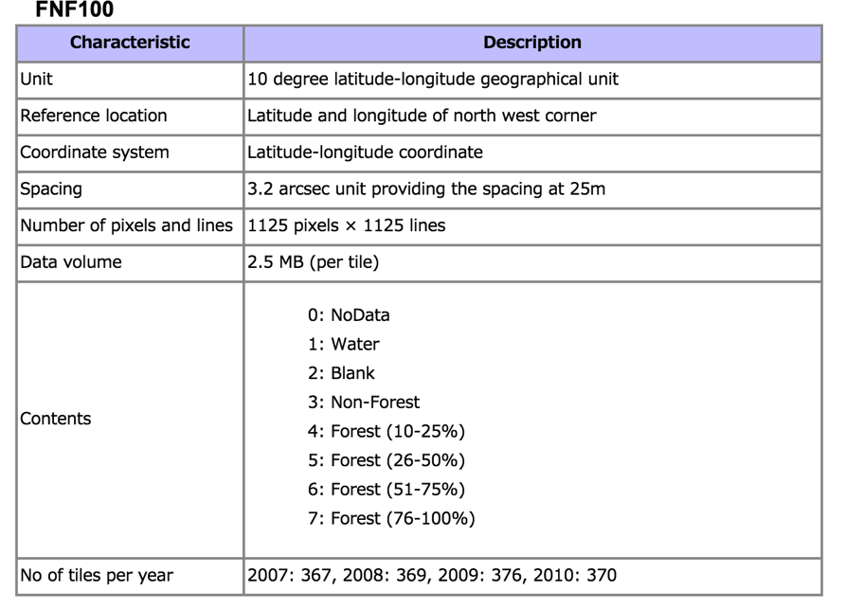
Contents of SAR BS ARD on Global Mosaics
PALSAR, PALSAR-2, and JERS-1 25 m global mosaic dataset:
Specifications and ancillary information (for PALSAR)

Slide 20
Compatibility Assessment of the Global Mosaics to the CARD4L BS PSF
General Metadata
Per-pixel Metadata
Radiometric Corrections
Geometric Corrections

Slide 21
Compatibility Assessment of the Global Mosaics to the CARD4L BS PSF
General Metadata
 | Item | Threshold (minimum) requirements | Target (desired) requirements | JAXA notes
1.1 | Traceability | Not required. | Data must be traceable to SI reference standard. For further information see, for example, http://l-a-b.com/information/traceability/ | At least threshold
1.2 | Metadata machine readability | Metadata is provided in a structure that enables a computer algorithm to be used to consistently and automatically identify and extract each component part for further use. | As threshold, but metadata is formatted in accordance with ISO 19115-2. | At least threshold
1.3 | Data collection time | The start and stop time of data collection is identified in the metadata, expressed in date/time, to the second, with the time offset from UTC unambiguously identified. | Acquisition time for each pixel is identified (or can be reliably determined) in the metadata, expressed in date/time at UTC, to the second. | Observation date per pixel provided.
1.4 | Geographical area | The surface location to which the data relates is identified, typically as a series of four corner points, expressed in an accepted coordinate reference system (e.g.,WGS84). | The geographic area covered by the observations is identified specifically, such as through a set of coordinates of a closely bounding polygon. The location to which each pixel refers is identified (or can be reliably determined) expressed in projection coordinates with reference datum.
1.5 | Coordinate reference system | The metadata lists the coordinate reference system that has been used. | As threshold

Slide 22
Compatibility Assessment of the Global Mosaics to the CARD4L BS PSF
General Metadata
 | Item | Threshold (minimum) requirements | Target (desired) requirements | JAXA notes
1.6 | Map projection | The metadata lists the map projection that has been used, and any relevant parameters required in relation to use of data in that map projection. | As threshold
1.7 | Geometric correction | The metadata describes the geodetic correction methods used, including reference database and ancillary data such as elevation model(s) and reference chip-sets. DOIs are used. | As threshold
1.8 | Geometric accuracy | A single-figure estimate of the Geometric accuracy is provided. The user is not necessarily provided with results of geometric correction processes pertaining to the dataset. | The metadata includes metrics describing the assessed geodetic accuracy of the data, expressed units of the coordinate system of the data. Accuracy is assessed by independent verification (as well as internal model-fit where applicable). Uncertainties are expressed as root mean square error (RMSE) or Circular Error Probability (e.g., CEP90, CEP95). | General dataset info in reference paper
1.9 | Instrument | The instrument used to collect the data is identified in the metadata. | As threshold, but including a reference to the relevant CEOS Missions, Instruments and Measurements Database record.
1.10 | Acquisition parameters | Acquisition parameters details: look direction (L, R) polarizations resolution (range x azimuth) orbit direction of data-take (ascending or descending) | As threshold. | Partial (pol, resolution)

Slide 23
Compatibility Assessment of the Global Mosaics to the CARD4L BS PSF
General Metadata
 | Item | Threshold (minimum) requirements | Target (desired) requirements | JAXA notes
1.11 | Processing parameters | Processing parameters details: pixel spacing (range x azimuth) number of looks and equivalent number of looks | As threshold. | Partial (pixel spacing)
1.12 | Sensor calibration | Sensor calibration details / list of scientific papers and articles websites describing the calibration approach/method used | As threshold.
1.13 | Radiometric accuracy | Not required. The general metadata does not include specific information on the radiometric accuracy of the data. OR, A global uncertainty estimate is provided | The metadata includes metrics describing the assessed absolute radiometric accuracy of the data, expressed as absolute radiometric uncertainty relative to a known reference standard (e.g., pseudo-invariant calibration sites) Note 1: for example, this may come from comparison with rigorously collected in situ measurements | Partial info in dataset reference paper
1.14 | Algorithms | All algorithms, and the sequence in which they were applied in the generation process, are identified in the metadata. | As threshold, but only algorithms that have been published in a peer-reviewed journal Note: It is possible that high quality corrections are applied through non-disclosed processes. CARD4L does not per-se require full and open data and methods. DOIs for each algorithm are identified in the metadata. The versions of the algorithms are identified. | In dataset reference paper

Slide 24
Compatibility Assessment of the Global Mosaics to the CARD4L BS PSF
General Metadata
 | Item | Threshold (minimum) requirements | Target (desired) requirements | JAXA notes
1.15 | Ancillary data | The metadata identifies the sources of ancillary data used in the generation process, ideally expressed as DOIs. Note 1: ancillary data includes DEMs, etc. data sources | As threshold, but the ancillary data is also available for free online download, contemporaneously with the product. | Partial?
1.16 | Processing chain provenance | Not required. | The metadata includes a description of the processing chain used to generate the product, including the versions of the software used. | In dataset reference paper
1.17 | Data access | The metadata identifies the location from where the product can be retrieved, expressed as a DOI. Note 1: Manual and offline interaction action (e.g. log in) may be required. | The metadata identifies an online location from where the data (including any available new records) can be consistently and reliably retrieved by a computer algorithm without any manual intervention being required. Note 1: Some manual interaction action may be required in the first instance (‘one off’ basis) to establish ongoing access to the data.
1.18 | Overall data quality | Not applicable | TBD. There is a perceived need for machine-readable metrics describing the overall quality of the data, however the specifications for these are yet to be determined. If there is not a clear case and clear specifications for such metadata, then “Overall data quality” will be removed.
1.19 | Performance Indicators | Provide performance indicators on resolution, SLR, NESZ. Those are not to be estimated on each product, but estimated once and annotated on all products | As threshold. | In dataset reference paper

Slide 25
Summary
JAXA SAR ARD production and release status updated:
  L-band SARs: JERS-1, ALOS, ALOS-2, …
  ALOS-2/PALSAR-2 2017 mosaic released,
  Scene-based O&F data processing are ongoing
A compatibility assessment to the CARD4L PSF:
  Just starting and further analysis necessary
  Feedback to products as well as PSF
JAXA will be continue working on CARD4L.

