Slide 1
Status of PFS progress for Nighttime Light Surface Radiance
Brian Killough, NASA, CEOS-SEO
LSI-VC Side Meeting
September 13, 2022

Slide 2
Status Report
The Nighttime Light Surface Radiance PFS applies to data in the VIS/NIR wavelengths at resolutions of 10m to 1km. The specs are similar to optical surface reflectance with several modifications and additions to account for lunar radiance and atmospheric scattering.
Coordinated by Brian Killough (CEOS SEO, NASA) with detailed support from Miguel Roman (NASA, USRA), Bhaskar Ramachandran (NASA GSFC) and Zhousen Wang (NASA GSFC). Overall, a team of ~20 people have contributed.
PFS development began in Oct 2020. The latest release (version 1.0) is ready for endorsement.
The VIIRS Day-Night Band (DNB) or NASA’s Black Marble is the best example dataset for this PFS. NASA is planning to migrate this dataset to the AWS cloud by the end of 2022.
The CEOS SEO has downloaded and tested this dataset for one location (Port Vila, Vanuatu) and has completed a preliminary PFS assessment. The Black Marble team has made several changes to the product and metadata to improve ARD PFS compliance.
Slide ‹#›

Slide 3
PFS Comparisons
The Nighttime Light Surface Radiance PFS (version 1.0) is VERY similar to the endorsed Surface Reflectance PFS (version 5.0).
The primary differences account for lunar radiance and atmospheric scattering. Here is a summary of those differences ...
Modify Requirement 2.11 (Solar and Viewing Geometry) – Change to “Lunar” and Viewing Geometry.
Added Requirement 2.14 – Moon Illumination Fraction (average or per-pixel)
Added Requirement 2.15 – Brightness Temperature (provided from thermal bands)
Added Requirement 2.16 – Solar Zenith Angle (supports stray-light corrections)
MOdify Requirement 3.4 (Directional Atmospheric Scattering) – Change to ”Atmospheric Corrections” – No Rayleigh scattering without the Sun
Remove Requirement 3.5 (Water Vapor Corrections)
Remove Requirement 3.6 (Ozone Corrections)
Added Requirement 3.5 (Lunar Radiance Corrections)
Added Reqiuirement 3.6 (Stray Light Corrections)
Slide ‹#›

Slide 4
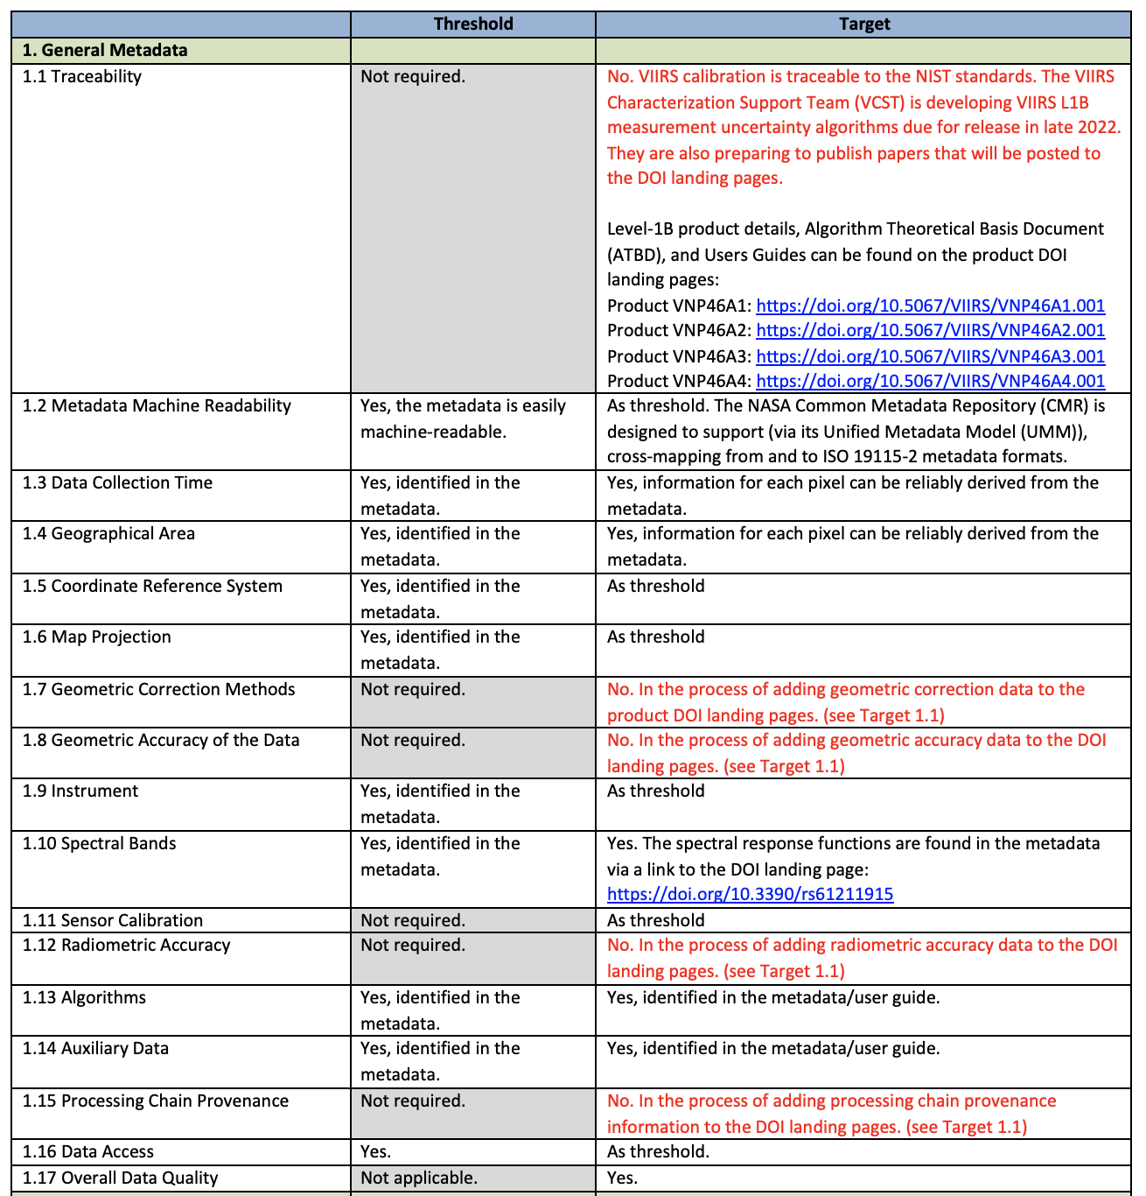
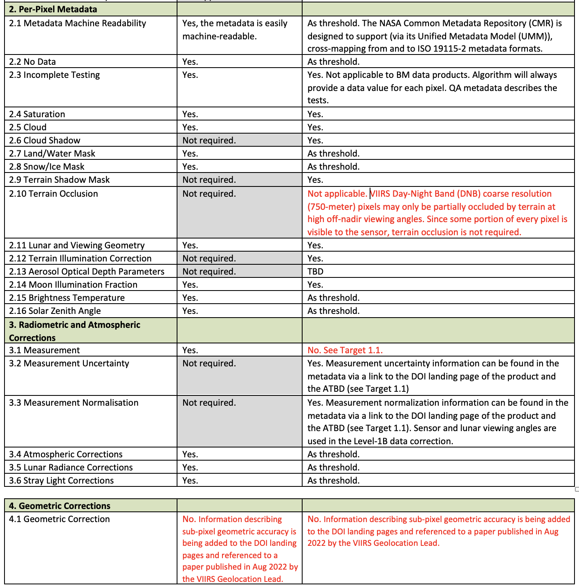
NASA’s Black Marble Dataset
Preliminary PFS Assessment (as of August 2022)
25 of 26 Threshold requirements met
(4.1) Information on sub-pixel geometric accuracy is referenced in a new published paper (Aug 2022) and will be added to DOI landing pages by the end of 2022.
33 of 40 Target requirements met
(1.1 and 3.1) VIIRS calibration traceable to NIST standards. Measurement uncertainty algorithms to be released in papers and DOI landing pages by end of 2022.
(1.7, 1.8, 1.12, 1.15) Plans to add this information to the DOI landing pages versus directly in metadata.
(2.10) Not applicable (see next chart)
(4.1) See 4.1 above
Slide ‹#›

Slide 5
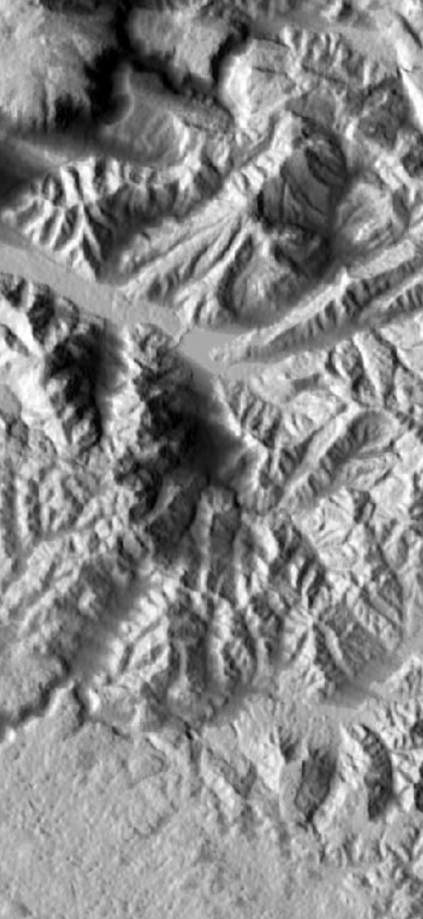
2.10 – Terrain Occlusion
There were many discussions among the team on how to address this requirement.
Threshold = Not required
Target = The metadata indicates pixels that are not visible to the sensor due to terrain occlusion during off-nadir viewing
The team has decided that the target requirement does not apply to the VIIRS Day-Night Band (DNB).
Proposed self-assessment response: VIIRS Day-Night Band (DNB) coarse resolution (750-meter) pixels may only be partially occluded by terrain at high off-nadir viewing angles. Since some portion of every pixel is visible to the sensor, terrain occlusion is not required.
The VIIRS team plans to address this situation in their next version of the ATBD.
Slide ‹#›

