Slide 1
LSI-VC-13
2023
CONAE´s Current Status of ARD Conversion for SAOCOM Data
D. Dadamia &
L. Frulla (CONAE)
Agenda Item: 3.6
LSI-VC-13 2023, ESA/ESRIN
23rd - 24th March 2023

Slide 2
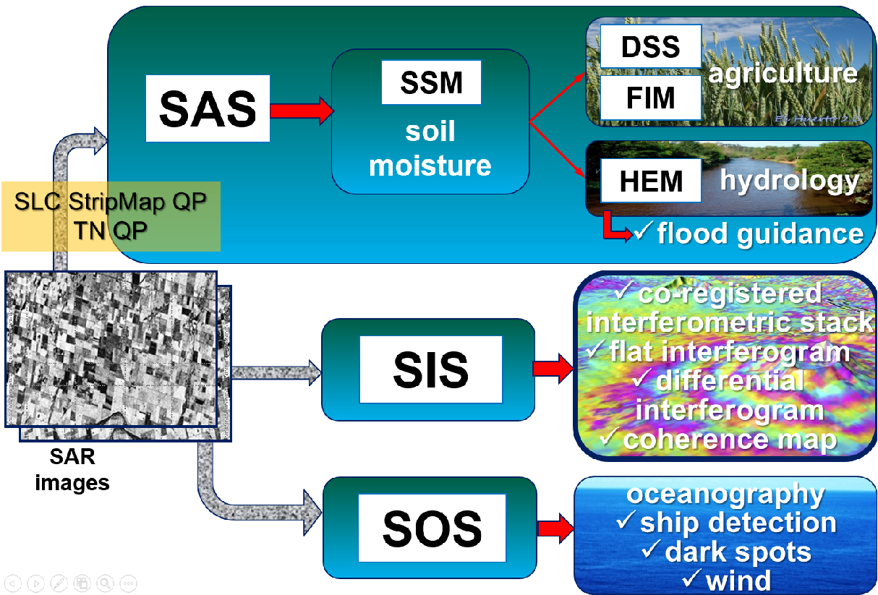
Level 2 and Higher Level
Notes:
I will not speak about SAOCOM features. The constellation is operational and generating Level 1 an Level 2 products. In relation of the Level 2 products we are operationally obtaining products useful for agriculture and hydrology, starting with the soil moisture maps.
support system for decision making in agriculture, yield estimate
wheat head blight disease forecast system.
Floods forcasts, particularly flood guidance
soporte a la decisión de siembra, fertilización y riego
optimización en el uso de fertilizantes
estimación de rinde
índice de afección de su lote
status de fusariosis
posibilidad riego
optimización en el uso de agroquímicos
estimación del progreso de la afección
cuencas de analizadas al momento:
Salado Norte
Gualeguay
Arrecifes
Luján Matanza-Riachuelo
Areco
SIS:
CRG: Co-registered interferometric stack
IPH: Flat interferogram
IPHG: Differential interferogram
Coherence Map

Slide 3
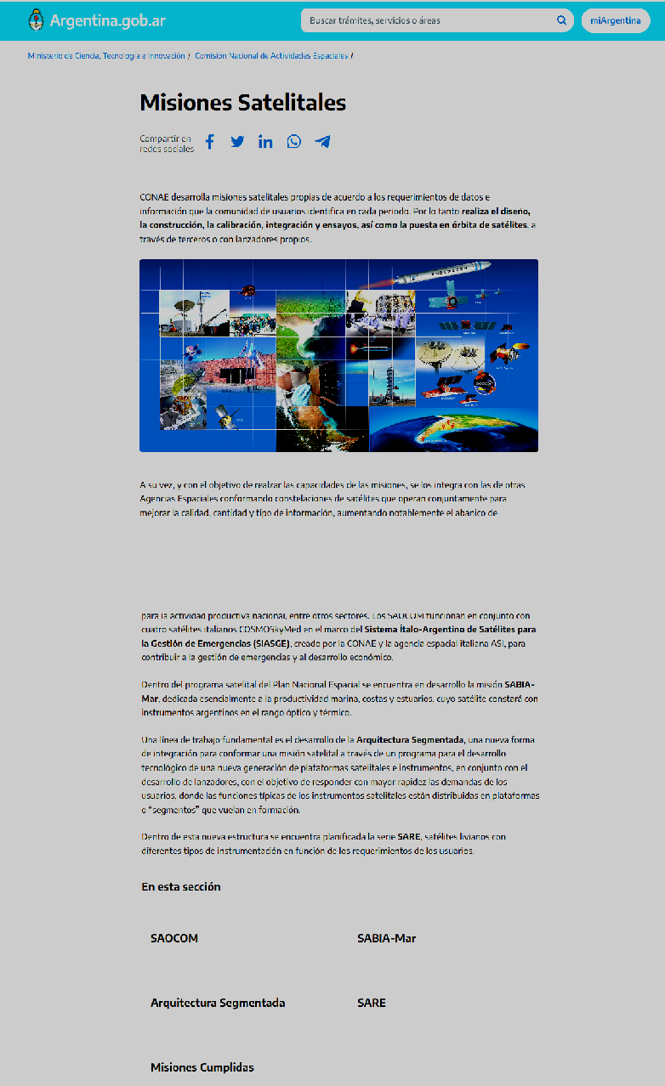
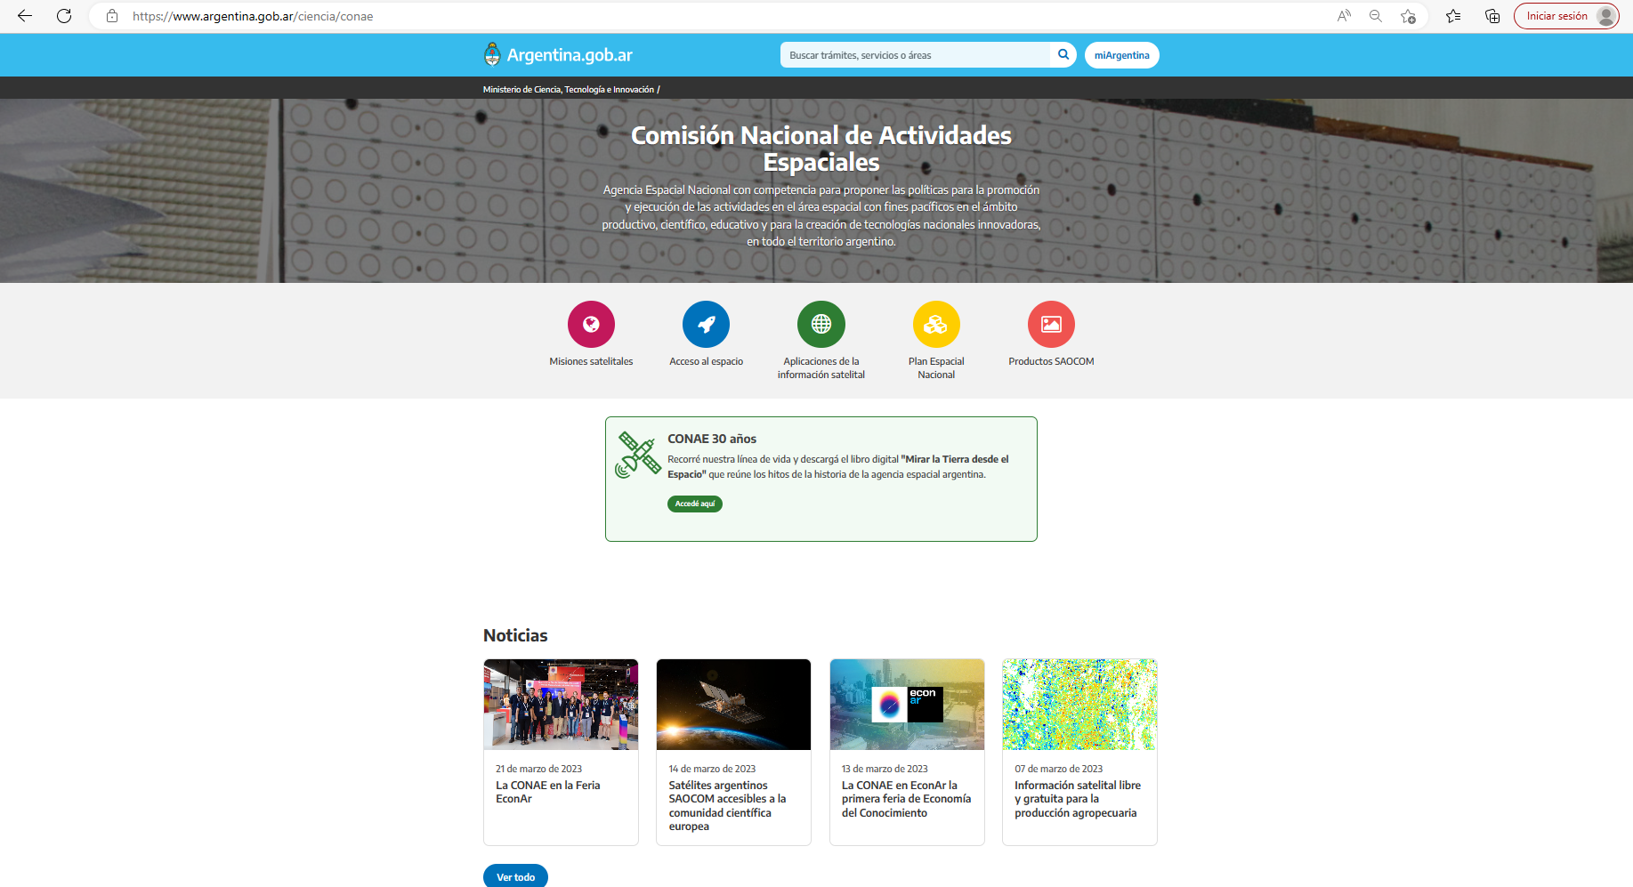
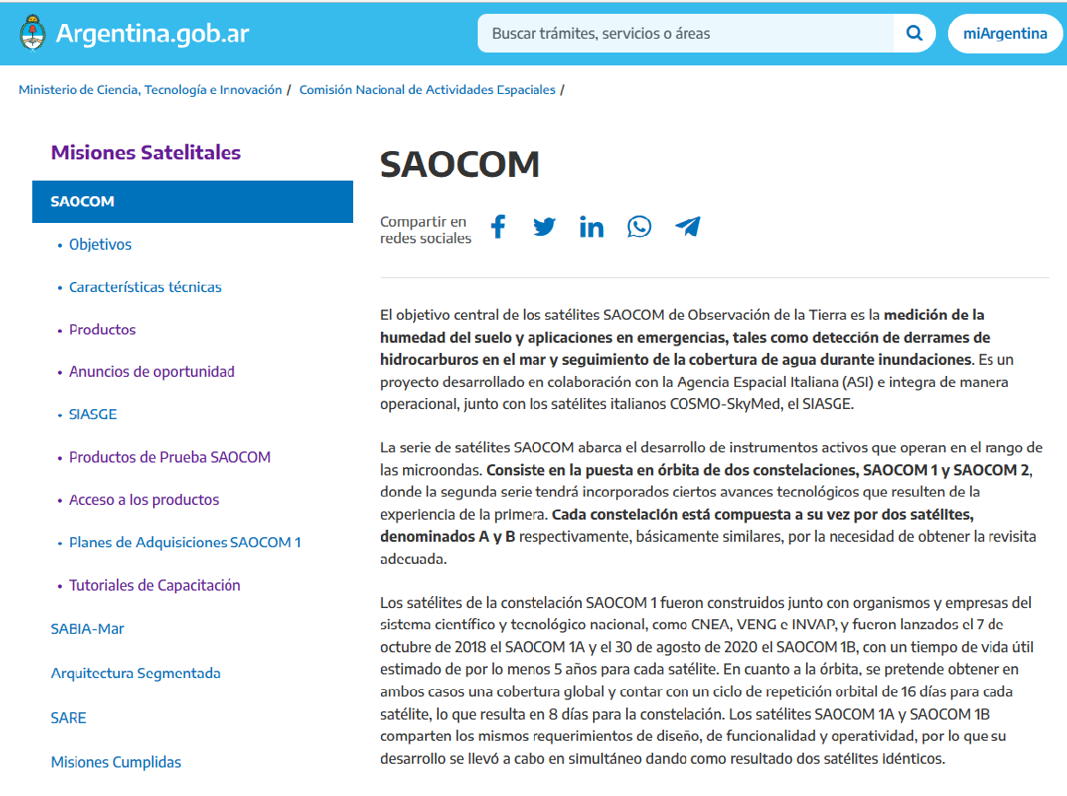
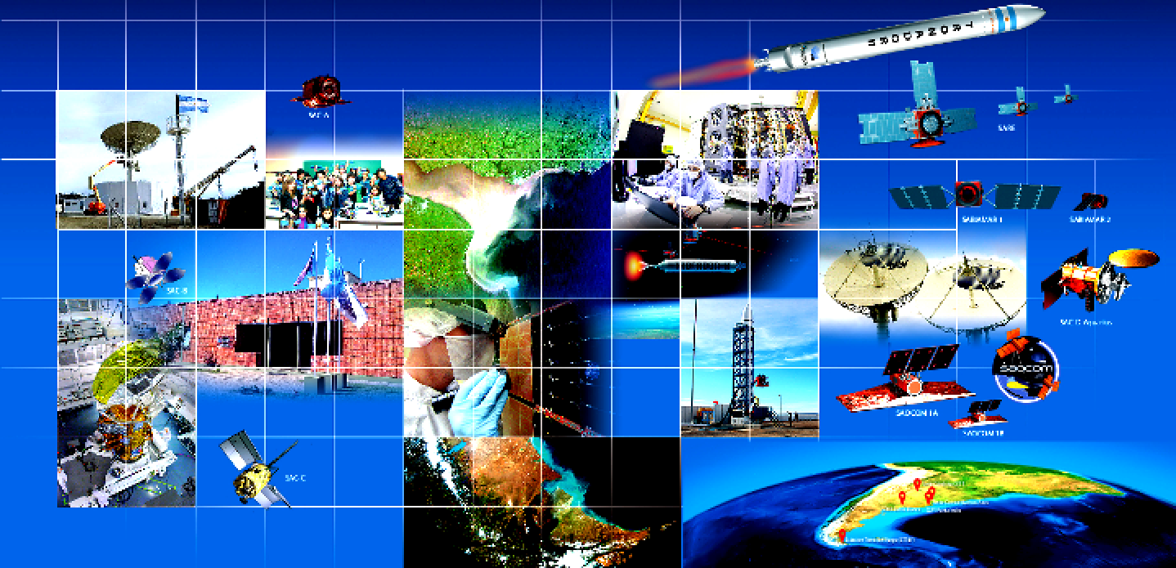
Where to go for SAOCOM Data?
https://www.argentina.gob.ar/ciencia/conae
Satellite missions
Objectives
Technical features
Products
Announcements of Opportunities
SIASGE
SAOCOM testing products
Product Access
SAOCOM Acquisition plan
Tutorials
SAOCOM
ARD converter

Slide 4
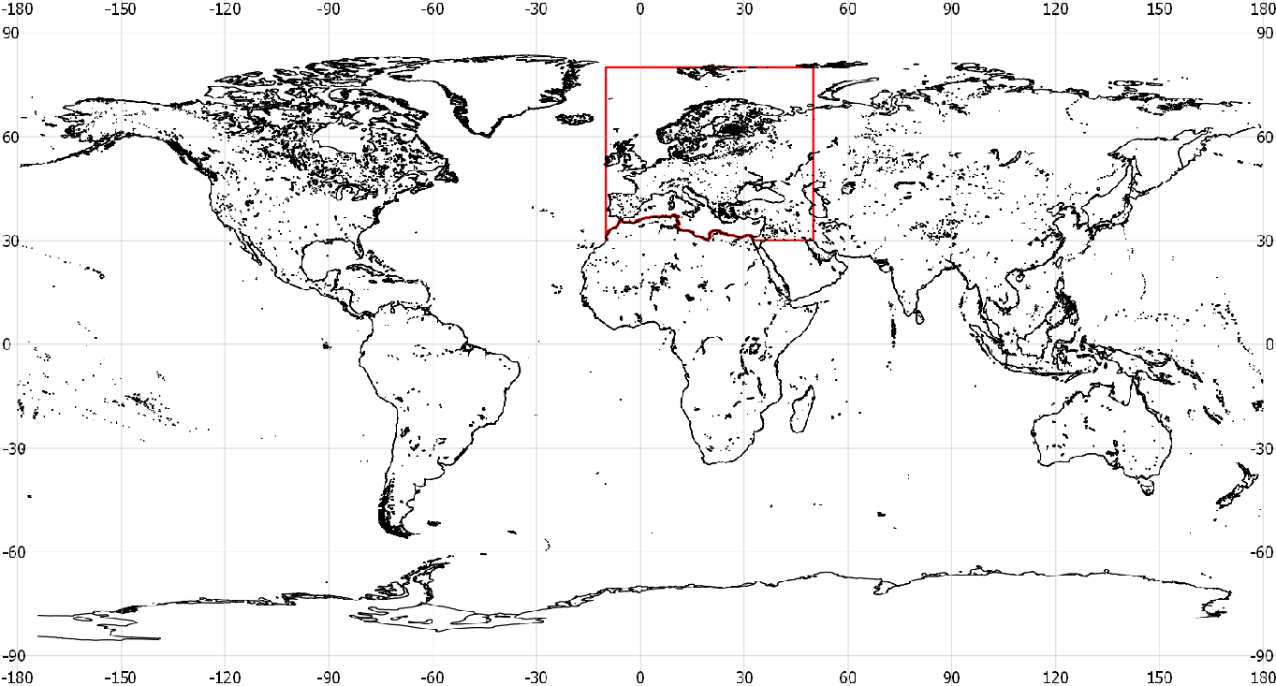
SAOCOM Data Access
From ASI-CONAE cooperation:
Inside ASI exclusivity area:
30º- 80ºN latitude
10ºW-50ºE longitude
https://www.asi.it/en/earth-science/saocom/
Outside ASI exclusivity area, u_inter@conae.gov.ar
SAOCOM Catalogue can be navigated freely to identify already existing data. Upon registration, quicklooks can be seen: https://catalogos.conae.gov.ar/catalogo/catalogoSat.html

Slide 5
Steps to Request SAOCOM
Send letter to: u_inter@conae.gov.ar
Direct the letter to CONAE’s CEOS Principal (Eng. Raul Kulichevsky) describing the overall project, its objectives, duration, participants, the area of interest (including, if possible, files in KML or Shapefile formats).
Sign the License of Use by the project participants who will work with the images.
Require the images to u_inter@conae.gov.ar (archived/new).
Data will be transferred through FTP

Slide 6
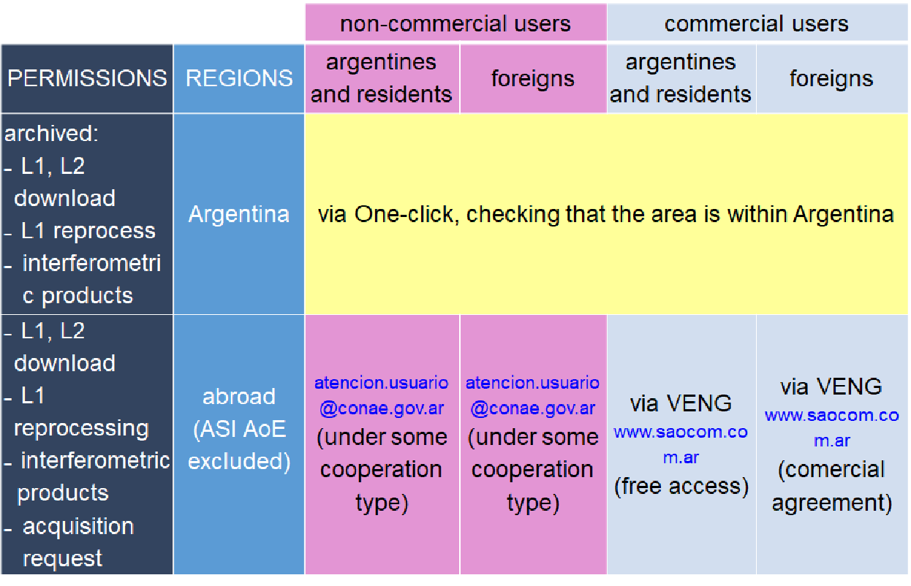
One Click Possibility

Slide 7
AO for SAOCOM ESA/CONAE_{(1/2)}
Announcement of Opportunity for SAOCOM ESA/CONAE: Promotion of Utilization and Mission Applications and Science (PUMAS)
https://www.argentina.gob.ar/ciencia/conae/misiones-satelitales/ao-iniciativa-puma-esa-conae
https://earth.esa.int/eogateway/announcement-of-opportunity/saocom
Initiative under Earthnet's Third Party Missions Programme
For science and application developments (EO)
The call will close on 31 july 2023
The 2nd ~ september/2023

Slide 8
AO for SAOCOM ESA/CONAE_{(2/2)}
The call is open
Project Proposals evaluated by ESA and CONAE
Data available: ESA (EO), Copernicus and SAOCOM
users of ESA Member States
joint users teams of ESA Member States and Argentina
Quota 40 SAOCOM images
archive (mainly)
~
<
acquisition (case by case)
Region available: out of the ASI AoE
A report will be required to summarise the results

Slide 9
ABOUT THE ARD SAOCOM
LEVEL 1 PRODUCTS CONVERSION …

Slide 10
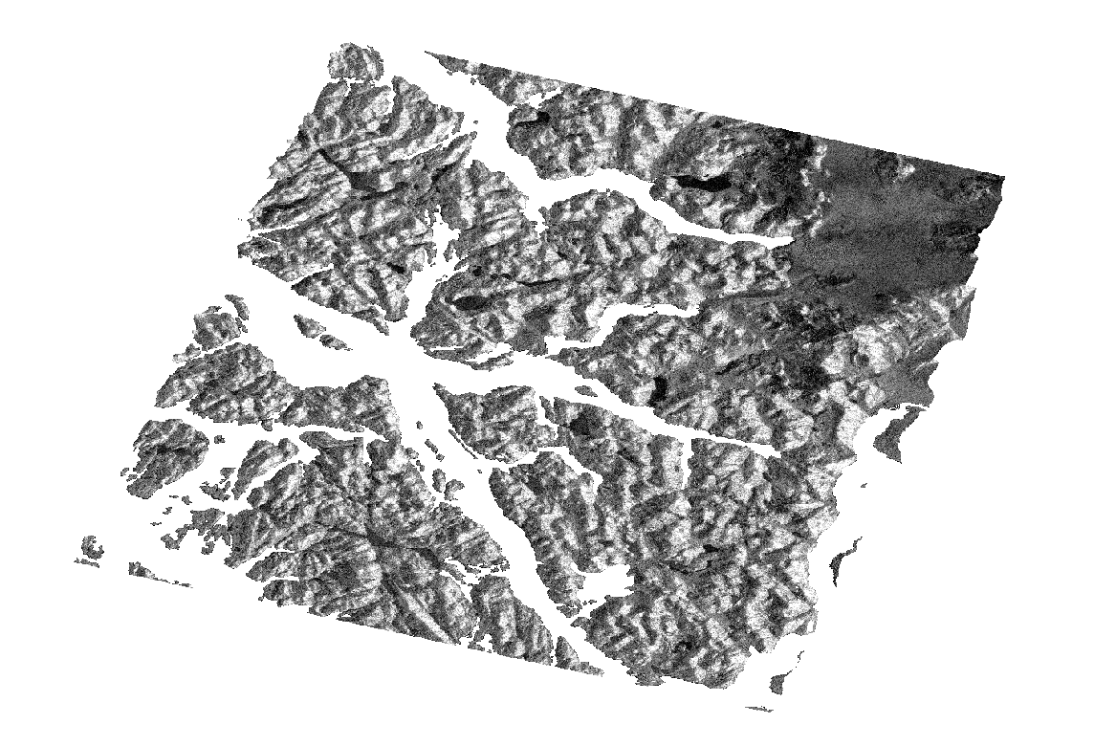
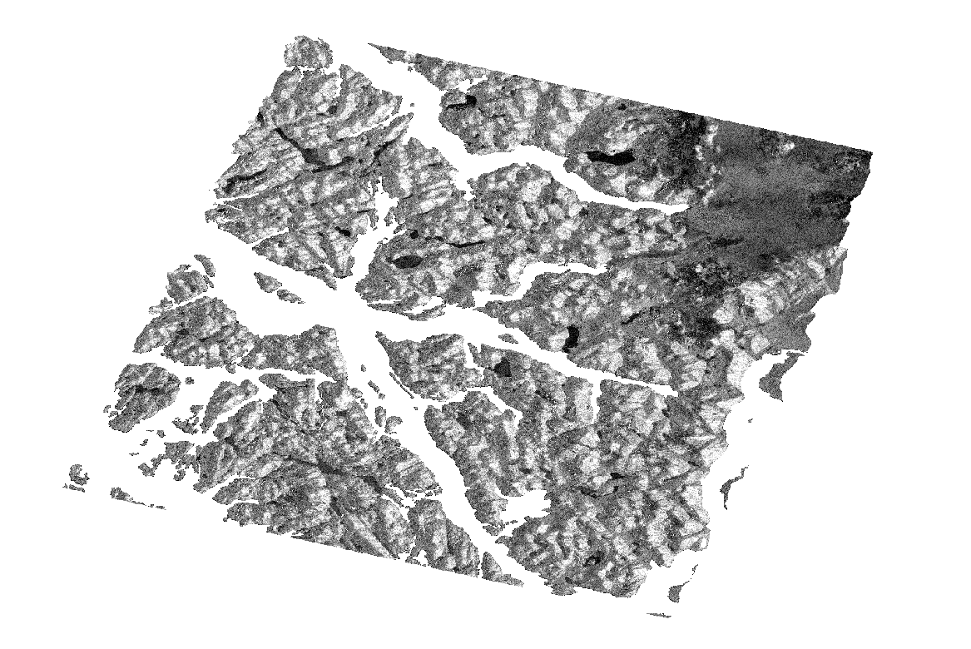
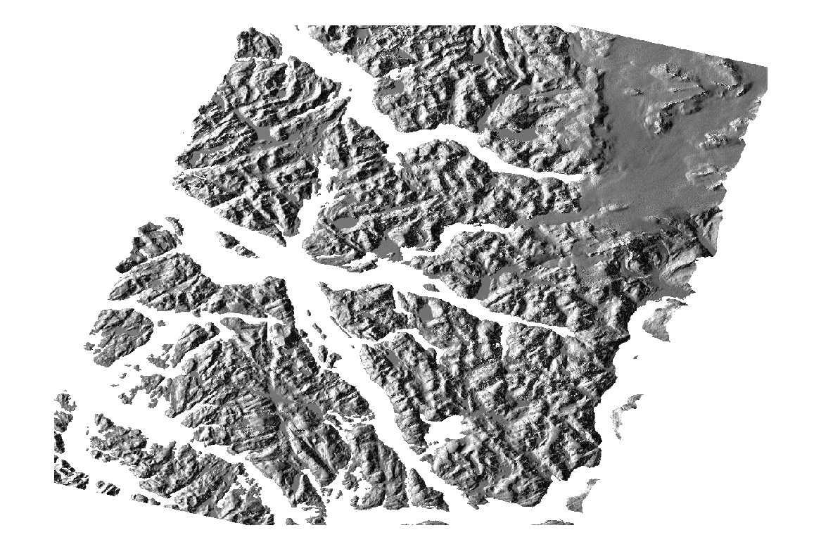
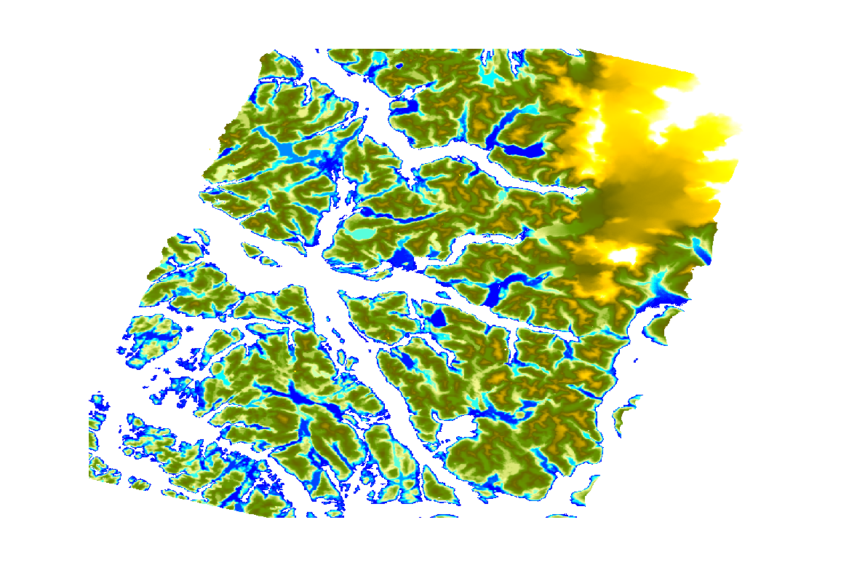
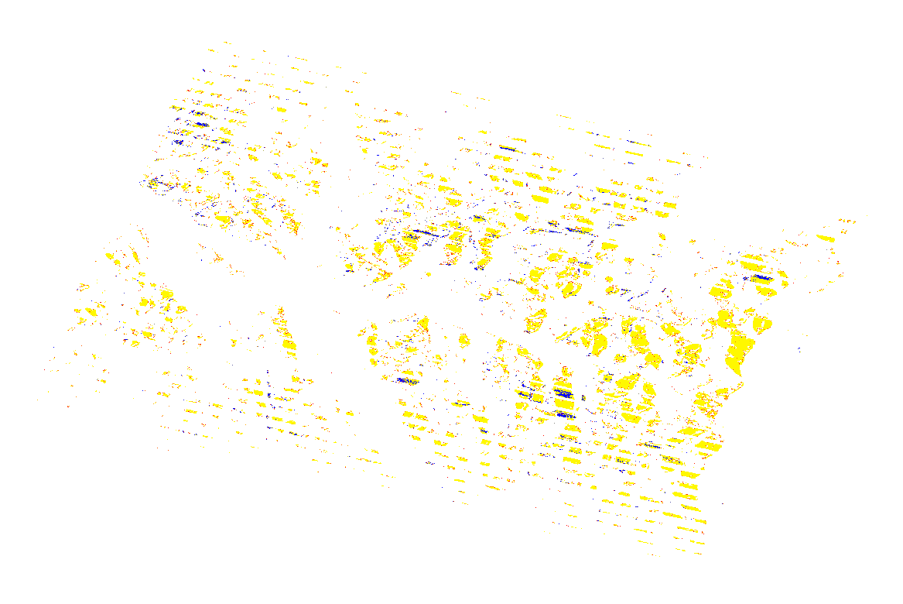
SAOCOM CARD4L Format_{(1/2)}
Inputs
q
i
Outputs
Images
SIGMA0
Corrected by Local Incidence Angle
GAMMA0
+
StripMap SAOCOM
L1A: SLC
Outputs
Auxiliary
Data
Layover Shadow Mask
Projected Local Incidence Map
DEM

Slide 11
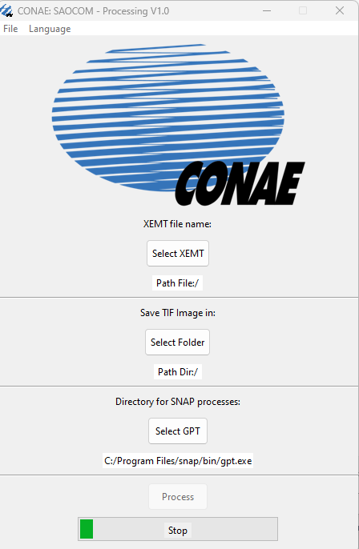
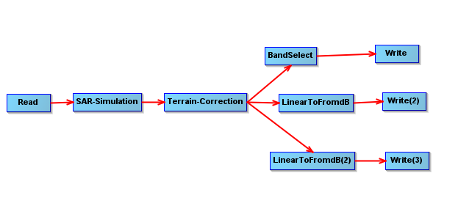
SAOCOM CARD4L Format_{(2/2)}
We use Python to:
Create the software that run on bash SNAP
Generate Front End
Process mask and build XML CARD4L format
+
User select SAOCOM input folder: XEMT
We use SNAP to:
Process SAOCOM images using SNAP tools
User select SAOCOM output folder
Optional: User select gpt (to run (SNAP))

Slide 12
Thank you !!

