Slide 1
CEOS New Space Task Team (NSTT)
IEEE Paper Recap
Steve Labahn, USGS
Agenda Item #: 4.1
LSI-VC-13 2023, ESA/ESRIN
23rd - 24th March 2023

Slide 2
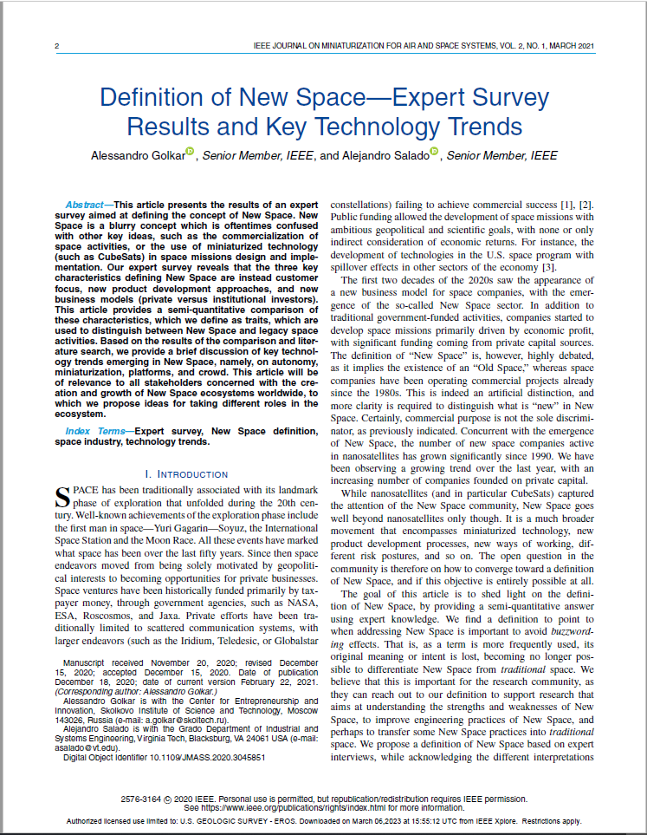
New Space Definition
Definition of New Space - Expert Survey Results and Key Technology Trends; IEEE Journal on Miniaturization for Air and Space Systems, Vol. 2, No. 1, March 2021; Alessandro Golkar, Senior Member, IEEE, and Alejandro Salado, Senior Member, IEEE
Presents expert survey results aimed at defining the concept of New Space (~20 respondents)
4 academia
1 government institution
13 space industry startups
2 space investment community
Key distinguishing traits (vs. ‘Traditional’ Commercial Space)
Customer focus
New product development approaches (Agile)
New business models (private vs. institutional investors)

Slide 3
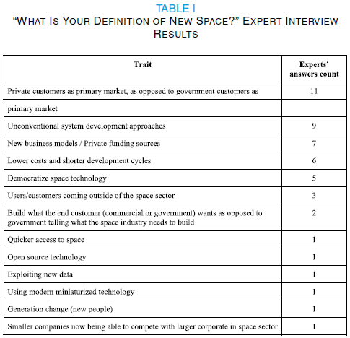
New Space Definition

Slide 4
New Space Definition
Companies started to develop space missions primarily driven by economic profit, with significant funding coming from private capital sources
Definition to point to when addressing New Space is important to avoid buzzwording effects (e.g., ARD)
Important for research community, as they can reach out to our definition to support research that aims at understanding the strengths and weaknesses of New Space, to improve engineering practices of New Space, and perhaps to transfer some New Space practices into traditional space
Use of unconventional system development approaches could have been enabled by the increase in private funding sources, the expectations of users/customers coming from outside of the space sector, and a generational change

Slide 5
New Space Definition
Future opportunities in New Space emerging by four technology macro-trends
Autonomy (autonomous spacecraft or autonomous ground station operations, e.g., StarLink)
Ongoing miniaturization of technology (instrumentation and satellite technology, propelled by the infusion of modern miniaturized digital technology into space systems, e.g., CubeSat)
Emergence of platforms (e.g., Ground Station as a Service (GSaaS), in-space cloud computing services)
Crowd approaches to space product design and lifecycle management (crowdfunding, co-creation, co-design, and co-manufacturing - trends at very early stages)
Federated satellite systems have the potential to represent instances of platforms, enabling marketplaces of digital resources in orbit
Platforms allow for sharing of resources which result in an overall efficiency improvement of space assets utilization
Implementation of platform approaches in orbit brings new sets of challenges, such as in orbit coordination and data privacy and security

Slide 6
New Space Definition
Traditional space missions have societal and national benefits as their primary stakeholder needs
Employ highly sophisticated technology, custom components, respond to the highest quality, and comply to normative standards in terms of design, procurement, manufacturing, and so on
Missions are developed according to rigid systems engineering processes, and tight configuration management control
As launch costs have been historically very high, the capital expenditures involved in a mission, compounded to the public nature of the funding, made it such to favor the emergence of a highly risk-averse environment, and very conservative design approaches
Technical performance historically prevailed over the economic efficiency in mission design

Slide 7
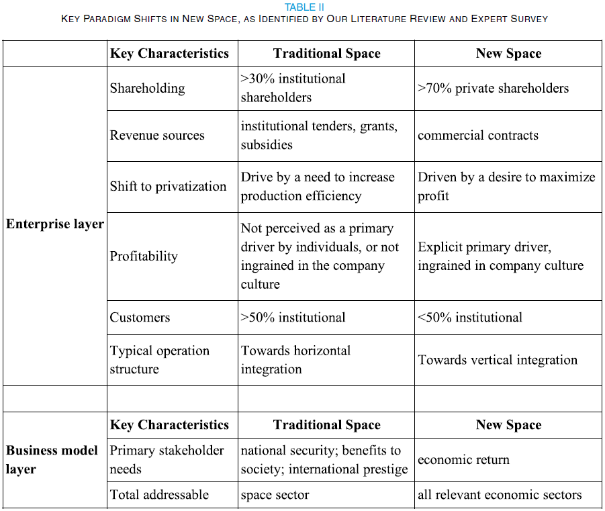
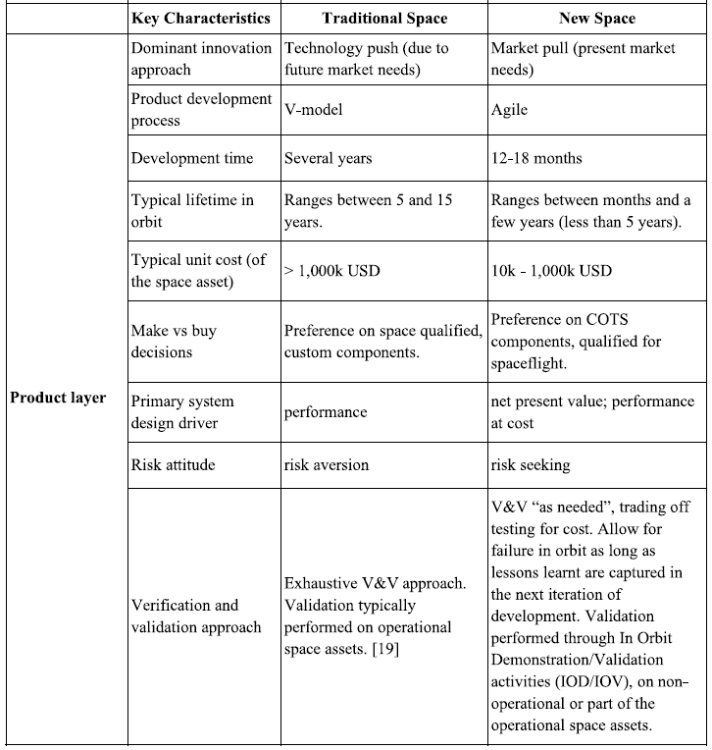
New Space Definition

